Slide 1

LABORATORI NAZIONALI DI FRASCATI
www.lnf.infn.it
A novel Micro-Pattern Gas-Detector based on the μ-RWELL technology
M. Poli Lener ^{(a)}
G. Bencivenni ^{(a)}, M. Gatta ^{(a)}, G. Morello ^{(a)} , R. de Oliveira ^{(b)}
    ^{(a)} LNF-INFN, Italy, ^{(b)} CERN, Meyrin, Switzerland
LNF Mini-Workshop Series: Development of novel detectors at LNF

Slide 2
OUTLINE
Micro-pattern gas detector (MPDG)
µ-RWELL technology
Detector performance
Towards a large area µ-RWELL
Summary

Slide 3
MPDG @ CERN: PRESENT

Slide 4
MPDG @ CERN: FUTURE (Phase-I)
CMS (GEM)
COMPASS (THGEM)
WA 105 (LEM)
LHCb (GEM)
ALICE (GEM)
CAST(InGrid)
ATLAS (MicroMeGas)
nTOF (MicroMeGas)

Slide 5
MPDG highlight
Non-exhaustive list
High flux capability
High gain
High space resolution
Good time resolution
Good energy resolution
Excellent radiation hardness
Good ageing properties
Large size
Relatively low Cost
The GOAL of R&D on the µ-RWELL detector is mainly motivated by the wish of improving:
stability under heavy irradiation (discharge containment)
simplify the construction/assembly technology

Slide 6
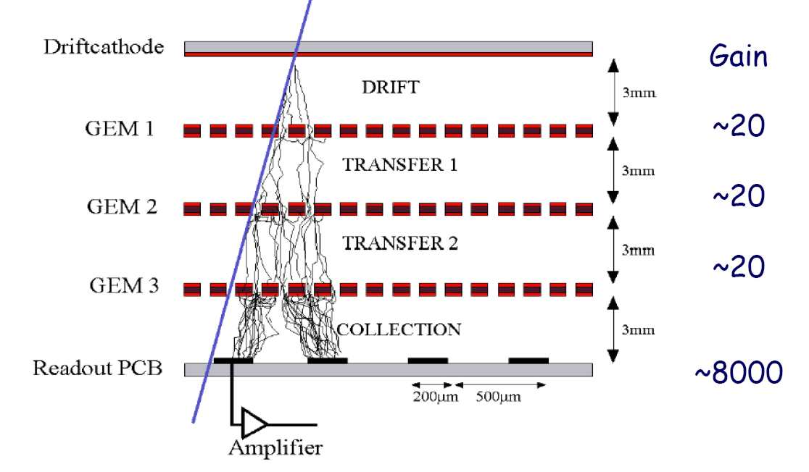
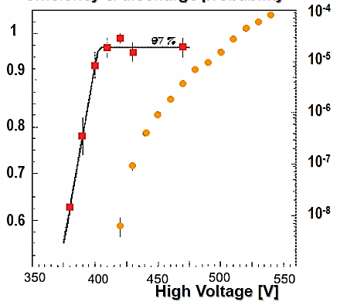
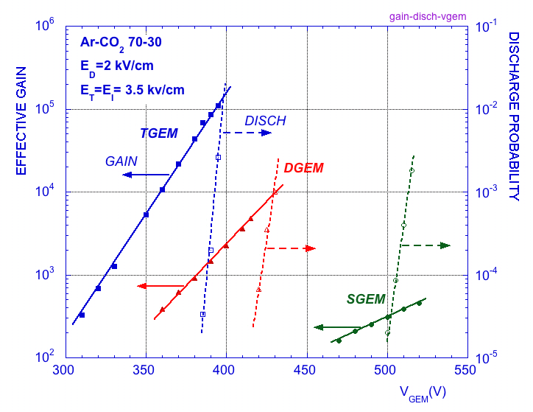
MPGDs: stability
The biggest “enemy” of MPGDs are the discharges.
Due to the fine structure and the typical micrometric distance of their electrodes, MPGDs generally suffer from spark occurrence that can be harmful for the detector and the related FEE.
GEM
MM
Efficiency & discharge probability
Efficiency
Strongly reduced but not completely suppressed
discharge probability
²⁴¹ Am α souce
10 GeV/c proton
S. Bachmann et al.,
NIMA A479(2002) 294
A. Bay et al.,
NIMA 488 (2002) 162

Slide 7
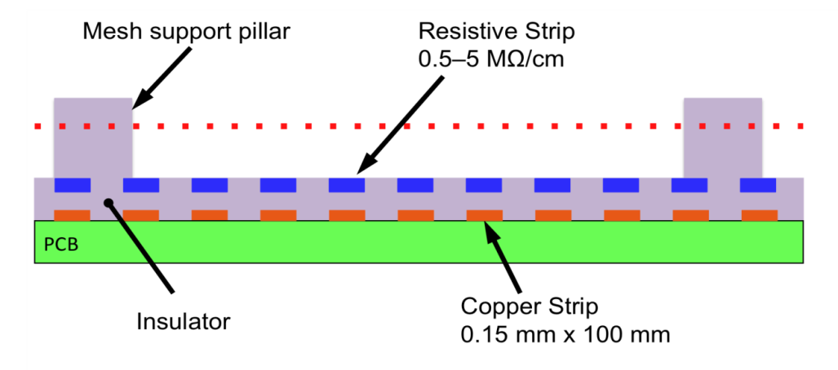
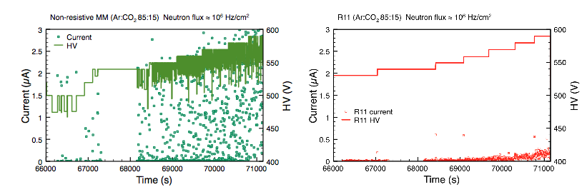
Technology improvement: resistive MPGD
For MM, the spark occurrence between the metallic mesh and the readout PCB has been overcome with the implementation of a “resistive layer” on top of the readout itself . The principle is the same as the resistive electrode used in the RPCs: the transition from streamer to spark is strongly suppressed by a local voltage drop.
by R.de Oliveira TE MPE CERN Workshop
The resistive layer is realized as resistive strips capacitive coupled with the copper readout strips.
voltage drop due to sparking

Slide 8
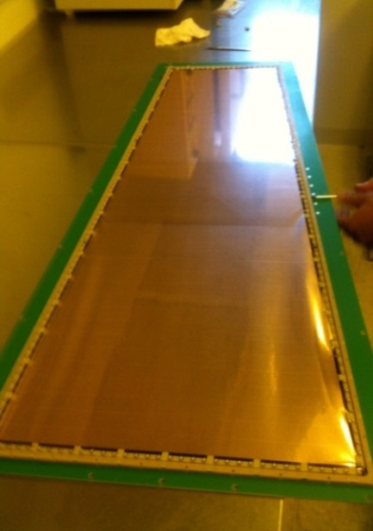
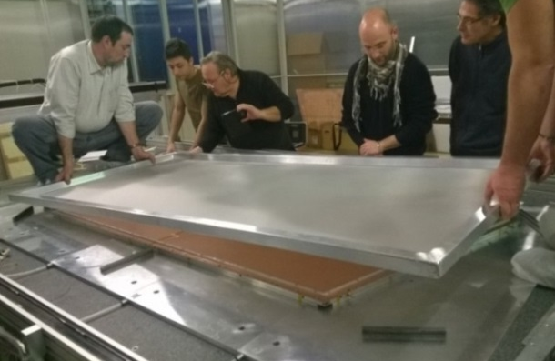
MPGDs: the challenge of large area
A further challenge for MPGDs is the large area:
NS2(CERN): no gluing but still stretching …
the construction of a GEM requires some time-consuming (/complex) assembly steps such as:
  the stretching of the 3 GEM foils (with quite large mechanical tension to cope with, ∼1 kg/cm)
  the splicing of GEM foils to realize large surfaces is a demanding operation introducing not negligible dead zones (~3 mm). The width of the raw material is limited to 50-60 cm.
similar considerations hold for MM:
  the splicing of smaller PCBs is possible, opening the way towards the large area covering (dead zone of the order 0.5 mm).
  The fine metallic mesh, defining the amplification gap, is a “floating component”: stretched on the cathode (~1 kg/cm) and electrostatically attracted toward the PCB
Possible source of gain non-uniformity
Handling of a stretched
mesh

Slide 9
The µ-RWELL technology

Slide 10
The µ-RWELL architecture
The µ-RWELL detector is composed by two elements:
the cathode and the µ-RWELL_PCB .
Drift/cathode PCB
The µ-RWELL_PCB is realized by coupling:
a “suitable WELL patterned kapton foil” as “amplification stage”
a “resistive stage” for the discharge suppression & current evacuation
  “Low particle rate” (LR) << 100 kHz/cm²: single resistive layer → surface resistivity ~100 MΩ/ (CMS-phase2 upgrade; SHIP)
  “High particle rate” (HR) >> 100 kHz/cm²: more sophisticated resistive scheme must be implemented (MPDG_NEXT- LNF; LHCb-Muon upgrade)
a standard readout PCB
Copper top layer (5µm)
Well pitch: 140 µm
Well diameter: 70-50 µm
Kapton thickness: 50 µm
DLC layer (<0.1 µm)
R ̴50-100 MΩ/□
1
2
3
Rigid PCB readout electrode
µ-RWELL PCB
G. Bencivenni et al., 2015_JINST_10_P02008

Slide 11
Principle of operation
A voltage 400-500 V between the
top copper layer and the grounded resistive foil, generates an an electric field of ~100 kV/cm into the WELL which acts as multiplication channel
top copper layer
kapton
HV
ρ
kapton
ε_{r}
t
The charge induced on the resistive foil is
dispersed with a time constant, RC, determined by
the surface resistivity, ρ
the capacitance per unit area, which depends on the distance between the resistive foil and the pad readout plane, t
the dielectric constant of the kapton, ε_{r} [M.S. Dixit et al., NIMA 566 (2006) 281]
The effect of the introduction of the resistive foil is the suppression of the
transition from streamer to spark by a local voltage drop around the avalanche location. The discharge quenching, allowing higher amplification field inside the WELL, permits to increase the detector gain. As a drawback, the capability to stand high particle fluxes is reduced.
Notes:
1) By applying a suitable voltage (400-500 V) between the top copper layer and the grounded bottom resistive layer, an electric field as high as ~100 kV/cm is generated into the WELL which acts as multiplication channel for electrons produced in the gas by an ionizing particle.
2) The localized charge induced on the resistive layer is dispersed with RC time constant, determined by the surface resistivity (ρ) and the capacitance per unit area, which depends on the spacing (t) between the resistive layer and the pad readout plane and on the dielectric constant (ε_{r}) of the kapton.
(M.S. Dixit et al., NIMA 566 (2006) 281)
3) The effect of the introduction of the resistive layer is the suppression of the transition from streamer to spark by a local voltage drop around the avalanche location. The discharge quenching, allowing higher amplification field inside the WELL, permits to increase the detector gain. As a drawback, the capability to stand high particle fluxes is reduced.

Slide 12
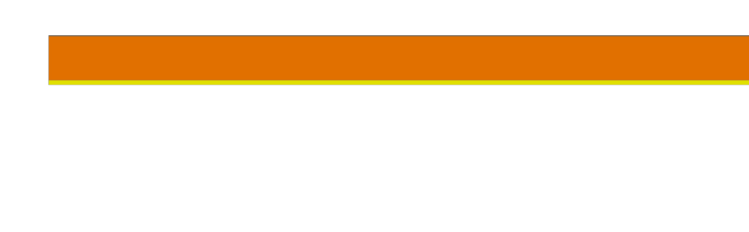
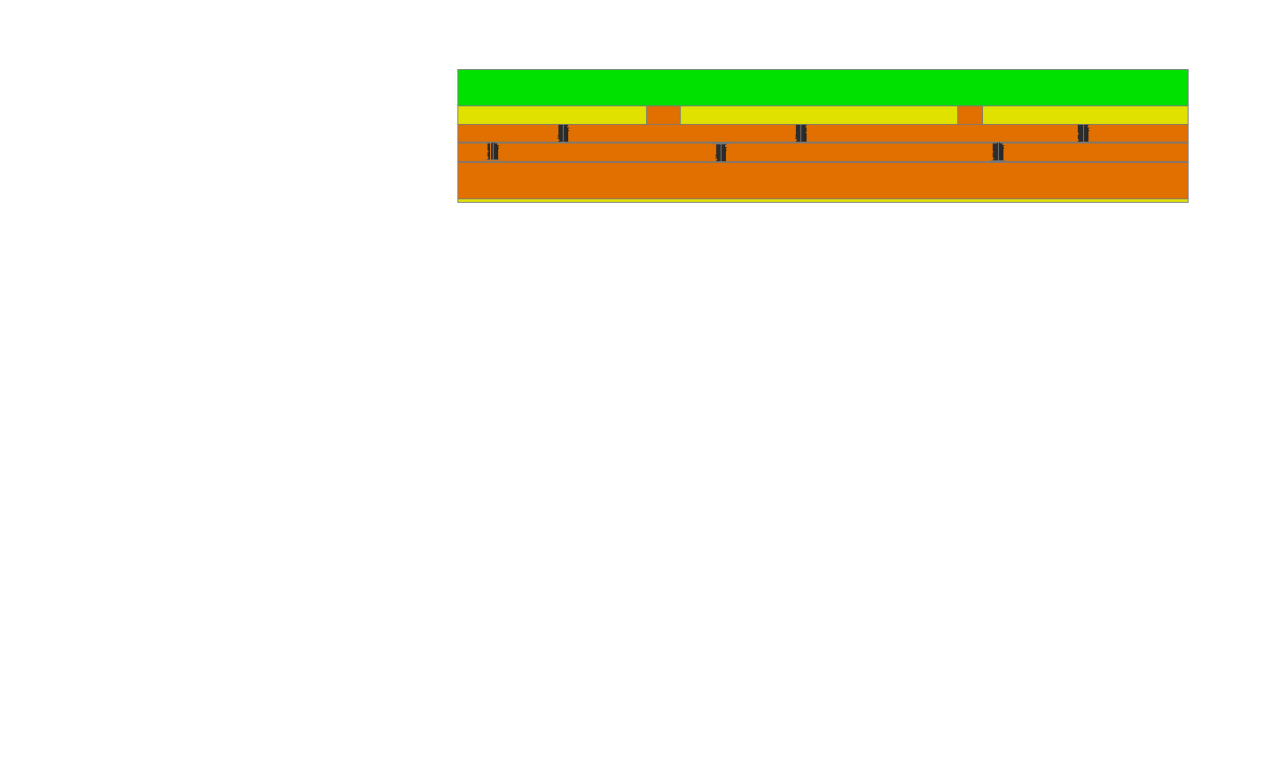
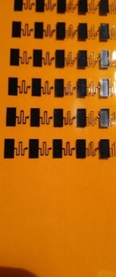
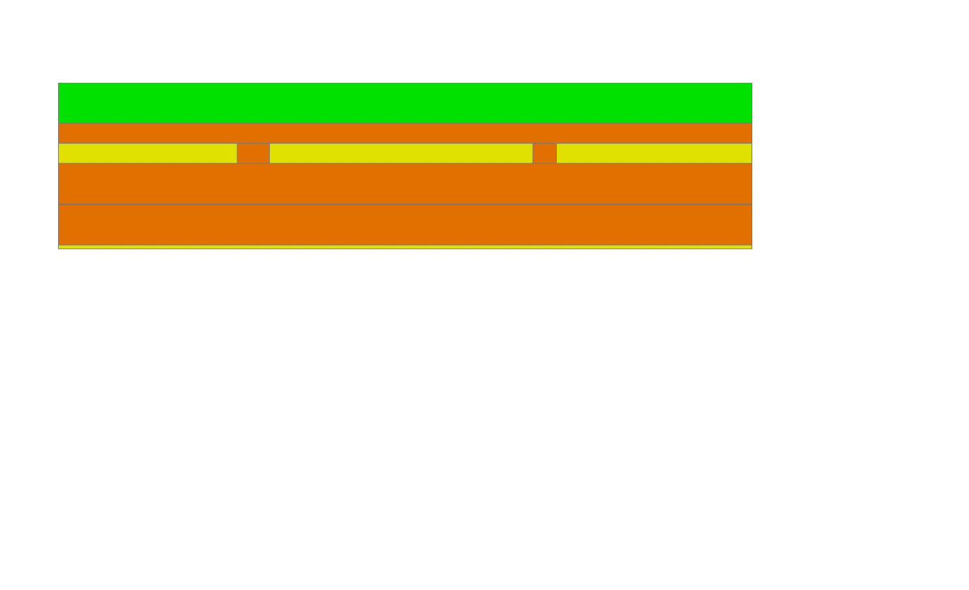
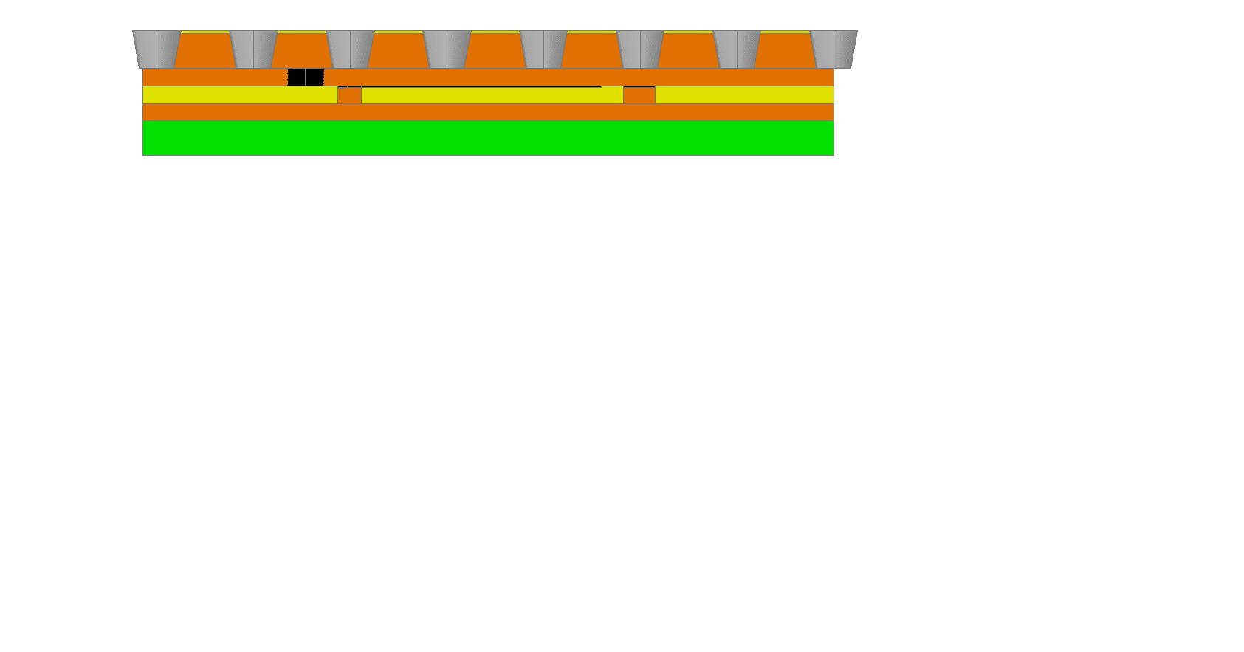
The µ-RWELL_PCB manufacturing
LR scheme: single resistive layer
HR scheme: double resistive layers
Copper layer 5 µm
1
Kapton layer 50 µm
DLC-coated kapton base material:
DLC layer ∼0.1-0.2 µm (10-100 MΩ/)
2nd resistive kapton layer (∼25 µm) with 1/cm² vias density, screen printed with an “embedded-resistors” pattern
10 mm
10 mm
DLC-coated kapton base material
2nd resistive kapton layer
2
Pre-preg 106 (50 µm)
Readout on kapton layer (25 µm) +
PCB (1mm)
PCB (1 mm)
3
DLC-coated base material after copper and kapton chemical etching (the WELL amplification stage)

Slide 13
The µ-RWELL: a GEM-MM mixed solution (I)
µ-RWELL
GEM detector sketch
MM detector sketch

Slide 14
The µ-RWELL: a GEM-MM mixed solution (II)
The µ-RWELL has features in common either with GEMs or MMs:
MMs are realized on rigid substrate
GEM on flex substrate
µ-­RWELL exploits both technologies, rigid and flexible (but also full-flex)
The µ-RWELL :
inherits and improves the GEM amplifying scheme with the peculiarity of a “well defined amplifying gap”, but ensuring higher and more uniform gas gain, with no transfer/induction gaps whose non- uniformity can affect the detector gain ­
inherits the MM resistive readout scheme that allows a “strong suppression” of the amplitude of the discharges.

Slide 15
Main features of the µ-RWELL detector
the µ-RWELL is intrinsically a spark protected detector and it has a very simple construction procedure:
only two mechanical components → µ-RWELL_PCB + cathode
no critical & time consuming assembly steps:
    no gluing
    no stretching
    easy handling
no stiff & large frames
suitable for large area with PCB splicing technique (more simple than GEM)
cost effective:
1 PCB r/o, 1 µ-RWELL foil, 1 DLC, 1 cathode and low man-power
easy to operate:
very simple HV supply → 2 independent channels or a trivial passive divider (3GEM detector → 7 HV channels)
Notes:
Non ha bisogno di cornici (frames) grandi e rigide (Stiff → rigido)

Slide 16
The µ-RWELL performance

Slide 17
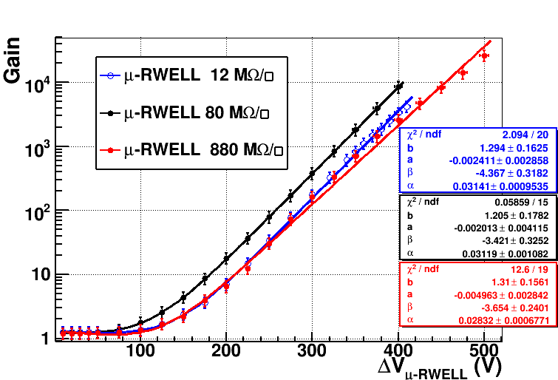
Gas gain
Prototypes with different resistivity (12-80-880 MΩ/) have been tested with an X-Ray gun (5.9 keV) with Ar/CO₂ =70/30, Ar/i-C₄H₁₀ =90/10 gas mixture and characterized by measuring the gas gain in current mode.
Ar/ISO=90/10
WELL kapton thickness = 50µm
70
50
55
50
70
30

Slide 18
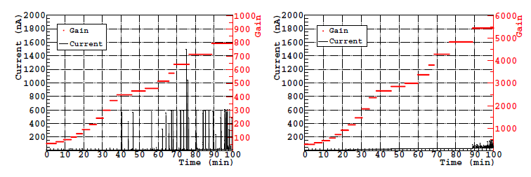
µ-RWELL: discharge study
Discharge study (qualitative): µ-RWELL vs GEM
Single-GEM
µ-RWELL
for µ-RWELL discharge amplitude of the order of few tens of nA (<100 nA @ max gain)
for GEM discharge amplitude of the order of 1µA
More quantitative studies must be clearly performed

Slide 19
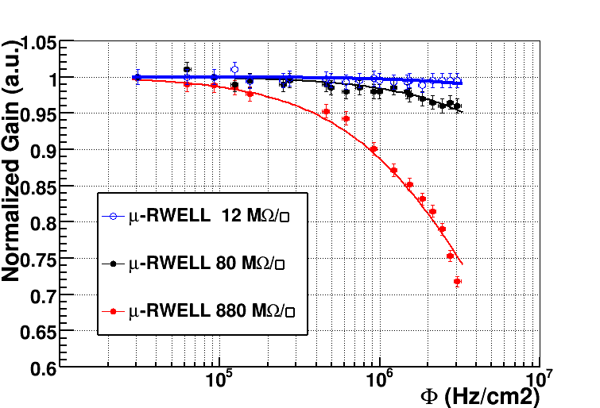
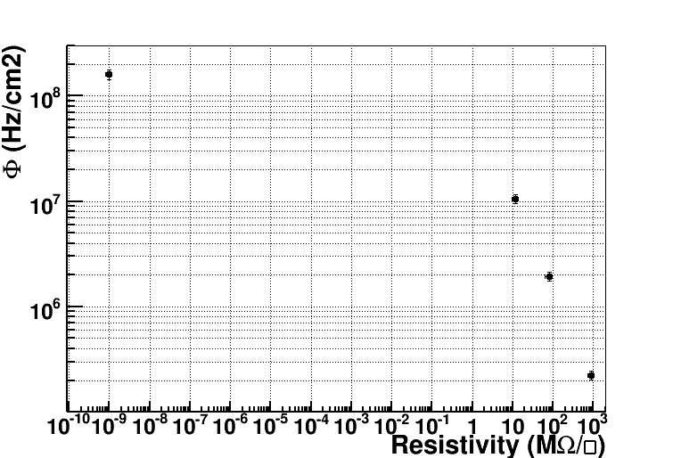
Rate capability vs layer resistivity
Ar/ISO =90/10, G = 1000
The gain decrease is correlated with the voltage drop due to the resistive layer
Solution for high rate: local evacuation of the current through embedded resistors on a kapton layer and connected by vias directly to the strips of the detector ➔ grounding pitch
test with X-ray
10 mm
GEM detector rate(*)
10 mm
rate for a drop ΔG = -3%
for m.i.p. × 7
With a 1×1 cm² grounding pitch & a resistivity of ≈10 MΩ/☐, a rate capability of ≈10 MHz/cm² can be achieved.
a re-scaling with the right gain would be required
(*) Bellazzini et al. NIMA 423 (1999) 125
Sauli et al., NIMA 419 (1998) 410
Notes:
local evacuation of the avalanche current through
embedded resistors screen printed on a kapton layer and connected by vias directly to the pads of the detector with a “grounding pitch” of the order of 1 cm2.
current evacuation directly on pads using kapton layers embedded with a matrix of vias and resistors

Slide 20
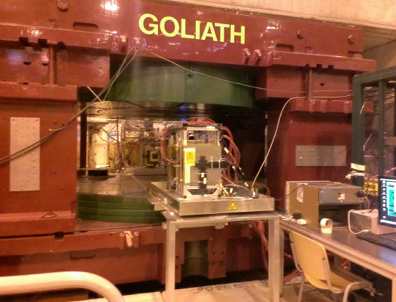
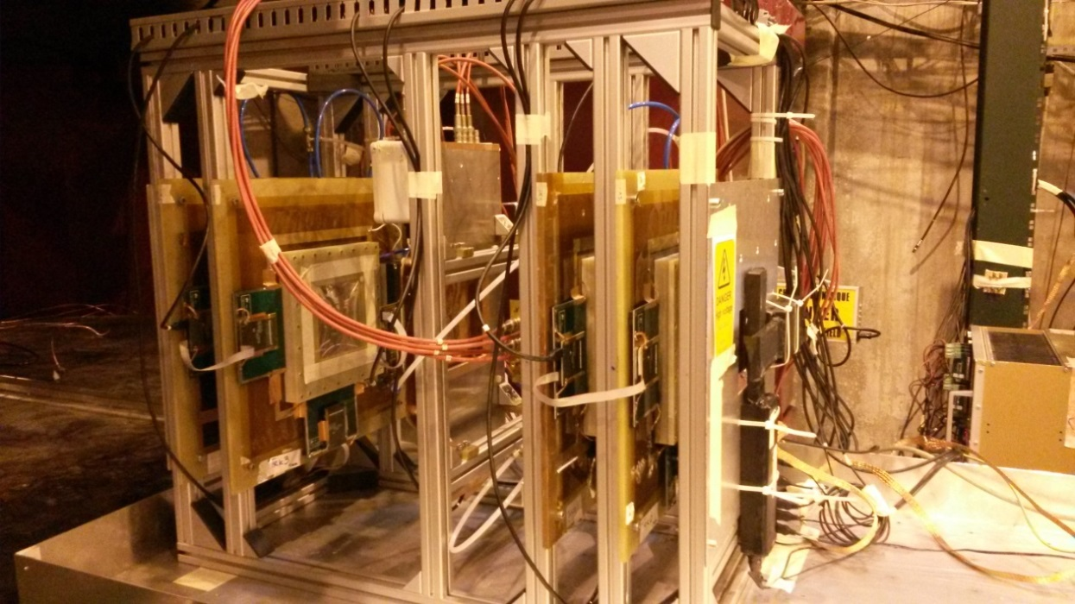
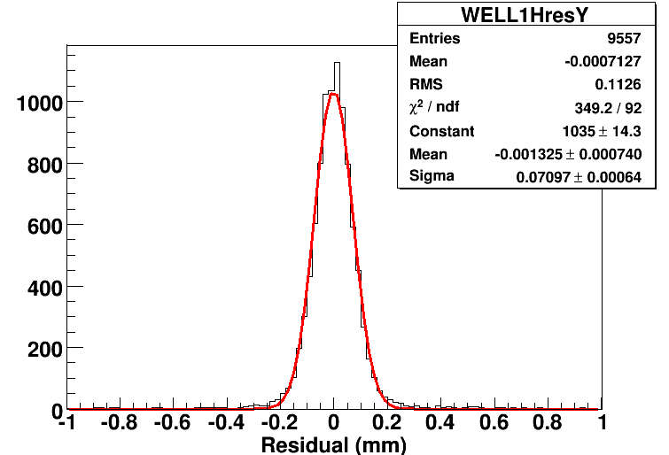
The µ-RWELL performance: Beam Tests
H4 Beam Area (RD51)
Muon beam momentum: 150 GeV/c
Goliath: B up to 1.4 T
10x10 cm² μ-RWELL proto
12-80-880 MΩ/□
400 µm pitch strips
APV25 (CC analysis)
Ar/iC₄H₁₀ = 90/10
σ_{RWELL} = (52+-6) µm
@ B= 0T after TRKs contribution subtraction
M.Poli Lener et al., NIM A 824 (2016) 565
GEMs Trackers

Slide 21
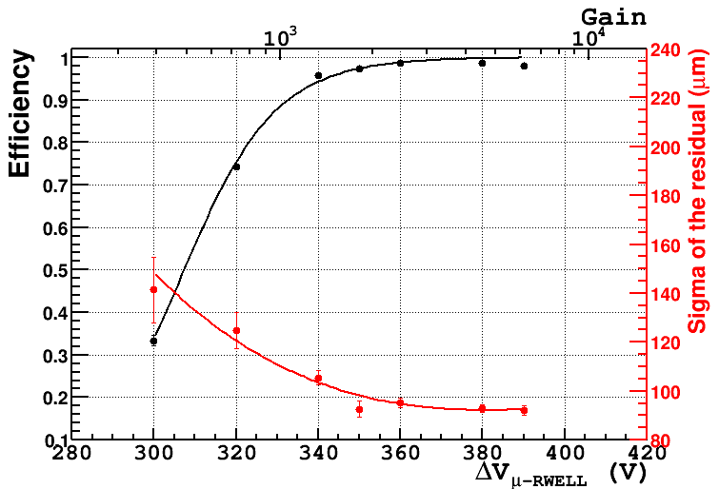
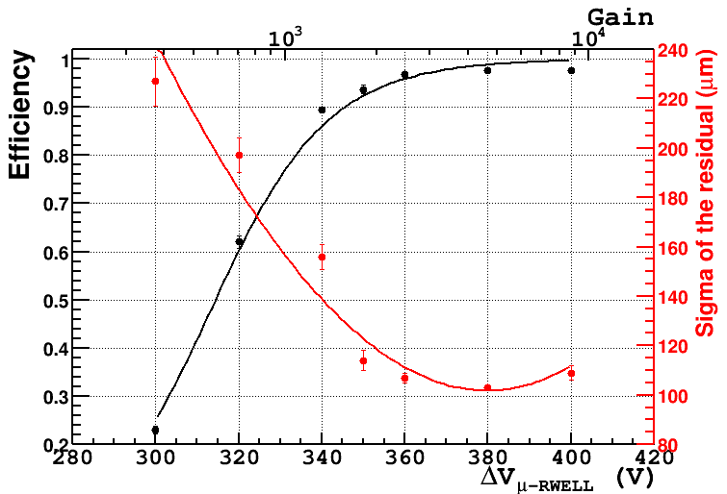
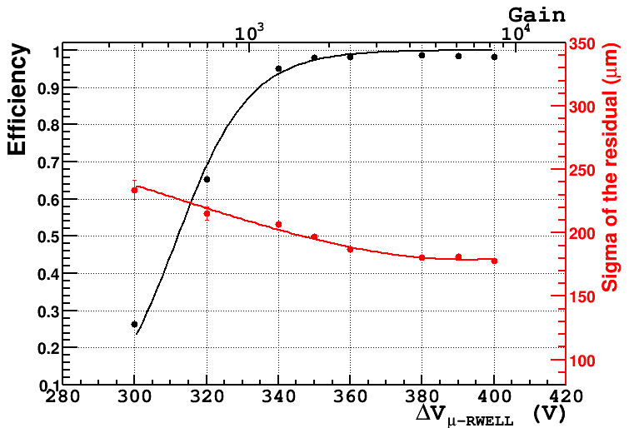
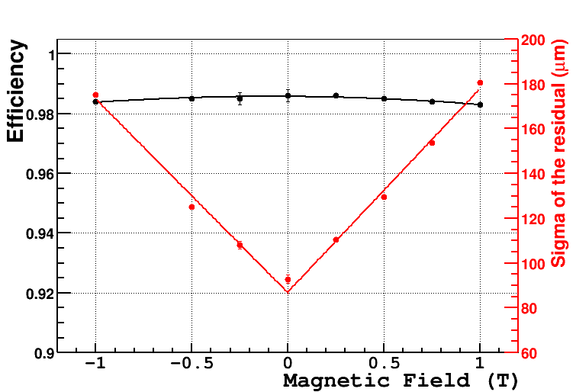
80 MΩ/ prototype with Ar/ISO=90/10
CC analysis
June 2015 – θ=0°, B= 0 T
Dec 2014 – θ=0°, B= 0.5 T
June 2015 – θ=0°, B= 1 T
June 2015 - θ=0°
For θ=0° and 0 < B < 1 T σ < 180 µm and ε > 98%

Slide 22
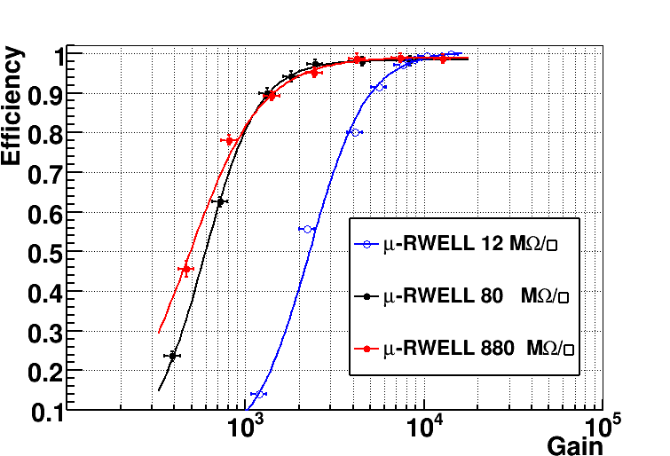
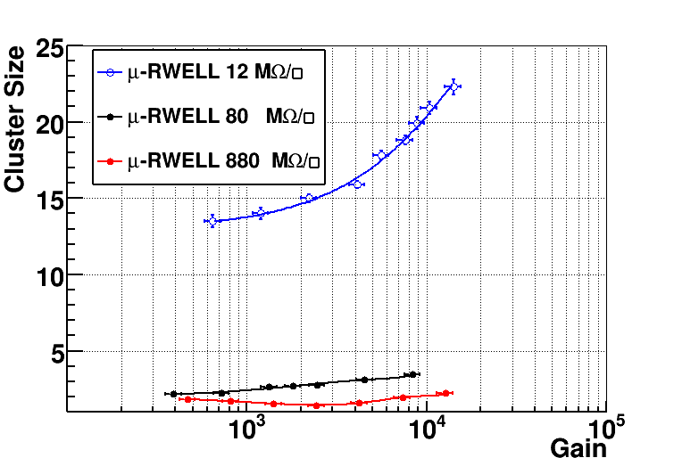
µ-RWELL vs resistivity (I)
CC analysis
Ar/ISO=90/10
Ar/ISO=90/10
At low resistivity the spread of the charge (cluster size) on the readout strips increases, thus requiring a higher gain to reach the full detector efficiency.

Slide 23
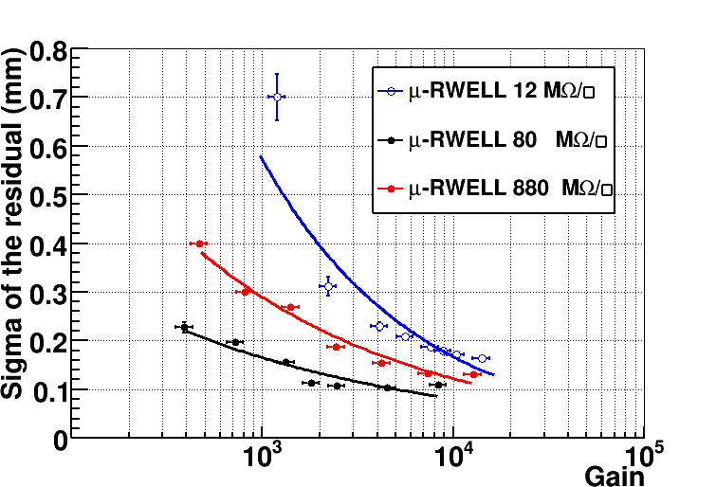
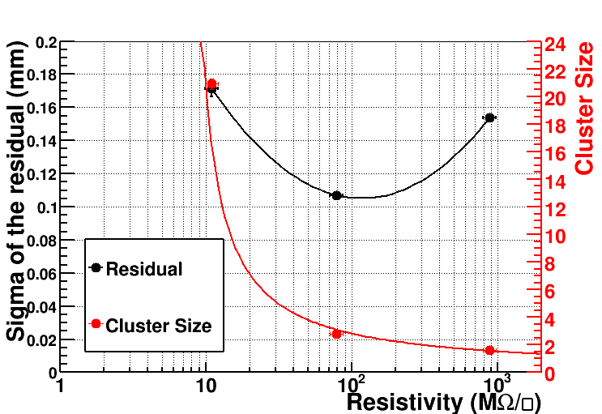
µ-RWELL vs resistivity (II)
CC analysis
Ar/ISO=90/10
Ar/ISO=90/10
The space resolution exhibits a minimum around 100MΩ/□.
At low resistivity the charge spread increases and then σ is worsening.
At high resistivity the charge spread is too small (Cl_size → 1) then the Charge Centroid method becomes no more effective (σ → pitch/√12).

Slide 24
µ-RWELL for future
Experiments Upgrade

Slide 25
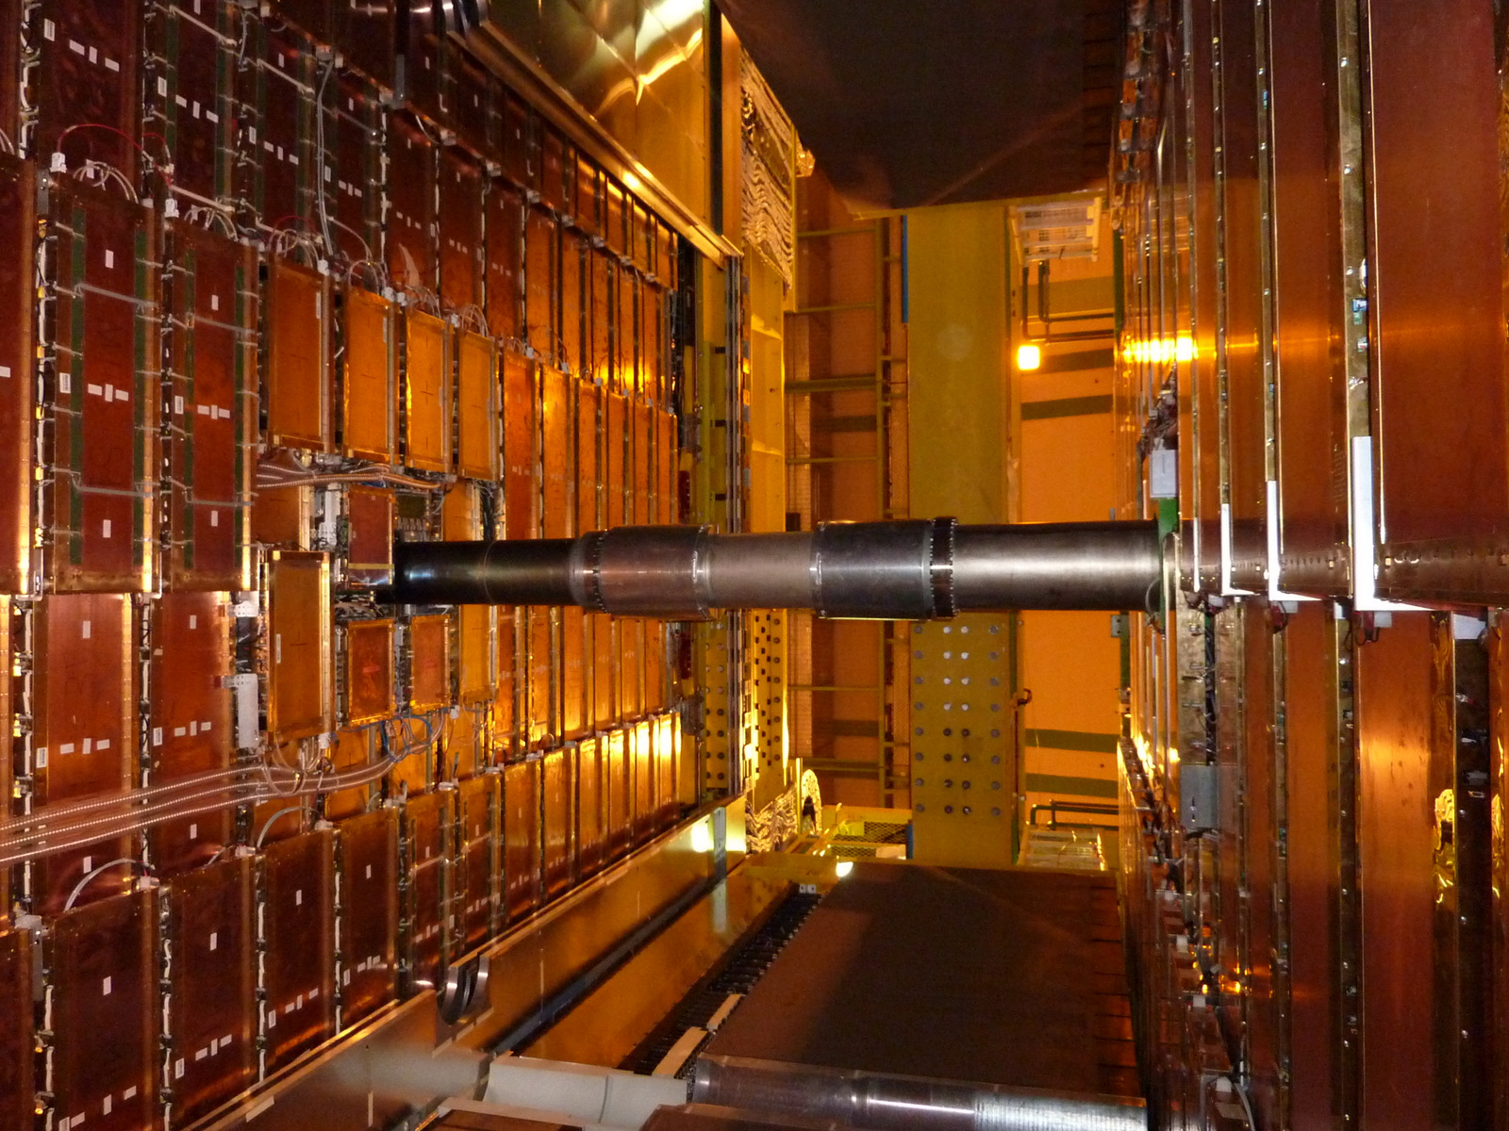
The µ-RWELL option for the
LHCb Muon System Upgrade

Slide 26
LHCb requirements @ 2×10³⁴cm⁻² s⁻¹
Rate up to 3 MHz/cm² with an additional filters in front of M2
Efficiency for single gap > 95% within a BX (25 ns)
Long stability up to 6 C/cm² accumulated charge in 10 y of operation
Pad cluster size < 1.2
 | Expected max rate MHz/cm² (*) | Active area cm² | Pad Size cm² (*) | Rate/Pad MHz | # pad/gaps | # gaps | #chamber 2 gaps
M2R1 | 3 | 30x25 | 0.63x0.77 | 1.5 | 1536 | 24 | 12
M2R2 | 0.5 | 60x25 | 1.25x3.15 | 0.5 | 384 | 48 | 24
M3R1 | 1 | 32.4x27 | 0.67x1.7 | 1 | 768 | 24 | 12
M3R2 | 0.15 | 64.8x27 | 1.35x3.4 | 0.15 | 384 | 48 | 24
(*) average rate is about 50% of maximum rate
(*) X, Y/4 w.r.t. present logical pads in M2R1; a factor 2 more in Y, to halve the rate/Pad
X, Y/2 w.r.t. present logical pads in M2R2, M3R1 and M3R2
In this framework the GEM detector is still a valid option,
however we are proposing a more safe solution for this harsh environment
➔ the µ-RWELL with HR scheme (see slide 19), which will be tested in a TB in Nov. 2016

Slide 27
Towards large area & detector engineering
In the framework of the CMS-Phase2 Muon Upgrade we are developing large size µ-RWELL. The R&D is performed in strict collaboration with Italian industrial partners (ELTOS SpA & MDT). The work will be performed in two years with following schedule:
Construction & test of the first 1.0x0.5m² (GE1/1) µ-RWELL 2016
Mechanical study and mock-up of 1.8x1.2 m² (GE2/1) µ-RWELL 12/2016
Construction & test of the first 1.8x1.2m² (GE2/1) µ-RWELL 12/2017- 6/2018
LR scheme
1.0x0.5m² (GE1/1) µ-RWELL
450
450
1.8x1.2m² (GE2/1) µ-RWELL
Splicing zone
< 0.5 mm wide
1000 mm
450
450
Four PCB µ-RWELL spliced with the same technique used for large ATLAS MM + only one cathode closing the detector

Slide 28
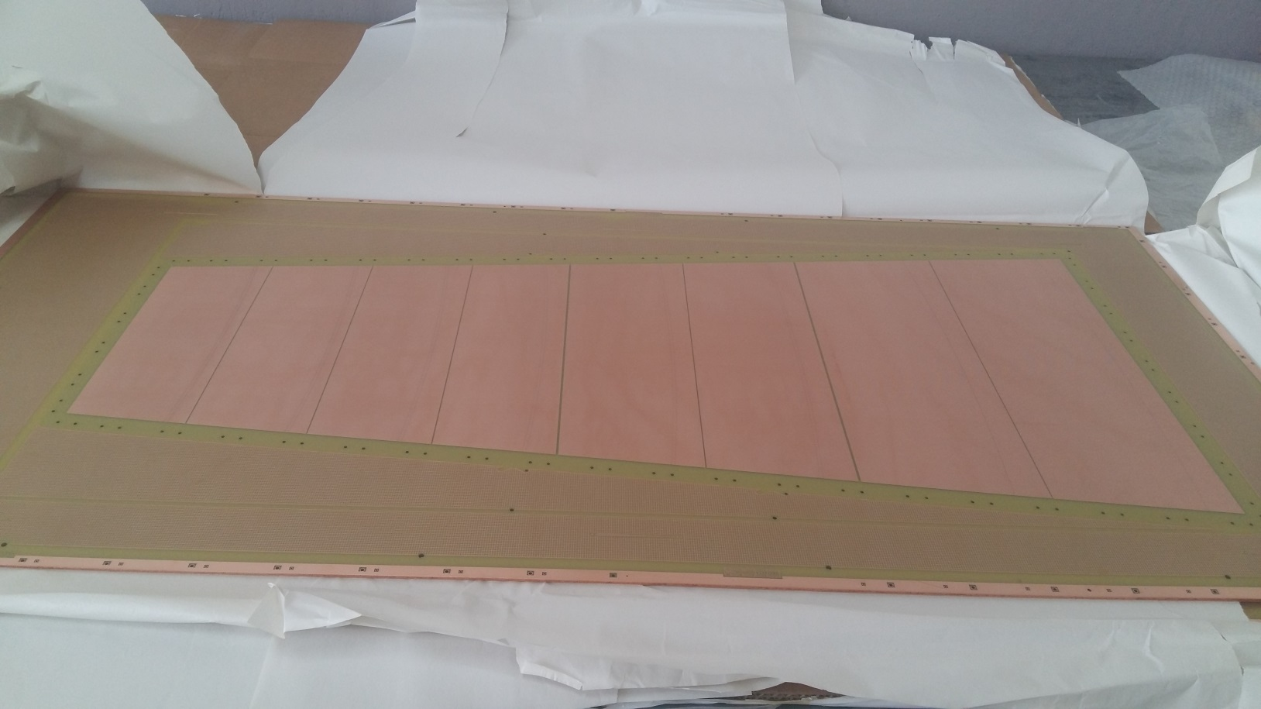
Readout-PCB production @ ELTOS
η-sector with 384 radial readout strips
500
1000

Slide 29
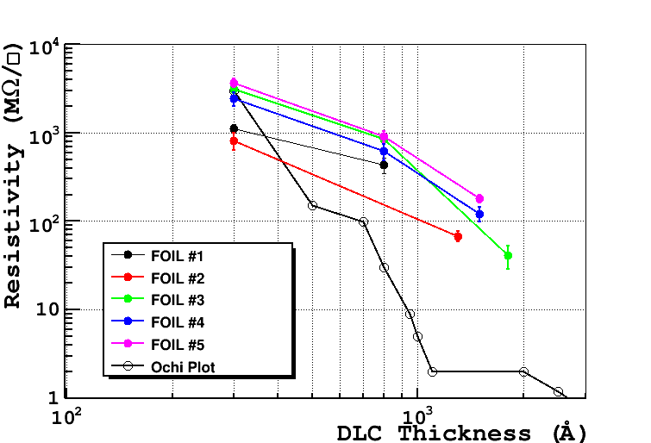
DLC sputtering on kapton foils (supervised by Ochi)
 | Foil 3 (1800A) | Foil 2 (1300A) | Foil 5 (1500A) | Foil 4 (1500A) | Foil 1 (800A)
Average Surface Resistivity MΩ/ | 41±12 | 68±9 | 180±17 | 122±22 | 433±90
Ar/ISO=90/10

Slide 30
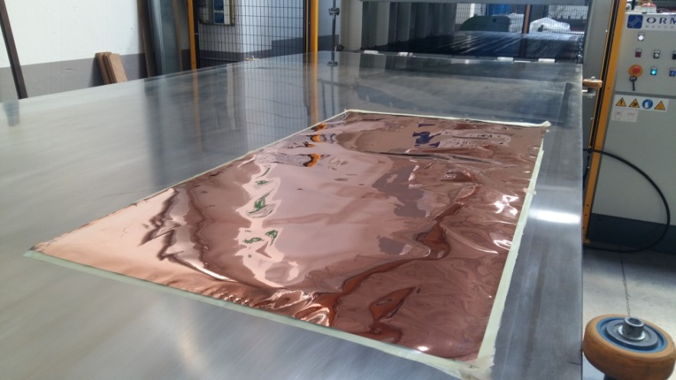
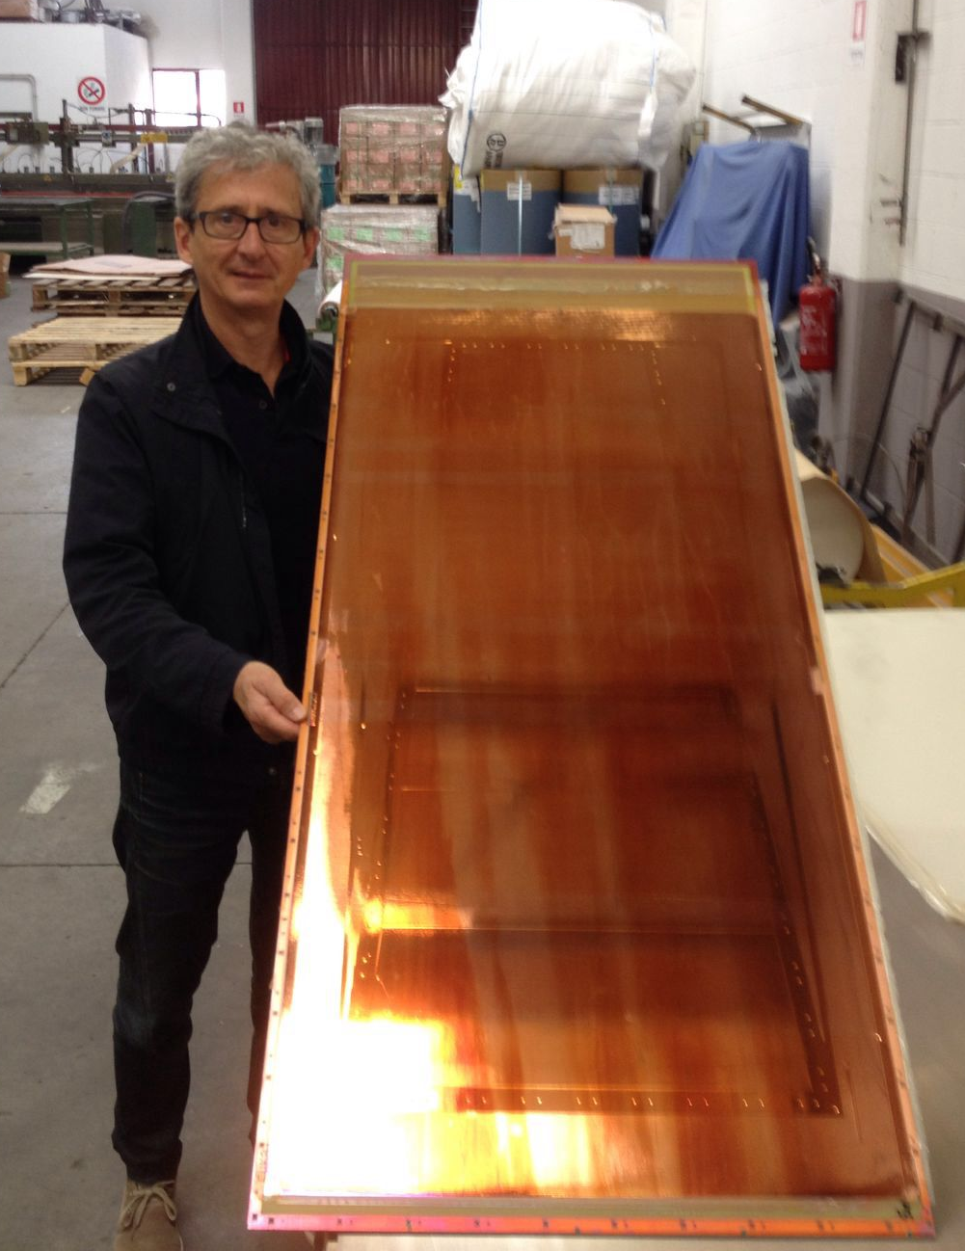
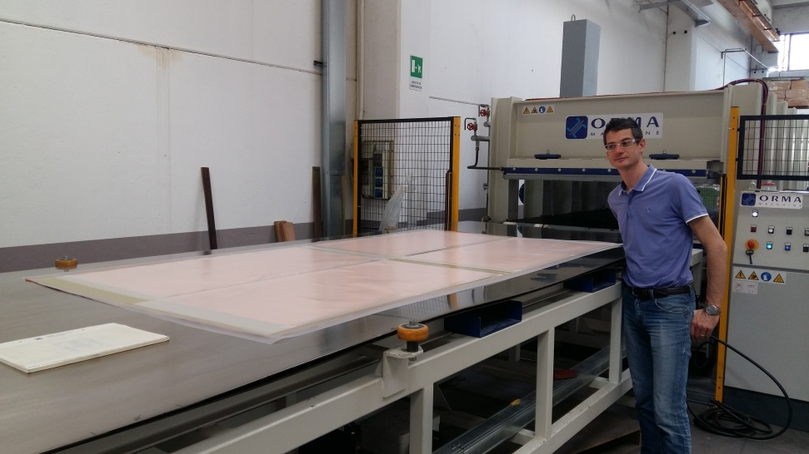
Coupling the DLCed Kapton with r/o-PCBs
DLC-coated kapton base material before the pressing
DLC-coated kapton base material on the readout PCB before the pressing
Final results of the DLC-coated kapton base material after the coupling

Slide 31
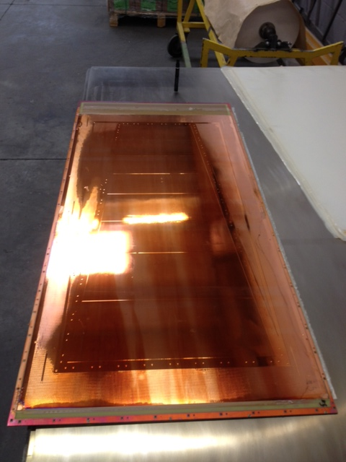
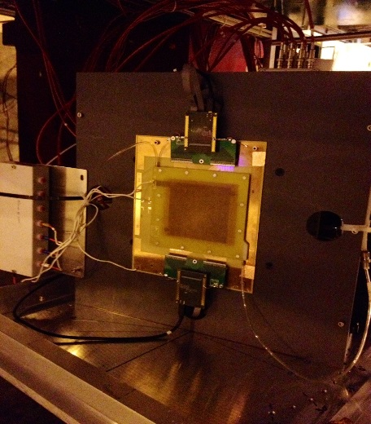
Summary of µ-RWELL development to date
X 50 in SIZE !
To GE1/1 Size
From 10 x 10 cm²
To 100 x 50 cm²
Final assembly expected by the first week of July
  PCB manufacturing (@ ELTOS - Italy) done
  DLC deposition (@ Be-Sputter Co. - Japan) done
  DLC coupling w R/out (@ MDT - Italy) done
  etching of the kapton/copper foils (@ CERN) completed by the end of June
First results from x-ray source expected by the end of September 2016
Test Beam organization for the end of the year is on going

Slide 32
Summary & Outlook
The µ-RWELL is a compact, simple to assemble & suitable for large area, MPGD:
gas gain ∼10⁴
intrinsically spark protected
rate capability ∼1 MHz/cm² for m.i.p
space resolution < 60µm
Lot of work/R&D in progress:
  large area (CMS, SHIP) with LR detector scheme;
  HR scheme (LHCb) with double resistive layers;
  large gain with 125µm thick WELL amplification stage (MPGD_NEXT-GR5)

Slide 33
Spare slides

Slide 34
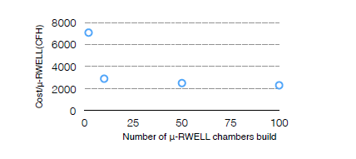
Cost of µ-RWELL and GEM for large volume production
Open dots: cost estimate (by ELTOS SpA) of a1.2x0.5m² µ-RWELL
Star: cost (by CERN) of a 1.2x0.5 m² GEM
34

Slide 35
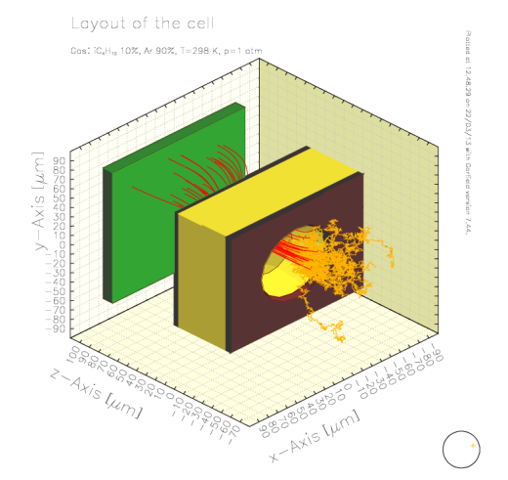
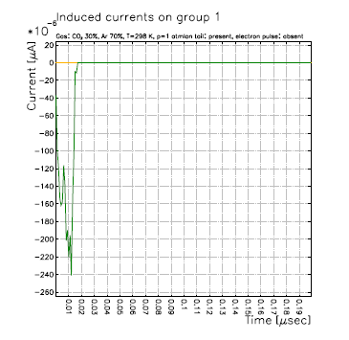
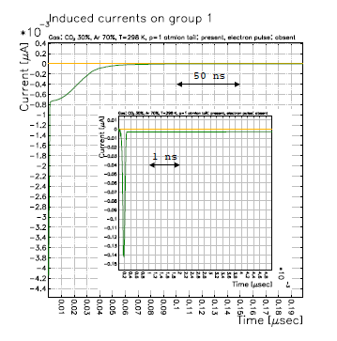
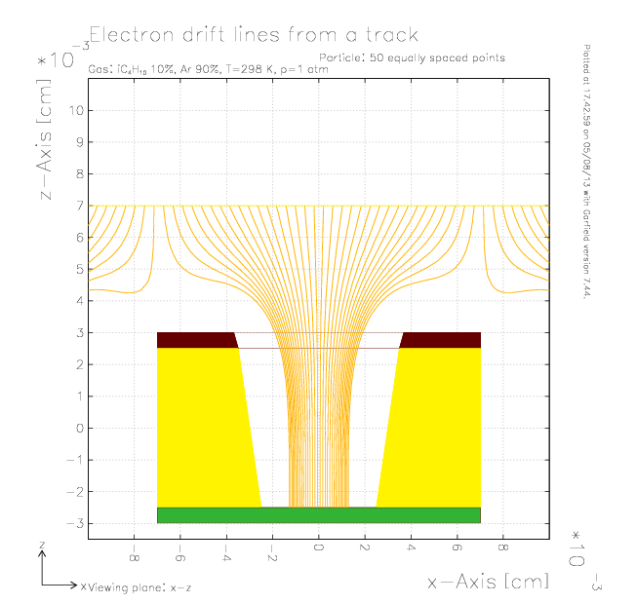
The µ-RWELL vs GEM (Garfield simulation)
GEM – Ar:CO2 70:30 gas mixture
Signal from a single ionization electron in a GEM.
The duration of the signal, about 20 ns, depends on the induction gap thickness, drift velocity and electric field in the gap.
Signal from a single ionization electron in a µ-RWELL.
The absence of the induction gap is responsible for the fast initial spike, about 200 ps, induced by the motion and fast collection of the electrons and followed by a ~50 ns ion tail.
µ-RWELL – Ar:CO2 70:30 gas mixture
Notes:
Schema di una gem …

Slide 36
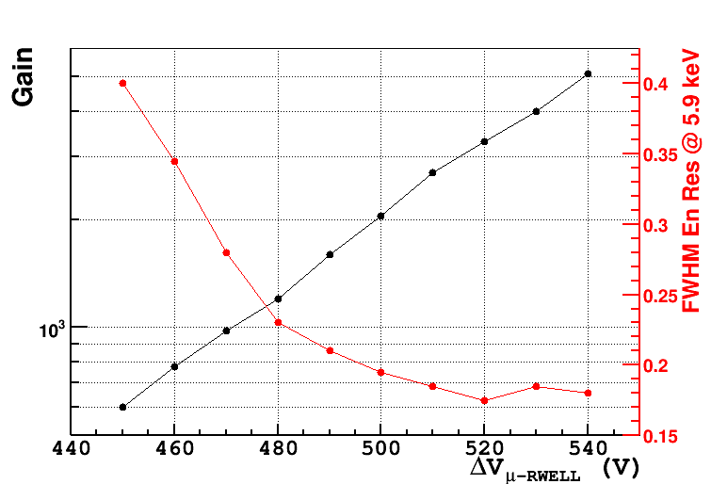
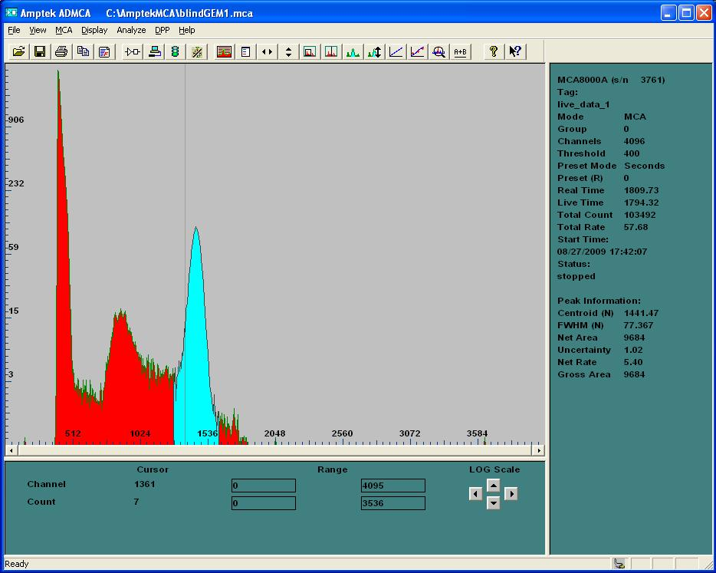
µ-RWELL: Energy Resolution
The prototype of µ-RWELL (100 MΩ/□) has been tested with X-rays tube (6keV) (Ar/CO2=70/30) & the signal has been readout vith an ORTEC amplifier
pedestal
6 keV
Argon
escape

Slide 37
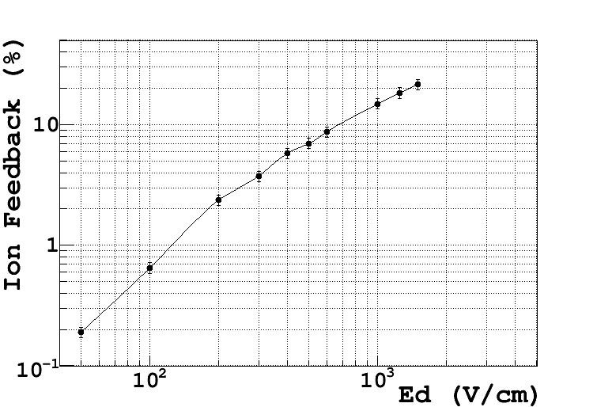
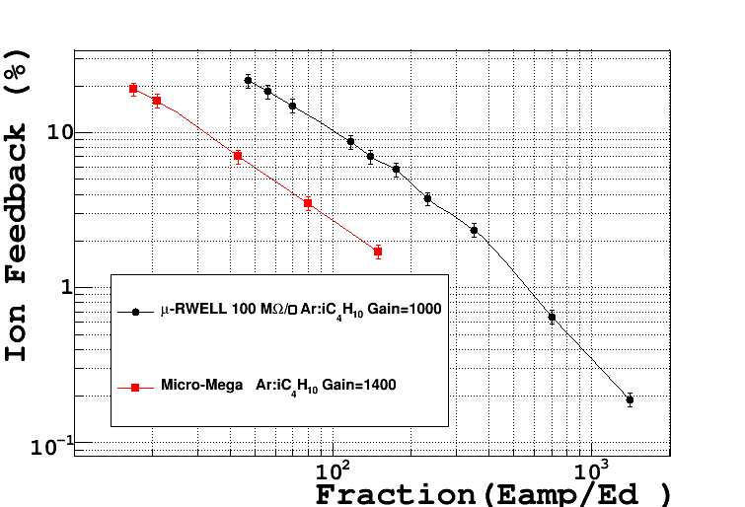
µ-RWELL: Ion Feed-Back measurement
The prototype of µ-RWELL (100 MΩ/□) has been tested in current mode with X-rays tube (6keV) (Ar/ISO=90/10)
Gain∼ 10³
MM IBF measurement: NIMA 535 (2004) 226

Slide 38
TB June 2015:
AR/CO2=70/30 vs AR/ISO=90/10

Slide 39
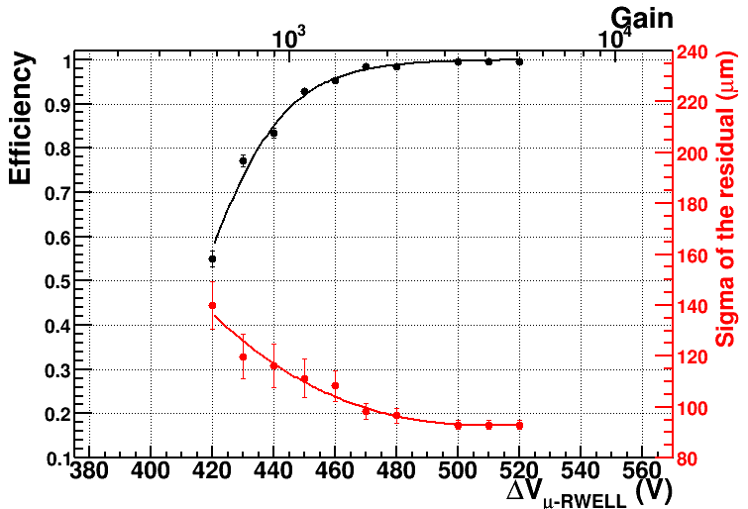
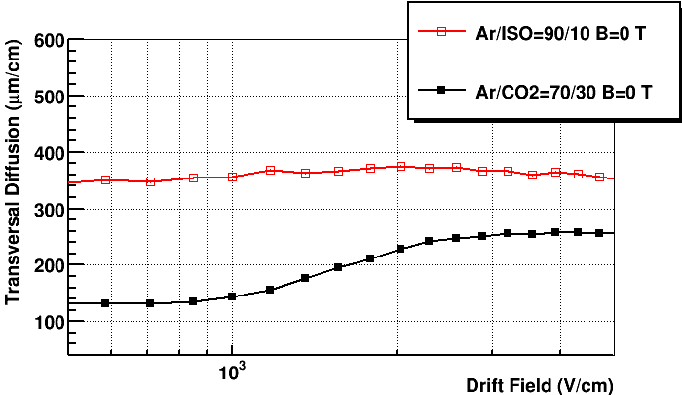
TB June 2015 B=0T & θ=0°
Efficiency & Residual vs gas mixture
σ-Residual w/out
TRK subtraction
June 2015 – Ar/CO₂=70/30
Ed=750 V/cm & B=0 T
Ar/CO₂=70/30
∼60 µm on 4 mm gap
GARFIELD
simulation
June 2015 – Ar/ISO=90/10
Ed=3.5 kV/cm & B=0 T
∼ 140 µm on 4 mm gap
No large difference observed between Ar/CO₂ & Ar/ISO due to:
µ-RWELL compactness
relatively large strip pitch (400 µm)
Ar/ISO=90/10

Slide 40
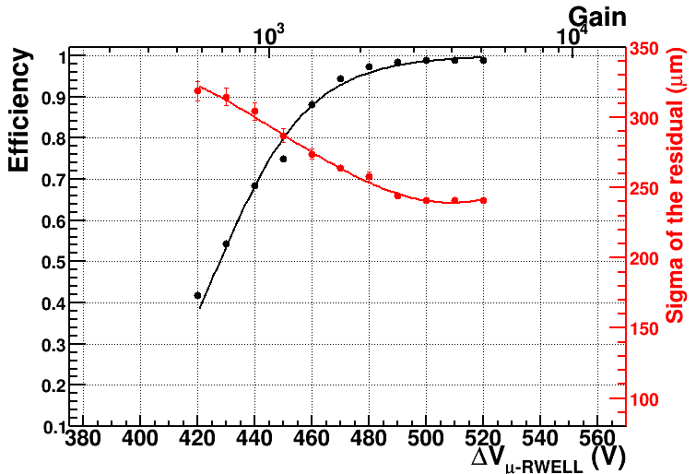
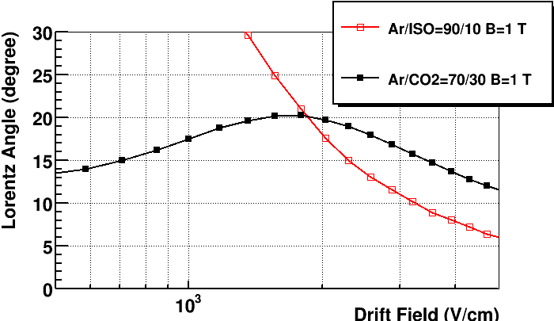
TB June 2015, B=1T & θ=0°
Efficiency & Residual vs gas mixture
σ-Residual w/out
TRK subtraction
Ar/CO₂=70/30
Ed=750 V/cm & B=1 T
B=1 T
α_{L}= 16°
GARFIELD
simulation
Ar/ISO=90/10
Ed=3.5kV/cm & B= 1 T
The difference on the residual is probably due to the diverse Lorentz angle
B=1 T
α_{L}=8.5°

Slide 41
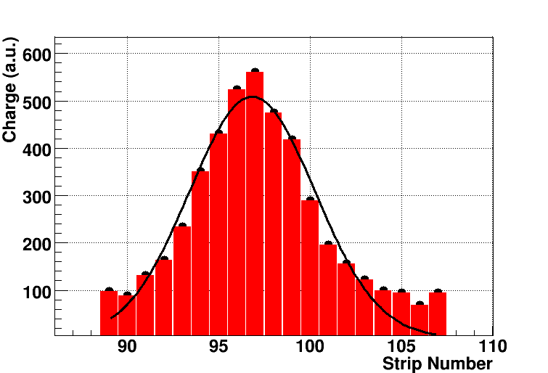
Cluster Size vs layer resistivity
Ar/ISO=90/10
400 µm pitch strips
6 mm LHCb pad
The use of low resistivity increases the charge spread (cluster size) on the readout strips.
Of course for large size pad r/out (as in LHCb muon), most of the charge is collected on a single pad. Then the expected Cluster size for LHCb should be ∼1

Slide 42
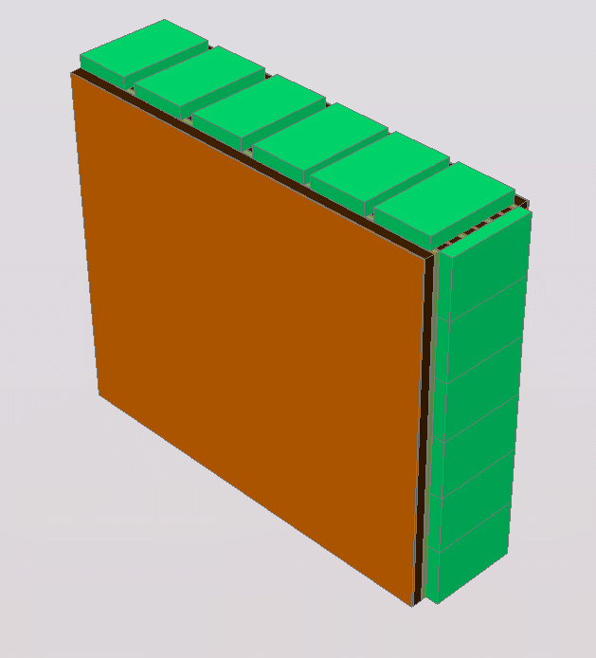

Possible layout for M2R1
M2R1 chamber with 2 µ-RWELL gas gaps r/o by 24 VFAT chips (equivalent to 3k channels) should fit in the current M2R1 available space.
Gas gap cross section
VFAT
VFAT
Stiff structure with honeycomb sandwiched r/o & cathode PCBs
VFAT
VFAT
VFAT
VFAT
1
Honey-comb
5
7
R/O & µ-RWELL
1
17
Cathode
3mm
gas gap
1
Honey-comb
5
7
1
68
Chamber Design

Slide 43
Milestones & schedule for G1/1 µ-RWELL (2016)
January.: drawings of the G1/1 µ-RWELL
10 Feb: ELTOS send formal offer for n.2 kit µ-RWELL (GE1/1 type)
25 Feb: order for n.3 kit µ-RWELL completed
5 April: PCB-readout (type GE1/1) completed at ELTOS
2 May: DLC sputtering on large Kapton foils (w/copper on one side) completed
12 May: discussion at ELTOS about the gluing/pressing of the kapton foil w/DLC(amplification stage of µ-RWELL) on the readout-PCB
12 May: the DLCed Kapton foils have been delivered at the LNF
17 May: preliminary test at MDT-Milano of the gluing/pressing of nake-kapton foils on one of the final PCB-readout; the goal of the test is to tune the parameters of the gluing/pressing and verifying the absence of air bubbles between the DLC surface and the prepreg
26 May: quality check (by Rui) of the sample prepared @ MDT
6-8 june: gluing the DLCed foils on the readout -PCBs @ MDT
13-30 June: etching at CERN of the kapton foils to produce the WELL-pattern
1- 30 July: closing and preliminary test of the detectors
1 sept – 19 oct: Beam Test preparation
19 oct – 8 nov: Beam Test at H8-B area (LHCb area)

Slide 44
Milestones & schedule for G1/1 µ-RWELL (2016)
 | Jan | Feb | Mar | Apr | May | Jun | Jul | Aug | Sep | Oct | Nov | Dec
Large µ-RWELL production chart
Kick-off meeting with ELTOS for the “GE1/1-size” µ-RWELL prototype (1m length) (12/01/16)
Realization of 1.2 m x 0.5 m kapton foil (50 µm) w/DLC by OCHI (RD51) in Japan (Feb. 2016)
PCB construction @ ELTOS
Gluing the DLC foil on the readout PCB by ELTOS
Copper & kapton etching by Rui
Detector closing & test with X-ray @ LNF
TB with muon & GIF++ @ CERN (data TB RD51)
2015 TB results with small size µ-RWELL
GE2-1 µ-RWELL design chart
GE2-1 µ-RWELL design (LNF+Ba) (start 14/1/16)
GE2-1 µ-RWELL mock-up (LNF+Ba)

Slide 45


µ-RWELL: rate capability(I)
A drawback correlated with the implementation of a resistive layer is the reduced capability to stand high particle fluxes
Ar/CO₂ – G_{µ-RWELL} = 2000, G_{GEM} ~ 1000
for m.i.p. × 7
100 MΩ/☐
X-Ray
150-200 kHz/cm² with X-Rays corresponding to 1 – 1.5 MHz/cm² m.i.p.
collimator aligned with the center of the detector
Taking into account that:
the ionization of a m.i.p. is a factor 7 smaller than X-rays
the resistive stage can be suitably segmented in order to evacuate the current every ∼ 1x1 cm² (a sort of “matrix of resistive pads put at ground” → HR scheme)
a rate of ∼1 MHz/cm² for m.i.p. should be easily achieved (tbd)

Slide 46

µ-RWELL: rate capability(II) vs layer resistivity
Bellazini et al. NIMA 423 (1999) 125
Sauli et al., NIMA 419 (1998) 410.
Ar/Iso - 2,5 mm Diameter Collimator
Gain =1000
Rate for a drop ΔG=-3%
Model based on a pure Ohmic behaviour
Resistivity declared by the deliverer: 1 GOhm/square
Resisivity=883.782 MOhm/square +- 176.756
Resistivity declared by the deliverer: 80 MOhm/square
Resisivity=79.2628 MOhm/square +- 15.8526
Resistivity measured by us: 7.5 MOhm/square
Resisivity=11.7345 MOhm/square +- 2.3469
G. Bencivenni et al., 2015_JINST_10_P02008

