Slide 1

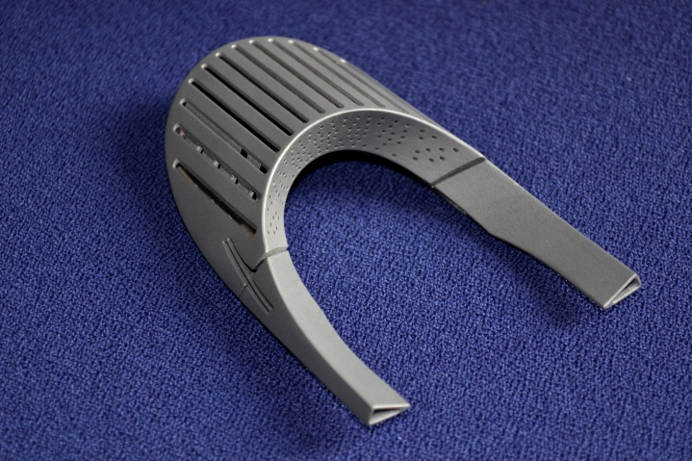
Short Introduction to the AM Technology
ORGANISATION EUROPÉENNE POUR LA RECHERCHE NUCLÉAIRE
CERNEUROPEAN ORGANIZATION FOR NUCLEAR RESEARCH
Additive production activities at CERN
Thomas Sahner, thomas.sahner@cern.ch
Tel.: +41.22 76 77176
Ing. Mechanics (calculations of structures and kinematics) University of Annecy
Master (Process Engineering) University of Grenoble
Eur. Ing. FEANI ( Federation of European Engineering associations )

Slide 2
ORGANISATION EUROPÉENNE POUR LA RECHERCHE NUCLÉAIRE
CERNEUROPEAN ORGANIZATION FOR NUCLEAR RESEARCH
Who we are
EN: Engineering department
MME : The Mechanical and Materials Engineering Group
Group Leader: Francesco Bertinelli
The mandate : provide to the CERN community specific engineering solutions combining mechanical design, production facilities and material sciences. This group owns, maintains and develops the know-how on the mechanical constructions in the accelerators and the physics detectors.
Engineering & Design
Fabrication
Machining & Maintenance
Preparation & Subcontracting
Assembly & Forming
Materials & Metrology
Internal Design Office facilities, 40 designers (Staff and Industrial Support)
CATIA / SmarTeam, ANSYS
Mechanical measurements lab
4000 m2 of internal workshop facilities, 50 technicians (Staff and Industrial Support): CNC machining, sheet metal work & welding, electron beam & laser, vacuum brazing
External subcontracting service
Free access Users workshop
Material selection, analysis & metallurgy: microscopy, mechanical testing
NDT: US, radiography, tomography
350 m2 of internal metrology facilities: CMM

Slide 3
Additive Manufacturing
Short introduction to the technology
CERN requirements
Additive manufacturing is heading for the alchemist’s dream: making anything.
Radio frequency parts (with high complex shapes)
Cryogenic parts (leek thigh for super fluid materials )
Vacuum parts ( outgazing )
Replacing traditional manufacturing methods by AM
New material development (e.g. Cu and Nb)

Slide 4
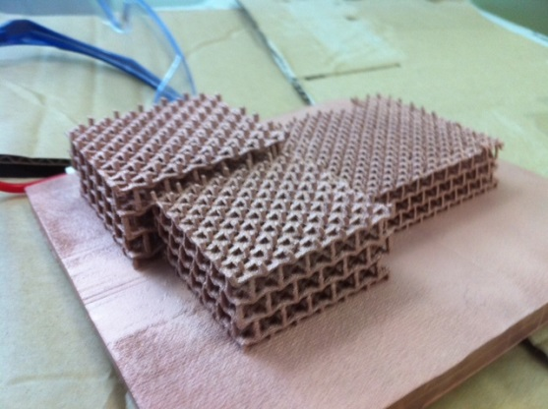
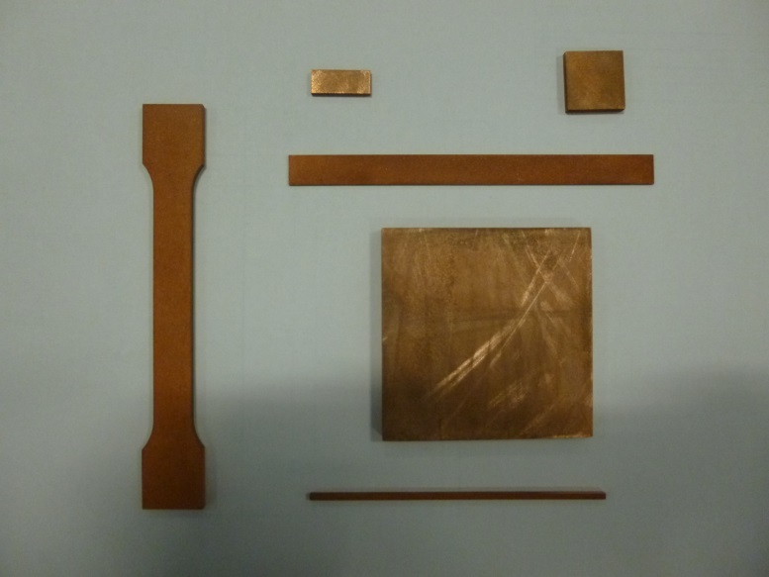
ORGANISATION EUROPÉENNE POUR LA RECHERCHE NUCLÉAIRE
CERNEUROPEAN ORGANIZATION FOR NUCLEAR RESEARCH
What we are doing at CERN:
Polymer materials
Printing models in some polymer materials at CERN
Subcontracting parts in polymer
Metal materials
Subcontracting parts in metal
Exploring the installation of an 3D metal printer
R&D to print pure Copper and Niobium
Further R&D of materials
Ceramic materials
Exploring ceramic materials
Subcontracting parts in ceramics
Ceramic material development
Several collaboration agreements in 3D printing
Contact to universities and other organisations

Slide 5
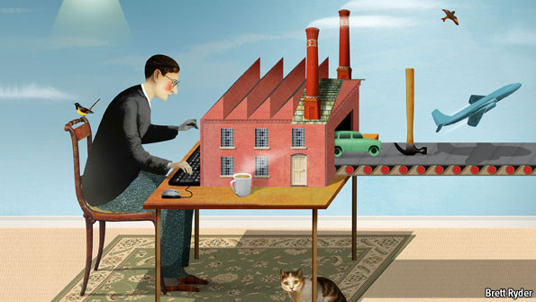
ORGANISATION EUROPÉENNE POUR LA RECHERCHE NUCLÉAIRE
CERNEUROPEAN ORGANIZATION FOR NUCLEAR RESEARCH
INTRODUCTION
The third industrial revolution ??
The digitization of manufacturing will transform the way goods are made –
and change the politics of jobs too

Slide 6
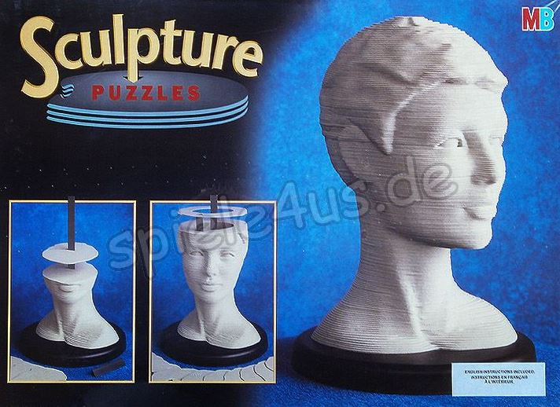
Additive Manufacturing
Short introduction to the technology
AM WHAT IS IT:
Additive Manufacturing by ASTM (American Society for
Testing and Materials ): “Process of joining materials to
make objects from 3D model data, usually layer upon layer,
as opposed to subtractive manufacturing methodologies,
such as traditional machining”
NAMING:
Rapid Prototyping: This term was used in the beginning of the professional use of the technology because the main application was the manufacturing of prototypes, mock ups and sample parts.
Todays most common terminologies are:
Additive Manufacturing (AM) or 3D Printing
“I guess the two definitions are valid”

Slide 7
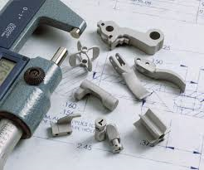
Additive Manufacturing
Short introduction to the technology
INTRODUCTION:
But:
Additive Manufacturing (AM) concerns as well some other technologies
Powder Injection Moulding (PIM), comprising Metal Injection Moulding (MIM) and Ceramic Injection Moulding (CIM), is an advanced manufacturing technology for the production of complex, high volume net-shape components.

Slide 8
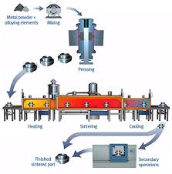
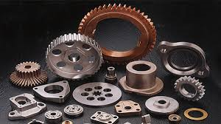
Additive Manufacturing
Short introduction to the technology
INTRODUCTION:
But:
Additive Manufacturing (AM) concerns as well some other technologies
Powder sintering is the process of blending fine powdered materials, pressing them into a desired shape or form (compacting), and then heating the compressed material in a controlled atmosphere to bond the material (sintering). The powder metallurgy process generally consists of four basic steps: powder manufacture, powder blending, compacting, and sintering. Compacting is generally performed at room temperature, and the elevated-temperature process of sintering is usually conducted at atmospheric pressure. Optional secondary processing often follows to obtain special properties or enhanced precision.

Slide 9
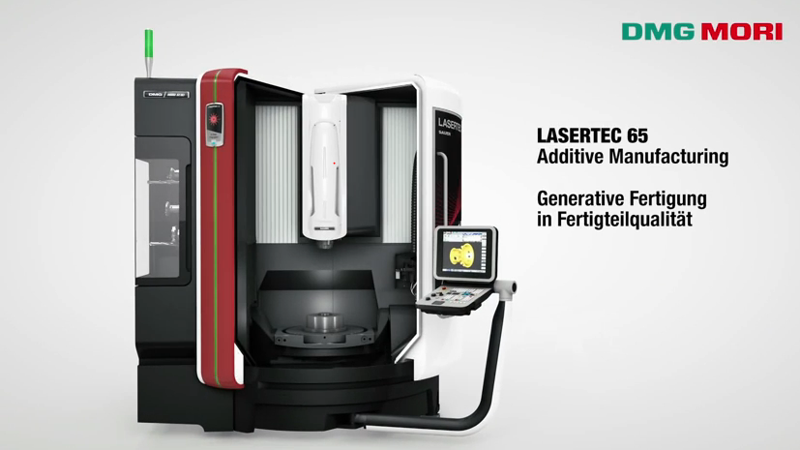
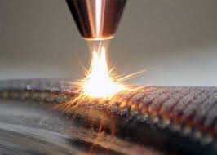
Additive Manufacturing
Short introduction to the technology
INTRODUCTION:
But:
Additive Manufacturing (AM) concerns as well some other technologies
Hybrid ( Additive and Subtractive manufacturing)
Laser Cladding Process with traditional machining
Laser Cladding Process description
In laser cladding, the laser beam is defocused on the work piece with a selected spot size. The powder coating material is carried by an inert gas through a powder nozzle into the melt pool. The laser optics and powder nozzle are moved across the work piece surface to deposit single tracks, complete layers or even high-volume build-ups.

Slide 10
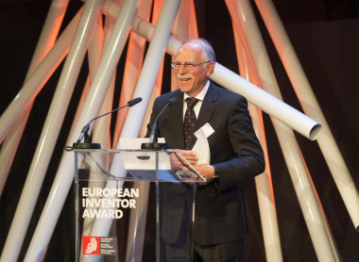
Additive Manufacturing
Short introduction to the technology
History of 3D Printing:
2000-
1980-2000
The earliest 3D printing technologies ﬁrst became visible in the late 1980’s, at which time they were called Rapid Prototyping (RP) technologies. This is because the processes were originally conceived as a fast and more cost-eﬀective method for creating prototypes for product development within industry.
1983 Charles Hull invents Stereolithography (SLA) Charles ‘Chuck’ Hull was the first to develop a technology for creating solid objects from a CAD/CAM file, inventing the process he termed ‘stereolithography’ in 1983. SLA works by curing and solidifying successive layers of liquid photopolymer resin using an ultraviolet laser. The field that came to be known variously as 'additive manufacturing', 'rapid prototyping' and '3D printing' was born.

Slide 11
Additive Manufacturing
Short introduction to the technology
As of today, AM applications have been developed in various industries
AM Revenues per industry segment (2012)
CONSUMER PROD./
ELECTRONICS
AUTOMOTIVE
MEDICAL/DENTAL
370 [EUR m]
320 [EUR m]
380 [EUR m]
TOOLS/MOLDS
OTHER
AEROSPACE
180 [EUR m]
230 [EUR m]
330 [EUR m]
Source: Wohlers Associates; Expert interviews; Roland Berger

Slide 12
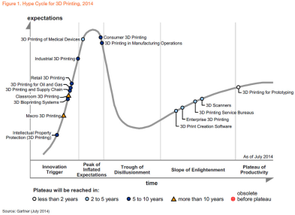
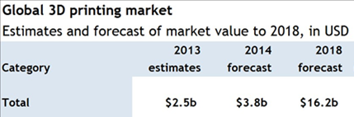

Additive Manufacturing
Short introduction to the technology
“3D printing’s potential to revolutionize manufacturing is quickly becoming a reality.”
In the frame of the Horizon 2020 project many European and National Networks are founded to see the potential of the technology.
President Obama announced his plan to invest $1 billion to catalyse a national network of up to 15 manufacturing innovation institutes…
Pilot institute : National Additive Manufacturing Innovation Institute (NAMII) with a budget of 30 M$ in 2013

Slide 13
Additive Manufacturing
Short introduction to the technology
The AM value chain consists of five steps – AM system providers are active in most areas of the value chain
Material
System
Software
Application design
Production
Mainly: Creation of metal powder
> Powder with high purity and a very narrow distribution of the granular size (usually 30µm)
> Hard to get from large providers due to small orders
>Usually sold by AM system providers
>Usually stand-
alone powder bed fusion systems
> System providers with low levels of vertical integration, standard components usually made by
contract manufacturers
> Providers integrate components system & software
>Differentiation
between process control and enhancement software
> Process control from system prov.
> Add-on software such as automatic support generation, design optimization
By specialized
companies
> Support for end customers
> Can be complex and demanding
> Done by system providers, software developers and/or service providers
> Not every service
provider is able to
design applications
>Different produc-
tion scenarios:
- Large OEM
- Contract manu- facturer/service provider
- Specialized part manufacturer
> Production is normally not done
by AM System providers
Players:
> Höganäs
> TLS Technik
> San
> etc.
Players:
> EOS
> SLM Solutions
> Concept Laser
> etc.
Players:
> Materialise
> netfabb
> With
> etc.
Players:
> 3T PRD
> Concept Laser
> EOS
> etc.
Players:
> 3T PRD
> Janke Engin.
> Layer Wise
> etc.

Slide 14
Additive Manufacturing
Short introduction to the technology
Advantages:
Design complexity and freedom:
The advent of 3D printing has seen a proliferation of products (designed in digital environments), which involve levels of complexity that simply could not be produced physically in any other way. While this advantage has been taken up by designers and artists to impressive visual effect, it has also made a significant impact on industrial applications, whereby applications are being developed to materialize complex components that are proving to be both lighter and stronger than their predecessors.
Speed:
You can create complex parts within hours , with limited human resources. Only machine operator is needed for loading the data and the powder material, start the process and finally for the finishing. During the manufacturing process no operator is needed.
Customisation
3D printing processes allow for mass customisation — the ability to personalize products according to individual needs and requirements. Even within the same build chamber, the nature of 3D printing means that numerous products can be manufactured at the same time according to the end-users requirements at no additional process cost.
Tool-less
For industrial manufacturing, one of the most cost-, time- and labour-intensive stages of the product development process is the production of the tools. For low to medium volume applications, industrial 3D printing — or additive manufacturing — can eliminate the need for tool production and, therefore, the costs, lead times and labour associated with it. This is an extremely attractive proposition, that an increasing number or manufacturers are taking advantage of. Furthermore, because of the complexity advantages stated above, products and components can be designed specifically to avoid assembly requirements with intricate geometry and complex features further eliminating the labour and costs associated with assembly processes.
Extreme Lightweight design
AM enable weight reduction via topological optimization

Slide 15
Additive Manufacturing
Short introduction to the technology
Advantages:
Sustainable / Environmentally Friendly
3D printing is also emerging as an energy-efficient technology that can provide environmental efficiencies in terms of both the manufacturing process itself, utilising up to 90% of standard materials, and, therefore, creating less waste, but also throughout an additively manufactured product’s operating life, by way of lighter and stronger design that imposes a reduced carbon footprint compared with traditionally manufactured products.
No storage cost
Since 3D printers can “print” products as and when needed, and does not cost more than mass manufacturing, no expense on storage of goods is required.
Increased employment opportunities
Widespread use of 3D printing technology will increase the demand for designers and technicians to operate 3D printers and create blueprints for products.

Slide 16
Additive Manufacturing
Short introduction to the technology
Disadvantages:
Questionable Accuracy
3D printing is primarily a prototyping technology, meaning that parts created via the technology are mainly test parts. As with any viable test part, the dimensions have to be precise in order for engineers to get an accurate read on whether or not a part is feasible. While 3D printers have made advances in accuracy in recent years, many of the plastic materials still come with an accuracy disclaimer. For instance, many materials print to either +/- 0.1 mm in accuracy, meaning there is room for error.
Support material removal
When production volumes are small, the removal of support material is usually not a big issue. When the volumes are much higher, it becomes an important consideration. Support material that is physically attached is of most concern.
Limitations of raw material
At present, 3D printers can work with approximately 100 different raw materials. This is insignificant when compared with the enormous range of raw materials used in traditional manufacturing. More research is required to devise methods to enable 3D printed products to be more durable and robust.
Considerable effort required for application design and for setting process parameters
Complex set of around 180 material, process and other parameters and specific design required to fully profit from the technology
Material cost:
Today, the cost of most materials for additive systems ( Powder ) is slightly greater than that of those used for traditional manufacturing .
Material properties:
A limited choice of materials is available. Actually, materials and there properties (e.g., tensile property, tensile strength, yield strength, and fatigue) have not been fully characterized. Also, in terms of surface quality, even the best RM processes need perhaps secondary machining and polishing to reach acceptable tolerance and surface finish.

Slide 17
Additive Manufacturing
Short introduction to the technology
Disadvantages:
Intellectual property issues
The ease with which replicas can be created using 3D technology raises issues over intellectual property rights. The availability of blueprints online free of cost may change with for-profit organizations wanting to generate profits from this new technology.
Limitations of size
3D printing technology is currently limited by size constraints. Very large objects are still not feasible when built using 3D printers.
Cost of printers
The cost of buying a 3D printer still does not make its purchase by the average householder feasible. Also, different 3D printers are required in order to print different types of objects. Also, printers that can manufacture in color are costlier than those that print monochrome objects.
Unchecked production of dangerous items
Liberator, the world’s first 3D printed functional gun, showed how easy it was to produce one’s own weapons, provided one had access to the design and a 3D printer. Governments will need to devise ways and means to check this dangerous tendency.

Slide 18
Additive Manufacturing
Short introduction to the technology
Over the last years AM technology became valid for the hole lifecycle of a product
Production planning
Testing
Design
Concept
Rapid
Prototyping
Rapid Manufacturing
Rapid
Tooling
Rapid
Spareing
Idea
Death of
the part
PRODUCT LIVE CYCLE

Slide 19
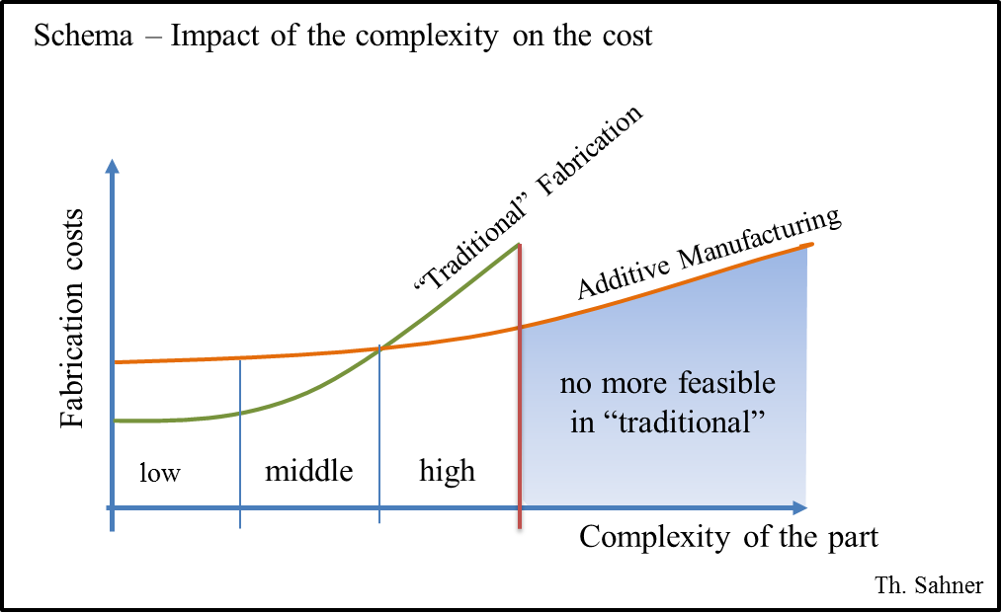
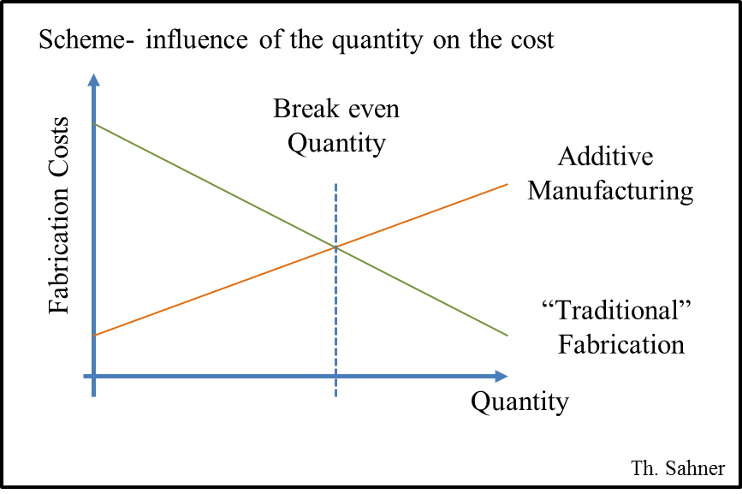
Additive Manufacturing
Short introduction to the technology
Complexity of the part
ADDITIVE MANUFACTURING
Time
Cost

Slide 20
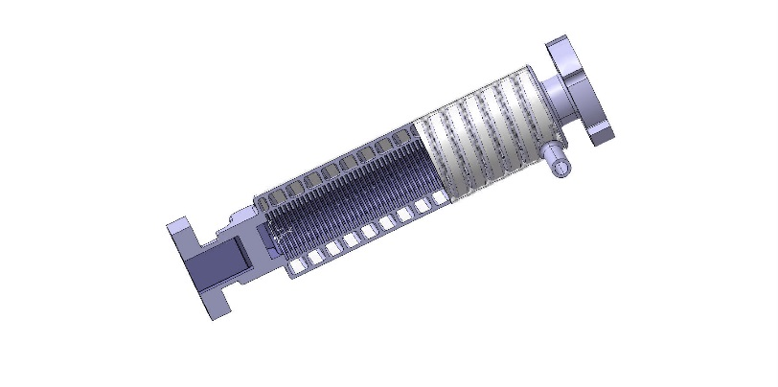
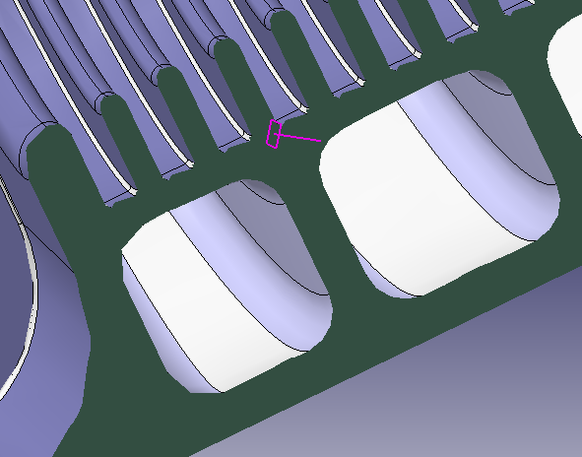
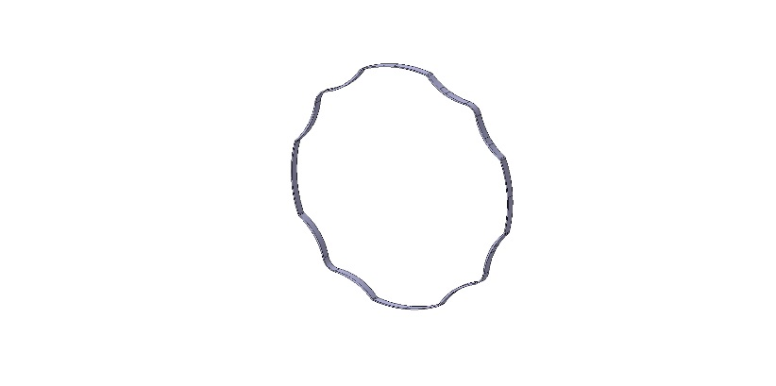
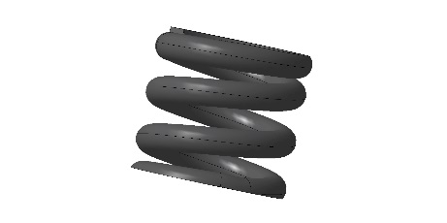
Additive Manufacturing
Short introduction to the technology
Complexity of the part
ADDITIVE MANUFACTURING
Time
Cost

Slide 21
Additive Manufacturing
Short introduction to the technology
PROCESSES
Major AM processes based on Hopkinson and Dickens’ classification
Stereolithography
Jetting Systems
Direct Light Processing
Liquid Based
Selective Laser Sintering
Three-Dimensional Printing
Fused Metal Deposite Systems
Electron Beam Melting
Selective Laser Melting
Selective Masking Sintering
Selective Inhibition Sintering
Electro photographic Layered
Manufacturing
High Speed Sintering
AM Processes
Powder Based
Solid Based
Fused Deposition Modelling
Sheet Stacking Technologies

Slide 22
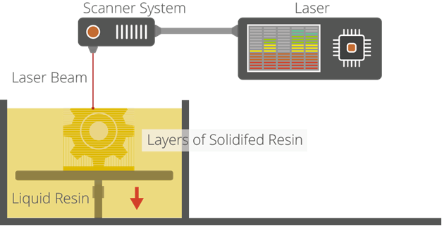
Additive Manufacturing
Short introduction to the technology
Stereolithography (SL)
is widely recognized as the ﬁrst 3D printing process;
it was certainly the ﬁrst to be commercialised. SL is a
laser-based process that works with photopolymer
resins, that react with the laser and cure to form a
solid in a very precise way to produce very accurate
parts.
It is a complex process, but simply put, the photopolymer
resin is held in a vat with a movable platform inside. A laser beam is directed in the X-Y axes across the surface of the resin according to the 3D data supplied to the machine (the .stl ﬁle), whereby the resin hardens precisely where the laser hits the surface. Once the layer is completed, the platform within the vat drops down by a fraction (in the Z axis) and the subsequent layer is traced out by the laser. This continues until the entire object is completed and the platform can be raised out of the vat for removal.
Because of the nature of the SL process, it requires support structures for some parts, speciﬁcally those with overhangs or undercuts. These structures need to be manually removed. In terms of other post processing steps, many objects 3D printed using SL need to be cleaned and cured. Curing involves subjecting the part to intense light in an oven-like machine to fully harden the resin. Stereolithography is generally accepted as being one of the most accurate 3D printing processes with excellent surface ﬁnish.
However limiting factors include the post-processing steps required and the stability of the materials over
time, which can become more brittle.

Slide 23
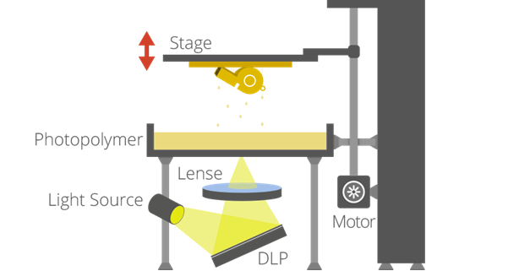
Additive Manufacturing
Short introduction to the technology
Digital Light Processing (DLP)
is a similar process to Stereolithography in that it is a 3D printing
process that works with photopolymers. The major diﬀerence is
the light source. DLP uses a more conventional light source, such
as an arc lamp, with a liquid crystal display panel or a deformable
mirror device (DMD), which is applied to the entire surface of the
vat of photopolymer resin in a single pass, generally making it faster
than SL.
Also like SL, DLP produces highly accurate parts with excellent resolution, but its similarities also include the same requirements for support structures and post-curing. However, one advantage of DLP over SL is that only a shallow vat of resin is required to facilitate the process, which generally results in less waste and lower running costs.

Slide 24
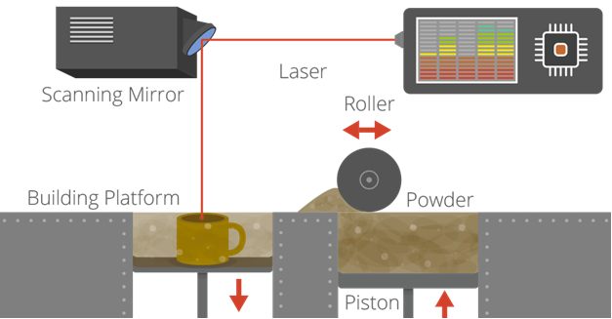
Additive Manufacturing
Short introduction to the technology
Laser sintering and laser melting (SL, SLM)
are interchangeable terms that refer to a laser based
3D Printing process that works with powdered
materials.
The laser is traced across a powder bed of tightly
Compacted powdered material, according to the
3D data fed to the machine, in the X-Y axes.
As the laser interacts with the surface of the
powdered material it sinters, or fuses, the particles
to each other forming a solid. As each layer is
completed the powder bed drops incrementally and a roller smoothes the powder over the surface of the bed prior to the next pass of the laser for the subsequent layer to be formed and fused with the previous layer.
The build chamber is completely sealed as it is necessary to maintain a precise temperature during the process speciﬁc to the melting point of the powdered material of choice. Once ﬁnished, the entire powder bed is removed from the machine and the excess powder can be removed to leave the ‘printed’ parts. One of the key advantages of this process is that the powder bed serves as an in-process support structure for overhangs and undercuts, and therefore complex shapes that could not be manufactured in any other way are possible with this process.

Slide 25
Additive Manufacturing
Short introduction to the technology
Laser sintering and laser melting (SL, SLM)
However, on the downside, because of the high temperatures required for laser sintering, cooling times can be considerable. Furthermore, porosity has been an historical issue with this process, and while there have been signiﬁcant improvements towards fully dense parts, some applications still necessitate inﬁltration with another material to improve mechanical characteristics.
Laser sintering can process plastic and metal materials, although metal sintering does require a much higher powered laser and higher in-process temperatures. Parts produced with this process are much stronger than with SL or DLP, although generally the surface ﬁnish and accuracy is not as good.

Slide 26
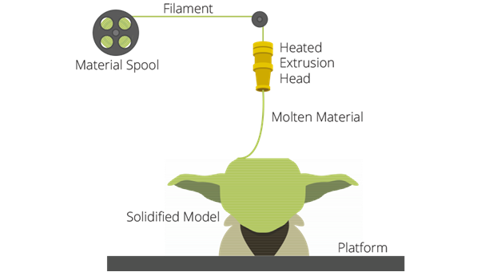
Additive Manufacturing
Short introduction to the technology
Fused Deposition Modelling FDM & Freeform Fabrication FFF
3D printing utilizing the extrusion of thermoplastic material is
easily the most common — and recognizable — 3DP process.
The most popular name for the process is Fused Deposition
Modelling, due to its longevity, however this is a trade name,
registered by Stratasys, the company that originally developed it.
Stratasys’ FDM technology has been around since the early 1990’s
and today is an industrial grade 3D printing process. However,
the proliferation of entry-level 3D printers that have emerged since
2009 largely utilize a similar process, generally referred to as Freeform Fabrication, but in a more basic form due to patents still held by Stratasys. The earliest RepRap machines and all subsequent evolutions — open source and commercial employ extrusion methodology. However, following Stratasys’ patent infringement ﬁling against Aﬁnia there is a question mark over how the entry-level end of the market will develop now, with all of the machines potentially in Stratasys’ ﬁring line for patent infringements.
The process works by melting plastic ﬁlament that is deposited, via a heated extruder, a layer at a time, onto a build platform according to the 3D data supplied to the printer. Each layer hardens as it is deposited and bonds to the previous layer.

Slide 27
Additive Manufacturing
Short introduction to the technology
Fused Deposition Modelling FDM & Freeform Fabrication FFF
Stratasys has developed a range of proprietary industrial grade materials for its FDM process that are suitable for some production applications. At the entry-level end of the market, materials are more limited, but the range is growing. The most common materials for entry-level FFF 3D printers are ABS and PLA.
The FDM/FFF processes require support structures for any applications with overhanging geometries. For FDM, this entails a second, water-soluble material, which allows support structures to be relatively easily washed away, once the print is complete.
Alternatively, breakaway support materials are also possible, which can be removed by manually snapping them oﬀ the part.
Support structures, or lack thereof, have generally been a limitation of the entry level FFF 3D printers. However, as the systems have evolved and improved to incorporate dual extrusion heads, it has become less of an issue.
In terms of models produced, the FDM process from Stratasys is an accurate and reliable process that is relatively oﬃce/studio- friendly, although extensive post-processing can be required. At the entry-level, as would be expected, the FFF process produces much less accurate models, but things are constantly improving.
The process can be slow for some part geometries and layer-to- layer adhesion can be a problem, resulting in parts that are not watertight. Again, post-processing using Acetone can resolve these issues.

Slide 28
Additive Manufacturing
Short introduction to the technology
Laminated object manufacturing (LOM)
is a rapid prototyping system developed by Helisys Inc.
In it, layers of adhesive-coated paper, plastic, or metal
laminates are successively glued together and cut to shape
with a knife or laser cutter. Objects printed with this
technique may be additionally modified by machining or
drilling after printing.
Typical layer resolution for this process is defined by the
material feedstock and usually ranges in thickness from
one to a few sheets of copy paper.

Slide 29
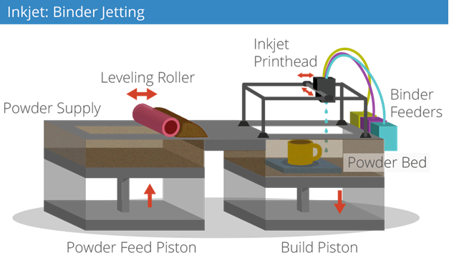
Additive Manufacturing
Short introduction to the technology
Binder Jetting
There are two 3D printing process that utilize a jetting technique.
Binder jetting: where the material being jetted is a binder,
and is selectively sprayed into a powder bed of the part material
to fuse it a layer at a time to create/print the required part.
As is the case with other powder bed systems, once a layer is
completed, the powder bed drops incrementally and a roller or
blade smoothes the powder over the surface of the bed, prior to
the next pass of the jet heads, with the binder for the subsequent layer to be formed and fused with the previous layer.
Advantages of this process, like with SLS, include the fact that the
need for supports is negated because the powder bed itself provides this functionality. Furthermore, a range of diﬀerent materials can be used, including ceramics and food. A further distinctive advantage of the process is the ability to easily add a full colour palette which can be added to the binder.
The parts resulting directly from the machine, however, are not as strong as with the sintering process and require post-processing to ensure durability.

Slide 30
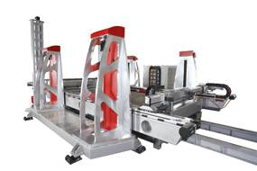
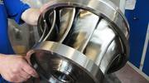
Additive Manufacturing
Short introduction to the technology
Binder Jetting
voxeljet is one of the leading manufacturers of industrial 3D printing systems and operates service centres in Germany, USA and UK for the "on-demand production" of molds and models for metal casting.
Voxeljet SYSTEMS business division focuses on the development, production and distribution of the fastest and most powerful 3D printing systems in the market. Today, Voxeljet has a well-coordinated product range that reaches from smaller entry models to large-format machines, and therefore offers the perfect 3D print system for many application areas.
Voxeljet

Slide 31
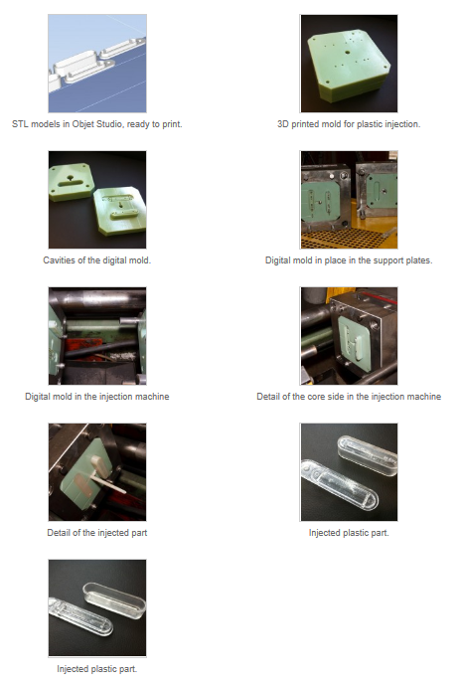
Additive Manufacturing
Short introduction to the technology
Tooling
3D printed tool inserts in polymer to print plastic
parts which can not printed directly with
3D printers (e.g. PP )

Slide 32
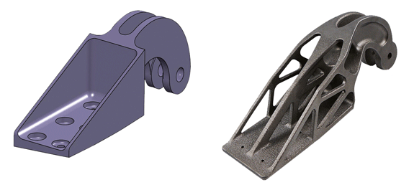
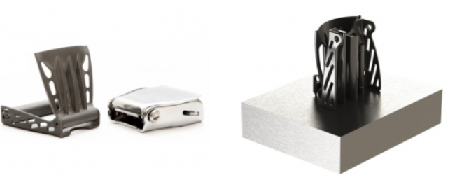
Additive Manufacturing
Short introduction to the technology
Applications
Conventionally designed and produced cast steel nacelle hinge bracket for an Airbus A320 (top) and optimised titanium version of the nacelle hinge bracket made by additive manufacturing technology.
“See the difference in the conception of the part”
Commercial airplanes can have up to several
hundred seed belt buckles. A standard buckle
weight is around 155g in St. and 120g in Al.
With AM the weight was reduced to 68 g in Ti.
Saving over the lifetime of an A380:
Fuel: 3.300.000 l
CO2 emission: 0,74Mt

Slide 33
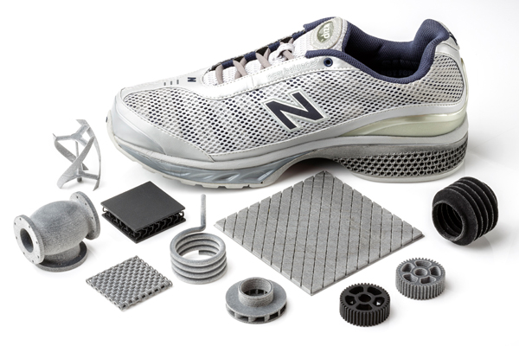
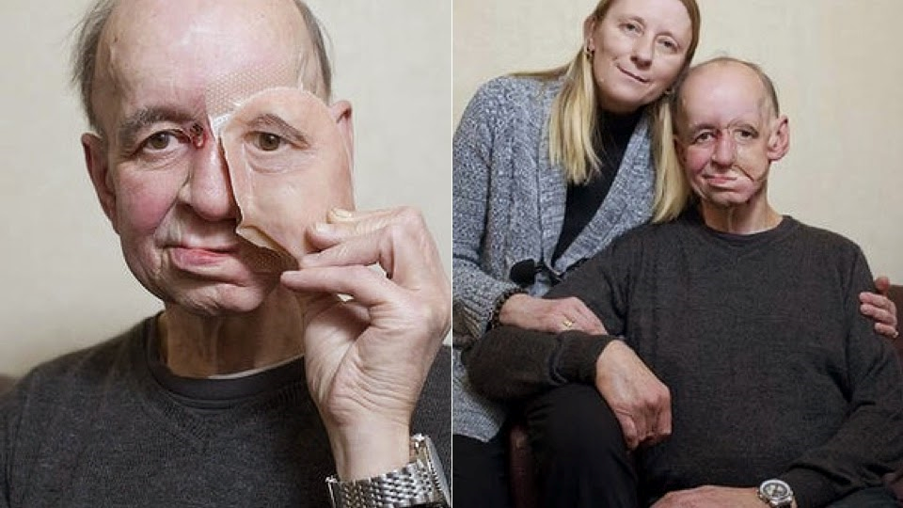
Additive Manufacturing
Short introduction to the technology
Part manufacturing
Advantage for sport shoe manufacturer is the data exchange between development and production over night. e.g. ADIDAS with the development in Germany an the production side in China.
Example for medical application
3D printing can be personalised
Giving back life quality

Slide 34
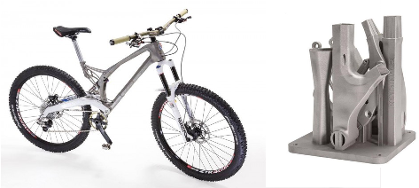
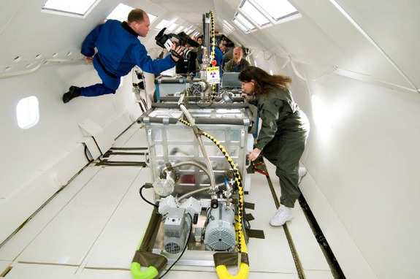
Additive Manufacturing
Short introduction to the technology
The assembly can be personalised and printed in one process.
NASA has carried out parabolic flights that mimic microgravity to test "additive manufacturing“
Many other applications for printing on-site

Slide 35
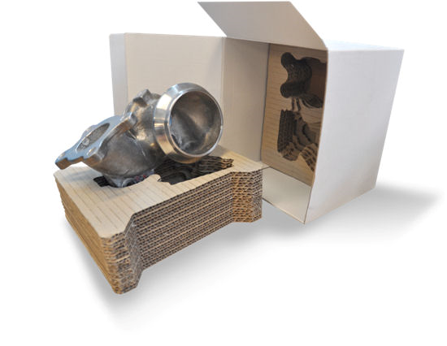

Additive Manufacturing
Short introduction to the technology
The fast packaging solution, French postal
The part is scanned in the post office and a cutter is cutting the different layer on site.
For her Spring/Summer 2015 collection, presented in Paris, Dutch fashion designer Iris van Herpen unveiled 3D-printed garments and accessories "grown" that explores the interplay of magnetic forces.
Her inspiration of this collection came after she visited CERN, and the Large Hadron Collider

Slide 36
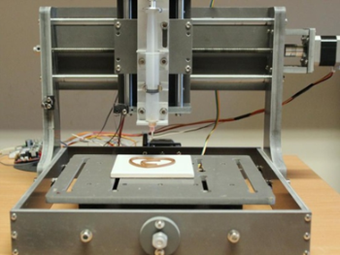
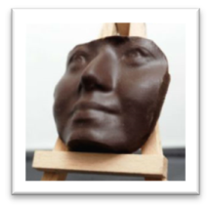

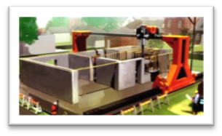
Additive Manufacturing
Short introduction to the technology
Chocolate printer
Figure Print
Concrete Printer

Slide 37
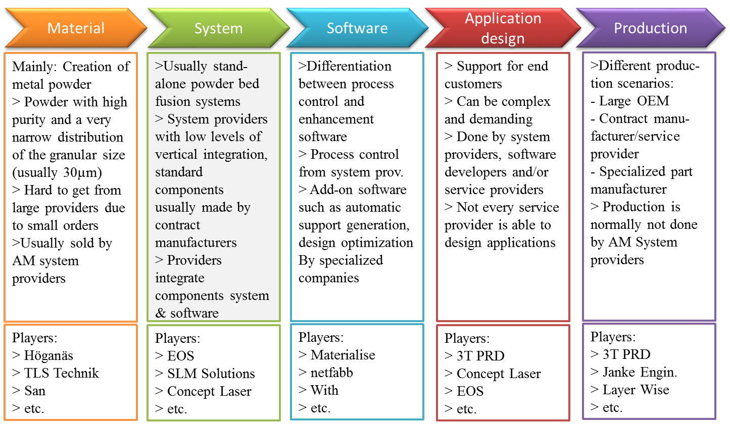
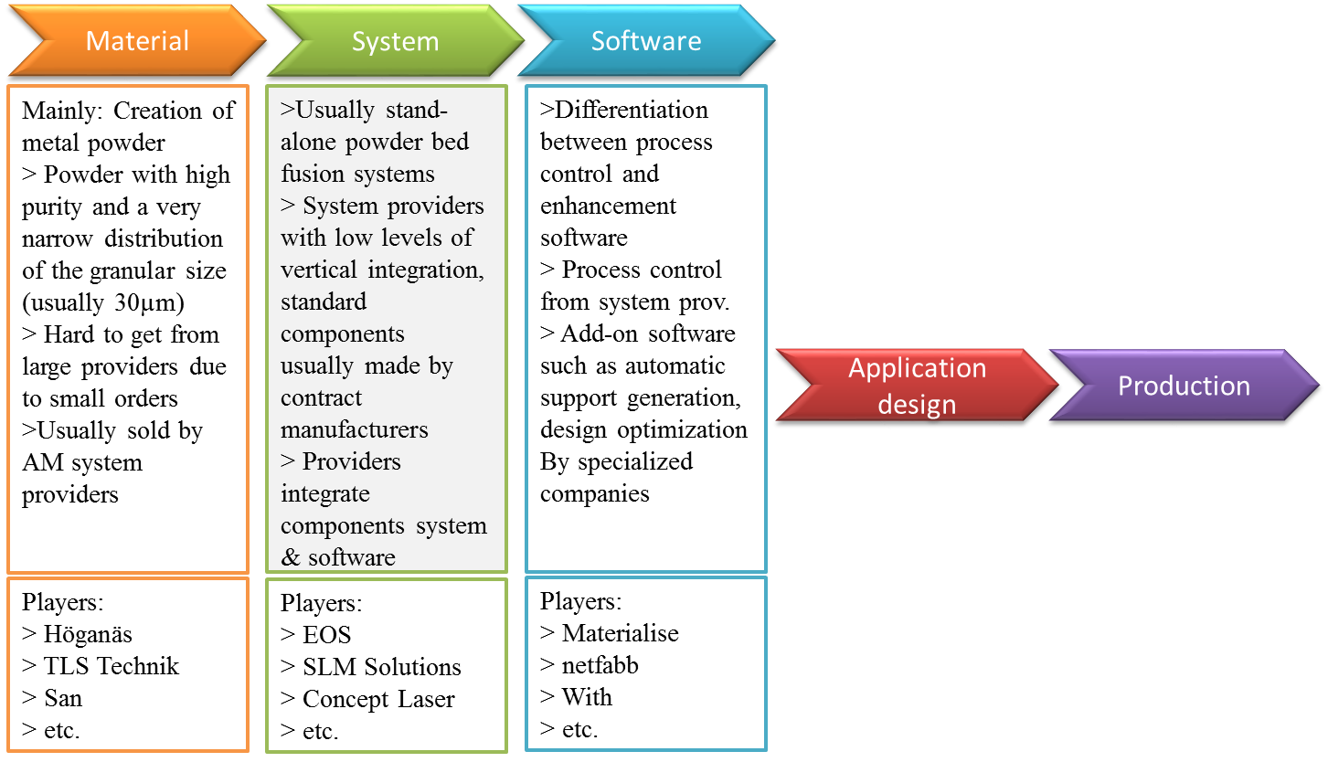
Additive Manufacturing
Short introduction to the technology
Do it by your own ?

Slide 38
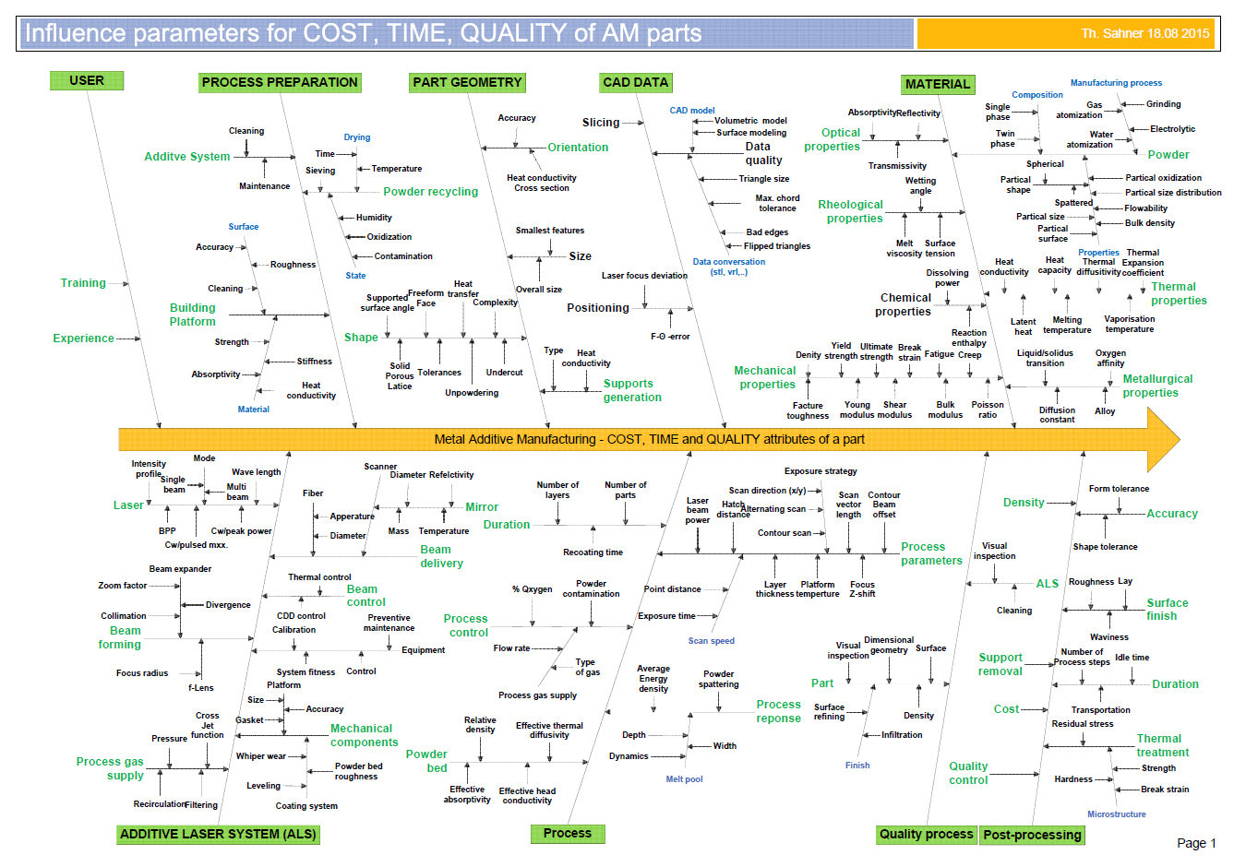
Additive Manufacturing
Short introduction to the technology
What knowledge is needed for successful AM ?

Slide 39
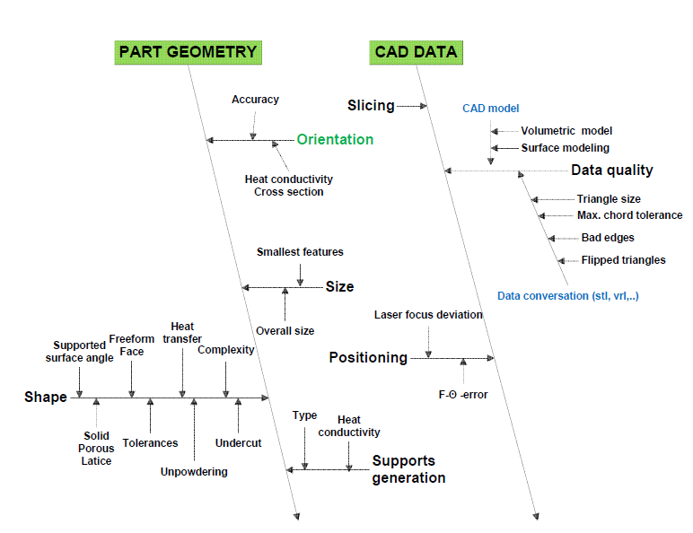
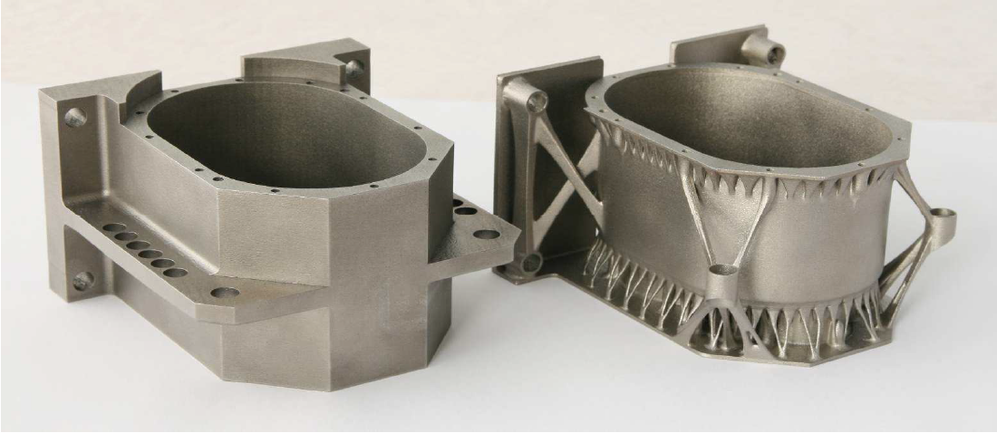
Additive Manufacturing
Short introduction to the technology
APPLICATION DESIGN
Change the way to design part – change your mind to additive thinking

Slide 40
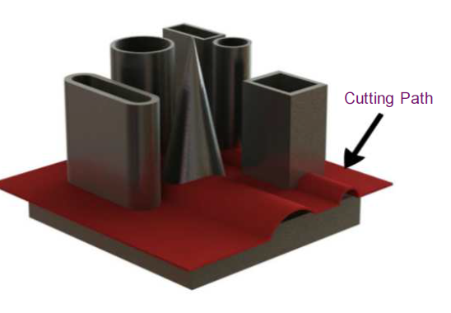
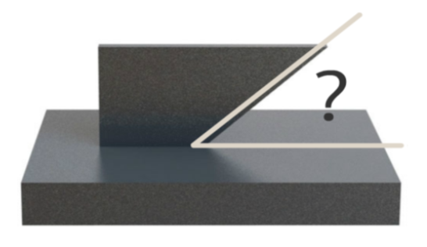
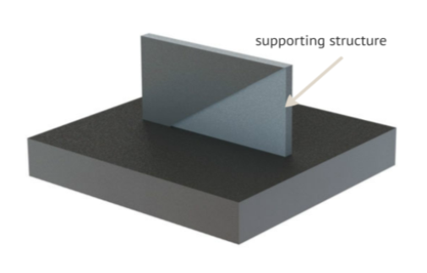
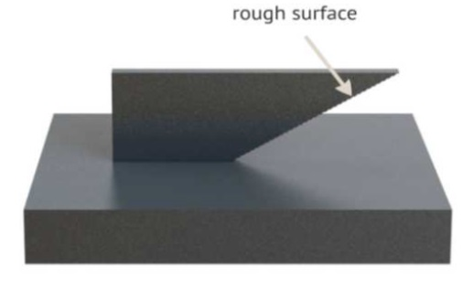
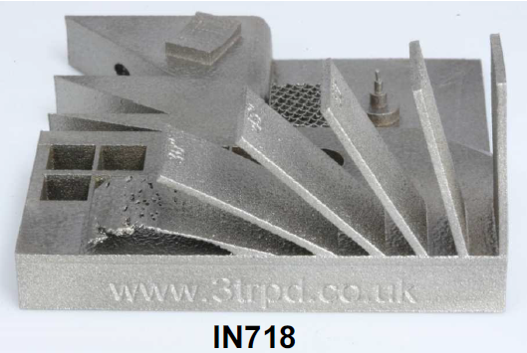
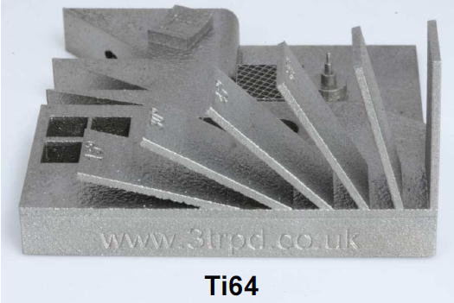
Additive Manufacturing
Short introduction to the technology
Easy Cutting Path
Angled surfaces

Slide 41
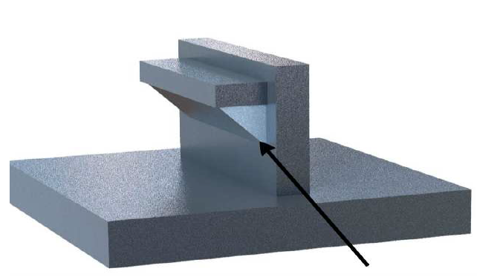
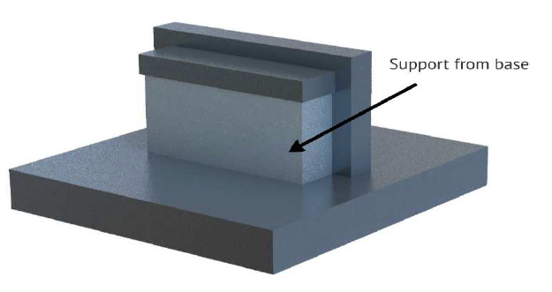




Additive Manufacturing
Short introduction to the technology
Supports
Holes

Slide 42





Additive Manufacturing
Short introduction to the technology
Down Ward Facing Surfaces

Slide 43







Additive Manufacturing
Short introduction to the technology
Increased Performance of a Hydraulic Actuator
Original design
Redesign of supports and channels
With new channel shape
Building
cavities
Optimized design

Slide 44


Additive Manufacturing
Short introduction to the technology
MATERIALS
NEW MATERIALS ARE THE GRAAL OF 3D PRINTING

Slide 45
Additive Manufacturing
Short introduction to the technology
AM Materials
However, there are now way too many proprietary materials from the many diﬀerent 3D printer vendors to cover them all here.
Instead, we will look at the most popular types of material in a more generic way. And also a couple of materials that stand out.
Liquid Based
Powder Based
Solid Based
What do we have at CERN:
Today we are only able to manufacture some polymers
The planning is to get a metall machine in spring 2016 in our main workshop

Slide 46

Additive Manufacturing
Short introduction to the technology
SLA® Viper si2 system
Acura Bluestone

Slide 47


Additive Manufacturing
Short introduction to the technology
3D Printer
For simple models, the purpose is in the rapid prototyping and 3D Mock-ups.
The mechanical properties can be improved by epoxy impregnation
Binder Jetting

Slide 48
Additive Manufacturing
Short introduction to the technology
AM Materials
Nylon, or Polyamide, is commonly used in powder form with the sintering process or in ﬁlament form with the FDM process. It is a strong, ﬂexible and durable plastic material that has proved reliable for 3D printing. It is naturally white in colour but it can be coloured — pre- or post printing. This material can also be combined (in powder format) with powdered aluminium to produce another common 3D printing material for sintering Alumide.
ABS is another common plastic used for 3D printing, and is widely used on the entry-level FDM 3D printers in ﬁlament form. It is a particularly strong plastic and comes in a wide range of colours.
ABS can be bought in ﬁlament form from a number of non- propreitary sources, which is another reason why it is so popular.
PLA is a bio-degradable plastic material that has gained traction with 3D printing for this very reason. It can be utilized in resin format for DLP/SL processes as well as in ﬁlament form for the FDM process. It is oﬀered in a variety of colours, including transparent, which has proven to be a useful option for some
some applications of 3D printing. However it is not as durable oras ﬂexible as ABS.

Slide 49
Additive Manufacturing
Short introduction to the technology
AM Materials
Ceramics
Ceramics are a relatively new group of materials that can be used for 3D printing with various levels of success. The particular thing to note with these materials is that, post printing, the ceramic parts need to undergo the same processes as any ceramic part made using traditional methods of production - namely ﬁring and glazing.
Paper
Standard A4 copier paper is a 3D printing material employed by the proprietary SDL process supplied by Mcor Technologies. The company operates a notably diﬀerent business model to other 3D printing vendors, whereby the capital outlay for the machine is in the mid-range, but the emphasis is very much on an easily obtainable, cost-eﬀective material supply, that can be bought locally. 3D printed models made with paper are safe, environmentally friendly, easily recyclable and require no post-processing.
Bio Materials
There is a huge amount of research being conducted into the potential of 3D printing bio materials for a host of medical (and other) applications. Living tissue is being investigated at a number of leading institutions with a view to developing applications that include printing human organs for transplant, as well as external tissues for replacement body parts. Other research in this area is focused on developing food stuﬀs - meat being the prime example.

Slide 50
Additive Manufacturing
Short introduction to the technology
AM Materials
Bio Materials
There is a huge amount of research being conducted into the potential of 3D printing bio materials for a host of medical (and other) applications. Living tissue is being investigated at a number of leading institutions with a view to developing applications that include printing human organs for transplant, as well as external tissues for replacement body parts.
Food
Experiments with extruders for 3D printing food substances has increased dramatically over the last couple of years. Chocolate is the most common (and desirable). There are also printers that work with sugar and some experiments with pasta and meat. Looking to the future, research is being undertaken, to utilize 3D printing technology to produce ﬁnely balanced whole meals.
Other
And ﬁnally, one company that does have a unique (proprietary) material oﬀering is Stratasys, with its digital materials for the Objet Connex 3D printing platform. This oﬀering means that standard Objet 3D printing materials can be combined during the printing process — in various and speciﬁed concentrations to form new materials with the required properties. Up to 140 diﬀerent Digital Materials can be realized from combining the existing primary materials in diﬀerent ways.
Concrete

Slide 51
Additive Manufacturing
Short introduction to the technology
AM Materials
Metals
A growing number of metals and metal composites are used for industrial grade 3D printing. The most commonly used metals for 3D printing are aluminium, stainless steel, and cobalt derivatives .
Other standard materials today on the market are for e.g.:
High-grade steels
Hot-work steels
Stainless hot-work steels
Nickel-base alloys
Titanium alloys
Pure titanium
Bronze alloys
Precious-metal alloys
Non standard materials from the catalogue to be seen with the machine manufacturer

Slide 52



Additive Manufacturing
Short introduction to the technology
System choice

Slide 53











Additive Manufacturing
Short introduction to the technology
System choice
Electron beam systems

Slide 54

Additive Manufacturing
Short introduction to the technology
CERN investment needs:
Machine for R&D ( not only part printing)
Man power 1-0,5 FTE (depending on the project)
Space requirements: 20-30m2
Machine Periphery
Auxiliary equipment ( temporary, Electro erosion, milling machine and compressed air)
AM Software eventual third party software
Consumable kit
Warranty & support
Operator training
Designer training

Slide 55
Additive Manufacturing
Short introduction to the technology
Machine for R&D ( not only part printing):
Laser printer system
Access to the material parameters (free or to pay)
Non standard material use
Build size ( min. 250x250x250mm)
Laser energy (200, 400, 500, 1000W)
Laser system (single laser, multi beam, multi Laser)
Build volume reduction ( to reduce powder need for expensive materials)
Process quality system
Security issues
Powder sieving station (manual, semi-automatic, automatic)
Willingness of collaboration
Contamination ( powder cleaning, ppm of build chamber contamination )
Zero-Point Clamping System (not needed)

Slide 56







Additive Manufacturing
Short introduction to the technology
Machine for R&D ( not only part printing):
Machine Periphery & auxiliary equipment
Vacuum Cleaner for flammable Metal Powders
Nitrogen Generator
Blasting System (sand and glass )
Furnace
Filling platform
AM Software eventual third party software
e.g. Materialize for design and process

Slide 57

Additive Manufacturing
Short introduction to the technology
The costs of AM part fabrication depends basically on:
Part related costs:
- Volume of the part.
- Cost of materials.
- Cost of consumables.
- Height of the part.
- Height of supports
- Number of slices
Man Power costs:
0,1-0,5 FTE (including the prize to design of the part optimized for AM)
Space requirements costs:
Approx. 25-30m2 for the machine, container, generator stocking room
Peripherals & Consumable:
Lifting and transportation device for material handling
Build platform
Cleaning and handling: hand sieves , brush, gloves filter mask shovel….
Recoaster blades
Antistatic waste bags
Maintenance:
Software and machine maintenance

Slide 58

Additive Manufacturing
Short introduction to the technology
Coût machine
 | Années | Semaines activées par année | Pièces par semaine | Heure de construction par pièce | Nombre d’ heures de construction en 5ans
 | 5 | 45 | 2 | 20 | 9000 | heures
Prix de la machine |  |  |  |  | Prix de la machine par heure
485000 | Euro |  |  |  | 53.89 | Euro/heure
Maintenance
 | Années | Active mois par année | Prix par mois |  | Prix maintenance en 5ans
 | 5 | 11 | €1`910.00 |  | 105`050.00 | Euro
 |  |  |  |  | Prix maintenance par heure
 |  |  |  |  | 11.67 | Euro/heure
Con sommables
Laser |  | Durée de vie en heures | Prix Laser |  | Laser/heure
 |  | 10000 | €60`000.00 |  | 6.00 | Euro/heure
Racleur |  | Racleur par semaine | Prix racleur |  | Racleur/heure
 |  | 1 | €45.00 |  | 1.13 | Euro/heure
Plaque de base |  | Plate/semaine | Prix Plaque de base |  | Plate/heure
 |  | 0.2 | €50.00 |  | 0.25 | Euro/heure
Logiciel |  | Licence & Maintenance | L&M/année |  | L&M/heure
 |  |  | €13`000.00 |  | 7.22 | (Euro/heure)
 |  | Cout estime par heure de construction |  |  | 80.16 | (Euro/heure)
heures/5ans | 9000 | 13500 | 18000 | 21500 | 27000
coût/heure | €80.16 | €55.44 | €43.08 | €37.04 | €30.72

Slide 59

Additive Manufacturing
Short introduction to the technology
Tableau 3 : Comparaison de coût total (Cas1 fabrication maison/ Cas2 fabrication externe)
Comparaison de coût total | Cas 1 int. Imprimante 3D | Cas 2 ext. par service
Coût des actifs amortissables (€) | 485.000
Valeur résiduelle (€) | 48.500
Durée de vie en années | 5
Capital engage moyen (€) [C_{em}] | 266.750
Prévision de production d’unités par an | 60 | 60
Capital et autres coûts fixes :[KF]
Intérêt moyen du capital engage moyen(€) [KZ_{AB}] Taux d’amortissement par an (€) [AB] Autres coûts fixes, contrat de maintenance (€) | 26.675
 | 87.300
 | 21.010
Total des coûts fixes (€) | 134.985
Coûts variables par an: [KV]
Frais de personnel (€) | 3.600
Matériau (€) | 12.000
Coût du service (€) | 0 | 120.000
Total des coûts variables (€) | 15.600 | 120.000
Coût total par an (€) [KG] | 150.585 | 120.000

Slide 60

Additive Manufacturing
Short introduction to the technology
RIKS
Safety features
Powder handling & changing - The following risks may be experienced while working with the systems:
Unhealthy air emissions
Risk or damage to respiratory tract and lungs when handling metal powders
Risk of eye damage when handling metal powder and filter dust.
Risk of compressed air outlet
Risk of suspected carcinogenic effect of the metal powder and filter dust
Principal risks of an laser system
IP and licensing deals
3D printers are energy hogs
Gun control loopholes
Responsibility of manufacturers
Bioprinting ethics and regulation
Possibility of 3D printed drugs
Safety of items that come into contact with food

Slide 61
Additive Manufacturing
Short introduction to the technology
Future
To make things a new way, you need to make companies a new way, too.
Once manufacturing went online, nothing would be the same again.

Slide 62
Additive Manufacturing
Short introduction to the technology
?
Many exiting examples can be found under: http://www.3ders.org/applications.html

Slide 63

Additive Manufacturing
Short introduction to the technology
Grazie per la vostra attenzione
Thank you for your attention
Merci pour votre attention

