Slide 1

Biomedical imaging using Cerenkov radiation from mouse to man
Antonello Spinelli
Experimental Imaging Centre, San Raffaele Scientific Institute, Milan
University of Rome, 13th of June 2016

Slide 2
Talk outline
Introduction to optical imaging
Optical imaging systems
Cerenkov imaging basic physics
Cerenkov imaging with mice
Cerenkov imaging with humans
Optical imaging of gamma and alpha emitters
Conclusions

Slide 3
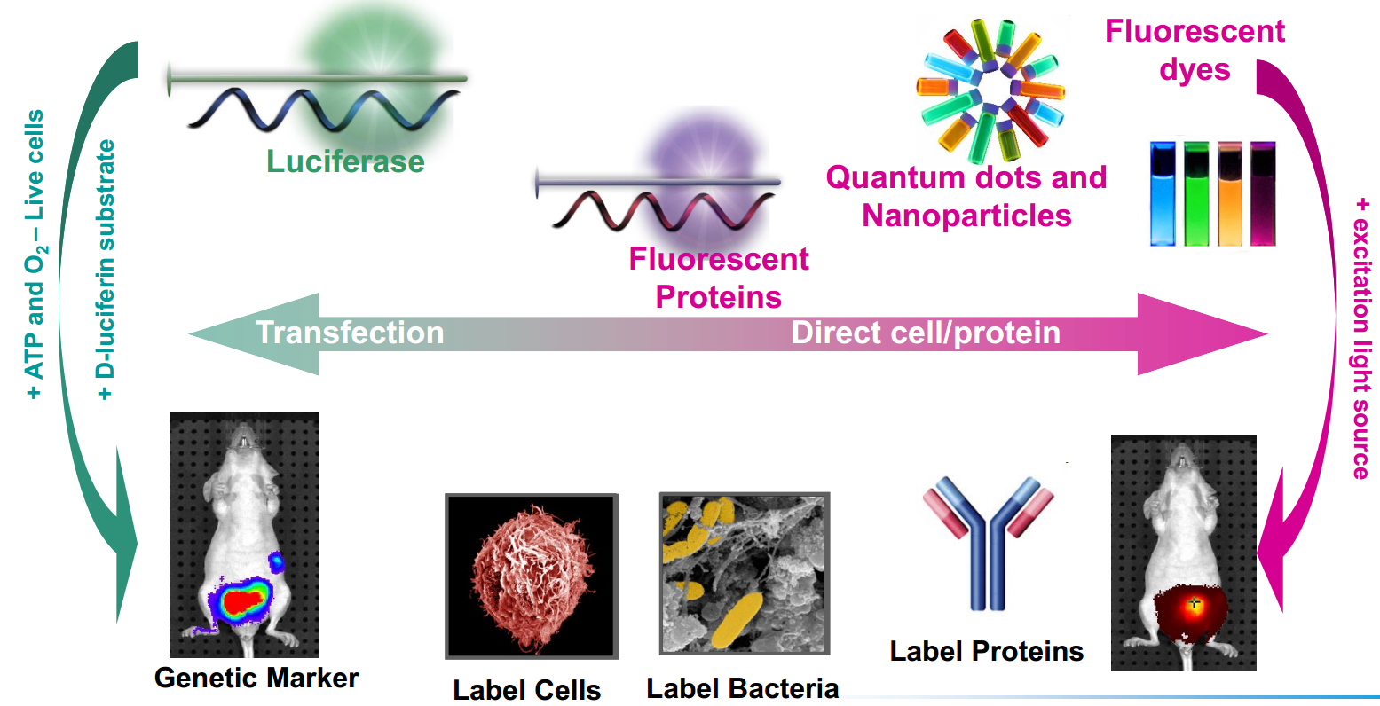
In vivo optical imaging

Slide 4
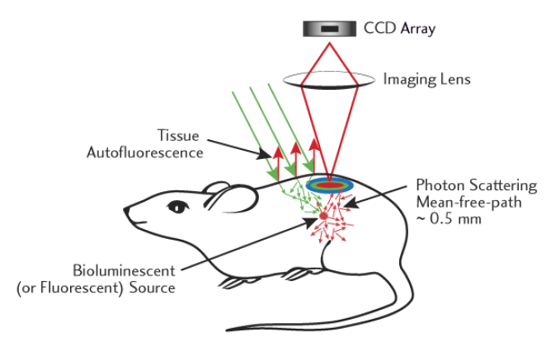
Optical Imaging principles
At 600-900 nm, light transmission through tissue is highest and the generation of autofluorescence is lower.
Therefore it is important to select fluorophores/bioluminecece sources that are active in the 600-900 nm range.

Slide 5
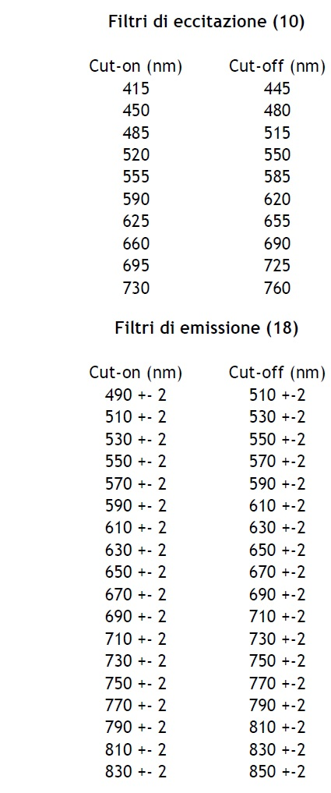
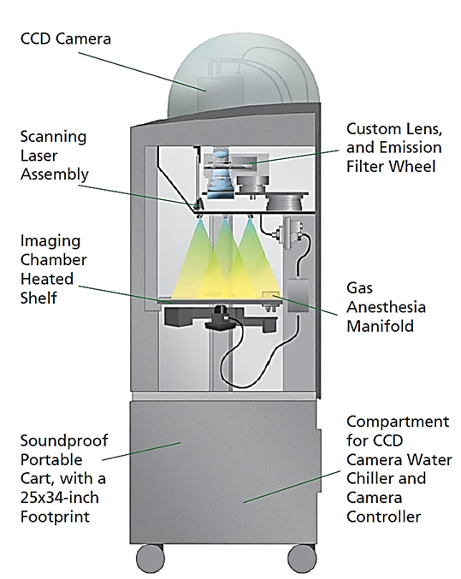
Imaging devices: commercial system

Slide 6
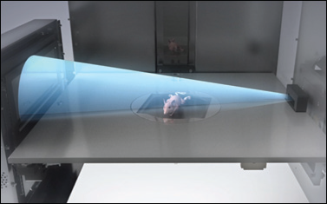
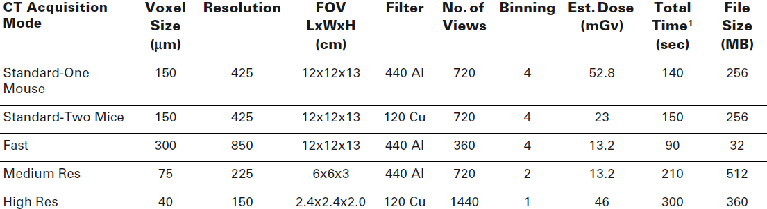
Imaging devices: commercial system
Flat panel CMOS
50 kV x rays, 50 μm focal spot.

Slide 7
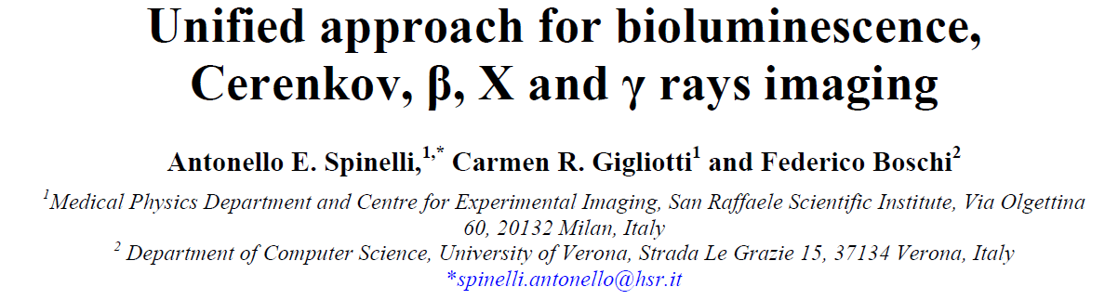
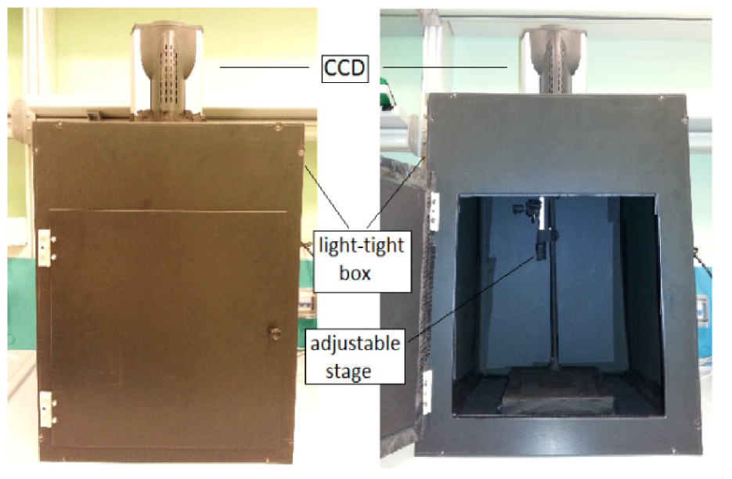
Imaging devices: a prototype
The CCD camera coupled with the lens is mounted on a black light-tight enclosure. An adjustable stage for the positioning of the sample is placed inside the enclosure.

Slide 8
Cerenkov luminescece imaging

Slide 9
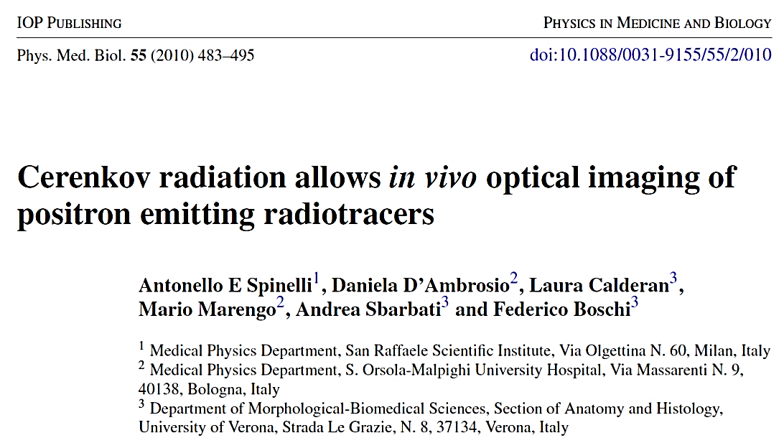
Introduction
We have shown that is possible to detect Cerenkov radiation (CR) by using a conventional small animals optical imaging system.
In this talk we will review our results on Cerenkov imaging and we will present data on the imaging of alpha and gamma emitters.

Slide 10
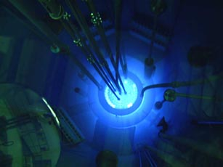
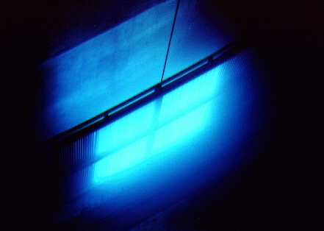
Introduction
Examples of Cerenkov radiation inside a nuclear reactor and a Co-60 source.
Co-60 source
Nuclear reactor

Slide 11
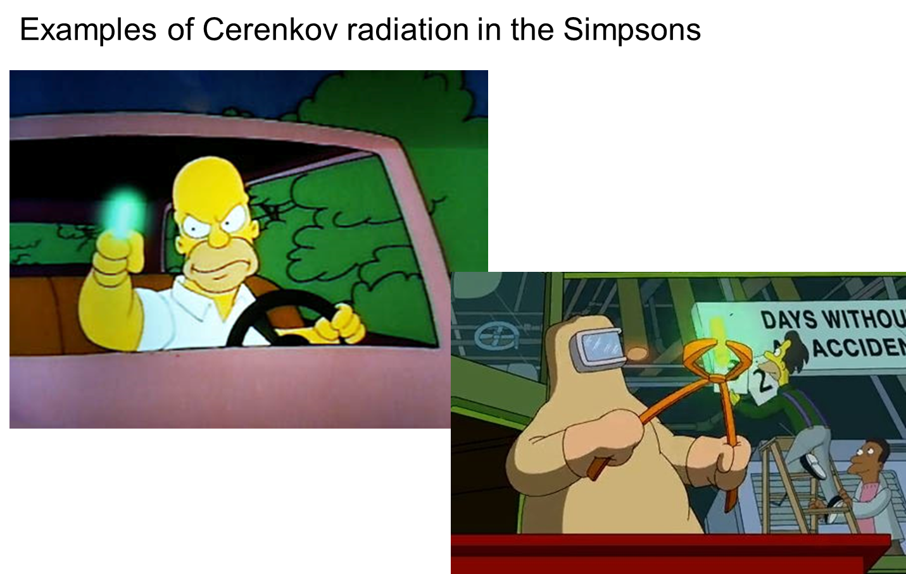
Introduction

Slide 12
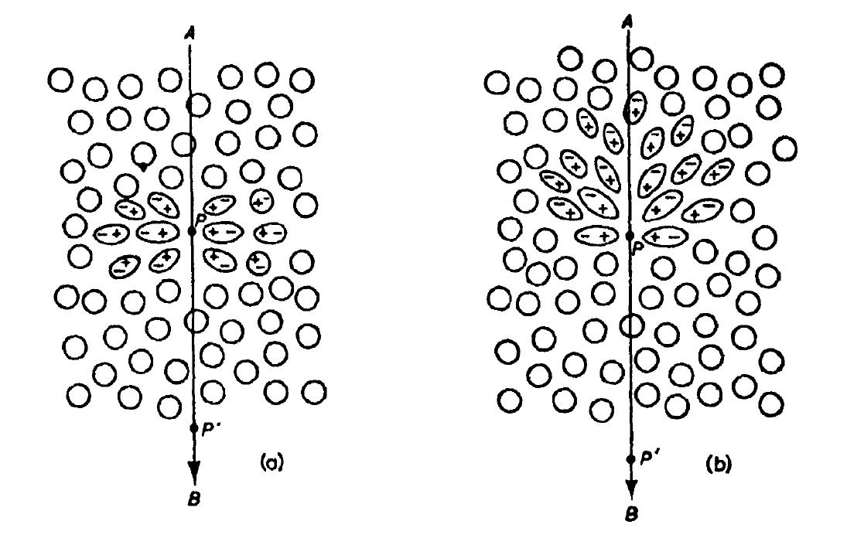
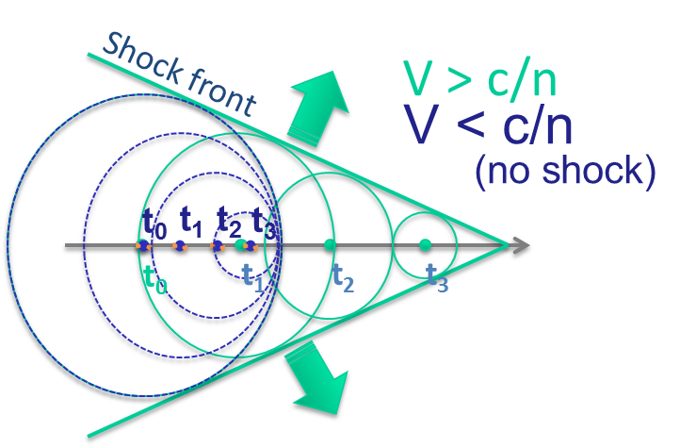
Cerenkov radiation production
The emission of Cerenkov radiation take places when a charged particle (in our case a beta particle) travels in a transparent medium with a velocity greater than the speed of light in the medium.
Atoms are momentarily polarized.
Depolarization follows. Matter radiates optical photons.
Threshold:
n = refractive index of the medium,
v = velocity of the particle,
c = vacuum speed of light.

Slide 13

Cerenkov radiation spectrum model
Spectrum: broad and continuous distribution from 300 nm to 700 nm.
Take home points:
Inversely proportional to the square of the wavelength (1/λ²)
Different radionuclides emits a different number of photons but show the same spectral distribution.

Slide 14
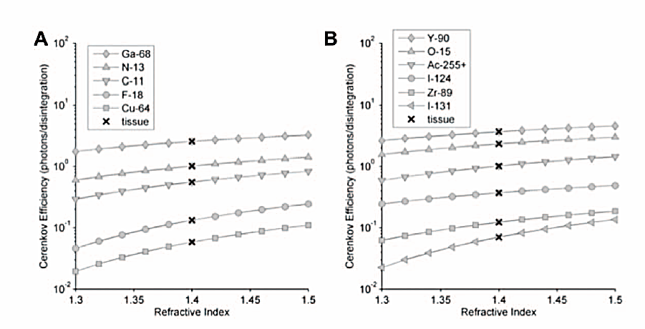
Cerenkov photons production
Monte Carlo simulations from Beattie et al PloSOne, vol 7, 2, 2012.

Slide 15
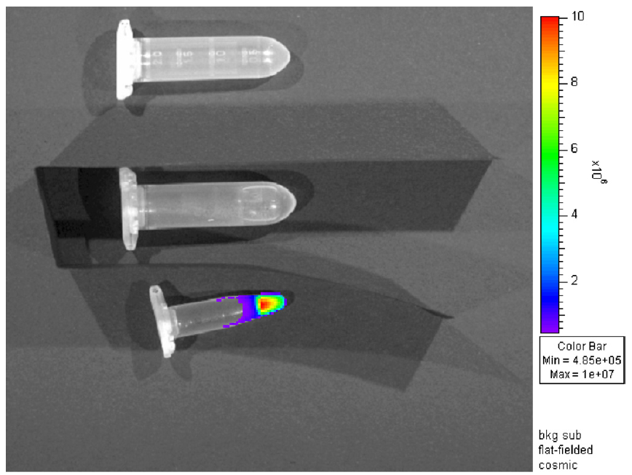
Cerenkov radiation detection using CCD
The image shows a comparison between the light emission of vials containing FDG, distilled water and an empty vial.
empty
water
FDG
The vials were separated by black paper in order to avoid light cross contamination between them.

Slide 16
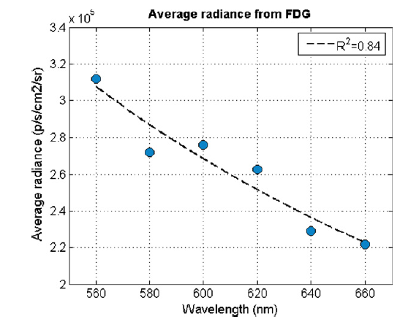
Cerenkov spectrum
Spectral distribution of the Cerenkov radiation emitted by FDG
1/λ²

Slide 17
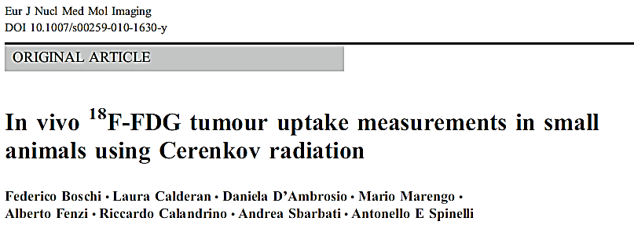
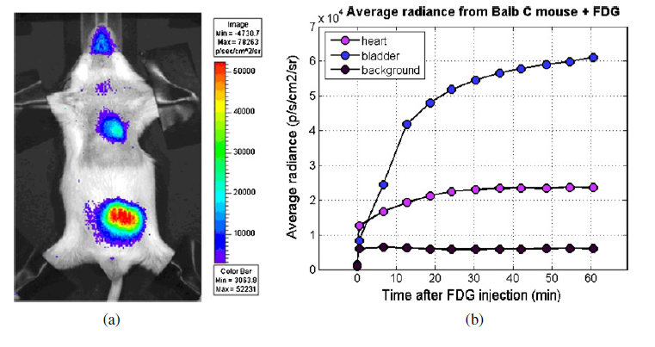
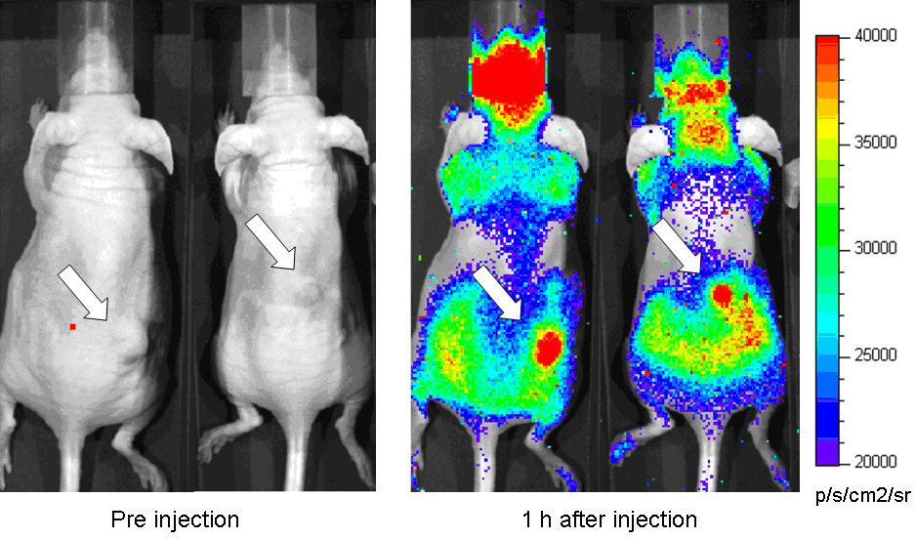
In vivo Cerenkov imaging
Below there are some examples of planar FDG Cerenkov luminescence images for mice injected with 25 MBq.
Control mouse FDG biodistribution
Xenograf model of mammary carcinoma

Slide 18
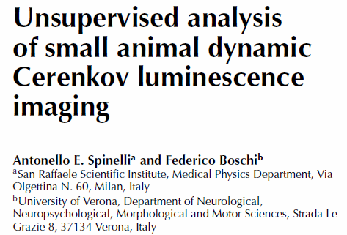
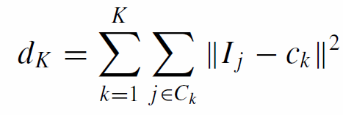
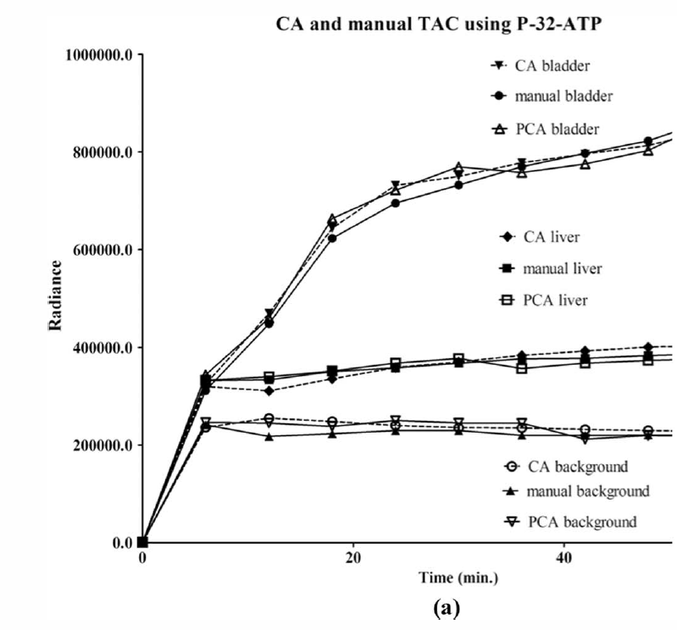
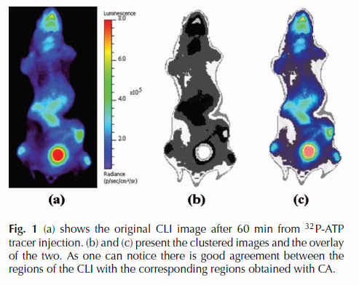
Clustering of CLI
Clustering can applied to dynamic Cerenkov images in order to perform image segmentation and extract automatically the TAC of different animal regions

Slide 19
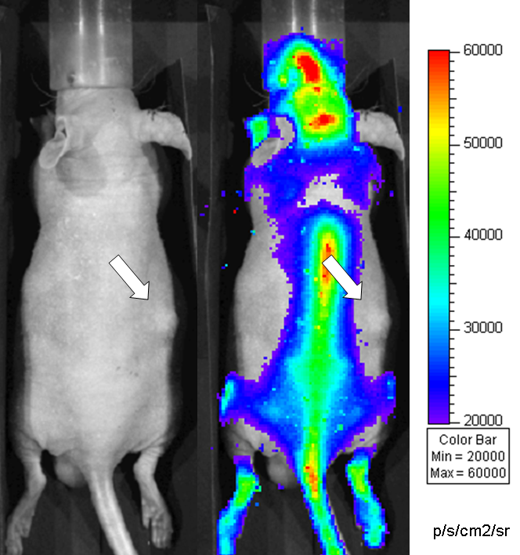
Cerenkov imaging with 18-F-Fluoride
CR image of a mouse injected with 18-F-fluoride, as one can see there is no tumour specific uptake and, as expected.
tumour
tumour
spine
Only the bone structures of the animal (in particular the spine and the head) are clearly visible.

Slide 20
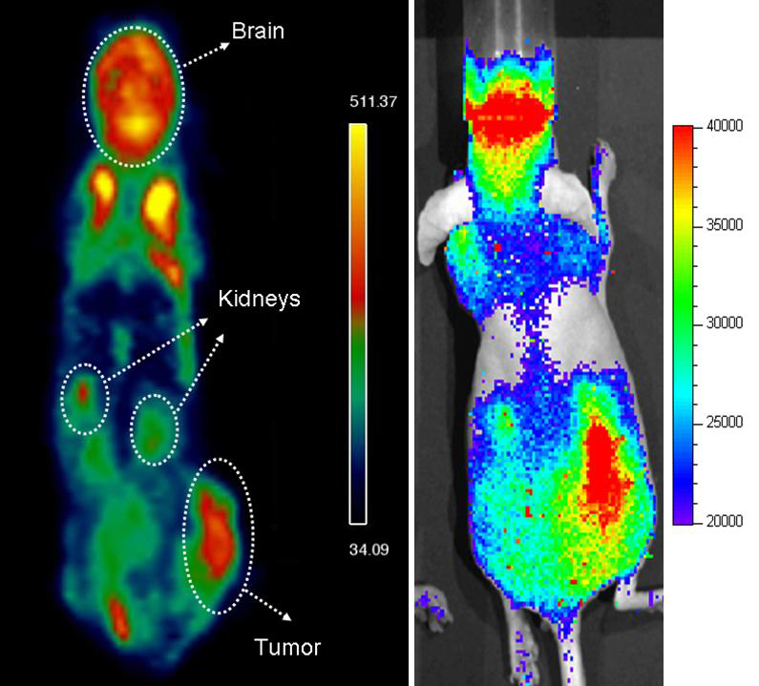
Comparison with PET
Comparison between FDG small animal PET and optical Cerenkov radiation images.
PET 3D image
CR optical image (2D)

Slide 21
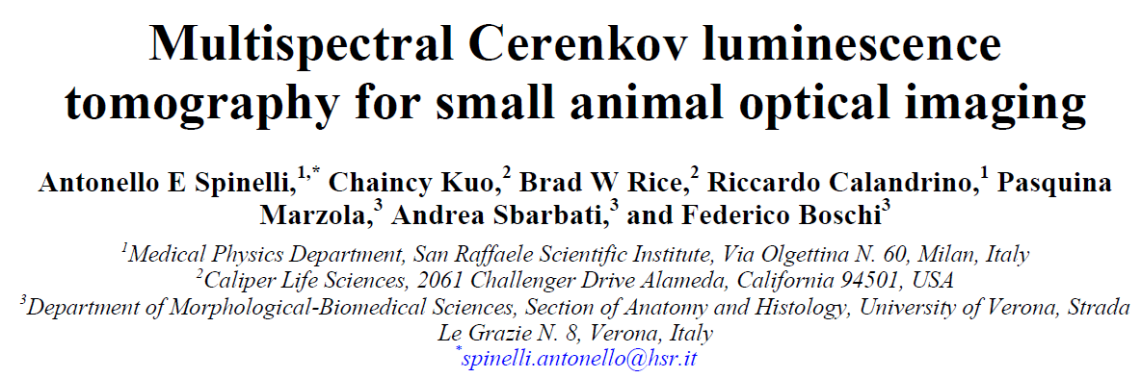
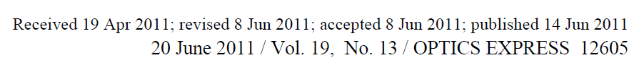
Cerenkov tomography based on diffusion eq
Diffusion theory can be successfully applied to describe the light photons transport in weakly absorbing turbid media.
In this case the photon density can be modelled using the steady-state diffusion equation:
Absorption coefficient
Photons rate density
Photons density
Diffusion coefficient

Slide 22
Cerenkov tomography based on diffusion eq
An approximate solution G(x) of the diffusion equation to can be derived by considering locally the object as a infinite plane boundary oriented tangentially to the object surface.
The source intensity solution s can be obtained using a regularized non negative (s ≥0) least square (NNLS) optimisation algorithm as follows:
Where G is the kernel matrix derived from the approximate solution of the diffusion equation.
L is set to be the identity matrix, and b is the Lagrange multiplier

Slide 23
Cerenkov tomography based on diffusion eq
In order to improve the convergence of the reconstruction algorithm, images were acquired using six different set of optical filters, more precisely:
G*
Images acquired at different wavelengths
Spectrum
fraction
CR

Slide 24
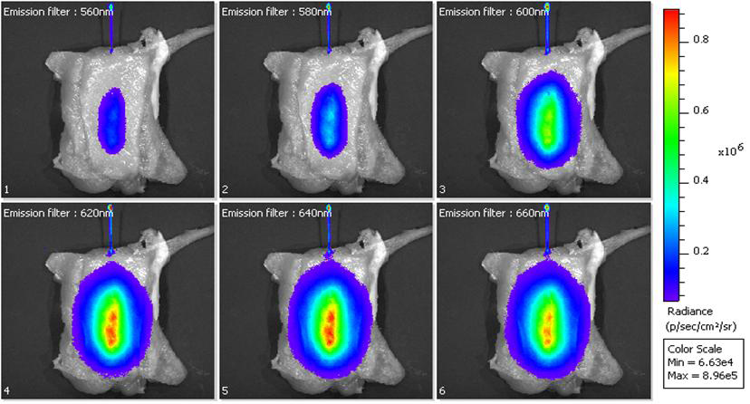
Reconstruction of a capillary at different depths
Images of a capillary acquired using different filters: 560, 580, 600, 620, 640, 660 nm. The capillary was placed between slices of chicken breast in order to simulate photon scattering and attenuation in the tissues. The source was placed at different depths (6, 9, 11 mm).

Slide 25
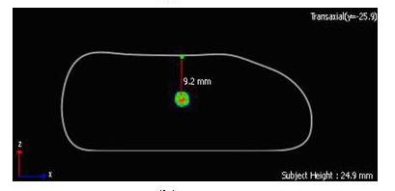
Reconstruction of a capillary at different depths
The plot shows a comparison between known and measured (from the 3D image) depth of the 32P-ATP filled glass capillary at various experimental depths.
True source depth (mm) | Depth errors %
6 | 1.7
9 | 6.7
11 | 0.9
Fitting
Equation | y = x
R² | 0,9692

Slide 26
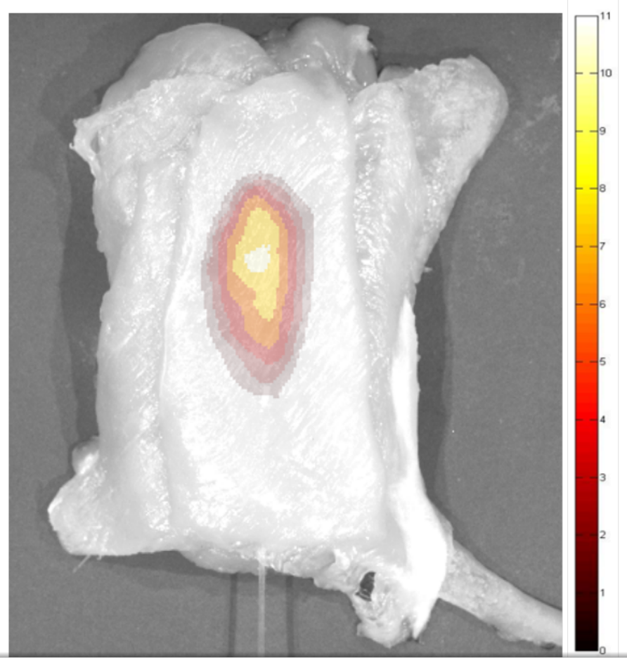
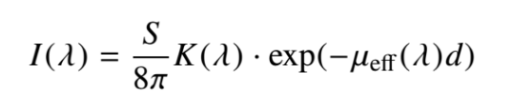
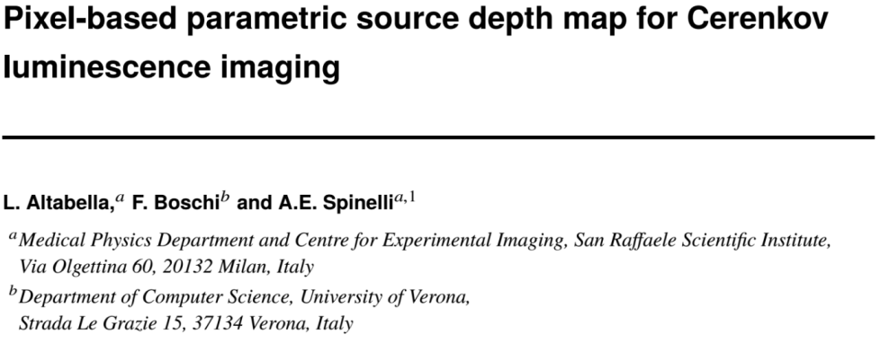
Parametric source depth maps
We developed a fast 2D corrected approach based on multispectral acquisitions, to obtain source depth and its intensity using a pixel-based fitting of source intensity.

Slide 27
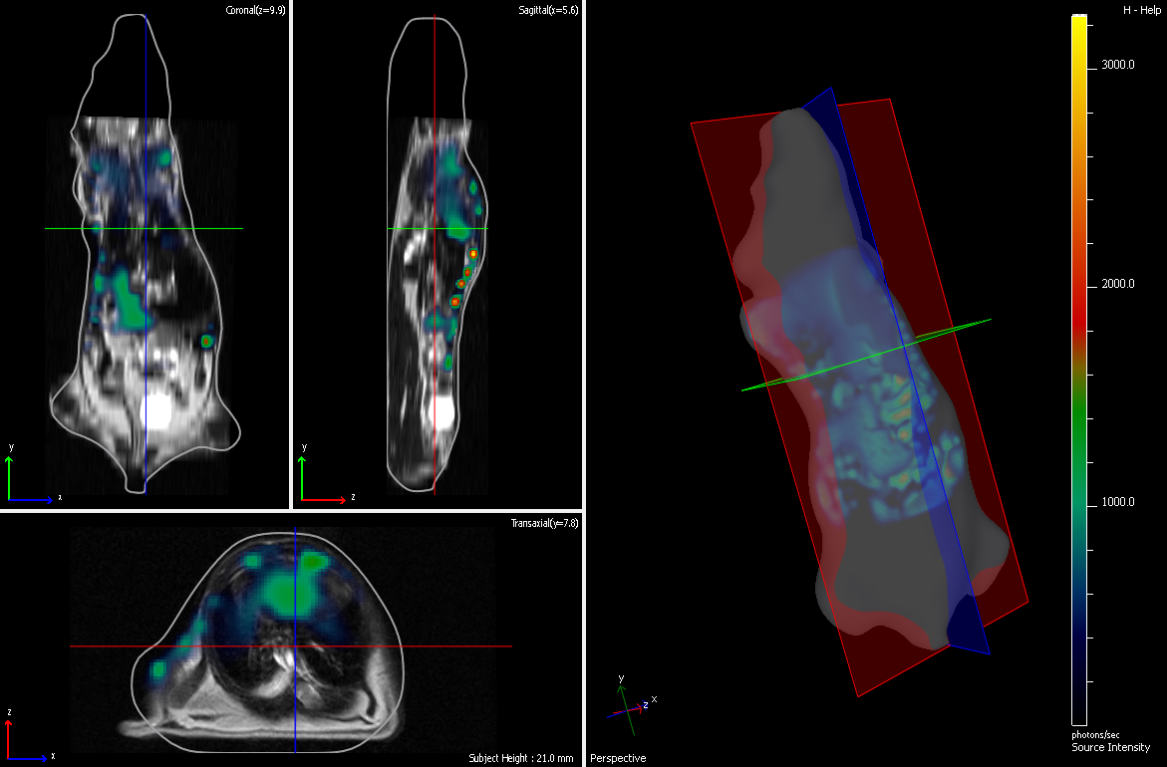
Multispectral Cerenkov tomography
Example of whole body CLI image reconstructed using the msCLT approach. As one can see by looking at the panel on the right is possible to distinguish very clearly the internal organs of the animal.

Slide 28
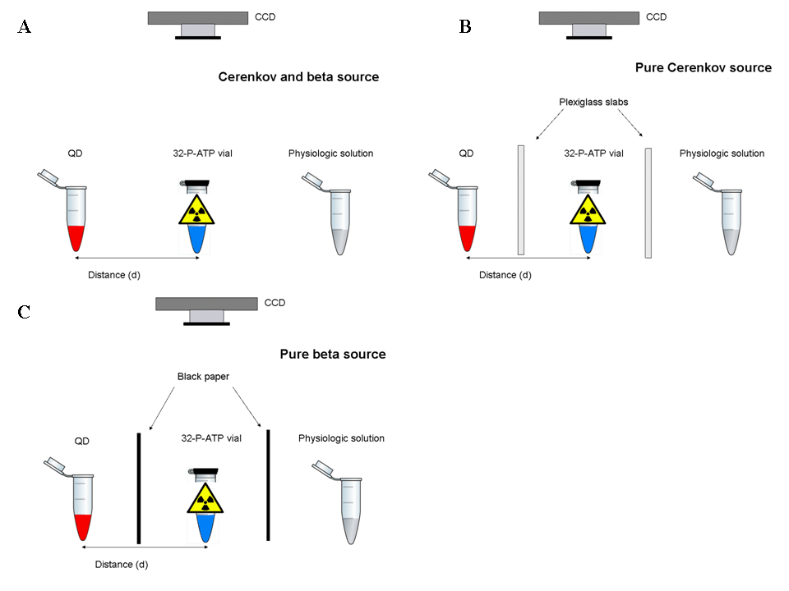
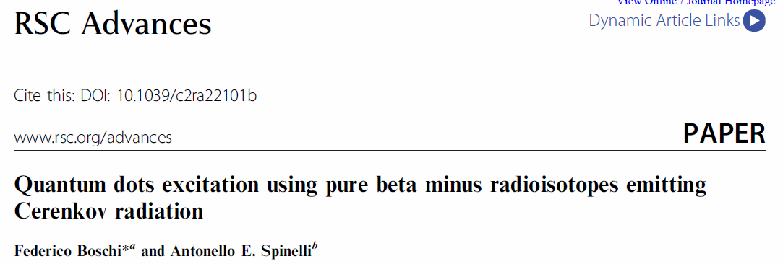
Cerenkov radiation and Quantum dots
We performed a set of experiments using different setup in order to investigate the interaction between QD and Cerenkov radiation

Slide 29
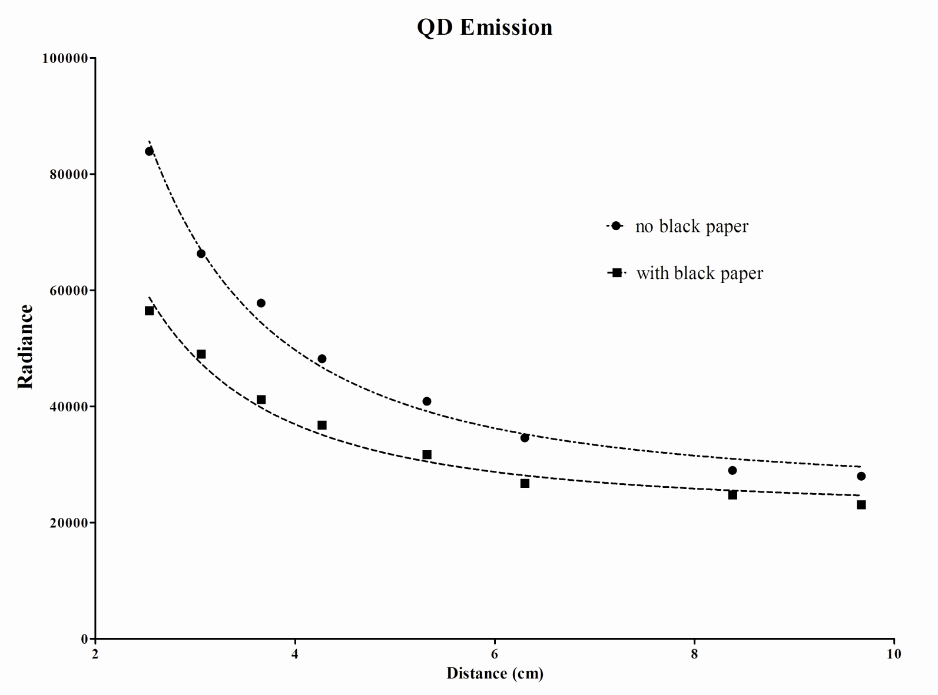
Quantum dots emission
The plots show the measured radiance (ph/s/cm2/sr) in the QD vial placed at different position for the experimental conditions with (■) and without (●) back papers between P32-ATP and QD’s solution.

Slide 30
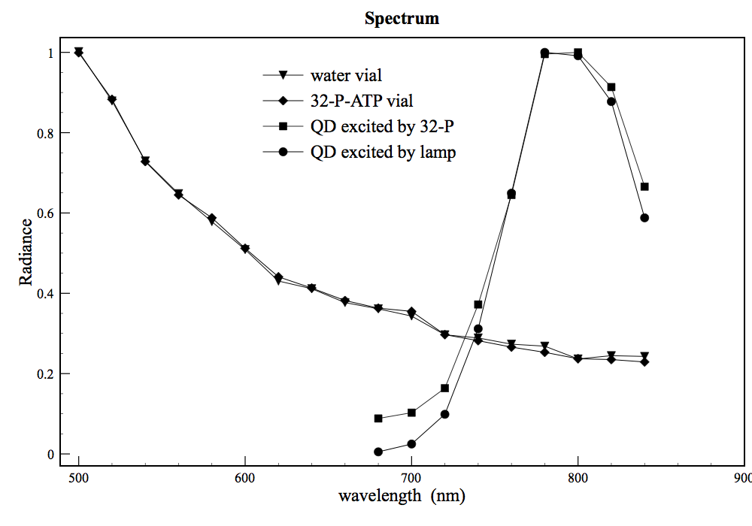
Quantum dots spectrum
The spectrum of both source and reference water vial shows the typical shape of Cerenkov spectrum.
The comparison between the emission spectrum obtained by exiting the QD with Cerenkov P-32 source and with an external lamp shows that both spectrums are almost the same at the QD emission peak (around 800 nm).

Slide 31
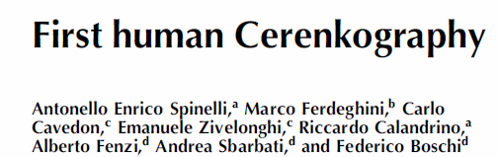
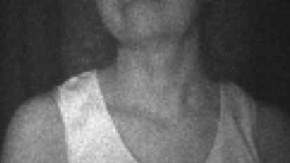
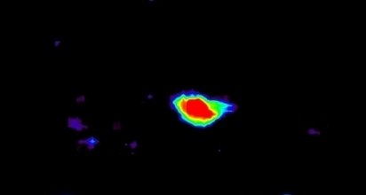
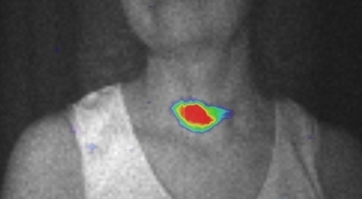

From mice to man….
The last image shows the overlay between a photographic image of the patient and the Cerenkov imaging of the thyroid gland treated with I-131. It is possible to notice a good correspondence between the region where CR is emitted and the thyroid.

Slide 32
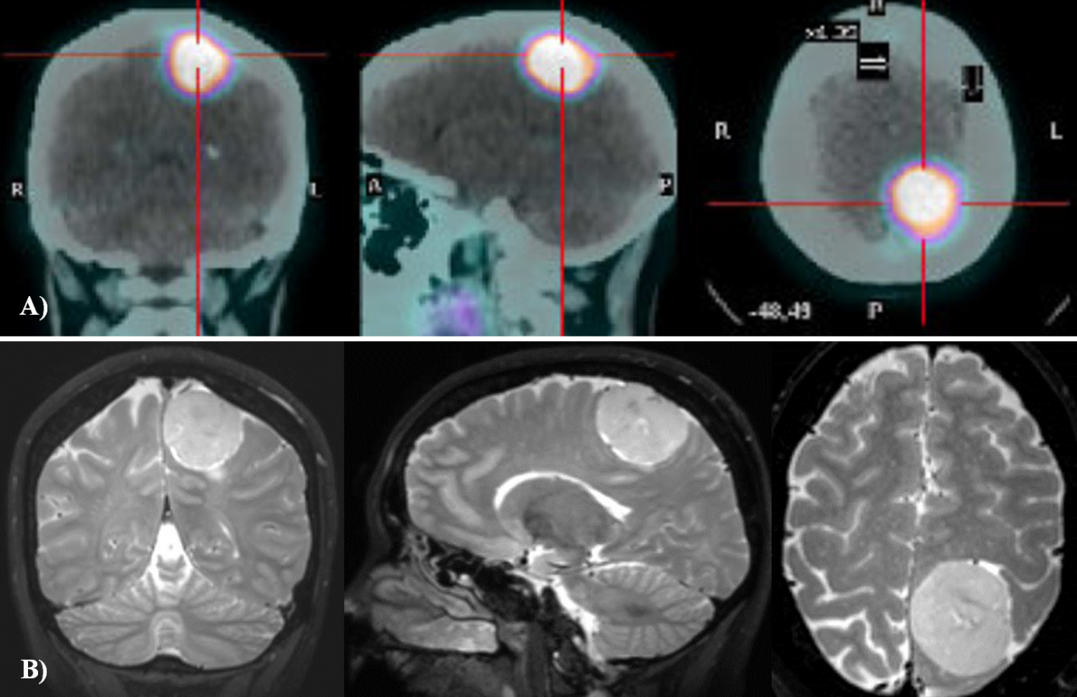
Cerenkov imaging of brain tumor specimens
A patient with a grade 1 brain meningioma, localized in left parietal region was injected with 166 MBq of 90 Y-DOTATOC the day before surgery.
The panel (A) shows the coronal, sagittal and axial PET-CT images of the patient injected with 68 Ga-DOTATOC. The PET images were used to estimate the activity concentration of 90 Y-DOTATOC in the tumor during surgery. Panel (B) shows the T2 MR images of the patient acquired without contrast medium.

Slide 33
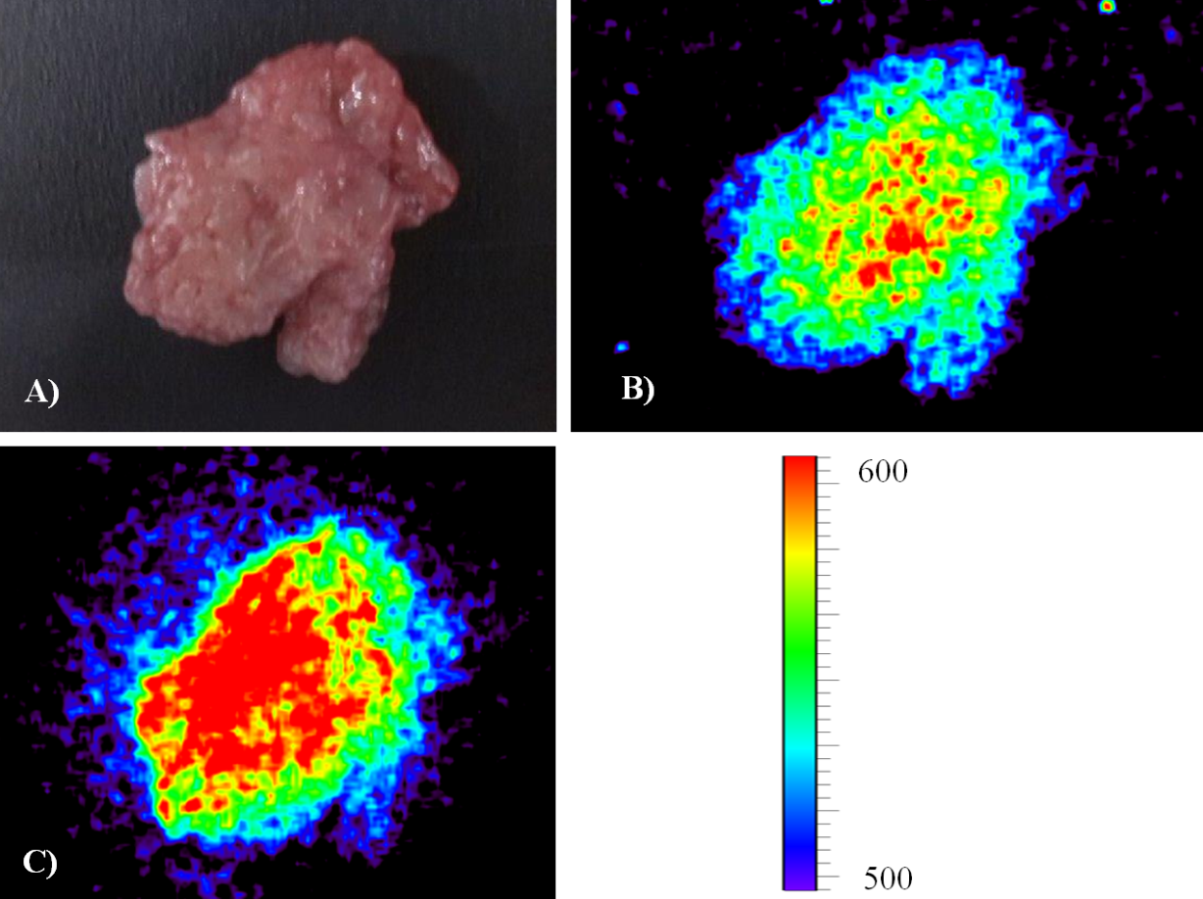
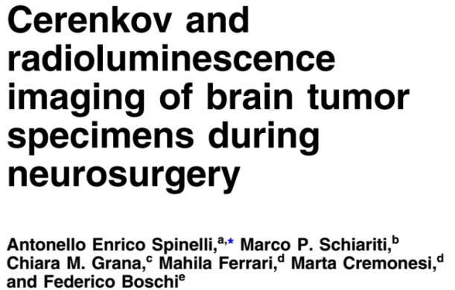


Cerenkov imaging of brain tumor specimens
Tumor specimen
Cerenkov image
Radioluminescence
image

Slide 34
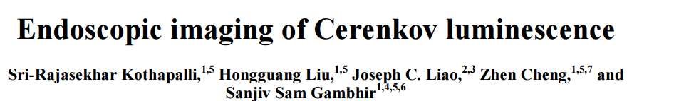
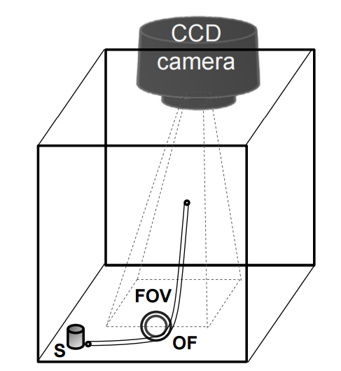
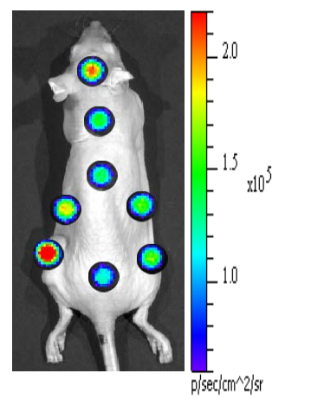
Endoscopic Cerenkov imaging
IVIS-200 system was adapted to image phantom samples/animal subjects
In vivo animal imaging using 6 mm fiber optic bundle with one minute exposure time.

Slide 35
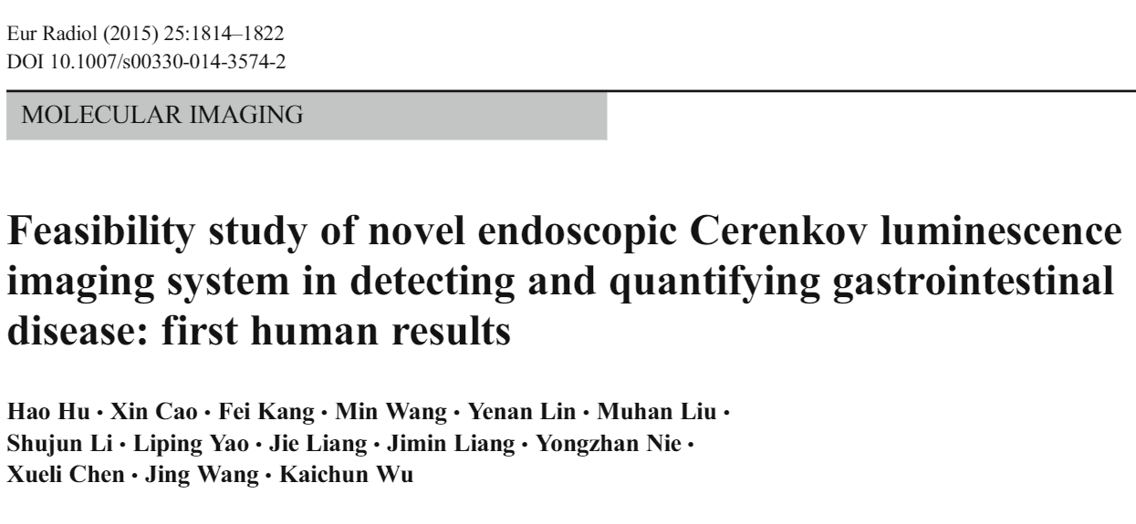
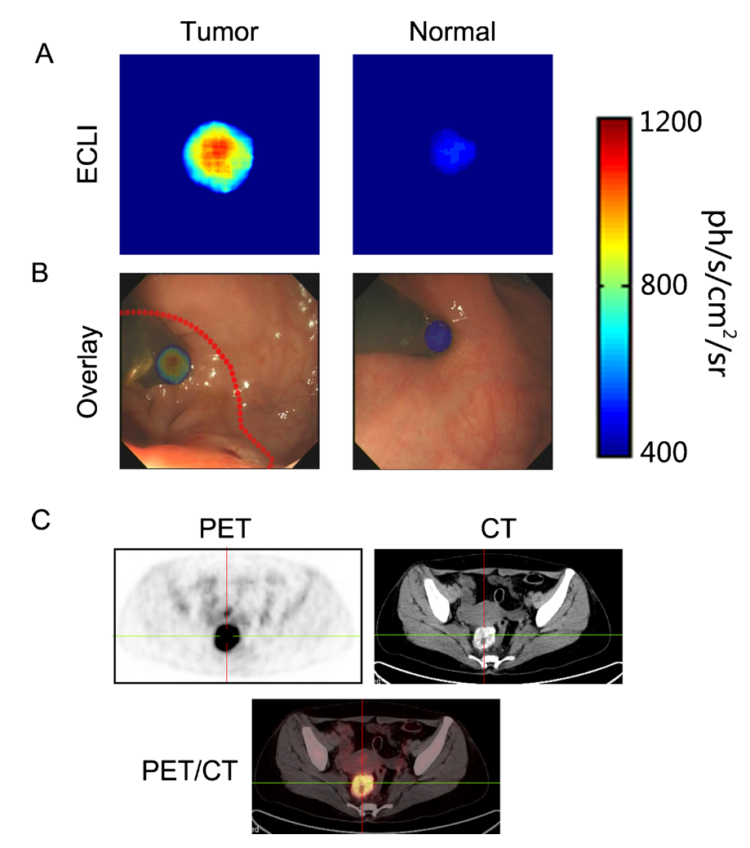

Endoscopic Cerenkov imaging

Slide 36



Measurement of skin dose for RT
Recently it has been shown that Cerenkov radiation can be used to visualize in real time the dose delivery during radiation therapy for breast cancer.
Images from: D. Gladstone

Slide 37

Measurement of skin dose for RT
Images from: D. Gladstone

Slide 38
Radioluminescence imaging

Slide 39


Optical imaging of gamma emitters
Radioluminescence image of a Tc99m source

Slide 40


Optical imaging of gamma emitters
RLI image of the 99mTc-pertechnetate distribution in Nu/Nu mice placed in supine position.
The regions anatomically corresponding to salivary glands, thyroid gland and stomach-intestine are the most important sources of emission.

Slide 41


imaging of alpha emitters
Luminescence image of the Am-241 source in air

Slide 42

imaging of alpha emitters
Piece of paper to stop alpha particles
Lateral view (using a mirror) of the Am-241 source in air

Slide 43

imaging of alpha emitters
Luminescence image of the Am-241 source placed under a mouse

Slide 44



Luminescence in non-scintillating material
We performed a series of experimental observations aiming to distinguish between Cerenkov and non-Cerenkov radioluminescence in organic and inorganic samples like ex vivo chicken tissue, glass and acrylic.
Schematics of the experimental setup. Sample radio-
luminescence can be excited by beta-minus emission from 32P or gamma emission from 99mTc which take place in separate experiments.

Slide 45
Cerenkov imaging is…
Cerenkov imaging is a fast growing preclinical imaging modality (≈ 200 papers in the past 5-6 years).
Is a fast and cheap modality with respect to PET.
Can be used to visualize in vivo radiotracers already available in the clinic.
Examples of Cerenkov imaging in humans have been shown in the literature.

Slide 46
Acknowledgements
Anatomy Department of the University of Verona, in particular Dr. Federico Boschi.
Medical Physics Department and Centre for Experimental imaging, Ospedale San Raffaele.

Slide 47




Further readings…

Slide 48



