Slide 1
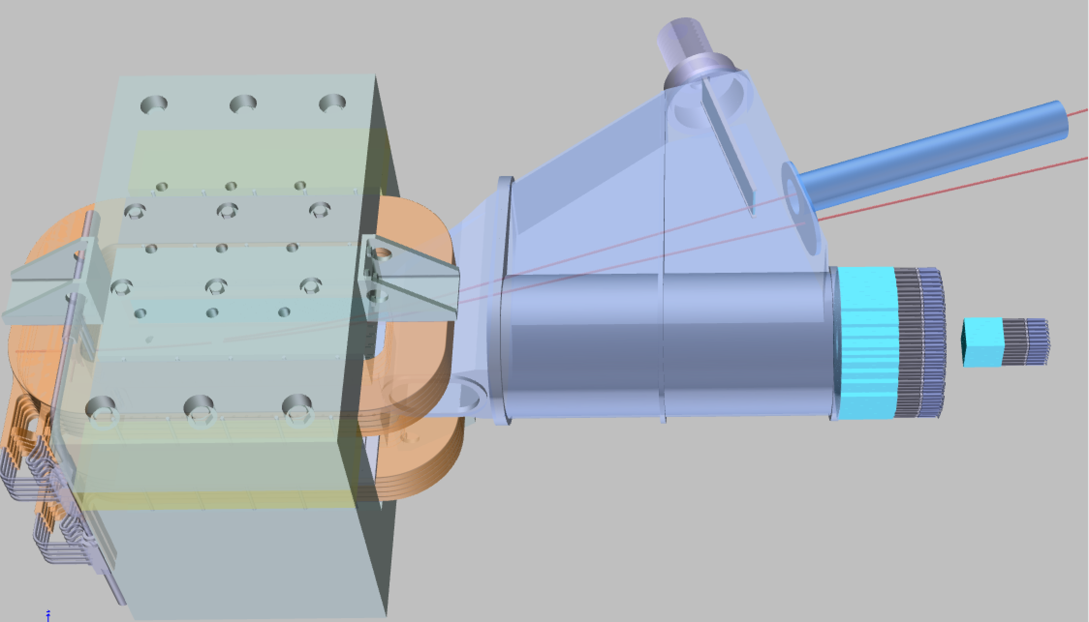
Status of the PADME experiment
Dr. Mauro Raggi,
INFN Laboratori Nazionali di Frascati
51st LNF Scientific Committee Meeting May 23-24, 2016
More info on PADME at:
  M. Raggi and V. Kozhuharov, Advances in High Energy Physics Vol. 2014 ID 959802
  Kick-off meeting di PADME: http://agenda.infn.it/event/padme-kickoff
  Indico PADME: https://agenda.infn.it/categoryDisplay.py?categId=782
  M. Raggi and V. Kozhuharov, “Results and perspectives in dark photon physics”:
  http://www.sif.it/riviste/ncr/econtents/2015/038/10/article/0

Slide 2
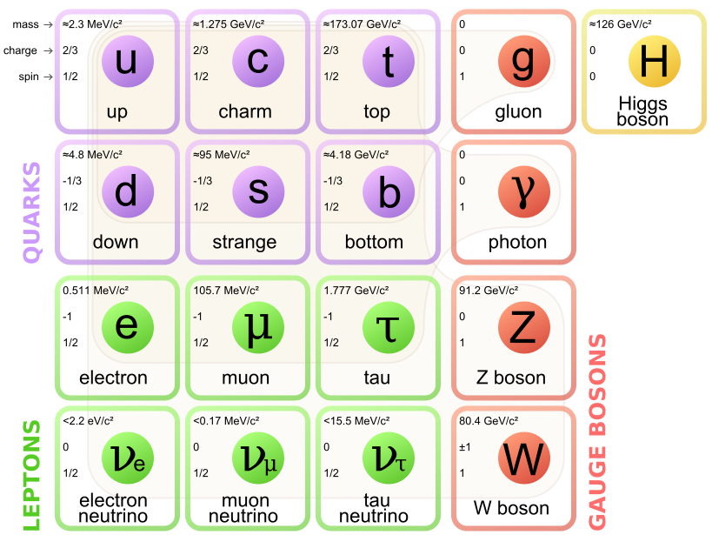
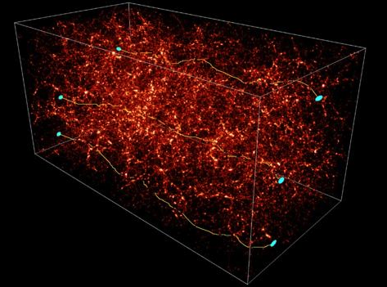
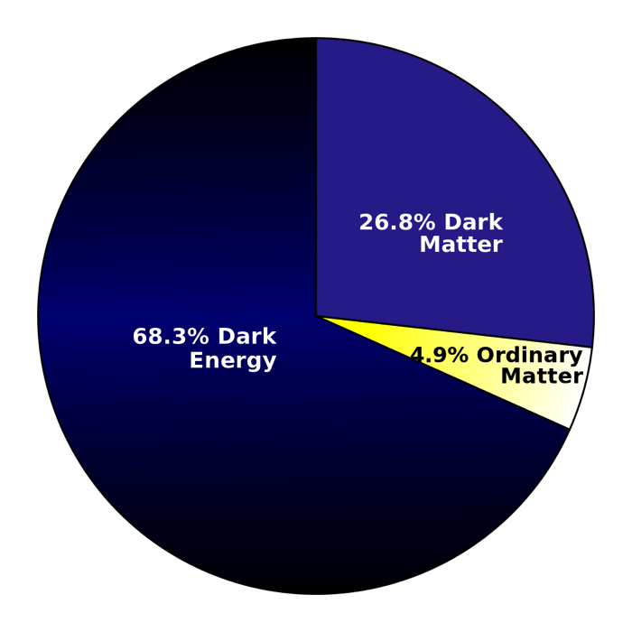
What is the universe made of?
???Dark Sector???
h’
Dark fermions?
χ
A’
Z’
Standard model only includes <20% of the matter in the universe
  We only know dark matter interact gravitationally
Many open questions
  What is dark Matter made of?
  How dark matter interact, if it does, with SM particles?
  Does one or more new dark force exist?
  How complex is the dark sector spectrum?

Slide 3

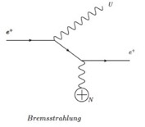
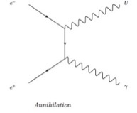
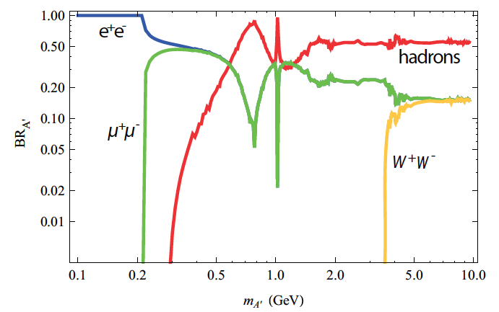
A’ production and decays
A’ can be produced in e⁺ collision on target by:
  Bremsstrahlung: e⁺N →e⁺NA’
  Annihilation: e⁺e⁻→ γA’
  Meson decays
Bremsstrahlung
Annihilation
If no dark matter candidate lighter than the A’ boson exists:
  A’→e⁺e⁻, μ⁺μ⁻, hadrons, “visible” decays
  For M_{A’}<210 MeV A’ only decays to e⁺e⁻ with BR(e⁺e⁻)=1
Meson decays
If any dark matter particle χ with 2M_{χ}<M_{A’} exists
  A’ will dominantly decay into pure DM
  BR(l+l-) suppressed by factor ε²
  A'→χχ ~ 1. These are the so called decays to “invisible”

Slide 4
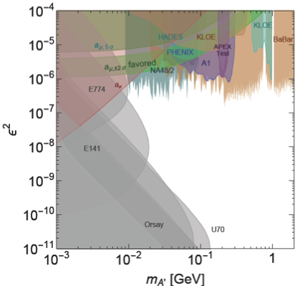
A’ →l⁺l⁻ visible searches status
Rely on the assumption that A’ decays to SM particles with universal coupling ε
Favored parameters values explaining (g-2)μ
(green band)
    A’-boson light: 10-100 MeV
  Beam dump experiments (grey):
      e+e- appearance after a dump
  Fixed target:
      Peak search over QED backgrounds
  Mesons decays:
      Peaks in M(e⁺e⁻) or M(μ⁺μ⁻)
Indirect exclusion from g_{e-2} and g_{μ-2}
    Recent tight limit in red filled area
arXiv:1411.1770v2
Many different assumptions on dark photon interaction models
    Kinetic mixing, decay to electrons, no dark sector particles
New measurement by KLOE e⁺e⁻ ->γA’ and A’->π⁺π⁻

Slide 5
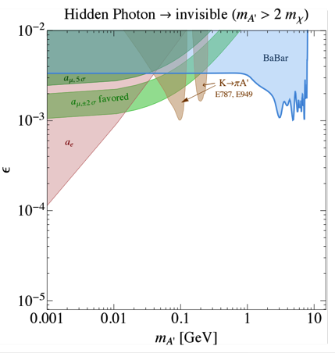
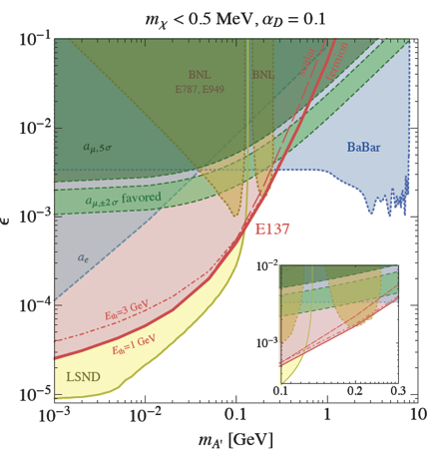
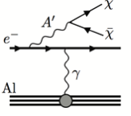
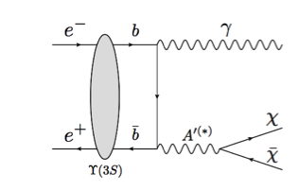
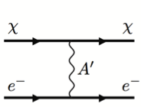
Status A’→χχ “invisible” decays
arXiv:1406.2698v1
Babar ’08 ArXiv 0808.0017
Search for Invisible Decays of a Light Scalar in Radiative
Transitions Υ_{3S}γA’
arXiv:1309.5084v1
α_{D}
α_{D}
Final BaBar result expected at ICHEP
ε² and M_{A’}
  ε², M_{A’},M_{χ} and α_{D}
ε
Two techniques are used: missing mass A’ search, dark matter χ scattering searches
  Missing mass searches for A’ only depend on 2 parameters : ε² and M_{A’}
  χ scattering searches depend on 4 parameters: ε², M_{A’},M_{χ} and α_{D}
  Kaon constraints are on the other hand more model dependent

Slide 6

The PADME approach to A’ searches
The goal
Perform a dark sector search as much as possible model independent
  Remove assumption on A’ decays and on the dark sector structure
Minimize the number of interactions and parameters in the data interpretation
  Need only to parameterize the production mechanism needs only coupling to electrons
Provide a strong and unquestionable experimental evidence for A’
  Measure mass and coupling simultaneously
  The way
Search for the process e⁺e⁻ ->γA’ A’->Inv. by measuring the final state missing mass
  Independent from the A’ decay mechanism, A’ lifetime, nature and mass of the dark matter χ
Measure ε² from rate and missing mass and M_{A’}
  Completely constrain the minimal A’ model
Measure ε² with minimal theoretical uncertainties

Slide 7
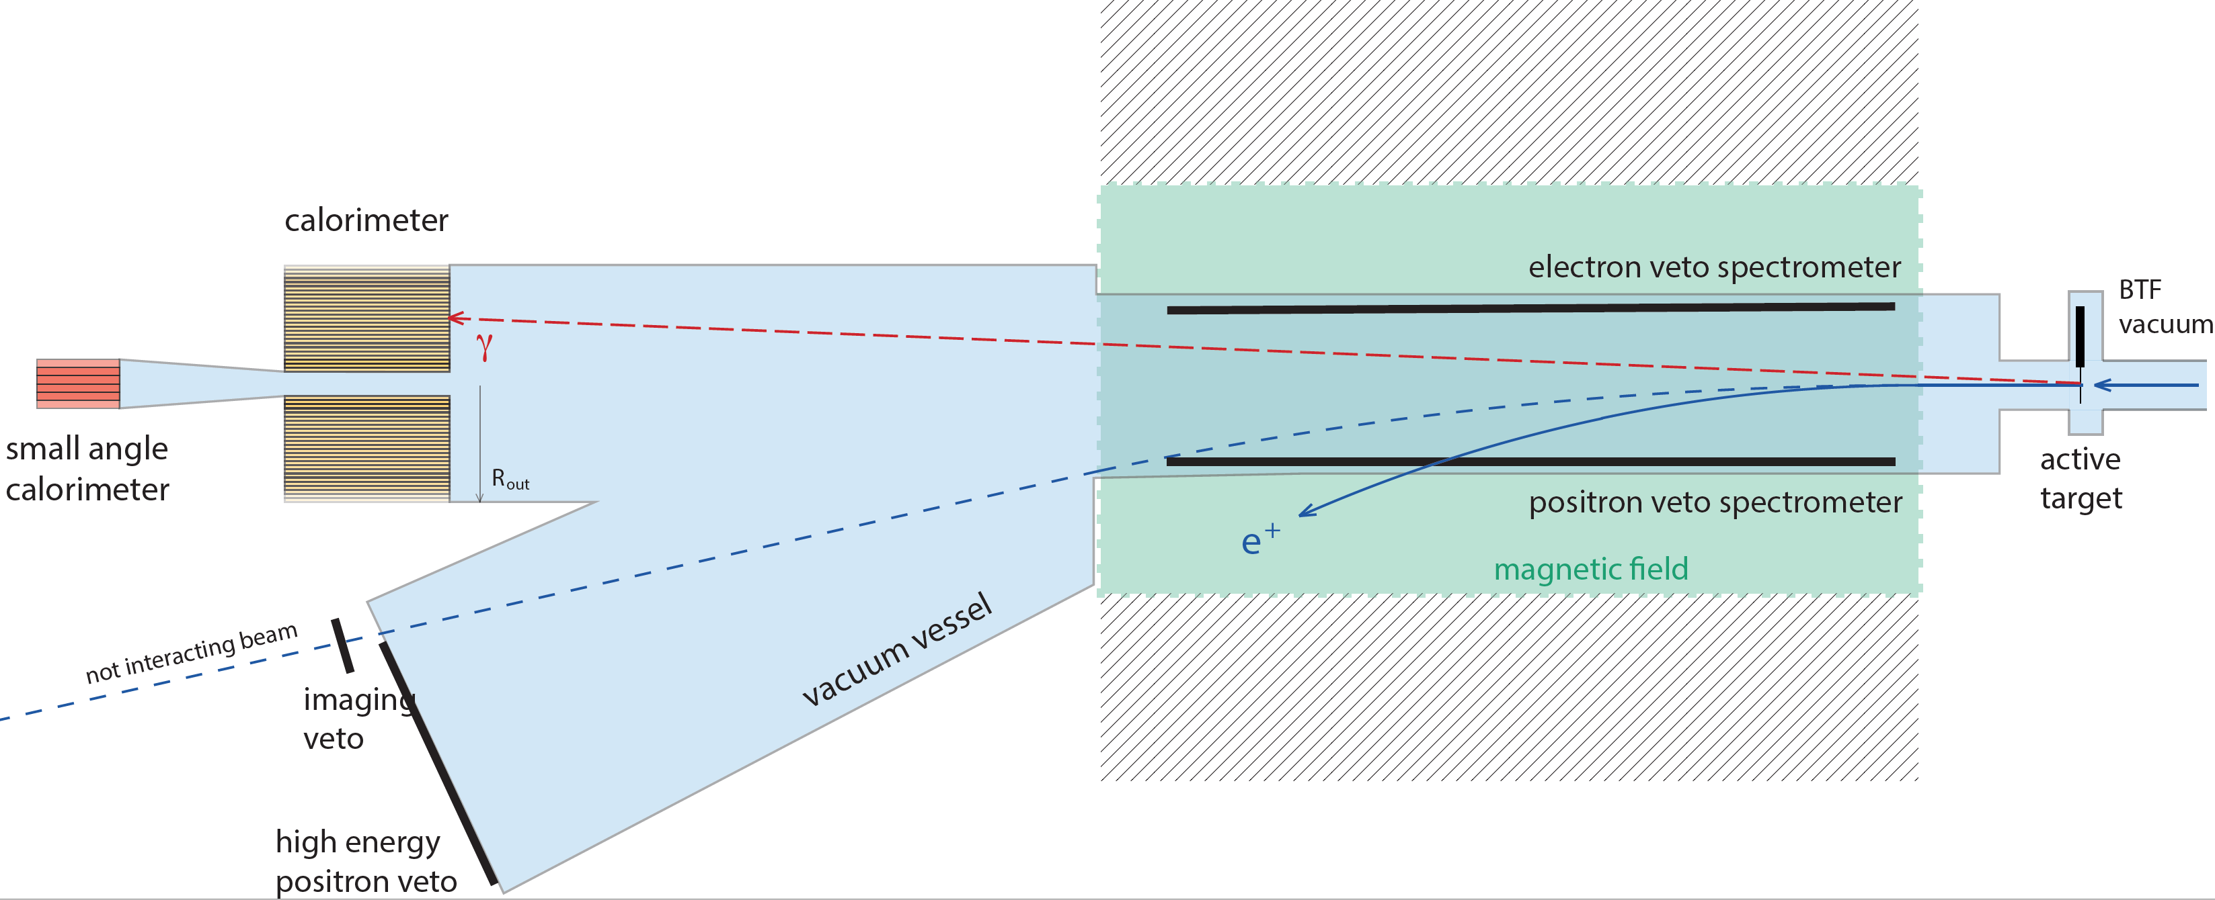
PADME invisible technique
A’
Search for the process: e+e- → γA’ on target e⁻ at rest electrons
(10⁴ 550 MeV e⁺)/bunch on a 50 μm diamond target with 50 bunch/s
  Collect 1x10¹³ e⁺ on target in one-two year of data taking period at BTF
Measure in the E_{Cal} the Eγ and θγ angle wrt to beam direction
Compute the M_{miss}² = (P4_{e−} + P4_{beam} - P_{4γ})²
  P⁴_{e-} =(0,0,0,m_{e}) and P⁴_{beam} =(0,0,P_{Beam},sqrt(P_{Beam}² + m_{e}²))

Slide 8

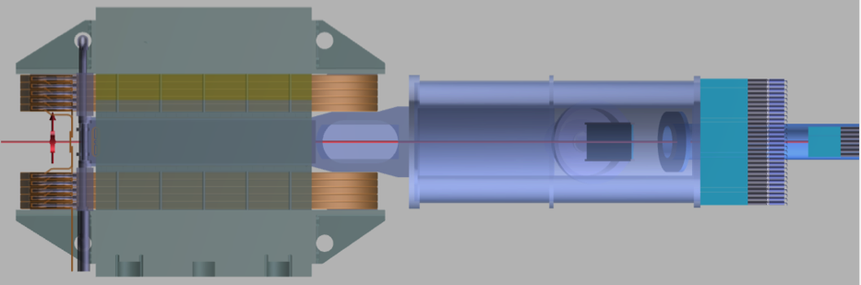
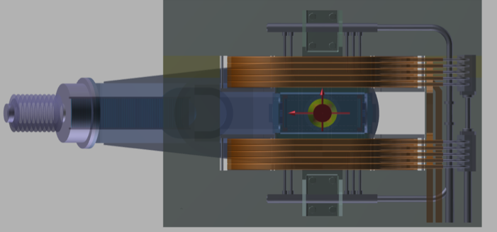
The PADME experiment layout
3m
1.25 m
  Beam: 6000 e⁺ on target per 40 ns bunch, at 50 bunch/s (10¹³ e⁺/year)
Main detector components:
    Active target, thin: 50-100μm diamond (Time, Ne-, beam position and spot size)
    Charged particles plastic scintillators veto system ~1m length
    Conventional magnet, B≈0.6T but large gap for gaining acceptance
    Cylindrical BGO crystal EM calorimeter
    Measures: time, energy and direction of photons
Compute the Mmiss² = (P⁴e⁻ + P⁴_{beam} - P⁴_{γ})²
  P⁴_{e-} =(0,0,0,m_{e}) and P⁴_{beam} =(0,0,550,sqrt(550² + m_{e}²))
  Veto additional charged particles and photons

Slide 9
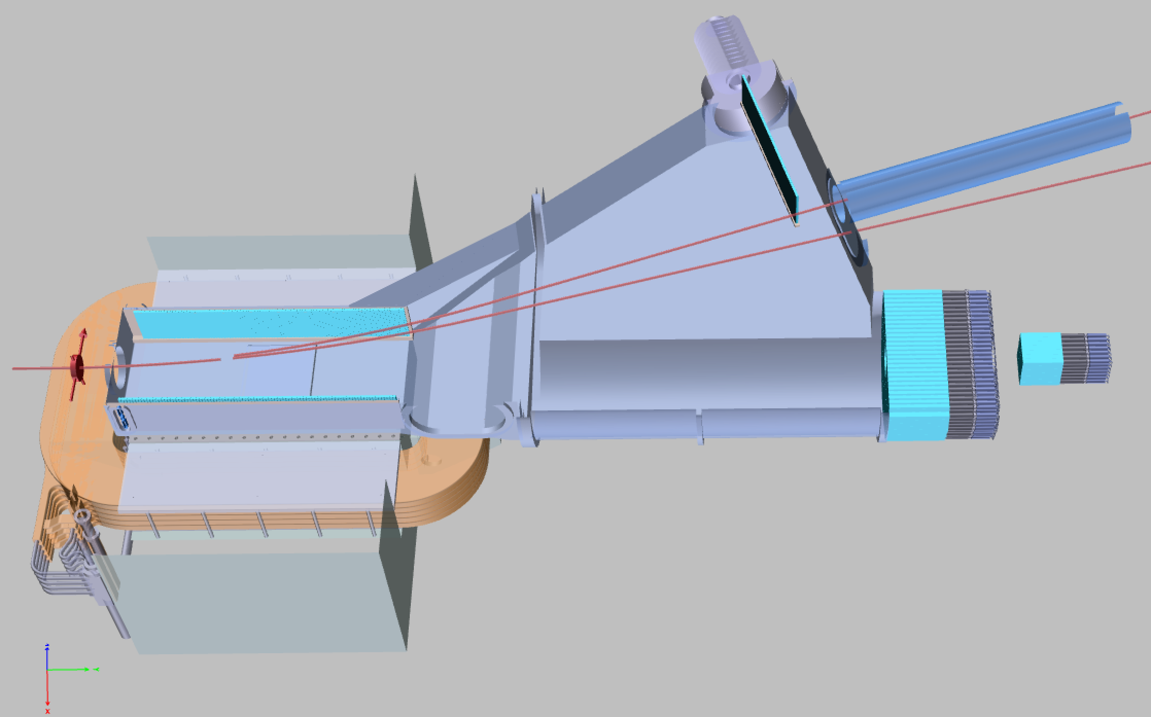
PADME detector
High Energy Positron veto
1 cm scintillators with SiPM readout
Dipole MBP-S
(transfer line SPS)
Calorimeter
BGO crystals 20×20x220mm³
Diamond target
50-100 μm
Positron veto
1 cm scintillators with SiPM readout
Positron beam
Electron veto
1 cm scintillators with SiPM readout
Small Angle Calorimeter

Slide 10
Status of the PADME detector

Slide 11
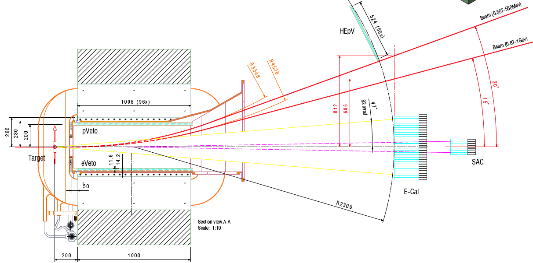
Layout
Main Detector components:
  Diamond active target: 50-100μm
  (Time, Ne⁺, beam position and spot size)
  Dipole Magnet, B≈0.6T with very large gap
  Inside magnet scintillating veto ~1m
  Cylindrical BGO crystal EM calorimeter
  Square shape Small Angle Calorimeter (SAC)
  High Energy Positron Veto
Top view
6
3
A’
4
1
3
5
2

Slide 12
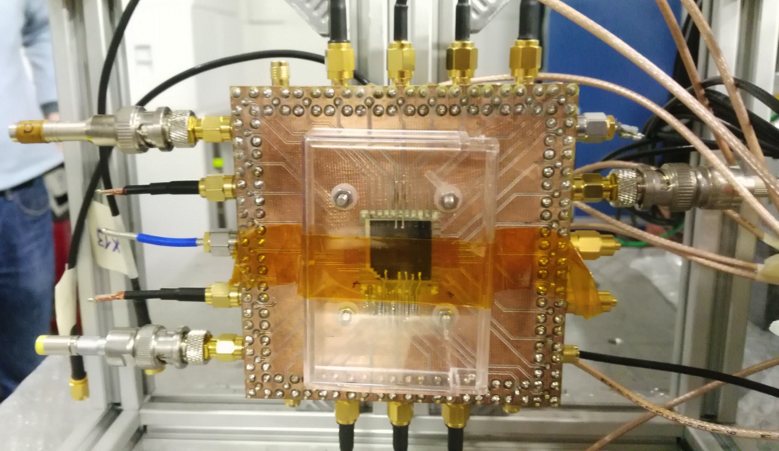
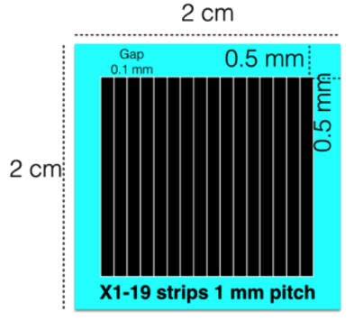

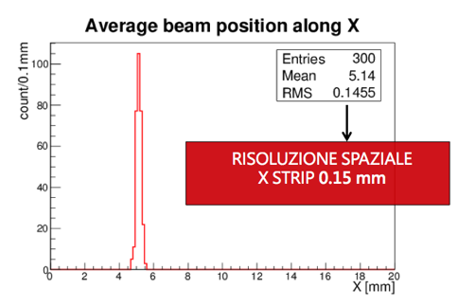
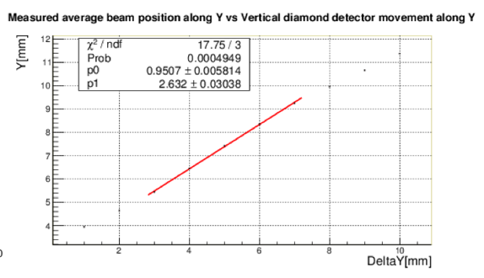
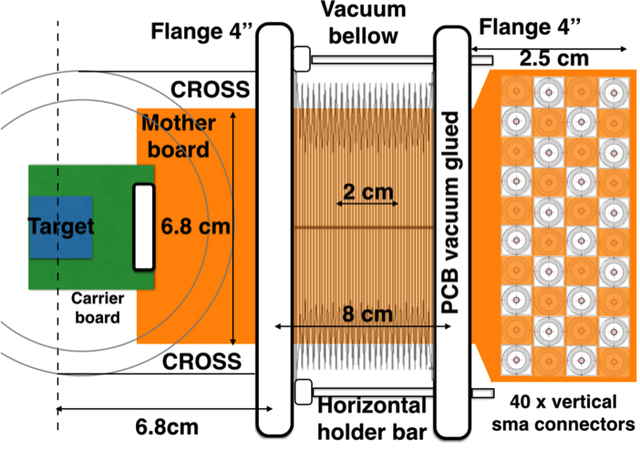
Active “full carbon” target
Prototype 20x20mm²x50μm polycrystalline
diamond during November test beam
18X +18Y graphite strips
Sensor 20×20×0.050 mm³
1 mm pitch x-y graphite strips produced with UV laser (INFN LE)
Fragile to handle
Movement and support under development
Position and # of positron measurement

Slide 13
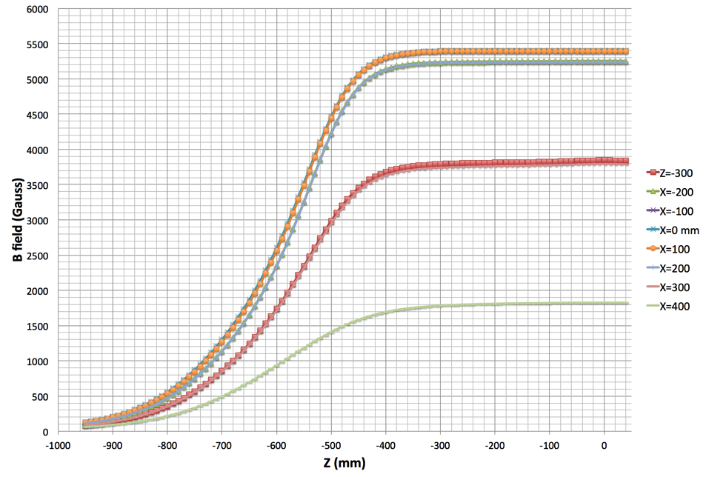
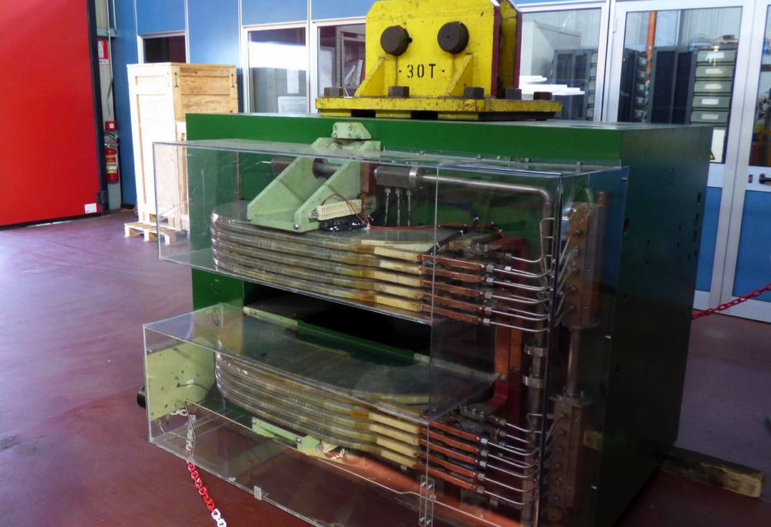
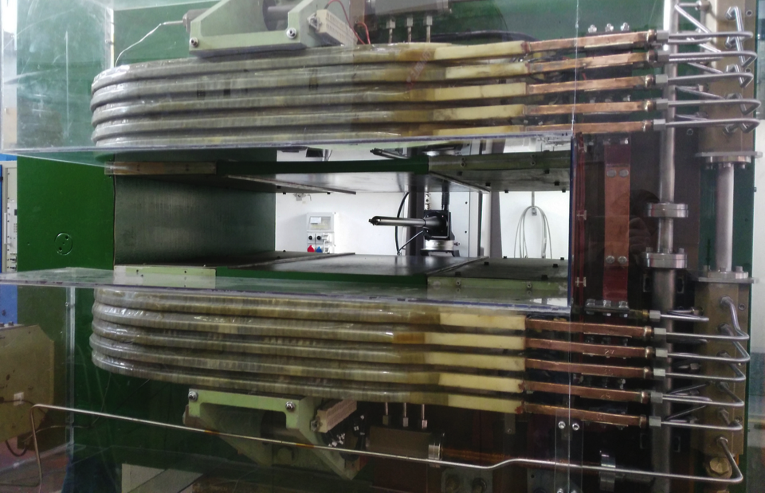
The PADME magnet
Bending spare from CERN SPS transport line:
  Arrived at Frascati on 16/12/2015
  Vertical gap dimension enhanced to 230mm
  ≈95 KW at maximum current of 675 A
Already performed steps :
  Mechanical survey (OK)
  Magnetic filed mapping at 400A 230mm gap
Significant field in the coil region
  Moved the target 20 cm upstream
Next steps :
  Mechanical support and BTF integration
End of coils
End of poles
Target

Slide 14
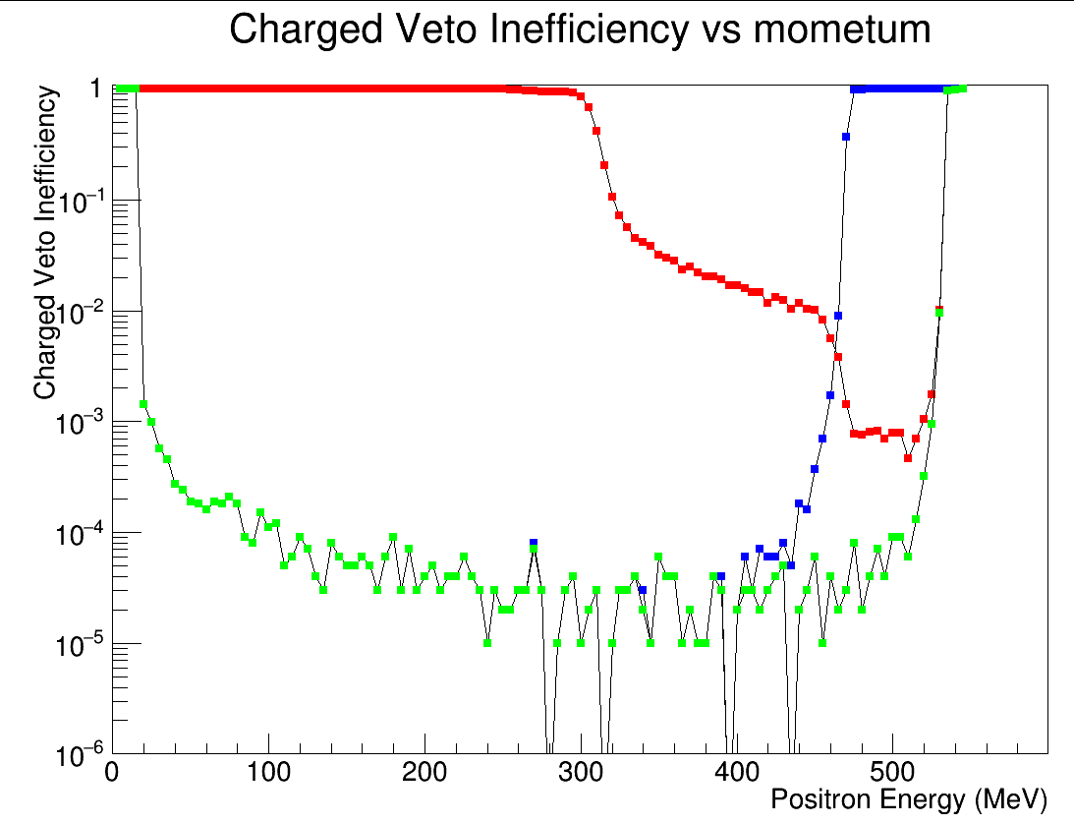
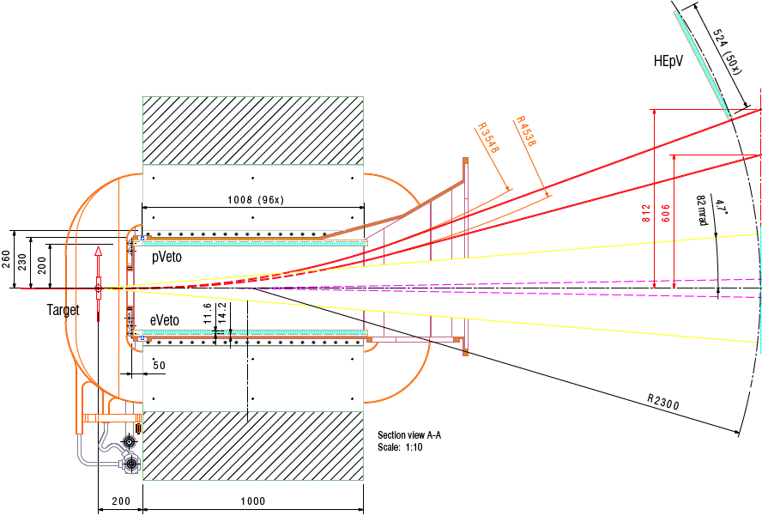
Charged particle veto
Positron veto
High energy positron veto
Detector geometry baseline design
  Extruded scintillator bars di 10x10x160 mm³
  Positron veto: 96 bars inside the magnet (veto e⁺ with 20MeV<P_{e}<450MeV)
  High energy positron veto: 50 bars outside magnet (veto e⁺ with 450MeV<P_{e}<520MeV)
  Read-out with 3x3mm² Hamamatsu SiPM in vacuum and magnetic filed region

Slide 15
PADME charged particle veto
Extruded plastic scintillator bars 10x10x160 mm³
3 sections for a total of 250 channels:
  Electrons (96), positrons (96), and high energy positrons (50)
Inside vacuum and magnetic field region
Main requirement:
  Time resolution ≃ 300 ps
  Momentum resolution of few % based on Z impact position
  Efficiency better than 99.9% for MIPs

Slide 16
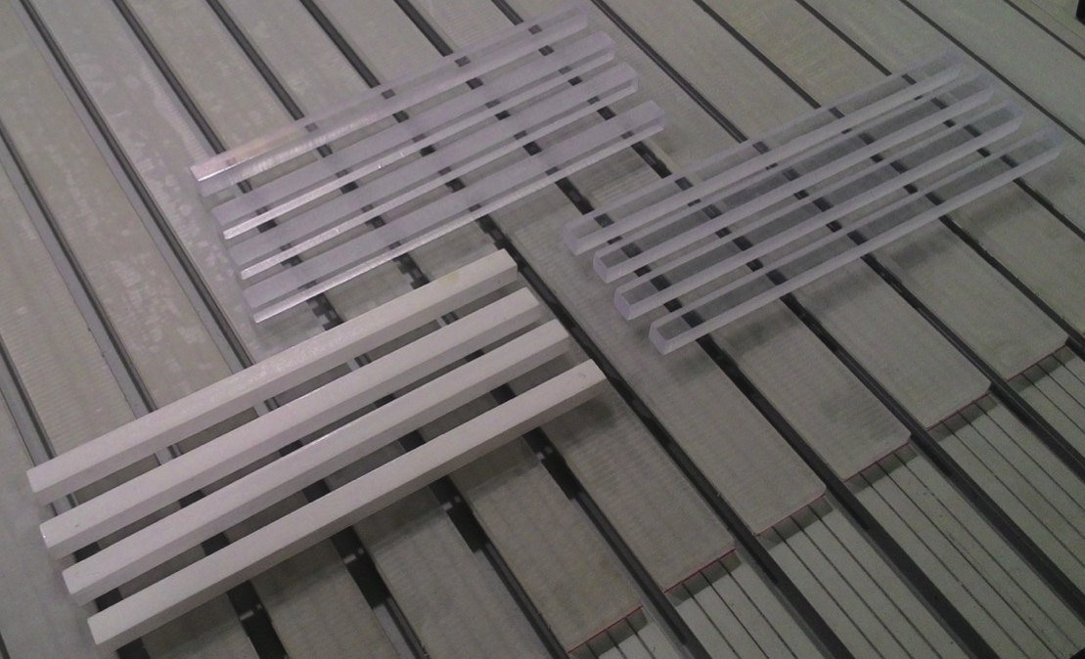
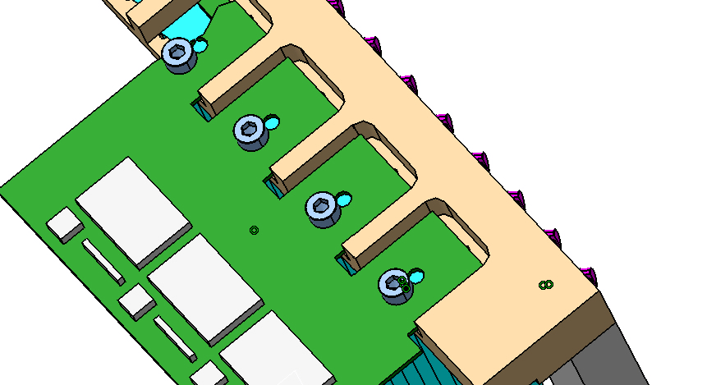
Hardware status
Scintillator bars in Sofia
Scintillators production finished
  Shipping to Frascati during this week
  Mechanical design advanced: prototype support during summer
  Readout design with fibres or direct coupling
  Readout technology choice by summer
Front-end and supply voltage electronics under development
  ~60 SiPM already available
  Detailed study of final layout available

Slide 17
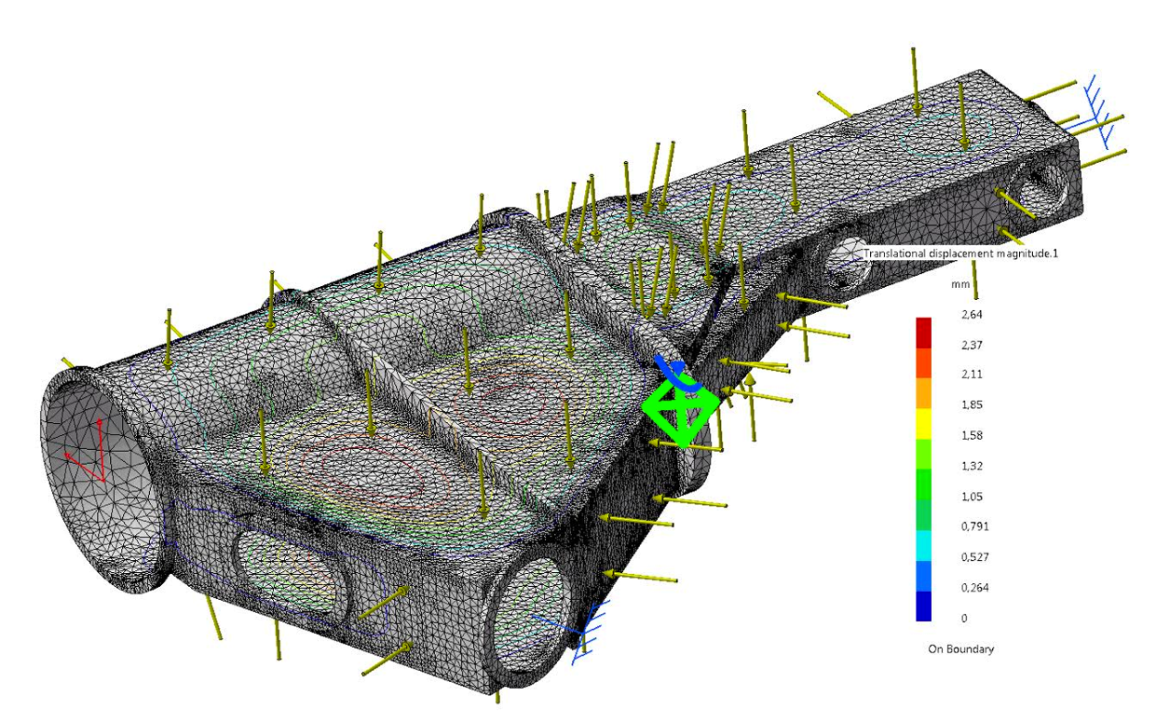
PADME vacuum vessel
Complex shape to follow the beam bending inside the magnet
Vacuum requirement fixed to 10⁻⁵-10⁻⁶ mbar
Preliminary studies indicates that 1-1.5mm stainless steel vessel might be able to sustain the pressure
Study of the target region not yet finished
Will incorporate all the charged veto
C. Capoccia

Slide 18
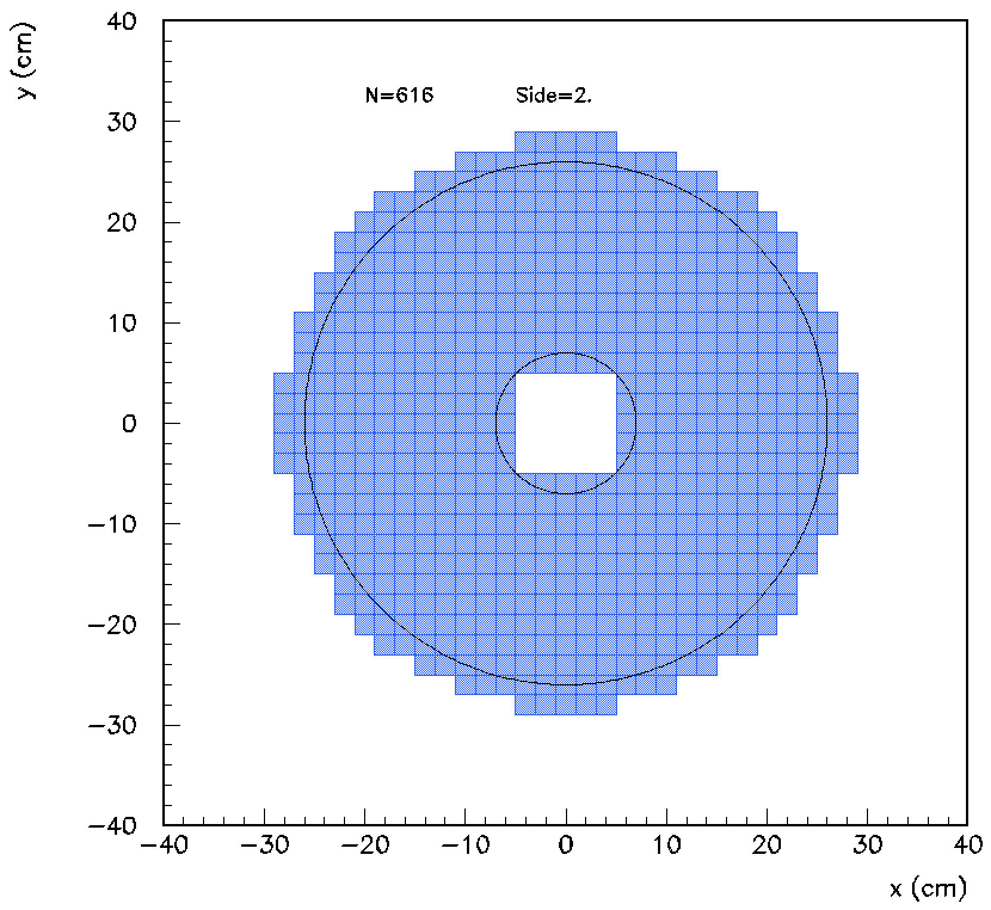
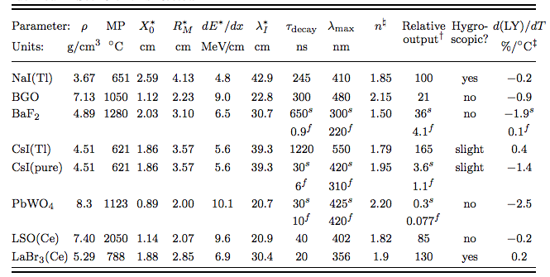
Calorimeter
Cylindrical shape: radius 290 mm, depth of 220 mm
  Square shape inner hole with L/2=50 mm
  616 crystals 20x20x220 mm³
Material BGO: high LY, high ρ, small X₀ and RM, long τ_{decay}, (free form L3 calorimeter)
Expected performance:
  σ(E)/E =1.1%/√E ⨁ 0.4%/E ⨁1.2% superB calorimeter test at BTF
  [NIM A 718 (2013) 107–109]
  σ(θ) ~ 1.5 mrad
  Angular acceptance (20 –93) mrad

Slide 19
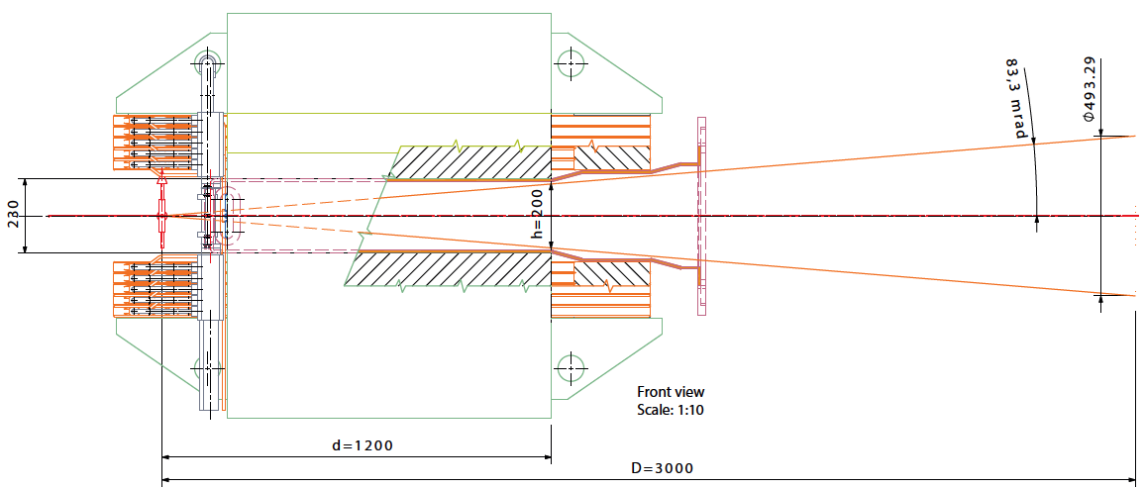
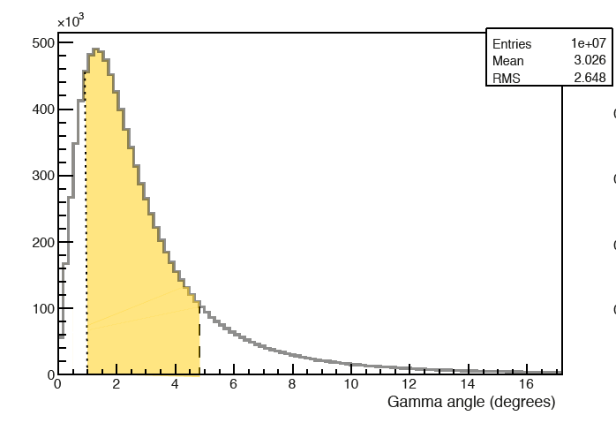
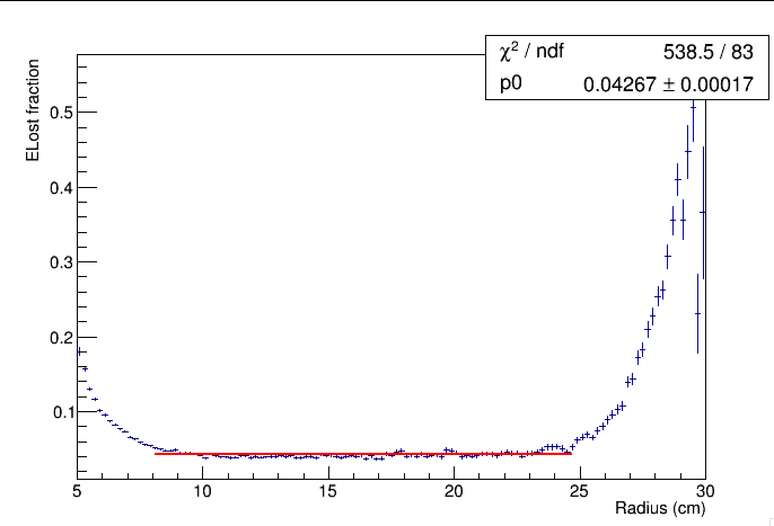
New calorimeter Layout
Diameter defined the magnet gap aperture
Cell size fixed by original L3 crystals
To get required angular resolution need at lest 3m distance
Max distance limited by the BTF hole lenght
Angular coverage 83 mrad
  Enough to reject 2γ and 3 γ
  High acceptance for all A’ masses
Acceptance region 8-25 cm with <5% energy loss
Beam plane cutting the centre of one row (29 rows of crystals)

Slide 20
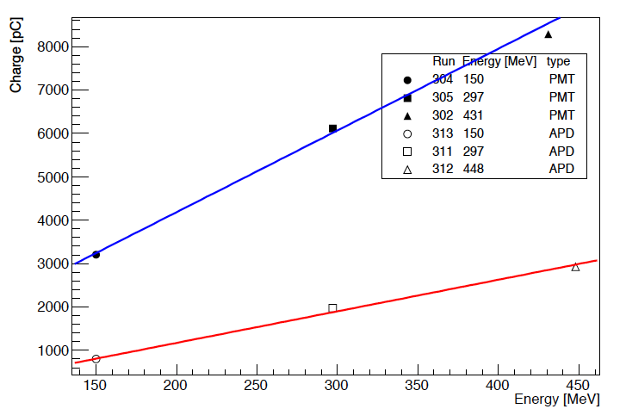
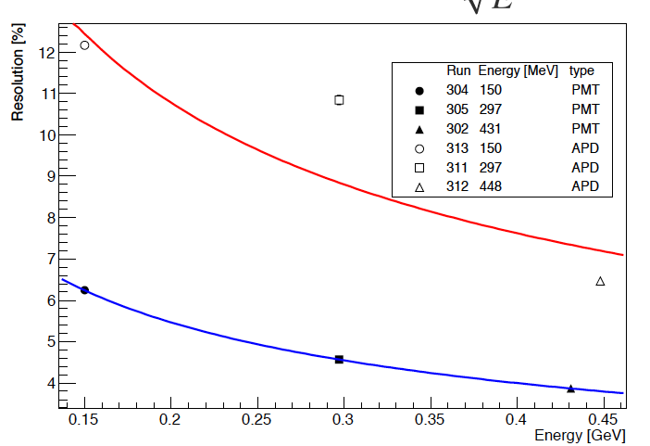
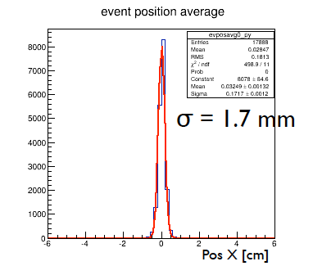
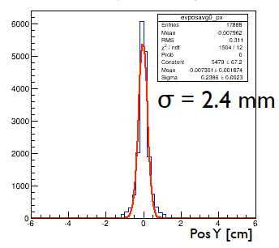
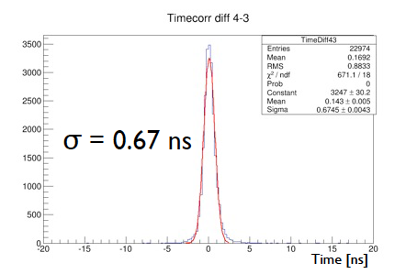
Highlights from test-beam
APD
Ham. S8664-1010
Preliminary
PMT
Ham. 1 inch
PMT
Ham. 1 inch
APD
Ham. S8664-1010
Preliminary
N_{pe}/MeV = q/(eGE_{beam}) = 3000pC/(e*2×10⁵*150) ~ 600 foto-electrons/MeV
Preliminary
Preliminary
Preliminary
PosY (cm)
PosX (cm)

Slide 21
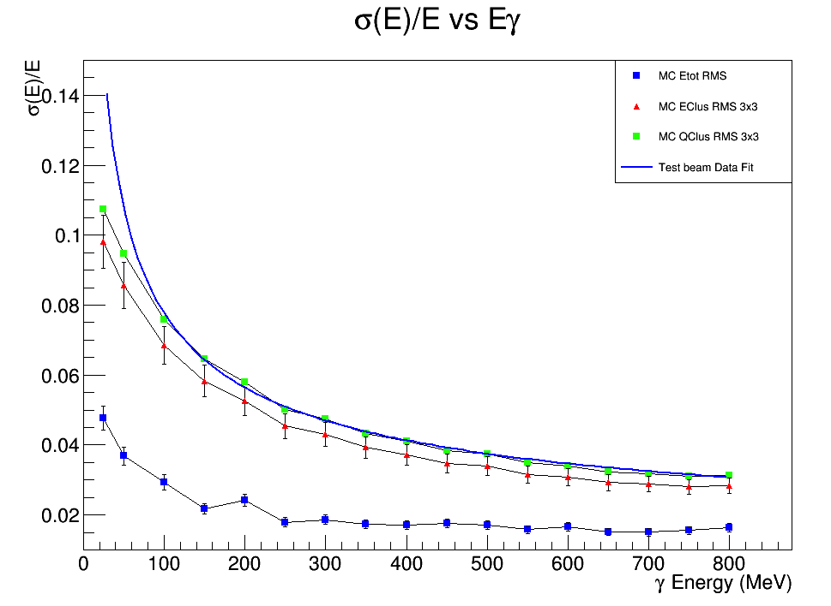
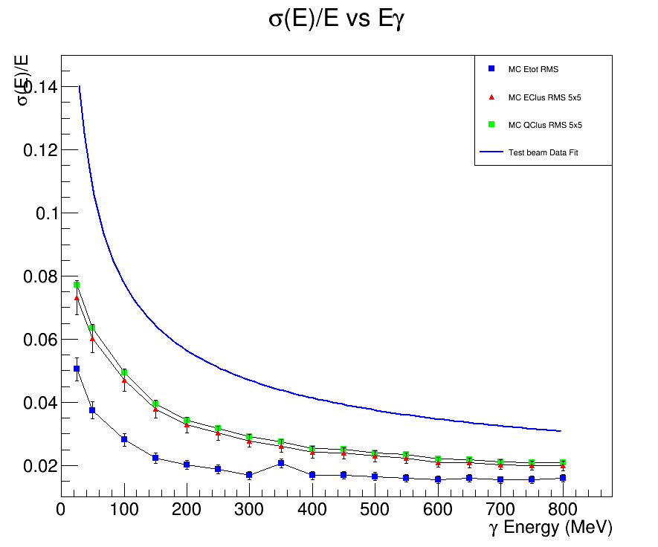
Data Monte Carlo comparison
Monte Carlo 3×3
Monte Carlo 5×5
Test beam 11/2015
3x3 crystals matrix
Test beam 11/2015
3x3 crystals matrix
MC 3×3 crystals MC
(Q_{Cluster} and E_{Cluster})
MC 5×5 crystals MC
(Q_{Cluster} and E_{Cluster})
Good data/Monte Carlo agreement for 3x3 crystals clusters wrt measurement obtained during November 2015 test beam
Substantial gain in the resolution predicted by MC using 5x5 crystal matrix
  Test beam foreseen in July this year

Slide 22
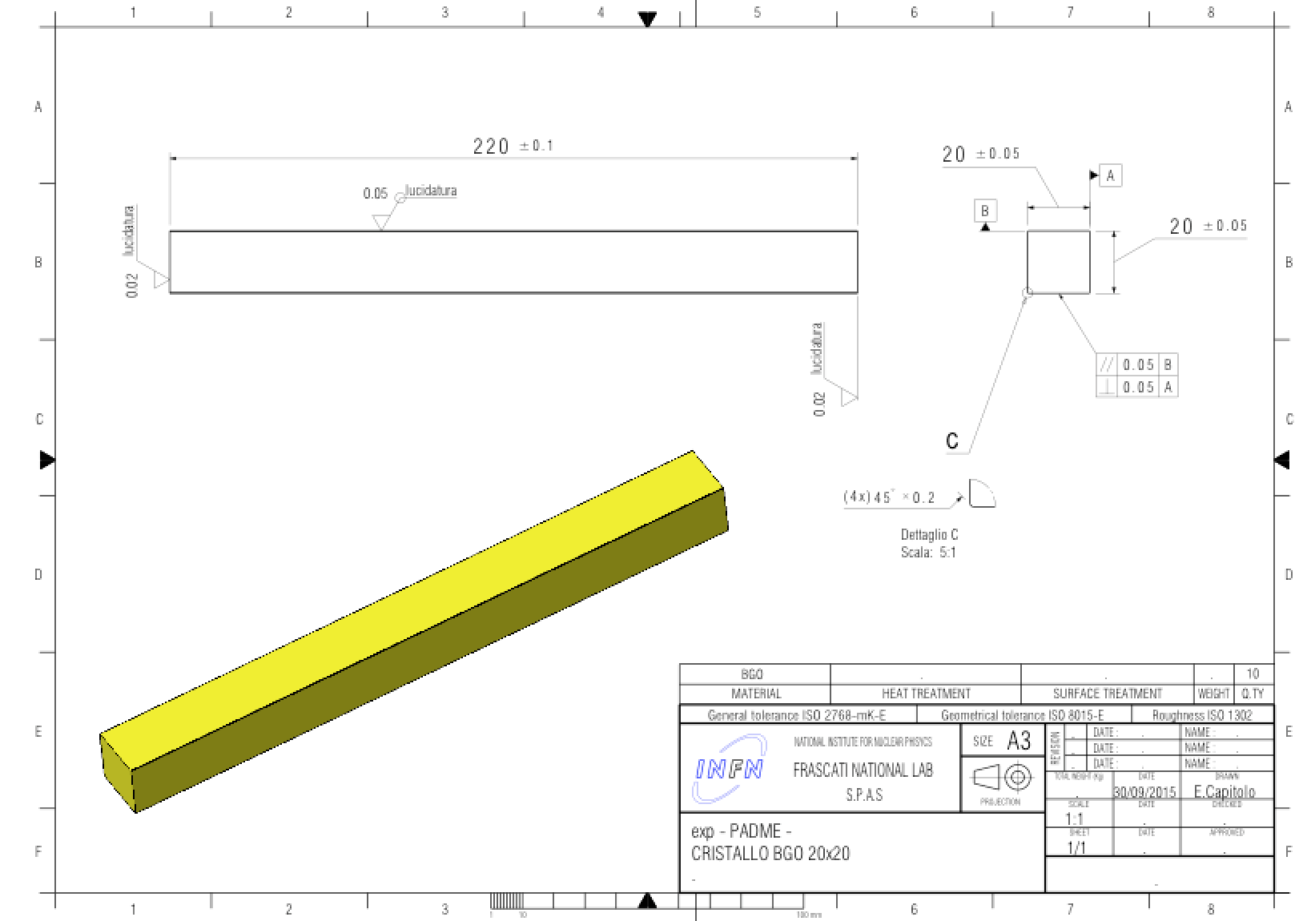
Crystal cutting results
25 crystals already cut by SILO
10 measured at LNF Metrology Service
N.02 crystals out of specs
  20.092 mm
  20.094 mm
N.08 crystals on specs:
  Average side = 20.029 mm
  RMS = 8 μm
  Deviation = < ±20 μm
Crystals out of specs can be machined again

Slide 23
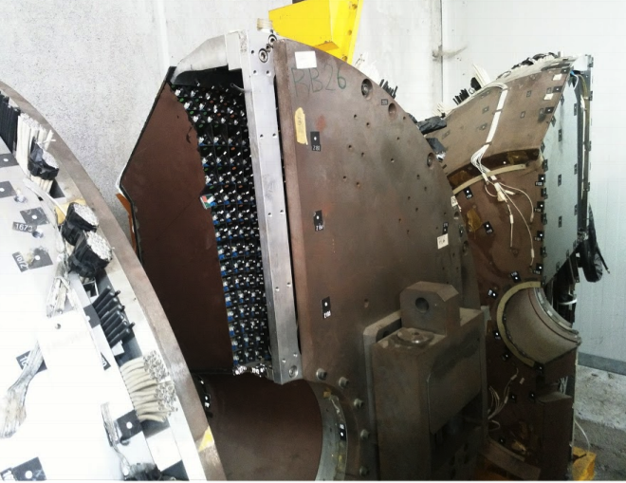
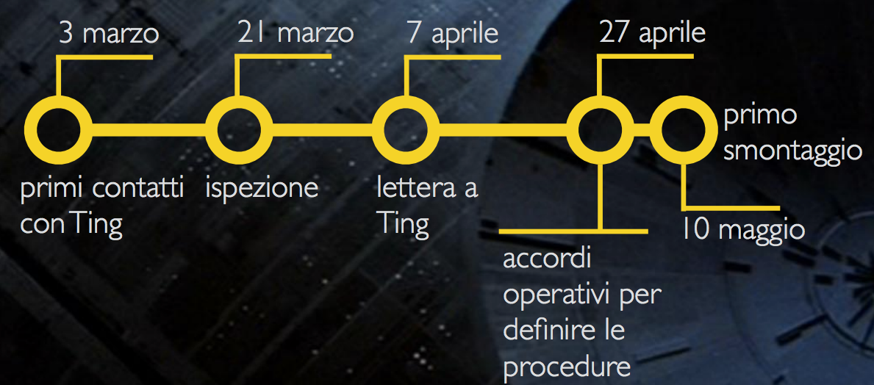
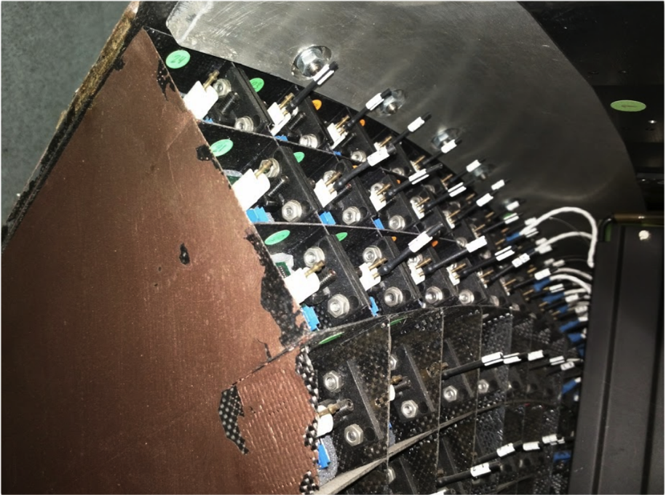
Finding the L3 calorimeter
Authorization obtained by S. Ting to get 600 crystals from the end-caps of L3
Types of crystal suitable for the PADME ecal identified
  Minimum front face size 22-23 mm size required
Recovery procedure established with Lab27 at CERN

Slide 24
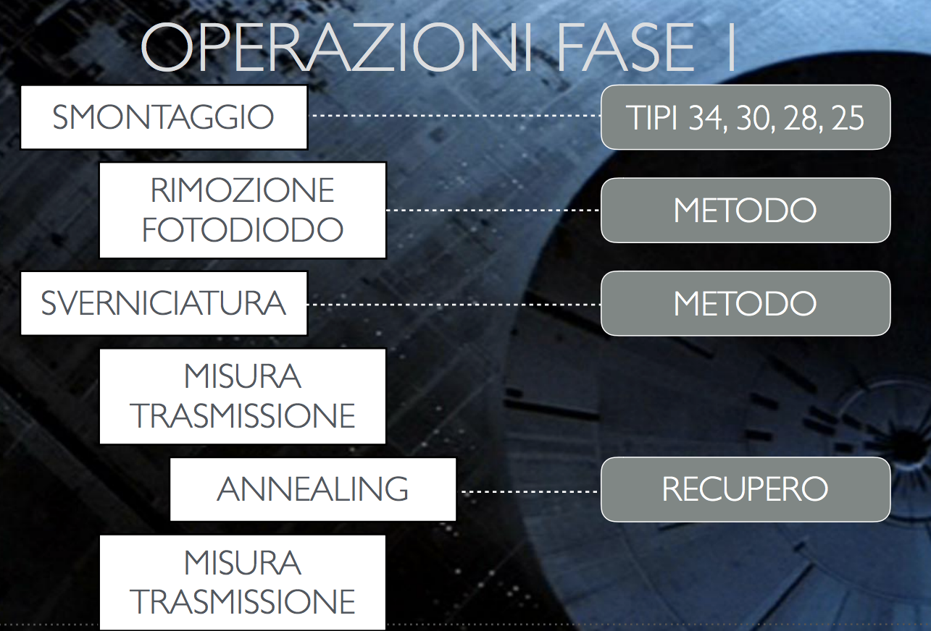
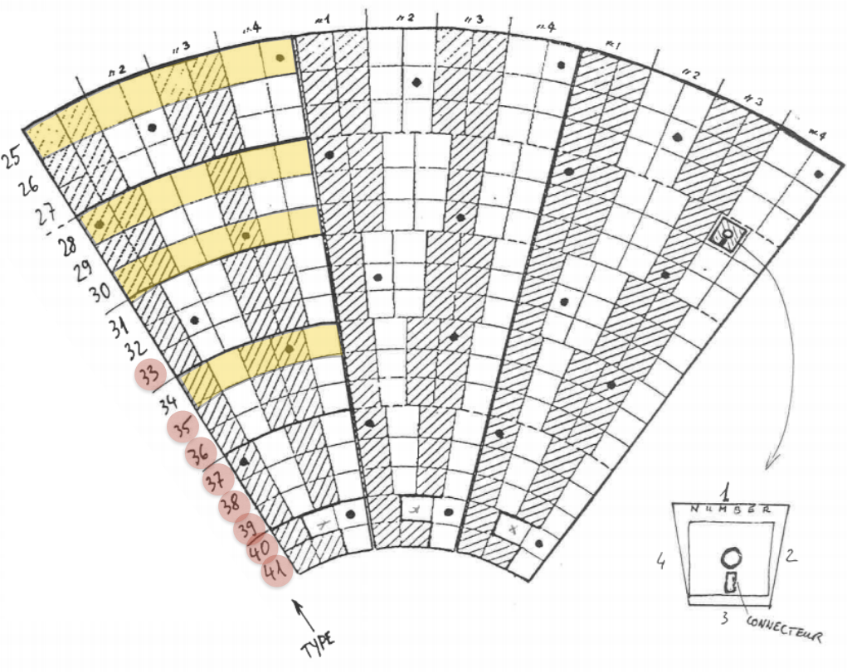
Crystal recovery phase I
G. Organtini
Extraction of few crystals of types 34,30,28,25 (successfully completed 14 crystals extracted)
Fotodiode and painting removal (ongoing at Lab 27)
Optical transmission measurement (Lab 27 CERN) (Next week)
Annealing (Lab 27 CERN) (Next week)
Optical transmission measurement (Lab 27 CERN) (Next week)

Slide 25
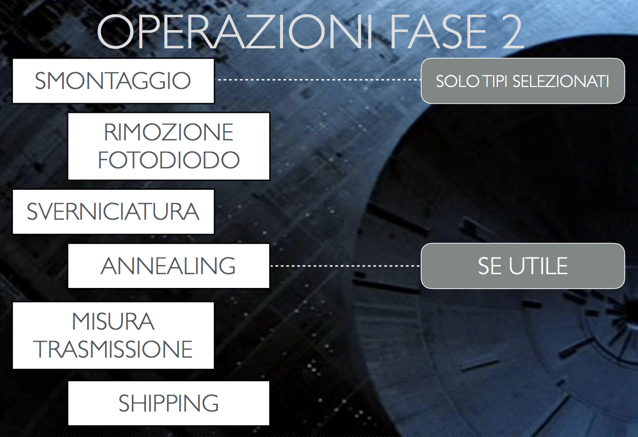

Crystal recovery phase II
FASE 2
FASE 1
G. Organtini
Massive extraction crystals types 34,30,28,25 (600 pcs)
Fotodiode and painting removal
Optical transmission measurement (Lab 27 CERN)
Annealing (if necessary) (Lab 27 CERN)
Optical transmission measurement (Lab 27 CERN)
Crystal recovery complete
by the end of July

Slide 26


Small angle calorimeter
BGO calorimeter cannot tolerate the Bremsstrahlung rate in the very central crystals
  Inner hole 4-8 cm radius
Small angle calorimeter aim to tolerate a rate of the order of 10 clusters per 40 ns
The only fast enough inorganic crystal is BaF2 with a fast PMT readout
  Test of the maximum tolerable rate and double pulse resolution with CAEN V1742 in July
Can a Cherenkov radiator be used?

Slide 27



SF57 based PADME SAC
  Need very fast signal several γ in 40 ns
  Minimum energy E_{γ} > 50 MeV
    No need for a high LY material
  Need very good time resolution (<300ps)
  Why not a Cherenkov radiator??
  25 blocks 20x20x200 mm³ already at LNF
    Obtained from a single SF57 ex OPAL ex NA62
  5 fast Hamamatsu PMTs already ordered
  SF57 in numbers
NA62 Inefficiency for electrons at BTF
  NA62 (from OPAL) SF57 block

Slide 28
International collaborations

Slide 29



Italy-USA collaboration
An international collaboration to study invisible decays search technique has been established with a the Cornell CESR experiment MMPS
Project has been financed by Italian and US foreign affair ministry
Interesting perspective to merge the two collaborations open
Dedicated workshop in November in Rome
Financed

Slide 30
More dark sector physics at PADME

Slide 31



The ATLAS excess of course…
Diphoton Excess through Dark Mediators
M. Pospelov et al. arXiv:1603.01256v2
ATLAS-CONF-2015-081

Slide 32





ALP physics at PADME
Phys rev D 38 11 1998
Limits on ALPs coupling to photons
Primakoff
Physics Letters B 753 (2016) 482–487
PADME can search for long living ALPs by looking for
1 γ + M²_{miss} final states
In the visible final state a->γγ all production mechanisms can be explored extending the mass range in the region of ~100MeV
The observables at PADME will be: eγγ or γγγ
BR(Z→γ+π⁰)≤5.2×10⁻⁵
Bremsstrahlung
Region of interest for PADME
Annihilation
arXiv:1512.03069
ALP decay to photons
+

Slide 33

Background to ALPs searches
Invariant γγ mass for all events collected by Ecal (2x10¹⁰ POT) with two in time clusters
Even without any selection cut PADME will be background free for masses above 40-50MeV
Main background e⁺e⁻→γγ, e⁺e⁻→γγ(γ) has a kinematic limit at M_{γγ} =24 MeV
Il background at higer masses is due to overlapping photons from different bremsstrahlung interactions.
  Can be suppressed by using the charged particle veto.

Slide 34




⁸Be anomaly
Observation of Anomalous Internal Pair Creation in ⁸Be: A Possible Indication of a Light, Neutral Boson PRL 116, 042501 (2016)
Not an ALP

Slide 35

Possible interpretation
“Evidence for a Protophobic Fifth Force from ⁸Be Nuclear Transitions”
J. L. Feng et al. arXiv:1604.07411

Slide 36


⁸Be anomaly at PADME?
??PADME ??
PADME has the unique chance of producing X in resonant mode BTF at 270 MeV
  Can profit of much longer beam pulse switching SLED compression off (bunch length up to 4μs)
  Expected precision in CM energy scan 40 KeV
Radiative BhaBha background to be understood could be the limiting factor
How many positrons do we need? Contact with authors to make an estimate for the resonant production cross section

Slide 37
PADME approval status

Slide 38

Technical Proposal
Draft
Draft TP submitted in October to INFN management
Experiment baseline layout description
Some detector have a baseline and backup solution
Some detectors still need a detailed study
Cost estimate with 10-20% uncertainties

Slide 39

PADME schedule
Technical run in late 2017 and first physics run in 2018 are foreseen

Slide 40

Approved financial plan 2016-2018
PADME has been financed inside the INFN “What Next” program
Budget for 2016 already secured by INFN

Slide 41
Conference talks 2016
P. Valente, “Dark photon searches in positron annihilations with the PADME experiment” LEPP 2016, Mainz, April 2016, invited talk
M. Raggi, “The PADME experiment at LNF” Dark Sector 2016, invited talk
V. Kozhuharov, “New projects on dark photon search”, Vulcano Workshop
G. Piperno, “The PADME experiment at LNF”, IFAE 2016, poster
G. Piperno, “The PADME experiment at LNF”, Frascati Spring School - LNF - May 9, 2016
F. Ferrarotto “Searching for dark photons with the PADME experiment at the DAFNE LINAC”, Rencontres de Blois, June 2016
S. Fiore, “The PADME experiment at LNF” Beach 2016, George Mason University, June 2016
M. Raggi, “The PADME experiment at LNF”, ICHEP 2016, Chicago, August 2016
M. Raggi, “The PADME experiment at LNF” invited seminar, LAPP, Annecy
M. Raggi, “The PADME experiment at LNF” invited seminar, Cambridge University

Slide 42
PADME members
Reserchers
INFN Lecce
G. Chiodini 25%
S. Spagnolo 20%
INFN Lecce and Università Salento
A. Caricato 20%
M. De Feudis (Dott.) 100%
G. Maruccio (Professore) 20%
M. Martino (Professore) 20%
A. Monteduro (Dott.) 20%
INFN LNF
(Divisione Ricerca)
M. Raggi 30%
R. Bedogni 10%
F. Bossi 20%
R. De Sangro 20%
G. Finocchiaro 20%
M. Palutan 20%
G. Piperno (A.d.R.) 100%
B. Sciascia 20%
T. Spadaro 20%
(Divisione Acceleratori)
B. Buonomo (20%)
L. Foggetta (20%)
A. Ghigo (10%)
INFN Padova
U. Dosselli 20%
INFN & Sapienza Roma
P. Valente 50%
F. Ferrarotto 70%
E. Leonardi 40%
S. Fiore 20%
G. Organtini 30%
University of Sofia
V. Kozhuharov (Università Sofia) 50%
G. Georgiev (Università Sofia) 50%
Debrechem Institute for Nuclear Research
Dr. A. Krasznahorkay, ……
New
Technical support
INFN Lecce
G. Fiore (Tecnico e progettista) 30%
INFN Lecce and Università Salento
M. Corrado (Tecnico) 20%
C. Pinto (Tecnico elettronico ) 20%
INFN LNF
(SPAS)
C. Capoccia (Progettista meccanico) 50%
E. Capitolo (Progettista meccanico) 50%
(SELF)
G. Corradi (Progettista Elettronico) 30%
(Servizio Vuoto)
V. Lollo 20%
Frascati Officina meccanica
3 mesi uomo 2 sem (2016)
INFN Roma
Supporto per smontaggio Ecal L3 20%
Supporto per elettronica di readout 20%

Slide 43
Conclusions
The PADME construction phase is just starting
  Magnet delivered at LNF in December
  Prototype diamond target tested (20x20mm²x50μm thickness)
  First calorimeter test-beam with 3x3 crystal matrix
  New test in July with 5x5 matrix
Approval status
  Experiment approved by INFN at the end of 2015
  Crystals from L3 experiment obtained dismantling of L3 end-cap started
  2016-2018 budget already secured in INFN CSN1 by “What Next” program
New physics channels for PADME identified (ALPs), and much more to explore
Dr. A. Krasznahorkay and collaborators of the Institute for Nuclear Research, Hungarian Academy of Sciences asked to join PADME
  Defining responsibility and preparing an agreement between Institutions

Slide 44

Join the dark side!
Nearest recruitment station: INFN Frascati

Slide 45
Spare slides

Slide 46

PADME Geant4 simulation
Positron veto
High energy
GEANT4 MC status
e⁺ on target simulated in GEANT4
  Dedicated MC e⁺e⁻→γγ(γ) CalcHEP
Dedicated A’ annihilation generator
Need fast simulation need 10¹¹ evt
  Showers in the SAC not simulated
  Beam dumping not simulated
Positron beam
Positron veto
Low energy
Target
Calorimeter
Small
angle
Veto
Realistic treatment of the beam
  Energy spread, emittance, micro-bunching, and beam spot
  Final geometry for the detectors implemented
    Measured magnetic field map
  Still to be implemented:
    Passive material, vacuum chamber
    Detector digitization except the calorimeter clustering

Slide 47


Main backgrounds
Signal e⁺e⁻->γA’
BG SM annih. e⁺e⁻->γγ(γ)
BG SM Brems.: e⁺N->e⁺Nγ
M_{miss}=M_{A’}
1 lost e⁺
P⁴_{γ},t
1 lost γ
γ
γ
γ
γ
P⁴_{e+},t
e⁺
e⁺
e⁺

Slide 48



Main backgrounds
Signal candidate selection
Just one cluster in Ecal
30 mrad < θ_{Cl} < 65 mrad
No in time tracks (±2 ns) in the charged veto system
No extra gamma with E_{γ}>50 MeV in ±2ns in the SAC
Cluster Energy in: E_{min}(M_{A’}) < E_{Cl} < E_{max}(M_{A’}) MeV
Invariant missing mass in: M_{A’}² ± σ(M_{miss2})
e⁺
γ
e⁺
γ
N
e⁻
(γ)
γ
e⁺
γ

Slide 49


Background estimates
Data M_{miss}²
e⁺e⁻→ γγ(γ)
e⁺N→e⁺Nγ
Pile up
BG sources are: e⁺e⁻→γγ, e+e-→γγ(γ), e+N→e+Nγ, Pile up
Pile up contribution is important but rejected by the maximum cluster energy cut and M_{Miss2}.
Veto inefficiency at high missing mass (E(e+)≃ E(e+)beam)
  New Veto detector introduced to reject residual BG
  New sensitivity estimate ongoing

Slide 50


PADME-invisible decay sensitivity
Based on 2.5x10¹⁰ fully GEANT4 simulated 550MeV e+ on target events
  Number of BG events is extrapolated to 1x10¹³ electrons on target
  Using N(A’γ)=s(N_{BG})
  δ enhancement factor δ(M_{A’}) = σ(Α’γ)/σ(γγ) with ε=1
PADME 2 years of data taking at 50% efficiency with bunch length of 40 ns
10¹³ EOT = 6000 e⁺/bunch × 3.1⋅10⁷s ⋅ 49 Hz
PADME can explore in a model-independent way the favourite by (g-2)_{μ} band up to M²_{A’} = 2m_{e}E_{e+}
E_{e+}=550 MeV: M_{A’} < 23.7 MeV/c²
E_{e+}=1 GeV: M_{A’} < 32 MeV/c²
  New estimate with optimized detector layout public by the summer!

Slide 51


PADME TDAQ
Readout based on digitizers CAEN V1742
~1000 channels
~33 FADC boards involved
Trigger and clock distribution to the 33 boards
Online FADC zero suppression (L0)
FADC boards synchronization to few 100ps needed

Slide 52



Calorimeter test beam
Digitized signal are acquired with CAEN V1742
Raw signal converted into charge integral in each crystal
Total charge spectrum obtained by summing over all crystals

Slide 53

Future projects LigthDAMS
PADME presented a project to study the possibility of a dump experiment at Frascati
  Visibile decays “PADME dump” and “invisible” decay BDX like experiment
  Deliverables: MC study and test beam to asses the background level into a “short dump” electron beam dump
preliminary

Slide 54



P348 to NA64 experiment
P348 proposal submitted to SPSc approved as an experiment: NA64
New document presented at SPSc, and arXiv:1604.08432
Obtained 4 weeks of running during October-November 2016 aiming to 10⁹-10¹⁰ e⁻ on target
ArXiv:1411.1404
http://na64.web.cern.ch/
Single event sensitivity for invisible decays not accounting dark photon acceptance in original proposal ArXiv:1312.3309
Recent revision reduced the SES by factor 30 but still significant in the region of interest for PADME even with 10⁹ electrons (but 0 background…), see also ArXiv:1411.1404

Slide 55


High energy positron production
10⁷ simulated 510 MeV e⁻
1.7 x₀
e⁻
e⁺
Present BTF target, 1.7 x₀
88%×730 MeV=640 MeV (M_{A’}=25.6 MeV),
  With a 0.5 x₀ target, reduce photons by 2 orders of magnitude wrt 1.7 x₀
  Of course also much increased high-energy electrons, mostly sweeped away by selecting dipole

Slide 56




Increasing linac beam pulse length
Diluting the same number of positrons in a longer pulse is a plus from the point of view of pile-up
Main limitation coming from the SLac Energy Doubling system (SLED) used to reach higher energy in our linac
Uncompressed RF field 4.5 μs long, but with a 1/9 lower accelerating field
Going off the flat top impacts the energy spread
New pulser capable of up to 1 μs pulses under consideration
500 ns pulses with 0.5% energy spread achieved at SLAC
F.-J. Decker et al.
SLAC-PUB-7214 (1996)

Slide 57
Main background sources
Geant4 simulation accounts for:
  Bremsstrahlung, 2 photon annihilation, Ionization processes, Bhabha and Moller scattering, and production ofδ-rays.
  Custom treatment of e⁺e⁻→γγ(γ) using CalcHep generator.
e⁻
A’
Signal:
e⁺e⁻→γ +missing mass (A’)
γ
e⁺
Backgrounds
e⁻
e⁻
γ
γ
γ
γ
e⁺
e⁺
γ
γ
γ
e⁺
e⁺
+1 electron
+1 γ
+2 γ

Slide 58



γγ normalization
2 clusters, 100 MeV < E₁+E₂ < 400 MeV

Slide 59


Zoom on (high energy) positron veto
calorimeter
small angle
veto
veto

Slide 60
JRA HADTECH project
Collaboration started with MAMI @ Mainz in a Horizon 2020 Joint Research Activity
  Niklaus Berger (Mainz) PI project is a part of HadronPhysicsHorizon (HPH)
PADME group of LNF, RM1, Sofia e Lecce are involved in a sub-task
  “Diagnostics tools for high current beams for beam dump experiments”
  Studies for use of the gas target at PADME
  Design suitable diamond detector and readout electronics. Validate the readout chain and complete system with a radio-active source (Lecce)
  Study use of the detector for the MESA beam dump experiment (Mainz)
  Install the detector inside the DAΦNE extracted beam line and provide the trigger and DAQ system (LNF)
  Operate the detector and perform a beam intensity scan up to 10¹⁰ particles/s (LNF, Lecce, Sofia)

Slide 61


Dark Higgs physics at PADME
Limits on Dark Higgs Models
Dark Higgs Production at PADME
Depending on dark Higgs dark Photon masses:
2MA’< Mh’ dominant A’h’->A’A’A’->6 leptons
2MA’> Mh’ dominant A’h’->A’ Inv.->2 leptons
A) In PADME just count the number of in time 6 leptons events with zero total charge and sum of the momenta <E_{beam}

Slide 62




Invisible A’ model dependence
Exclusion with Kaons
Scattering exclusion
Explicitly depends on χ mass
In models assuming that the dark photon couples to SM through kinetic mixing ε_{q}≠0 K±→π±νν can be used to constrain K±→π±A’
Z_{d}=A’
Depending on how the model is built the limit can change significantly for example allowing the mass mixing with SM Z.
PhysRevD.89.095006

Slide 63

PADME in the new BTF

