Slide 1
CERN Site Engineering - Opportunità nell’ingegneria civile al CERN
Dr. Ing. Luigi Scibile
Head of the Site Engineering Group
Site Management and Buildings Department
ROMA 28th June 2016

Slide 2
CERN/SMB-SE – Civil engineering
Introduction
Existing CERN Infrastructure and brief history
Scope of work
Organization: Services and projects.
Site planning and development
Examples of planned projects
Opportunities at CERN for Consultancy firms & Contractors

Slide 3
Existing CERN Infrastructure and brief history
CERN/SMB-SE – Civil engineering

Slide 4
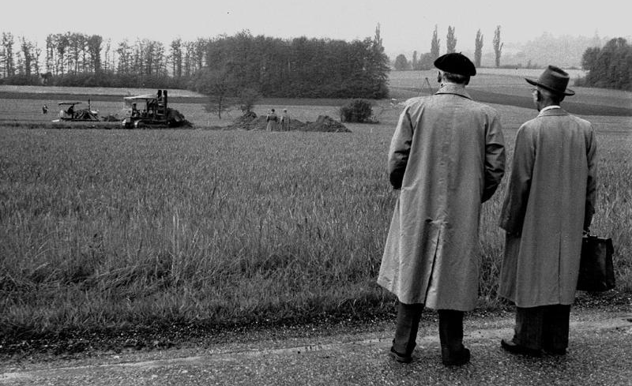
1954 – Day 1

Slide 5
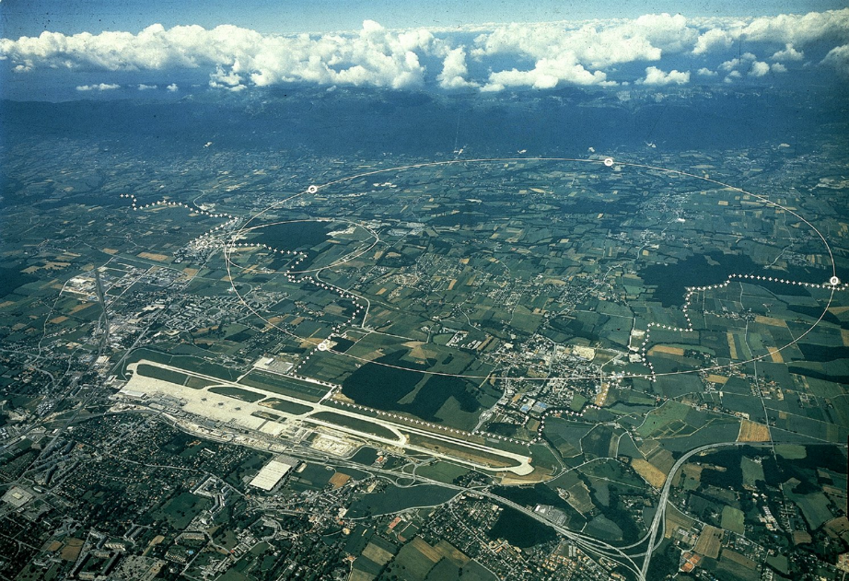
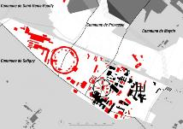
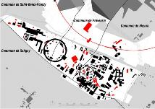
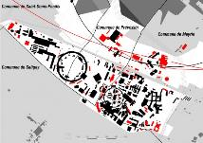
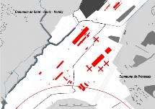
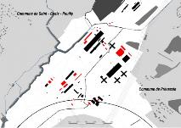
Two sites with a story
MEYRIN
1950-60
1960-75
1975-85
1985-10
PREVESSIN
1970-80
1980-10

Slide 6
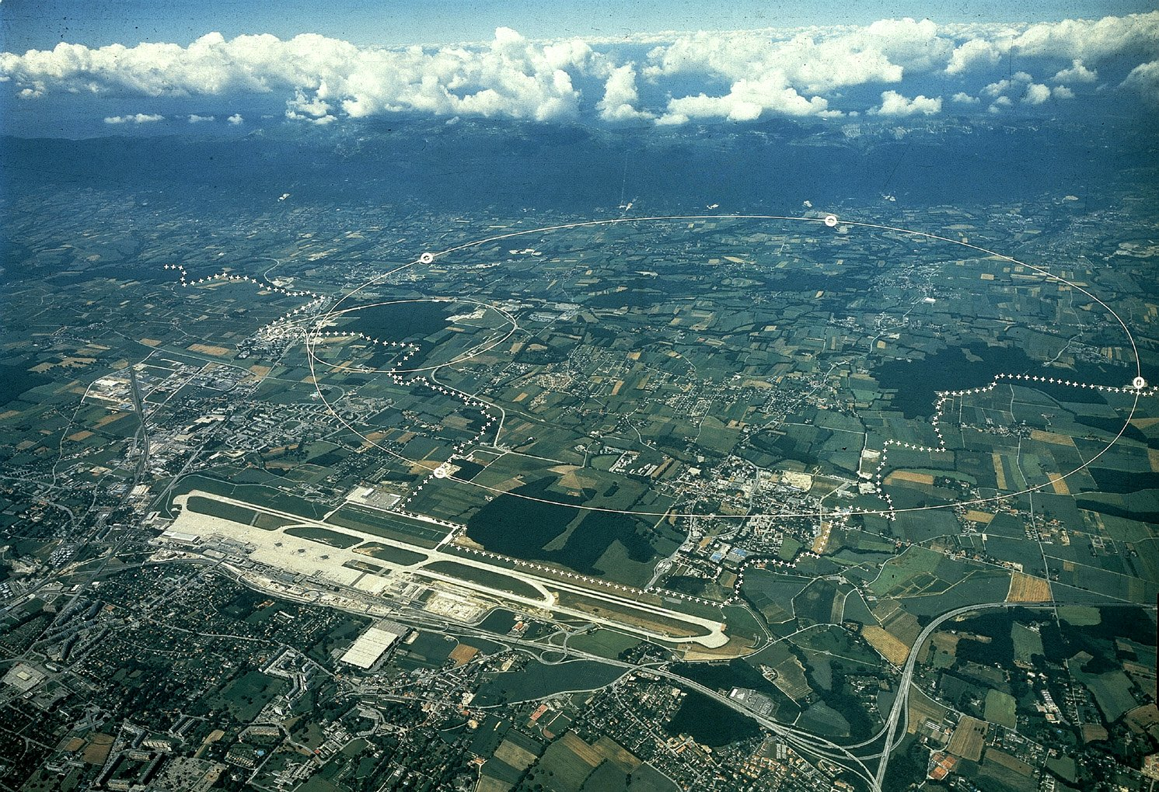
CERN Area
Prévessin (FR) Campus
Meyrin (CH) Campus
(it extensds in French
LHC
Border
Geneva Airport

Slide 7
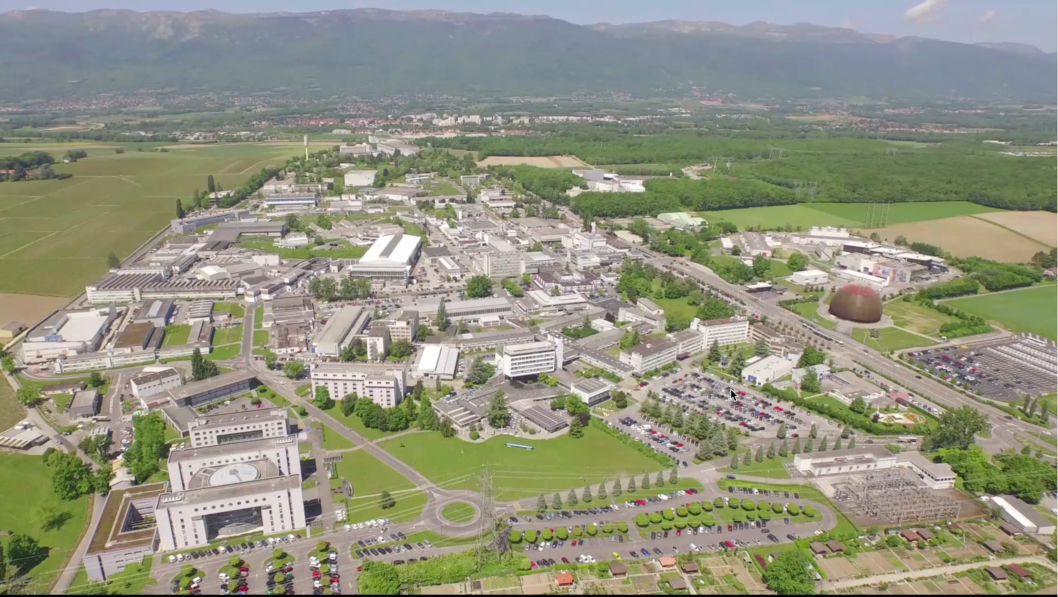
Meyrin Site

Slide 8
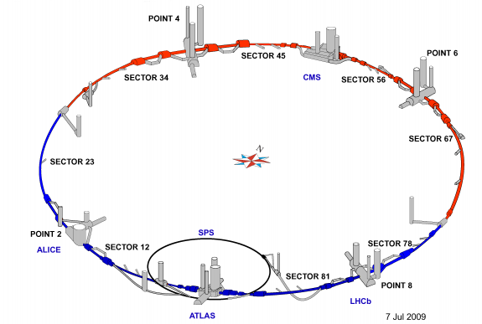
Current underground infrastructure
Tunnels:
27 km long
100 m approx. below grade
̴ 60km total length of tunnels

Slide 9
CERN Accelerator Complex
ILO event, Rome 28.06.2016, L. Scibile, EDMS: 1702197

Slide 10
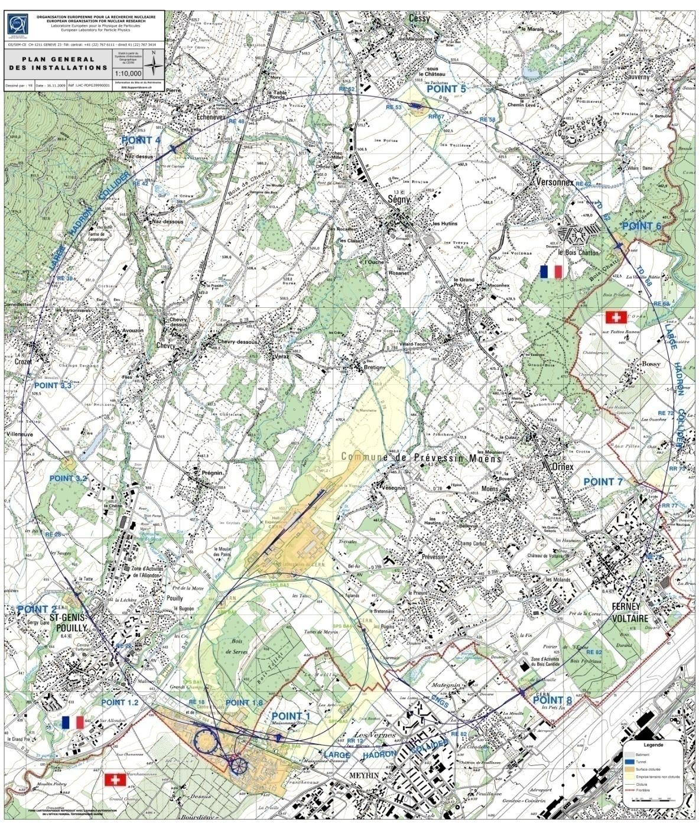
Overall key figures
GENERAL LAYOUT
Two main sites :
Meyrin (CH-FR) : 80 hect.
Prévessin (FR) : 83 hect
15 satellite sites
Number of buildings : ̴ 674
10m² up to 20.000m² , 425,000 m² of surface
60% of the buildings are 30+ years old
Tunnel lengths : ̴ 60 km
30 km of roads
1000 km of buried services
Total CERN fenced territory : 208 hect.
Total CERN unfenced territory : 418 hect
fenced territory - CH: 51 hect.
unfenced territory - CH : 59 hect.
fenced territory - F : 157 hect.
unfenced territory - F: 359 hect.
494 hostel rooms in Meyrin Site
̴ 2300 Staff
̴ 700 Fellows and Paid Assoc.
̴ 10’000 Users
----------------------------------------------
9’500 people every day at CERN
ILO event, Rome 28.06.2016, L. Scibile, EDMS: 1702197

Slide 11
CERN – Meyrin Layout (surface buildings)
Age of buildings
FRANCE
SWISS
ILO event, Rome 28.06.2016, L. Scibile, EDMS: 1702197

Slide 12
CERN – Prévessin Layout (surface buildings)
Age of buildings
FRANCE
ILO event, Rome 28.06.2016, L. Scibile, EDMS: 1702197

Slide 13
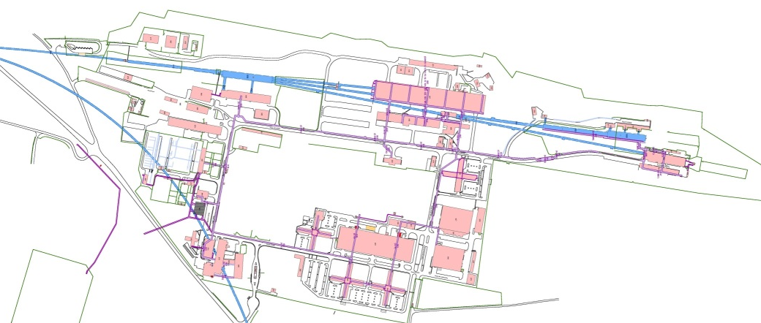
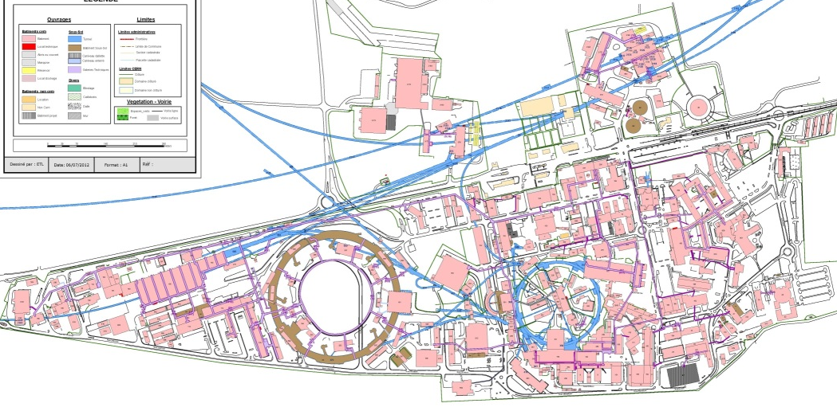
CERN – Meyrin and Prévessin Layout
(with tunnels and galleries) – Explaining the “chaotic” development of the sites
ILO event, Rome 28.06.2016, L. Scibile, EDMS: 1702197

Slide 14
Site Engineering Group
The Site Engineering Group is responsible for :
Design of all new buildings & civil engineering structures on CERN Site. Feasibility studies more often done in-house with outsourced consultancy services for more detailed design.
Project Management for execution (with Consultants for larger projects)
Maintenance of all buildings and underground structures
Renovation Works
HVAC & Electrical installation and maintenance for ‘tertiary’ buildings
Patrimony data management
Group consists of approximately :
10 engineers/architects
10 draughtsman/designers
25 technicians
Annual Group Budget approximately
50+MCHF for Projects & Operation / Renovation Works

Slide 15
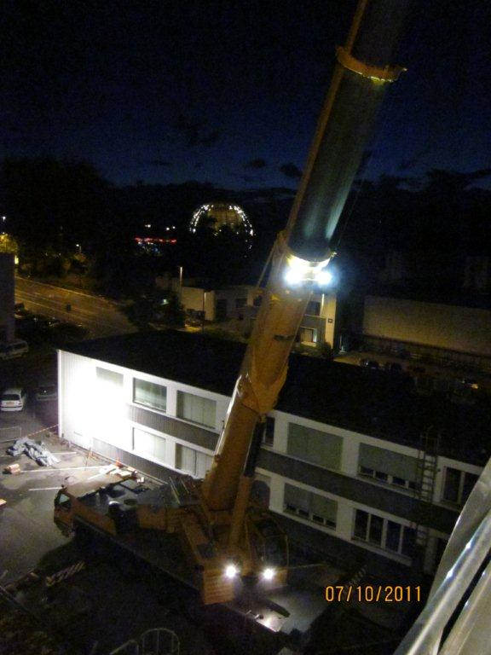
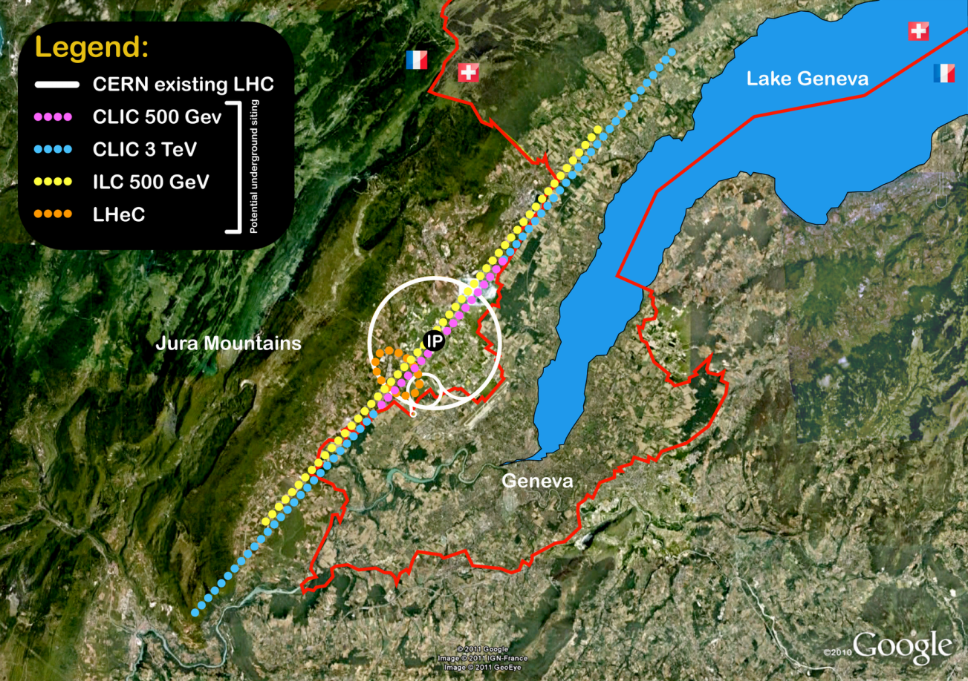
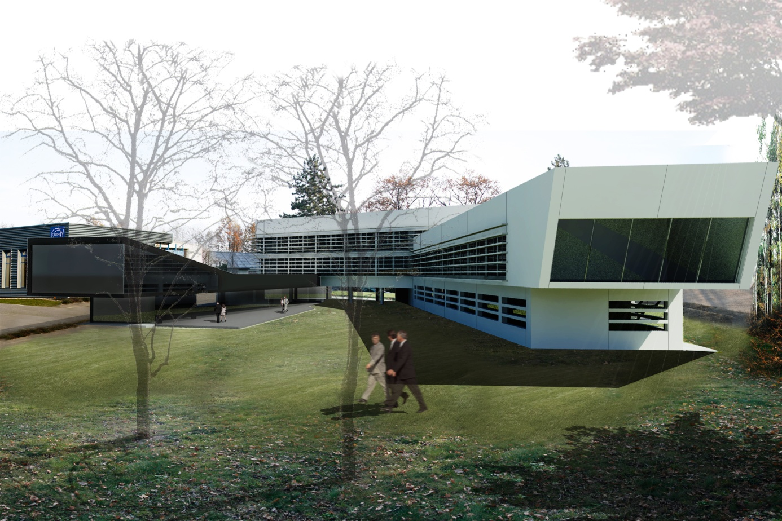
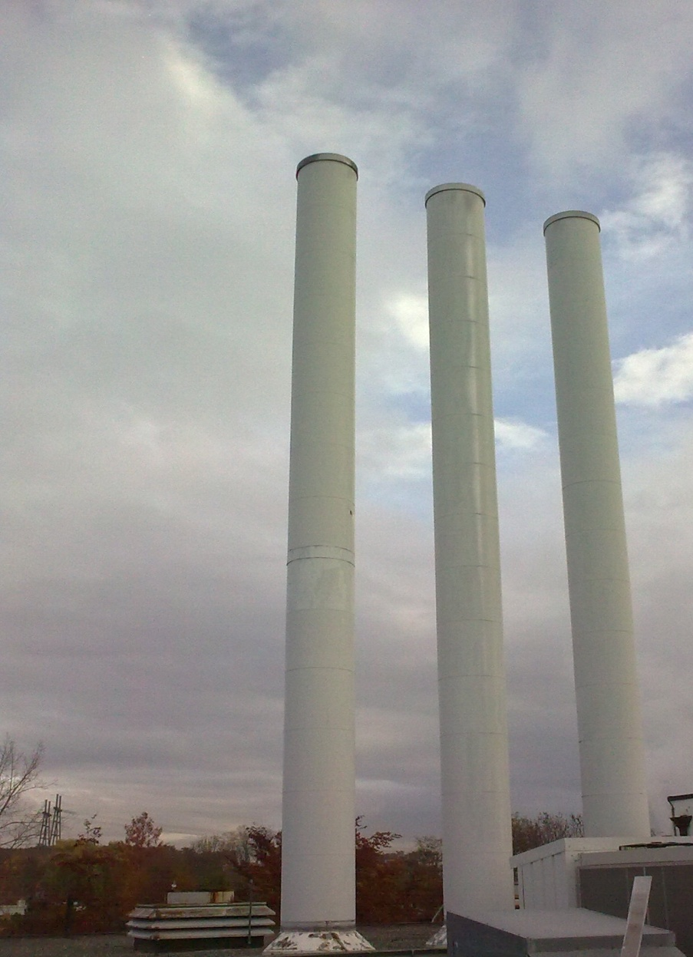
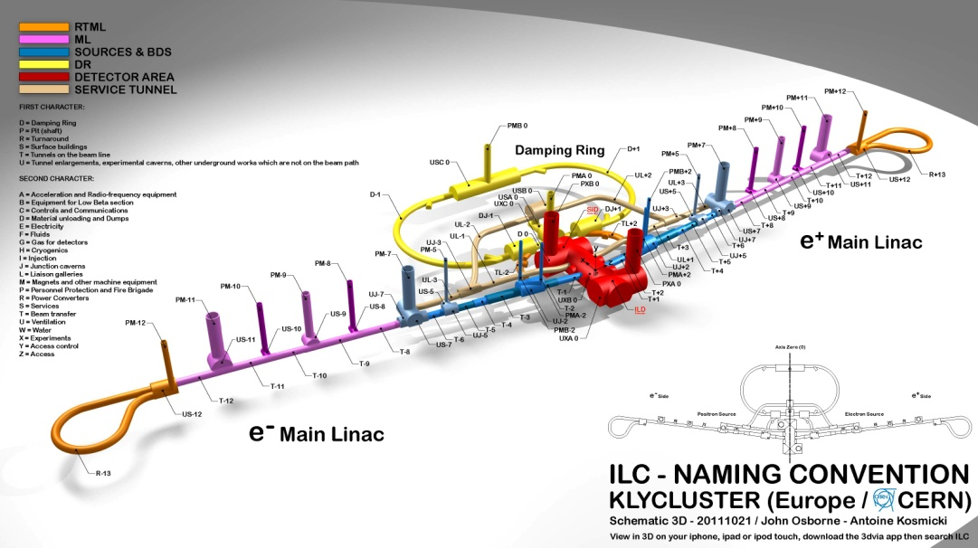
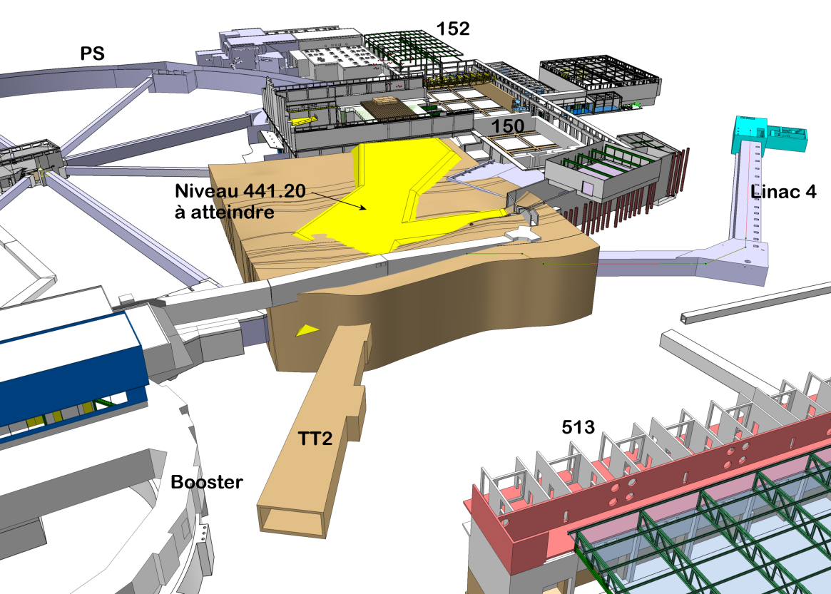
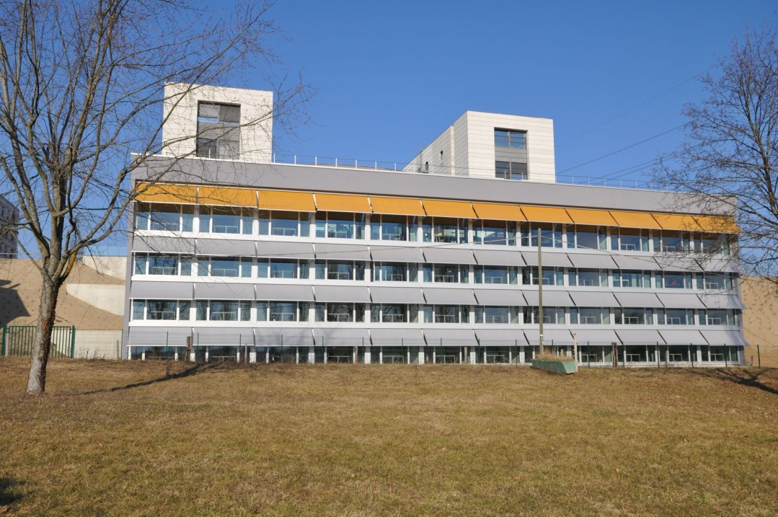
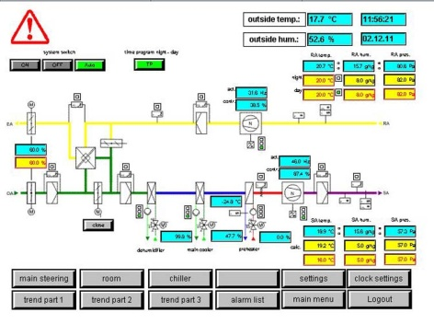
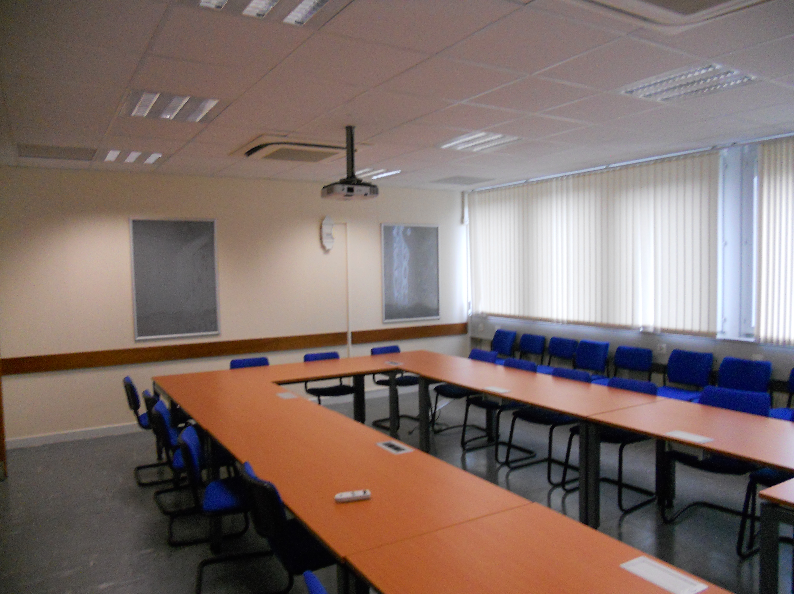
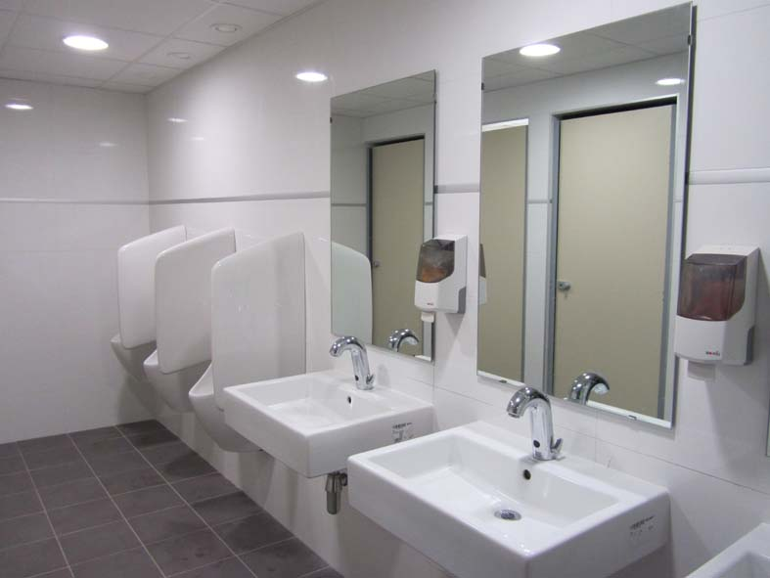
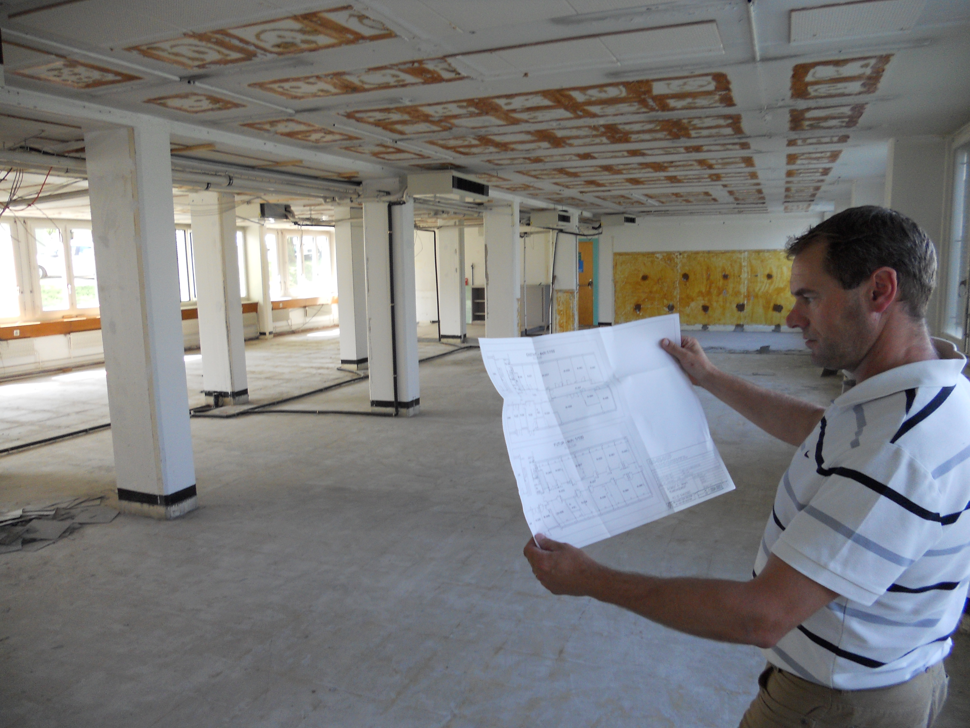
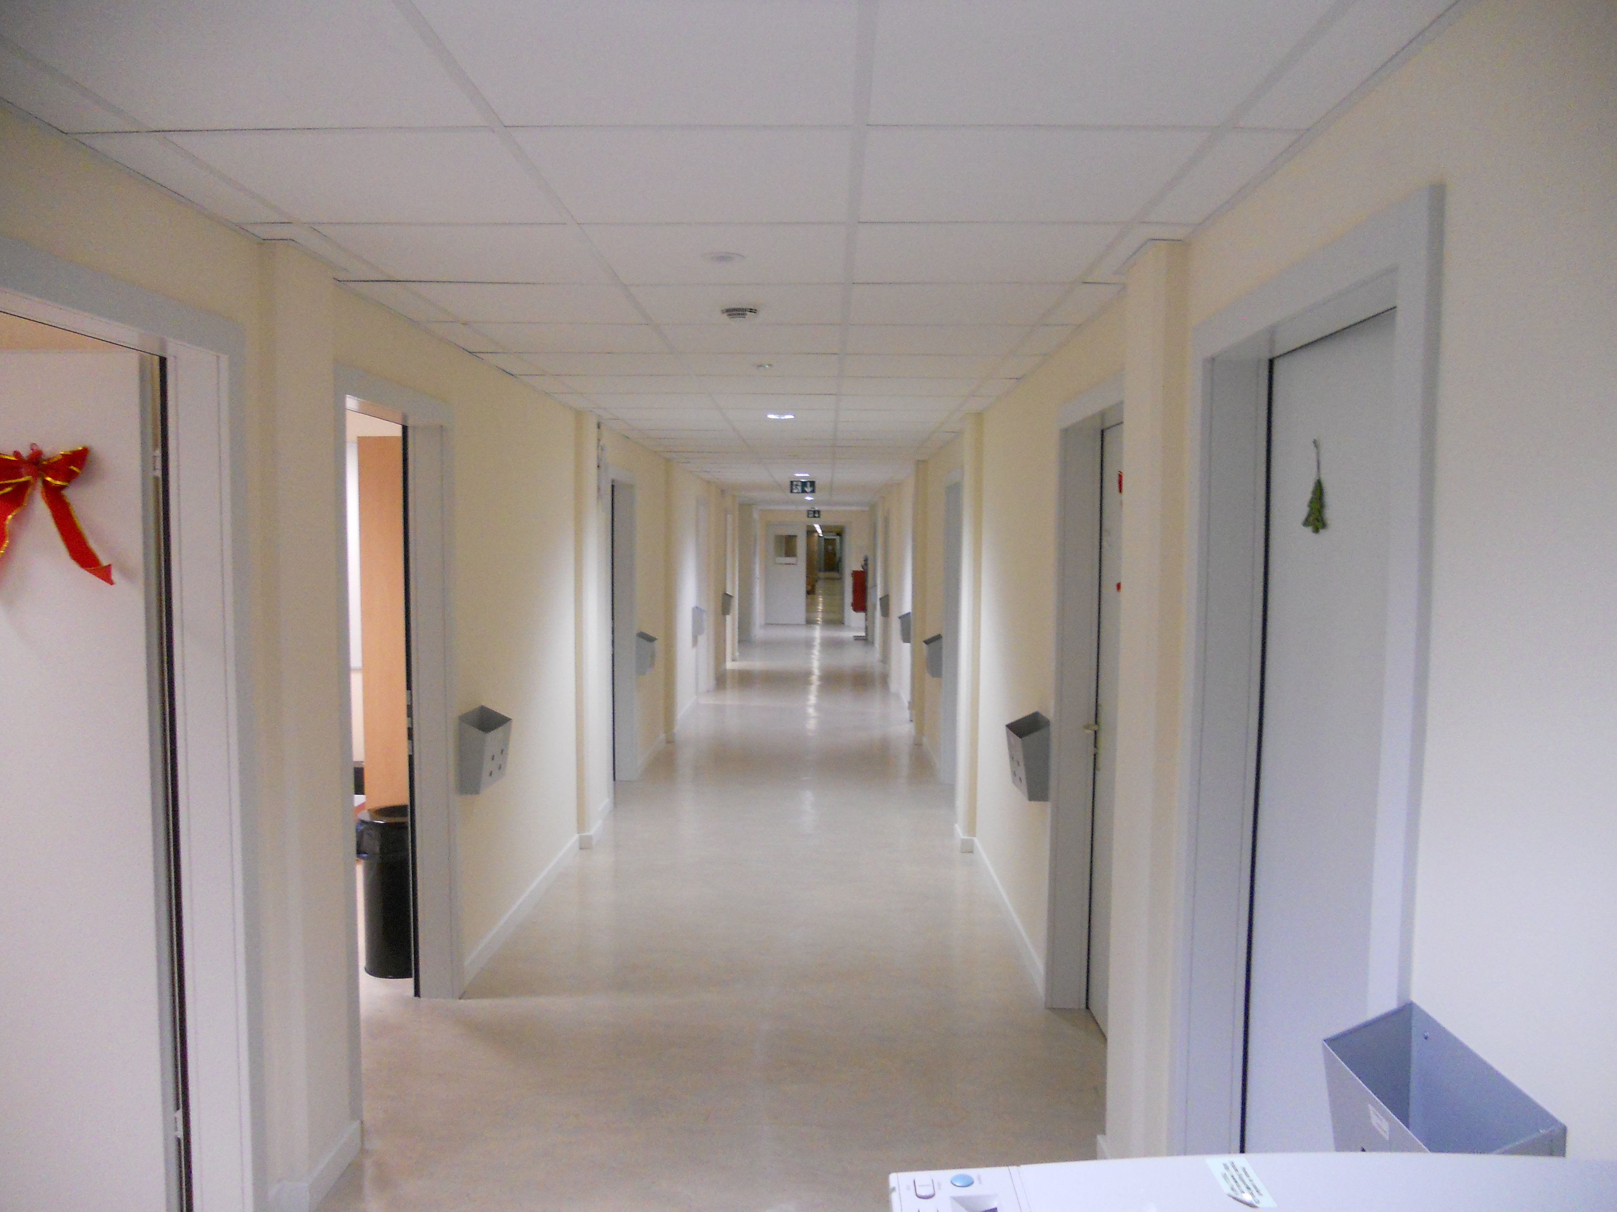
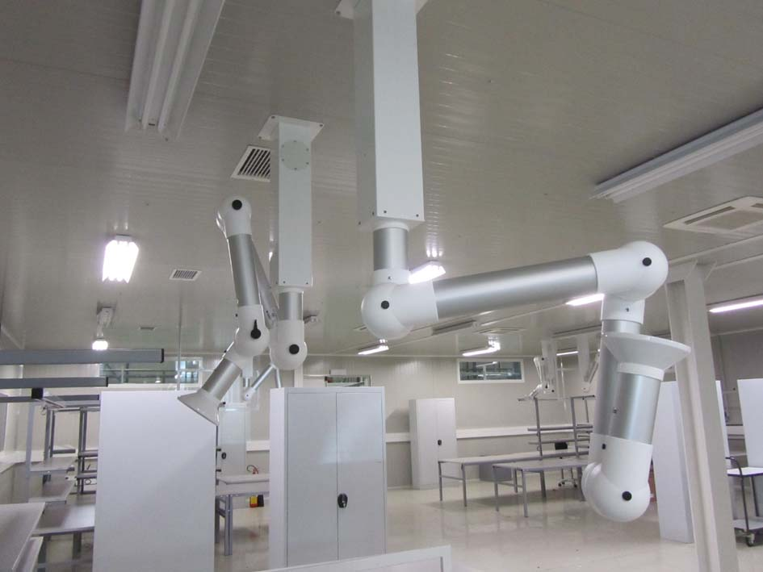
Group scope
to large projects
COMPLEXITY
and Operation
& Maintenance
From Design
to construction
TIME
From minor works

Slide 16
Organization
Service oriented approach for
Maintenance interventions
Small works
Design studies
Patrimony
Project oriented approach for
Large renovations (consolidation program)
New buildings or change of usage
Underground civil engineering
Tools:
- InforEAM
- ServiceNOW

Slide 17
Services 1/2
Services
Building, tunnels and road maintenance, repairs, minor works
HVAC maintenance and works for tertiary buildings
Electricity maintenance and works for tertiary buildings
Patrimony and GIS
CERN district heating operation and maintenance
Barracks management and rental
Engineering support
Green spaces
Service Desk
Access to most the group services is via the Service Desk and it is integrated in the ServiceNow tool: https://cern.service-now.com/
In the last 12 months, ~8000 incidents and ~5000 requests were carried out.

Slide 18
Services 2/2
600
320

Slide 19
Projects
Machine projects (linked to the functioning of the accelerator)
Tertiary projects (linked to the functioning of the site)

Slide 20
Some examples of recent projects
Projects

Slide 21
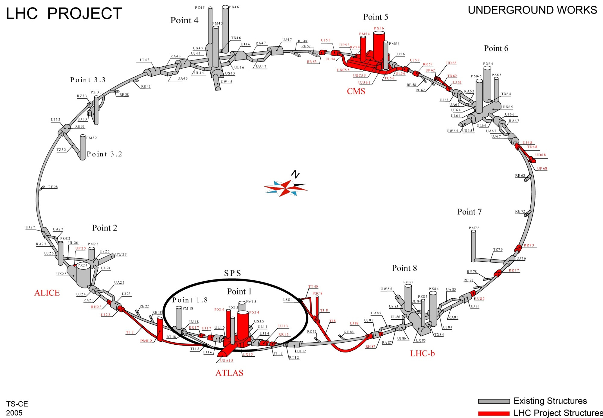
LHC Project

Slide 22
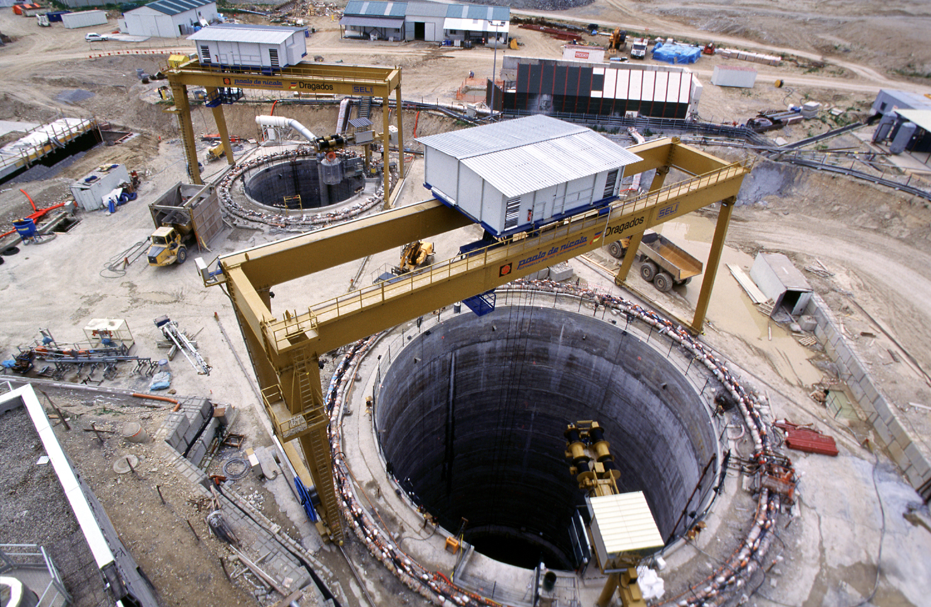
LHC – Point 5
Shafts 12.1m and 20.5m diameters, both approx. 100m deep
2001

Slide 23
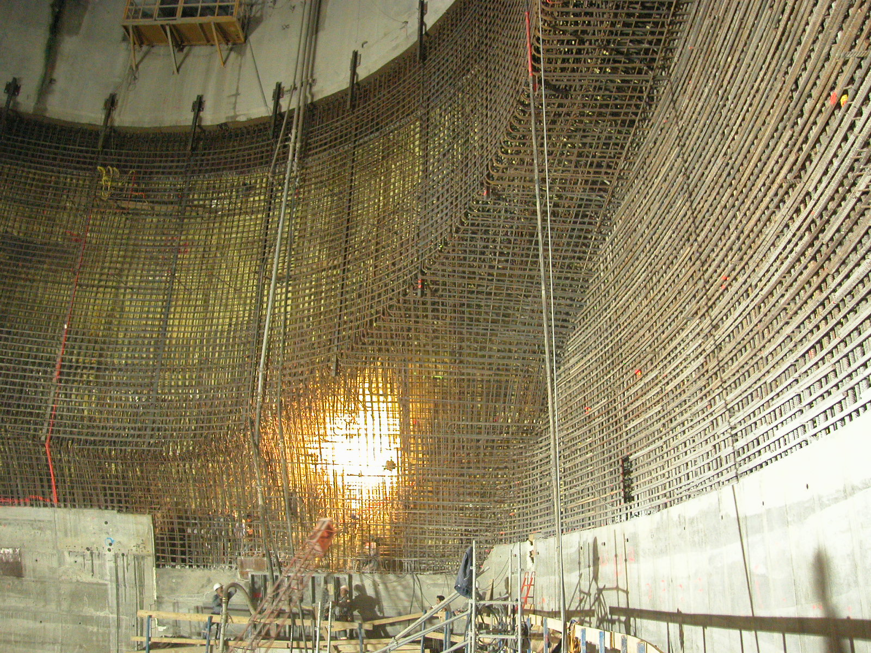
2004

Slide 24
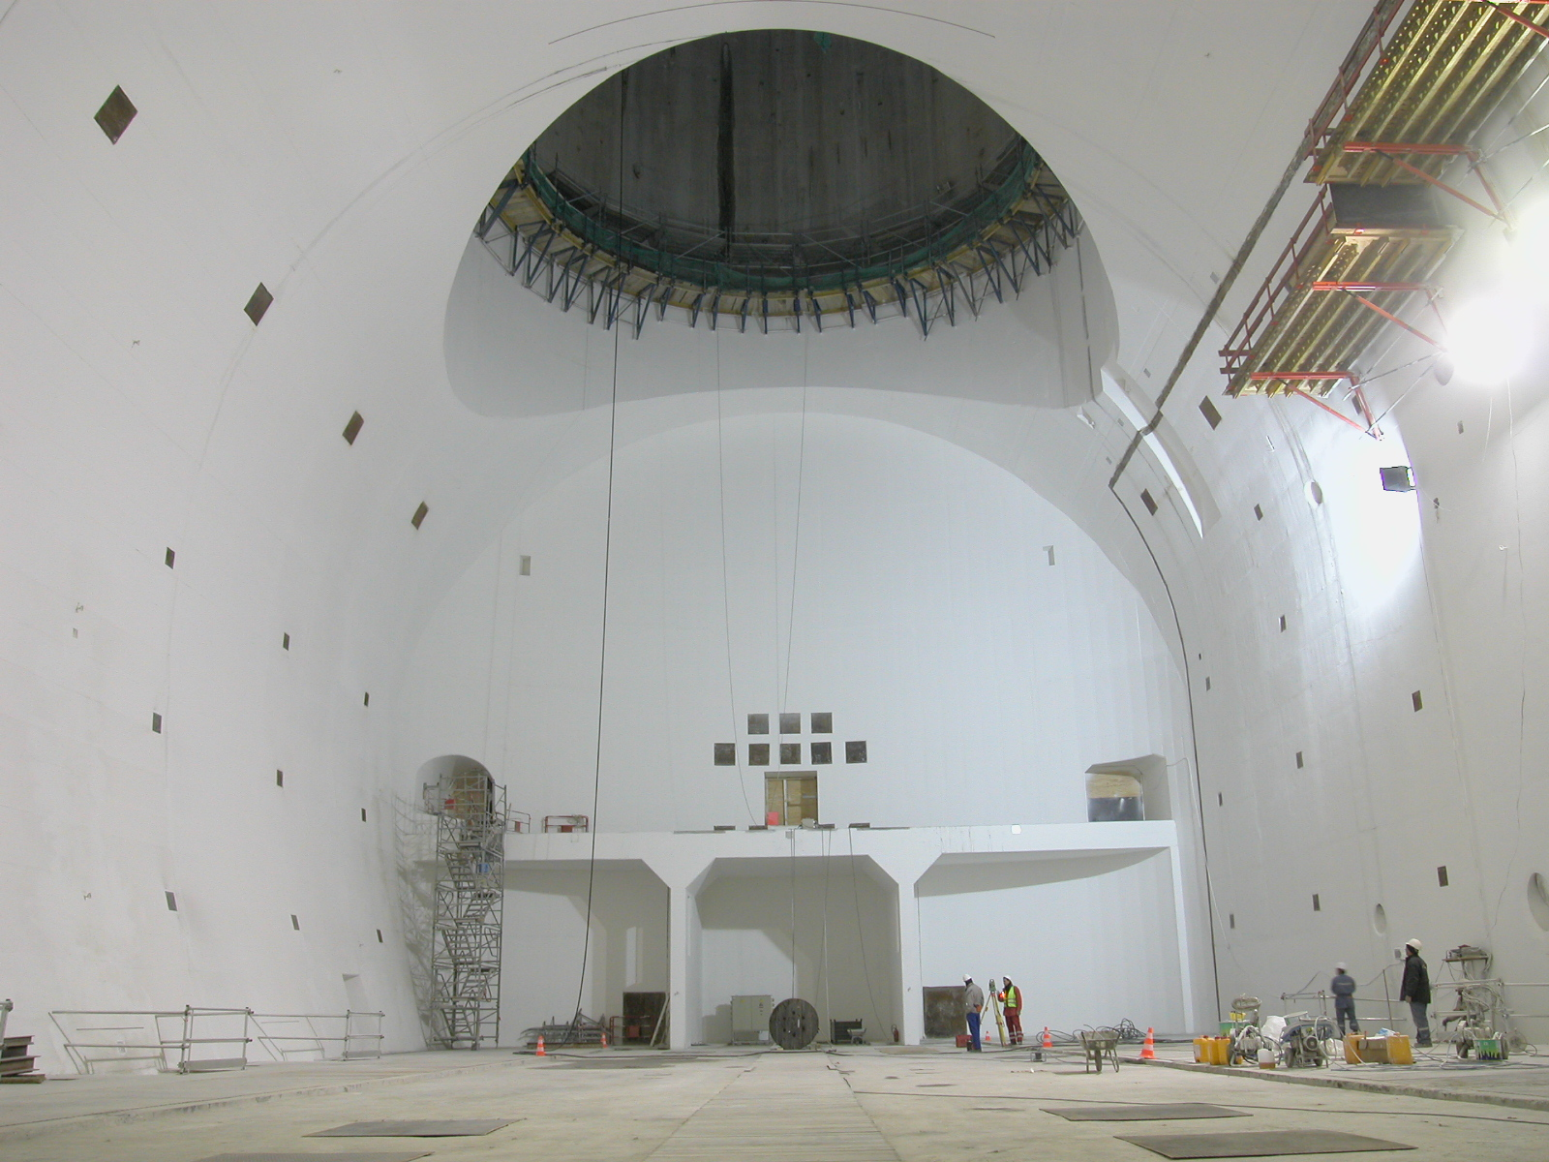
CMS cavern 53m long, 27m wide by 25m high
2005

Slide 25
Building 42
Major achievements 2011
Tertiary Building - officies
Surface gross area : 3200 m2
Delivered : february 2013
Notes:
25

Slide 26
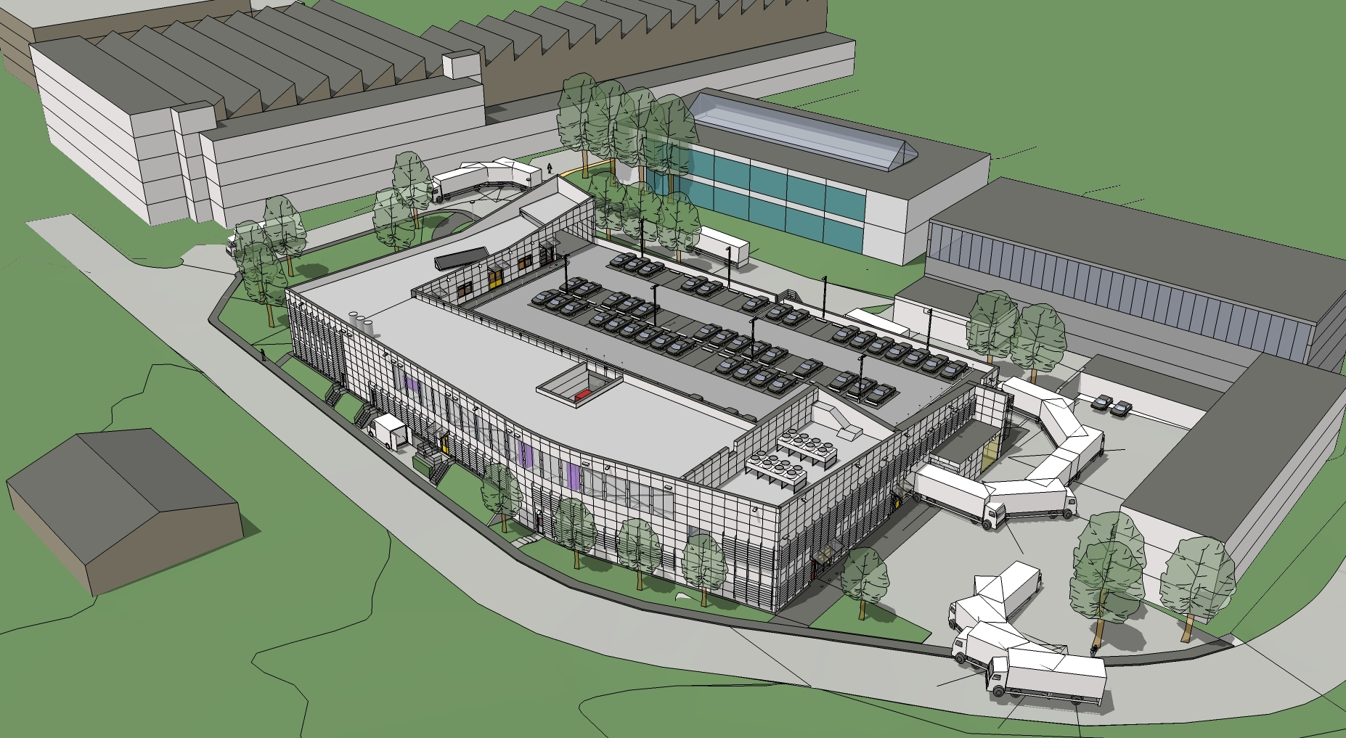
Recent Projects – Building 107
GS-SE Review 2011
Bld 107 : New Chemical Surface Treatment Facility
Industrial Building
Surface finishing
Printed Circuit Boards
Electronic Modul design
̴ work in progress

Slide 27
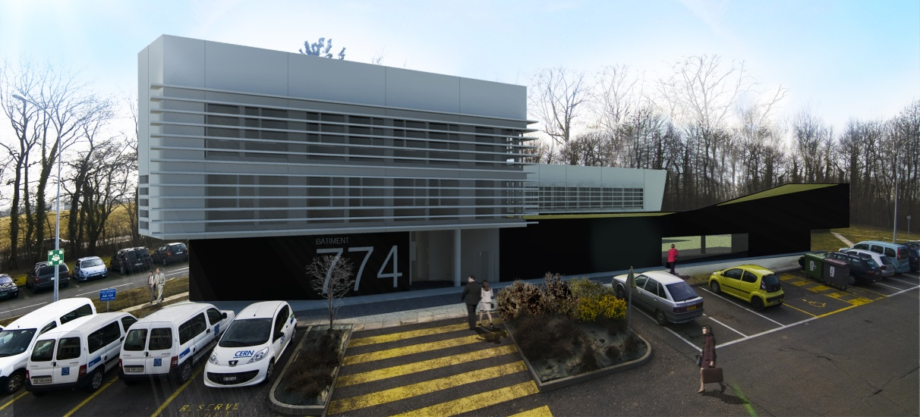
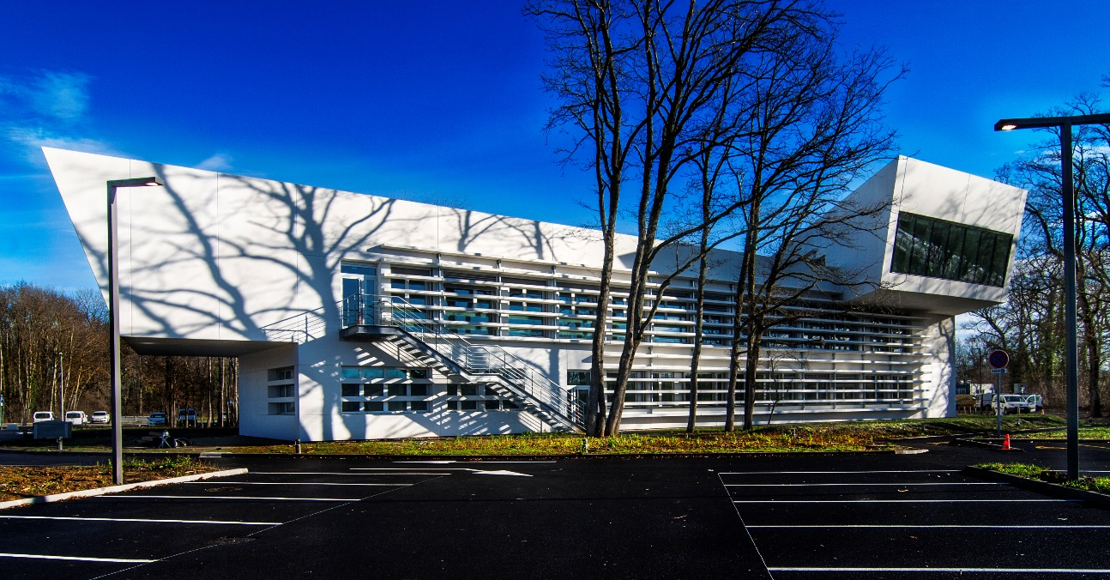
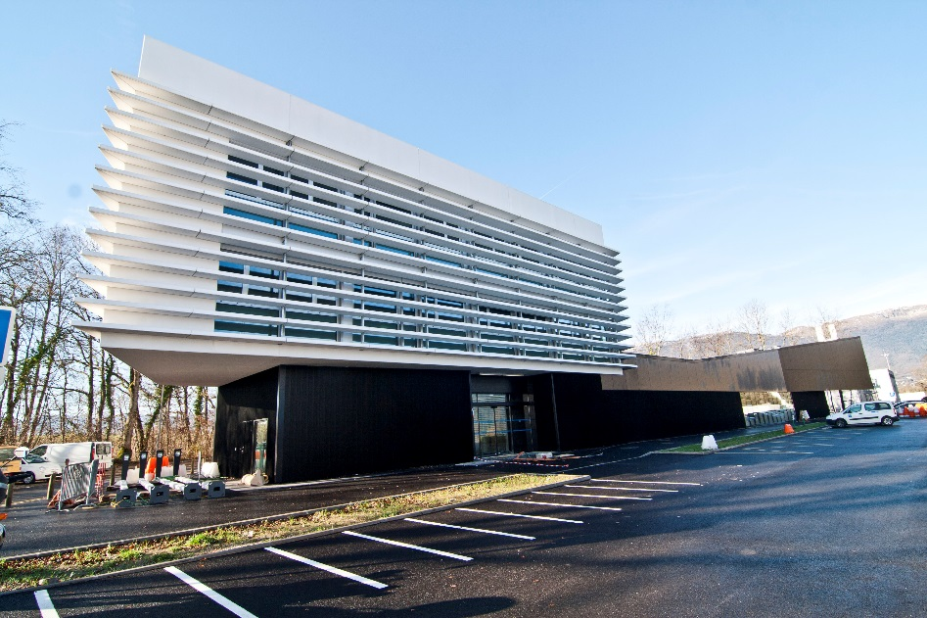
Building 774
Major Objectives 2012
Tertiary Building : officies and labs
Surface gross area : 3950 m2
Delivered : february 2015
Notes:
27

Slide 28
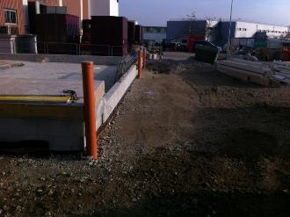
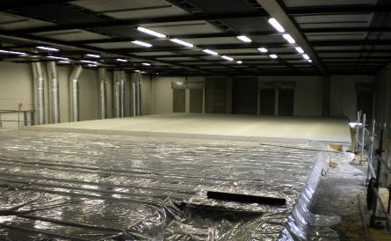
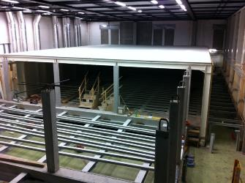
Computer Centre Upgrade

Slide 29
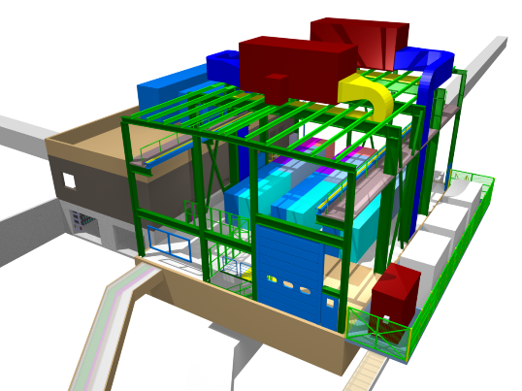
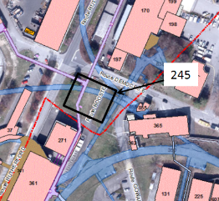
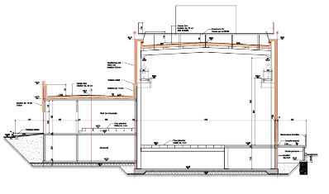
LIU-Booster – New Building 245 MPSB
Machine Building
Delivered : June 2016

Slide 30
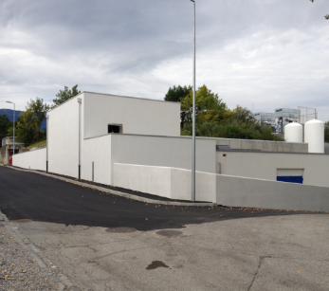
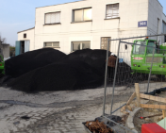
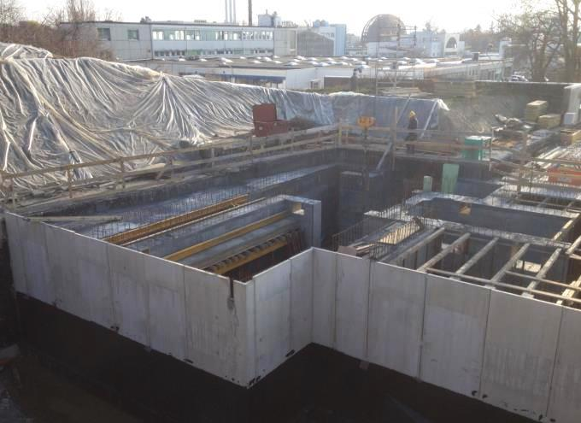
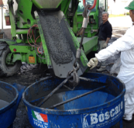
MEDICIS works
Addition of experimental area
Special shielding
Cross-border difficulties
Magnetite ore
Magnetite concrete high density 3.9 kg/dm3 (normal concrete 2.2 kg/dm3)
Preparation

Slide 31
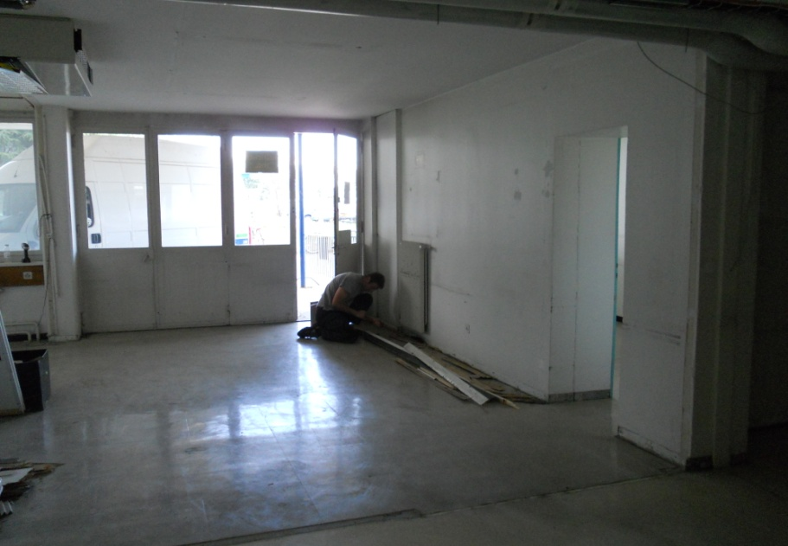
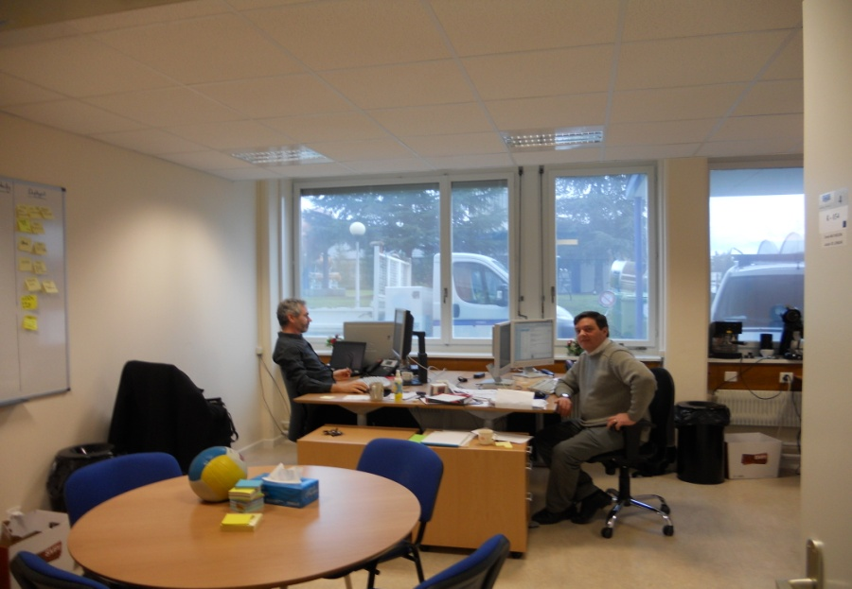
Renovation works : Offices
Notes:
What are the challenges for the next 12 months?
1 slide

Slide 32
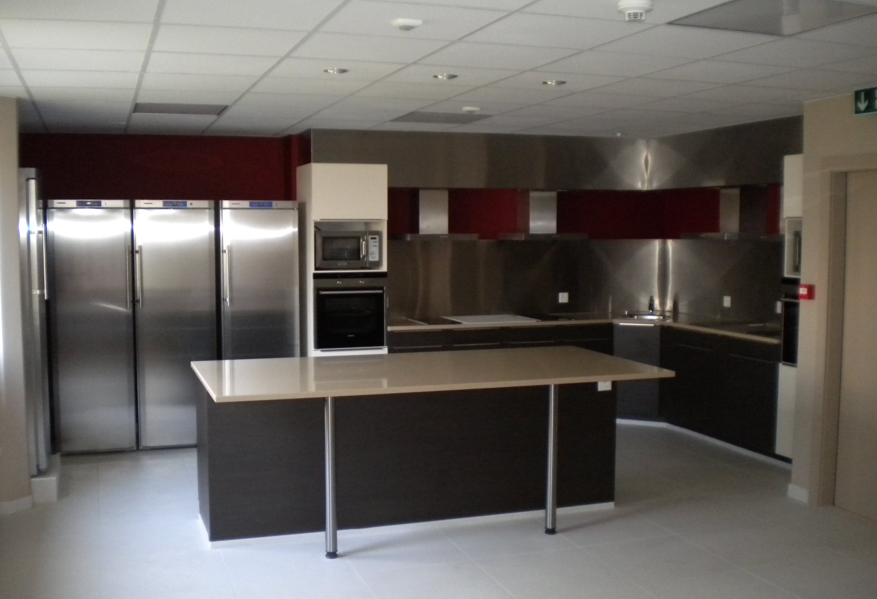
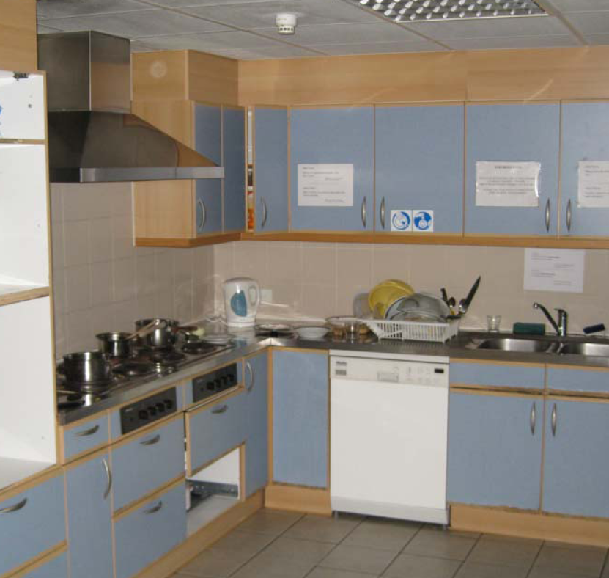
Renovation works : Hotels

Slide 33
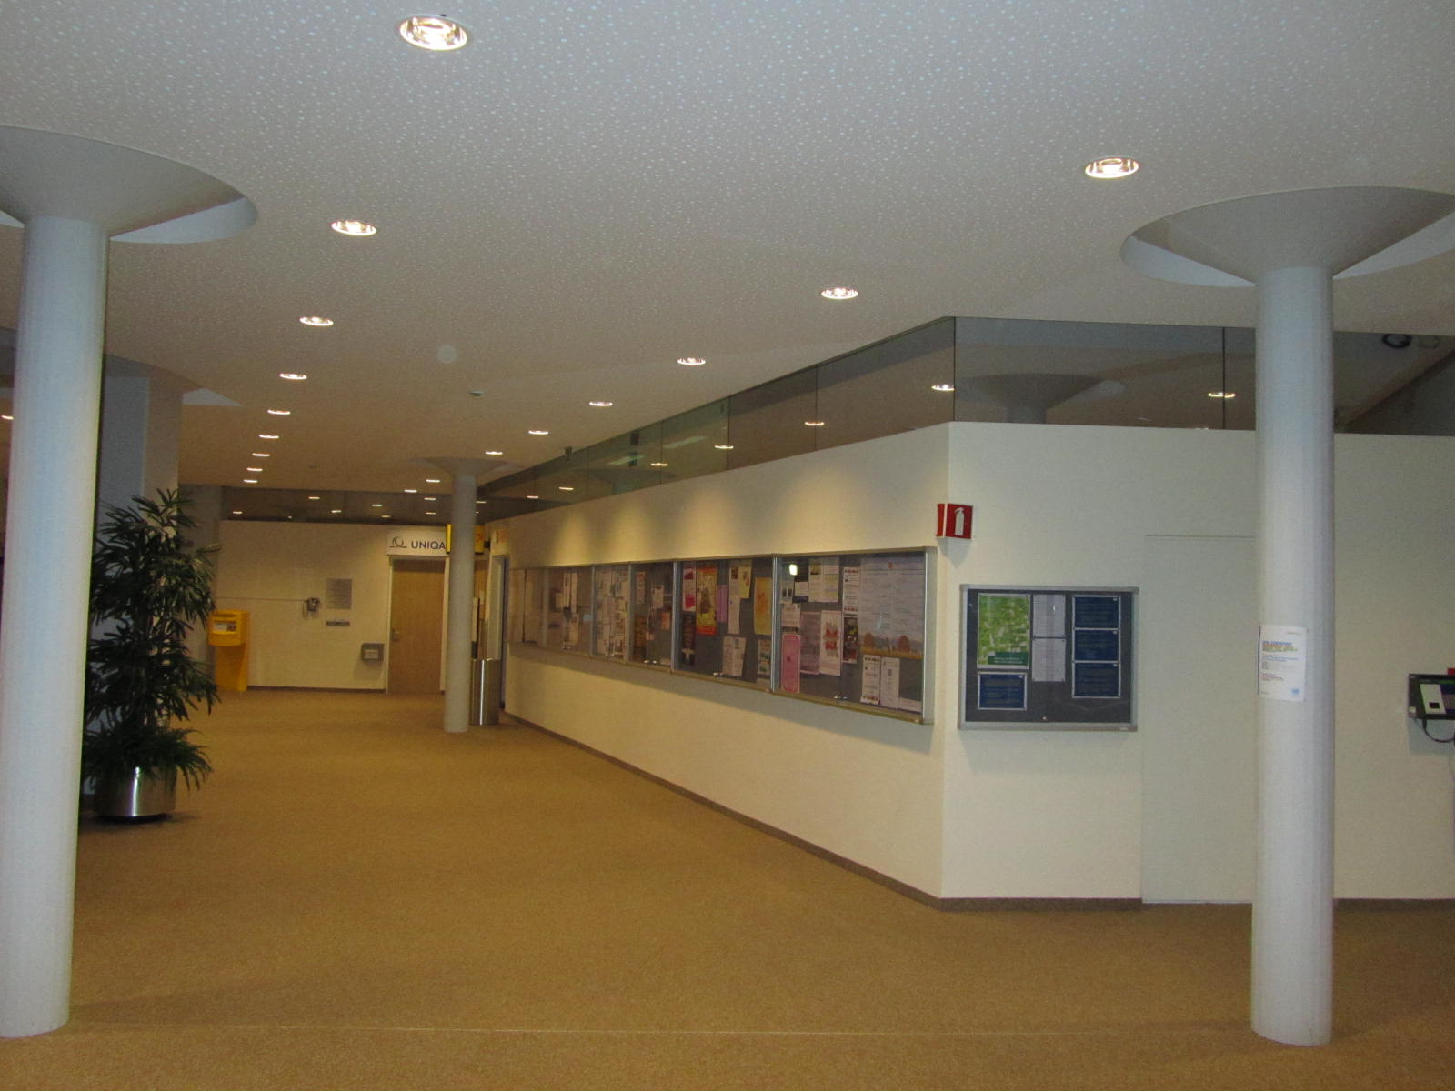
Renovation works : Main Hall
Notes:
Given the vision and the short term issues; how does this translate in objectives for the next 12 months
1 to 3 slides?

Slide 34
Renovation Works: Main auditorium

Slide 35
Site planning and development
CERN/SMB-SE – Civil engineering

Slide 36
CERN 2030 Urban Masterplan
Déclaration d’intentions :
« Le Masterplan CERN 2030 vise à répondre aux besoins d’un laboratoire global, offrant à ses utilisateurs des zones fonctionnelles bien définies, desservies par des infrastructures et des services efficaces, permettant de garantir un fonctionnement opérationnel durable, tout en s’intégrant dans le développement du Projet d’agglomération franco-valdo-genevois .»
TLEP

Slide 37
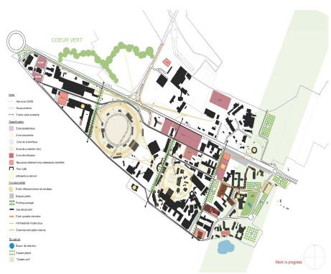
CERN 2030 Masterplan
TLEP

Slide 38
Opportunities at CERN
For Consultancy firms & Contractors
Call for tender for ‘Framework’ Contracts
Call for tender for specific Projects.

Slide 39
Future and ongoing “Call for Tender” 1/2
Accelerator’s related (2017-2022)
~6 Contracts 3500kCHF ÷ 10000kCHF
~10 Contracts 200kCHF ÷ 750kCHF
HL-LHC (2017-2022):
See previous presentation

Slide 40
Future and ongoing “Call for Tender” 2/2
Implementation of the Consolidation of the infrastructure program and new buildings (2017-2022):
~ 3 contracts 3500 KCHF to 10000 KCHF
~ 15 contracts 750 KCHF to 2500 KCHF
~ 45 contracts 200 KCHF to 750 KCHF
Hotels interior renovation (2017-2022):
~ 3 Contract ~ 2000 KCHF
Renewal of frame contracts (2017-2019):
~5 contracts 1000 KCHF/Y to 8000 KCHF/Y

Slide 41
Examples of on-going and planned projects
CERN/SMB-SE – Civil engineering

Slide 42
Extension Building 887
Lower slabbing
Cam view
3D Model
Pits earthworks

Slide 43
New Building 311 for magnetic measurements
Machine Building : magnet measurement hall
Surface gross area : 1250 m2
Starting of the works : march 2016

Slide 44
New Building 90 – Flex space
Tertiary Building : officies and labs
Gross area : 5490 m2
To be delivered : decembre 2019
+ entire renovation of the main building

Slide 45
New SPS Beam Dump
Option 2
Option 1
Drilled core
Possible tunnel works from SPS5 in LS2

Slide 46
Underground works – HL-LHC Points 1 & 5
High Luminosity LHC (HL-LHC)

Slide 47
Future Accelerators
FCC

Slide 48
Conclusions
Opportunities for medium and large companies
Different specialties (underground and buildings)
Special attention to be paid to:
The location and local rules (CH/F)
The local prices (materials, wastes, workforce, etc.)
CERN framework (Radiation, Worksites, Safety rules, etc.)

Slide 49
Thank You for your attention

