Slide 1
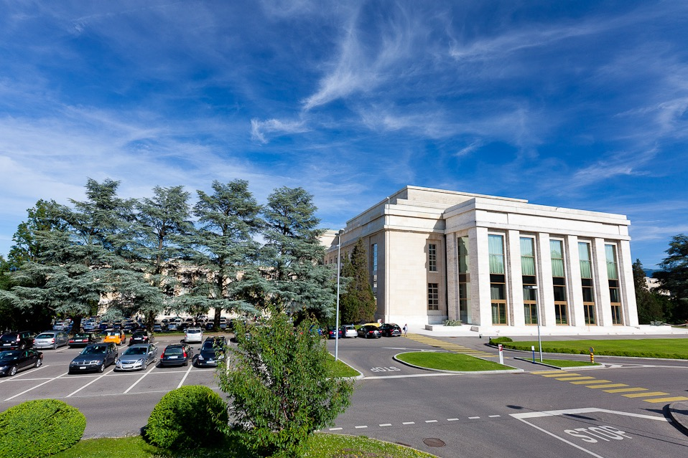
Italian
UN SHP Business Seminar
“Doing business with the United Nations and SHP Procurement Processes and Timelines”
Presentato da: Boi-Lan Nguyen
Lemoine SHP/UNOG
Data: 28 Giugno 2016

Slide 2
An overview of the United Nations

Slide 3
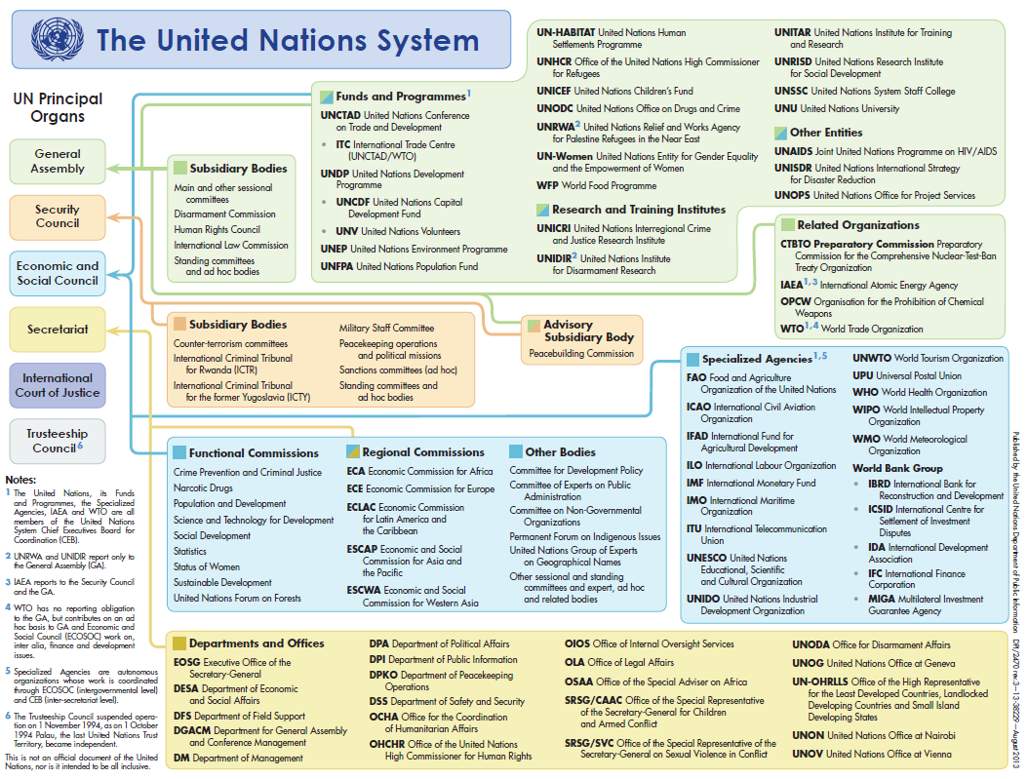
United Nations System

Slide 4
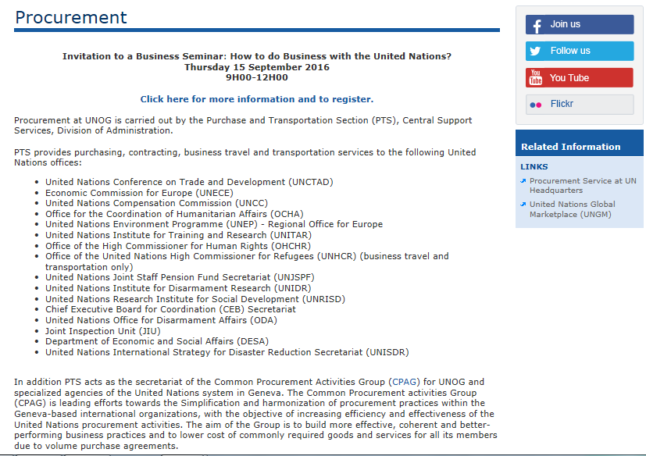
United Nations System

Slide 5
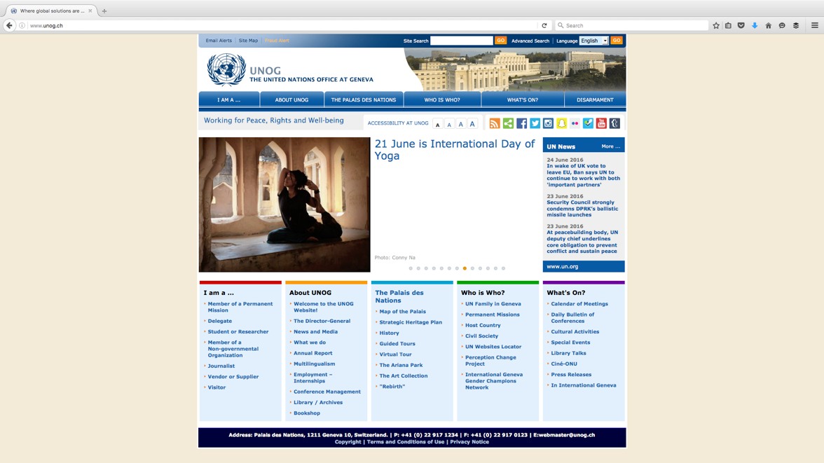
Business Seminar

Slide 6
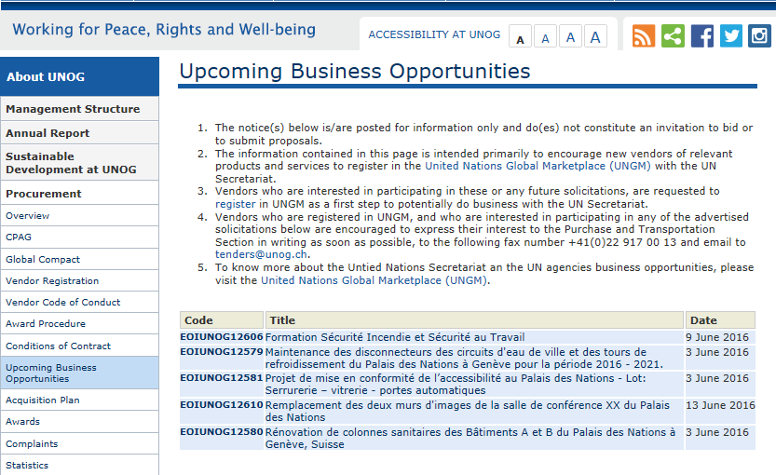
Upcoming Business Opportunities

Slide 7
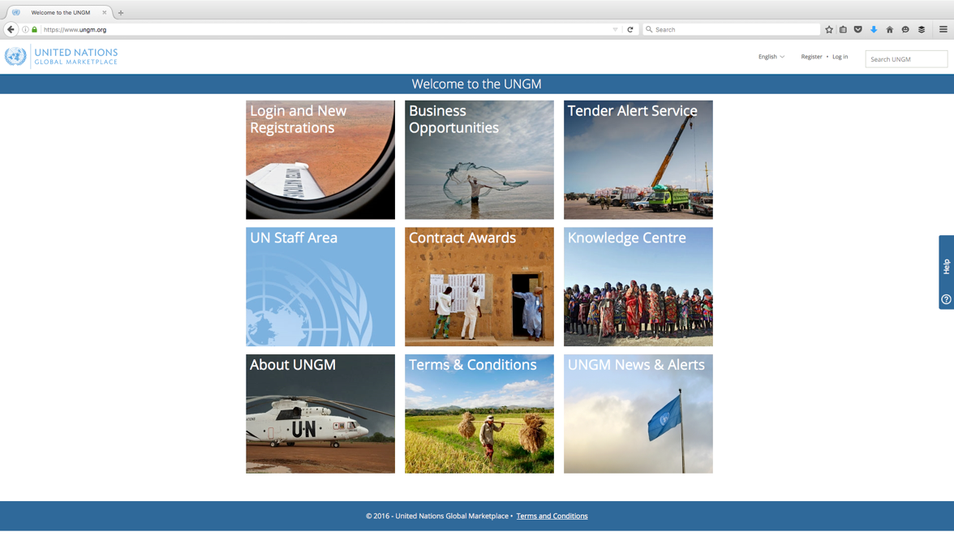
Madatory Registration at UNGM
Register on-line at: www.ungm.org

Slide 8
UNGM functionalities
Keeping abreast of upcoming business opportunities
Over 300 active notices at any one time
Published by over 40 UN organizations and entities
FREE access to procurement notices
FREE registration form online available in 3 languages
One of first steps in doing business with the UN
Becoming a requirement for more and more UN organizations in order to participate in tenders

Slide 9
Procurement Basic Level
Contract value - up to USD 40,000
Basic vendor information (name, address, etc.)
Pre-requisites for eligibility
Acceptance of UN Supplier Code of Conduct
Information on countries in which you do business
Classification of your goods and services

Slide 10
Procurement Level 1
Contract value < USD 500,000
In business for >3 years
Certificate of incorporation or equivalent document
3 independent, non-affiliated references
Names of owner(s) and principals
The names of intermediaries, agents and/or consultants
Notes:
Contract value < USD 500,000
In business for a min. of 3 years;
Current certificate of incorporation or equivalent document verifying legal status/capacity;
Details and email addresses of at least 3 independent, non-affiliated references;
Names of owner(s) and principals (including parent company, subsidiaries/affiliates, CEO/Managing Director, and those with controlling interests, if applicable).
The names of intermediaries, agents and/or consultants, (if any) used in relation to United Nations contracts or bids/proposals.

Slide 11
Procurement Level 2
Contract value > USD 500,000
Reference letters from three independent, non-affiliated clients/companies
Income Statements and Balance Sheet (audited/certified financial statements or equivalent) for the last three years
Completed Basic and Level 1 registration.
Registration level visible in UNGM (email alert).
If not sure send an email to the contact in UNGM or UNOG Procurement
Notes:
Contract value < USD 500,000
In business for a min. of 3 years;
Current certificate of incorporation or equivalent document verifying legal status/capacity;
Details and email addresses of at least 3 independent, non-affiliated references;
Names of owner(s) and principals (including parent company, subsidiaries/affiliates, CEO/Managing Director, and those with controlling interests, if applicable).
The names of intermediaries, agents and/or consultants, (if any) used in relation to United Nations contracts or bids/proposals.

Slide 12
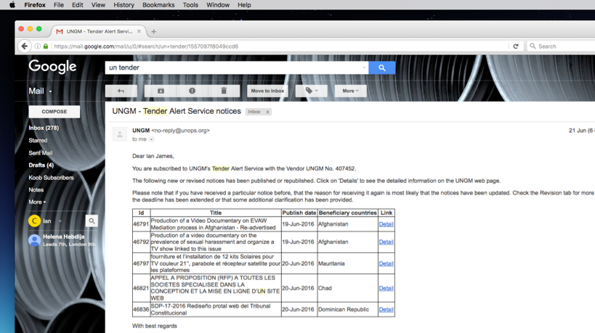
UNGM Tender Alert Service
Online and easy subscription to the Tender Alert Service on www.ungm.org
Receive relevant business opportunities
Automatic e-mail alerts
UNGM Interactive Guide
Notes:
Online and easy subscription to the Tender Alert Service on www.ungm.org
Receive relevant business opportunities
Automatic e-mail tender alerts
UNGM Interactive Guide available to guide potential suppliers to subscribe to this valuable service.

Slide 13
Useful tips for UNGM registration
In order to do business with UNOG, select UN Secretariat
Translation (English or French) of certificate of incorporation
Financials audited/ established by 3rd party
Provide a GENERIC email address(es)
For any queries please contact: procurement@unog.ch
Notes:
In order to do business with UNOG, select UN Secretariat;
Official translation (English or French) of the certificate of incorporation;
Financials audited/established by 3rd party;
Provide a GENERIC email address(es)
For any queries please contact: procurement@unog.ch

Slide 14
Types of Solicitations
REOI Request for Expression Of Interest
RFQ $4k < $40k Request For Quotation Award to lowest priced technically compliant offer
ITB $40k -> + Invitation to Bid Award to the lowest priced technically compliant offer
RFP $40k -> + Request For Proposal Award to most responsive Best Value for Money
Notes:
In order to do business with UNOG, select UN Secretariat;
Official translation (English or French) of the certificate of incorporation;
Financials audited/established by 3rd party;
Provide a GENERIC email address(es)
For any queries please contact: procurement@unog.ch

Slide 15
Typical Tender Process Stages
RFI / EOI
Solicitation (RFP / ITB / RFQ)
Bidders Conference / Q&A
Bid Opening
Technical + Commercial Evaluation
Contract Award
Debriefing of Vendors
Internal Approval / HCC Review
Notes:
In order to do business with UNOG, select UN Secretariat;
Official translation (English or French) of the certificate of incorporation;
Financials audited/established by 3rd party;
Provide a GENERIC email address(es)
For any queries please contact: procurement@unog.ch

Slide 16
Request for Proposals (RFP)
Formal solicitation with est. value > USD 500,000
Goods / Services medium to high complexity
Evaluation of proposals based on both Mandatory Requirements and Scoring methodology (Best Value for Money)
Contract awarded on ‘Best Value for Money’ basis to the bidder submitting the most economically advantageous bid
Notes:
Formal solicitation with est. value > USD 500,000
Goods / Services with medium to high complexity
Evaluation of proposals based on both Mandatory Requirements and Scoring methodology (Best Value for Money)
Contract awarded on «Best Value for Money» basis to the bidder submitting the most economically advantageous bid

Slide 17
Request for Proposals (RFP)
Cover Letter
Technical specifications & Annexes (drawings and calculations)
Special Instructions
Evaluation questionnaire
Calculation sheets
UN General Conditions of Contract
UN Form of Contract
Acknowledgement Letter
Language: English

Slide 18
How to prepare your proposal
Read the tender documents carefully and ask questions, as necessary;
Respond to ALL questions
Provide all documents requested
Separate commercial from technical documents
Do not wait until the last minute
Notes:
Read the tender documents carefully and ask questions, as necessary;
Respond to all questions asked. If you do not provide information, it cannot be scored;
Provide all documents requested;
Separate commercial from technical documents;
Send your offer in good time. Do not wait until the last minute;

Slide 19
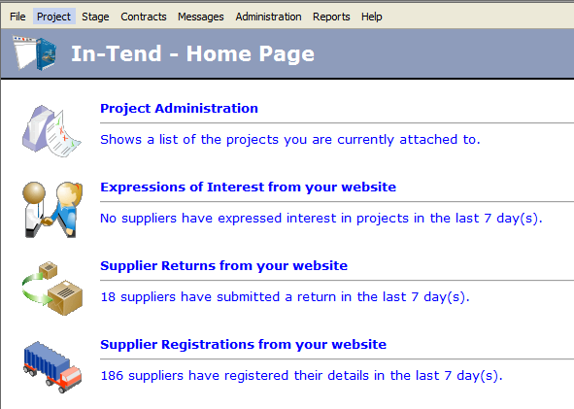
UNOG E-tendering
Issuance of RFP
Clarifications
Submission of proposals
Integrated with UNGM
Used by many Organizations
RFP Documents

Slide 20
SHP Contract awards and Ongoing Procurement
Contracts in the range between 10m to 100m CHF
Architectural & Design Services – Awarded to SOM / Burckhard + Partners
Project Management Services – Awarded to Hill International
Risk Management Services awarded to MACE
Technical Services Consultant – Bid - Under Evaluation
Legal Services – Bids under evaluation

Slide 21
UNOG E-tendering
Contracts below 10m CHF
Civil and Structural Engineering Services awarded to PRAS TECNICA
Hazardous Materials Intrusive Survey awarded to BMG
RFP Documents

Slide 22
SHP Currently Anticipated Procurement Opportunities
Contracts with estimated value below 10m CHF
Enabling Works Construction Contract
Audio Visual / Conference / Congress / Interpretation Equipment
New Furniture (offices/collaboration)
New Furniture (conference/specialist)
Move / Relocation Contract
Artwork specialist (move/protect/preservation /restoration)
Project Related Insurances
The possible procurements identified are intended indicative only
Notes:
Contracts with estimated value below 10m CHF
Enabling Works Construction Contract (earthworks and construction site establishment)
Audio Visual / Conference / Congress / Interpretation Equipment
New Furniture (offices and collaboration spaces)
New Furniture (conference rooms and specialist areas)
Move / Relocation Contract
Artwork specialist (move / protect / preservation / restoration)
Project Related Insurances
The possible procurements identified are intended indicative only

Slide 23
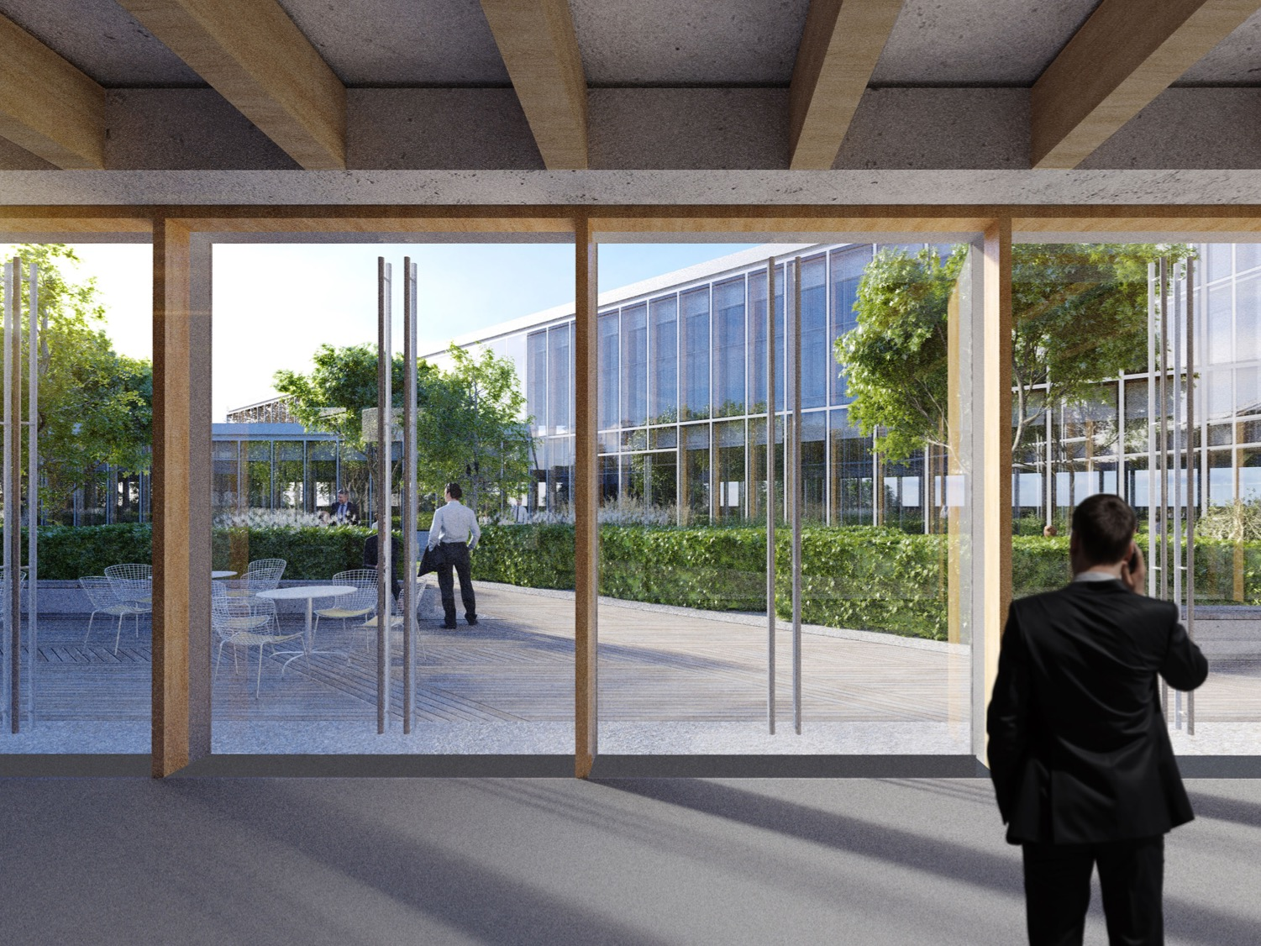
Next Steps
New Building
EOI – March/June 16
RFP – June/November 16
Submission – Aug/16 /Jan 17
Contract Award – Jan /May 17
Start on Site – Jan/ June 17
Complete – Jun 16/ 2019
Renovation Existing Buildings
EOI – May 2017
RFP – Oct 2017
Submission– Jan 2018
Contract Award – Sep 2018
Start on Site – Oct 2018
Complete – 2023

Slide 24
Key Dates - Enabling Works for the New Building
March 2016 Expression of Interest (EOI)
End- June 2016 Request for Proposal (RFP)
Mid- Aug 2016 Submission of Bids
Aug to Sep 2016 - Technical & Commercial Evaluation
Oct to Nov 2016 – Approvals
Nov 2016 Notifications
Nov - Dec 2016 - Contract Discussions
Jan 2017 – Signature
Jan 2017 – Works on Site

Slide 25
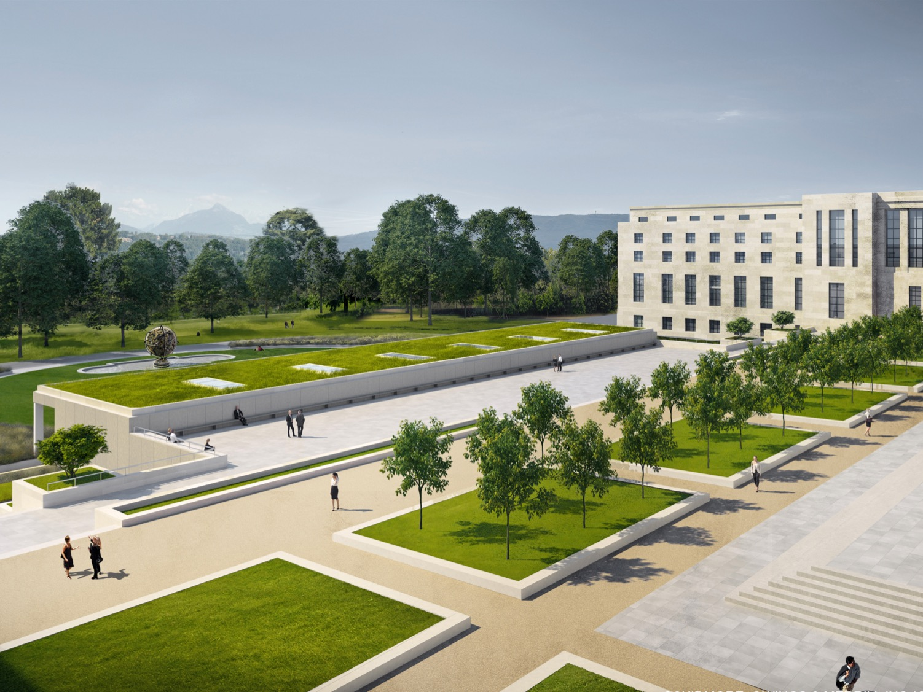
Key Dates -Construction Works New Building
Jul 2016 - Expression of Interest (EOI) with Pre-Qualification
Oct 2016 - Request for Proposal (RFP)
Mid- Jan 2017 - Submission of Bids
Mid-Jan to mid-Mar 2017 - Technical & Commercial Evaluation
Mid-Mar to mid-Apr 2017 – Approvals
Mid-Apr 2017 - Notifications
Apr - May 2017 - Contract Discussions
Jun 2017 - Signature
Jun 2017 - Works on Site

Slide 26
Grazie
Domande?

