Slide 1


Experimental program on Nuclear Astrophysics at the CERN n_TOF facility
C. Massimi
on behalf of the n_TOF Collaboration
Notes:
titolo

Slide 2

Outline
The n_TOF facility
  timeline, basic parameters and features
PAST (Phase I + Phase II)
  (n, γ) and (n, α) measurements with C₆D₆, BaF₂, MicroMegas and diamond detector
PRESENT (Phase III)
  (n, γ); (n, α) and (n, p) measurements with C₆D₆, BaF₂, MicroMegas, diamond and Silicon detectors …

Slide 3
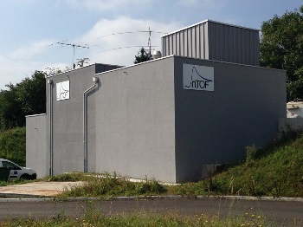
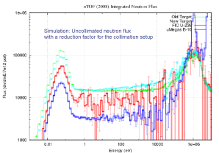
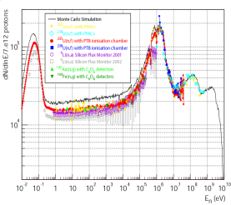
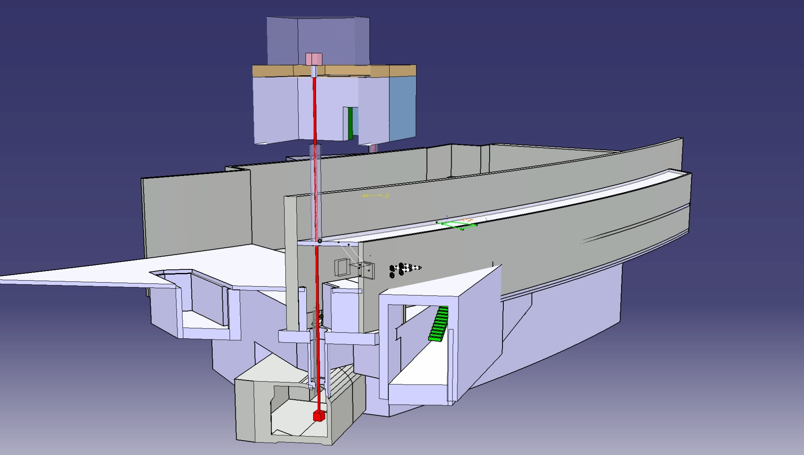
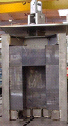
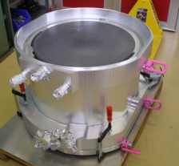
Facility timeline
2014-201X
n_TOF Phase 3
2013-2014
EAR-2 construction
Phase 3
2011
EAR-2 project
2009
Re-Commissioning
2010 Upgrades:
Borated-H₂O
Class-A
2000
Commissioning
2001-2004
n_TOF Phase 1
Phase 2
1997
2009-2012
n_TOF Phase 2
2015
1998
Preliminary studies
CERN/LHC/98-02+Add
Phase 1
2004
Spallation target seriously damaged
1999
Construction
2008
New target
>60 isotopes investigated
>300 publications
1997
Idea from C.Rubbia
CERN/ET/Int. Note 97-19

Slide 4

Phase I: 1999-2004
Milestones
1999 Design
2001 Commissioning
2002-2004 Data taking

Slide 5
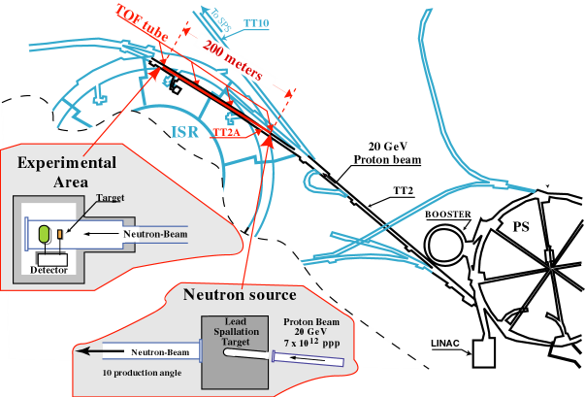
Phase I: 1999-2004
n_TOF is a spallation neutron source based on 20 GeV/c protons from the CERN PS hitting a Pb block (~300 neutrons per proton).
Experimental area at 200 m.

Slide 6
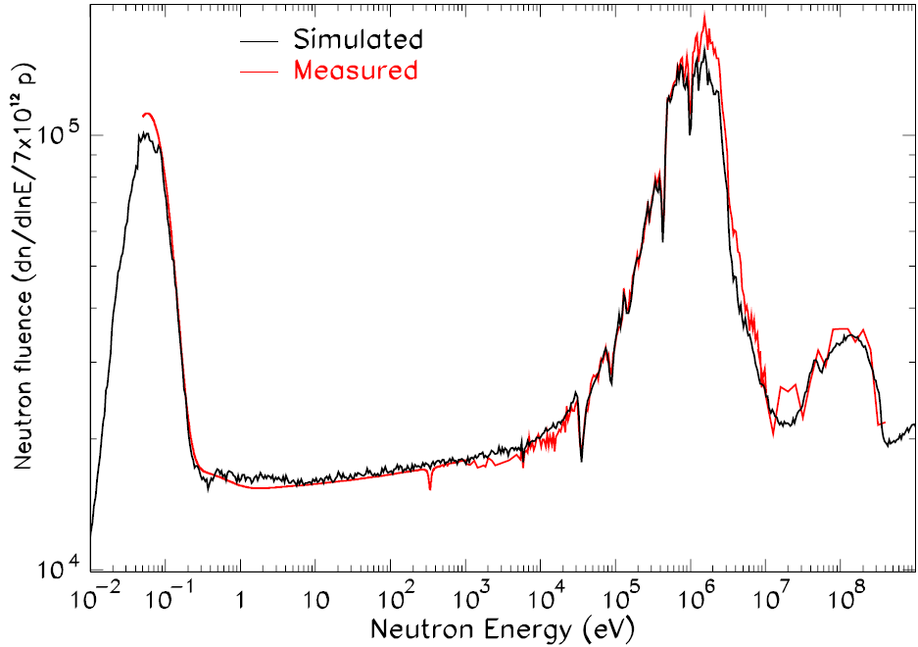
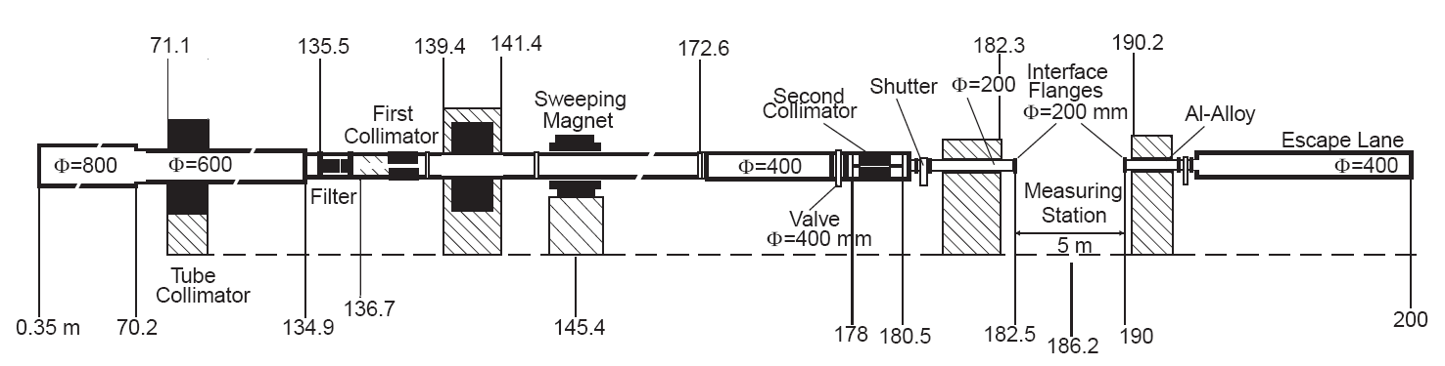
Phase I: 1999-2004
Proton beam momentum | 20 GeV/C
Intensity (dedicated mode) | 7x10¹² protons per pulse
Pulse width | 6 ns
n/p | 300
Flight path | 185 m
Neutron flux at sample position | ~10⁶ neutrons per pulse

Slide 7
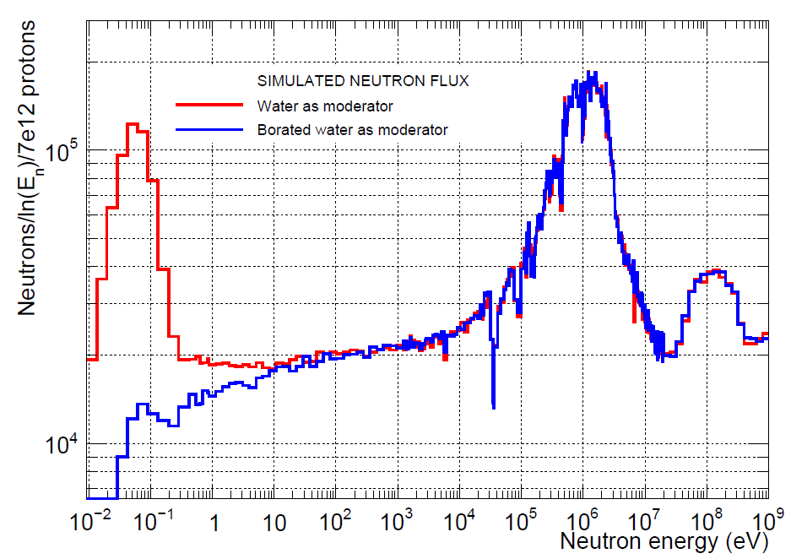
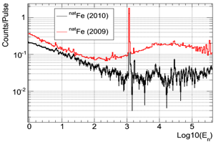
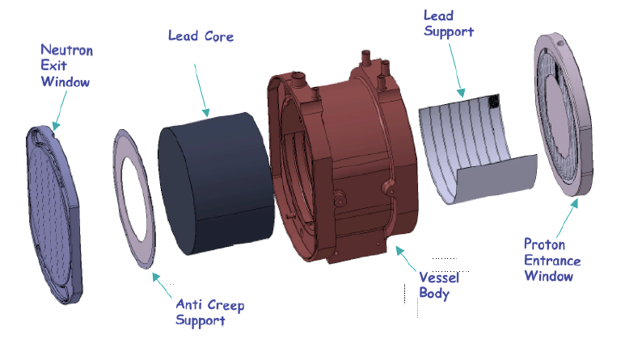
Phase II, 2009-2012
Milestones
2007 New design Target and cooling
2008 commissioning
2009-2012 Data taking
Water
Borated water

Slide 8
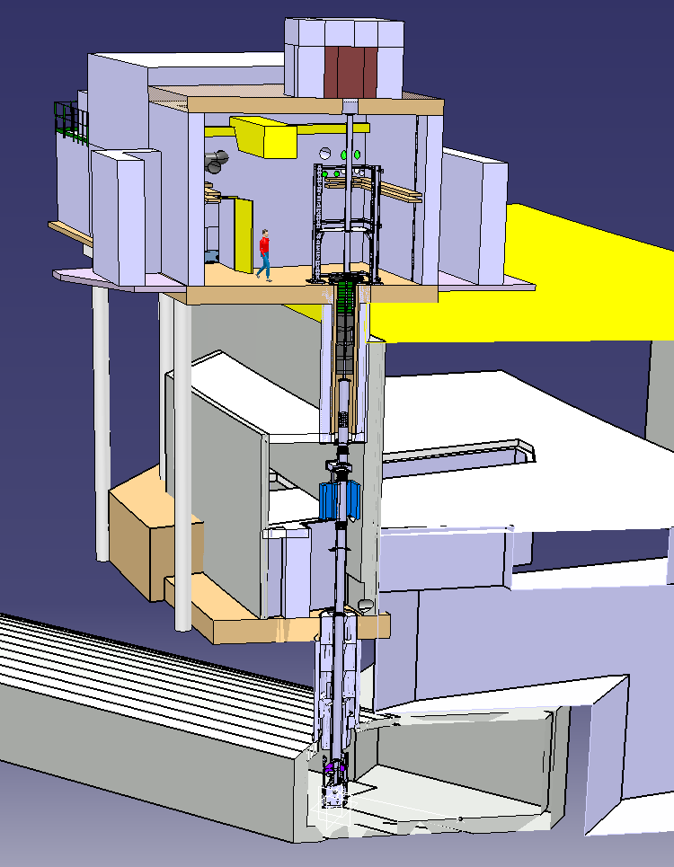
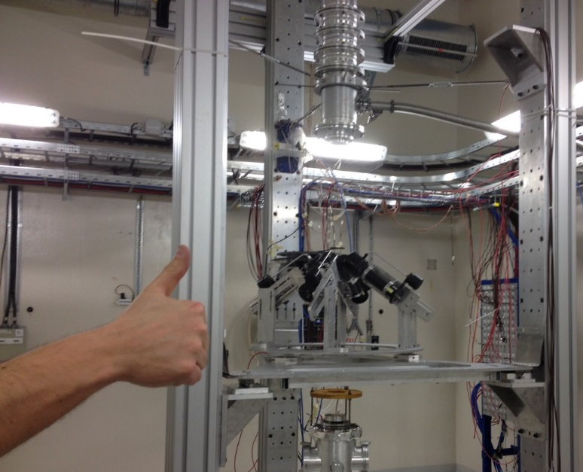
Phase III: 2014-20xx
h [m]
Milestones
2011 Design
2014 Commissioning
2014-20.. Data taking
Beam Dump
24.4
EAR-2
18.1
2nd Collimator
New Area
Filter Box
Magnet
9.8
1st Collimator
Existing Area
EAR1
0
Target

Slide 9
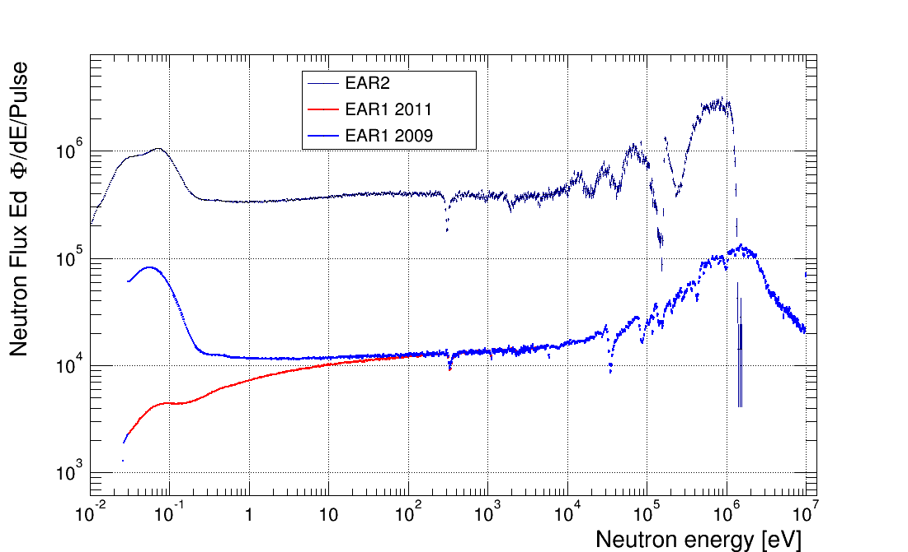
Phase III: 2014-20xx
Higher fluence, by a factor of 25, relative to EAR1
The shorter flight path implies a factor of 10 smaller time-of-flight
Global gain by a factor of 250 in the signal/background ratio for radioactive isotopes!
Maximum neutron fluence gain: x27 (keV region)
The huge gain in signal-to-background ratio in EAR2 allows to measure radioactive isotopes with half lives as low as a few years.

Slide 10
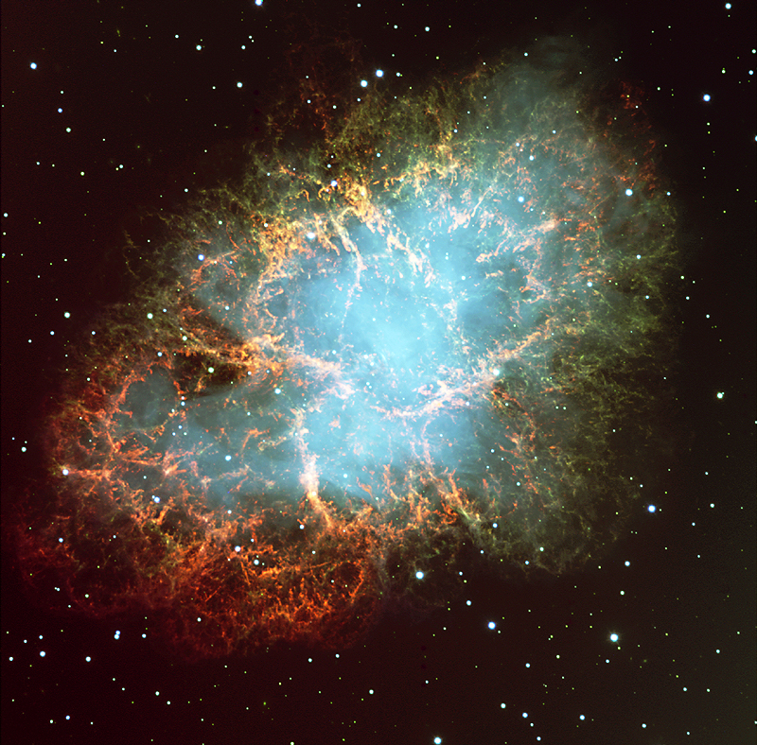
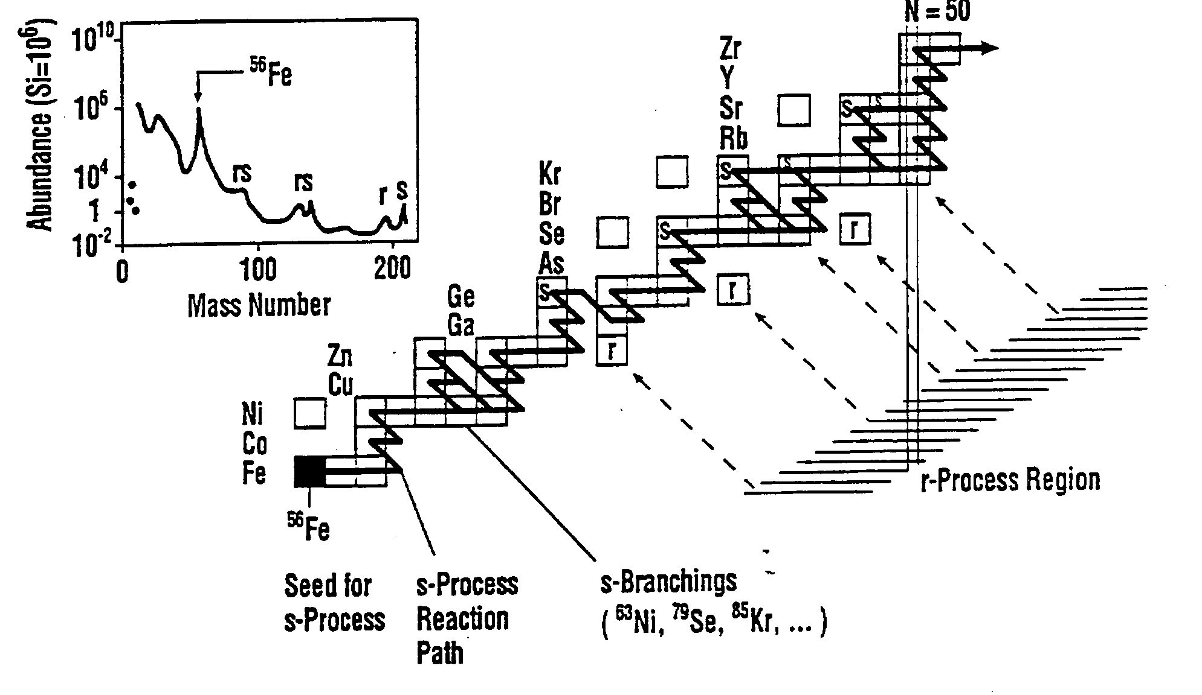
Nuclear Astrophysics
The neutron-capture cross sections are key ingredients:
stable isotopes
Radioactive isotopes
Isotopes with low σ_{γ}
Isotope with Γ_{n}>>Γ_{γ} ratio
Rare isotopes
Stellar nucleosynthesis → s process
Stellar thermal condition
Cosmochronology

Slide 11

Experiments 2002-2004
Capture (n, γ)
¹⁵¹Sm
^{204,206,207,208}Pb
²⁰⁹Bi
²³²Th
^{24,25,26}Mg
^{90,91,92,94,96}Zr
⁹³Zr
¹³⁹La
^{186,187,188}Os
¹⁹⁷Au
^{233,234}U
²³⁷Np, ²⁴⁰Pu
²⁴³Am
Target | Motivations & Notes
^{24,25,26}Mg | Isotopic abundance ratios in stellar grains. Importance of ²²Ne(α,n)²⁵Mg for the s-process neutron Balance. Light nuclei, small cross sections.
^{90,91,92,93,94,96}Zr | s-process branching at A=95 & observed abundance patterns in stellar grains. Sensitivity to neutron flux during the s-process. ⁹³Zr(τ_{1/2} = 1.5 Myr)
¹³⁹La | Bottleneck in the s-process flow. N=82 neutron shell closure
¹⁵¹Sm | s-process branching at A ≈ 150. ¹⁵¹Sm is radioactive (τ_{1/2} = 93 yr)
^{186,187,188}Os | Nuclear cosmochronology (Re/Os clock) s-process branching at A ≈ 185
^{204,206,207,208}Pb ²⁰⁹Bi | Termination of the s-process. Small σ_{γ}/σ_{el}

Slide 12
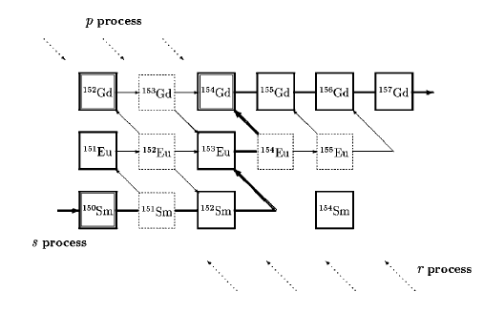

Experiments 2002-2004
Capture (n, γ)
¹⁵¹Sm
^{204,206,207,208}Pb
²⁰⁹Bi
²³²Th
^{24,25,26}Mg
^{90,91,92,94,96}Zr
⁹³Zr
¹³⁹La
^{186,187,188}Os
¹⁹⁷Au
^{233,234}U
²³⁷Np, ²⁴⁰Pu
²⁴³Am
¹⁵¹Sm: a key nucleus for s process in the AGB stars
Theoretical estimation:
<σ>≈2 b
<σ> = MACS,
N = s-process abundance,
λ = β decay rate,
n_{n}<σv> = neutron capture rate,
n_{n} = the neutron density.

Slide 13
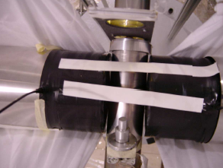
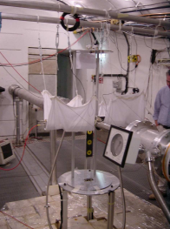
Experiments 2002-2004
Capture (n, γ)
¹⁵¹Sm
^{204,206,207,208}Pb
²⁰⁹Bi
²³²Th
^{24,25,26}Mg
^{90,91,92,94,96}Zr
⁹³Zr
¹³⁹La
^{186,187,188}Os
¹⁹⁷Au
^{233,234}U
²³⁷Np, ²⁴⁰Pu
²⁴³Am
Sm₂O₃ sample
10x1 mm²
0.2064 g
Activity = 156 GBq !
TOTAL ENERGY DETECTION SYSTEM
→ Weighting Functions

Slide 14
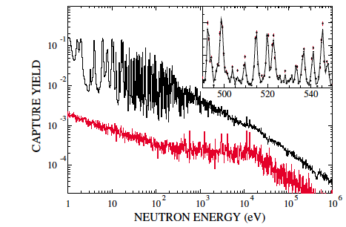
Experiments 2002-2004
Capture (n, γ)
¹⁵¹Sm
^{204,206,207,208}Pb
²⁰⁹Bi
²³²Th
^{24,25,26}Mg
^{90,91,92,94,96}Zr
⁹³Zr
¹³⁹La
^{186,187,188}Os
¹⁹⁷Au
^{233,234}U
²³⁷Np, ²⁴⁰Pu
²⁴³Am
Theoretical estimation:
<σ>≈2 b
MACS experimentally determined for the first time
<σ> = 3.1±0.16 b
at kT=30 keV
Phys. Rev. Lett. 93, 161103 (2004)

Slide 15
Experiments 2002-2004
Capture (n, γ)
¹⁵¹Sm
^{204,206,207,208}Pb
²⁰⁹Bi
²³²Th
^{24,25,26}Mg
^{90,91,92,94,96}Zr
⁹³Zr
¹³⁹La
^{186,187,188}Os
¹⁹⁷Au
^{233,234}U
²³⁷Np, ²⁴⁰Pu
²⁴³Am
Theoretical estimation:
<σ>≈2 b
MACS experimentally determined for the first time
<σ> = 3.1±0.16 b
at kT=30 keV
Phys. Rev. Lett. 93, 161103 (2004)

Slide 16
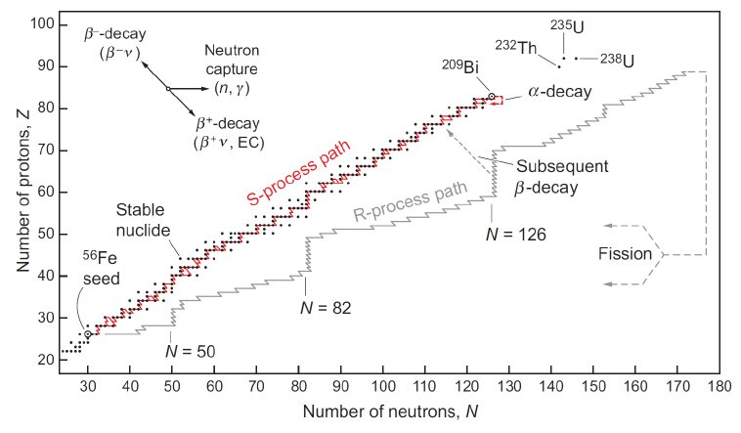
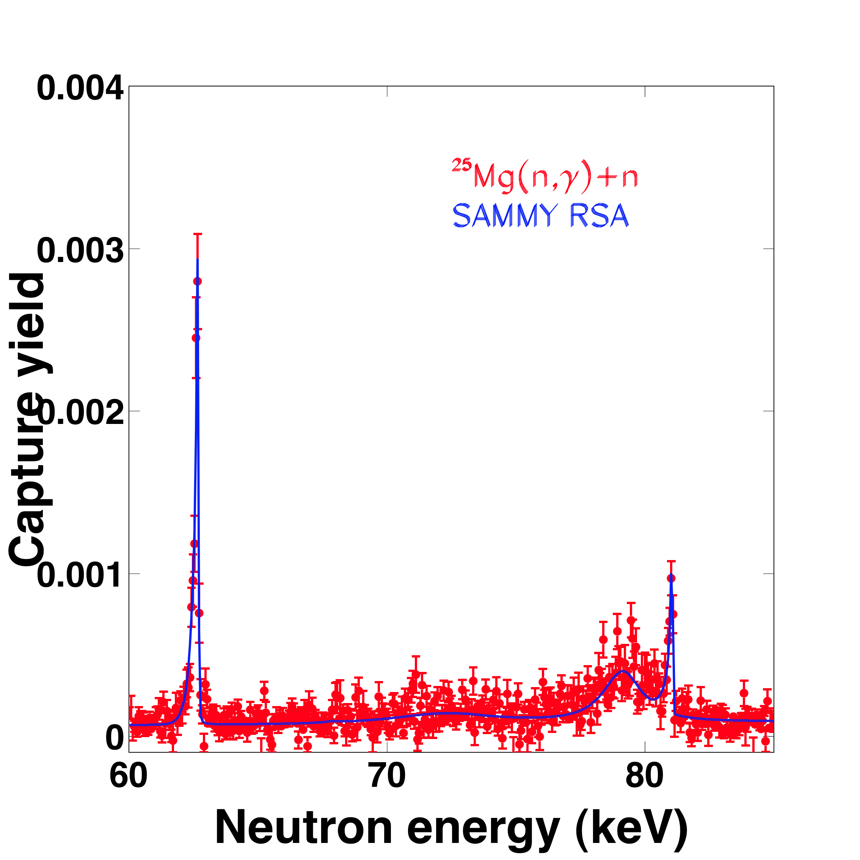
Experiments 2002-2004
Capture (n, γ)
¹⁵¹Sm
^{204,206,207,208}Pb
²⁰⁹Bi
²³²Th
^{24,25,26}Mg
^{90,91,92,94,96}Zr
⁹³Zr
¹³⁹La
^{186,187,188}Os
¹⁹⁷Au
^{233,234}U
²³⁷Np, ²⁴⁰Pu
²⁴³Am
Mg is a neutron poison during the s-process nucleosynthesis
²²Ne(α, n)²⁵Mg is a neutron source in AGB and Massive stars
Result: reduced poisoning effect
Lower MACS of ²⁵Mg →higher neutron density.
C. Massimi et al., Phys. Rev. C 85, 044615 (2012)

Slide 17
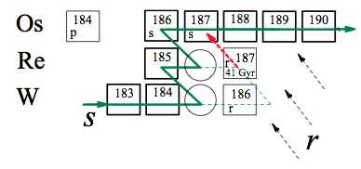
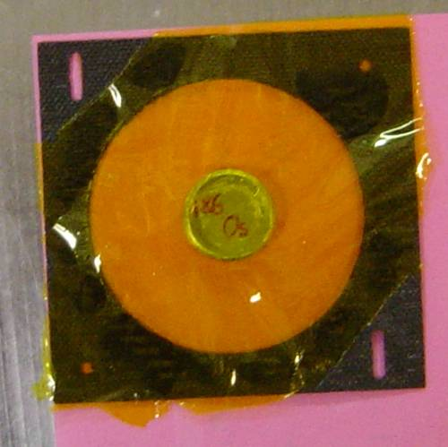
Experiments 2002-2004
Capture (n, γ)
¹⁵¹Sm
^{204,206,207,208}Pb
²⁰⁹Bi
²³²Th
^{24,25,26}Mg
^{90,91,92,94,96}Zr
⁹³Zr
¹³⁹La
^{186,187,188}Os
¹⁹⁷Au
^{233,234}U
²³⁷Np, ²⁴⁰Pu
²⁴³Am
^{186,187,188}Os: Re/Os clock
Isotop | Mass (g) | I. A. (%)
¹⁸⁶O | 2 | 79.48
¹⁸⁷O | 1.9 | 70.43
¹⁸⁸O | 1.99 | 93.98
15 mm

Slide 18
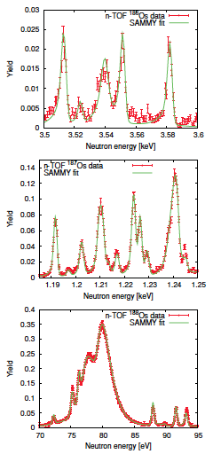
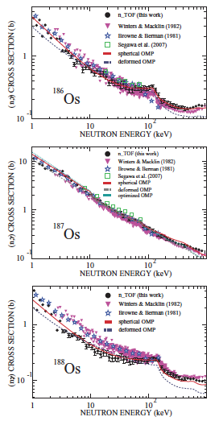
Experiments 2002-2004
Capture (n, γ)
¹⁵¹Sm
^{204,206,207,208}Pb
²⁰⁹Bi
²³²Th
^{24,25,26}Mg
^{90,91,92,94,96}Zr
⁹³Zr
¹³⁹La
^{186,187,188}Os
¹⁹⁷Au
^{233,234}U
²³⁷Np, ²⁴⁰Pu
²⁴³Am
^{186,187,188}Os: Re/Os clock
Resolved resonance region
+
Unresolved resonance region
=
T-t₀=15.3±0.8±2 Gy
15 mm
REDUCED the uncertainty due to nuclear data
M. Mosconi et al., Phys. Rev. C 82, 015802 (2010), K. Fujii et al., Phys. Rev. C 82, 015804 (2010)

Slide 19
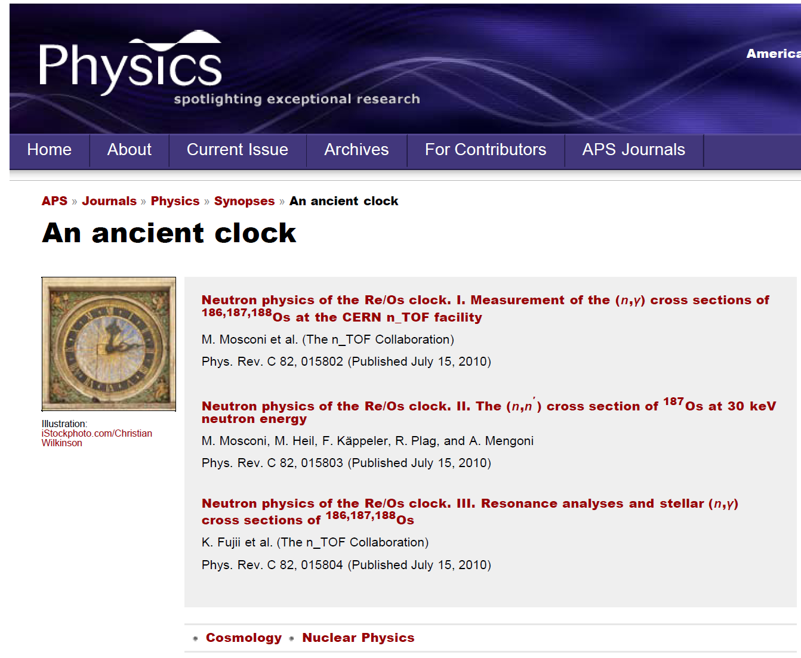
Experiments 2002-2004
Capture (n, γ)
¹⁵¹Sm
^{204,206,207,208}Pb
²⁰⁹Bi
²³²Th
^{24,25,26}Mg
^{90,91,92,94,96}Zr
⁹³Zr
¹³⁹La
^{186,187,188}Os
¹⁹⁷Au
^{233,234}U
²³⁷Np, ²⁴⁰Pu
²⁴³Am

Slide 20
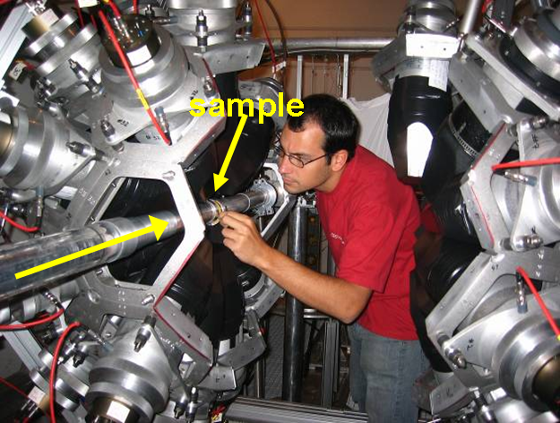
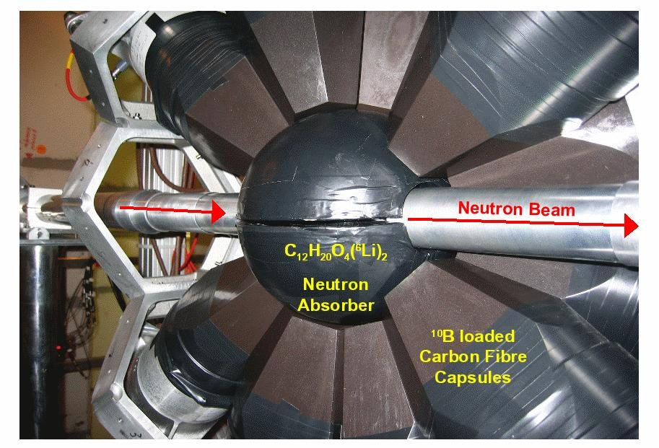
Experiments 2002-2004
Capture (n, γ)
¹⁵¹Sm
^{204,206,207,208}Pb
²⁰⁹Bi
²³²Th
^{24,25,26}Mg
^{90,91,92,94,96}Zr
⁹³Zr
¹³⁹La
^{186,187,188}Os
¹⁹⁷Au
^{233,234}U
²³⁷Np, ²⁴⁰Pu
²⁴³Am
¹⁹⁷Au(n, γ): the reference for (n, γ) measurements
4p detector ~ 100% efficiency
40 BaF₂ crystals
15-cm spherical shell
¹⁰B-loaded carbon-fiber capsules
C. Guerrero et al., EPJ A 48, 29 (2012)
5-cm-thick spherical shell made of C₁₂H₂₀O₄(⁶Li)₂
Energy resolution of 15% at 662 keV and 6% at 6.1 MeV
C. Guerreto et al., NIM A 608, 424 (2009)
C. Massimi et al., Phys. Rev. C 81, 044616 (2010),
C. Lederer et al.,Phys. Rev. C 83, 034608 (2011)

Slide 21
Phase II

Slide 22
Experiments 2009-2012
Capture (n, γ)
^{58,62}Ni
⁶³Ni
^{54,56,57}Fe
²⁴¹Am → × 2
^{235,236,238}U → × 2
²⁵Mg
⁹³Zr
⁸⁷Sr
(n, α) Reaction
¹⁰B
⁵⁹Ni
³³S
Target | Motivations & Notes
^{58,59,62,63}Ni ^{54,55,56}Fe | Beginning of the s process & propagation effect in the weak component, Massive stars. ⁶³Ni (t_{1/2} = 101 yr).
⁹³Zr | New measurement: improved sample (no Ti) and better experimental condition. ⁹³Zr (t_{1/2} = 1.5 Myr).
²⁵Mg | New measurement: improved sample (metallic) and better experimental condition.
⁵⁹Ni | (n,α) and (n,p) channels open in the neutron energy of the s process. Competing reaction with neutron radiative capture. Diamond detectors.
³³S | “Puzzling” origin of ³⁶S in stars. MicroMegas detector.

Slide 23
Experiments 2009-2012
Capture (n, γ)
^{58,62}Ni
⁶³Ni
^{54,56,57}Fe
²⁴¹Am → × 2
^{235,236,238}U → × 2
²⁵Mg
⁹³Zr
⁸⁷Sr
(n, α) Reaction
¹⁰B
⁵⁹Ni
³³S
Weak component (Massive stars) – Propagation effect
⁶³Ni (t_{1/2}=100 y) represents the first branching point in the s-process reaction path:
  Highest uncertainty in ^{63,65}Cu abundances comes from the ⁶³Ni(n,γ) unknown cross section

Slide 24
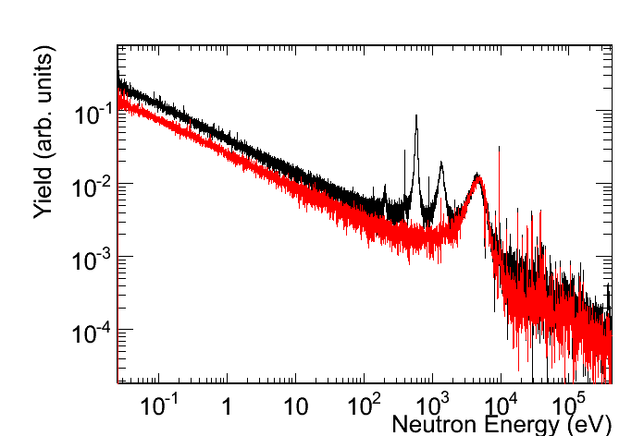
Experiments 2009-2012
Capture (n, γ)
^{58,62}Ni
⁶³Ni
^{54,56,57}Fe
²⁴¹Am → × 2
^{235,236,238}U → × 2
²⁵Mg
⁹³Zr
⁸⁷Sr
(n, α) Reaction
¹⁰B
⁵⁹Ni
³³S
⁶³Ni-sample
⁶²Ni-contam.
⁶²Ni sample irradiated in thermal reactor (in 1984 and 1992) total mass of 1002 mg.
Enrichment in ⁶³Ni: ~13 % (131.8 mg)
Contaminants: ~15.4 mg ⁶³Cu
→ chemical separation PSI
First high-resolution measurement of ⁶³Ni(n,γ) in the astrophysical energy range
First experimental observation of resonances in the keV region.
C.Lederer, C.Massimi, et al. Phys. Rev. Lett. 110 (2013) 022501

Slide 25
Phase III

Slide 26
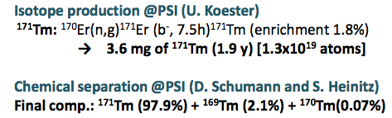
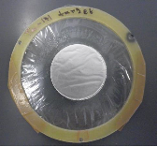
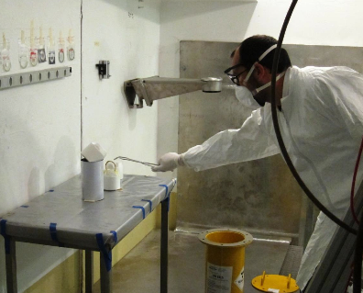
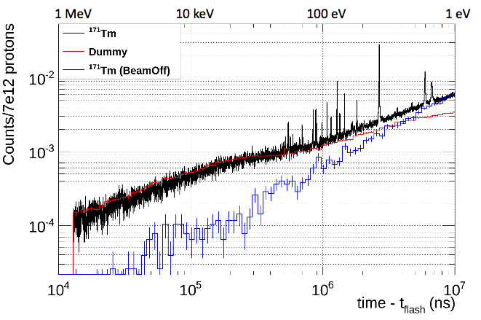
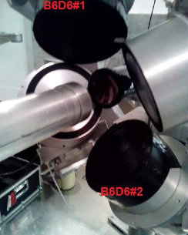
Experiments 2014-20..
Capture (n, γ)
¹⁷¹Tm
^{203,204}Tl
^{70,72,74,76}Ge
¹⁴⁷Pm
^{239, 242}Pu, ²³³U
^{244,246}Cm
(n,α) and (n,p) Reaction
⁷Be, ²⁶Al,
³⁵Cl,¹⁶O, ¹⁴N, ³³S
…

Slide 27
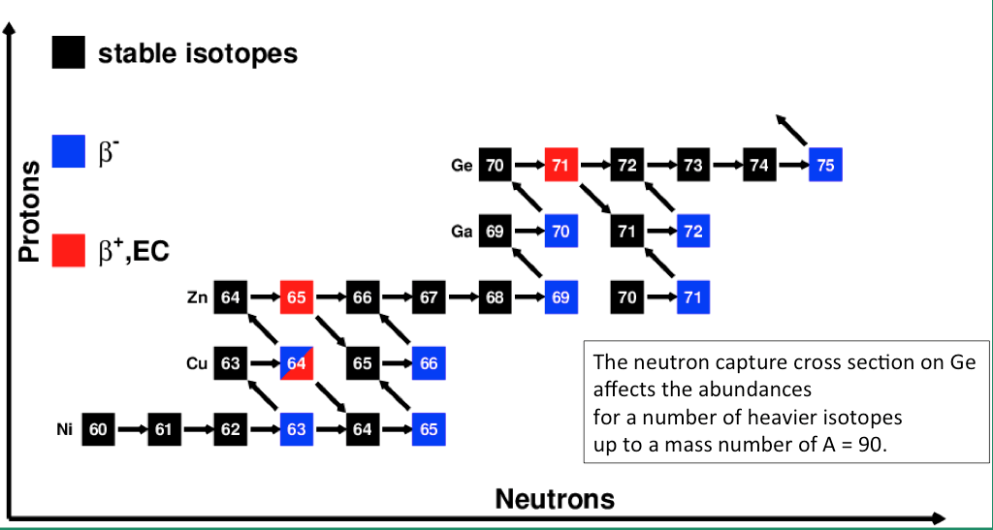
Experiments 2014-20..
Capture (n, γ)
¹⁷¹Tm
^{203,204}Tl
^{70,72,74,76}Ge
¹⁴⁷Pm
^{239, 242}Pu, ²³³U
^{244,246}Cm
(n,α) and (n,p) Reaction
⁷Be, ²⁶Al,
³⁵Cl,¹⁶O, ¹⁴N, ³³S
…
Ongoing measurement in EAR1

Slide 28
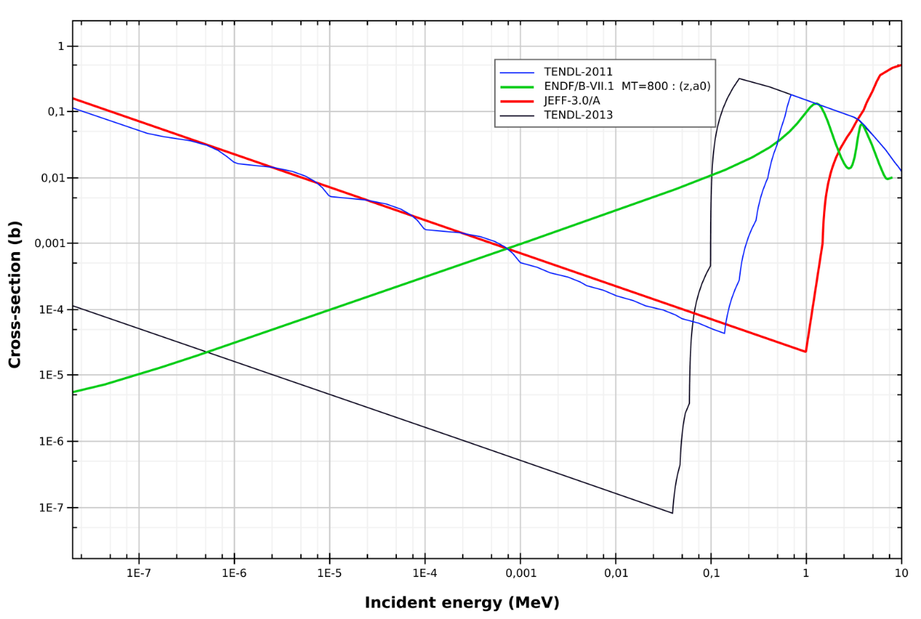
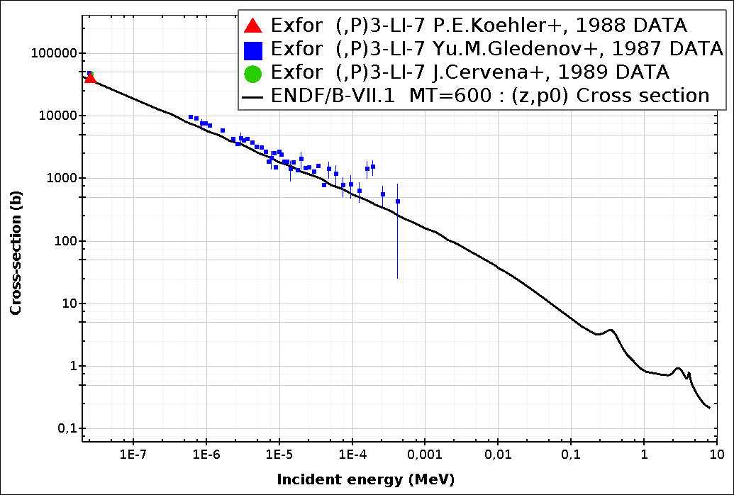
Experiments 2014-20..
..coming soon – EAR2
Capture (n, γ)
¹⁷¹Tm
^{203,204}Tl
^{70,72,74,76}Ge
¹⁴⁷Pm
^{239, 242}Pu, ²³³U
^{244,246}Cm
(n,α) and (n,p) Reaction
⁷Be, ²⁶Al,
³⁵Cl,¹⁶O, ¹⁴N, ³³S
…
BBN successfully predicts the abundances of primordial elements such as ⁴He, D and ³He.
Large discrepancy for ⁷Li, which is produced from electron capture decay of ⁷Be
⁷Be(n, p)
⁷Be(n, α)
few μg of ⁷Be from PSI
(activity of 478 keV
γ-rays 1 GBq/μg)
Silicon 1
Sample
neutrons
Silicon 2

Slide 29
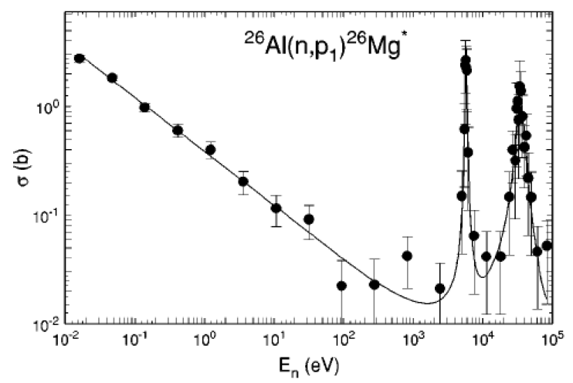
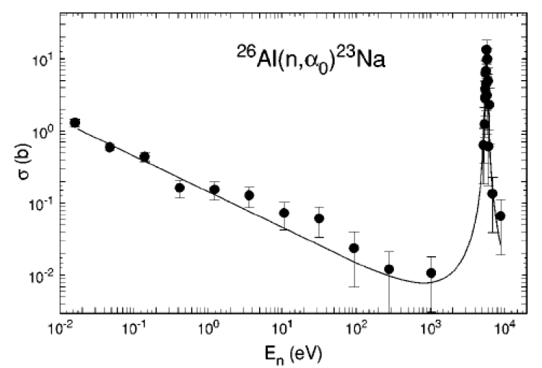
Experiments 2014-20..
Capture (n, γ)
¹⁷¹Tm
^{203,204}Tl
^{70,72,74,76}Ge
¹⁴⁷Pm
^{239, 242}Pu, ²³³U
^{244,246}Cm
(n,α) and (n,p) Reaction
⁷Be, ²⁶Al,
³⁵Cl,¹⁶O, ¹⁴N, ³³S
…
Observation of the cosmic ray emitter ²⁶Al is proof that nucleosynthesis is ongoing in our galaxy. Large uncertainty related to its neutron destruction.
²⁶Al(n, p)
²⁶Al(n, α)

Slide 30
Conclusions
Neutron cross sections are key quantities for studying stellar evolution and nucleosynthesis.
n_TOF facility offers good conditions to obtain these nuclear physics quantities with the required accuracy.
The n_TOF Collaboration is carrying on an extensive plan to measure cross sections relevant for nuclear astrophysics. In particular for the s-process nucleosynthesis studies.
Opportunities for obtaining new data for presently inaccessible nuclei (using extremely low quantities of material) is now open with the EAR 2.

Slide 31

Cristian Massimi
Department of Physics and Astronomy
cristian.massimi@unibo.it
massimi@bo.infn.it
www.unibo.it

Slide 32
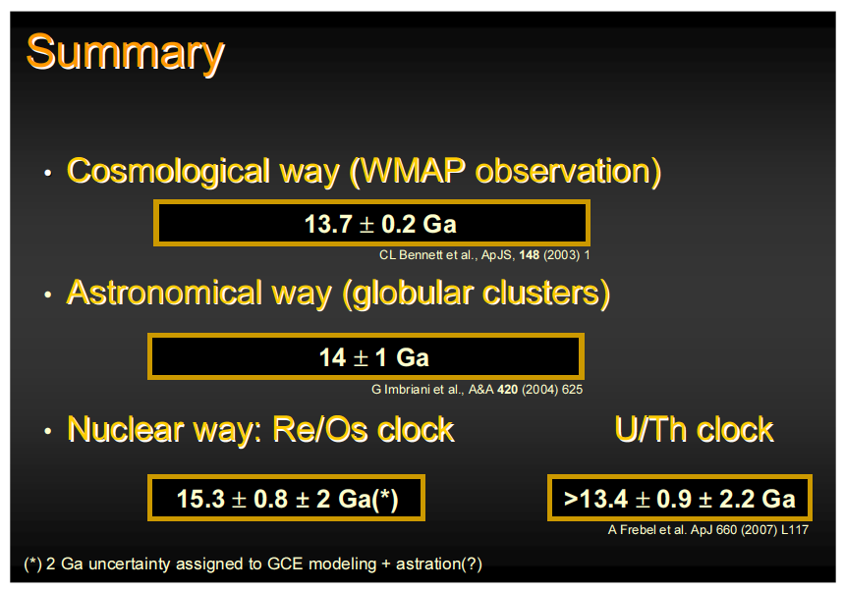
Ages
By A. M.

Slide 33
Cosmocronology
Tnucleosynthesis
BANG!
4.5 Gyr
Now
Galaxies
Solar system
nuclear clocks
²³⁵U / ²³⁸U
²³²Th / ²³⁸U
¹⁸⁷Re / ¹⁸⁷Os
By A. M.

Slide 34
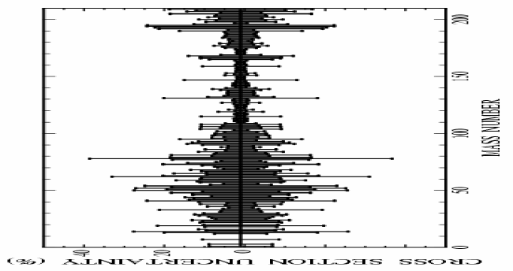
Uncertainties
Neutron magic nuclei
A<120
Unstable branching isotopes
By F. K. and N. C.

Slide 35
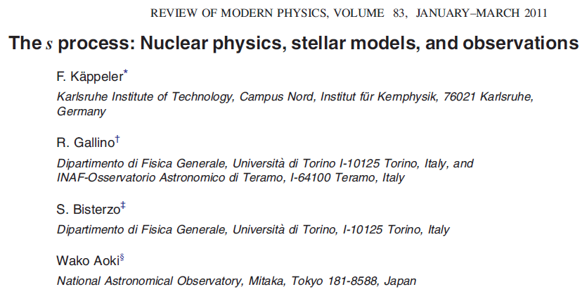
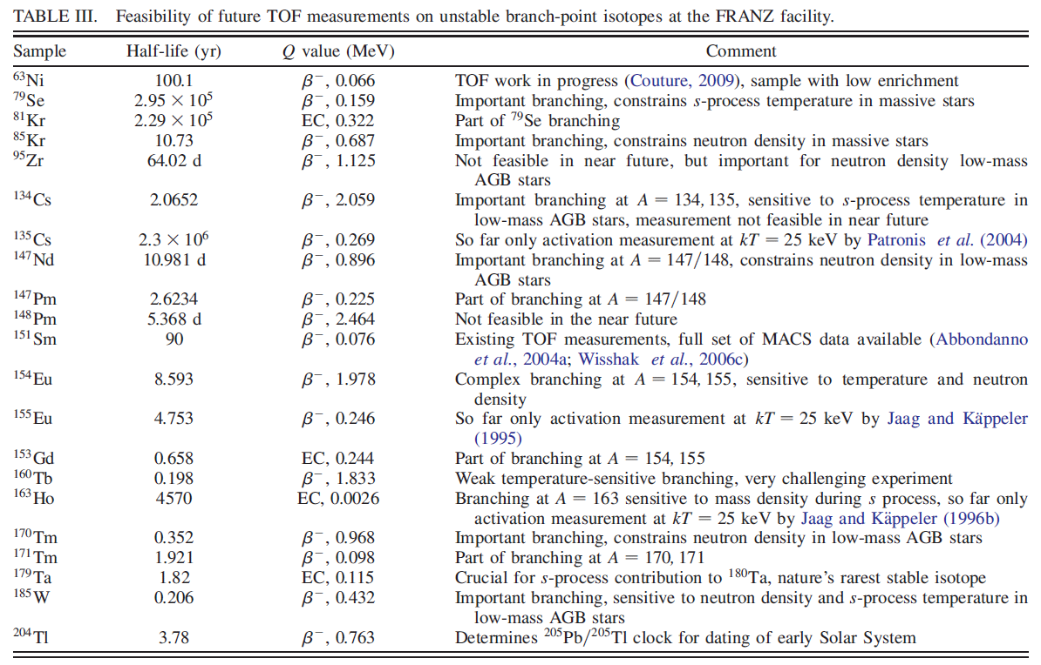
Branching points along the s-path

