Slide 1
Update on USolids/VecGeom integration in Geant4
Gabriele Cosmo, CERN EP/SFT

Slide 2
Contents
Status of implementation of shapes
Status of testing in Shape Tester
Open issues to address
Status of VecGeom shapes usage in Geant4
Geometry features expected in Geant4 10.3

Slide 3
USolids to VecGeom
Geant4
geometry
modeler
ROOT/TGeo
AIDA USolids
VecGeom
~1995
~2002
~2010
~2013
USolids (Unified Solids) library started as AIDA project
  Goal: develop a new library of geometrical primitives to unify algorithms existing in Geant4 and Root
VecGeom: started as feasibility study of vectorization for geometry
Geometry primitives code development as long-term evolution of USolids
  Developed back-to-back with USolids as independent library
  Now incorporating USolids implementation and sharing same interfaces
  Will replace USolids in the medium/long term
  Activity part of AIDA-2020/WP3

Slide 4
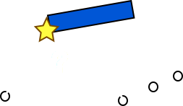
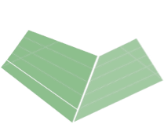
VecGeom: targeting vectorization
Vector signatures
Internal algorithm vectorization
internal loop over
lateral planes for
distance calculation
“parallel” collision detection

For vectorized transport
Beneficial for current
simulations

Slide 5
Status of implementation of shapes

Slide 6
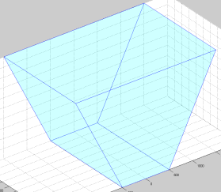
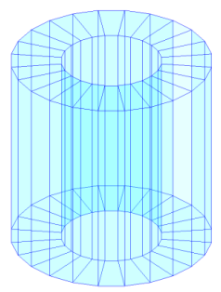
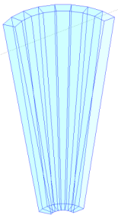
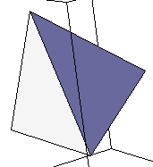
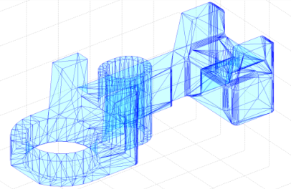
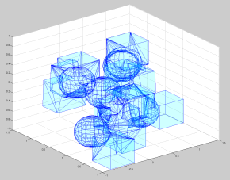
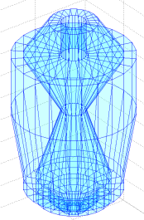
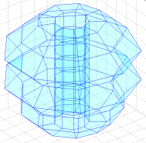
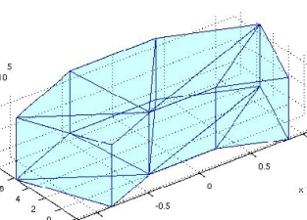
Available shapes: status
Both in USolids and VecGeom:
  Box, Orb, Trapezoid (Trap), Simple Trapezoid (Trd), Sphere (+ sphere section), Tube (+ cylindrical section) , Cone (+ conical section), Generic Trapezoid (Arb8), Polycone, Polyhedron
Only in Usolids:
  Tetrahedron (Tet), Multi-Union, Tessellated Solid, Generic Polycone, Extruded solid
Only in VecGeom:
  Paraboloid, Parallelepiped (Para), Hyperboloid, Ellipsoid, Torus (+ torus section), Scaled Solid, Boolean (addition, subtraction, intersection)
Missing:
  Elliptical Cone, Elliptical Tube, Cut Tube, Twisted shapes (box, trap, tube)

Slide 7
Available shapes: final target
in VecGeom:
  Box, Orb, Trapezoid (Trap), Simple Trapezoid (Trd), Sphere (+ sphere section), Tube (+ cylindrical section) , Cone (+ conical section), Generic Trapezoid (Arb8), Polycone, Polyhedron
  Tetrahedron (Tet), Multi-Union, Tessellated Solid, Generic Polycone, Extruded solid
  Paraboloid, Parallelepiped (Para), Hyperboloid, Ellipsoid, Torus (+ torus section), Scaled Solid, Boolean (addition, subtraction, intersection)
  Elliptical Cone, Elliptical Tube, Cut Tube, Twisted shapes (box, trap, tube)

Slide 8
The testing suite
Geant4 tests
- Unit tests
- SBT(solid batch test)
- SurfaceChecker
- OpticalEscape
- SurfaceVisTest
- testDistanceAccuracy.cc
…
Extensive Testing Suite
Root tests
CheckShape:
-ShapesDistances()
-ShapesSafety()
-ShapeNormal()
Possibility to test shape on Run Time
USolids tests
-SBT
-OpticalEscape
-SBTperformance (Comparison
Usolids, Root, Geant4)
Unit tests
Shape Tester
Geant4+USolids+Root tests
New 'X-Ray Scan' Test
SBTperformance
Testing Suite

Slide 9
Coverage extension in Shape Tester - ongoing
One shape for each different topology
  Sections, shells, …
  Degenerated configurations
  Pathological cases
Shapes selection from a DB
  DB generated from imported LHC experiments geometries
Random generation of shapes
  Per type, dimension and position in space
Batch or interactive mode

Slide 10
Status of testing in Shape Tester & open issues

Slide 11
Current status of shapes in ShapeTester
Shape | Conventions test | Stress tests
Box (o) | OK | OK
Tube (o) | OK | OK
Trapezoid (o) (x) | OK | OK
Generic Trapezoid (Arb8) (o) (x) | OK | OK
Simple Trapezoid (Trd) | OK | OK
Orb (o) | OK | OK
Sphere | OK | OK
Paraboloid (o) | OK | OK
Cone (x) | OK | OK
Parallelepiped (Para) (o) | OK | OK
Polycone (x) | Failures | Failures
Polyhedron (x) | OK | OK
Torus (x) | Failures | Failures
All other shapes either missing or showing failures
(o) Migrated to new framework
(x) Being worked out now…

Slide 12
Currently working on …
Migration of shapes to new framework adopting VecCore
  Rationalization of interfaces and vector signatures
  Careful evaluation of performance figures: no impact expected
Improvement of Trap performance
  Special focus on DistanceToIn() function
Addressing issue affecting Cone and Polycone
  Errors reported from ShapeTester
  Scalability with increasing number of Z-sections in Polycone
  Internal vectorisation
Review of CalculateExtent() in Geant4 for geometry optimisation
  Rationalize and improve existing code
  Need to apply same voxelisation technique to VecGeom shapes as for G4 ones
  Required in order to have meaningful performance comparisons

Slide 13
Shapes: immediate open issues to address
Fix errors reported by Shape Tester
  Including any new added topologies
Improve Trap performance
  DistanceToIn() in UTrap is faster
  Internal vectorisation
Improve robustness and performance for Cone and Polycone
Complete migration to new VecCore framework for all shapes
Complete review of CalculateExtent() in Geant4 for all shapes
Robustness and fixes for problems detected only when running on complex setups

Slide 14
Status of VecGeom shapes usage in Geant4

Slide 15
Using VecGeom from Geant4 - status
USolids can be used in Geant4 since release 10.0
  Passing the whole Geant4 testing suite
  Some run-time warnings with CMS bench
VecGeom solids can be used seamlessly since Geant4 10.2 as external library
  Part of nightly builds in Geant4
    VecGeom shapes from Git master
    Tested on CentOS/gcc-5.3
    A number of tests failing (mainly FPE errors) or showing run-time errors/warnings
  With current Geant4 development version, VecGeom works in batch and interactive mode
    Also in multi-threading (MT), including parameterisations
  Ability to select shapes to replace at installation, since 10.2.p02.
Future plan: provide specialised navigation interface class to VecGeom navigation

Slide 16
Building Geant4 to use USolids/VecGeom
Install USolids/VecGeom libraries
  Configure to either use USolids implementation:
    cmake -DBACKEND=Scalar -DGEANT4=OFF -DUSOLIDS=ON -DUSOLIDS_VECGEOM=OFF \
    [...other optional VecGeom switches as needed...] \
    -DCMAKE_INSTALL_PREFIX=${VecGeomINSTALLDIR} ${VecGeomSOURCE}
    make install
  or VecGeom implementation:
    cmake -DBACKEND=Scalar -DGEANT4=OFF -DUSOLIDS=ON -DUSOLIDS_VECGEOM=ON \
    [...other optional VecGeom switches as needed...] \
    -DCMAKE_INSTALL_PREFIX=${VecGeomINSTALLDIR} ${VecGeomSOURCE}
    make install
Install Geant4
  export USolids_DIR=${VecGeomINSTALLDIR}/lib/Cmake/USolids
  Add -DGEANT4_USE_USOLIDS=ON when configuring Geant4 with CMake
NOTE: reasonably recent version of the gcc/clang compilers required. Windows VC++ not supported

Slide 17
Geometry features in Geant4 10.3

Slide 18
Expected geometry features in Geant4 10.3
Ability to exercise a limited set of shapes from VecGeom
  Box, Tube, Cone, Orb, Para, Sphere, Trap, Trd, Torus, Polycone, Polyhedron
  Approaching “production quality” in terms of correctness and robustness
Extension of Geant4 CMake build system to enable use of shapes individually (already available in 10.2.p02 and 10.3-beta)
Ability to scale shapes along Cartesian axes
  Extended GDML schema (new version 3.1.4)

Slide 19
Summary
Most common shapes now implemented in VecGeom
  Shapes passing Shape Tester: box, tube, cone, orb, para, sphere, trd, trap, generic trap, paraboloid, polyhedron
  Performance issues: cone, trap, polycone
In process to extend Shape Tester
  On going extension of coverage for shapes topologies
VecGeom through Geant4 in place (shapes level)
  Expecting near to “production quality” performance in Geant4 release 10.3 for a set of relevant shapes

