Slide 1
Geant4 Reverse MC status
Laurent Desorgher, Institute of Radiophyics

Slide 2
Outline
  Status in Geant4
  Recent developments in Geant4
  Ongoing development in Geant4
  Recent developments in GRAS
  Test (see next talk by F. Lei et al.)

Slide 3
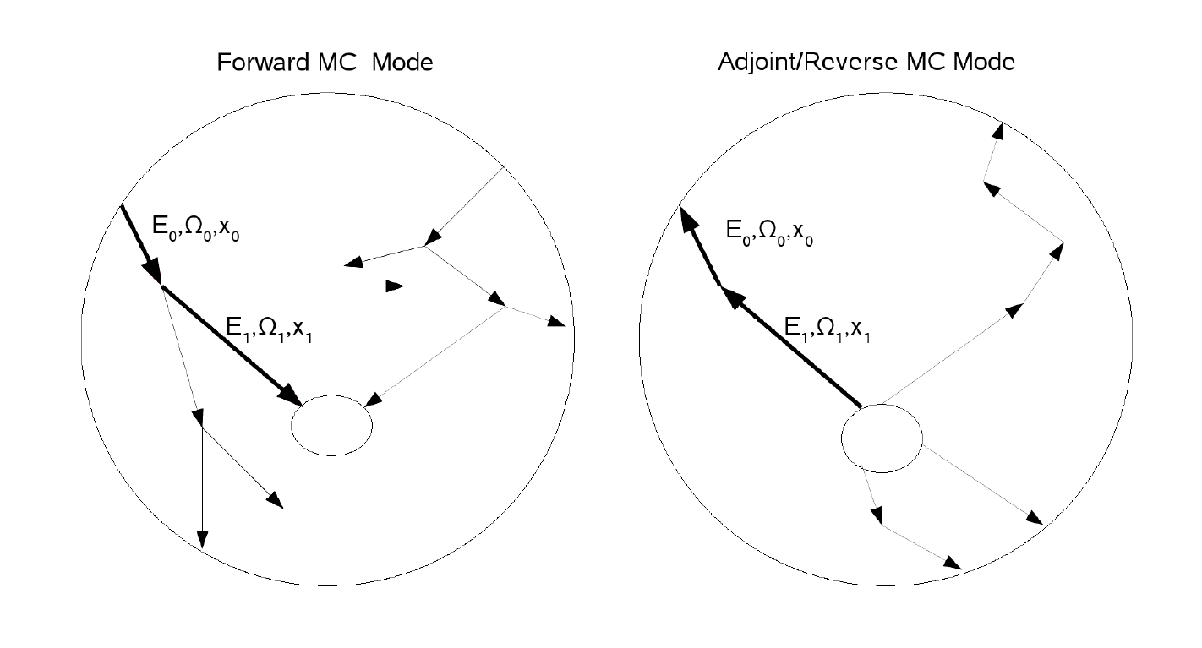
Reverse MC method
Reverse MC
Start from the tiny sensitive volume
Reverse tracking with occurence of reverse processes till external sources
In Geant4 Reverse Compton, Photoe-electric, bremsstrahlung, ionisation e-,protons

Slide 4
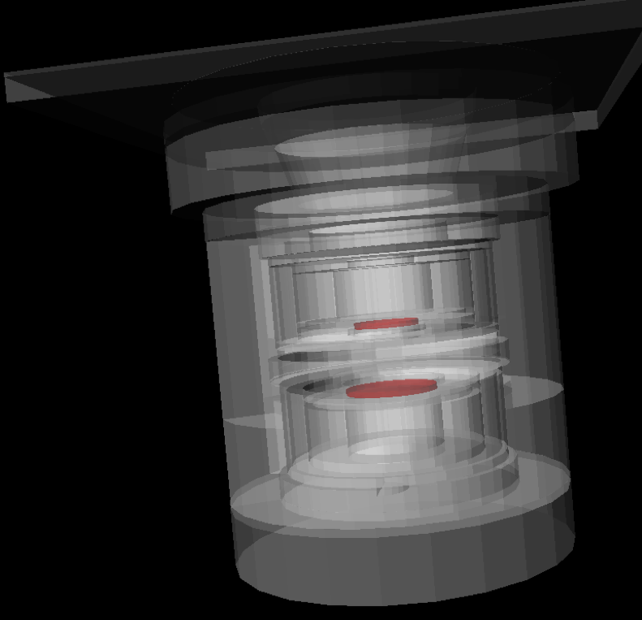
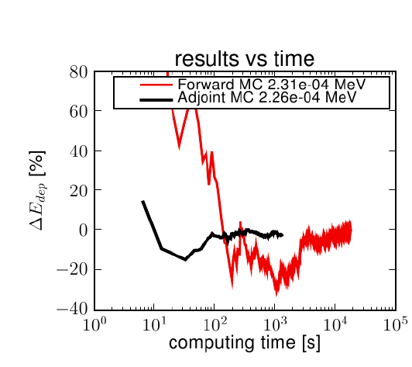
Reverse MC example with
SREM detector of ESA
Primary spectrum exp(-E/1MeV)

Slide 5
Recent developments in G4
  Correction of bug in reverse multiple scattering
  Implementation of splitting of reverse tracking

Slide 6
Correction of bug im multiple scattering
Bug description:
  The Multiple scattering was considering the adjoint electron as an ion when computing the maximum step limit
  Much shorter steps than in fwd tracking
  Increase the computing time fo reverse e- tracking
  I do not know when the bug was introduced
Solution:
  New classes G4UrbanAdjointMScModel and G4eAdjointMultipleScattering
  Force at initialisation to recognise the adjoint e- as an electron for multiple scattering
  Will discuss with Vladimir to implement the change directly in original classes

Slide 7
Implementation of reverse tracking splitting
Several tracks can reach the external source during the same event
The user has now the possibility to split creation of adjoint primary /adjoint/SetNbOfPrimaryAdjGammasPerEvent
/adjoint/SetNbOfPrimaryAdjElectronsPerEvent
Open the possibility to implement other biasing method for reverse tracking

Slide 8
Test adjoint primary splitting
Code 2 times slower for a gamma splitting factor of 10 : winning factor 5
Smooth the gamma spectrum

Slide 9
Ongoing Implementation of forced interaction in gamma reverse physics
Most of the time the reverse/forward gamma will not interact with the geometry
Force interactions along the track of the reverse gamma to go back to a primary electron on the other side of the shielding
Give more weights for interaction in external layers
Only valid for gamma induced by primary elecetrons

Slide 10
Recent developments in GRAS Reverse Monte Carlo mode
  Adapt GRAS for the reverse splitting
  Implementation of Log interpolation of RMC external spectra
  Extend the adjoint point detector analysis mode to gamma dose computation
  Add the registering of convergence of dose results for gamma and electrons separately

Slide 11
Implementation of gamma dose for point detector analysis
Use of Mass Energy-Absorption Coefficient, μ_{en}/ρ
for Xrays and gammas published by NIST
Dose = fluence * E *μ_{en}/ρ
Fluence computed at the position of the point detector
Table of coefficients μ_{en}/ρ implemented in code for
  Si, Al, C, SiO2, GaS

Slide 12
Gamma fluence to dose conversion coefficient in GRAS Reverse Monte Carlo

