Slide 1
GRAS Reverse MC Tests Results
F. Lei, P. Truscott, L. Desorgher, G. Santin
21st G4 Collaboration Meeting, Ferrara, 14/09/2016

Slide 2
Outline
Background
Simple Spherical Shell Shield Results
Point Detector Results
Outlook

Slide 3
Background
A small project supported by ESA:
  To develop and execute a set of tests of the performance of the Geant4 Reverse MC physics, as implemented in GRAS
  Carry out improvements to G4 ReverseMC and GRAS
  To identified areas for future improvements
  Work started in May/June and to complete end of the year

Slide 4
Performance Test
Assessment of performance of existing Geant4 and GRAS models in particular for the Jovian electron environment.
Evaluations on physics accuracy, computational speed, and convergence issues:
  Using spherical geometry and more complex 3D geometries
  Test the doses and secondary particle spectra between GRAS, with G4 forward MC, and SD2
  Perform the tests with the different reverse processes switch on/off
  Analyse the contribution of pair productions to dose behind thick shielding
  For each test cases consider at least the JUICE and Galileo type of primary spectra

Slide 5
Spherical Shielding Tests
Version of GRAS/Geant4 tested
  GRAS:Trunk HEAD
  G4: geant4-10-02-ref-07
Running the spherical shell tests with both FMC and RMC:
  JUICE e- spectrum
  0.1 – 50 mm Al and Ta spherical shell of 10 cm inner radius
  Evaluated quantities:
    in 10 micro thick Si placed immediately inside the shell
    Electron and gamma spectra after the shell
    Convergence of the calculated Dose, in the case of RMC

Slide 6
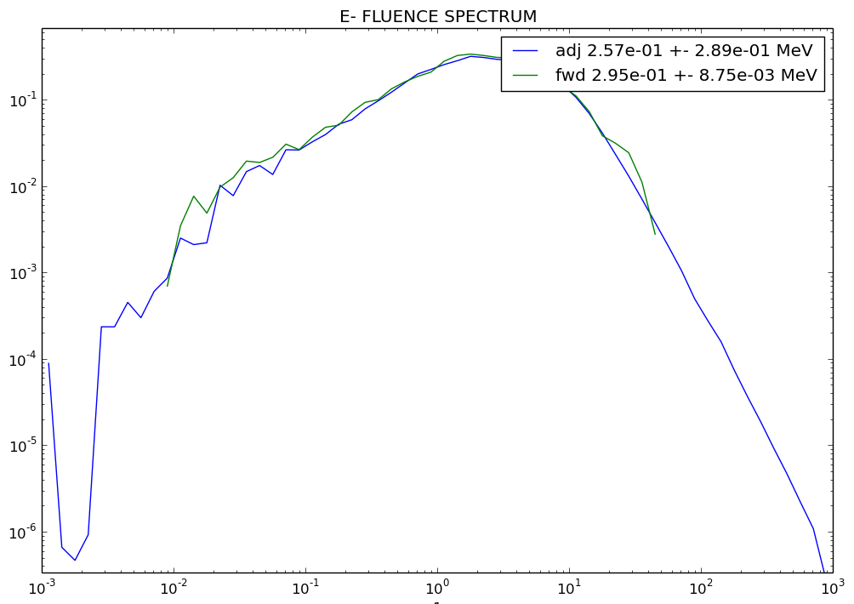
5 mm Al Shielding
nb particles
Energy [MeV]

Slide 7
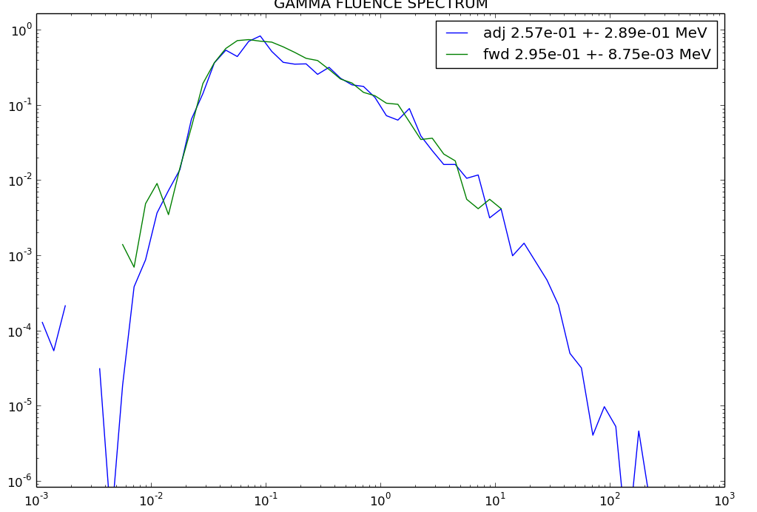
5 mm Al Shielding
nb particles
Energy [MeV]

Slide 8
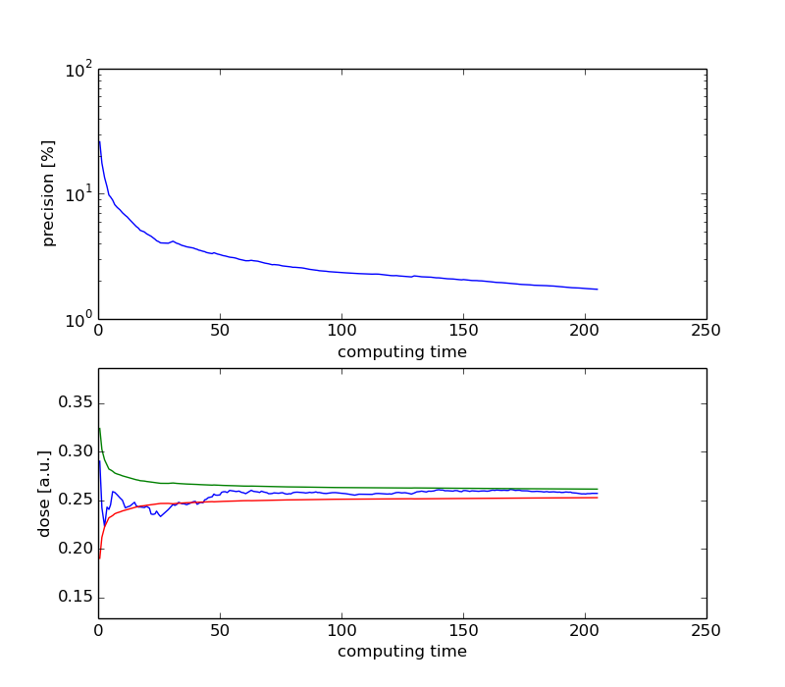
5 mm Al shielding

Slide 9
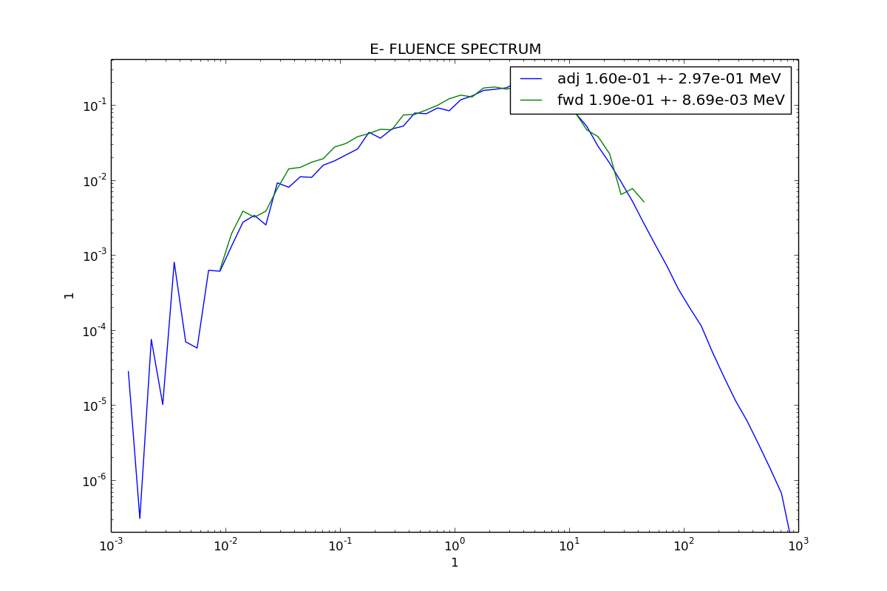
5 mm Al eq Ta, JUICE Spectrum
nb particles
Energy [MeV]

Slide 10
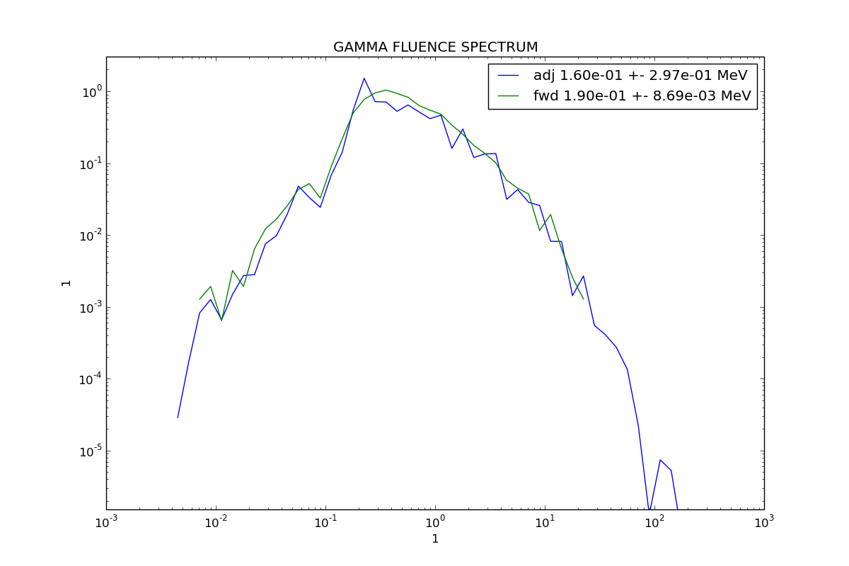
5 mm Al eq Ta shielding
nb particles
Energy [MeV]

Slide 11
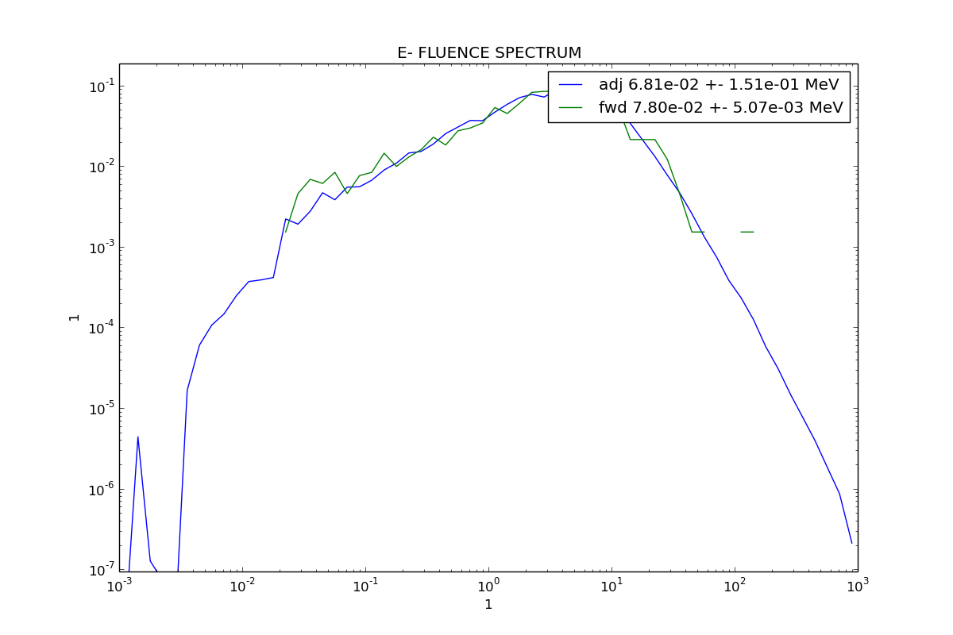
10 mm Al, JUICE Spectrum
nb particles
Energy [MeV]

Slide 12
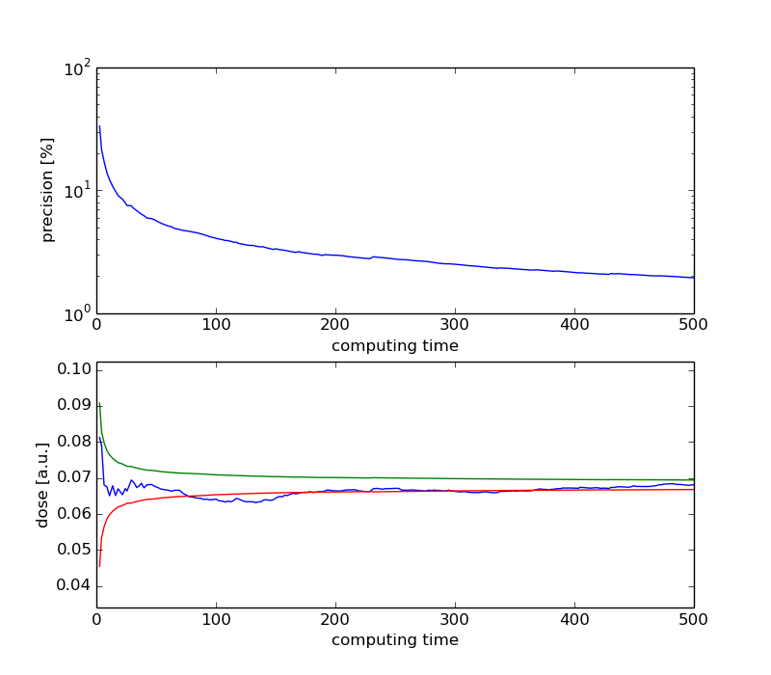
10 mm Al, JUICE Spectrum

Slide 13
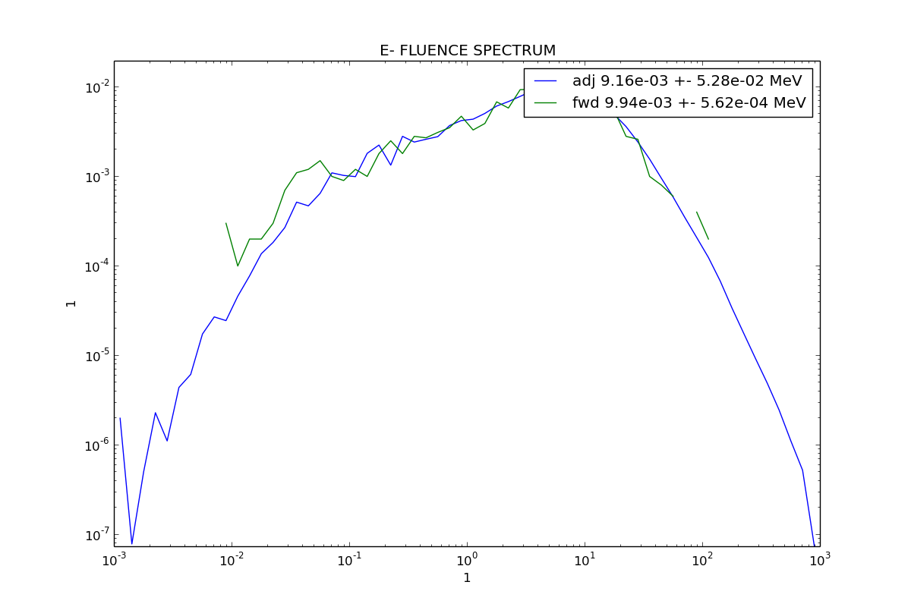
25 mm Al, JUICE Spectrum
nb particles/ MeV
Energy [MeV]

Slide 14
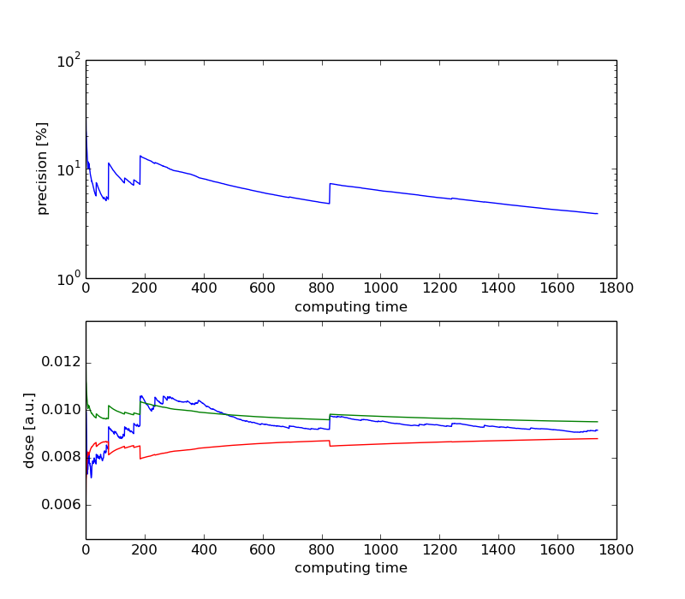
25 mm Al, JUICE Spectrum

Slide 15
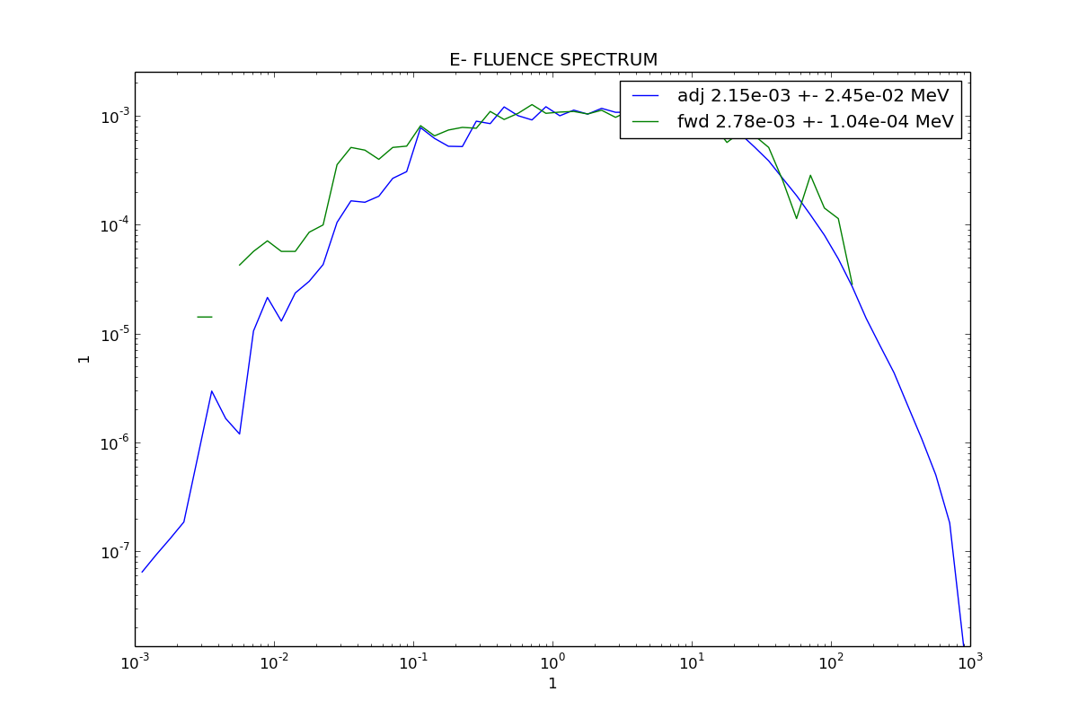
50 mm Al, JUICE Spectrum
nb particles
Energy [MeV]

Slide 16
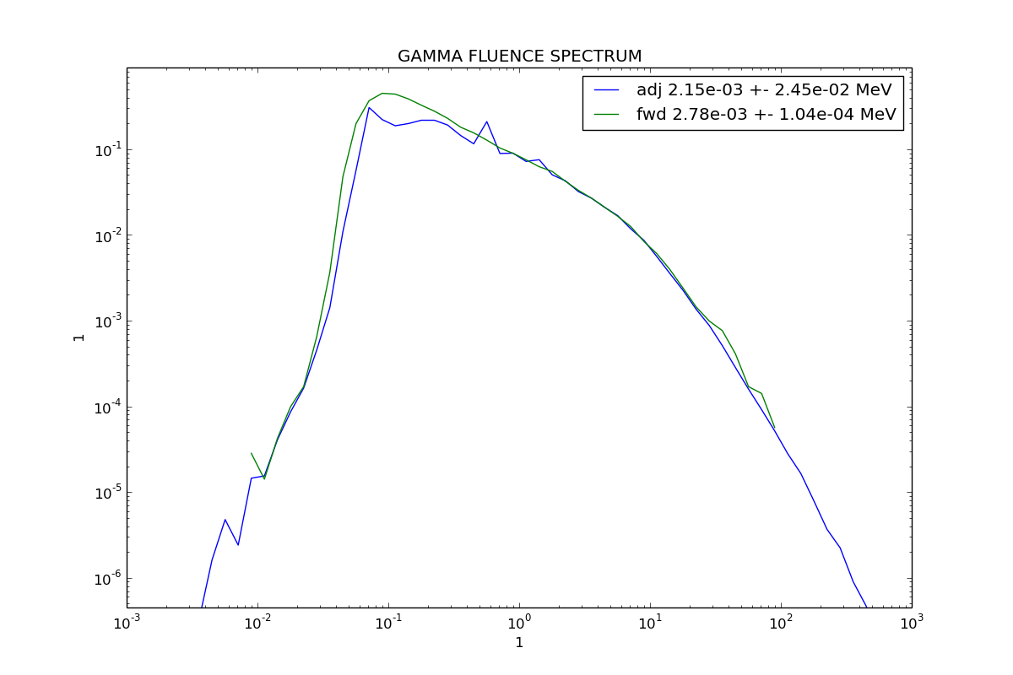
50 mm Al, JUICE Spectrum
nb particles
Energy [MeV]

Slide 17
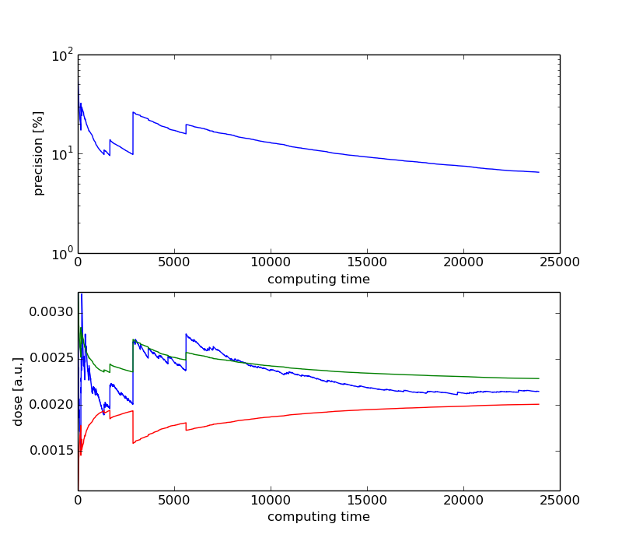
50 mm Al, JUICE Spectrum

Slide 18
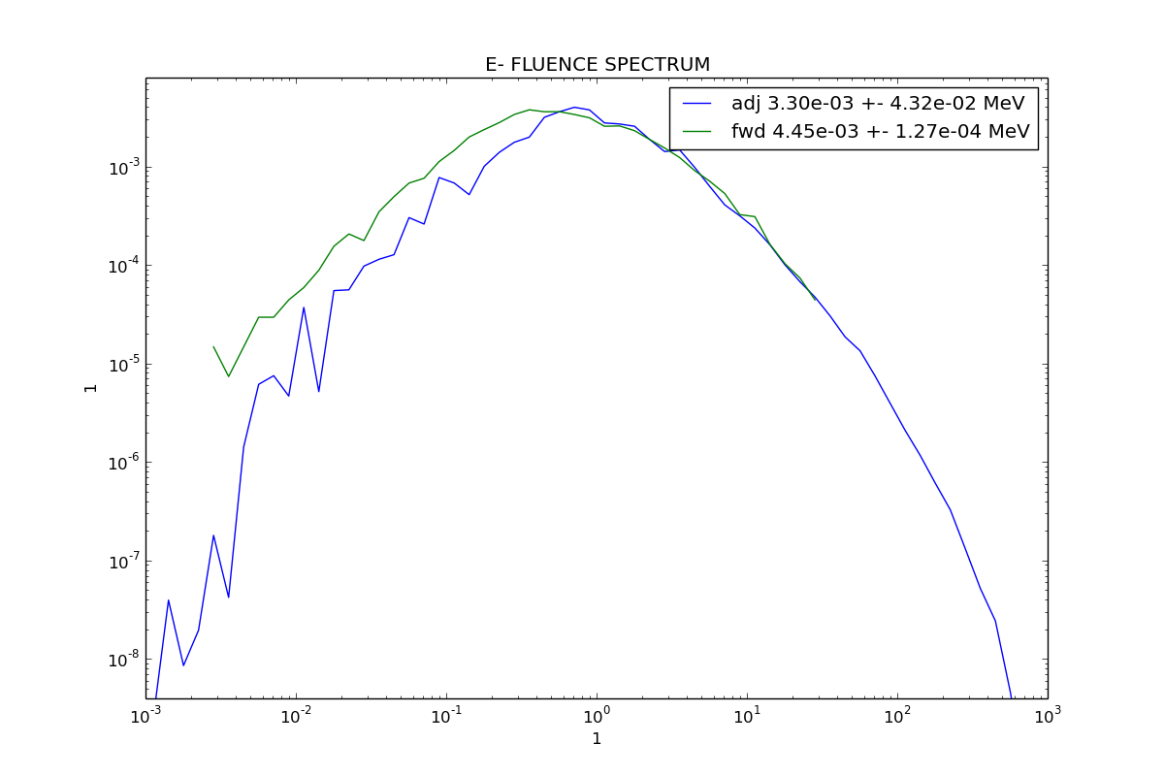
50 mm Al eq Ta, JUICE Spectrum
nb particles/MeV
Energy [MeV]

Slide 19
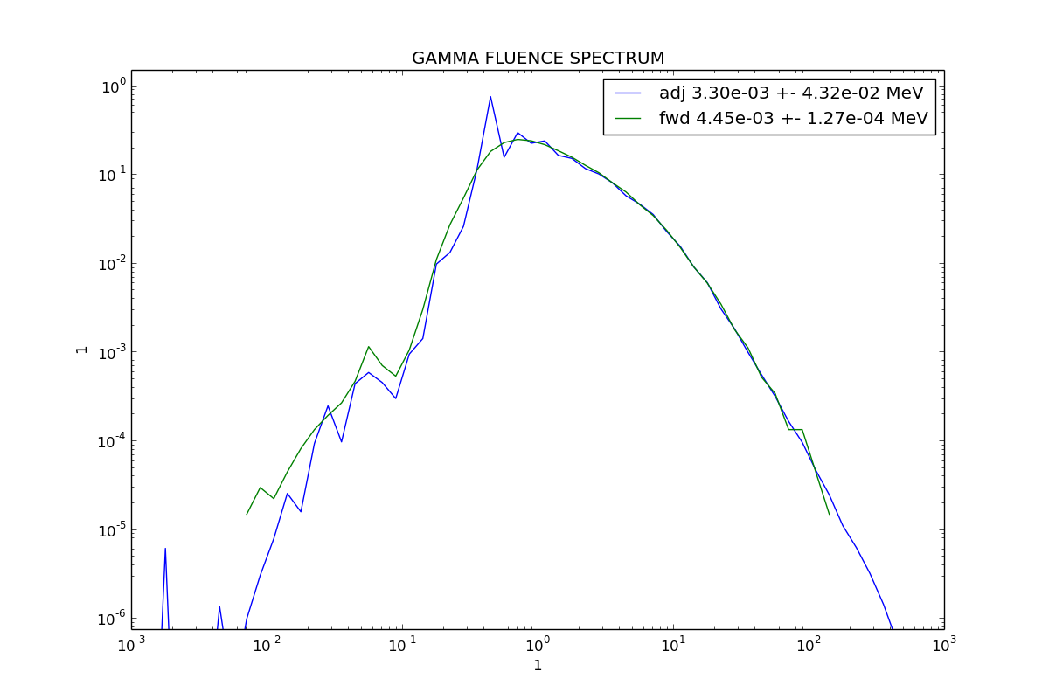
50 mm Al eq Ta, JUICE Spectrum
Energy [MeV]

Slide 20
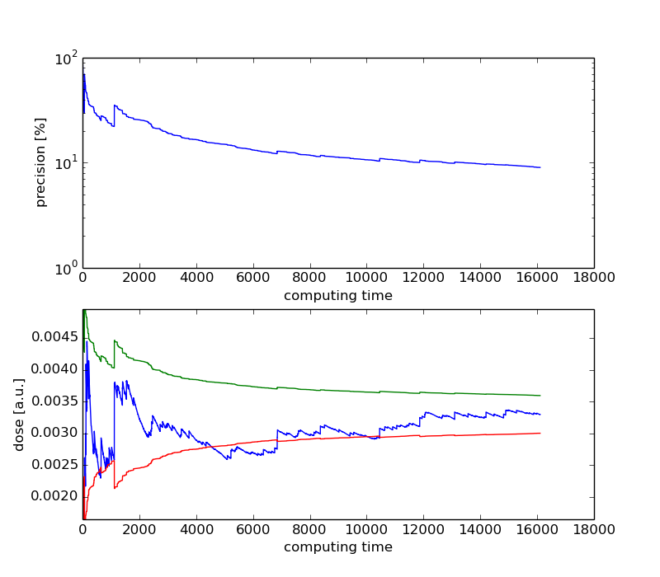
50 mm Al eq Ta, JUICE Spectrum

Slide 21
Problems Identified
The RMC dose is always lower than the FMC one
  10-20 % for <10 mm cases
  >20% for >10 mm cases
Large individual dose depositions in > 10 mm cases
  Are they physical?
  Due to too large weight?

Slide 22
Preliminary Point Detector Tests
New point detector analysis module in GRAS, based on the use of
  dE/dx for charged particles
  Mass-absorption coefficients for gammas
A repeat of the 50mm Al spherical shell case
  Convergence of the calculated doses
    Gamma, electron and combined

Slide 23
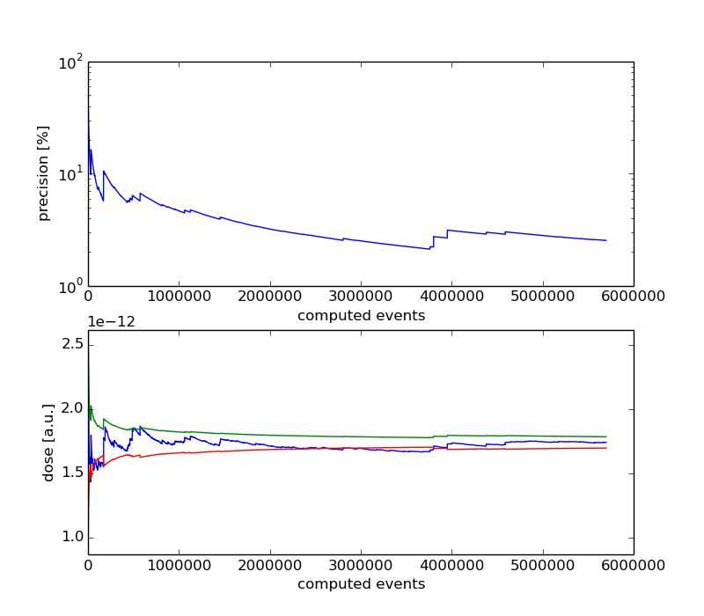
50 mm Al, JUICE Spectrum, Electron Dose

Slide 24
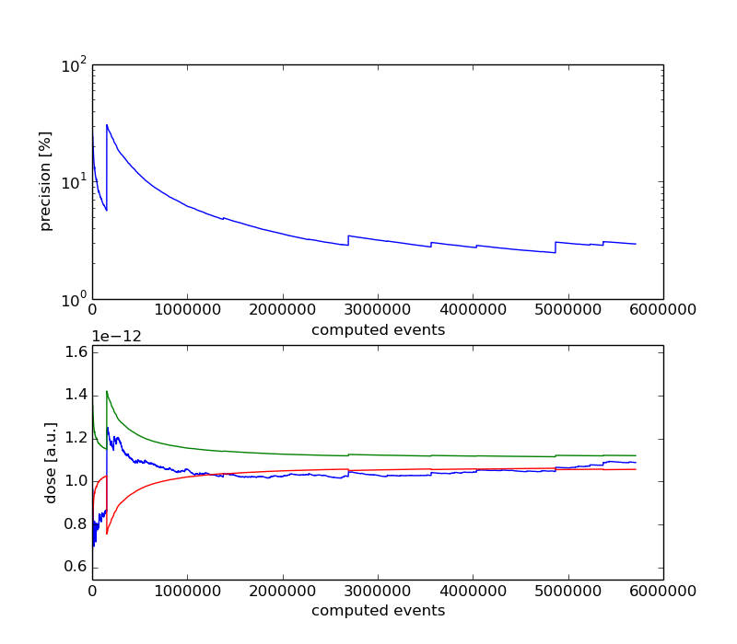
50 mm Al, JUICE Spectrum, Gamma Dose

Slide 25
Outlook
The development of more tests
  For point-detectors
  With more complicated 3D geometries
  For more environments – e.g. Galileo
Investigation of the convergence issue:
  Possible connection with the primary particle spectrum sampling – the JUICE spectrum has a dynamical range > 10^6.
  Review the dose calculation algorithm in cases of extreme weights

