Slide 1
New extended example
/medical/dna/chem4
Pier Piersimoni
Mathieu Karamitros

Slide 2
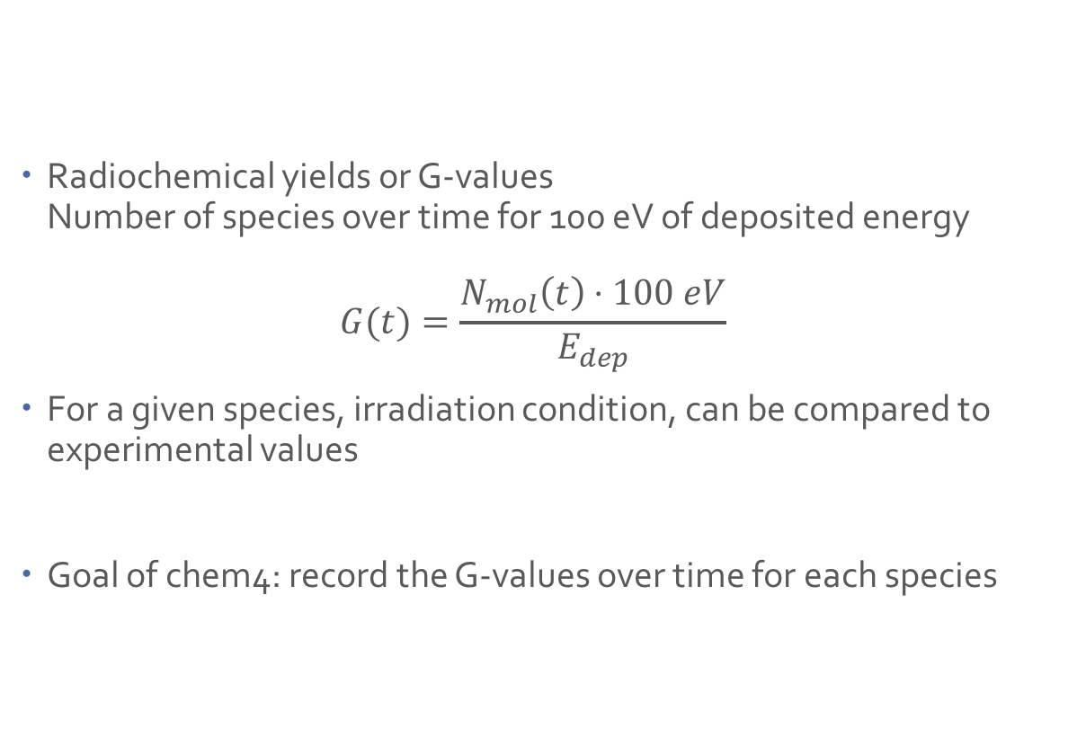
Radiochemical yields
Radiochemical yields or G-values
Number of species over time for 100 eV of deposited energy
$G(t)=\frac{N_{mol}\left(t\right)⋅100 eV}{E_{dep}}$
For a given species, irradiation condition, can be compared to experimental values
Goal of chem4: record the G-values over time for each species

Slide 3
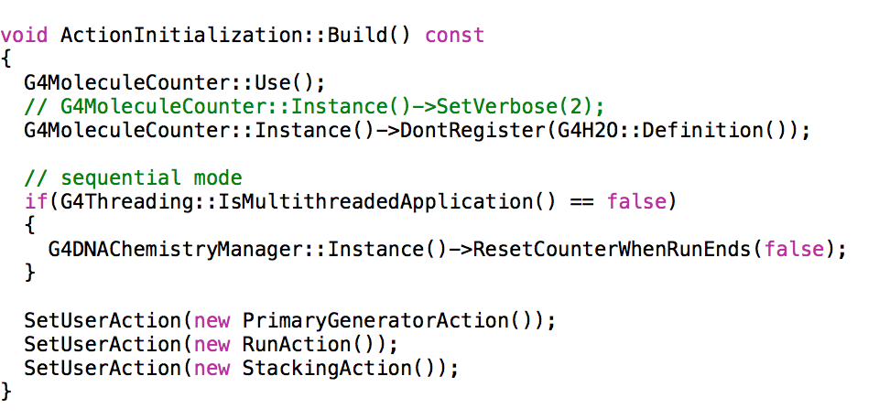
Run application
Relevant classes
G4MoleculeCounter
Where Component of Geant4
Role Records only the changes of chemical species over time
Usage

Slide 4
Run application
Relevant classes
G4MoleculeCounter
Where Component of Geant4
Role Records only the changes of chemical species over time
ScoreSpecies
Where Component of the application
Role 1. Scores the total energy deposited
2. Retrieves from G4MoleculeCounter the number of chemical species at given time (use SpeciesScorer::AddTimeToRecord)
PrimaryKiller
Where Component of the application
Role Kills the primary track after it has lost more than a certain threshold
UI /primaryKiller/eLoss 600 eV

Slide 5
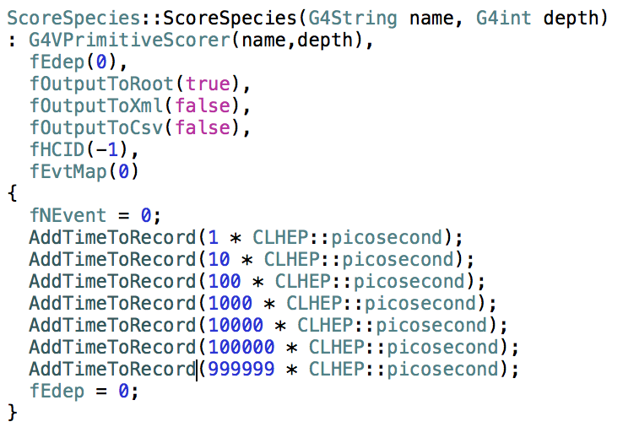
Run application
Relevant classes
ScoreSpecies
Where Component of the application
Role 1. Scores the total energy deposited
2. Retrieves from G4MoleculeCounter the number of chemical species
at given time (use SpeciesScorer::AddTimeToRecord)
Usage
Time to record is hard coded
can be removed using
ScoreSpecies::ClearTimeToRecord()

Slide 6
Run application
Relevant classes
G4MoleculeCounter
Where Component of Geant4
Role Records only the changes of chemical species over time
ScoreSpecies
Where Component of the application
Role 1. Scores the total energy deposited
2. Retrieves from G4MoleculeCounter the number of chemical species at given time (use SpeciesScorer::AddTimeToRecord)
PrimaryKiller
Where Component of the application
Role Kills the primary track after it has lost more than a certain threshold
UI /primaryKiller/eLoss 600 eV

Slide 7
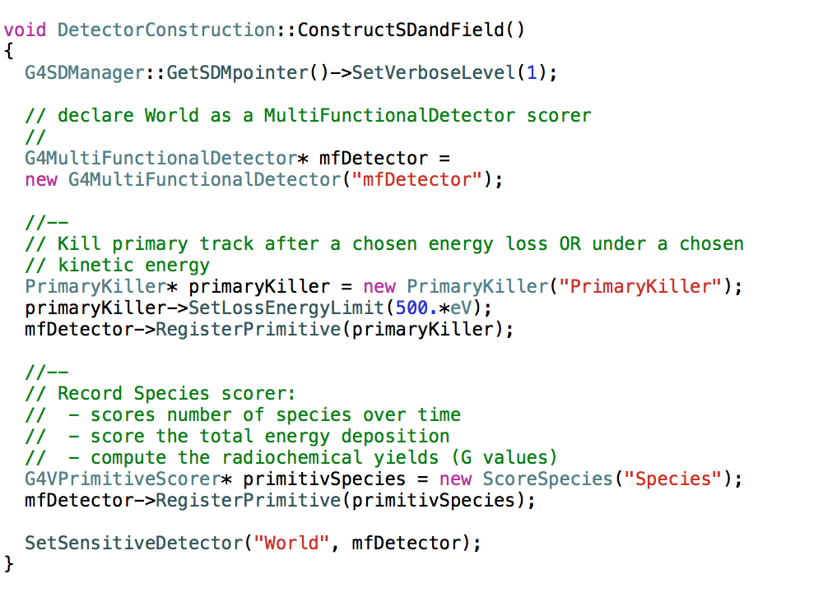
Run application
Relevant classes
Usage of PrimaryKiller and ScoreSpecies
Default value
Can be modified through UI
/primaryKiller/eLoss 600 eV

Slide 8
Run application
Usage
Basic geometry: a cube
Constructors: G4EmDNAPhysics & G4EmDNAChemistry
Launch the application
$ chem4 -mac beam.in -mt 6
An output file called Species.root is created

Slide 9
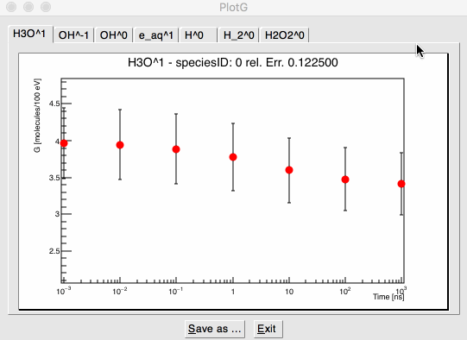
Plot application
Launch the application
$ plot Species.root
Alternatively, launch plot without argument, a window will open to select the ROOT file
Display G-values in respect to time
Default unit is nanosecond
Each tab = a different species
Example
Primary: 1 MeV electron,
Energy loss limit: 600 eV,
Only few events considered

