Slide 1
Update of data-driven nuclear models
KOI, Tatsumi
SD/EPP/Computing
SLAC National Accelerator Laboratory
21st Geant4 collaboration meeting
2016/Sep/16
Ferrara, Italy

Slide 2
Update for ParticleHP (now includes NeutronHP)
NeutronHP and ParticleHP was successfully merged in v10.02
  Header files of NeutronHP still remains in the release
    Consisting of only type alias
      using G4NeutronHPXX = G4ParticleHPXX;
    Therefore, users still be able to use G4NeutronHPXXX in their codes.
G4TENDL data
  Data files for ParticleHP
  Inelastic reactions of light ions (p, d, t, He3 and a) are supported
    G4NDL provides neutrons data for ParticleHP
  Derived from TENDL-2014 or ENDF-VII.r1
    ~400 isotopes are compiled in G4TENDL1.x
    Those isotopes present in the G4NDL4.5 have been included in the data set.
    Rest of isotopes (>2000) will be provided through IAEA web page
  Compressed by zlib (http://www.zlib.net)
    Total size of data files was 2.5Gb (v10.02)
    now 561Mb (v10.03)
  Adding information of based evaluation in each file
    “TENDL-2014” or “ENDFVII.r1”

Slide 3
GND, GIDI and G4LEND
G4LEND: Geant4 Low Energy Nuclear Data
  G4LEND is a package of low energy nuclear interaction model of Geant4. It uses data written in GND format through GIDI interface.
GND: Generalized Nuclear Data
  New, modern structure to replace legacy nuclear data formats (e.g., ENDF-6)
GIDI: General Interaction Data Interface
  Interface to GND
G4LEND has been in release of Geant4 since v9.5 (2011) and it had major update last year
  Migrated recent update of GND and GIDI
  Introduced gamma as projectile
  New data translated from ENDF/BVII.1 was prepared
    Neutrons projectile: 421 nuclides, from H to Es
    Gamma projectile 162 nuclides, from H to Pt

Slide 4
Validation of gamma incidence reaction

Slide 5
Update of LEND
Delayed neutron emission after fission
  A neutron emitted after a nuclear fission event, by one of the fission products
  The neutron emissions delayed a time scale of precursor beta decay from the time of fission.
  Important in nuclear reactor control and safety analysis.
  LEND fission supports these delayed neutrons in 10.03 and later
    Production point of delayed neutron is not sampled and it is exactly same to the place fission happened
Memory consumption of multithreading application
  Like other hadronic models, each thread has own LEND object
    Static data of the objects should be shared, otherwise memory consumptions become proportional to number of threads
    This will be implemented in v10.03
Extension to charged particles incidence
  Coordinated work with EM group is required to avoid double counting of coulomb scattering
  Will be available soon

Slide 6
Delayed neutron emissions and memory consumption in multithreading application

Slide 7
A new neutron capture model based on PGAA data base
  In some isotopes (for example Cd113), we have poor agreement in spectra of gammas after capture of neutrons.
  This causes troubles to adapt our result in non-destructive inspection
  Neutron-capture prompt-gamma activation analysis (PGAA) data base is provided by IAEA
  It provides
    isotopic composition
    thermal radiative cross section (total and partial)
    Westcott g-factors,
    energy of the gamma rays (prompt and delayed)
    decay mode
    half life and branching ratios
    For all natural elements, 250 isotopes from H to U
  PGAA data also provided in ENSDF format
  Plan to provide a model based on the data base.

Slide 8
Prompt Gamma Ray Emission from 113Cd(n,g)114Cd
G4
  NeutronHPCapture
    Photo Evaporation
PGAA TypeA
  Just follow partial cross sections
    Breaking conservations
PGAA TypeB
  Adapting efforts to establish energy conservation and reproduce multiplicity
measurement
  Mheemeed et al., Nuclear Physics A412 113 (1984)
  only show >0.01 and 2 point from high energy end

Slide 9
Handling self-shielding effects in unresolved resonances region(URR)
  Currently we use cross sections which NJOY99 RECONR module provides in the region
  This implies the effect of self-shielding in URR is underestimated in thick materials.
    In other words, we used infinite dilute cross section
  The scales of impact are
    ~10% in most cases
    ~100% in extreme case; in pure material from single isotope
  We began to investigate applying “Probability Table Method” for proper handling of self-shielding effects at the region.

Slide 10
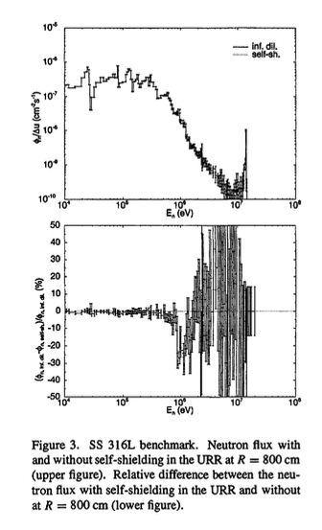
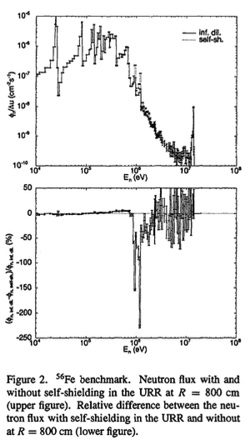
Impact of the self-shielding effects in unresolved resonances region
Stainless Steel 316L
Pure ⁵⁶Fe
From “WHY SELF-SHIELDING IS NEEDED IN MCNP-CALCCILATIONS”,
CONTRIBUTION TO THE 18TH SYMPOSIUMON FUSION TECHNOLOGY, KARLSRUHE, GERMANY, 22-26 AUGUST, 1994

