Slide 1
Qt driver status / new drivers ?
Laurent Garnier OSUR / INSU / CNRS
John Allison Geant4 AI
Geant4 Collaboration Meeting – Ferrara – 15 September 2016

Slide 2
New and Recent Features of Geant4 Visualisation 2016
Significant recent (and not so recent) developments
  OpenGL drawing speed
  Improved command guidance
  Magnetic field drawing
  Multi-threading
  Turning off vis
  Keeping and reviewing events
  /vis/specify
  /vis/drawTree
  /vis/geometry commands
  Selecting touchables
  Qt driver only :
    Fix “set visible” bug
    Making movies : Update parameters to improve the quality

Slide 3
New and Recent Features of Geant4 Visualisation 2016
Planned for Geant4 10.3
  G4Orb, G4Sphere, G4Torus and G4Ellipsoid default drawing
  Drawing by encountered volume
  Interpolation of saved views
    movie making
  UI completion

Slide 4
OpenGL drawing speed
The currrent default is to draw every volume and component of every trajectory to screen immediately
  This is very expensive (glFlush)
Current workaround
  /vis/ogl/set/eventsDrawInterval 999999
    Improves speed of drawing dramatically (×100 – ×1000)
    May have to wait for trajectories to appear on screen for complex events
    All primitives are flushed to the screen at end of event anyway.
Proposed new command
  /vis/ogl/flushAt [ endOfEvent | eachPrimitive | <N> ]
    Default: endOfEvent

Slide 5
Improved command guidance
Use “help”
  on command line or “Help” pull-down menu in Qt
  or browse ADG Section 7.1
This is where to go for information and documentation!!!!!
  nowhere else!!!!!
Just one example (next slide):
  /vis/scene/add/volume
  (Shows a way of getting a cutaway view)

Slide 6
/vis/scene/add/volume
Command /vis/scene/add/volume
Guidance :
Adds a physical volume to current scene, with optional clipping volume.
If physical-volume-name is "world" (the default), the top of the
main geometry tree (material world) is added. If "worlds", the
top of all worlds - material world and parallel worlds, if any – are
added. Otherwise a search of all worlds is made, taking the first
matching occurence only. To see a representation of the geometry
hierarchy of the worlds, try "/vis/drawTree [worlds]" or one of the
driver/browser combinations that have the required functionality, e.g., HepRep.
If clip-volume-type is specified, the subsequent parameters are used to
to define a clipping volume. For example,
"/vis/scene/add/volume ! ! ! -box km 0 1 0 1 0 1" will draw the world
with the positive octant cut away. (If the Boolean Processor issues
warnings try replacing 0 by 0.000000001 or something.)
If clip-volume-type is prepended with '-', the clip-volume is subtracted
(cutaway). (This is the default if there is no prepended character.)
If '*' is prepended, the intersection of the physical-volume and the
clip-volume is made. (You can make a section/DCUT with a thin box, for
example).
For "box", the parameters are xmin,xmax,ymin,ymax,zmin,zmax.
Only "box" is programmed at present.

Slide 7
Magnetic field drawing
/vis/scene/add/magneticField
  simple arrows

Slide 8
Multi-threading
Worker threads put the event in a queue for drawing by a special vis thread
Queue can easily get full
    the default is to hold up the worker threads
    you can ask for events to be discarded (you then see just a sample)
      /vis/multithreading/actionOnEventQueueFull
    you can increase the queue size
      /vis/multithreading/maxEventQueueSize

Slide 9
Turning off visualisation
  /vis/disable
  /tracking/storeTrajectory 0
You may wish to disable trajectory production too:
"/tracking/storeTrajectory 0"
but don't forget to re-enable with
“/vis/enable”
"/tracking/storeTrajectory 2" (for your case).

Slide 10
Keeping and reviewing events
In SteppingAction or SensitiveDetector::ProcessHits or anywhere
  event->KeepTheEvent () or
  G4EventManager::KeepTheCurrentEvent()
If this is for rare events
  /vis/disable
Then at end of run
  /vis/reviewKeptEvents

Slide 11
/vis/specify <logical-volume-name>

Slide 12
/vis/drawTree
  restores original view
  default changed to show logical volume names
  help message appears only once
G4ASCIITreeSceneHandler::BeginModeling: writing to G4 standard output (G4cout)
…
# Now printing with verbosity 1
# Format is: PV:n / LV (SD,RO)
# Abbreviations: PV = Physical Volume, LV = Logical Volume,
# SD = Sensitive Detector, RO = Read Out Geometry.
"worldPhysical":0 / "worldLogical"
"magneticPhysical":0 / "magneticLogical"
"firstArmPhysical":0 / "firstArmLogical"
"hodoscope1Physical":0-14 / "hodoscope1Logical" (SD="hodoscope1")
"chamber1Physical":0 / "chamber1Logical"
"wirePlane1Physical":0 / "wirePlane1Logical" (SD="chamber1")
…

Slide 13
/vis/geometry commands
  Set vis attributes of logical volumes
  From examples/basic/B1/vis.mac
/vis/geometry/set/visibility World 0 false
/vis/geometry/set/visibility Envelope 0 false

Slide 14
Selecting touchables
  Set vis attributes of touchables
    Set touchable
    Set vis attribute
    Visibility and colour can be done
    with Qt Scene tree
      a good way to get path
      /control/verbose 2
      click in scene tree
/vis/set/touchable World 0 Envelope 0 Shape1 0
/vis/touchable/set/forceAuxEdgeVisible
/vis/touchable/set/lineSegmentsPerCircle 36
/vis/touchable/set/colour cyan

Slide 15
« Set visible » bug
Laurent Garnier has move from LAL to OSUR, less time to play with Geant4 last year
Fix a major bug called « setVisible » on
  * Linux/Windows
  * Mac with Qt4 (or with Qt5)
Crash log :
  #1 do_system (line=<optimized out>) at ../sysdeps/posix/system.c:148
  #2 TUnixSystem::StackTrace() () from /home/gate/Progs/root_v5/lib/libCore.so
  #3 TUnixSystem::DispatchSignals(ESignals) () from /home/gate/Progs/root_v5/lib/libCore.so
  #4 <signal handler called>
  #5 QWidgetPrivate::showChildren(bool) () from /usr/lib/x86_64-linux-gnu/libQt5Widgets.so.5
  #6 QWidgetPrivate::show_helper() () from /usr/lib/x86_64-linux-gnu/libQt5Widgets.so.5
  #7 QWidgetPrivate::showChildren(bool) () from /usr/lib/x86_64-linux-gnu/libQt5Widgets.so.5
  #8 QWidgetPrivate::show_helper() () from /usr/lib/x86_64-linux-gnu/libQt5Widgets.so.5
  #9 QWidget::setVisible(bool) () from /usr/lib/x86_64-linux-gnu/libQt5Widgets.so.5
  #10 G4UIQt::SessionStart() () from /home/gate/Progs/Geant4/geant4.10.01.p02-install/lib/libG4interfaces.so
  #11 main ()

Slide 16
Planned features for 10.3

Slide 17
  G4Orb, G4Sphere, G4Torus and G4Ellipsoid default drawing
By default auxiliary edges will be drawn
  This ensures they are visible in wireframe
    (They are solids that may not have real edges so currently there is the possibility that they are invisible in wireframe mode)

Slide 18
Drawing/filtering by encountered volume
Coming in release 10.3
/vis/scene/add/trajectories rich
/vis/modeling/trajectories/create/drawByEncounteredVolume
/vis/modeling/trajectories/drawByEncounteredVolume-0/set Shape1 cyan

Slide 19
Interpolation of saved views
Tips
  /vis/ogl/set/eventsDrawInterval 9999
  (will become default in 10.3)
Save a sequence of views
  with or without events (trajectories)
  for each view: /vis/viewer/save
  view parameters are saved to a sequence
  of files
    g4_00.view, g4_01.view, etc.
/vis/viewer/interpolate
  with or without the same or different events
/vis/viewer/interpolate ! ! ! ! export
  produces G4OpenGL_viewer-0_nnnn.pdf
  (default 50 per saved view)
  make a movie with iMovie, for example
    set “duration” of each file to 0.1 s (this seems to be the minimum)
    play it back at ×2 or ×4
See https://drive.google.com/file/d/0B-AysSpq22huRUthSmx3bC03Ukk/view?usp=sharing

Slide 20
Interpolation of saved views
Video

Slide 21
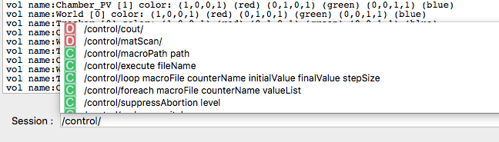
UI completion (Only available for Qt driver)
Autocomplete Geant4 command by matching command or directory

Slide 22
The future?

Slide 23
Keep requirements and comments coming
Wt / WebGL?
New OpenGL version (ongoing)
RayTracer enhancements?

Slide 24
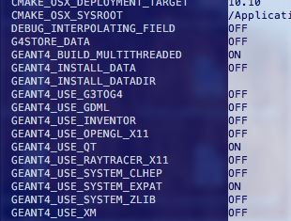
Qt still our flagship !
Need Qt driver ?

Slide 25
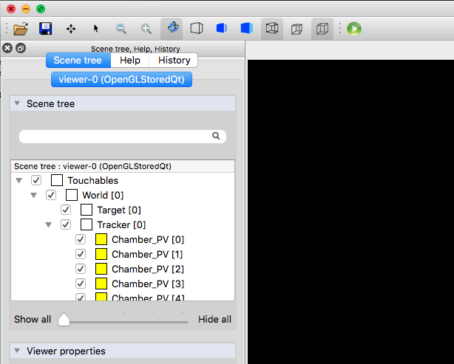
Qt still our flagship !
Set icons by default at startup?

Slide 26
Qt still our flagship !
Define “freeRotation” rotation by default
  Current is theta/phi rotation. Ensure the upVector remain the same
  “freeRotation” does not constraint the upVector. But more natural way to rotate things

Slide 27

Other drivers ? (from our workplan)
G4DAE exporter: Creation of a new driver in order to export/import Collada format
  « COLLADA defines an XML Namespace and database schema to make it easy to transport 3D assets between applications without loss of information, enabling diverse 3D authoring and processing tools to be combined into a content production pipeline. »
Supported by many softwares:
  3ds Max (ColladaMax) / Adobe Photoshop/ Allplan/ ArtiosCAD/ Blender/ Bryce/ Carrara/ Cheddar Cheese Press (model processor)/ Chief Architect Software/ Cinema 4D (MAXON)/ CityEngine/ CityScape/ Clara.io/ DAZ Studio/ Delphi/ E-on Vue 9 xStream/ Esko Studio/ FreeCAD/ FormZ/ GPure/ Houdini (Side Effects Software)/ iBooks Author/ LightWave 3D (v 9.5)/ MakeHuman/ Maya (ColladaMaya)/ MeshLab/ Mobile Model Viewer (Android)/ Modo/ OpenRAVE/ Poser Pro (v 7.0)/ Presagis Creator/ Robot Operating System/ SAP Visual Enterprise Author/ Shade 3D (E Frontier, Mirye)/ Softimage|XSI/ Strata 3D/ Ürban PAD/ Vectorworks/ Visual3D Game Development Tool for Collada scene and model viewing, editing, and exporting/ Wings 3D/ Xcode (v 4.4) /

Slide 28
Other drivers ? (from our workplan)
PDF3D driver - Universal 3D (U3D)
  The format is natively supported by the PDF format and 3D objects in U3D format can be inserted into PDF documents and interactively visualized by Acrobat Reader (since version 7).
  Supported by many sofwares:
    Adobe Acrobat / Adobe Photoshop CS3, CS4 and CS5 Extended / ArchiCAD/ Bluebeam Revu/ DAZ Studio/ iText/ Jreality/ MeshLab/ MeVisLab/ MicroStation/ Poser 7/ Autodesk Inventor/ SolidWorks/ ArtiosCAD/ SimLab Composer/ SpaceClaim/ SAP VE Author

Slide 29
Thanks !

