Slide 1
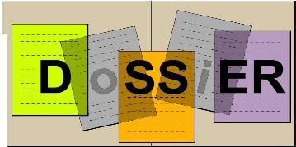
Demo: from running a test to displaying the results
Outline:
The conversion tool.
Prerequisits.
Providing the metadata.
Extracting histogram or TGraph from a root file and creating json file for upload to DoSSiER
Uploading the data using the Web Application.
Displaying the result.
1
Hans Wenzel 21st Geant4 Collaboration Meeting, Ferrara, Italy, September 12 to 16, 2016
9/14/2016
Notes:
1

Slide 2
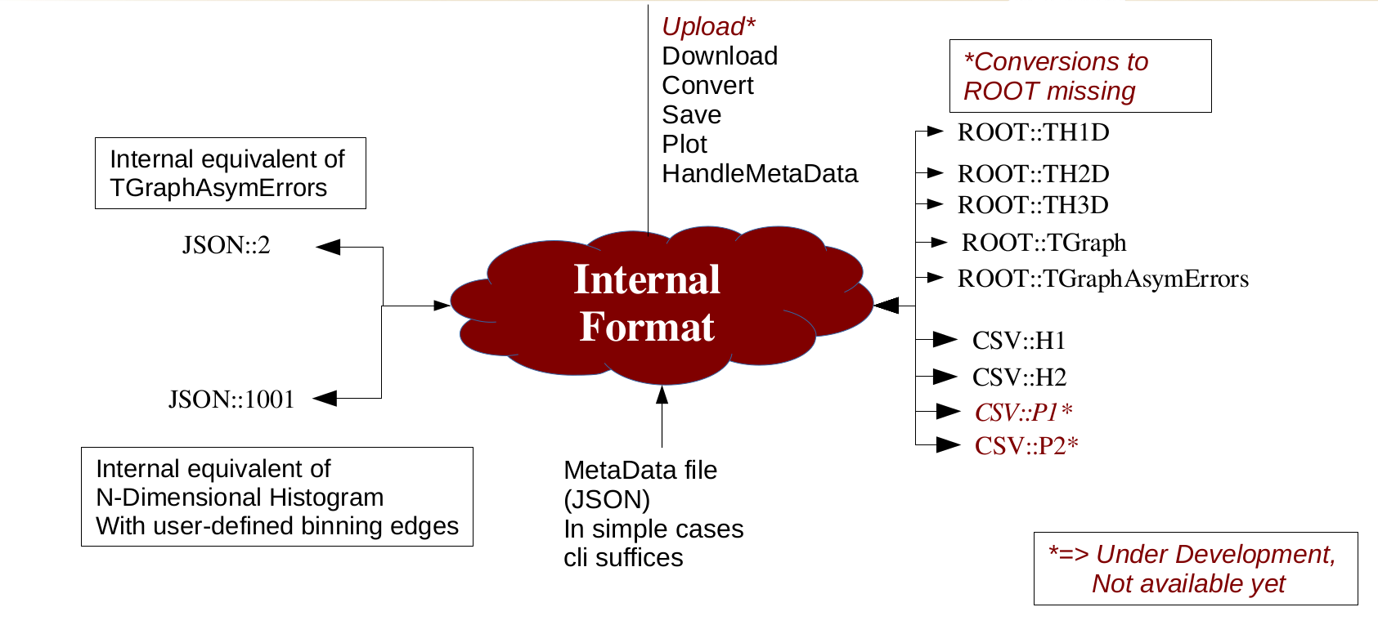
Ancillary Tools: Conversion Tool
Python program
to read and convert histograms from/to different formats: ROOT, ASCII (CSV), JSON
Download from and upload to DoSSiER
Inspect and interact with histograms (matplotlib)
CLI (script integration) or API (integration in python programs) are available
For more details see Andrea’s talk.
2
Hans Wenzel 21st Geant4 Collaboration Meeting, Ferrara, Italy, September 12 to 16, 2016
9/14/2016

Slide 3
Prerequisits (Linux)
You need python, various python modules(e.g. numpy) and Root with python support. If it doesn't exist on your System get the 2.7 version of Anaconda from: https://www.continuum.io/downloads
then build root against the python version provided by Anaconda.
Finally obtain the upload tool from gitlab: https://gitlab.cern.ch/PhysicsValidationDB/uploader
3
Hans Wenzel 21st Geant4 Collaboration Meeting, Ferrara, Italy, September 12 to 16, 2016
9/14/2016

Slide 4
Prerequisits (MaCOSX)
Get homebrew form
http://brew.sh/
/usr/bin/ruby -e "$(curl -fsSL https://raw.githubusercontent.com/Homebrew/install/master/install)"
brew install root6
brew info root6 → follow the instruction what to add to your .bashrc_profife
brew install homebrew/python/numpy
Then you should be ready to go:
python ./plot_histofiles.py --metadatafile meta_pion-_G4Al_totalxserr.json -c convert --output pion-_G4Al.json pion_xs.root:pion-_G4Al_totalxserr
4
Hans Wenzel 21st Geant4 Collaboration Meeting, Ferrara, Italy, September 12 to 16, 2016
9/14/2016

Slide 5
Upload Tool: usage
Usage: plot_histofiles.py [--comand|-c <cmd>] [--output|-o <ofile>] [--metadata|-m k[:type]=v] [--metadatafile <mdf>] <files>
where:
<files> are the files to read.
File extension determines format. CSV is the text format
from G4Analyais. For ROOT format, you need t specify the
name of the file to be read in. Ex: file.root:h1
pickle format is supported (file should be created with command "save")
<cmd> is one of ("plot", "convert","save","genmd","list")
"plot" (default) to plot the content of the file
(requires matplotlib)
"convert" creates an output file in JSON format suitable
for FNALdb upload
"save" saves histograms in internal format to pickle file "histos.pkl"
"genmd" generates a metadata skeleton file as specified in <files>
"list" shows content of ROOT File (TKey). Only for ROOT format.
<ofile> is the output file name (default="output.json") for
converted output for FNALdb
<hn:k[:type]=v> is a key-value pair to add as metadata to FNALdb output
hn is a regexp to assing the metadata to histogram based on names.
k is the key of the metadata, type (default INT) can be INT if the value has to
interpreted as integer value of STR if it must be interpreted as string
or FLT if it is a floating point value
e.g. -m .*A:INT=1 means add to all objects the integer metadata 1 with key A
<mdf> is a json of pickle file containing the metadatada in a format of the type:
{ "regexpName" : { metadata } } where regexpName is a regular expression that
matches a converted object name (the name being the ROOT TObject name or CSV full-filename)
5
Hans Wenzel 21st Geant4 Collaboration Meeting, Ferrara, Italy, September 12 to 16, 2016
9/14/2016

Slide 6
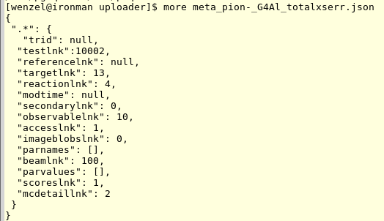
Extracting TGraph from a root file and creating json file for upload to DoSSiER
Command used to add one record to the database
(cross sections for pion- on Aluminium)
python ./plot_histofiles.py --metadatafile meta_pion-_G4Al_totalxserr.json \
-c convert \
--output pion-_G4Al.json pion_xs.root:pion-_G4Al_totalxserr
The Meta Data file: (in addition from the meta data provided by root)
6
Hans Wenzel 21st Geant4 Collaboration Meeting, Ferrara, Italy, September 12 to 16, 2016
9/14/2016

Slide 7
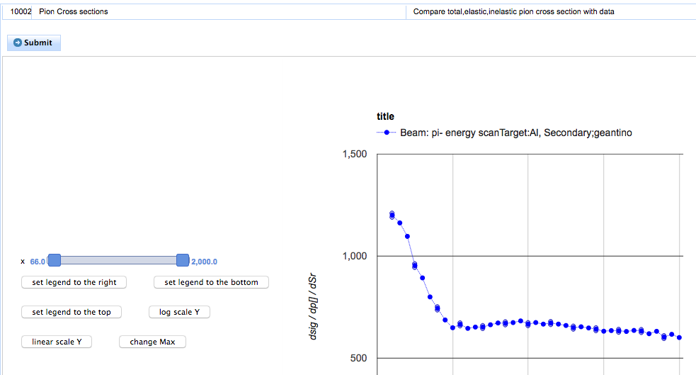
Data Base we start with
No selection Menus????
7
Hans Wenzel 21st Geant4 Collaboration Meeting, Ferrara, Italy, September 12 to 16, 2016
9/14/2016

Slide 8
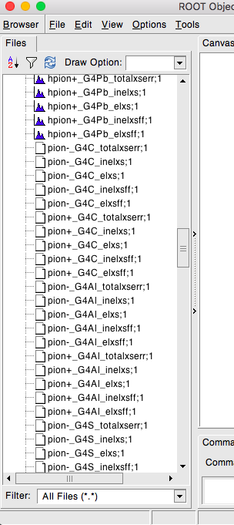
root pion_xs.root
File contains pi+/pi- cross sections (total, elastic, inelastic) for various elements (C,Al,S,Ca,Fe,Cu,Ag,Sn,Au,Pb) both as histograms and TGraphError.
So first let’s enter the missing 9 entries for the pi- beam to the database
8
Hans Wenzel 21st Geant4 Collaboration Meeting, Ferrara, Italy, September 12 to 16, 2016
9/14/2016

Slide 9
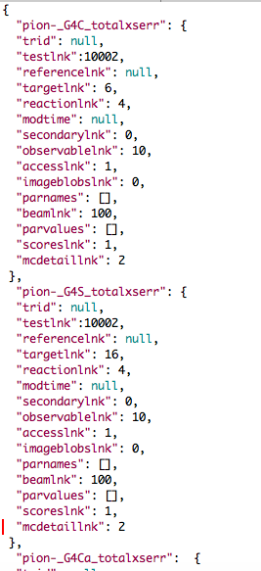
File with metadata: meta_pi-_all_totalxserr.json
Command to convert:
python ./plot_histofiles.py \
--metadatafile meta_pi-_all_totalxserr.json -c convert \
--output pi-_all.json \
pion_xs.root:pion-_G4C_totalxserr \
pion_xs.root:pion-_G4S_totalxserr \
pion_xs.root:pion-_G4Ca_totalxserr \
pion_xs.root:pion-_G4Fe_totalxserr \
pion_xs.root:pion-_G4Cu_totalxserr \
pion_xs.root:pion-_G4Ag_totalxserr \
pion_xs.root:pion-_G4Sn_totalxserr \
pion_xs.root:pion-_G4Au_totalxserr \
pion_xs.root:pion-_G4Pb_totalxserr
9
Hans Wenzel 21st Geant4 Collaboration Meeting, Ferrara, Italy, September 12 to 16, 2016
9/14/2016

Slide 10
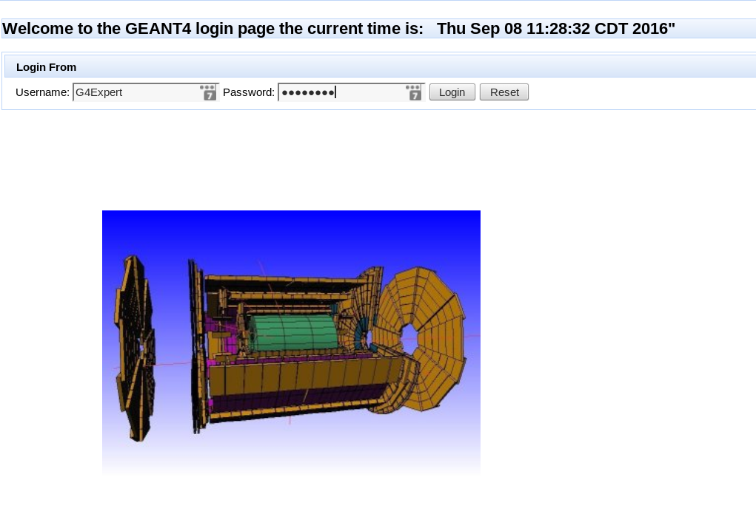
Uploading to DoSSiER: Log in to the Geant 4 Collaborators page
10
Hans Wenzel 21st Geant4 Collaboration Meeting, Ferrara, Italy, September 12 to 16, 2016
9/14/2016

Slide 11
Uploading to DoSSiER: Now select FileUpload
11
Hans Wenzel 21st Geant4 Collaboration Meeting, Ferrara, Italy, September 12 to 16, 2016
9/14/2016

Slide 12
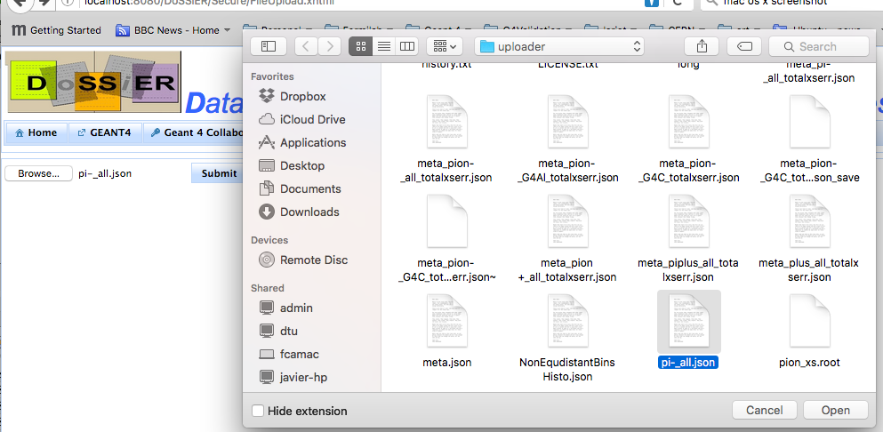
Uploading to DoSSiER: select the file to upload and press submit.
12
Hans Wenzel 21st Geant4 Collaboration Meeting, Ferrara, Italy, September 12 to 16, 2016
9/14/2016

Slide 13
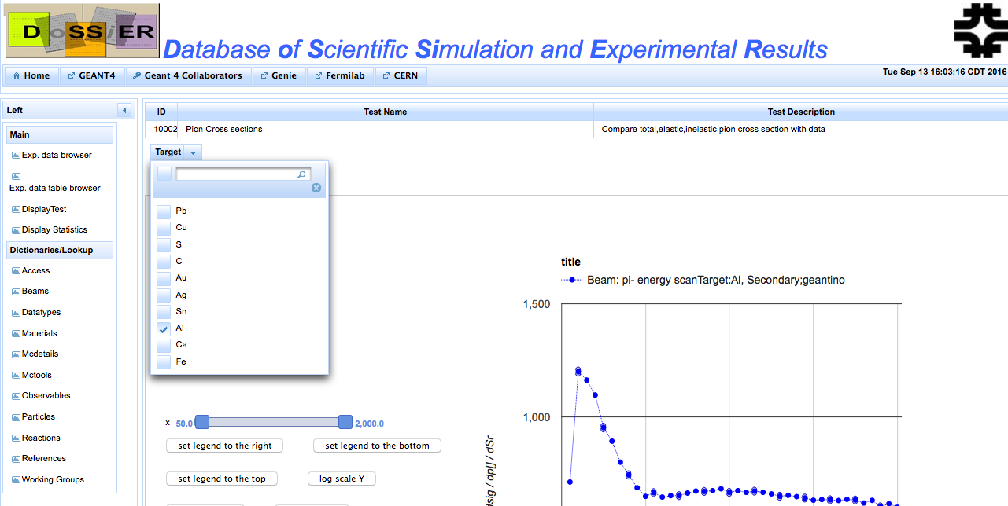
We got a Menu now!!!!!
Let’s select all
13
Hans Wenzel 21st Geant4 Collaboration Meeting, Ferrara, Italy, September 12 to 16, 2016
9/14/2016

Slide 14
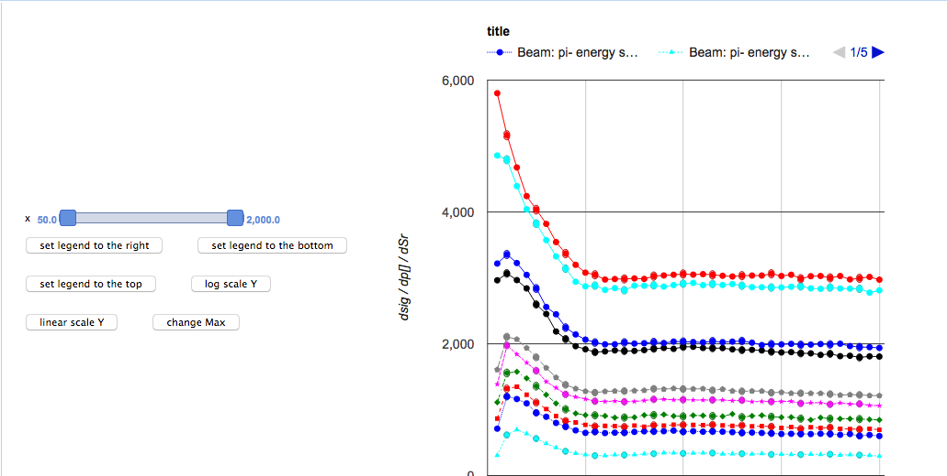
Cool!!!!: pi- cross section for 10 different elements
14
Hans Wenzel 21st Geant4 Collaboration Meeting, Ferrara, Italy, September 12 to 16, 2016
9/14/2016

Slide 15
Conclusion
This wasn’t so difficult → No excuse not to try!!!!
Will add upload via web service soon → staged.
Move to fermilab/CERN SSO (saml/shibboleth)
Thanks to Andrea and Julia !!!!
15
Hans Wenzel 21st Geant4 Collaboration Meeting, Ferrara, Italy, September 12 to 16, 2016
9/14/2016

Slide 16
Backup

Slide 17
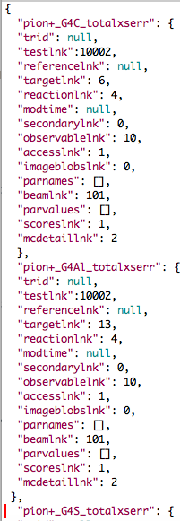
Ok let’s also add the pi+
Command to convert:
python ./plot_histofiles.py \
--metadatafile meta_pi+_all_totalxserr.json -c convert \
--output pi+_all.json \
pion_xs.root:pion+_G4C_totalxserr \
pion_xs.root:pion+_G4Al_totalxserr \
pion_xs.root:pion+_G4S_totalxserr \
pion_xs.root:pion+_G4Ca_totalxserr \
pion_xs.root:pion+_G4Fe_totalxserr \
pion_xs.root:pion+_G4Cu_totalxserr \
pion_xs.root:pion+_G4Ag_totalxserr \
pion_xs.root:pion+_G4Sn_totalxserr \
pion_xs.root:pion+_G4Au_totalxserr \
pion_xs.root:pion+_G4Pb_totalxserr
17
Hans Wenzel 21st Geant4 Collaboration Meeting, Ferrara, Italy, September 12 to 16, 2016
9/14/2016

