Slide 1
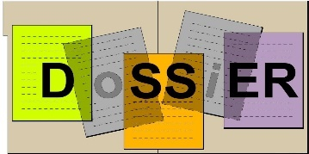



Database of Scientific Simulation and Experimental Results:
Status
Hans Wenzel, Julia Yarba, Krzysztof Genser, Daniel Elvira (Fermilab)
Witold Pokorski, Federico Carminati, Dmitri Konstantinov, Alberto Ribon, Gunter Folger (CERN)
Andrea Dotti (SLAC)
Outline:
Motivation
Requirements
What's new?
DoSSiER
  Components
  Ancillary Tools
  Meta Data
Status of the project
  Prototype: G4WebAppNG
  Status of DoSSiER: web application and web service
Accommodating Neutrino Generators (Genie)
Summary, Conclusions and Plans
1
Hans Wenzel 21st Geant4 Collaboration Meeting, Ferrara, Italy, September 12 to 16, 2016
9/14/2016
Notes:
1

Slide 2
Motivation
Provide guidance to experimenters and answers to questions like:
  What data is used to validate the physics of Geant4/GeantV/GENIE/… ?
  How well does the Geant4/GeantV/GENIE/… simulation describe the data of interest for the experiment?
  Which model provided by Geant4/GeantV/GENIE best describes the data of interest for the experiment?
  What are the benefits of switching to the latest version of Geant4/GeantV/GENIE/…? What changed?
  What systematic uncertainties are involved?
2
Hans Wenzel 21st Geant4 Collaboration Meeting, Ferrara, Italy, September 12 to 16, 2016
9/14/2016

Slide 3
Requirements
Provide repository:
  to store experimental validation data as raw data,
  to store simulation results as raw data and as static plots.
Provide display web-application which:
  allows to select and overlay compatible tests,
  allows to overlay experimental data,
  allows automatic upload into repository,
  allows to display static images,
  provides search functions and easy navigation.
Provide REST-ful Web service which:
  allows programmatic access to the data e.g to be accessed by C++ validation programs.
  Allows automatic upload
Modern look, meaningful search, easy to navigate menus.
Based on modern internet technology and industry standards.
Secure!
3
Hans Wenzel 21st Geant4 Collaboration Meeting, Ferrara, Italy, September 12 to 16, 2016
9/14/2016

Slide 4
What's new?
We have new Database schema which:
  Allows to serialize multidimensional histograms and data point sets.
  Uses the same tables for experimental and simulated data.
  Uses dictionaries for data like materials, particles ..
We completed the full JAVA API (CRUD: create, read, update, delete) based on the DAO (Data Access Object) pattern and the new db schema.
We now Provide a REST (representational state transfer)-ful Web service which:
  allows programmatic access to the data e.g. by C++ validation programs → already used by validation jobs that Julia runs.
We provide programmatic access from C++ application provided using DbReader by Dimitri → see his presentation.
The software is now packaged using maven (ValidationLib, web Application/Service)
We provide
  easy to use formats (json/xml) for data exchange and upload of results.
  Tools to convert result from validation jobs (.root, .csv...) to json format that then can be uploaded→ see Andrea’s presentation and Demo.
  Upload web application.
  Documentation: https://twiki.cern.ch/twiki/bin/view/Geant4/ExtendingFnalDb
We switched as much functionality as possible to external tools: e.g. Connection Pools, authentication, Inspire….
4
Hans Wenzel 21st Geant4 Collaboration Meeting, Ferrara, Italy, September 12 to 16, 2016
9/14/2016

Slide 5


Components:
Web Browser
JAVA
API
Web Application
Connection Pool
Validation Database
Clients:
C++
Web Service
Java
Python
…
Glassfish
C++ API
C++ Client
Read only access
Direct or via web service
5
Hans Wenzel 21st Geant4 Collaboration Meeting, Ferrara, Italy, September 12 to 16, 2016
9/14/2016

Slide 6
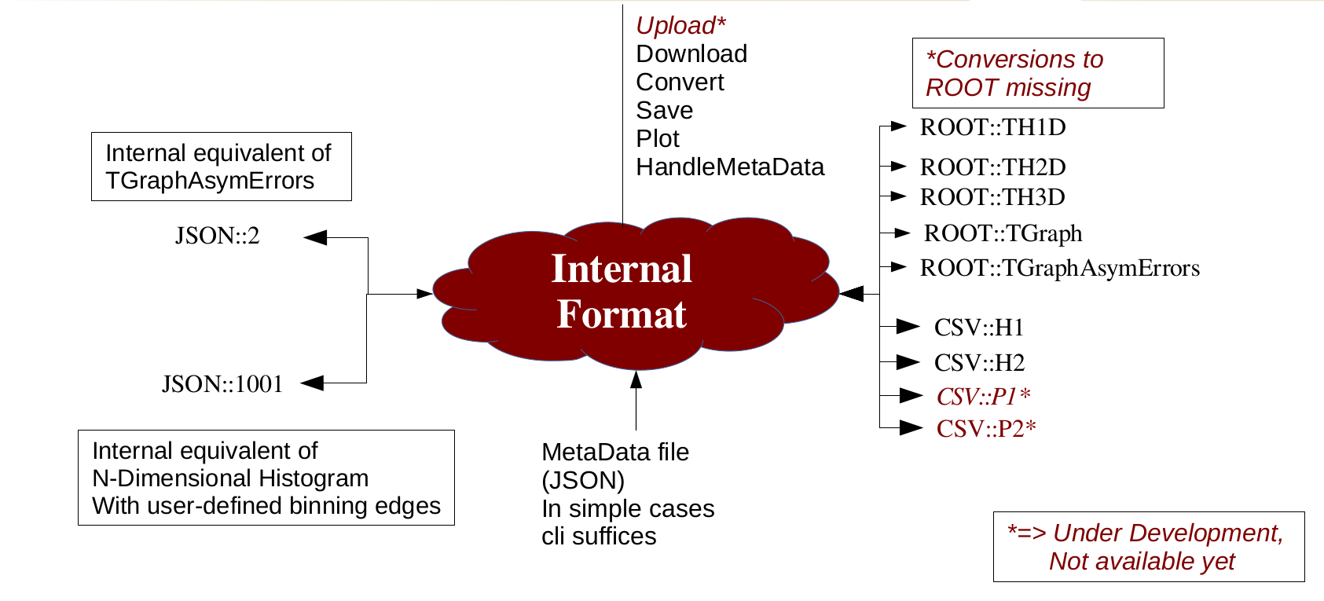
Ancillary Tools: Conversion Tool
Python program
to read and convert histograms from/to different formats: ROOT, ASCII (CSV), JSON
Download from and upload to DoSSiER
Inspect and interact with histograms (matplotlib)
CLI (script integration) or API (integration in python programs) are available
For more see Andrea’s presentation and Demo how to use.
6
Hans Wenzel 21st Geant4 Collaboration Meeting, Ferrara, Italy, September 12 to 16, 2016
9/14/2016

Slide 7
Meta data to classify a result
Beam: mono energetic neutrons
Target: Carbon.
Secondary: protons.
Observable: differential cross section
Reaction: particle production
MC detail: e.g. BIC, geant4.10.1.p02
In addition parnames/parvalue pairs can be added
n (500 MeV)
p
C
Example: n induced p production
Note:
Values for metadata stored in dictionaries:
(Beams, Materials, Particles, Observable, Reaction, MC details…).
Meta data used to match experimental and simulated results.
Complicated Beams (e.g. neutrino flux files, test beams consisting of many
particles can be described by the schema).
Ditto for Materials (e.g. Target test beam Calorimeter).
Dictionaries can evolve as needed.
7
Hans Wenzel 21st Geant4 Collaboration Meeting, Ferrara, Italy, September 12 to 16, 2016
9/14/2016

Slide 8
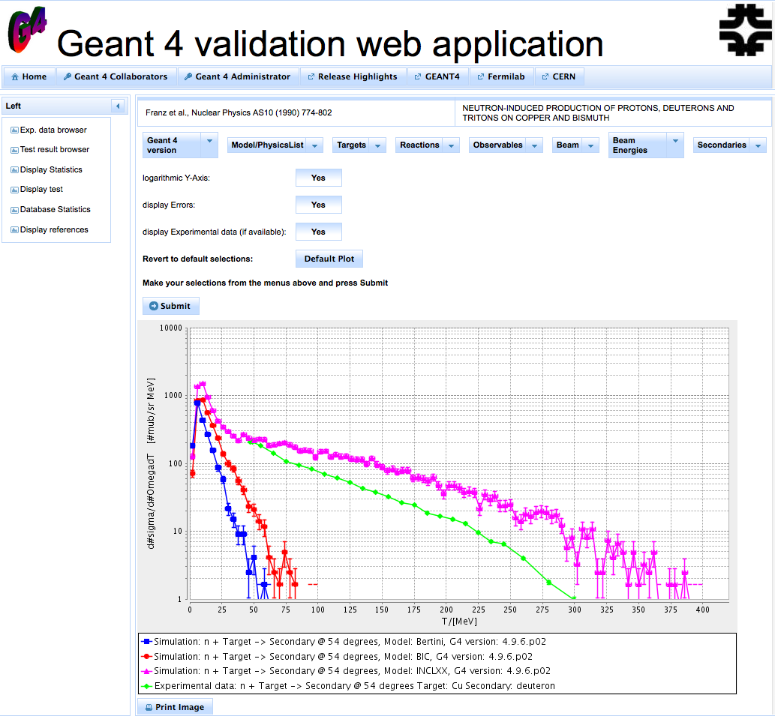
G4WebAppNG: Test Result Browser
Based on prototype schema and API. Can be found at the following URL: http://g4validation.fnal.gov:8080/G4WebAppNG/ → in the process of porting to DoSSiER!!!!!
This allows to select Geant4 simulation results of interest, and to compare them to the experimental data as applicable. Shown on the right is neutron induced deuteron (default selection).
Different Models:
  BIC(blue),
  Bertini (red)
  INCL++(magenta)
  Experimental Data (green)
8
Hans Wenzel 21st Geant4 Collaboration Meeting, Ferrara, Italy, September 12 to 16, 2016
9/14/2016
Notes:
8

Slide 9
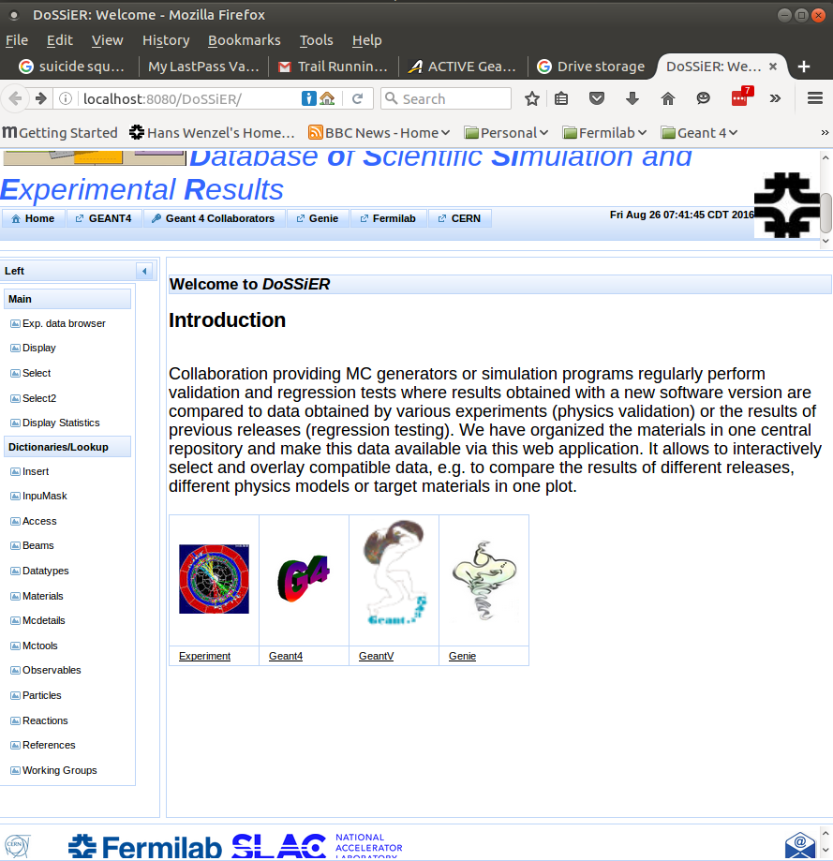

Web application: http://g4devel.fnal.gov:8080/DoSSiER/
Currently:
Based on new JAVA API and database schema.
Can display exp. /simulated Data. (graph and table)
Displays dictionaries.
Displays statistics.
Allows uploads using json/xml file formats.
But many features still missing, need porting from prototype (G4WebAppNG).
9
Hans Wenzel 21st Geant4 Collaboration Meeting, Ferrara, Italy, September 12 to 16, 2016
9/14/2016

Slide 10
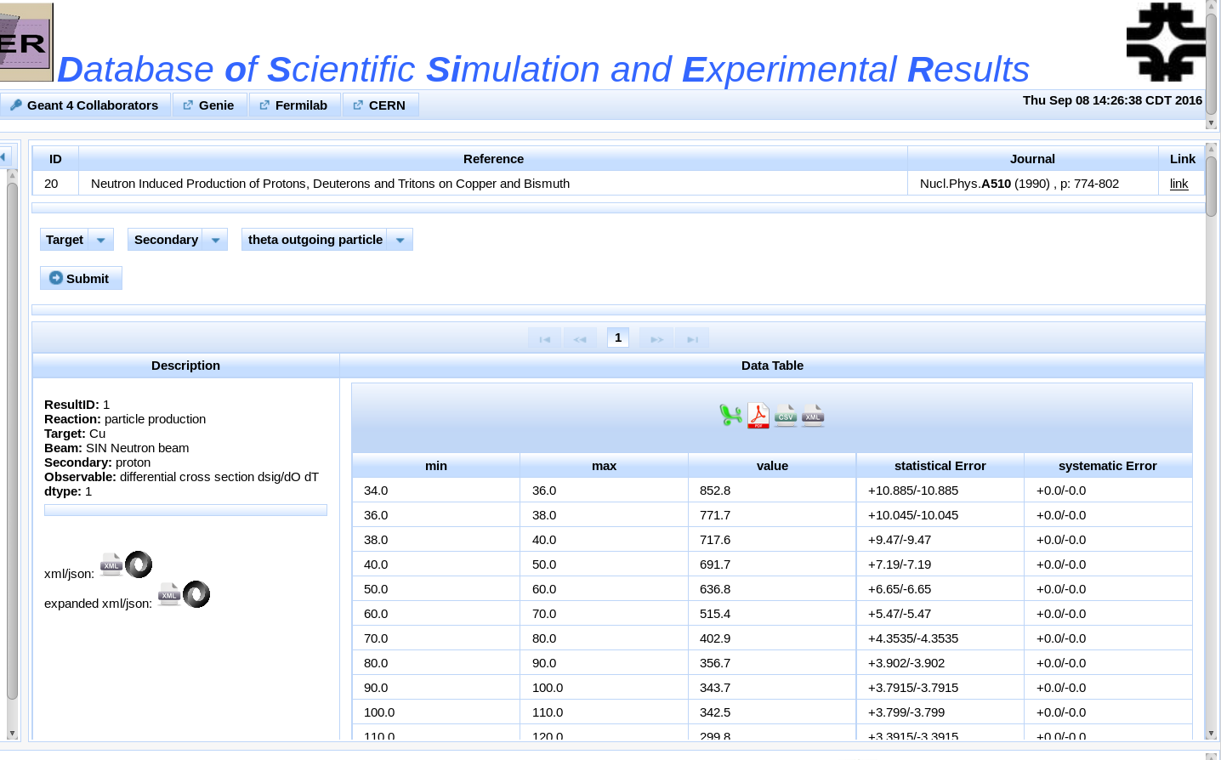
Experimental data Browser
In addition to showing data as plots, one can select "Display data table", to extract the data in a tabulated form that is easy to cut and paste. Or can be retrieved as json/xml, or excel,pdf,csv,xml
10
Hans Wenzel 21st Geant4 Collaboration Meeting, Ferrara, Italy, September 12 to 16, 2016
9/14/2016
Notes:
10

Slide 11
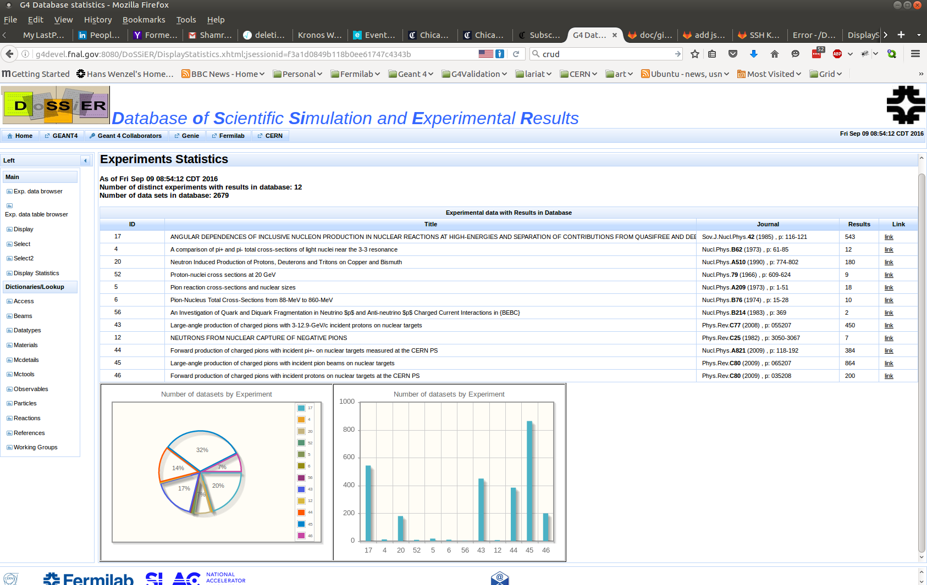
Experimental statistics
INSPIRE or exp. website
11
Hans Wenzel 21st Geant4 Collaboration Meeting, Ferrara, Italy, September 12 to 16, 2016
9/14/2016

Slide 12

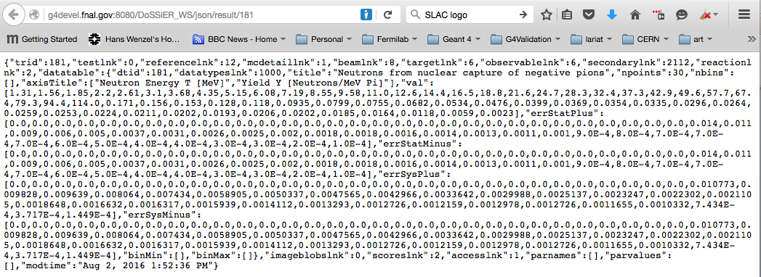
The Web service
Based on: Java API for REST - ful (Representational State Transfer) Services (JAX-RS)
Deployed on the development server: http://g4devel.fnal.gov:8080/DoSSiER_WS/json/result/181
Allows programmatic retrieval of results in json or xml format (with dictionaries expanded or not) these are the same formats used for uploads!
C++ clients already used by selected Geant4 validation jobs by Julia.
Planned:
  Search functions like in INSPIRE/SPIRES.
  Programmatic upload to database (staged).
12
Hans Wenzel 21st Geant4 Collaboration Meeting, Ferrara, Italy, September 12 to 16, 2016
9/14/2016

Slide 13

Accommodating the GENIE generator
Reference for neutrino hadron production added to development Database.
Beams for various neutrino fluxes added.
Experimental data for neutrino hadron production added.
Plan:
  add Minerva GENIE simulations.
  Provide slide shows/dashboard summarizing relevant data/highlights for each GENIE release.
13
Hans Wenzel 21st Geant4 Collaboration Meeting, Ferrara, Italy, September 12 to 16, 2016
9/14/2016

Slide 14
Summary and Conclusions
DoSSiER: Database of Scientific Simulation and Experimental Results is actively being developed with participation by Geant4 groups at CERN, Fermilab and SLAC.
GENIE group is providing input and requirements.
Experimental data and results from simulation (Geant4, GeantV?, GENIE(soon)) are stored in a relational database.
Data can be imported and exported using json/xml formats. (scripts are provided to extract data from root files or ASCII tables and convert to json/xml.)
Web application progressing quickly:
  allows to select and search.
  Will allow to overlay experimental and simulated data.
  authentication is necessary to have access to internal data and functions (e.g. upload, edit, delete).
Web service: allows programmatic retrieval of data e.g. by validation jobs.
Porting from prototype G4WebAppNG to DoSSiER well under way!!
If you want more info or want to contribute (always welcome) visit our twiki: https://twiki.cern.ch/twiki/bin/view/Geant4/ExtendingFnalDb
14
Hans Wenzel 21st Geant4 Collaboration Meeting, Ferrara, Italy, September 12 to 16, 2016
9/14/2016

Slide 15
Plans
Port all functionality from G4WebAppNG, then ask for user feedback for additional functionality.
Import more tests and experimental data. On-board other groups like GENIE, GeantV…
Move to FNAL/CERN SSO (single sign on) (saml/shibboleth) for authentication.
Provide programmatic upload tool via web service.
Evaluate different tools (node.js) to provide all of DoSSiER's functionality → see presentation by Ioana.
15
Hans Wenzel 21st Geant4 Collaboration Meeting, Ferrara, Italy, September 12 to 16, 2016
9/14/2016

Slide 16
Backup

Slide 17





Choice of technologies
 | Open source relational data base, hosted by Fermilab data base group.
 | Glassfish: Web Application server hosted on fermicloud
 | Primefaces JSF (Java Server Faces) based framework to create modern looking web pages and easy to navigate menus.
 | Integrated Development Environment
 | Java programming language, JAVAEE, JAX-RS
Google Charts | JavaScript library used to create interactive graphs
17
Hans Wenzel ICHEP August 3 – 10, 2016 Chicago
8/4/2016

Slide 18
Ancillary Tools
A set of stand-alone python based tools, integrated with DoSSiER are being developed to:
  allow for interaction from command-line or in applications with validation data.
  perform comparisons between results and simulations independently of web-application.
  integrate DoSSiER into Geant4 semi-automatic testing.
Focus is on simple and portable command line applications
18
Hans Wenzel ICHEP August 3 – 10, 2016 Chicago
8/4/2016

Slide 19
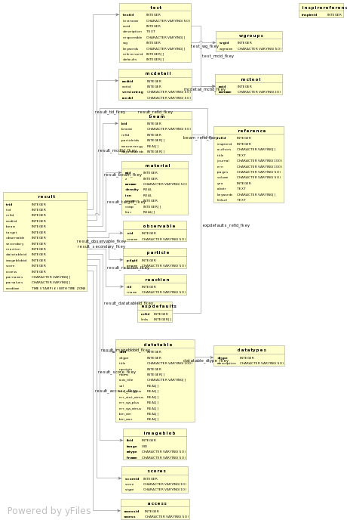

Slide 20
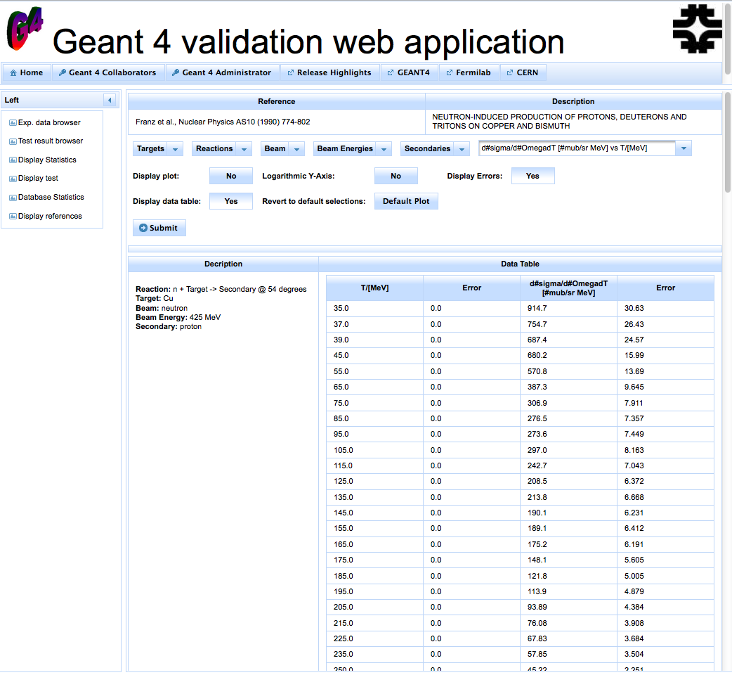
G4WebAppNG: Experimental data Browser
In addition to showing data as plots, one can select "Display data table", to extract the data in a tabulated form that is easy to cut and paste.
20
Hans Wenzel ICHEP August 3 – 10, 2016 Chicago
8/4/2016
Notes:
20

Slide 21
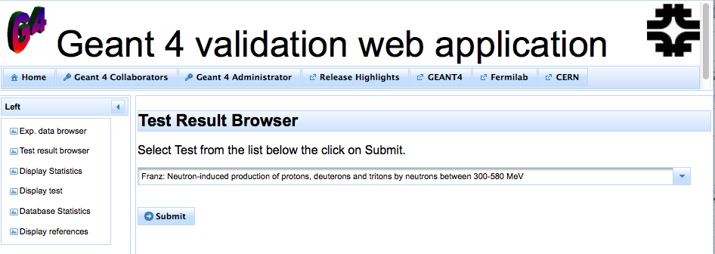
Status: G4WebAppNG (predecessor of DoSSiER)
Can be found at the following URL: http://g4validation.fnal.gov:8080/G4WebAppNG/
Based on prototype schema and API
21
Hans Wenzel 21st Geant4 Collaboration Meeting, Ferrara, Italy, September 12 to 16, 2016
9/14/2016

