Slide 1
Geometry
Summary of Parallel Session 7-B
J.Apostolakis, G.Cosmo – CERN EP/SFT

Slide 2
Parallel Session 7-B

Slide 3
Recent updates to USolids/VecGeom - 1
Analysed top consumers in
ALICE: Polyhedron, Extruded
Solid, Polycone, Assemblies
Implemented a Simple Extruded
Solid shape (SExtru) with only
two Z sections
Implemented Assembly volume
structure, re-using VecGeom
voxelisation and components
from navigation

Slide 4
Recent updates to USolids/VecGeom - 2
Using ray-tracing technique
(XRayBenchmarker) for
validation
Excellent ray-tracing
performance in complex ALICE
modules

Slide 5
Update on USolids/VecGeom integration in Geant4 - 1
In process of “translating”
USolids shapes to VecGeom
and complete standard set of
shapes
‘Ongoing progress in
validation of shapes thorough
the ShapeTester suite

Slide 6
Update on USolids/VecGeom integration in Geant4 - 2
Priorities to-do list
Adoption of VecGeom
through Geant4 also with
selection of individual
shapes

Slide 7
Review of open problem-reports
  #1449 - Particle not scored when step length proposed by
  StepLimiter lands exactly on a geometry boundary
  #1709 - Frequent GeomNav0003 G4Exceptions
#1728 - Particle erroneously propagated to the mother volume
#1885 - G4PhantomParametrisation::GetReplicaNo and G4PSEnergyDeposit3D::GetIndex use different ordering
J.Apostolakis
P.Arce

Slide 8
Field propagation in G4
Integrated new embedded RK methods (10.3β)
  Fewer field evaluations/step; FSAL & Interpolation
Implemented the Bulisrch-Stoer method
  From family of Extrapolation methods that can be more efficient than the Runge-Kutta.
Use interpolation to improve integration & volume intersection
  Dense output: evaluate solution at any point in integration interval
  Cost: requires a fixed number of extra field/function evaluations
Dmitry Sorokin (GSoC 2016), John Apostolakis (CERN)
Somnath Banerjee (GSoC 2015) & Jason Suagee (GSoC 2015),

Slide 9
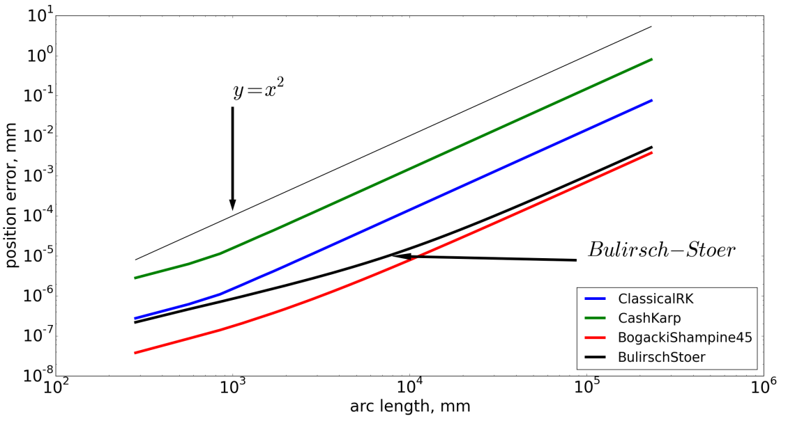
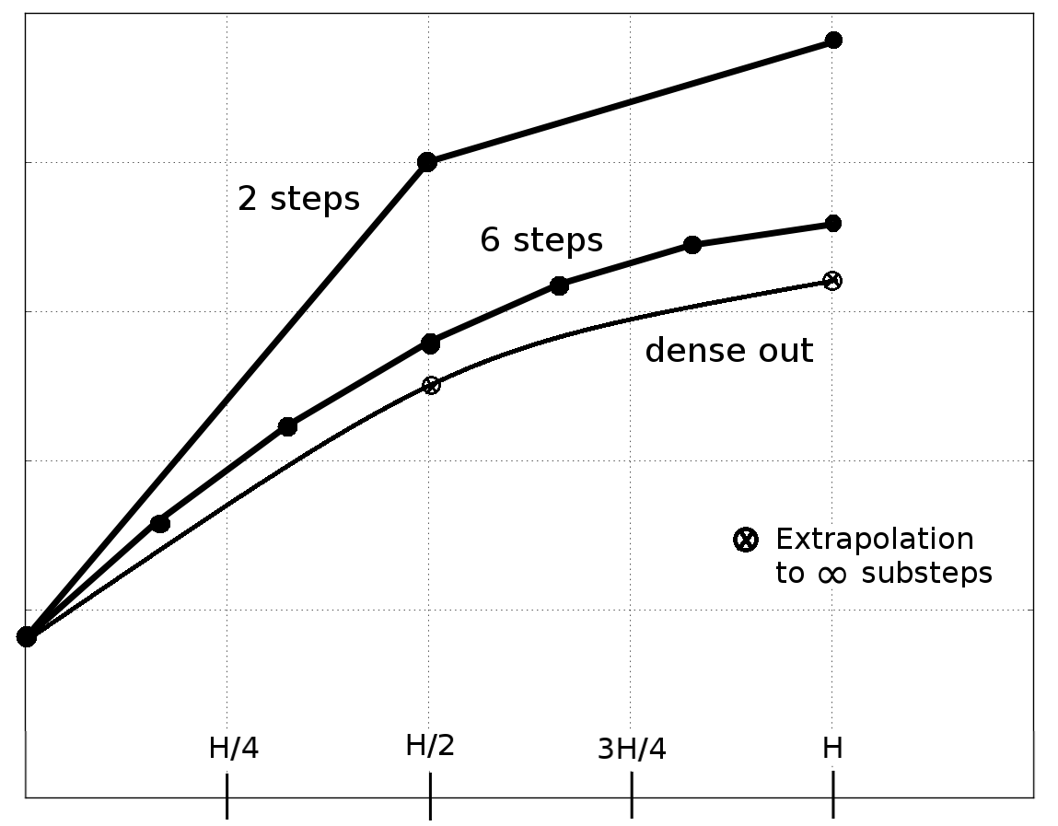
Validation in uniform magnetic field
1 MeV proton in the uniform 1 tesla magnetic field. Radius of the circle in xz plane is 102.20 mm
Momentum is 43.33 MeV/c. deltaOneStep = 1e-4 mm, deltaIntersection = 1e-5 mm
Sketch of Bulirsh-Stoer
method
Promising first results for dense methods
Bogacki Shampine 4/5 dense is best
Bulirsch Stoer close in some regions
Issues of accuracy of interpolation raised

Slide 10
QSS - Alternative Integration method

Slide 11
QSS: Validation & Performance
Promising results for constant, without interactions
In realistic example 34-49% slower
(but not using interpolation – dev. Item.)

