Slide 1
Performance profiling and benchmark for medical physics
Gean4 Collaboration Meeting
Ferrara, Italy
Sep. 12~16, 2016
Kihyeon Cho (KISTI)
(Working with Wonqook Choi)

Slide 2
Contents
Introduction
Brachytherapy
Methodology
Results
Summary

Slide 3
Introduction
Why profiling?
Diversity of physics applications
Evolving Computing
S/W development
Profiling tools
To draw community interests for collateral effort

Slide 4
There are many efforts to develop HEP software to save CPU Time and Memory.
(https://g4cpt.fnal.gov)
However, there are not enough codes for profiling system.
=> To use FNAL Geant4 computing performance profiling protocol and tools as a starting point

Slide 5
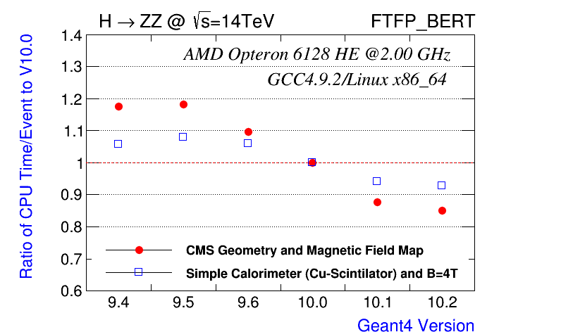
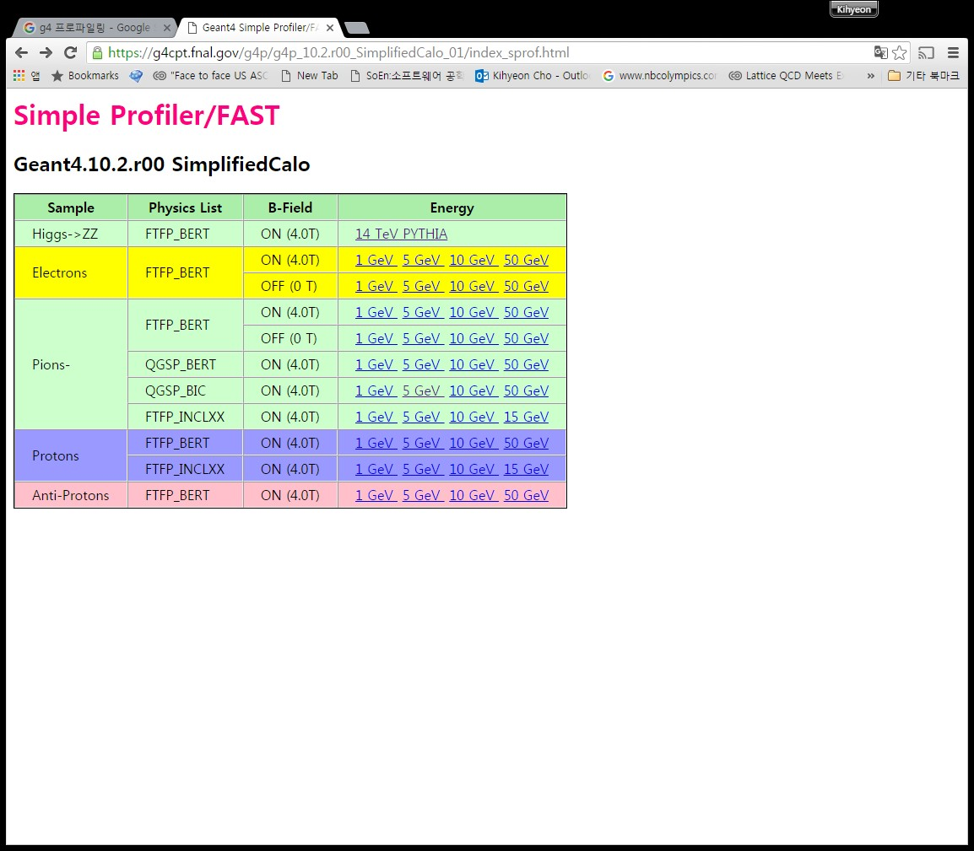
Current status
High energy physics profiling (Fermilab)
SimpliCarlo (Sequential)
CMSExp (Multi-Thread)
Low energy physics profiling
Does not exists
Using Brachytherapy code

Slide 6
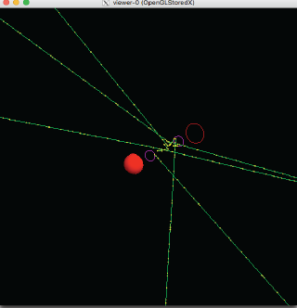
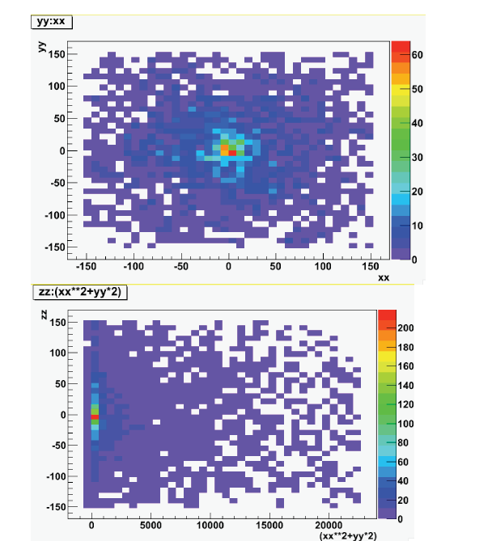
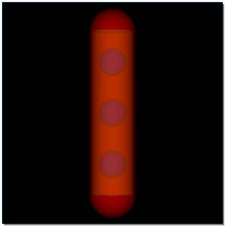
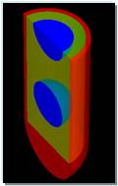
Brachytherapy
Using Brachytheray simulation in advanced examples
Brachytherapy seed

Slide 7
Goal on Brachytherapy
Low Energy Physics Profiling
CPU/Memory Usage
Mesh Size
Version dependency
Scalability for new computing architecture (KISTI supercomputer)

Slide 8
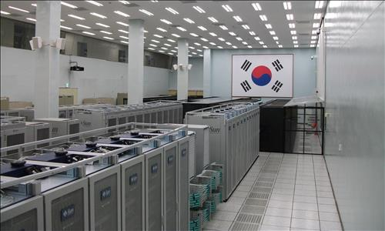
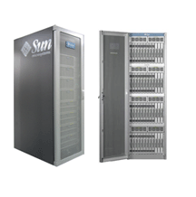
Bench mark @ current machine
The 4th supercomputer @ KISTI
Rpeak | 300TFlops
Nodes Number | 3,176
Processor | Intel Xeon X5570 2.93GHz
CPU Number | 25,408
Memory | 76.8 TB
Storage | 1,061TB
Service date | 2010.11

Slide 9
Scalability to Future Hybrid machine
The 5th supercomputer @ KISTI
100 X Scalability ?
Mini component supercomputer? 1PFlops
Rpeak | 25PFlops
Price | $90 Million
Processor | CPU+GPU? MIC? Hybrid
Service date | 2017.6
Memory | ??
Storage | ??

Slide 10
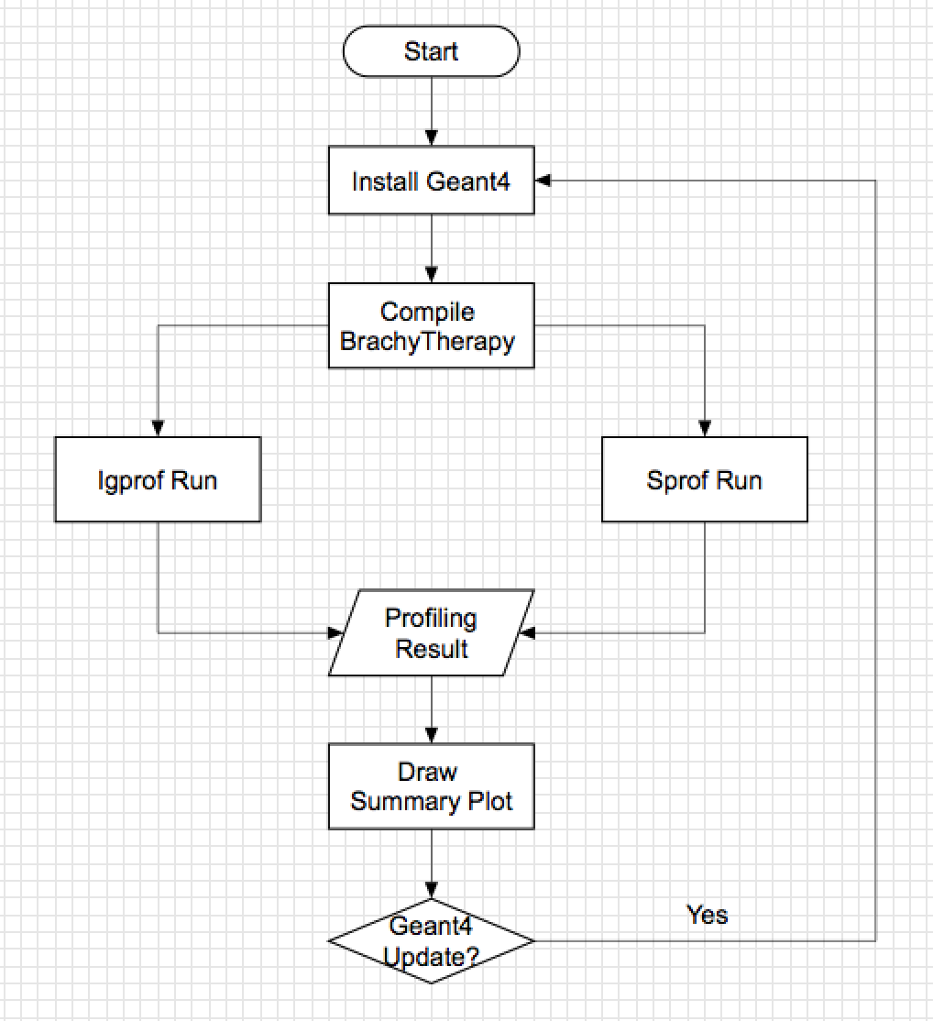
Methodology

Slide 11
Machines
 | Machines | OS | batch jobs | Input file | outputfile
Install Geant4 | tachyon2 | Linux | PBS | - | -
Compile Brachytherapy code | tachyon2 | Linux | PBS | - | -
Igprof Run | tachyon2 | Linux | - | kumac | IgProf_iodine.FTFP_INCLXX_HP.35.0_MEM_LIVE_1.txt
Sprof Run | tachyon2 | Linux | - | kumac | g4profiling_1_X.tgz
Draw plot | hepkisti | Linux | - | Ouput of ig and sprof | png
Web site | hepkisti | Linux | - | Ouput of ig and sprof | html

Slide 12
SimpliCarlo vs. Brachytherapy
 | SimpliCarlo | Brachytherapy
Energy | More than TeV | Less than MeV
CPU time | Long | Too short
CPU time / event (sec) | 0.01 | 0.0002
Snapshot time | 30 | 5
Institute | Fermilab | KISTI
Extended mode: Nfunction
Print + N Step , N Track information additionally

Slide 13
Settings
Code
Brachytherapy (v10.02)
Macro file
IodiumSourceMacro.mac (endocavitary brachytherapy)
IridiumSourceMacro.mac (interstitial brachytherapy)
LeipzigSourceMacro.mac (superficial brachytherapy)
Physics list
FTFP_INCLXX_HP,
QGSP_INCLXX_HP

Slide 14
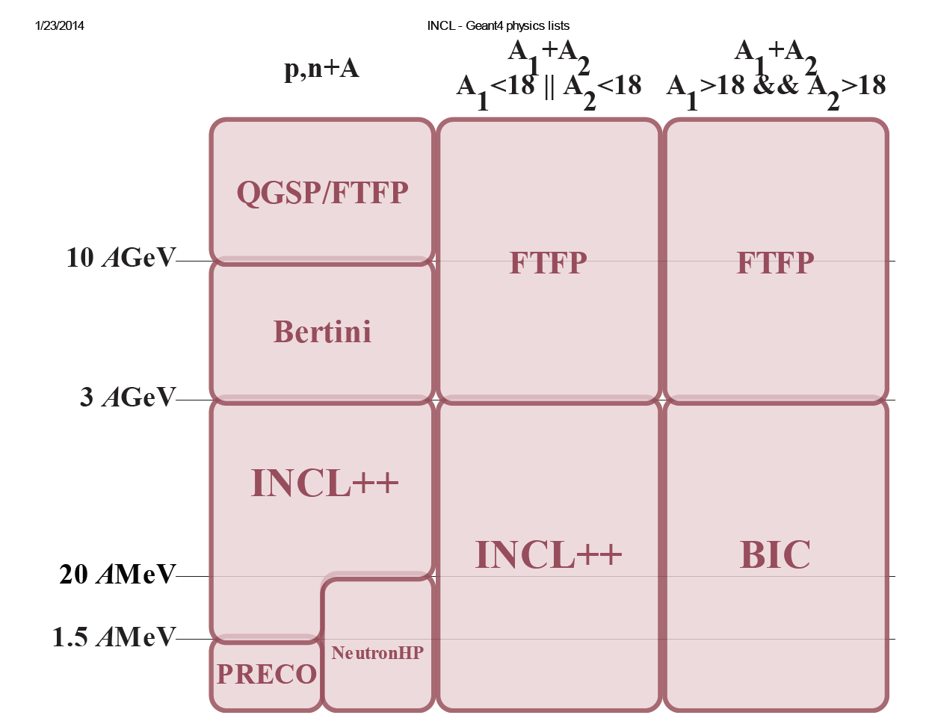
Physics List
Name | Content | Energy
QGS | Quark Gluon String Model | > ~20 GeV
FTF | Fritiof string model | > ~ 5GeV
BIC | Binary Cascade | < ~ 10GeV
BERT | Bertini-style cascade | < ~10GeV
HP | High Precision neutron model | >20MeV
P | G4Precompund model used for deexcitation

Slide 15
Results
CPU time and Memory
Which module will take most CPU/memory
Path & Leaf
Comparing Profiling
Mesh size

Slide 16
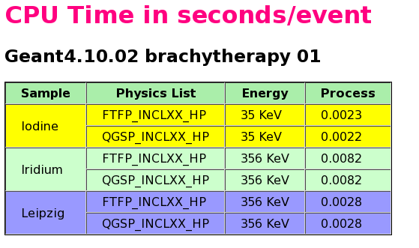

Slide 21
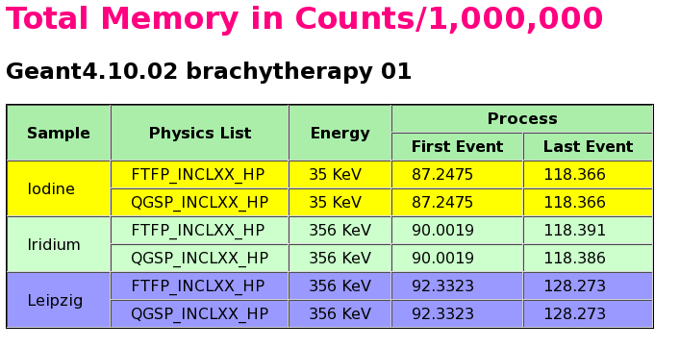

Slide 23
Comparing Profiling
Mesh information
Number of events: 10,000
CPU time: total 2.19 sec
Trial time: 8
Mesh size: 300 : 30, 300, 900, 1500, 3000, 6000
Snap shot time: 5 sec

Slide 24
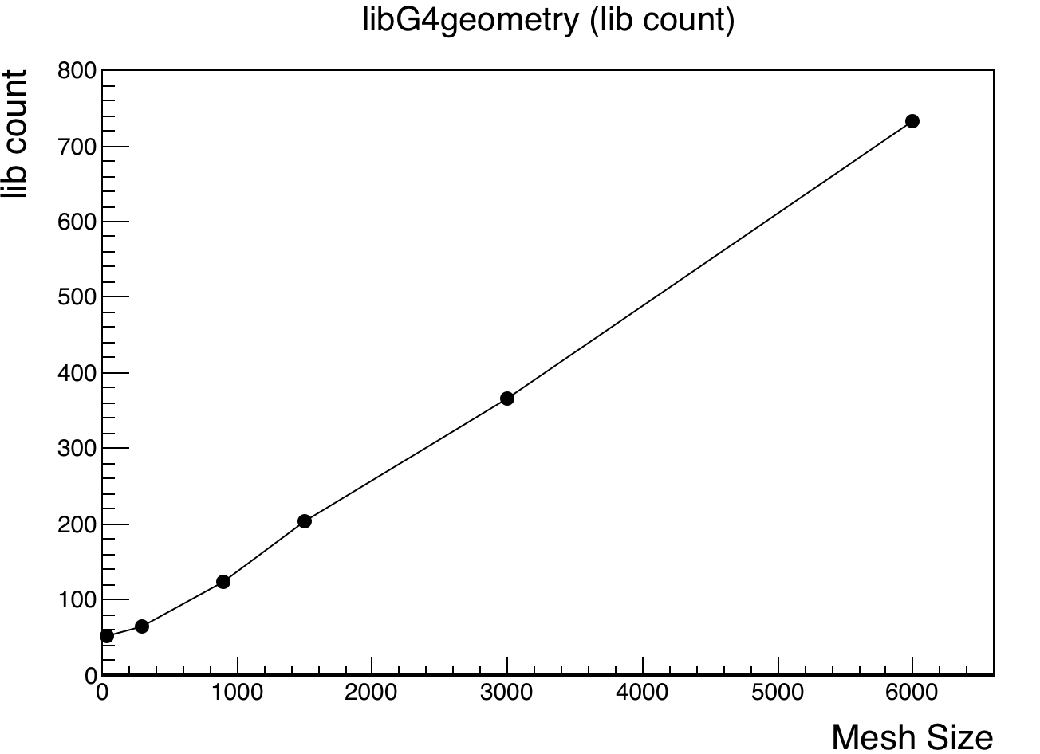
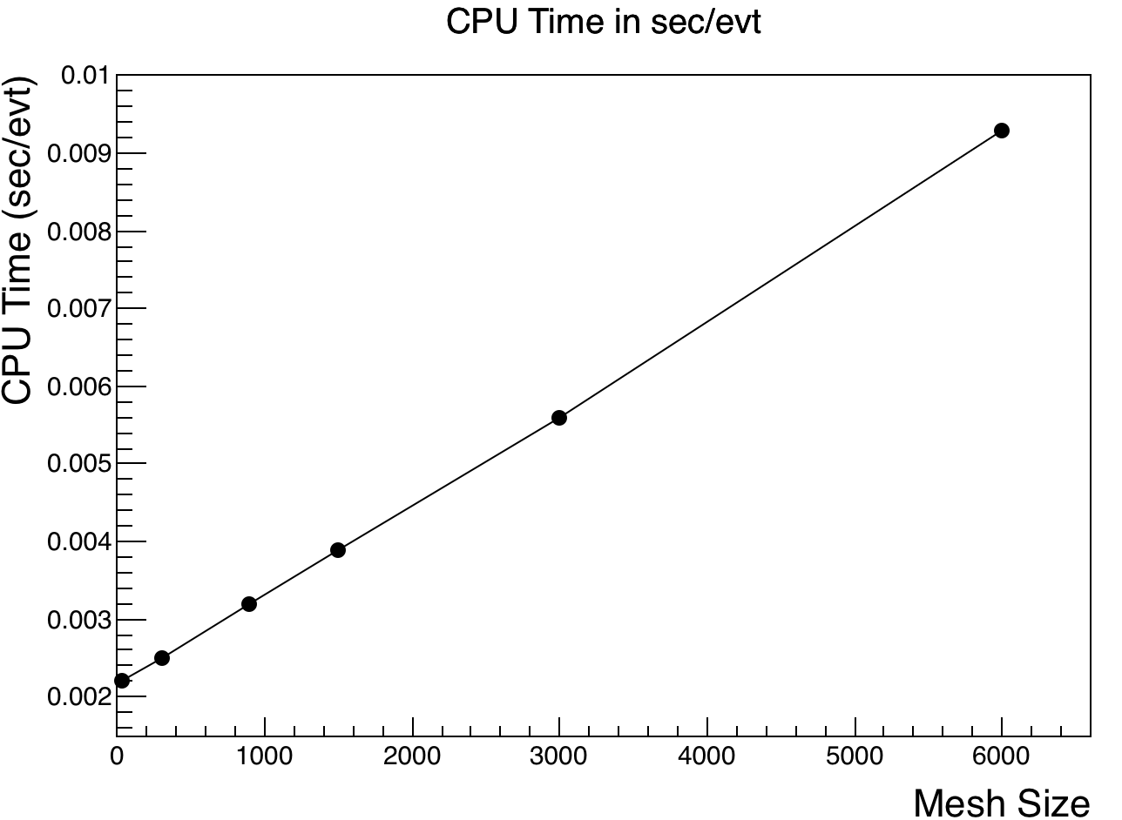
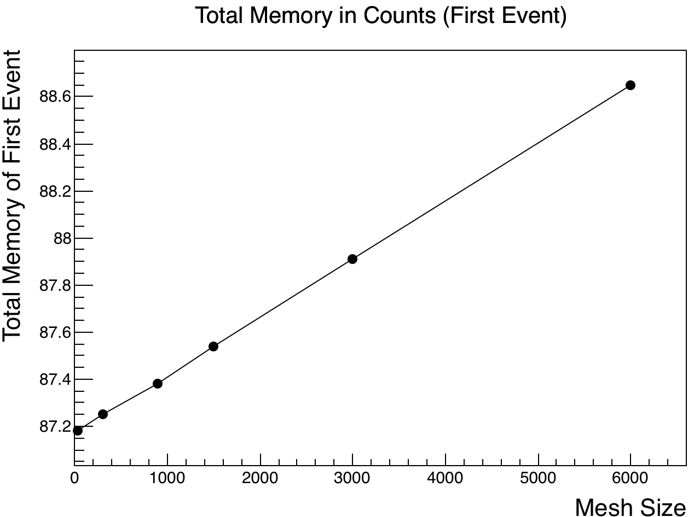
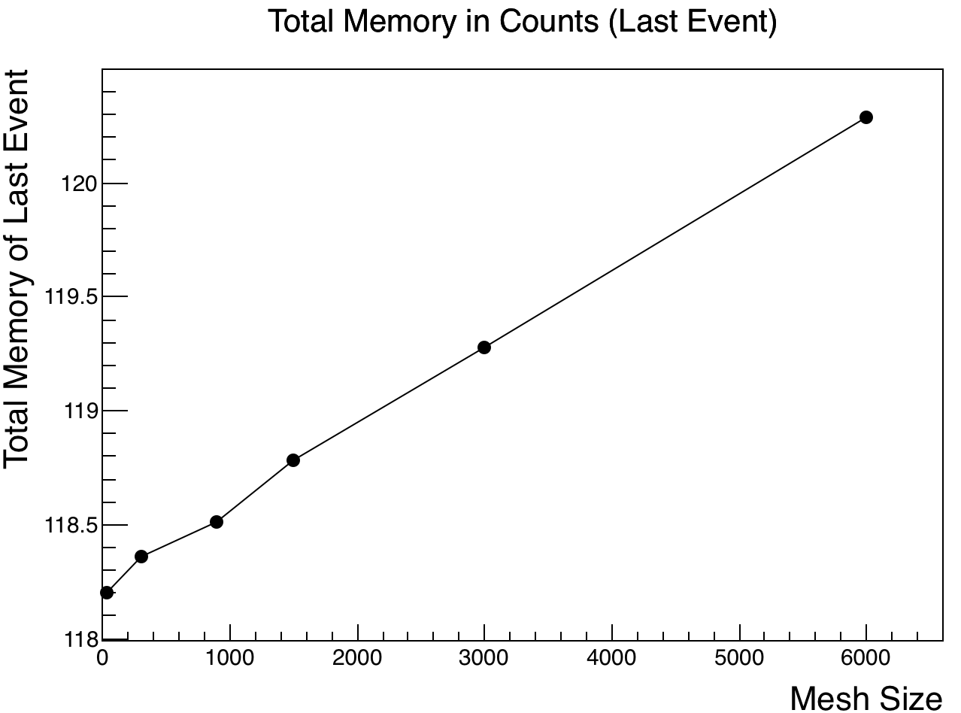
Mesh profiling
- Linear depending on mesh size

Slide 25
Summary
Shown
Low Energy Physics Profiling code
CPU/Memory usage
Comparing profiling using mesh size
Future
To usage: Geant4 profiling test => G4 Q&A
Version dependency
Scalability for new computing architecture (KISTI supercomputer)

Slide 26
Acknowledgement
Soon Yung Jun

