Slide 1
Geant4 Computing Performance Task with Open|Speedshop
Soon Yung Jun, Krzysztof Genser, Philippe Canal (Fermilab)
21st Geant4 Collaboration Meeting, Ferrara, Italy
Sept. 12 - 16, 2016

Slide 2
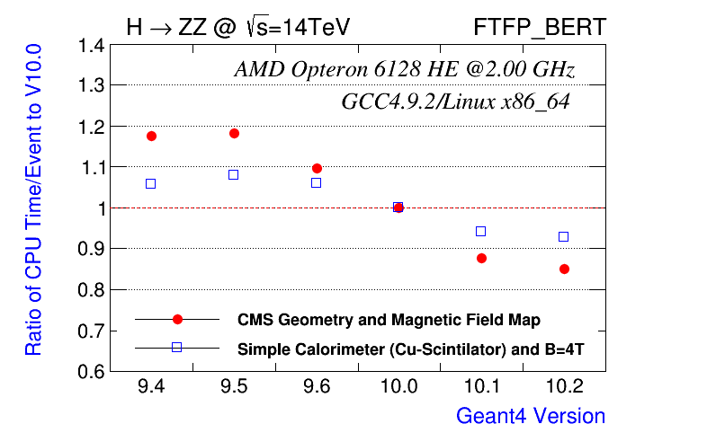
Geant4 Computing Performance (Review 1/4)
Progressive improvements over the last five years
(more information at https://g4cpt.fnal.gov/g4p/prplots/cpu_by_version.html)
~30%

Slide 3
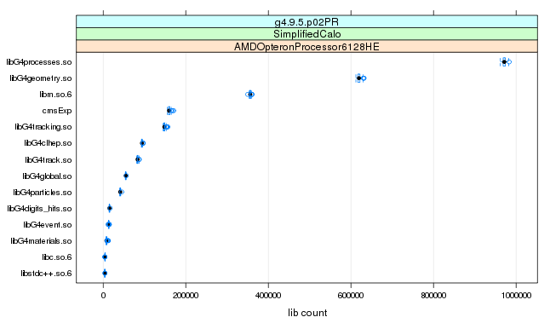
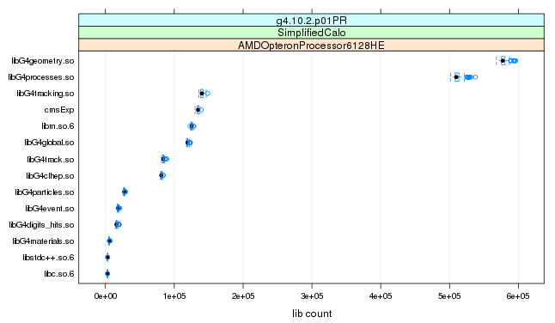
Geant4 Computing Performance (Review 2/4)
Changes in linked objects (libraries): from 9.5 to 10.2
Also many changes in hot functions from 9.5 to 10.2
Library | 9.5 | 10.2 | 9.5/10.2
libG4processes | 971348 | 577240 | 1.68
libG4geometry | 619304 | 509816 | 1.21
libm.so | 356072 | 125249 | 2.90
libG4tracking | 148078 | 140128 | 1.06

Slide 4
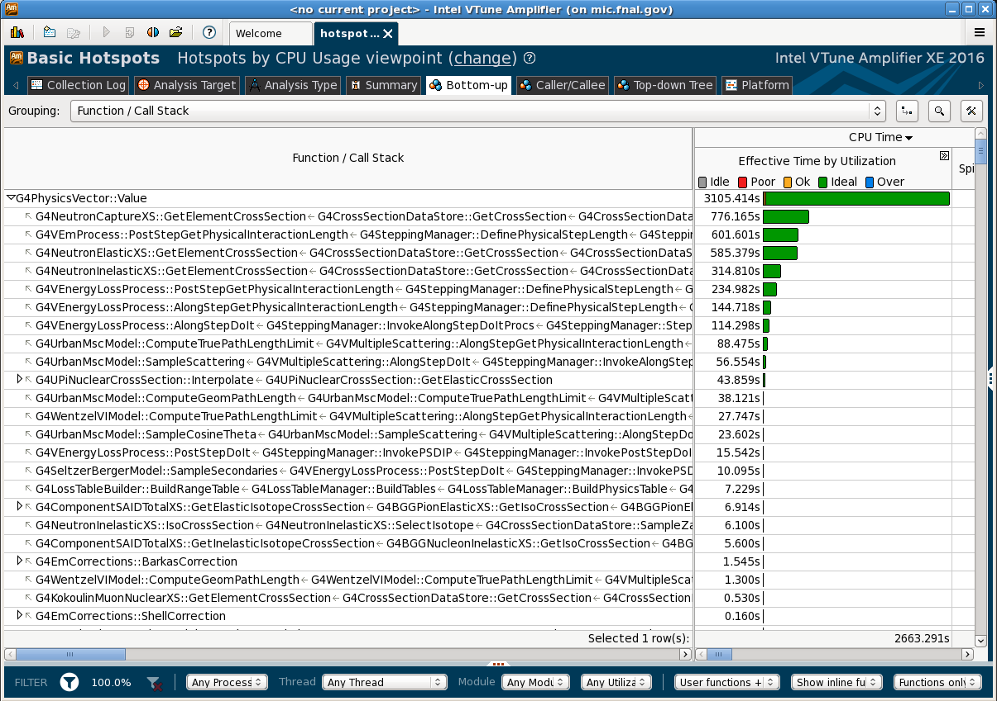
Geant4 Computing Performance (Review 3/4)
The current hot spot: G4PhysicsVector::Value (~6%)
73%
Top 4-Callees

Slide 5
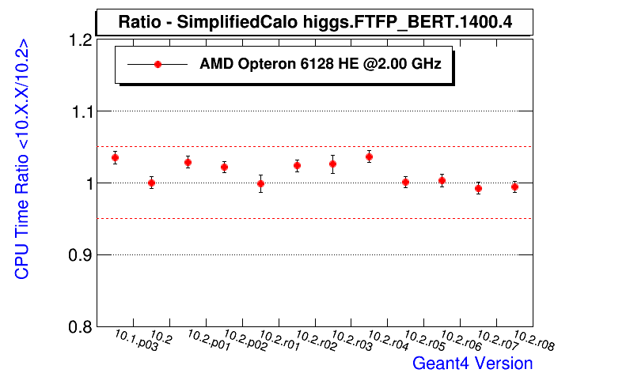
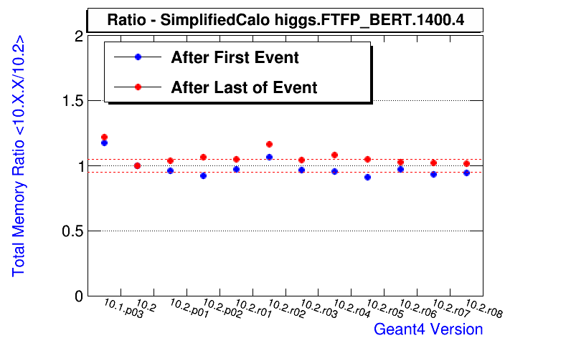
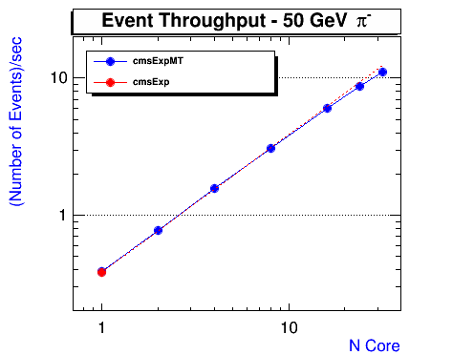
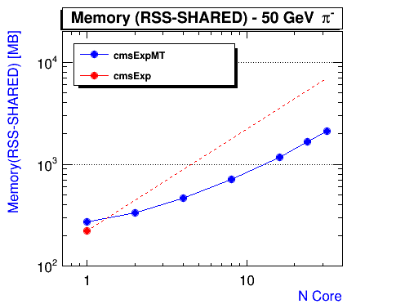
Geant4 Computing Performance (Review 4/4)
10.2 cycle: CPU/mem under control while improving physics
Geant Multi-threading: good scalability and memory reduction

Slide 6
Current Profiling Tools and Primary Metrics
Tools
FAST (CPU Profiling)
IgProf (Memory profiling)
Open|Speepshop (Geant4 MT profiling)
Metrics (Observables)
Timing
Event
Function (exclusive and inclusive)
Library
Memory
Footprint (live, total)
statm (top)
Multi-threaded applications
Event throughput and memory reduction

Slide 7
Challenges and New Requirements
Flat profile
No obviously reducible hot spots or bottlenecks
Need more specific metrics
Measurement uncertainty
Fixed rate for sampling and call path collections (100Hz)
Different optimization paths when recompiling Geant4 libs ?
Rerun reference for each release (4 nodes x 32 jobs)
Limited extensibility
Not all tools are capable for profiling multi-threaded applications
Not capable for profiling codes on new hardware architectures
Identify the better profiling tool(s) for G4CPT
Pick a right (integrated) tool to meet all new requirements
Surveyed several tools and selected Open|Speedshop

Slide 8
Introduction to Open|Speedshop
Open source (the Krell institute, https://openspeedshop.org/ )
Sampling Experiments (Light weighted)
Support for Call Stack Analysis
Hardware Performance Counters
Memory Function Tracing
MPI Profiling and Tracing
I/O Profiling and Tracing
Floating Point Exception Analysis
POSIX Thread Function Tracing (Multithreading-capable)
Flexible analysis options (GUI, command line, online)
Support Intel MIC architecture and NVIDIA CUDA
Well documented and supported

Slide 9
Sampling Experiments in OSS
pcsamp (periodic sampling the program counters)
Low overhead overview of time distribution
usertime (call path profiling)
Inclusive and exclusive timing data
Call paths, caller and callee relationships
hwcsamp (periodic sampling hardware counters)
Profile of hardware counter events (PAPI events)
mem (memory tracing)
Call paths for memory related function call events
Aggregate and individual rank, thread, or processing timings
pthreads (POSIX thread tracing)
io (I/O tracing)
Many other useful experiments

Slide 10
Measurement Overheads and Output Size
pcsamp: exclusive time - insensitive to sampling frequency (default 100Hz, set to 100000 Hz for G4CPT)
usertime: inclusive time and call paths – large overhead (default 35, set to 100Hz): similar overhead for hwcsamp

Slide 11
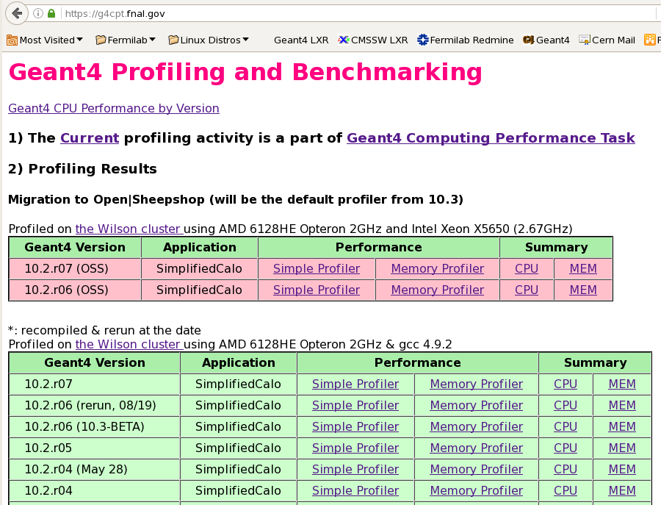
Migration Plan and Status:
Replace SimpleProfiler (FAST) with Open|Speedshop (OSS)
All information provided by old tools are reproduced with OSS and results have been posted since 10.2.r06

Slide 12
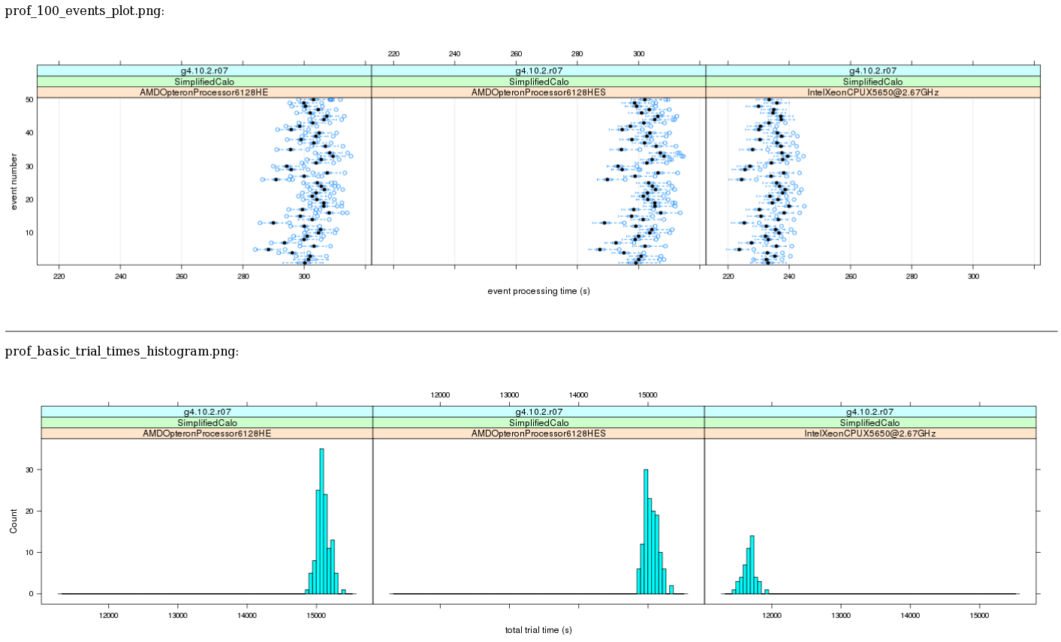
Results: Average CPU Time
Triple-cross-checks (2 sets x 128 AMD nodes, 1set x 48 Intel nodes) - example: H →ZZ (SimplifiedCalo)
Event Time
Total Time

Slide 13
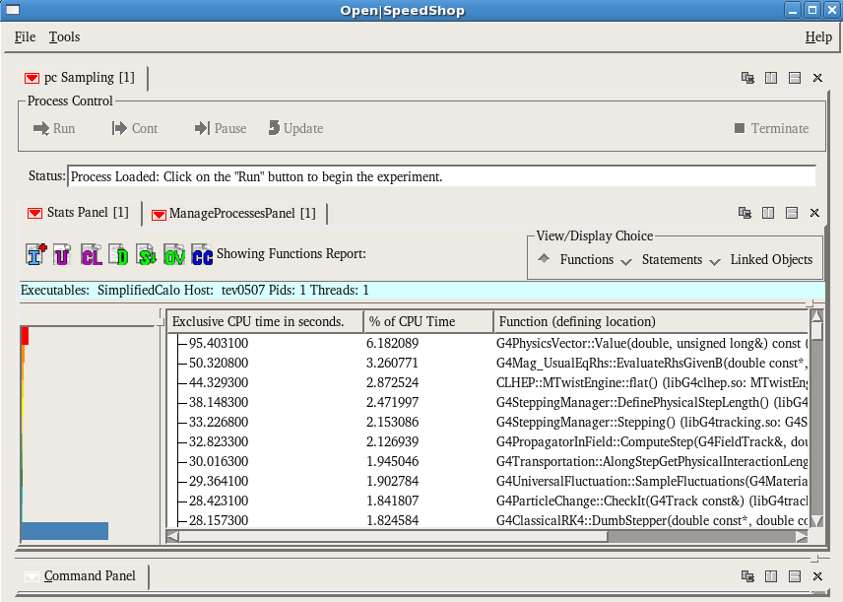
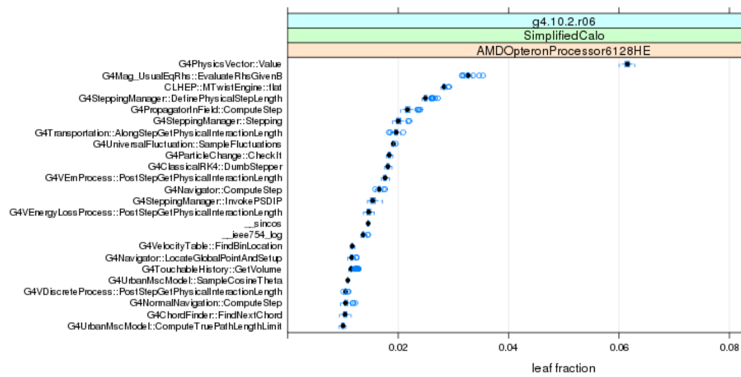
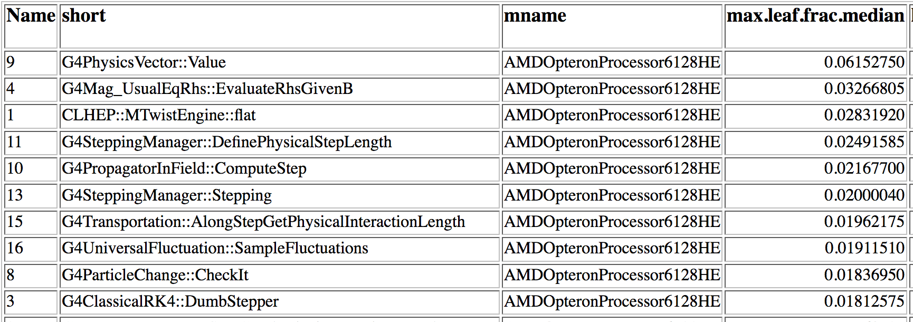
OSS pcsamp (program counter sampling) Experiment
→ g4cpt web plot/table
OSS GUI example: Function view
Other views: linked object (libraries), function paths and so on

Slide 14
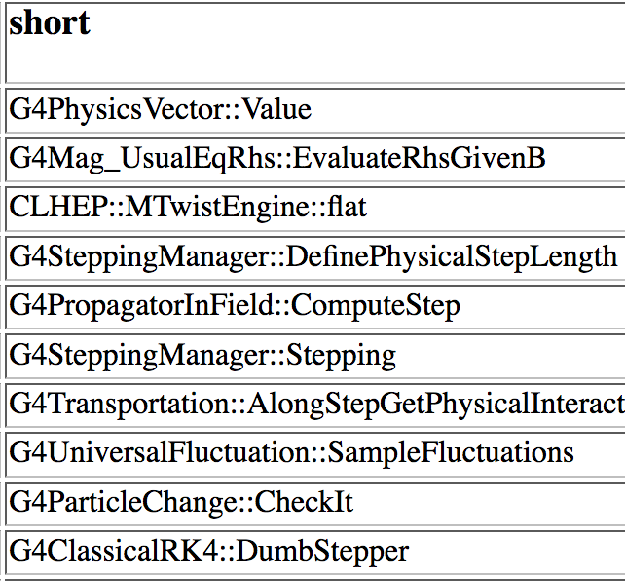
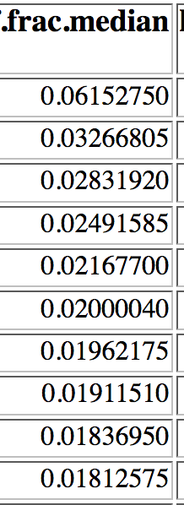
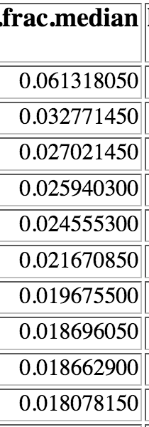
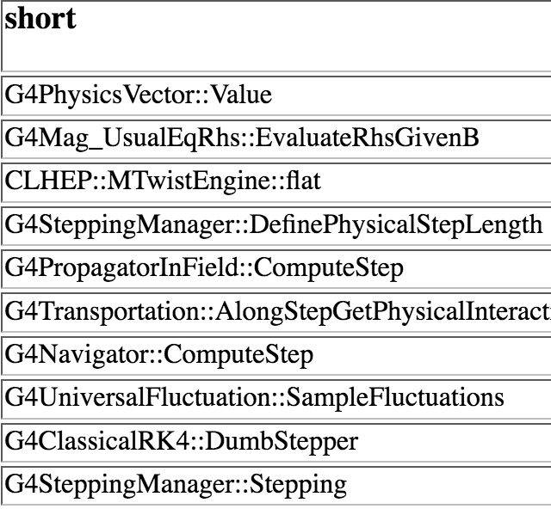
Comparison between FAST and OSS: Top Ten Functions
Exclusive time fraction (10.2.r06, H→ZZ, SimplifiedCalo)
Also consistent profiling results for exclusive timing (call paths) and linked objects
FAST (100 Hz)
OSS (10 KHz)

Slide 15
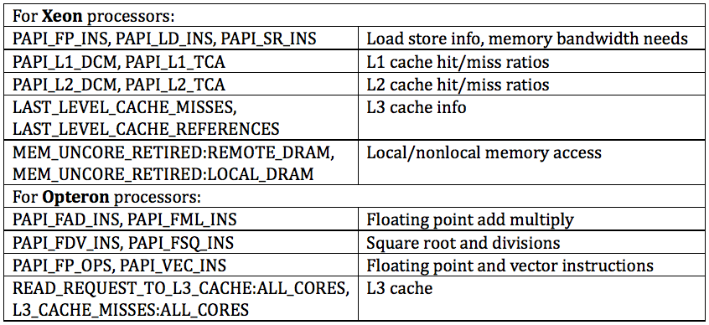
Open|Speedshop: Experiments with Hardware Counters
Periodic sampling hardware counters (hwcsamp)
Supports both derived and non-derived PAPI presets
A list of some possible hardware counter combinations

Slide 16
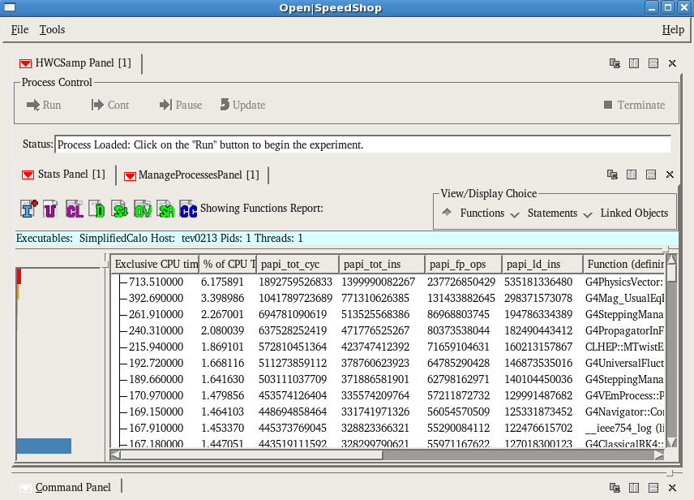
OSS hwcsamp (hardware counters) Experiment
hwcsamp example: TOT_CYS, TOT_INC, FP_OPS, LD_INS (10.2.r06, H→ZZ, SimplifiedCalo)

Slide 17
Code Performance by Hardware Counter Metrics
Derivatives: examples
Example: Higgs → ZZ (10.2.r06) with SimplifiedCalo
IPC = 0.74 (relatively small)
FMO = 0.30
Hardware Counter Metrics Derivatives | Performance
IPC (Instruction/Cycle) | Large values suggest good balance with minimal stalls.
FPC (FLOPS/Cycle) | Large values for floating point intensive codes suggests efficient CPU utilization
FMO (FLOPS/Memory Ops) | Good data locality, Computational Intensity
LPC (Loads/Cycle) | Useful for calculating FMO, may indicate good stride through arrays.
SPC (Stores/Cycle) | Useful for calculating FMO, may indicate good stride through arrays.

Slide 18
More OSS Post Analysis
Profiling information at the function statement (line) level
Will provide the top-100 list from 10.3
Multi-threading capability (see the next talk)
Compare two experiments (osscompare): examples to use
two releases
Two experiments with the different numbers of threads
Call path analysis based on DB

Slide 19
Work Plan
Migration to Open|speedshop (partially done)
Have been tested with recent releases since 10.3.beta
Reproduced all performance data that we used to measure
More information are ready to be added
Current set of experiments
pcsamp (exclusive time)
usersamp (inclusive time and call path)
hwcsamp (PAPI hardware counters)
Extension
mem (memory tracing)
pthreads (POSIX thread tracing)
io (I/O tracking)

Slide 20
Summary
Reviewed Geant4 computing performance for recent releases
Challenges and new requirement in G4CPT have been addressed
Open|speedshop is selected as the default profiler for the future computing performance task
Migration is done and computing performance profiling and benchmark are ready to be extended

Slide 21
Backup Slides

Slide 22
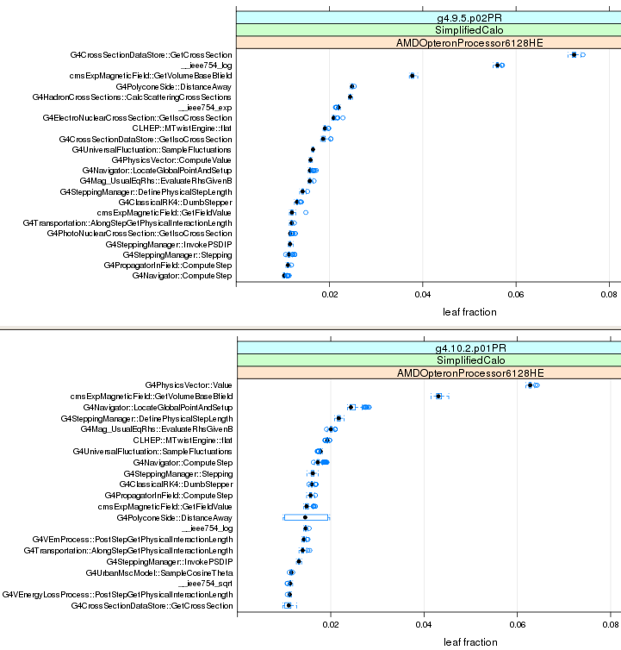
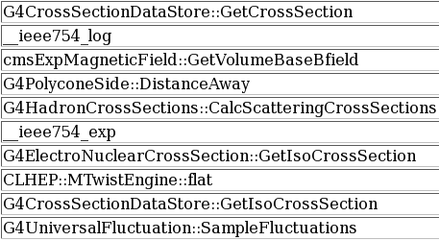
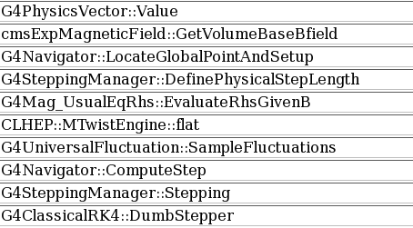
Geant4 Computing Performance: Hot Functions
Changes in hot functions from 9.5 to 10.2

Slide 23
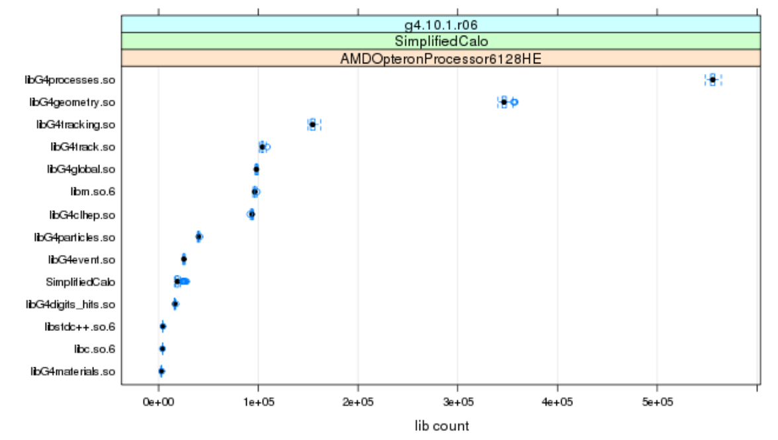
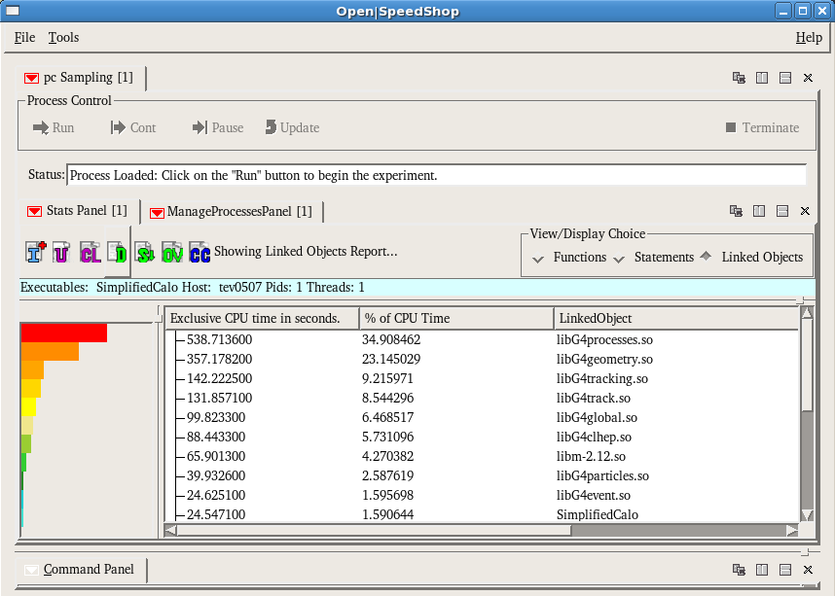
Results: OSS linked Objects
→ g4cpt web plot
OSS GUI example: Linked Objects view

