Slide 1
Geant4 MT Performance
Soon Yung Jun (Fermilab)
21st Geant4 Collaboration Meeting, Ferrara, Italy
Sept. 12 - 16, 2016

Slide 2
Introduction
Geant4 multi-threading (Geant4 MT) capabilities
Event-level parallelism
Available since 10.0
Status (see Andrea’s talk in Plenary 7)
Readiness for large-scale computing?
Validation (not a scope of this talk)
Performance
Basic performance metrics
Event throughput (weak scaling)
Memory reduction
Scopes of this talk
MT performance on different hardware platforms
Profiling results

Slide 3
Performance Profiling Experiments
Application : a standalone CMS detector simulation
the CMS geometry (gdml)
a volume based magnetic field map excerpted from CMSSW
single particle samples (50 GeV pi-,e-) and PYTHIA H → ZZ
cmsExp (sequential) and cmsExpMT (multi-threading)
Platform tested for this talk
Intel Xeon X5650: dual-socket 6-core (total 12 cores), 12GB
AMD Opertron 6128: quad-socket 8-core (total 32 cores), 64GB
Intel Xeon Phi 5110P (MIC, Knight’s Corner): 60 cores, 8GB
Intel Xeon Phi (Knight’s Landing), 64 cores, 96GB+16MCDRAM
Profiling tools
Open|Speedshop (OSS) v2.2
Intel VTune Amplifier XE (VTune) 2016

Slide 4
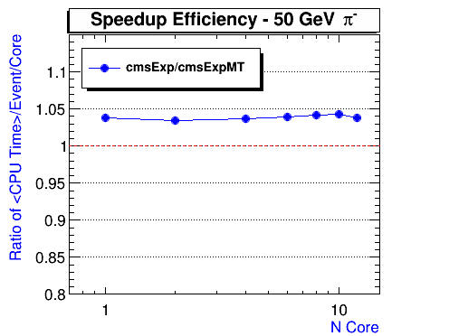
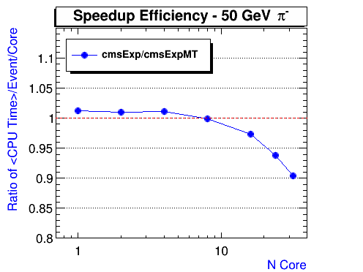
MT Performance on General Purpose CPUs: Intel vs. AMD
Event throughput = the number of event processed/time
Speedup efficiency:$ε\left(Nthreads\right)= \frac{Throughput(Sequential)}{Throughput(Nthreads)} × Nthreads$
What to understand (Geant4 10.2.r06)
MT is (sometimes) faster than sequential
Degradation as the number of threads increases in AMD
Intel Xeon X5650
AMD Opteron 6128

Slide 5
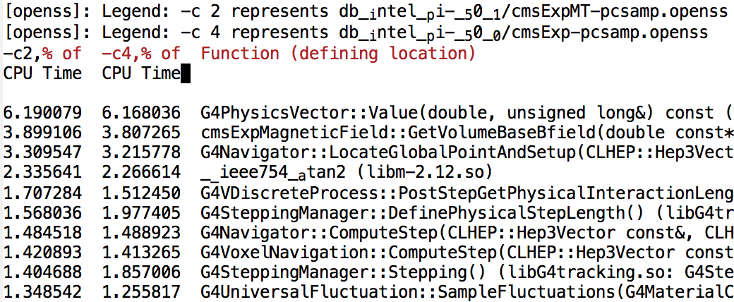
Profiling Comparison: Intel Xeon
OSS compare: Sequential vs. MT with1 thread (% of time)
Reported time: 1951 (s1) vs. 1878 (t1) seconds for 1028 events of 50 GeV pions (10.2.r06)
A hint of difference in SteppingManager, but not conclusive
Need to cross-check the number of steps/tracks (by the particle type)
t1 s1

Slide 6
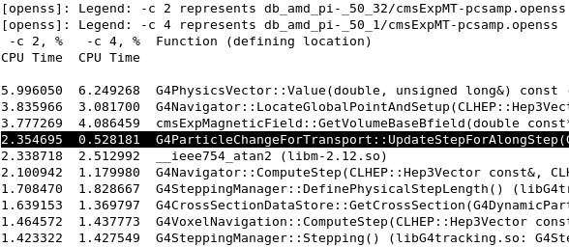
Profiling Comparison: AMD Opertron
OSS compare: 32 threads vs. 1 thread (% of time)
Experiment with 1028 events of 50 GeV pions (10.2.r06)
Clear signs of difference in G4Navigator and ParticleChangesForTransport::UpdateStepForAlongsStep
t32 t1

Slide 7
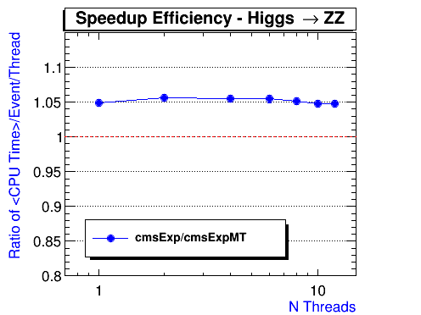
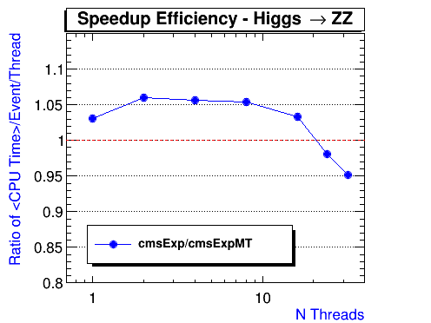
H → ZZ : Intel vs. AMD
Speedup efficiency ($ε$) as the number of threads (10.2.r06)
The number of events processed = 50 x Nthreads
Intel Xeon X5650
AMD Opteron 6128

Slide 8
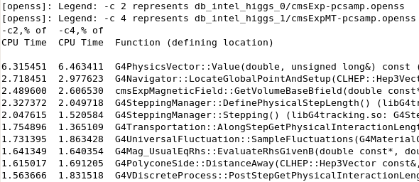
Profiling Comparison: Intel Xeon
OSS compare: Intel sequential vs. MT 1 thread (% of time)
Experiments with 50 events of H → ZZ (10.2.r06)

Slide 9
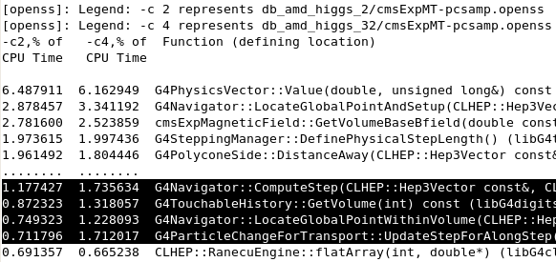
Profiling Comparison: AMD Opertron
OSS compare: MT 2 threads vs. MT 32 thread (% of time)
Experiments with 50xNthreads events of H->ZZ (10.2.r06)
Again hints of difference: adding counters for the number of steps tracks by the particle type for MT

Slide 10
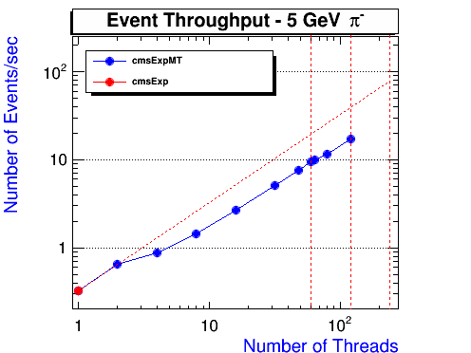
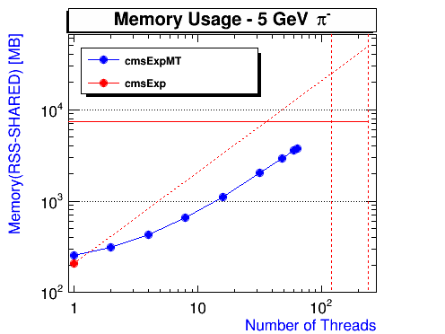
MT performance: Xeon Phi 5110 (MIC, Knight’s Corner)
cmsExp on MIC: 5 GeV pi- (Events = 1028 x N-threads)
60 cores (4 way hyper-threading), 1.03 GHz, 7.8 GB memory
Significant scalability loss from N threads = 2 to N threads = 4
Hit memory limit (~7.3 GB available) @ 120 threads
Need to re-measure throughput with physics samples (threshold for the memory limit and the maximal cores to utilize)

Slide 11
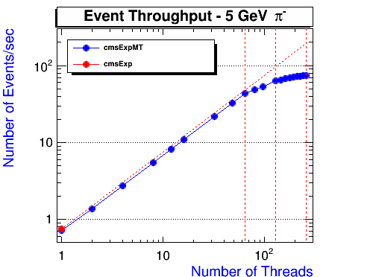
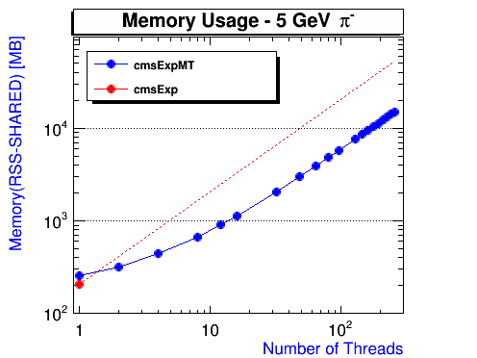
MT Performance on KNL
Performance on Intel Xeon Phi Processor (Knight's Landing )
Developer Edition: Single Socket 1.30 GHz, 64 core
MEMORY: 96GB, 2133MHz DDR4, 16GB MCDRAM memory
Geant4 10.2.p02 with -xMIC-AVX512
Experiment with N-threads x1028 Events of 5 GeV pi- (10.2.r06)

Slide 12
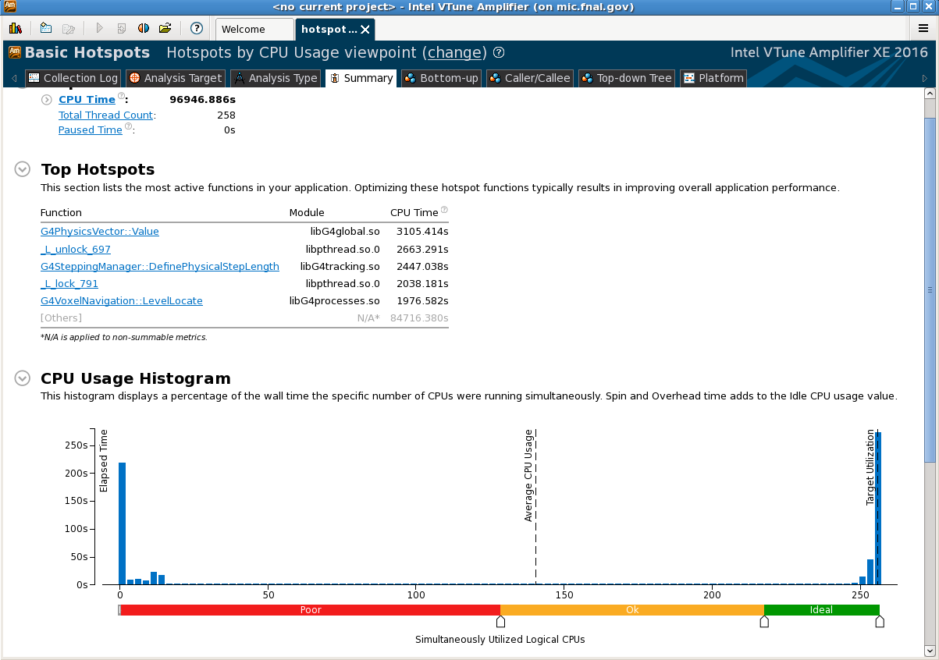
Profiling Results: KNL
Hotspots with N-threads = 256
_L_unlock/lock

Slide 13
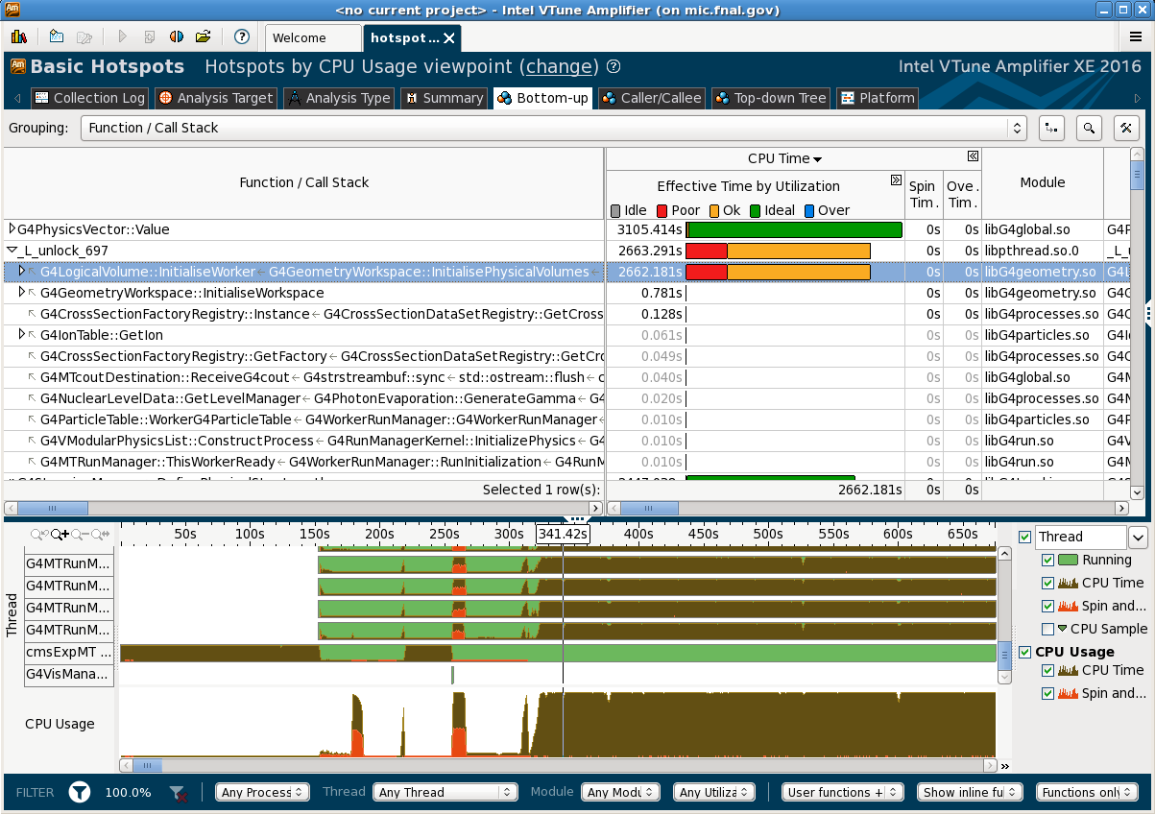
Profiling Results: KNL (N threads = 256)
_L_lock: also called by G4LogicalVolume::initialiseWorker
G4LogicalVolume::initialiseWorker

Slide 14
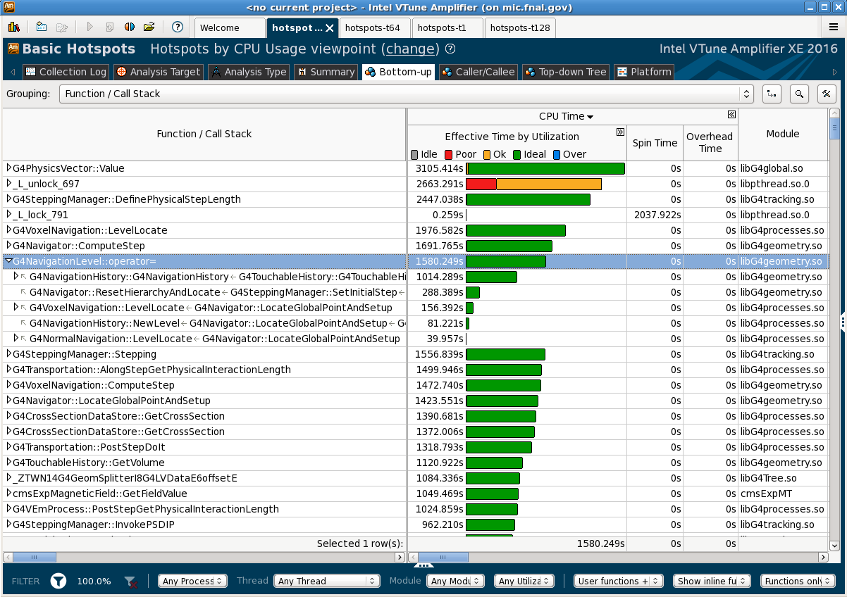
Profiling Results: KNL (N threads = 256)
Also seen with N threads = 198 and 128
G4NavigationLevel::operator=

Slide 15
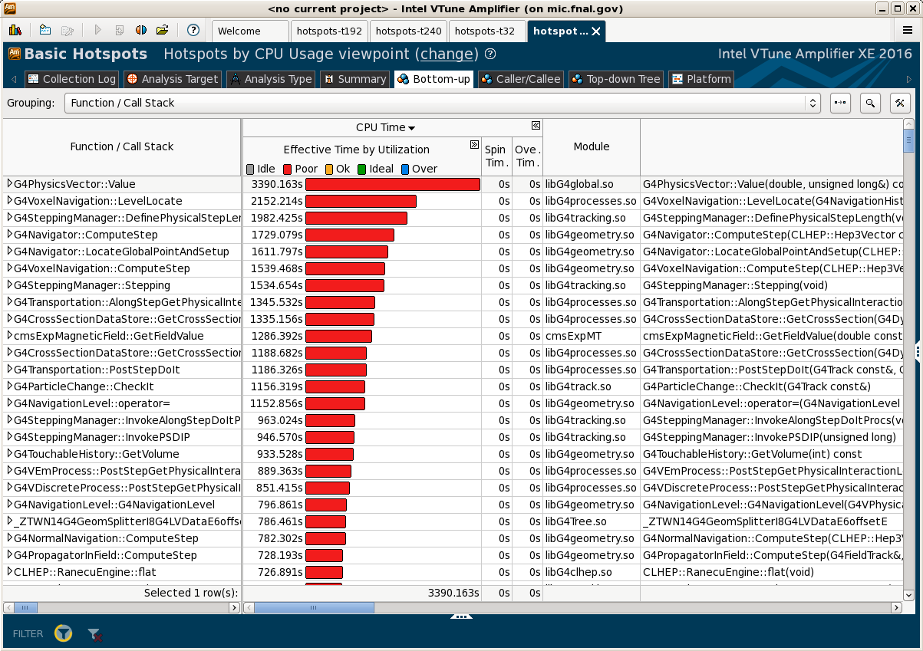
Geant4MT: Profiling Result ( N threads =128)

Slide 16
Summary
Reviewed Geant4 MT performance
standalone CMS detector simulation (single particle, H→ZZ)
Performance on different systems and profiling results
No major issues on Intel Xeon
Degradation seen on AMD as the number of threads is partially understood
Xeon Phi (KNC) shows problems at N-threads > 120
Xeon Phi (KNL) shows stable performance
More tests to understand results of AMD/KNL profiling data
Examine stepping information on AMD and KNL (sequential vs. 1-threads and 1-thread vs. N-threads)
Test H → ZZ on KNL (scalability and memory)

Slide 17
Backup Slides

Slide 18
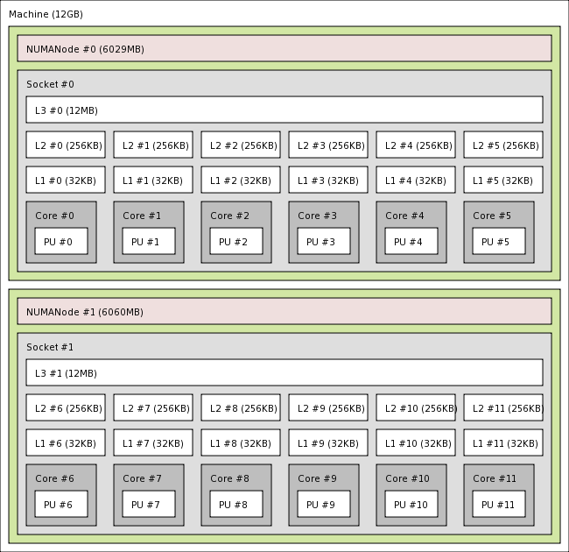
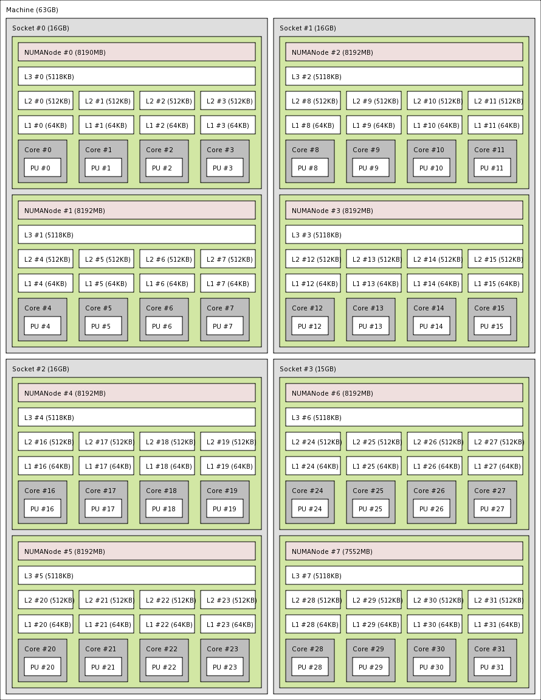
Intel Xeon vs. AMD Opteron
NUMA memory nodes, sockets, shared caches cores
Xeon X5650
Opteron 6128HE

Slide 19
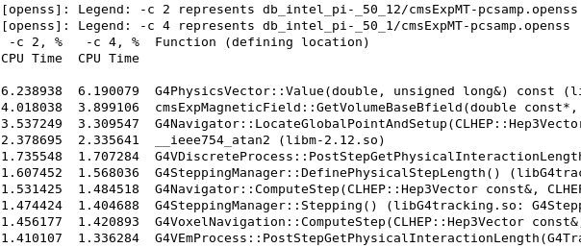
Exclusive time: Intel Xeon
OSS compare: 1 threads vs. 12 thread (% of time)
Experiment with1028 events of 50 GeV pions (10.2.r06)
No changes in call paths
No significant timing perturbation (a good sanity check!)
t12 t1

Slide 20
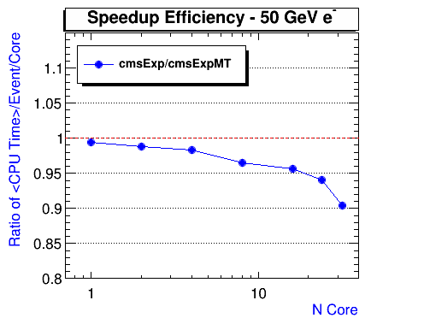
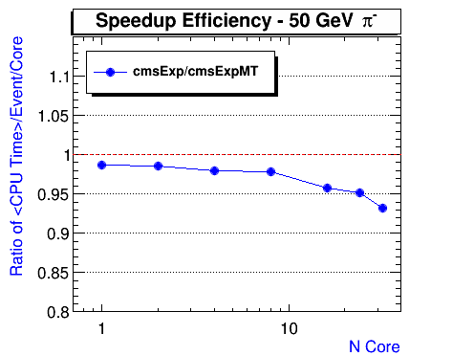
AMD
OSS compare: AMD 32 threads vs. 1 thread (% of time)
Persistency in difference (by version, by different samples)?
Experiments with 1028 events of 50 GeV e- and pi- (10.2.r07)

Slide 21
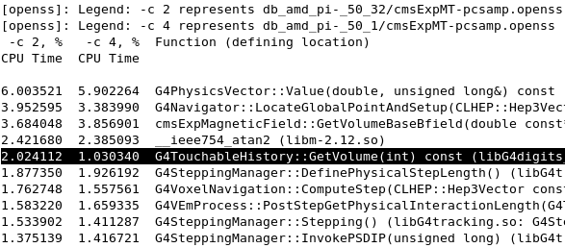
Degradation on AMD: Persistency
OSS compare: AMD 32 threads vs. 1 thread (% of time)
Experiment with 1028 events of 50 GeV pi- (10.2.r07)
G4Navigator::LocateGloalPointAndSetup is perturbative (consistent with 10.2.r06)

Slide 22
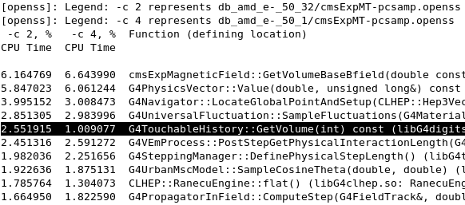
Degradation on AMD: Persistency
OSS compare: AMD 32 threads vs. 1 thread (% of time)
Experiment with 1028 events of 50 GeV e- (10.2.r07)
G4TouchableHistory::GetVolume

Slide 23
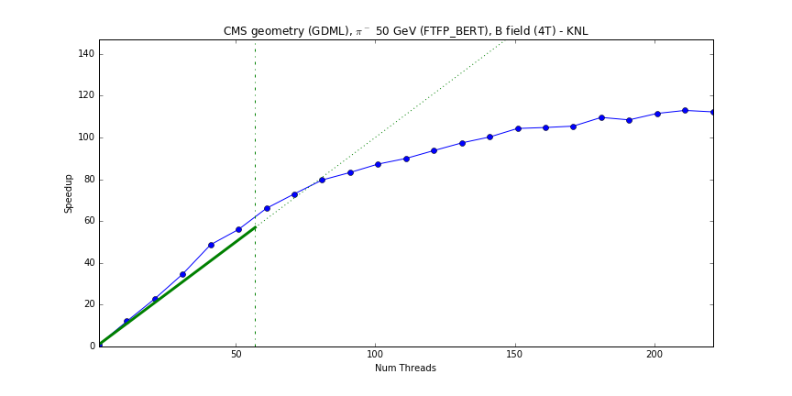
Geant4 MT Performance: Xeon Phi (Andrea Dotti)
CMS geometry, uniform (4T) B-filed (10.2.r06)
Total number of events processed = 10*(number of threads)
Intel Xeon Phi 3210A (57 cores), 6GB
Xron Phi (MIC)

Slide 24
Geant4MT: Profiling Result (N threads = 256)

Slide 25
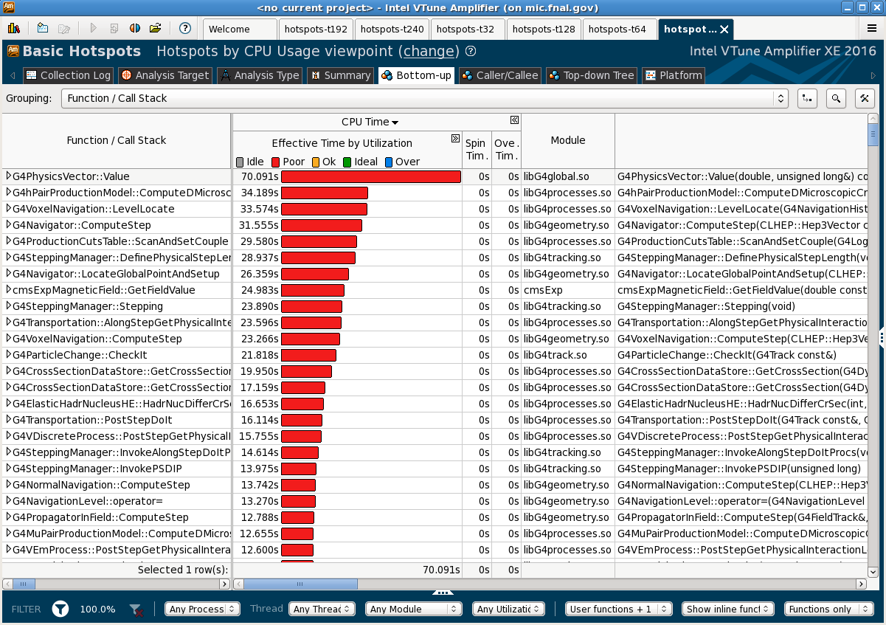
Geant4MT: Profiling Result (Sequential)

Slide 26
Geant4MT: Profiling Result ( N thread = 1)

Slide 27
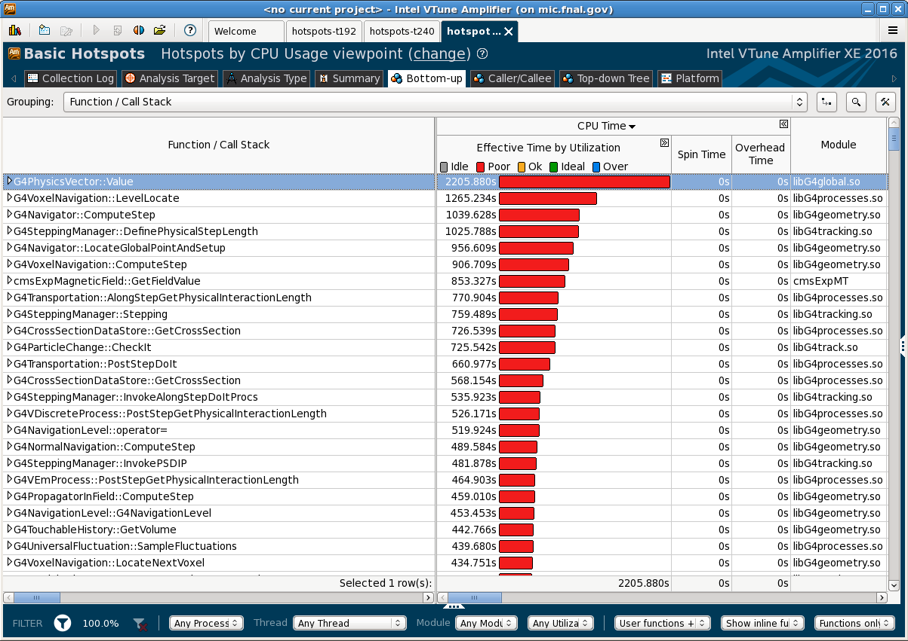
Geant4MT: Profiling Result (N threads = 32)

Slide 28
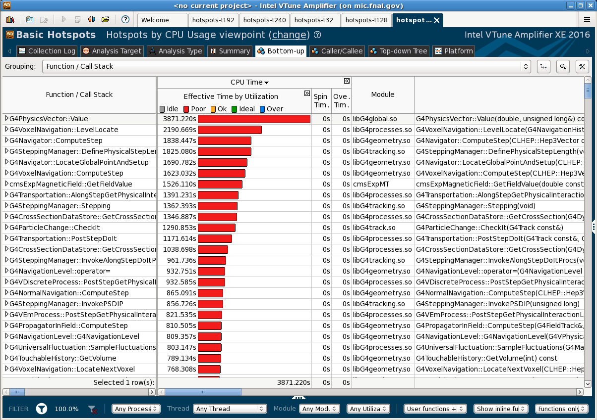
Geant4MT: Profiling Result (N threads = 64)

Slide 29
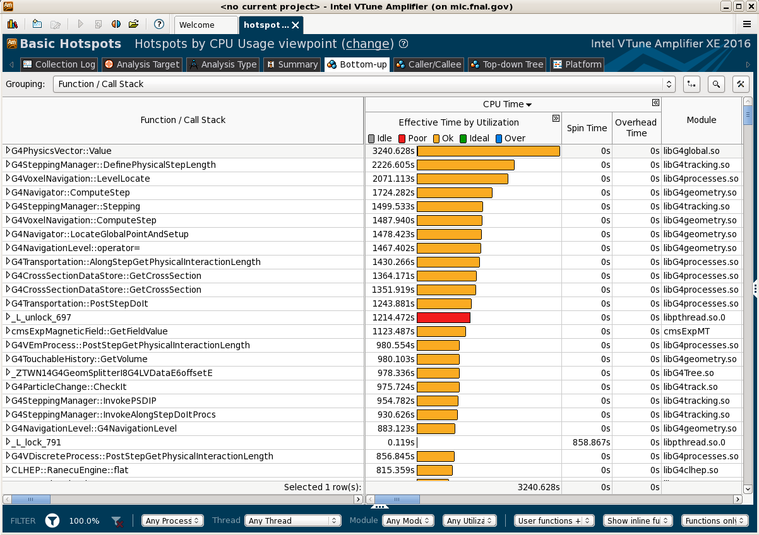
Geant4MT: Profiling Result (N threads = 192)

Slide 30
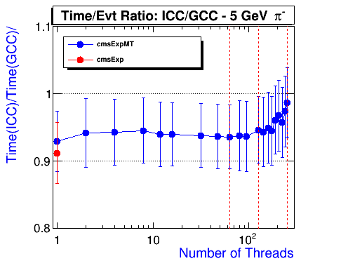
Geant4MT Performance on KNL: icc (16.0.3) vs. gcc (4.9.1)
Performance on Intel Xeon Phi Processor (Knight's Landing )
KNL triples both scalar and vector performance compared with KNC and offers, up to 3.0 TFlop/sec (double) per processor.

