Slide 1
Vector Electromagnetic Physics Models & Field Propagation
Guilherme Amadio (UNESP),
Ananya,
John Apostolakis, Marilena Bandieramonte, Mihaly Novak (CERN)
Soon Yung Jun (Fermilab)
21th Geant4 Collaboration Meeting
January 18 – 22, 2016
Ferrara, Italy

Slide 2
Outline – EM Physics Models
Context
Approaches
  Tabulated (pre-simulated) reactions
  Borrowing distributions from established G4 models
  Re-constituted modeling
EM processes
  Electron models
  Photon models
Validation & speedup of photon models
Outlook

Slide 3
Approaches in Modeling
Tabulated (pre-simulated) reactions
  Use 5 G4 interactions per (projectile, target, energy) tuple,
  Aims to obtain a (mostly) realistic shower development
  Choice of production threshold in energy for each library created
  Used as a first implementation
“Straight-forward” vectorization & new sampling
  Borrowing distributions from established G4 models
  Allows faster ‘startup’ of models
  Used for photon processes
Re-constituted modeling “from the ground up”
  Recalculation from first principles of models (as applicable)
  Went back to original measurements/tabulations for available ‘core’ quantities
  To date, undertaken for all electron processes

Slide 4
Photon Models: Sampling and its Validation
Physics validation
  simulate interactions at fixed input energy points
  compare results (final states of interaction) w.r.t “Geant4” (code copied/extracted from Geant4)
Criteria
  χ² comparison & p value
  Plot ratio of distributions, residuals
  Q-Q plot: quantiles of two distributions ( 2% point vs 2% point, 4% vs 4%, … )

Slide 5
Verification of Compton Klein Nishina model – 1 MeV
Identifying
problem
points

Slide 6
Verification of Compton Klein Nishina model – 100 MeV

Slide 7
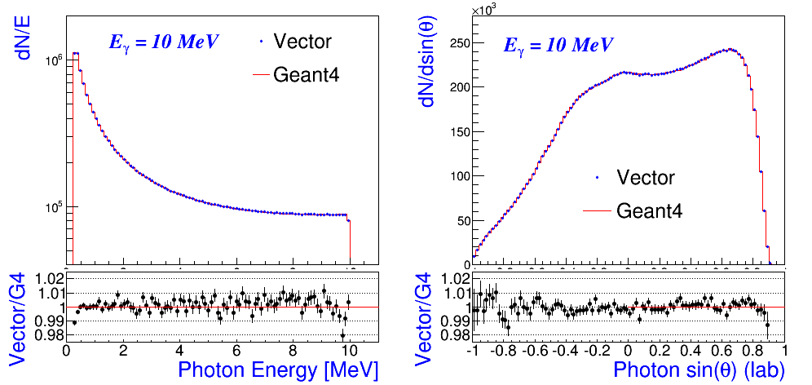
Preliminary Validation: Alias Sampling Method vs. Geant4
Compton: scattered photon energy and angular distributions with input photon energy = 10 MeV (Vector)
  1%-level agreement up to 100 MeV with alias table size [100,200]

Slide 8
Validation and Performance Evaluation (Preliminary)
Performance measurement
  10 experiments, 100 repetitions per experiment
  time for simulating N secondary interactions with a exponentially falling input energy spectrum in the range;
    input energy range = [2MeV:20MeV] with 16 Z-elements
    also tested in E [10keV:1MeV], E [10MeV:1GeV], E [10GeV:1TeV]
    note that performance of Geant4 depends on the energy range
  sample and store secondary particles, and update primary tracks
  speedup = scalar/vector or scalar/GPU as the number of input particles (tracks) for the same task

Slide 9
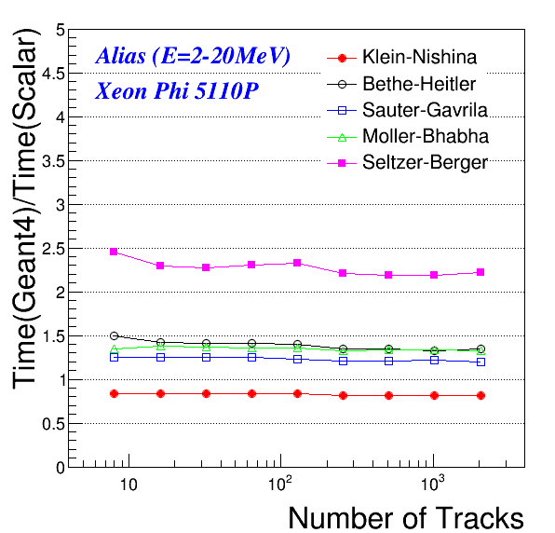
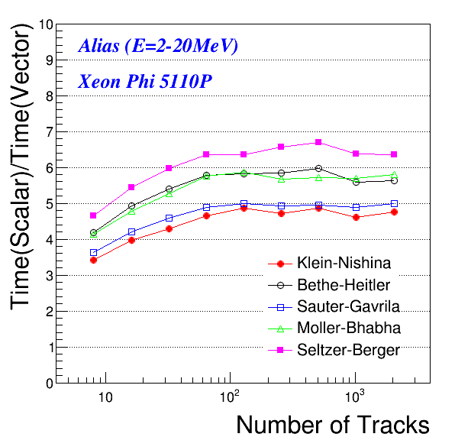
Preliminary Performance: Alias Sampling Method
Vector performance
  input particle energy: 2-20 MeV (valid range for all models)
  using 16 elements (random for each track)
  MIC (Intel Xeon Phi 5110P 60 cores @ 1.053 GHz) - 8 vector pipelines for double precision – see also SSE/AVX in backup

Slide 10
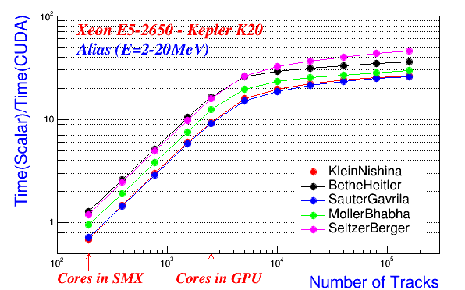
Preliminary Performance: Alias Sampling Method – GPU
GPU
  GPU: Nvidia Kepler (K20), 2496 cores @ 0.7 GHz - <<<26,192>>>
  Host: Intel Xeon E5 – 2650 @ 2.60 GHz

Slide 11
Next steps & Outlook
Integration into GeantV tracking loop – with validation
  a single gamma processes (in progress)
  multiple gamma processes
  electron process(es)
Full set of electron & gamma processes in tracking loop
  Validation of EM showers
  Profiling & optimisation
  Speedup evaluation
Neutron processes
  Process cross section – full reevaluation (BARC)

Slide 12
Electron processes and models
Model for multiple scattering prepared
  Portable between G4 and GeantV
  Approach & validation presented in 2015 Geant4 workshop
  Released as ‘GS’ Mult.Scat. model in Geant4 10.2 (Dec 2015)
Models for bremmstrahlung
  Prepared new ‘ground-up’ implementation of brem
  Fully integrated density & LPM effects
  Identified correction for LPM effect in G4 brem model (fixed)
Models for ionisation
Status
  Further validation underway
  Integration into GeantV tracking is in preparation

Slide 13
VecPhys Summary
Demonstrated feasibility of implementing electromagnetic physics models for scalar, Vector(SIMD) and GPU (SIMT) architectures with common source code
Integrated different sampling methods (alias, adaptations of accept/reject) for models of photon processes
New electron models ‘from the ground up’ – multiple scattering fully validated in Geant4 simulations
Validating physics results with Geant4 and evaluating computing performance
Outlook
  Optimize further for both SIMD and SIMT
  Integrate in the GeantV framework
  Measure performance in full simulation

Slide 14
Magnetic Field Propagation
Ananya
John Apostolakis
Outline
GeantV and magnetic field tracking
The CMS magnetic field
  Approximation using Bilinear Interpolation
  Vectorization and memory layout
  Optimization
  VTune Analysis
Vectorization of Integration of motion

Slide 15
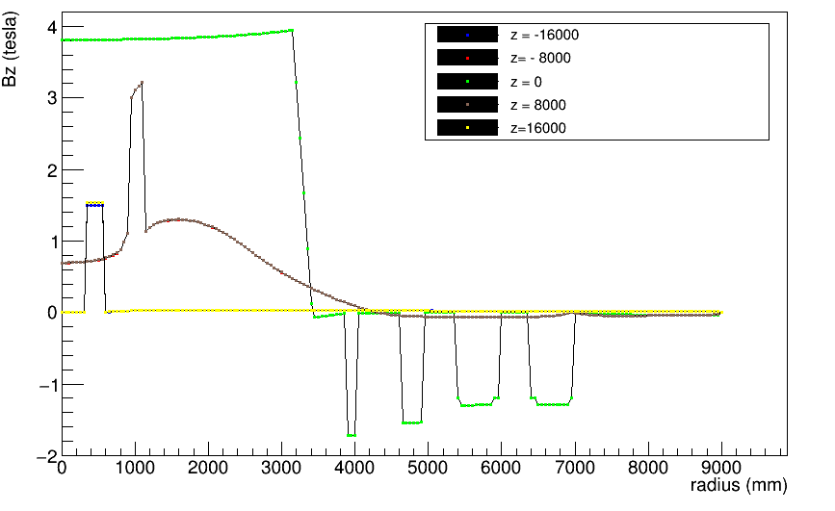
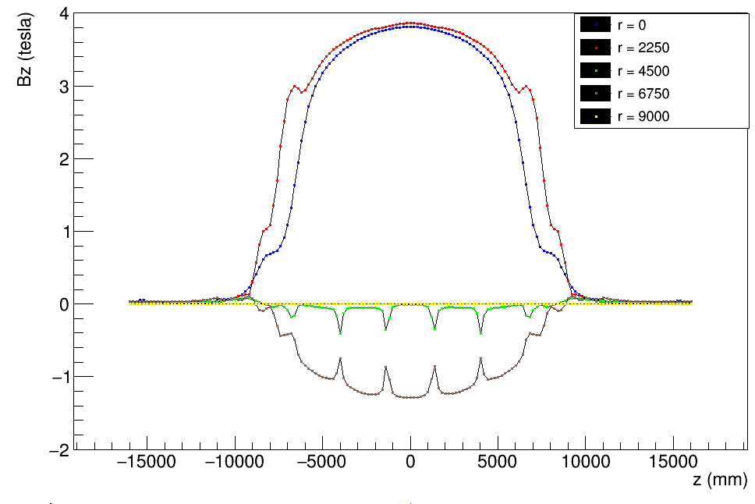
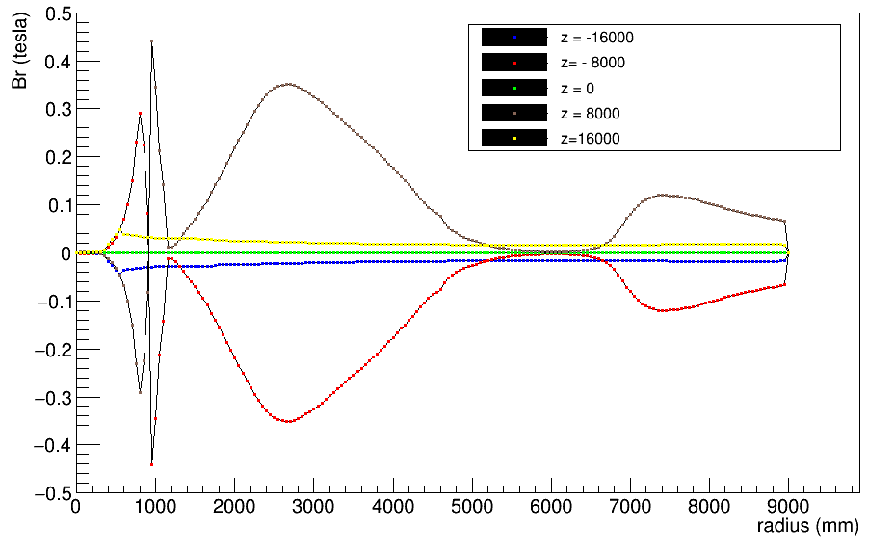
Problem statement
Start with sample values of 2D CMS field.
Assume phi-symmetric field.
Find magnetic field given a point in 3D space.

Slide 16
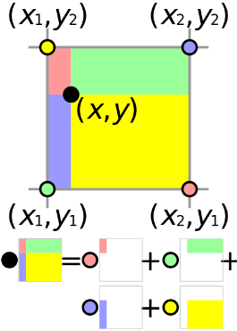
WHAT DO WE DO?
Read given 2D map.
Find corresponding magnetic field using bilinear interpolation on values from map.

Slide 17
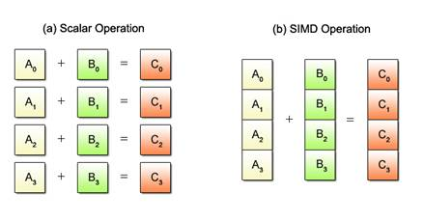
Vectorization
"Vectorization" (simplified) is the process of rewriting a loop so that instead of processing a single element of an array N times, it processes (say) 4 elements of the array simultaneously N/4 times.
What are we doing?
  Processing multiple particles/tracks simultaneously

Slide 19
Different Ordering of gather
Gather1
Gather2
i1[0]
i1[1]
i1[2]
i2[0]
i2[1]
i2[2]
i3[0]
i3[1]
i3[2]
i4[0]
i4[1]
i4[2]
i1[0]
i1[1]
i1[2]
i2[0]
i2[1]
i2[2]
i3[0]
i3[1]
i3[2]
i4[0]
i4[1]
i4[2]

Slide 21
observations
Speedup factor of ~3
Semi-realistic benchmark:
  Half the points are new; the other half are ‘moved’ near to previous values.
  Exponential random distribution.
  Time reduced by ~5%. Likely effect is from cache.
Difference in performance from changing doubles to floats:
  3-20% for sequential
  30-40% for vector version
Difference in performance from changing order of memory operations:
  5-7% for sequential
  5-20% for vector version

Slide 22
Integrating motion
Vecotrizable
✓
Magnetic Field
Force
✓
Equation of motion (ODE)
✓

Slide 23
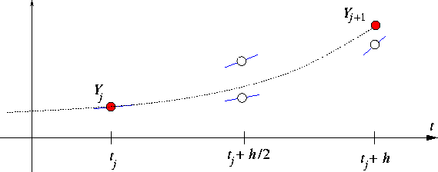
Vectorizable
Runge Kutta
✓
Input : y_{o}
Output: y₁, Δy₁
Driver
Error Control
Adaptive Stepsize
✗
(Not Naively vectorizable)
fail
success

Slide 24
Field Propagation - Outlook
Vectorized field propagation is in progress
  Field & equation of motion vectorised
  Helix and different RK steppers vectorised
  ‘Driver’: different methods for keeping vectorisation when handling multiple tracks are under investigation

Slide 25
Backup slides

Slide 26
Vtune analysis
 |  | Elapsed Time | Instructions Retired | CPI Rate | Back-end Bound | Memory Bound | Core Bound | Port Utilization
Sequential (nRep = 200) | Reorder2 (Haswell Xeon) | 8.166 | 31.7B | 0.947 | 0.786 | 0.282 | 0.505 | 0.327
Vector (nRep = 500) | Reorder2 (Haswell Xeon) | 7.665 | 33.8B | 0.776 | 0.697 | 0.143 | 0.555 | 0.463

Slide 27
Code improvement
First Version:
  27 multiplications
  32 additions/subtractions
  7 divisions
  8 modulus
  5 trigonometric ops
  1 sqrt
Current Version:
  29 multiplications
  24-28 additions/subtractions
  2 floor
  3 max/min
  1 division
  1 sqrt
Speed enhancement by O(100) (~e-8 s/event)

Slide 28
Memory Layout
‘Standard layout’ – used also by Reorder/Reorder2
B_{r} | B_{phi} | B_{z} | B_{r} | B_{phi} | B_{z} | B_{r} | B_{phi} | B_{z}
i1 |  |  | i2 |  |  | i2+1(!=i3)
 |  |  | B_{r} | B_{phi} | B_{z} | B_{r} | B_{phi} | B_{z}
 |  |  | i3 |  |  | i4
Minimum Memory
1 MagCellStruct (CellVersion)
B_{r} | B_{phi} | B_{z} | B_{r} | B_{phi} | B_{z} | B_{r} | B_{phi} | B_{z} | B_{r} | B_{phi} | B_{z}
i1 |  |  | i2 |  |  | i3 |  |  | i4
More memory
1 MagCellArray (AutoVec)
B_{r1} | B_{r2} | B_{r3} | B_{r4} | B_{phi1} | B_{phi2} | B_{phi3} | B_{phi4} | B_{z1} | B_{z2} | B_{z3} | B_{z4}
B_{r} |  |  |  | B_{phi} |  |  |  | B_{z}

