Slide 1
Scheduling fine grain workloads in GeantV
A.Gheata
Geant4 21st Collaboration Meeting
Ferrara, Italy
12-16 September 2016

Slide 2
HEP simulation: where should we go?
2016
Intel® Many Integrated Core Architecture (MIC - KNL)
The LHC uses more than 50% of its distributed computing power for simulations and related jobs
  There is a tremendous need from LHC, likely to increase with factors
Technology is evolving faster than our software
  Our production code is able to use a smaller and smaller fraction of the power of the machines we run onto
Re-engineering the code towards fine grain parallelism can bring improvements with large factors
  GeantV project aims for x3-x5 speedup understanding hard limits for more
  Fast simulation integrated seamlessly
The work required is far from trivial, but not optional
Transistors density evolves by Moore’s law, but HEP programs have to evolve to profit: parallelism has to be enabled at instruction level

Slide 3
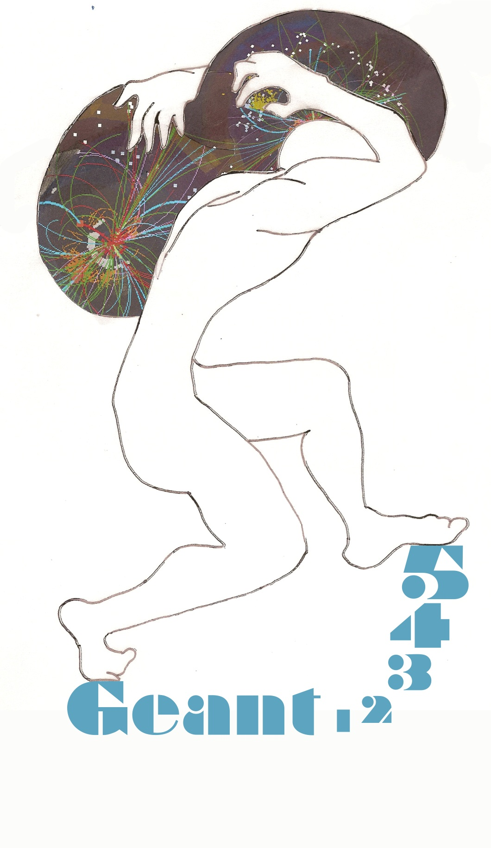
GeantV – Adapting simulation to modern hardware
Classical simulation
hard to approach the full machine potential
GeantV simulation
can profit at best from all processing pipelines
Stack approach
Single event transport
Embarrassing parallelism
Cache coherency – low
Vectorization – low (scalar auto-vectorization)
Basket approach
Multi event transport
Fine grain parallelism
Cache coherency – high
Vectorization – high (explicit multi-particle interfaces)

Slide 4

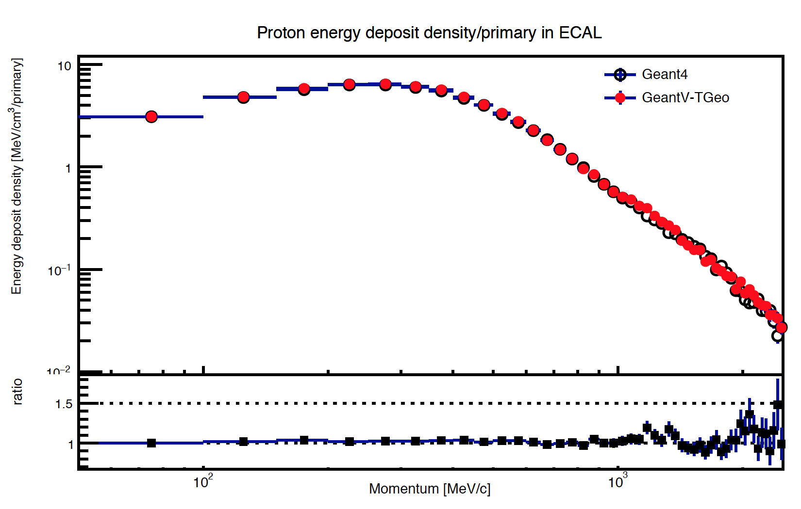
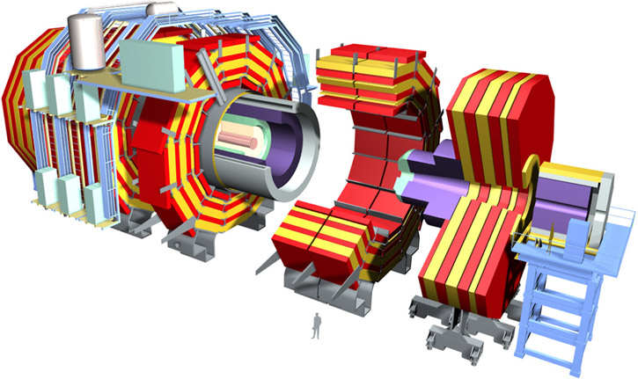
GeantV targets
GeantV
scheduler
Portable performance
  GeantV developed a thin layer of back-ends allowing to exploit hardware at its best, maintaining portability
High-performance re-engineered components
  VecGeom – a fully vector-aware geometry modelling package, aiming at a future replacement of the geometry in Geant4 and ROOT
  VecPhys – a highly optimized EM physics package having the same capability as Geant4 but better performance
Embedded fast simulation capability
  Provide combined full/fast simulation hooks and examples to drive further experiment customization within the framework
Tests from the onset on large setups (LHC-like)
  Demonstrate performance compared to standard simulation approach
CPU
GPU
Phi
Atom
XXX

Slide 5
Integration with task-based frameworks
Some experiments (e.g. CMS) adopted a task based aproach
  Integrate GeantV in the simulation->reconstruction->analysis workflow is very important (and now possible)
  Scenario (task flow):
Event Generator/
Reader
Particle filter (type, region, energy, …)
Fast simulation
(GeantV or exp. framework)
Digitization (MC truth + det. response)
Tracking/
Reconstruction
Full simulation
(GeantV)
Experimental data
Analysis

Slide 6
Framework: GeantV moving to a task approach
Transport task may be further split into subtasks
Feeder task
Reads from file a number of events. Invokes the concurrent basketizer service
Transport task
Transports one basket for one step
spawn
spawn
reuse tracks keeping locality
output
transported tracks
inject
particle
input
Basketizer(s)
concurrent service
injects full baskets
enqueue basket
Basket queue
concurrent service
spawn
Scoring
This is a user task reading track info and creating ”hits”
event finished?
command
dump all your baskets
inspect
event finished?
I/O task
Write data (hits, digits, kinematics) on disk
Garbage collector
Forces partially filled baskets into the basket queue to boost concurrency
spawn
Flow control task
event finished? queue empty?
queue empty?
spawn
Digitizer task
This is a user task working on “hits” data
Fully re-structured GeantV to support both a “static” thread approach and TBB tasks

Slide 7
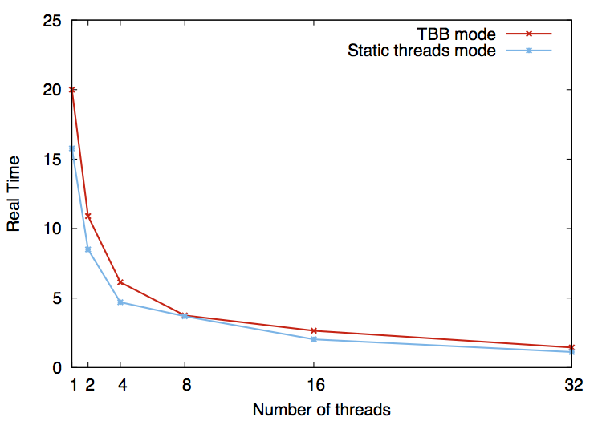
Preliminary TBB results
A first implementation of a task-based approach for GeantV using TBB was deployed.
  Connectivity via FeederTask, steering concurrency by launching InitialTask(s)
Some overheads on Haswell/AVX2 not so obvious on KNL/AVX512
Some more code restructuring and tuning needed
KNL/AVX512
AVX2
Intel(R) Xeon(R) CPU E5-2630 v3 @ 2.40GHz
2 sockets x 8 physical cores

Slide 8
Re-structuring of GeantV for sub-NUMA clustering
Known scalability issues (see next) of full GeantV due to fine grain synchronization in re-basketizing
New approach deploying several propagators with SNC implemented
  Objectives: improved scalability at the scale of KNL and beyond, address HPC mode with MPI event servers (workload balancing) + non-homogenous resources
  Now debugging and tuning
GeantV
run manager
GeantV
propagator
NUMA discovery service
(libhwloc)
GeantV
propagator
GeantV
propagator
(…)
Scheduler
node
Scheduler
Scheduler
Basketizer
socket
socket
socket
Basketizer
Basketizer

Slide 9
Scalability (old model)
Intel Xeon Phi 7210
@1.30 GHz
Xeon(R) E5-2630 v3
@ 2.40GHz

Slide 10
Multi-propagator mode
Launch more than one propagators working with a fixed number of threads each
  Reuse geometry, cross sections, …
Same as multi-process, but using work stealing for balancing
NUMA awarness not yet added
Adds one level in complexity, needs more tuning
Xeon(R) E5-2630 v3
@ 2.40GHz

Slide 11
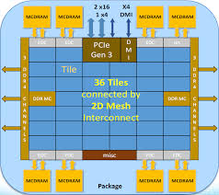
NUMA aware GeantV
Scheduler₀
Global basketizer
Scheduler₁
Basketizer₀
Basketizer₁
Transport
Transport
Replicate schedulers on NUMA clusters
  One basketizer per NUMA node
  libhwloc to detect topology
  Possible to use pinning/NUMA allocators to increase locality
Multi-propagator mode running one/more clusters per quadrant
  Loose communication between NUMA nodes at basketizing step
  Currently being integrated
Tracks
Tracks
Scheduler₂
Scheduler₃
Tracks
Basketizer₂
Basketizer₃
Tracks
Transport
Transport

Slide 12
GeantV plans for HPC environments
Standard mode (1 independent process per node)
  Always possible, no-brainer
  Possible issues with work balancing (events take different time)
  Possible issues with output granularity (merging may be required)
Multi-tier mode (event servers)
  Useful to work with events from file, to handle merging and workload balancing
  Communication with event servers via MPI to get event id’s in common files
Node₁
Node₂
Node_{mod[N]}
Event feeder
Event feeder
Event server
Numa₀
Numa₁
Numa₀
Numa₁
Numa₀
Numa₁
Transport
Transport
Transport
Transport
Transport
Transport
Merging service
Node₁
Node₂
Node_{mod[N]}
Event feeder
Event feeder
Event server
Numa₀
Numa₁
Numa₀
Numa₁
Numa₀
Numa₁
Transport
Transport
Transport
Transport
Transport
Transport
Merging service

Slide 13
Conclusions
GeantV needs to address parallelism in a fine-grained approach to address locality (cache coherence, vectorization) efficiently
  Amdahl overheads due to that to be compensated by a thread clustering approach
    Implementation ready – currently fixing/tuning
    The improvement effect visible in the preliminary version
Additional levels of locality (NUMA) available in modern HW
  Topology detection available in GeantV, currently being integrated
Integration with task-based HEP frameworks now possible
  A TBB-enabled GeantV version ready
Studying more efficient use of HPC resources
  Using a multi-tier approach for better workload balancing

