Slide 1



SPhN
(Nuclear Science Division)
Update on intra-nuclear cascade models
[Mostly on the new eta production in INCLXX ]
Jean-Christophe David

Slide 2
Plan
A few words about Binary Cascade and Bertini Cascade
η(ω) in INCL++
Update on intra-nuclear cascade models

Slide 3
Binary Cascade
From Gunter Folger
For Binary Cascade and Binary Light Ion Cascade,
there has been no development in the last year.
Update on intra-nuclear cascade models

Slide 4

From Dennis Wright
Updates and Plans for Bertini Cascade
For 10.3
  complete extension of kaon interactions from ~5 to ~15 GeV
    required the addition of 8- and 9-body final state partial cross sections, and inclusion of data up to 32 GeV to get correct behavior
    reactions enabled: K+, K-, K0, K0bar on p, n
  no longer do filtering of low energy gamma-nuclear final states by default: too time-consuming
For 10.4
  re-tune gamma-nuclear with larger data set
  re-examine giant dipole physics
  examine de-excitation code for possible bug: may be the cause of observed over-production of low energy neutrons
Update on intra-nuclear cascade models

Slide 5
Plan (2)
A few words about Binary Cascade and Bertini Cascade
η(ω) in INCL++
  Introduction
  Motivations
  Inputs:
      σ_{R} (production, scattering, absorption)
      features of the reaction products (particles, E, θ)
      in-medium Potential
      Decay
  Results
Update on intra-nuclear cascade models

Slide 6
Introduction
INCL++ (INCLXX)
  a reaction code in Geant4
  INC (~10 MeV → 10-15 GeV)
  followed by a de-excitation code
  until 2010-2011 → 2-3 GeV
  Then, with Multipion channels → 10-15 GeV
  However other particles are produced
      η, ω, … 2016
      K, Y 2017
      Minor roles, but New Physics
Update on intra-nuclear cascade models

Slide 7
Motivations
Why η, ω?
  a necessary step toward K, Y
  what’s the role in π production? (decay product)
  source of dileptons (= clean information of nuclear matter)
  to study rare decays violating a conservation law
Update on intra-nuclear cascade models

Slide 8
Inputs
  Inputs:
      σ_{R} (production, scattering, absorption)
      features of the reaction products (particles, E, θ)
      in-medium Potential
      Decay
Update on intra-nuclear cascade models

Slide 9
σ_{R} - production
Inputs
πN → ηN
NN → η + X
Update on intra-nuclear cascade models

Slide 10
σ_{R} - production
Inputs
πN → ηN
T_{π} ≈ 3 GeV
Fit on exp. data
Update on intra-nuclear cascade models

Slide 11
σ_{R} - production
Inputs
NN → η + X
exclusive (NN→ NNη): Fit on exp.data
inclusive (NN→ η + X): parameterization from Sibirtsev - Z. Phys. A 358, 357 (1997).
case of pn!!!
. Exclusive
At low E pn = 6.5 pp
At high E hyp. : same factor
. Inclusive
Same hypothesis…
. pn → dη considered as pn → pnη
T_{p} ≈ 14 GeV
Update on intra-nuclear cascade models

Slide 12
σ_{R} - scattering
Inputs
ηN → ηN
Fit of ANL-Osaka model result
ANL-Osaka model - PRC 88, 035209 (2013)
a Dynamical Coupled-Channel model
based on Lagrangians
Courtesy of H. Kamano
T_{η} ≈ 1.5 GeV
Update on intra-nuclear cascade models

Slide 13
σ_{R} - absorption
Inputs
ηN → X
Fit of ANL-Osaka model results
  ηN → ηN (elastic)
  ηN → πN
  ηN → ππN
  ηN → ΚY (Y=Λ or Σ)
  up to now no KY in INCL++,
  so used later
Courtesy of H. Kamano
T_{η} ≈ 2 GeV
Update on intra-nuclear cascade models

Slide 14
σ_{R} - absorption
Inputs
ηN → X
Fit of ANL-Osaka model result
  ηN → ηN (elastic)
  ηN → πN
  ηN → ππN
Courtesy of H. Kamano
BUT THE RESULTS WILL BE SHOWN WITH
  πN = Tot – elastic – ππN
T_{η} ≈ 2 GeV
Update on intra-nuclear cascade models

Slide 15
Inputs
  Inputs:
      σ_{R} (production, scattering, absorption)
      features of the reaction products (particles, E, θ)
      in-medium Potential
      Decay
Update on intra-nuclear cascade models

Slide 16
Final products
p - θ
Inputs
A+B → C+D
Type of C and D → Obvious or via Clebsch-Gordan
E → given by the center-of-mass energy and masses
θ →
    No information: Isotropy or Phase-Space
    Information: Fit on exp.data or Model results
A+B → C+D+…
Type of C,D,… → Clebsch-Gordan or model
E, θ → Phase-Space
Update on intra-nuclear cascade models

Slide 17
Final products
p - θ
Inputs
η
πN → ηN
Fit data
NN → η + X
Phase space
ηN → ηN
Fit Model
ηN → πN
Fit Model
ηN → ππN
Phase space
Update on intra-nuclear cascade models

Slide 18
Final products
p - θ
Inputs
η
πN → ηN
Fit data
NN → η + X
Phase space
ηN → ηN
Fit Model
ηN → πN
Fit Model
ηN → ππN
Phase space
Update on intra-nuclear cascade models

Slide 19
Final products
p - θ
Inputs
Fit on exp.
πN → ηN
(mb/sr)
(mb/sr)
Reminder:
Only the shape is important!
NB: ANL-Osaka model could be used also
(mb/sr)
(mb/sr)
Update on intra-nuclear cascade models

Slide 20
Final products
p - θ
Inputs
Fit on model
ηN → ηN
Plab < 250 MeV/c
~ Isotropic
50 MeV
400 MeV/c
250 MeV/c
Plab > 250 MeV/c
Fit with polynomials (p,θ) of dσ/dΩ
from ANL-Osaka Model
Courtesy of H. Kamano
600 MeV/c
650 MeV/c
700 MeV/c
Cross Section (mb/sr)
900 MeV/c
1100 MeV/c
1400 MeV/c
Update on intra-nuclear cascade models

Slide 21
Final products
p - θ
Inputs
Fit on model
ηN → πN
50 MeV/c
400 MeV/c
200 MeV/c
Fit with polynomials (p,θ) of dσ/dΩ
from ANL-Osaka Model
Courtesy of H. Kamano
600 MeV/c
650 MeV/c
700 MeV/c
Cross Section (mb/sr)
cosine
900 MeV/c
1100 MeV/c
1400 MeV/c
Update on intra-nuclear cascade models

Slide 22
Final products
p - θ
Inputs
NN → η +X
When 1 η
2 nucleons
up to 3-4 π π
From Fritiof (geant4 10.1-p02)
Update on intra-nuclear cascade models

Slide 23
Final products
p - θ
Inputs
NN → η +X
When 1 η
2 nucleons
up to 3-4
So multipion applied
NN → NNη + xπ
(from NN → NN + xπ)
4π
3π
2π
π (direct)
π (via Δ)
exclusive
np → npη
Update on intra-nuclear cascade models

Slide 24
Inputs
  Inputs:
      σ_{R} (production, scattering, absorption)
      features of the reaction products (particles, E, θ)
      in-medium Potential
      Decay
Update on intra-nuclear cascade models

Slide 25
Potential
Inputs
η
Few information
3 values tested
      V = 1.5 V_{π0}
      V = V_{π0}
      V = 0
Update on intra-nuclear cascade models

Slide 26
Inputs
  Inputs:
      σ_{R} (production, scattering, absorption)
      features of the reaction products (particles, E, θ)
      in-medium Potential
      Decay
Update on intra-nuclear cascade models

Slide 27
Decay
Inputs
η
  2γ 39.72 %
  3π⁰ 32.93 %
  π⁺π⁻π⁰ 23.10 %
  π⁺π⁻γ 4.25 %
η decays only after being emitted
Decay can be switched off (option using a time threshold)
Update on intra-nuclear cascade models

Slide 28
Results
η production
π⁺(680 MeV/c) + X (Ye. S. Golubeva et al, NPA 562 (1993) 389)
    σ_{η_production} with several targets
    T_{η} spectrum (X = ¹²C)
p(1 GeV) + X (Ye. S. Golubeva et al, NPA 562 (1993) 389)
    σ_{η_production} with several targets
    T_{η} spectrum (X = ¹¹B)
p(3.5 GeV) + Nb (G. Agakishiev et al., PRC 88, 024904 (2013))
    transverse momentum distribution
Threshold
and
Subthreshold
Reactions
Update on intra-nuclear cascade models

Slide 29
Results
π production
HARP experiment
η: no effect on π production
with η
without η
Update on intra-nuclear cascade models

Slide 30
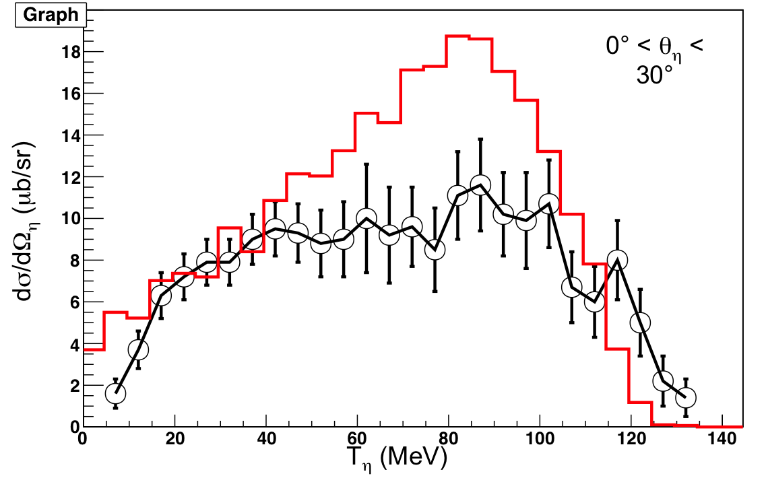
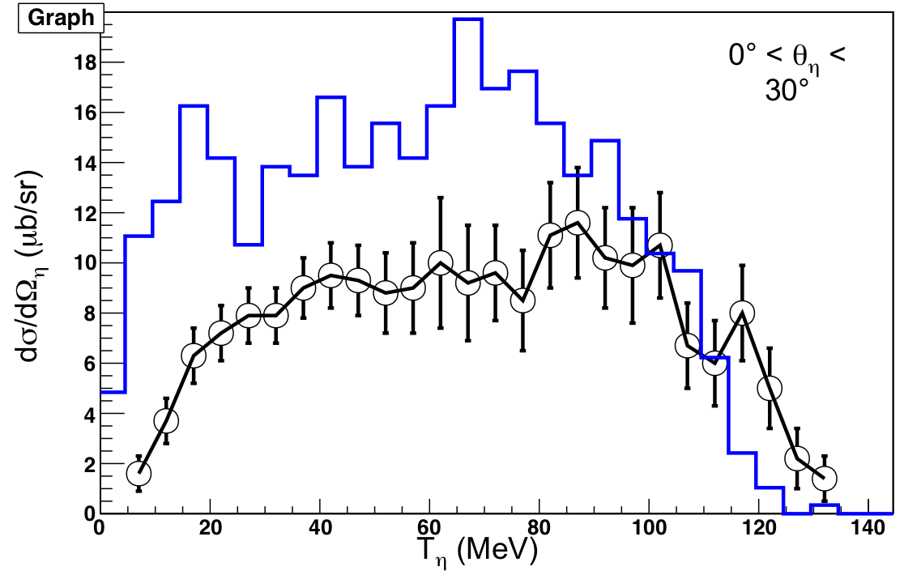
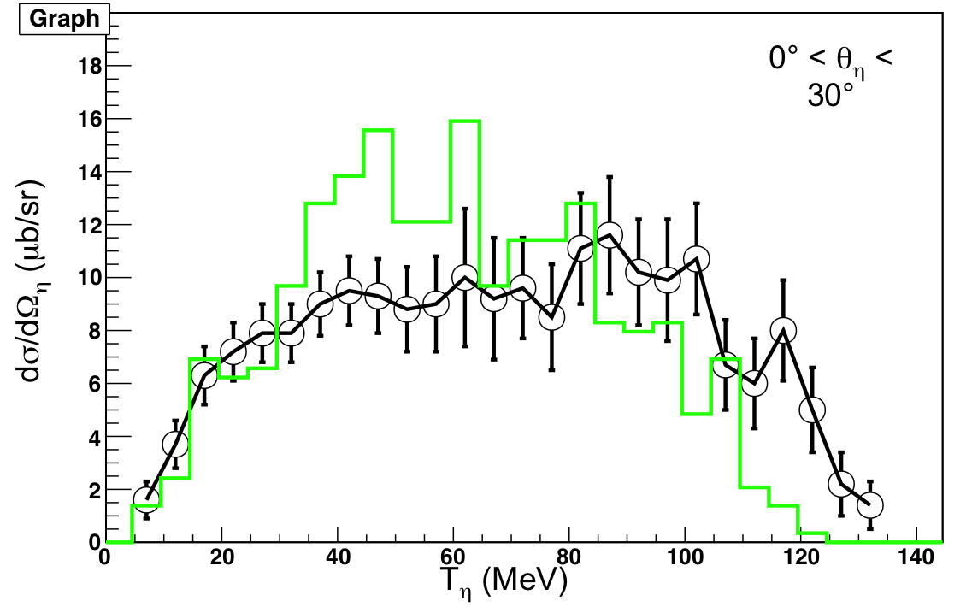
Results
π⁺(680 MeV/c) + ¹²C
(η Spectrum)
0° < θ_{η} < 30°
0° < θ_{η} < 30°
V_{η} ~ 50 MeV
V_{η} ~ 33 MeV
V_{η} = 0 MeV
0° < θ_{η} < 30°
Better Results with V=0!
T_{η} (MeV)
Update on intra-nuclear cascade models

Slide 31
Results
π⁺(680 MeV/c) + X
(η Production)
0° < θ_{η} < 30°
Good Results with V=0
Whatever the target
dσ/dΩ_{η} (mb/sr)
A^{1/3}
V_{η} ~ 50 MeV
V_{η} ~ 33 MeV
V_{η} = 0 MeV
T_{η} (MeV)
Update on intra-nuclear cascade models

Slide 32
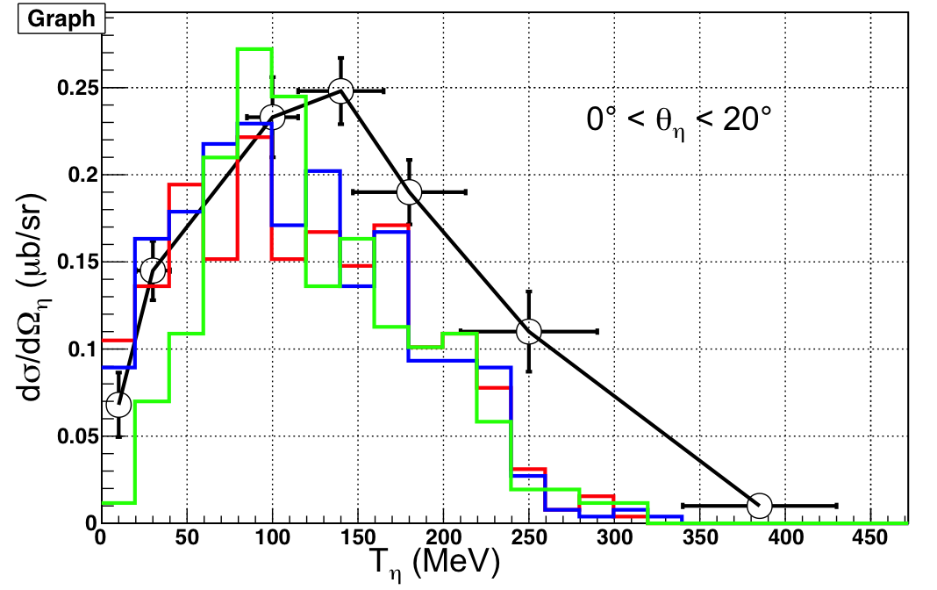
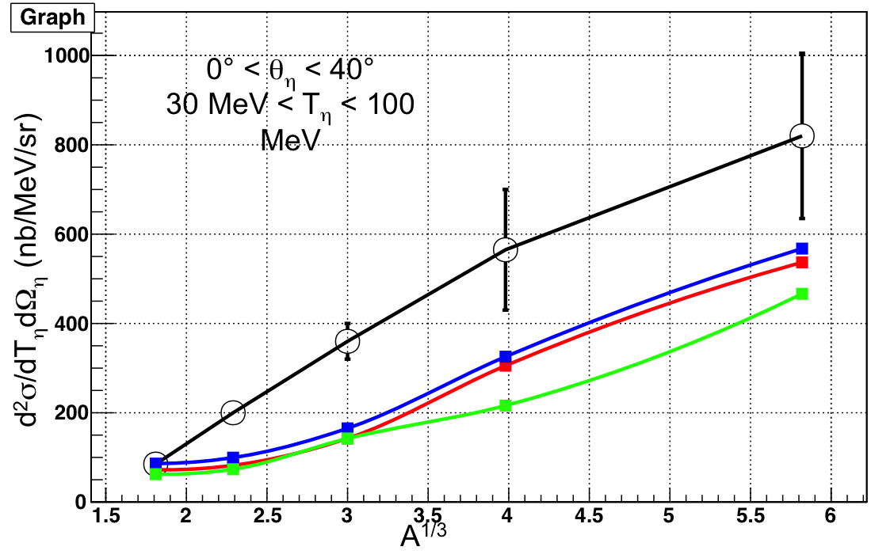
Results
p(1 GeV) + ¹¹B
p(1 GeV) + X
V_{η} ~ 50 MeV
V_{η} ~ 33 MeV
V_{η} = 0 MeV
V=0, not better not worse…
BUT subthreshold reaction → more tricky (momentum distribution of the Ns…)
T_{η} (MeV)
Update on intra-nuclear cascade models

Slide 33
Results
Phys.Rev. C 88, 024904 (2013)
p(3.5 GeV) + Nb
data:
HADES
collaboration
Update on intra-nuclear cascade models

Slide 34
Thanks to
R. Holzmann and B. Ramstein
(exp. data)
Results
Phys.Rev. C 88, 024904 (2013)
p(3.5 GeV) + Nb
data:
HADES
collaboration
INCL++
Pretty good result
compared to
experiment and other models
Update on intra-nuclear cascade models

Slide 35
Conclusions
η is in INCL++ and gives good results
A first implementation in Geant4 works
Some (minor) changes until the official version
ω is almost in INCL++ and soon in Geant4
(unfortunately no data to test it)
See you next year for the strangeness (PhD - Jason Hirtz)
Update on intra-nuclear cascade models

Slide 36
Thank you!
Grazie!
Update on intra-nuclear cascade models

Slide 37
backup
Update on intra-nuclear cascade models

Slide 38
σ_{R} - production
Inputs
NN → ω + X
exclusive (NN→ NNη): parameterization from Cassing
- NPA 604, 455-465 (1996)
modified (low energies)
inclusive (NN→ η + X): parameterization from Sibirtsev modified (recent datum from HADES - A. Rustamov et al., AIP Conference Proceedings, 1257, 736 (2010))
case of pn
factor 3
Update on intra-nuclear cascade models

Slide 39
σ_{R} - production
Inputs
NN → ω + X
exclusive (NN→ NNη): parameterization from Cassing
- NPA 604, 455-465 (1996)
modified (low energies)
inclusive (NN→ η + X): parameterization from Sibirtsev modified (recent datum from HADES - A. Rustamov et al., AIP Conference Proceedings, 1257, 736 (2010))
case of pn
factor 3
Update on intra-nuclear cascade models

Slide 40
σ_{R} - scattering
Inputs
ωN → ωN
Lykasov - EPJ A 6, 71 (1999)
Update on intra-nuclear cascade models

Slide 41
σ_{R} - absorption
Inputs
ωN → πN
detailed balance
ωN → ππN
ππN = Inelastic – πN
Lykasov - EPJ A 6, 71 (1999)
Update on intra-nuclear cascade models

Slide 42
Decay
Inputs
η
ω
  2γ 39.72 %
  3π⁰ 32.93 %
  π⁺π⁻π⁰ 23.10 %
  π⁺π⁻γ 4.25 %
  π⁺π⁻π⁰ 90.09 %
  π⁰γ 8.36 %
  π⁺π⁻ 1.55 %
2 particles: Isotropy --- 3 particles: Phase-Space
η decays only after being emitted
Decay can be switched off (option using a time threshold)
Update on intra-nuclear cascade models

