Slide 1
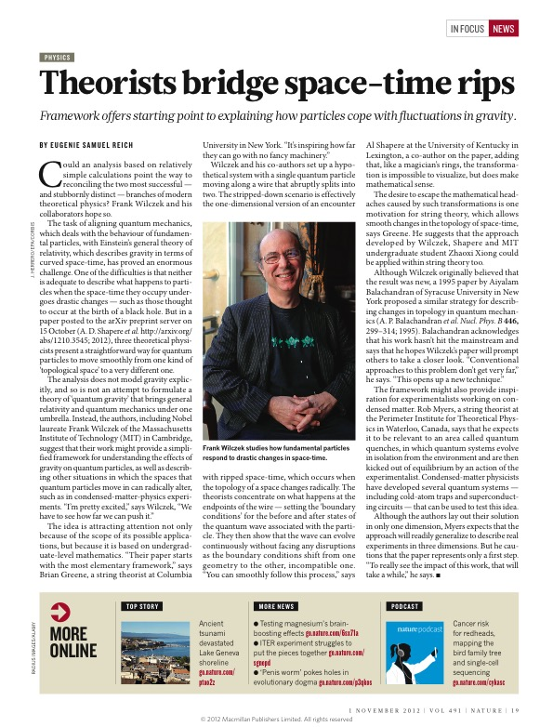
Some papers with Beppe
The same idea has been taken up a few years ago by F. Wilczek and co-workers at MIT

Slide 3

The puzzle of the thermal Casimir force
Giuseppe Bimonte
Physics Department
Università di Napoli Federico II-ITALY
INFN- Sezione di Napoli
Policeta, 11-13 July, 2016

Slide 4
Casimir effect (1948)
H.B.G. Casimir

Slide 5
A toy model : a massless scalar field on the interval
Let us neglect polarizations of the em field and let us suppress two space dimensions. One is left with a massless scalar field on an interval [0,a]. For Dirichlet bc:
n=1,2,...
To regularize the divergent zero-point
energy we use a cut-off δ:
For small δ
However the density e^{δ} _{0 free} of
vacuum energy in free space is
The resulting vacuum energy in the interval [0,a] :
This gives for the difference a FINITE value:
After we remove the regularization (δ-> 0)
we obtain the Casimir energy of the interval [0,a]
The resulting Casimir force is
It can be shown that the result is independent of the choice of the cut-off function

Slide 6
By an analogous computation for the em field in a perfectly conducting plane-parallel cavity one finds that the density of the Casimir energy per unit area of the plates is (Casimir 1948)
Note that E_{Cas}(a) depends only on:
The fundamental constant ħ (quantum origin of the energy)
The speed of light c (retardation effect)
The distance between the plates
The corresponding Casimir force per unit area is
The minus sign in front signifies that the force is attractive
for an area of 1 cm²
The Casimir force increases rapidly as the separation decreases and it is the dominant force between two neutral objects at submicron distances.
At 10 nm , the Casimir pressure equates the atmospheric pressure!

Slide 7
All this is for ideal mirrors. The theory for real materials was developed by Lifshitz (1956).
Lifshitz computed the interaction between two NEUTRAL
infinite plane-parallelel dielectric slabs separated by a gap
(possibly filled with a third dielectric)
ε₁
ε₃
ε₂
Slab 1
gap
Slab 2
Fluctuational Electrodynamics
For a review on FE see: G.B., T. Emig, M. Kardar and M. Kruger
arXiv 1606:03740 in press on Rev. Cond. Matt. Phys.
The approach is entirely macroscopic: distance between the bodies is assumed large w.r.t. atomic size
The interaction occurs through the fluctuating e.m. field.
The e.m. field is not explicitly quantized (classical Maxwell eqs. are used)
The source of the e.m. field is constituted by fluctuating dipoles inside the bodies (Rytov)
According to the
FLUCTUATION-DISSIPATION
theorem, inside any dispersive and
dissipative medium with permittvity ε(ω)
there exist fluctuating dipole moments:
fluctuations of dipole moments exist only if dissipation is present (ε’’(ω)>0)
dipole moments at different places are uncorrelated
quantum and thermal fluctuations are both included

Slide 8
The physical picture is simple: fluctuating dipole moments in either slab generate e.m. fields that reach
the other slab and induce in it dipole moments. The CORRELATION between fluctuating and induced
dipole moments results in an interaction between the two slabs.
ε₁
ε₃
ε₂
Slab 1
gap
Slab 2
EM field
P_{fluc}
P_{ind}
Lifshitz theory shows that for small separations, when retardation effects are small, and for diluted bodies
the Casimir force smoothly reduces to the well known van der Waals DISPERSION force of chemistry.
In addition to old theory of van der Waals forces, here one takes account of:
retardation effects
many-body interactions due to induction processes in condensed bodies
finite skin depth of e.m. fields
optical features of the slabs
temperature
roughness of slabs surfaces
Lifshitz theory can be used to study:

Slide 9


In Lifshitz theory one computes the correlator of the em field at points between the plates:
Thereof one computes the (quantum and statistical) average of the stress tensor from which the Casimir pressure is obtained. After a Wick rotation to imaginary frequencies Lifshitz obtained
for the Casimir pressure between two PLANE-PARALLEL plates the general formula:
k┴ is the projection of the wave-vector along the film surface
Matsubara (imaginary) frequencies
Fresnel refl. coeff. of plate i=1,2
Lifshitz original derivation was for isotropic materials obeyng local electrodynamics. Nowadays it is known
that his formula holds also in case of spatial dispersion, provided only the appropriate expression for the
reflection coefficients of the plates is used.
Recent progress: using a scattering approach Lifshitz theory has been
generalized to NON-PLANAR geometries

Slide 10
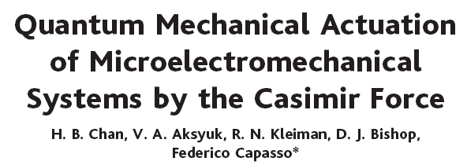
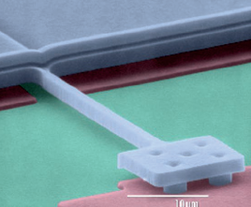
A micromachined torsional
device realized at Bell labs.,
Lucent technologies
The Casimir force tilts the plate for sphere-plate
distances less than 300 nm
metallic sphere
“..we demonstarted that when the separation between the
surfaces is small, quantum effects...correctly describe the
operation of our micromachined device. This could open new
possibilities for novel actuation schemes in MEMS based on
the Casimir force..”
Polysilicon plate
100 μm
Torsional rods

Slide 11
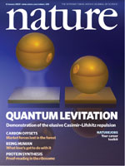
Quantum levitation
Casimir repulsion between two bodies immersed in
a fluid has just been demonstrated experimentally
(J.N.Munday et al. Nature 457 (2009), 170).
This is in accordance with Lifshitz theory, when
ε₁ > ε₃ > ε₂
R=39.8 μm
Distance (in nm)

Slide 12
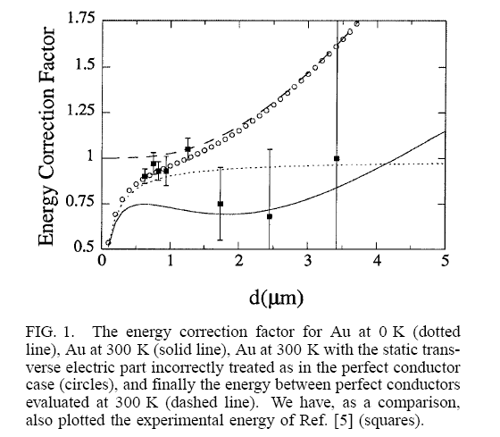


A yet unresolved theoretical puzzle has recently emerged
What is the thermal correction to the Casimir force ?
For two ideal plates the fractional thermal correction δF_{C} at small separations a << λ_{T} is very small
Energy correction factor η_{E}
η_{E}=E/E_{id}
For a >> λ_{T}
Drude model (with damping)
Plasma model of IR optics
(no dissipation)
Picture from Bostrom and Sernelius PRL 84 (2000) 4757
Experimental data from Lamoreaux, PRL 78 (1997) 5; 81 (1998) 5475.

Slide 13




Mathematical origin of the large thermal correction in dissipative metals
By a Wick rotation, one can write the free energy as a sum over discrete imaginary frequencies ξ_{l} (Matsubara frequencies):
TM
TE
TE zero-mode gives zero
Dissipation
TE zero-mode gives contribution

Slide 14
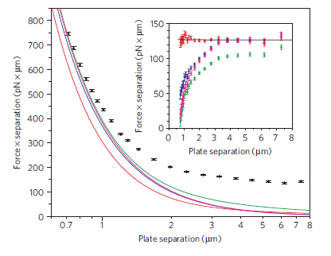
Experimental results are contradictory
Experimental data obtained by a micromechanical
torsional oscillator (Decca et al. 2007). The error bars
denote the total experimental error at 95% confidence.
The black and grey bands are the predictions of
Lifshitz theory with the plasma and Drude prescriptions,
respectively
From Klimchitskaya et al. Int. J. Mod. Phys.: Conf. Ser.
3, 515, (2011)
From Sushkov et al. Nature Physics 7, 230 (2011)
Torsion balance experiment

Slide 15
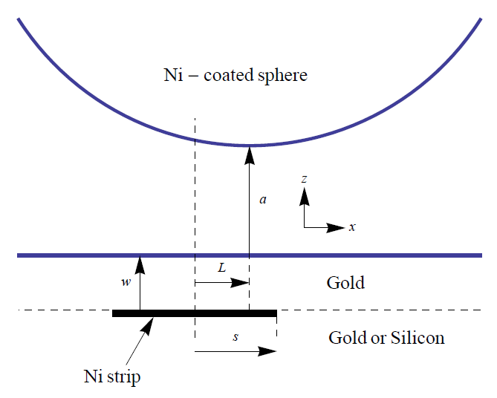


A new proposal to observe the thermal Casimir force
The first experiment has been done at IUPUI
G. Bimonte, D. Lopez, R. S. Decca, Phys. Rev. B 93 (2016) 184434
Differential measurement
Photons with frequencies ~ω_{c} cannot reach the Ni strip

Slide 16
Implementation and results (R.S. Decca IUPUI)
Ni
Ni
Si
Ni
Ti
Si
Ni
Ni

Slide 17
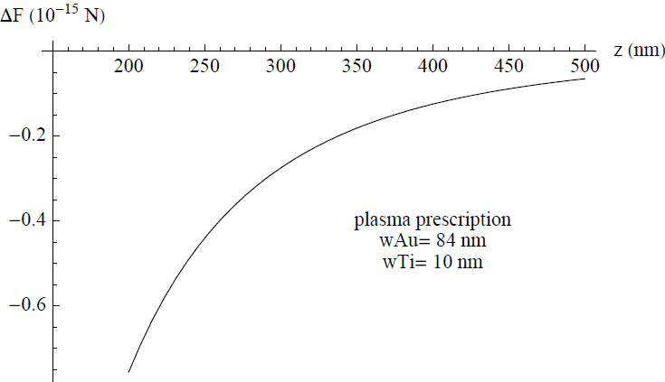
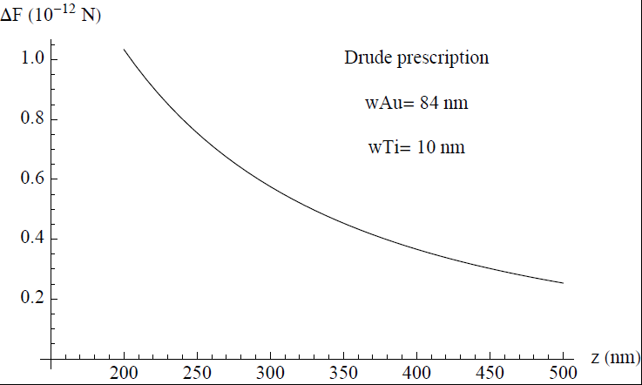
Implementation and results
Quadrature
Factor of -1200 difference!

