Slide 1
EuroGammaS Gamma Characterisation System for ELI-NP: The Nuclear Resonance Scattering Technique
Maria Grazia Pellegriti
INFN-Sezione di Catania- Italy
EuroGammaS Association
Physics and Applications of High Brightness Beams – Havana, Cuba – March 28th/April 1st 2016

Slide 2
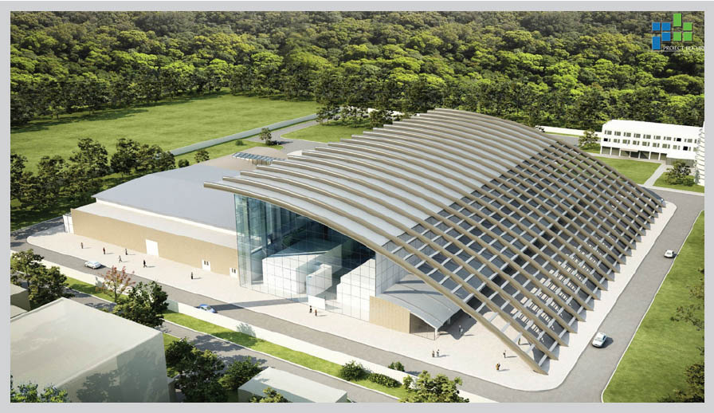
Outlook
Eli-np facility
The accelerator and the Gamma characterization system
Compton System, Calorimeter, Imager
Nuclear Resonant Scattering System
Magurele, Romania
 | E_{γ} (MeV) | ΔE_{γ} (%) | I^{bw} (ph/sec)
ELI-NP | 0.2-19.5 | ≤0.5 (rms) | ≤8.3∙10⁸ (FWHM)
See talks of A. Variola and G. Palumbo
Maria Grazia Pellegriti - INFN, Sezione di Catania - Italy
PAHBB - Havana, March 29th 2016

Slide 3
Machine layout
High Energy
Laser
Interaction
Chamber
Photoinjector
Linac
High Energy Line
Low Energy Line
Low Energy
Laser
Interaction
Chamber
High energy
collimation and
characterisation system
Low energy
collimation and
characterisation system
For the two beam-lines (high and low energy), two identical complete systems for collimation and characterisation of the gamma beam will be delivered, each one optimized for the corresponding energy range.
Measurement of the gamma beam energy distribution
Measurement of the number of photons per pulse
Measurement of the size and spatial distribution of the gamma beam
Maria Grazia Pellegriti - INFN, Sezione di Catania - Italy
PAHBB - Havana, March 29th 2016

Slide 4
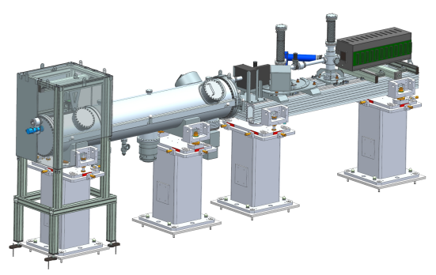
Gamma beam characterization system
Profile
imager
Calorimeter
Nuclear resonant
scattering System
Compton
Spectrometer
γ-beam
Compton Scattering Spectrometer
high–precision measurements of single Compton scattering from thin target
Absorption Calorimeter
calorimetric, total absorption technique
Profile Imager
Nuclear Resonant Scattering calibration System
high-precision energy measurement at selected energy values for absolute energy calibration
Maria Grazia Pellegriti - INFN, Sezione di Catania - Italy
PAHBB - Havana, March 29th 2016

Slide 5
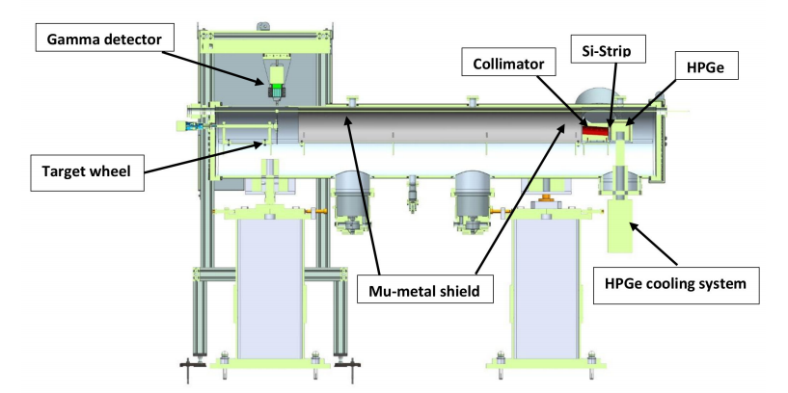
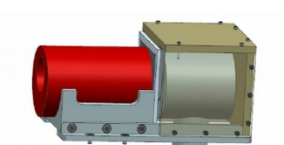
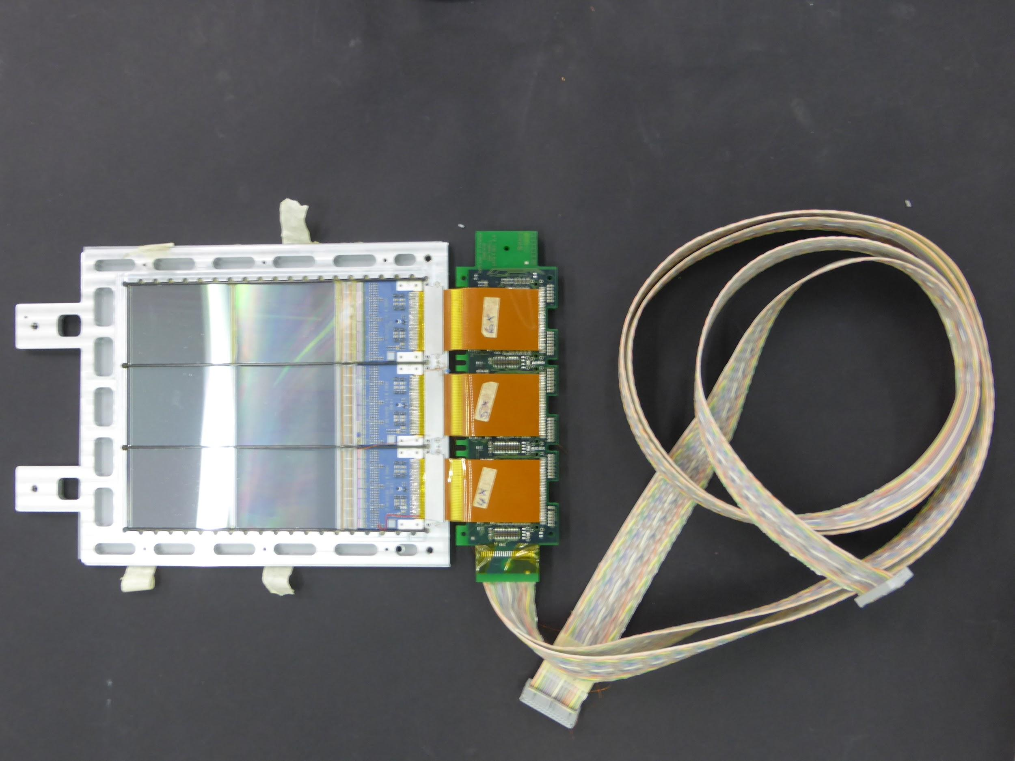
Compton Spectrometer
Gamma energy is obtained by measuring Compton scattered electron energy
$$E_{gamma}=\frac{m_{e} T_{e}}{cos∅ \sqrt{T_{e}(T_{e}+{2m}_{e})− T_{e}}}$$
γ
γ’
φ
e-
→Micrometric target is micrometric (1-2 µm) and low-Z material
→High resolution electron detectors -> HPGe (energy) + Si-strip (position)
→Measure also the scattered gamma in coincidence for background reduction
Position detector
γ-beam
Cu collimator
Be-window
Energy detector
300 µm thick n-type silicon
25.5 µm/66.5 µm pitch for the X/Y side
Maria Grazia Pellegriti - INFN, Sezione di Catania - Italy
PAHBB - Havana, March 29th 2016

Slide 6
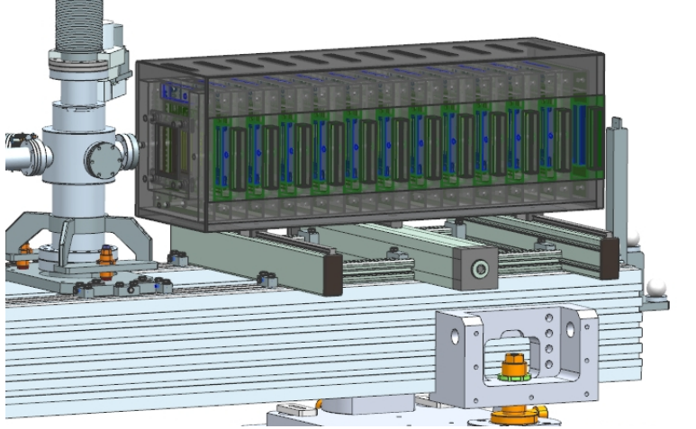
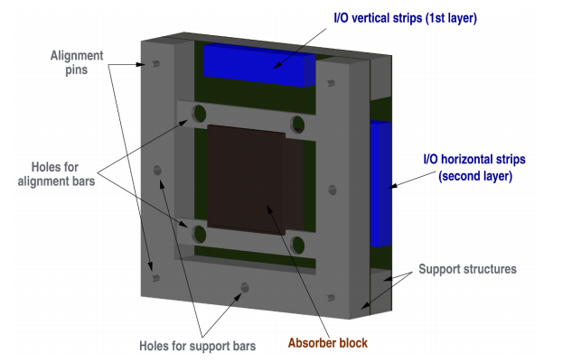
Gamma calorimeter
Longitudinally segmented calorimeter
Stack of 25 plastic converters (low Z) interleaved by Si detectors
For increasing gamma energy the cross-section decreases -> shower depth increases
Si detectors
Plastic converters
Maria Grazia Pellegriti - INFN, Sezione di Catania - Italy
PAHBB - Havana, March 29th 2016

Slide 7
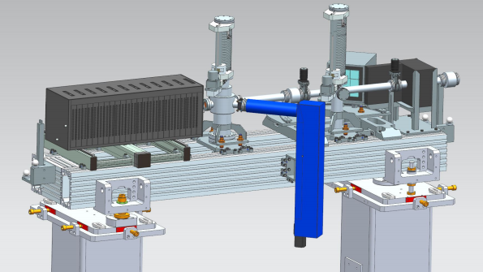
Profile Imager
The gamma profile Imager is is composed by a cross vacuum chamber in which scintillator targets intercept the gamma beam at 45°.
The light emitted by the scintillator is acquired using a mirror and lens system to focus onto a CCD camera.
Scintillator targets
vacuum chamber
Gamma beam
CCD
Maria Grazia Pellegriti - INFN, Sezione di Catania - Italy
PAHBB - Havana, March 29th 2016

Slide 8
Nuclear Resonant Scattering System – Concept
Task: Provide an absolute energy scale calibration for other detectors
Working principle: detection of the gamma decays of properly selected nuclear levels of a given nucleus X when resonant condition with the beam energy is achieved
CROSS-SECTION
E_{r}
width for gamma transition to ground state
excited level spin
width for transition
to a specific channel
E_{γ}
$σ_{i}^{0}(E)=π$ƛ²$\frac{2J_{1+1}}{2\left(2J_{0}+1\right)} \frac{Γ0Γi}{{\left(E−E_{r}\right)}^{2}+\frac{1}{4}Γ2}$
E_{γ}
Performing a scan of the beam energy
X
the resonant energy E_{r} can be matched through the detection of the corresponding
decay photons E_{γ}
Ground state spin
Level total width
Metzger F.R., Progress in Nuclear Physics 7 (1959) 53
Examples: ²⁶Al: 2.982 MeV; 2.212 MeV
¹²C: 4.439 MeV; 15.11 MeV
⁹Be: 2.429 MeV
⁶Li: 3.563 MeV
Maria Grazia Pellegriti - INFN, Sezione di Catania - Italy
PAHBB - Havana, March 29th 2016

Slide 9
Nuclear Resonant Scattering System – Concept
Perform an energy scan of the beam and precisely identify the resonant energies, by detecting the corresponding characteristic gamma emissions
Very narrow lines!!!! (43.6 eV for the 15.11 MeV C¹² line)
→ Very accurate calibration
Electron energy tuning
Γ < ΔE
dE < ΔE 0.3%
NRSS counts
Photon density
ΔE
Beam steps
Beam steps
Maria Grazia Pellegriti - INFN, Sezione di Catania - Italy
PAHBB - Havana, March 29th 2016

Slide 10
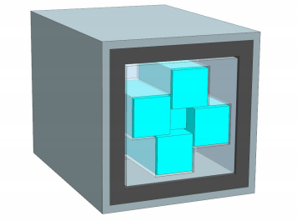
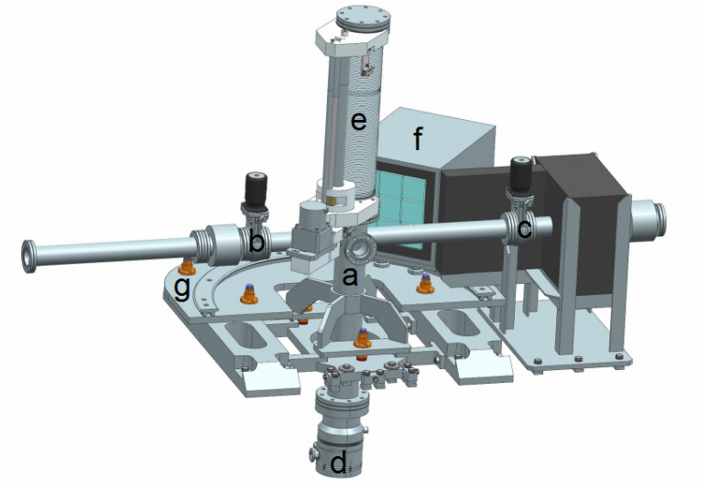
Nuclear Resonant Scattering System – Design
Set of thin targets made of materials with precisely known gamma de-excitation emission spectra.
Detector:
Gamma counter, for fast energy scan to provide a prompt information on the established resonant condition; good energy resolution not required, high overall efficiency needed.
Gamma spectrometer, aimed to precisely identify resonant excited levels, in particular when a complex decay pattern is expected.
Gamma
beam
Target
135°
Gamma
spectrometer
n. 4 BaF₂ counters
Gamma
counters
Target
shifter
Pb shields
n.1 central LYSO
γ-beam
Maria Grazia Pellegriti - INFN, Sezione di Catania - Italy
PAHBB - Havana, March 29th 2016

Slide 11
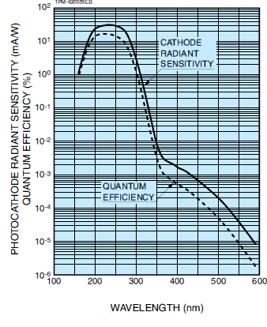
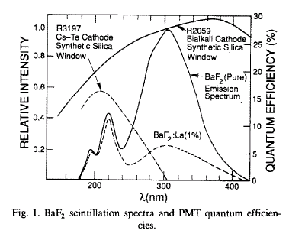
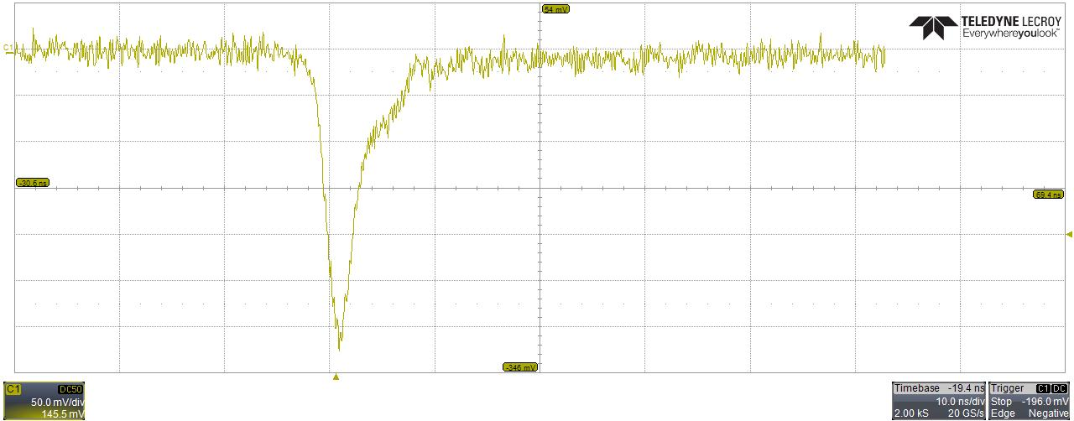
Fast Counting Mode and timing
Fast component: 0.88ns; Slow component: 600ns
MACRO-PULSE
16+16=32 pulses
Pulse lenght= 0.91 ps
Pulse to pulse separation=16 ns
Macro-pulse
repetition rate =100 Hz
10 ns
BaF2 coupled with
the R2078 PMT
Maria Grazia Pellegriti - INFN, Sezione di Catania - Italy
PAHBB - Havana, March 29th 2016

Slide 12
Simulation: efficiency
BaF₂
LYSO
Maria Grazia Pellegriti - INFN, Sezione di Catania - Italy
PAHBB - Havana, March 29th 2016

Slide 13
Thanks for the attention!
Maria Grazia Pellegriti - INFN, Sezione di Catania - Italy
13
PAHBB - Havana, March 29th 2016

Slide 14
WP09-Collaboration
M. Gambaccini , P. Cardarelli, M. Andreotti, E. Consoli, F. Evangelisti , G. Di Domenico , M. Marziani , M. Statera
INFN – Ferrara
M. Veltri, O. Adriani , G. Graziani , G. Passaleva, R. Borgheresi, M. Lenzi, A. Serban , O. Starodubtsev
INFN – Firenze
S. Albergo , G. Cappello, A. Tricomi , M.G. Pellegriti, B. Zerbo
INFN - Catania
EuroGammaS Association
Physics and Applications of High Brightness Beams – Havana, Cuba – March 28th/April 1st 2016

