Slide 1
Enhanced X-ray FEL performance from tilted electron beams
Eduard Prat, Simona Bettoni and Sven Reiche :: Paul Scherrer Institut
Physics and Applications of High Brightness Beams
Havana, March 28, 2016

Slide 2
Contents
Introduction
Athos: the soft X-ray beamline of SwissFEL
Applications of a tilted beam:
  Generation of XFEL radiation with ultra-large bandwidth
  [E. Prat and S. Reiche, under review at JSR]
  Generation of 2 color XFEL pulses
  [S. Reiche and E. Prat, under review at JSR]
  Generation of high-power and short XFEL pulses
    [E. Prat, F. Löhl and S. Reiche, PRSTAB 18 100701 (2015)]
Beam tilt generation
  Transverse deflecting structure
  Transverse wakefields
  Dispersion
Conclusion

Slide 3
Introduction
A transverse tilt is a correlation between the transverse and longitudinal coordinates of the electrons
We will refer to linear tilts: tilt amplitude in offset dx/ds and in angle dx’/ds
A tilted beam traveling through the undulator produces XFEL radiation only for the centered (on-axis) slices
The XFEL amplification for the other slices is suppressed due to the betatron oscillations – no good transverse overlap between electrons and photons
A tilt is normally unwanted since only a small part of the electron beam generates XFEL radiation
Emma and Huang already proposed to use a tilt to reduce the XFEL pulse duration [P. Emma and Z. Huang, NIMA 528, 458 (2004)]
The pulse duration of the produced radiation can be tuned with the tilt amplitude and the focusing strength
Tilted Beam
Betatron
oscillation

Slide 4
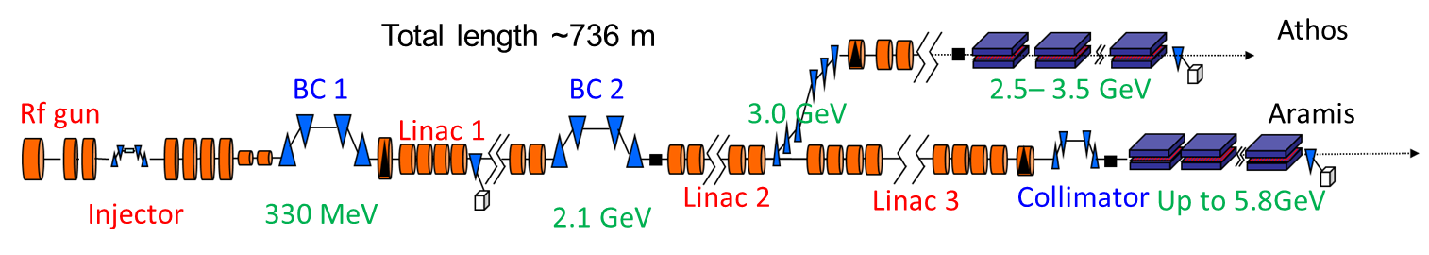
Athos: the soft X-ray beamline of SwissFEL
SwissFEL will serve two beamlines:
  Aramis: 0.1-0.7 nm. Commissioning starts in June 2016, first light in 2017.
  Athos: 0.7-7nm. First XFEL light expected for 2020.
Athos undulators:
  APPLE devices, K = 0.9-3.9, λ_{u}= 40 mm
  Module length is 2 m. Initially 20 modules
  Allow for special configurations, e.g. transverse-gradient undulator (TGU)
  Installed chicanes between the modules, inter-undulator space is 0.75 m
Simulation parameters
Parameter | Value
e⁻ charge | 200 pC
Current profile | Flat
Peak current | 2-6 kA
Pulse duration | 33-100 fs
e⁻ Energy | 3-3.5 GeV
Normalized Emittance | 300 nm
Energy spread | Variable Nominal is 350 keV

Slide 5
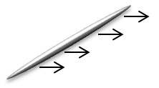
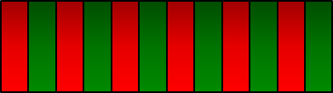

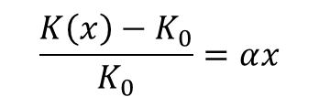
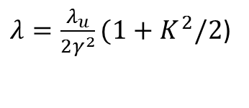
Ultra-large bandwidth XFEL pulses
Motivation: producing XFEL pulses with large bandwidth is required for some applications (e.g. crystallography, absorption spectroscopy)
XFEL resonance condition:
An energy-chirped electron beam will produce broadband XFEL pulses. The chirp can be created with different methods (overcompression, wakefields). Practical limit to few %
In a transverse-gradient undulator (TGU) there is a (linear) dependence of the undulator field on the transverse position
A tilted beam traveling
through a TGU will produce
broadband XFEL radiation
Easy to tune!
To allow that every slice lases at the same frequency the beam needs to travel parallel:
  Initial tilt only in offset & no external focusing
  Drawback of no focusing: larger beta-functions → decrease of FEL performance
Additional possibilities of the scheme:
  Multiple colors with slotted foil at the undulator entrance
  XFEL pulse compression (sign of the chirp can be controlled)
$λ=\frac{λ_{u}}{2γ^{2}}(1+K^{2}/2$)
$$\frac{K\left(x\right)−K_{0}}{K_{0}}=αx$$
On-axis field
Gradient
Tilted electron
beam
Transverse-gradient
undulator
Large-bandwidth
XFEL pulse

Slide 6
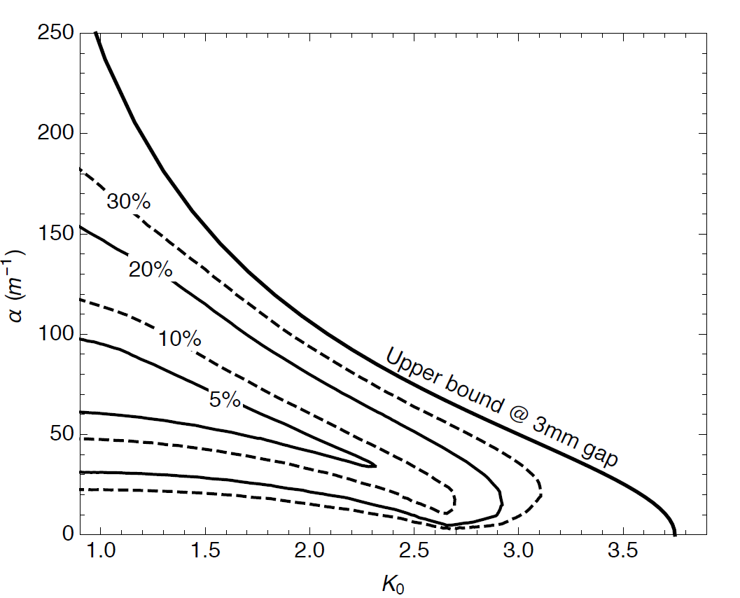
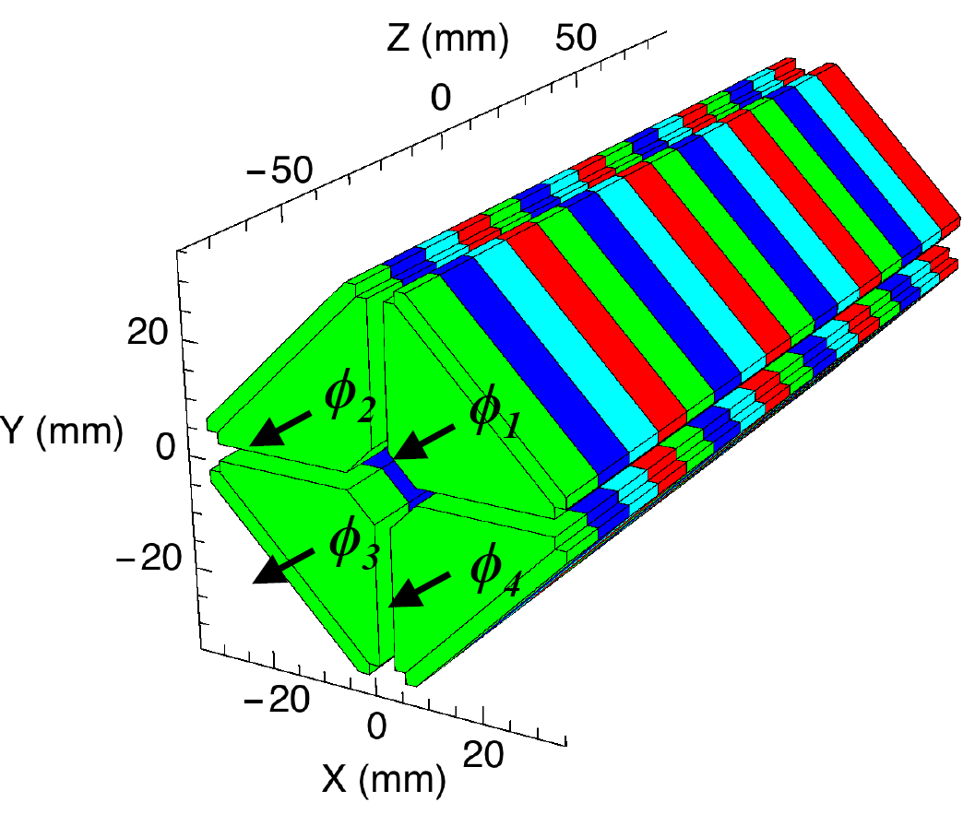
Gradient generation
Undulator with canted poles
More versatile option: Apple undulators with variable gap. Gradient and on-axis field can be tuned independently
Calculation with RADIA for Athos
Sketch of standard Apple undulator
Deviation from linearity
For deviation better than 20%, a gradient
α=30-80 m⁻¹ is obtained for K=1-2
Outlook: new device type to allow planar and circular polarization and to improve linearity
The gradient is created by
longitudinally shifting the arrays

Slide 7
Simulations
A gradient of 48 m⁻¹ and a tilt in offset of 125 produces XFEL radiation with 10 % bandwidth and peak powers of ~10 GW
Continuous undulator of 40 m without focusing (β_{x}=40m, β_{y}=35m)
Simulation parameters: I = 3 kA, σ_{E} = 350 keV
Central wavelength: 1 nm
Performance for different optimum gradient/tilt values
Too strong tilt: radiation slips out of the electron beam
Too strong gradient: wavelength change within slice transverse size is too large
Spectrum
Power profile
We can obtain XFEL pulses with 20 % bandwidth and few GW peak power

Slide 8
Two-color XFEL pulses
Motivation: two-color XFEL radiation is required for pump-probe experiments, for instance for stimulated Raman scattering
Existing methods mainly use:
  Undulators tuned at different K (low power, good tunability, long undulator)
  2 electron bunches with different energy (high power, limited tunability, short undulator)
We propose to use a tilted beam, two variable gap undulator sections and a chicane.
  In the first stage the “tail” is centered and lases at λ₁
  The electron beam is delayed and the “head” is realigned
  In the second stage the “head” lases at λ₂
The method offers high power for both pulses (similar to SASE), great tunability, but it requires a long undulator
Tunability: beam delay with chicane, wavelength difference with gap, length of each pulse with tilt amplitude and/or focusing strength
Delay + Alignment
1st Stage
Tuned to 1st photon energy
2nd Stage
Tuned to 2nd photon energy
Tilted Beam
Adjustable Delay
Betatron
oscillation
1st pulse

Slide 9
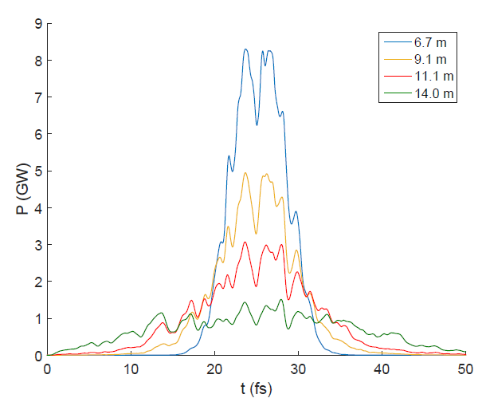
Simulations
Power profile and spectrum
Parameters:
E= 2.91 GeV, I = 2 kA, σ_{E}= 460 keV
Wavelengths: 4.4 nm (K=3.5) / 2.3 nm (K=2.35)
10 undulator modules in section 1 and 2
Tunability
Parameters | Values
Individual Pulse Length | 2 – 10 fs
Individual Pulse Energy | 50 – 250 µJ
Relative Delay | -10 to 1000 fs
Tuning Range | Factor 5 (e.g. 240 – 1200 eV)
Power profile after 2nd stage vs β-function
The performance of both colors can be adjusted by using different betatron functions at each stage

Slide 10
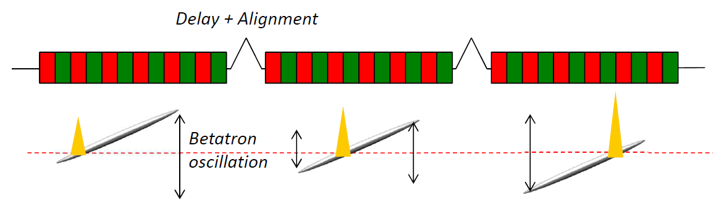
Short and high-power XFEL pulses
Motivation: in certain fields (i.e. bioimaging, nonlinear optics) there is a demand to get higher pulse powers and/or shorter pulses than in standard facilities (TW-as pulses)
There are already some good ideas to achieve shorter pulses by reducing the electron pulse (e.g. slotted foil, low charge) and using external lasers
Tanaka recently proposed a complicated scheme to get TW-as pulses [T. Tanaka, PRL 110, 084801 (2013)]. We suggested a simpler method using a multiple-slotted foil and small chicanes between the modules
Here we propose to use a tilted beam and chicanes to get TW-as pulses in an efficient way
The scheme has N undulator sections and (N-1) chicanes. The beam is split in N subpulses
In the first undulator section only the first subpulse (tail) produces XFEL radiation
Then the electron beam is delayed and aligned such that the 2nd subpulse overlaps with the XFEL pulse. Only this part is amplified.
This is repeated until all the electrons have contributed to amplify the short pulse

Slide 11
Simulations
E = 3.5 GeV, σ_{E} = 350 keV, average β-function is 5 m
8 undulator sections (7 chicanes)
Results are averaged over 5 seeds
λ(nm) | I (kA) | Undulator modules | Tilt amplitude in offset | Peak power (TW) | Pulse energy (mJ) | FWHM pulse duration (as)
1 | 3 | 38 (10+7*4) | 50 | 0.63±0.06 | 0.60±0.2 | 1400±700
2 | 6 | 20 (6+7*2) | 150 | 1.62±0.58 | 1.01±0.24 | 460±260
2 | 6 | 20 (6+7*2) | 300 | 1.48±0.20 | 0.52±0.05 | 300±10
By tuning the tilt amplitude one can choose shorter pulses with less energy or longer but more energetic pulses
FEL radiation profile after each undulator section for a tilt amplitude of 300 (λ=2 nm, I=6 kA, 1 seed)
XFEL radiation profile at the undulator end (λ=1 nm, I=3 kA)

Slide 12

Tilt generation
The tilt can be generated with different methods. Here we consider:
Transverse deflecting structure (TDS)
Transverse wakefields
Introducing dispersion to an energy chirped beam
An energy chirp is not a problem for the performance of the 3 applications (provided that the undulator field can be tuned)
We consider how to obtain at the undulator entrance
a tilt only in offset of 1 mm
along the nominal bunch (I=3kA, total length is 20 µm or 66.7 fs, tilt amplitude is 50)
for an average beta function of 10 m along the undulator beamline
Optics at the undulator entrance: β_{x} = 12.2 m, α_{x} = 1.26, β_{y} = 7.8 m, α_{y} = -0.82
Invariant of motion
Invariant at the head and tail for our case: J = 53 nm
This tilt amplitude is sufficient for the three applications at Athos
$$J{=x}^{2}γ+{x′}^{2}β+2xx′α$$

Slide 13
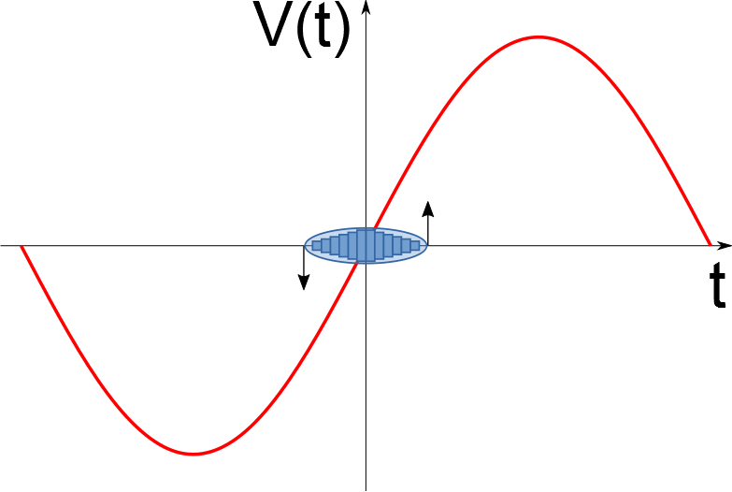
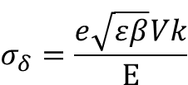


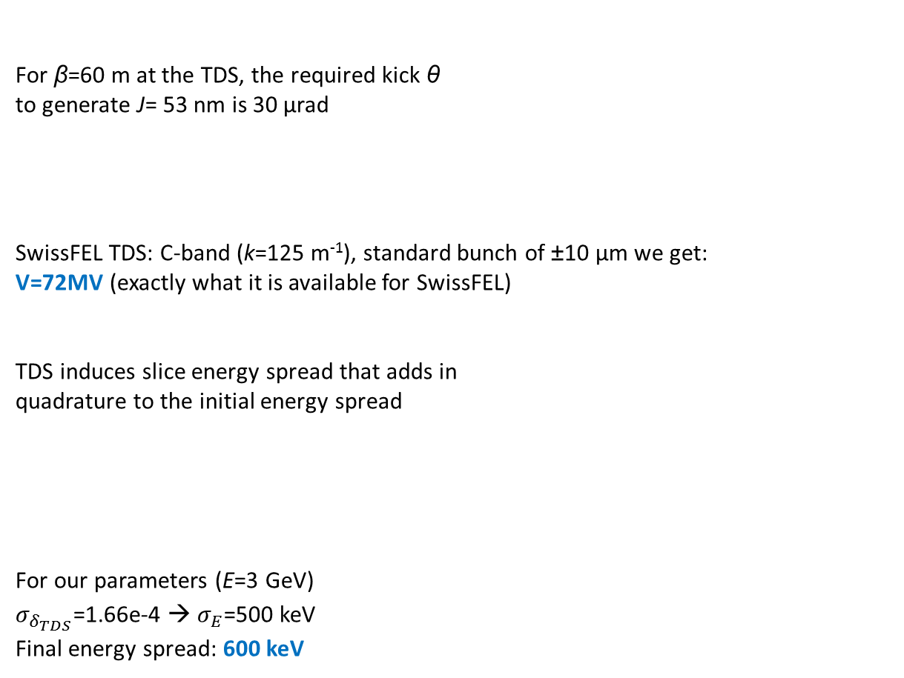
Tilt generation with a TDS
For β=60 m at the TDS, the required kick θ
to generate J= 53 nm is 30 µrad
SwissFEL TDS: C-band (k=125 m⁻¹), standard bunch of ±10 µm we get:
V=72MV (exactly what it is available for SwissFEL)
TDS induces slice energy spread that adds in
quadrature to the initial energy spread
For our parameters (E=3 GeV)
$σ_{δ_{TDS}}$=1.66e-4 → $σ_{E}$=500 keV
Final energy spread: 600 keV
$${J=x}^{2}γ+{x′}^{2}β+2xx′α$$
$$θ=\frac{Vkσ_{s}}{\text{E}}$$
Elegant simulations
$$σ_{δ}=\frac{e\sqrt{εβ}Vk}{\text{E}}$$

Slide 14
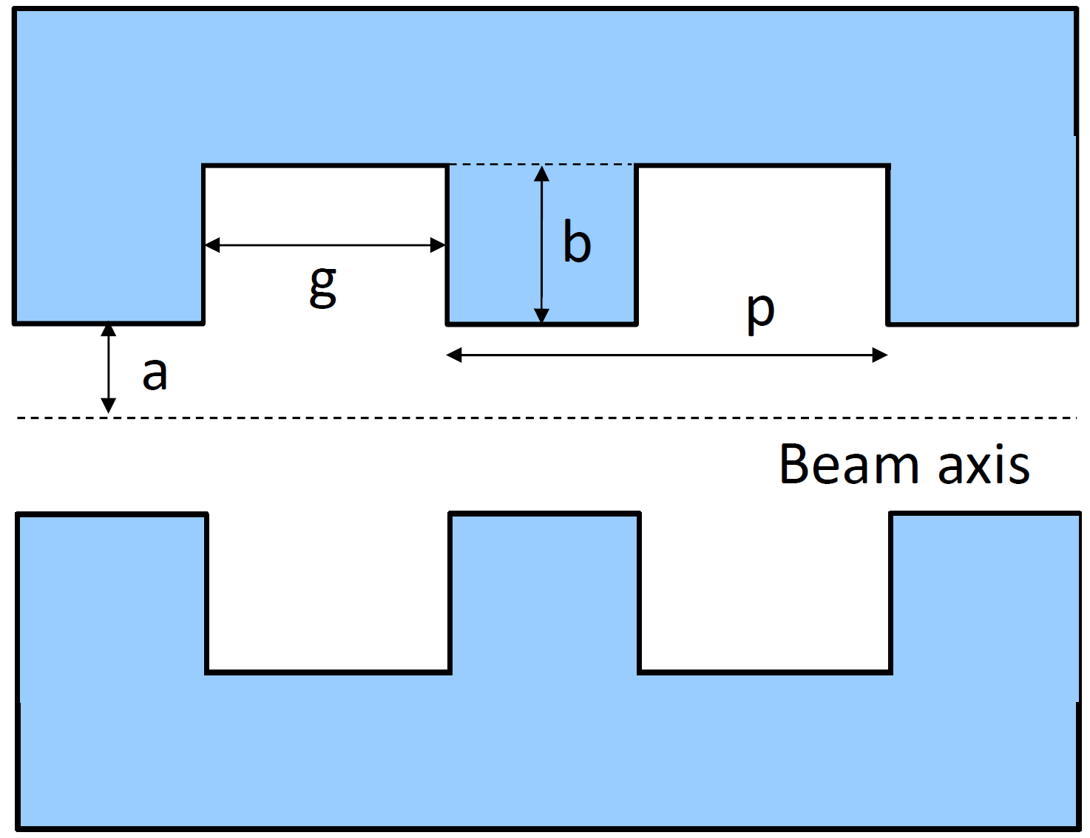
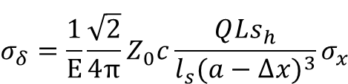
Tilt generation with wakefields
Different structures can be used:
Rf cavities
More effective such as dielectric tubes and corrugated plates
We use a corrugated plate due to its good tunability.
We take the device that will be used for SwissFEL as a “dechirper”
L = 8 m, g = 100 µm, p = 200 µm, b= 200 µm
The structure induces an energy spread increase
s_{h} is position with respect to the head,
l_{s} is total bunch length
A transverse offset Δx = 0.25 mm and a = 1 mm
give the required tilt with the minimum energy spread
increase (1.83 MeV at the bunch end where s_{h}=l_{s})
The device induces an energy chirp (it is a dechirper!)
The tilt is not linear. The linearity could be improved by collimating the beam or modifying its longitudinal profile
Elegant simulations (energy spread increase is not included)
$$σ_{δ}=\frac{1}{\text{E}}\frac{\sqrt{2}}{\text{4}π}Z_{0}c\frac{QLs_{h}}{{l_{s}(a−∆x)}^{3}}σ_{x}$$

Slide 15
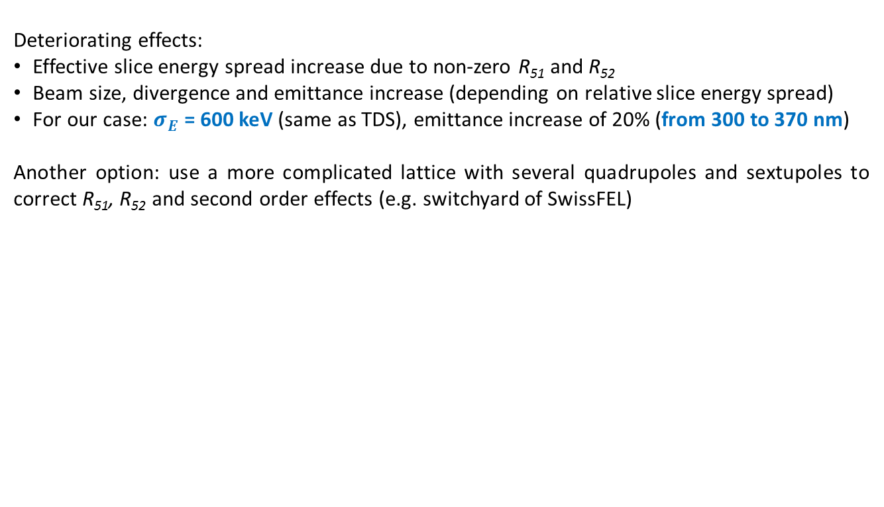

Tilt generation with dispersion
The tilt can be created anywhere where the beam has a chirp and dispersion can be induced. The best place is the last compressor of the facility:
The beam has a chirp by default
A quadrupole creates dispersion without altering the centroid trajectory
For β=40 m at the quadrupole and a total energy chirp along the bunch of ±0.5%, the required dispersion kick to generate J = 53 nm is D’=7.3mrad
kl =D’/D = 4mrad/280mm = 0.026 m-1
This can be achieved with l=0.1, k_{q}=0.26m⁻²
$${J=D}^{2}δ^{2}γ+{D′}^{2}δ^{2}β+2DD′δ^{2}α$$
Elegant simulations of tilt
generation with a quadrupole in BC2 of Athos
Deteriorating effects:
Effective slice energy spread increase due to non-zero R₅₁ and R₅₂
Beam size, divergence and emittance increase (depending on relative slice energy spread)
For our case: $σ_{E}$ = 600 keV (same as TDS), emittance increase of 20% (from 300 to 370 nm)
Another option: use a more complicated lattice with several quadrupoles and sextupoles to correct R₅₁, R₅₂ and second order effects (e.g. switchyard of SwissFEL)

Slide 16
Deteriorating effects of tilt generation
I = 3 kA, λ = 1 nm
Average β-function: 5 m
Tilt amplitude only in offset of 50
14 modules (enough for saturation)
FWHM pulse duration is about 2 fs
Reference case: 350 kev, 300 nm
FEL performance vs energy spread
Power profile for reference case
FWHM pulse
length is 2 fs
FEL performance vs emittance (log scale)
FEL performance is more sensitive to emittance than energy spread
Deteriorating effects are acceptable

Slide 17
Tilt generation summary
 | TDS | Wakefields | Dispersion
Strength scaling | TDS voltage | Structure length and/or Structure offset | Magnets strength Energy chirp
Hardware requirements | TDS | Structure to generate wakefields efficiently | A quadrupole in a BC is sufficient (several quads and sextupoles for better lattice)
Impact to the beam | Slice energy spread | Slice energy spread Energy chirp | Slice beam size, divergence and emittance (slice energy spread)
Other issues | Sensitive to time jitter | No linear chirp
Dispersion method is the best in terms of hardware requirements. It has the drawback that the emittance is increased
The best method to generate a given tilt depends on the beam parameters (e.g. wavelength, energy spread, emittance) and project conditions (e.g. availability of TDS)

Slide 18
Wir schaffen Wissen – heute für morgen
Transverse tilts can be used to generate
  … Ultra-large bandwidth XFEL radiation
… Two-color XFEL pulses
  … TW-as XFEL pulses
  The tilts can be generated using standard components of XFEL facilities
  The deteriorating effects are acceptable for soft X-rays

