Slide 1
LCLS Injector Improvements & Plans
Feng Zhou
SLAC
Presented at HBB, Havana, Cuba, March 29, 2016

Slide 2
What are the major impacts on 24/7 LCLS injector performance?
LCLS injector routine projected emittance for hard x-ray FEL (2014-2016)
24/7 LCLS injector emittance is mainly impacted by:
Drifting of laser location on Cu photocathode
Changing of UV drive laser spatial performance

Slide 3
LCLS injector improvements
Boosted QE by 25-30 times w/ laser cleaning on the LCLS Cu cathode, which has operated for 5 yrs.
Improved emittance and better understood injector emittance measurements:
Applied truncated-Gaussian laser for emittance reduction
Developed laser profile tolerances for maintaining ultra-low emittance
Lengthened laser pulse for emittance reduction
Reliably characterized injector emittance
What is the next?
Shaping laser with spatial filter
Shaping e-beam with transversely circular collimator

Slide 4
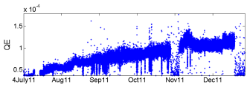
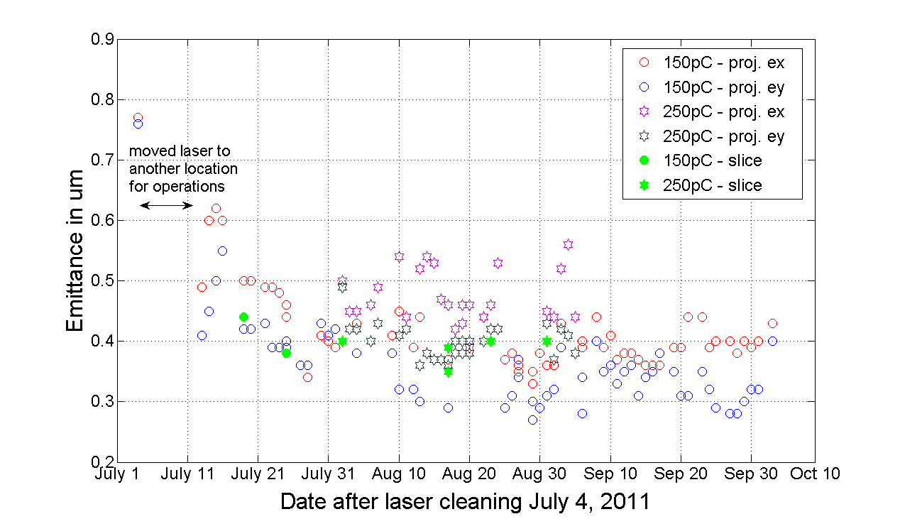
LCLS laser cleaning in 2011: QE/emittance evolution
QE increased by 25-30 times compared with original 5e-6:
QE was increased by ~8 times upon the laser cleaning
QE was further increased by 3-4 times in the first 6 months following laser cleaning
Emittance recovery took 2-3 wks:
High-power RF conditioning may improve e- emission profile
Provided a very simple but a very robust way for XFEL application
OTR emittance

Slide 5
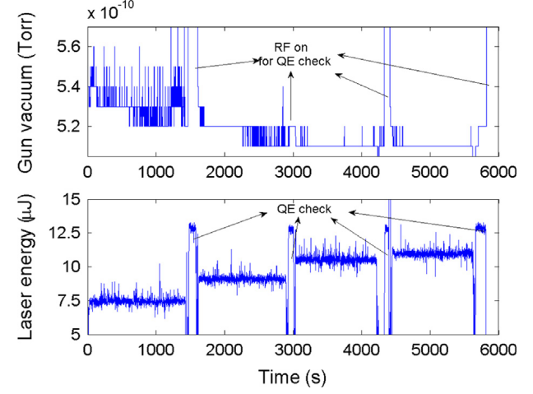
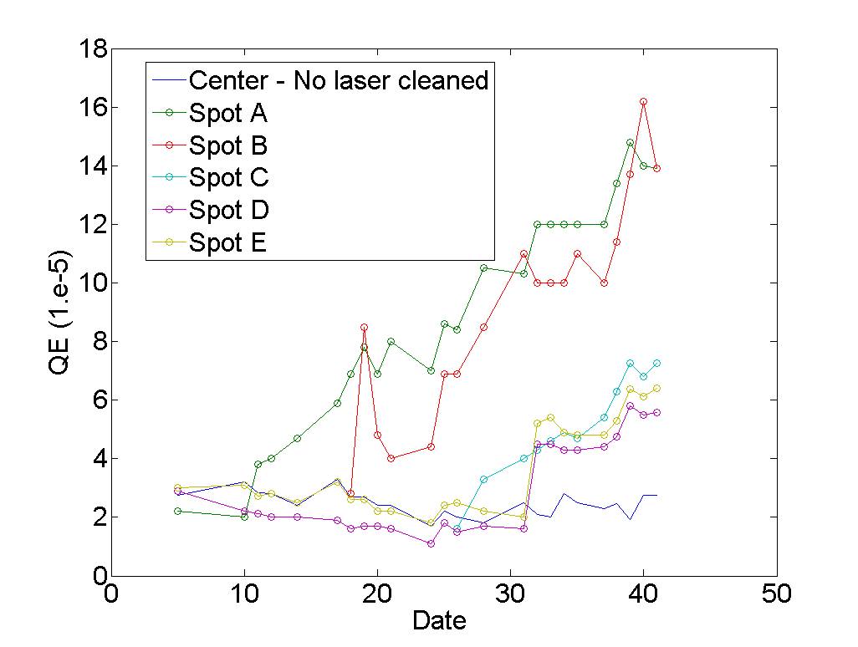
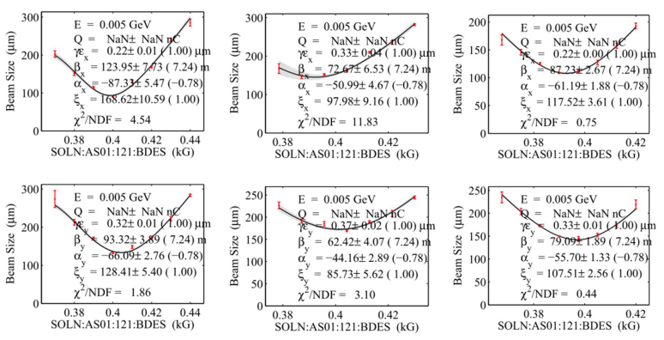
We can do better w/ laser cleaning …
Improved laser cleaning procedures at the gun test bed resulting in much better QE and emittance evolution.
~3 wks QE ~1e-4
F. Zhou et al., NIM A 783 (2015)
Immediately after cleaning
Next day after cleaning

Slide 6
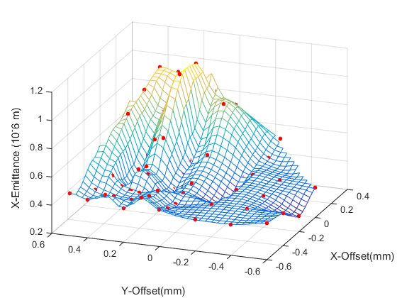
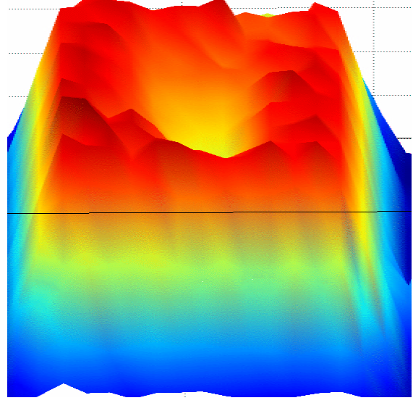
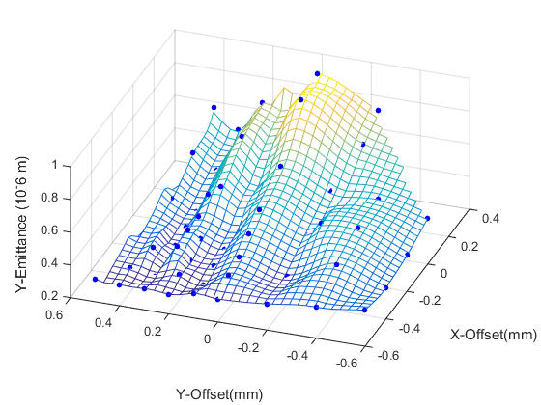
After ~5 years 24/7 operations
Optimized projected εx ~0.4 µm @250pC
QE: 1.5e-4 of QE
electron/ion back bombardment effect
2 mm
1.2 mm laser size
2 mm

Slide 7
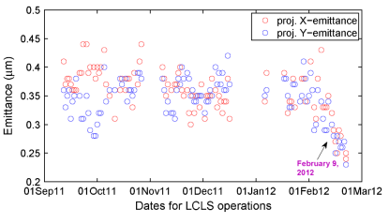
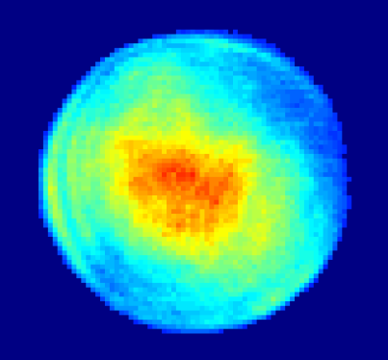
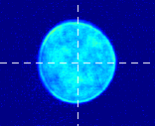
Truncated-Gaussian laser for operations
Implemented truncated-Gaussian laser profile for the routine operations:
Improved injector emittance
Laser power needed from laser systems is reduced by about 3 times with truncated-Gaussian laser on the cathode compared with the one with pseudo-uniform laser:
Relaxed laser system significantly
150 pC
F. Zhou et al., PRST-AB 15, 090701 (2012)

Slide 8
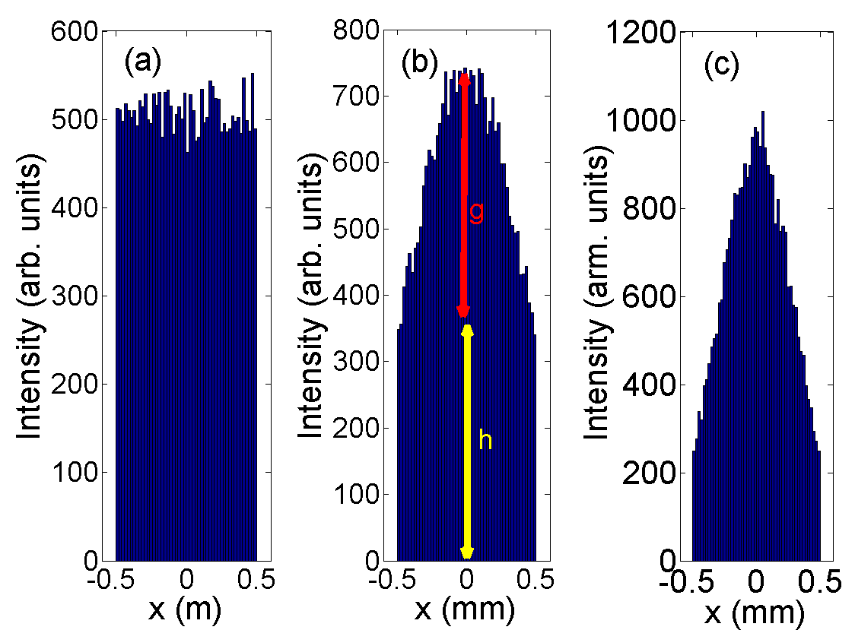
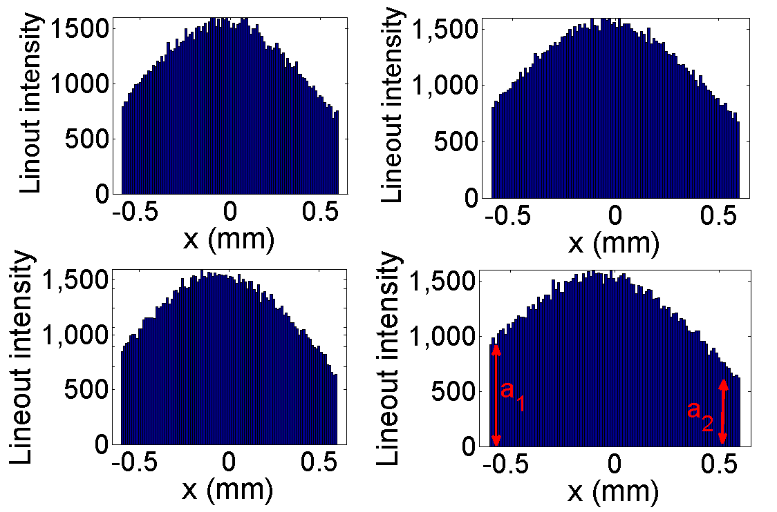
Spatial laser profile tolerances: w/ lineout method
How to define/maintain the desired laser profile for 24/7 operations??
Spatial laser tolerances can be characterized with simple lineout method when the laser is reasonably clean
Laser profile tolerances, such as g/h, a1/a2, are strongly required for maintaining good laser profiles.
simulated lineout profiles

Slide 9
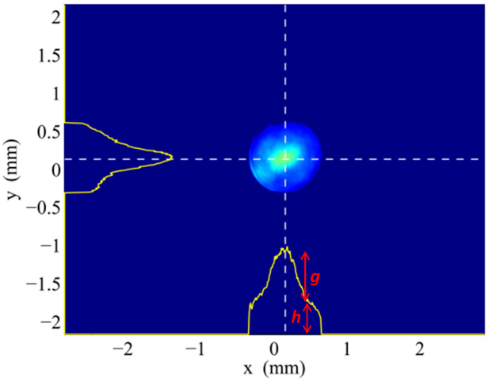
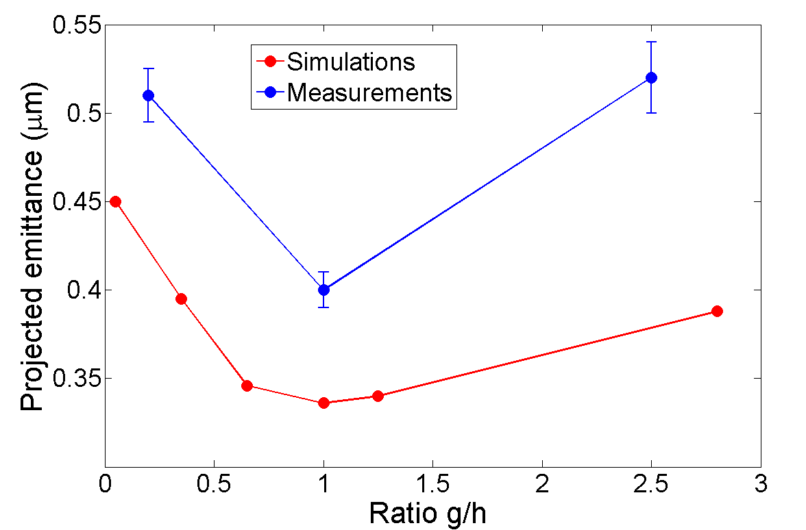
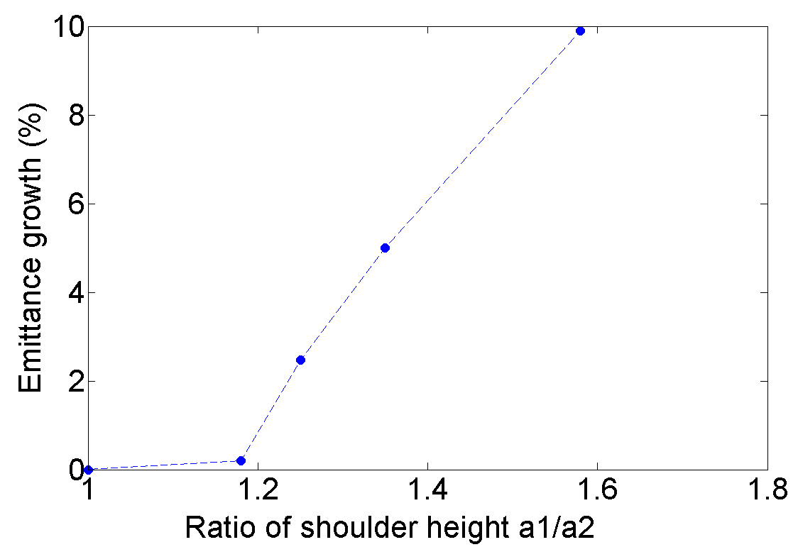
Laser profile tolerance: w/ lineout method
For <5% of emittance growth, the spatial laser requirements:
g/h: 1±0.25
a1/a2: 1±0.3
a1
a2
Simulation

Slide 10
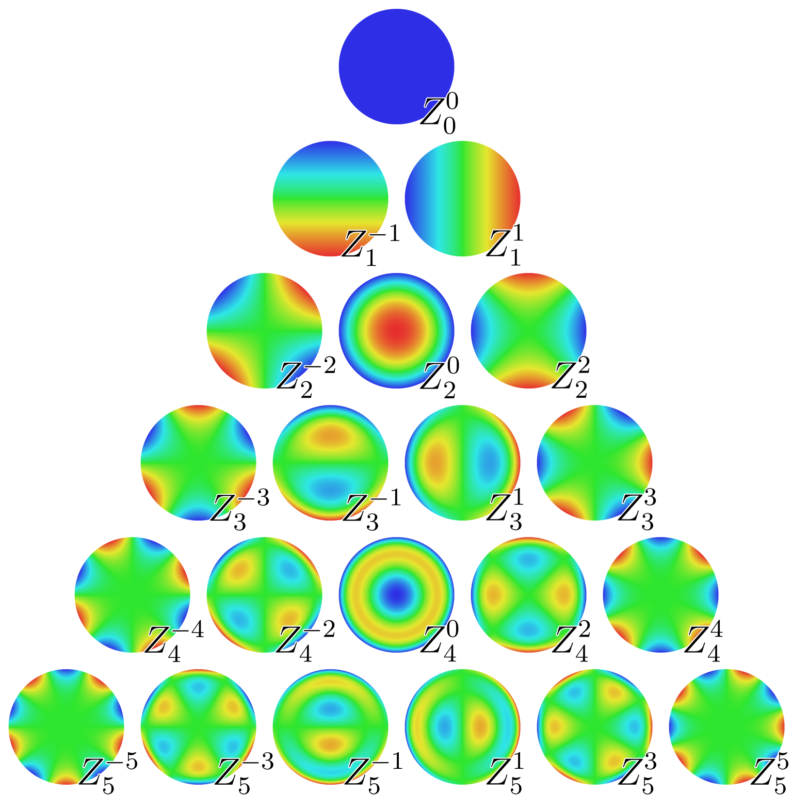
General method: w/ Zernike modes
Zernike functions are orthogonal over the unit circle:
where
The coefficients for Zernike modes
Actual laser profile is represented:
Symmetry power Psymmetry:
(n≠0)
Asymmetry power Pasymmetry:
(m≠0)
F. Zhou et al FEL15
Example: 21 Zernike modes Z_{n}^{m}

Slide 11
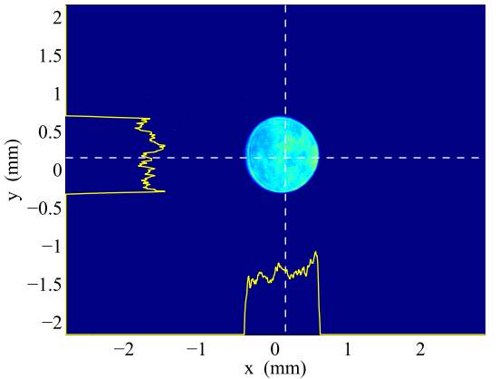
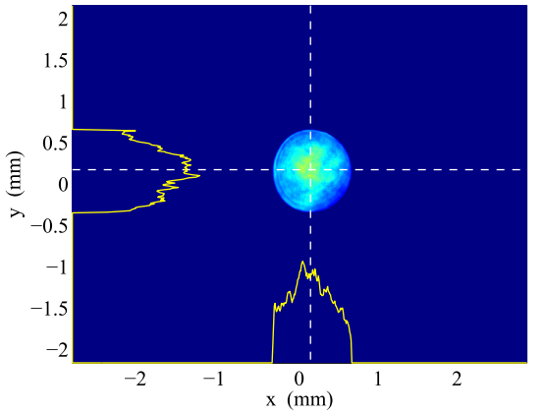
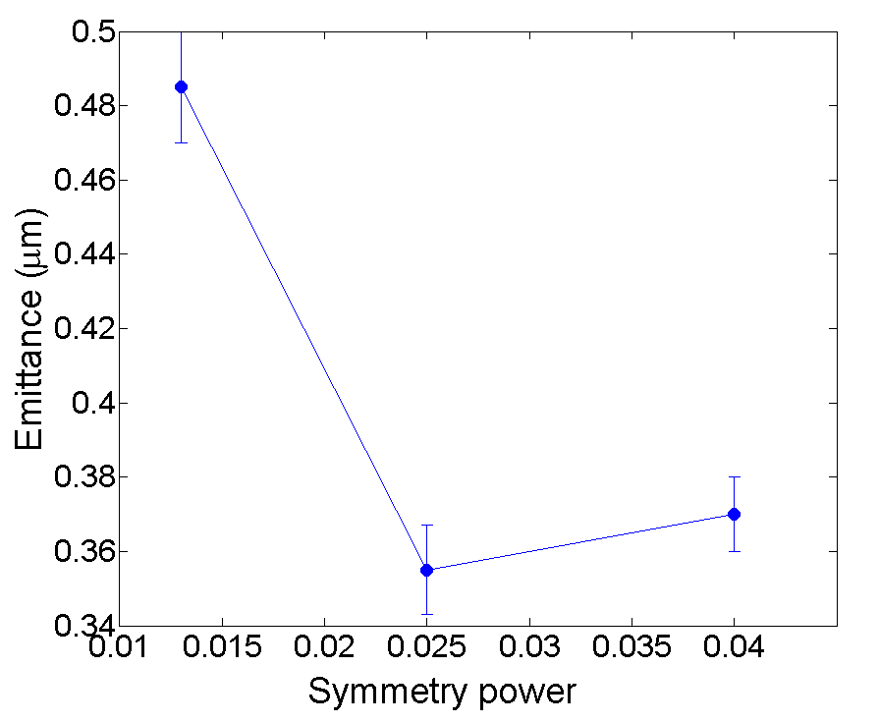
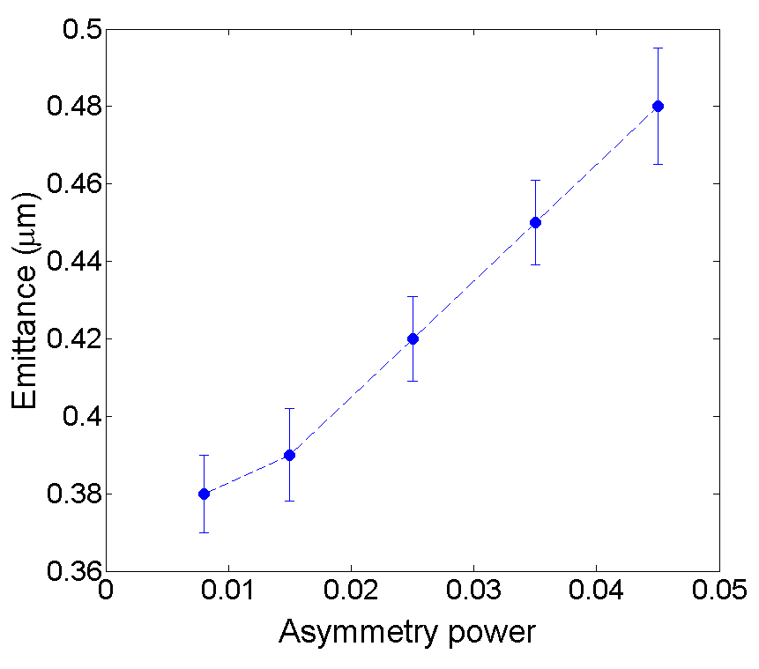
Zernike method: measurements Requirements: Psymmetry 0.025-0.04; and Pasymmetry <0.015
(a): pseudo-uniform
(b): truncated Gaussian
(c): truncated Gaussian
(a)
Pasymmetry: <0.015
Psymmetry: 0.025-0.04
measurements
(b)
(c)
measurements

Slide 12
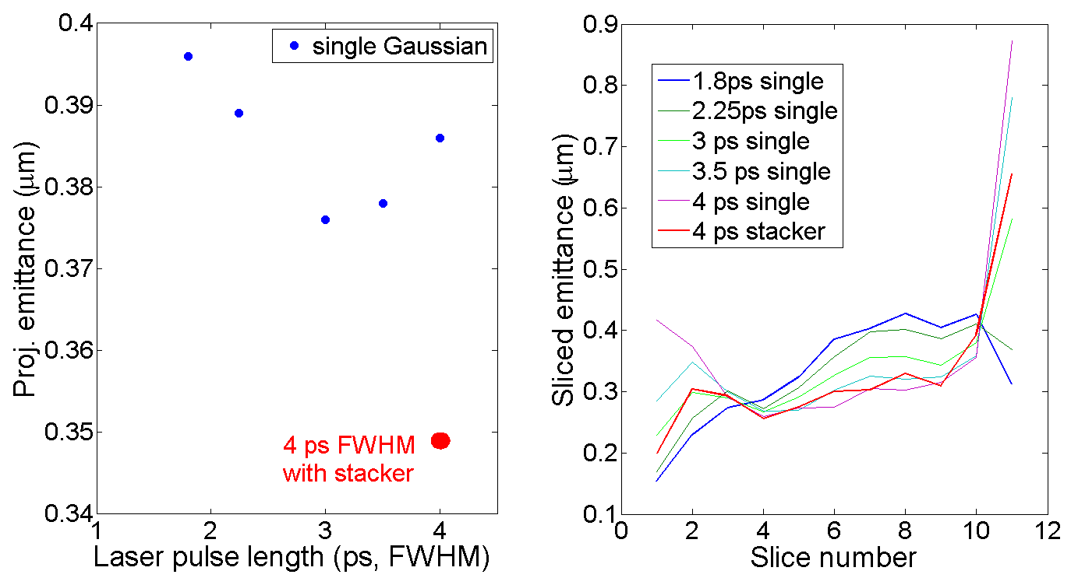
Laser temporal requirement: stacking 2ps lasers with 1.5-2ps separation
LCLS typical laser pulse ~2ps FWHM of Gaussian
Pulse stacking with s- and p-polarization with 1.5-2ps separation to lengthen the pulse length
Compromise RF emittance w/ space charge emittance
simulations
simulations
measurements
measurements

Slide 13
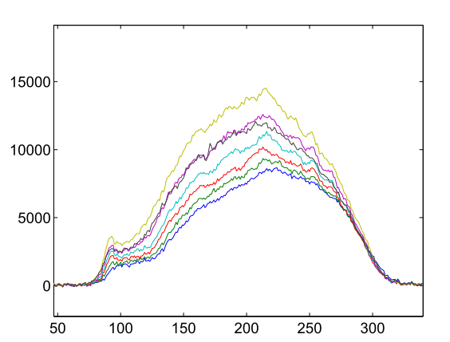
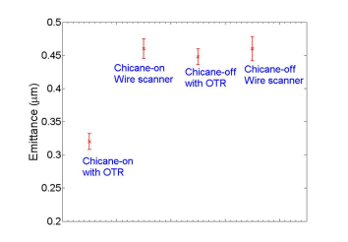
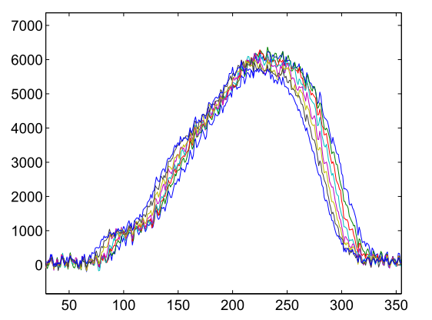
Better understanding LCLS Injector emittance measurement
OTR light for different quad settings
Injector emittance measured with an OTR screen (downstream of laser heater chicane) is underestimated:
μ-bunching through the small laser heater chicane makes core beam brighter resulting in smaller beam size
Laser heater chicane ON
OTR light fir different quad settings
Laser heater chicane OFF
F. Zhou et al., PRST-AB, May 2015

Slide 14
Crosscheck slice-emittance measurement w/ BC1 collimator
Measured projected emittance for the sliced beam in the non-bending plane ≈ injector emittance.
Measured projected emittance for slice beams in the bending plane is 25% larger than the injector emittance:
it includes CSR effect – cannot be used for slice emittance measurement for the bending plane
F. Zhou et al., PRST-AB 18, 050702 (2015)

Slide 15
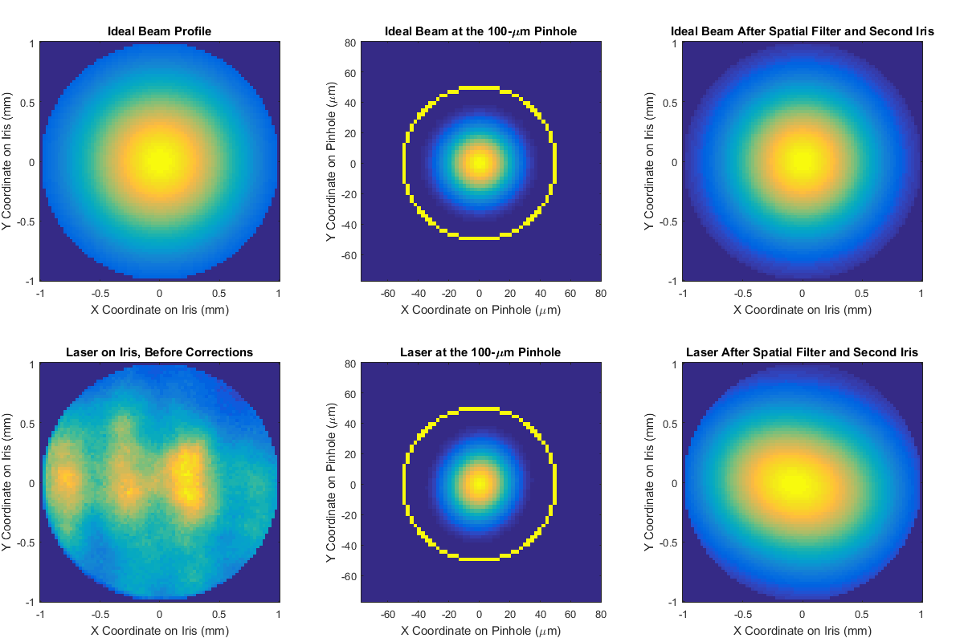
What is the next? - clean spatial laser w/ spatial filter
Studying 4 major issues before implementing it to LCLS drive laser system:
Damage issues
Beam loss
Pointing stability
Reliability
Alan Fisher

Slide 16
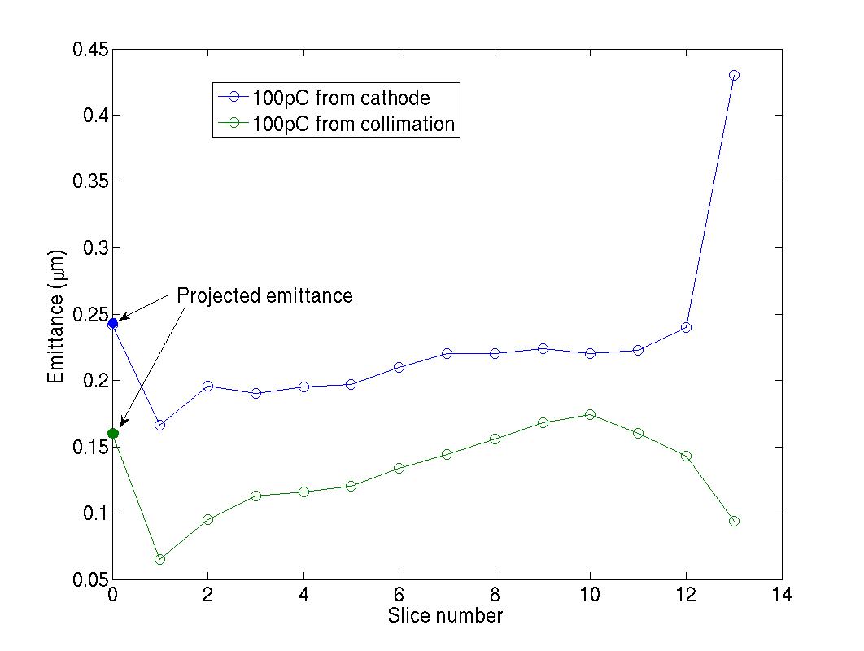
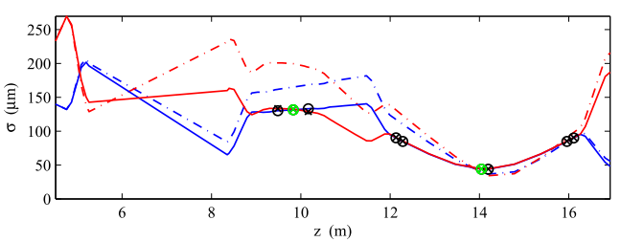
What is the next? - clean e-beam w/ circular collimator
With circular collimator, only dipole wake contributes to emittance growth:
25μm tolerance is required to control emittance growth <1% for 0.3mm aperture (Bane).
40% emittance reduction is expected from simulations
Study is planned before implementing it to LCLS:
Full simulation for FEL with circularly collimated beam
Reliability of controlling 25um transverse tolerance
40% reduction
Candidate collimator location

Slide 17
Summary
QE is increased by 25-30 times with laser cleaning. The cathode has operated for 5 yrs.
Optimized projected emittance is ~0.4μm for 250pC:
With truncated Gaussian spatial laser; defined/controlled spatial laser profile
With stacking of 2-ps pulses lengthening temporal laser
Reliably characterized injector emittance measurements
Near-term plans:
Shaping laser with spatial filter and
Shaping e-beam with circular collimation

