Slide 1



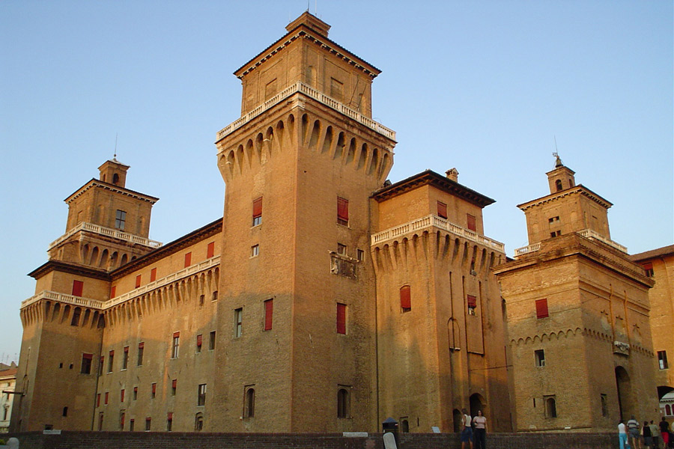
Status report on Ferrara activity
“on behalf of the Ferrara GAP Group”
Ilaria Neri
University of Ferrara
and INFN - Italy
Ferrara, March 23rd, 2016

Slide 2
Outline
Design and development of the Timing Trigger and Control (TTC) HSMC daugthercard (TTC_Interface).
NaNet&GPU as L0TP: “fixed latency trigger” module implemented.
A solution for TTC&NaNet-10 interface.
“Merger” on DE4 Terasic Altera FPGA for PFRING solution.

Slide 3
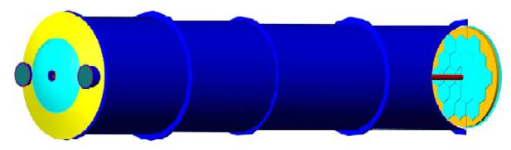
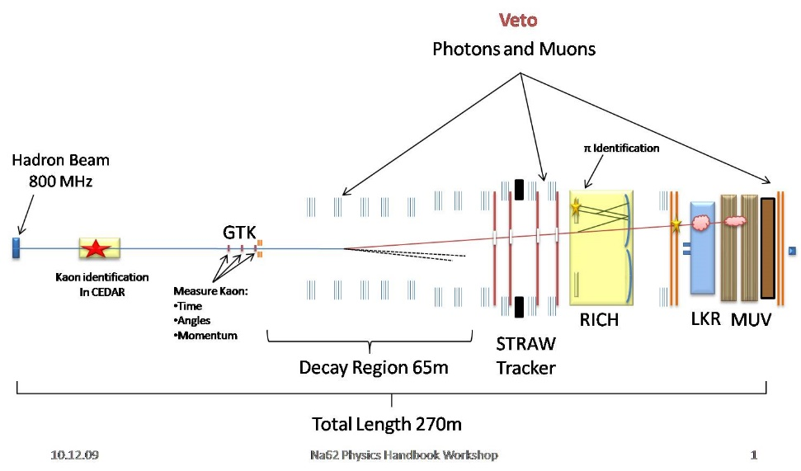
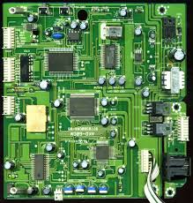
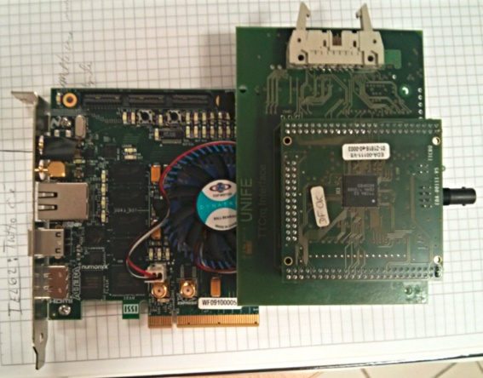
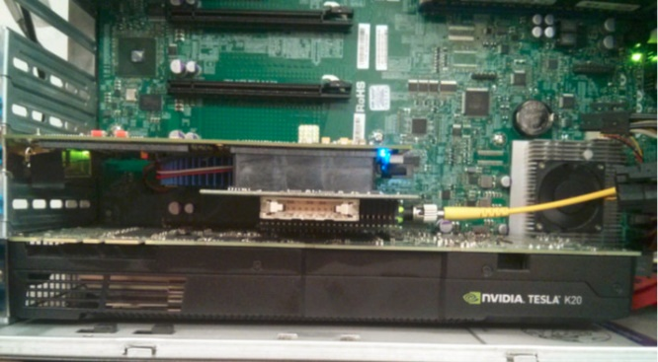
NA62 case study
RICH detector
NA62 experiment @ CERN
TEL62 ReadOut boards
TTC_Interface
board & NaNet-1
Connected to the High Speed Mezzanine Card (HSMC) port B of the FPGA board.
Provide NaNet-1 either trigger and 40 MHz clock streams distributed from TTC system via optical cable.
NANET-1
TTC Interface
TESLA K20

Slide 4
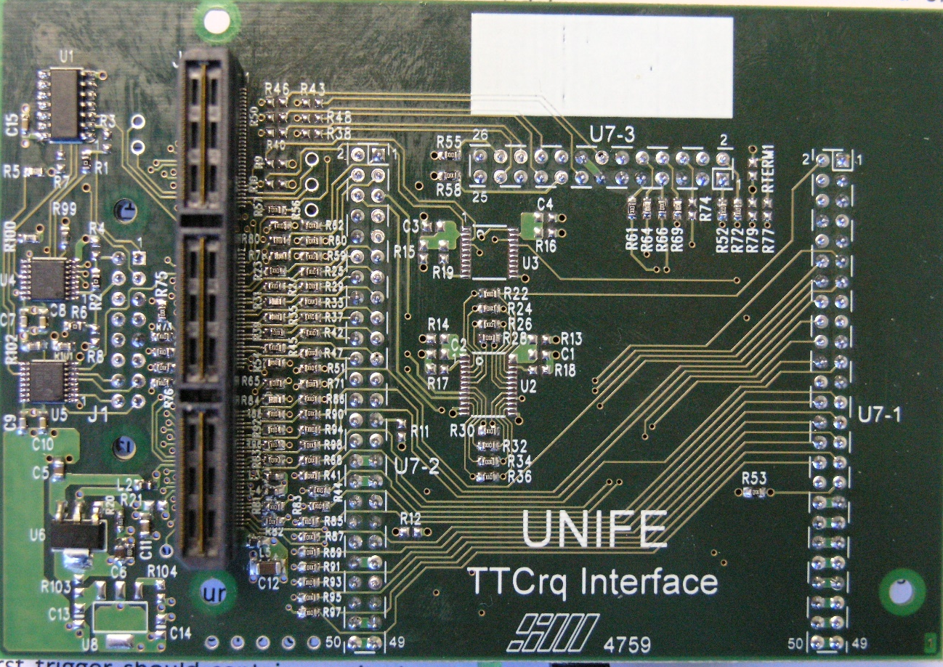
TTC_Interface board
Designed and developed at Physics Department at University of Ferrara in May 2014.

Slide 5
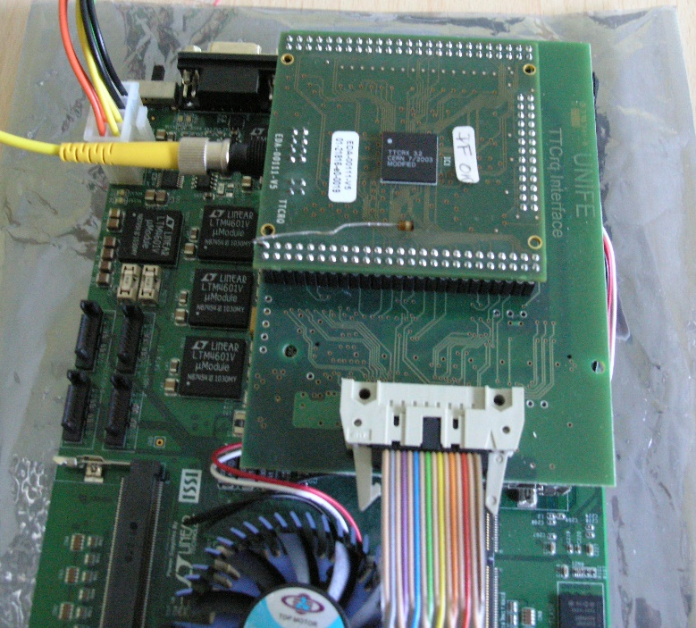
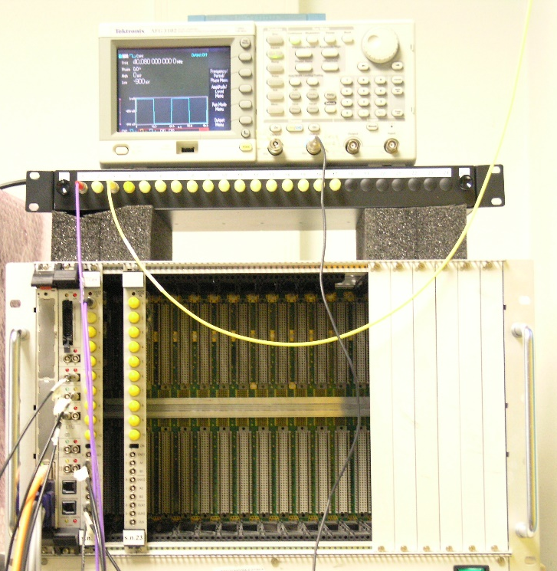
First tests of
TTC_Interface board
The TTC_Interface board has been mounted and tested on a Terasic DE4 (Altera Stratix IV FPGA).
Synchronisation of the DE4 with the TTC system through the daughterboard has been tested by using a Local Trigger Unit (LTU) in Ferrara.
40.08 MHz clock generator
40.08 MHz clock
+ SOB + EOB
signals
DE4 FPGA connected to the TTC board
LTU and TTCex

Slide 6
LTU setup
set LTU to “standalone” (or local) mode in order to receive triggers by LTU.
configure the TTCrx to work in trigger mode “11” (by sending a special B channel short message).
set LTU to “global” mode, to send triggers to LTU.
configure the LTU with a trigger list and generate triggers during the simulated burst period.

Slide 7
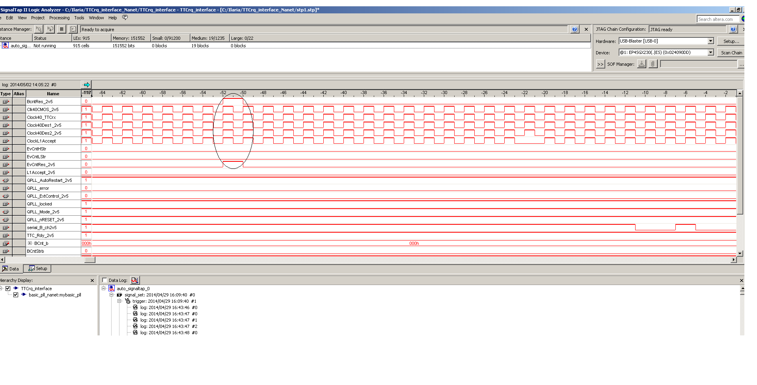
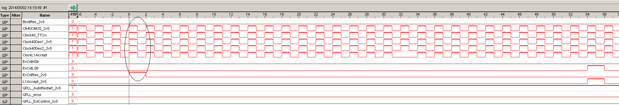
SOB and EOB correctly received
The Start of Burst (SOB) condition is determined by the BCntRes and EvCntRes signals going high for one clock period.
The End of Burst (EOB) condition is marked by only the EvCntRes signal going high for one clock period.

Slide 8
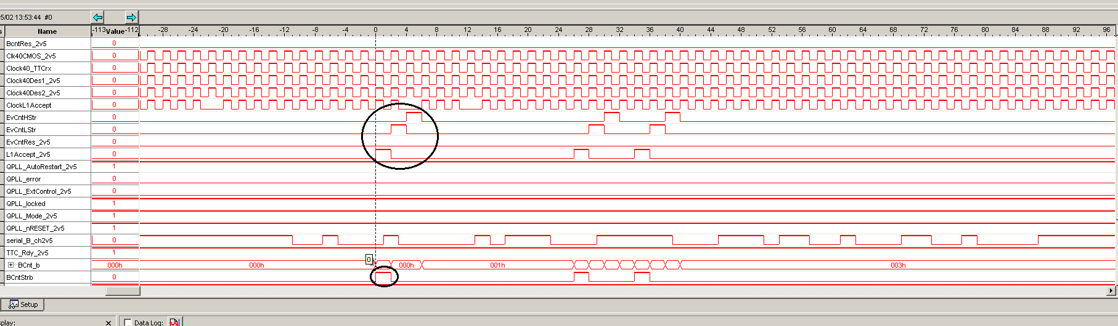
Triggers by LTU
In trigger mode “11”, each L1Accept trigger is followed by the EvCntLStr and EvCntHStr signals, as depicted in TTCrx reference manual.
The whole system TTC_Interface&DE4 proved to correctly receive all the signals necessary to synchronise the detectors.

Slide 9
TTC_Interface board
TTC_Interface
board & NaNet-1
Provide NaNet-1 either trigger and 40 MHz clock streams distributed from TTC system via optical cable.
Synchronization of NaNet-1 with the TTC system of the experiment NA62 through the TTCrq module, has been tested by realizing an interface board between NaNet-1 and the TTCrq.
The whole system TTCrq-interface-NaNet-1 proved to correctly receive all the signals necessary to synchronise the detectors, and in particular clock, event counter reset and bunch counter reset, these latter encoding start-of-burst and end-of-burst commands.

Slide 10
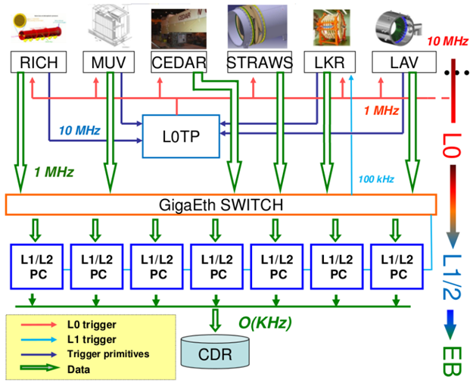
Level 0 Trigger Processor
Using NaNet and GPU as L0TP of the experiment
Time align and match
primitives from detectors
with programmable masks.
Synchronously send selected
triggers to the detectors
through TTC system
with fixed latency.

Slide 11
Fixed latency L0 trigger
Implementation of vhdl module which generates fixed latency triggers and send them to Local Trigger Unit (LTU) of the experiment.
Altera Stratix-IV GX230 FPGA on a Terasic DE4.
Triggers correctly
sent to LTU

Slide 12
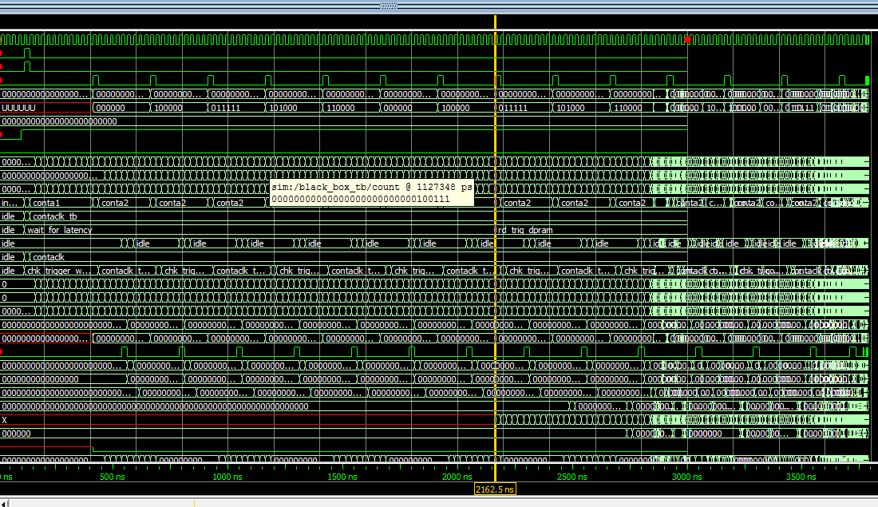
Simulation
Start Of Burst

Slide 13
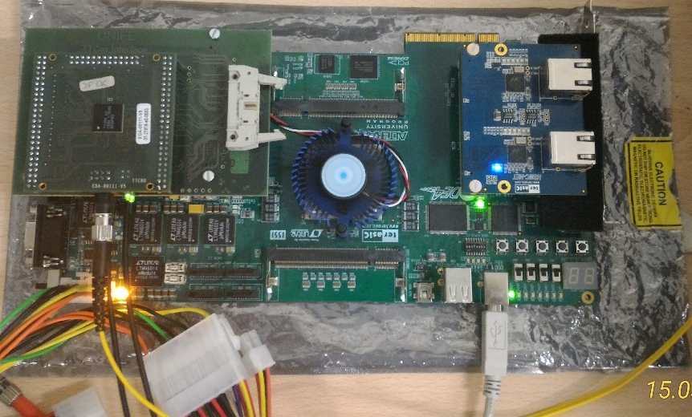
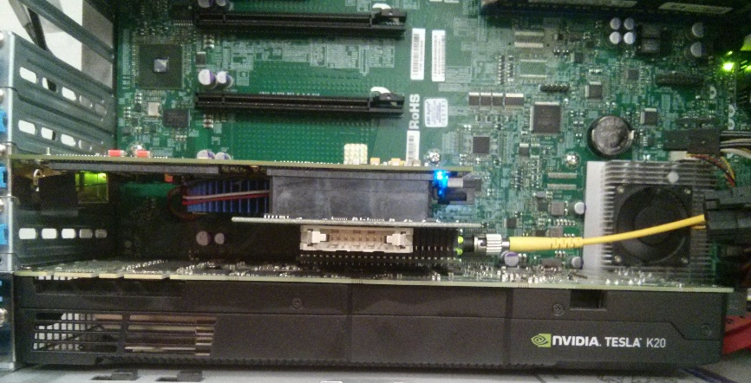
A solution for
TTC&NaNet-10 interface
The system DE4&TTC_Interface is used to distribute the clock and a signal, which encodes the status of the burst, to NaNet-10.
Two coaxial cables (clock and in/out burst) are used from the DE4 board to NaNet-10.
Two SMA connectors in input mode must be used on NaNet-10.
SMA_CLKIN receives the 40 MHz clock a (clock40CMOS).
SMA_CLKOUT (must be programmable in input mode) receives the inburst/out-of-burst signal.
40.08 MHz clock
+ SOB + EOB
signals

Slide 14
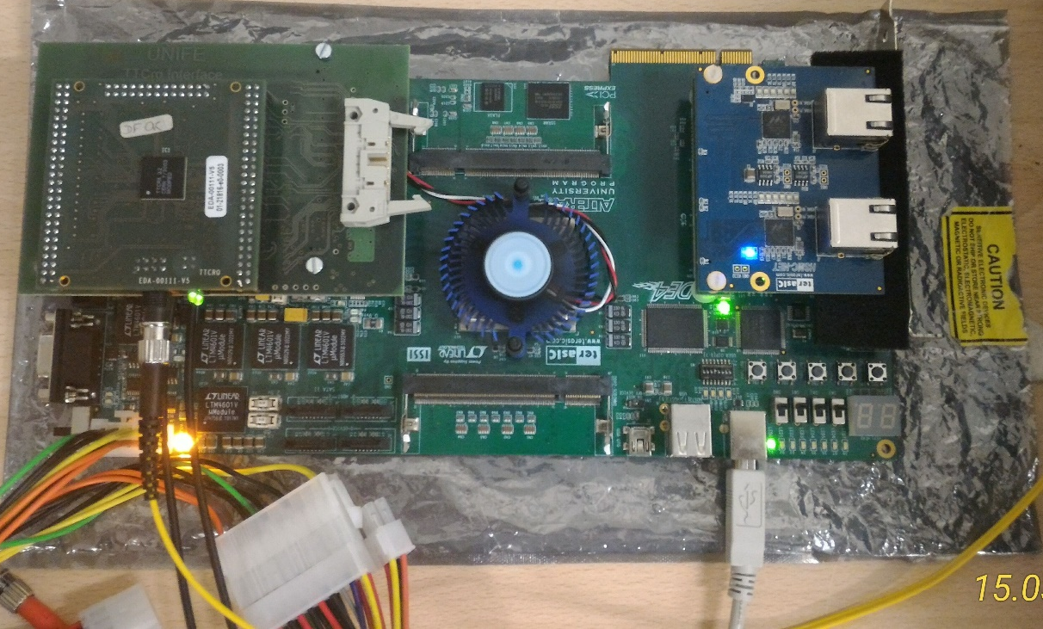
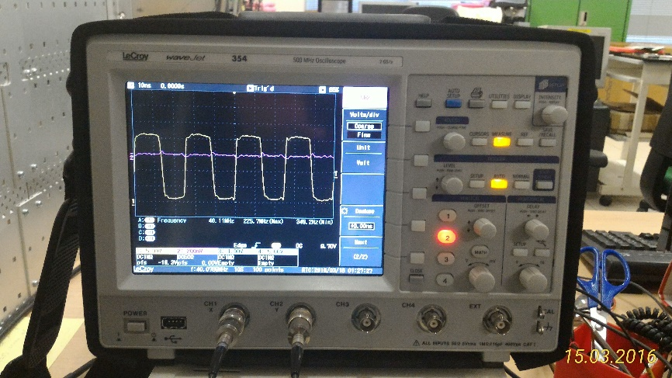
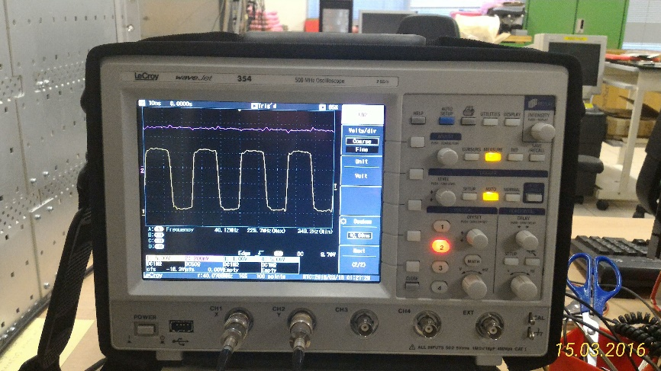
Tested in Pisa - 15.02.2016
LTU is set in “global” mode.
Clock, SoB and EoB are received via optical cable.
The signal is high for the entire burst period, and low out-of-burst.

Slide 15
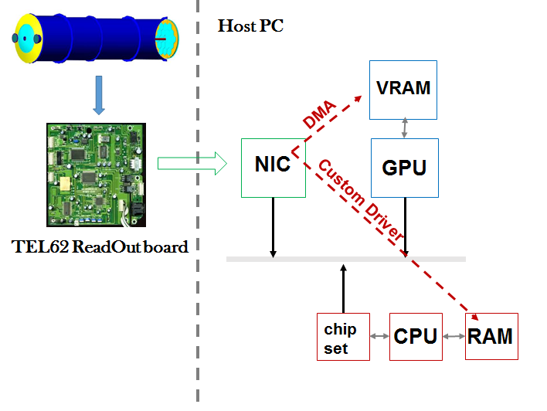
PFRING solution
PFRING DNA (Direct NIC Access) is a way to map NIC memory to userland so that there is no additional packet copy besides the DMA transfer done by the NIC.

Slide 16
UDP packets
MGP format
Over 1/2/3/4 Gbe links
Altera DE IV
MERGE MGP
and
DECOMPRESS (?)
TEL62
1/2/3/4 Gbe links
HOST
GbE
PFRING driver
UDP packets
MGP merged
and decompressed in a later development (?)
Gather MGPs
Decompress (as a first step)
Use E2MGP format (?)
Copy into GPU device memory
  buffers in E2MGP format
  buffers with gathered MGP (needs another kernel to extract data)
  or data structures with hits, TS ecc.
Launch computing kernel
L. Pontisso 15.03.2016

Slide 17

Merger on
DE4 – Altera FPGA
Fast trigger data (MGP) from different sources is merged and optimized for GPU environment. Output packets are re-sent via ethernet links to Host for GPU processing (PFRING solution).
Rx and Tx Ethernet modules are the same developed for GTKR0, L0TP-FPGA and L0TP-PC but must be adapted for GPU environment.
FPGA
Rx
Ethernet
Merging
logic
Tx
Ethernet
MGP
PFRING
MGP

Slide 18
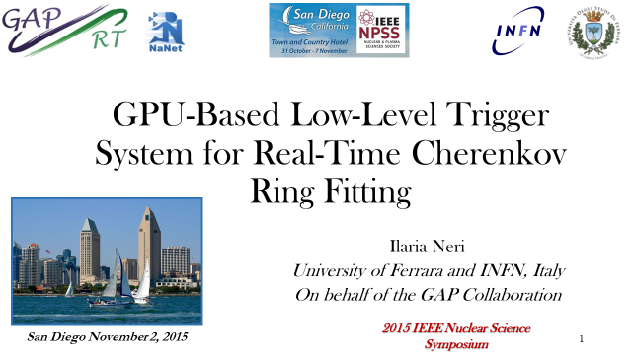
IEEE NSS 2015

Slide 19
Thank you for attention!

