Slide 1
Water Productivity using ET estimations from Remote Sensing and Hydrological Models
Ann van Griensven & Hichem Sahli
Vrije Universiteit Brussel
TowardanOpenResourcesUsingServices
Torus project meeting, June 6-10, Ferrara, Italy

Slide 2
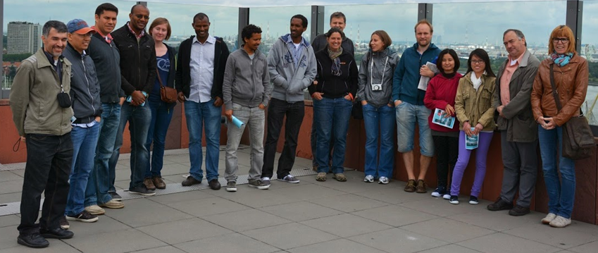
HYDR: Large group of international researchers
3 full time professors / 3 part-time professors (10%)
3 Post-Doctoral Researchers
~20 PhD Researchers

Slide 3
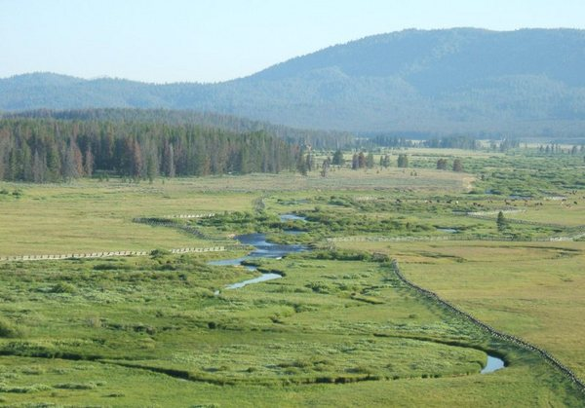
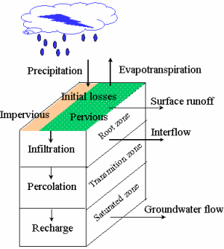

Where do we want to make a difference
Hydrological modelling using field and remote sensing data
Model developments using open source software
WETSPA-python
SWAT
…
Notes:
WETSPA python– spatially distributed hydrological catchment model obtained by reimplementing the Wetspa model.
Advatanges are
- flexible
Process based and modular
SWAT – Soil and Water Assessment Tool, is an open source tool developed to asses the impact of land management decisions on water, and agricultural chemical yields in large complex basins.

Slide 4
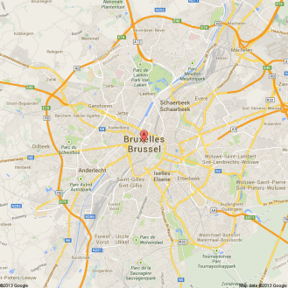
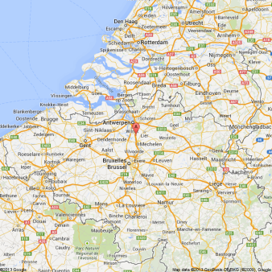
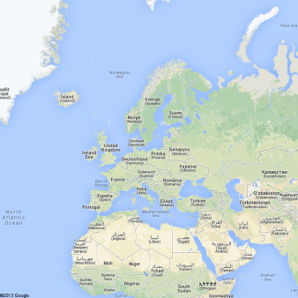
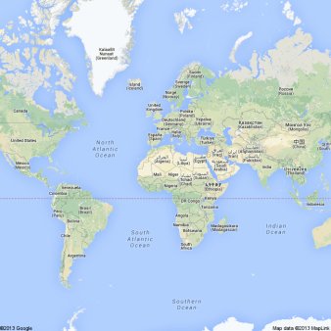
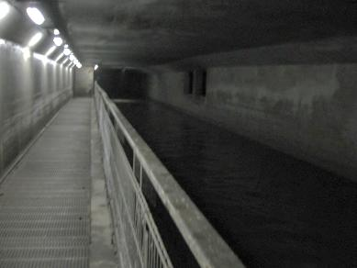
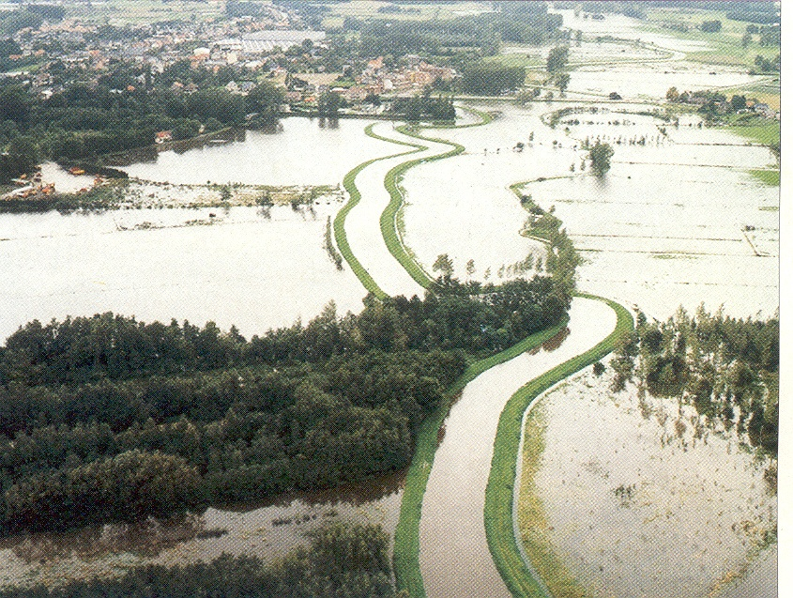
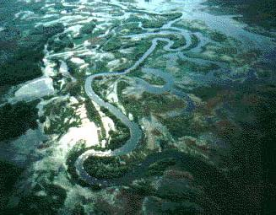
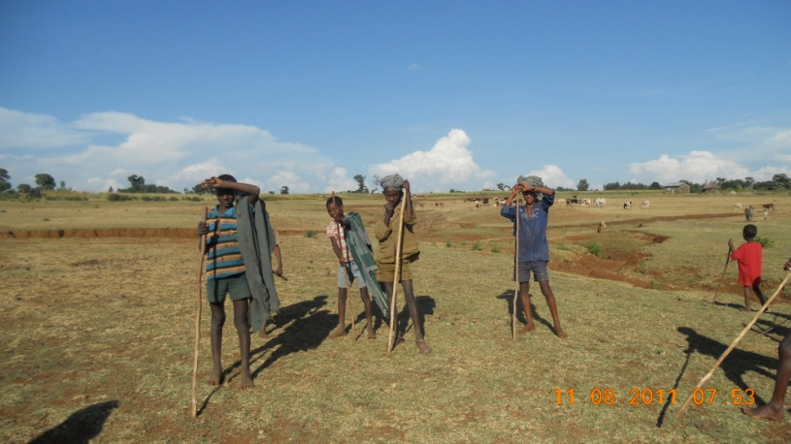
Research in water across scales and disciplines
Scale
Services
Urban drainage
Brussels
Flooding
Nete basin, Belgium
Ecosystems
Bierbza, Poland
Food security
Ethiopia

Slide 5
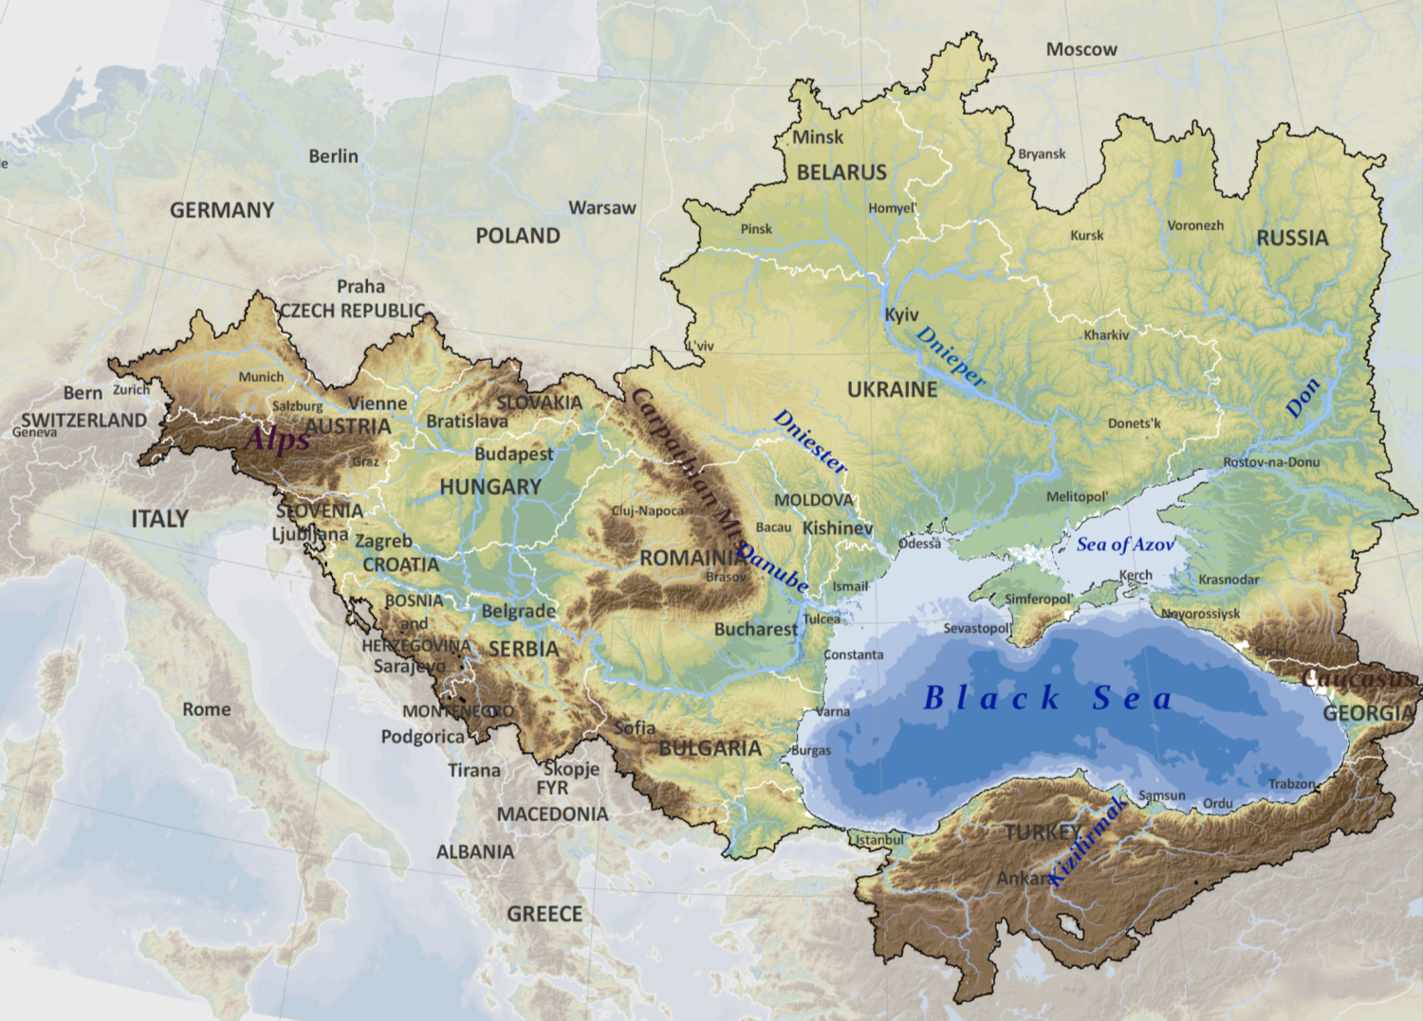
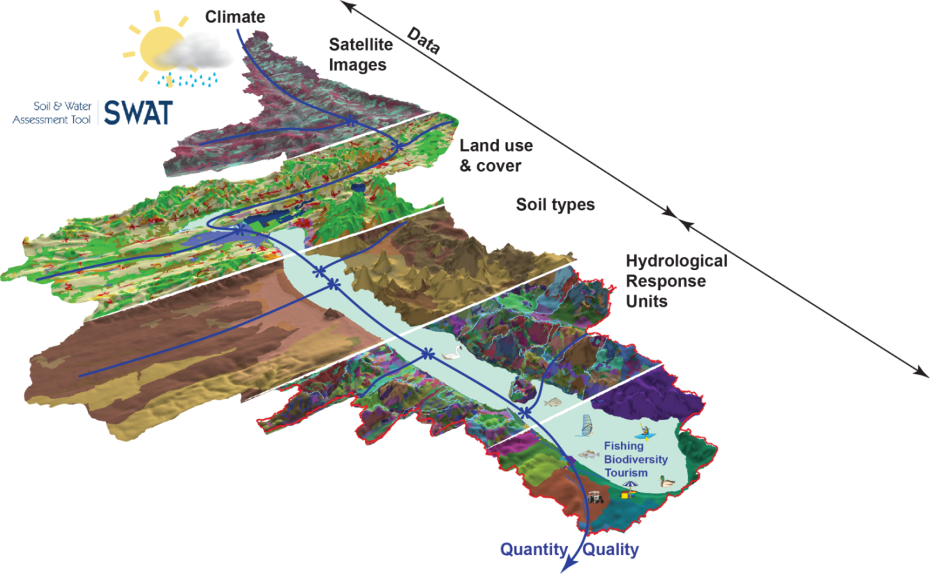


FP7:
FP7: EnviroGRIDS
Building Capacity for a Black Sea Catchment
Observation and Assessment System
supporting Sustainable Development
23 countries
>160 million people
>2.2 million km²

Slide 6

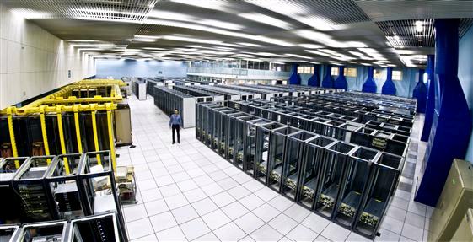
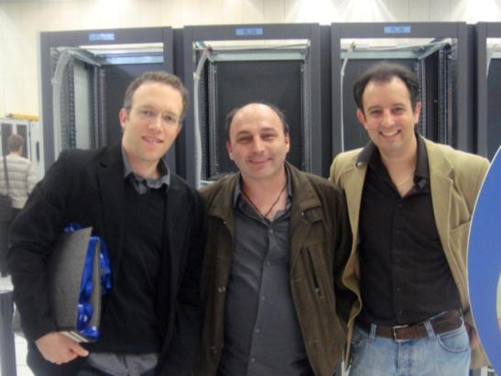
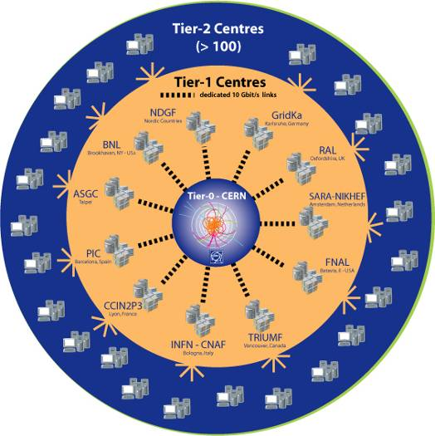
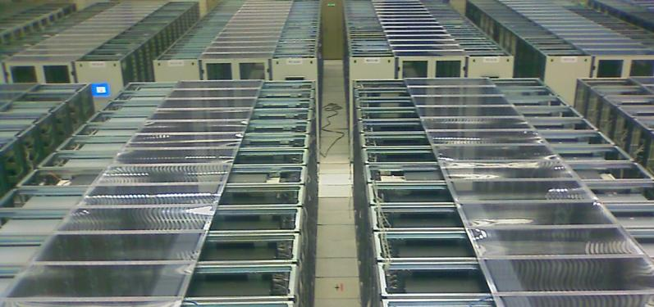
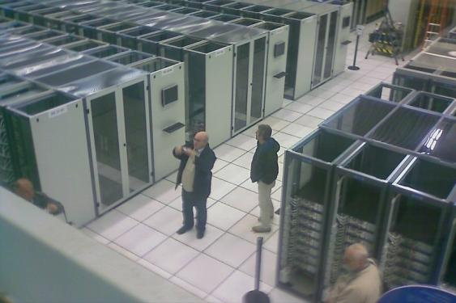
Yalew, S.G., van Griensven, A. Kokoszkiewicz L., Ray N., Betrie G. D. (2013). Parallel computing of large scale SWAT models, Environmental Modelling and Software, 41, 223-230.
Notes:
We had a chance to visit the core part of this system during the kickoff meeting of the enviroGRIDS project that took place in Geneva in April this year.
I think we can even recognize Volodymyr Medinets on the lower right picture!
The core part of the system comprises already several thousands of processors and thousands of Petabytes of disk space. EnviroGRIDS will use only a very small fraction of these capacities.

Slide 7
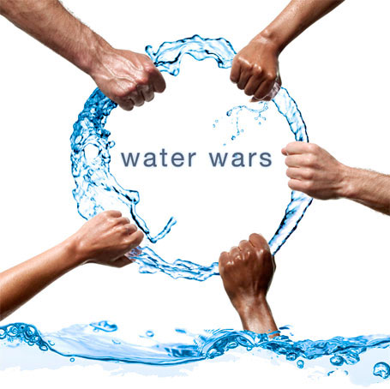
Estimation of Agricultural
Water Productivity
Ecosystem Services
Irrigation
Industry
Domestic Use
Energy

Slide 8
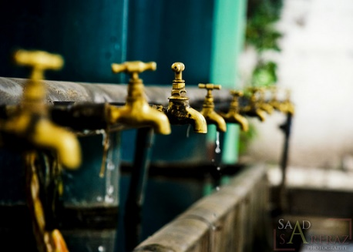
What is Water Productivity?
“Crop yield per unit water” – cultivated areas
“Ecosystem services per unit water” – natural areas

Slide 9
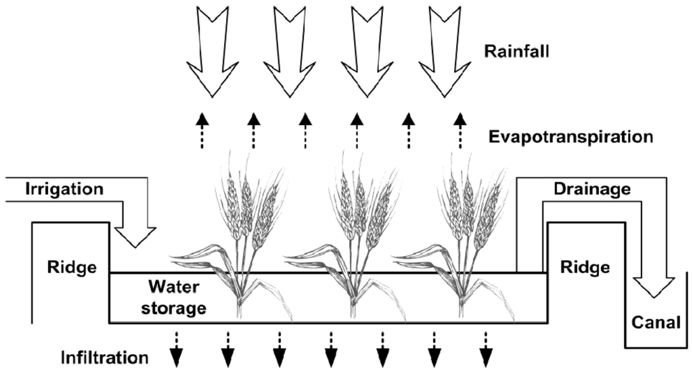
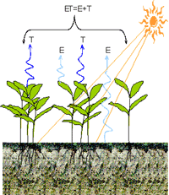
From Efficiency to Water Productivity
Crop
yield

Slide 10
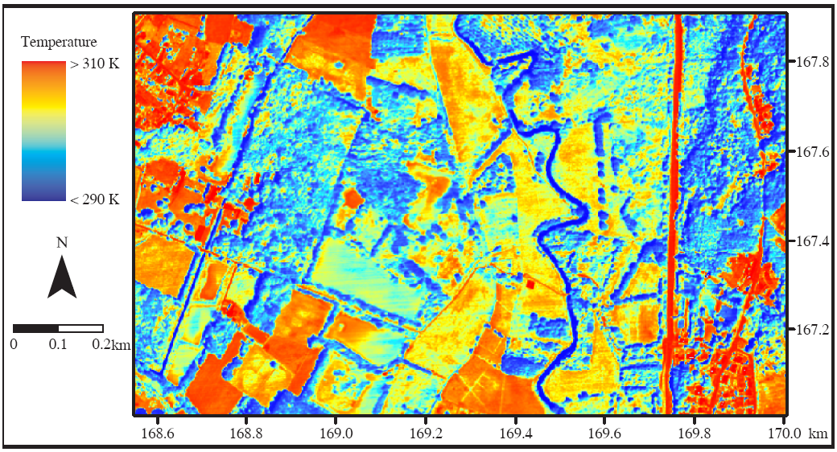
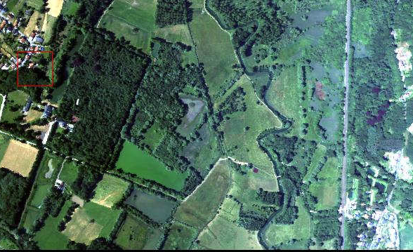
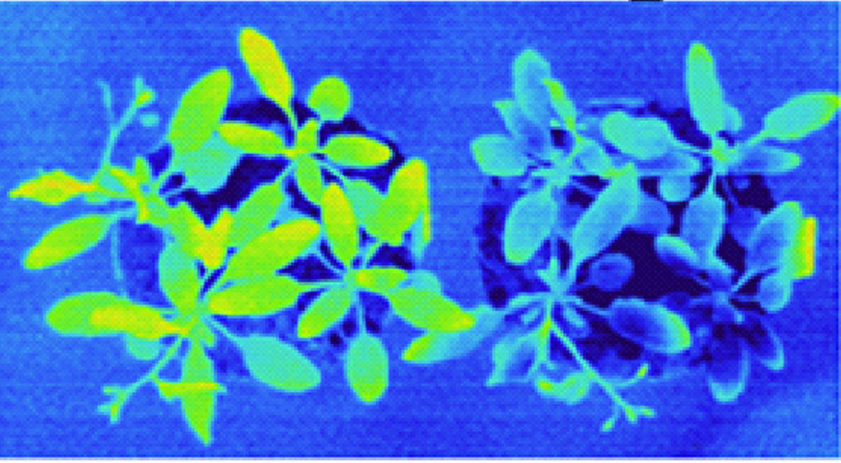
ET can be derived from Temperature
LOW ET - HIGH T° HIGH ET - LOW T°
Doode Bemde Wetland - Land Surface Temperature
DRY WET
Notes:
PLANT
Doode Bemde – AHS thermal image (LST)
Temperture used for vegetation monitoring (e.g. VHI) but at coarse resolution.
Thermal monitoring at high resolution > added value! Also for wetland monitoring?!
Eye-catcher to grasp attention of panel: thermal image/picture to demonstrate thermal variability in wetlands
The hypothesis is that this thermal variability is not only indicating differences in vegetation type, but also in vegetation health. Thermal monitoring has been used before to describe vegetation health (VHI = Vegetation Health Index) but at very coarse resolutions (AVHRR: 4 to 16 km resolution). Is it also useful for temperate inland wetland monitoring?
Temperature can be used to estimate evapotranspiration and more important evaporative stress, which is assumed an indicator for (wetland) ecosystem health.
Moisture deficiency in the vegetation root zone leads to the closure of stomata, a reduction in transpiration and elevated canopy temperatures. In addition, the depletion of water from the soil surface layer causes the soil surface to heat up rapidly and results in reduced evaporation.

Slide 11
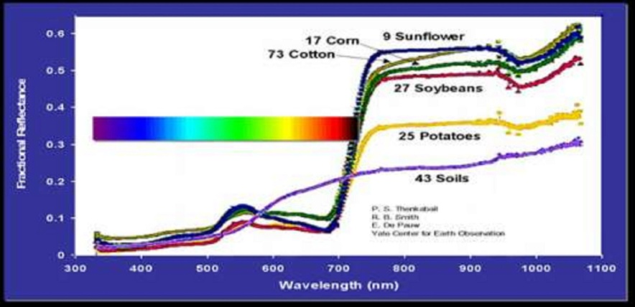
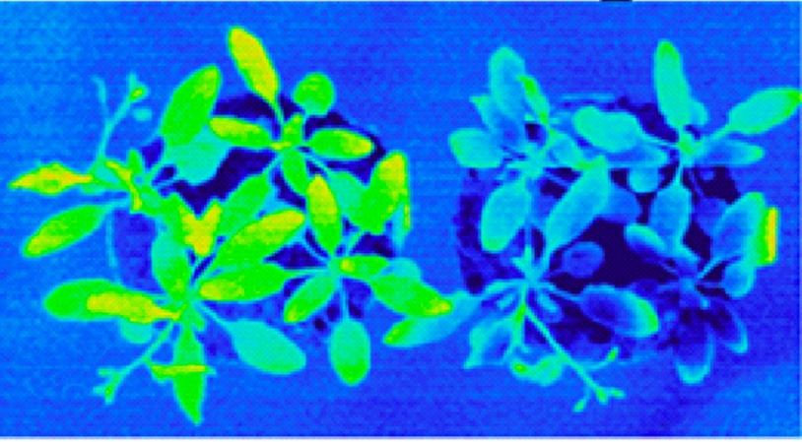
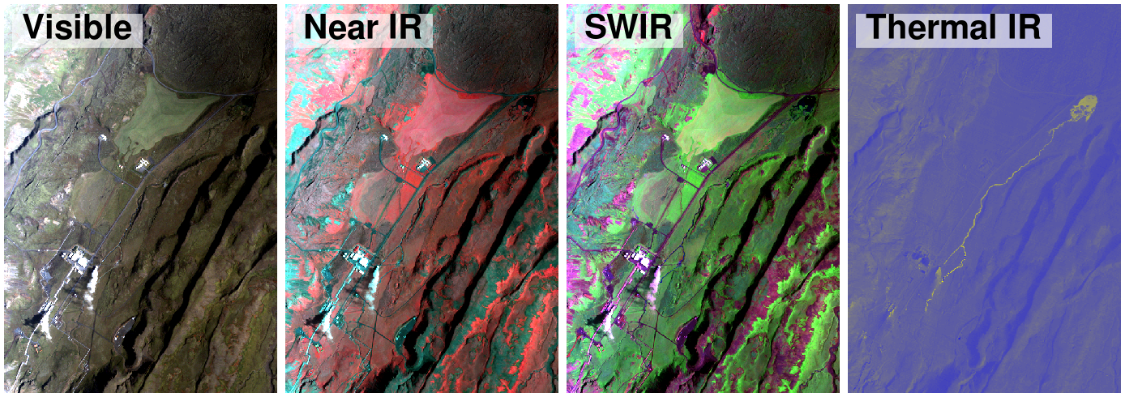
Development of remote sensing technologies
Temperature

Slide 12
Coupled Water-Energy Balance
Watershed mass-balance
  P = Q + E + ΔS/Δt
Surface energy-balance
  R_{n} = H + λ_{v}E + G + ΔS/Δt
Notes:
NOTE: Rn is not necessarily positive !!

Slide 13
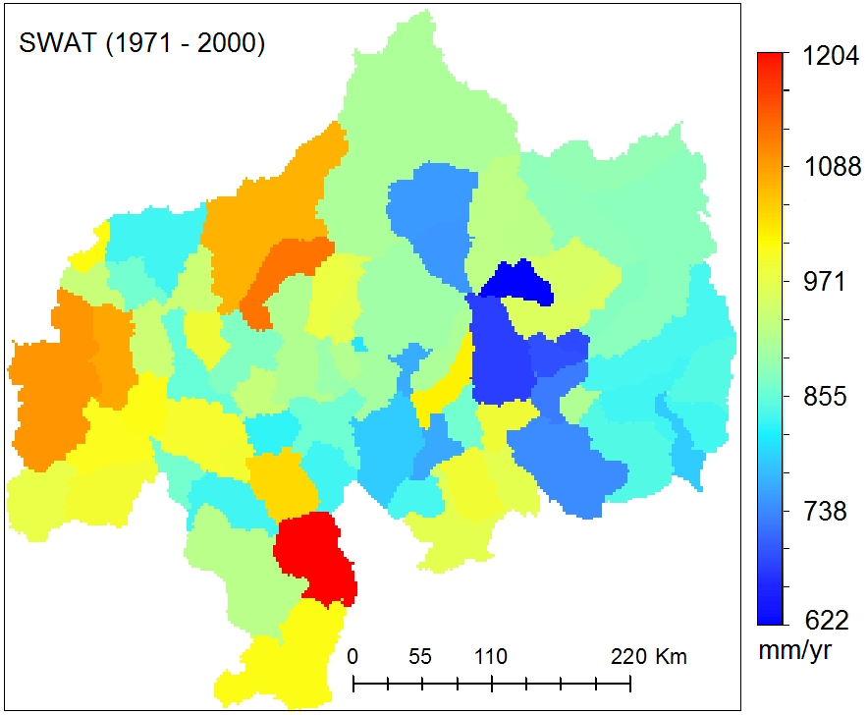
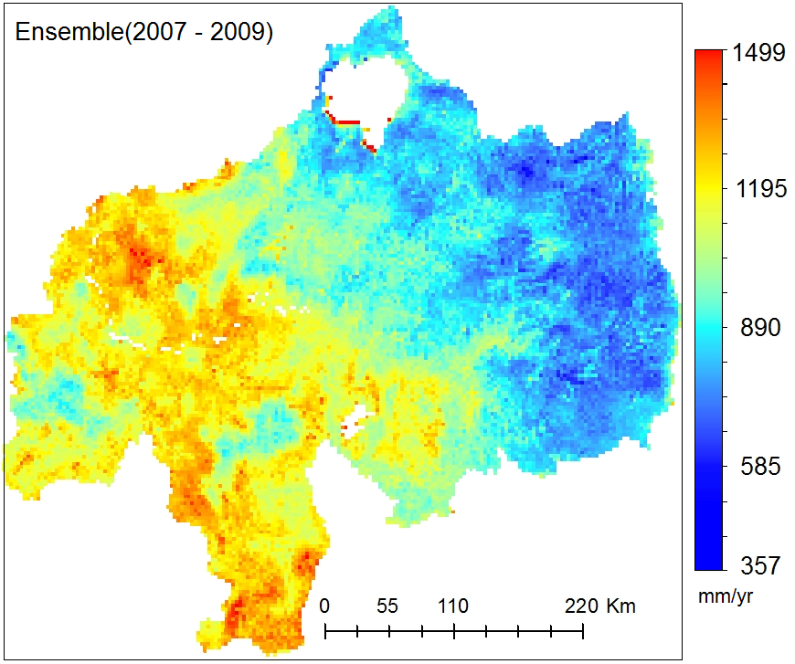
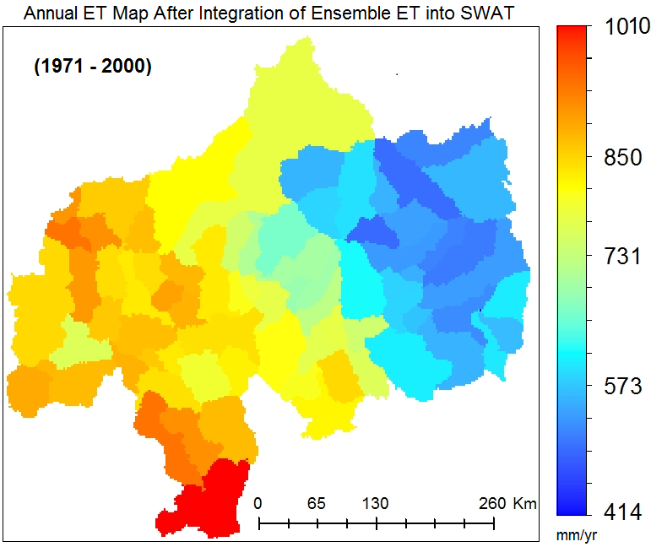
Improved spatial pattern of water balance models
Original SWAT
Remote sensing ensemble
SWAT-RS

Slide 14
Tools
Remote Sensing (RS) and ENERGY BALANCE MODELS eg Landsat images and SEBAL
Hydrological models: eg SWAT/WETSPA models
CROP MODELS: eg AQUACROP models
Modelling techniques: Sensitivity analysis, autocalibration, uncertainty analysis, data assimilation

Slide 15
Collaborations ?
We welcome collaborations for work within this project for catchments in Asia ☺
AND
Cloud computing for processiong of remote sensing, hydrological models, sensitivity analysis, calibration, uncertainty, data assimiliation
AND
Workshops & Conferences in Brussels

Slide 16


Conferences
OpenWater conferences
2011, Delft, Netherlands
2013, Brussels, Belgium
2015, Addis Ababa, Ethiopia
2017, Rabat, Morocco
iEMSs conference Toulouse, July 2016
Torus conference in Brussels 2017?

Slide 17
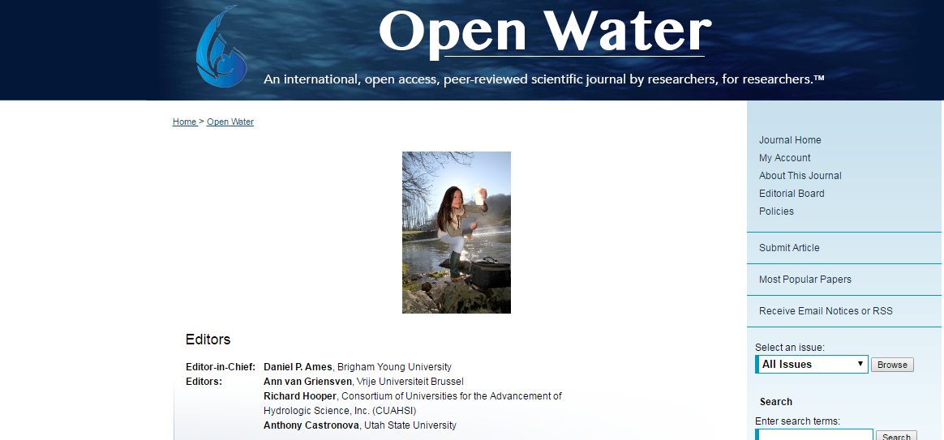
www.openwaterjournal.com

