Slide 1
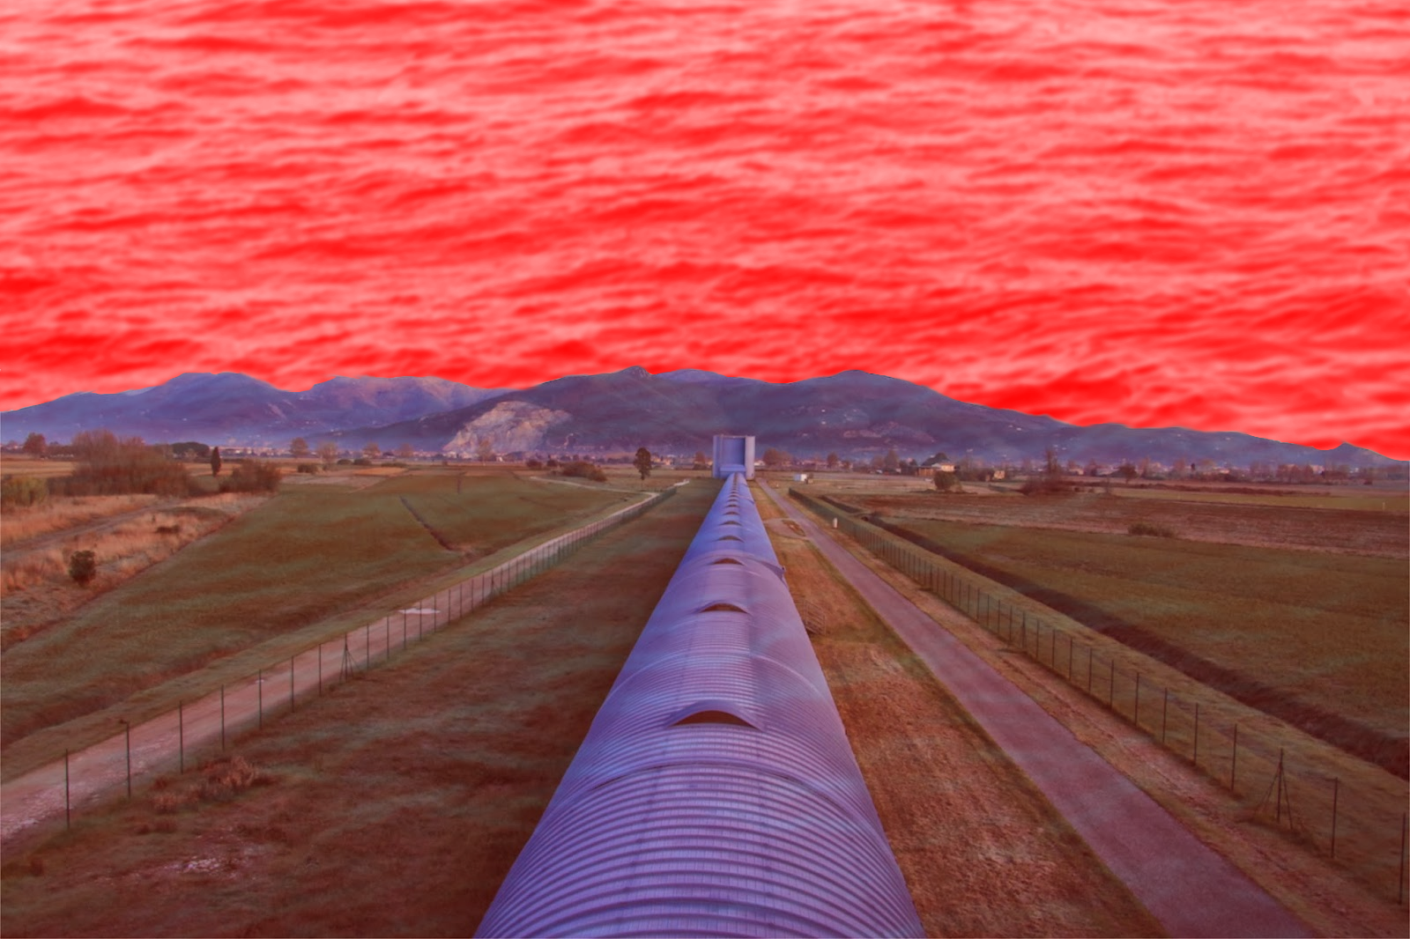



The search for a stochastic background of gravitational waves
Giancarlo Cella – INFN Pisa & Virgo collaboration

Slide 2
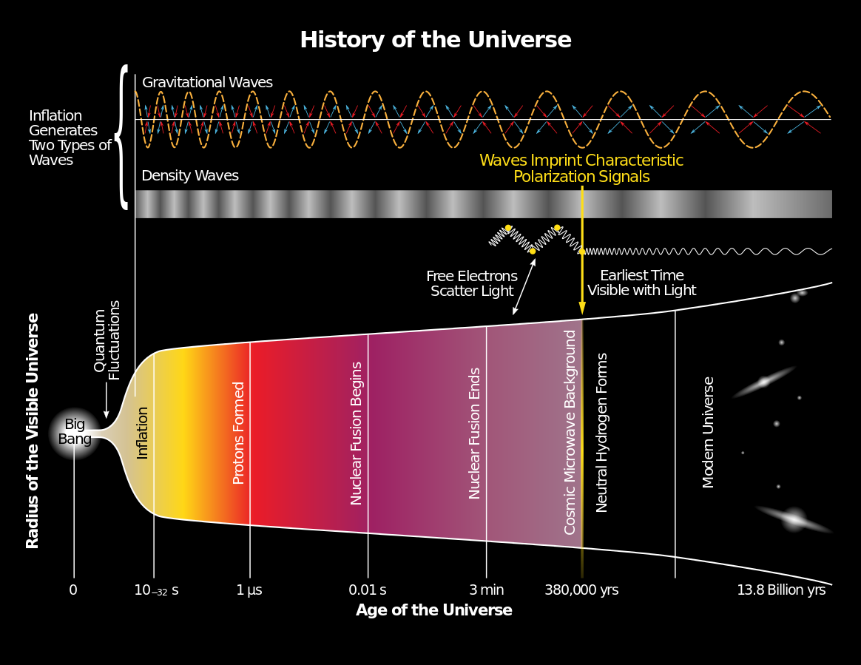
Stochastic background in a nutshell
A stochastic background can be seen as
a GW field which evolves from an initially random configuration
the result of a superposition of many uncorrelated and unresolved sources
Two different kinds:
Cosmological:
  signature of the early Universe
  inflation, cosmic strings, phase transitions…
Astrophysical:
  sources since the beginning of stellar activity
  compact binaries, supernovae, rotating NSs, core-collapse to NSs or BHs, supermassive BHs…
Typical «first approximations» :
  Gaussian, because sum of many contributions
  Stationary, because physical time scales much larger than observational ones
  Isotropic (at least for cosmological backgrounds)
If these are true, SB is completely described by its power spectrum

Slide 3
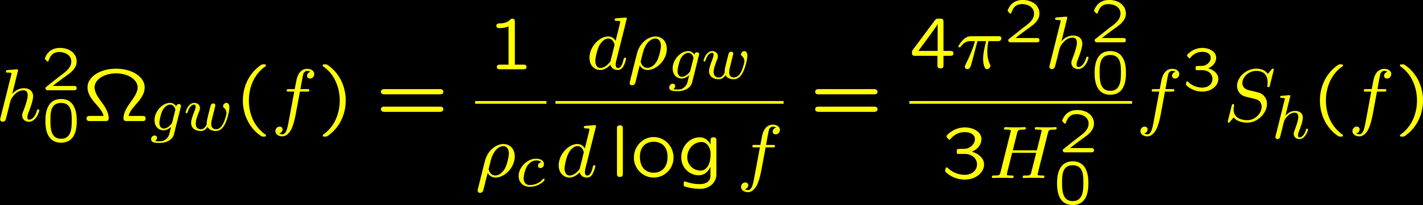
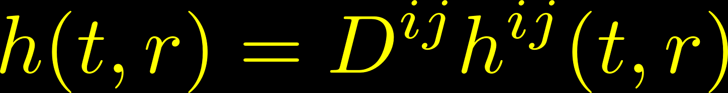
Description (simplest model)
1. Correlation between GW modes
2. Connection with GW energy density
3. Strain at the detector: sum over modes
4. Signal at the detector: projection on the detector’s tensor

Slide 4
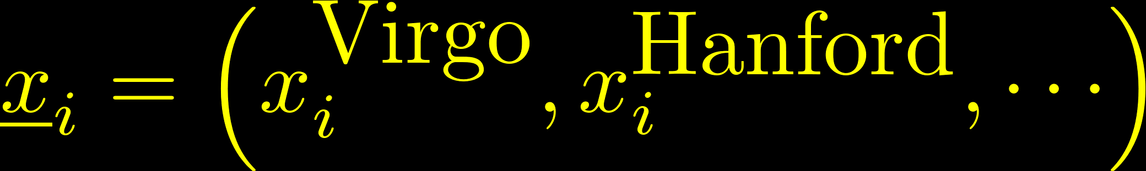
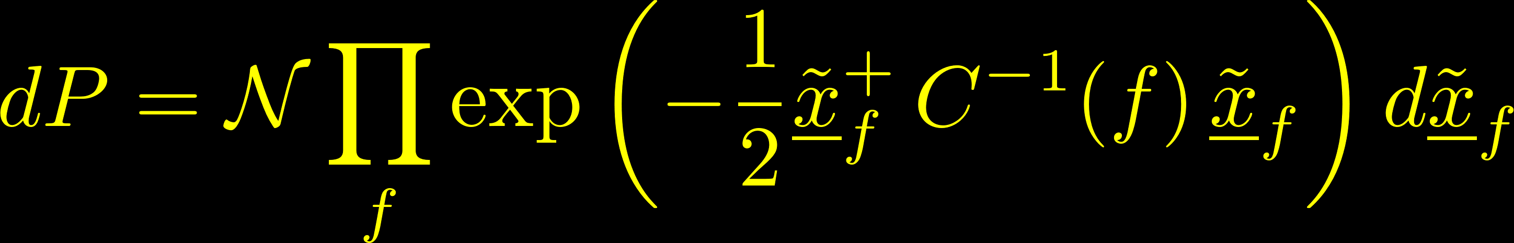
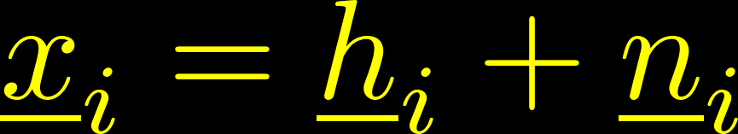
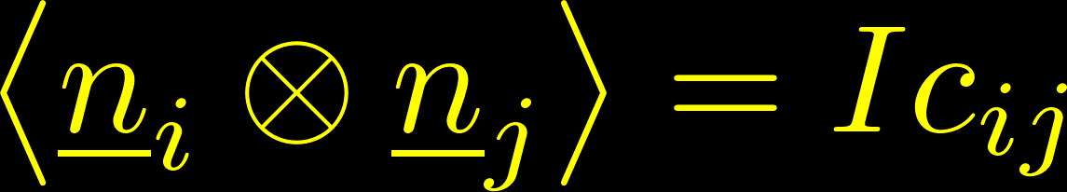


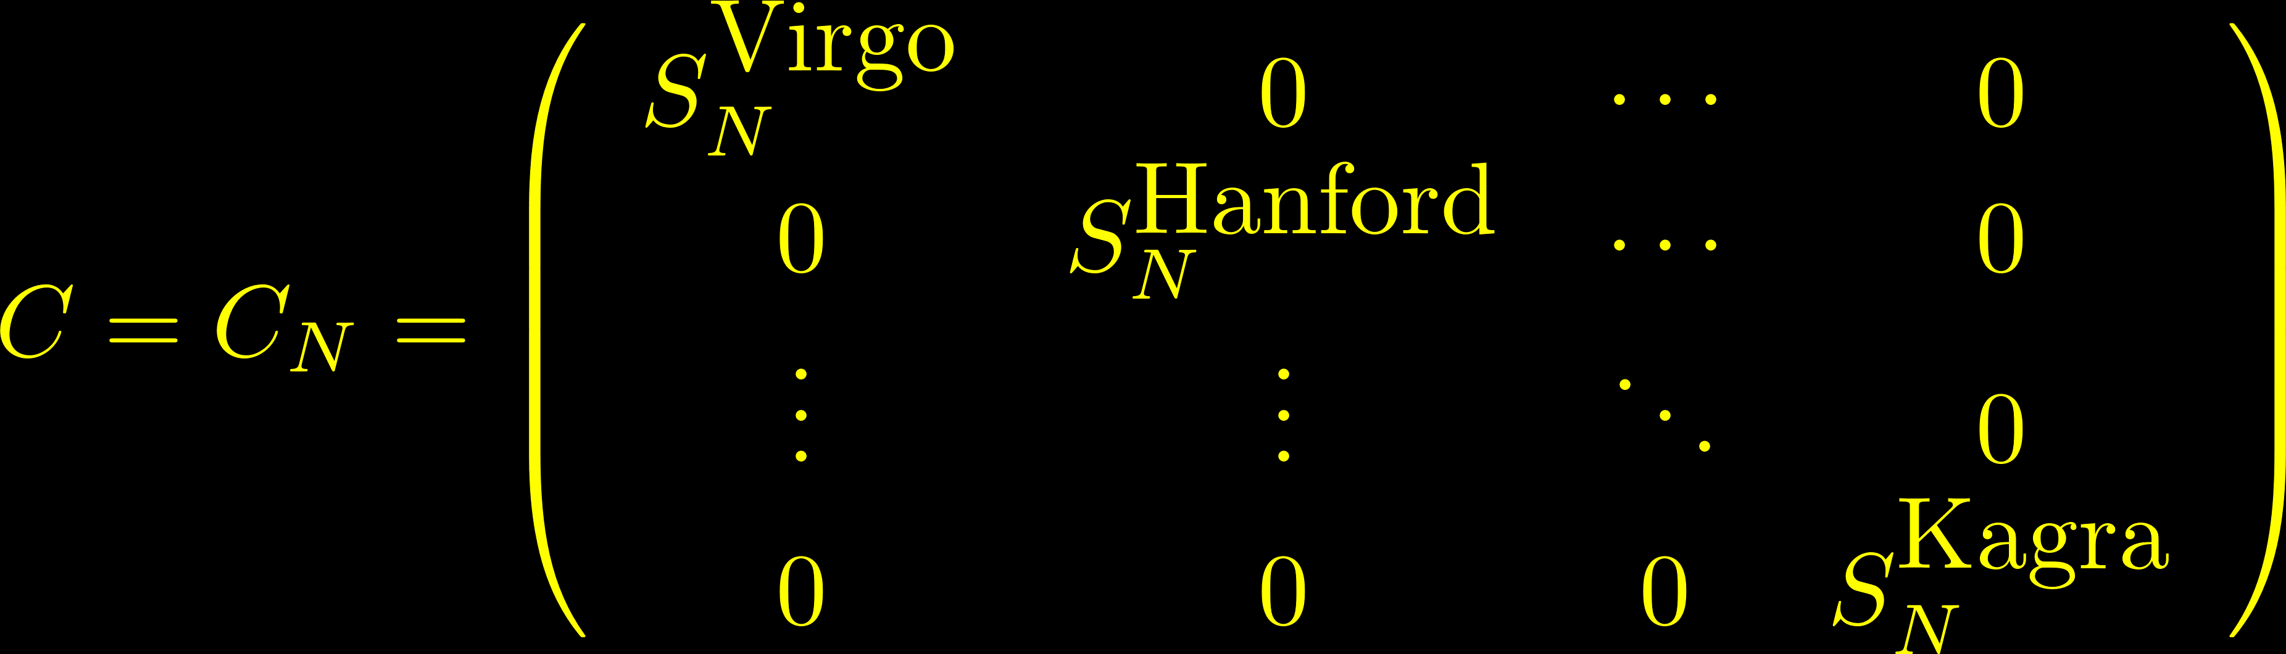
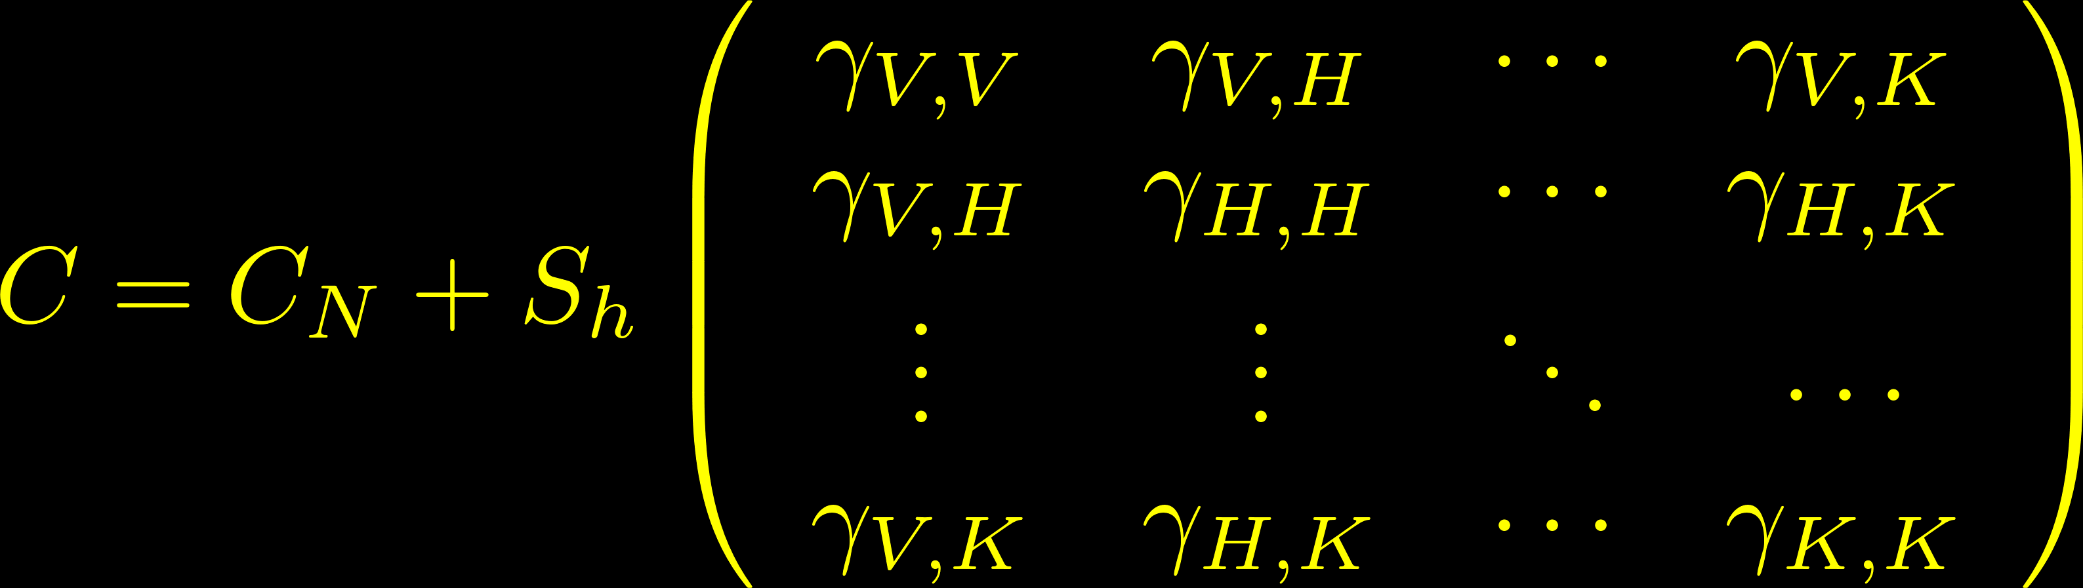
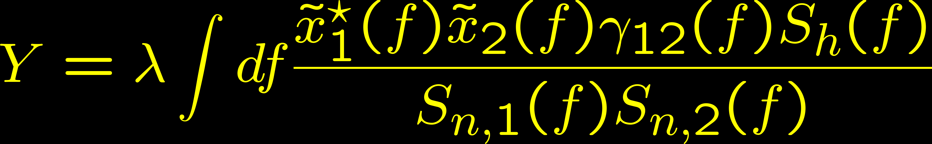
How it is possible to (directly) detect it
We have a vector-valued Gaussian stochastic process
We must discriminate between two hypothesis:
Optimal statistic (two detectors):

Slide 5
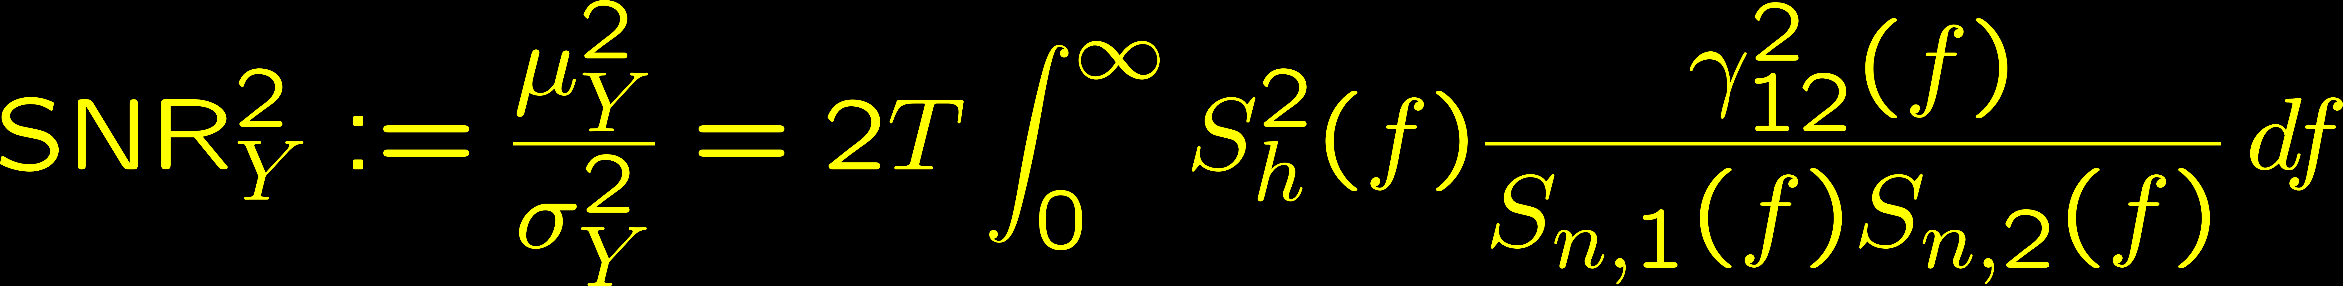
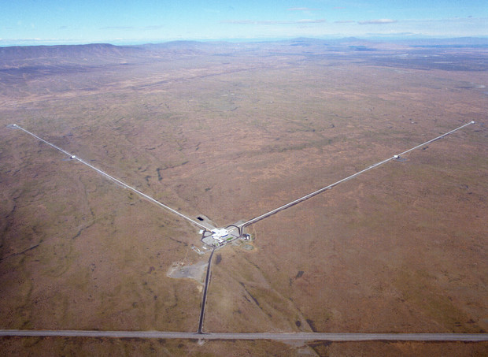
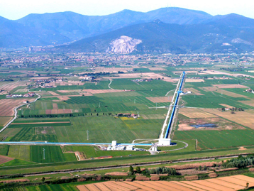
Overlap reduction function (a.k.a. coherence)

Slide 6
Overlap reduction function (a.k.a. coherence)

Slide 7
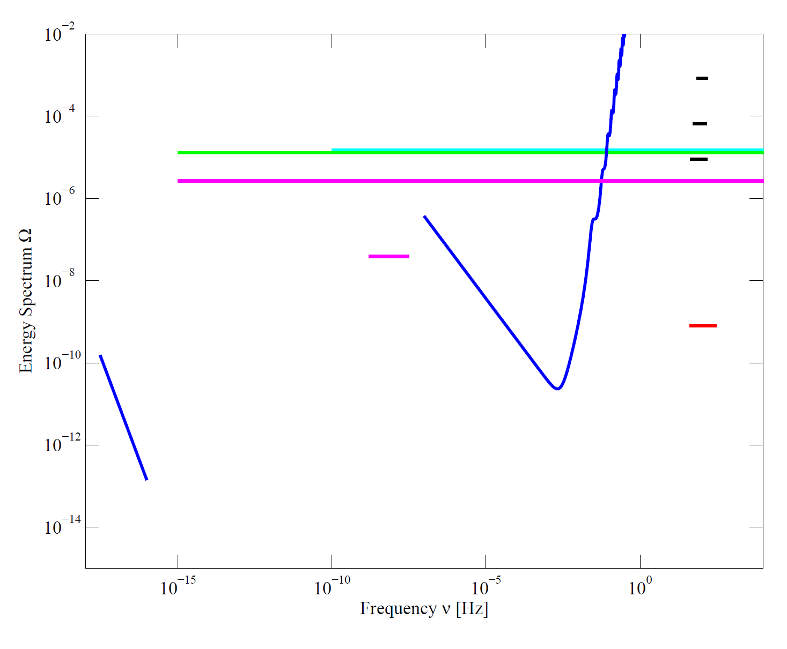
Upper limits & expected sensitivities
CMB+LSS
BBN
LIGO (VIRGO)
Big-Bang Nucleosynthesis model and observations constrain the total GW energy at the time of BBN (integral bound)
Similar bound from CMB observations
Too much GW gives too much large angle anisotropy by the Sachs Wolfe effect
Signal from millisecond pulsars works as a (big) interferometer:
PLANCK
PULSAR
LISA
CMB Large Angle
ADVANCED
ET
INFLATION

Slide 8
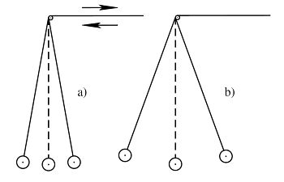
Inflation
Parametric amplification of vacuum quantum fluctuations
Standard inflationary models are weakly dependent on frequency
Tight bound: CMB large angle anisotropy
Out of reach of advanced detectors by 5 orders of magnitude
CMB+LSS
BBN
LIGO (VIRGO)
PLANCK
PULSAR
LISA
CMB Large Angle
ADVANCED
ET
INFLATION

Slide 9

Resonant preheating
CMB+LSS
BBN
LIGO (VIRGO)
PLANCK
During a resonant preheating phase at the end of the inflation, inflaton energy can be transferred efficiently to other particles
Can produce a significant GW background
Spectrum peak depends on energy scale (here 10 GeV, higher frequencies for a larger scale)
PULSAR
LISA
CMB Large Angle
ADVANCED
ET
INFLATION
Easther & Lim, JCAP 0604, 010 (2006)
Easther et al., PLR 99, 221301 (2007)
Easther, Nucl. Phys. Proc. Suppl. 194, 33 (2009)

Slide 10
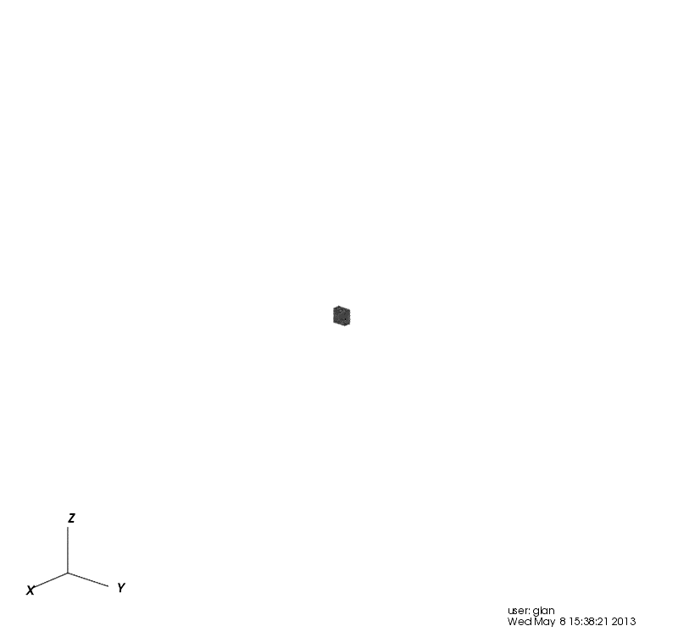
Cosmic (super)string models
Dynamical network:
  Strings entering in the horizon
  Interconnection: loops generation
  Radiation (GW and other fields): loop destruction
Most efficient emission mechanisms: cusps and kinks
Integrating over the whole universe leads to a GW background
Large parameter space
Damour & Vilenkin, PRL 85, 3761 (2000)
Siemens et al., PRL 98, 111101 (2007)
Olmez et al., PRD 81, 104028 (2010)

Slide 11
Cosmic (super)string models
Dynamical network:
  Strings entering in the horizon
  Interconnection: loops generation
  Radiation (GW and other fields): loop destruction
Most efficient emission mechanisms: cusps and kinks
Integrating over the whole universe leads to a GW background
Large parameter space
CMB+LSS
BBN
LIGO (VIRGO)
PLANCK
PULSAR
LISA
CMB Large Angle
ADVANCED
ET
INFLATION
Damour & Vilenkin, PRL 85, 3761 (2000)
Siemens et al., PRL 98, 111101 (2007)
Olmez et al., PRD 81, 104028 (2010)

Slide 12
Axion-based inflation models
Models include axion-gauge couplings
Gauge back-reaction on the inflaton extends inflation
The late inflationary phase increases GW production at high frequencies
Barnaby, Pajer and Peloso - Phys. Rev. D 85, 023525
CMB+LSS
BBN
LIGO (VIRGO)
PLANCK
PULSAR
LISA
CMB Large Angle
ADVANCED
ET
INFLATION

Slide 13
Pre-BB models
Alternative cosmologies
Evade the CMB large angle anisotropy bound
Evade the BBN-CMB integral bound
Can be significant at Virgo/LIGO frequencies
CMB+LSS
BBN
LIGO (VIRGO)
PLANCK
PULSAR
LISA
CMB Large Angle
ADVANCED
ET
INFLATION
Gasperini & Veneziano, Phys. Rep. 373, 1 (2003)
Buonanno et al., PRD 55, 3330 (1997)

Slide 14
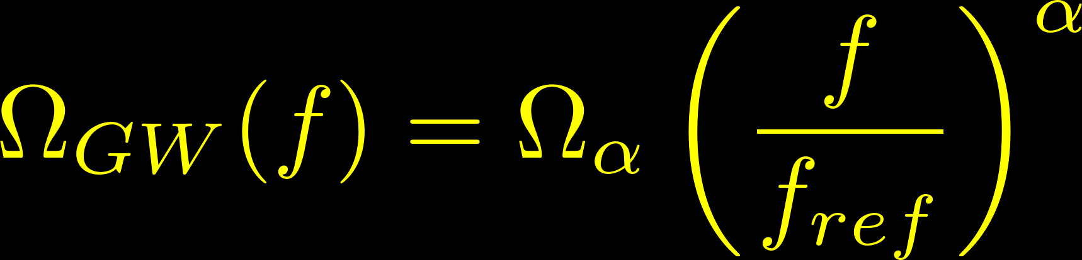

Isotropic upper limits
Best current upper limit
PRL 113, 231101 (2014)
Colocated interferometers
$O_{1}$ analysis
(advanced detectors)
is in progress.
Phys. Rev. D 91, 022003 (20015)

Slide 15
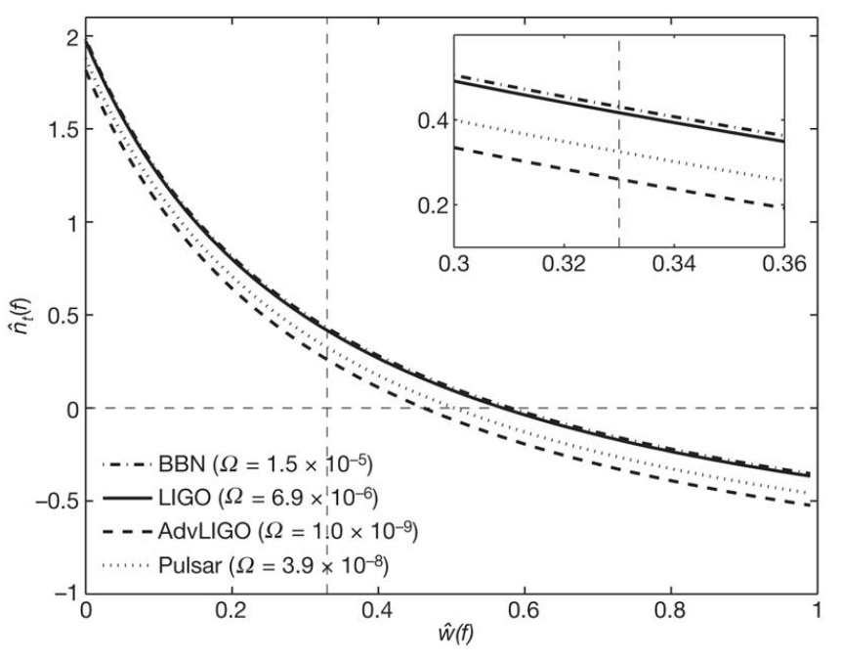
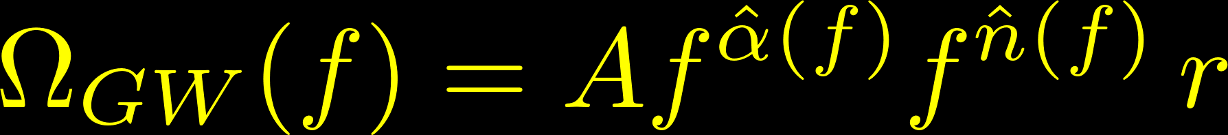
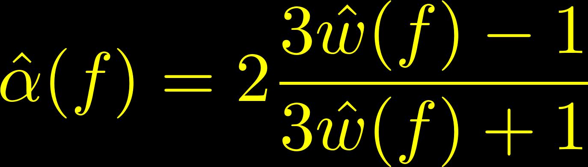
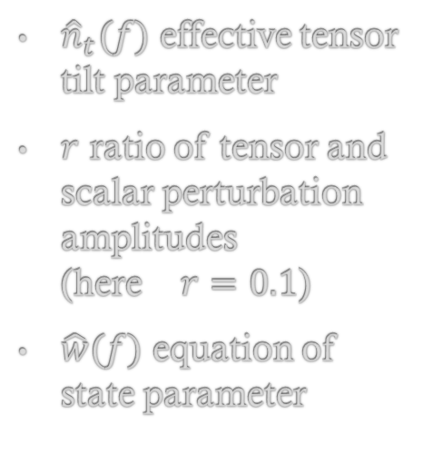
Constraint on early universe state equation
Spectrum parameterization:
${\hat{n}}_{t}(f)$ effective tensor tilt parameter
$r$ ratio of tensor and scalar perturbation amplitudes
(here $r=0.1$)
$\hat{w}(f)$ equation of state parameter
LSC/Virgo Collaboration, Nature 460, 990-994 (2009)
PRD 78, 043531 (2008)

Slide 16
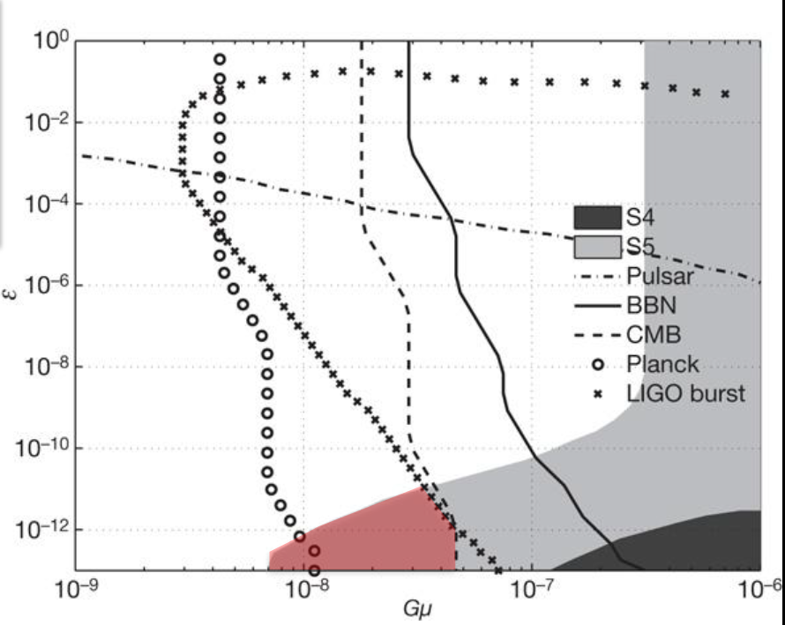
Constraint on cosmic strings models
Network of cosmic strings parameterized by:
String tension µ
Reconnection probability p
Loop size
(parameterized by ɛ)
Gµ<10⁻⁶
(CMB observations)
ɛ unconstrained
10⁻⁴ < p < 1
(p = 10⁻³ here)
Region excluded: entire plane will be probed by advanced detectors.
LSC/Virgo Collaboration, Nature 460, 990-994 (2009)
PRD 80, 062002 (2009)
PRL 98, 111101 (2007)

Slide 17
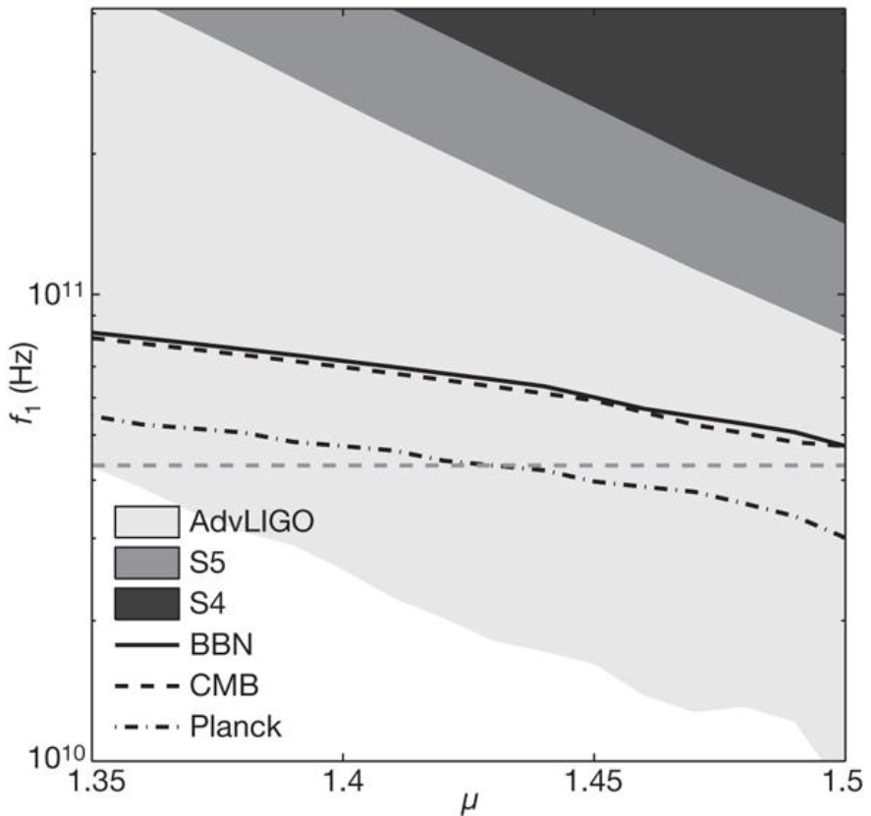
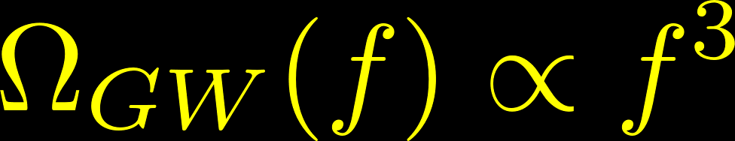
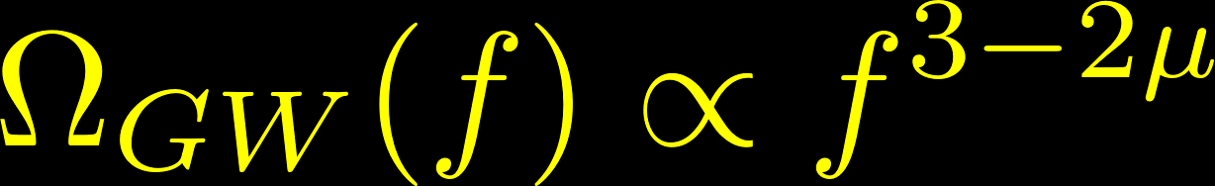
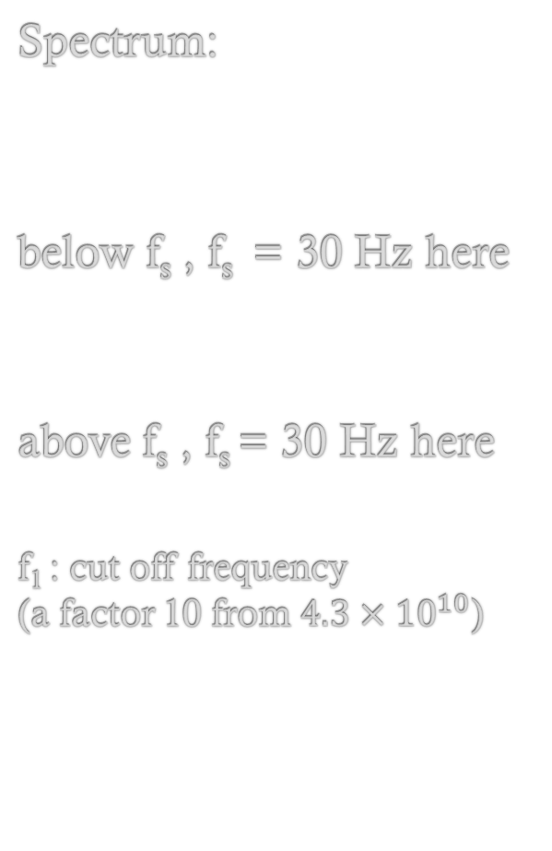
Constraints on pre-Big-Bang models
Spectrum:
below f_{s} , f_{s} = 30 Hz here
above f_{s} , f_{s} = 30 Hz here
f₁ : cut off frequency
(a factor 10 from $4.3×{10}^{10}$)
LSC/Virgo Collaboration, Nature 460, 990-994 (2009)
PRD 73, 063008 (2006)

Slide 18
Phys. Rev. X 6, 011035 (2016)

Slide 19

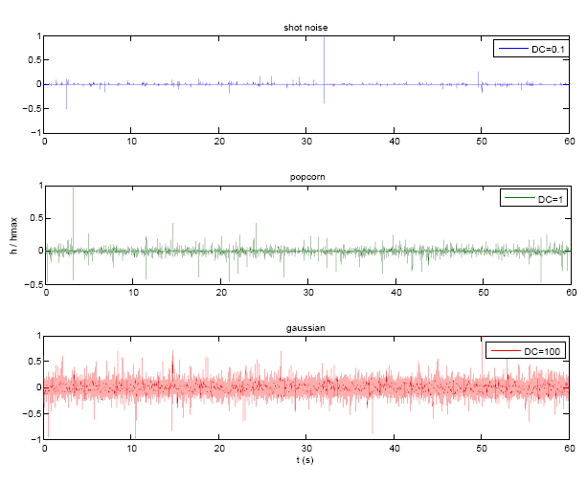
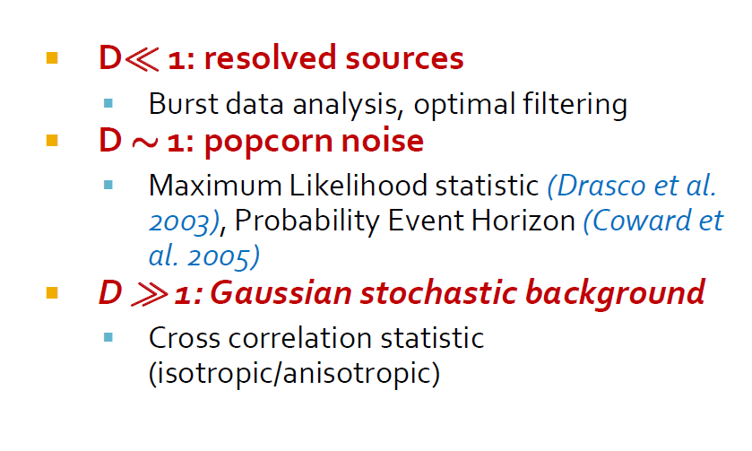
Astrophysical Stochastic Background
Core collapse supernovae
  Neutron star formation: Blair & Ju 1996, Coward et al. 2001-02, Howell et al. 2004, Buonanno et al. 2005
  Stellar Black Hole formation: Ferrari et al. 1999, de Araujo et al. 2000-04
Neutron stars
  tri-axial emission: Regimbau & de F. Pacheco 2001-06
  bar or r-modes: Owen et al. 1998, Ferrari et al. 1999, Regimbau 2001
  phase transitions: Sigl 2006
Stellar Compact Binaries
  near coalescence (NS, BH): Regimbau et al. 2006-07 , Coward et al. 2005 (BNS), Howell et al. 2007 (BBH)
  low frequency inspiral phase: Ferrari et al. 2002, Farmer & Phinney 2002, Cooray 2004 (WD-NS)
Capture of compact objects by SMBHs : Barack & Cutler 2004

Slide 20

Non standard polarizations
Looking at alternative theories of gravity
Indirect constraints on scalar modes
  Binary pulsars
  WMAP
Need many detector pairs to disentangle different contributions

Slide 21
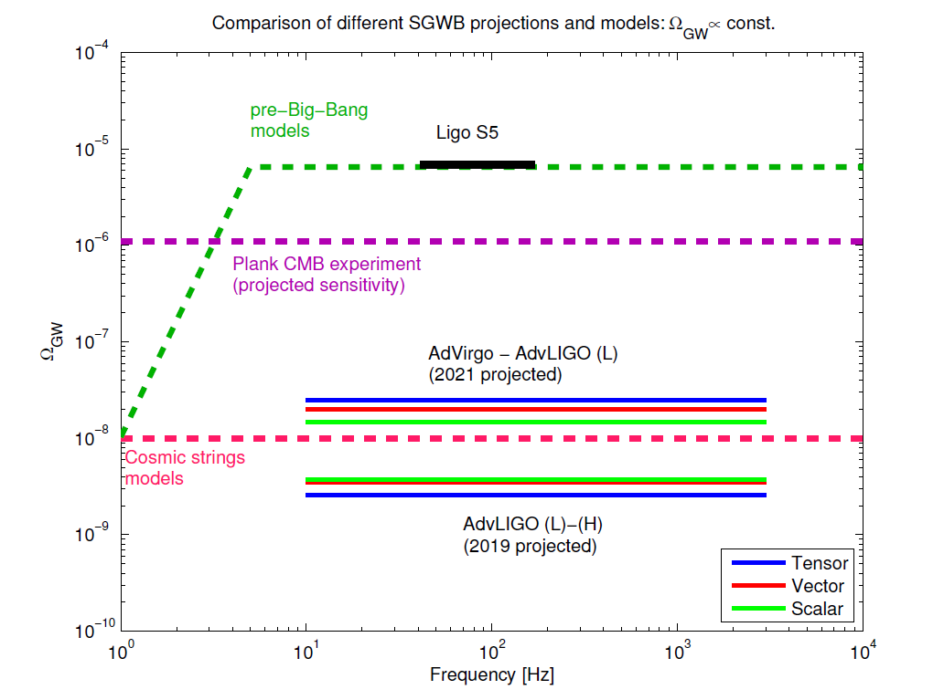
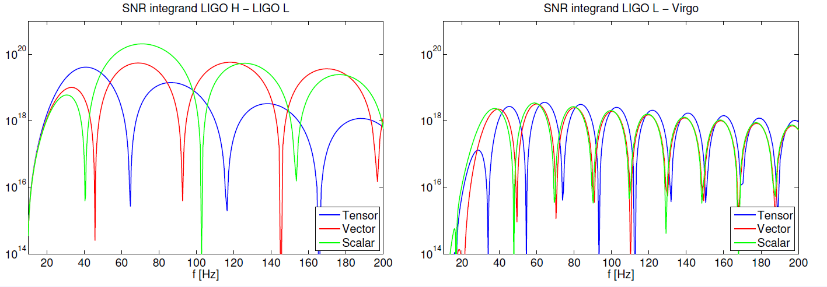
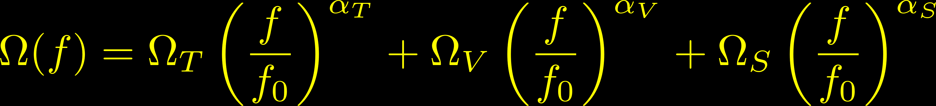

Slide 22
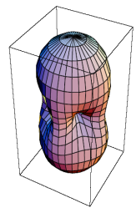

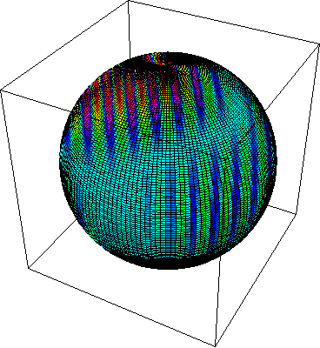
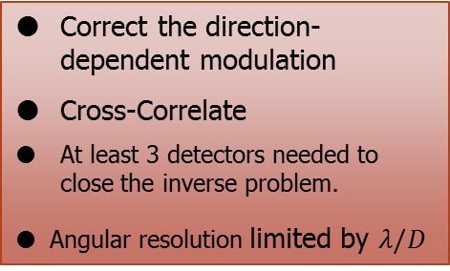
Targeted search: reconstruct a map of the gravitational wave luminosity in the sky

Correct the direction-dependent modulation
Cross-Correlate
At least 3 detectors needed to close the inverse problem.
Angular resolution limited by $λ/D$
Δt
3000km
PRD76, 082003, 2007
Virgo+WA 200 Hz
Phys. Rev. Lett. 107, 271102

Slide 23
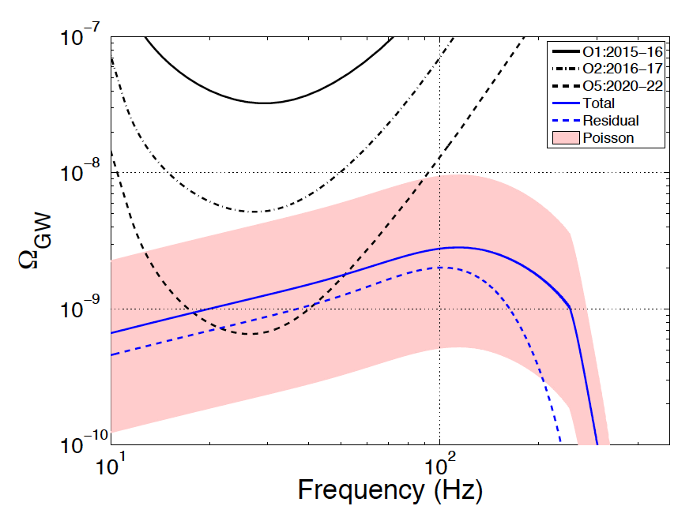



Implications of LIGO first detection
$$O_{1}$$
$$O_{2}$$
$$O_{3}$$
B. P. Abbott et al. (LIGO Scientific Collaboration and Virgo Collaboration) Phys. Rev. Lett. 116, 131102

Slide 24
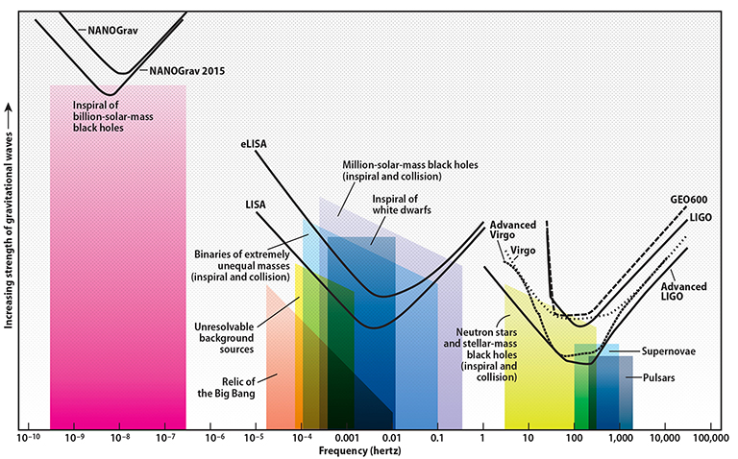
Thank you for your attention….

