Slide 1


A 3rd generation GW observatory:
Einstein Telescope (ET)
Michele Punturo
INFN Perugia

Slide 2
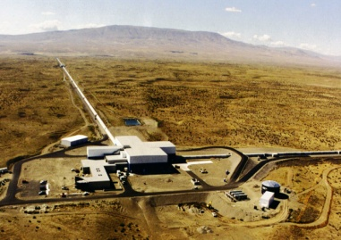


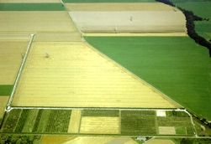
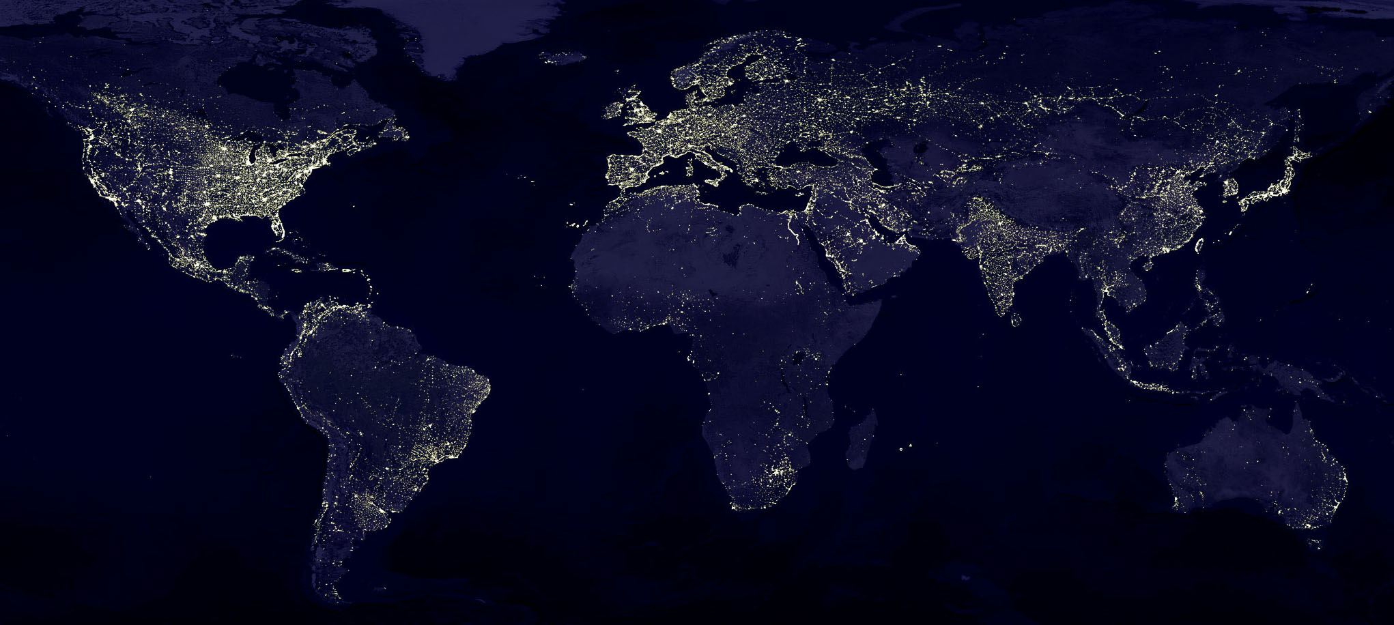
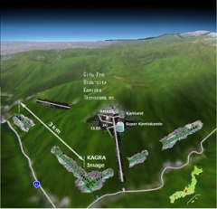
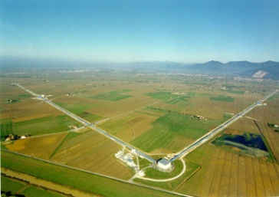


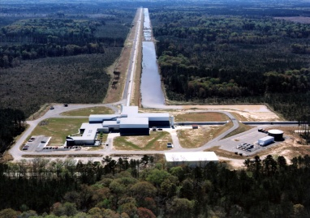

Terrestrial Detectors
Advanced detectors 2015-2025
GEO, Hannover, 600 m
~2019
aLIGO Hanford, 4 km
2015
~2024
2017
AdV, Cascina, 3 km
aLIGO Livingston, 4 km

Slide 3


AdV+ R&D
AdV
AdV+
A+/Voyager R&D
aLIGO
A+
Voyager
KAGRA
LIGO India
R&D
Installation
Commissioning
Data taking
Other
2016
2017
2018
2019
2020
2021
2022
2023
2024
2025
2026
2027
2028
2029
2030
2031
2032

Slide 4
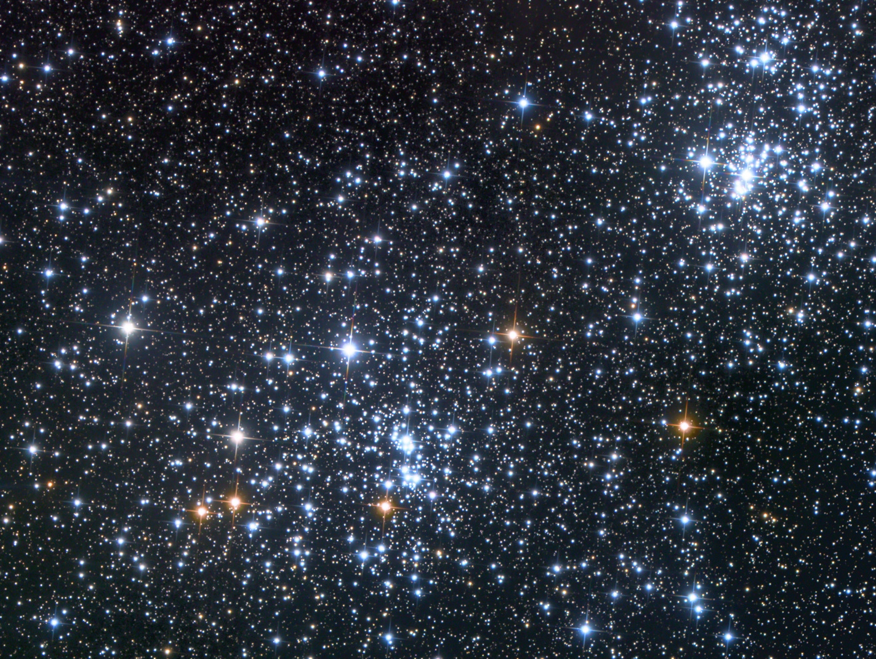

Detectors sense GW amplitude
The amplitude of the GW signal emitted by a mass distribution with quadrupolar moment Q
Considering an uniform distribution of GW sources, 10 times more detection range correspond to 10³ increase of signal rate
10×r
r

Slide 5
What “Next”?
Although Advanced GW detectors era just started and although GW have been just detected, the GW scientific community is investigating the long term future
What?
  What is ET?
Where?
  The site
Why?
  Motivation for a next generation of GW interferometers
When?
  Is it the right time to work on 3G?

Slide 6
What?

Slide 7
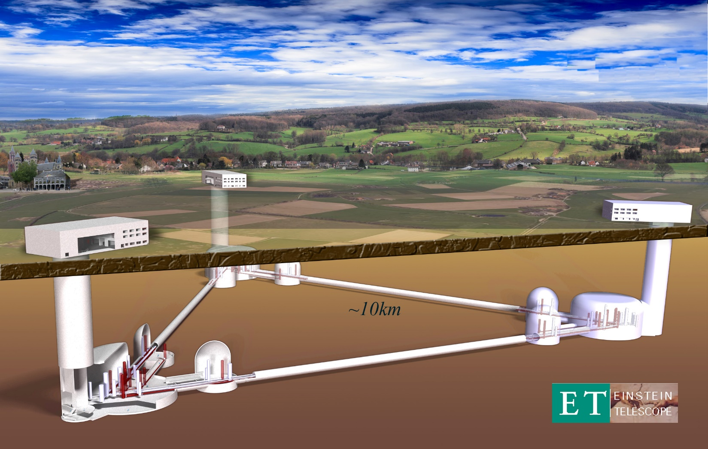
The Einstein Telescope

Slide 8
The ET design study
Design study funded by the EC in FP7 (2008-2011)
  Involving France, Germany, Italy, the Netherlands, UK
Now the ET community includes also Hungary, Poland and Spain
Project included in sectorial roadmaps (GWIC, APPEC, OECD,. …) and worldwide recognized as leading 3G project

Slide 9
The ET idea
To realise a 3G GW observatory
  3G: Factor 10 better than advanced (2G) detectors
  Observatory:
    Wide frequency, with special attention to low frequency (few HZ)
      Stellar mass Black Holes
    Capable to work alone (characteristic to be renegotiated)
      Localization capability
      High duty cycle: redundancy
    50-years lifetime of the infrastructure
      Capable to host the upgrades of the hosted detectors

Slide 10
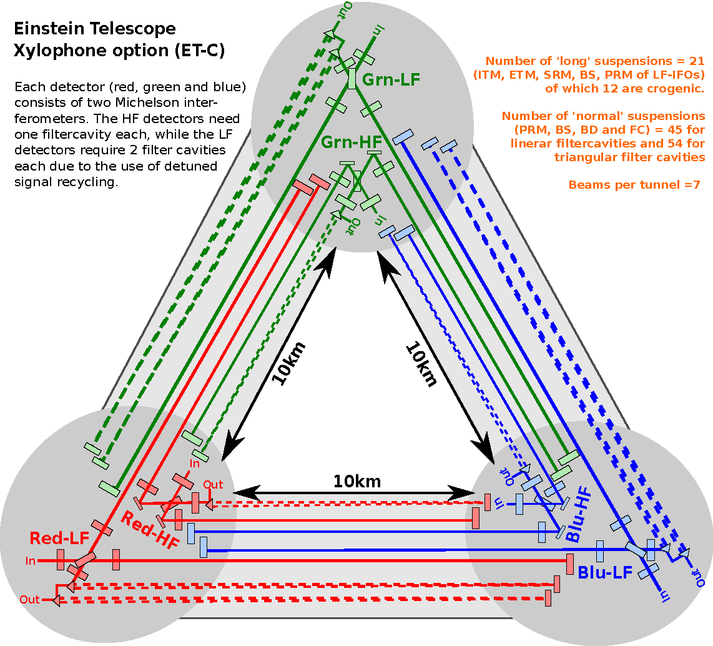
The ET infrastructure

Slide 11
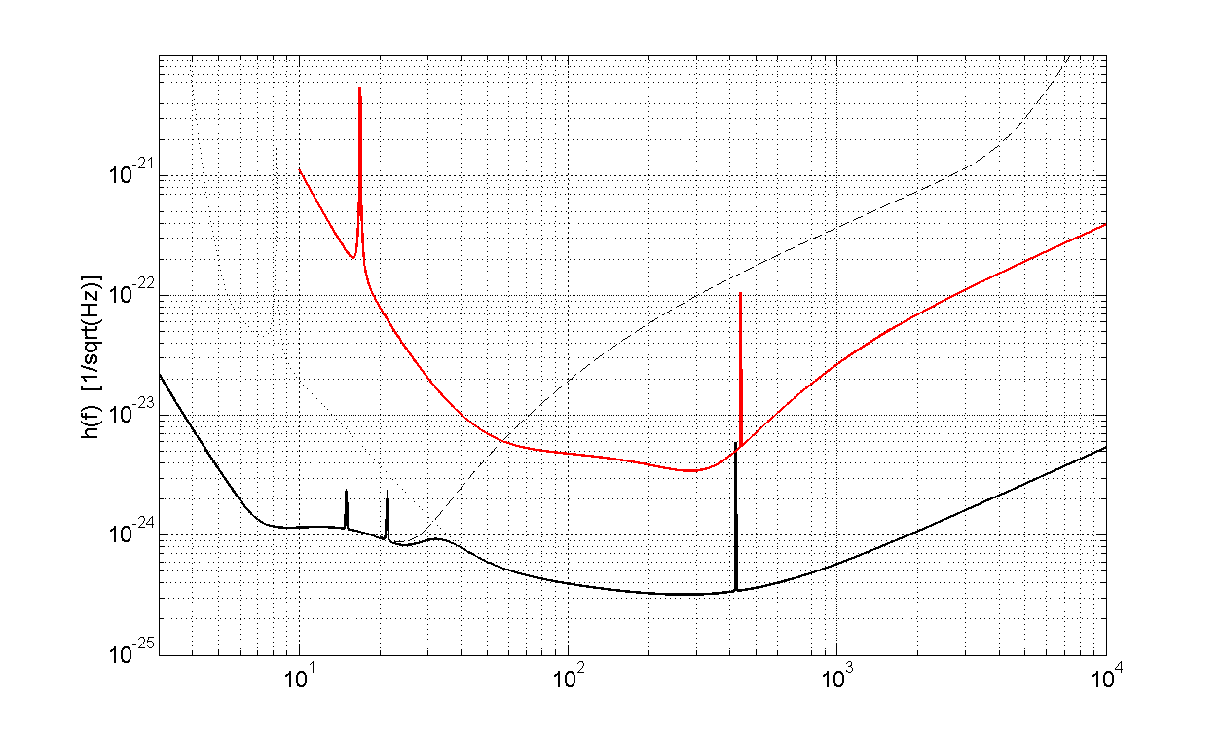
Sensitivity Curve
AdV
ET-D

Slide 12
Technologies
The main ingredients are:
  Size: 10km vs 3km
  Xylophone design: ET-LF, ET-HF
  ET-LF:
    Underground
    Cryogenics
    Silicon (Sapphire) test masses
    Large test masses
    New coatings
    New laser wavelength
    Seismic suspensions
    Frequency dependent squeezing
  ET-HF:
    High power laser
    Large test masses
    New coatings
    Thermal compensation
    Frequency dependent squeezing

Slide 13
Where?

Slide 14
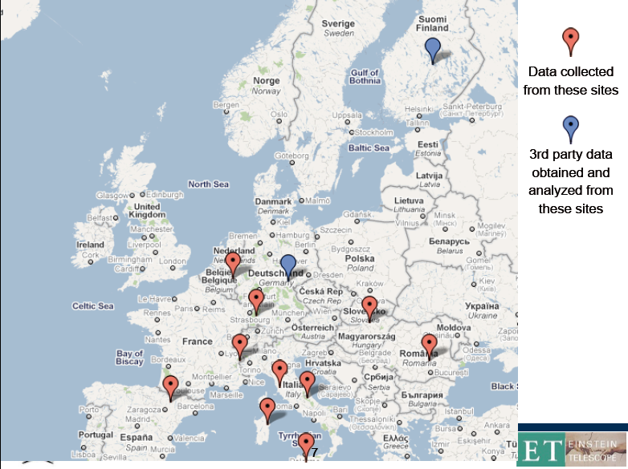
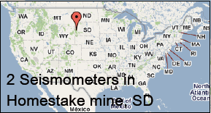
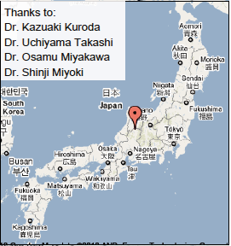
ET site(s)
In the Design Study several EU sites have been investigated

Slide 15
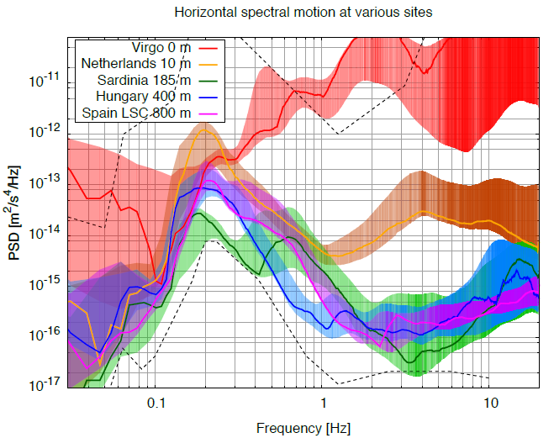
Underground Seismic noise Measurement
Underground sites are the candidates for a very quiet site
Credits: J.v.d. Brand

Slide 16
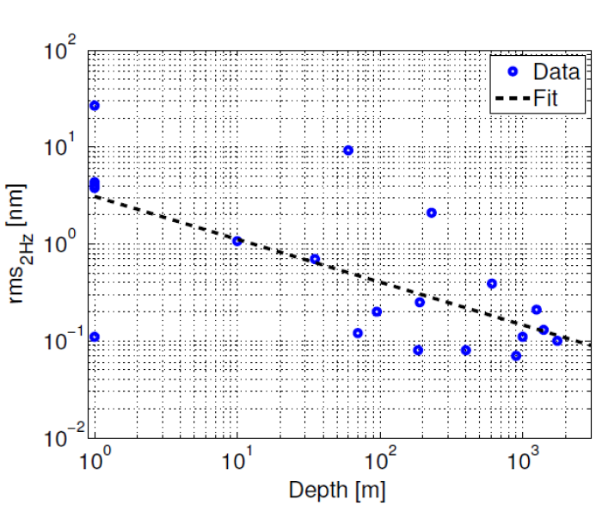
Underground Seismic noise Measurement
Underground sites are the candidates for a very quiet site
Credits: J.v.d. Brand

Slide 17
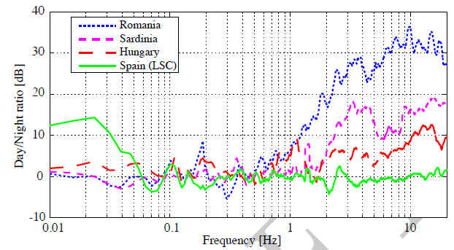
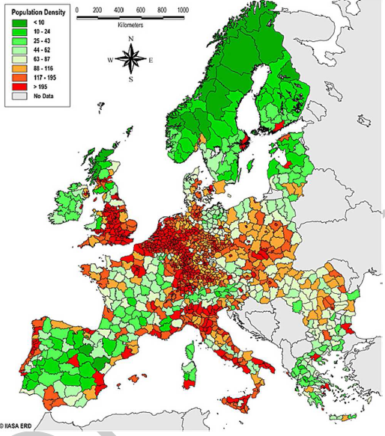
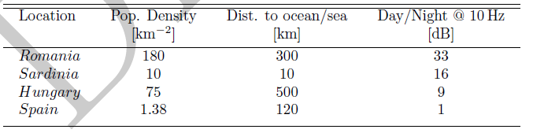
Day/Night variability vs population density
Credits: J.v.d. Brand

Slide 18
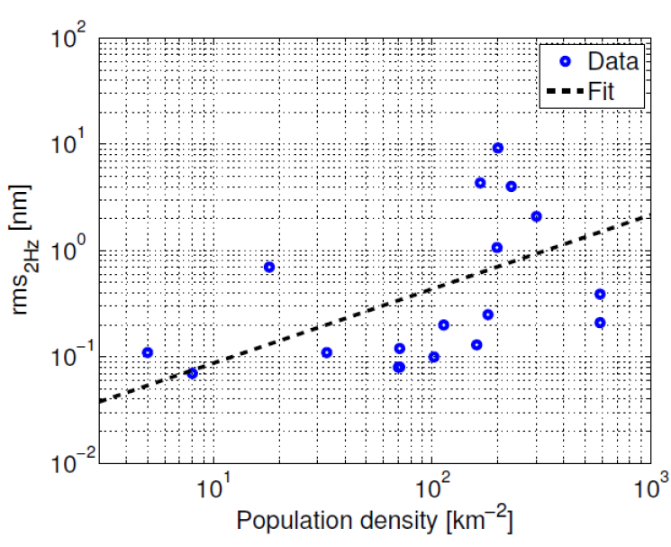
Day/Night variability vs population density
Credits: J.v.d. Brand

Slide 19
Why?

Slide 20
Beyond the detection
The GW detection is a crucial milestone, but, what kind of physics is possible to do with improved / 3G GW detectors?
The Physics of Extreme in:
  Fundamental physics
  Gravity
  Astronomy & Astrophysics
  Cosmology

Slide 21
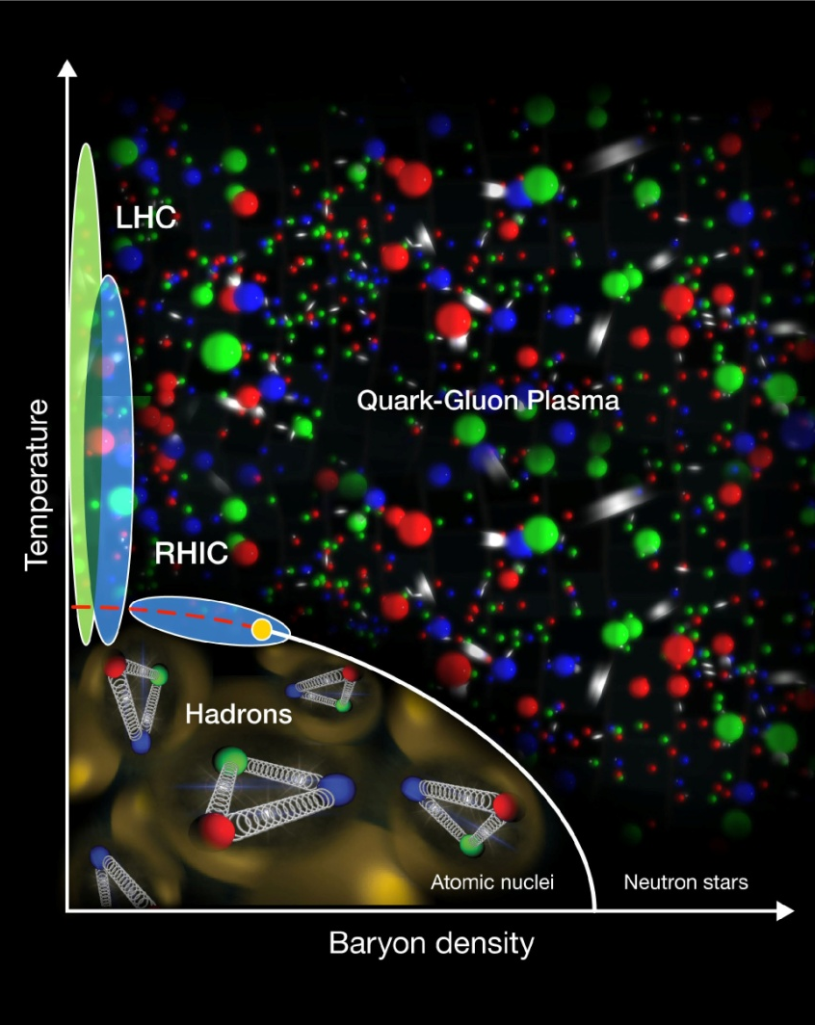
Extreme matter
Neutron Stars (NS) are a laboratory of nuclear physics at densities unreachable in Lab
We don’t know the state of matter in NS

Slide 22
NS Equation of State
There is a plethora of possible NS EOS

Slide 23
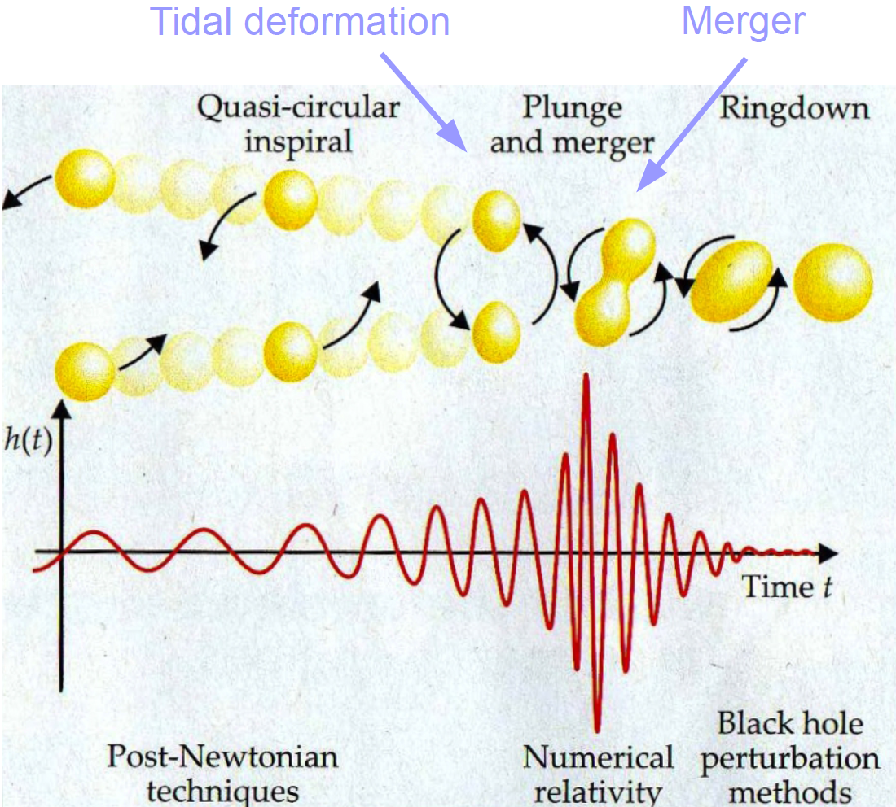
Observing BNS deformation
GW observation from NS coalescing binaries could constrain the EOS:
  Tidal deformation λ of the NS under external field is related to its EOS and it affects the binary orbital evolution
  Crucial: high SNR

Slide 24
Disentangle EOS (on Advanced)
Agathos+, 2015

Slide 25
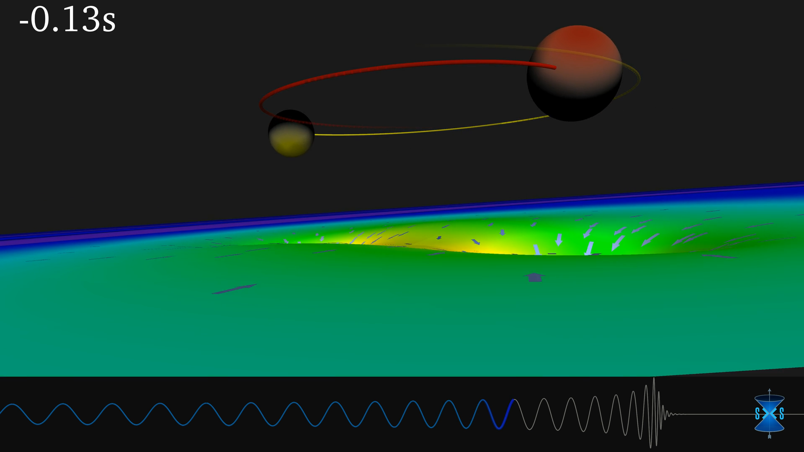
Extreme Gravity

Slide 26
Extreme Gravity
Are really two BH coalescing in GW150914 and GW151226?
Credit:B.Sathyaprakash

Slide 27
What we seen in GW150914
Last 3-7ms of the signal are compatible with the least damped QNM of a BH as predicted by GW, but to test no-hair theorem we need at least 2 QNM and higher SNR

Slide 28
Extreme Gravity: do we need the darkness?
Today we need more “matter” in the Universe to keep GR
But the Einstein field equations are the “simplest” solution in a curved space-time
There are a series of alternative theories of the gravity (for example f(R) theories) that could introduce an extra-curvature stress-energy tensor
To verify GR in condition of strong field could test the need of modified gravity theories

Slide 29
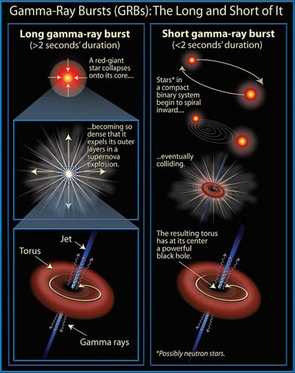
Extreme Universe:
GRB progenitors
Short GRB are probably emitted by BNS
In a multi-messenger context, if GRB are observed simultaneously with GW, it is possible to solve the GRB enigma
Credit:B.Sathyaprakash
Notes:
Cosmological model: spatially flat Friedman-Robertson-Walker universe

Slide 30
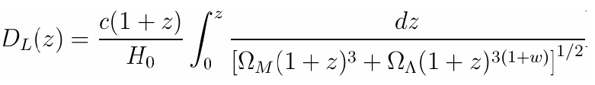
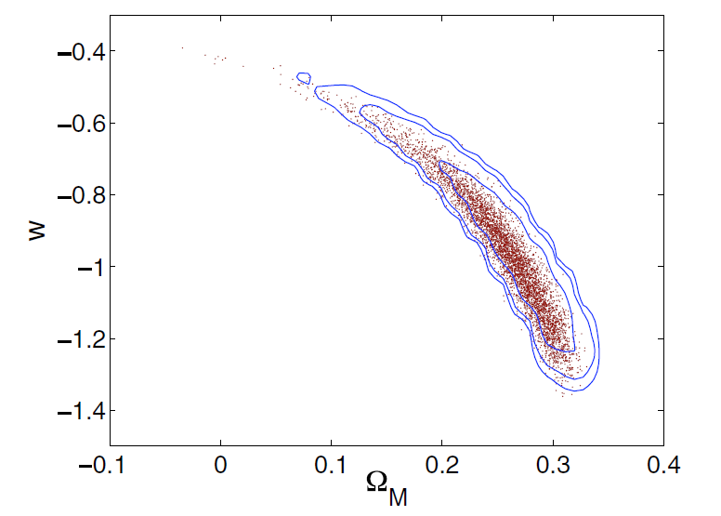
Extreme Universe:
GRB progenitors
Short GRB are probably emitted by BNS
In a multi-messenger context, if GRB are observed simultaneously with GW, it is possible to fit the cosmological model of the Universe
GW
GRB
GRB are localised at high z.
B.S.Sathyaprakas et al, CQG 27 (2010) 2015006
Ω_{M}: total mass density
Ω_{Λ}: Dark energy density
H₀: Hubble parameter
w: Dark energy equation of state parameter
Crucial:
high rate = huge detection distance
To reconstruct Dark Energy parameters with relevant precision it is needed to observe 100’s of BNS coalescences associated with GRB in one year
Notes:
Cosmological model: spatially flat Friedman-Robertson-Walker universe

Slide 31
When

Slide 32
Virgo
AdV
aLIGO
ET
1985
R&D
1990
15 years
White Paper, CDR (1989)
R&D
Approval (1994)
R&D
1995
Final Design, TDR (1995)
Beginning
Infrastructure (1996)
2000
R&D
CDR (1999)
Completion installation
Detector (2003)
First AdV
sensitivity projection (2004)
R&D
2005
AdV White Paper, CDR (2005)
First Idea (2005)
Scientific data taking
(2007)
Funding (2006)
Approval (2009)
Building (2008)
R&D
2010
Decommissioning (2011)
First orders (2010)
CDR (2011)
TDR (2012)
Installing completion
(2014)
R&D
2015
Completion Installation (2016)
Data taking (2015)
First data taking (2017)
2020
TDR ?
2025
Construction ?

Slide 33
Virgo
AdV
aLIGO
ET
1985
R&D
1990
White Paper, CDR (1989)
R&D
Approval (1994)
R&D
1995
Final Design, TDR (1995)
Beginning
Infrastructure (1996)
2000
R&D
CDR (1999)
Completion installation
Detector (2003)
15 years
First AdV
sensitivity projection (2004)
R&D
2005
AdV White Paper, CDR (2005)
First Idea (2005)
Scientific data taking
(2007)
Funding (2006)
Approval (2009)
Building (2008)
R&D
2010
Decommissioning (2011)
First orders (2010)
CDR (2011)
TDR (2012)
Installing completion
(2014)
R&D
2015
Completion Installation (2016)
Data taking (2015)
First data taking (2017)
2020
TDR ?
2025
Construction ?

Slide 34
Virgo
AdV
aLIGO
ET
1985
R&D
1990
White Paper, CDR (1989)
R&D
Approval (1994)
R&D
1995
Final Design, TDR (1995)
Beginning
Infrastructure (1996)
2000
R&D
15 years
CDR (1999)
Completion installation
Detector (2003)
First AdV
sensitivity projection (2004)
R&D
2005
AdV White Paper, CDR (2005)
First Idea (2005)
Scientific data taking
(2007)
Funding (2006)
Approval (2009)
Building (2008)
R&D
2010
Decommissioning (2011)
First orders (2010)
CDR (2011)
TDR (2012)
Installing completion
(2014)
R&D
2015
Completion Installation (2016)
Data taking (2015)
First data taking (2017)
2020
TDR ?
2025
Construction ?

Slide 35
Virgo
AdV
aLIGO
ET
1985
R&D
1990
White Paper, CDR (1989)
R&D
Approval (1994)
R&D
1995
Final Design, TDR (1995)
Beginning
Infrastructure (1996)
2000
R&D
CDR (1999)
Completion installation
Detector (2003)
First AdV
sensitivity projection (2004)
R&D
2005
AdV White Paper, CDR (2005)
First Idea (2005)
Scientific data taking
(2007)
Funding (2006)
Approval (2009)
Building (2008)
R&D
2010
Decommissioning (2011)
First orders (2010)
CDR (2011)
TDR (2012)
15 years
Installing completion
(2014)
R&D
2015
Completion Installation (2016)
Data taking (2015)
First data taking (2017)
2020
TDR ?
2025
Construction ?

Slide 36



AdV+ R&D
AdV
AdV+
A+/Voyager R&D
aLIGO
A+
Voyager
KAGRA
LIGO India
Mission definition
Space system development
eLISA
ET R&D
ET Infrastructure
Technical Design
ET Detector Technical Design
ESFRI
Roadmap
ET Observatory & Detector funding
ET site construction - detector installation & commissioning
Cosmic Explorer R&D
CE site&detector installation
R&D
Installation
Commissioning
Data taking
Other
2016
2017
2018
2019
2020
2021
2022
2023
2024
2025
2026
2027
2028
2029
2030
2031
2032

