Slide 1
From high altitude EAS experiments at YangBaJing to the new generation EAS experiment LHAASO
Hongbo Hu
Institute of High Energy Physics, CAS, China
22/10/2016, SciNeGHE2016, Pisa, Italy

Slide 2
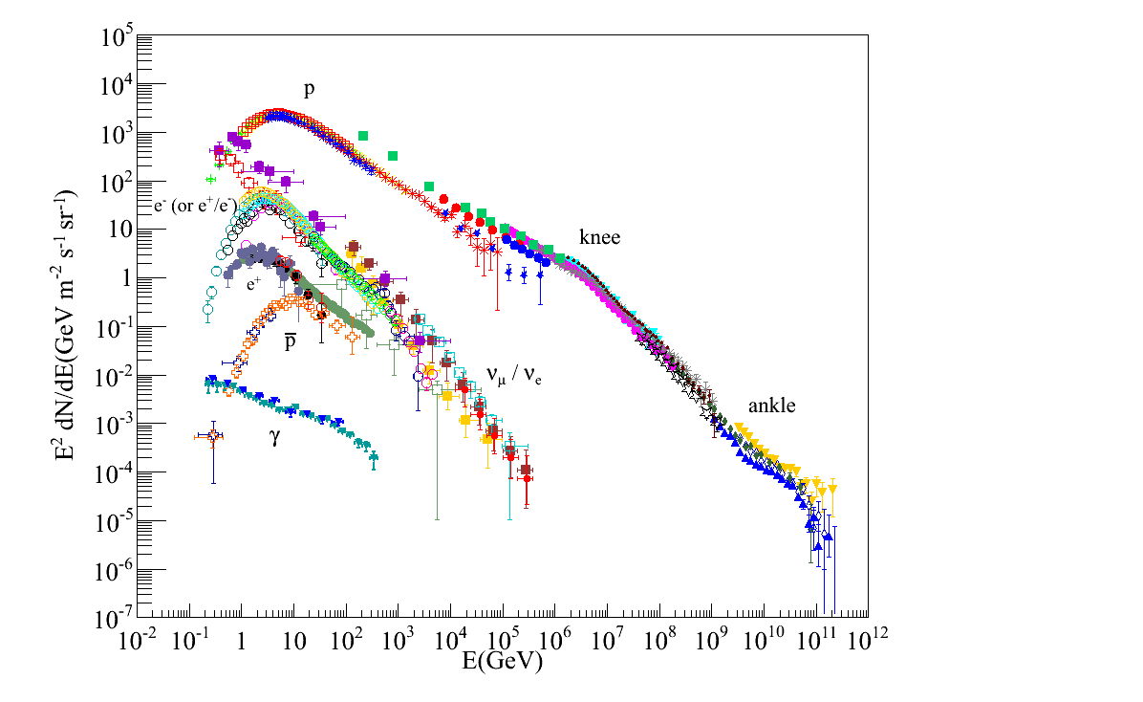
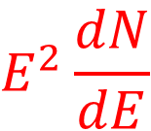
Origin, acceleration, propagation of cosmic rays
& quest for new physics
CR ~99% nuclei, electron ~1%
Space borne
2nd ~10⁻⁴, diffuse γ ~10⁻⁴⁽⁻⁵⁾
$$E^{2}\frac{dN}{dE}$$
Ground based
Featureless power law
  Steepening at ~4PeV—knee
  Hardening at ~4EeV --ankle
knee
(~4PeV,pc)
Galactic origin below knee
Power: 10⁴¹ ergs/s, ~10% of
the power released by SNRs；
ankle
(~4EeV,kpc)
LHC
New physics: DM etc.

Slide 3
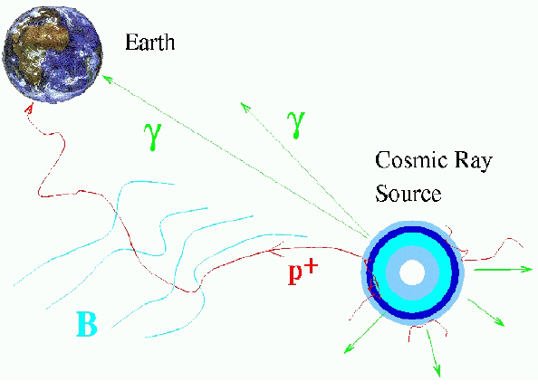
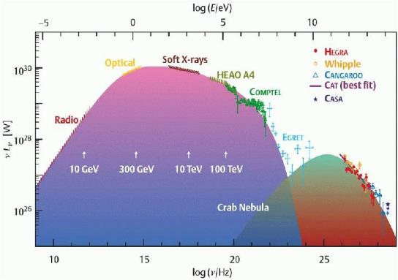
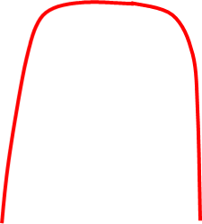
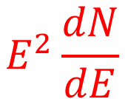
Identification of individual source: γ rays observation
The standard candle Crab: a typical electron source
$$E^{2}\frac{dN}{dE}$$
ν
100TeV
Synchorotron Radiation
PeV
IC
scattering
(Voelk)

Slide 4

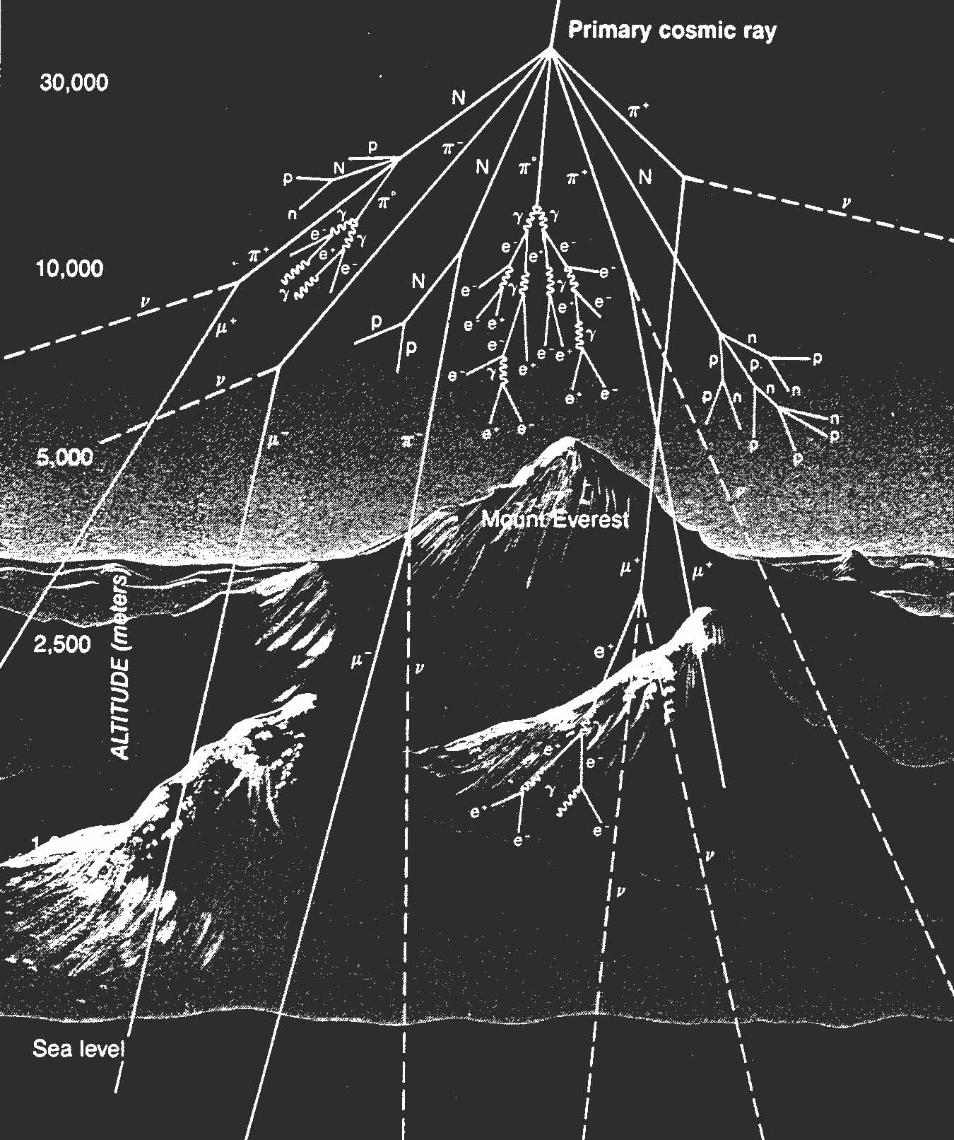
Extensive Air
Shower
A schematic view

Slide 5
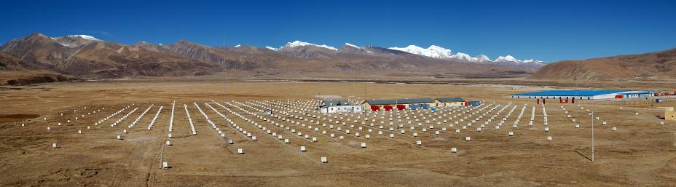
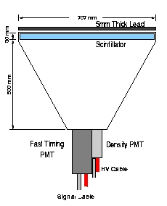
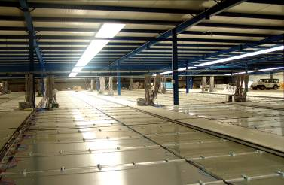
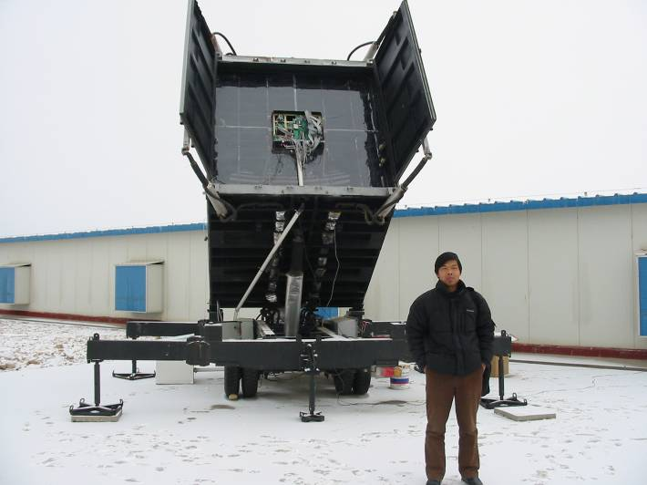
ASγ(1989-),ARGO(2006-2013) (4230m,a.s.l, High Duty Cycle, Large F.O.V)
CRs Spectrum: 100TeV-100PeV
CRs anisotropy: 10TeV-PeV
γ rays: ~3TeV, Sensitivity:~1Crab;
CRs spectrum: 5TeV-5PeV
Crs anisotropy: 1TeV-20TeV
γ rays: ~300GeV, Sensitivity: ~0.6Crab
Sino-Italian ARGO-YBJ: ~100M×100M
Sino-Japanese AS γ: ~270M×270M
AS γ scintillation counter
ARGO hall, floored with RPC
Wide field of view Cherenkov Telescope (2006-)
4.7 m² spherical mirror composed of 20 hexagon-shaped segments
256 PMTs (16 ⨉ 16 array)
pixel size 1º
FOV: 14º ⨉ 14º
CRs:>100TeV

Slide 6
EAS γ ray vs IACT & space experiments
EAS IACT Space borne
Resolution fair(~0.2º-1º) excellent(<0.1º) good (~0.1º)
Duty cycle high (~90%) low (10%) high(~100%)
Eff. area big(10⁴M²) big(10⁴M²) small(~1M²)
F.O.V. large(π) small(<5º) big（ >2π,
re-orientable）
Discr.γ/p poor excellent(~99.9%) excellent
E resolution fair(~100%) good(~20%) good<10%,
small systematic）
Sensitivity ~100%I_{crab}@TeV ~1%I_{crab} @TeV high ~ 1%I_{crab}@GeV

Slide 7
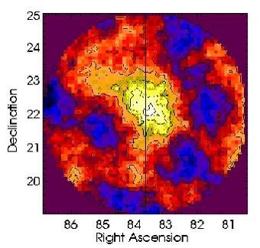
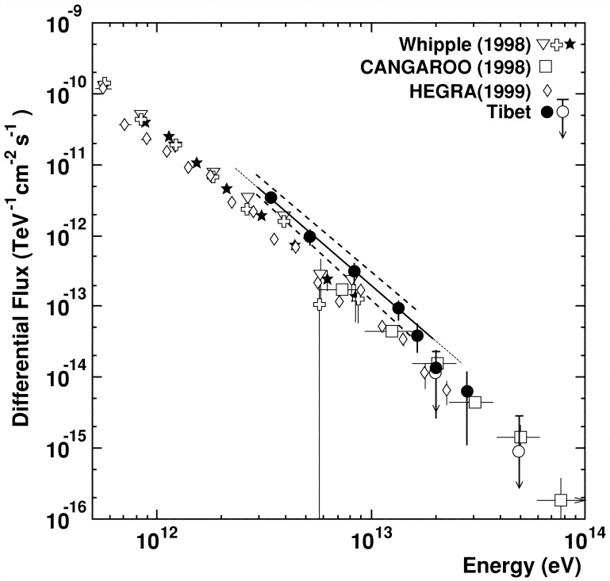
ASγ: Crab at >3TeV (1996-99) (5.5σ)
The Astrophysical Journal, 525:L93-L96, 1999 November 10

Slide 8
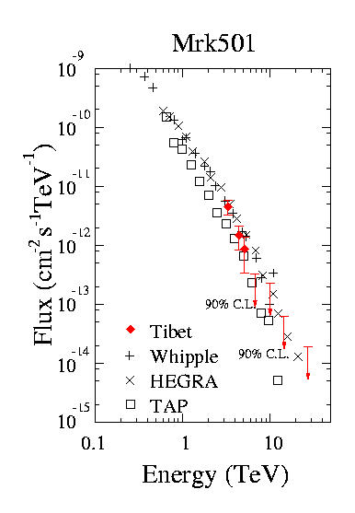
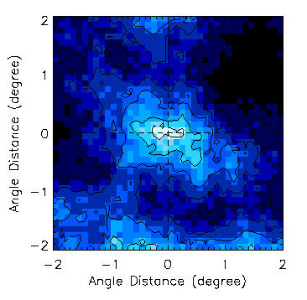
ASγ:Mrk501
Active:
Feb.1997-Aug.1997. Only observation
from conventional air shower array.
The Astrophysical Journal, Volume 532 (2000), Issue 1, pp. 302-307

Slide 9
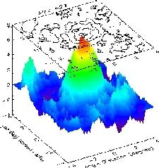
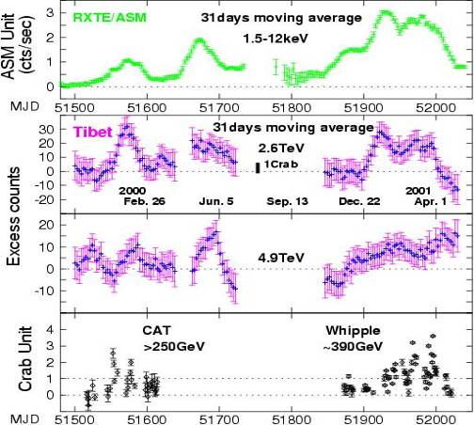
ASγ:Mrk421 (6.9σ)
1)ASγ observation of the high status of Mrk421 in 2000-2001.
2)High duty cycle makes EAS a better coverage in time.
The Astrophysical Journal, Volume 598 (2003), Issue 1, pp. 242-249

Slide 10
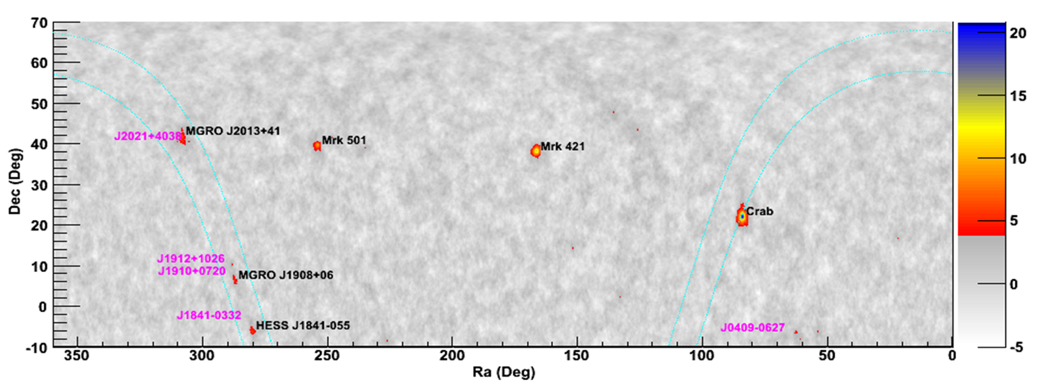


ARGO-YBJ: 6 TeV sources + 5 candidates
Identifying the GeV super bubble as a TeV emitter
7 large flarings etc：verifying SSC mechanism
$$E^{2}\frac{dN}{dE}$$
$$E^{2}\frac{dN}{dE}$$
TeV
TeV

Slide 11
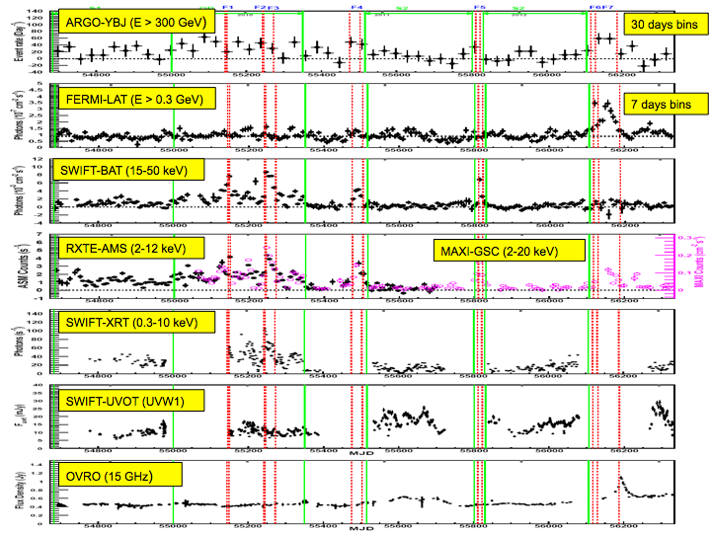
Contineous monitoring on Mrk421 emission for 4.5 years

Slide 12
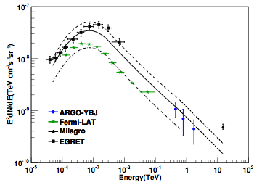
Diffuse γ-rays from the Galactic Plane
Diffuse γ-rays are produced by relativistic electrons by bremsstrahlung or inverse Compton scattering on bkg radiation fields, or by protons and nuclei via the decay of πº produced in hadronic interactions with interstellar gas.
The space distribution of this emission can trace the location of the CR sources and the distribution of interstellar gas.
Cygnus region: 65° < l < 85°; |b|< 5°
This result is obtained after masking all the sources detected in the region (in particular the TeV counterpart of the Cygnus Cocoon) and removing the residual contamination.
The TeV diffuse flux in the Cygnus region does not show
a strong excess like that reported by Milagro at 15 TeV.
72° < l < 88°; |b|< 15°
The difference may be due to the Cygnus Cocoon, not yet discovered at the time of the Milagro measurement.
65° < l < 85°; |b|< 2°
The different lines indicate the energy spectra expected from the Fermi/LAT template (with spectral index -2.6) in the different sky regions investigated by the detectors.
ApJ 806 (2015) 20

Slide 13
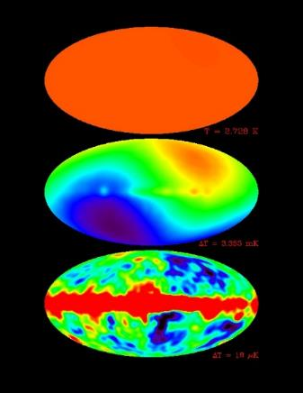
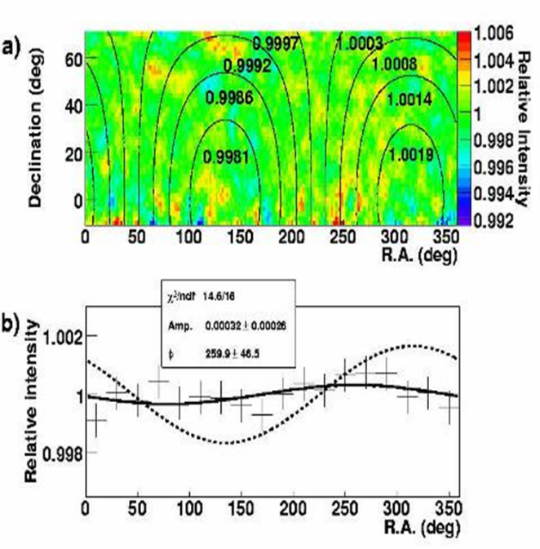
Global propagation of GCR：co-rotation with environments
Intensity @ E~300TeV
CMB anisotropy by COBE
Amp=0.16% w/o corotation;
Observation: 0.03%±0.03%.
~10⁻⁴
10⁻³
10⁻⁶
Science 314(2006)439-443

Slide 14
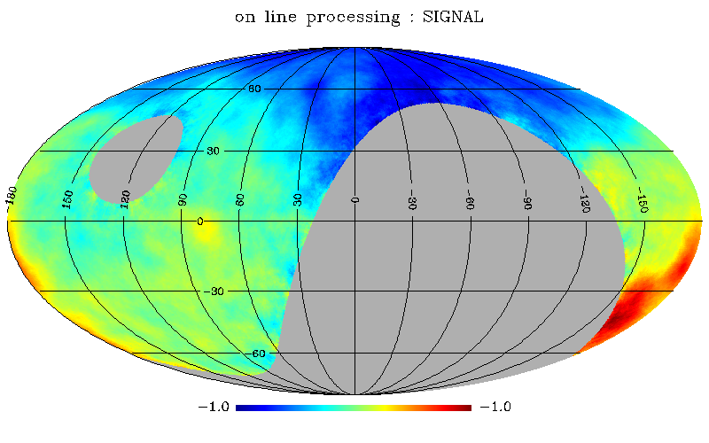
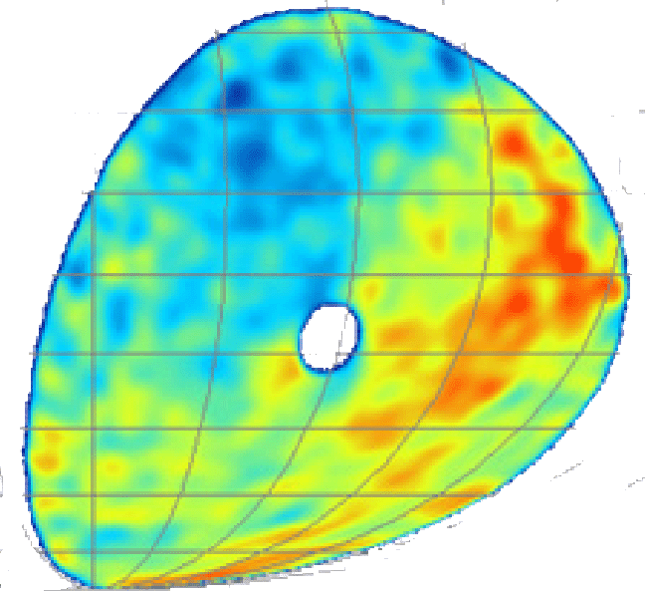

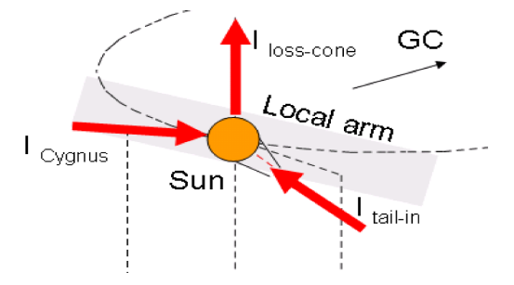
TeV CRs anisotropy in the Galactic coordinates
Loss cone
Tibet III
Icecube
excess
3 directions for the CRs motion
Inward
outward
Qu et al，ApJ, 750, L17 2012

Slide 15
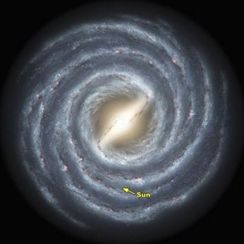
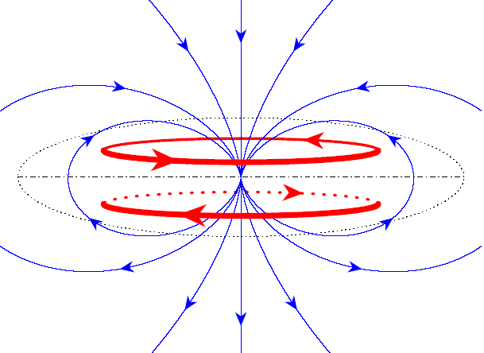
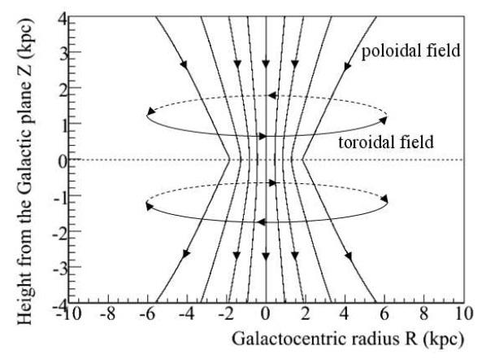
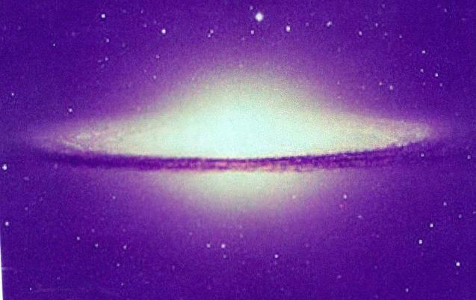
3 anisotropy components
=〉3 global CRs motions
=〉3 electricity currents
=〉global magnetic field
By Applying Copernicus’ principle
Up：CRs anisotropies;
Down：calculated magnetic field；
Qu et al., ApJ, 750, L17 2012
Galactic halo magnetic field observed by astronomer

Slide 16
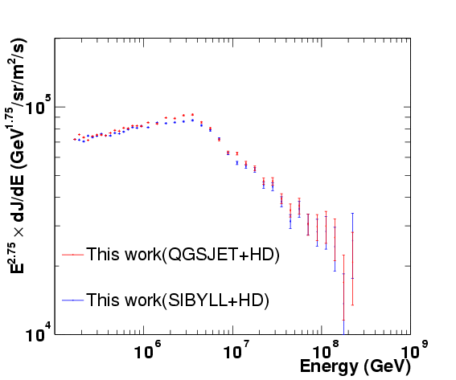
All-particle spectrum measured by Tibet-III array
A very sharp knee around 4 PeV was observed.
Indication of a
single source (SS)?
But even the mechanism in SS model is uncertain.
ApJ 678, 1165-1179 (2008)
Notes:
16

Slide 17
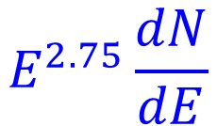
ARGO-YBJ+LHAASO-WFCTA: knee of proton+Helium spectrum
$$E^{2.75}\frac{dN}{dE}$$
2015
Energy reconstruction: WFCTA
Identification of primary: Imaging by WFCTA and particle density at shower core by ARGO-YBJ
PhysRevD.92.092005

Slide 18
Accelerating and on site interaction
2) At later time, when CR energy is higher, the photon density and temperature maybe low.
1) At early time when CR’s energy is low, the number density of background light is high, also the photon temperature might be high.
~O(100PeV) Fe
~<1eV photons
~1eV photons
SN
~>TeVe⁺e⁻
~PeV proton
TeVe⁺e⁻
Shock wave
3) Background light maybe fill the SNR or mainly a point like source. When filled, electron interact with it as well. Only when it is not so much filled, the e⁺e⁻ pair are observable.

Slide 19
e⁺e⁻ pair production between CR s and radiation BKG => knee
Hu et al., Astrophysical Journal 700 (2009) L170-173;
Wang et al., Sci. China G53:842-847,2010

Slide 20
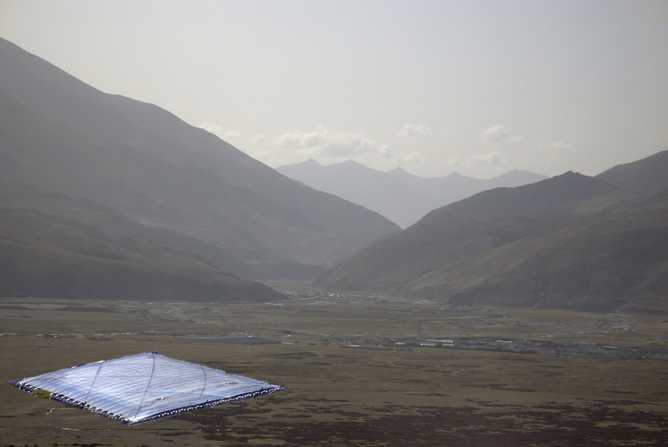
40000M²、 full coverage、50mCrab
GG. Sinnis, A. Smith, J.E. McEnery, astro-ph/0403096
HAWC: A Next Generation All-Sky VHE Gamma-Ray Telescope
e
μ
γ
200 meters

Slide 21
T.Weisgarber
TeVPA2016

Slide 22
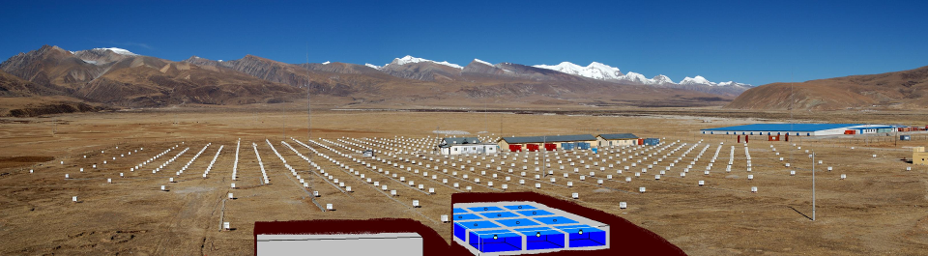
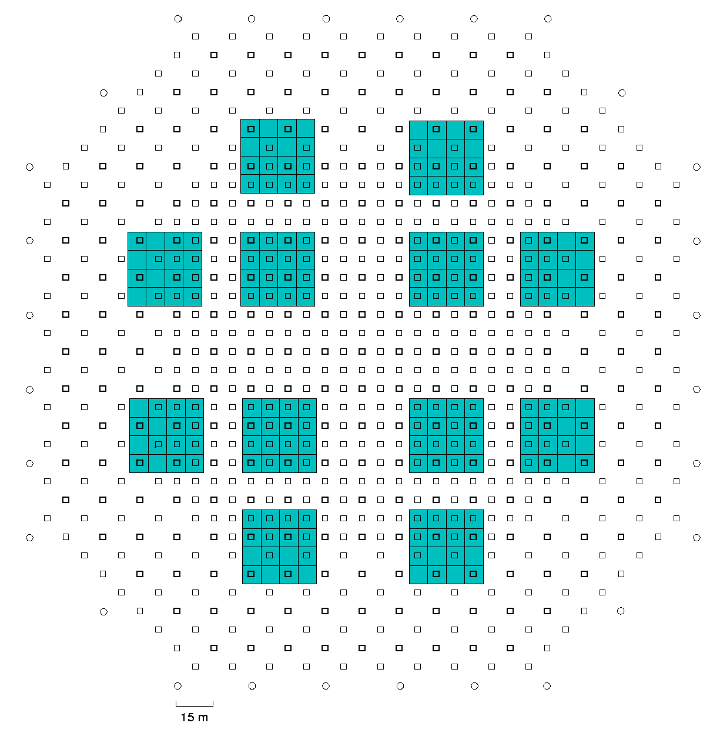
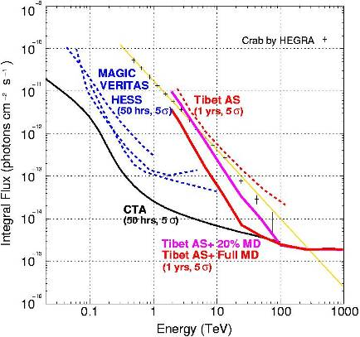
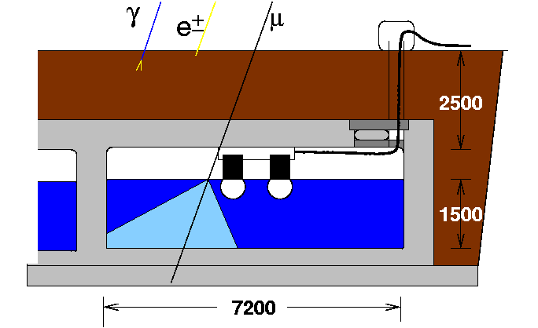
Sensitivity with Tibet III-Muon @100TeV
40

Slide 23
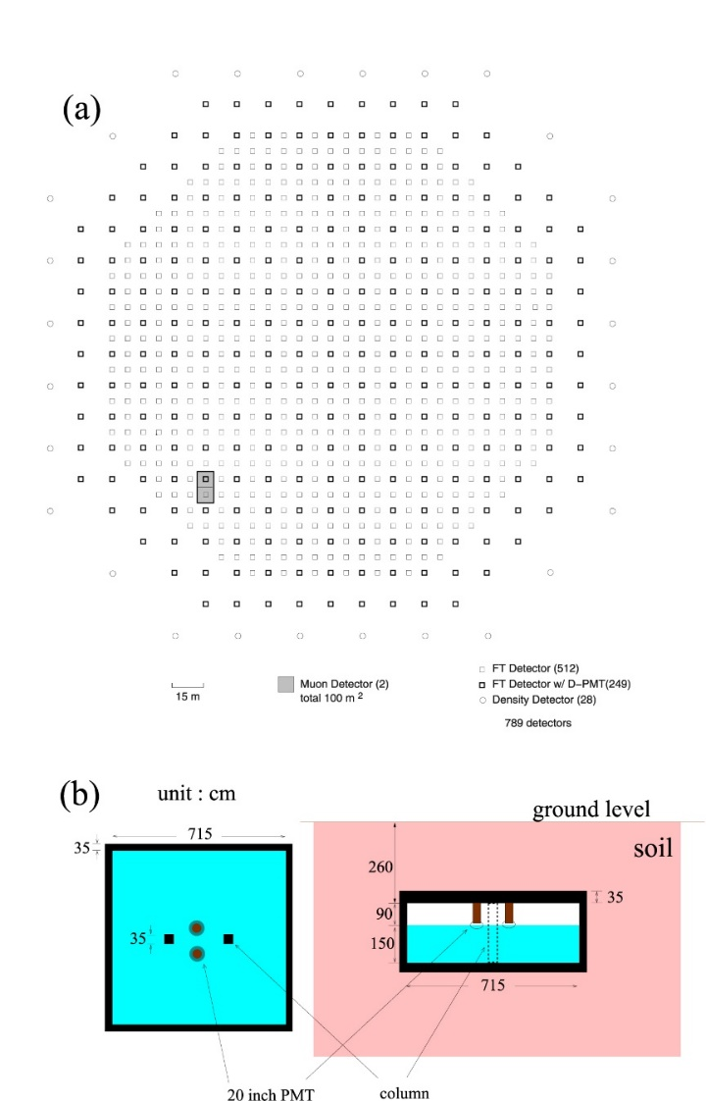
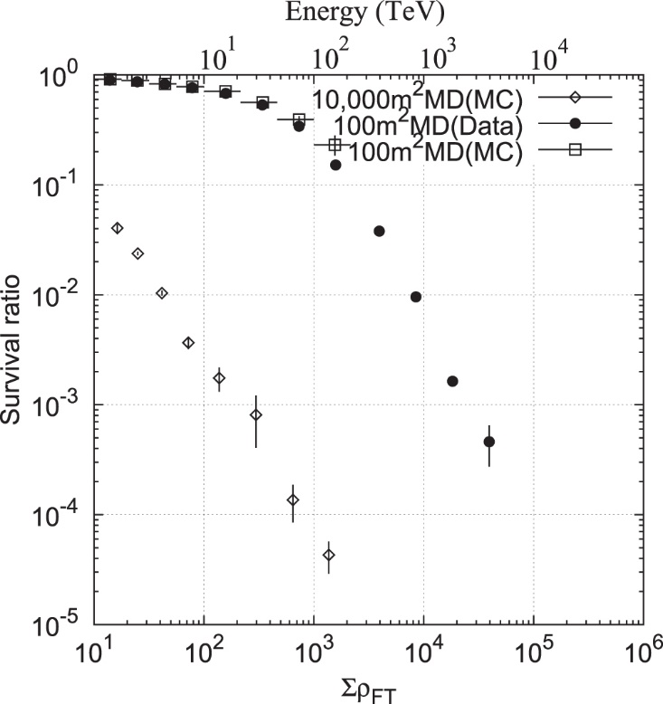
Demonstration on the γ/CR separation power
100m² muon detector
M. Amenomori et al. 2015 ApJ 813 98

Slide 24
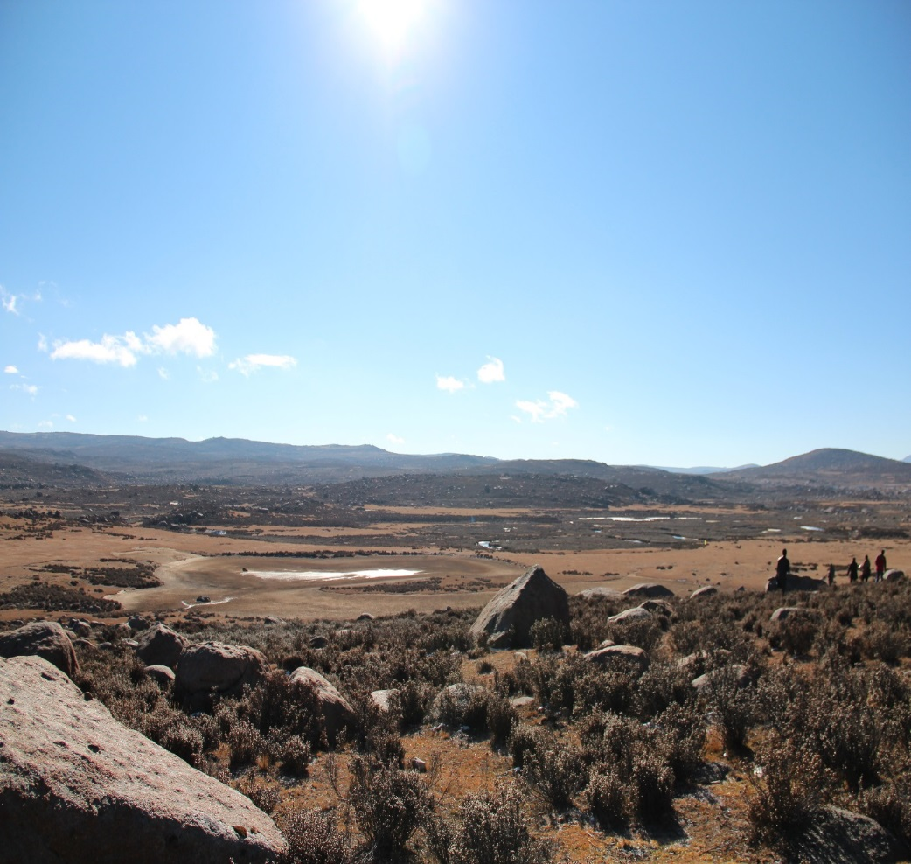
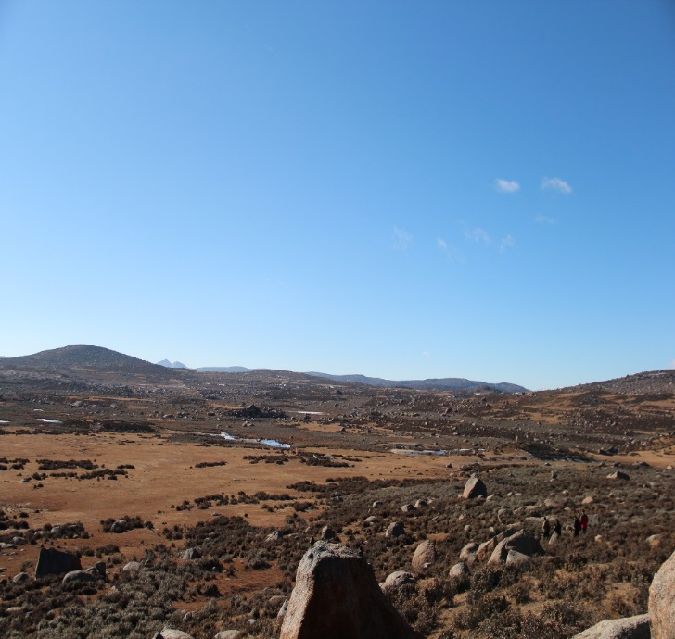
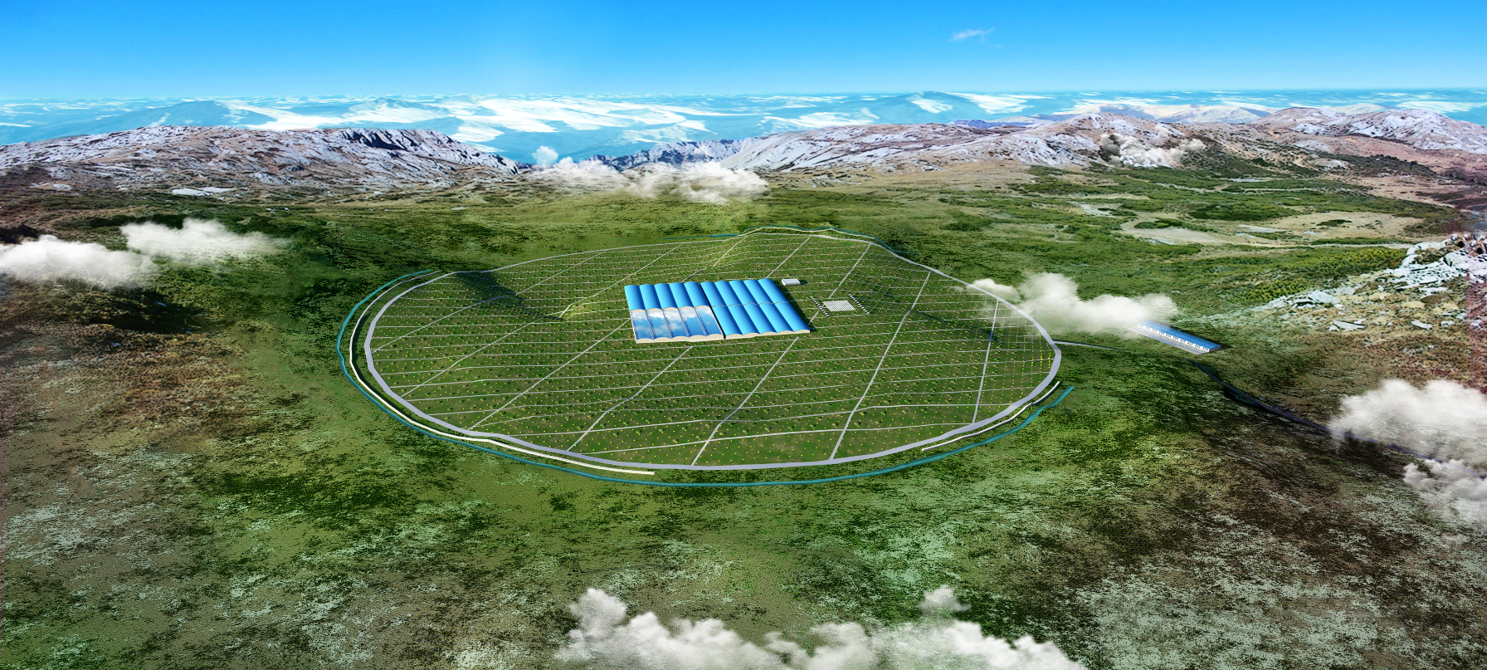
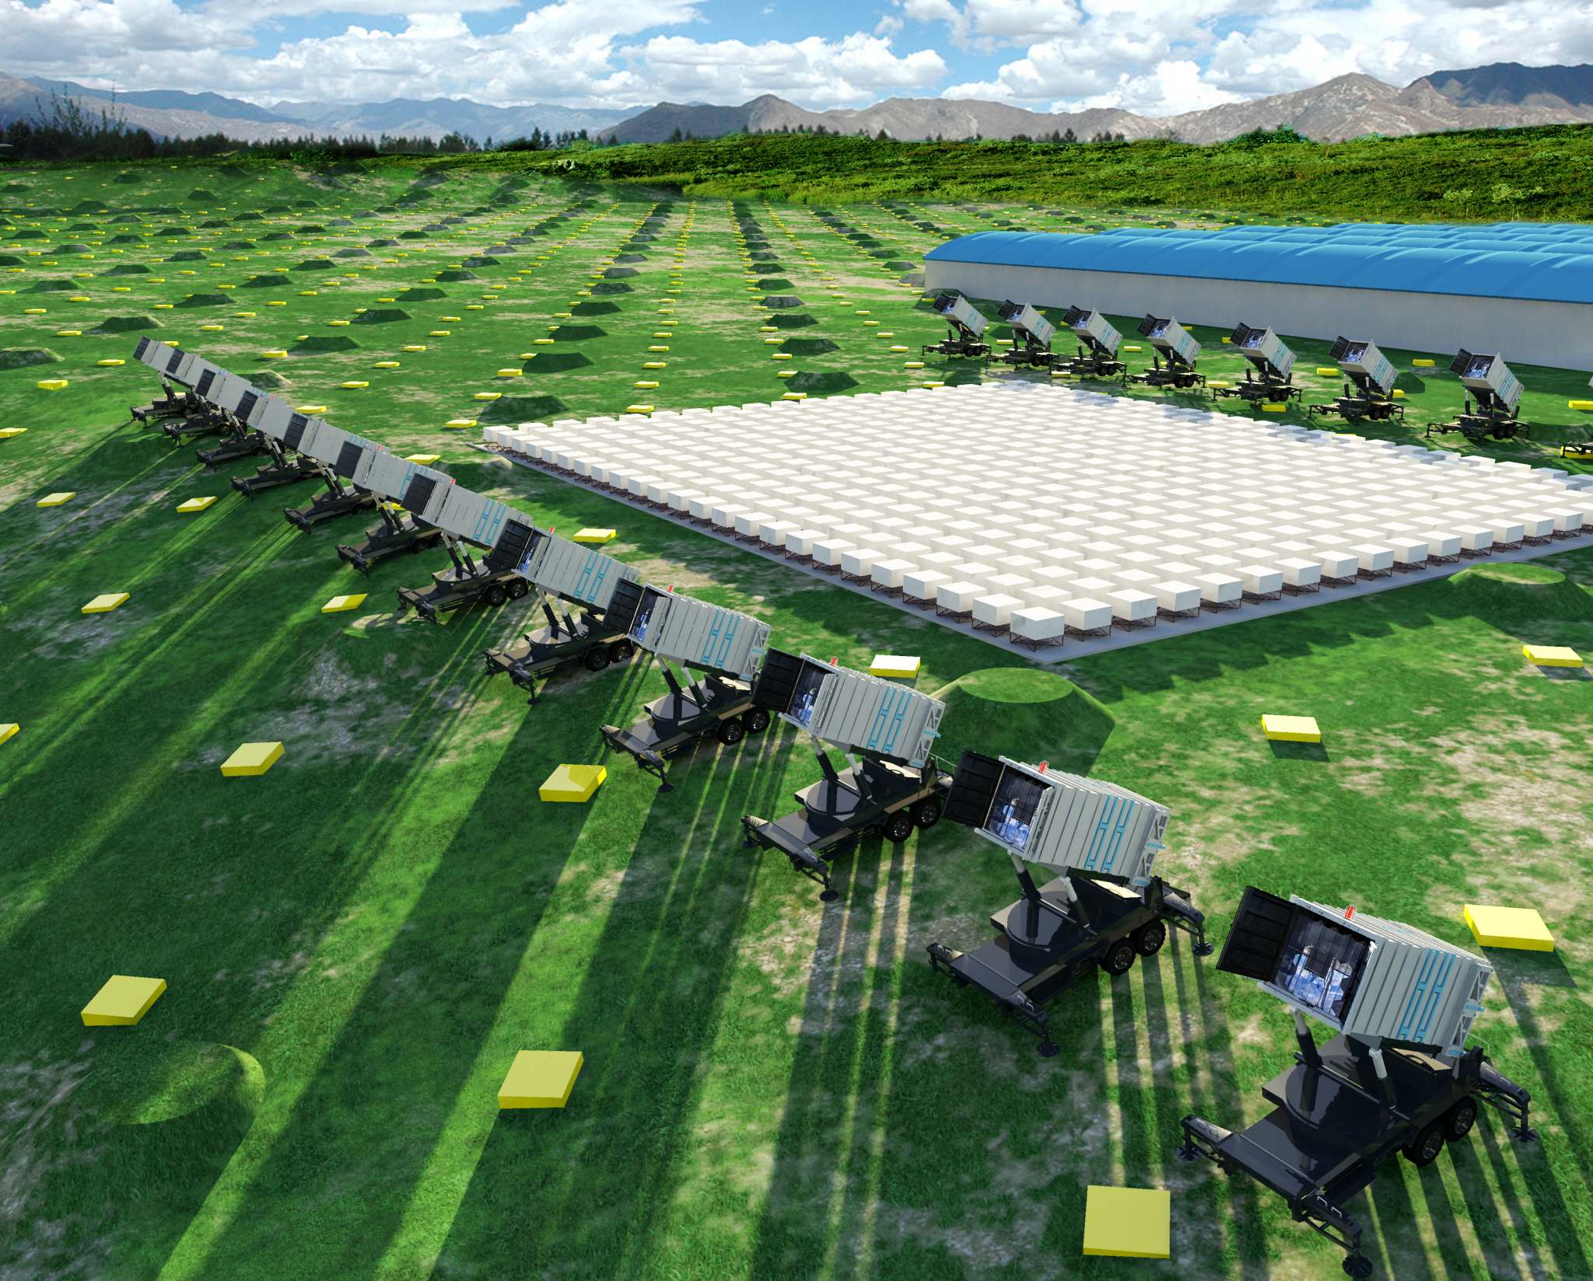
Large High Altitude Air Shower Observatory (LHAASO) Project
Site at 4400 m a.s.l.
Main Array:
5195 scintillator detectors every 15 m
&
1171 μ–detectors every 30 m
Water Cherenkov Detector
78,000 m²
CR Detectors：
18 Wide field View Cherenkov telescopes & Large Dynamic WCDA++：
precision measurement of CR spectrum

Slide 25
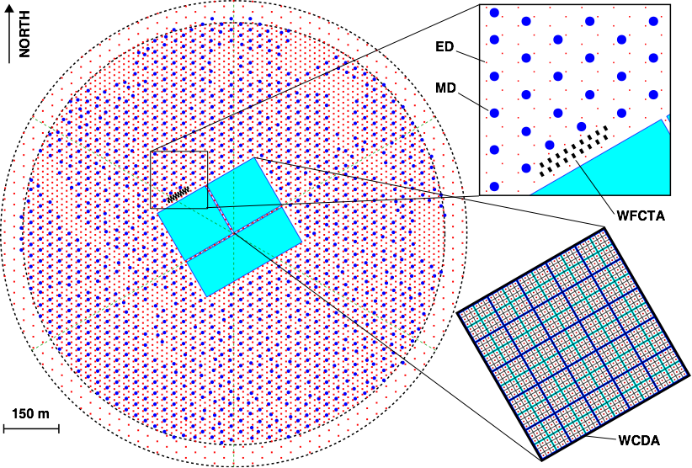
LHAASO layout
KM2A:
1 km² array, including 5195 scintillator detectors 1 m² each, with 15 m spacing.
An overlapping 1 km² array of 1171, underground water Cherenkov tanks 36 m² each, with 30 m spacing, for muon detection (total sensitive area ≈ 42,000 m²).
A close-packed, surface water Cherenkov detector facility with a total area of 80,000 m².
18 wide field-of-view air Cherenkov (and fluorescence) telescopes.
~30X TibetIII-Muon
WCDA:
~4X HAWC

Slide 26
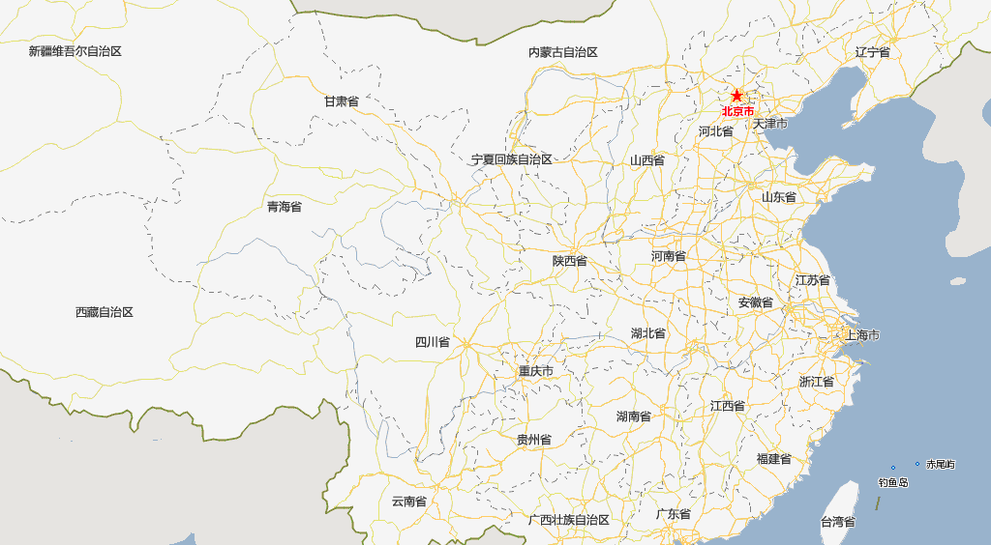
清华大学
北京大学
高能所
空间中心
南开大学
国家天文台
Domestic Collaboration
20 institutions
大气所
山东大学
河北师范大学
四川大学
LHAASO
中国科技大学
西南交通大学
西藏大学
南京大学
紫金山天文台
成都分院：山地所
生物所
云南天文台
云南大学
广西大学
International collaborations
France：IPNO
OMEGA
Russia：RAS
INPR
Thailand:
Italy：U. Rome I, II, III
U. Torino
Switzerland:
U. Geneva

Slide 27
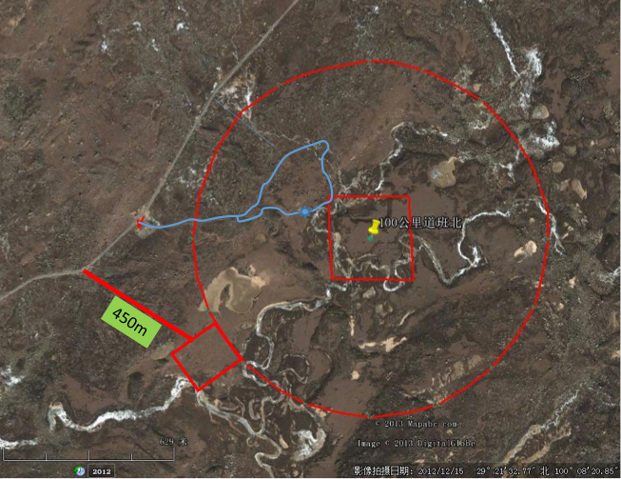
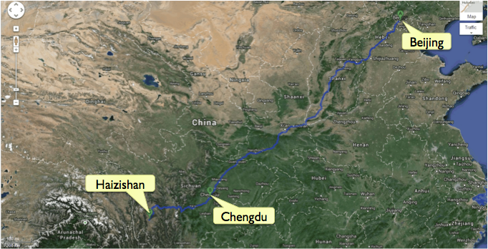
The LHAASO site
The experiment will be located at 4400 m asl (600 g/cm²) in the Haizishan (Lakes’ Mountain) site, Sichuan province
Coordinates: 29º 21' 31’' N, 100º 08' 15’' E
700 km to Chengdu
50 km to Daocheng City (3700 m asl, guest house)
10 km to the highest airport in the world

Slide 28
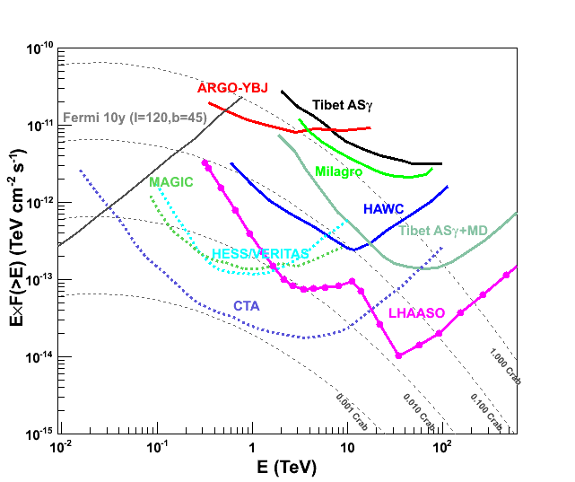
LHAASO sensitivity
Crab: spectrum with cut off
WCDA ~ 1% I_{crab} @3TeV
KM2A ~ 2% Icrab @30TeV
KM2A ~ 10% Icrab @100TeV
WCDA
Lose sensitivity in ~100GeV
KM2A

Slide 29
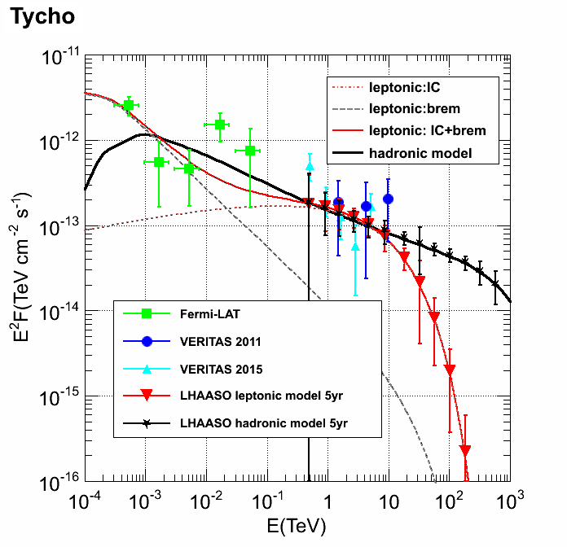
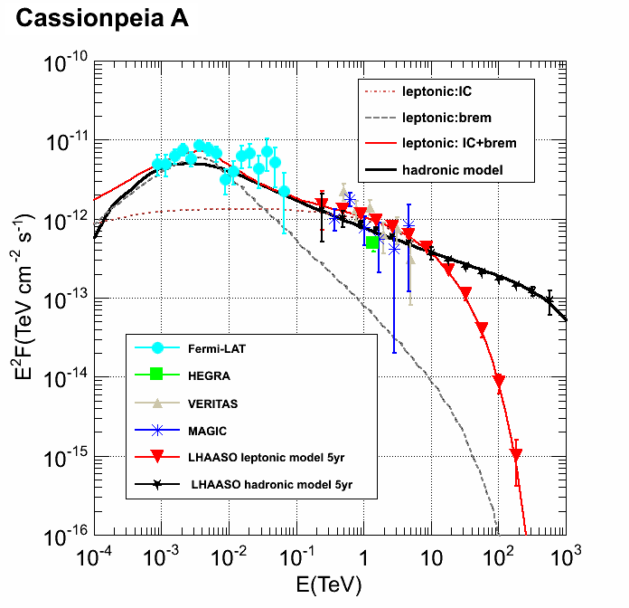
(1) Tycho & Cassiopeia A (Liu Ye et al, ApJ，826:63(2016))
leptonic & hadronic model (Yuan Qiang et al, ApJ, 2012 )
Statistic error ~10% @100TeV, LHAASO is capable to distinguish leptonic and hadronic sources

Slide 30
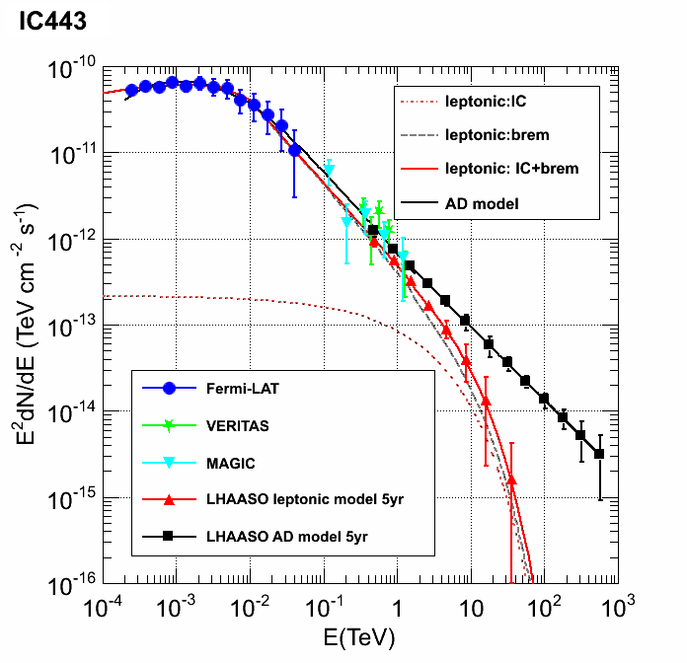

(2) IC 443 & W51C：(Liu Ye et al, ApJ，826:63(2016))
AD model： Li Hui & Chen Yang, 2010, 2012
Statistic error ~10% @100TeV, LHAASO is capable to distinguish leptonic and hadronic sources

Slide 31
Cygnus Cocoon: (Liu Ye et al, ApJ，826:63(2016))
(1) ARGO J3031+4157; (2) Superbubble; (3)Extended source, ~4°;
(4) Candidate hadronic source，total energy ~1.5x10⁵⁰ erg，E_{cut}=150TeV

Slide 32


LHAASO sensitivity to diffuse γ-ray flux
Colored lines: Diffuse gamma flux calculated by GALPROP, assuming different composition, absorption by radiation bkg has been included.
Dashed line: Estimated 5σ sensitivity
Extrapolation of the Fermi spectrum E^{-2.65±0.05} with a steepening due to CR knee
Absorbed
Y. Q. Guo, et al., ApJ. 795:100 (6pp), 2014 November 1
by P. Lipari & S. Vernetto: RICAP 2016

Slide 33

Galactic Center (zenith angle~60º) Observation with LHAASO-KM2A

Slide 34





Expected AGN observation with
LHAASO
38 detectable with D11 model
33 sources with K06 model
39 sources with F08
34 sources with F10
Y.Zhao et al., International Journal of Modern Physics D, Volume 25, Issue 1, id. 1650006
30-40 Blac objects with redshift available in Fermi 2LAC sources will be detectable by LHAASO in TeV;
~100 AGNs is expected considering another half of 2LAC BL sources have no measured redshift
40 sources with G12 model

Slide 35

Cosmic Ray Physics with LHAASO
To fill the gap in the CR detection between the low and the very high energy ranges with a single experiment.
ARGO-YBJ
DAMPE
1⁰ Knee
ISS CREAM
AUGER
TA
LHAASO
Ankle

Slide 36


GAW: Gamma Air Watch
Study on the Wide FoV Cherenkov Telescope @ high altitude
By Refractive Optics
G. Cusumano ICRC2011:ID1352
Phase 1 : Large FoV (6º×6º) will be achieved by using refractive optics made of single side flat Fresnel lens of moderate size (2.13 m diameter).
Phase 2 : Larger FoV (24º×24º)

Slide 37





A 0.9m diameter prototype water lens + 9PMTs camera
Same Cosmic Ray seen by 9 PMTs
VERY PRELIMINARY !
Same cosmic ray seen by EAS array
PMT: 2,3,4,5,6,7,8,9
PMT: 1
Zenith: 4.7°
Azimuth: 57.2°
(Due North is 0 degree, rotated by clockwise ）
3
6
9
N
2
5
8
1
4
7

Slide 38
Summary
The last generation high altitude EAS experiments at YangBaJing were successful in gamma rays and cosmic rays observation.
The new generation high altitude EAS experiment LHAASO will improve the sensitivity over the old generation by a factor of 100 from TeV-100TeV, rich physics are expected from LHAASO.
High altitude wide field of view Cherenkov telescope is under study and hopefully to improve the gamma sensitivity at ~100GeV

Slide 39


Prospects and Status
LHAASO observatory
  Unique at 10 TeV gamma monitoring with the highest sensitivity in the world
  Window for discovering the hadronic origins of cosmic rays
  Crucial CR data covering a very wide energy range of knees
  Exploring for new physics, such as DM or quantum gravity
LHAASO will be one of the major infrastructural instruments in HE astroparticle physics, together with CTA, IceCube, AUGER
LHAASO has been approved, one of the important projects of CAS in 5 years
LHAASO: 3rd generation
LHAASO
in space
in ground
in 3000km²

Slide 40


二、
三、
四、
五、

Slide 41


Configuration and Schedule
¼ ARRAY (2017)
Operation for
physics
大门
装配大厅

Slide 42
Time Schedule
now
Detector R/D： 1.5yr
Electronics R/D: 2 yr
Production: 1.5 yr
DAQ R/D 0.5 yr
Deployment: 4 yr
1%prototype Oper: 1 yr
¼ operation： 2 yr
Deployment
¼ operation
2017
 | LHAASO construction （month）
Civil construction | 24
Detector production |  | 36
Deployment |  |  | 36
¼ operation |  |  |  | 28
Full operation |  |  |  |  |  |  | 2,验收
2019
2020
2021

Slide 43


Status of LHAASO
LHAASO is finally approved and funded for detectors and infrastructures
2015: geo survey and final layout fixed.
Installation of detectors started in September 2015 for tests.
July 30th: starting ceremony of the big construction at the site: power station at the site, a power line of 29 km to the nearest major power line in the national grid, the roads in the field, data center and living base.
April 2017: Construction of first pond and MD tanks
By the middlle of 2018, the first quarter of the whole array, i.e. 22,500 m² water Cherenkov detector, surrounded by 300 MDs and 1200 scintillator counters, and 6 wide FoV Cherenkov telescopes will be put in operation.
2021: conclusion of installation of main components.
Construction of muon detectors

Slide 44




LHAASO installation

Slide 45
γ and CR separation by KSCADE data
252 * 3.2 m² muon detectors, with muon threshold energy as 250MeV

Slide 46
γ and CR separation by KSCADE Grande data
~150,000m2 effective area, ~150m² muon tracking detector

Slide 47

Evolution of CR anisotropy between 10 and 1000 TeV
Smooth radius: 30º
15 TeV
~[-80σ,50σ]
~[-20σ,15σ]
50 TeV
~[-11σ,6σ]
100 TeV
300 TeV
~[-6σ,7σ]
Consistent with IceTop result
1 PeV
~[-5σ,6σ]

