Slide 1










First steps to observing gravitational waves in space
Results from LISA Pathfinder
Peter Wass for the LISA Pathfinder Collaboration
SciNeGHE 2016

Slide 2
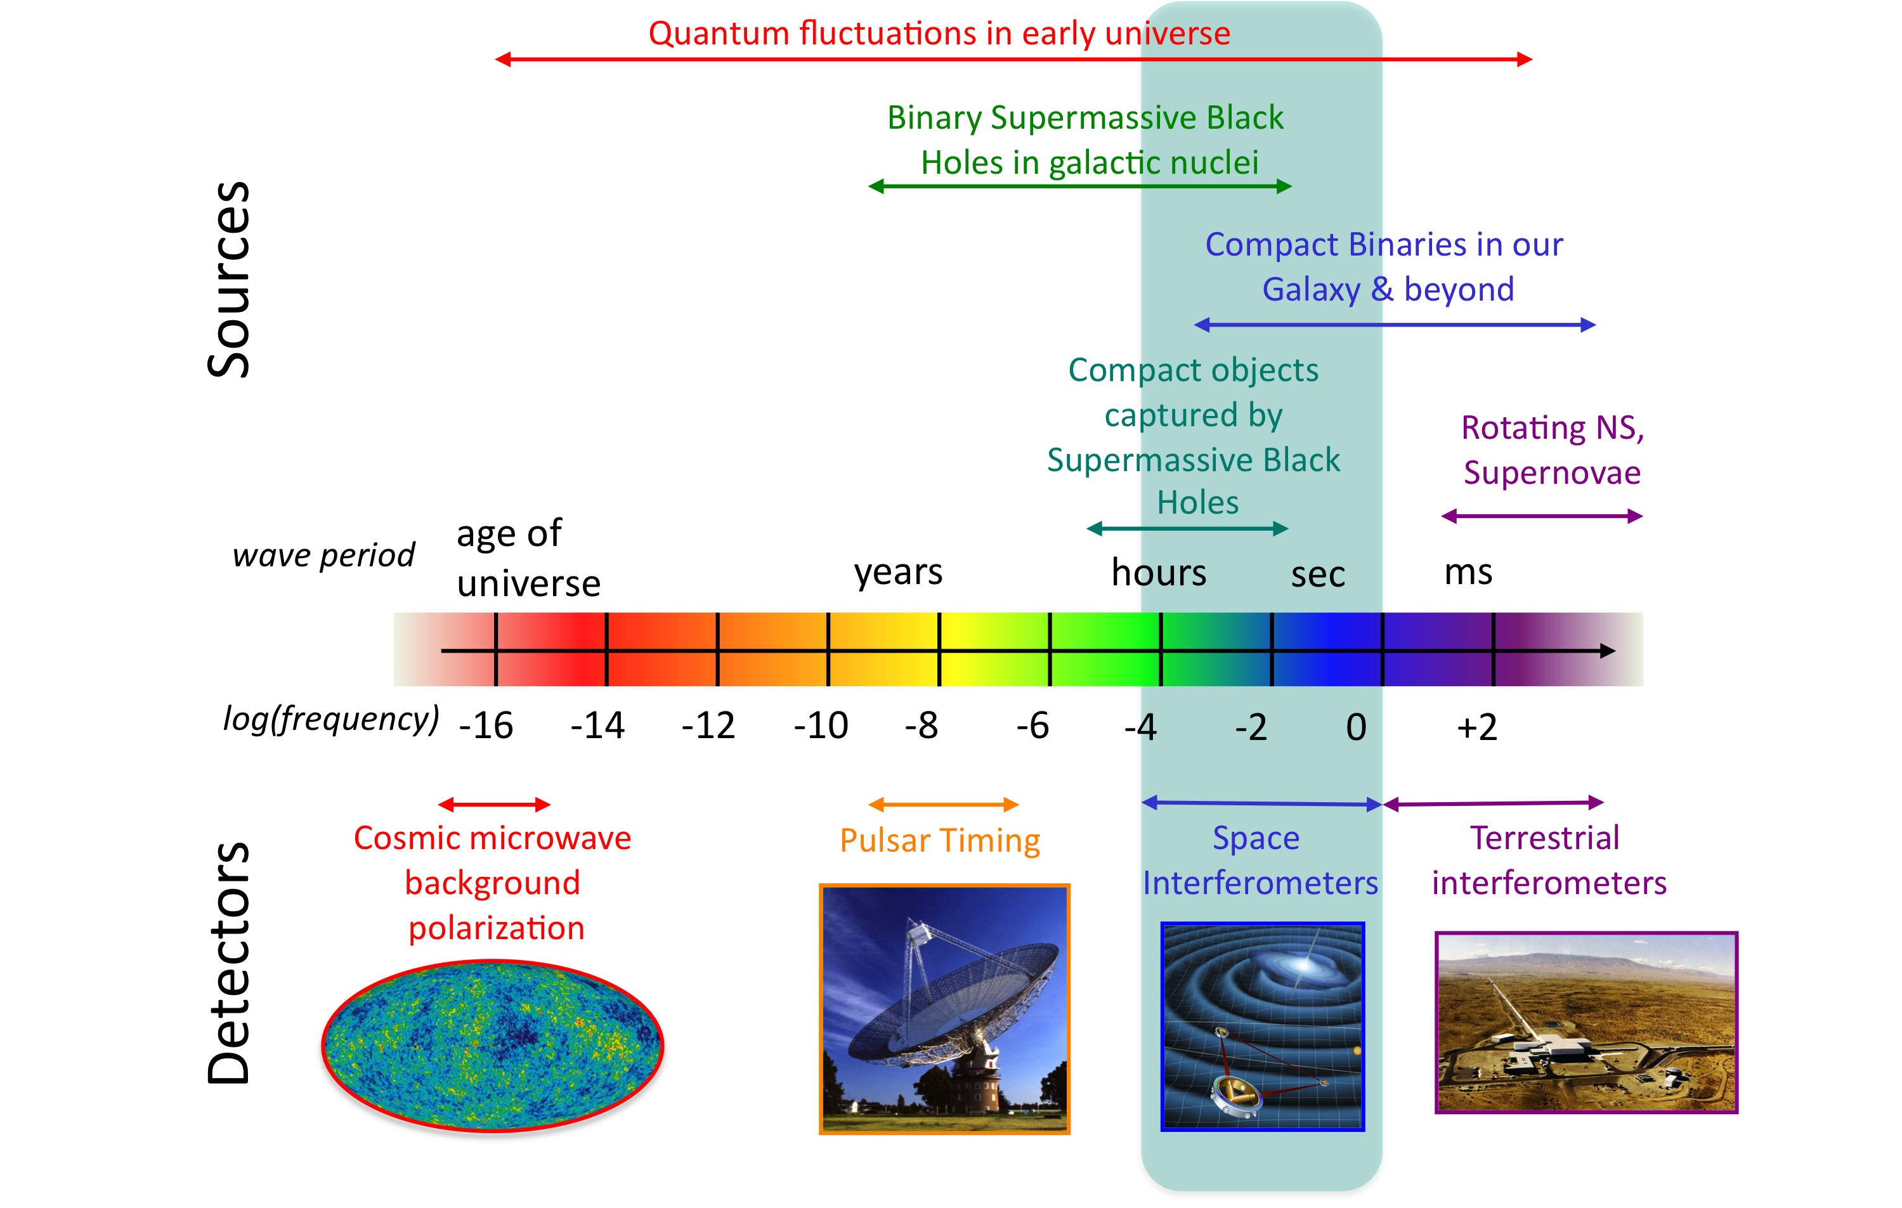
Gravitational wave spectrum
Credit: NASA Goddard Space Flight Center

Slide 3
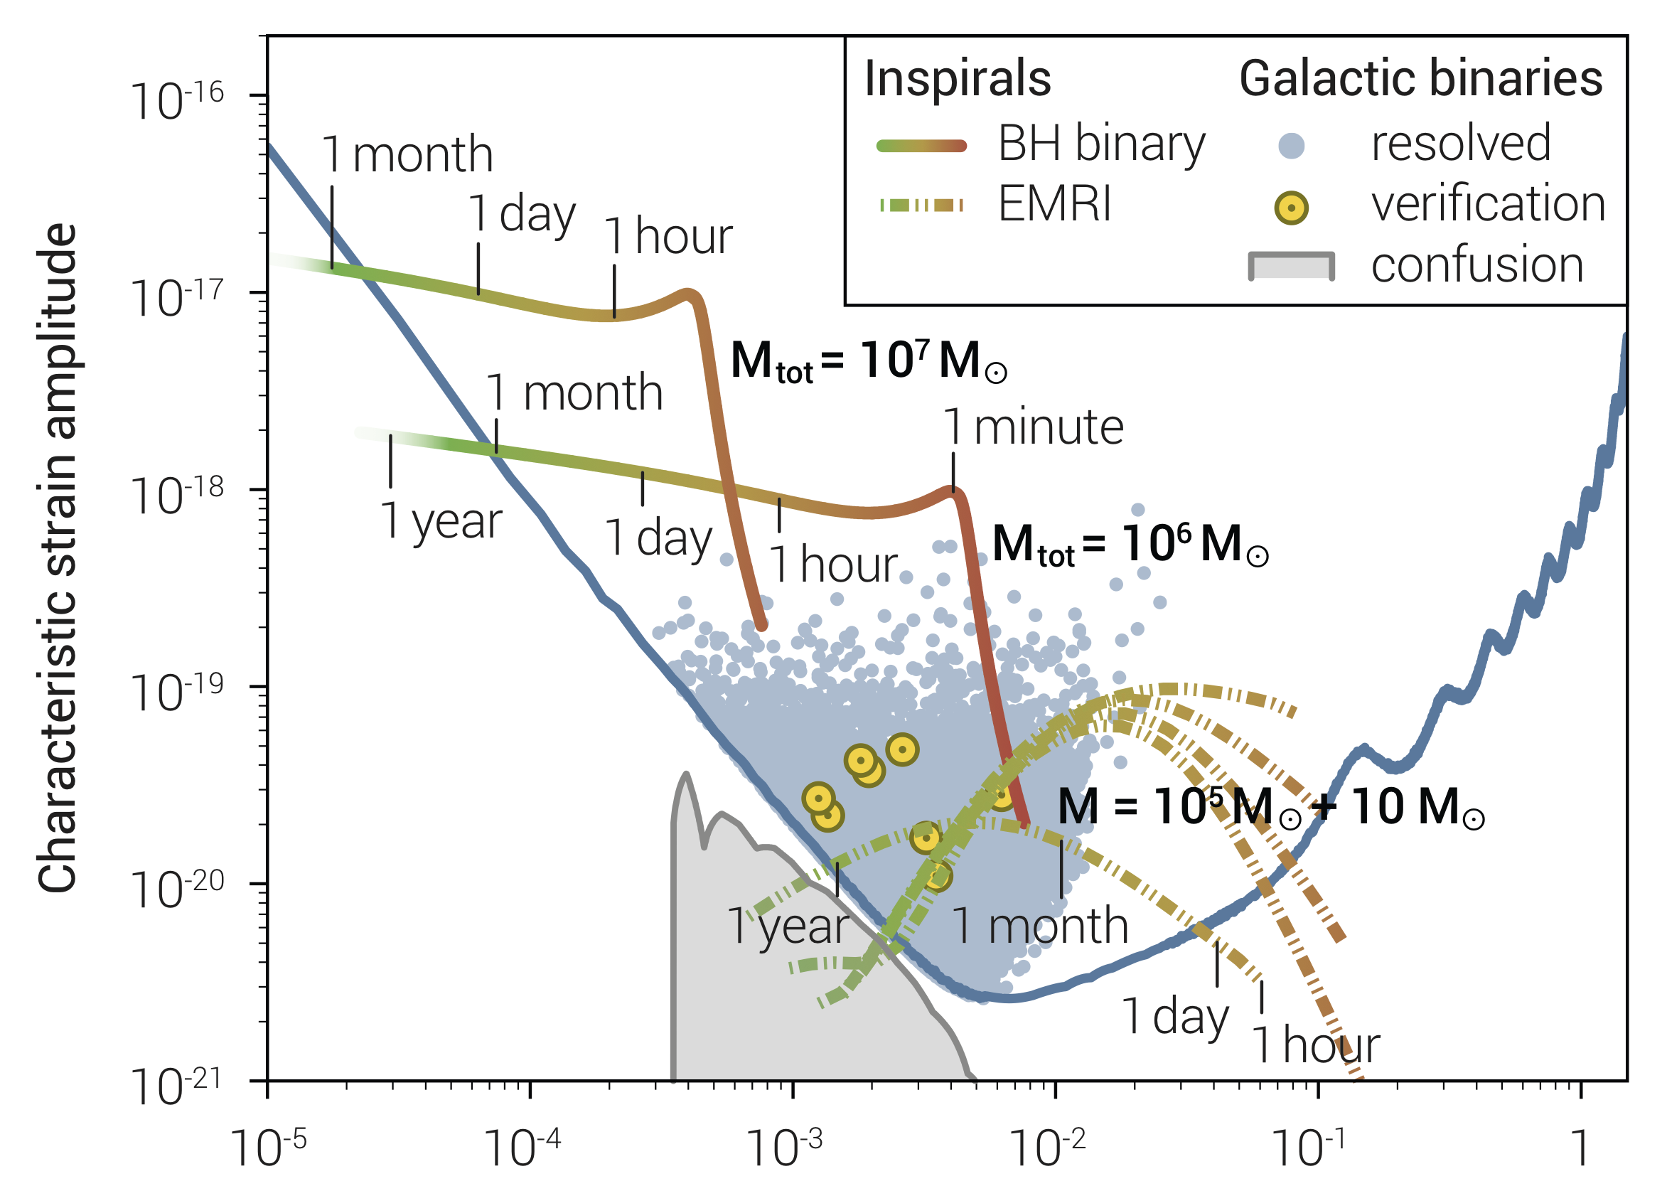
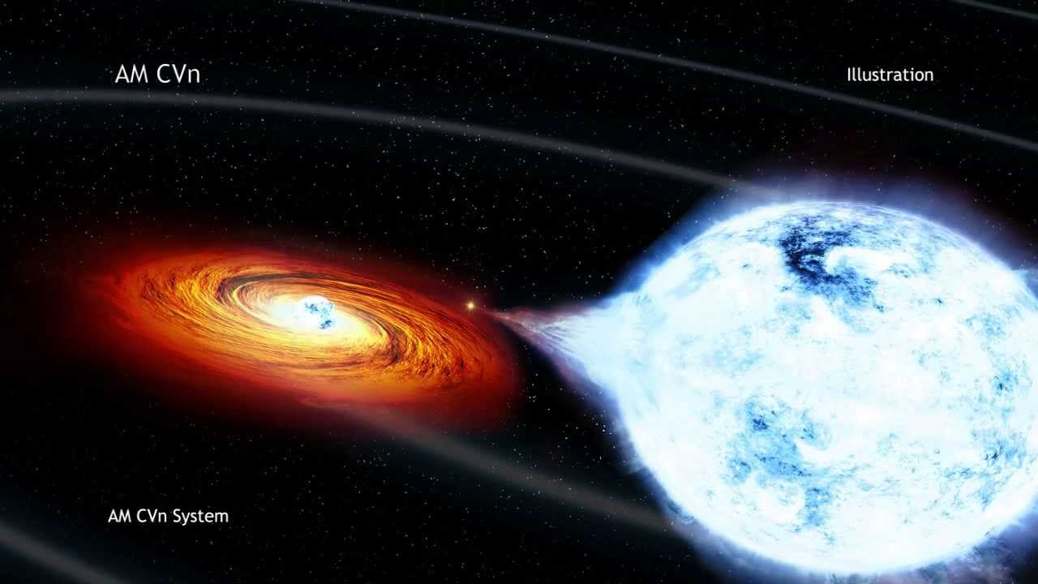
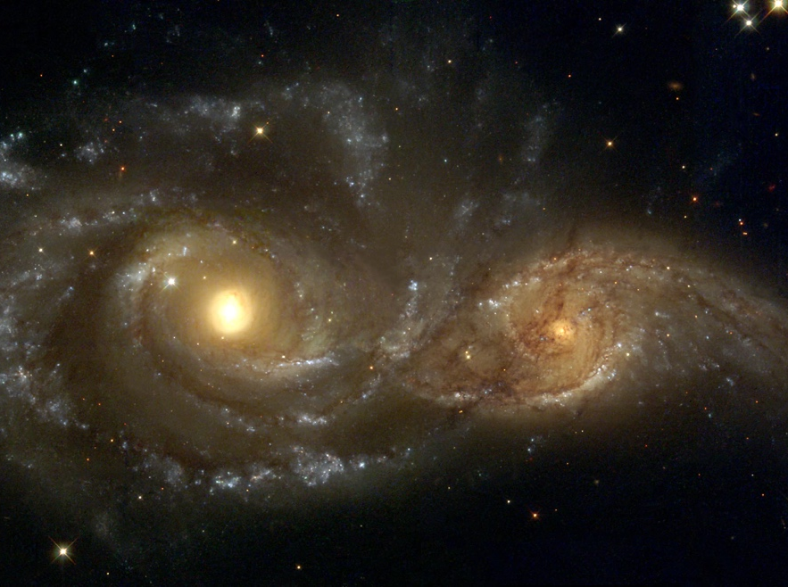
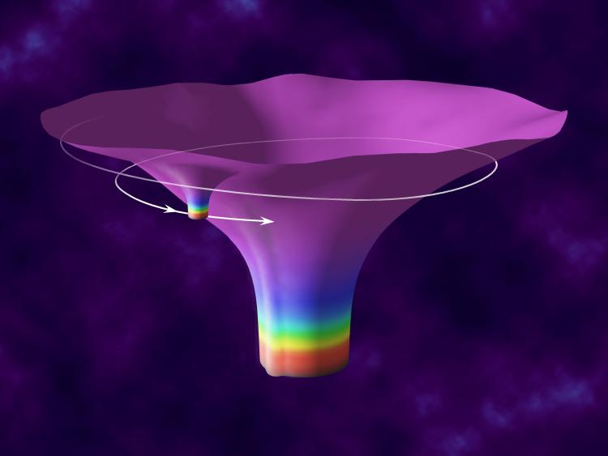
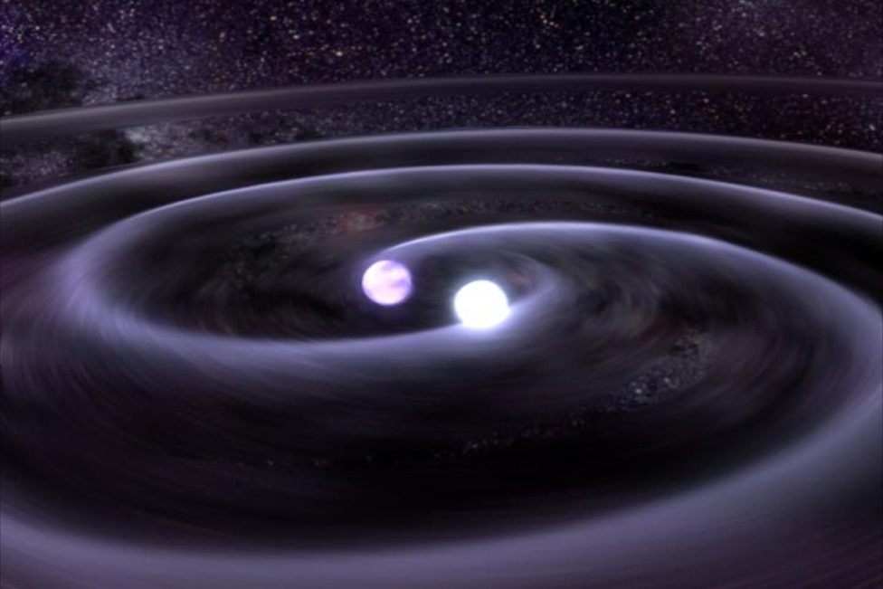
mHz Gravitational waves
The Gravitational Universe
http://elisascience.org

Slide 4
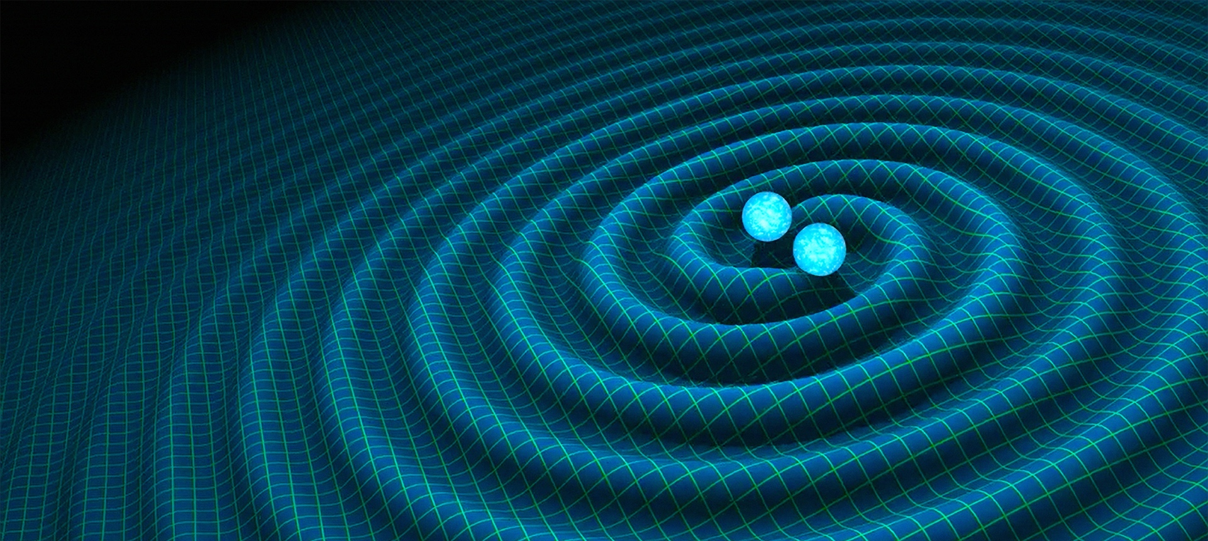
Why go to space?
LISA
LIGO/VIRGO
M up to 10⁷M_{S}
Years from merger
Z up to >10 (@SNR 100s)
SNR >1000s
1000s of sources
Signal dominated
M<100M_{S}
<1s from merger
Z<0.1
SNR <100
100s of sources(?)
Noise dominated

Slide 5
Multi-band GW astronomy
Sesana PRL 116 231102 (2016)

Slide 6
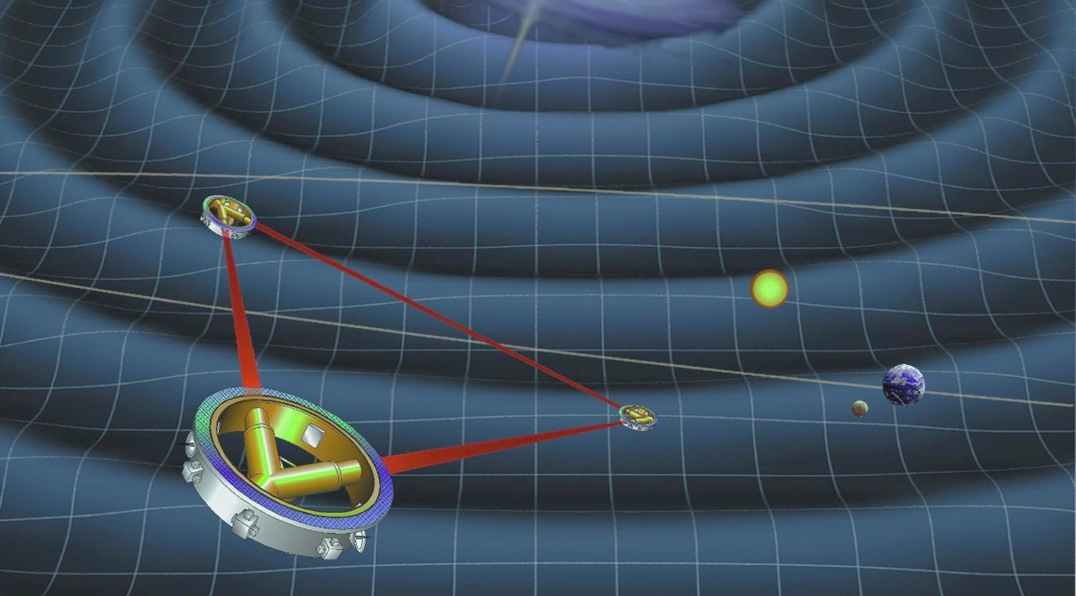
LISA
Gravitational universe theme selected for L3 launch slot in 2034
3 Spacecraft Million-km
arm-lengths
Test masses in sub-femto-g free fall
(10⁻¹⁵ m/s²/√Hz)
Laser interferometry
Satellite-satellite and
TM-satellite
pm/√Hz TM position readout

Slide 7
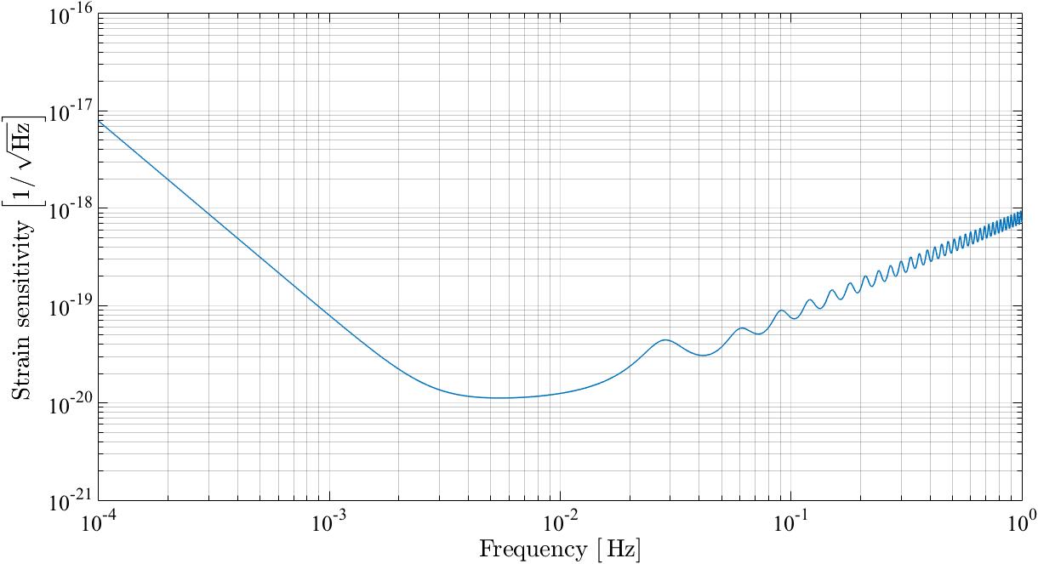
LISA sensitivity
Acceleration noise on test masses
3fm/s²/√Hz
Attenuation by arm-length
5 million km
Interferometer shot noise
20pm/√Hz total

Slide 8
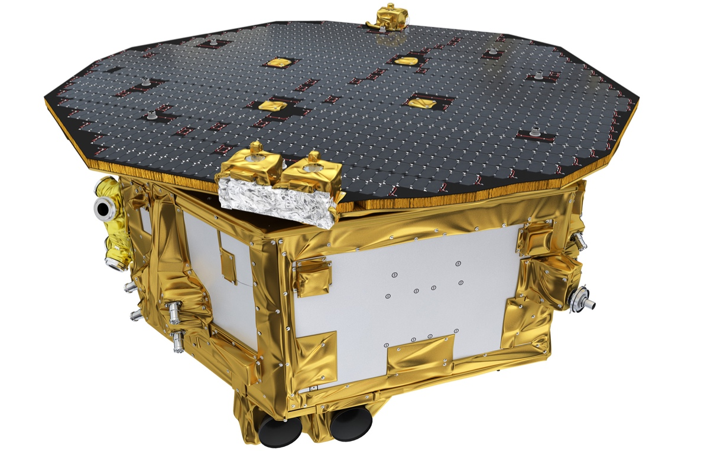
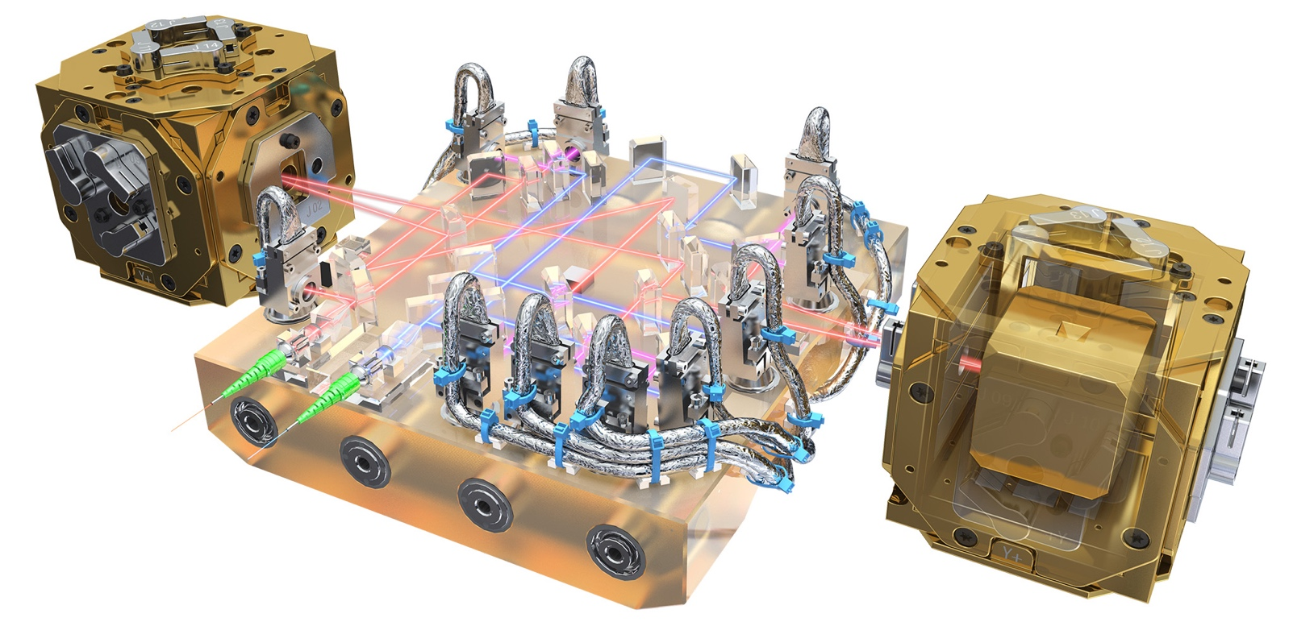
LISA Pathfinder
Demonstrating: TM free-fall,
6-DoF position sensing and actuation
Drag-free with µN thrusters,
Local interferometry
ESA/ATG MediaLab
http://sci.esa.int/lisapathfinder

Slide 9
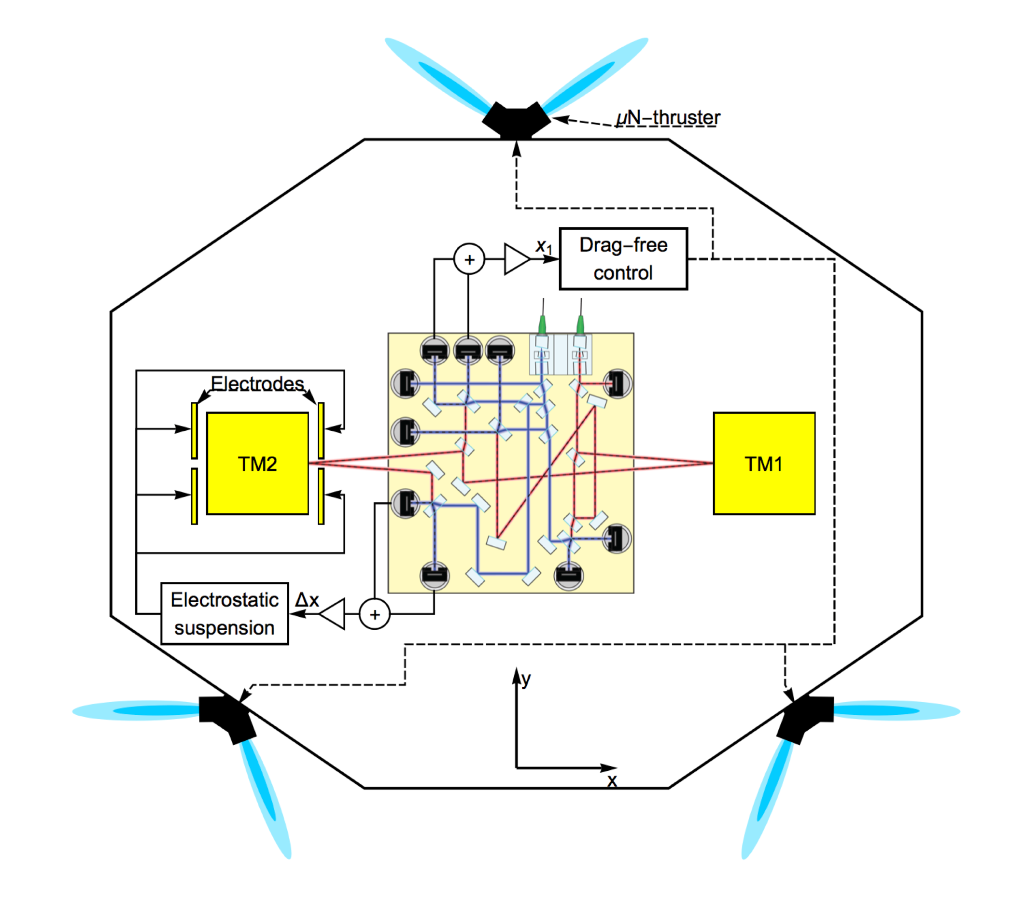

LISA Pathfinder
Spacecraft follows TM1
TM2 forced to follow TM1 with F_{x}
$$∆_{g}=\frac{d^{2}x_{12}}{dt^{2}}−\frac{F_{x}}{m}−ω_{12}^{2}x_{1}−ω_{2}^{2}x_{12}−…$$

Slide 10
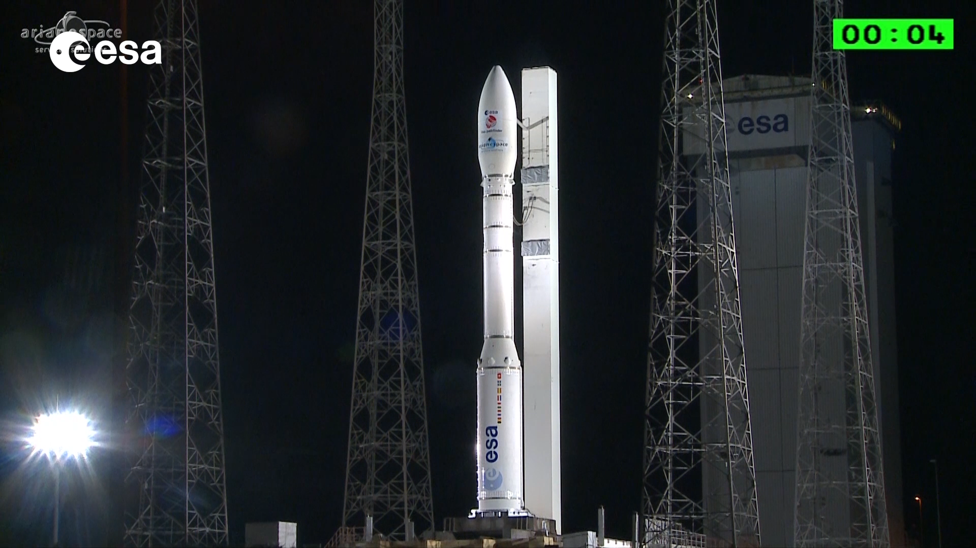
sd

Slide 11
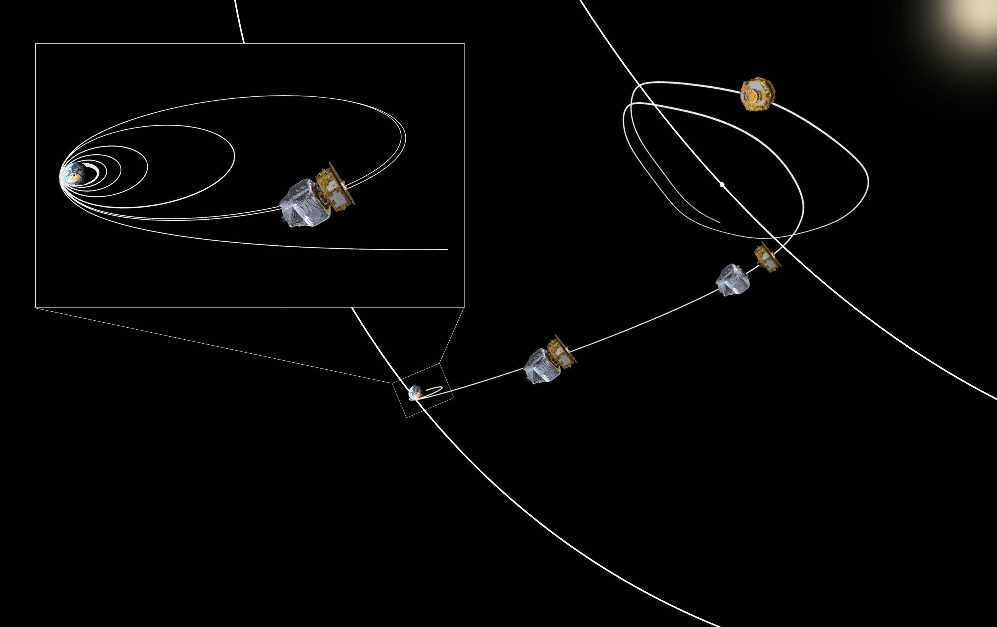
Journey to L1

Slide 12
Commissioning

Slide 13
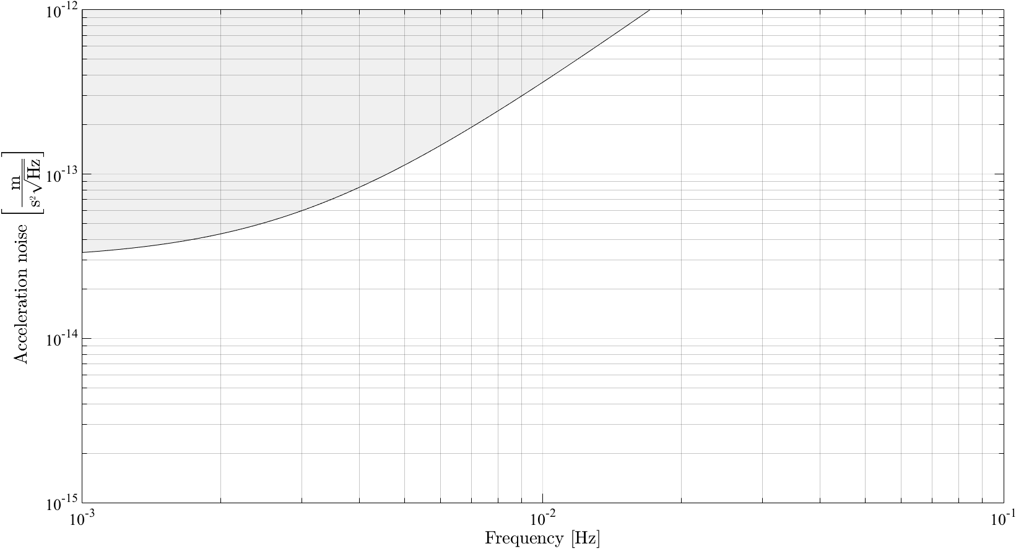
LISA Pathfinder requirements

Slide 14
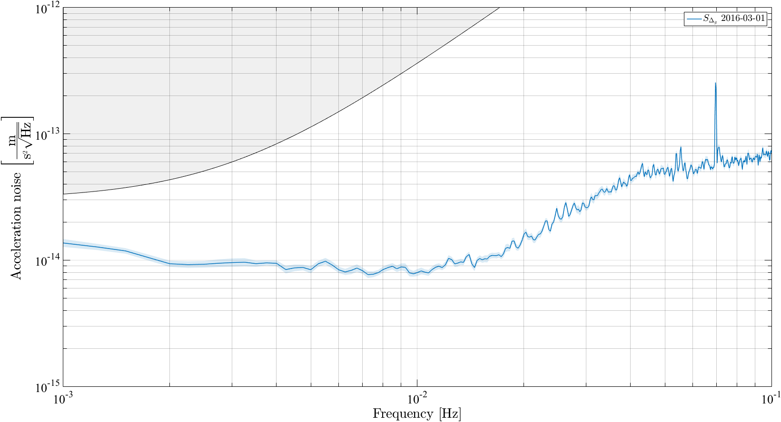
LISA Pathfinder requirements

Slide 15
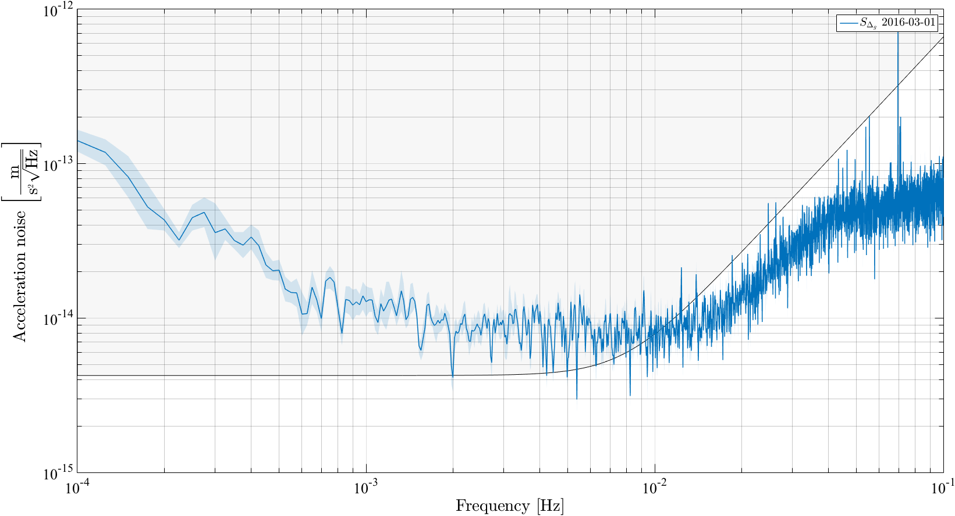
LISA requirements

Slide 16
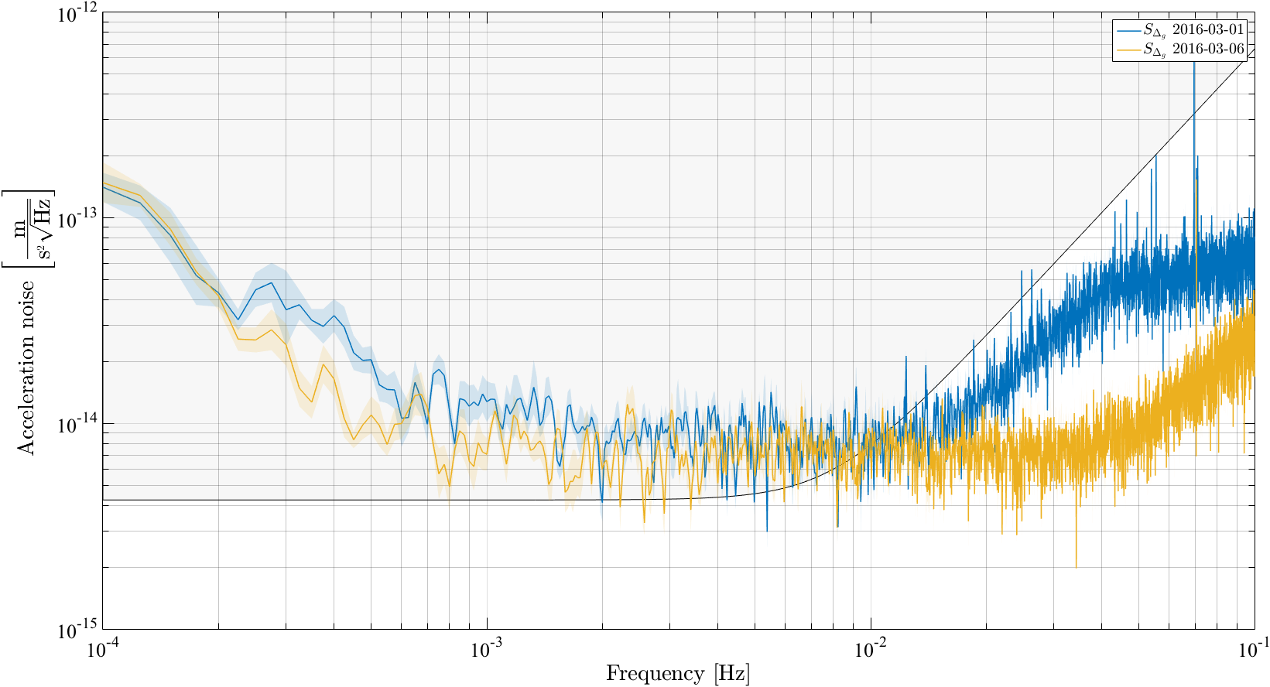
LISA requirements
Spacecraft motion coupling through Interferometer misalignment
Reduce F_{x}

Slide 17
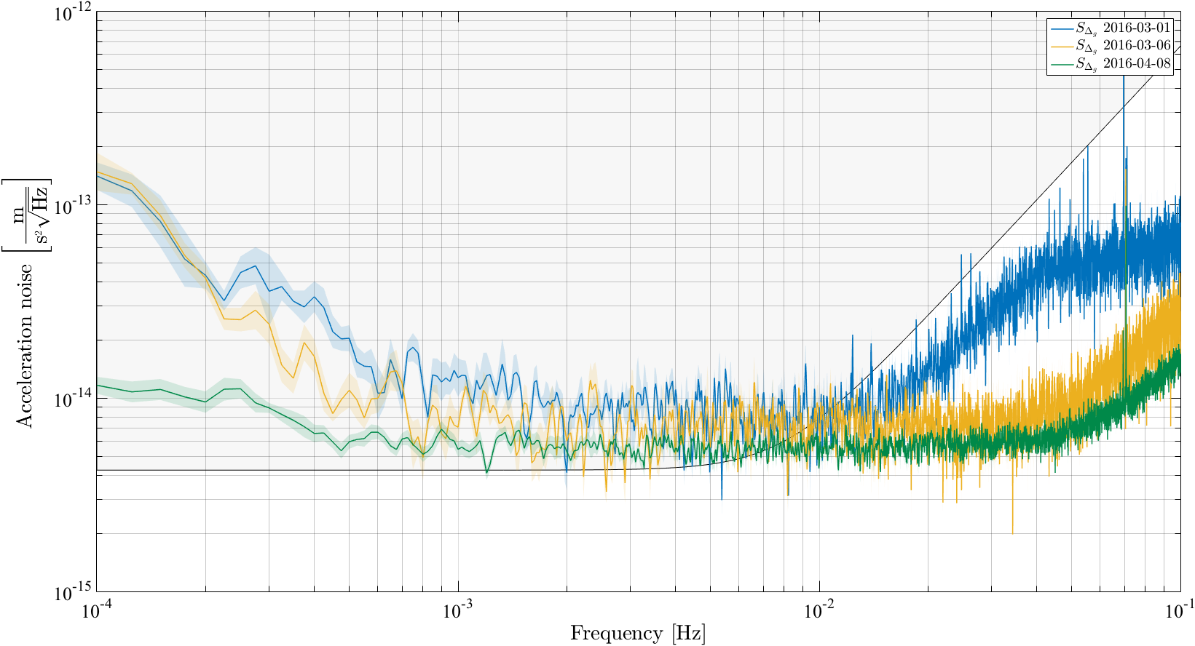
LISA requirements
Low-frequency settling of spacecraft structure
Pressure decrease around TMs
Phys. Rev. Lett. 116, 231101 (2016)

Slide 18
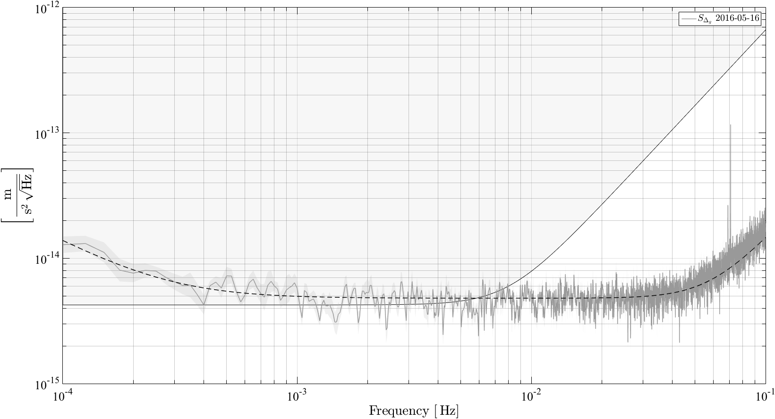
Best performance (so far...)
Unexplained
low-frequency excess f<0.5mHz
Local interferometer performance: 35fm/√Hz
White noise approaching the LISA level 0.5>f>400mHz

Slide 19
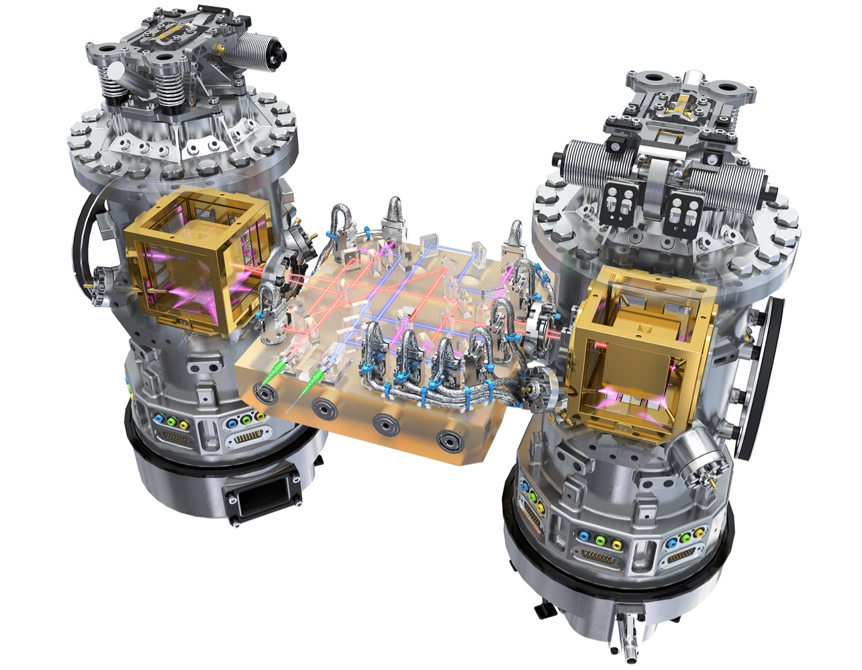
Noise budget
Physics lab in space: characterising force disturbances
  Electrostatic
  Magnetic
  Thermal/Pressure
  Laser power fluctuations
  Spacecraft coupling and cross talk
ESA/ATG MediaLab
http://sci.esa.int/lisapathfinder

Slide 20
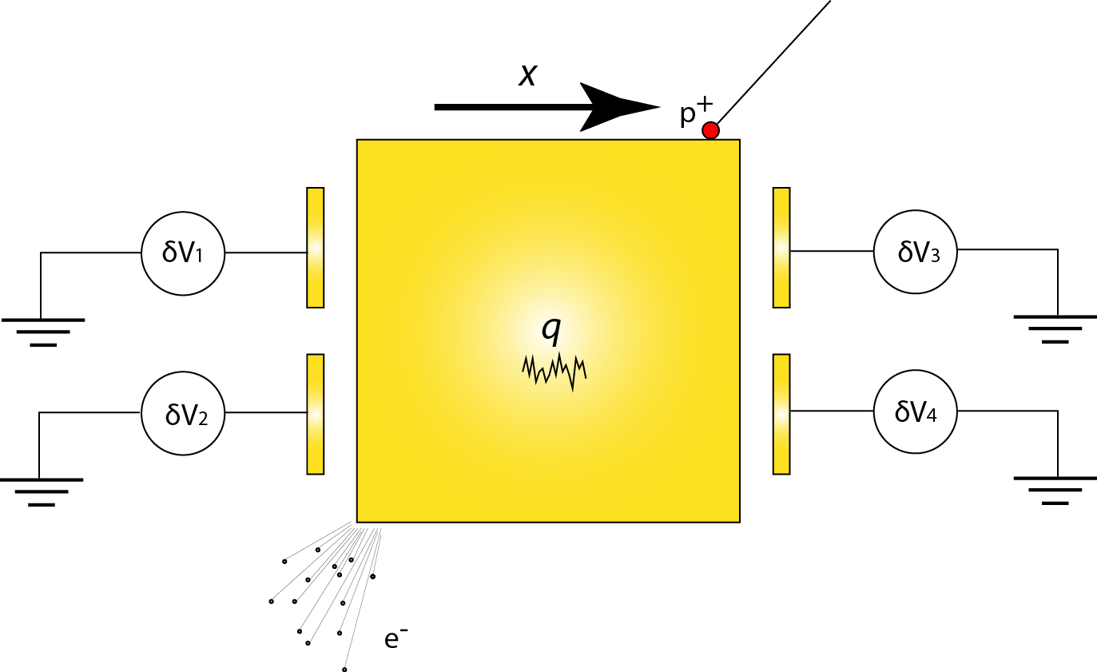
Charge noise
Predictions using GEANT4
25 e/s/√Hz
Wass et al CQG 22 (2005) S311
Araujo et al Astropart.Phys 22 (2005) 451

Slide 21
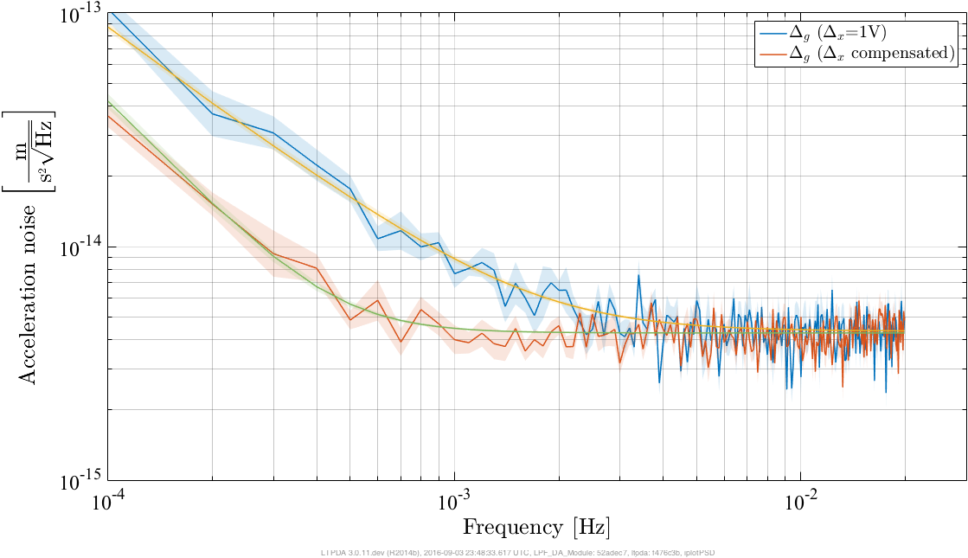

Charge noise
$$S_{∆g}^{1/2}=−\frac{1}{m}\left|\frac{∂C_{x}}{∂x}\right|\frac{1}{C_{\text{tot}}}\sqrt{S_{q1}∆_{x1}^{2}+S_{q2}∆_{x2}^{2}}$$
$$∆_{x1}=∆_{x2}=1\text{V}$$

Slide 22
Current status
Nominal mission complete, NASA operations underway
Some figures:
  92 days of science operations
  ~24 days of ‘non-science’ activities (e.g. station keeping)
  2214 hours of data taking, of which:
  1491 hours of noise measurement (taking data with no injections)
  723 hours of ‘active” investigations
  1 interruption caused by on-board software bug
  ~20GB of data (typically 56kbps for 8hr per day)

Slide 23
Impact for LISA
Noise still improving with pressure after 9 months – LISA transfer will be >1 year
Inertial sensor technology fully demonstrated
Local interferometer performing >100X better than required
Current LPF performance would enable a GW observatory with capability very close to ‘classical’ LISA

Slide 24
Future
LISA Pathfinder extended mission – Low-f performance the focus
LISA is happening now
Mission call issued this month
NASA will provide a contribution
Grace Follow-On testing spacecraft-spacecraft
laser interferometry in 2018

Slide 25

Thank You

