Slide 1
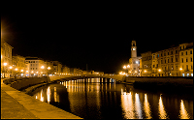


Results from the ANTARES Neutrino Telescope
Maurizio Spurio
University of Bologna and INFN
on behalf of the ANTARES collaboration
SciNeGHE– Pisa 19/10/2016

Slide 2
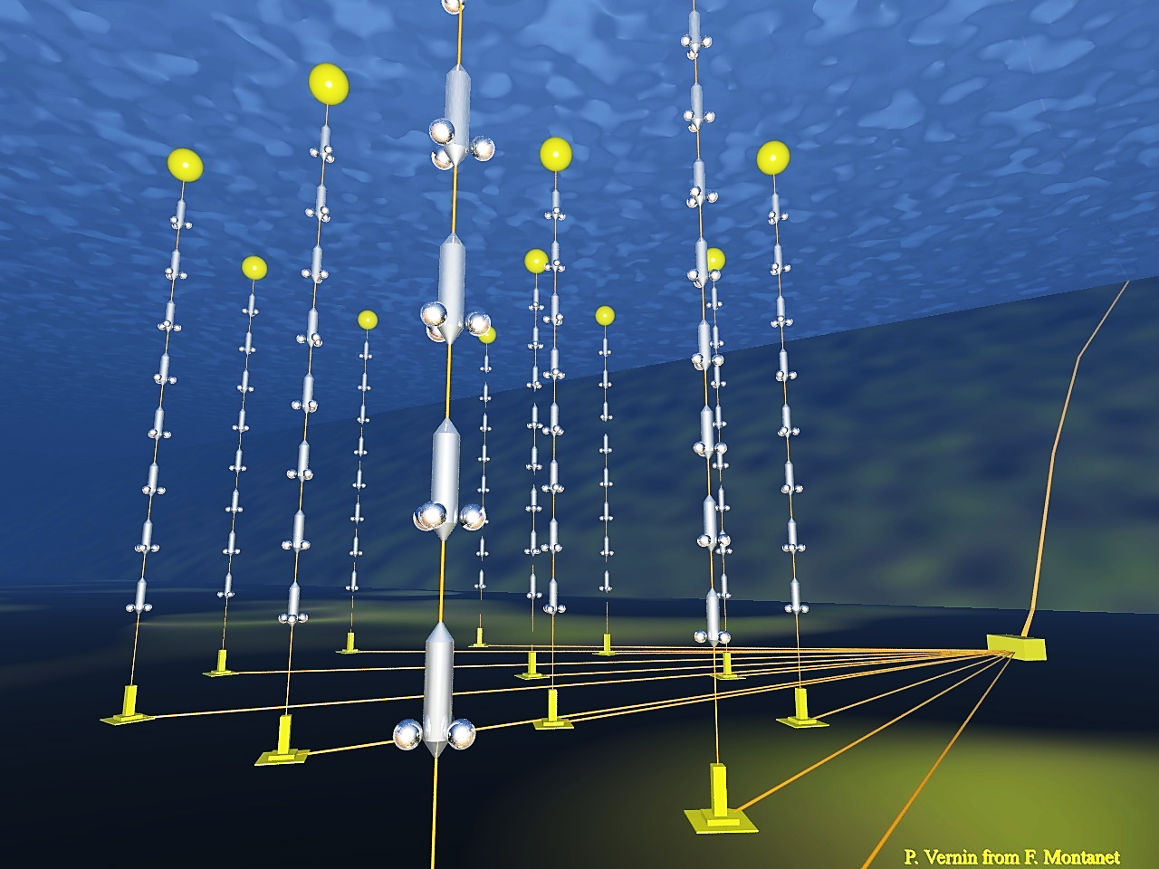
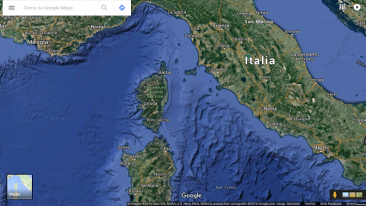
Details: see arXiv 1409.4552
Running since 2007
885 10” PMTs
12 lines
25 storeys/line
3 PMTs / storey
2500m
SciNeGHE
ANTARES
40 km to
shore
450 m
Junction
Box
70 m
Interlink cables

Slide 3
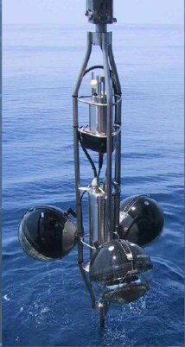
Details: see arXiv 1409.4552
2500m
40 km to
shore
450 m
Junction
Box
70 m
Interlink cables

Slide 4
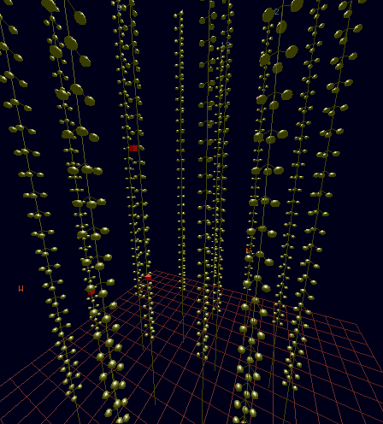
Details: see arXiv 1409.4552
2500m
40 km to
shore
450 m
Junction
Box
70 m
Interlink cables

Slide 5
The scientific goals of ANTARES
Neutrino astrophysics
Multi-messenger studies
Dark Matter searches
Study of atmospheric neutrinos, oscillations
Particle searches: nuclearites, monopoles
Acoustic detection
Sea sciences
}
Not covered in this talk

Slide 6
On the quest for the origin of the IceCube astrophysical ν’s
Isotropic, diffuse
HESE – 4 years

Slide 7
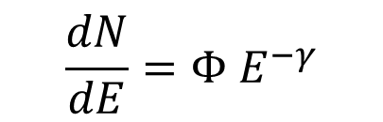
The IceCube spectral anomaly
Evidence for astrophysical neutrinos (HESE,MESE,…) from partially contained events. Upgoing and downgoing events
Evidence for Astrophysical Muon Neutrinos ν_{μ} from the Northern Sky [PRL 115 (2015) 081102]. Results updated: arXiv:1607.08006
A 3.2σ tension among the two samples (HESE…, ν_{μ})
This tension can be solved assuming e.g. a two-component origin of the IC signal (one galactic, one extragalactic)
arXiv:1607.08006
$$\frac{dN}{dE}=Φ E^{−γ}$$
  M. Spurio, PRD 90 (2014) 10, 103004
  A. Neronov, D. Semikoz, APP 75(2016)60
  D. Gaggero et al. APJ L25(2015) 815
  Palladino, F. Vissani, ApJ. 826 (2016) 185
  ….
Γ, Astrophysical ν spectral index

Slide 8


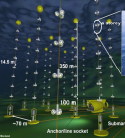
Down in IC = Up in ANTARES
Almost in scale

Slide 9
ANTARES searches for astrophysical neutrinos
Searches for a diffuse flux
Searches for point-like sources
Searches for «enhanced» diffuse flux (extended regions)
Transient/multimessenger studies

Slide 10
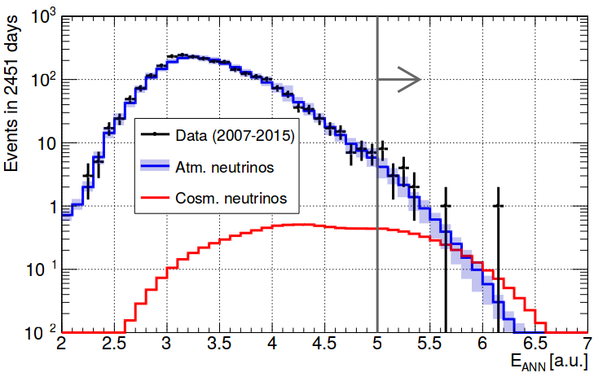
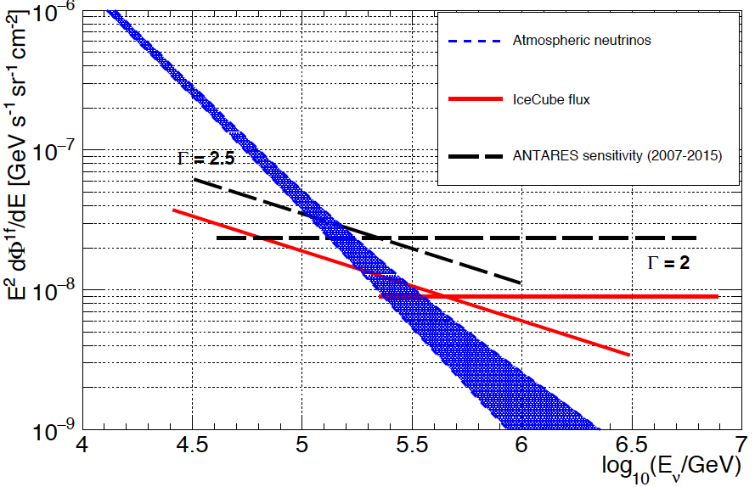
1. ANTARES diffuse flux (tracks)
Search for excess of reconstructed HE events w.r.t atmospheric ν’s
Data: 2007-2015 (2451 livedays)
Optimization based on IC best fit flux (spectral index Γ = 2 and 2.5)
Variables used checked with burn sample (‘0’ ending runs)
preliminary
Reconstructed Energy
preliminary
Above E_{cut}:
Observed: 19 events
Background: 13.5± 3
IC-like signal: 3 events
Plot: ANTARES upper limits and sensitivity

Slide 11
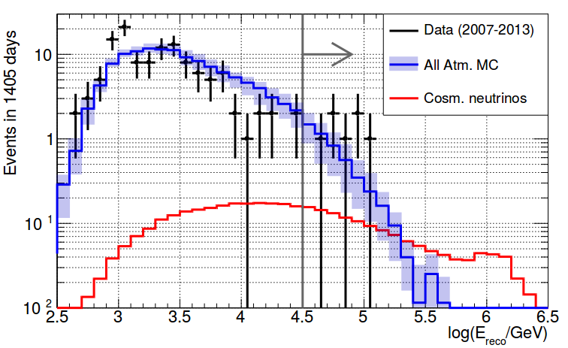
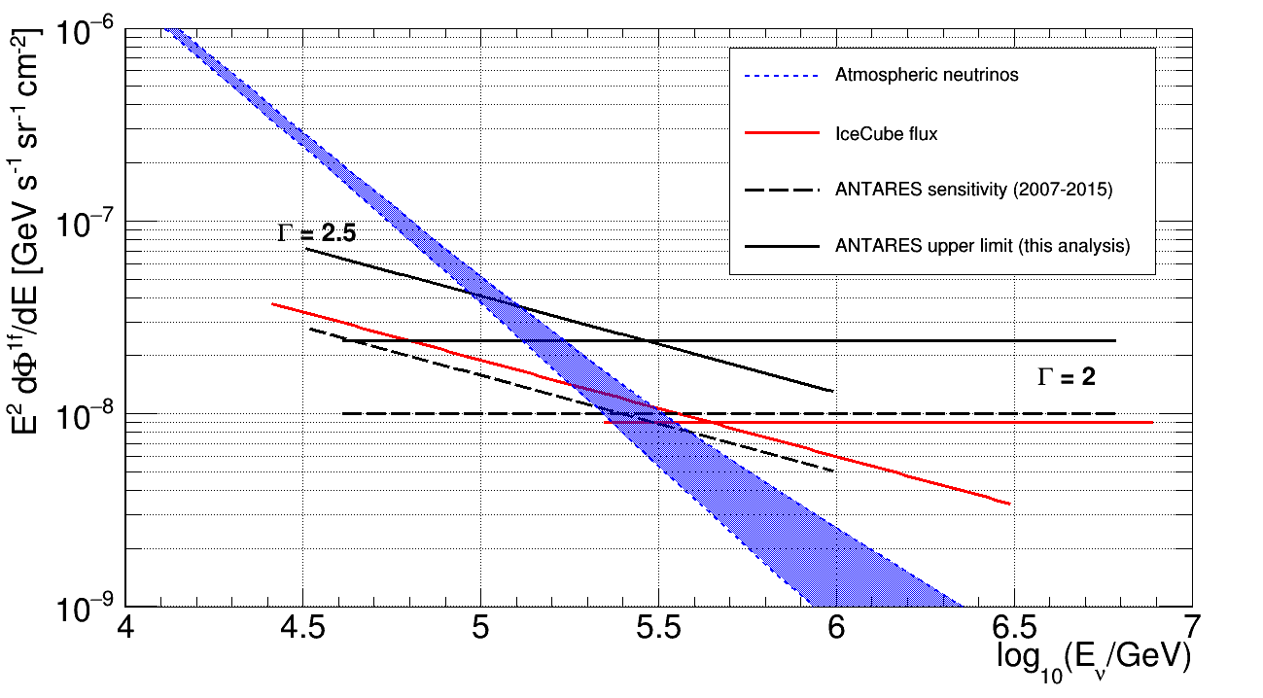
1. ANTARES diffuse flux (cascades)
Search for excess of reconstructed HE events w.r.t atmospheric ν’s
Data: 2007-2013 (1405 livedays)
Optimization based on IC best fit flux (spectral index Γ = 2 and 2.5)
Variables used checked with burn sample (‘0’ ending runs)
preliminary
Reconstructed Energy
Above E_{cut}:
Observed: 7 evts
Background: 5± 2
IC-like signal: 1.5 evts
Plot: ANTARES combined upper limits and sensitivity (2007-2015) for traks+showers
preliminary

Slide 12
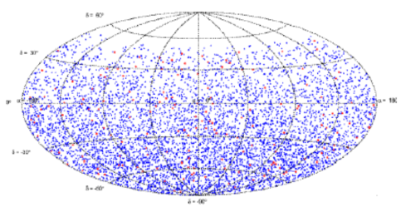
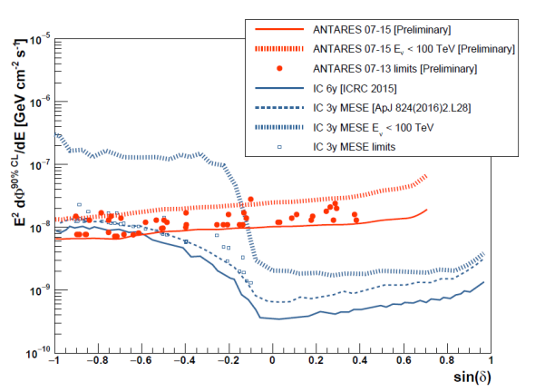
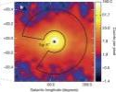
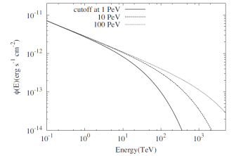
2. Point Sources
2007-2013: 1690 days (+2014-2015 next weeks)
6490 tracks , 172 cascades
Unbinned all-sky search
54 candidate sources + 8 HESE μ
Unsurpassed limits for E<100 TeV
HESS PeVatron
Nature 531 (2016) 476

Slide 13
3. “Enhanced” diffuse flux ?
Fermi Bubbles
Galactic Plane
HS

Slide 14
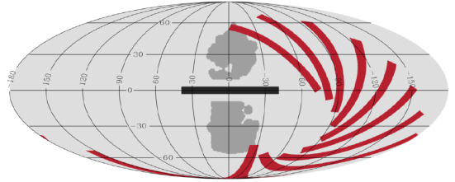
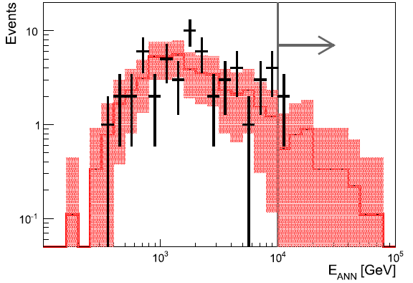
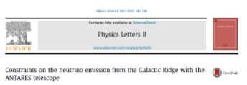
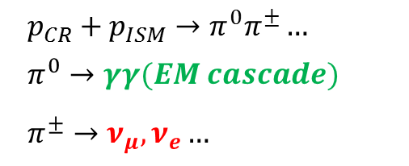
3. The Galactic ridge
ν’s and γ-rays produced by CR propagation
$$p_{CR}+p_{ISM}→π^{0}π^{±}…$$
$$π^{0}→γγ(EM cascade)$$
$$π^{±}→ν_{μ},ν_{e}…$$
Search for ν_{μ} , data 2007-2013
Search region |l|<30° , |b|<4°
Cuts optimized for Γ=2.4-2.5
Counts in the signal/off zones
No excess in the HE neutrinos
90% c.l. upper limits: 3<E_{ν}<300 TeV
PLB 760 (2016) 143

Slide 15
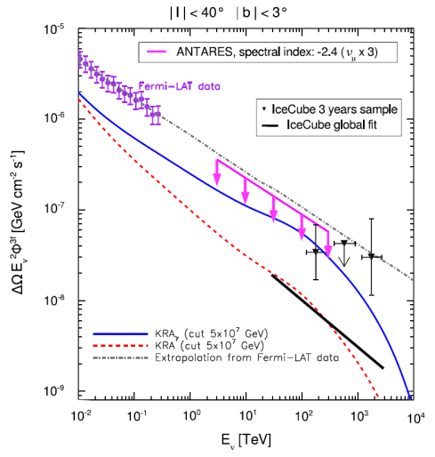
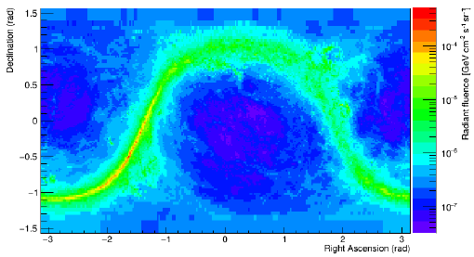

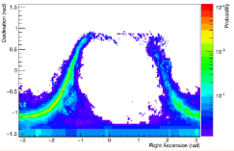

The simple extrapolation of the Fermi-LAT γ-ray measurement to the IC ν flux in the Galactic Plane area excluded
For a neutrino flux ∝E^{−2.5} ≥ 3 HESE originating in this region excluded at 90% c.l.
More information soon (tracks up to 2015+cascades) and max-likelihood analysis
Seen as a shower
preliminary
Seen as a track
preliminary
ν’s yield (positions and E): KRAγ model

Slide 16
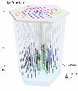
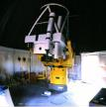
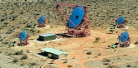

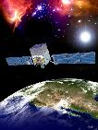




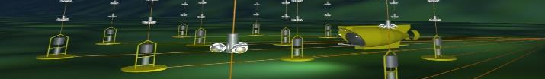
4. Multimessenger program
A way to better understand the related physics mechanisms
A way to increase the detector sensitivities
Multi wavelength follow-up of neutrinos
Radio Visible X-ray GeV-ray TeV-ray GW ν
MWA TAROT Swift Fermi-LAT HESS Ligo IC
ZADKO HAWC Virgo
MASTER
Alerts 12/yr 30/yr 6/yr (Offline) (1-10/yr) (Offline)

Slide 17
4. Multimessenger program
A way to better understand the related physics mechanisms
A way to increase the detector sensitivities
Real-time (follow-up of the selected neutrino events):
optical telescopes [TAROT, ROTSE, ZADKO, MASTER]
X-ray telescope [Swift/XRT]
GeV-TeV γ-ray telescopes [HESS, HAWC]
radio telescope [MWA]
Online search of fast transient sources [GCN, Parkes]
Multi-messenger correlation with:
Gravitational wave [Virgo/Ligo]
UHE events [Auger]
Time-dependent searches:
GRB [Swift, Fermi, IPN]
Micro-quasar and X-ray binaries [Fermi/LAT, Swift, RXTE]
Gamma-ray binaries [Fermi/LAT, IACT]
Blazars [Fermi/LAT, IACT, TANAMI…]
Crab [Fermi/LAT]
Supernovae Ib,c [Optical telescopes]
Fast radio burst [radio telescopes]

Slide 18

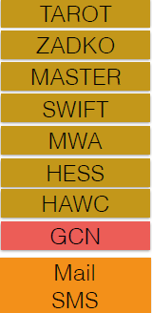

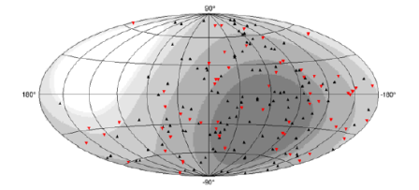
Real-time follow-up (TAToO)
APP 35 (2012) 530 (method)
JCAP 02 (2016) 062 (optical)
AJ 820 (2016) L24 (radio)
External server
ANTARES trigger
single HE ν (~10 TeV)
single ν correlated to local galaxies for SNe (~1 TeV)
doublet of ν’s
Performances:
Time to send an alert: ~ 5 s
Median angular resolution: 0.3º - 0.4º
First image of the follow-up: <20 s
Dedicated optical image analysis

Slide 19
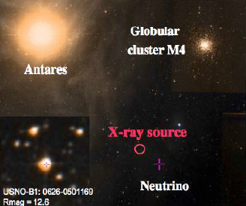
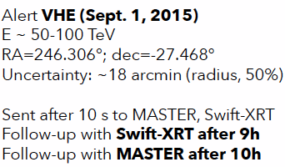
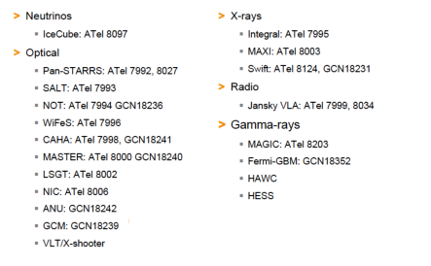
A particular event: ANT150901
Multifrequency observations:
16 ATEL + 6 GCN
GCN CIRCULAR NUMBER: 18236
(Optical + NIR spectroscopy from NOT)
..All this points to USNO-B1.0 0626-0501169 being a young accreting G-K star, undergoing a flaring episode that produced the X-ray emission. We also note that this object is close to the nearby Rho Ophiuchi star forming region, being probably associated with it.

Slide 20
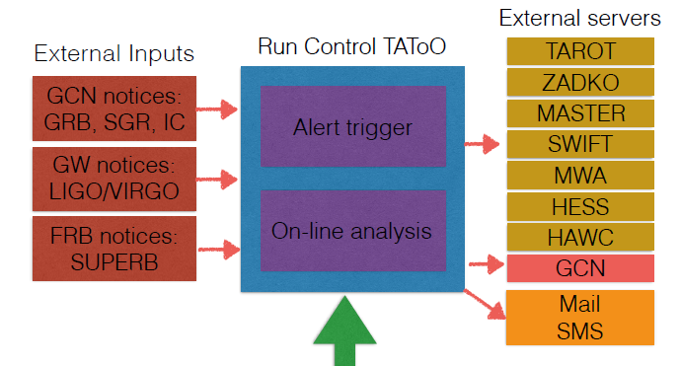
On-line set-up
External server
External input
ANTARES run control
Alert trigger
On-line analysis
ANTARES
on-line data
Private MoU with all the observatories
Different transfer protocols (mail, GCN socket, VO Event…)

Slide 21
4. Multimessenger program
A way to better understand the related physics mechanisms
A way to increase the detector sensitivities
Real-time (follow-up of the selected neutrino events):
optical telescopes [TAROT, ROTSE, ZADKO, MASTER]
X-ray telescope [Swift/XRT]
GeV-TeV γ-ray telescopes [HESS, HAWC]
radio telescope [MWA]
Online search of fast transient sources [GCN, Parkes]
Multi-messenger correlation with:
Gravitational wave [Virgo/Ligo]
UHE events [Auger]
Time-dependent searches:
GRB [Swift, Fermi, IPN]
Micro-quasar and X-ray binaries [Fermi/LAT, Swift, RXTE]
Gamma-ray binaries [Fermi/LAT, IACT]
Blazars [Fermi/LAT, IACT, TANAMI…]
Crab [Fermi/LAT]
Supernovae Ib,c [Optical telescopes]
Fast radio burst [radio telescopes]

Slide 22
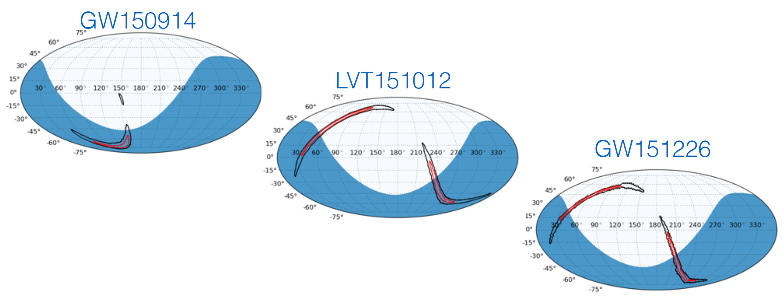
Neutrino follow-up of GWs
3 alerts sent by LIGO during the run 01 (2015/09 → 2016/01):
GW150914: merging of 2 BHs (M= 36/29 M_{s} - 410 Mpc - 5.1 σ)
LVT151012: merging of 2 BHs (M= 23/13 M_{s} - 1000 Mpc - 1.7 σ)
GW151226: merging of 2 BHs (M= 14/7 M_{s} - 440 Mpc - >5 σ)
ANTARES visibility

Slide 23
Neutrino follow-up of GW150914 a joint ANTARES/IceCube/LigoSC/Virgo. Phys.Rev. D93 (2016), 122010
No ANTARES events in ±500 s from the GW time (0.015 expected)
Limits from ANTARES dominates for Eν < 100 TeV
U.L. from IC dominated above 100 TeV
Size of GW150914 : 590 deg² ANTARES resolution: <0.5 deg²
Limits on total energy radiated in neutrinos: <10% GW
Future: Receive / send alerts in real time

Slide 24
4. Multimessenger program
A way to better understand the related physics mechanisms
A way to increase the detector sensitivities
Real-time (follow-up of the selected neutrino events):
optical telescopes [TAROT, ROTSE, ZADKO, MASTER]
X-ray telescope [Swift/XRT]
GeV-TeV γ-ray telescopes [HESS, HAWC]
radio telescope [MWA]
Online search of fast transient sources [GCN, Parkes]
Multi-messenger correlation with:
Gravitational wave [Virgo/Ligo]
UHE events [Auger]
Time-dependent searches:
GRB [Swift, Fermi, IPN] arXiv:1608.08840, JCAP 1303 (2013) 006
Micro-quasar and X-ray binaries [Fermi/LAT, Swift, RXTE]
Gamma-ray binaries [Fermi/LAT, IACT]
Blazars [Fermi/LAT, IACT, TANAMI…]
Crab [Fermi/LAT]
Supernovae Ib,c [Optical telescopes]
Fast radio burst [radio telescopes]
arXiv:1609.07372
JCAP 1512 (2015), 014; A&A 576 (2015) L8
in preparation
in preparation

Slide 25
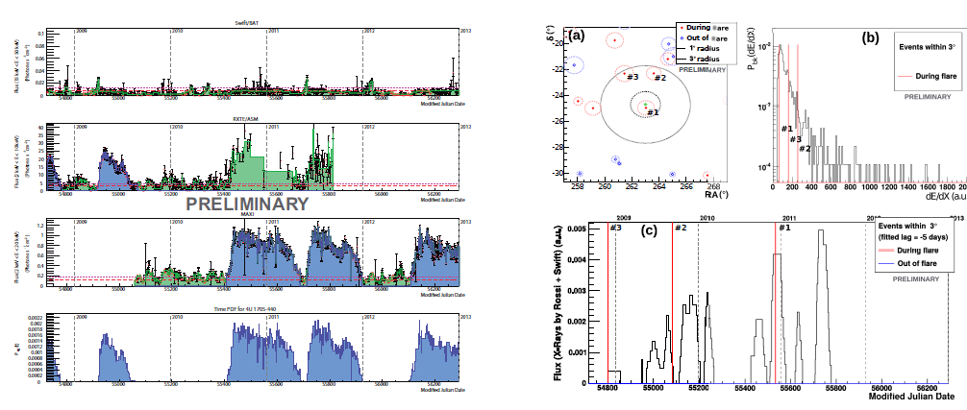
ν_{μ} associated with GeV and TeV γ-ray flaring blazars and X-ray binaries
Search for ν’s (2008-2012) correlated with high activity state
Blazars monitored by FERMI-LAT and IACTs (JCAP 1512 (2015), 014)
33 X-ray binaries during flares observed by Swift-BAT, RXTE-ASM and MAXI. Transition states from telegram alerts (paper in prep.)
No significant excess (best post-trial 72% for GX 1+4).
Upper limits on ν fluence and model parameters constrain

Slide 26

Dark Matter searches
ν
DM→
Searches for a possible ν_{μ} excess due to DM annihilation from the Galactic center, the Sun core, the Earth nucleus

Slide 27
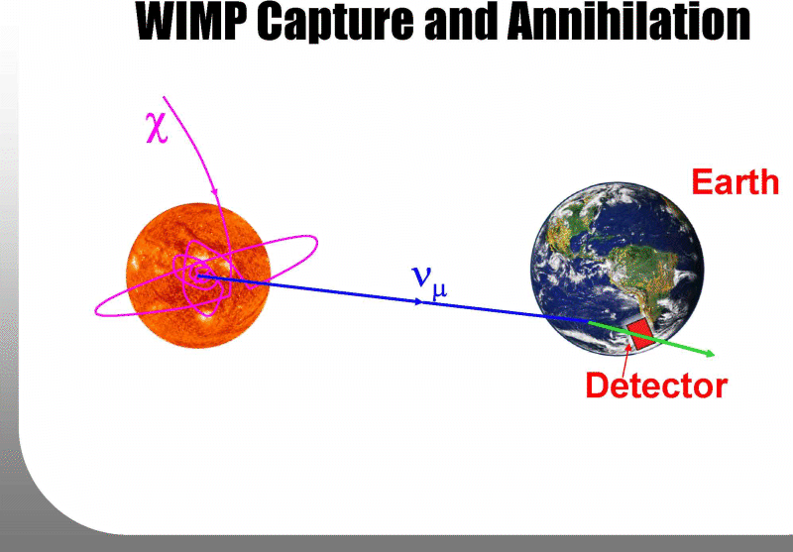
Search from the Sun
DM particles scatter with Sun’s nuclei and accumulate in its centre.
Among the final products, only neutrinos could escape.
HE ν’s from the Sun would be a very clean indication of DM (no significant astrophysical backgrounds expected)
For the Earth and the Sun analyses the DM, the ν_{μ} spectrum calculated with WIMPSIM [Blennow,Edsjö,Ohlsson,arXiv:0709.3898]
Annihilations into: b‾b, τ⁺τ⁻, W⁺W⁻, μ⁺μ⁻ (and non-SUSY) ν‾ν used as benchmark
Background estimated from time scrambled data.
The sensitivities optimized w.r.t. a search cone and reconstruction quality No excess observed
Most restrictive limits for
spin-dependent cross section

Slide 28
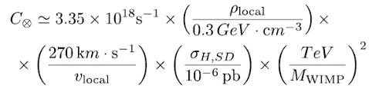

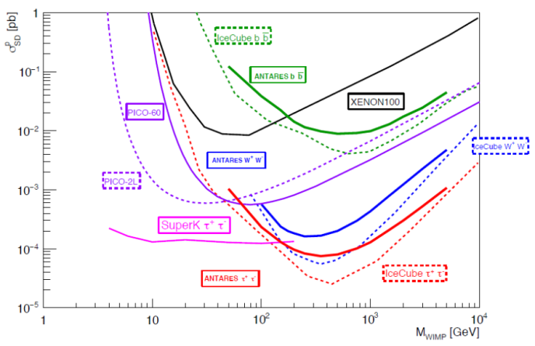
Search from the Sun (result)
Equilibrium assumed between capture and annihilation in the Sun
2Γ≅
Spin dependent cross section
Phys.Lett. B759 (2016) 69-74

Slide 29




DM from the Galactic Center
ANTARES in the North hemisphere: very good visibility of the GC (Ice Cube: veto used)
J-factor s calculated with CLUMPY
Particle physics
DM distribution
x
preliminary

Slide 30
Summary
ANTARES is significantly contributing to understand the origin of cosmic neutrinos observed by IceCube;
Southern sky: studied with ν_{μ} competitive sensitivities and excellent angular resolution for both tracks and cascades;
  Upper limits on known GeV-TeV γ-ray sources <10⁻⁸ GeV/(cm² s)
  Sensitivity for a diffuse flux close to the level of the IC signal
Detailed study of extended regions (Galactic plane, Fermi Bubbles)
  no ν_{μ} excess from the Galactic ridge/IC hot spot;
A large multimessenger effort
  EM radiation: radio (MWA), optical, X-ray, γ-rays (LAT,IACTs)
  Gravitational Wave observatories and IceCube
ANTARES contribute to the indirect searches for Dark Matter
  Most competitive limits for spin-dependent cross-section
  Competitive <σv> limits from the Galactic center

Slide 31





Thank you!
ANTARES demonstrate the great potential of deep-sea Neutrino Telescopes
… the future is today: see next talk
ν

Slide 32
Spares

Slide 33
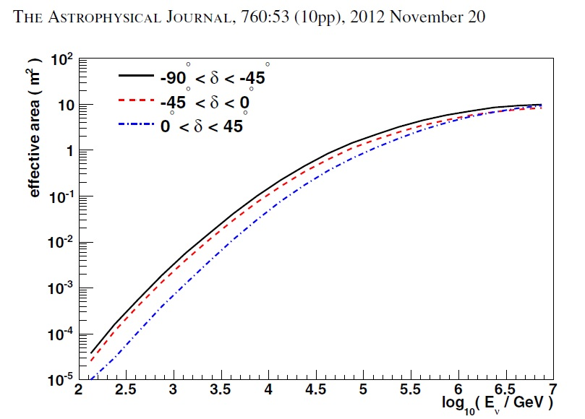


How limits on fluence are deduced?
Assume a neutrino spectrum
Use the neutrino effective area
The number of expected events is:
In a time T=1000s, the value that yields $N_{exp}$ =2.3 events is
$$Φ^{90\%cl} ≅3 {10}^{−3} GeV {cm}^{−2}s^{−1}$$
or a fluence of ($Φ^{90\%cl}∙T) ≅3 GeV {cm}^{−2}$
When integrated in different energy ranges we get (for E⁻² spectrum):
$$E_{min} −E_{max}$$

Slide 34
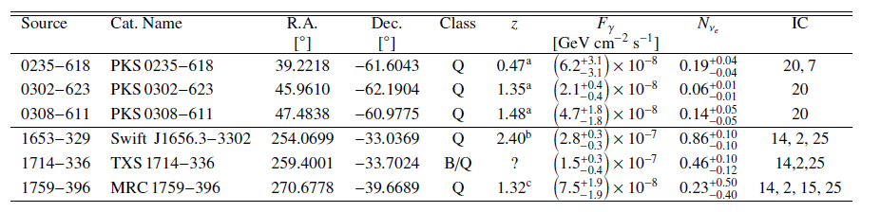


Blazars monitored by TANAMI*
* Multiwavelength monitoring of extragalactic jets in the Southern Sky. Krauß, et al. 2014, A&A, 566, L7
Three blazars associated with IC14 (Bert) and three with IC20 (Ernie)
All 6 in the FoV of ANTARES. Exposure (A_{eff}T) larger than IC for E_{ν}<100 TeV
From the photon flux F_{γ}→ ν_{e} in IceCube ∼ ν_{μ} ANTARES
One event in correspondence of two of the blazars (IC14)
Compatible with an atmospheric origin; blazar-origin hypothesis of the IceCube event IC14 for a range of blazar spectra not excluded
PKS B1424−418: A high-fluence blazar in the IC 35 field (BigBird).
ANTARES observes no events from PKS B1424−418
A&A Lett. 576 (2015) L8
IceCube
ANTARES
PKS B1424−418
many
35
0
Notes:
The maximum-likelihood procedure estimates Nsig as a continuous variable

Slide 35
IC-HESE vs. ANTARES A_{eff}
Comparisons among experiments must be done using the effective areas, which depend on the particular analysis

Slide 36
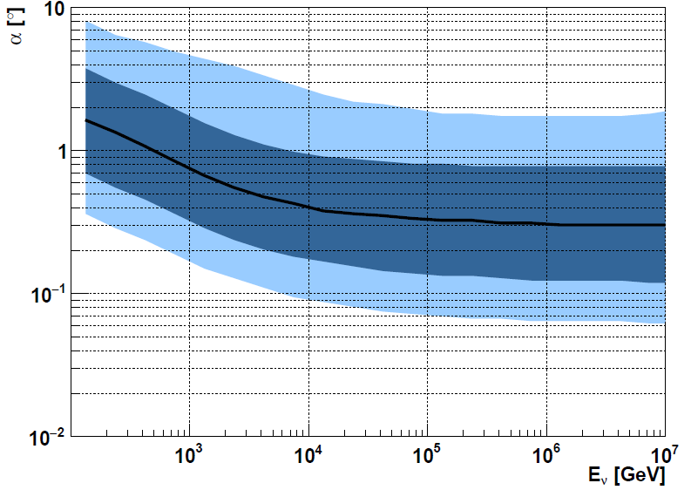

Tracks (ν_{μ}CC) in ANTARES
ANTARES angular resolution vs Eν.
Black line: median resolution
dark-blue 1σ region
light-blue 2σ region
Tracks best suited for astronomy
Median <0.4° above 10 TeV
90% purity

Slide 37
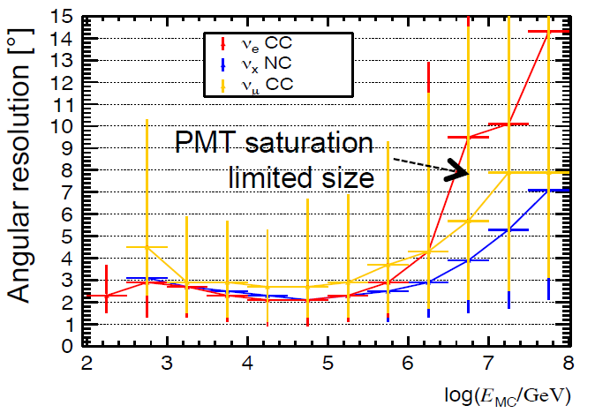
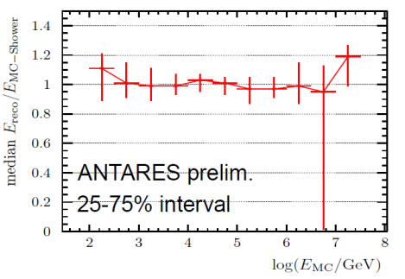
Cascades (ν_{e}CC, NC) in ANTARES
Cascade events (upgoing) also used for astronomy
Shower confined within ∼10m
Angular resolution 3°
Better measurement of the neutrino energy
Energy resolution better than ∼ 10% in a wide energy range

Slide 38
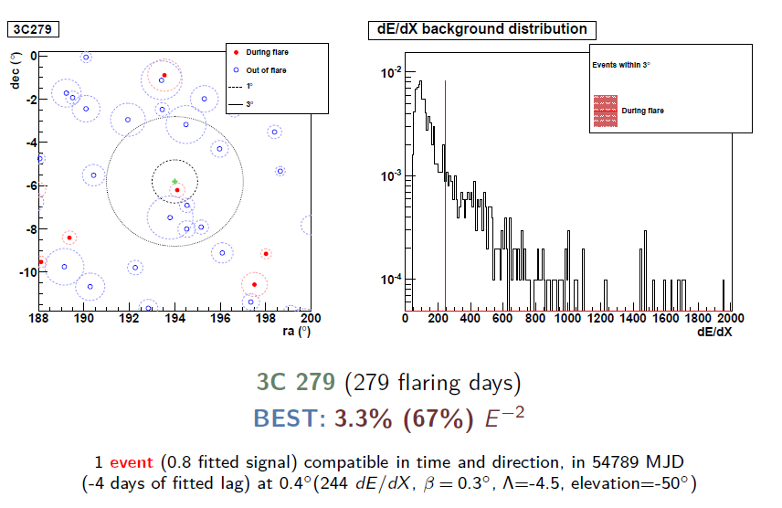
3C 279 Blazar

Slide 39
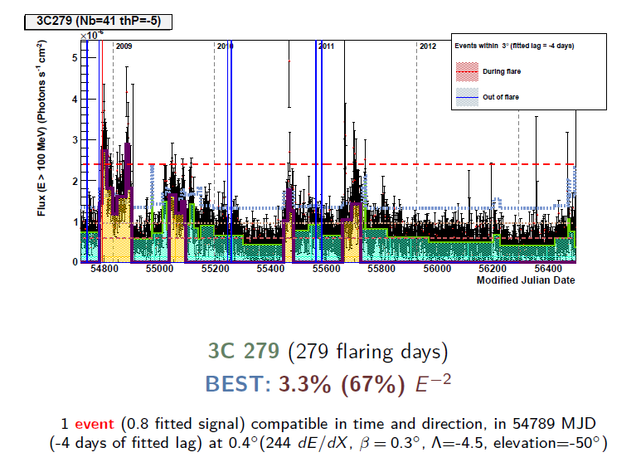
3C 279 Blazar

Slide 40
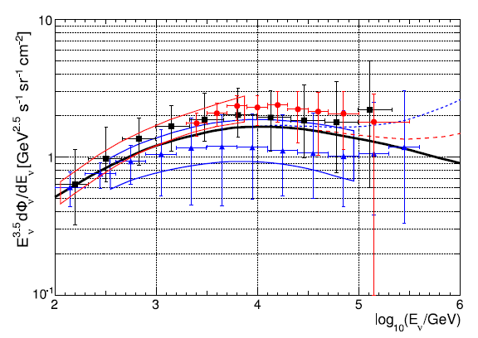
Atmospheric neutrinos
The ν_{μ} channel allows a proxy estimate of the energy
of reconstructed ν_{μ} within 0.4° (for E⁻² spectrum)

Slide 41
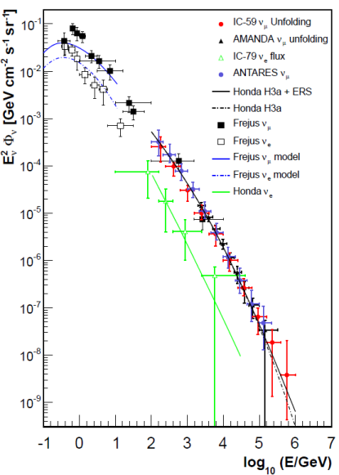
Atmospheric neutrinos → irreducible background
The expected signal spectrum is harder than the background of atmospheric neutrinos
The search methods rely on the event-by-event estimate of the ν_{μ} energy (the muon light yield gives a proxy)
Comparison between the signal region and off-signal zones
Cosmic Signal
∝ Φ₀E^{−Γ}
IceCube Coll. arXiv:1409.4535v3
ANTARES EPJ C (2013) 73:2606

Slide 42
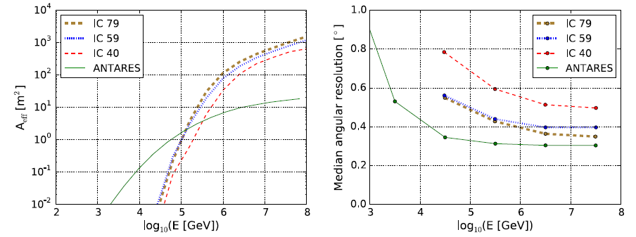
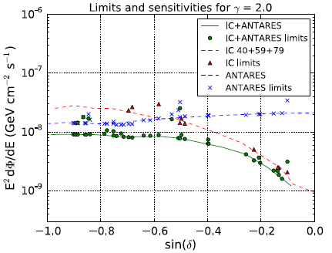
2. Joined ANTARES-IC PS searches
Effective areas (IC, ANTARES)
IceCube
IceCube
Angular resolution (IC, ANTARES)
Combined 90% CL sensitivities (green line) and limits (points) for E⁻² spectrum.
Blue (Red ) curves/points indicate ANTARES (IceCube) sensitivities/limits
Astrophys.J. 823 (2016) no.1, 65

Slide 43



2.Hidden PS producing n_{p} HESE?
A Point Source with Φ₀E^{−Γ} can produce some of the HESE?
The ANTARES 90% C.L. upper limit excludes that a single point-like source produces n_{p}>6 HESE, assuming Γ=2.0.
A single point-like source yielding n_{p}>3 is excluded for Γ=2.3
δ=-29º
Γ=2.4
Γ=2.2
Γ=2.0
declination
n_{p}=

Slide 44



3. ν from Fermi Bubbles
ANTARES EPJ C (2014) 74:2701
The ν can test the hadronic origin of the bubbles
E⁻² ,E^{-2.18} spectra [Lunardini et al. PRD92 (2015) ] and different cutoff : 50, 100, 500, ∞ TeV
comparison on-zones/off‑zones (3) of ΔΩ=0.66 sr
2008-2015 analyzed (806+366+593 (new) days).
28 events observed /19.7 average bck expected
Excess of 1.5σ (decreased from the 806+366 days)

