Slide 1

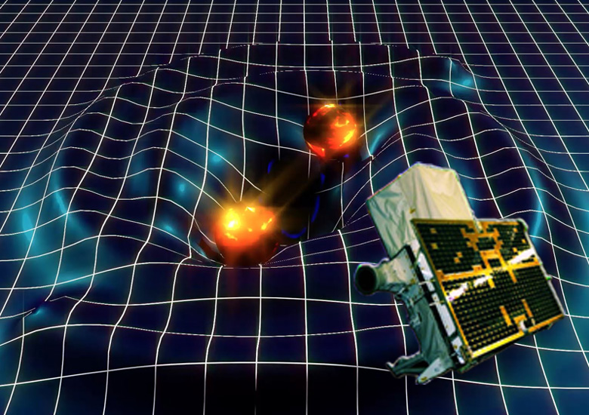
AGILE
observations of GW events
Imma Donnarumma, on behalf of the AGILE Team
SciNeGHE 2016, Pisa, October 18 - 21, 2016

Slide 2
AGILE two "lives": pointing and spinning
AGILE | POINTING | SPINNING
time period | Jul.07 – Oct.09 | Nov. 2009 - today
attitude | fixed | variable (rotation ~ 0.8º/sec)
sky coverage | 1/5 | ~ 70-80 %
1-day exposure (≤ 30 deg off-axis, @ 100 MeV) | ~ 2 x 10⁷ (cm² sec) | (0.5 - 1) x 10⁷ (cm² sec)

Slide 3
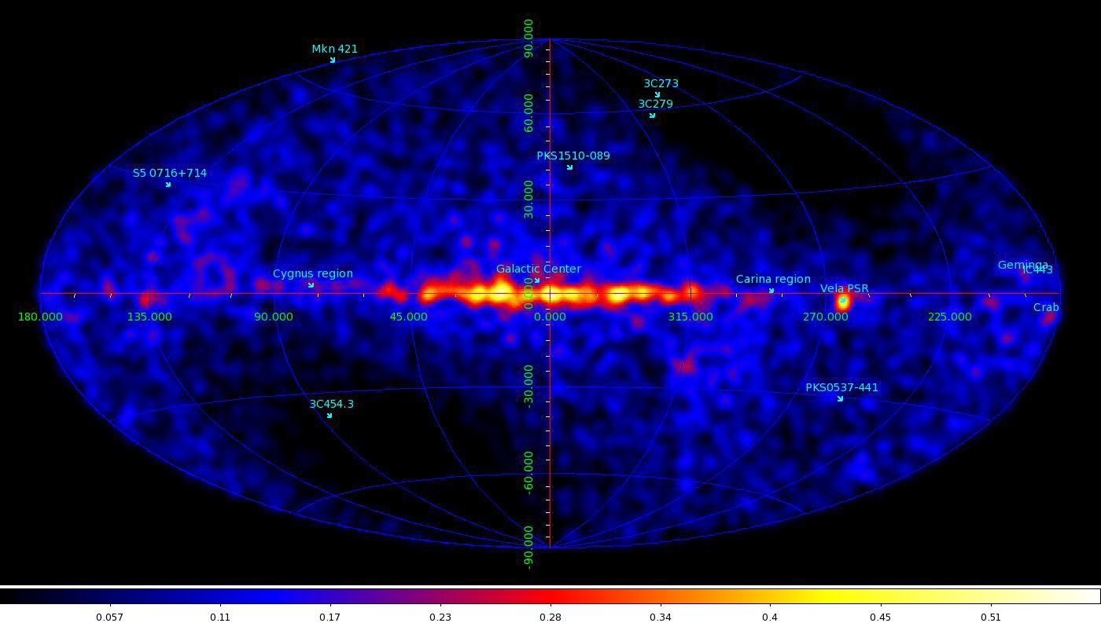
AGILE in spinning coverage of the gamma-ray sky, E > 100 MeV
(8 March, 2016)

Slide 4
AGILE’s life
Gamma-ray detector and MCAL fully operational, ideal in the range 50 MeV – 1 GeV, and active in:
gamma-ray astrophysics
terrestrial high-energy physics
search of GW counterparts

Slide 5
AGILE has the shortest reaction time to bright gamma-ray transients
  Blazars (fast ATels)
  Galactic transients (recently Cyg X-3, Crab Nebula flare)
excellent for GW source searches
  very large field of view (2.5 sr)
  200 passes/day over more than 80% of the sky
  High probability of prompt event coverage

Slide 6
AGILE can play a crucial role in the search of GW source counterparts
AGILE and GW150914 (and GW151226)
Prospects for a first detection of prompt gamma-ray emission GW sources

Slide 7
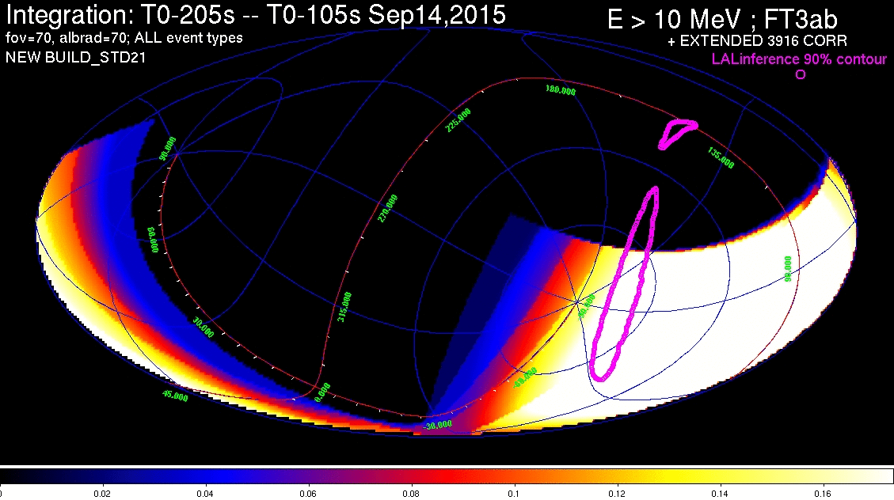
AGILE in spinning: revolution including T₀ of GW150914

Slide 8
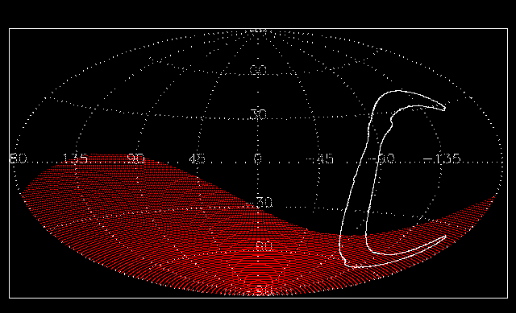
Earth occultation during one orbit (95 min)

Slide 9
Search for gamma-ray transients
gamma-ray imager: covers 80% of the sky
200 revolutions / day
(Earth occultations, SAA) - > 100 useful passes
passes of 150 sec duration
  sensitivity ~ (1-2) 10⁻⁸ erg cm⁻² s⁻¹ in 100 sec.
GRB – like searches, MCAL, AC

Slide 10
GW150914
T₀ = 9:50:45 UT, 14 September, 2015
learned about the event on Feb. 11, 2016
(no MoU active yet)
archival search

Slide 11
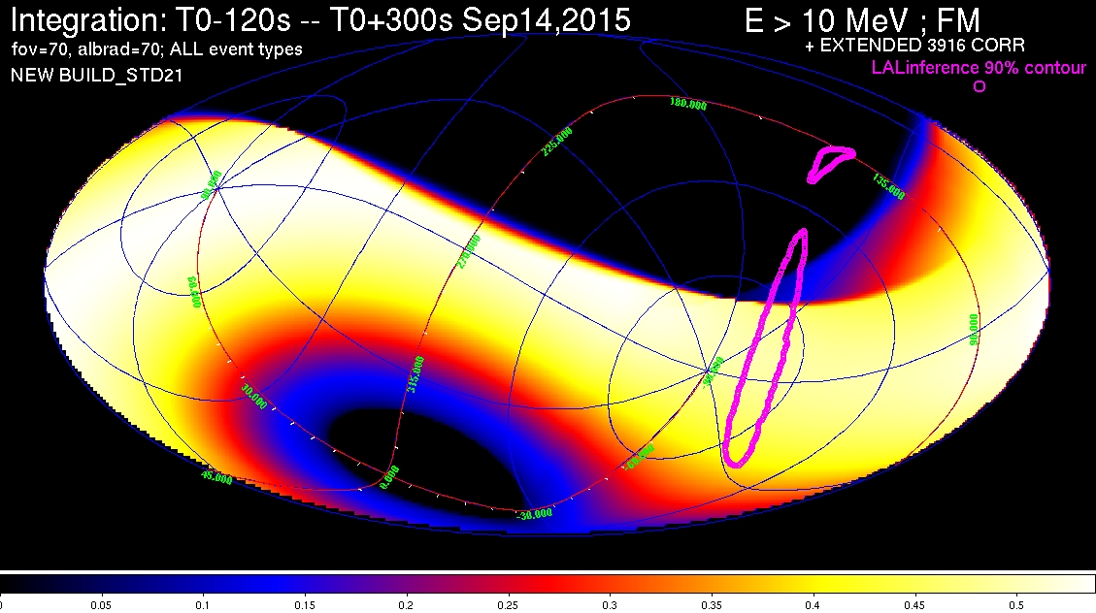
exposure: revolution -120/+300 sec from T₀

Slide 12
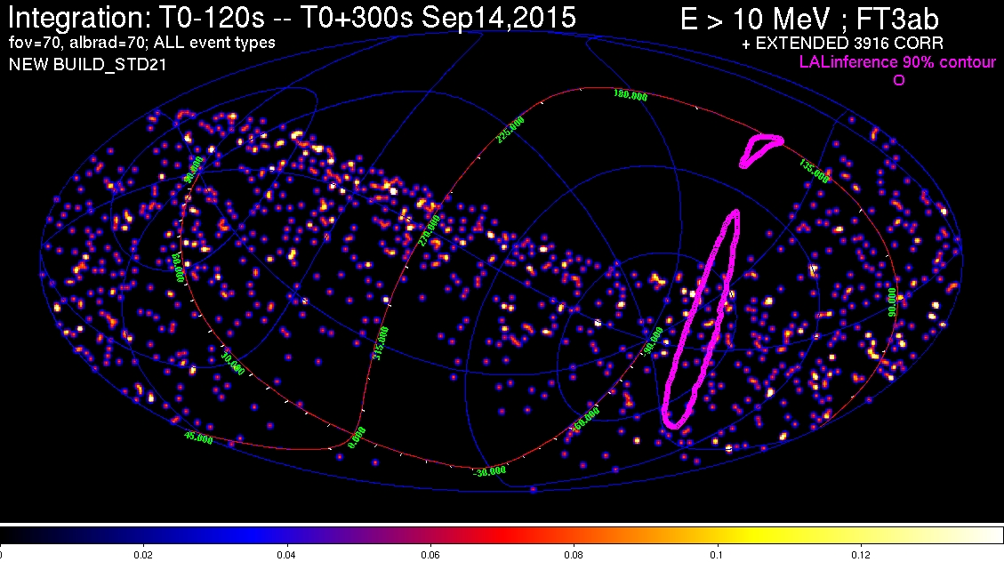
exposure: revolution -120/+300 sec from T₀

Slide 13
AGILE field at T₀ = 09:50:45 UT

Slide 14
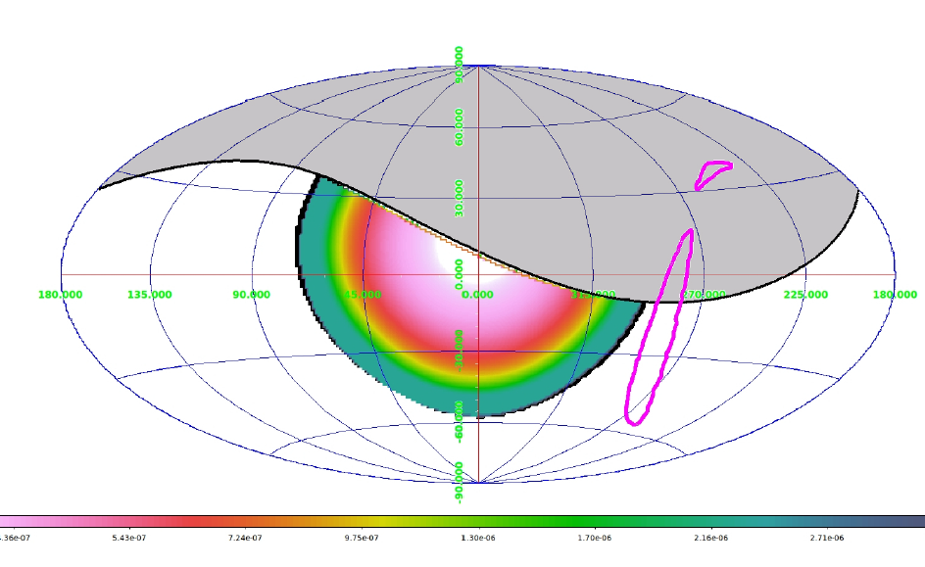
just missed it (-5 / +40 sec)

Slide 15
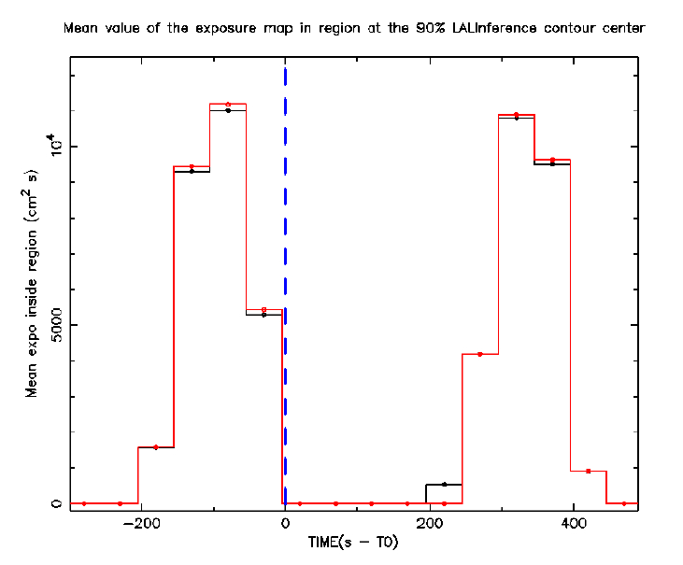
Central LIGO contour exposure scan: from T₀ -300s to T0 +500s
Mean exposure within 7º x 25º region (black) and 10º radius circular region (red) at about the LIGO contour center
100s exposure scan
65% of LIGO contour
covered ~10-60s before T0

Slide 16
AGILE observation of GW150914
probability of covering with the imaging GRID-FoV the region (error box) of the prompt GW event: ~ 10% (½ x 1/5)
much larger than any other imaging large-FoV (2-2.5 sr) instruments in space (Swift-BAT, Fermi-LAT)
even larger than < 1-sr FoV instruments of INTEGRAL and NuStar
14th AGILE Science Workshop, ASI HQ, Jun 20-21, 2016

Slide 17
300 sec later…

Slide 18
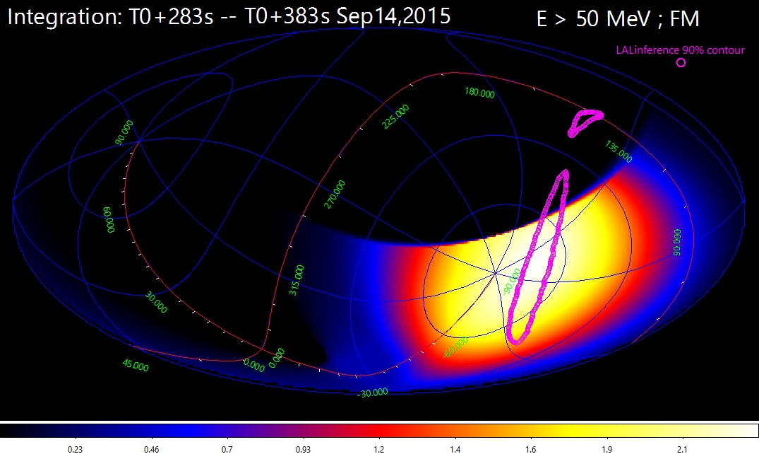
AGILE exposure 330 sec (+/- 50 sec)

Slide 19
AGILE exposure 330 sec (+/- 50 sec)
2-sigma upper limit (E > 50 MeV) = 1.5 x 10⁻⁸ erg cm⁻² s⁻¹

Slide 20
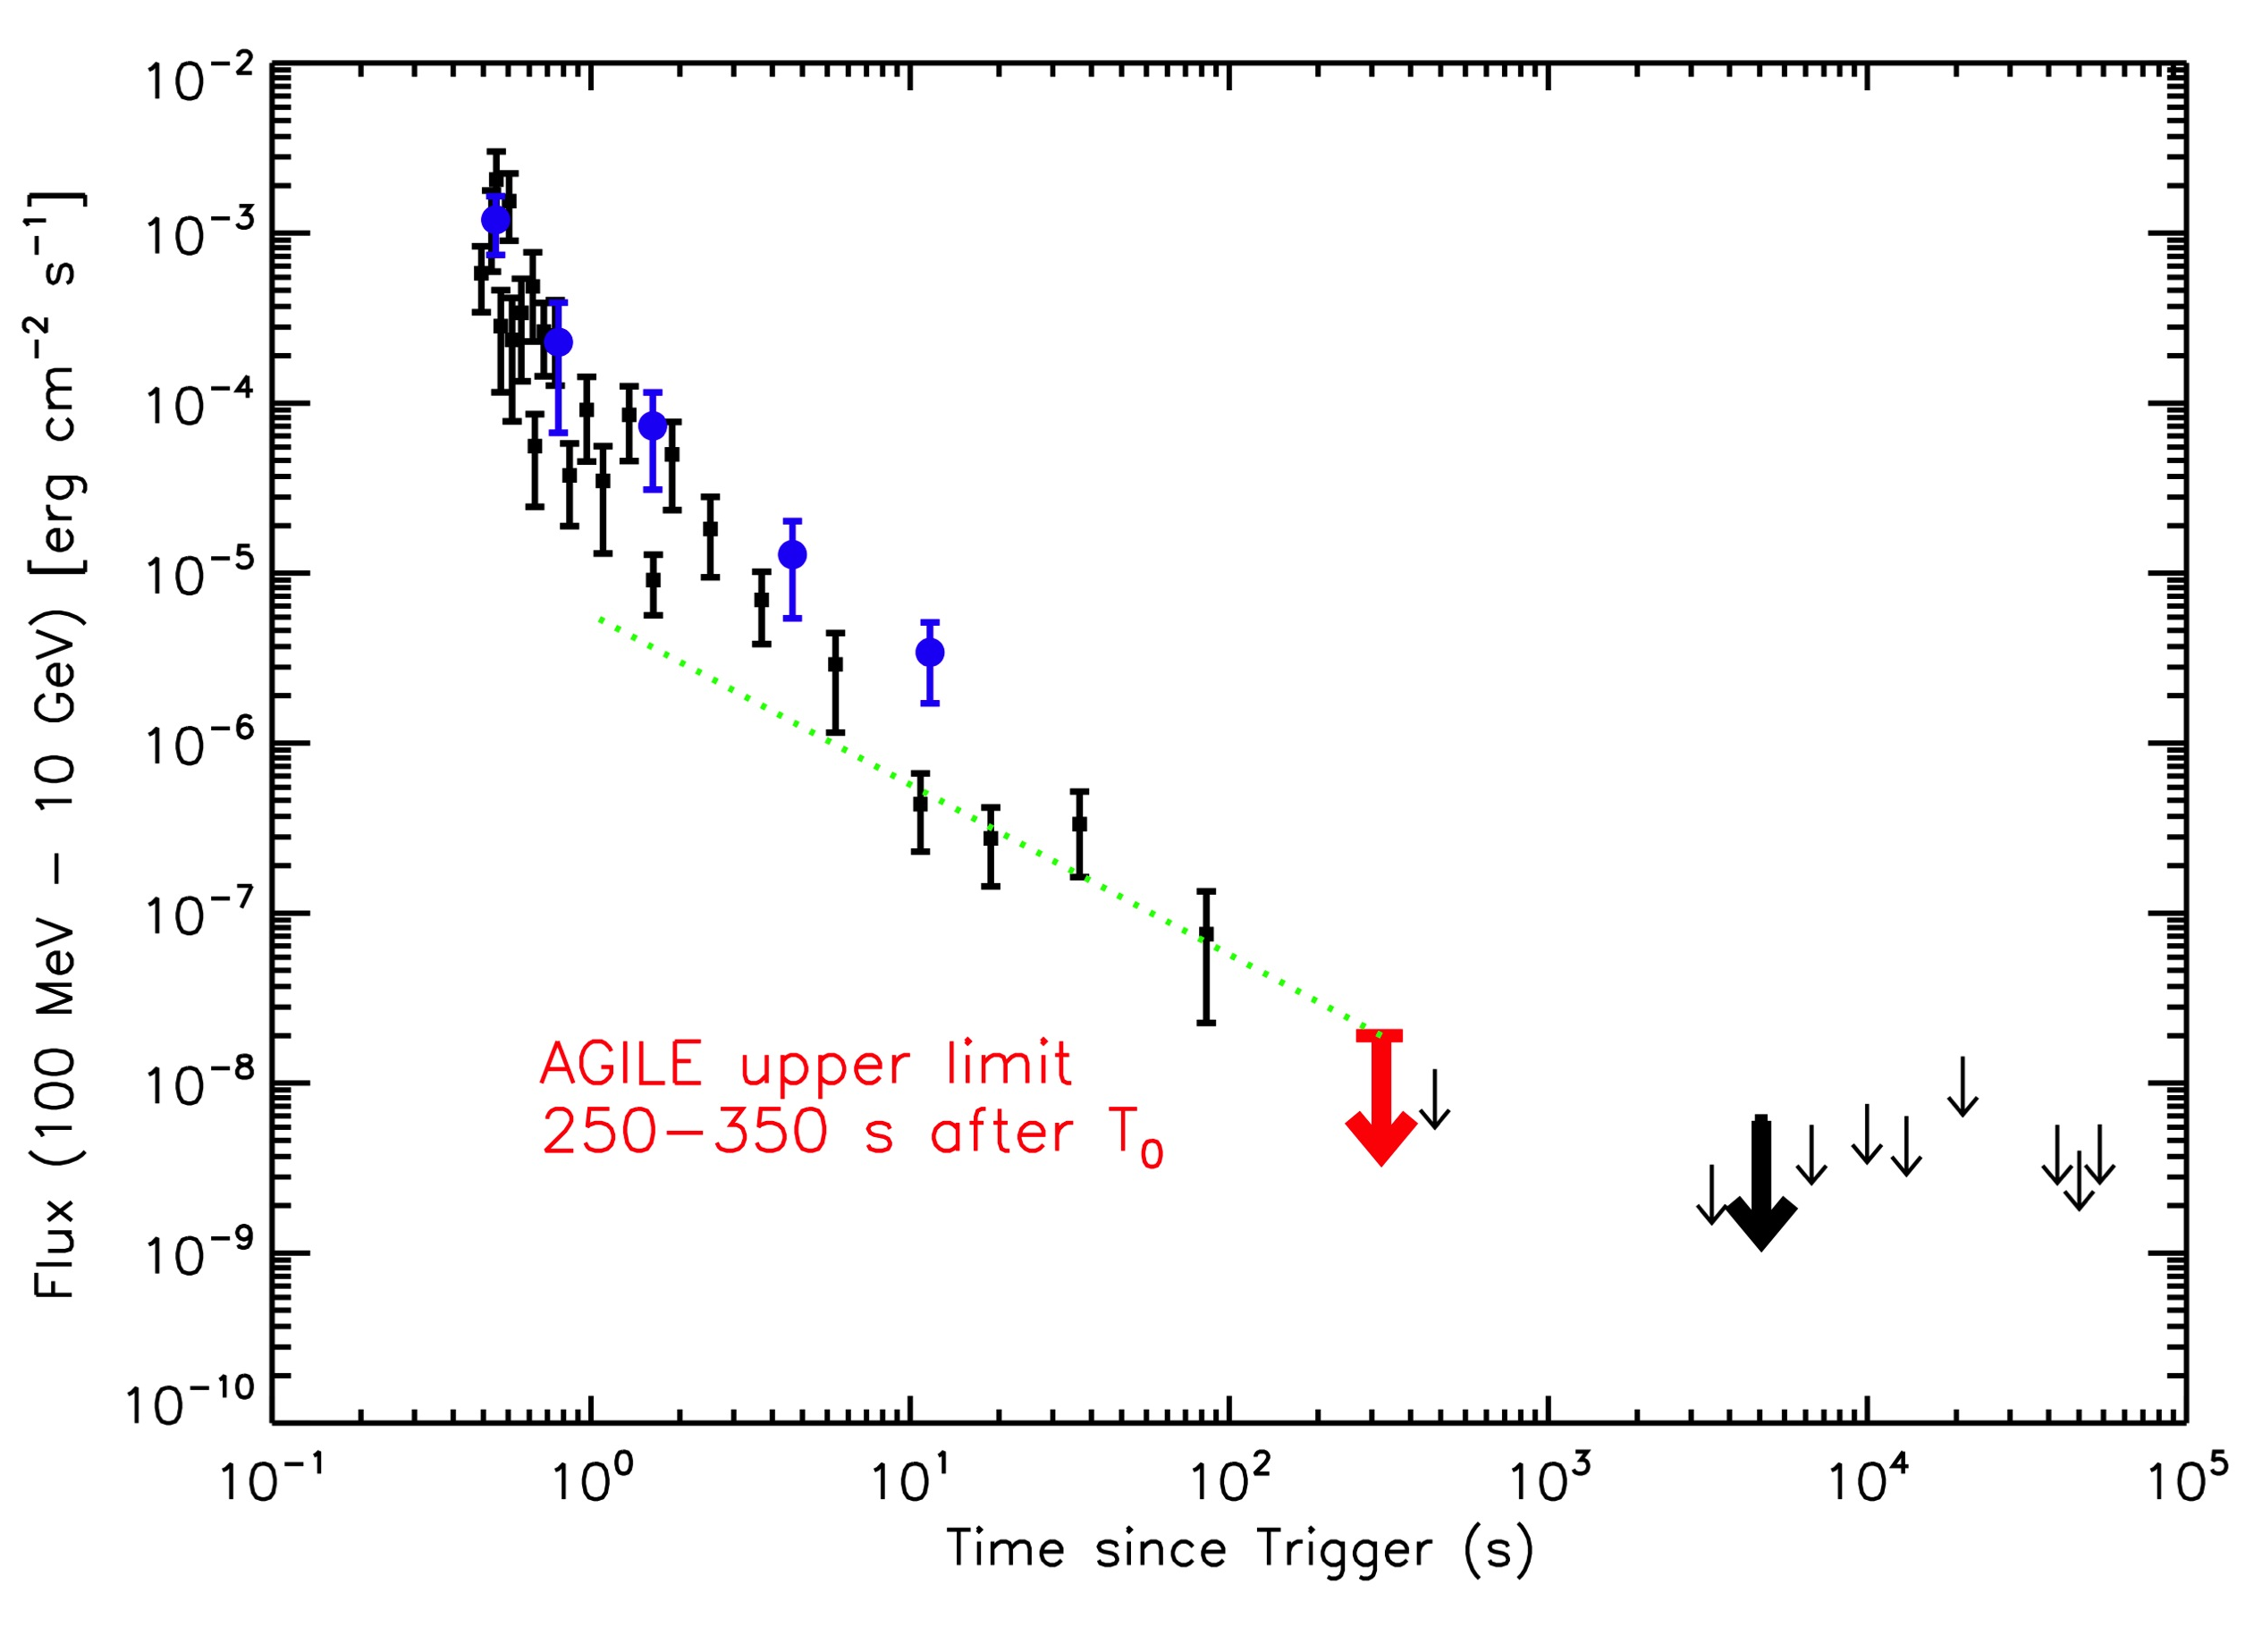
AGILE and Fermi-LAT upper limits in the GRB090510 lightcurve
(repositioned at z = 0.1, adapted from Fermi-LAT Collab., 2016)
AGILE upper limit
250-350 sec after T₀
Fermi-LAT UL
> 4500 s after T₀

Slide 21
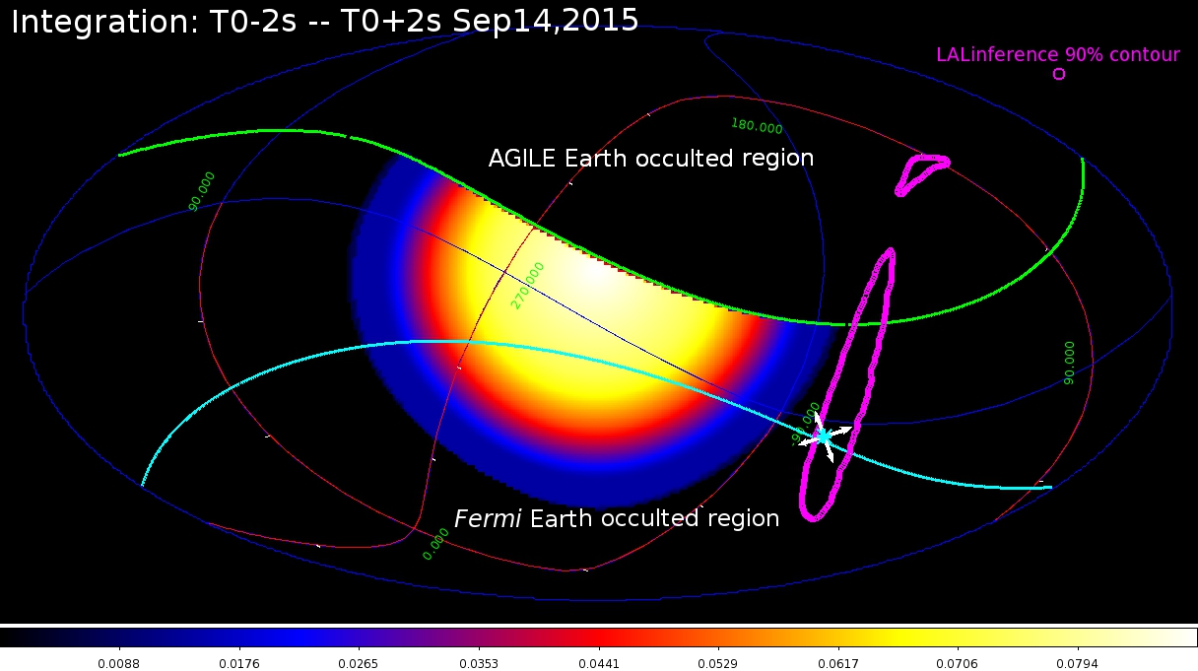
AGILE-MCAL and Fermi-GBM exposure at the GW150914 prompt time

Slide 22
AGILE does not detect the Fermi-GBM transient
at the GW150914 prompt time, best GBM position region at about 90° off-axis for AGILE GRID and MCAL
limited exposure of MCAL
AGILE 5-sigma MCAL upper limit
F_{GBM} = 2 x10⁻⁶ erg cm⁻² (0.45 – 100 MeV),
2.5 times larger than GBM event extrapolation at 1 MeV
F_{GBM} = (2 ± 1) x10⁻⁷ erg cm⁻² (10 keV – 1 MeV), photon index 1.4

Slide 23
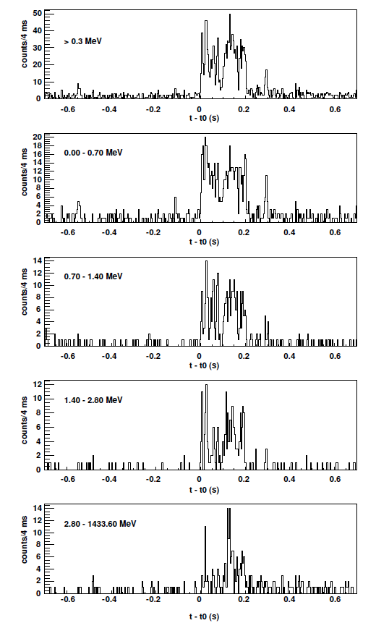
AGILE-MCAL GRB090510 light curve
GRB090510 light curve as
detected by MCAL (4ms bin), Giuliani + 2010
->15ms soft precursor at T=T0 - 0.55 s (E_{peak} < 0.7MeV)

Slide 24
Search for precursors

Slide 25
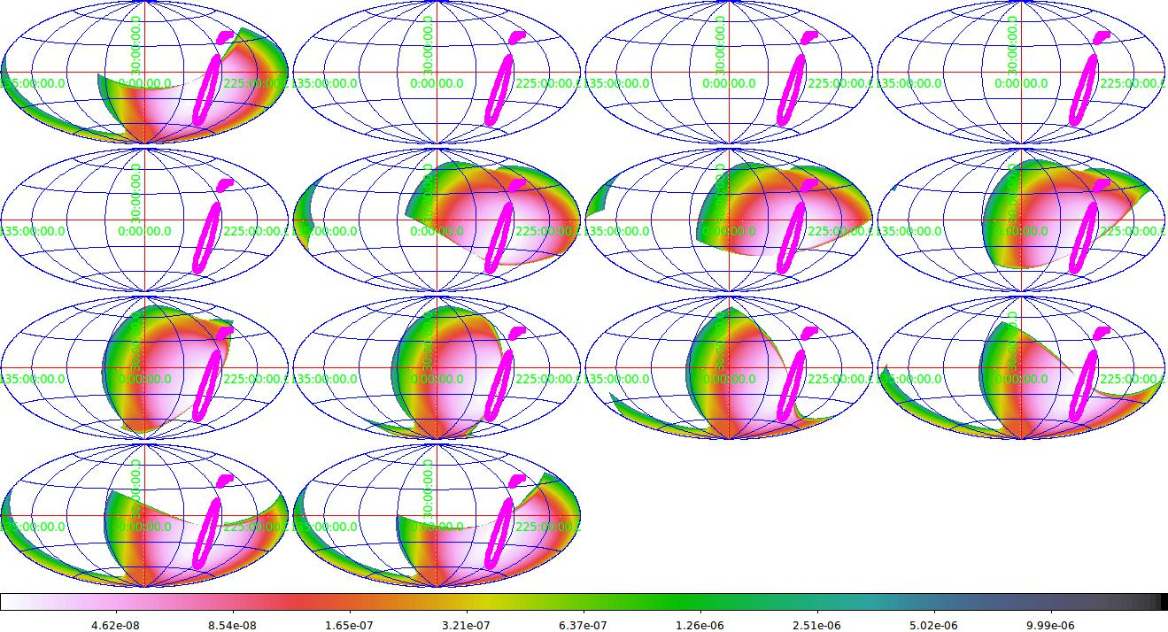
precursor search (passes -13/+1, 95 minutes)
-13
-12
-11
-10
-9
-8
-7
-6
-5
-4
-3
-2
-1
+1
25

Slide 26
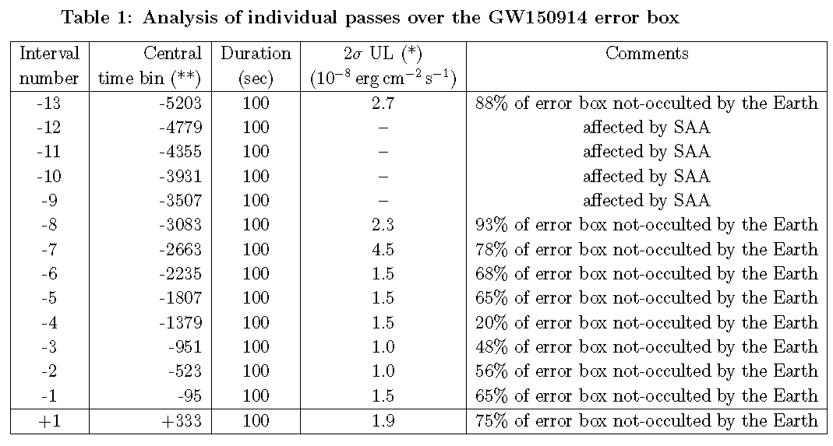

Slide 27
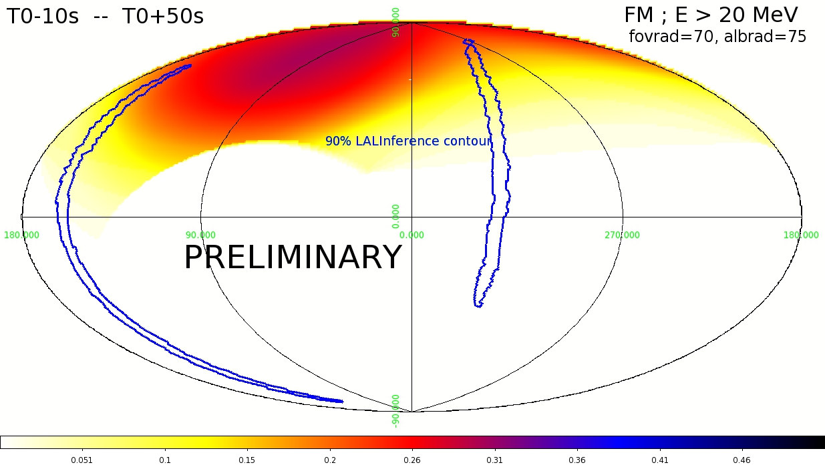
GW 151226
27

Slide 28
Ready for the O2 Run
New on-board configuration
Enhanced configuration of Mcal triggers-> improved at sub-ms/ms timescales (short GRBs)
SuperAGILE active

Slide 29
a factor of 4-5 better than before)

Slide 30
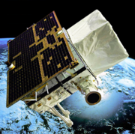




AGILE GW on-line analysis
@IASF-BO
RT-PIPE
Visibility check (RT)
MoU
manual injection
GCN notice
RT-ALERT DB
external alerts
GW analysis
GRB analysis
1 LVC_PRELIMINARY: Provides the time, significance, and basic parameters about a GW detection candidate. No localization information. Sent with a latency of a minute or so.
2 LVC_INITIAL: A rapid sky localization is available. Sent with a latency of a few minutes.
3 LVC_UDPATE: A refined sky localization is availaable. Sent with a latency of hours or more.
SPOT6 analysis

Slide 31
the future: e-ASTROGAM

Slide 32

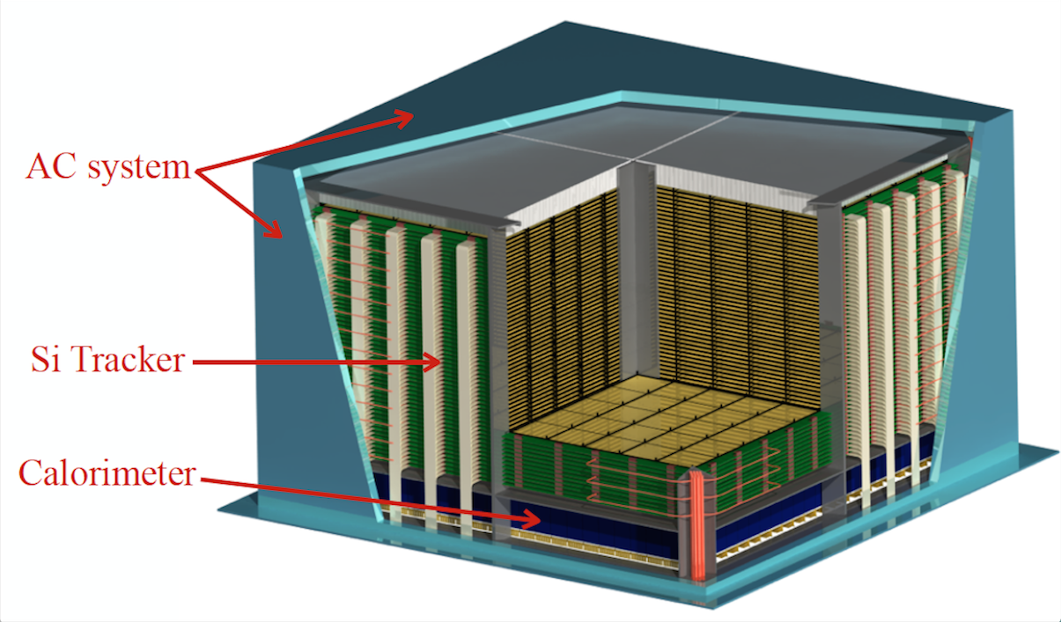

Slide 33
The e-ASTROGAM core science
Processes at the heart of the extreme Universe: prospects for the Astronomy of the 2030s
The origin and impact of high-energy particles on galaxy evolution, from cosmic-rays to antimatter
Nucleosynthesis and the chemical enrichment of our Galaxy

