Slide 1
Trasferimenti di conoscenze dal CERN: come accelerare l'innovazione
Enrico Chesta
CERN – European Organization for Nuclear Research
Knowledge Transfer Group
Industry Procurement and Knowledge Transfer Department

Slide 2


CERN impact beyond science

Slide 3

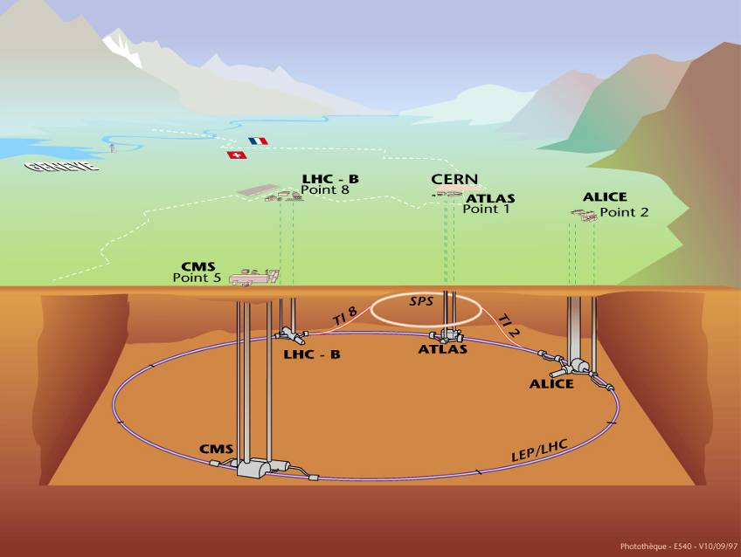

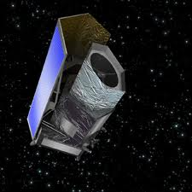
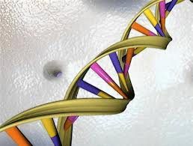
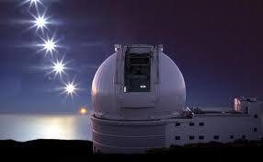
Knowledge Transfer

Slide 4
CERN Technology Areas…
… and Application Fields

Slide 5
A
P
P
L
I
C
A
T
I
O
N
S
M
E
D
I
C
A
L
CE
RN

Slide 6
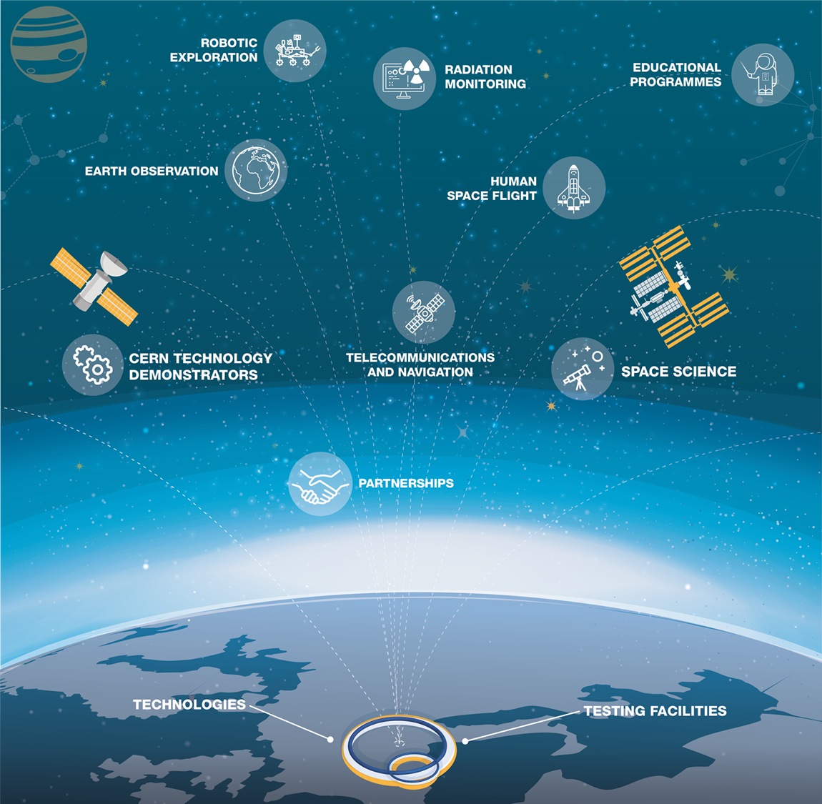
A
P
P
L
I
C
A
T
I
O
N
S
A
E
R
O
S
P
A
C
E
CE
RN

Slide 7
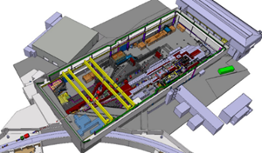
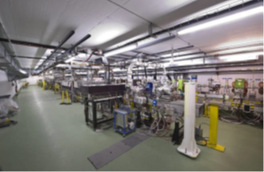
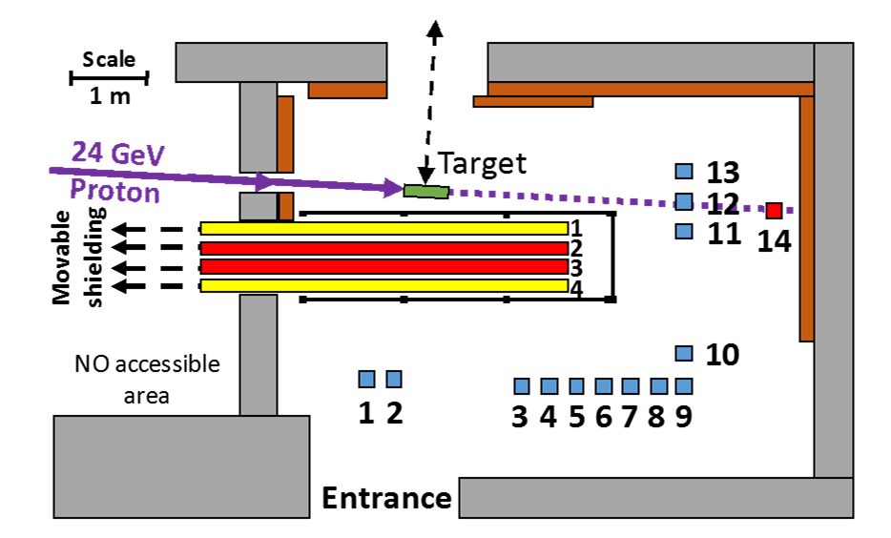
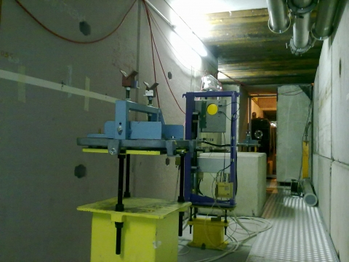
CERN Irradiation Facilities
VESPER
Very energetic Electron facility for Space Planetary Exploration missions in harsh Radiative environments
CHARM
CERN High energy AcceleRator Mixed field/facility
CERF
CERN-EU high-energy reference radiation facility

Slide 9
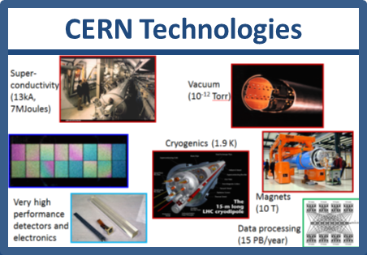

KT Business Partnerships - modes
Market pull
Contract research
Consultancy
Services
R&D Collaborations
Licensing
Spin-outs
Technology push

Slide 10
























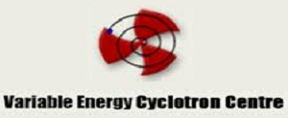















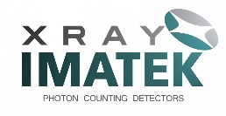






KT Business Partnerships - exemples
Laboratories
Companies
Universities

Slide 11
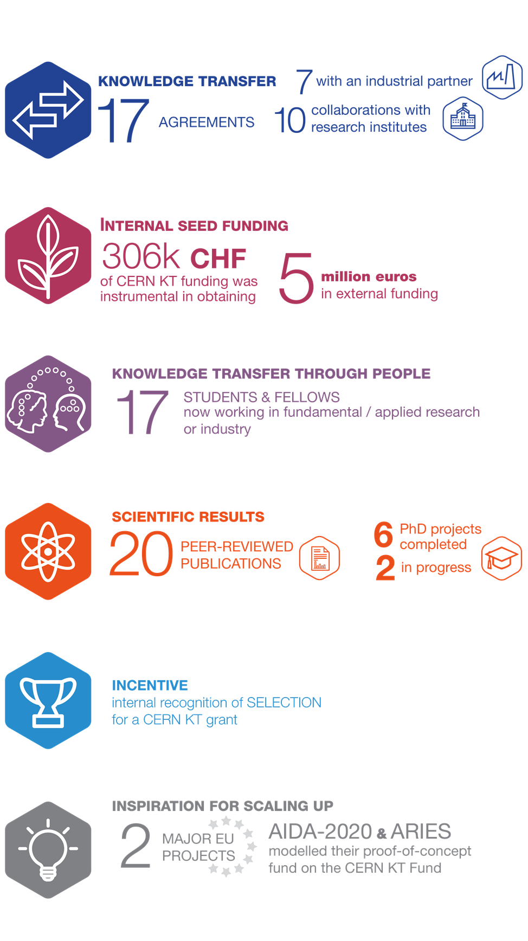
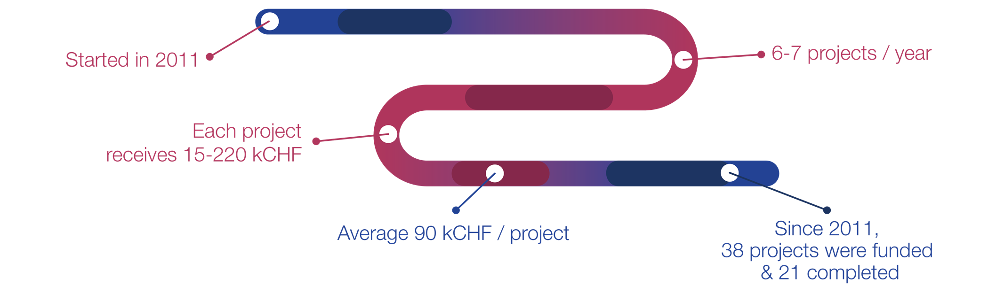
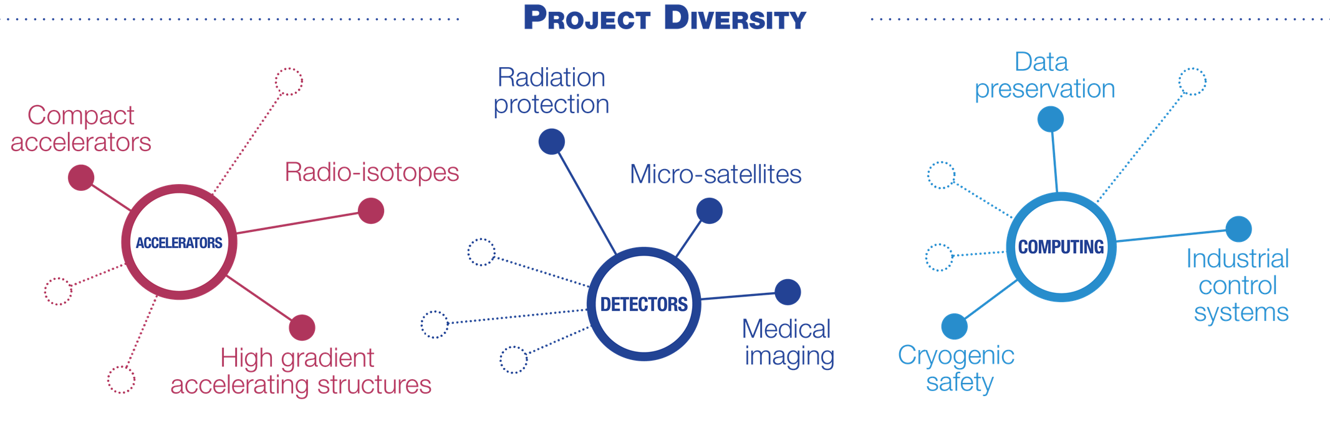
KT Fund Tool

Slide 12
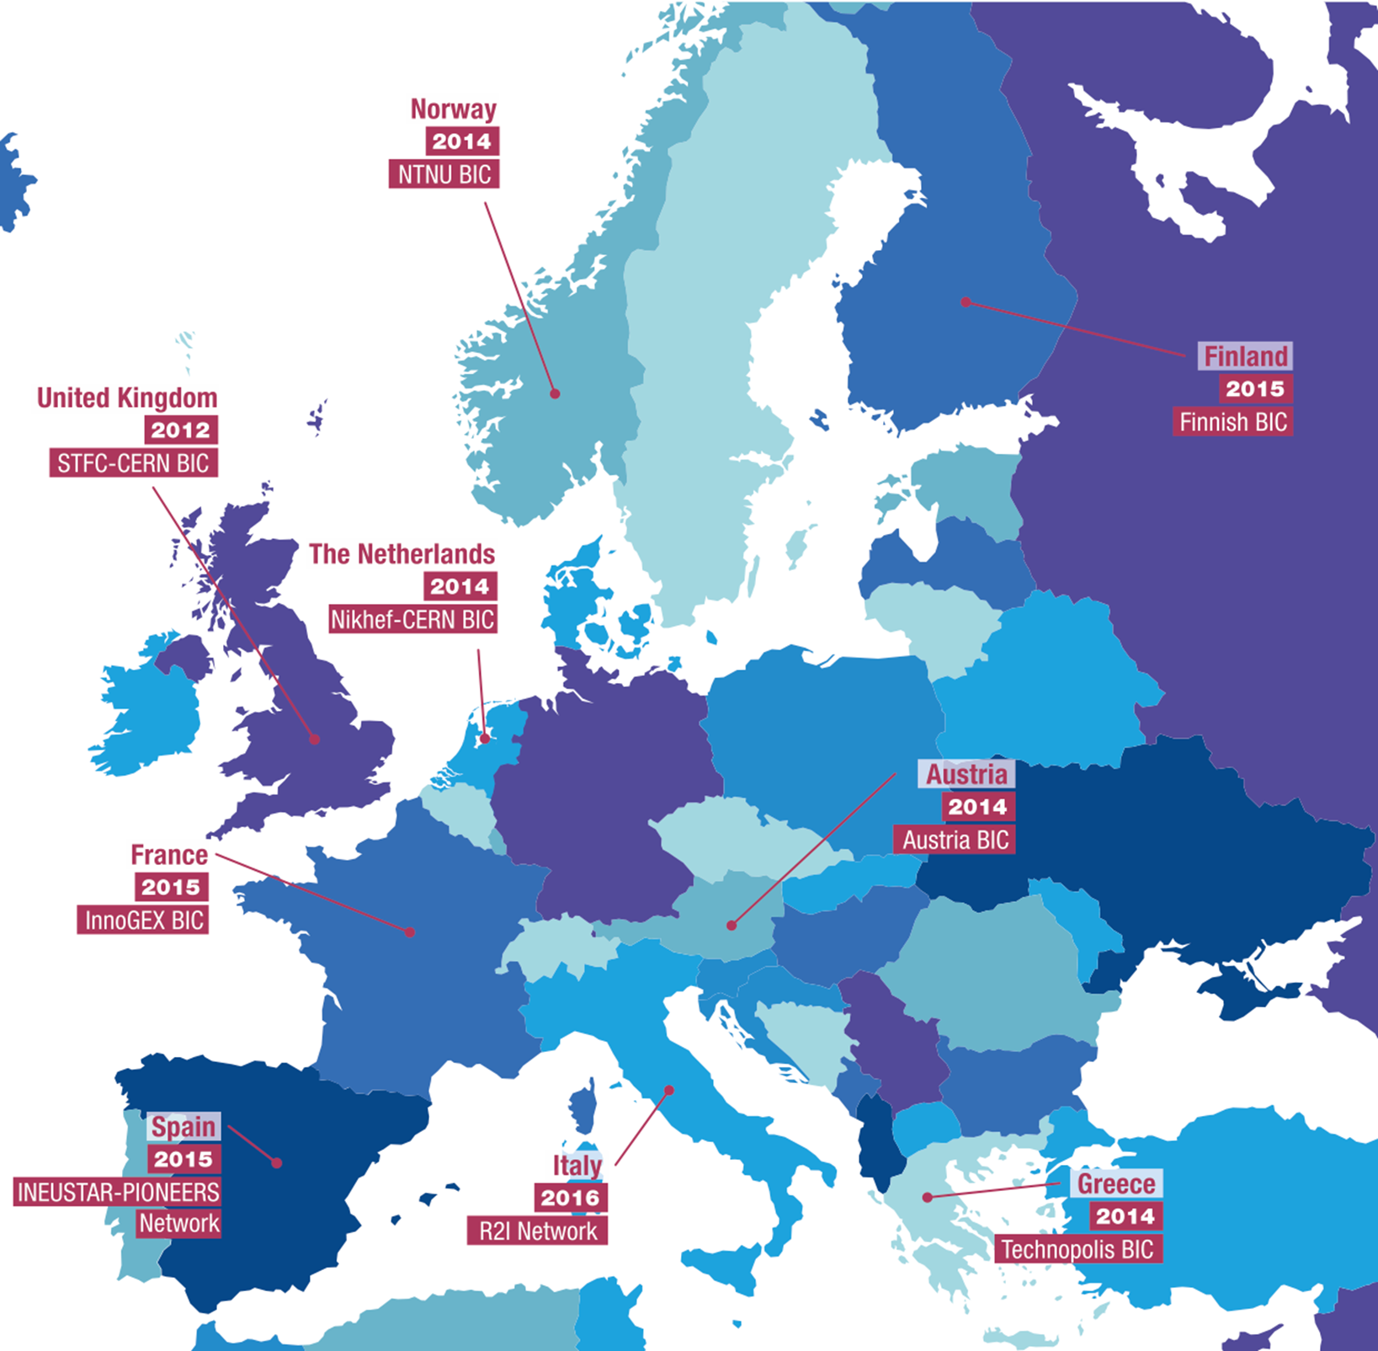
C
E
R
N
B
I
C
N
e
t
w
o
r
k

Slide 13
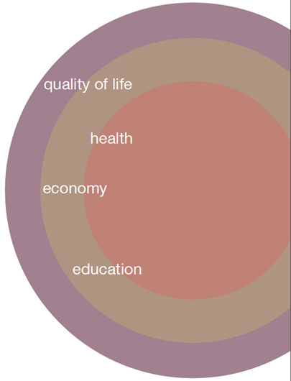

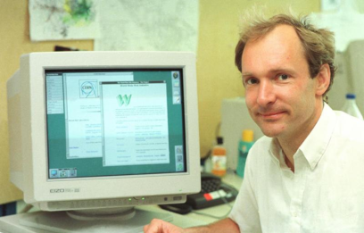
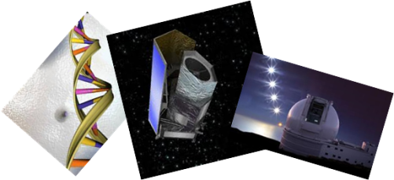
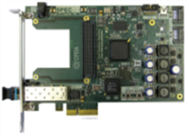
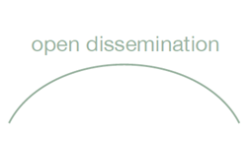

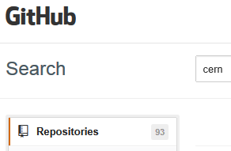
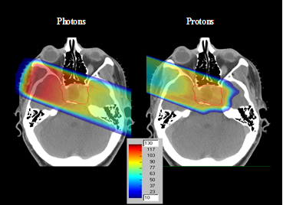
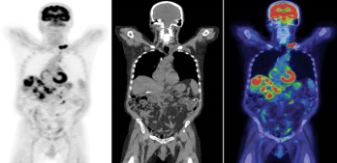
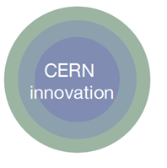
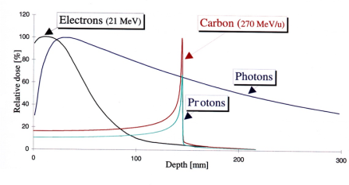
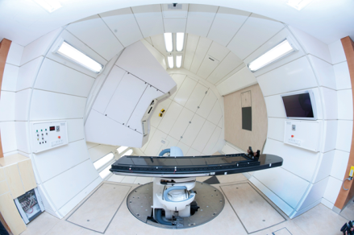

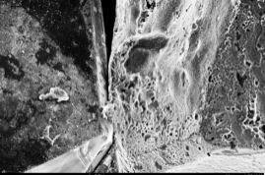
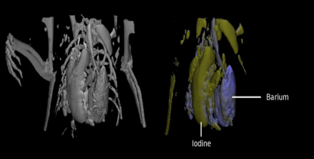
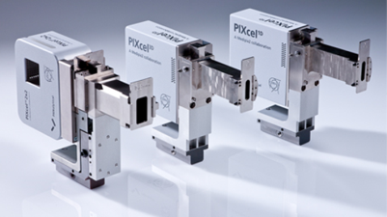
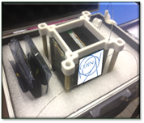
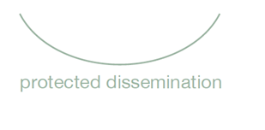
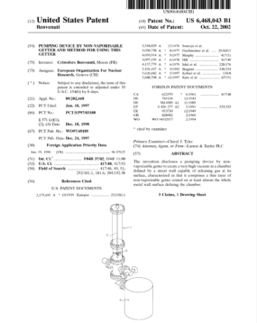
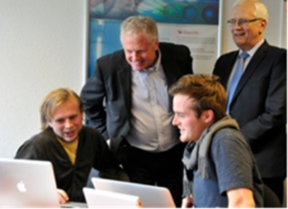
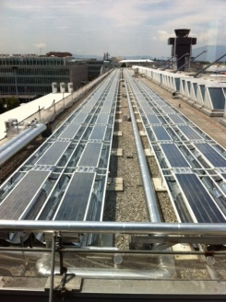

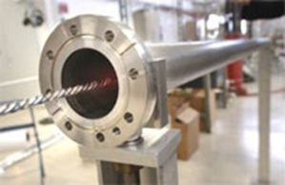
CERN KT impact-driven model

Slide 14

Overview – KT agreements with Italian Partners
9 Commercial Licenses
3 R&D Licenses
3 R&D Partnership
3 Collaboration agreements
2 Service/Consultancy agreements

Slide 15
Per maggiori informazioni:
www.cern.ch/kt
Grazie per l’attenzione!

