Slide 2
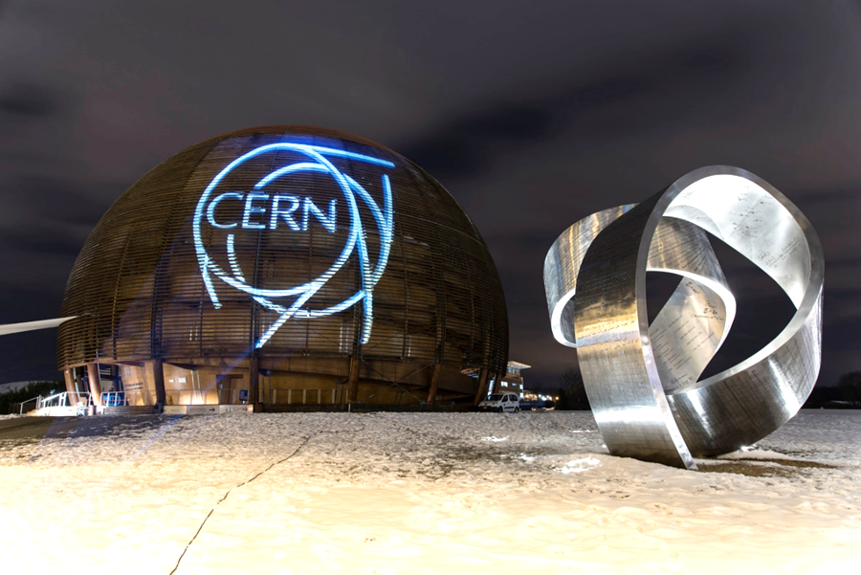
Italy at CERN
Ultra vacuum components and systems
R. Kersevan (*), TE-VSC-VSM
CERN, 4-7 April 2017
(*) reporting for the VSC group

Slide 3
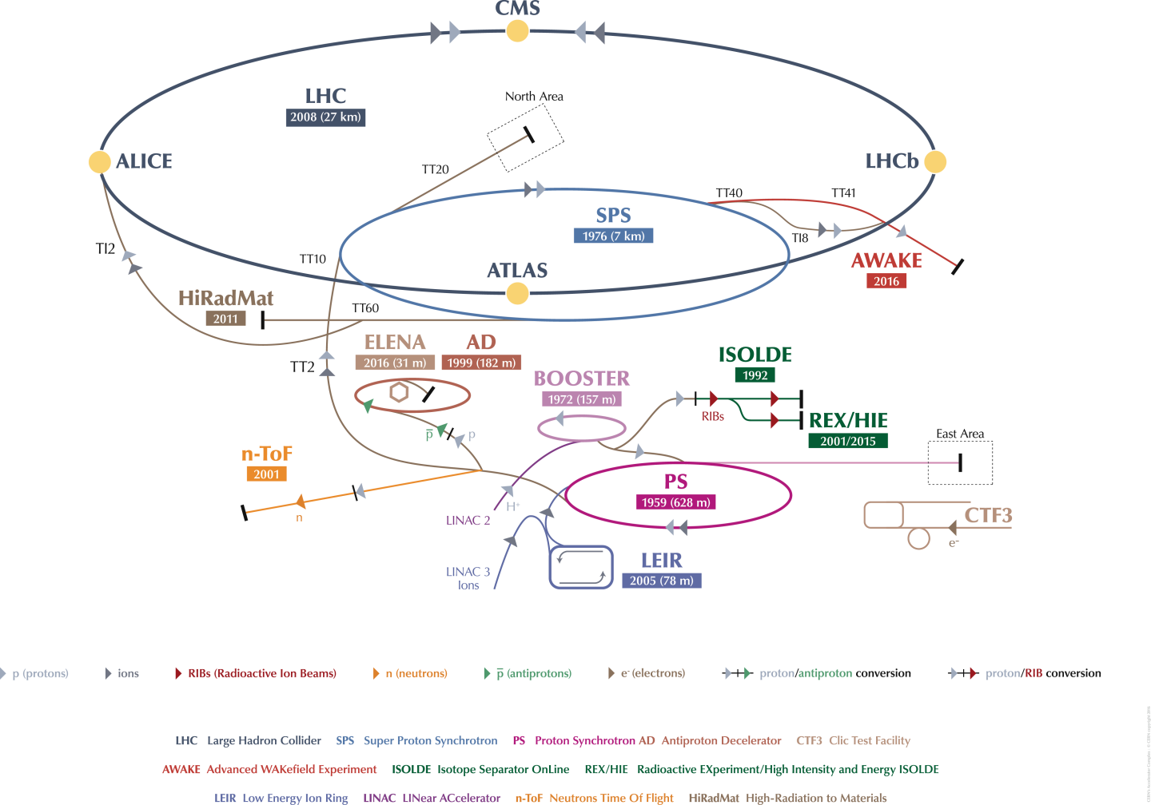
CERN ACCELERATOR COMPLEX

Slide 4

77
60

Slide 5
LHC

Slide 6
CERN ACCELERATOR COMPLEX

Slide 7
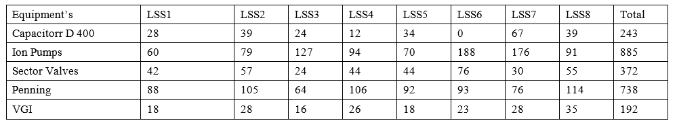
Pumps, Gauges, and Gate Valves Installed along the Long Straight Sections (LSS) of the LHC
Very large number of components, critical to the functioning and operation of the LHC: → high reliability is compulsory!

Slide 8

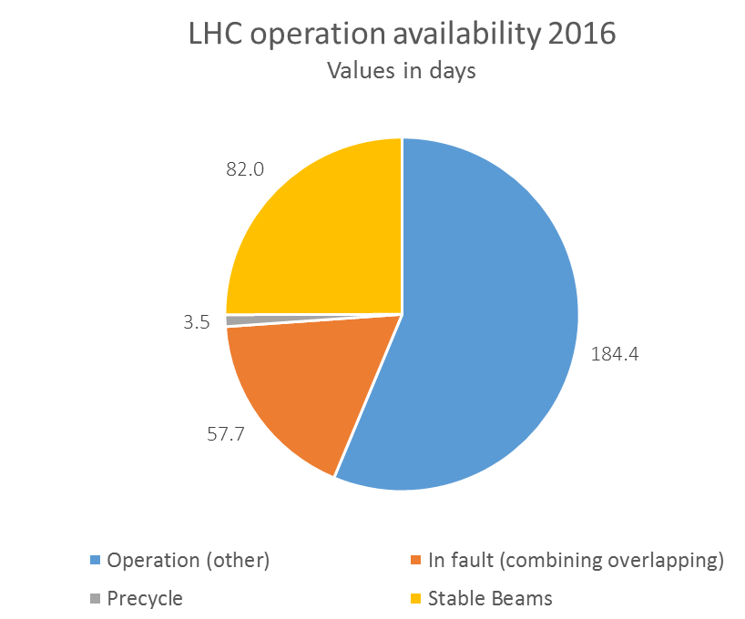
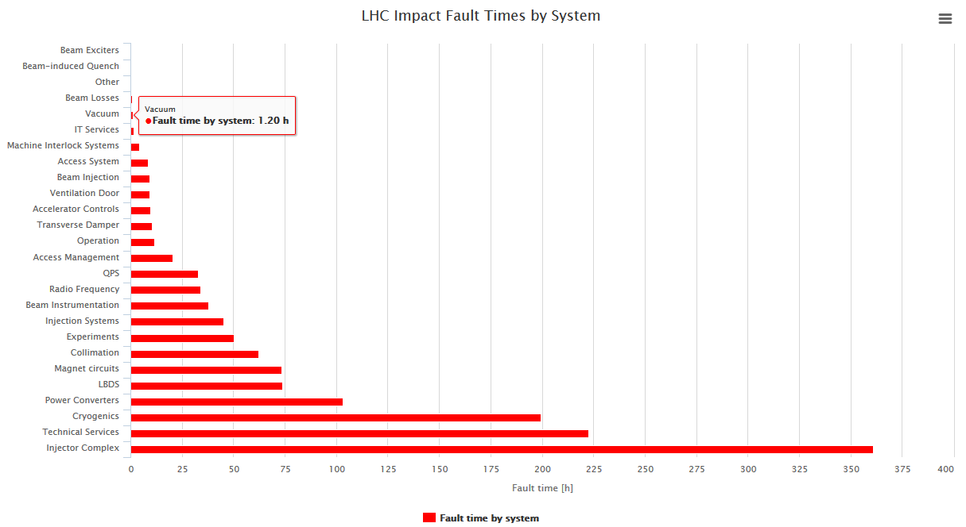
LHC VSC Operation Fault
Availability of LHC vacuum system 99.98%
Parent / Child issue | Issue count [1] | Total duration [hh:mm] | Beam dump [1]
Parent | 2 | 01:22 | 0
Child | 0 | NA | NA
Based on data from LHC Cardiogram and
BVO OP tracking

Slide 9
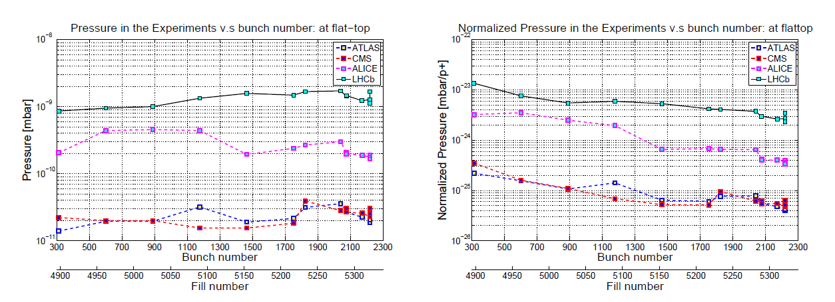
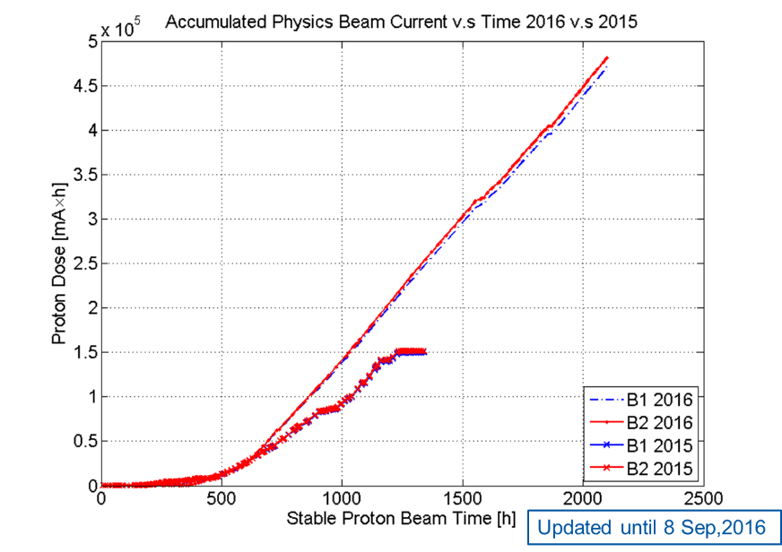
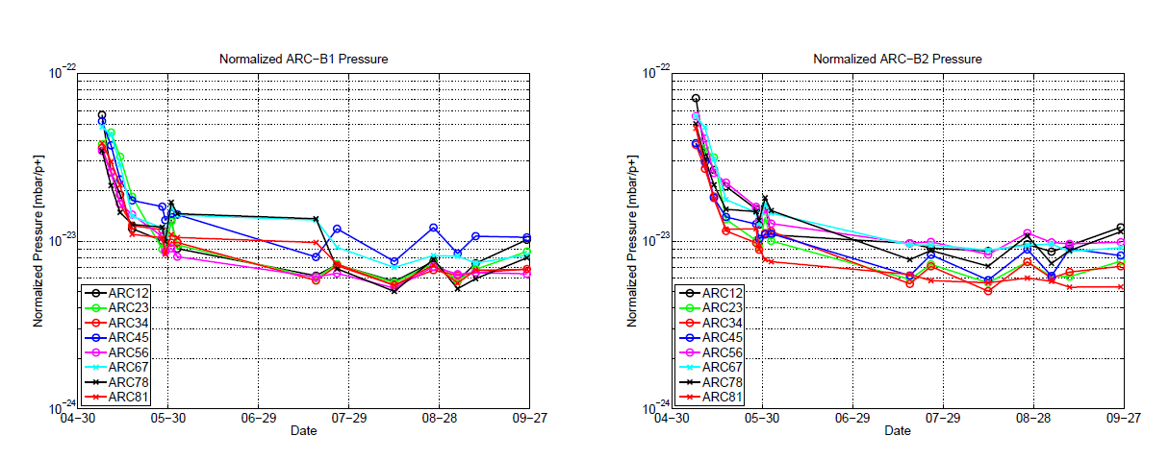
LHC Vacuum Operation
TE-VSC-BVO role for the LHC Vacuum Operation:
Participation for the scrubbing runs, MDs, normal operation.
Vacuum validation for upgrade in the LHC
Support for the experiment background studies and machine operation committee.
2016 Pressure evolution in the LHC Experiments
2016 Normalized pressure to bunch intensity: ARCs

Slide 10
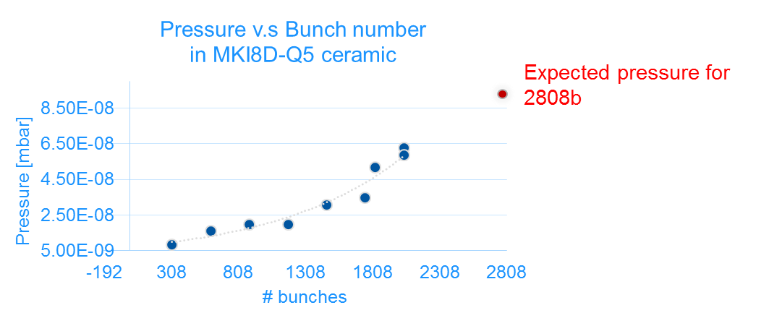
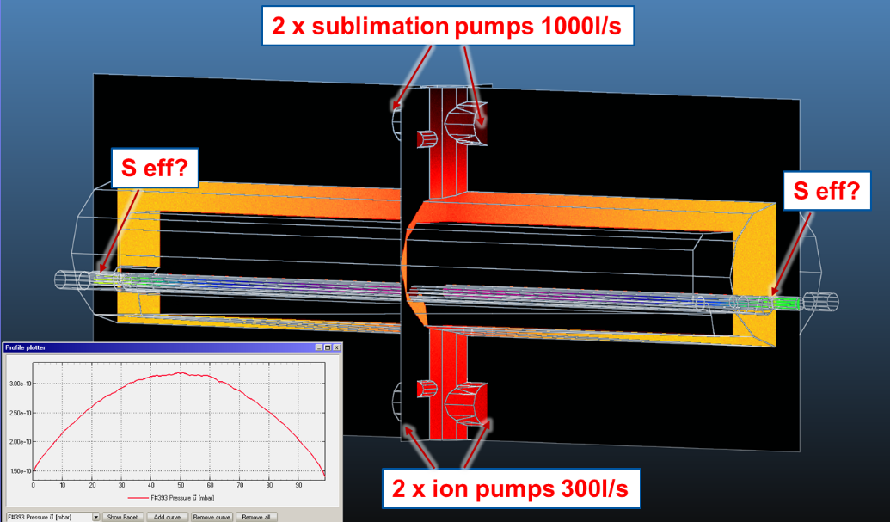
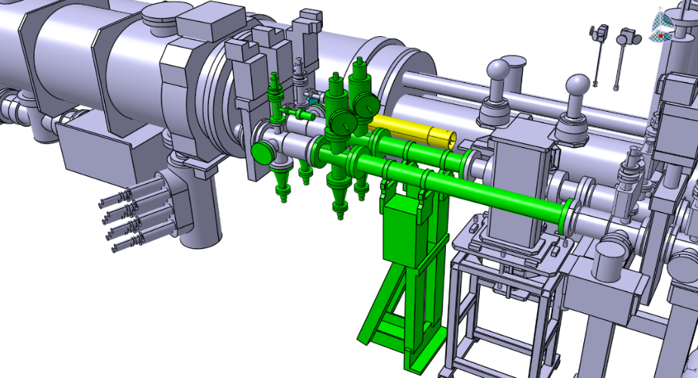
LHC Vacuum Operation
TE-VSC-BVO role for the LHC Vacuum Operation:
Participation for the scrubbing runs, MDs, normal operation.
Vacuum validation for upgrade in the LHC
Support for the experiment background studies and machine operation committee.
MKI Limiting for future intensity increase
MKIs Analysis of the effective pumping speed
Improvement put in place
Vacuum Sector I5R8

Slide 11
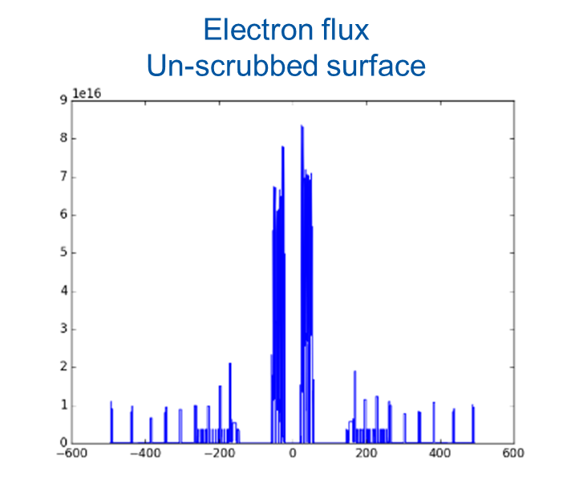
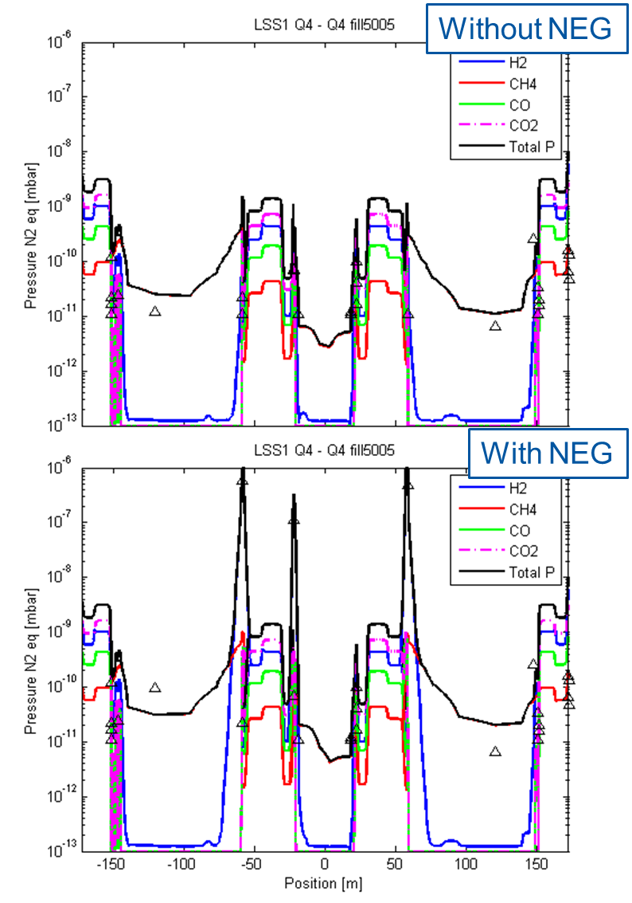
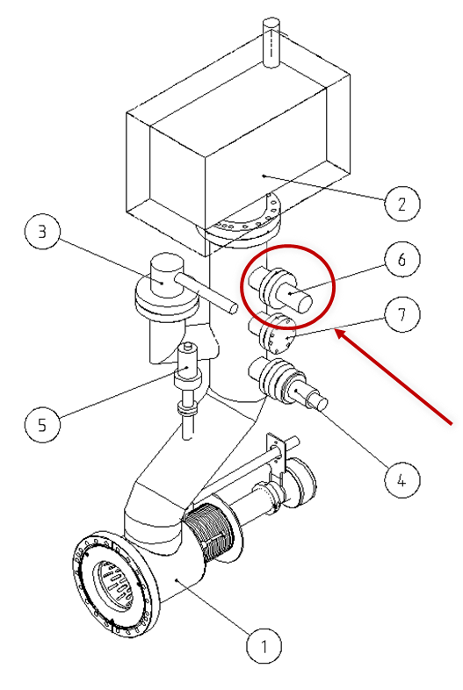
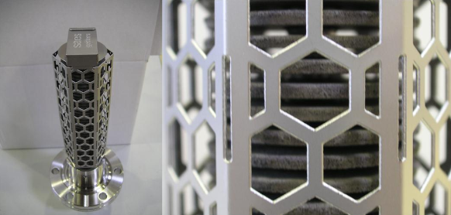
LHC Vacuum Operation
TE-VSC-BVO role for the LHC Vacuum Operation:
Participation for the scrubbing runs, MDs, normal operation.
Vacuum validation for upgrade in the LHC
Support for the experiment background studies and machine operation committee.
Fill 5005: LSS1
Dynamic pressure profile by considering synchrotron radiation and electron cloud
MD 1224:
Use NEG cartridges to create pressure bumps to study beam-gas induced background for the four experiments
Module used in ATLAS
Zr-V-Fe:
S_{H2} = 400 l/s
S_{N2} = 100 l/s
S_{CO} = 180 l/s
ATLAS contribution

Slide 12
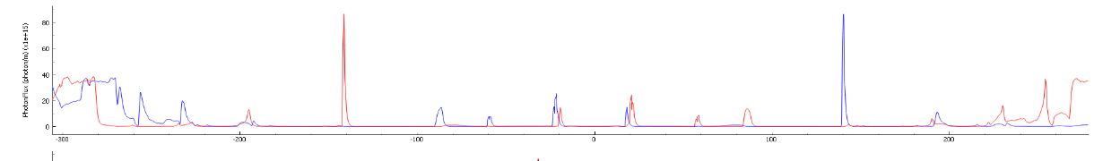

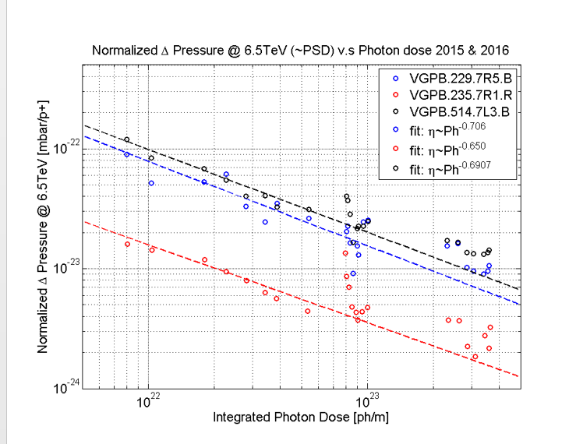
Synchrotron Radiation in the LHC
ATLAS Long Straight Section Photon Flux Distribution
Synchrotron Radiation
Distance [m]
Distance [m]

Slide 13

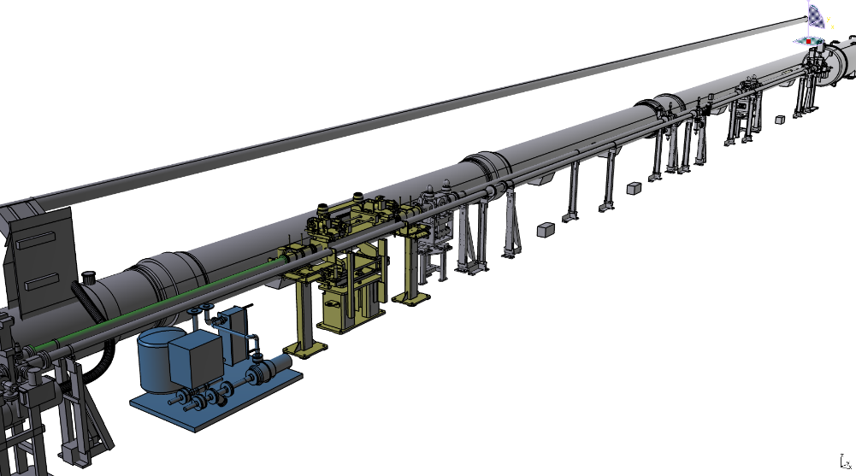
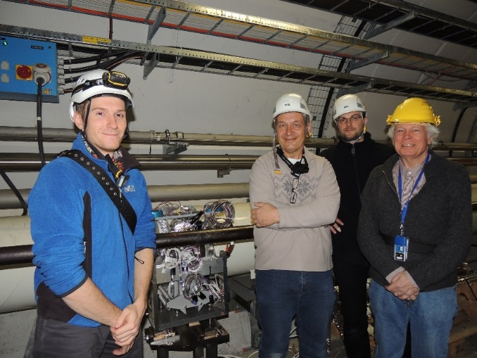
Experimental areas upgrade – ATLAS
ATLAS Forward Physics project (EYETS installation).
  During the YETS 2015 – 2016 the first arm (two stations) of AFP experiment was successfully installed in LSS1R (sector A6R1).
  Plan for EYETS 2016 – 2017 is to complete the installation with second arm (two stations) located in LSS1L (A6L1). New layout and the stations are ready for the installation.
Q5L1
TCL.6L1
Q6L1
Near station (-206 m from IP1)
Far station (-218 m from IP1)
EYETS 2017 – Integration in A6L1
YETS 2016 – Installation in A6R1

Slide 14

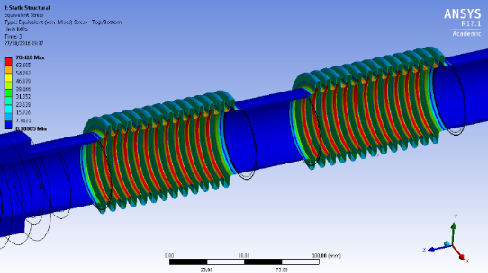
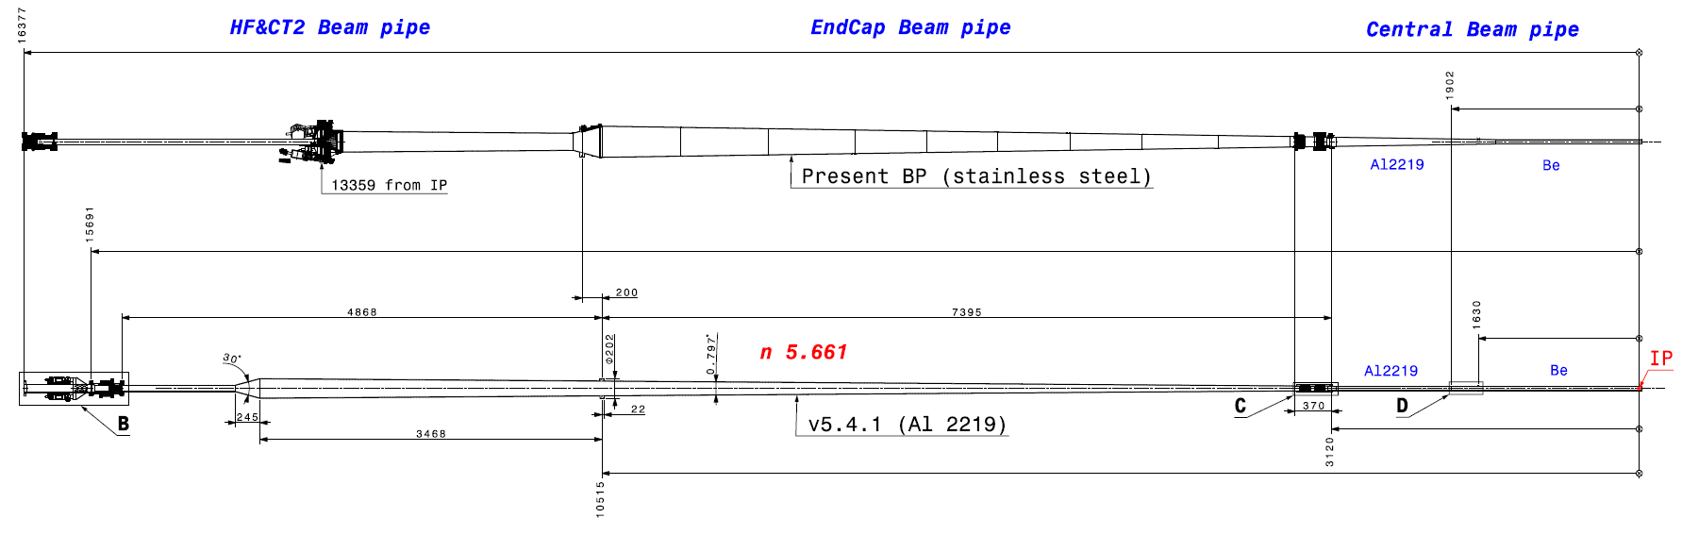
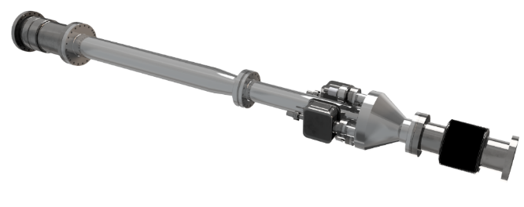
Experimental areas upgrade – CMS
LS2 vacuum layout close to the approval (technical spec. ready)
  Performed both vacuum and structural studies of a new IP5 layout.
  New Central beam pipe is requested by CMS (Launching tender in Q1 2017).
  8 new aluminium chambers announced with production deadline Q4 2019 (excluding spares).
  Development and qualification of aluminium bellows and thick welds.
  Procurement of detail production drawings ongoing.
New aluminium bellows
New forward region design

Slide 15

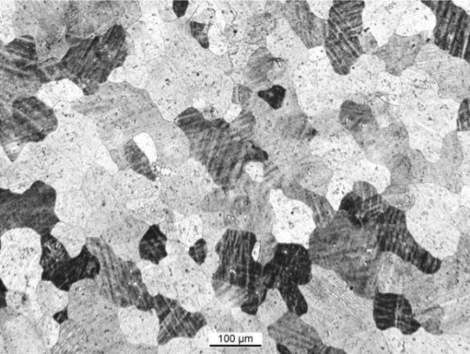
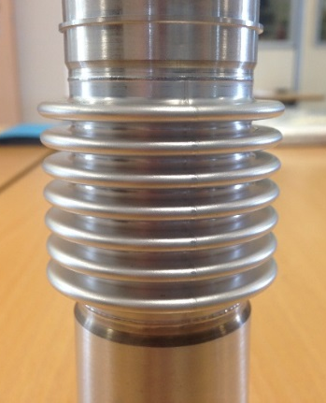
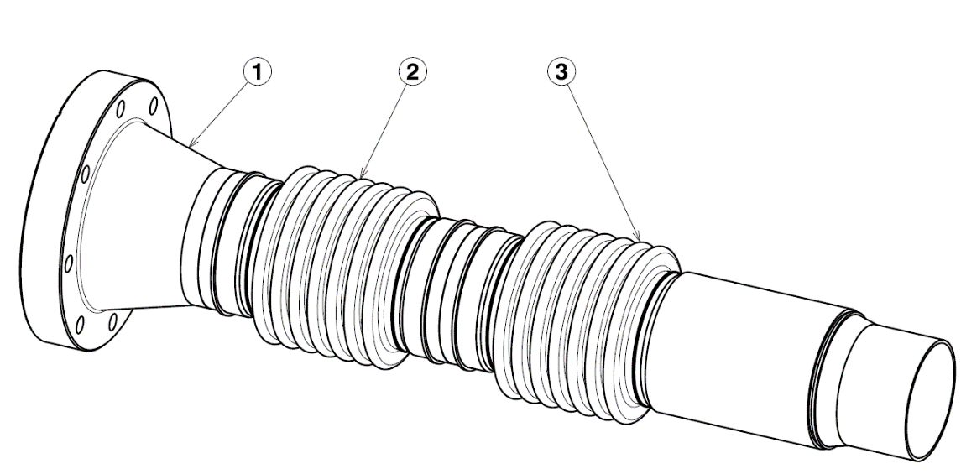
Experimental areas upgrade – ALICE
Central beam pipe released for production (Tender signed)
  Technical specifications for the LS2 central beam pipe prepared and accepted on both sides.
  MATERION production process of the new central beam pipe for LS2 launched ☺
  Raw material issue with EN AW-2219 T6 grain size resolved – produced by Imbach.
  Manufacturing plan ready and raw material on the way.
  Qualification of the aluminium bellows ongoing (CERN will supply double bellow assembly).
Microstructure of the aluminium 2219 for LS2 chambers
New aluminium bellow for ALICE and double bellow assembly

Slide 16

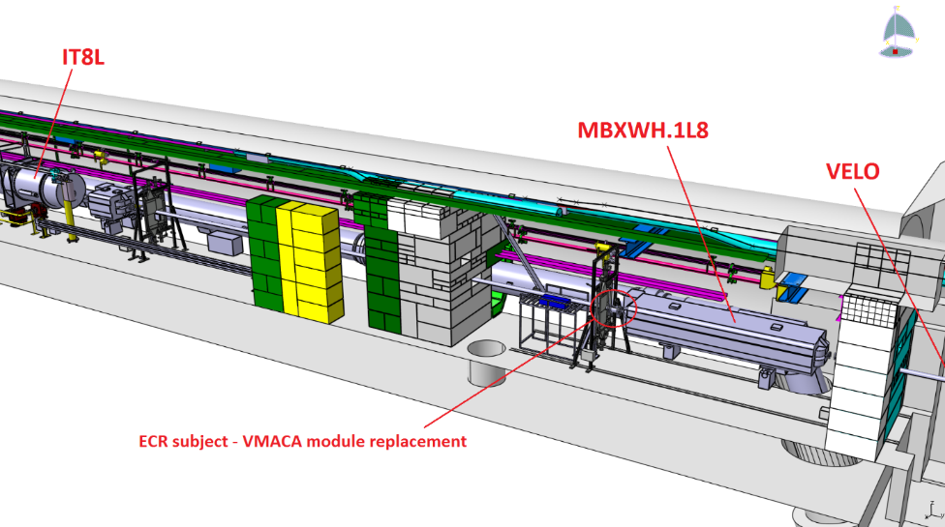
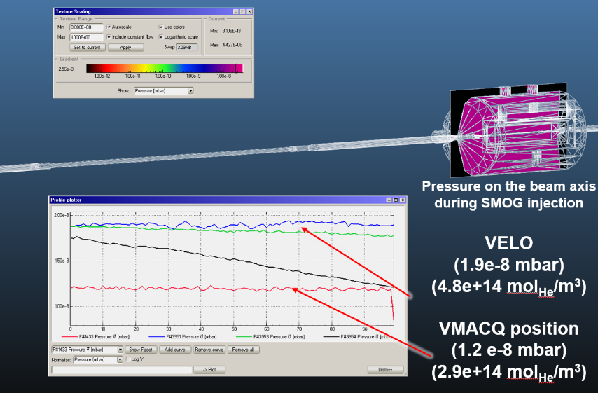
Experimental areas upgrade – LHCb
Absolute gas density measurements for SMOG injection
  New calibrated Bayard Alpert gauge to be installed in A1L8 during the EYETS.
  Collaboration between BVO (layout modification and installation) and VSM (gauge calibration).
  LHCb requested vacuum simulations of IP8 and SMOG injection in order to support future physics.
Installation of the Bayard Alpert gauge close to the VELO

Slide 17
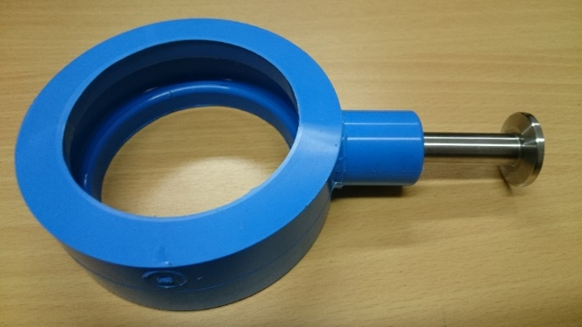
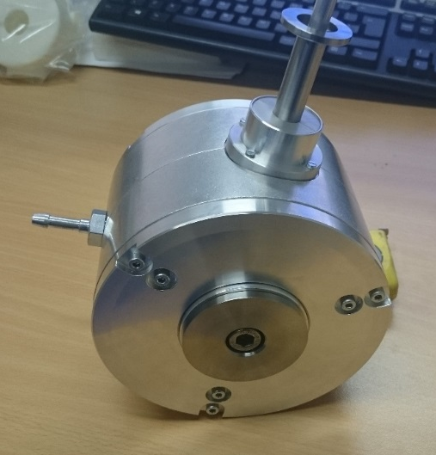
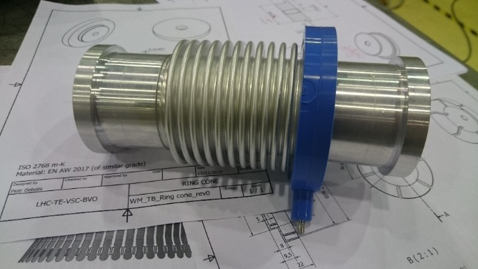
LHC beam vacuum system
Continuous improvement for fast interventions
The LHC Differential pumping tools
Installed in case of vacuum leak
(in case of ATLAS - preventive measure).
Clamp with pressure in mbar range on atmospheric side of a chamber reduces the leak rate by factor 100.
Allows to operate the machine up to TS or EYETS without impact on the operations performance.
Fast installation (≈ minutes).
Design ready for application on chambers, flanges and bellows.
Drift chamber clamp
Custom built precise mould
Bellow clamp

Slide 18
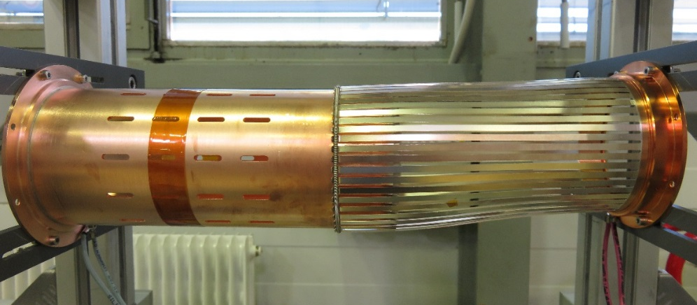
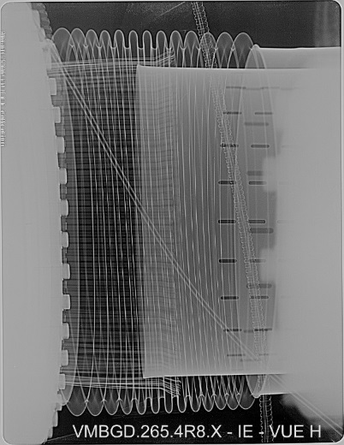
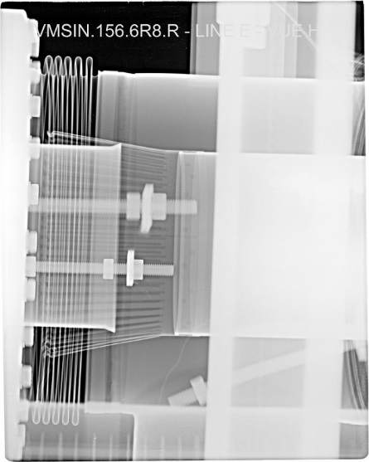
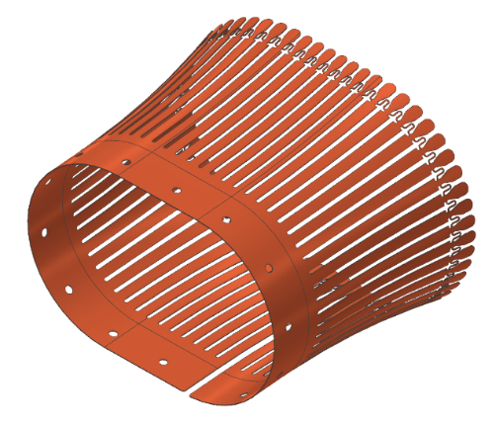
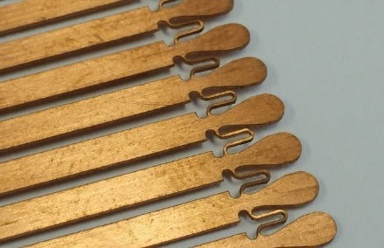
LHC beam vacuum system
Continuous improvement for fast interventions
“Springless” RF contact design
Tension spring is the weakest element of the existing RF bridge design.
If the spring slides out of the working zone, the RF bridge lose the electrical contact.
New design of the RF contact part instead of the spring introduces the flexible bridge.
Transition tube
RF contact (fingers)
Tension spring
New RF contact design
Examples of nonconformities (the spring is out of position)

Slide 19
SPS Complex

Slide 20
CERN ACCELERATOR COMPLEX

Slide 21
SPS Operation Fault
SPS machine availability
Percentage of downtime due to vacuum faults or interventions

Slide 22
SPS Vacuum Operation Fault
355 days of beam time
Relative percentage of downtime due to vacuum faults or interventions
Hours of downtime due to VSC intervention

Slide 23
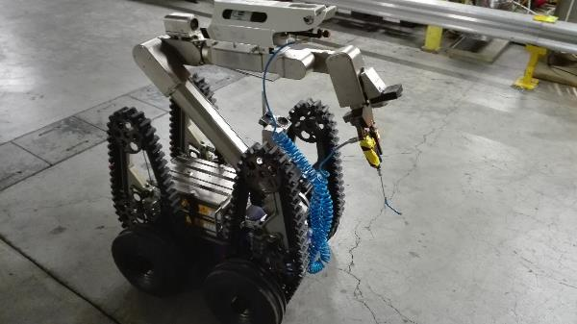
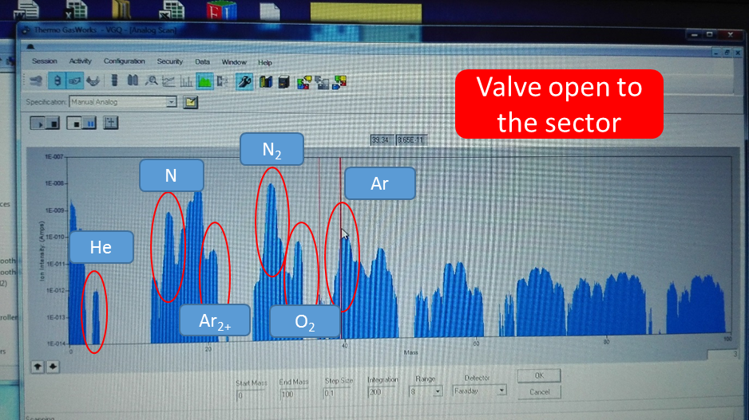
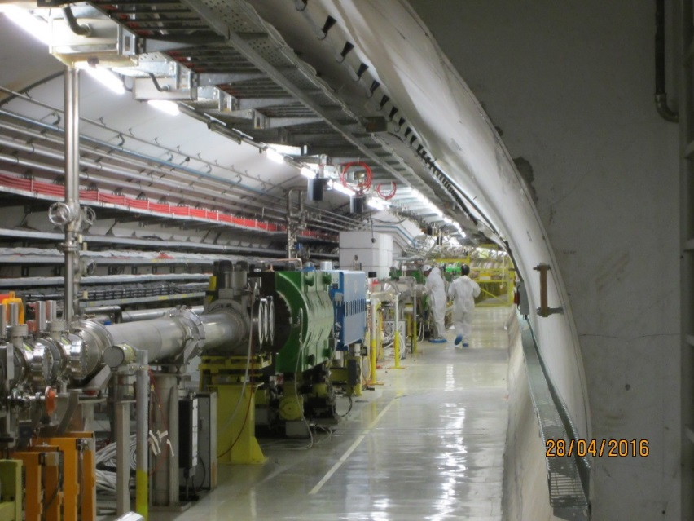
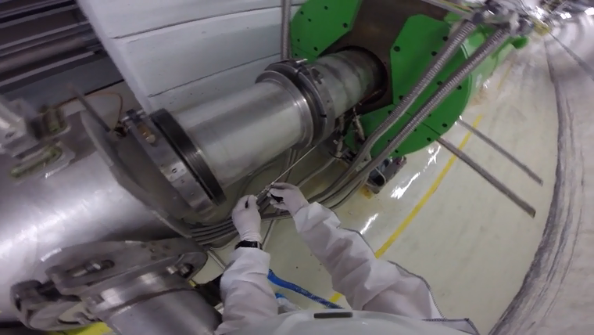
SPS Operation Intervention: Some examples
TDIVG#3 Intervention
TIDVG#3 leak detection
ALARA2 WDP;
Remote and manual leak detection;
RGA analysis for leak detection;

Slide 24
SPS Operation Intervention: Some examples
TDIVG#3 Intervention
Vacuum intervention
Leak development
Pressure evolution over the past months: small drift of pressure: interlock level 4*10⁻⁷ mbar.

Slide 25
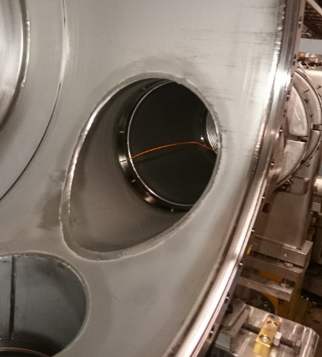
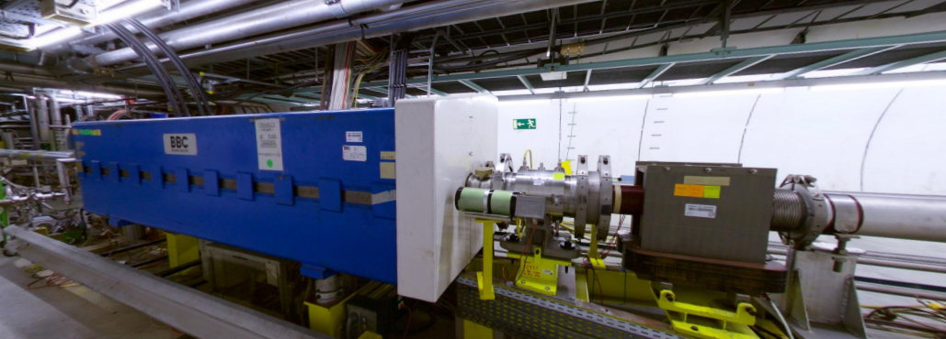
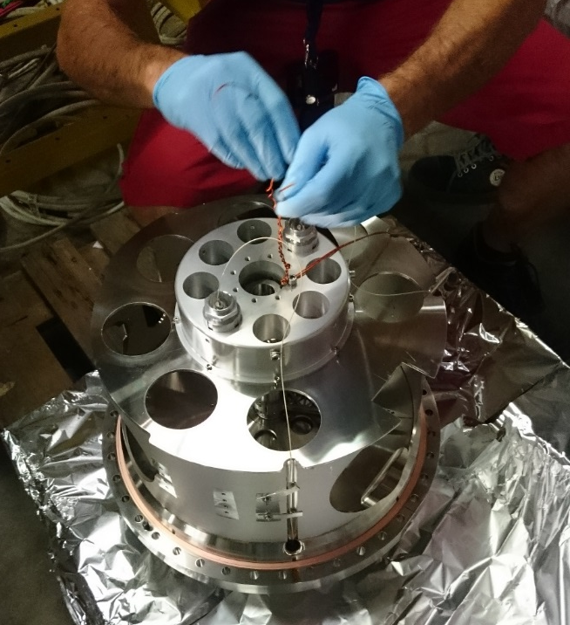
SPS Operation Intervention: Some examples
BA5 – Fast Wire Scanner
BA2 – QDA 219 leak development
Sudden pressure rise: no leak detected, further investigations during the EYETS.
Localised beam losses due to the broken wire.

Slide 26
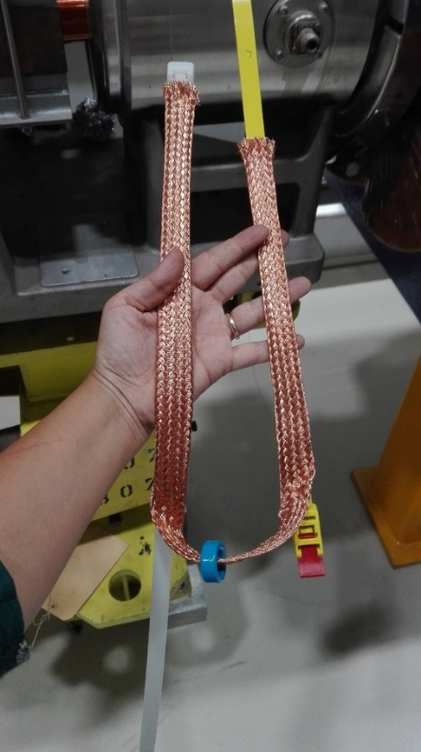
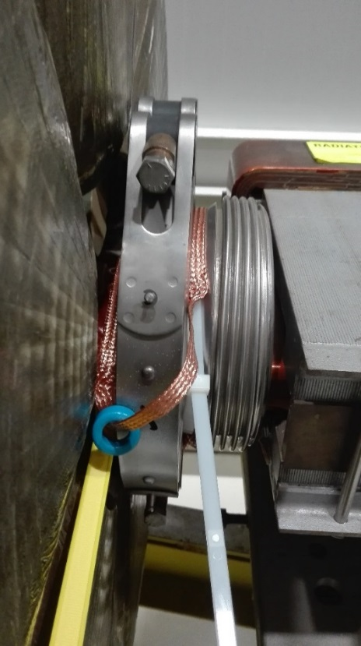
SPS Operation Intervention: Some examples
Soft Clamps for beam impedance reduction:
100 positions all over the ring.
Leak detection sector 520: sudden pressure rise during operation. Leak found on a conical flange – 2 hours intervention

Slide 27
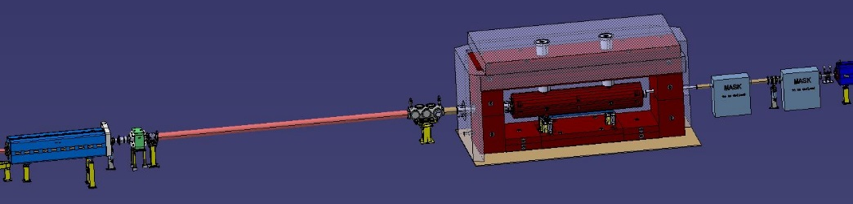
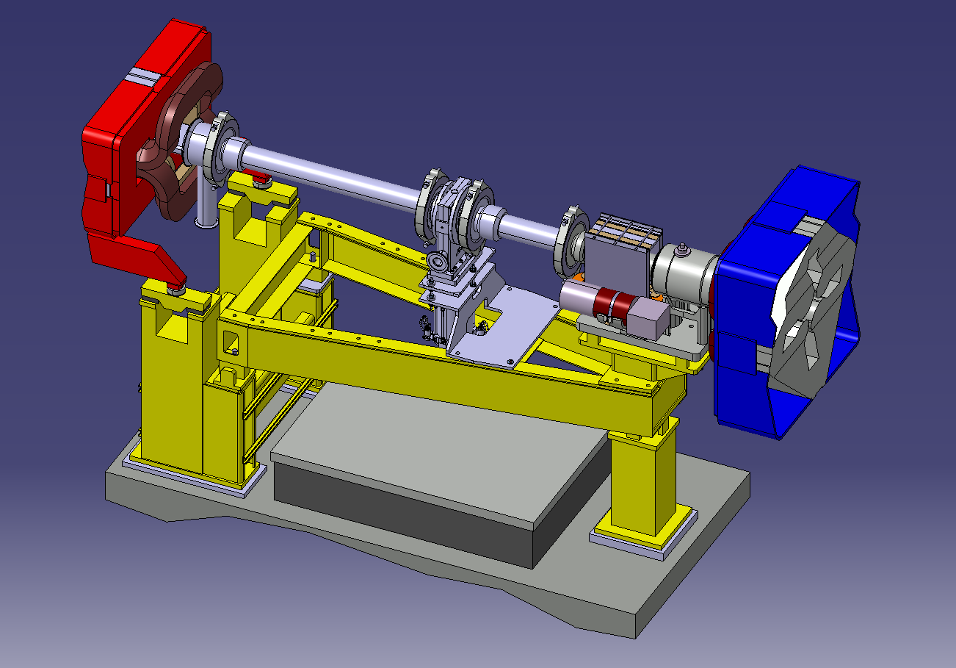
SPS Projects: LIU (LHC Injectors Upgrade)
LSS1 and LSS5 vacuum layouts for the reconfiguration of the SPS dumping system.
Arc sectorisation.
LSS3 RF system upgrade.

Slide 28
CERN ACCELERATOR COMPLEX

Slide 29

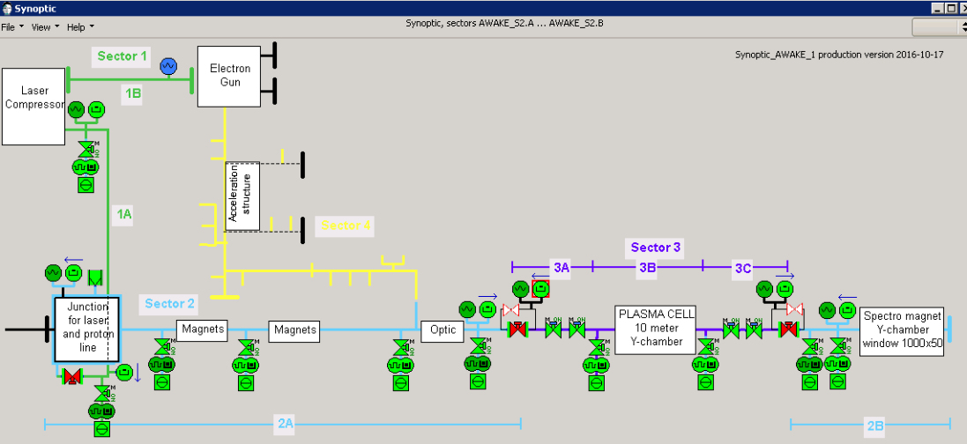
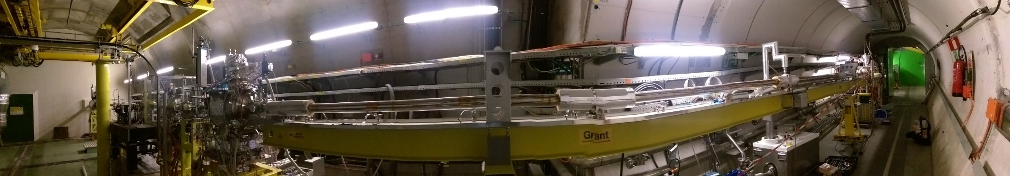
SPS Projects: AWAKE Installation
Laser line and proton line commissioned: first proton beam sent on the 16th of June.
Plasma cell preparation to commission it with Rubidium vapour ongoing.
Next year:
Electron line installation;
Secondary laser beam line installation;
10 m-long rubidium plasma cell

Slide 30
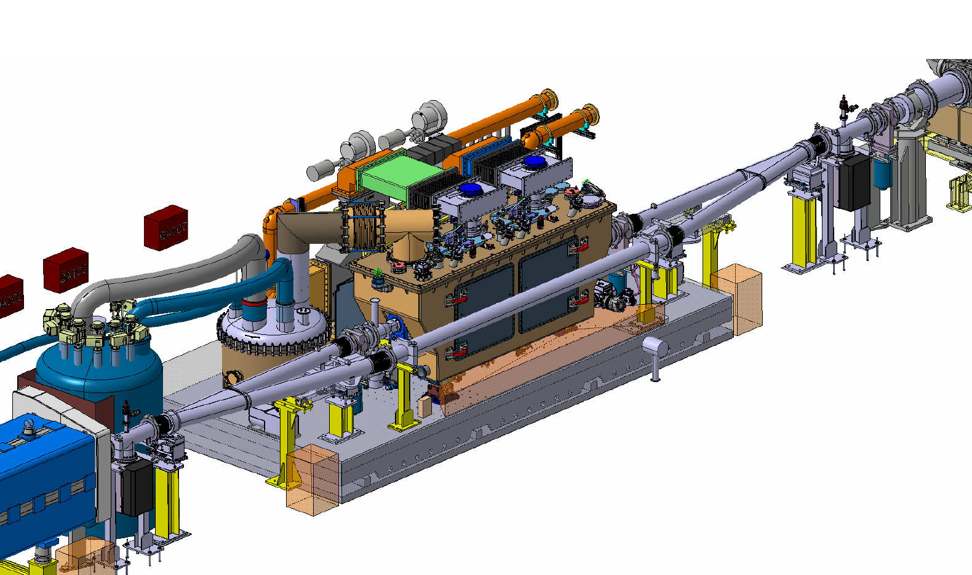

SPS Projects: HL-LHC
VGHA + VGHB
VGHA + VGHB
VGHA + VGHB
VGHA + VGHB
VPIB
500 l/s
VPIB
500 l/s
VGHB
CRAB CAVITIES TEST STAND INTEGRATION IN SPS – LSS6

Slide 31
PS Complex

Slide 32
CERN ACCELERATOR COMPLEX

Slide 33
cPS Operation
November 2015 to November 2016
Without PS intervention
<2.5%
<1%

Slide 34
cPS Operation
November 2015 to November 2016
19h of beam lost due to TE-VSC in cPS (excluding PS intervention)
Only 1.6h on LHC injection chain from a total of 940h in fault (0.2%)
Extracted from e-logbook. Next year: Accelerator Fault Tracker available for the injectors → Better statistics
Without PS intervention
<2.5%
<1%

Slide 35
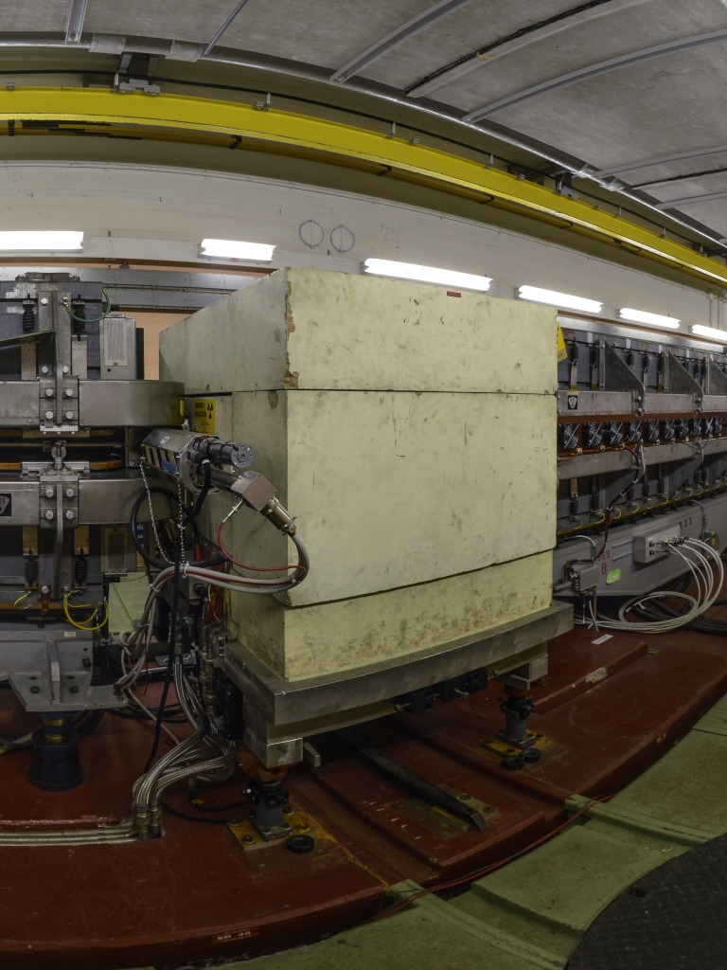

cPS PS: Leak in SS48
Sudden pressure increase in around SS48 of PS in August
Leak downstream flange on SS48
Spark damaged the aluminium seal → Bad RF bypass

Slide 36
cPS Interventions Overview
> 100 days

Slide 37






cPS Projects: LIU Involvement
Preparation vacuum chambers for MU41 and MU42
Preparation of FWS in 4L1 PSB
Validation of LIU components for LINAC4 early connection

Slide 38





cPS Projects: LINAC4
Validation and installation of RF cavities
Acceptance test of components
Installation and commissioning of transfer line and Half Sector Test
160 MeV commissioning

Slide 39


cPS Projects: HIE-Isolde
CM: Superconducting RF Cryomodules
(Copper cavities, in-house Niobium-coated)
Installation of CM2
Repair of CM1
Preparation of CM3
Acceptance test of components before installation
Design and procurement of XT03 and extension XT02
2017 → Installation of CM3, XT03 and HELIOS experiment with extension of XT02

Slide 40




cPS Projects: MEDICIS
Layout definition (50%)
Validation of some components
Procurement (50%)
Collection chamber specification
Installation and commissioning 2017

Slide 41
CERN ACCELERATOR COMPLEX
ELENA circumference: 30.5 m

Slide 42


ELENA Pressure requirements:
Ring: ~ 10⁻¹² mbar
Experimental Beamlines: ~ 10⁻¹¹ mbar
ELENA
Extensive use of hybrid ion/NEG pumps.
16’000 l/s lumped pumping on 30m ring.
100’000 l/s lumped pumping on beamlines.

Slide 43



cPS Projects: ELENA Installation

Slide 44




cPS Projects: ELENA Installation

Slide 45





cPS Projects: ELENA Commissioning
  Pressure after NEG vacuum activation
  10⁻¹¹- 10⁻¹² mbar
First beam on BTV 16/11/2016 !

Slide 46


cPS Projects: ELENA Acceptance tests
136 vacuum components tested
≈185 week·man spent for all the acceptance tests
Up to 4 test benches in parallel to cope with the tests
Summary of devices tested
Summary of weeks spent per group

Slide 47
Laboratory Activities

Slide 48

Laboratory activities in 2016: Acceptance tests

Slide 49




Some examples
Kicker ELENA
Lab. 867-RW25 (Prevessin)
TCSPM jaw
Gun e-cooler ELENA

Slide 50


Some examples
Multi-Channel Plate
Monitor H Recombined

Slide 51




Some examples
Fast deflector – ELENA
Graphite TDI LHC
TIDVG graphite - SPS
TCTW jaw tests

Slide 52


FCC Design Study

Slide 53


Slide 54


FCC-ee: 45.5, 80, 120, 175 GeV, e⁻e⁺ Collider
SUPERKEKB

Slide 55



The LHC Beam Screen Design is not Applicable to FCC-hh
A Sawtooth profile is embedded in the LHC beam screen to reduce the photoelectron yield and the forward reflectivity
In dipoles, electron shield are clamped to protect the cold bore from electron cloud heat load
~ 40 μm
Detail of the sawtooth profile:
Courtesy N. Kos CERN TE/VSC
~ 500 μm

Slide 56

FCC-hh: 50+50 TeV pp Collider: Much Higher Synchrotron Radiation Flux
Beam screen concept
SC He Cooling channels
Magnet cold bore
1.9 K
Copper layer, 0.3 mm for impedance
Screen
40~60 K
Deflector
Copper strips for heat transfer
Ribs:
Mechanical strength
Photon stopper
Pumping holes
Laser treatment
Must sustain a quench force of 24 tons/m

Slide 57
Summary
As it has been shown during this short presentation of few selected sample cases, the CERN Vacuum Surfaces and Coatings group (VSC) is involved in a constant program of refurbishing of older machines, in order to guarantee the highest levels of overall machine availability
VSC is also heavily involved in the study, development and operation of approved projects (High-Luminosity LHC (HL-LHC), LHC Injectors Upgrade (LIU), AWAKE, MEDICIS, ELENA) and also of conceptual design studies (BioLEIR, FCC-ee, FCC-hh, etc…)
There is a constant need for new vacuum chambers and components, such as gauges, pumps, fittings, flanges, materials, surface treatment, and more…)
Reliable, competent industrial partners are an important asset without whom our daily activities and long-term project would not be possible
VSC is also heavily involved in knowledge transfer to and from industry, such as thin-film coatings (NEG, niobium), surface treatments (e.g. laser ablation), novel sealing technologies (e.g. shape-memory alloys and flanges)
We look forward to continuing this collaboration in the future with the many Italian companies which are already working with us and possibly with new ones as well.
Thank you for your attention ☺

