Slide 1
Superconducting Links and Cold Powering components for HL-LHC
A. Ballarino, CERN, TE-MSC
ITALY AT CERN, 4-7 Aprile 2017

Slide 2
Outline
Introduction
System description
Components to be produced
Cryostats, Superconductor, Superconducting cables, Current leads
Timeline for procurement
Conclusions

Slide 3
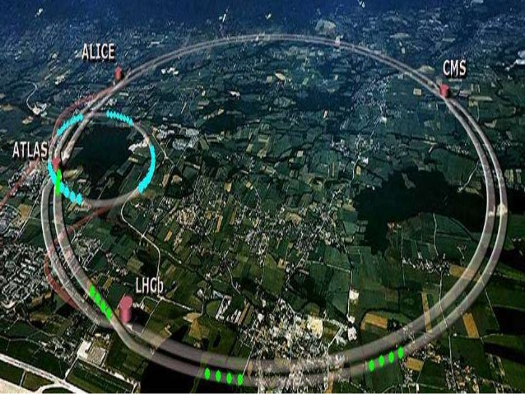
Powering of LHC HL-LHC Magnets (WP6a)
A. Ballarino

Slide 4
Powering of LHC HL-LHC Magnets
Use of superconducting links providing the powering of the HL-LHC magnets from remote distance
Use of materials operating at higher temperatures. Advantages:
Temperature margin during operation
Stability of materials operated at higher temperature
Efficient cooling of cold powering system (He gas cooling)
Choice of materials:
MgB₂ conductor covering the long distance (∼ 80 m -100 m)
HTS conductor at the warmer section – near the current leads (10 m - 15 m)
Advantage of MgB₂: potentially low cost
Drawback: required qualification of new technology
A. Ballarino

Slide 5
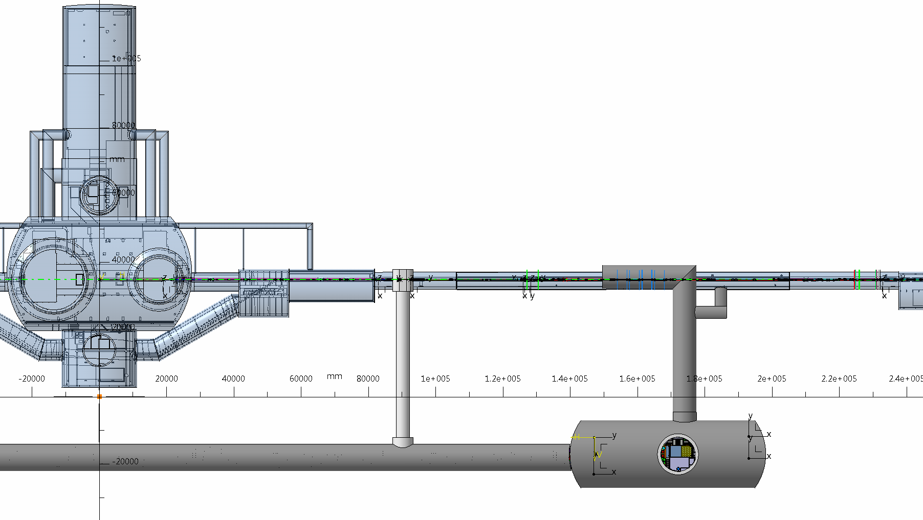
Powering of LHC HL-LHC Magnets
Triplets
Matching Section
Q1
Q2A
Q2B
Q3
CP
D1
D2
Q4
Q5
Q6
Atlas
A. Ballarino

Slide 6
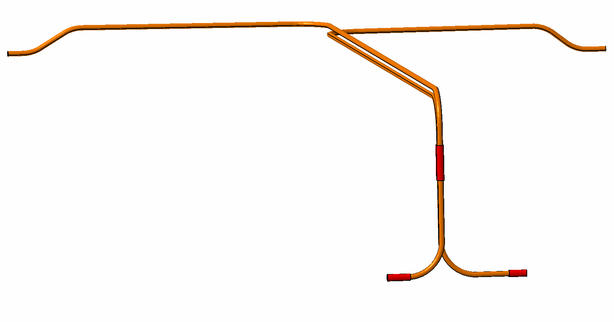
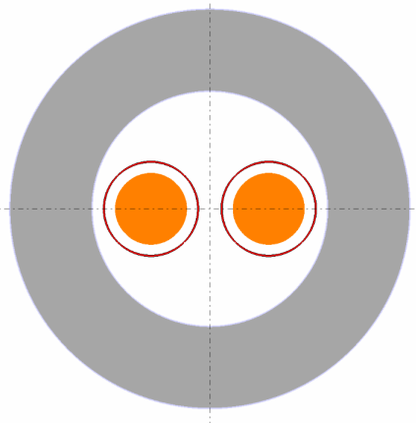
Powering of LHC HL-LHC Magnets
L ∼ 80 m
L ∼ 80 m
∼ 8 m
Ø 1000
A. Ballarino

Slide 7
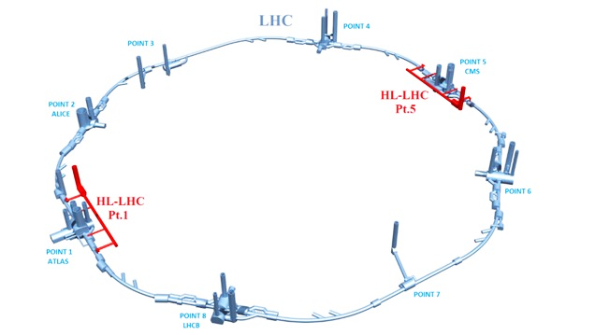
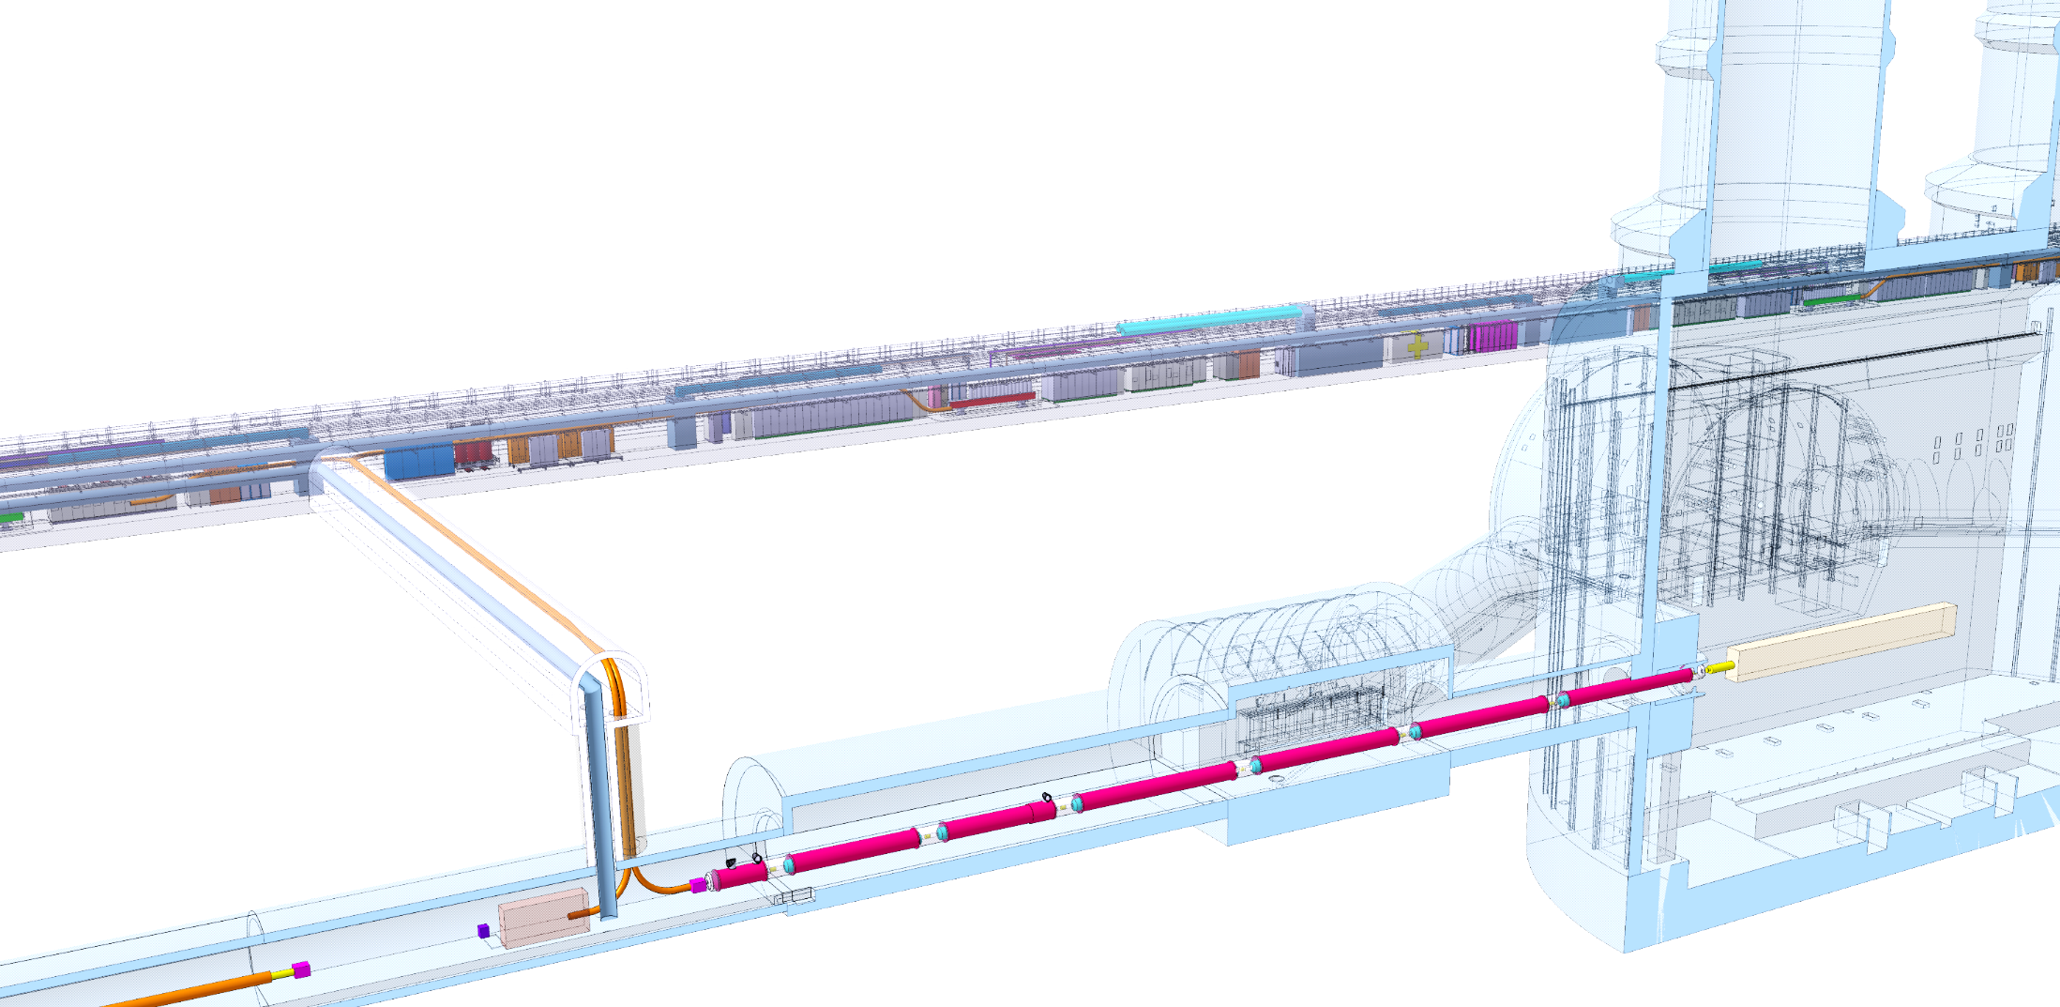
Quantities and Components
Each high luminosity interaction point (IP1, ATLAS and IP5, CMS) requires:
a) dedicated cold powering for the triplet and D1 magnets;
b) dedicated cold powering of matching sections
8 cold powering systems in total
DFHX
DFHM
SCLink DSH
Q1
IP
Q2a
DFX
Q2b
Q3
Illustration of the position of the DFX
(not latest version for details)
DFM
D1
CP
A. Ballarino

Slide 8
Quantities and Components
Each cold powering system includes:
1 SC link (DSH);
1 DFH(X or M) cryostat, connecting the SC link to the current leads
1 DF(X or M) cryostat, connecting the SC link to the magnets
MgB₂ cables;
Several current leads – different current ratings (from 0.12 kA to 18 kA)
DFHX
DFHM
SCLink DSH
Q1
IP
Q2a
DFX
Q2b
Q3
Illustration of the position of the DFX
(not latest version for details)
DFM
D1
CP
A. Ballarino

Slide 9
Quantities and Components
In total, for the DF: 20 series units + 4 spare units
4 (+1 spare) DFX;
4 (+1 spare) DFM;
4 (+1 spare) DFHX;
4 (+1 spare) DFHM;
DFHX
DFHM
SCLink DSH
Q1
IP
Q2a
DFX
Q2b
Q3
Illustration of the position of the DFX
(not latest version for details)
DFM
D1
CP
A. Ballarino

Slide 10
Quantities and Components
In total, for the DSH: 8 series units + 2 spare units
In total, for the current leads:
16 units rated at 18 kA
8 units rated at 13 kA
48 units rated at 2 kA
80 units rated at 0.2 kA
32 units rated at 0.8 kA
DFHX
DFHM
SCLink DSH
Q1
IP
Q2a
DFX
Q2b
Q3
Illustration of the position of the DFX
(not latest version for details)
DFM
D1
CP
A. Ballarino

Slide 11
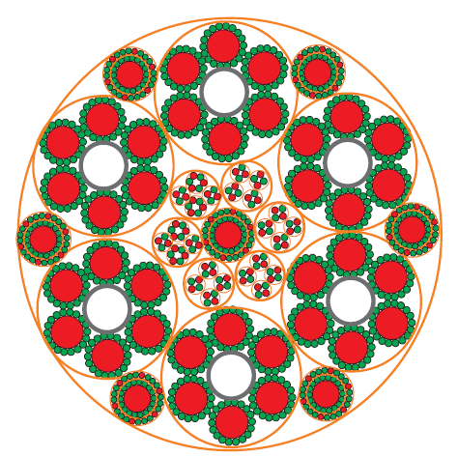
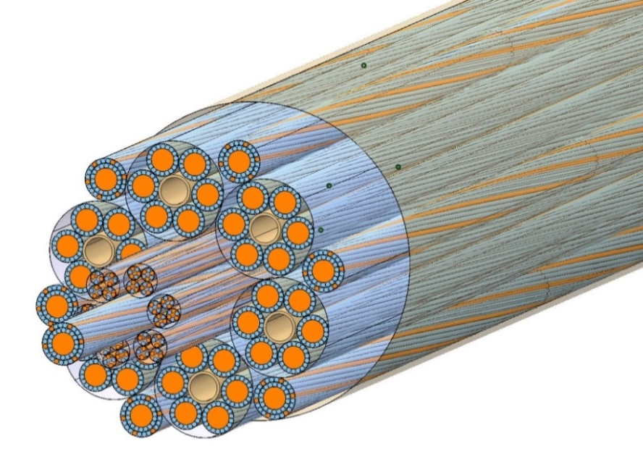
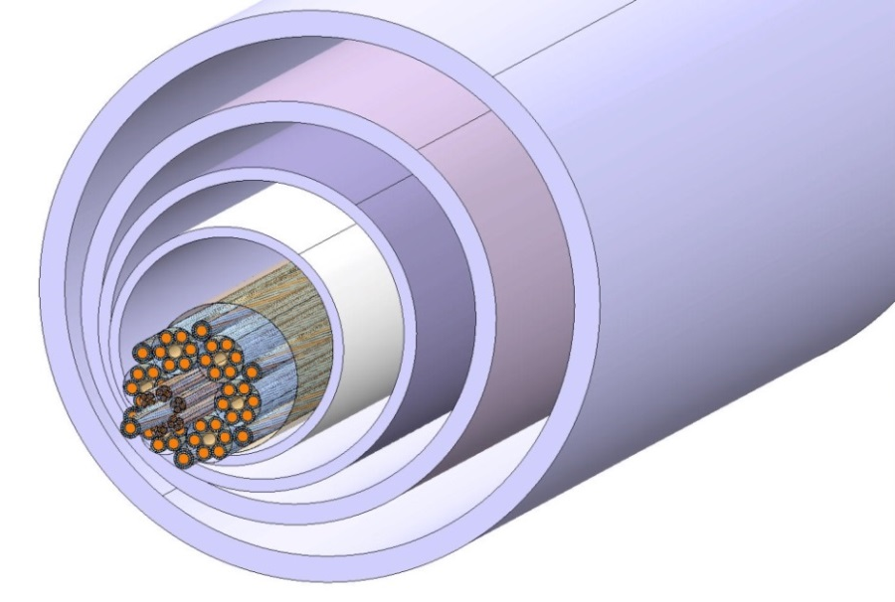
MgB₂ cable assemblies and DSH
Φext ∼ 65 mm
Mass ∼ 10 kg/m
Green: MgB₂
Red : Copper
Φext ∼ 220 mm
A. Ballarino

Slide 12
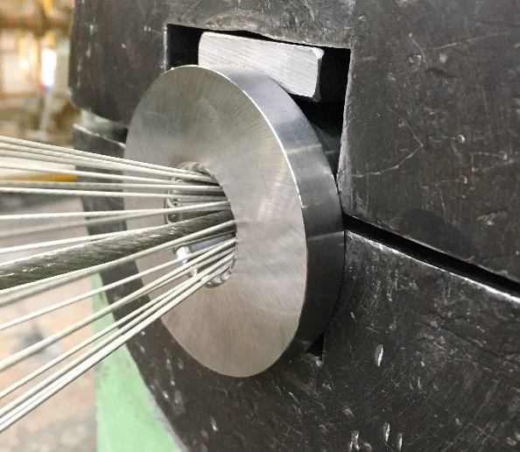
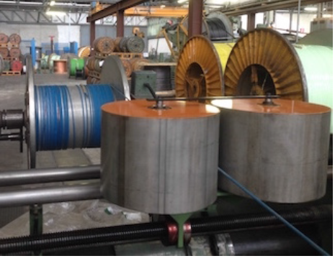
MgB₂ wires and cables
3 kA @ 20 K
MgB₂ Wire (Φ = 1 mm)
37 MgB₂ Filaments
> 100 km of wire
procured
3 kA @ 20 K, CERN
A. Ballarino

Slide 13
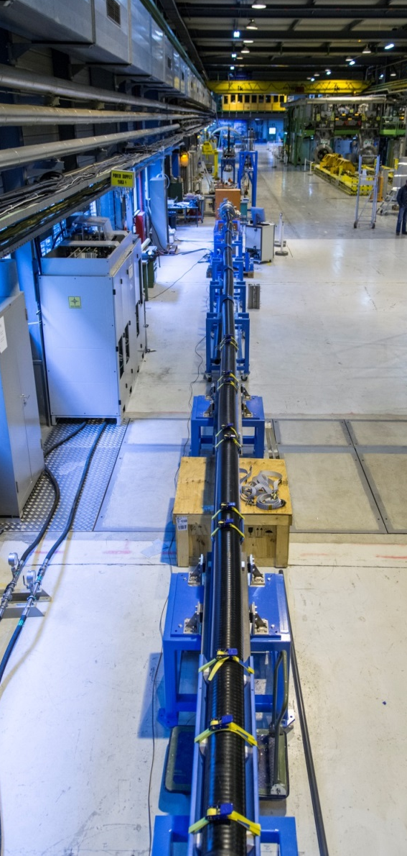
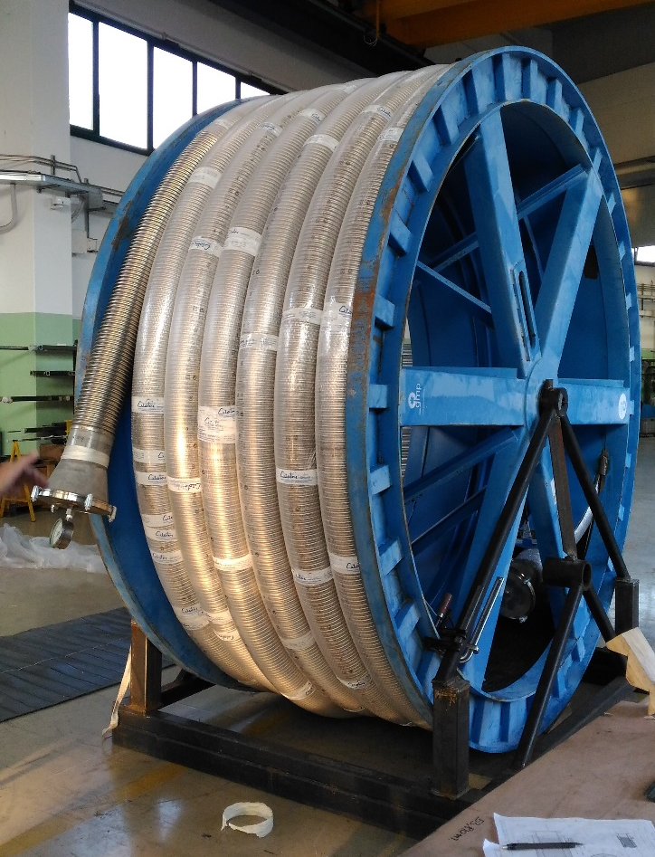
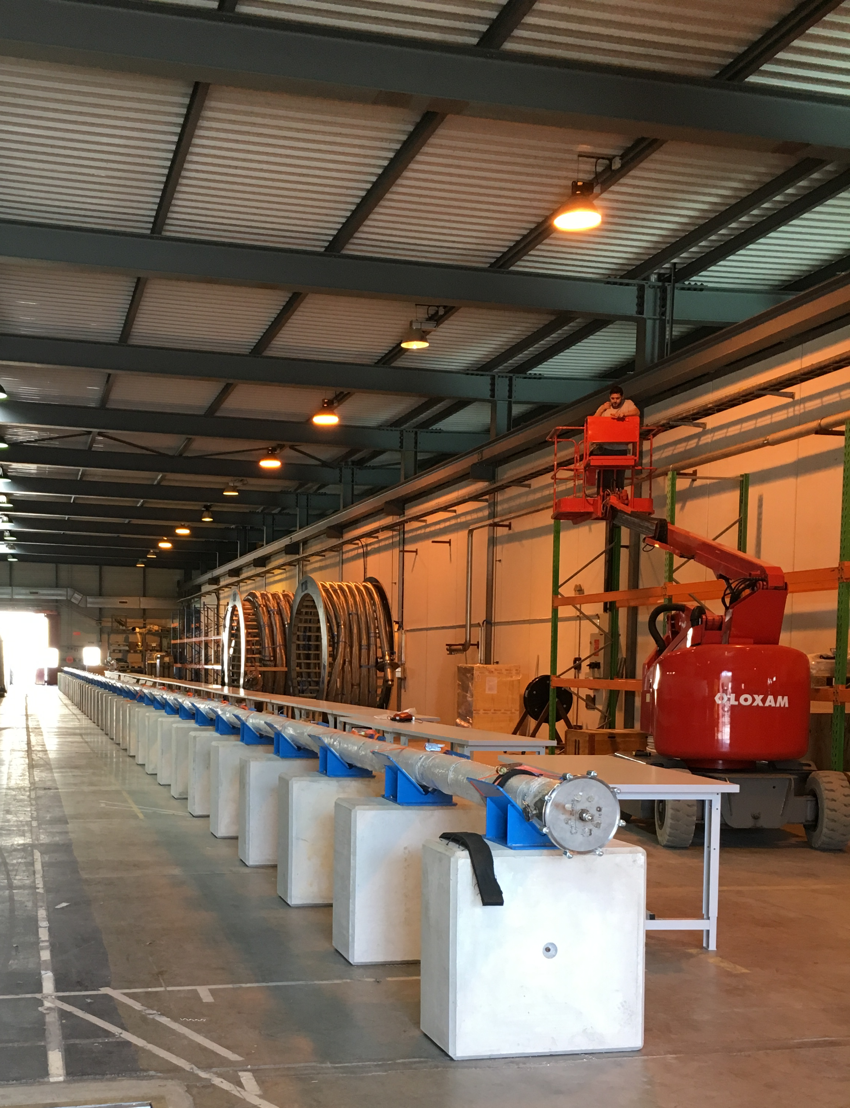
CERN, SM-18
Cryotec
CERN, Building 927
L= 20 m
L ∼ 20 m
GHe
5 K- 70 K
± 1 K
A. Ballarino

Slide 14
Timeline
Prototype activity
Series Production
Test of Series
2013
2014
2015
2016
2017
2018
2021
2024
Test in String of Magnets
Test at CERN of
Demo System
Integration in LHC
A. Ballarino

Slide 15
Summarizing
Of interest for industry:
Cryostats (DFH and DF)
Flexible cryostats (DSH)
MgB₂ wire
Cabling
Current leads
Future in-kind contributions for current leads and
DF cryostats being discussed
A. Ballarino

Slide 16
Contact persons at CERN
Amalia Ballarino, Patrick Retz: superconducting links, currents leads, superconducting cables
Vittorio Parma, Yann Leclercq: cryostats, DFH(X,M), DF(X,M) cryo-modules
A. Ballarino

Slide 17
Thanks for your attention !

