Slide 1
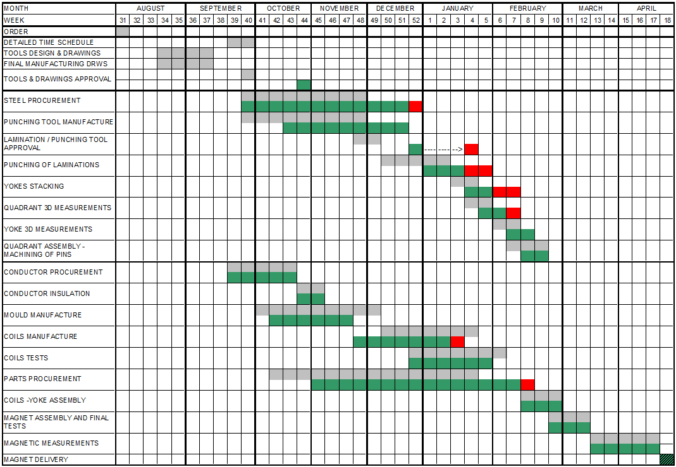
Timeplan

Slide 2
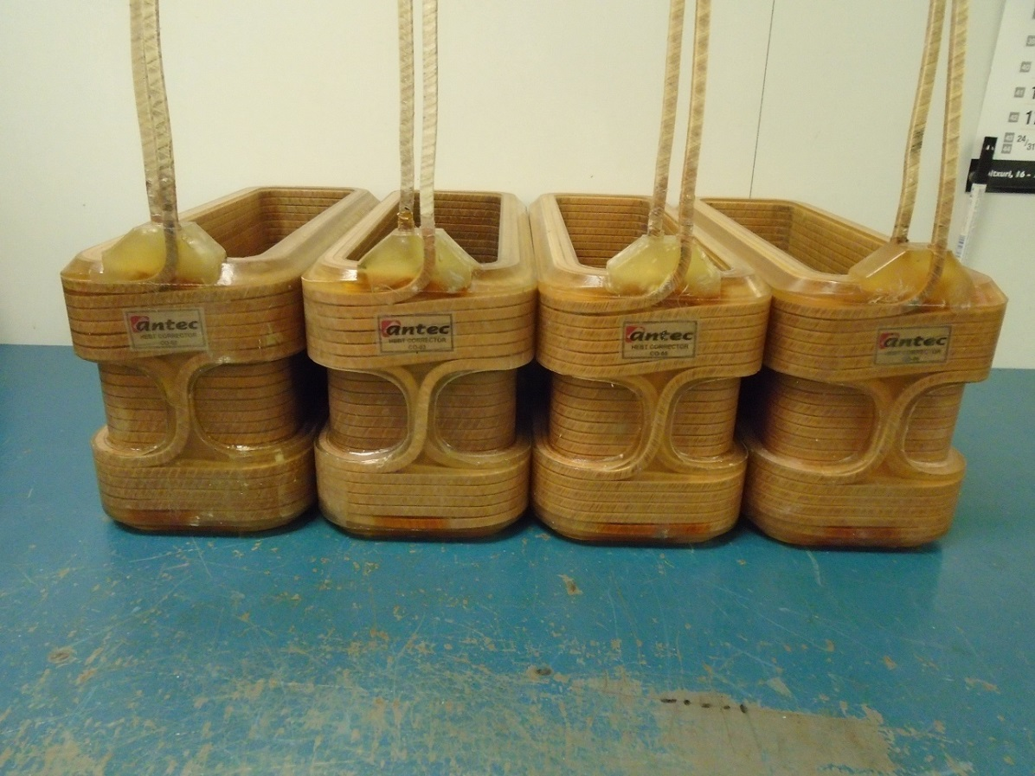
Coils
All the coils are already manufactured and tested

Slide 3
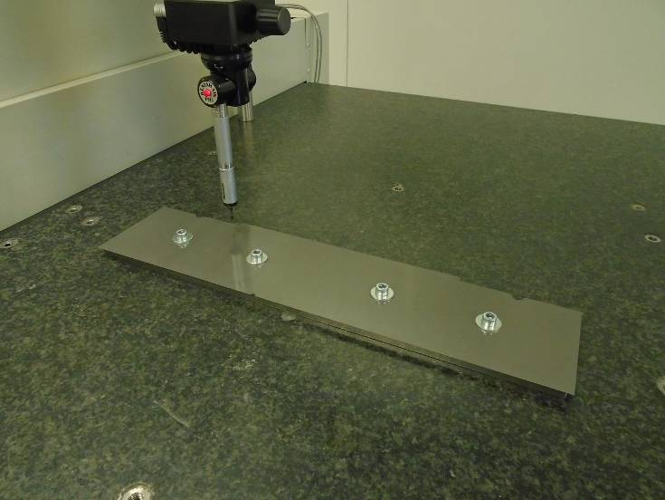
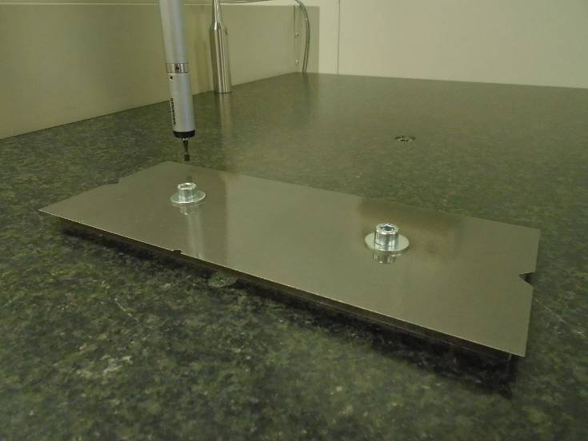
LAMINATIONS
The punching tool was manufactured. The first laminations were punched and measured. They met the tolerances specified in the drawings, and the rest of the laminations were punched and received

