Slide 1
Imaging using plasma betatron radiation
Jason Cole
The John Adams Institute for Accelerator Science
Imperial College London
ELIMED 2016, Catania

Slide 2





Acknowledgements
P. Abel², R. Abel⁹, S. Alatabi¹, E. Aboagye², J. Bryant¹, J. Cole¹, R. C. Combes², D. Dangor¹, S. Hawkes⁸, C. Hooker⁸, A. Jin⁵, S. Johnson⁶, L. Kenny², A. Lim³, N.C. Lopes^{1,7},S.P.D. Mangles¹, K. Mecseki¹, Z. Najmudin¹, N. Ngo⁴, Q.D. Nguyen², D. Norris⁶, R. Pattathil⁸, K. Poder¹, J. Sanderson⁶, S. Sousha³, C.Spindloe⁸, M. Sroya⁴, D. Symes⁸, L. Teboul⁶, H. Westerberg⁶, M. Winkler³, J. C. Wood¹
¹ The John Adams Institute for Accelerator Science, Imperial College London
² Department of Surgery and Cancer, Imperial College London
³ NHS Healthcare Trust, Imperial College London
⁴ Healthcare Tissue Bank, Imperial College London
⁵ Department of Mechanical Engineering, Imperial College London
⁶ MRC Mammalian Genetics Unit, Harwell Campus
⁷ GoLP, Instituto Superior Técnico, Lisboa, Portugal
⁸ Central Laser Facility, STFC, Rutherford Appleton Laboratory, Didcot, OX11 0QX, UK
⁹ MSK Laboratory, Department of Surgery and Cancer, Imperial College London

Slide 3
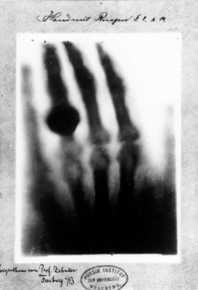
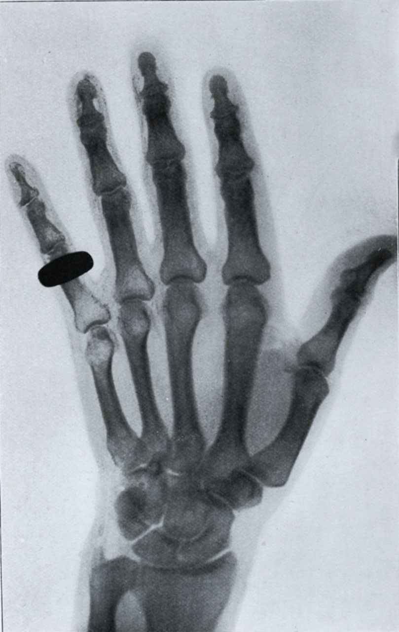
Challenges in medical radiography
Standard diagnostic for a hundred years. Simple to image large dense objects, e.g. bone
Still difficult to image soft tissues at high resolution, e.g. breast, lung, prostate cancers.
Difficult to image hard tissues at high resolution in 3D, e.g. micron-scale cracks and mineral distribution in bone.
Need for high-flux, high-resolution laboratory scale x-ray sources

Slide 4
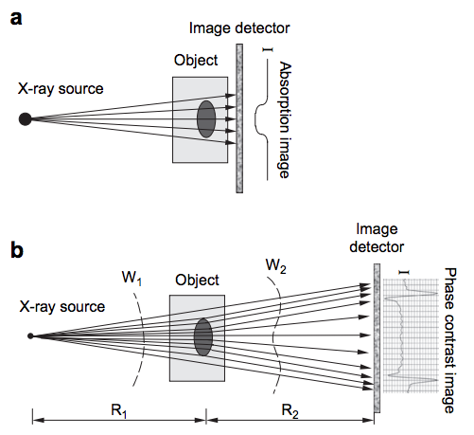
Phase vs. absorption contrast
Absorption contrast
Phase shift
Absorption
Contrast through photon absorption
Phase contrast
Object deflects photons, highlighting edges
Propagation-based, works for polychromatic sources
Zhou S-A and Brahme A, Physica Medica (2008) 24

Slide 5
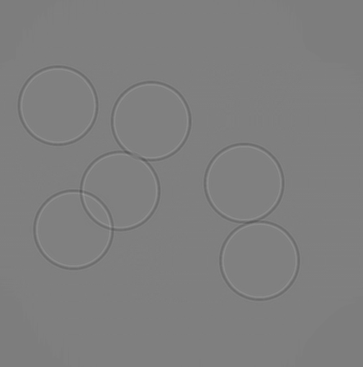
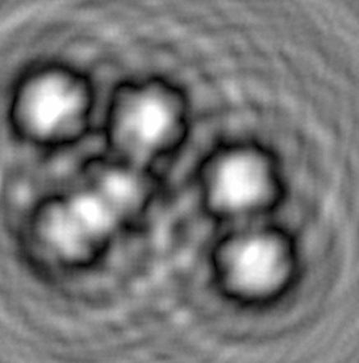
Picking the right imaging energy is important
F = 0.8
F = 0.0001
Absorption contrast is sensitive to d/dE (absorption)
Typical peak in the signal-to-noise ratio (SNR).
Important for reducing dose
Phase contrast function of Fresnel number F
Optimal imaging distance proportional to photon energy

Slide 6
Challenges in medical radiography
Medical requirement
Source requirement
Need high resolution
Need to penetrate macroscopic objects
Need to be able to image different tissues
Need to image lots of objects
Need to perform phase contrast imaging
Small source size
Hard x-rays – 10-100s keV
Spectrum should be tunable
High photon flux, high stability
Source should be spatially coherent

Slide 7
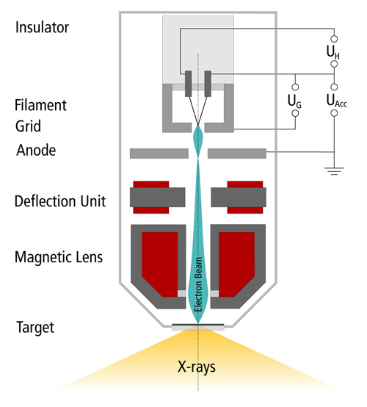
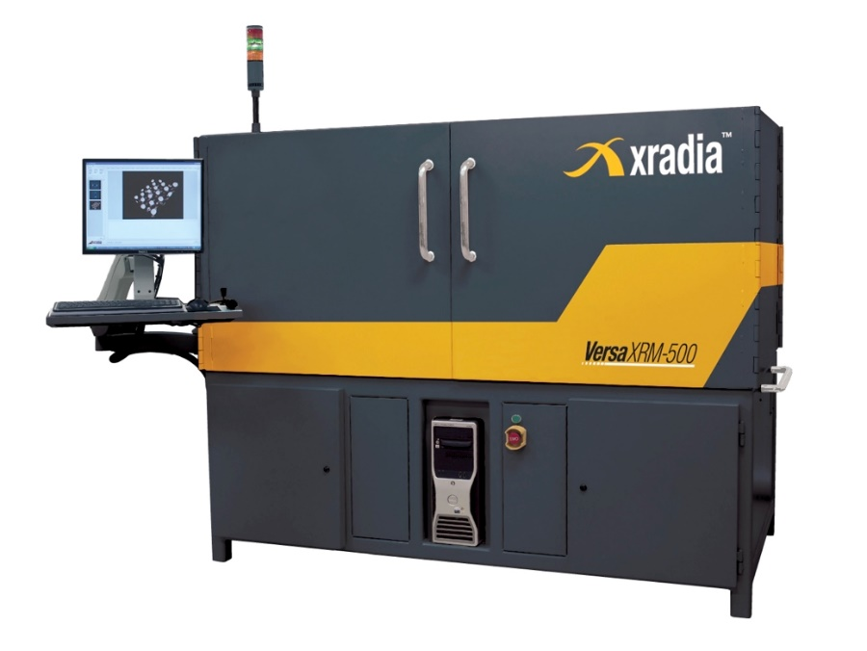
There are a limited number of suitable x-ray sources
Commercial microfocus-based scanners
Focus electron beam onto target anode
X-ray source size limited by electron beam size, minimum ~5 micron
(smaller with x-ray optics)
X-ray flux limited by melting of electron beam anode
Large divergence – propagation phase contrast difficult. Possible with Talbot gratings

Slide 8
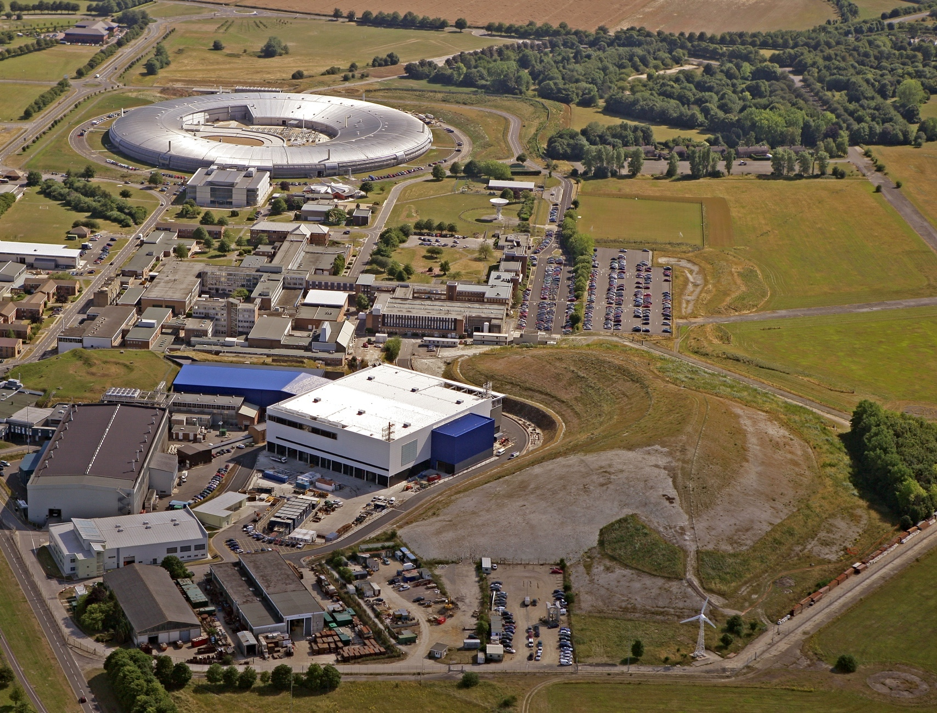
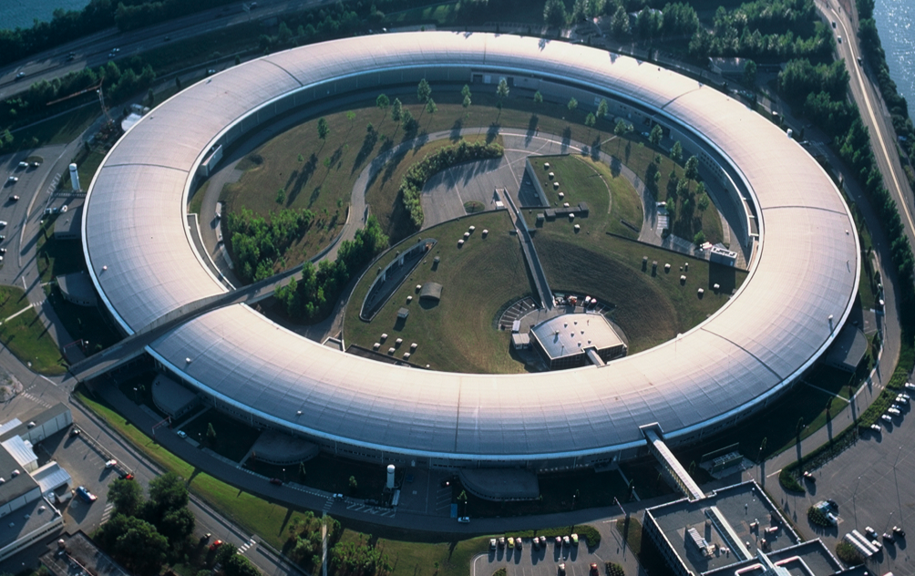
There are a limited number of suitable x-ray sources
Diamond (RAL)
Synchrotron light sources
Wiggle a ~GeV electron bunch, produce broadband synchrotron radiation
Very high flux
Can monochromate beams
Extremely expensive
Won’t fit in a hospital basement
ESRF (Grenoble)

Slide 9
A laser-driven x-ray source
Diamond - £300 million
3 GeV
4 football pitches
Astra Gemini- £5 million
2.5 GeV
1 tennis court
Laser-driven synchrotron sources are a fraction of the cost and size of conventional synchrotrons

Slide 10
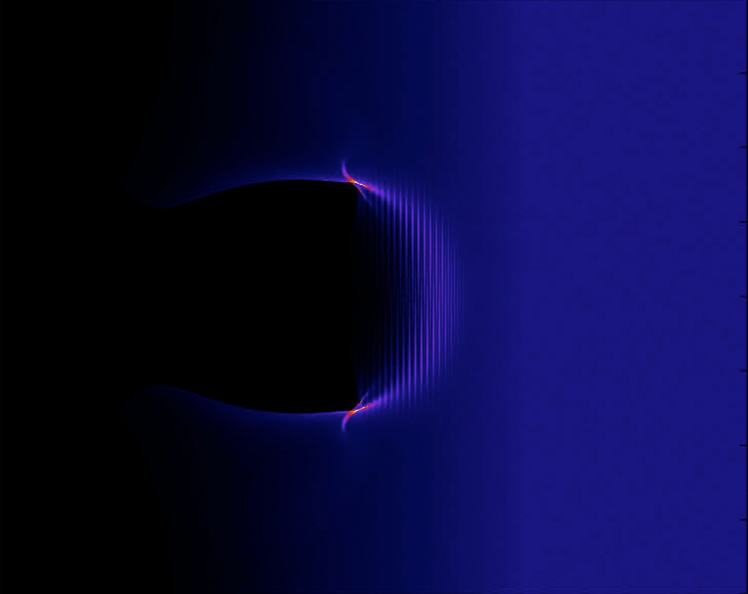
Betatron radiation from laser-wakefield accelerators
Underdense plasma
(Electron density)
Intense laser pulse ➔

Slide 11
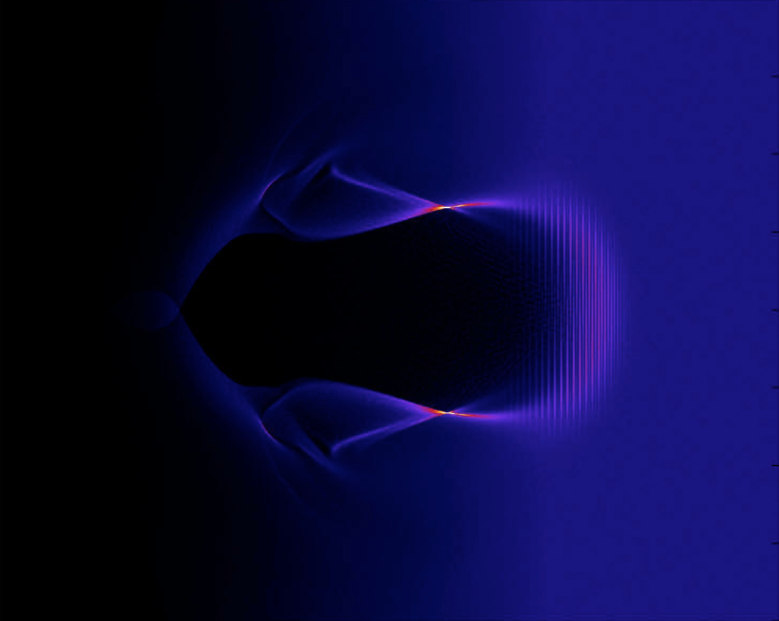
Betatron radiation from laser-wakefield accelerators
Electrons
swept aside
(Electron density)
Ion cavity

Slide 12
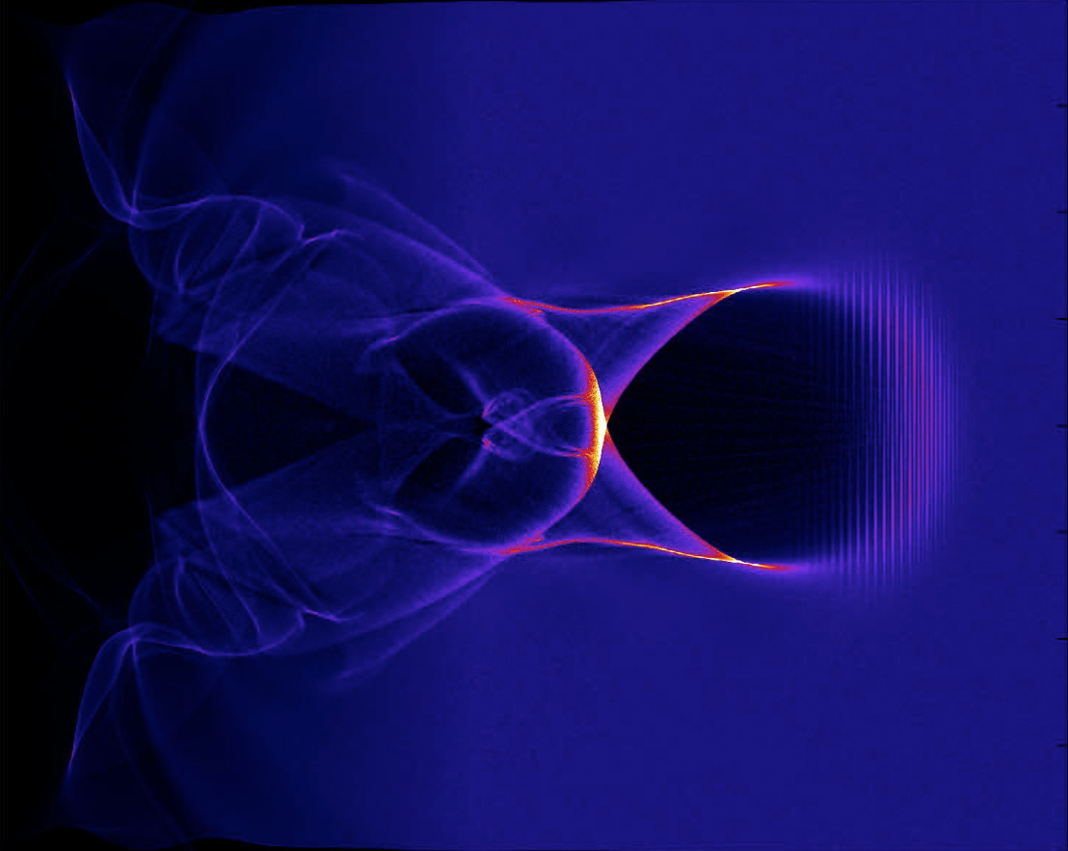
Betatron radiation from laser-wakefield accelerators
Electrons slip to rear of bubble and get accelerated by longitudinal fields
e⁻
(Electron density)

Slide 13
Betatron radiation from laser-wakefield accelerators
As seen in an EPOCH simulation (moving window)
1/γ
(Electron density)
1 μm
Generate synchrotron-like radiation spectrum
Characteristic energy

Slide 14
Experimental Setup
Experiments in 2013 and 2015
Astra-Gemini laser facility
Rutherford Appleton Laboratory, UK

Slide 15
Experimental Setup
Gemini laser pulse
5 - 10 J on target, 45 fs

Slide 16
Experimental Setup
Adaptive optic
Wavefront error 0.2λ RMS

Slide 17
Experimental Setup
2013 - f/20 parabolic mirror, 25 x 32 μm spot, I = 18 x 10¹⁸ Wcm⁻², a₀ = 3.0
2015 - f/40 parabolic mirror, 54 x 45 μm spot, I = 4.8 x 10¹⁸ Wcm⁻², a₀ = 1.5

Slide 18
Experimental Setup
Gas cell
Contains He
1-10 x 10¹⁸ cm⁻³

Slide 19
Experimental Setup
Adjustable plasma length
0 – 40 mm

Slide 20
Experimental Setup
Laser pulse
Electrons
Betatron x-rays

Slide 21
Experimental Setup
Laser pulse blocked with 25 μm aluminium foil

Slide 22
Experimental Setup
Electrons deflected by 1T permanent magnet onto LANEX spectrometer screen

Slide 23
Experimental Setup
Biological sample

Slide 24
Experimental Setup
Transmitted x-rays detected on camera
For low energies, deep-depletion
silicon CCD – up to 20 keV
For high energies, CsI scintillator
fibre-coupled to CCD – up to 150 keV

Slide 25
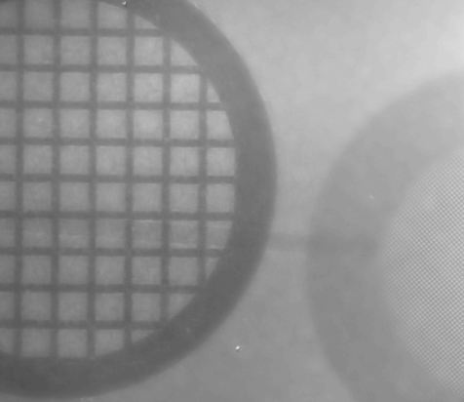

X-ray beams
Source size < 3 µm
Resolution target + processing
Zoom
5 µm
Copper grids
20 µm

Slide 26
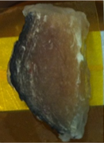
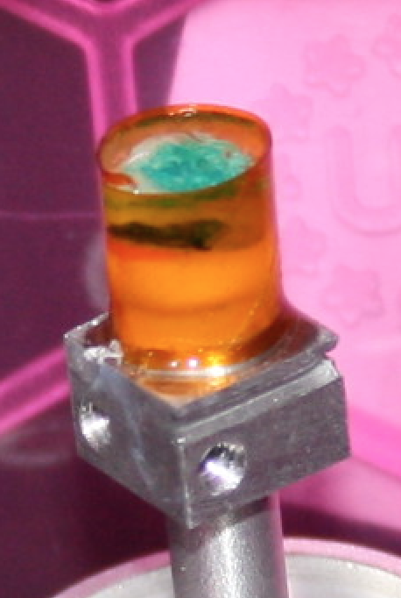
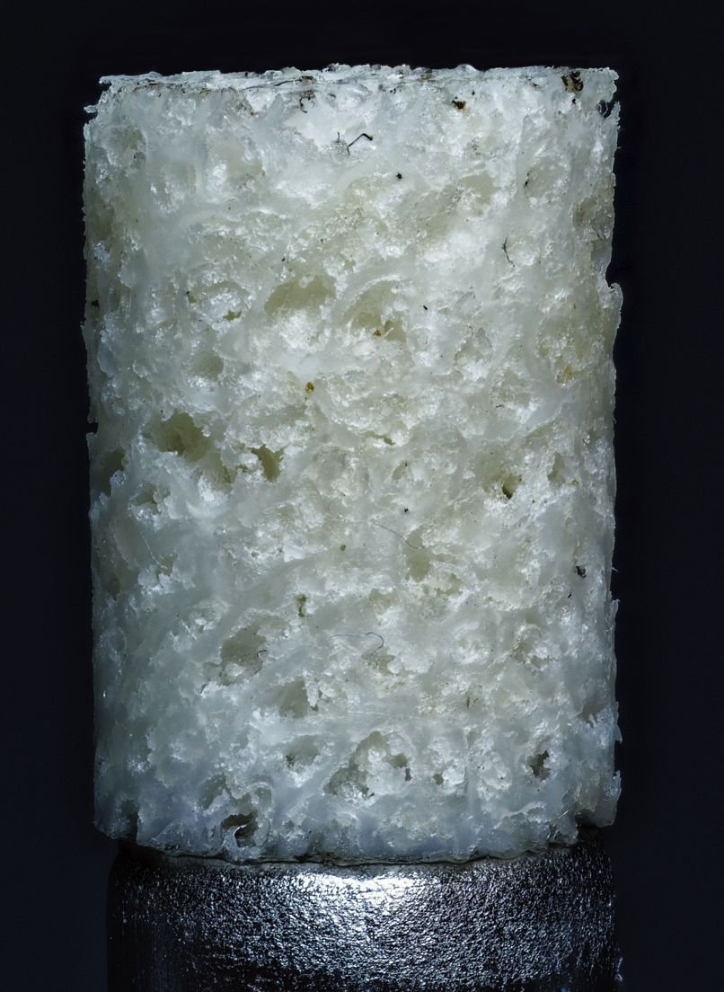
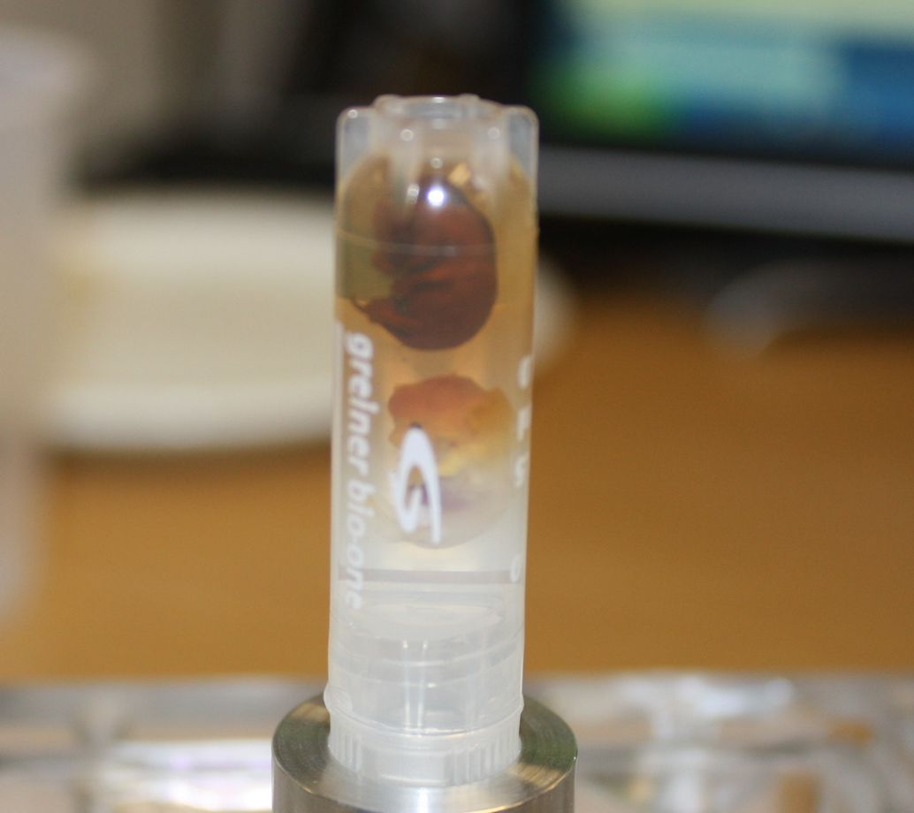
Our imaging objects
Phase contrast
Absorption contrast
Human prostate samples
Human breast samples
Human bone sample
Mouse embryos
2D high resolution radiography
3D tomography of highly absorbing samples
See also Fourmaux, Opt. Lett. (2011), Kneip, Appl. Phys. Lett. (2011), Wenz, Nat. Comm. (2015)

Slide 27
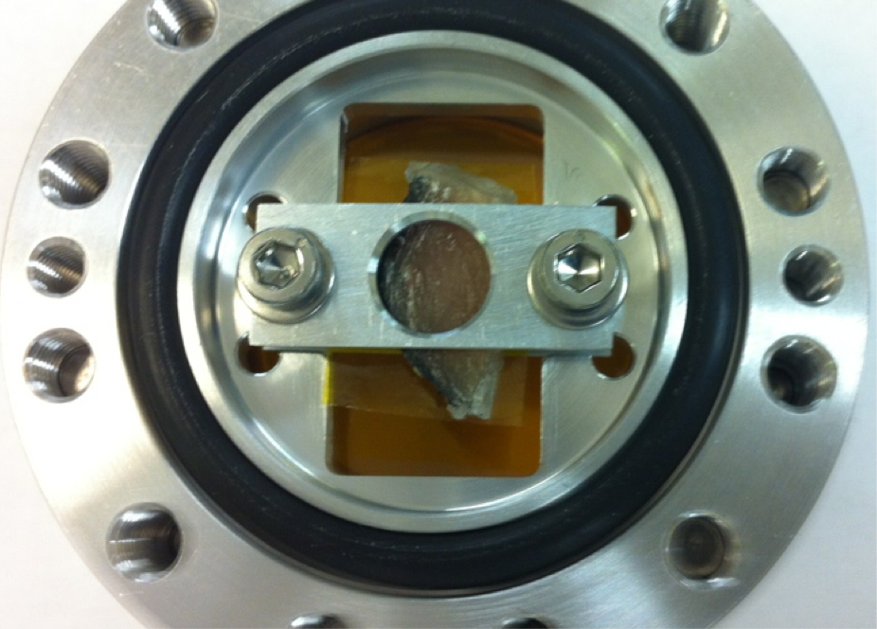
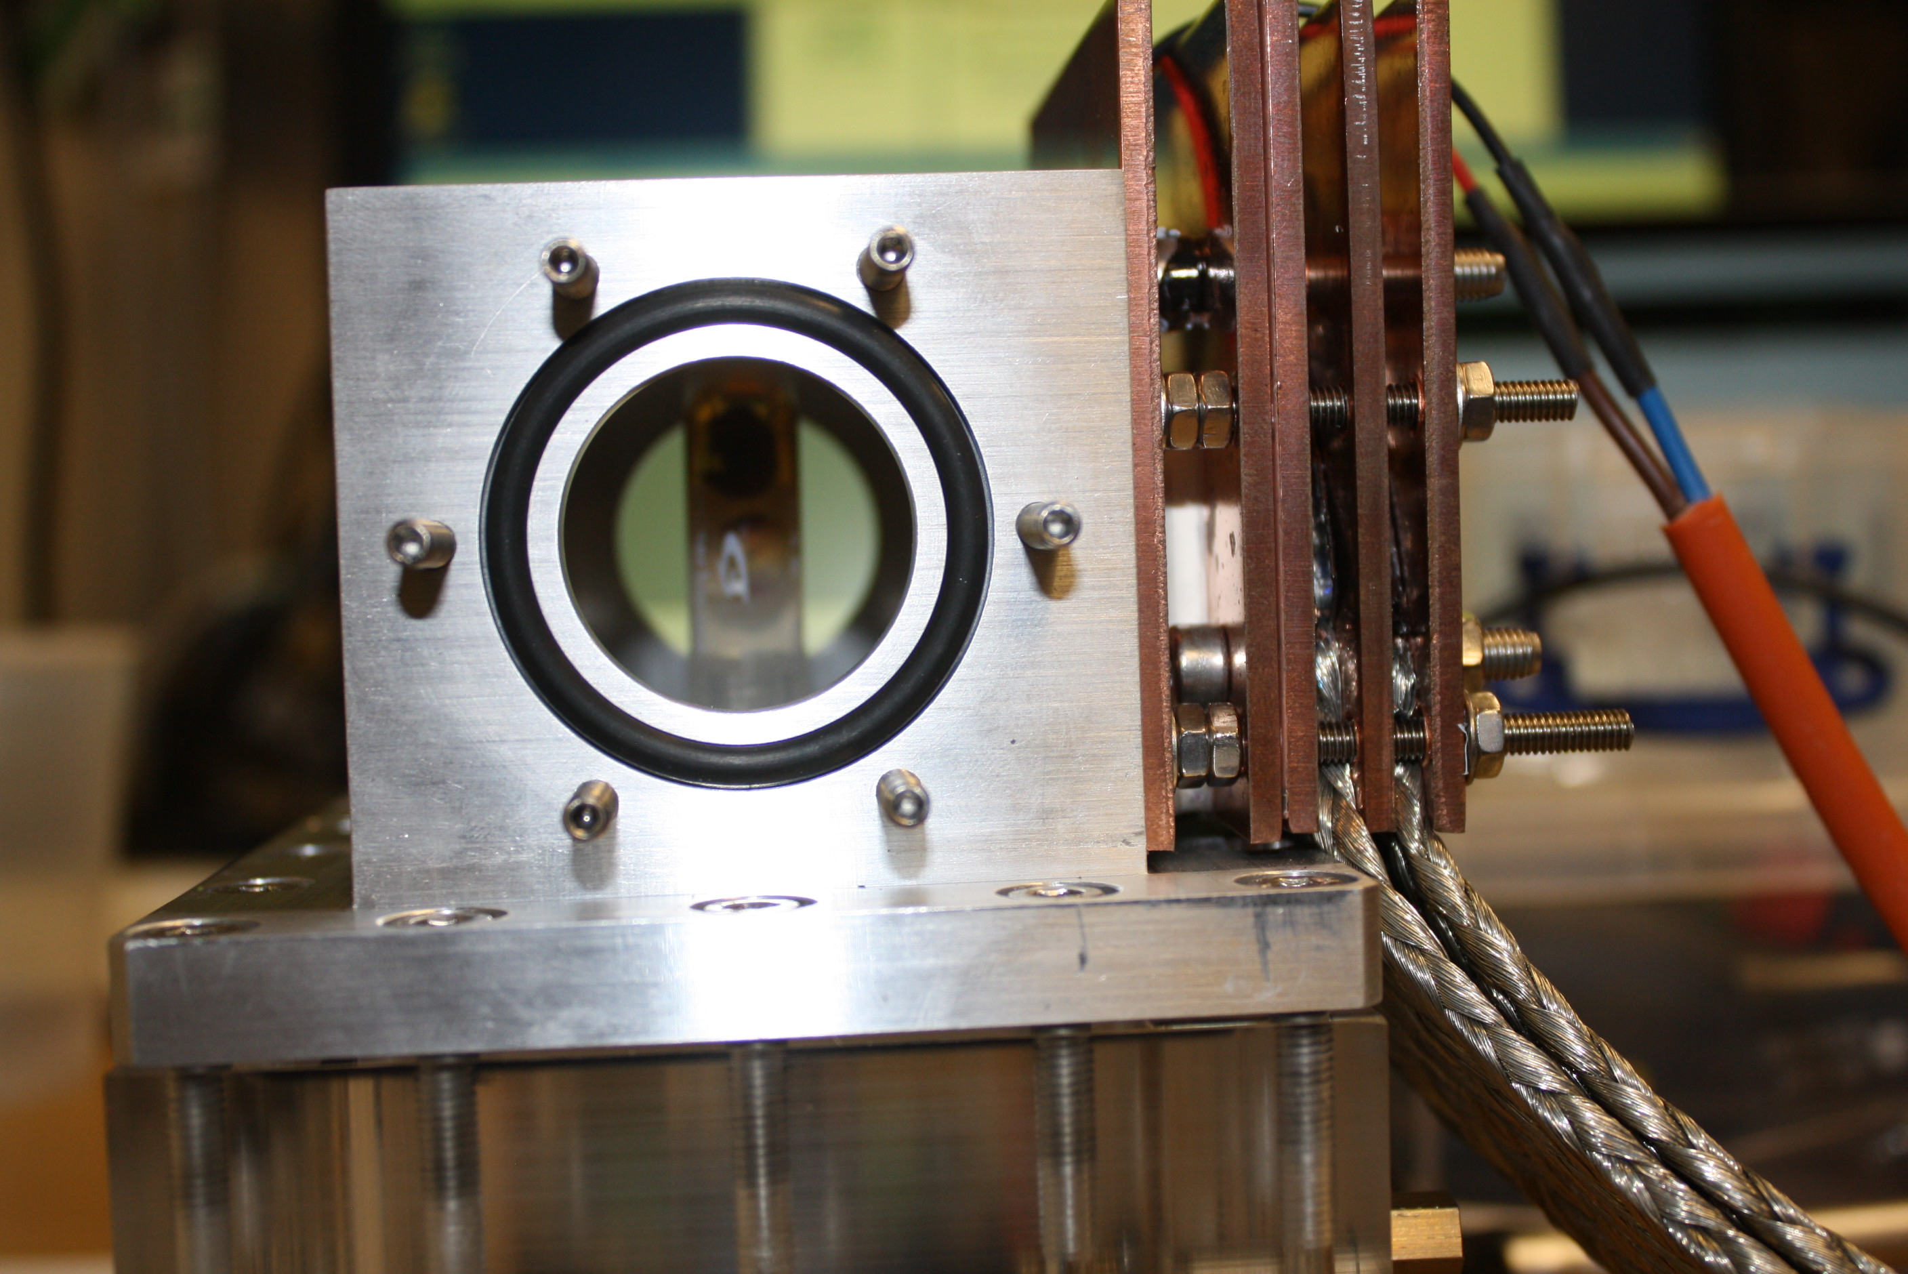
Imaging in vacuum
Delicate tissue samples need to be kept at atmospheric pressure
No rotation
Rotation
Kapton windows
Imaging region
Rotation mount
Thermal control
(Nelson Lopes & Kristjan Poder)

Slide 28
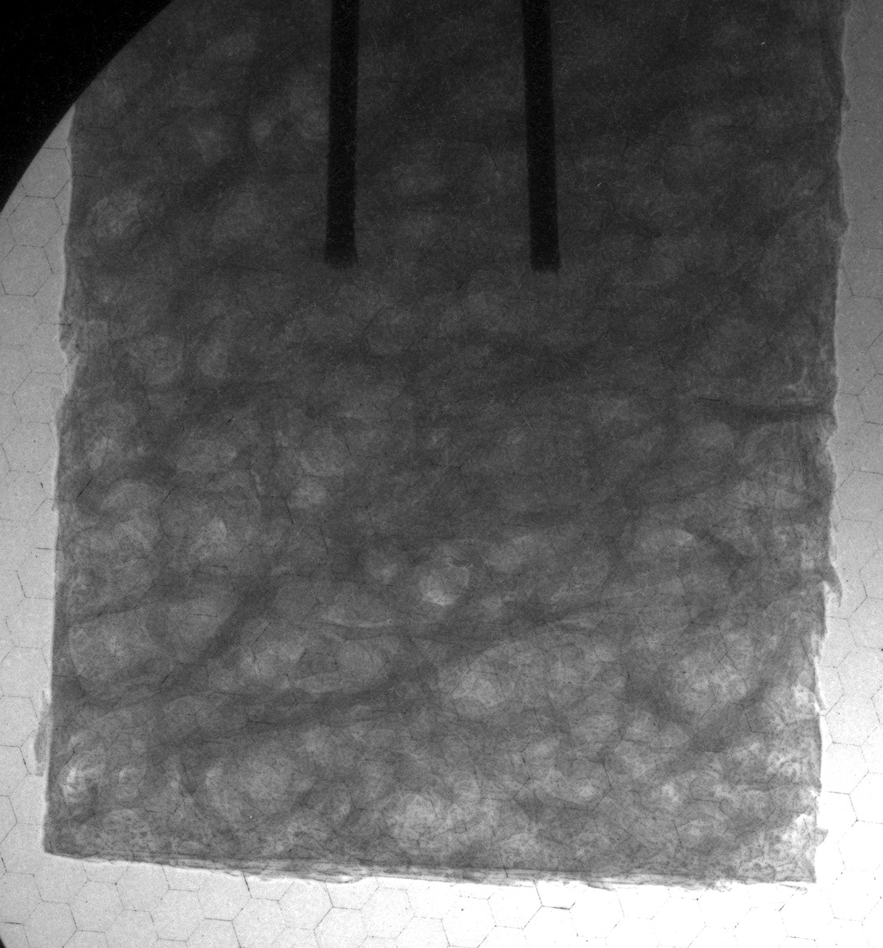
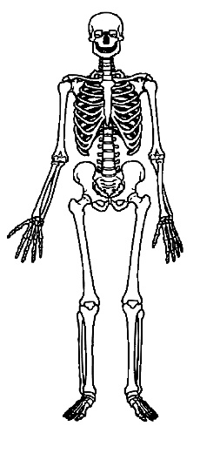
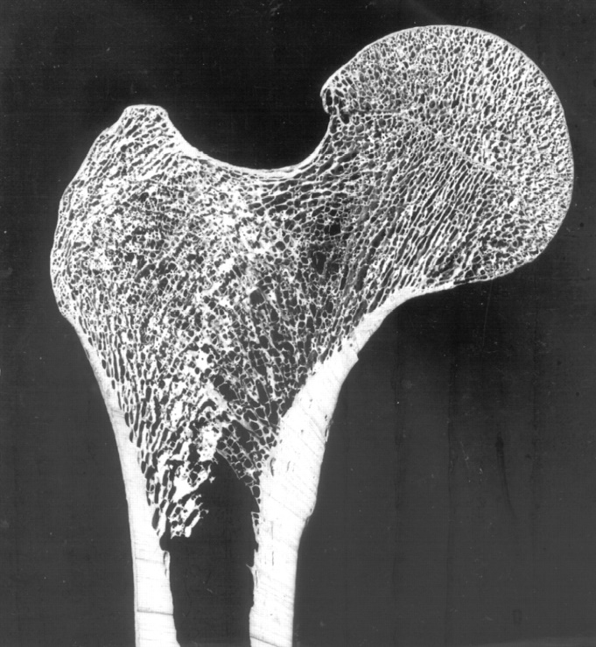
Bone tomography
Cylindrical trabecular bone section from human femur
Single shot
Good contrast
High resolution
Poor beam profile

Slide 29
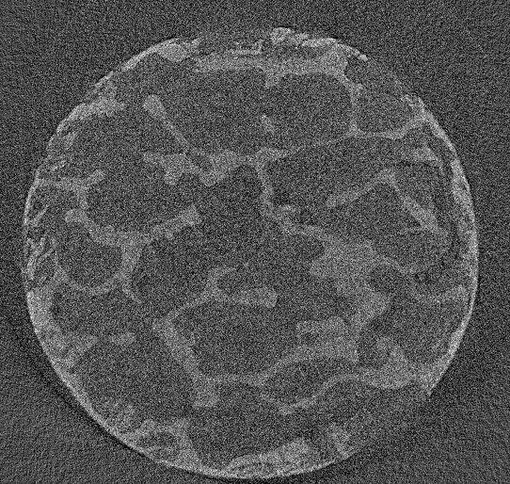
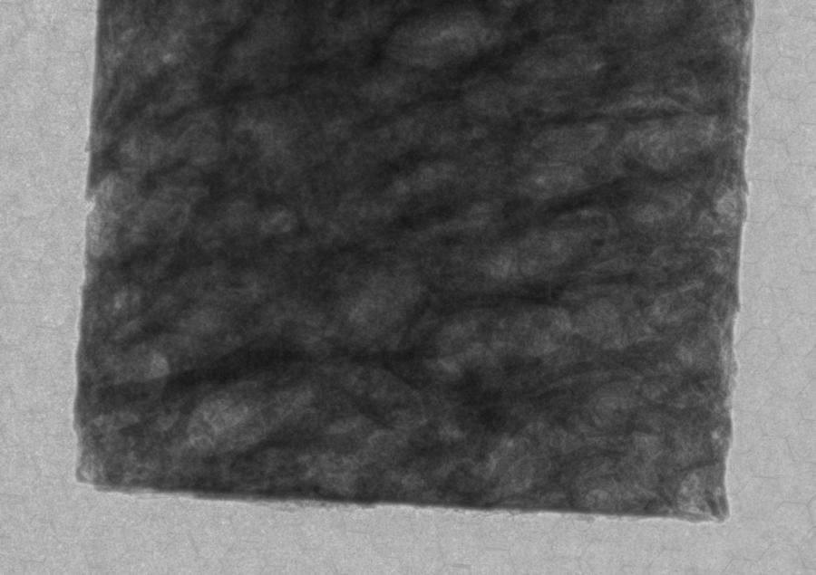
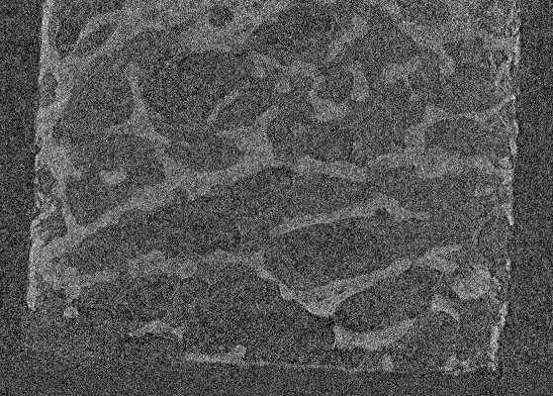
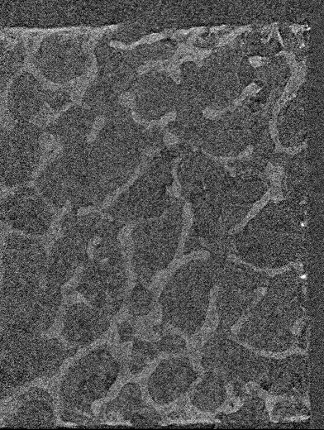
Record 180 consecutive projections
Reconstruct single-pixel slices at a time
(after correcting for beam fluctuations)
Repeat to recover full 3D reconstruction

Slide 30
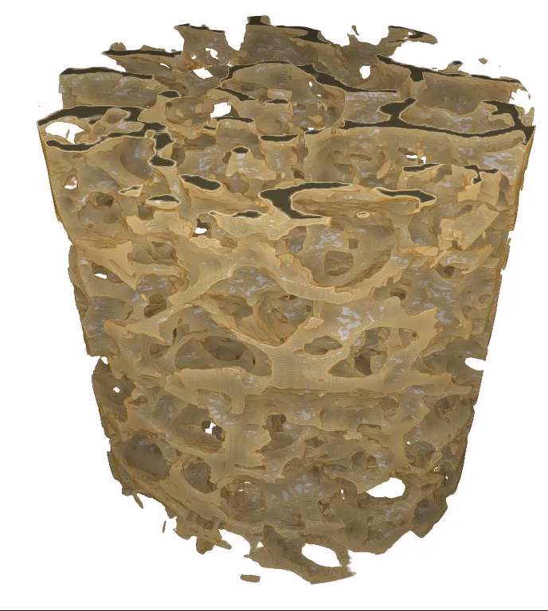
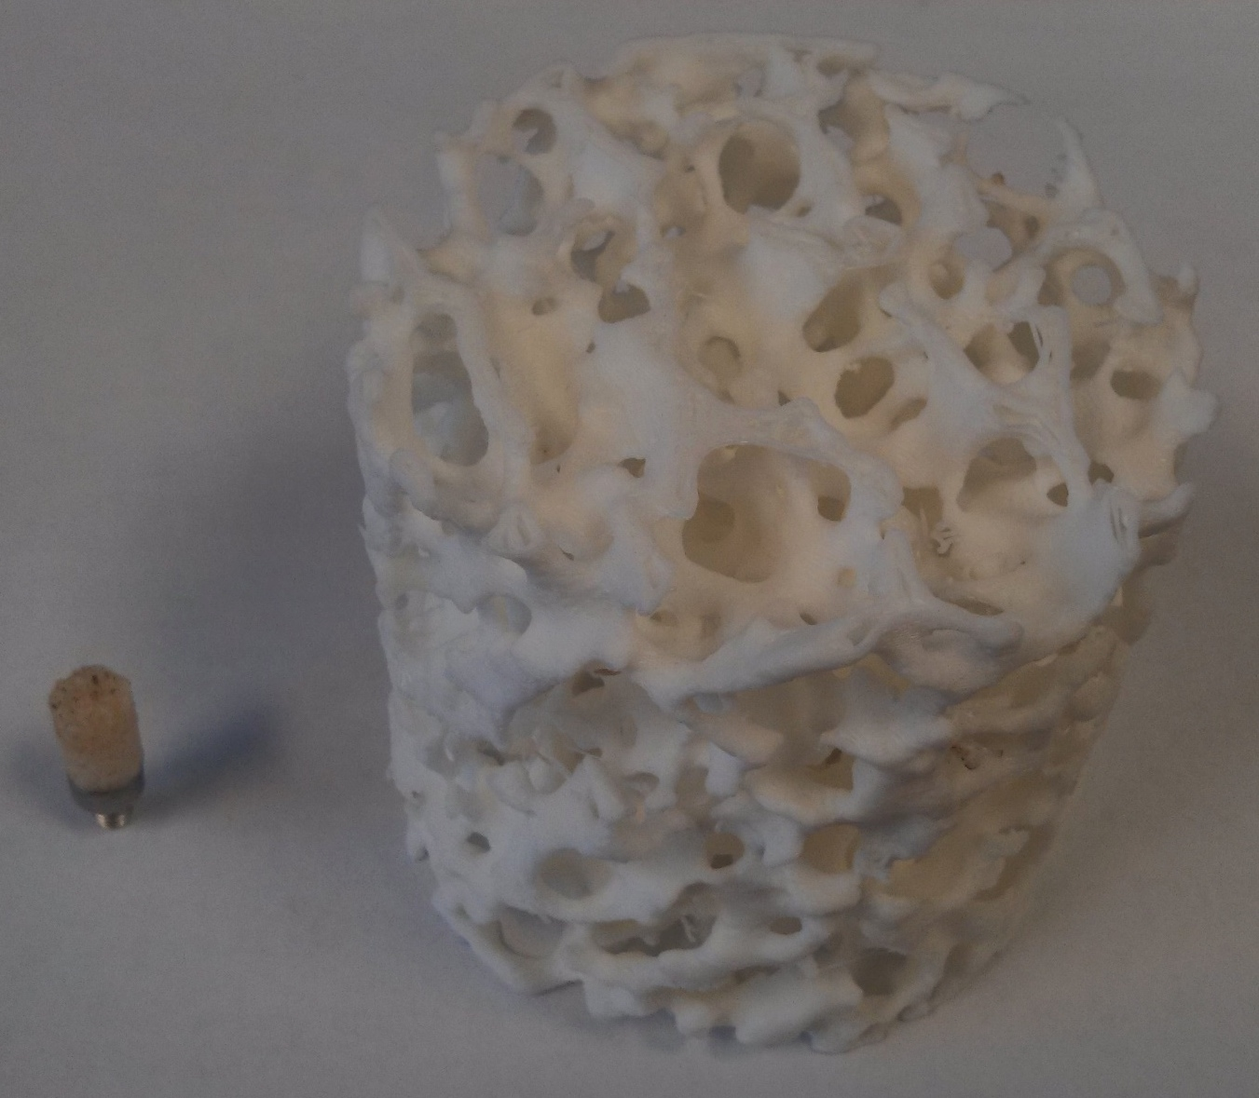
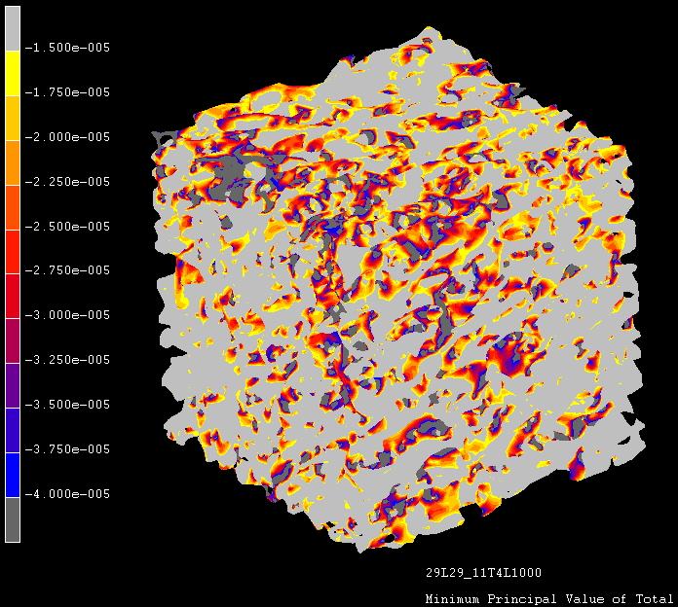
3D reconstruction
Voxel size
4.8 x 4.8 x 4.8 μm
Best resolution ~50 μm, limited by number of projections, photon noise and detector PSF
Total scan time 4 hours

Slide 31
Mouse embryonic samples
Mouse neonate imaging important in the context of International Mouse Phenotyping Consortium
(>$1B project)
14.5 day-old embryo
Stained with iodine
Suspended in agarose – important to stop dehydration

Slide 32
X-ray flux competitive with laboratory-scale sources
Synchrotrons
LWFA?
μCT
Scale to higher photon flux at same source size – requires high laser repetition rates

Slide 33
What next?
Increase number of recorded projections – higher rep rate laser?
Increase resolution – different detector?
Proposed upgrades to Gemini to enhance repetition rate and beamline length
Conclusions
Phase contrast imaging and microtomography of medically-relevant tissue samples
Bright, hard x-rays on every shot as required for raster scans and tomography
For further information see J.M.Cole et al, Scientific Reports, 2015

