Slide 1

Overview and plans of the
ITK Layout Task Force
C. Gemme, S. Miglioranzi, March 15th, 2016

Slide 2
Layout Task Force
Layout Task Force established in Dec 2014, coordinated by Andi S. and CG. In the TF representatives of the ITK WGs and detectors, as well as performance, physics and upgrade groups. Biweekly meetings on Friday 4-6 pm
Mailing list: atlas-itk-ILTF@cern.ch
Twiki: https://twiki.cern.ch/twiki/bin/viewauth/Atlas/ITkLayoutTaskForce
Now working in strict contact with the ITK Simulation and Performance group coordinated by Helen Hayward and Robert Harrington. Since September time devoted to Layouts also in the Sim./Perf
Wednesday 4-6 pm meetings (biweekly for the Layout part)
Mailing list: atlas-upgrade-itk-simu-perf@cern.ch
Twiki: https://twiki.cern.ch/twiki/bin/viewauth/Atlas/UpgradeSimulationInnerTracker
Moreover close collaboration with Tracking CP (Heather, Shih-Chieh)
Upgrade Tracking (Haichen Wang, Ben Hooberman) → Thu at 6pm

Slide 3
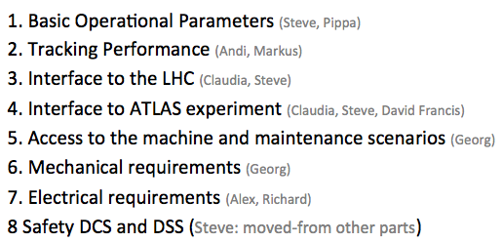
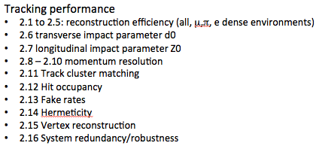
Starting point: ITK requirements
ATL-COM-UPGRADE-2015-015 https://cds.cern.ch/record/2025549
Main editors: N. Hessey, S. McMahon, P. Wells
A set of high level requirements for the design of the ITk.
The requirements should avoid any “magic” numbers
Grouped into themes and include required tracking performance.
On EDMS: https://edms.cern.ch/document/1575923/1
|η| <2.7

Slide 4
Timeline and achievements so far
June Workshop:
4P + 5.1S → 5P + 4S
Pixel/Strip Layers:
In June we have decided to have 5P+4S. Arguments illustrated by Pixel, Strip, Physics to prefer this solution to the LoI.
September ITK Week
Fixed Pixel/Strip volumes
2015
September/October
Agree on settings for STEP1 Layouts
November Workshop
Material discussion
First discussion with CP groups
2016
Sim/Perf February 10th
Step1 sign-off

Slide 5
Timeline and achievements so far
June Workshop:
4P + 5.1S → 5P + 4S
September ITK Week
Fixed Pixel/Strip volumes
2015
Pixel/Strip Volumes:
We have collected several inputs since the June Workshop: detectors, mechanics and budget are fine with Pixel volume @ 345 mm
Left room for a 6th pixel layer
September/October
Agree on settings for STEP1 Layouts
November Workshop
Material discussion
First discussion with CP groups
2016
Sim/Perf February 10th
Step1 sign-off

Slide 6
Timeline and achievements so far
June Workshop:
4P + 5.1S → 5P + 4S
Detector characteristics:
We have agreed on the baseline for the detector description, the same in all the layouts.
Detailed studies in a reference layout.
September ITK Week
Fixed Pixel/Strip volumes
2015
September/October
Agree on settings for STEP1 Layouts
November Workshop
Material discussion
First discussion with CP groups
2016
Sim/Perf February 10th
Step1 sign-off

Slide 7
Timeline and achievements so far
June Workshop:
4P + 5.1S → 5P + 4S
September ITK Week
Fixed Pixel/Strip volumes
2015
Detector Layouts:
Started the optimization of layouts concepts at 3.2 and 4.0 in η coverage, “Extended barrel” vs “Inclined”.
STEP1 with 3 layouts in evaluation
Same detector blocks and envelopes.
The services must be properly evaluated. Some iterations may be necessary starting from a first approximation.
September/October
Agree on settings for STEP1 Layouts
November Workshop
Material discussion
First discussion with CP groups
2016
Sim/Perf February 10th
STEP1 sign-off
7

Slide 8
Timeline and achievements so far
June Workshop:
4P + 5.1S → 5P + 4S
September ITK Week
Fixed Pixel/Strip volumes
2015
September/October
Agree on settings for STEP1 Layouts
STEP1
Layouts optimized
Release ready
Launching the samples production
November Workshop
Material discussion
First discussion with CP groups
2016
Sim/Perf February 10th
STEP1 sign-off
8

Slide 9
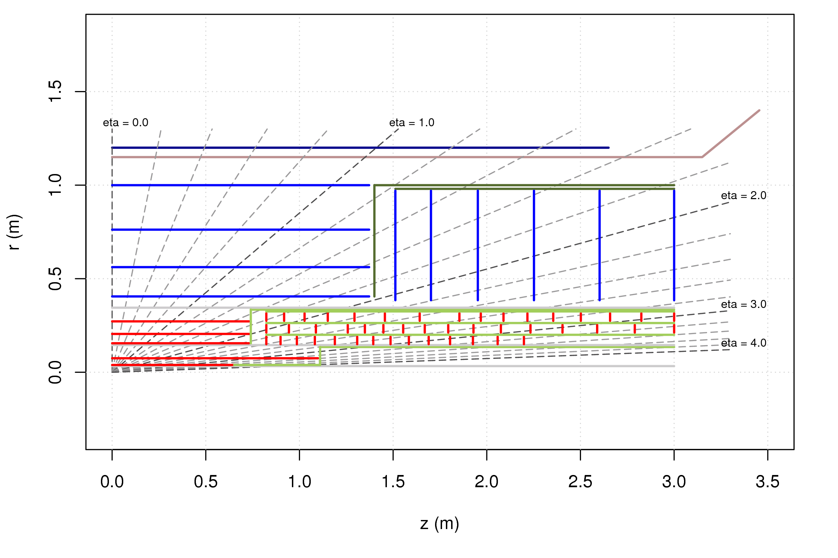
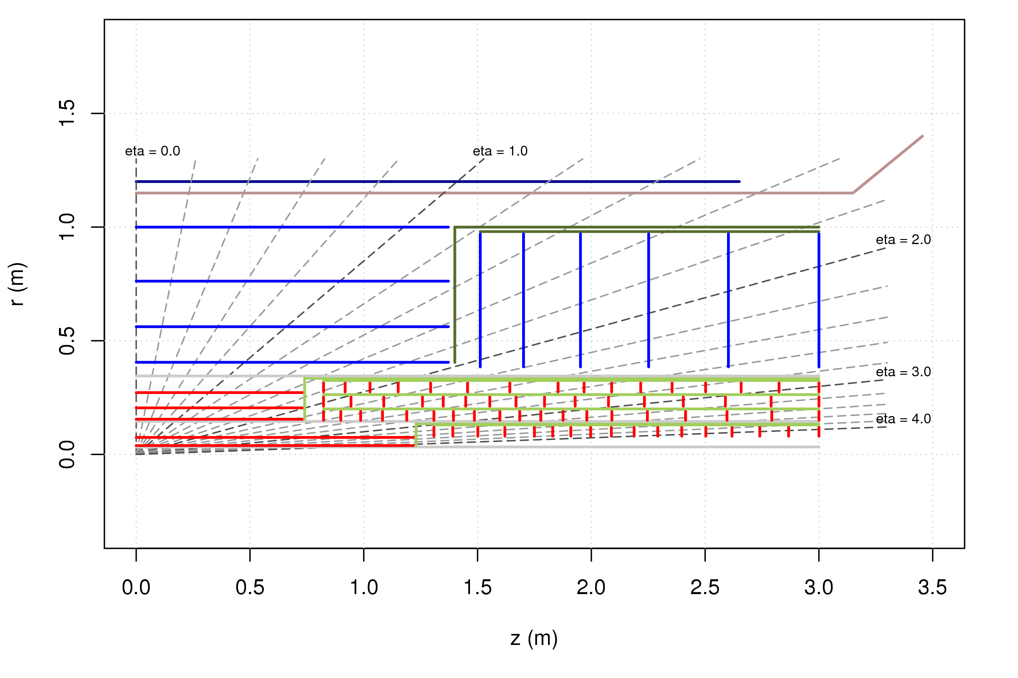
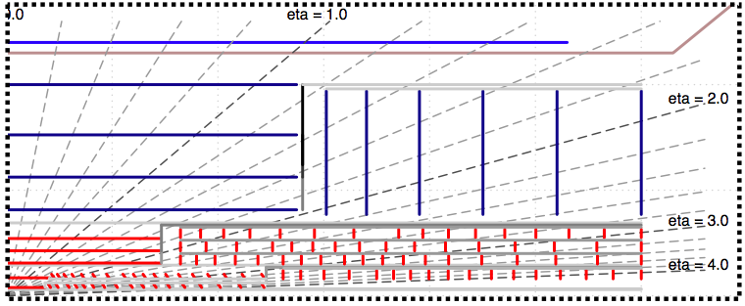
Layouts strategy – Step 1
Extended@3.2
Simulate three layouts with
PixelRadius@345,
5P+4S,
Pixel EC and Strips optimized for the Extended@4.0, variations only in the innermost pixel layers.
Extended@4.0
Extended@3.2
Starting from Extended@4.0 and reduce the coverage.
Extended@4.0
Extended barrel in L0/L1
Inclined@4.0
Starting from Extended@4.0 , changed extended L0/L1 in inclined.
Large eta
studies
Inclined@4.0
Tracking
studies

Slide 10
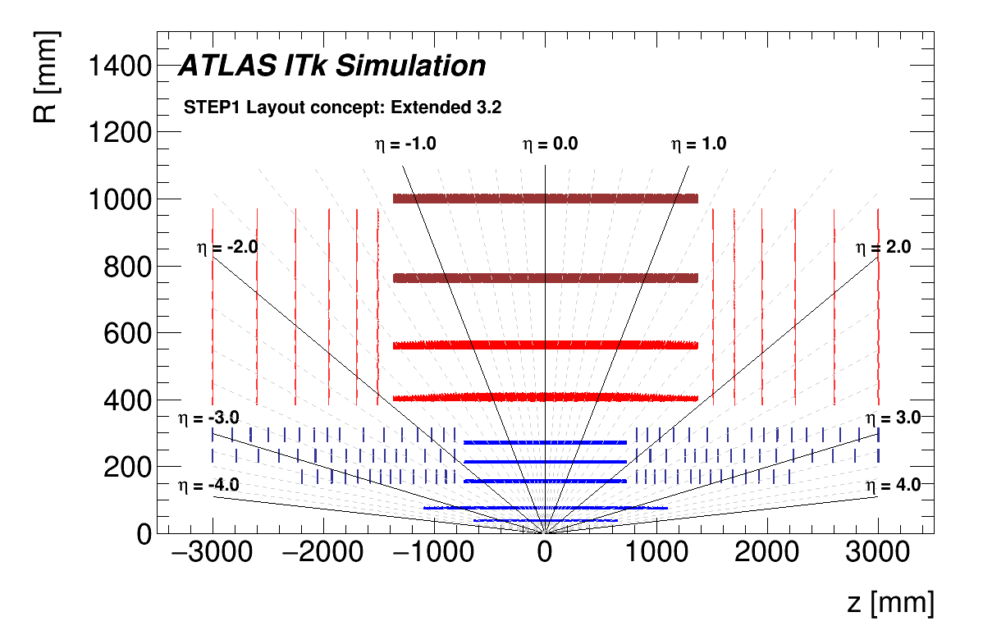
Extended@3.2

Slide 11
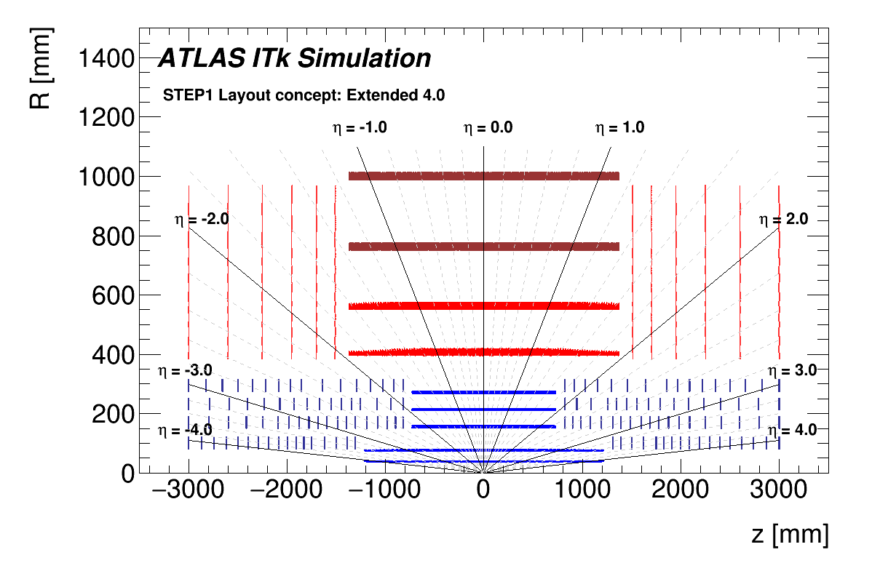
Extended@4.0

Slide 12
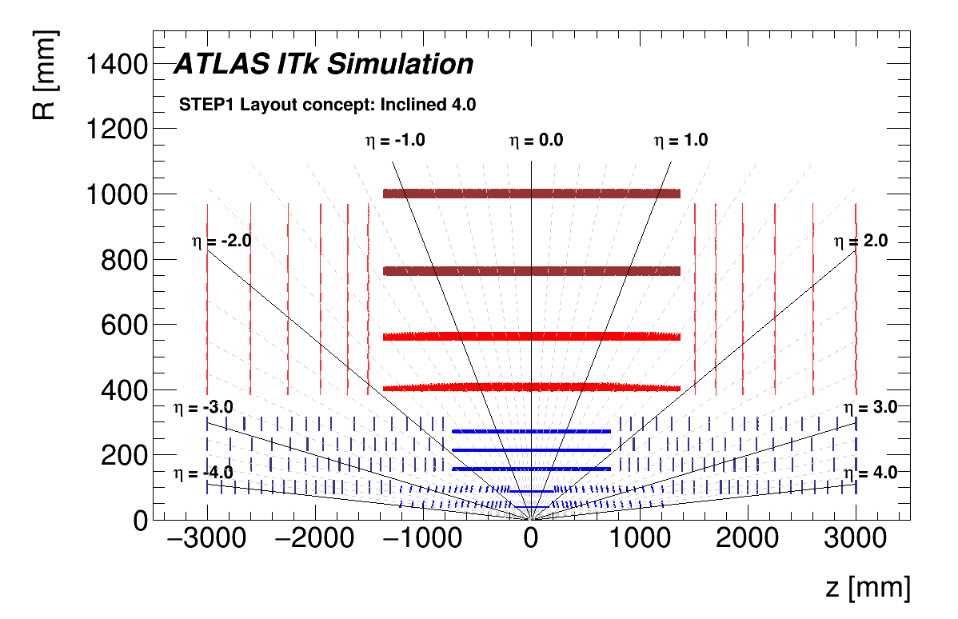
Inclined@4.0

Slide 13
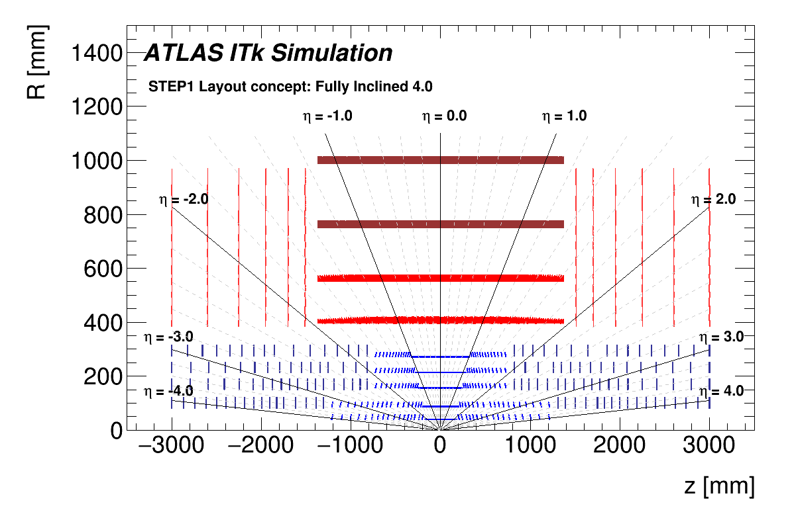
FullyInclined@4.0

Slide 14
Step 1: Scope
Extended@3.2
Given the overall timescale the scope of STEP1 has to be clear and focused.
A small experts group started bi-daily meetings to converge on a working release
Release ready (simon, Noemi release coord)
Tracking studies are the priority!
Extended@4.0
Extended:
More realistic tracking studies for the forward region, including comparing 3.2 and 4.0
Pattern recognition studies and performance with long clusters, including simplify the forward region for STEP2 layout
Inclined@4.0
Inclined:
Resolution and pattern recognition studies; quantify the advantage of multiple hits/layers
Optimization of the full barrel and forward region for STEP2 layout
Strips:
Verify 8mm module gap fix in the barrel works
Test strip performance vs Pixel layout input to strip TDR strategy

Slide 15
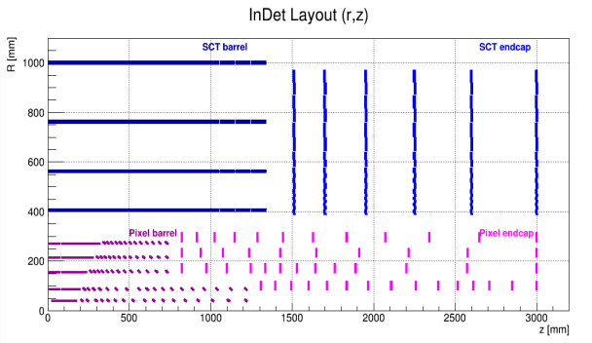
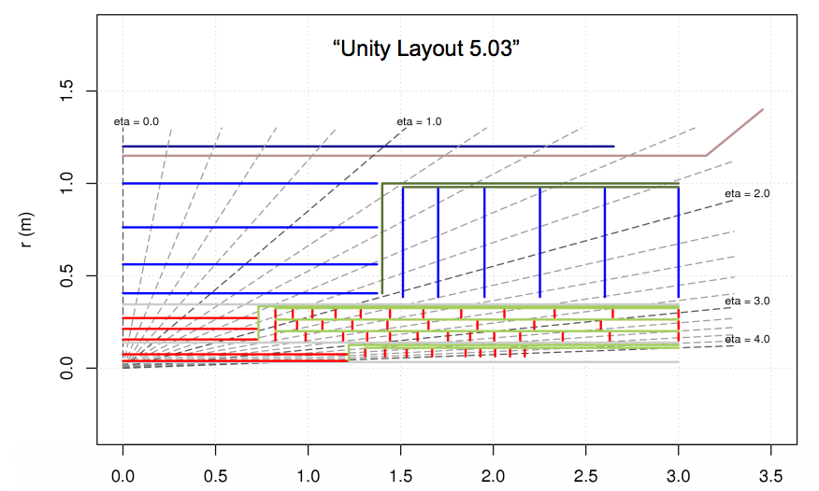
Layouts strategy – Step 2
Work in Progress
Will profit by
ongoing studies
Inclined@4.0
Inclined in L0/L1 only.
BaselineInclined@4.0
Optimization in the inclined approach in the full detector, including outer barrel and in the end-caps.
Extended@4.0
Extended barrel in L0/L1
BaselineExtended@4.0
Extended barrel in L0/L1 and optimized end-cap, assuming that the extended “hit” is not just a hit.
Optimization
Optimization

Slide 16
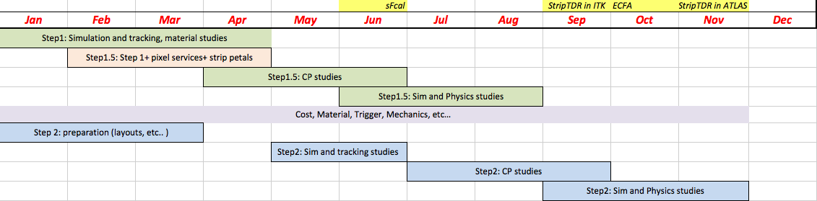
Timeline
Ready for Strip TDR production!
STEP1 three layouts – difference in innermost layers
STEP1.5 Layouts for strip TDR!
STEP2 Layouts for TF final report

Slide 17
Step 1.5: Scope
Extended@3.2
Given the overall timescale the scope of STEP 1 has to be clear and focused.
A small experts group started bidaily meetings to converge on a working release
Release report today!
Tracking studies are the priority!
Extended@4.0
Strips:
Realistic enough for strip TDR!
Include strip petal description and module gap in EC
Pixel:
Realistic enough for sFCAL decision strip TDR!
Include better material and services description
Extended:
More realistic tracking studies for the forward region, including comparing 3.2 and 4.0
Pattern recognition studies and performance with long clusters, including simplify the forward region for STEP2 layout
Inclined@4.0
Inclined:
Resolution and pattern recognition studies; quantify the advantage of multiple hits/layers
Optimization of the full barrel and forward region for STEP2 layout
Strips:
Verify 8mm module gap fix in the barrel works
Test strip performance vs Pixel layout input to strip TDR strategy

Slide 18
Timeline
STEP1 three layouts – difference in innermost layers
STEP1.5 Layouts for strip TDR!
STEP2 Layouts for TF final report
Strip TDR production!
STEP 1.5: Used for sFCAL, Strip TDR and ECFA
Strips:
8 mm gap and petals description for the end-cap
Material description
Detector characteristics
… anything else that is relevant for the TDR!
Pixel:
Probably two layouts (Inclined and Extended @4.0) → will not change the conclusions for the Strip.
Baseline is STEP1 layouts not to delay samples for Strip TDR. Let’s check where we are in one month.
Services (critical for the forward region) and material
Reasonable detector characteristics

Slide 19
Simulation samples production
20.20.X will be used for step 1 production (sweeps from 20.7.X)
(howto in https://its.cern.ch/jira/browse/ATLSWUPGR-31)
strip description developments for ITK step 1.5 layouts in MIG9
for each layouts requested:
minbias (100k@high pt and 1M@lowpt) → already finshed
5k of single pions (pi0,pi+,pi-), single μ, ttbar
sample production status in:
https://twiki.cern.ch/twiki/bin/viewauth/Atlas/UpgradeSimulationInnerTracker
main issues:
ITK only samples so far → need to validate full detector
LOI is not yet validated in 20.7
pulls fine except ExtBrl3.2

Slide 20
Material description
Material budget of beapipe+ITK
Differences between layouts needs to be debugged (discussion with engineers needed…)
1M geantinos
rel 20.20.0.2
X0 computed with
FastGeoModel
(ExtBrl32 →bug now understood)
CAUTION! Placeholders are used for some values, while waiting for realistic numbers!
B. Smart’s report
https://indico.cern.ch/event/472743/contribution/4/attachments/1238902/1820659/LAPP_ITk_simulation_X0_studies_Ben_Smart_4_3_16.pdf

Slide 21
Layout work in the next months
Layout TF is … not only tracking performance!
Important feedback from Trigger, Detectors community, engineers, will be crucial in these months
All communities need to work on the intermediate STEPs
The Layout TF will need to take into account not only tracking performances but also other parameters
Costs, feasibility, integration, mechanical properties, impact on ATLAS, etc..
Discussion of the innermost radius ongoing:
Electronics and FE size, Coverage and integration, Tracking performance, Radiation damage
Next important milestones:
STEP1 lessons and Sign-off STEP1.5 → extended Layout meeting (mini-workshop) mid-March, 18th
Check status of STEP2 layouts
sFCAL feedback

