Slide 1


Ivana Scovassi
DNA damage Part II: How cells respond
DNA damage
Transient cell cycle arrest to allow DNA repair
DDR
Efficient DNA repair
Unrepaired/Unfaithfully repaired DNA damage
Genome instability
Sublethal DNA damage
Cell cycle progression
Survival
Hyperplasia
Cancer
Persistent high level of damage
Cell cycle arrest
Specific markers:
cellular morphology
signal transduction pathways
gene expression profiles
cell identity
Senescence
Suicide

Slide 2
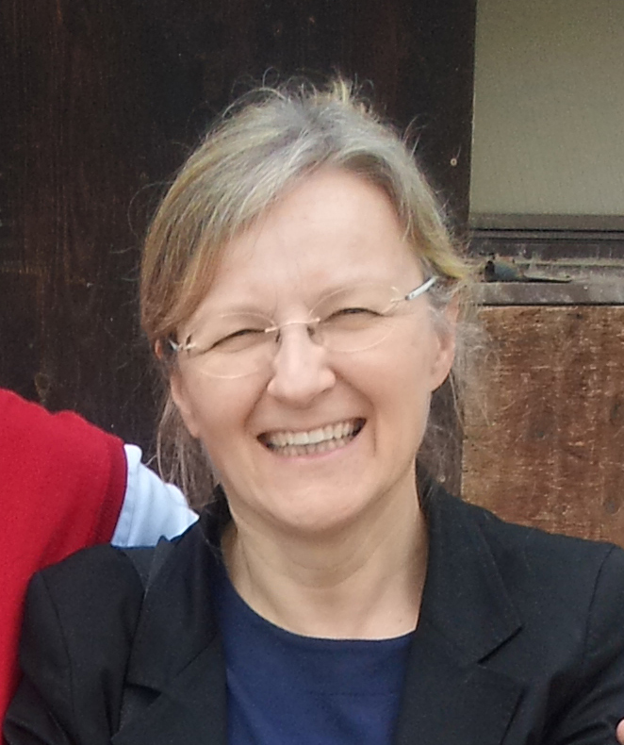
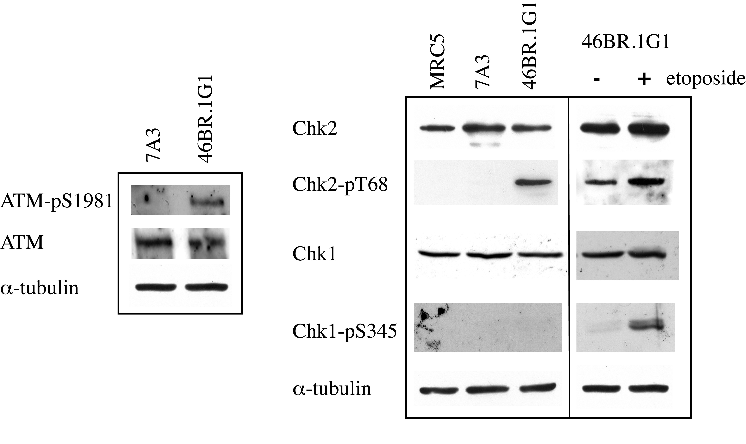
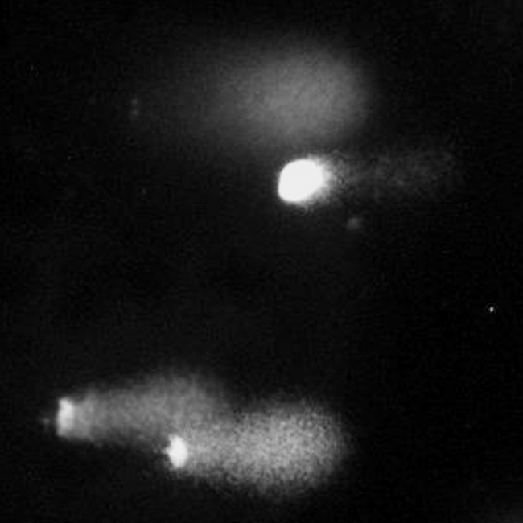
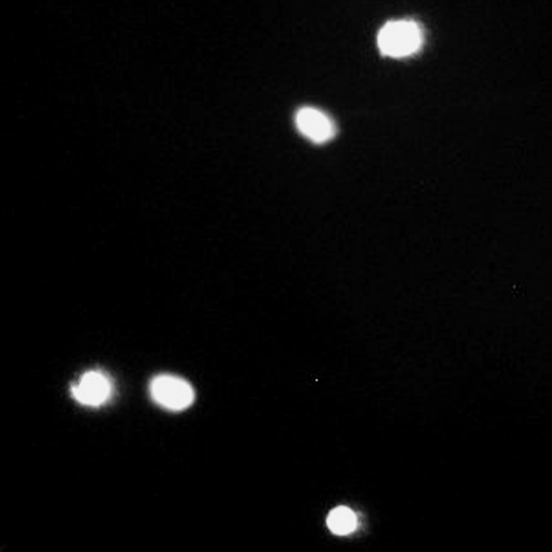
Research interest
Alessandra
Montecucco
Effects of sublethal DNA damage on cell identity
Molecular mechanisms involved
To what extent DNA damage can drive differentiation programs and affect cell identity?
Model systems to study the cell response to endogenous DNA damage
Proliferating human DNA ligase mutants (46BR.1G1) DNA breaks
Post-mitotic neuron-like cells with mutations of mtDNA (PD63) ROS
We can follow the same approach to investigate the effect of exogenous sources of DNA damage
1. What kind of DNA damage
2. What signaling pathway
DNA damage signal transduction
DNA breaks
46BR.1G1
7A3
Comet assay
ATM/Chk2 signaling pathway

Slide 3
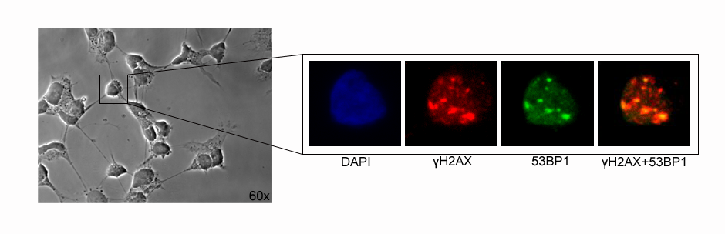
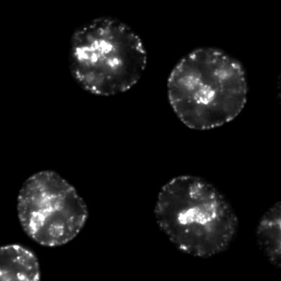
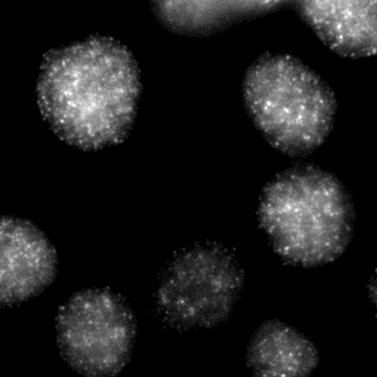
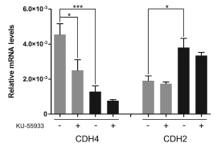
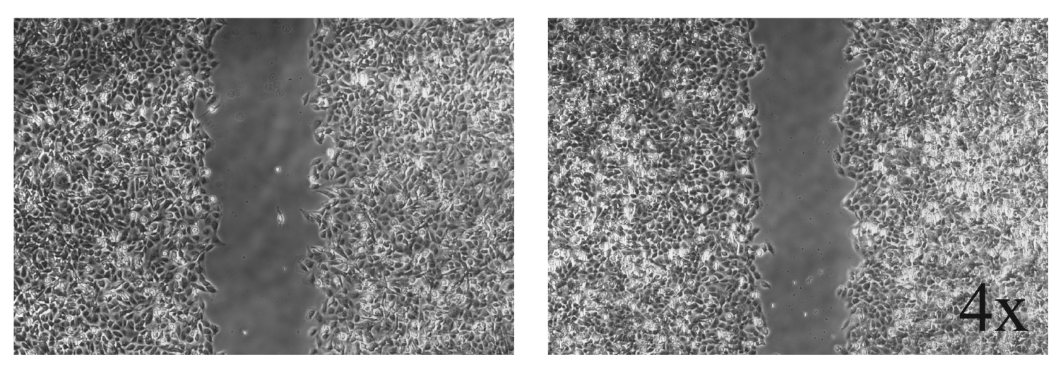
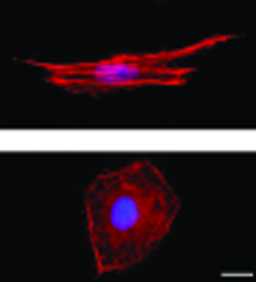
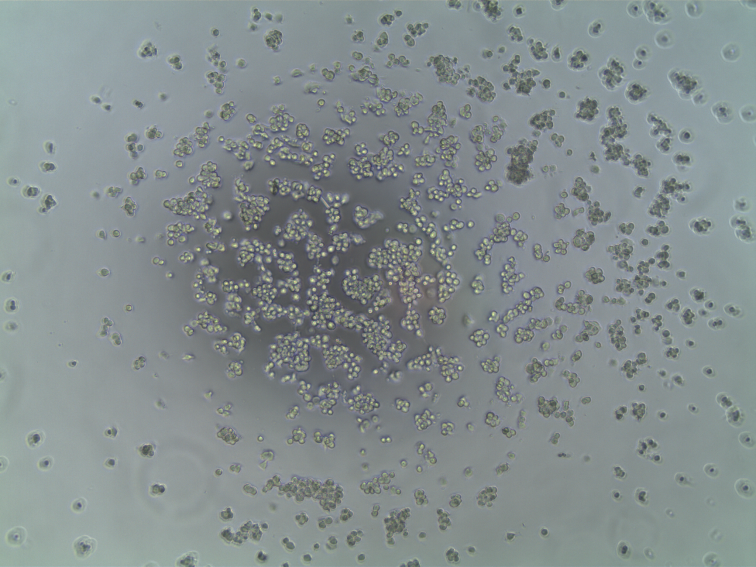
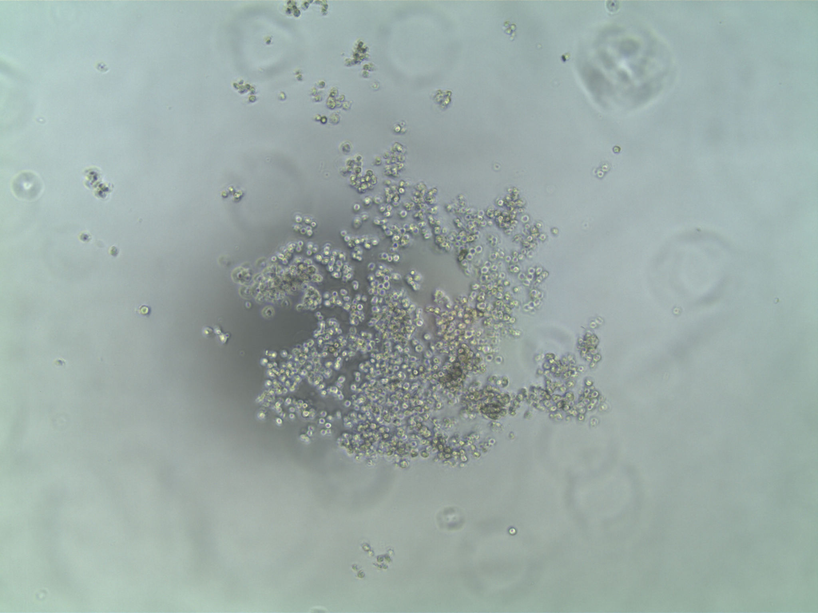
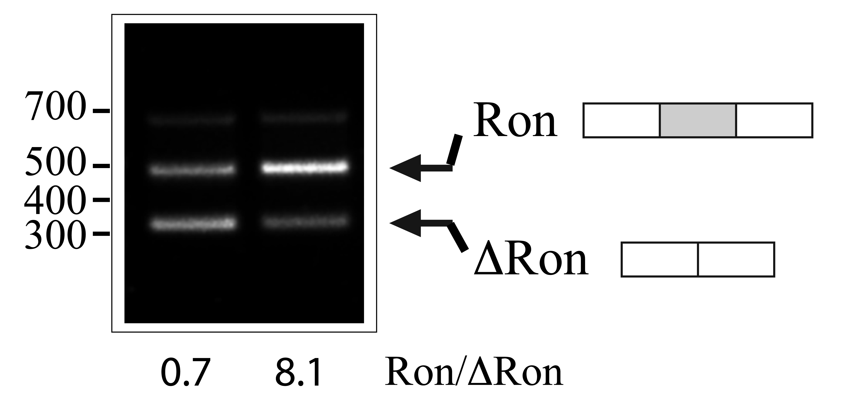
3. What effect on the functional organization of cell nucleus
DNA replication foci and factories
DNA repair foci
etoposide
HeLa cells
Stressed neurons
4. What effect on cell identity
Transcription program
Cell morphology
Cell motility
Wound healing
Accelerated migration
Actin filaments
Wound healing
ATM inihibition affects cadherin expression
Cell-cell interaction
Alternative splicing/EMT
Altered organization of stress fibers
Aggregates

Slide 4
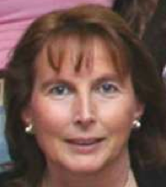
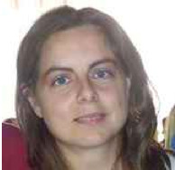
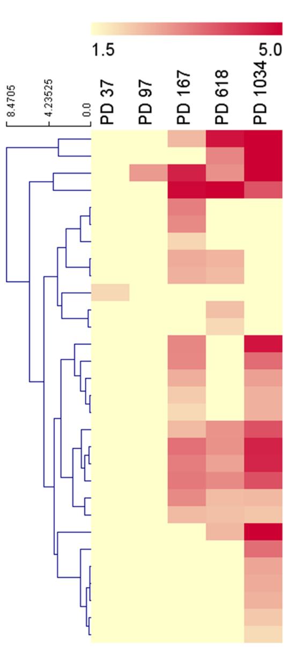

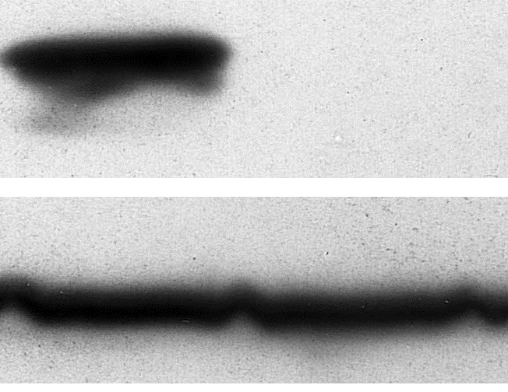
GENOME INSTABILITY AND CELLULAR TRANSFORMATION
Chiara Mondello
Ilaria Chiodi
Chromosomal instability
gene amplification
Genome instability
Acquisition of genetic
and epigenetic changes
Neoplastic transformation
Uncontrolled
proliferation
Immortalization
Invasion
Stepwise neoplastic transformation of telomerase immortalized human fibroblasts
Cells at different stages of transformation
Analysis of molecular and cellular changes
Gene expression variations
Genome wide gene and miRNA expression profiles: microarray analysis
RNA and protein levels
Normal
Normal
Tumor
Tumor
p16^{INK4A}
p16^{INK4A}
Gene ontology biological process
enrichment
actin
γ-tubulin
RT-PCR
Western blotting

Slide 5
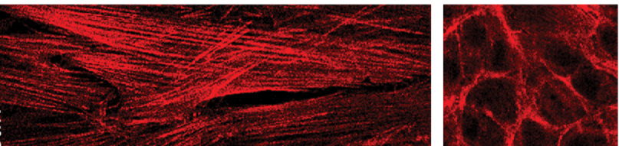
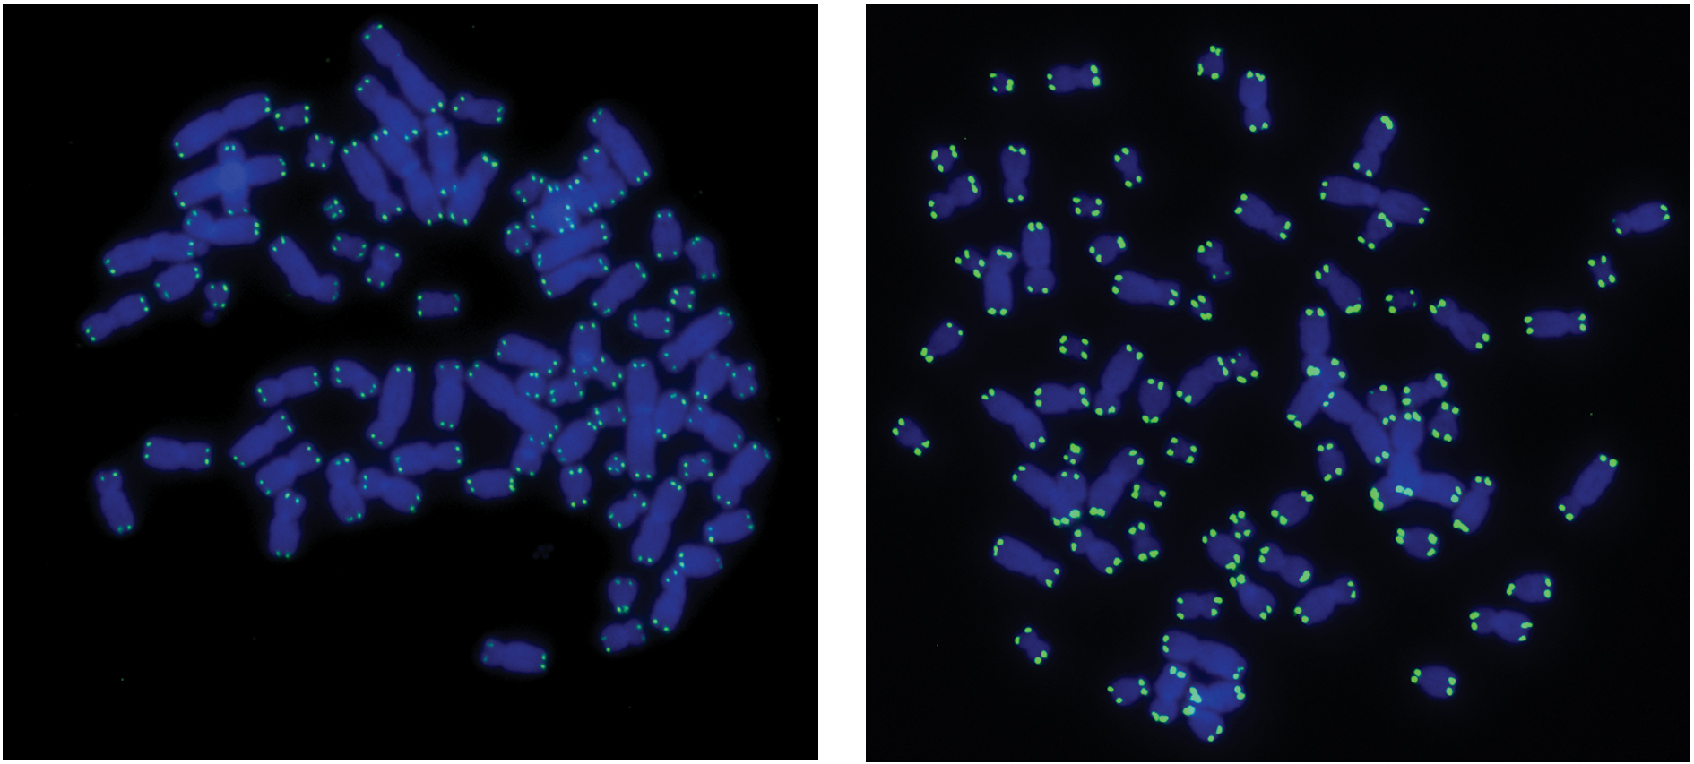
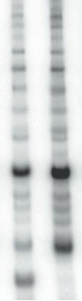


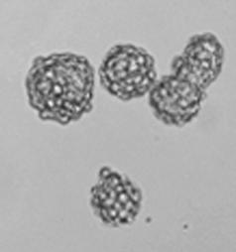
Stepwise neoplastic transformation of telomerase immortalized human fibroblasts:
analysis of molecular and cellular changes
Cytoskeletal organization cell shape and movement
Telomere length
Telomerase
activity
Actin organization
Normal fibroblasts
Tumorigenic cells
2D growth
Telomeric FISH
TRAP assay
3D growth
Tumorspheres: an approach for the isolation of cancer stem cells (CSC)
CSC and high LET radiation sensitivity

Slide 6
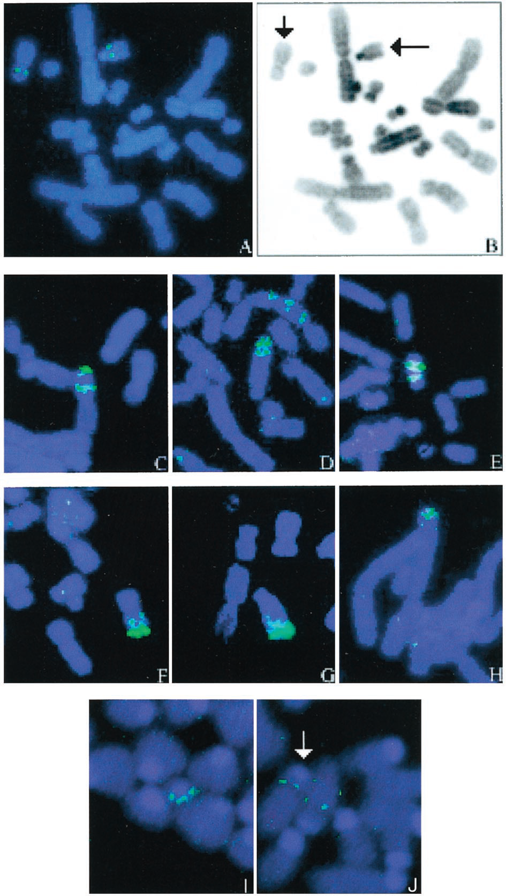
Chromosomal instability and gene amplification: a response to DNA damage
Gene amplification: an increase in the copy number of a portion of the genome
A hallmark of cancer cells: - increase in oncogene copy number, cancer progression
- drug resistance
γ-rays increase gene amplification
a deficiency in DNA double strand break repair increases gene amplification
Do high LET radiations induce gene amplification?
Cellular model systems with different genetic backgrounds
Molecular and cellular techniques to investigate the amplification of target genes
Mondello et al. γ-ray and hydrogen peroxide induction of gene amplification in hamster cells deficient in DNA double strand break repair. DNA Repair 1 (2002) 483–493
Mondello et al. Increased gene amplification in immortal rodent cells deficient for the DNA-dependent protein kinase catalytic subunit. Cancer Res. 61 (2001) 4520–4525

Slide 7
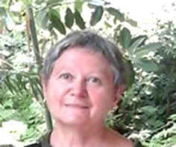
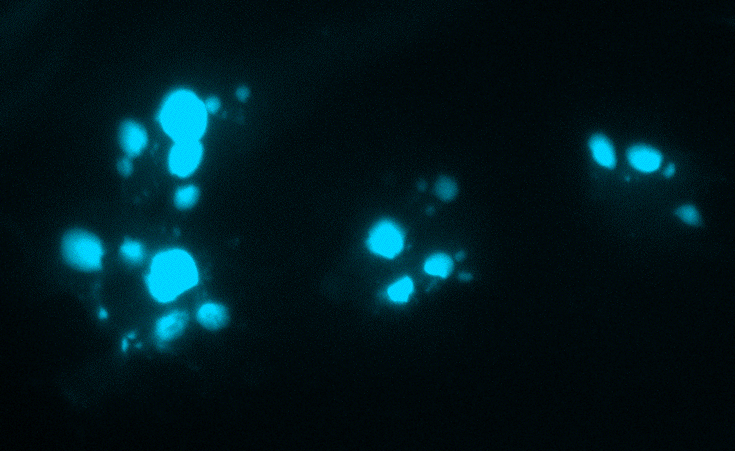
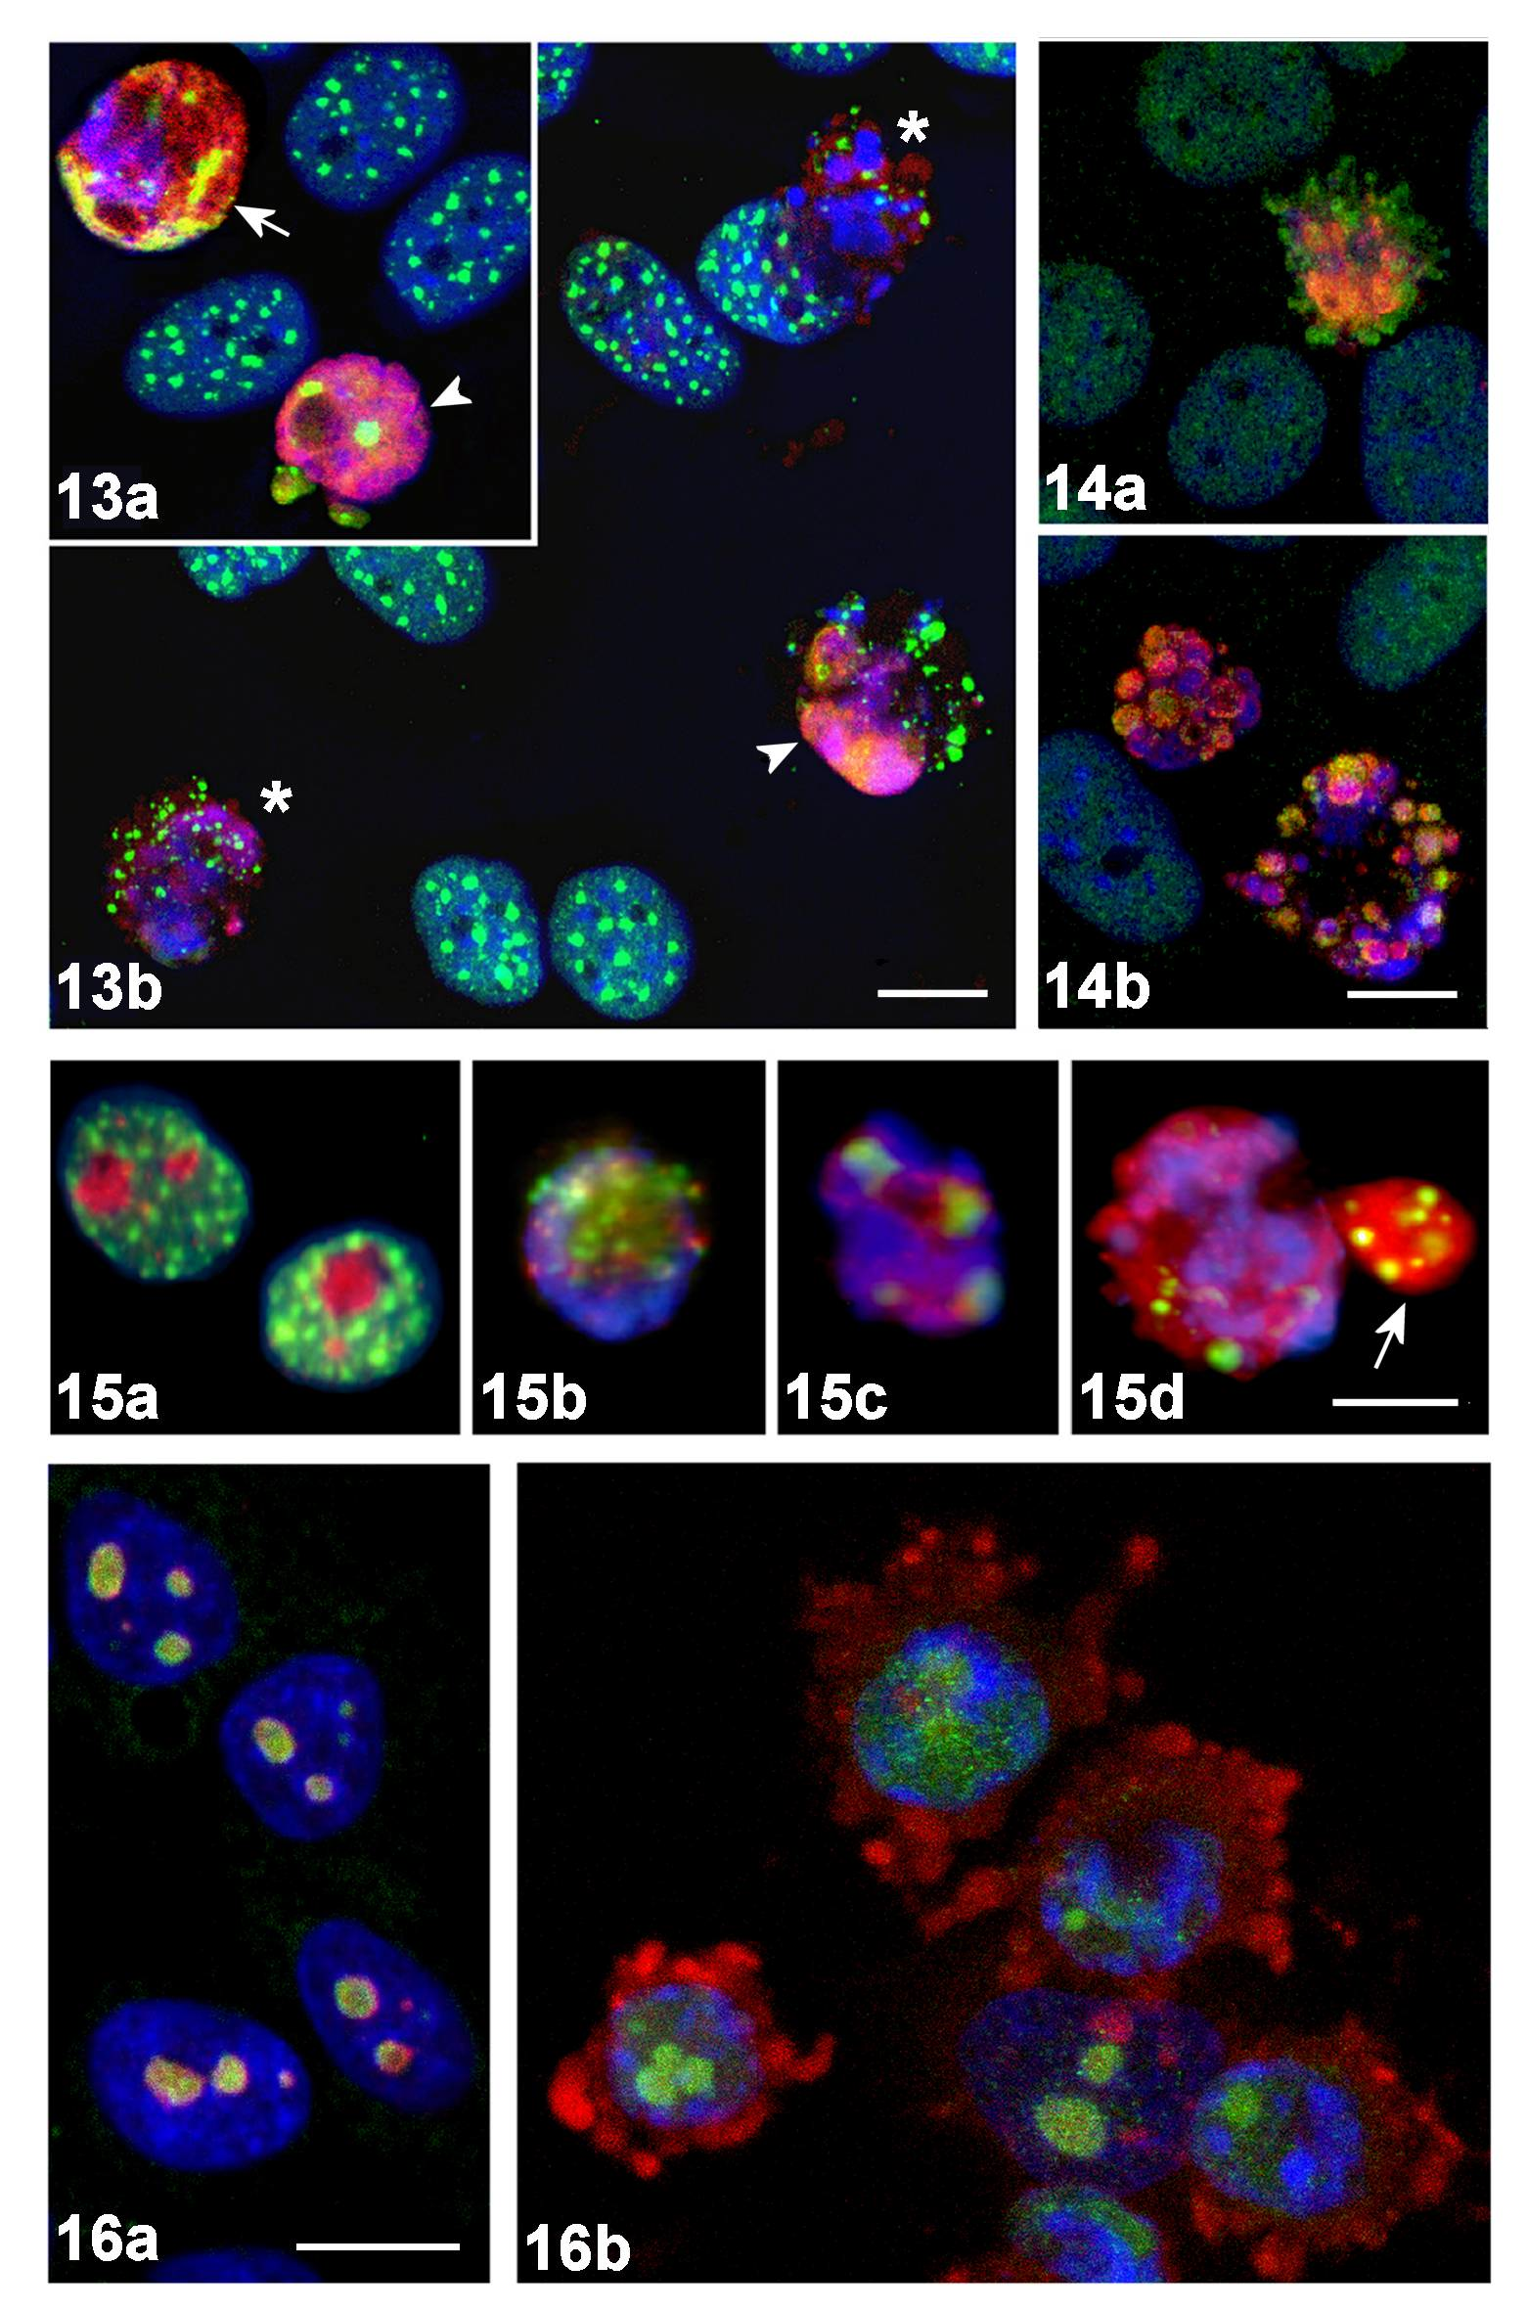
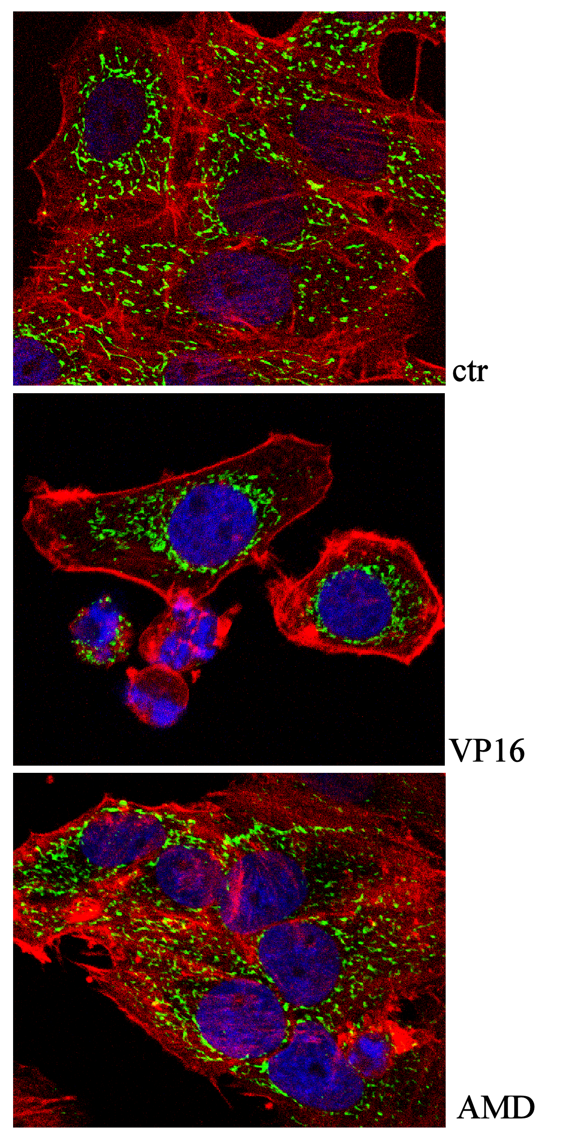
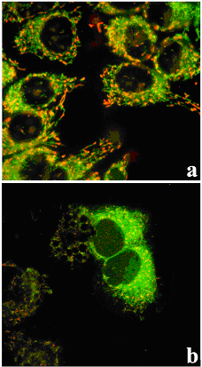
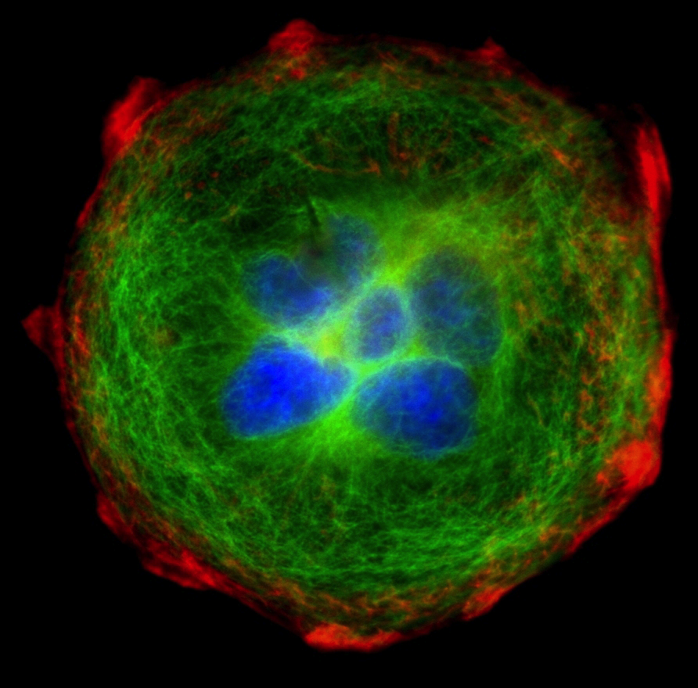
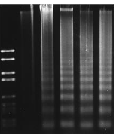
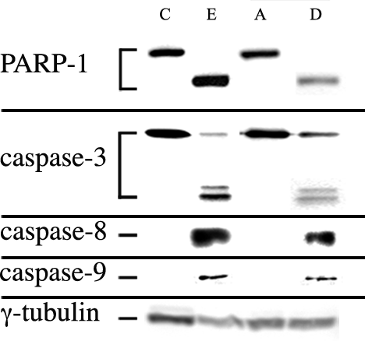
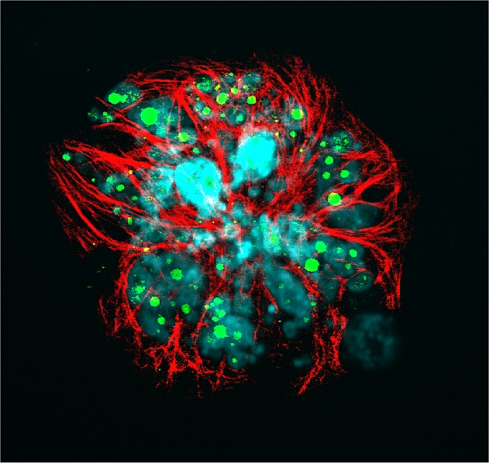
Aim of the research
Identification of agents triggering cell death in human cancer cell lines
APOPTOSIS
Ivana Scovassi
Analysis of morphological and biochemical markers
Mitochondria structure/ function
C
C
Nucleus/cell morphology
Eto
Eto
DNA fragmentation
Caspase activation
PARP-1 proteolysis
Extrusion of proteins

Slide 8
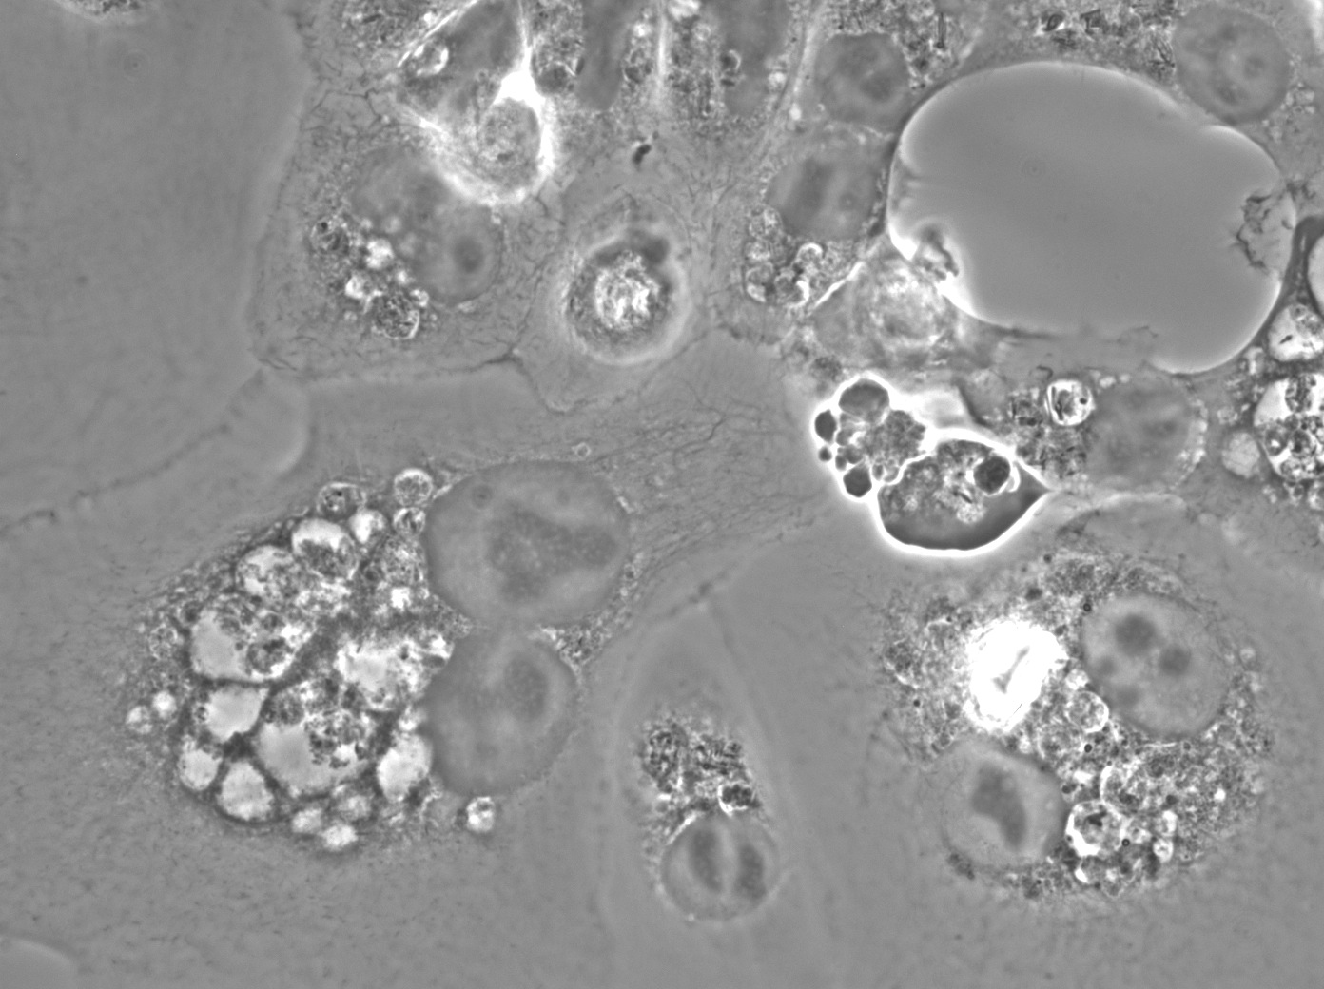
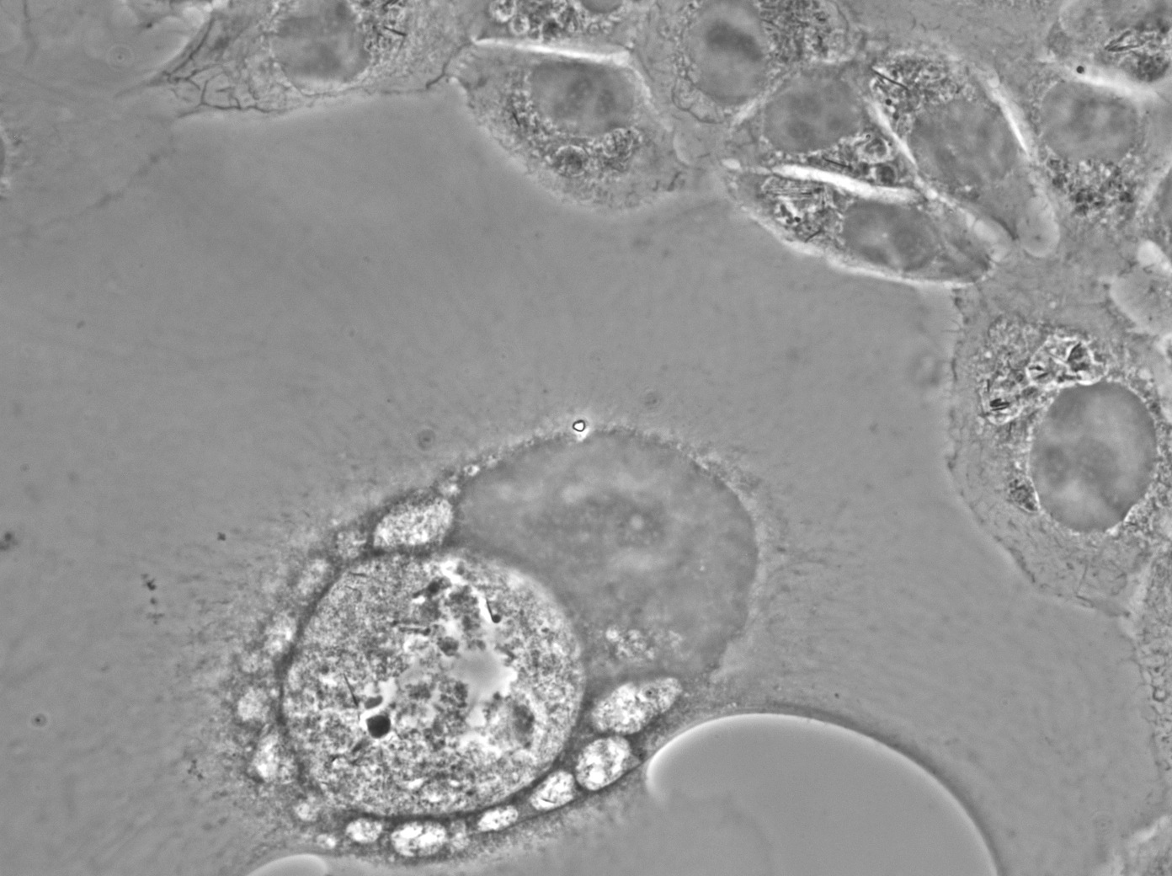
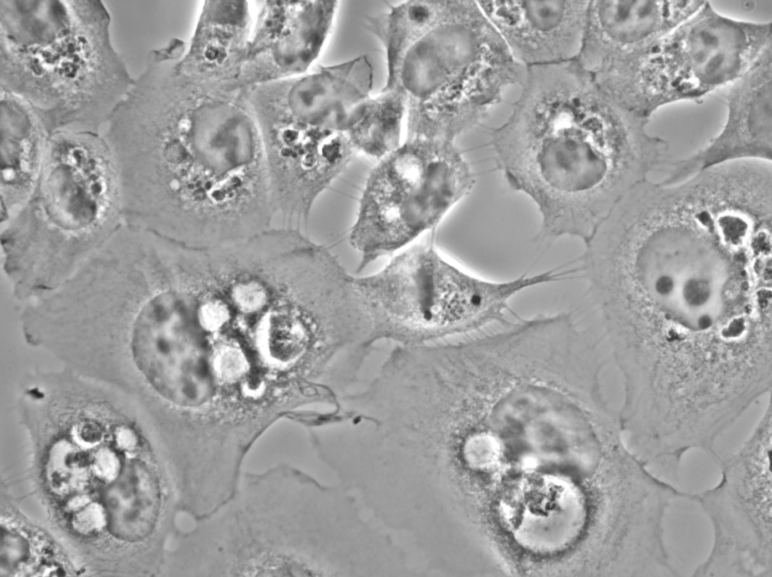
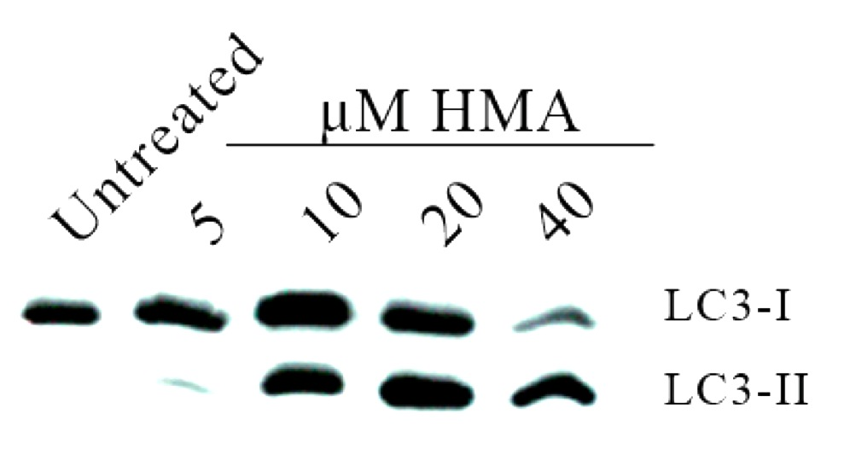
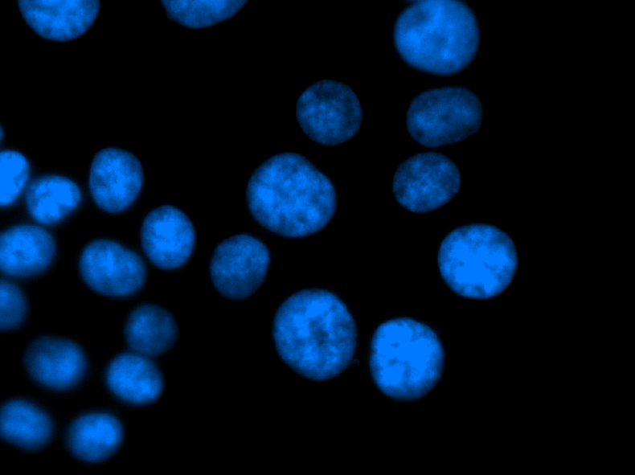

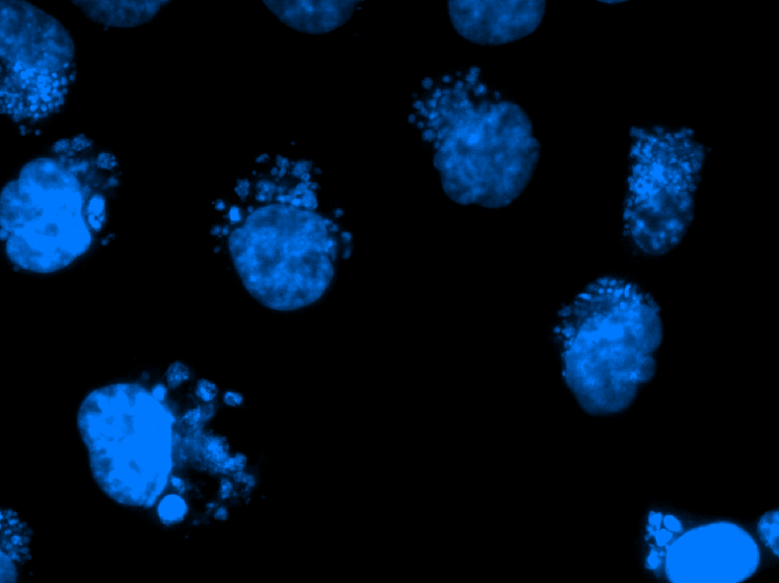
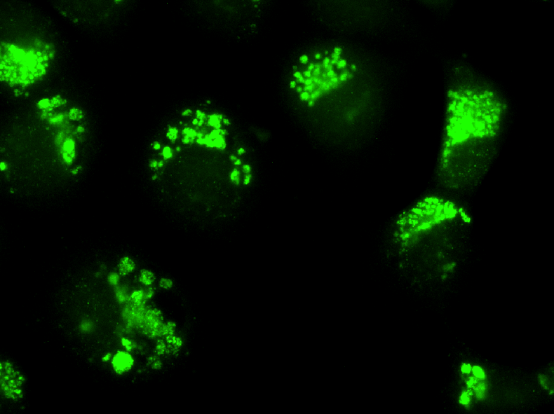
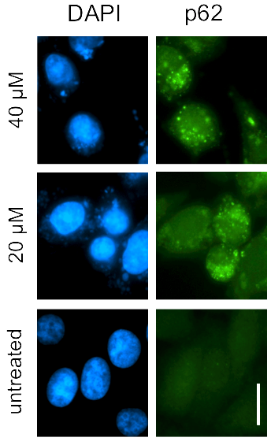
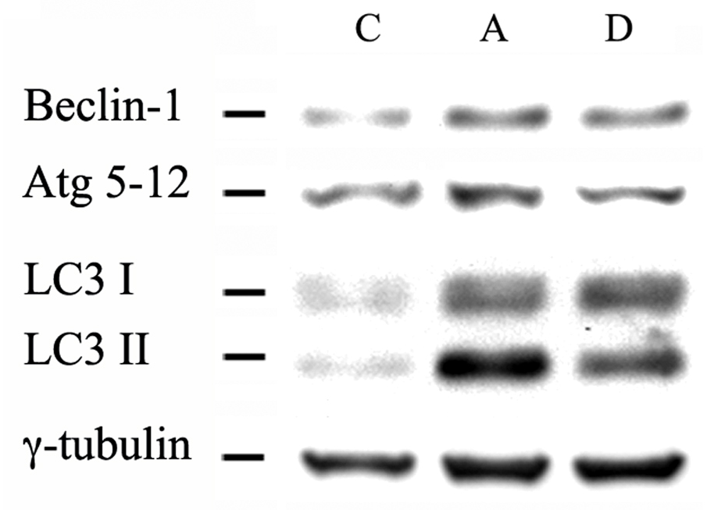
AUTOPHAGY
Analysis of autophagy markers
Active involvement of autophagy in drug resistance of cancer cells, given that it can antagonize drug-induced apoptosis
Vacuolized morphology
LC3 conversion
C
Autophagy
HMA
Protein expression

Slide 9
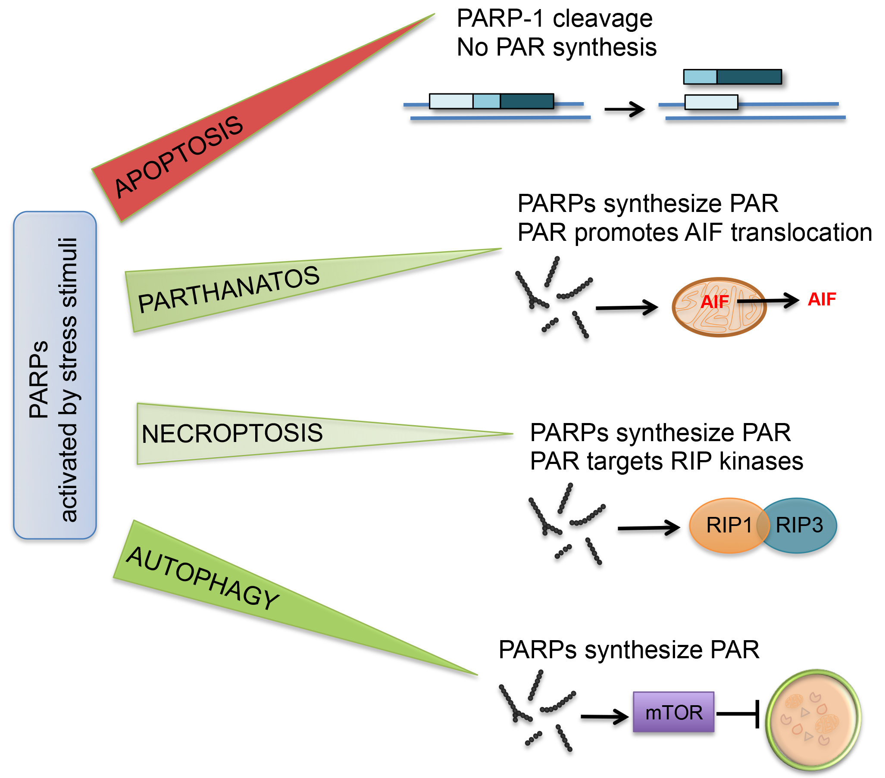
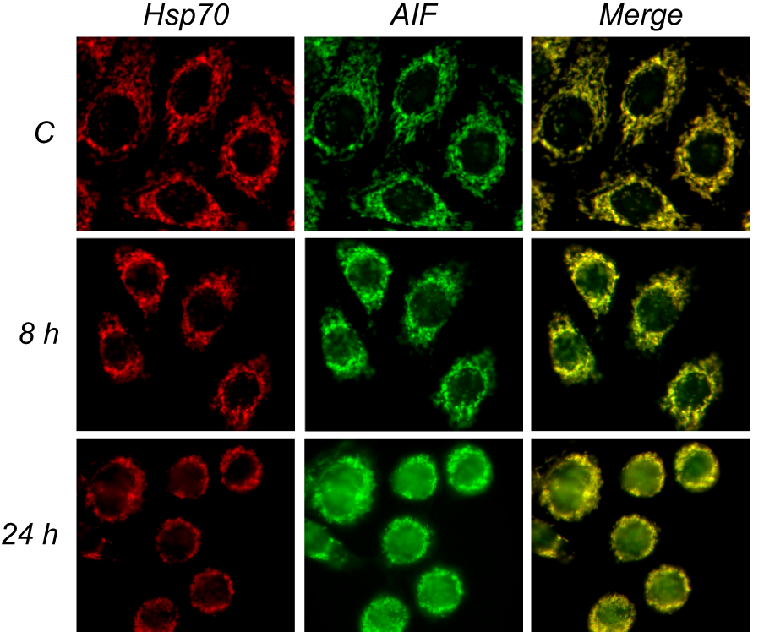
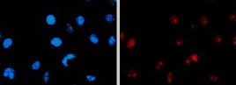
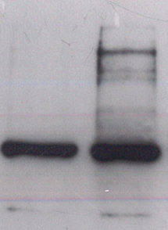
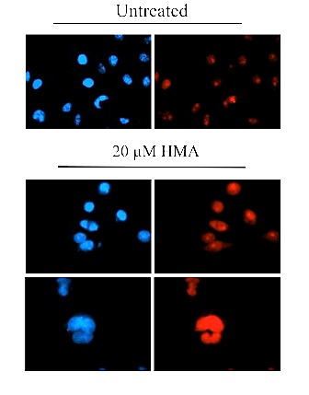
OTHER PARADIGMS OF CELL DEATH
Accumulation of poly(ADP-ribose)
Analysis of parthanatos markers
AIF translocation
Increased PAR synthesis
Control
HMA
Analysis of necroptosis markers
Protein expression
C HMA
RIP1
RIP3
MLKL
tubulin

Slide 10
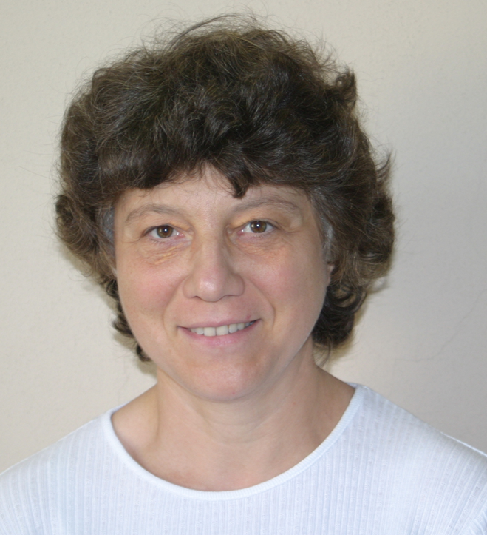
Damage not only to DNA
but - ROS mediated - also to
macromolecules and organelles
Anna Cleta Croce
Ionizing radiation
Direct/indirect (via H₂O₂) oxidizing effects on biological macromolecules
Native oxidized, fluorescing products
proteins
lipofuscin-like lipopigments
lipids
glucides advanced glycation products
ROS

Slide 11
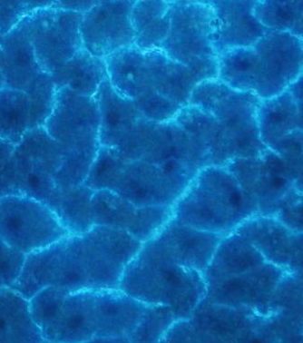
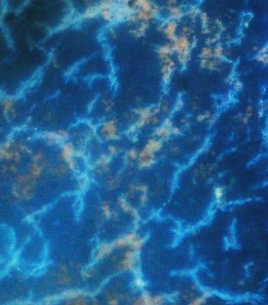
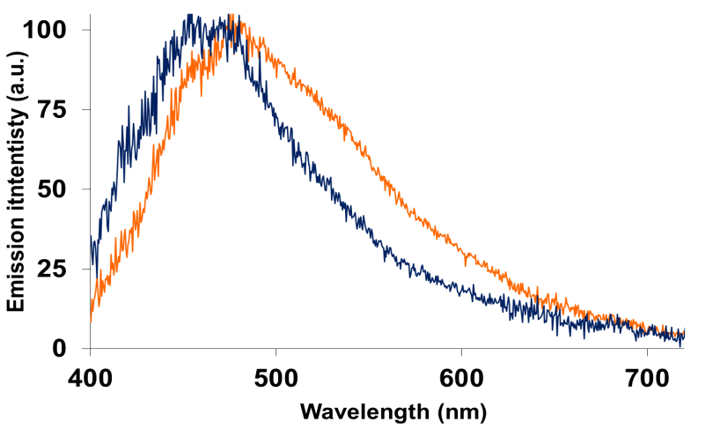
In situ direct detection of oxidized products
Fluorescence microscopy
Lipofuscin-like detection in liver tissue
“Young” liver parenchima: dark nuclei, bright network of proteins delineating the sinusoidal space
B) “Old” liver parenchima: protein/lipids oxidation revealed as lipofuscin-rich areas
Autofluorescence imaging: detection of architectural and compositon alteration in unfixed, unstained tissue sections.
The color change allows the easy detection of liver lipofuscins, endogenous biomakers of physiological senescence or oxidative stress.
ROS + Proteins / Lipids
A)
B)
Microspectroscopy
Fluorescing biomolecules (Endogenous Fluorophores) can be identified depending on their typical spectral shapes, and quantitated by a specific analysis (curve fitting) of their contribution to the overall autofluorescence emission signal.
Autofluorescence is recorded under excitation light at 366 nm, allowing a simultanenous detection of the main Endogenous Fluorophores.
ROS +
Proteins/
Lipids
Autofluorescence translated to spectroscopy via fiber optic probe allows real time, in situ, in vivo analyses, limiting the number of animals to be used. Also time and cost for the processing (fixation, staining, observation) of multiple samples will be reduced and limited to pre-selected items.

Slide 12
Expertise
Multiple approaches to investigate the biological effects of high LET
Possible collaboration
Define the impact of high LET on tumor-surrounding tissues
End points: Analysis of
DNA damage
Different repair mechanisms
Signal transduction pathways regulating survival/death
Gene expression
RNA metabolism

