Slide 1
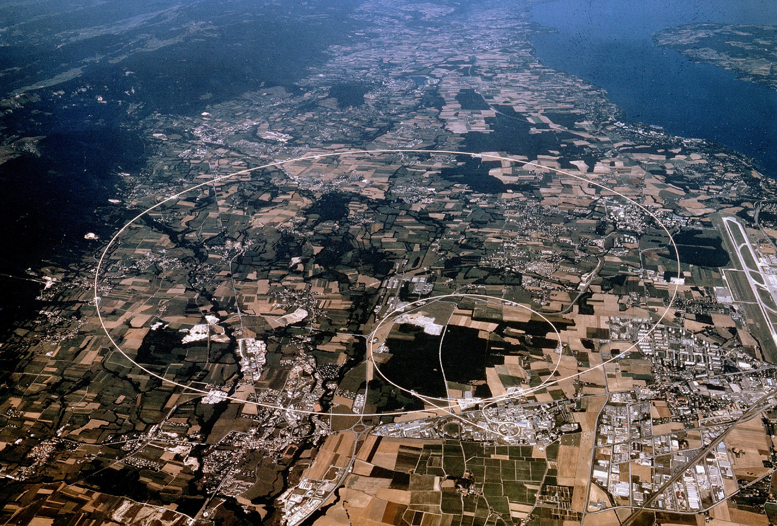
Searching for New Physics with
Dedicated Experiments@ the LHC
Albert De Roeck
CERN, Geneva, Switzerland
Antwerp University Belgium
UC-Davis California USA
NTU, Singapore
September 7th 2016

Slide 2
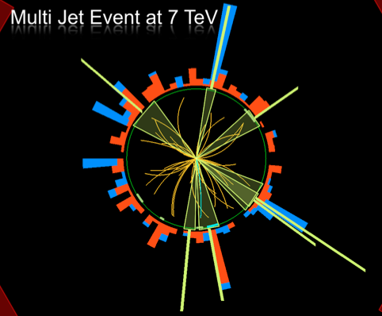
Outline
Search for Physics Beyond
the Standard Model
The MilliQan experiment plan
The idea for MAPP
MATHUSLA, for long lived
particles
Other ideas?
Summary

Slide 3
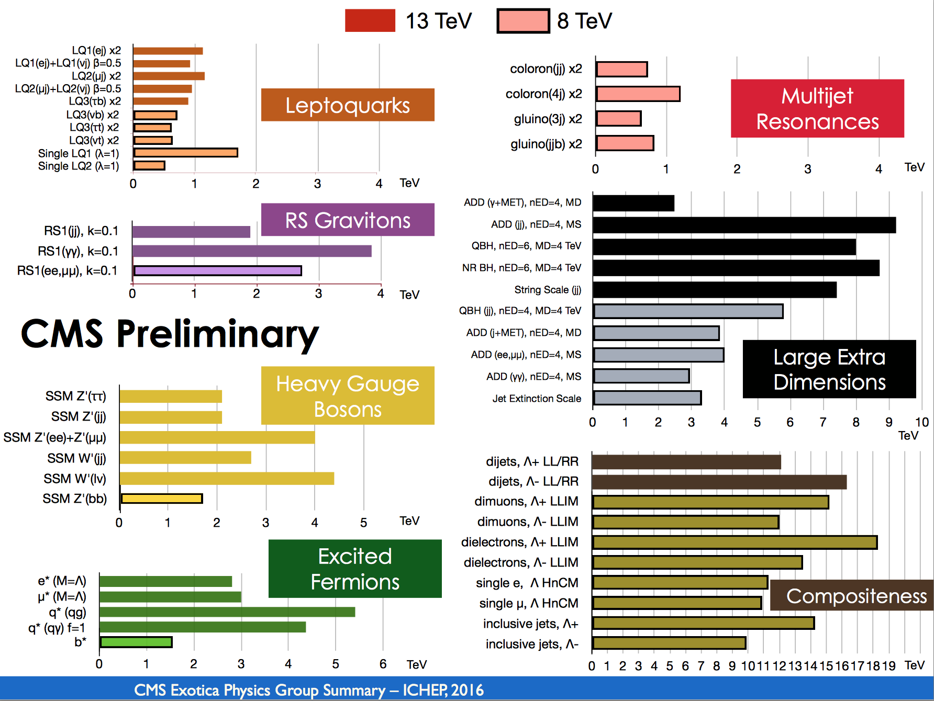
Summary of Exotica Searches (CMS)

Slide 4
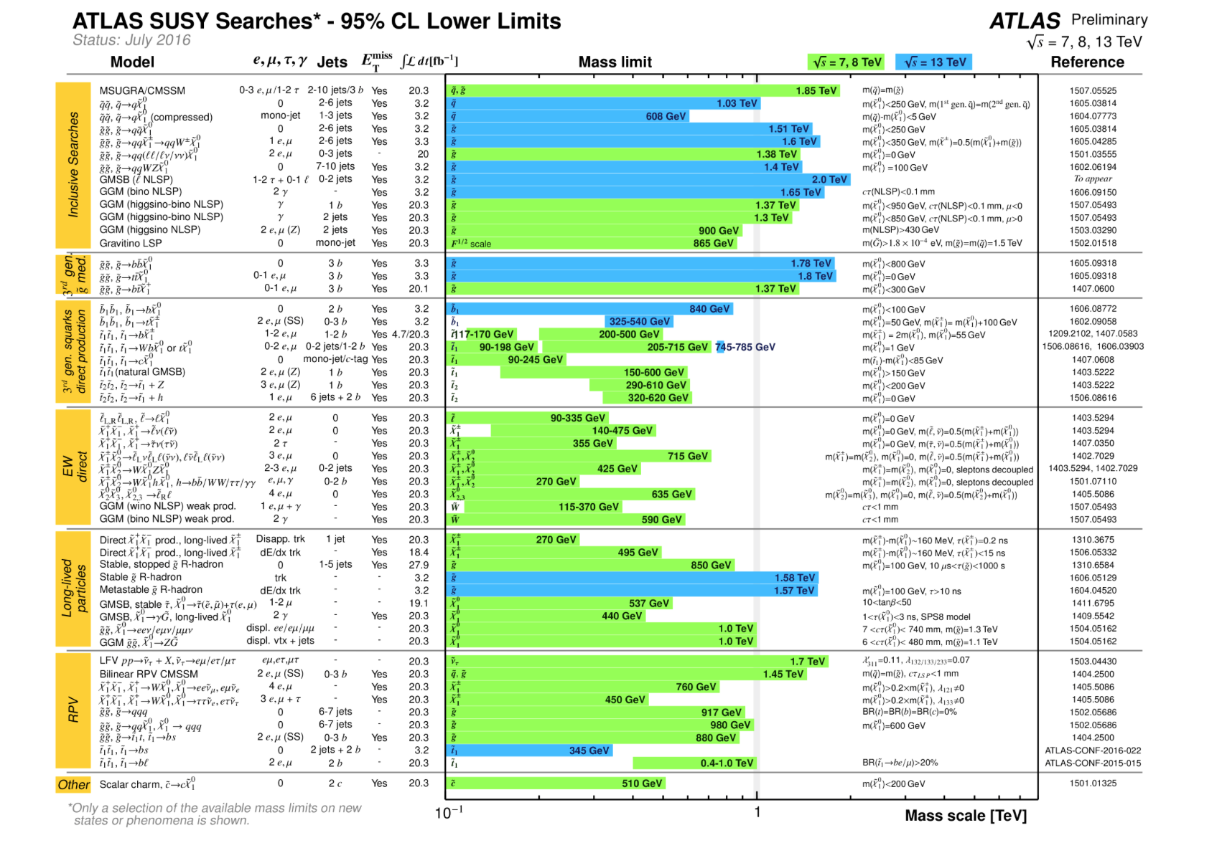
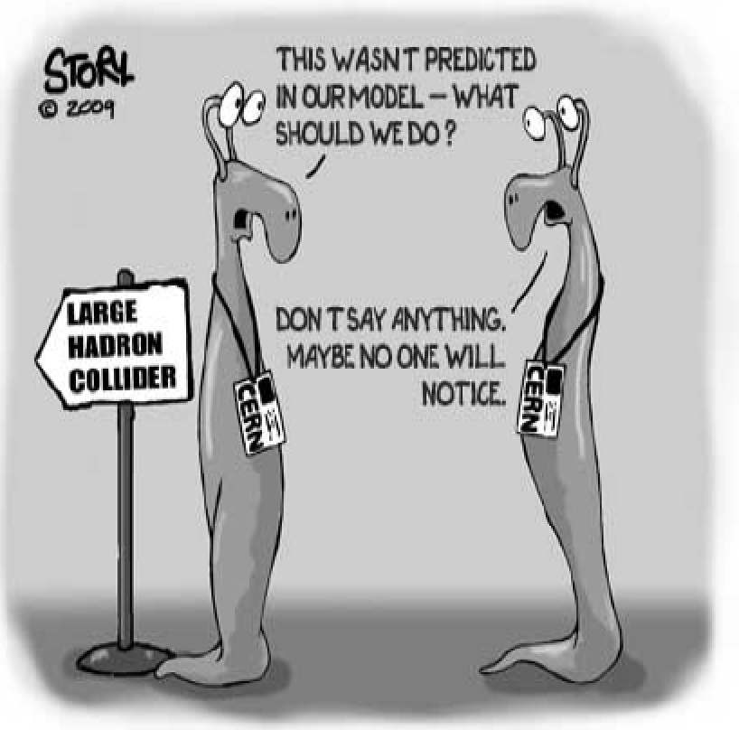
Summary of SUSY Searches (ATLAS)
In short: no clear sign of SUSY with the data collected so far

Slide 5
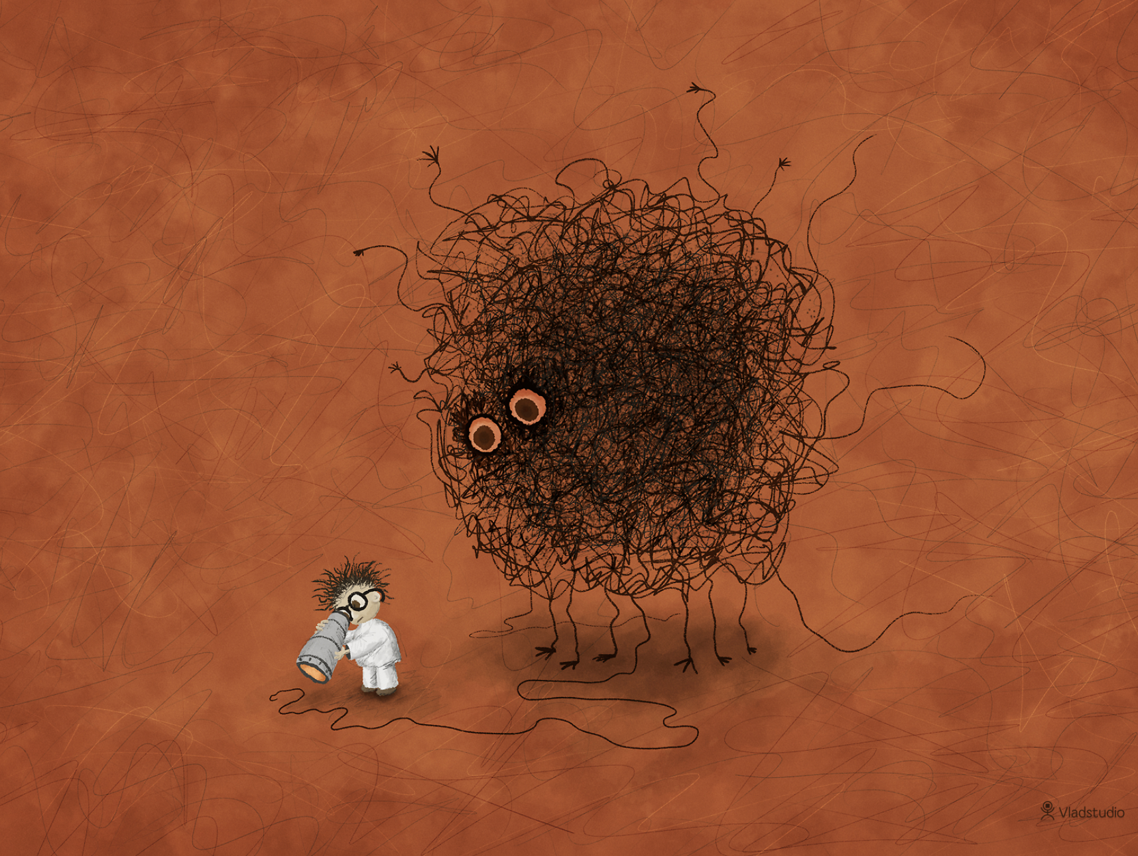
Are we leaving no stone unturned?
The LHC BSM searches are indispensable and should be continued in the new energy regime and with increasing statistics.
But if we still do not see more than a 2 sigma at the end of run-III, the HL-LHC will be likely mostly a precision physics machine. (Of course we await the verdict on the 750 GeV…)
Are we looking at the right place? Time for more effort in thinking of complementary searches?
Are we looking at the right place?
Leave no stone unturned!!

Slide 6
Alternative Searches: Examples
Searches at the LHC
Explicit Search for Monopoles (and more) with MoEDAL
Search for Milli-charge particles: a new proposal formulated for an experiment, called MilliQan
In MoEDAL: MAPP (Monopole Apparatus for detecting Penetrating Phenomena). A proposal for a MoEDAL upgrade?
Explore the Lifetime Frontier with MATHUSLA (new!)
Trapping in beampipe & using the LHC ring for Monopole searches are discussed later this meeting (previous talk)
Other ideas?
Searches for new signatures in CMS/ATLAS/LHCb etc will continue of course. SUSY? Exotica? Monopoles?...
Ideas for new Diffraction measurementsin other talks
Reflecting personal interest…

Slide 7
The MilliQan Experiment Proposal

Slide 8
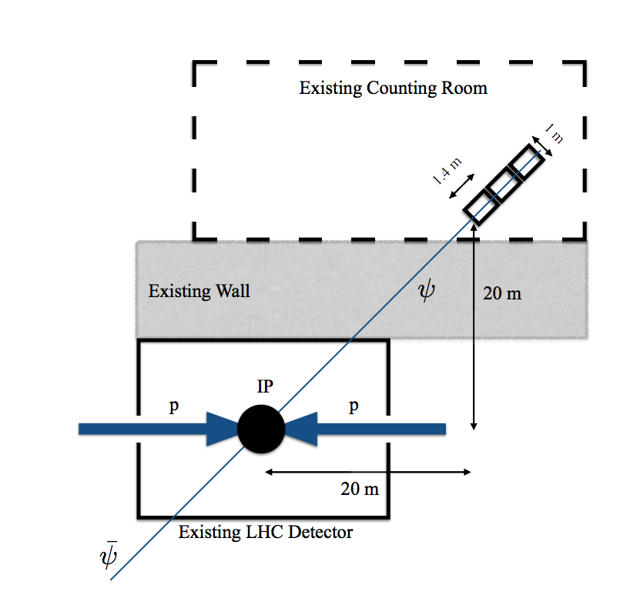
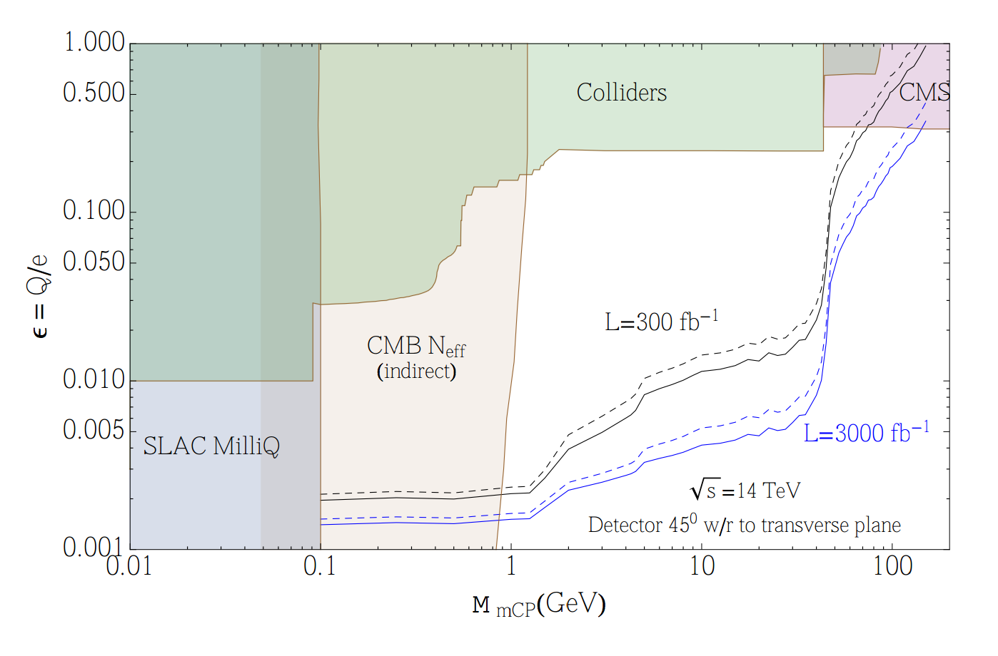
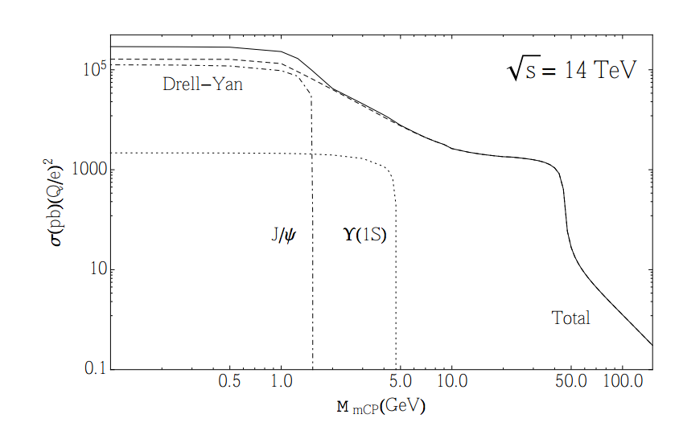
Particles with Milli-Charges?
CMS search for fractional charged particle arXiv:1210.2311
Q=1/3e > 140 GeV; Q=2/3e >310 GeV (95% CL. dE/dx)
A “new” idea -> Hunting for particles with charges
~ 0.3-0.001e arXiv:1410.6816

Slide 9
Particles with Milli-Charges?
Possible extensions of the standard model of elementary particle physics suggest the existence of particles with small, un-quantized electric charge... Milli-charged have been searched for in some dedicated experiments eg at SLAC.
Eg. New sub-GeV gauge forces ("dark/hidden photons") that kinetically mix with the photon can provide a promising scenario for MeV-GeV dark matter.
Formalism used for the study is ‘dark QED’ (Holdom 1986), ie an extra abelian gauge boson that is kinematically mixed with the SM hypercharge. Charged fermions in the additional U(1) can interact with SM particles as though they have reduced electric charge
Direct DM via milli-charged particles: eg arXiv:0809.1953

Slide 10
Massless Dark Photons!

Slide 11
Idea for the MilliQan Experiment
Few slides taken from C. Hill
Contacts: drandyhaas@gmail.com and Christopher.Hill@cern.ch

Slide 12
The PX56 Observation and Drainage Gallery

Slide 13
Location in the Drainage Gallery

Slide 14
The PX56 Observation and Drainage Gallery

Slide 15
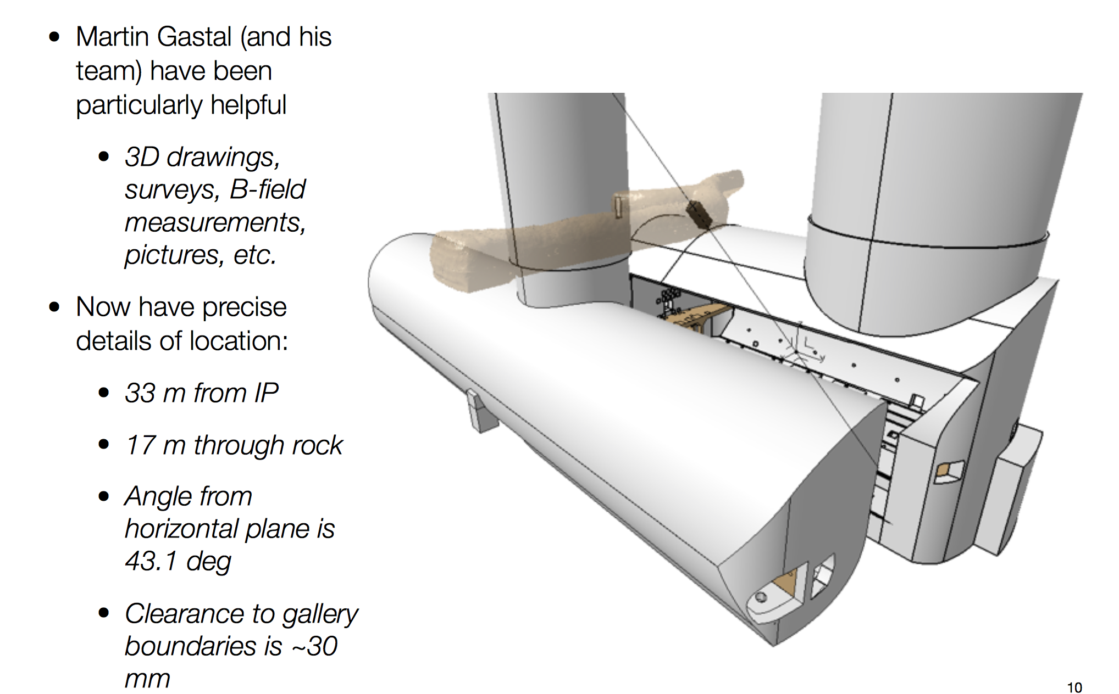
Location in the Drainage Gallery

Slide 16
Testing Background Levels
MilliQan will look for signals down to a few photo-electrons produced.
(A minimum ionizing particle leaves ~2x10⁶ photons/meter)
Shielding is key. Test background and effect of collisions in IP5 in
underground counting room at IP5 with scintillators during summer ‘15
Backgrounds are low. Effect of collisions in IP seen (linear dep. on Lumi)
New measurements on the muon background from CMS ongoing this week

Slide 17
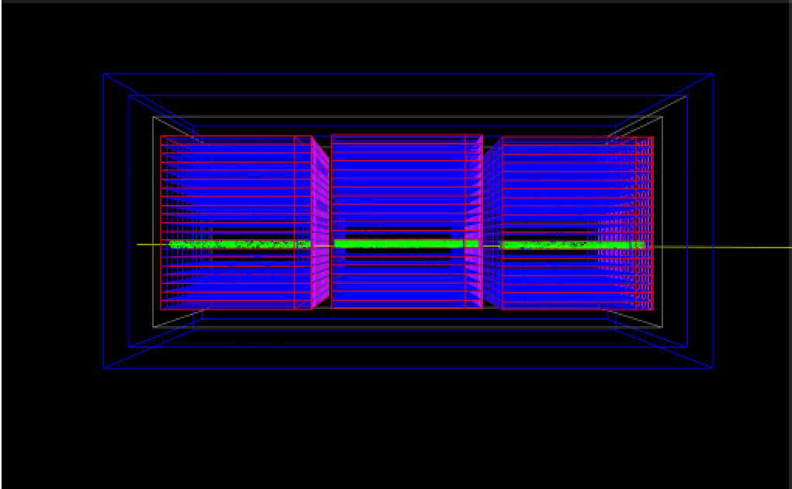
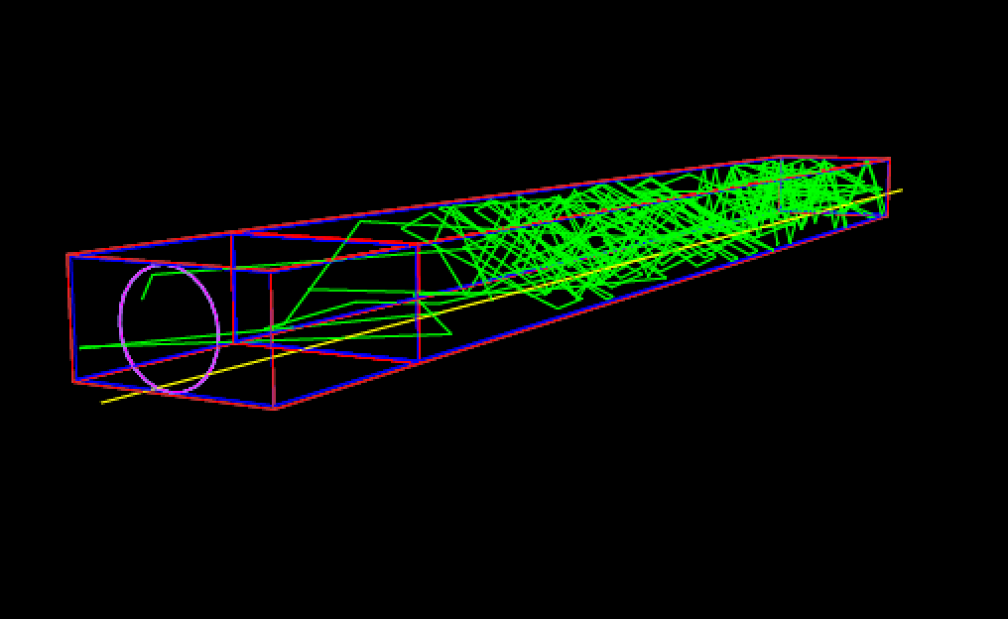
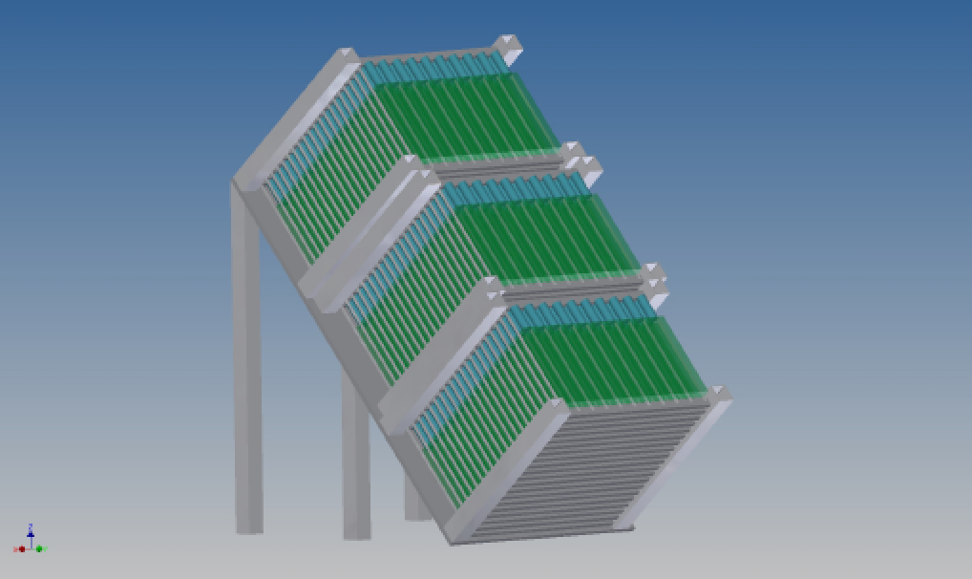
Simulation of MilliQan (Geant4)
Full detector in Geant4
Millicharge particle simulation

Slide 18
Basic Readout and Trigger

Slide 19
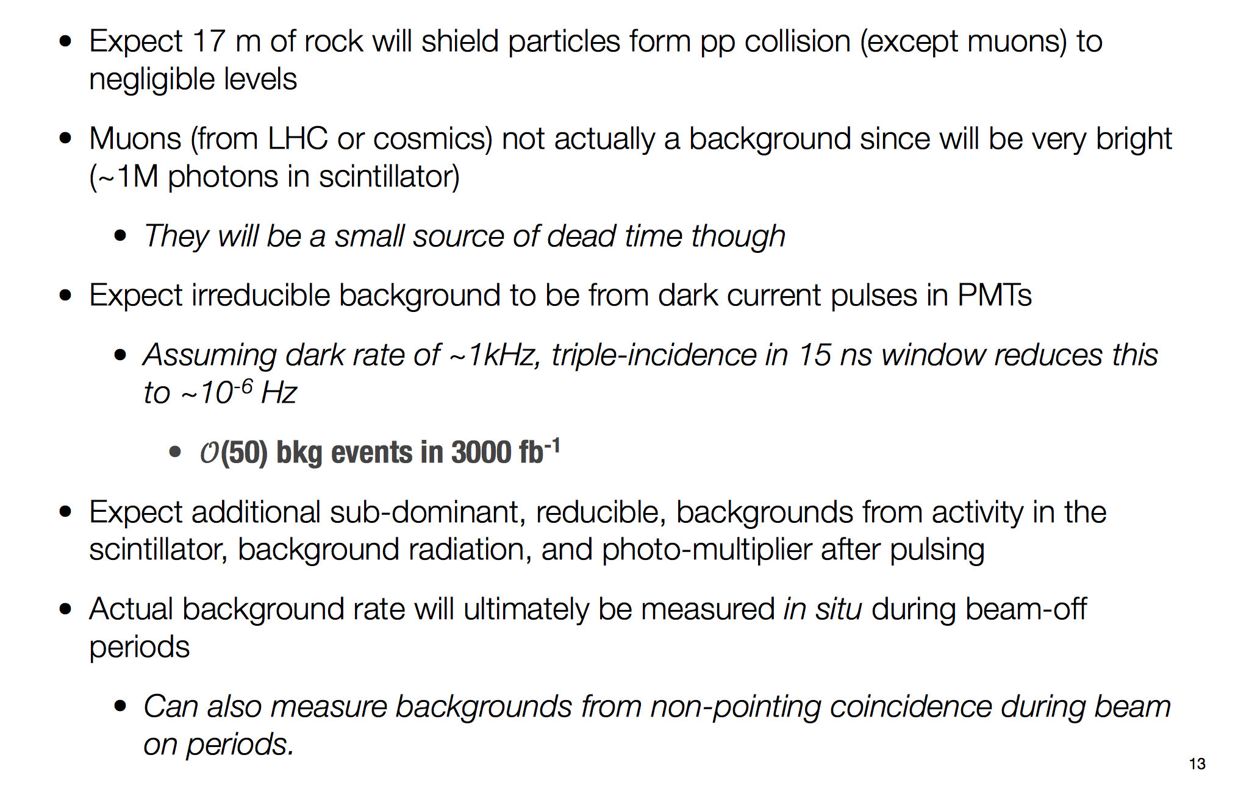
Expected Backgrounds

Slide 20
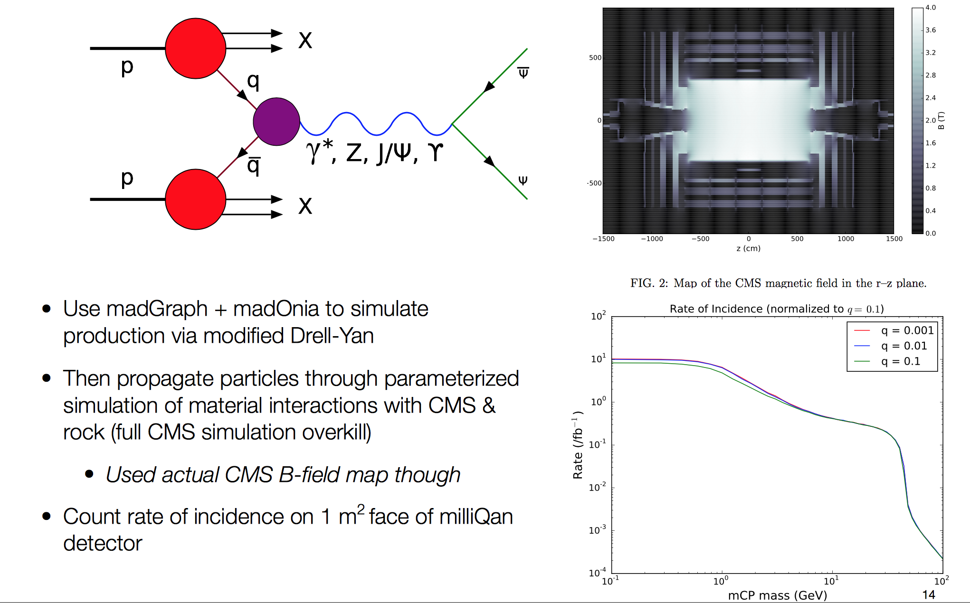
Expected # of MCPs in MilliQan

Slide 21
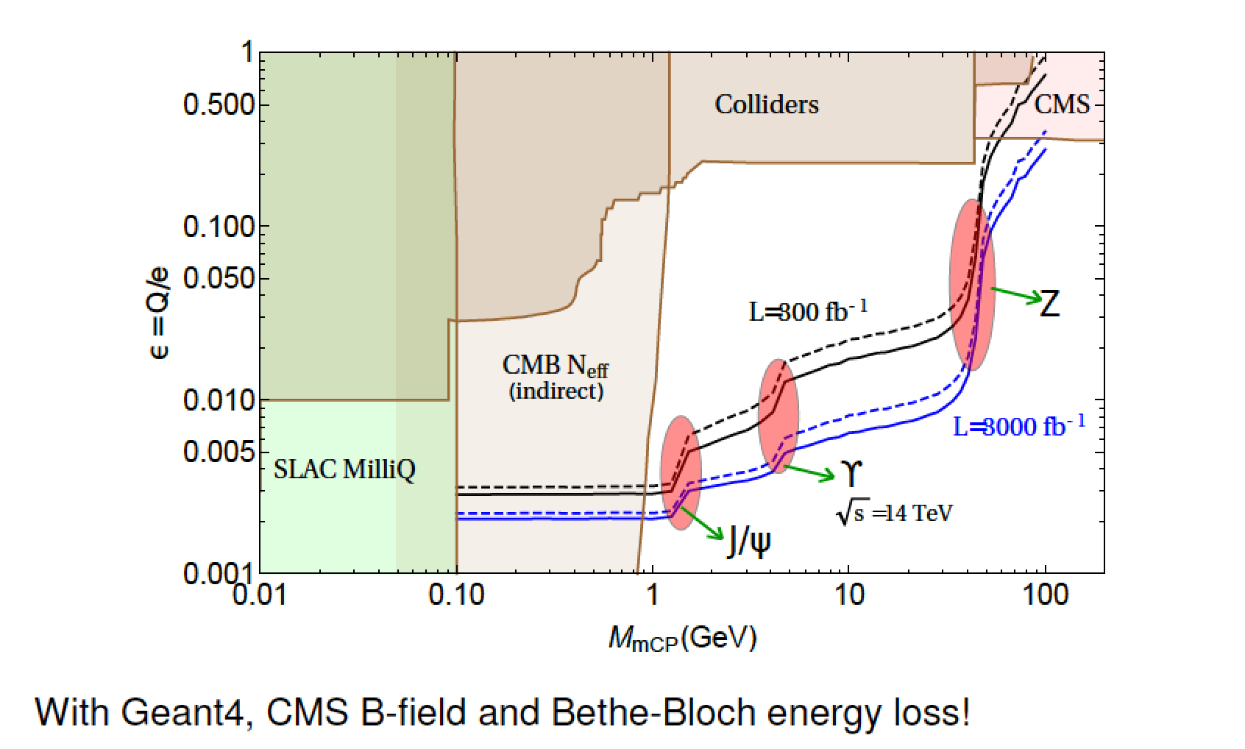
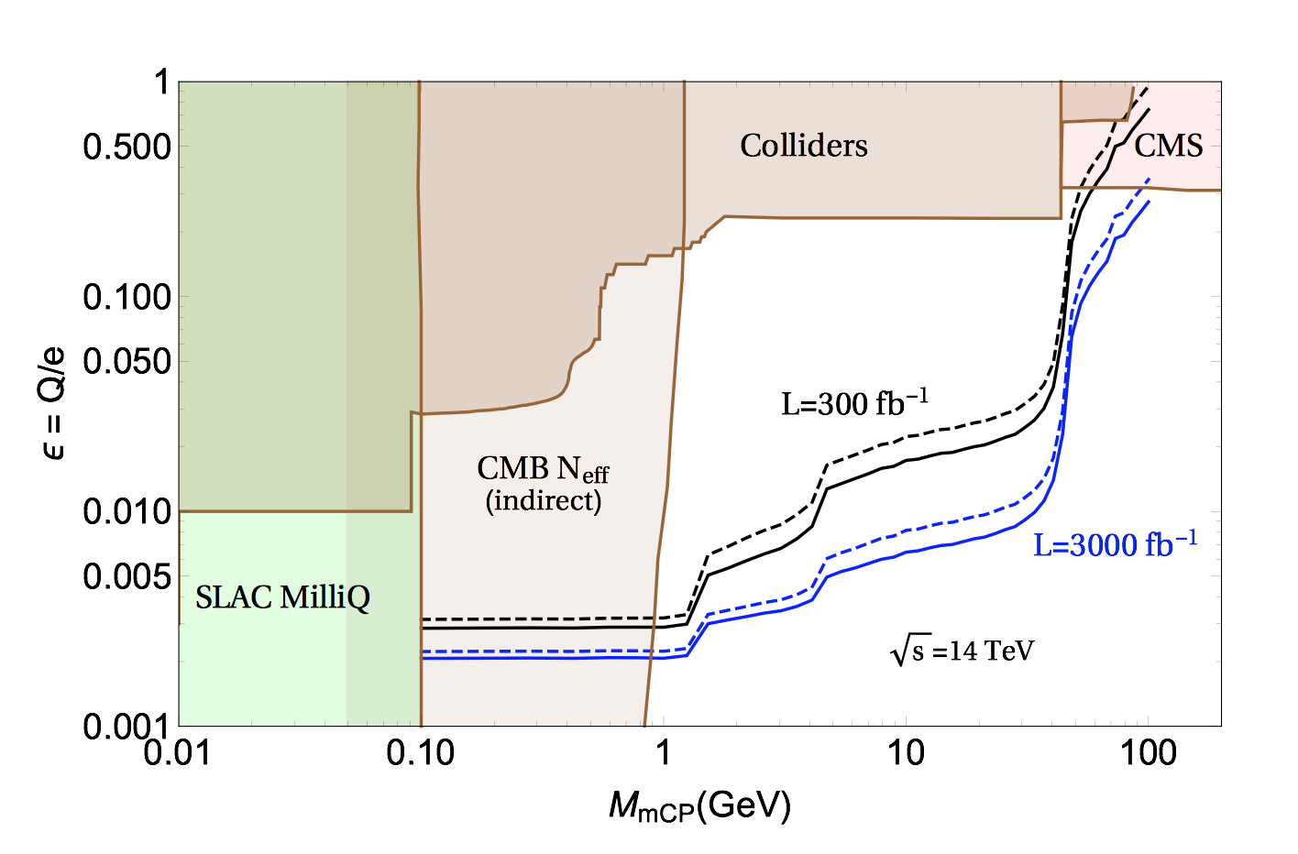
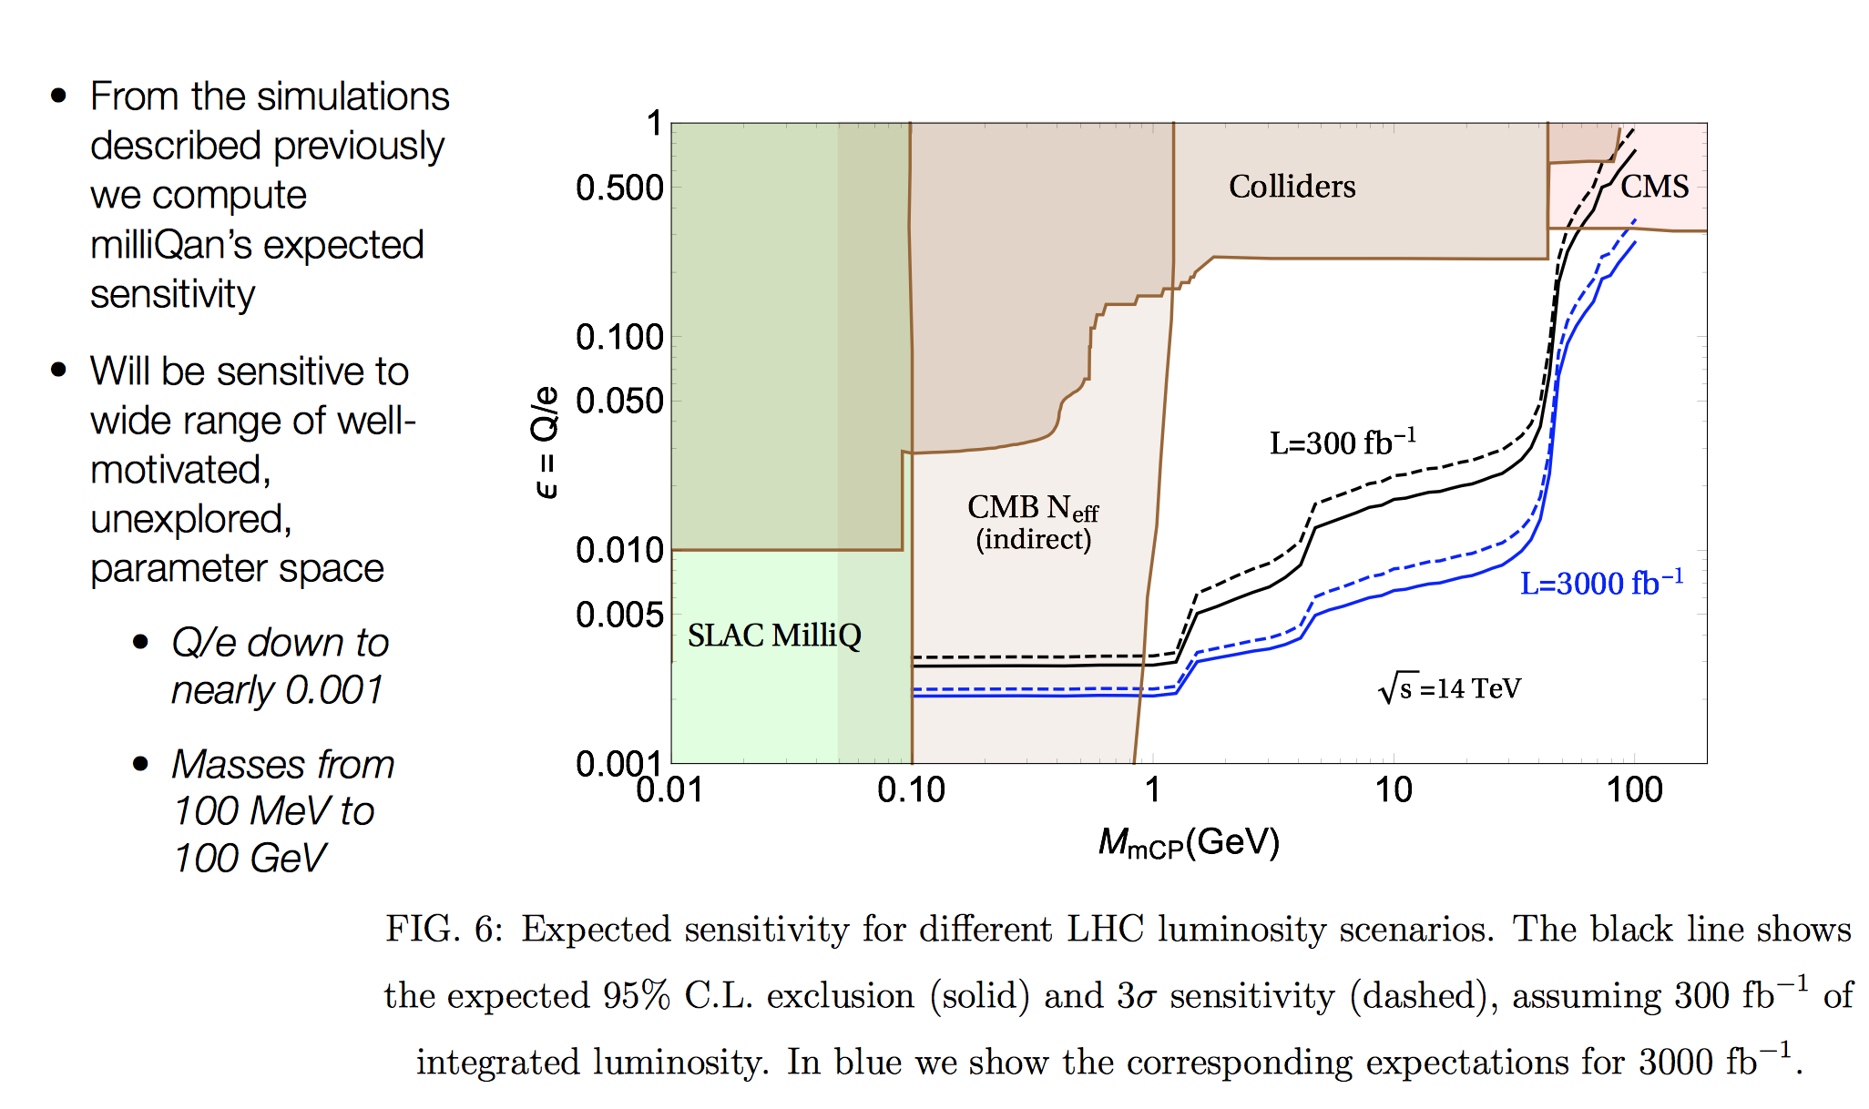
Expected Sensitivity

Slide 22
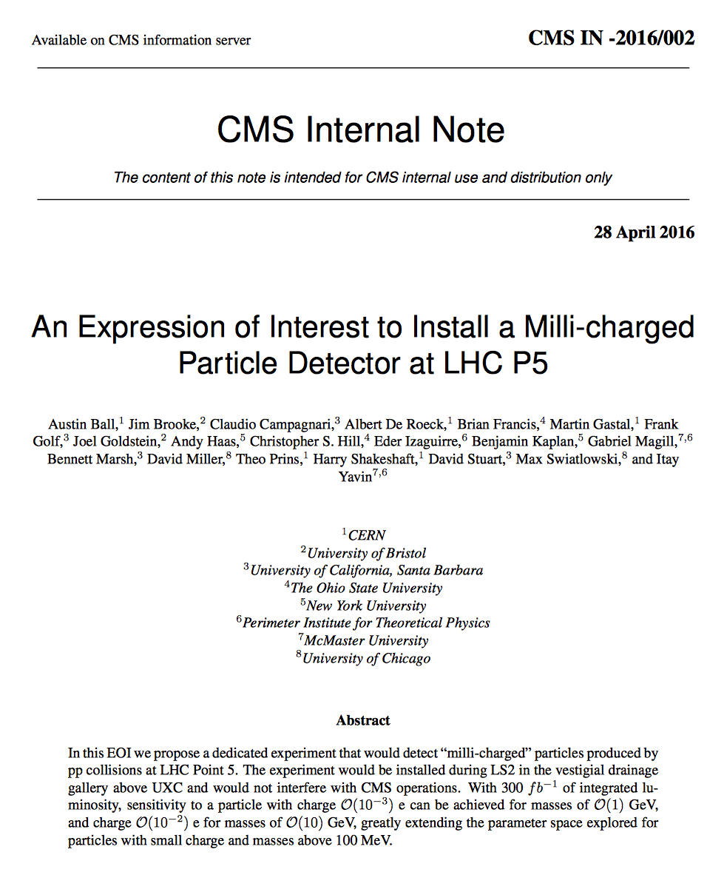
Next Steps/Schedule
•The experiment is proposed to be
associated with CMS, ie use the cavern
have and some support and interaction
(ie lumi) but be open to non-CMS members
•Membership to date:
-5 CMS groups (+ 2 being considered)
-2 ATLAS groups and 1 Theory group
•Request being evaluated in CMS based
on the submitted EOI (April 2016)
•Funding request being organized O(1)MCHF
•Further studies/developments:’
-Scintillator and PMT tests -Electronics tests/firmware development
-Online-offline software organization
-Analysis framework set-up
-Real size mechanical model test(?)
-Measurements in situ of the background
-New simulations being conducted with
‘final’ set-up…
Still an open collaboration
Expect to install prototype in
Run-2 but full detector in
Run-3

Slide 23
MoEDAL Monopole and Exotica Detector At the LHC

Slide 24
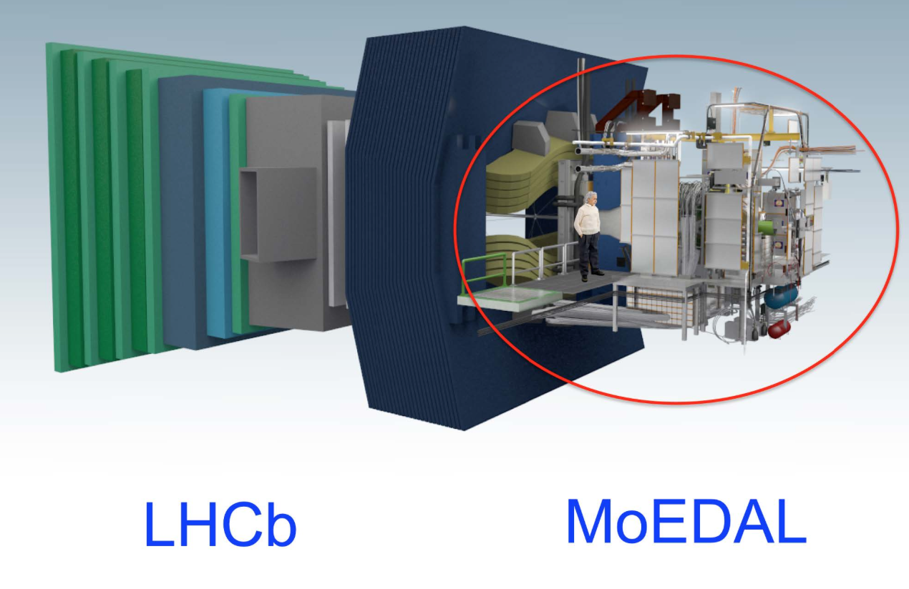
The MoEDAL Experiment

Slide 25
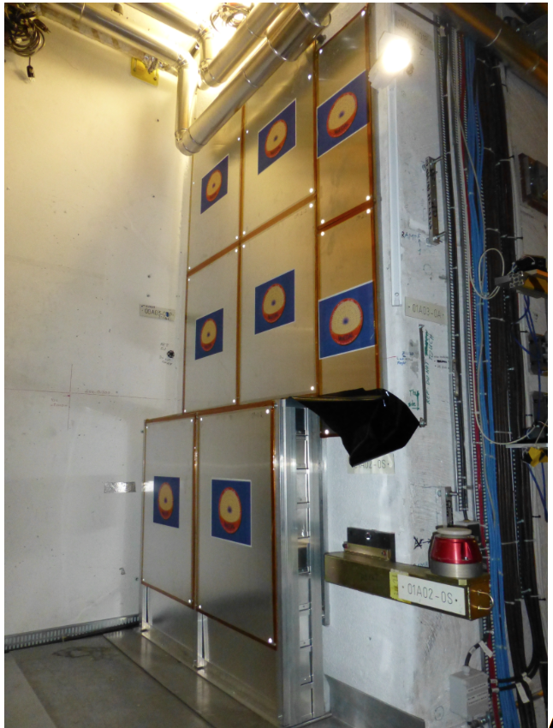
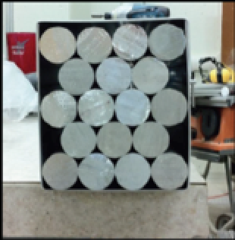
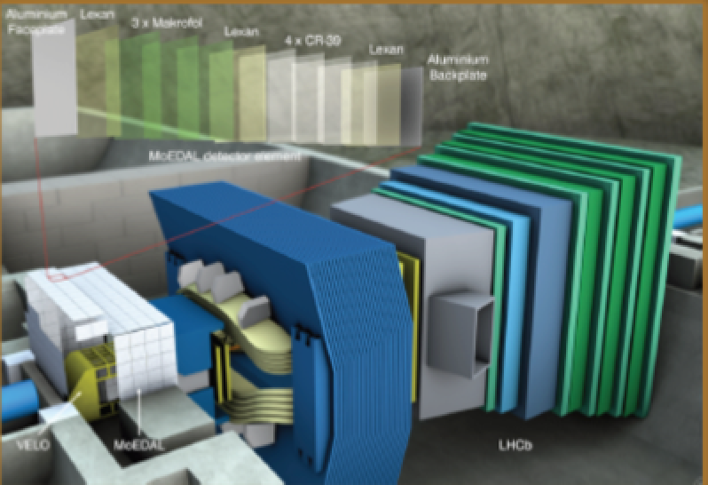
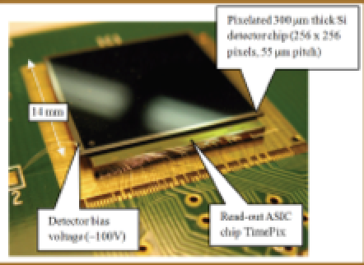
The MoEDAL Experiment
-> Three subdetector systems
Passive Nuclear Track-Etch Detectors (NTDs)
- 18m² of CR39 and Makrofol (for very high ionization)
- Detection threshold is “charge/β > 5”
Passive Trapping Detectors (MMTs)
- 800 kg of aluminium bars
MediPix chip based online radiation monitor system
The NTD and MMT detectors have been exchanged in
December ‘15. These removed detector are being analysed

Slide 26
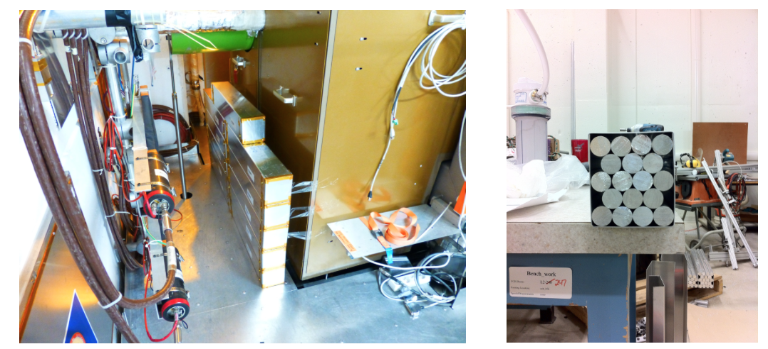
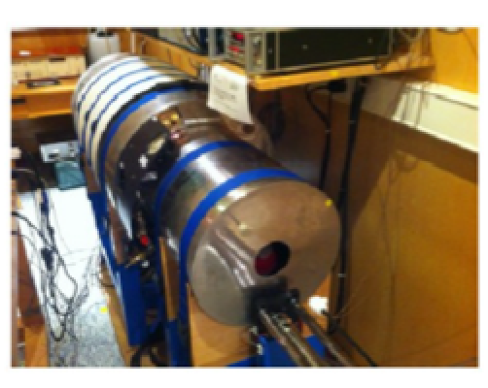
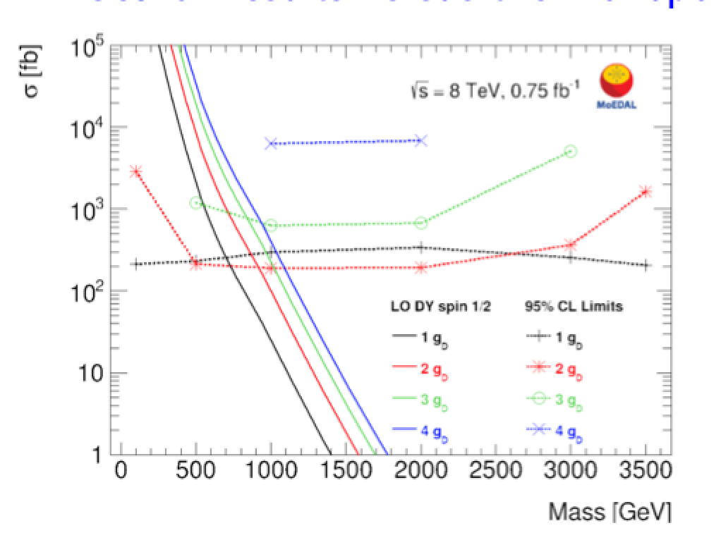
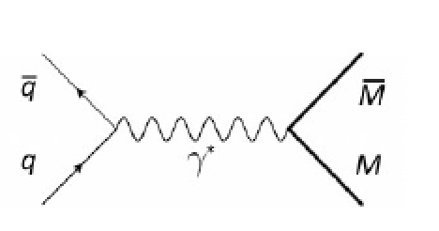
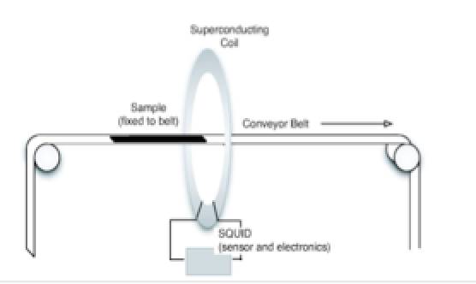
MoEDAL: Search for Monopoles
DC SQUID
Zurich
160 kg Magnetic Monopole Trapper prototype made of 198 aluminium rods of 2.5 cm diameter and 60 cm length (0.75 fb^{-1 @} 8 TeV)
No Monopoles found yet-> Limits!
arXiv:1604.06645

Slide 27
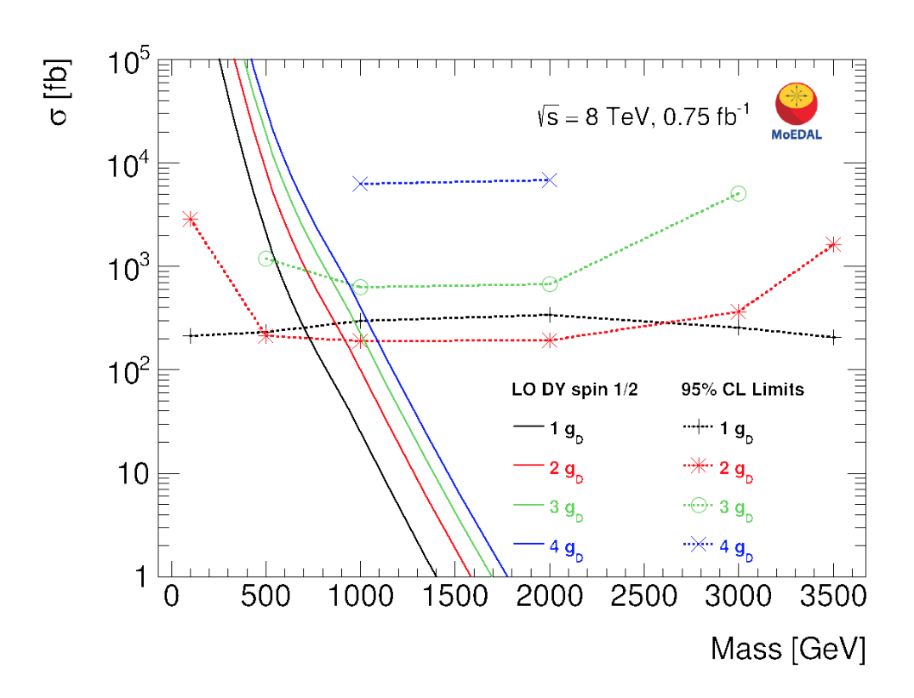
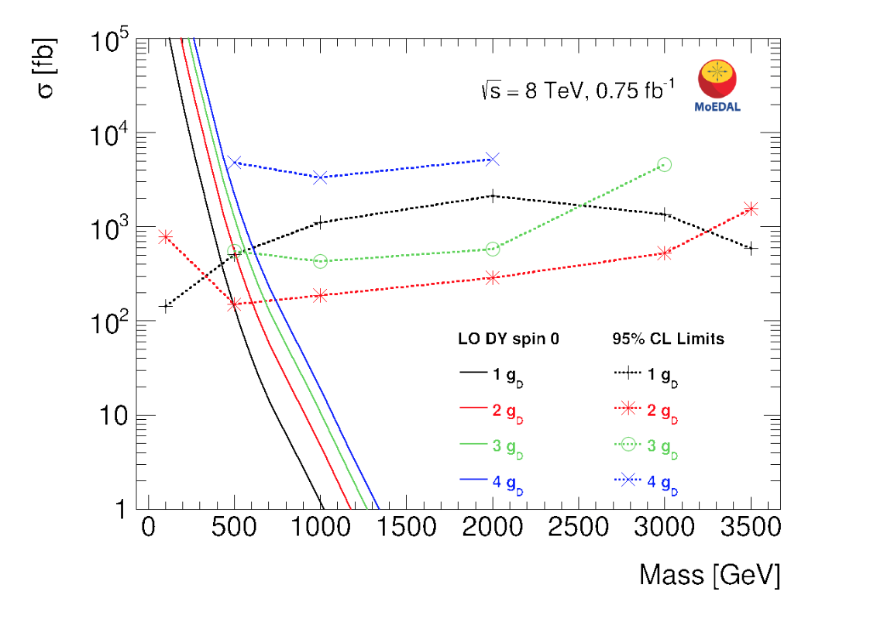
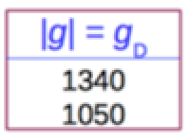
Limits for Different Monopole Charges
Search results versus the monopole mass
arXiv:1604.06645
arXiv:1509.08059
ATLAS 8 TeV
•Limits on masses in the range of 100 GeV < m < 3500 GeV
•In particular sensitive to high magnetic charges (new at the LHC!)

Slide 28
MAPP Monopole Apparatus for detecting Penetrating Phenomena

Slide 29
MAPP: For MoEDAL Upgrade?
•Same basic idea for millicharges, based on arXiv:1410.6816
But also aim for more general exotica phenomena
•Location in the LHCb cavern (Lumi versus acceptance trade-off?)
•Different set-up. Different timescale?

Slide 30
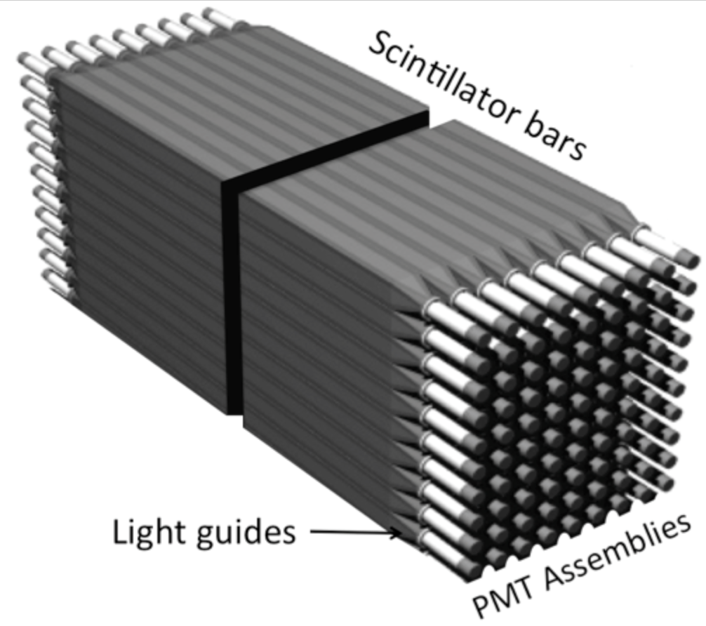
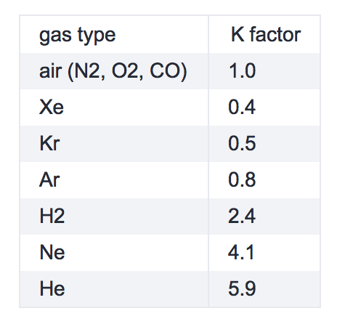
MAPP
Possible set-up
Bonus of the LHCb area:
SMOG: gas fixed target project
Data exchange with LHCb?
To search for penetrating
phenomena including
(but not limited to)
those that are generated
by the SMOG fixed target
program at LHCb
SMOG: for m < 50 GeV
and O(pb) cross sections
Studies required:
Acceptance/sensitivity (simulation)
Background measurements
Dark current limit to detect small charge
Detector performance estimates
…
For discussion as a possible
Upgrade in MoEDAL
Contact: J. Pinfold

Slide 31
MATHUSLA Massive Timing Hodoscope for Ultra Stable neutraL pArticles

Slide 32
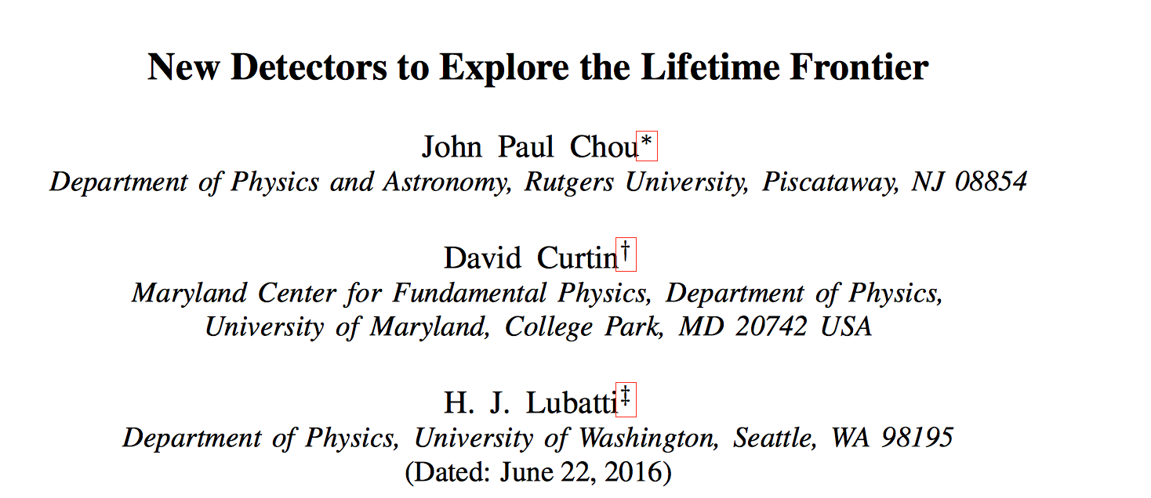
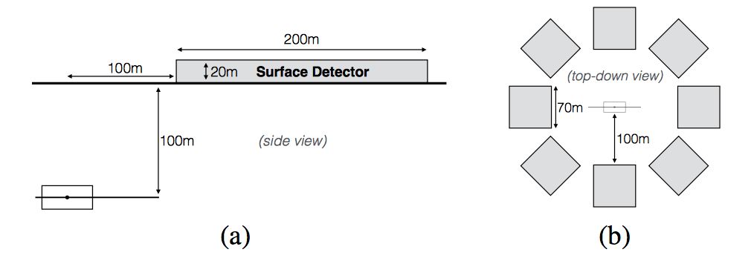
MATHUSLA
A new paper in June:
A proposal for a large area surface array to detect ultra
long lived particles coming
from the pp collisions
Aim to cover the range
~ BBN constrained inspired
contacts
arXiv:1606.06298
Possible detector
surface array eg
above ATLAS or
CMS:
(200m)²
8 x (70m)²

Slide 33
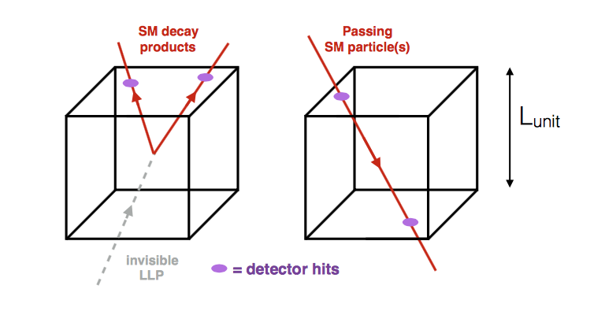
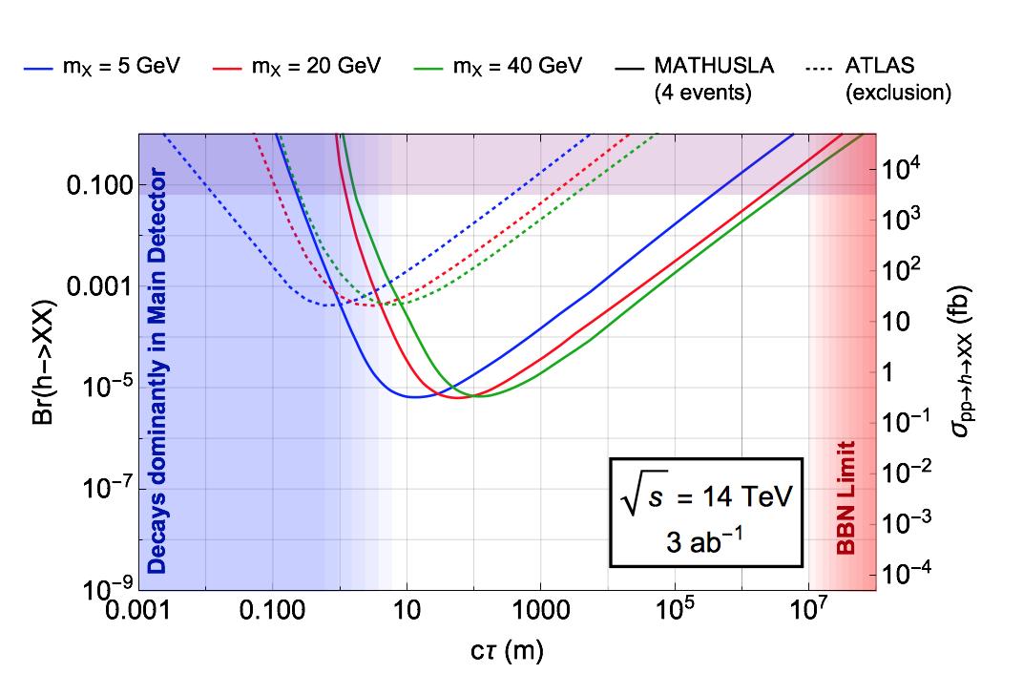
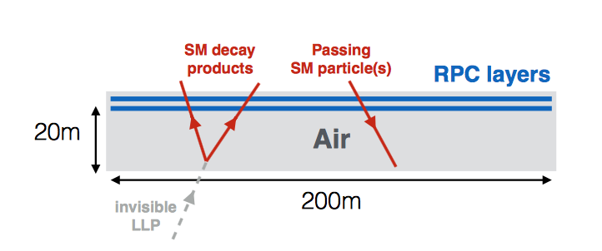
MATHUSLA
Possible technologies for the detector
Sensitivity
Benchmark: exotic Higgs decay in
long lived neutrals
scintillators
RPCs
Good timing required
No detailed design yet. Guestimate for the cost ~ O(20) MUSD

Slide 34
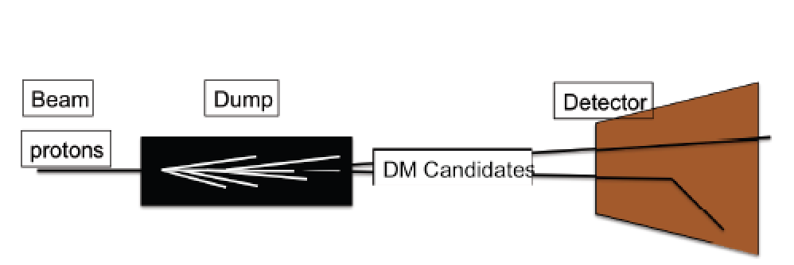
Other Ideas?
Very preliminary: expresion of interest
CERN-OPEN-2016-006
Brainstorming on
thoughts for
detection/detectors
starting
Use the beam dumped at the LHC to produce & detect Dark Matter

Slide 35
Summary: Exotica Searches
The LHC has entered a new territory. The ATLAS and CMS experiments are heavily engaged in searches for new physics. No clear sign of new physics yet in the first 20 fb⁻¹ at 8 TeV. The ultimate test start now with 13 TeV and higher lumi. The 750 GeV excess is (unfortunately) gone ☹
It is certainly useful to prepare for alternative searches with dedicated “smaller” experiments. A few examples
MilliQan: dedicated search for particles with millicharges
MoEDAL search for Monopoles and alike, taking data now.
MAPP: discussion for an upgrade for MoEDAL
MATHUSLA: Search for ultra-long lived particles
Using Beampipes/ LHC ring discussed before
Other ideas?
Maybe one day soon:

Slide 36
Backup

