Slide 1
Diffraction 2016
Santa Tecla di Acireale , September 2-8
Relating low-x DIS structure functions to hadronic total cross sections
Francesco Govanni Celiberto, Univ. della Calabria &
Madrid University francescogiovanni.celiberto@fis.unical.it ,
László Jenkovszky, BITP, Kiev, jenk@bitp.kiev.ua ,
and
Volodymyr Myranoneko, DESY, myronenko@desy.de

Slide 2
_{DIS}
Reconstruction of the DVCS amplitude from DIS
_{or}
?

Slide 3
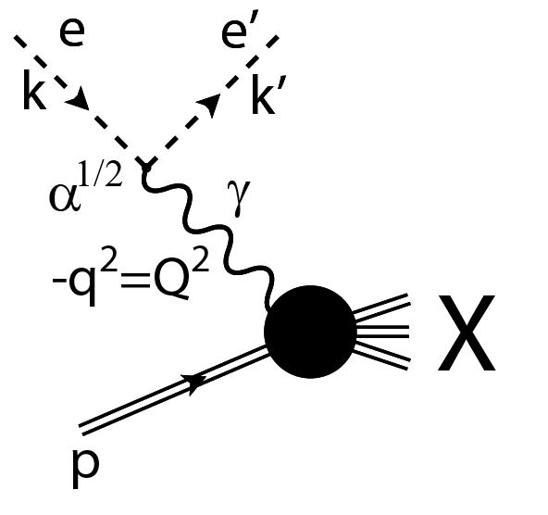

Slide 4
Two ways of relating SF to hadronic total cross sections:
Through sum rules in Q^2 (see also: Jan Kwieciński, Phys. Letters, 120B (1983) 418; L.L. Jenkovszky and B.V. Struminsky, Yad. Fizika, 38 (1983) 1568);
Using the additive quark model, the number of active quark-partons being determined by SFs (preliminary results presented by F. Celiberto, L. J. and V. Myronenko at the Quarks2016 (St. Petersburg) and Low-x (Gyöngyös) conferences).

Slide 5
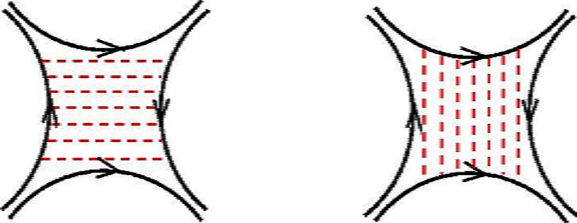

Slide 6
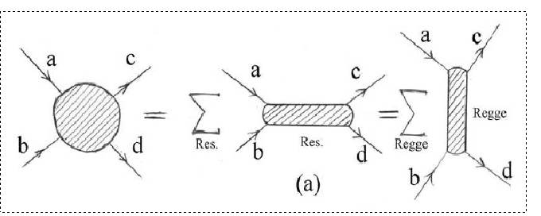
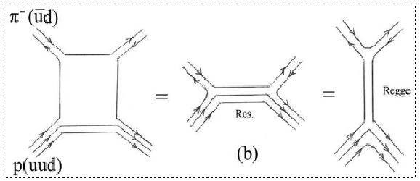
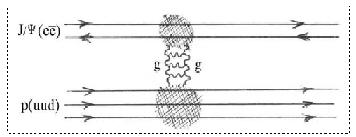

Slide 7
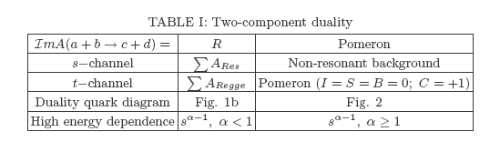

Slide 8
Im h
1/2
R(s)
→
0
b

Slide 9
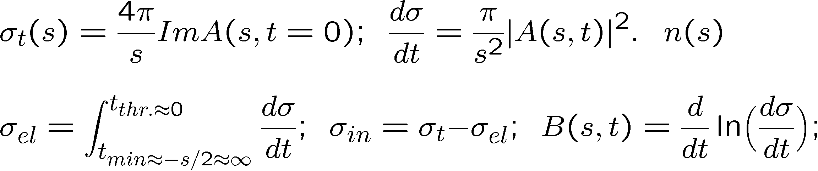

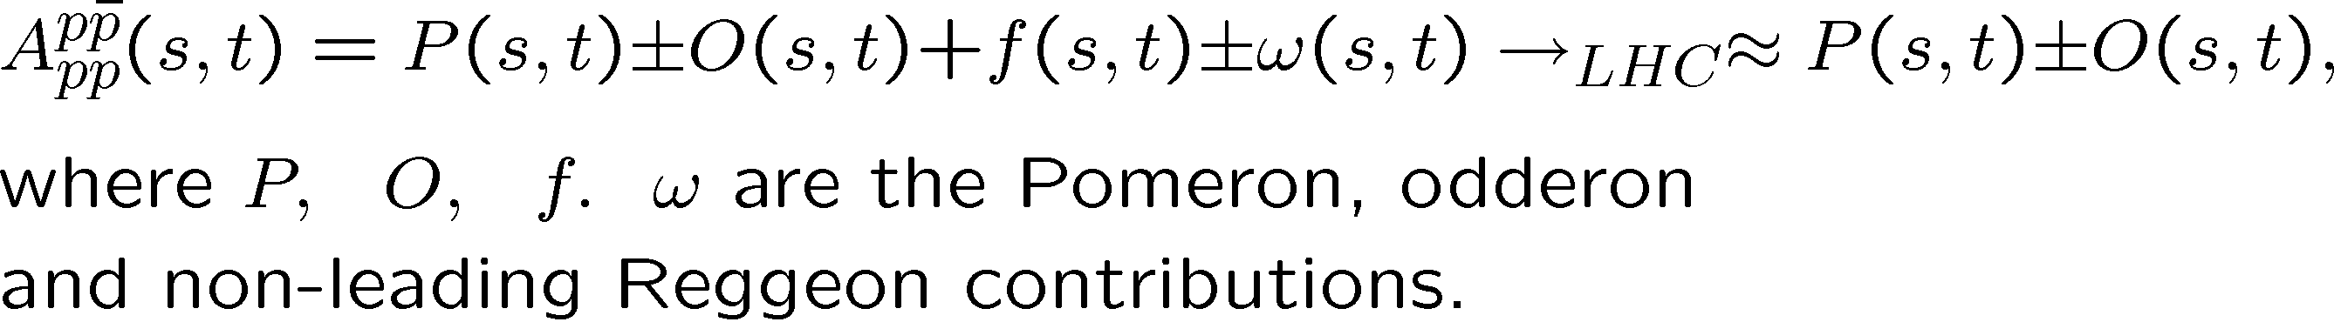
α(0)\C | + | -
1 | P | O
1/2 | f | ω

Slide 10
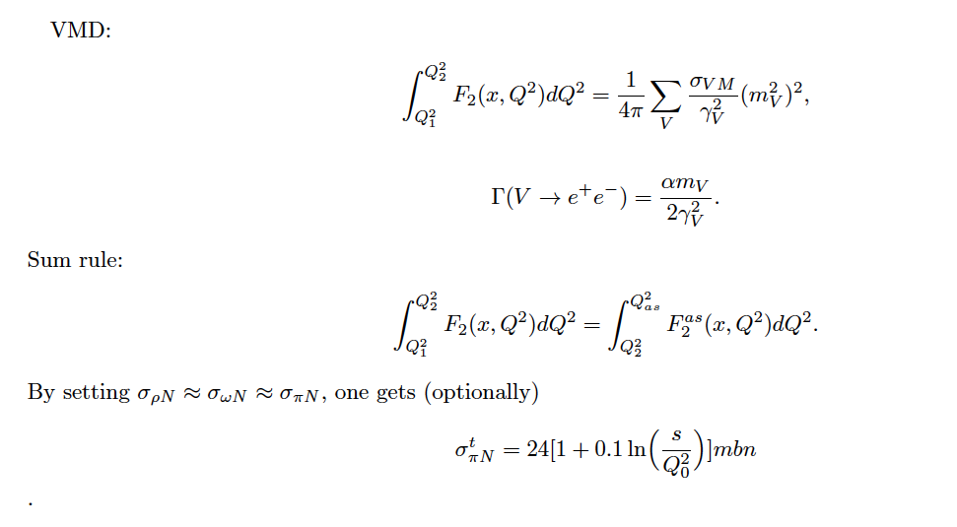
Sum rules in Q^2: Jan Kwieciński, Phys. Letters, 120B (1983) 418;
L.L. Jenkovszky and B.V. Struminsky, Yad. Fizika, 38 (1983) 1568.

Slide 11
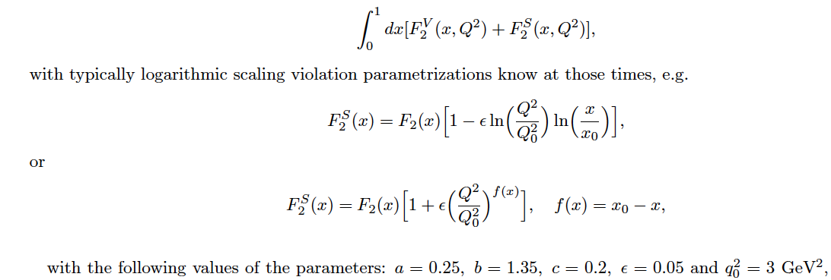

Slide 12
Sum rules in Q^2: Jan Kwieciński, Phys. Letters, 120B (1983) 418;
L.L. Jenkovszky and B.V. Struminsky, Yad. Fizika, 38 (1983) 1568.

Slide 13
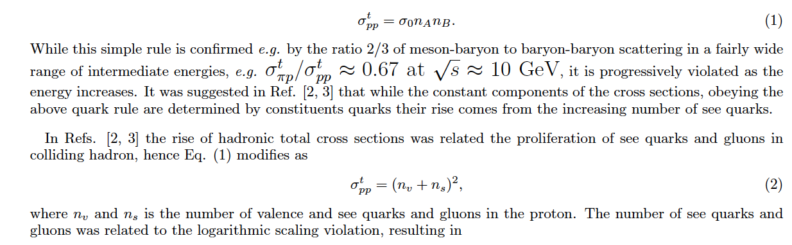
Direct, s-channel point of view: additive quark model,
single and multiple scattering of partons (Glauber).
Additive quark model relations (Levin-Frankfurt, 70-ies):

Slide 15
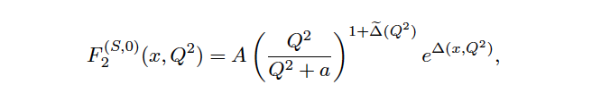

Unitarity bounds in DIS SF and in hadronic total cross sections.
An advanced model for DIS SF: P. Desgrolard, L. Jenkovszky and F. Paccanoni:
EPJ C 7 (1999) 263; hep-ph/9803286
Interpolating between “soft” (VMD, Pomeron, Δ~0.1) and hard (DGLAP, Δ~0.4) regimes:
1) DGLAP evolution, x fixed, Q^2→infty; 2) Gauge inv.: x fixed, Q^2→0; 3) x→0, Q fixed (Regge)
with “effective power”

Slide 16


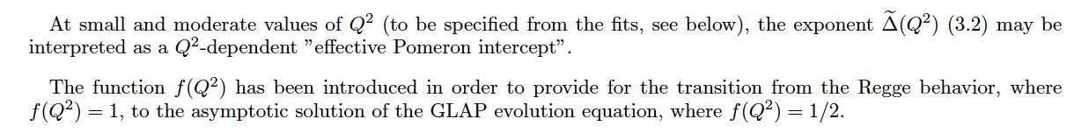

Slide 17
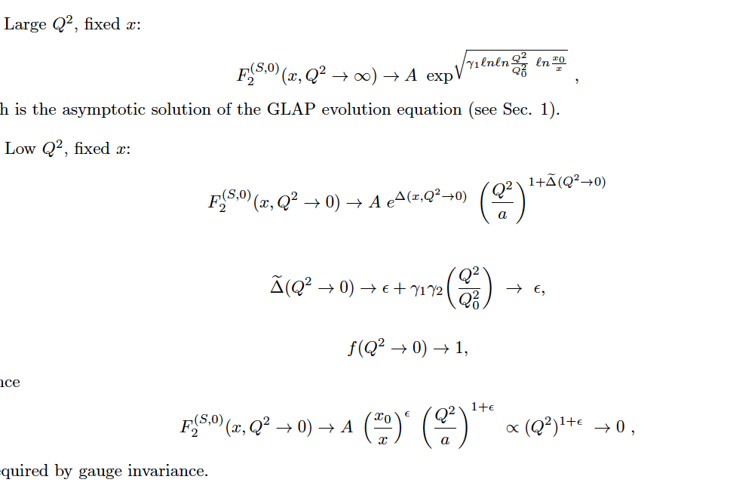

Slide 18
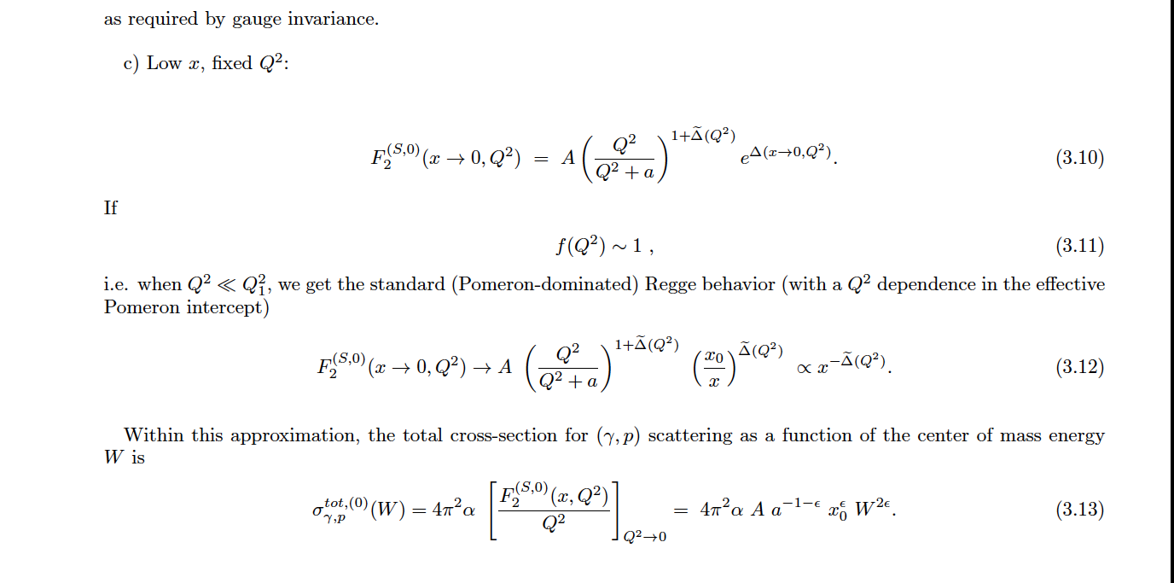

Slide 19
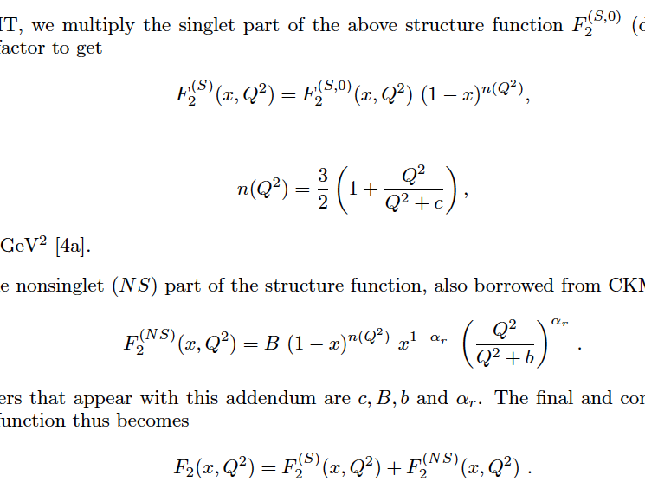

Slide 21
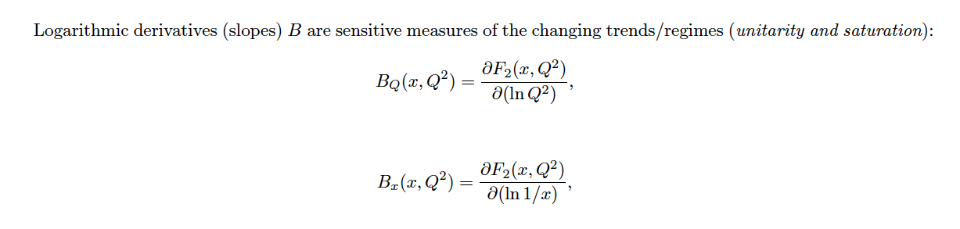
Saturation and slopes

Slide 27
A turn-over of the neutral current (NC) reduced cross section at low x_{Bj} and low Q² due to the contribution from F_{L}, which is directly connected to the gluon PDF, was not well described. The analysis called HHT presented here focuses on a simple ansatz to add higher-twist terms to the DGLAP-based evolution. New sets of PDFs were extracted at next-to-leading order (NLO) and next-to-next-to-leading order (NNLO). The predictions from these analyses are compared to the reduced HERA cross sections at low Q ² and low x_{Bj}.
σ±_{r,NC} = F₂ − y²F_{L}/Y₊ , Y₊ =1+(1-y)² , y=sx/Q² , s^{1/2 =} 318 GeV;
F₂^{HT} = F₂^{DGLAP} (1 + A₂ ^{HT} /Q² ) ,
F_{L}^{HT} = F _{L}^{DGLAP} (1 + A_{L}^{HT} /Q² ) ,

Slide 28
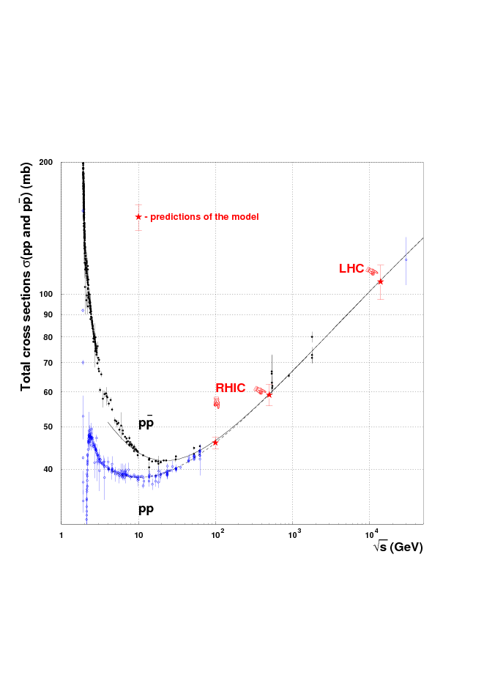

Slide 29
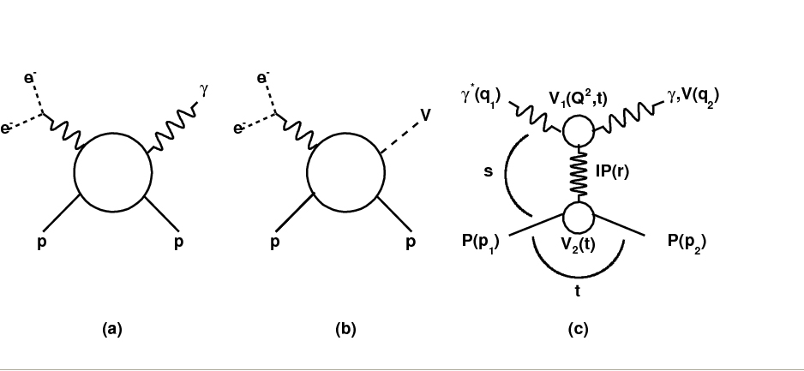
LHC and HERA: parton distribution functions (PDF) and diffraction (the Pomeron) at HERA (“hard”?) and at the LHC (“soft”?);
Diagrams of DVCS (a) and VMP (b) amplitudes and their Regge-factorized form (c)

Slide 30
Thank you!

