Slide 1
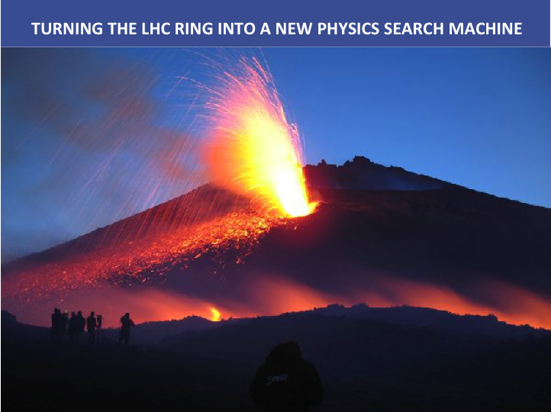
2-8/09/16
DIFFRACTION 2016 - Acireale

Slide 2
LHC RING AS A SEARCH MACHINE FOR NEW PHYSICS
Risto Orava
University of Helsinki, Helsinki Institute of Physics, CERN

Slide 3
THE PLAN
  PROTONS EXITING THE LHC RING
  TAGGING PHYSICS PROCESSES
  FURTHER DEVELOPMENT
  SUMMARY

Slide 4
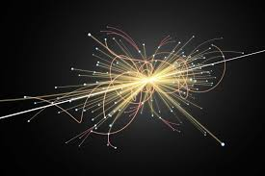
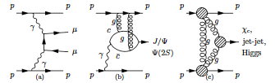
CENTRAL EXCLUSIVE PRODUCTION
pp -> p + M + p
CENTRAL SYSTEM
J^{PC} = 0⁺⁺, 2⁺⁺,...
p
void
void
p
X

Slide 5
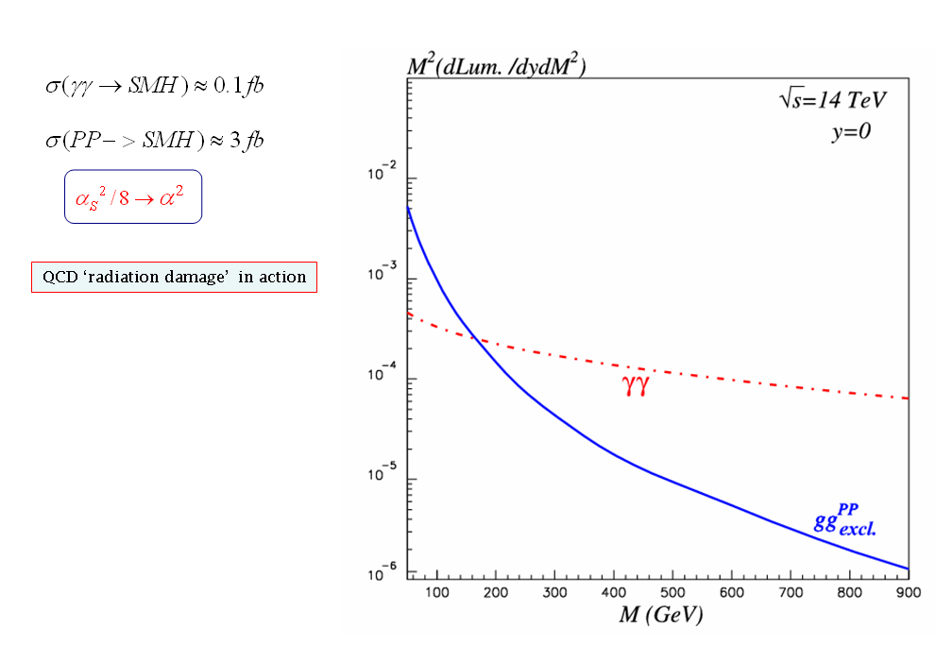
GLUON vs. PHOTON INDUCED PRODUCTION
M_{X} = 125 GeV
M_{X} = 750 GeV
exclusive production strongly
dominated by γγ at large M_{X}!
KMR: arXiv 0111078(2001)
see also: KMOR, Eur.Phys.J.C19:313 (2001).

Slide 6
SCANNING FOR MASSIVE NEW PARTICLES
(RECYCLING THE LEFT-OVER PROTONS)
Albert De Roeck (CERN, CH), Werner Herr (CERN, CH), Matti Kalliokoski
(CERN, CH), Jerry W. Lämsä (Iowa State University, U.S.), Vladyslav
Litichevsky (HIP, FIN), Christina Mesropian (Rockefeller University, U.S.), Mikael Mieskolainen (HIP; UH, FIN), Toni Mäkelä (HIP;Aalto U, FIN), Risto Orava (CERN,CH; HIP, UH, FIN), James Pinfold (U.Alberta, Canada), Stefano Redaelli (LHC,CERN), Sampo Saarinen (UH, FIN), Marek Tasevsky (FZU, CZ),Vicente Vento (IFIC, UV, S)

Slide 7

A SSC AUTOMATIC ROMAN POT SYSTEM PROPOSED BY DINO IN 1987

Slide 8
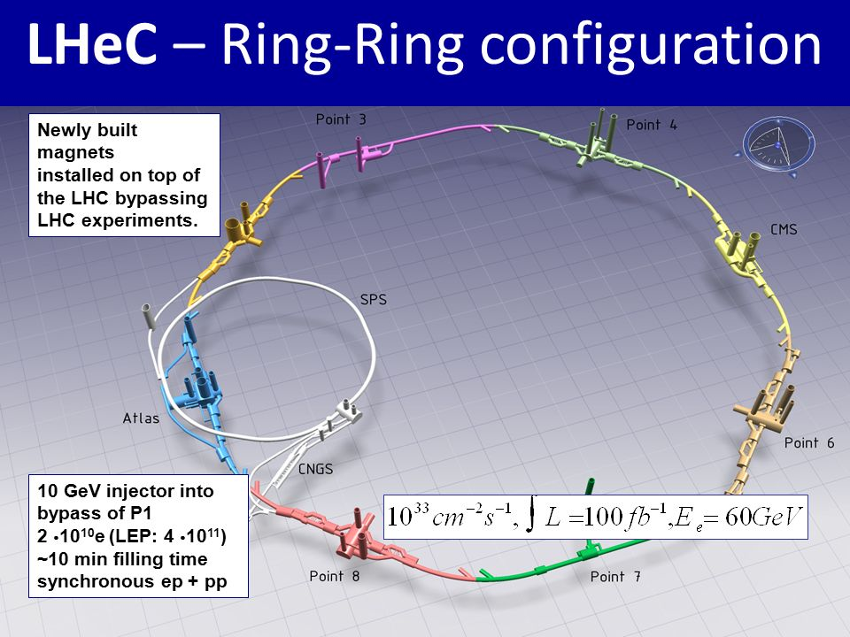
LHC RING AS A NEW PHYSICS SEARCH MACHINE
Beam Loss Monitors to tag exit protons
Point 2
CMS/Totem 20 fb⁻¹
ALICE 20 pb⁻¹
4 ✕ LIGO!
Point 1
ATLAS/LHCf 20 fb⁻¹
LHC experiments for analysis of the central systems
correlations with the collimators and other beam instrumentation devices
LHCb/MoEDAL 1 fb⁻¹

Slide 9
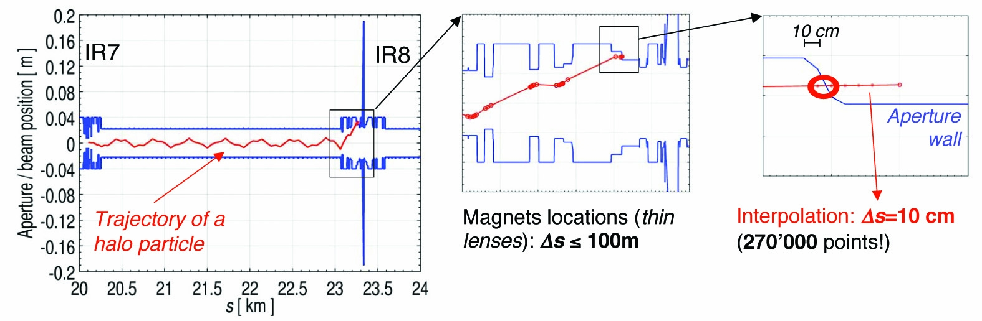
tracing the beam-like protons
Stefano Redaelli et al. CERN
simulation of beam-like protons (MAD-X, SIXTRACK)
proton loss simulation at the BLMs – GEANT4, Fluka
proton shower simulation in the machine elements – GEANT4, Fluka
simulation of gluon and photon induced processes: SuperChic

Slide 10
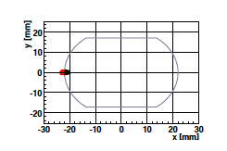
PROTON EXIT POINTS vs. ξ
arXiv:1604.5778

Slide 11
PROTON PAIRS IN CEP:
EXIT POINTS
arXiv:1604.5778

Slide 12
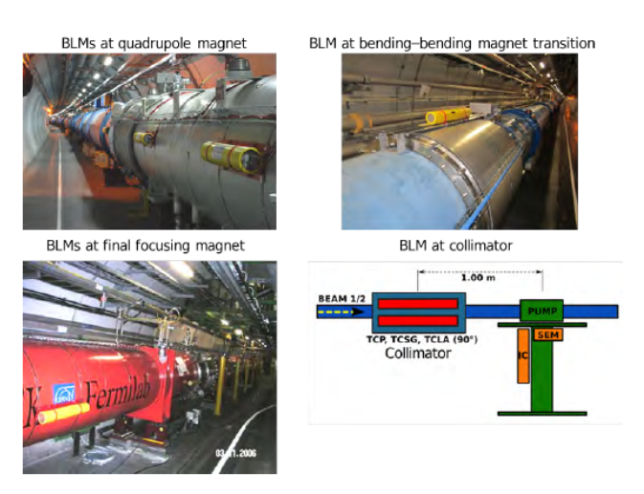
LHC BLM SYSTEM
see Matti Kalliokoski’s talk!
ref. Matti Kalliokoski, this meeting

Slide 13
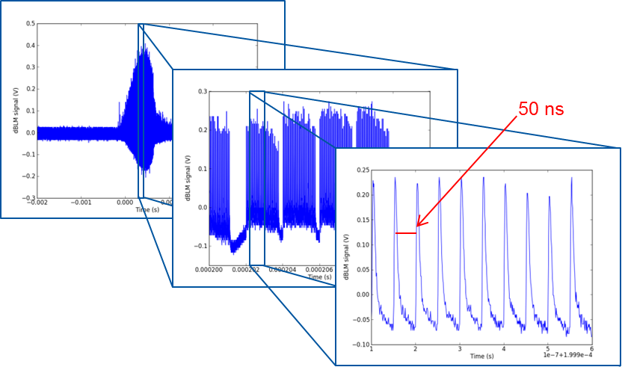
Upgrades to the BLM system
In addition to the main BLM system there are other types of detectors already installed or planned to be installed
Cryo-BLM
Diamond BLM
M.R. Bartosik et al., IBIC2015
Courtesy O. Stein
Matti Kalliokoski - Diffraction 2016

Slide 14
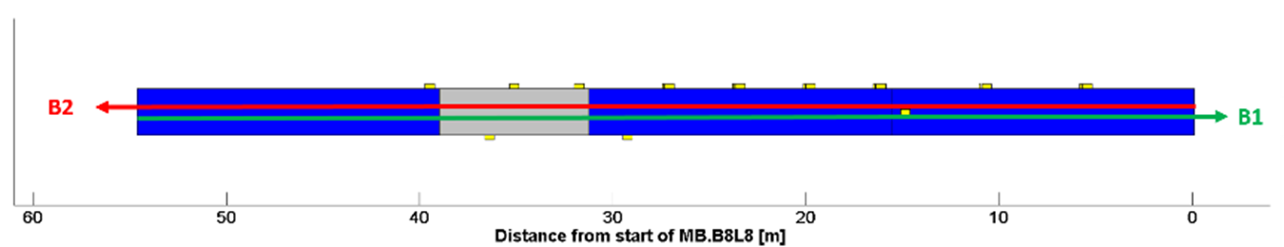
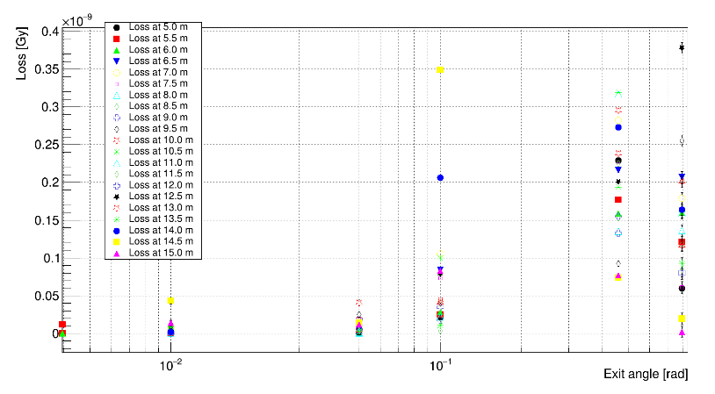
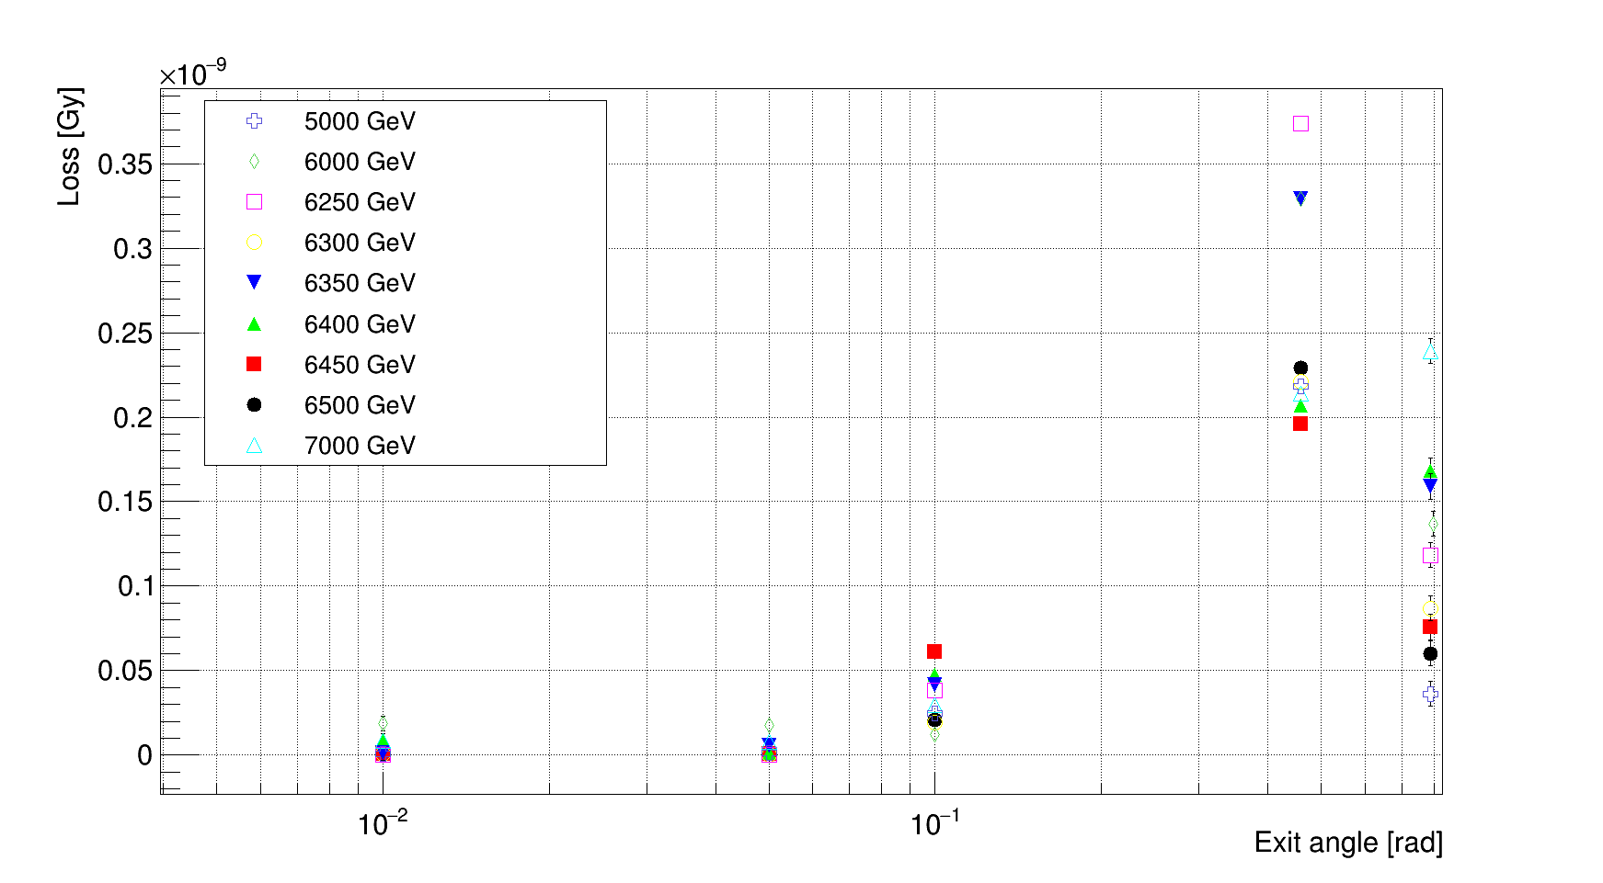
Optical Beam Loss Monitors, oBLM
Optical fibres can be used as detector
The detection mechanism is based on Cherenkov radiation the charged particles produce inside the fibre
Distances up to 100 m can be covered without significant attenuation
Allows sub-ns timing
Dual energy measurement
04/09/2016
Matti Kalliokoski - Diffraction 2016
14

Slide 15
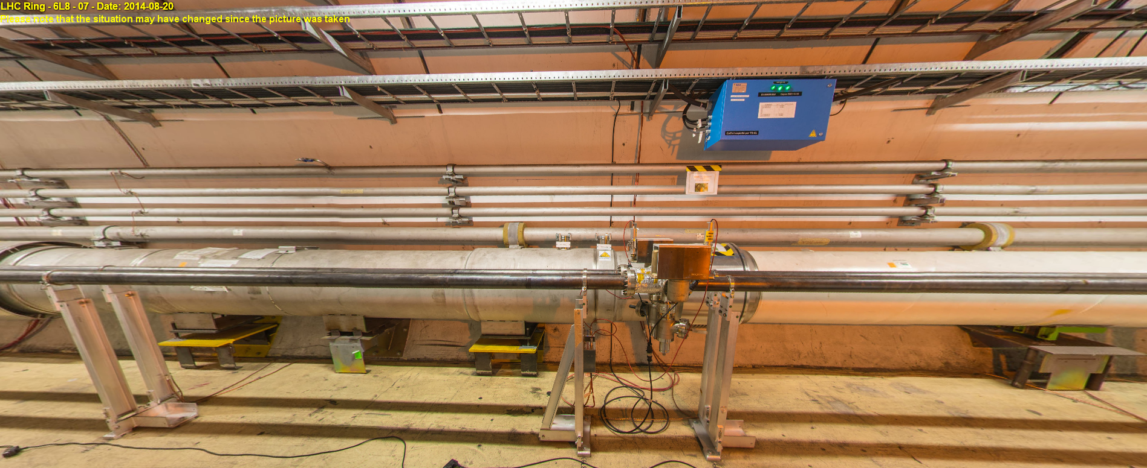
ACCESS TO THE BEAM VACUUM CHAMBER:
LOCATION AT 230 METERS
direct access to the beam pipe
corresponds to central masses of ≈2000 GeV

Slide 16
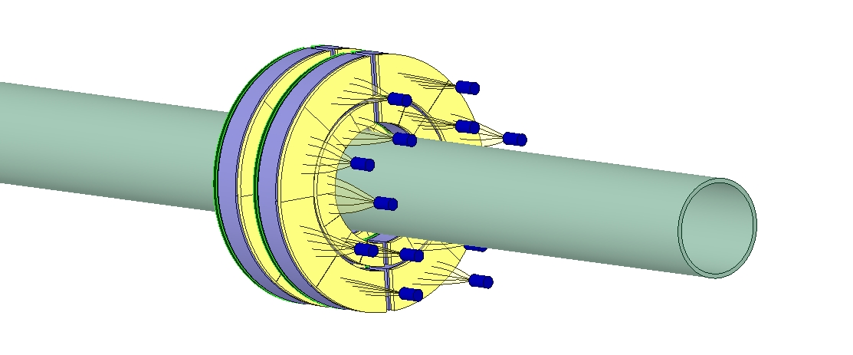
csm scintillation detectors for the 230m location
1st and 2nd scintillation rings
Emulsion in front of scintillation rings
MCP PMTs with clear fiber bundles

Slide 17
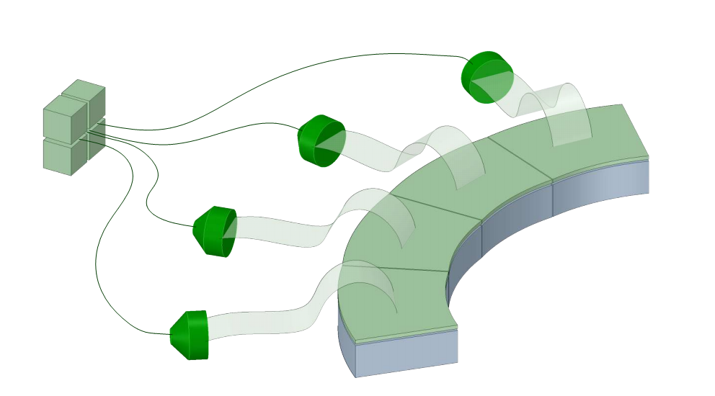
FOT + MCP-PMT scintillation light readout scheme
Bundle of optical fibers
FOT
MCP-PMT
FOT need to be used at least for 3 external rings of detector
Light guide
supporting substrate
Plastic
Scintillator

Slide 18
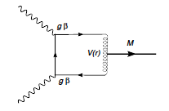
330 meters – magnetic monopolium
p
p
p
p

Slide 19
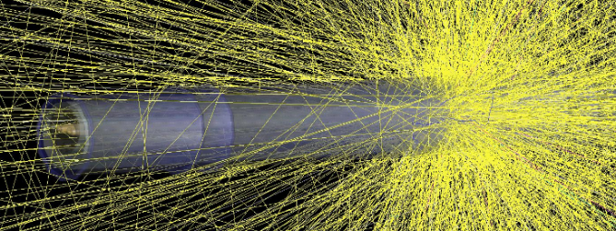
PROTON EXIT WITHIN AN LHC DIPOLE
GEANT4 simulation by Matti Kalliokoski
- LHC dipole CAD description from the LHC data base

Slide 20
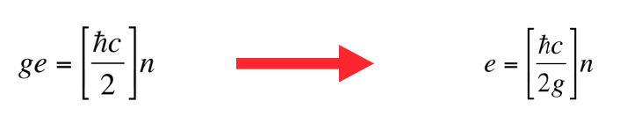
MONOPOLIUM
Pierre Curie suggested in 1984 that magnetic charges should exist => restoration of em symmetry in Maxwell equations
Paul Dirac introduced magnetic monopoles in QM and arrived in charge quantization
‘t Hooft and Polyakov showed in 1974 that monopoles could arise as topological objects from gauge theories and therefore have natural size
Paul Dirac: “I would be surprised if Nature had not made use of them”.
Ed Witten: “..almost all theoretical physicists believe in their existence”

Slide 21
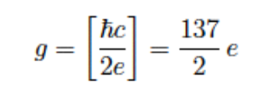
MONOPOLIUM
the quantization condition leads to a strong magnetic force even for the weakest (n = 1) monopole:
Paul Dirac (1934): “The attractive force between two magnetic poles is 4692 ¼ times that between the electron and the proton. This very large force may perhaps account for why the monopoles have never separated.”
Yakon Zeldovich (1979): “Monopoles are not seen because they are bound due to their strong magnetic forces.”
MONOPOLIUM

Slide 22
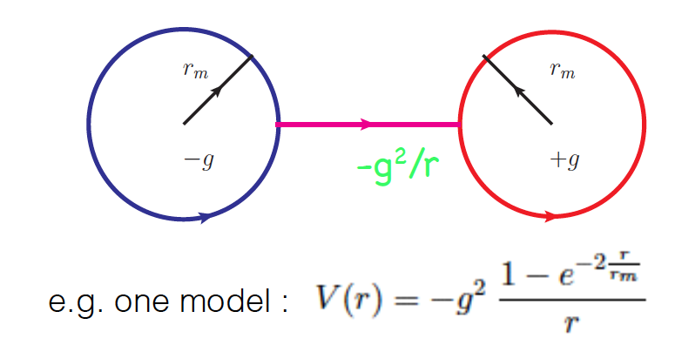
MONOPOLIUM
monopolium is a monopole – antimonopole bound state whose dual object (B <-> E) is the positronium
the lowest monopolium state is also a scalar and disintegrates into an even number of photons
differences: (a) coupling g >> e, (b) topology of the monopole: finite size => Coulomb interaction acts at long distances only,
(c) mass of the monopole, m, and mass of the monopolium, M (i.e. r_{m}) are unknown

Slide 23



MONOPOLIUM
Epele, Fanchiotti, Garcia Canal and Vento proposed (2008) that monopolium might be easier to detect than a monopole by itself – look at the photon-photon interaction
p
p
p
p
Luis N. Epele et al., “Monopolium detection at the LHC”, arXiv:1107.3684v1 [hep-ph] 19 Jul 2011

Slide 24
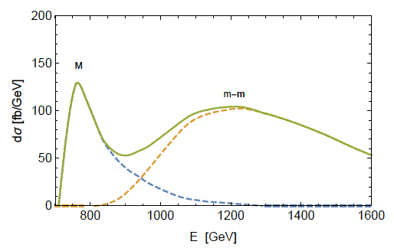
MONOPOLIUM

Slide 25
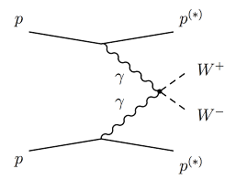
400 meters – W⁺W⁻ pairs

Slide 26
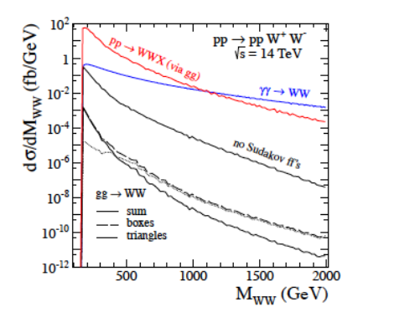
WW PAIR PRODUCTION
Piotr Lebiedowicz, Roman Pasechnik and Antoni Szczurek, arXiv:1203.1832v2 [hep-ph] 18 Feb 2013.
two-photon processes at high luminosity at the LHC, arXiv:0912.5161v1 [hep-ph] 28 Dec 2009.

Slide 27
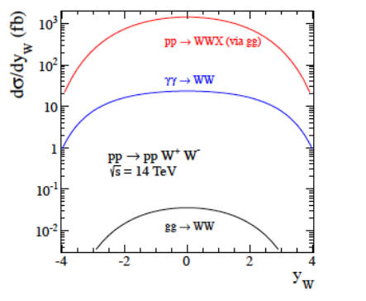
WW PAIR PRODUCTION

Slide 28
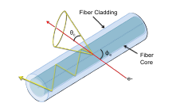
pinpointing the proton exit points
detector
D
R
beam pipe
z_{hit}
z_{det}
T_{meas} = (z_{hit} + D)/c
T₀ = z_{det}/c
ΔT = T_{meas} – T₀
z_{hit} = z_{det} – ΔT × c

Slide 29
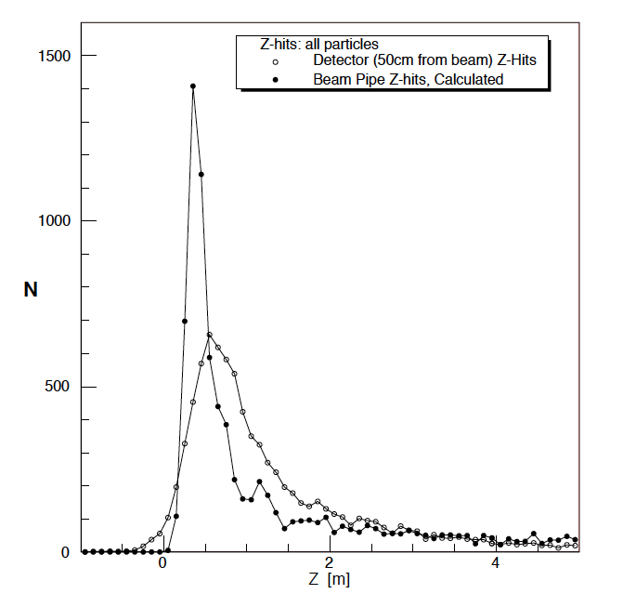
USING TIMING INFORMATION
no. of hits along the z-axis:
peak at ≈50 cm from the impact point
most within ≈2 m, long tail
FWHM ≈1 m
by using time information:
peak at ≈30 cm from the impact point
FWHM ≈30 cm
localise the exit point within ≈30 cm
impact points simulated to a few cm’s for
a fixed ξ
beam pipe z-hits,
using time information
no. of z-hits in a detector
at 50 cm from the beam
simulation by Jerry Lämsä

Slide 30
150 to 400 meters - anomalous couplings
W’W’/Z’Z’, SUSY, ALRGE EXTRA DIMENSIONS...

Slide 31
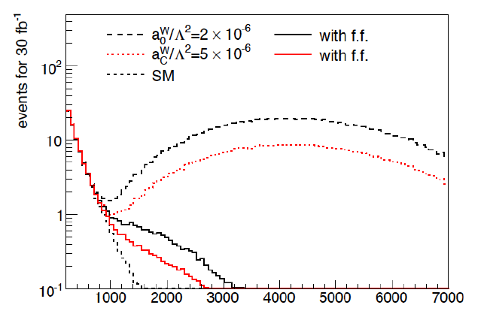
ANOMALOUS COUPLINGS
E. Chapon, C. Royon, and O. Kepka. \Anomalous quartic
Phys. Rev. D81 (2010), p. 074003. doi: 10.1103/PhysRevD.81.074003.
arXiv: 0912.5161 [hep-ph]

Slide 32
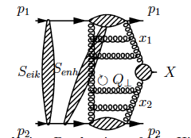
427 meters - SM Higgs

Slide 33
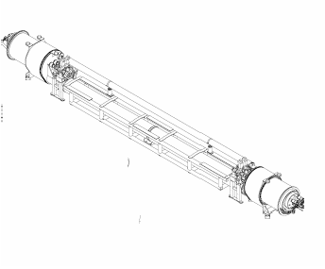
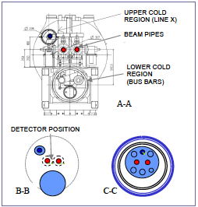
connecting cryostat at 420m

Slide 34
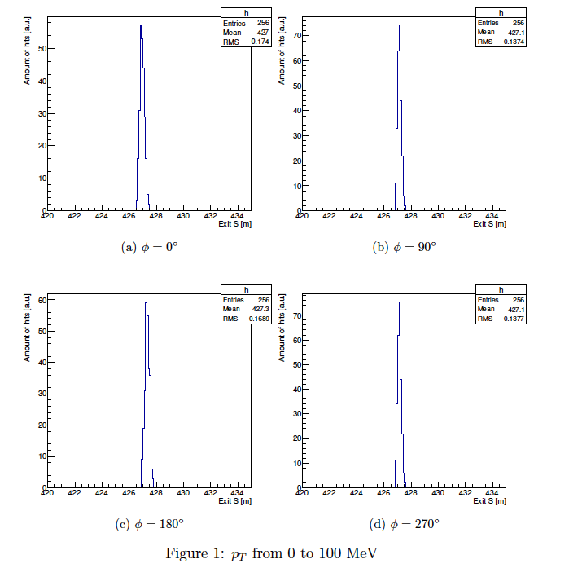
SM Higgs – exit points: z, p_{T}, φ
measure exit point to 10 cm
azimuthal angle measurable in selected locations

Slide 35
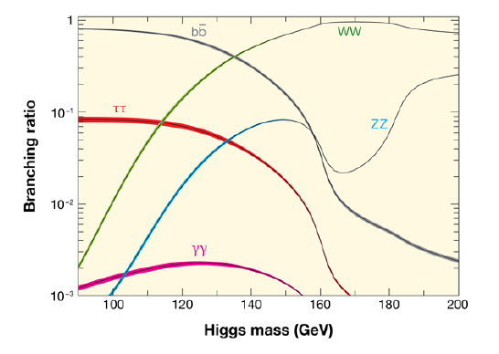
SM HIGGS

Slide 36
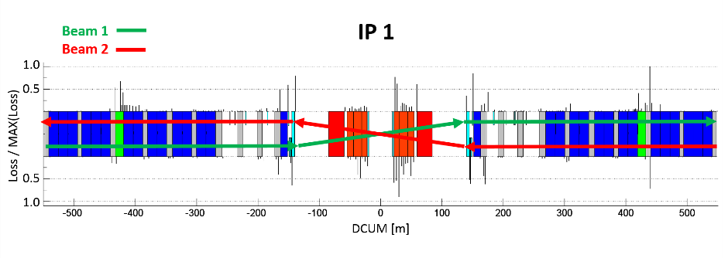
CEP Higgs?
Matti Kalliokoski - Diffraction 2016

Slide 37
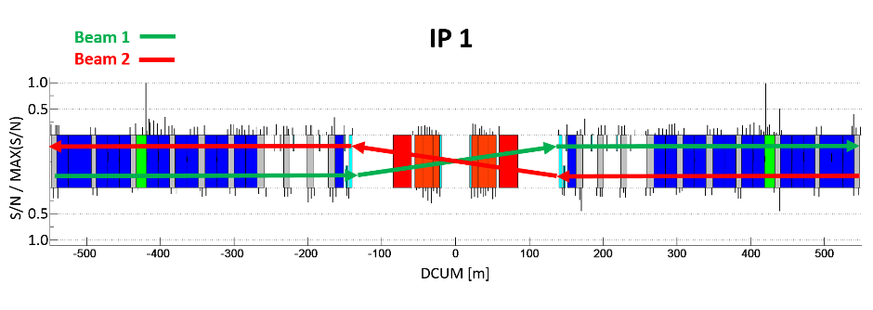
CEP Higgs?
Matti Kalliokoski - Diffraction 2016

Slide 38
> 420 meters – CEP gluon jets
JET
JET

Slide 39
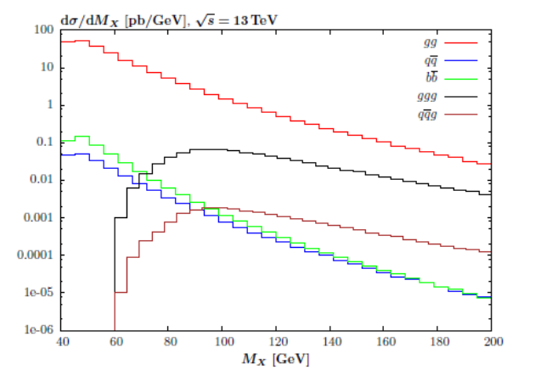
CEP AND GLUON JETS

Slide 40
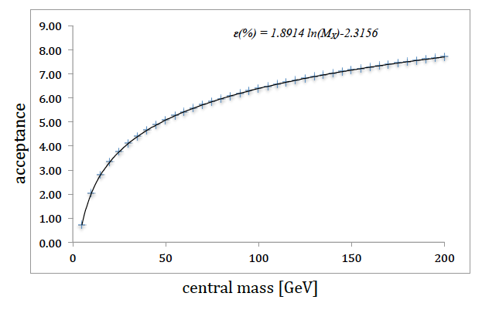
CEP JET ACCEPTANCE

Slide 41
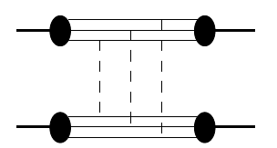
40-60 meters – high-t elastic scattering

Slide 42
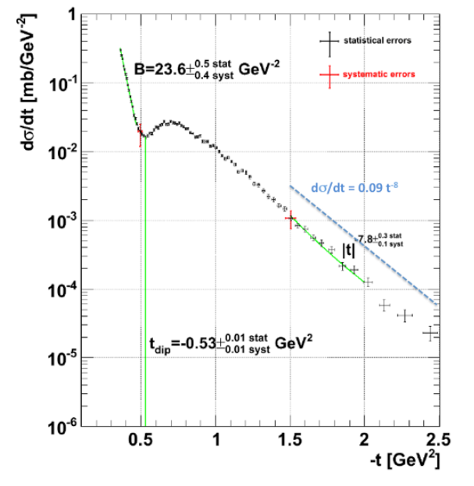
HIGH-t ELASTIC SCATTERING

Slide 43
DISORIENTED CHIRAL CONDENSATES
J.D. Bjorken, K.L. Kowalski and C.C. Taylor, Observing disoriented chiral condensates, SLAC-PUB-6413, HEP-PH 9309235 December 1993 (1993).

Slide 44
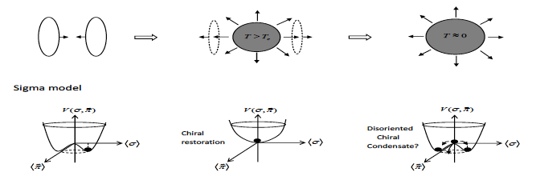
DCC FORMATION
the highly Lorentz contracted nuclei collide – leave behind baryon free plasma
in the central rapidity region - the chiral symmetry is then restored.
the plasma cools down through rapid hydrodynamic expansion via non-equilibrium
chiral phase transition
DCC probes the chiral structure of the QCD vacuum

Slide 45
DCC CANDIDATES
UFO & ULO losses: a BLM monitor registers a secondary shower
along with monitors in the intersection.

Slide 46
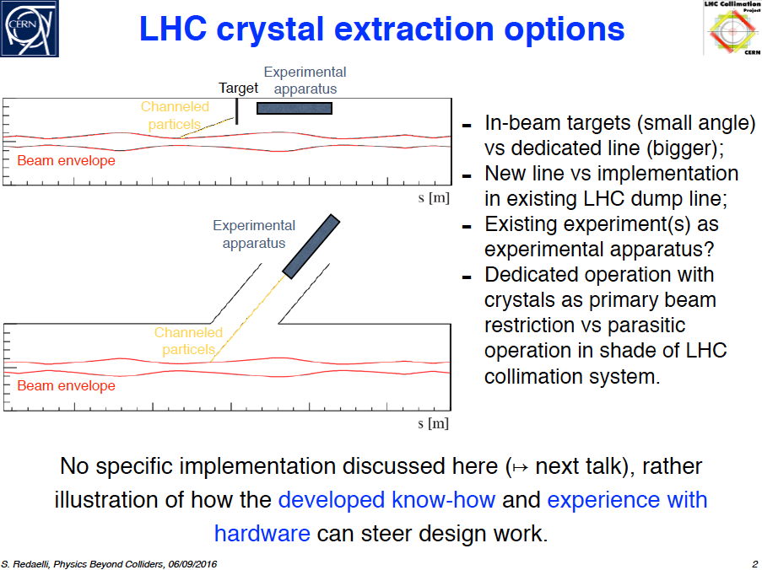
AN ULTIMATE DETECTOR SYSTEM
FOR FORWARD PHYSICS
A BENT CRYSTAL TEST BENCH – A STRAIGHT COLLIMATOR - INSTALLED IN IP7!

Slide 47
SUMMARY
NEW HEAVY PARTICLES, SUCH AS MONOPOLIUM, W’/Z’, SUSY, EXTRA DIMENSIONS - PRODUCED IN CEP - ARE SCANNED – INDEPENDENTLY OF THEIR DECAY MODES - BY USING THE PROTON EXIT POINTS ALONG THE LHC RING
A WAY TO SEARCH FOR INVISIBLE DECAYS –TURNING LHC INTO A DARK MATTER FACTORY!?
FIRST CANDIDATE EVENTS BEING LOOKED AT, ACCEPTANCE x EFFICIENCY CALCULATIONS ONGOING
THE METHOD CAN BE EXTENDED TO ALL LHC IPs; CORRELATIONS WITH EXISTING DETECTORS, COLLIMATORS etc. WILL BE EXPLOITED
AUTOMATIC SCANNING OF THE BLM DATA WILL BE SOON AVAILABLE
TRIGGERING OF THE CEP EVENT CANDIDATES vs. CENTRAL MASS etc.

