Slide 1
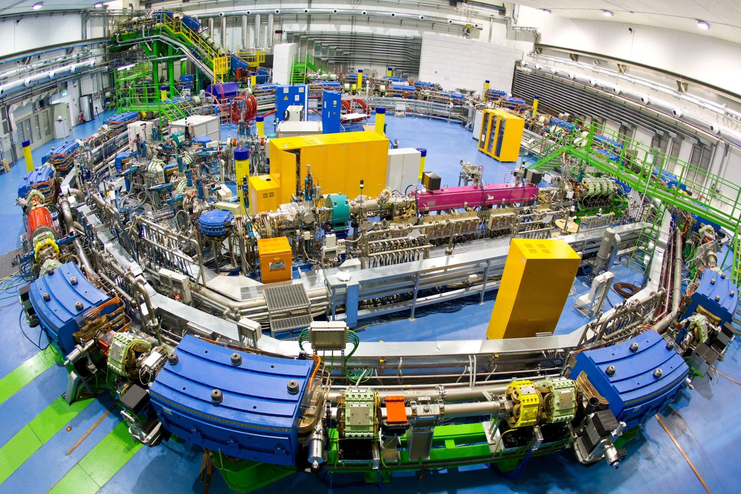
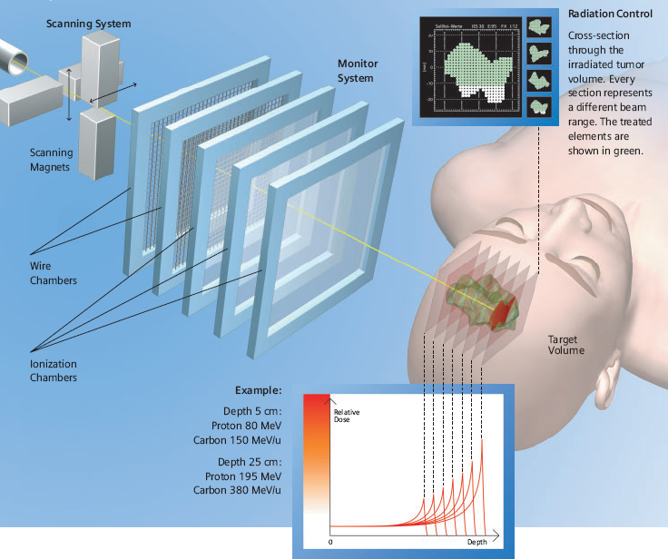

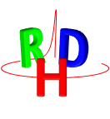

Charged Particle Therapy and Nuclear Physics
Giuseppe Battistoni,
INFN, Milano, Italy
  European Network for Light Ion Hadron Therapy
Notes:
1

Slide 2
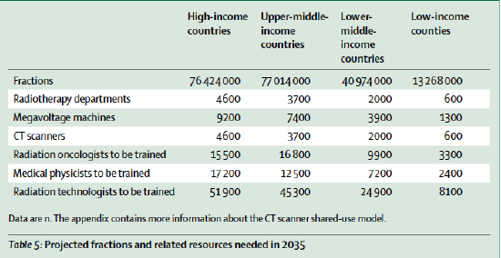
Cancer and radiotherapy
Atunet al., Lancet Oncol16:1153-86, 2015
Only 40-60% of patients with cancer have access to radiotherapy
~50% of all cancer patients
•Highly individualized treatment
•50% of cures –radiotherapy sole treatment or major component
•Organ-and function sparing, well tolerable
•More than 4m long term survivors in Europe
•Favorable cost/benefit
Benefits
2012:
1.5M pts. Local Control, 0.58M Survival
2035:
2.5M pts. Local Control, 0.95M Survival

Slide 3
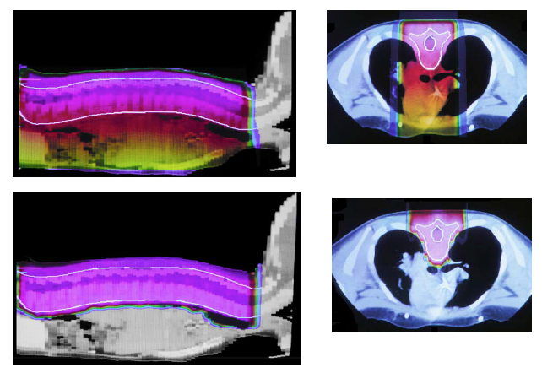
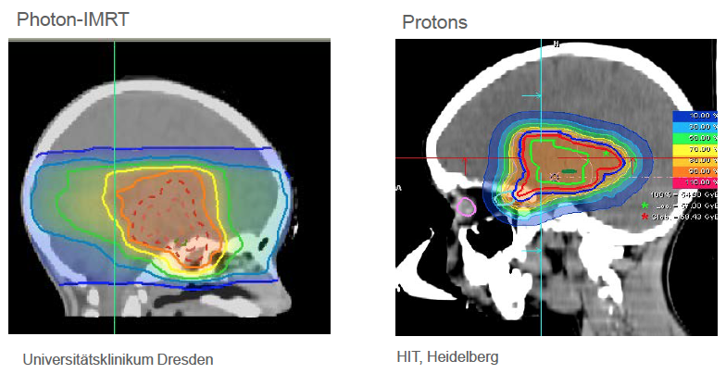
Rationale of Charged Particle Therapy
Image guided, conformal (IMRT), photon therapy
35% local recurrence
Preventable distant metastases
Large volumes irradiated
Early, late and very late normal tissue damage

Slide 4
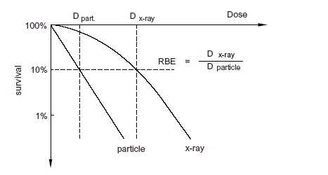
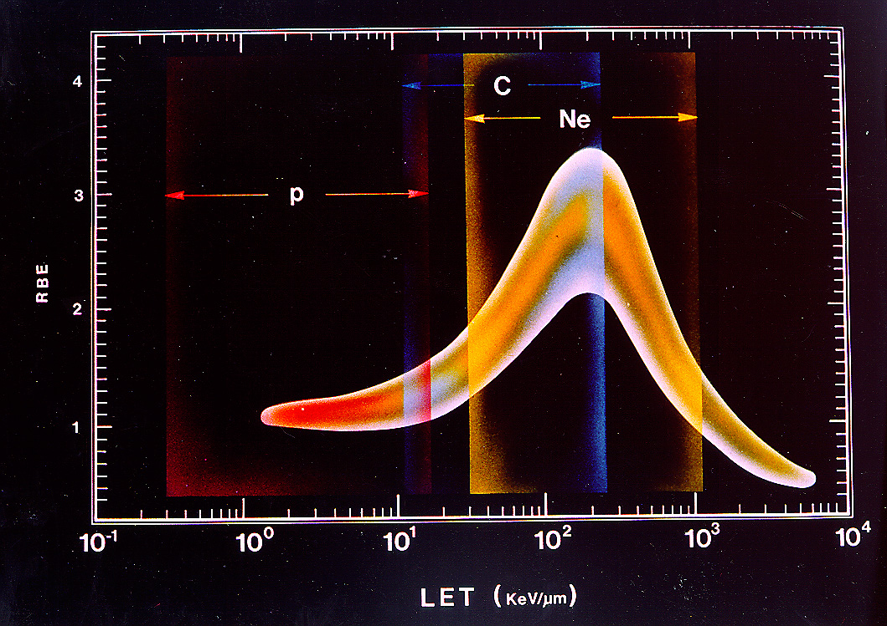

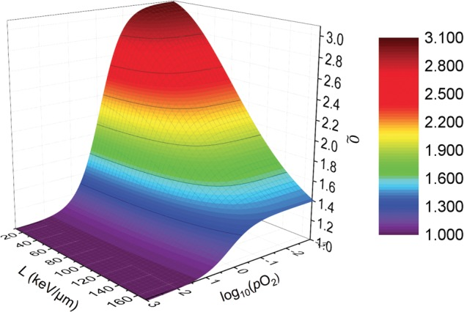
Radio Biological Effectiveness (RBE) and Oxygen Enhancement Ratio (OER)
D₀
SF_{XR}
for a given type of biological end-point and its level of expression.
For example:
Survival Fraction of 10%
SF _{p}
4
3
2
1
RBE
1 10 100 LET
Laura Antonovic et al.
J Radiat Res. 2014 Sep; 55(5): 902–911.

Slide 5
Nuclear projectiles in Particle Therapy today
protons: 50-250 MeV
Relative Biological Effectiveness (RBE) ~ 1.1 (under discussion…)
accelerated by cyclotrons or synchrotrons
¹²C: 60-400 MeV/u
Higher RBE → well suited for radio-resistant tumors
reduced no. of fractions
reduced lateral spread with respect to protons
However:
variable RBE vs energy, LET, …
accelerated by larger machines
Nuclear Fragmentation (➜complex RBE)
heavier gantries and magnets…

Slide 6
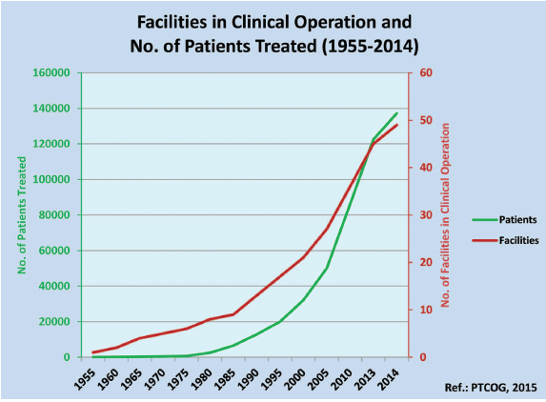
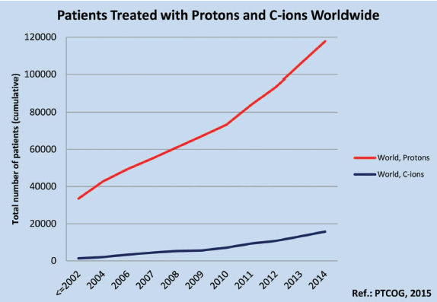
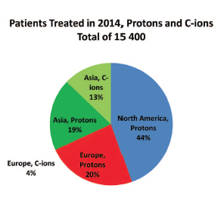
Patient Statistics 2014 (www.ptcog.ch)
Jermann M.. Int J Particle Ther. 2015;2(1):50–54.
He 2054 1957-1992
Pions 1100 1974-1994
C-ions 15736 1994-present
Other ions 433 1975-1992
Protons 118195 1954-present
Grand Total 137179
48 particle therapy facilities were in clinical operation at the end of 2014
In 2014, about 10% of patients were pediatric and another 10% were treated for ocular melanomas.
Notes:
1954 – Berkeley treats the first patient and begins extensive studies with various ions
1957 – first patient treated with protons in Europe at Uppsala
1961 – collaboration between Harvard Cyclotron Lab. and Massachusetts General Hospital
1993 – patients treated at the first hospital-based facility at Loma Linda
1994 – first facility dedicated to carbon ions operational at HIMAC, Japan
2009 – first European proton-carbon ion facility starts treatment in Heidelberg
At the beginning of 2015, more than 30 particle therapy centers, with a total of about 80 treatment rooms,
were under construction worldwide.
~1/2 in the United States and ~1/3 in Asia.
About 15 centers expect to start technical and/or clinical commissioning in 2015 and
about half of them should be ready for patient treatment before the end of 2015.

Slide 7
TCP vs NTCP
Tumor Control Probability
Tumor Control Probability
Aim of Research
Normal Tissue
Complication Probability
Normal Tissue
Complication Probability
Dose
Dose (Gy)

Slide 8

What clinicians ask today
•High quality clinical data for high level evidence
•Health economic assessments; global epidemiological assessments
•Improved clinical research structures, including IT
•Radiobiological core data (e.g. RBE)
•Integration into precision medicine era (e.g. biomarkers, combined modality effects)
•Range uncertainty reduced
•Control of organ motion, of anatomic changes during treatment, of biological changes during treatment
•Full image guided adaptive RT equipment
•Lower cost
M. Baumann
Taking full advantage of particle therapy in terms of physics requires:
Full image guidance (real time)
Reduced range uncertainties (real time beam imaging)
In vivo dosimetry
Highest level treatment planning
Adaptive algorithms including all items above
Very rapid and exact dose delivery (repainting, tracking)
Reliable simulation tools (and fast !!)
…
Hardware + Software

Slide 9

The contribue of physics to particle therapy development
There is still a significant fraction of people in the clinical community who consider hadrontherapy (ion therapy) too complicate, too expensive, not able to reach in practice the expected high level of precision, not yet in the realm of evidence-based medicine
paradigmatic case of a topic in between research and actual clinical practice, where the contribution coming from physicists remains fundamental
Physics modelling
Nuclear Fragmentation
Range and Dose Monitoring

Slide 10
Physics of the Bragg Peak
Pure CSDA: MCS off; nucl. int. off;
dE/dx fluct. off
MCS, Energy loss fluctuations
and nuclear interactions
do affect the shape!
MCS on;
nucl. int. off;
dE/dx fluct. off.
dE/dx at low energy:
Nuclear Stopping Power
Shell Corrections
High order corrections
Barkas correction (∝ z³)
Bloch correction (∝ z⁴)
Mott corrections
MCS off;
nucl. int. on;
dE/dx fluct. off
MCS off;
nucl. int. off;
dE/dx fluct. on
Full physics:
MCS on;
nucl. int. on;
dE/dx fluct. on
p @ 200 MeV in H₂O

Slide 11
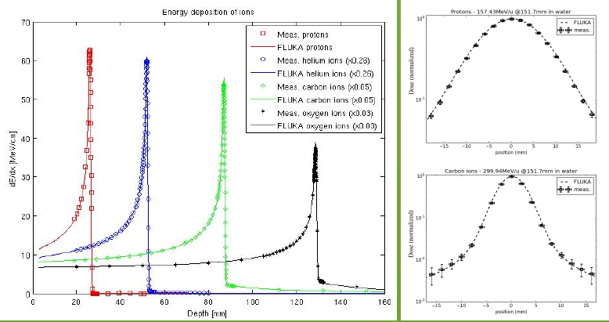
Some apparently trivial parameter is not well known. For example: <I>
Tail beyond the Peak due to nuclear fragmentation of Projectile

Slide 12
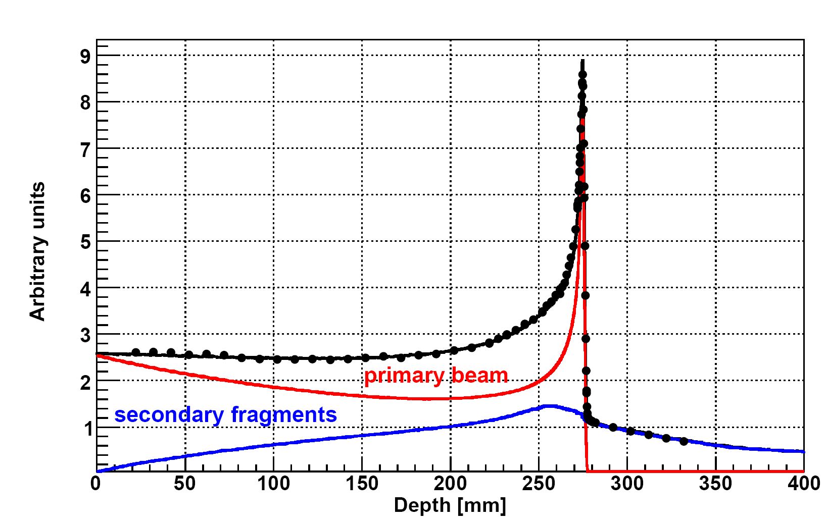
Why reliable MC is important in Particle Therapy
MC simulations are needed for the design and commissioning of novel clinical facilities
MC calculations are needed for the commissioning of Treatment Planning Systems (TPS).
MC codes are used for validation, and possibly the improvement, of analytical TPS.
In situations where experimental validation is unavailable and/or analytical methods are inadequate, MC simulation allows patient-specific dose calculation.
MC essential to predict infos for therapy monitoring
Production of fragments with higher range vs primary ions
Production of fragment with different direction vs primary ions: Different biological effectiveness of the fragments wrt the beam
¹²C (400 MeV/u) on water
Bragg-Peak
Dose beyond the Bragg Peak :
Dose release in healthy tissues with possible long term side effects ➔must be carefully taken into account in the Treatment Planning System
C ~ 15 %

Slide 13
Recent thin target, Double Diff Cross Section C-C measurements
The community is exploring the interesting region for therapeutic application, in particular for the ¹²C beam.
Yet there is a lot of energy range to explore in the range 150-350 AMeV ( i.e. 5-17 cm of range…)
GANIL 95AMev C beam - E600 collaboration (2011)
GSI 400Mev C beam
FIRST experiment
(2011)
LNS 62AMev C beam
(2009)
GANIL 50AMev C beam

Slide 14
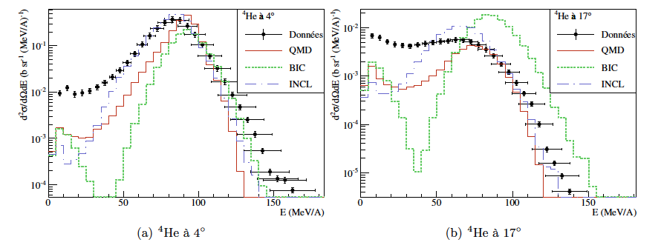
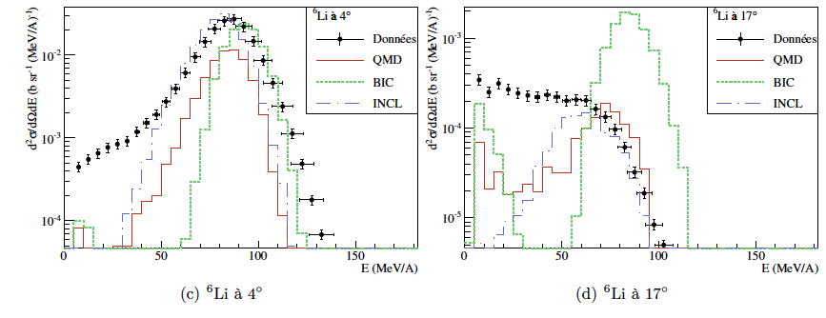
Nuclear Fragmentation:
C-C interactions at 95 MeV/u (Ganil) and comparison to MC
http://hadrontherapy-data.in2p3.fr/

Slide 15
C-C @ 50 MeV/u (Ganil)
Comparison with GEANT-4 (QMD)
Comparison with FLUKA
At these energies QMD is not used

Slide 16
Some steps in hadron and nucleus interactions modelling

Slide 17
Nucleus-Nucleus interactions at energies useful for Particle Therapy
QMD (Quantum Molecular Dynamics) approach
Interaction of two nuclei starting from their initial state, modeled as a Fermi gas, following the propagation of each nucleon in the potential generated by all others nucleons. Described according to a quantum mechanical formalism. Dynamical evolution of particles, formation of heavy and light fragments and secondary nucleons is then predicted.
Different implementations exist
Invented to work down to ~ 1 GeV/u.
Sometimes difficult to extend it below
FLUKA MC code (reference at CNAO and Heidelberg):
0.12 GeV/u < E/A < 5 GeV/u: rQMD H. Sorge, Phys. Rev. C 52, 3291 (1995)
E/A < 0.12 GeV/u: BME M. Cavinato et al., Nucl. Phys. A 679, 753 (2001)
It describes the evolution of the de-excitation of the system of The two interacting nuclei during the pre-equilibrium phase. By solving a set of time-dependent transport equations, the model describes the evolution towards an equilibrium state through a sequence of two body reactions and ejection of unbound particles, whose multiplicity can be calculated

Slide 18
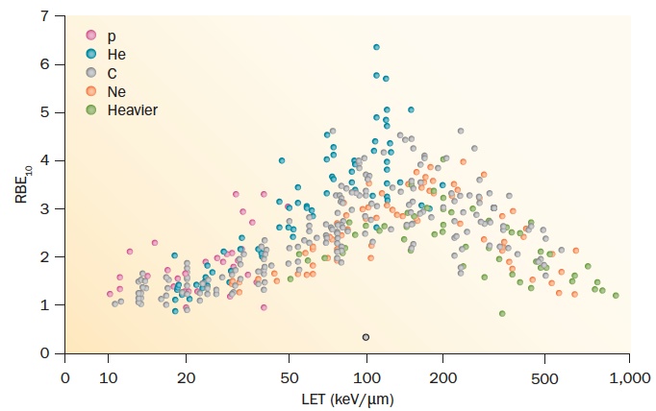
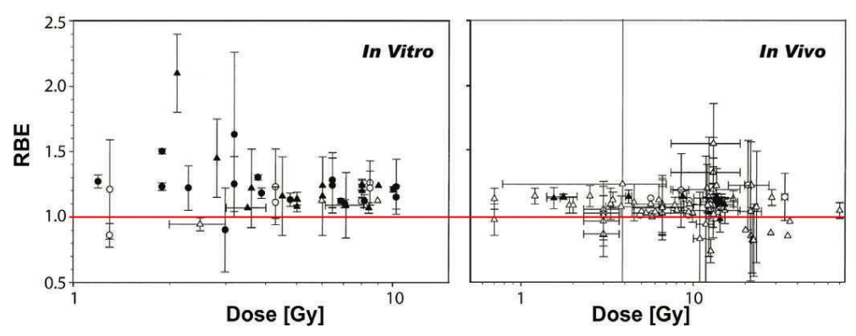
Radiobiology
Jay S. Loeffler and Marco Durante,
Nat. Rev. Clin. Oncol. 2013
RBE versus LET from published experiments on in vitro cell lines. RBE is calculated at 10% survival.
RBE of protons
recomm.: 1.1
Paganetti 2002 PMB
New Paradigm for Proton Radiobiology
(Girdhani 2013 Radiat Res)
Protons and photons present distinct physics and biological properties at Sub-Cellular, Cellular and Tissue level

Slide 19
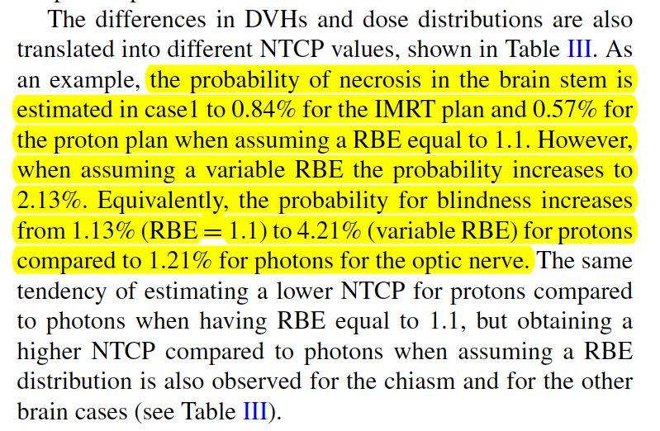
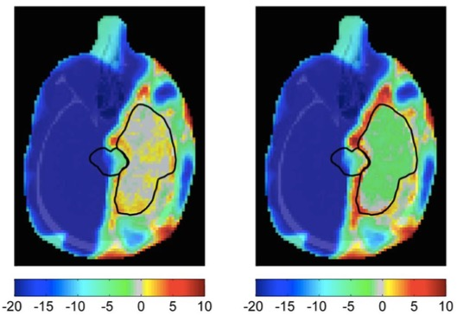
Proton Therapy: can target fragmentation contribute to a variable RBE?
Can we overcome the ICRU recommendation for protons (RBE=1.1) in clinical operation?
Lately has been pointed out possible impact of variable proton RBE on clinical NCTP values
RBE=1.1
Variable RBE
Wedenberg 2014 Med Phys

Slide 20
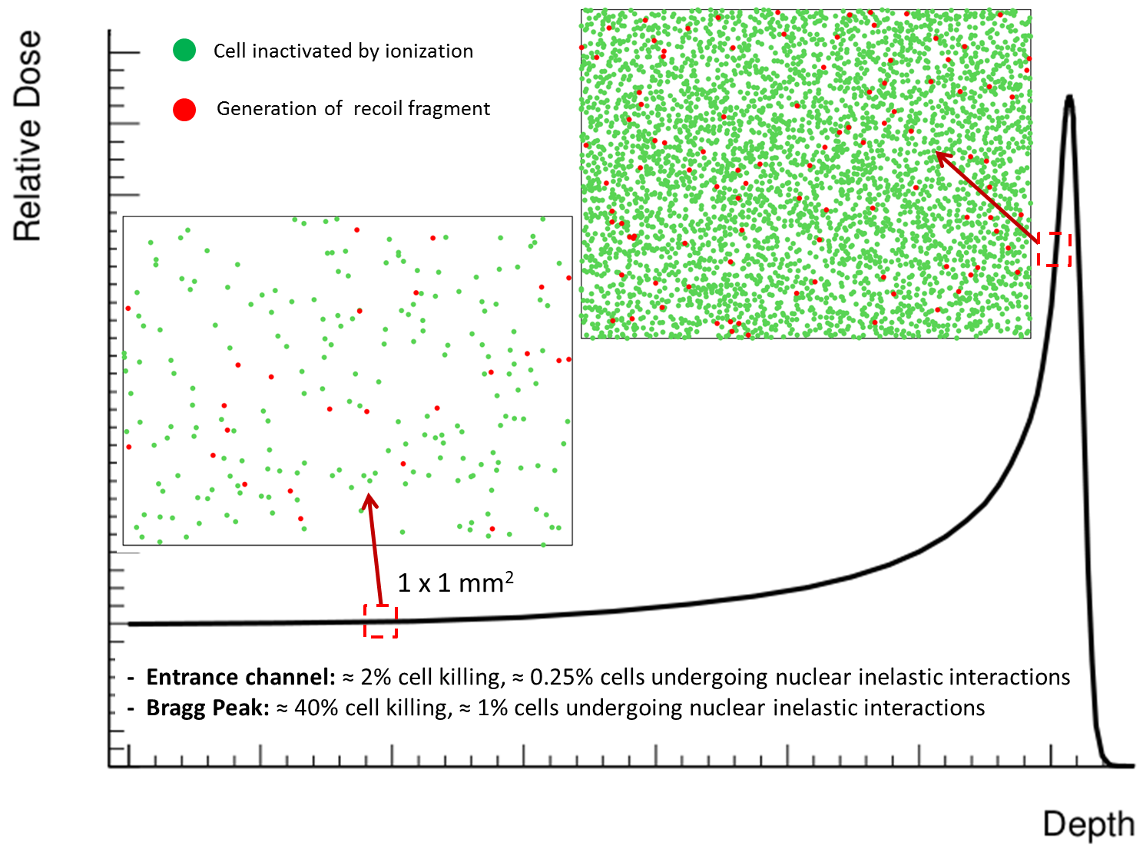
Warning: nuclear interaction may change RBE in the normal tissue
Target fragmentation in proton therapy: gives contribution also outside the tumor region!
Cell killed by ionization
Recoil fragment generated
About 10% of biological effect in the entrance channel due to secondary fragments
Largest contributions of recoil fragments expected from
He, C, Be, O, N
See also dedicated MC studies:
- Paganetti 2002 PMB
- Grassberger 2011 PMB
R=1/40
R=1/8
250 MeV proton beam in water
Cancers 2015,7 Tommasino & Durante
Notes:
Entrance channel 0.5 KeV/mum and 0.2 Gy -> about 3% cell killing
Bragg peak 2.5 keV/mum and 2 Gy ‘_ about 60% cell killing

Slide 21
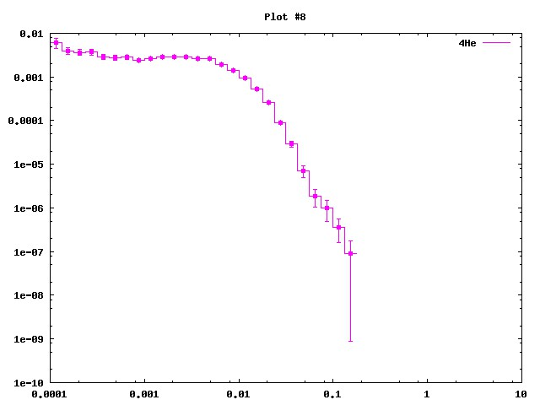
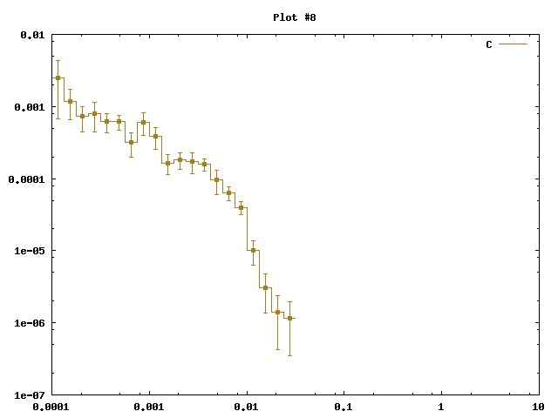
p scattering on Brain tissue @200 MeV
“Heavy” (A≥4) fragment emission energy and angle largely unknown.
Very low energy-short range fragments.
MC (FLUKA) prediction of production of heavy fragments for 200 MeV p on “BRAIN” : production of He & C
dN/dlog(E[GeV])
⁴He
¹²C
dN/dlog(E[GeV])
15 μm range
15 μm range
for RBE: the knowledge of dσ/dE is mandatory!!
Ekin tot (GeV)
Ekin tot (GeV)

Slide 22
Inverse kinematic strategy
Target fragments travel few μm in the target-> difficult to directly detect them, even for very thin target (10 μm?)
let’s shoot a β=0.6 patient (C,O,N nuclei) on a proton at rest and measure how it fragments!!
Then if we measure the X-section, provided that we apply an inverse velocity transformation, the result should be the same.
Use (as patient) beams N, O, C ions with β= 0.6 ➔ Ekin=200 A MeV.
The heavy fragment (all but p,d,t,He) has ~200 MeV/nucleon kinetic energy and are forward peaked
H target difficult!!
A possible solution is to use twin targets. The fragmentation cross section can be obtained by subtraction.
C
CH₂

Slide 23
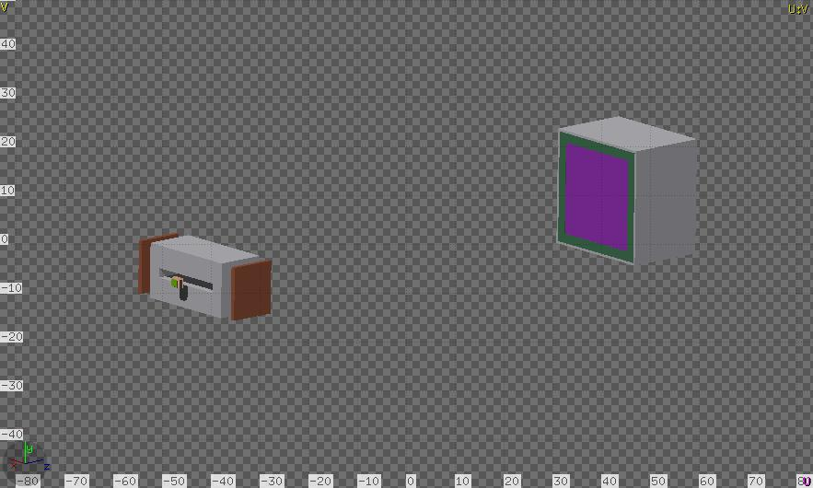


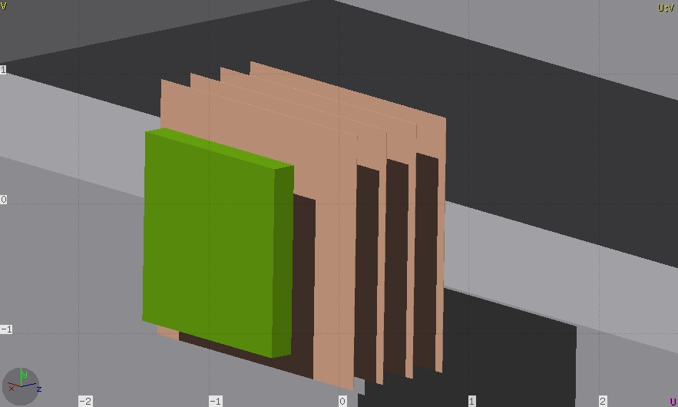
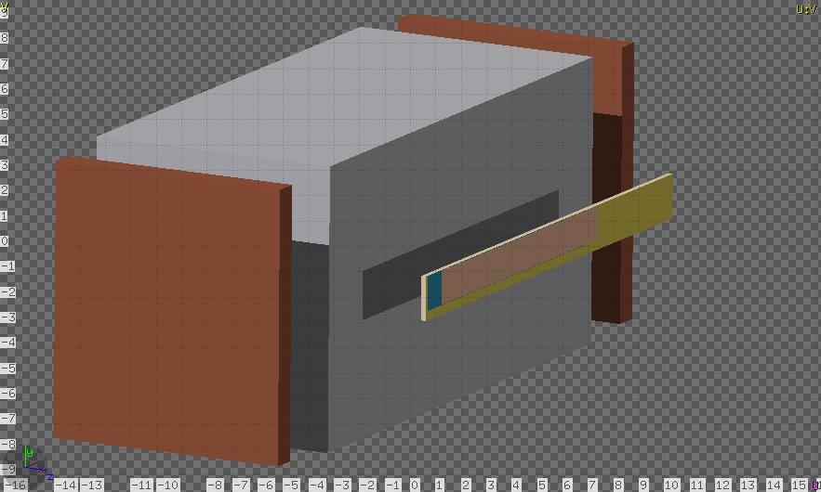
A possible new target fragmentation Experiment
FramentatiOn Of Target
Scint. Fiber Tracker (INSIDE)
(Prin2015 proposal: POP)
F
O
O
T
20 cm
Permanent Magnet (0.5 T)
20 cm
Silicon Pixel Back Tracker (“Plume”)
Silicon Pixel (20 μm)
Front Tracker
C or CH₂ Target
0.75 cm
0.75 cm

Slide 24
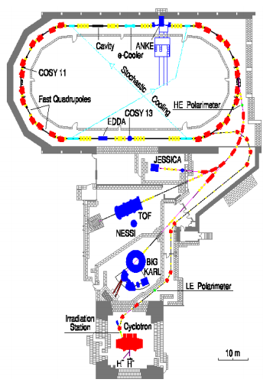
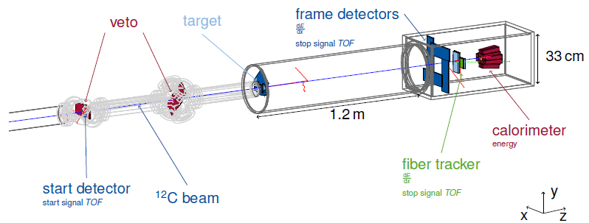
Aachen experiment
Experimental tests performed at the Cooler Synchrotron (COSY) facility

Slide 25
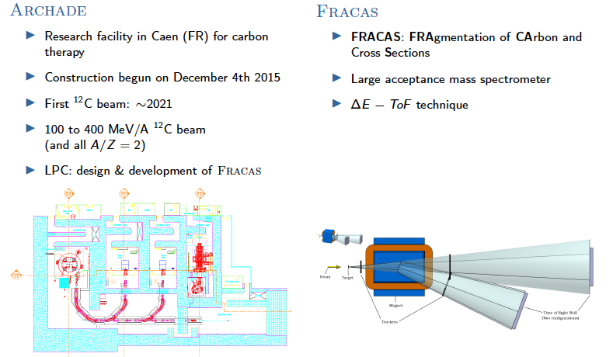
Other possible future experiments about fragmentation

Slide 26
The need for in-vivo monitoring of particle therapy
Photon therapy
Air gap
Dose
Tumor
Again uncertainties:
dose calculation
imaging artefacts, positioning errors
Organ motion
Anatomic/physiologic variations
Air gap
Dose
Tumor
Depth
Charged Particle therapy

Slide 27
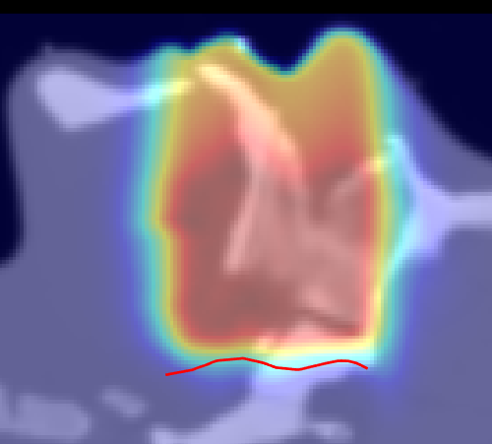
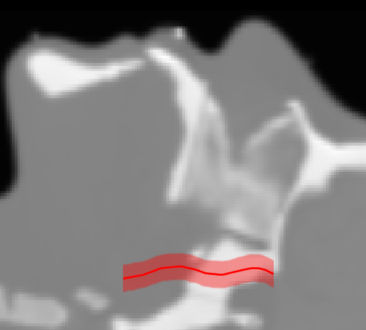
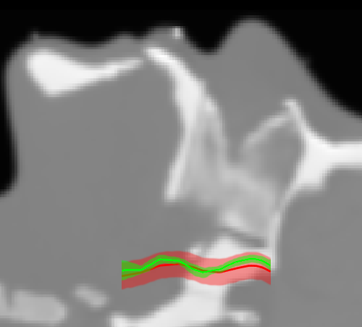
Uncertainties related to particle range
The error intrinsic in this conversion (due to μ(η_{e},Z) dependency on atomic number and electron density) is the principal cause of proton range indetermination (3%, up to 10 mm in the head)‏
[Schneider U. (1994), Med Phys. 22, 353]
AAPM 2012: main obstacle to proton therapy becoming mainstream:
• 35 % unproven clinical advantage of lower integral dose
•19 % never become a mainstream treatment option
• 33 % range uncertainties
beam
beam
Planning uncertainty > 5 mm
(margin of 3.5% + 2 mm)

Slide 28

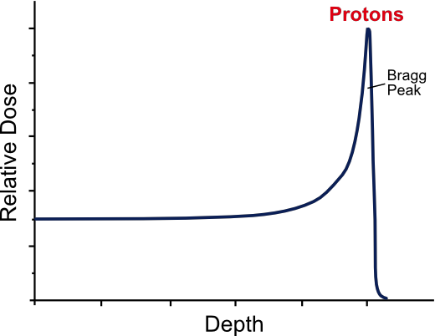





Help from Nuclear Physics: exploiting secondary products
The therapeutic beam is absorbed inside the patient: a monitor device can rely on secondaries, generated by the beam coming out from the patient. The p, ¹²C beams generate a huge amount of secondaries: prompt γs, PET- γs, neutrons and charged particles/fragments
Activity of β⁺ emitters is the baseline approach
Isotopes of short lifetime ¹¹C (20 min), ¹⁵O (2 min), ¹⁰C (20 s) with respect to conventional PET (hours)
Low activity asks for quite a long acquisition time (some minutes at minimum) with difficult in-beam feedback
Metabolic wash-out, the β⁺ emitters are blurred by the patient metabolism
511 keV
proton
Beam
511 keV
prompt
neutron

Slide 29
Correlation between β⁺ activity and dose
Projectiles & target fragmentation
Target fragmentation

Slide 30
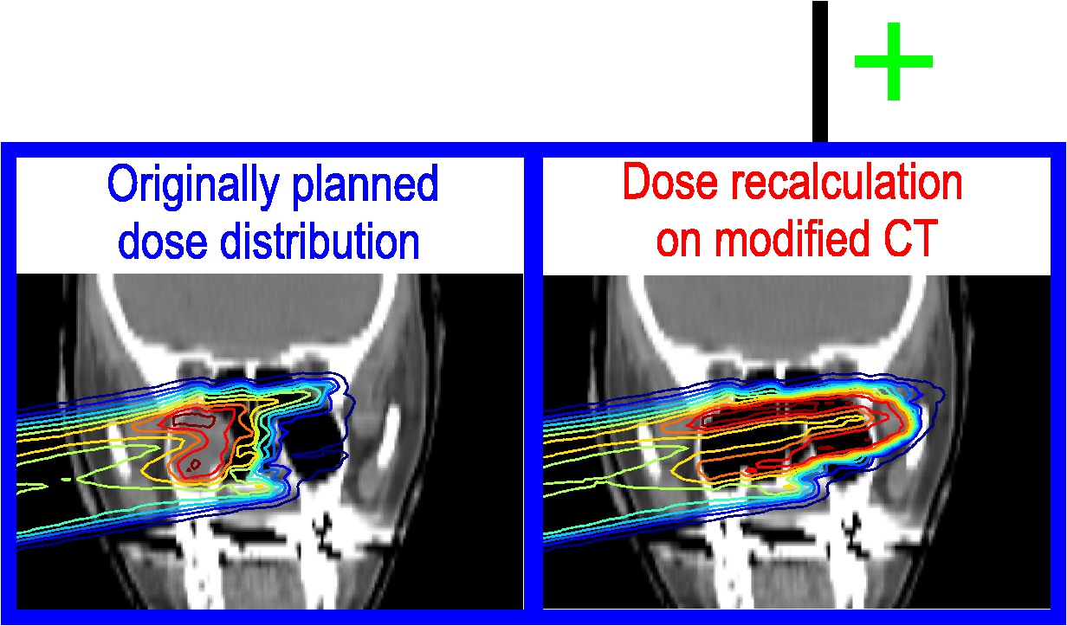
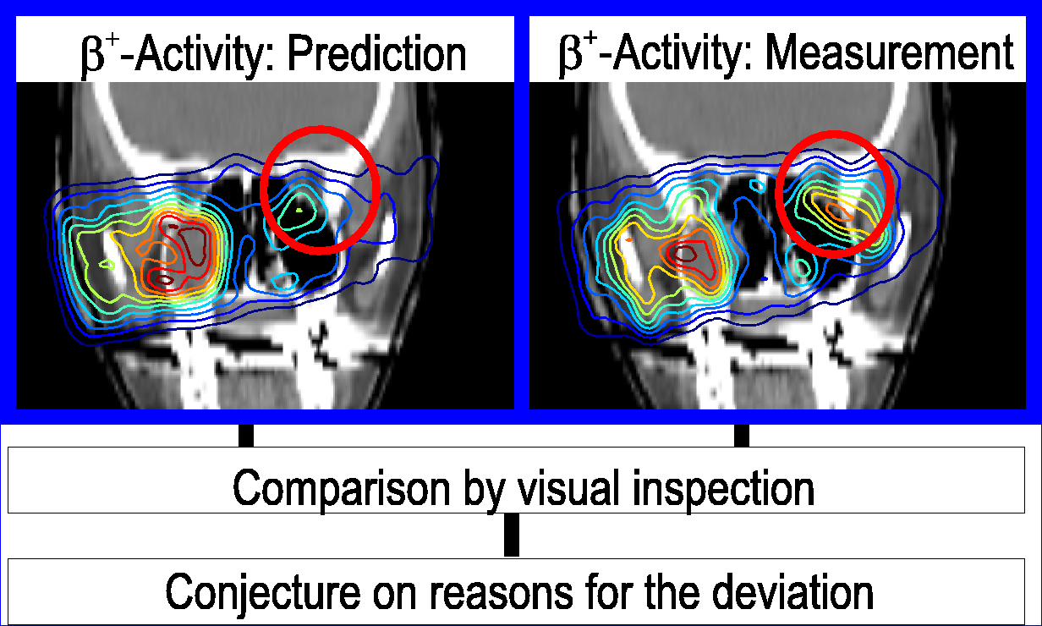
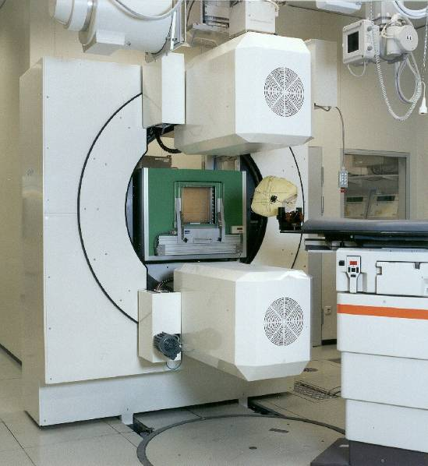
In-Vivo range measurement with PET: workflow and potential
W. Enghardt et al.: Radiother. Oncol. 73 (2004) S96
Monte Carlo
Dose
Irradiation and PET
β⁺-activity
Evaluation and reaction
β⁺-activity
Dose
Problem to solve: Metabolic Washout! In-beam measurement is really necessary, but difficult. Trade-off: in-room or off-room measurement after irradiation (Heidelberg for example)
Notes:
30

Slide 31
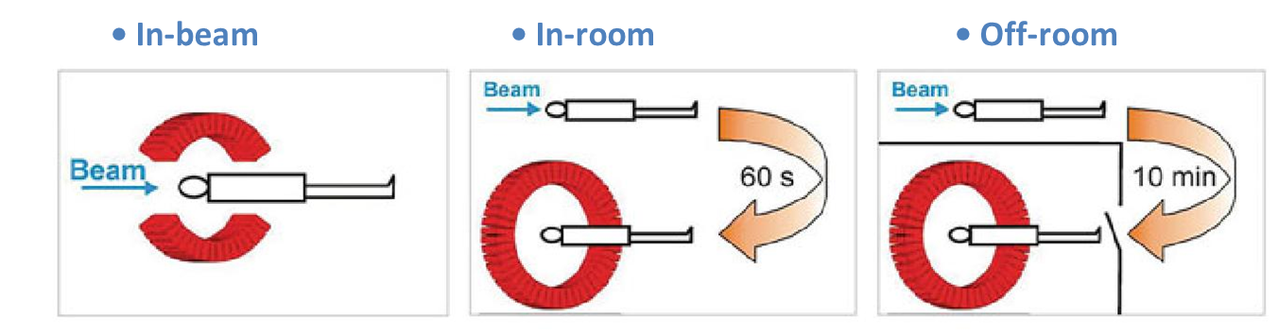
Towards real in-beam measurement
Ambition
practice
@Heidelberg

Slide 32
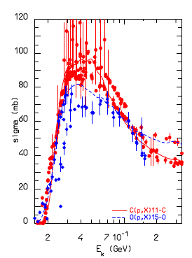

MC predictions and available data
Isotope production cross sections (in mb) for the fragmentation of 86 MeV/n 12C ion projectiles on a carbon target. Data are compared to FLUKA predictions, integrated over the measured angular range. The experimental uncertainty is on the order of 10%
T_{1/2} (s)
¹¹C 1221.84
¹⁵O 122.24
¹³N 597.9
…................
¹²C(p,x)¹¹C and ¹⁶O(p,x)¹⁵O
MC: cont. lines
Exp. Data: symbols
Notes:
Isotope production cross sections (in mb) for the fragmentation of 86 MeV/n 12C ion projectiles on a carbon target. Data are compared to FLUKA predictions, integrated over the measured angular range from 2to 22. The experimental uncertainty is on the order of 10%

Slide 33
“prompt” de-excitation γ’s
☺
• 4 · 10⁹ /fraction (2 Gy)
• γ-energy: 0… ~8 MeV
not suited for standard
gamma-imaging devices
of nuclear medicine
☹
MC prediction
Exp. tests validated the idea in recent years
Huge background from neutrons and γ’s produced by neutrons.
TOF: not easy to implement in clinical practice

Slide 34
MC prediction of de-excitationγ’s
MC: γ Energy spectrum produced by p impinging on a PMMA target
4.32 MeV from ¹¹C
4.44 MeV from ¹²C (mostly from O fragmentation)
~2 MeV from
¹¹C ¹¹B ….
5.18 MeV 5.24 MeV from ¹⁵O
6.4 MeV from ¹⁶O
~3 MeV from ¹⁰C
Broadening: nuclear recoil
MeV
0.511 MeV from e⁺ annihilation

Slide 35
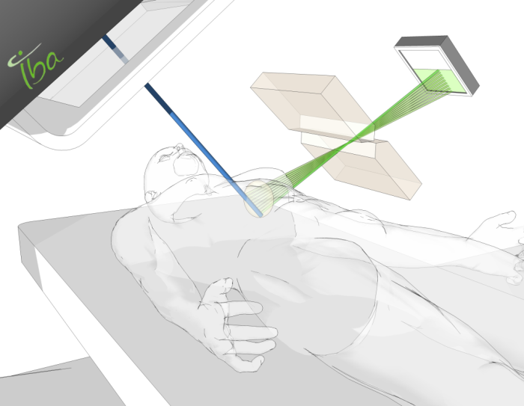
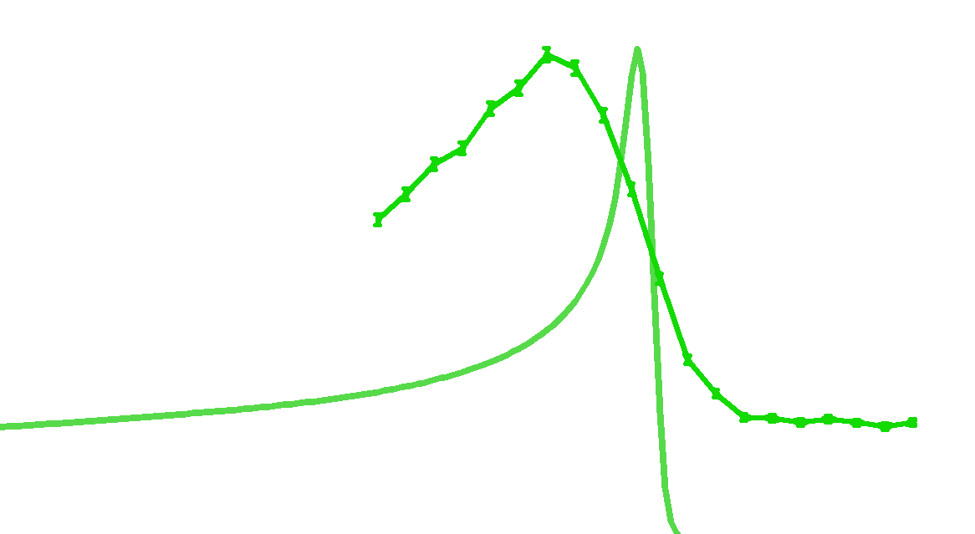
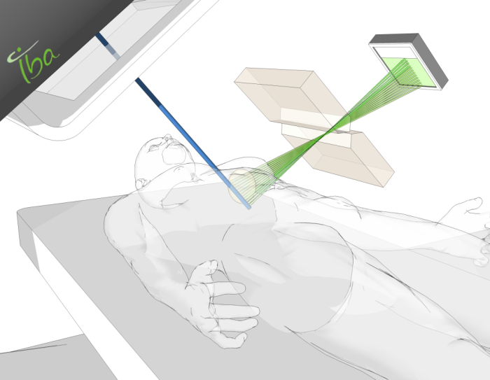
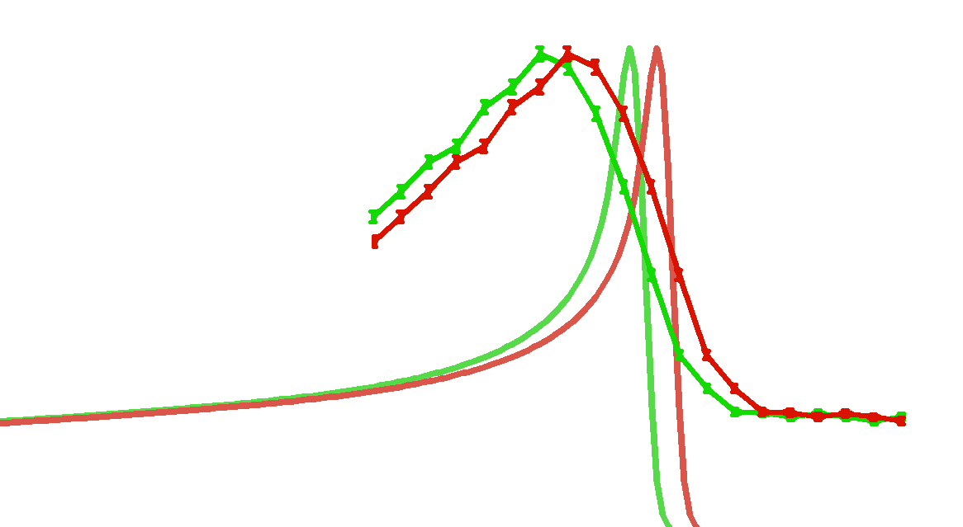





Knife-edge-slit camera by IBA
Collimator, software and project PI

Slide 36
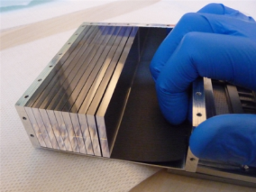
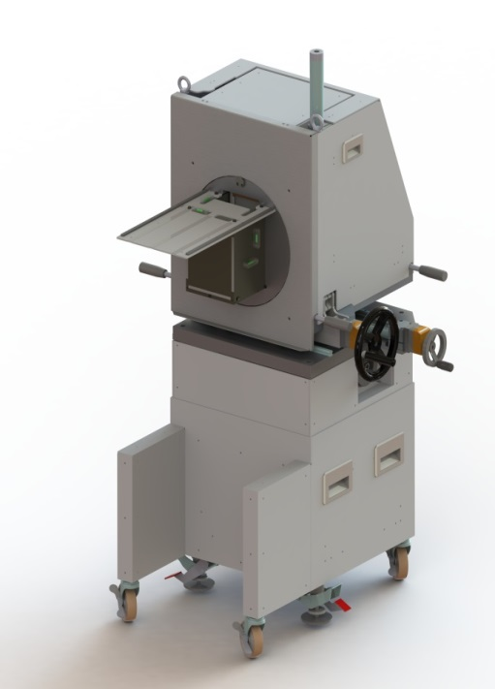
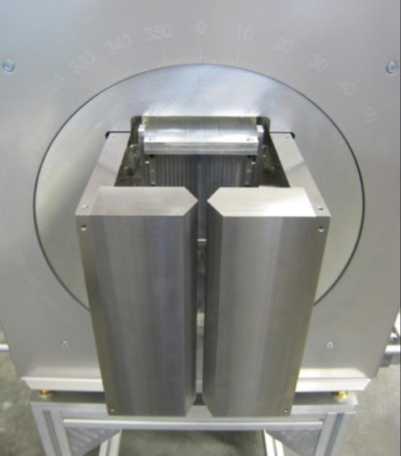
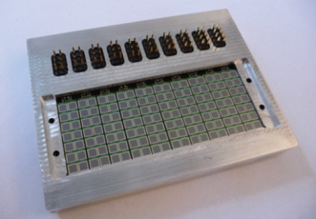
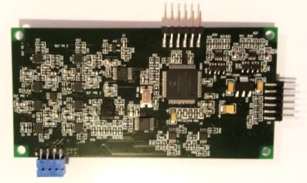


The Gamma camera: detector and electronics
500 cm³ LYSO distributed in
2 rows of 20 slabs
53 kg W collimator
for a 10 cm FOV
Light readout of one extremity of each LYSO slab by a row of 7 SiPM
40 independent acquisition channels operating in two modes
(slow calibration and fast counting)
Detector and Electronics

Slide 37
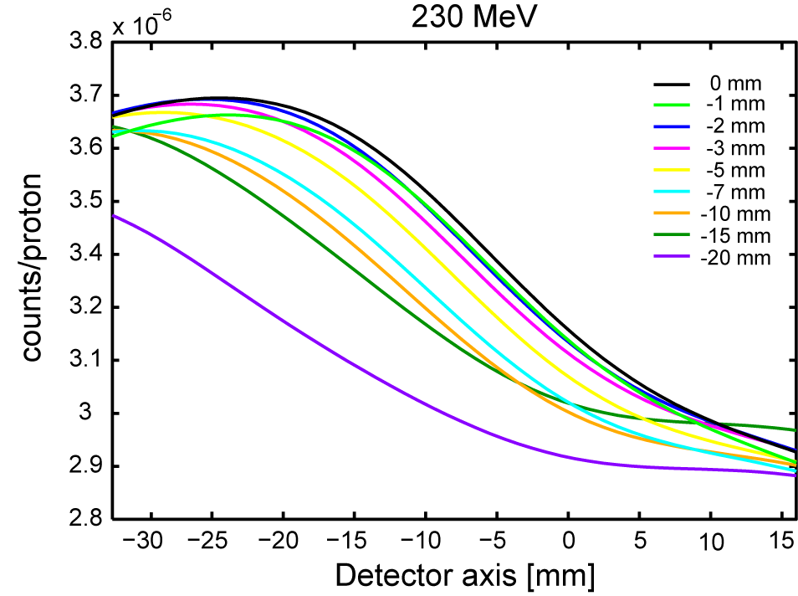


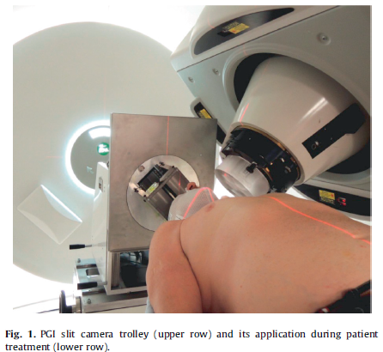
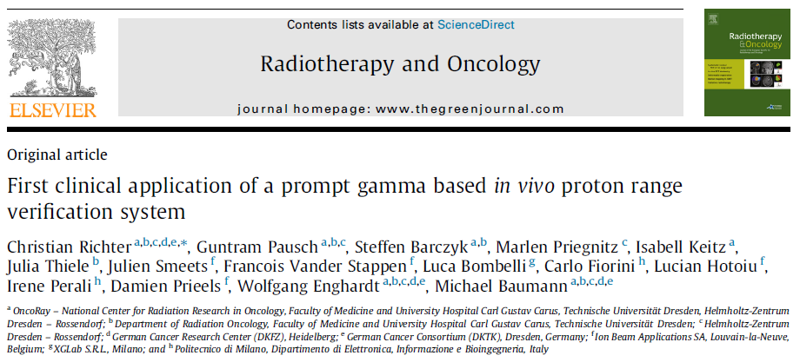
Experimental Validation
Clinical partner
Shift measurements

Slide 38


How many particles/fragments out of a patient?
MC simulation of a 12C treatment plan
on a patient (CNAO)
(Battistoni, Cappucci, Mairani, 2014)
1 energy (220 MeV/u)
in a single fraction of a ¹²C treatment
10⁷ ions in ~250 x-y spots
Total fraction: 2 10⁸ ion
Total plan:
~ 12/15 fractions
θ
Beam
z
θ
To be validated by experiment

Slide 39


First Exp. Test at large angle with ¹²C ions
L. Piersanti et al. 2014 Phys. Med. Biol. 59 1857
Charged secondary produced at 90⁰ by ¹²C 220 MeV/u at GSI
Beam radiography
Beam radiography
Beam
Beam
Bragg
Peak

Slide 40





New ion beams proposed for therapy
Beam lateral deflection
⁴He (50-300 MeV/u):
negligible fragmentation, higher RBE than protons, but more limited lateral scattering
¹⁶O (100-500 MeV/u):
to be used in particular case where high-LET is needed
hypoxical tumors
Beam size at the Isocenter
  MC simulation of the CNAO beamline
For a discussion of New Ions in therapy: F. Tommasino, E. Scifoni, and M. Durante, Int. J. Particle
Ther. 2015 2:3, 428-438

Slide 41


New test at Heidelberg with He, C and O beams:
Prompt γ and Charged particles Detection
G. Battistoni, F. Bellini, F. Collamati, E. De Lucia, M. Durante, R.Faccini, M. Marafini, I. Mattei, S. Morganti, R. Paramatti, V. Patera, D. Pinci, A. Rucinski, A. Russomando, A. Sarti, A. Sciubba, M. Senzacqua, E. Solfaroli Camillocci, M. Toppi, G. Traini, C. Voena
Beam
PMMA Target
Plastic Scintillator for
TOF measurement
p
Drift Chamber
LYSO Crystal

Slide 42


Prompt 𝛾 fluxes (total absorption of primary in target)
preliminary
φ = 60°
From the number of He, C and O primaries needed to deliver 1Gy dose to a tumor volume of ~120 cm³ (in ~40 slices), we evaluated an achievable resolution on the beam range estimation of ~ 2-3 mm for a treatment using the IBA slit camera as photon detector ^{[4]} .
[1] LYSO Mattei I et al., Jour. of Inst. 10, P10034 (2015).
[2] BaF, submitted to Phys. Med. Biol.
[3] Pinto M et al., Phys. Med. Biol. 60, 565–594 (2015).
[4] Smeets et al., Phys. Med. Biol. 57, 3371 (2012).

Slide 43



Charged particle production at large angle
Particle ID
p d t
preliminary
He beam
90°
Detection angle and space resolution
Typically, at HIT or CNAO, a ¹²C Beam at 200 MeV/u has a FWHM ~ 0.8 cm at the isocenter

Slide 44


Charged Particle Production and BP monitoring
A non negligible production of charged particles at large angles is observed for all beam types
data
preliminary
Y (cm)
BP
He 145
He 125
He 102
Preliminary
¹⁶O 60 deg
⁴He 90 deg
Z (cm)
data
preliminary
# of tracks/0.4 cm
¹⁶O 90 deg
BP
⁴He 60 deg
¹²C 90 deg
Z (cm)

Slide 45

E_{kin} of secondary protons in ¹⁶O runs

Slide 46





detecting inhomogeneities with charged particles
Reference Target: no AIR spaces
10.15 cm
Segmented 12.15 cm Target: with AIR spaces
BP
preliminary
preliminary
~4k tracks;
#¹⁶O ions: 8 10⁸

Slide 47




The Project @
INnovative Solutions for In-beam DosimEtry in Hadrontherapy
Funds: PRIN + Centro Fermi + INFN (RM1-TO-MI-PI)
proton emission
Tracker +
Calorimeter =
DOSE PROFILER
β⁺ activity distribution
IN-BEAM PET HEADS
Dual signal operation
integrated in treatment room
Provide in-beam feedback on beam range
Challenge: fusion of charged and PET information
Notes:
based on the combination of a in-beam PET scanner and a tracking system

Slide 48

The INSIDE PET System
Detectors to measure the 511 keV back-to-back photons in order to reconstruct the β⁺ activity map.
Two planar panels: 10 cm x 20 cm wide => 2 x 4 detection modules;
1-2 mm resolution expected along the beam path
  Each module = pixelated LSO matrix 16 x 16 pixels, 3 mm x 3 mm crystals (pitch 3.1mm)
  LYSO matrix readout: array of SiPM (16x16 pixels) coupled one-to-one.
  Custom TOF-PET asic (Courtesy of M. Rolo, LIP and ENDOTOFPET EU project)

Slide 49



Slide 50



Proton beam on a 3 cm x 3 cm surface
Two “slices” at different energies: 75 MeV and 103 MeV
2 cases: - PMMA phantom
- PMMA phantom with 1 cm air gap

Slide 51


The INSIDE charge Profiler
Tracker: back-tracking of secondary protons to the beam line
Calo: select higher energy protons to minimize MS in the patient.
Reconstruction: deconvolution of absorption inside the patient from the emission shape
Calibration: BP position vs Emission shape parameters
LSO CALO
⊡ 3 x 3 mm²
MAPMT 64 ch
Fiber readout
SiPM ⊡ 1 mm
6 UV PLANES
Fiber ⊡ 0.5 mm

Slide 52
INSIDE Dose Profiler
Heavy charged secondary cross all TRK planes up to LYSO crystals
Electrons from Compton event have winding tracks (mul. scatt.) and are not detected in the calorimeter
19,2 cm
p
19, 2 cm
2 cm
not to scale
Particles are reconstructed with a track finding algorithm that starts from deposits in the fibers grouped together to form 3D clusters.
Protons detected at 90º
Average resolution on the single proton emission point along the primary beam direction σ ~ 0.4 cm
(Dominated by MCS in the patient)

Slide 53



Estimated no. of protons detected at ~60º as a function of energy in a single fraction
Primary
Secondary
Protton
2-port 12C treatment
Only one of the 2 beams considered (~2 GyE)
~2.3 10⁵ primaries/spot
~1000 protons/spot
➜2-3 mm resolution on the distal slices

Slide 54

EMPATHY project
To exploit the full power of charged fragments monitoring and
  maximize the statistics collected
  customize the detector positioning for each patient/treatment
  take into account the effects caused by the interaction with the matter traversed by the charged fragments while exiting from the patient body
an ERC Consolidator project has been prepared: A customizable online device for “dosE Monitoring in PArticle THerapY” (EMPATHY).
A. Sarti
Main elements and goal:
  provide a several (up to 5) small, compact detection units that could be easily placed close to the patient in the region of maximum charged fragments output flux.
  Detection unit made of scintillating fibers, with a novel readout capable of high single photon detection efficiency
  provide an “on-line” correction for matter interactions, using a fast GPU-bases MC for proton tracking

Slide 55

EMPATHY challenge
High detection efficiency using a fiber tracker (the adopted layout is 5x5x2 cm³, with squared fibers of 250 µm side).
  Small light yield expected: integrated CMOS electronics capable of high Single Photon detection efficiency
  ➞ know how developed by FBK in the SPADnet project.
Optical tracking system to monitor the units positioning and allow for a global dataset reconstruction using all the tracks collected.
Positioning optimized on the basis of MC simulations

Slide 56


PT, secondary cancers, pediatric tumors
Secondary primary malignancies account for ~16% of risk for all cancer surviving patients. Radiotherapy is one of the causes
Secondary effect of diffuse dose could be relevant for pediatric tumor, where the expected life span is longer.
Protons
The neutron contribution is particularly difficult to model and to be taken into account in TPS (environment, beam halo, etc..
In PT neutron flux dominates, by orders of magnitude, the total secondary flux. Neutrons directly produced by the beam in PT are mainly ultra fast neutrons [20-200 MeV]
Accurate n production X-section by ¹²C beam (or other nuclei) on (O,C), with angle and energy distribution, are still incomplete.
Neutron monitoring during PT is particularly difficult
Neutrons usually not included in TPS
 | X-ray | IMRT | Proton
CTV | 90% | 90% | 90%
Heart | 18.2 | 17.4 | 0.1
Right lung | 3.5 | 21.9 | 0.1
Esophagous | 11.9 | 32.1 | 10.2
Stomach | 3.7 | 20.6 | 0.1
Right kidney | 3.3 | 29.8 | 0.1
Transvers colon | 2.6 | 18.0 | 0.1
Photons
Notes:
56

Slide 57


He 100 MeV/n Sato et al. Phys. Rev. C 64, 034607 (2011).
2.16 g/cm²
Mashnik S. G. Validation and verification of MCNP6 against high-energy experimental data and calculations by other codes.II. The LAQGS Mtesting primer. LANL Repor tLA-UR-11-05627. Los Alamos (2011). Available from: https://mcnp.lanl.gov/.
Iwata Y, et al. Double-differential cross sections for the neutron production from heavy-ion reactions at energies E/A 290–600 MeV. Phys Rev C (2001) 64:054609. 1.80 g/cm²
Notes:
Iwata: 1.80 g/cm2

Slide 58

Funded by SIR 2014+INFN Young Grant 2015
JINST M.Marafini et al 2015
Centro Fermi

Slide 59

Initial performance study
S.M. Valle, , G. Battistoni , V. Patera , D. Pincic , A. Sarti, A. Sciubba, E. Spiriti, M. Marafini
Efficiency for neutron reconstruction:
uniform energy distribution 20-400 MeV in a cone of 5º aperture

Slide 60
Conclusions
Fragmentation studies are still an open issue. This will become more important when entering the precision era of Particle Therapy.
Not only ¹²C: the possible next use of ⁴He and ¹⁶O beams requires specific studies.
The importance of MC in particle therapy is increasing. Models are improving but there are not enough valuable data for benchmarking
Real Time Monitoring in Particle Therapy is still an open issue.
  In-beam PET is not yet established. ¹¹C beams?
  The exploitation of prompt photons in clinics (protontherapy) is starting.
  Charged Particles seem to be an interesting alternative, to be explored in the next two years.
  Fancy alternatives are now proposed (acoustic waves)
The evaluation of (low) neutron dose in patients is now starting to be considered, mainly in view of long term effects
Not reported in this talk:
  All the radiobiological issues…, Treatment Planning, Fast MC models and codes for dose recalculation, Image Guided Hadrontherapy, Detectors for Beam Monitoring at future high intensity beams, Accelerator developments/cost reduction: compact systems, new components, new acceleration techniques

Slide 61
Acknowledgmentes:
V. Patera, M. Marafini, A. Rucinski (UniRm1, INFN-Rm1, CF) A. Sarti (UniRm1,INFN-LNF),
M. Durante, F. Tommasino (INFN Tifpa),
Mairani, R. Orecchia, P. Fossati (CNAO), M. Schwarz (APSS, Trento),
A. Ferrari, (CERN), S. Muraro, I. Mattei, P.Sala (INFN Mi),
G. Bisogni, V. Rosso (INFN & Univ. Pisa)
and in the general the colleagues from RDH-IRPT coll., FLUKA coll., ARPG

