Slide 1
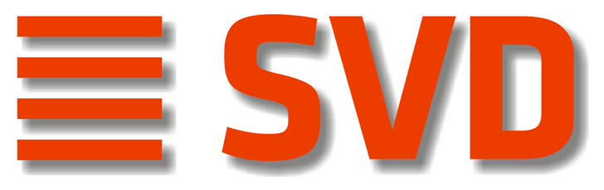
The Belle II Silicon Vertex Detector
Christoph Schwanda
Institute of High Energy Physics
Austrian Academy of Sciences
10th Belle PAC, February 9, 2016, KEK, Japan

Slide 2
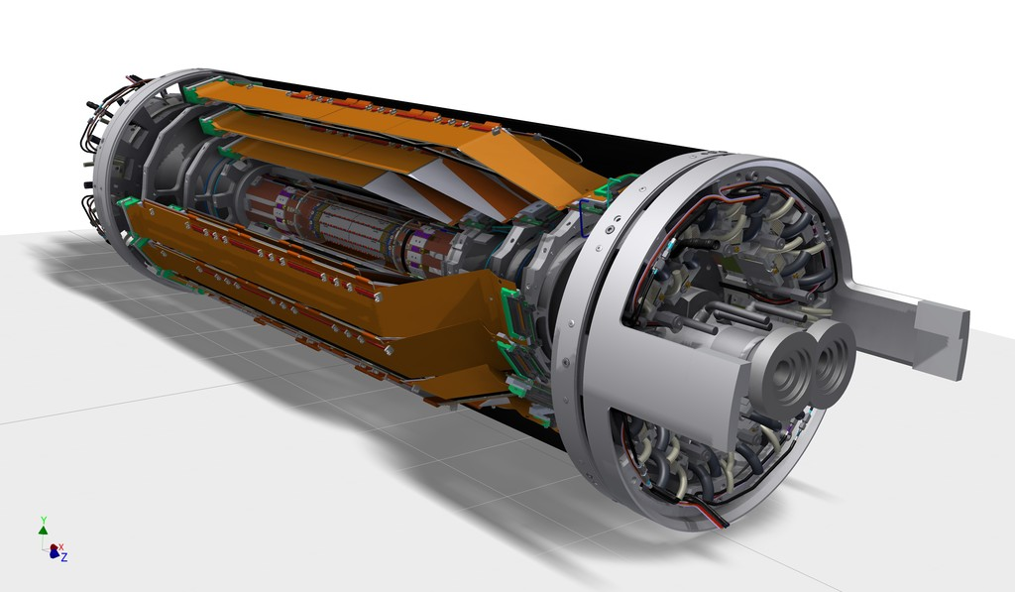
Components of the Belle II SVD
Carbon fiber (CF) cone
Outer CF shell
End flange
End rings
Ladders
Beam pipe
PXD (independent sub-detector inside SVD)

Slide 3
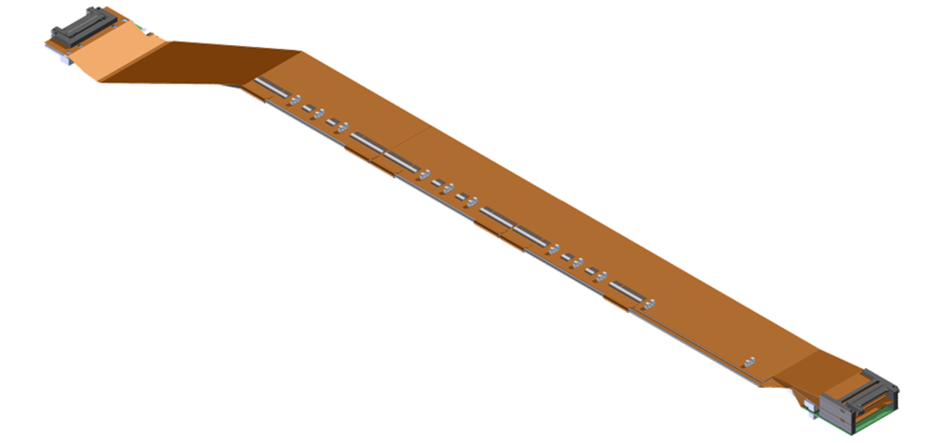
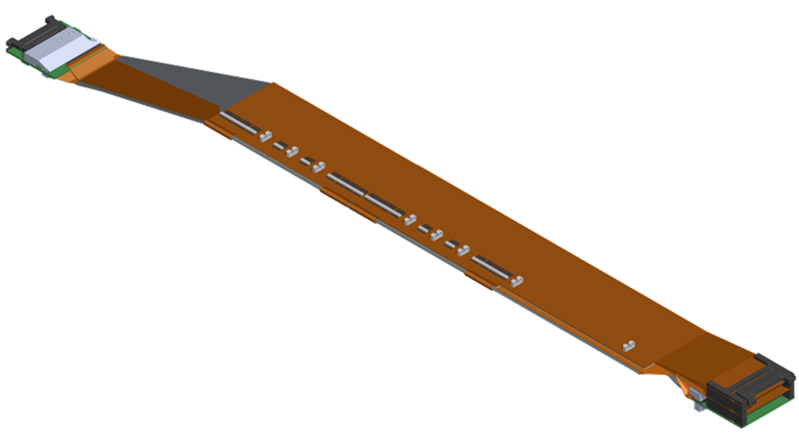
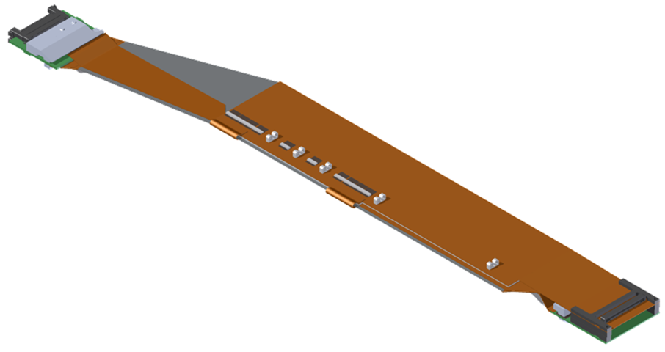
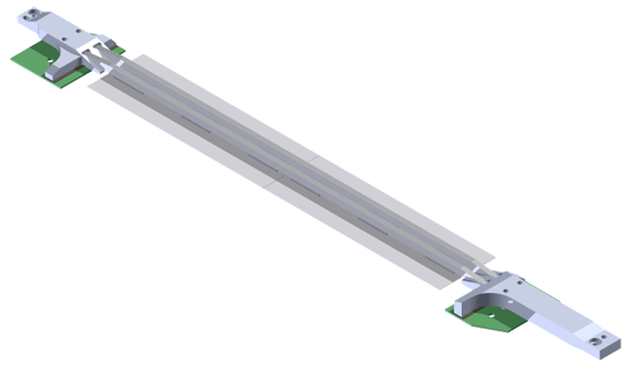
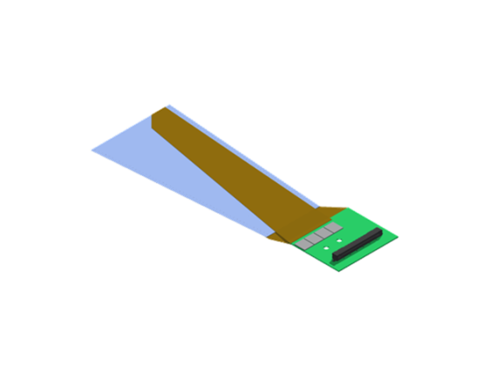
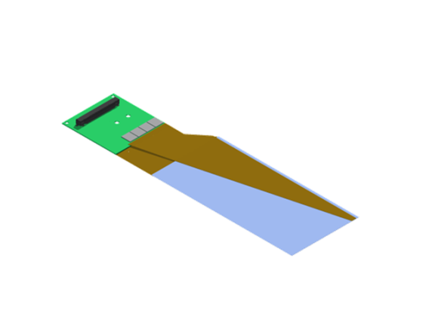
SVD ladders
Layer | Ladders (spares) | DSSDs / ladder
6 | 16 (4) | 5
5 | 12 (3) | 4
4 | 10 (2) | 3
3 | 7 (2) | 2
L6 Ladder (Kavli IPMU)
FWD module
FWD
Origami +z
L5 Ladder
(HEPHY)
Origami ce
47 FW/BW + spares (4)
BWD
Origami -z
L4 Ladder (TIFR)
BWD module
L3 Ladder (Melbourne)
Cooling pipe
FWD module
(Pisa)
Cooling pipe
BWD module (Pisa)
Cooling pipe

Slide 4
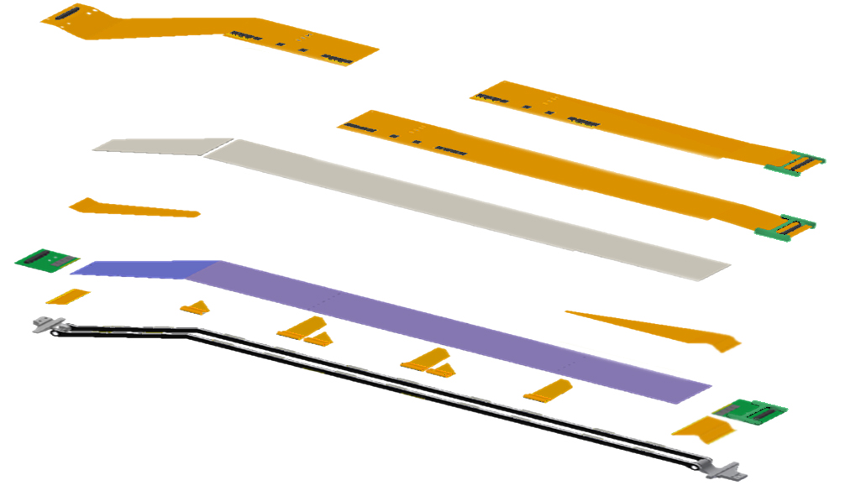
Ladder Anatomy (L6 ladder)
Origami hybrid
DSSDs
2 small rectangular (L3)
2-4 large rectangular (L4-6)
1 trapezoidal (L4-6)
APV25
Origami hybrid
Flexible circuit to transmit detector signals to the ladder ends
APV25
Readout ASIC of the strips
PA0
PF2
FlexPA (PA/PF/PB)
Flexible circuit to transmit detector signals to the APV25
PF1
PB2
AIREX
PA1
PA2
DSSD
PA0
Flexible circuit glued on the Origami hybrid to transmit n-side detector signals to the APV25
PB1
AIREX
Thermal insulator between the DSSD and APV25
Rib

Slide 5
What happened since the focused VXD review in October 2015?
The Melbourne group (L3) was qualified to start ladder production (end of Oct 2015)
The TIFR and Kavli IPMU groups were qualified to assemble their final prototype (class B) ladders (Jan 2016)
Keratherm issue and its mitigation (Oct-Dec 2015)
PXD-SVD L3 clearance issue and its mitigation (Oct-Dec 2015)
Origami flex blister issue (since Nov 2015)

Slide 6
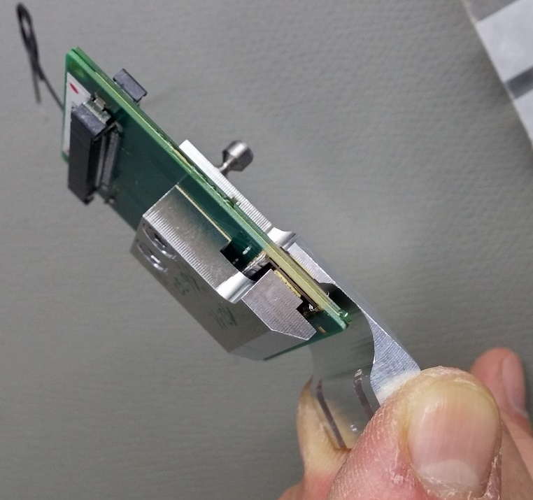
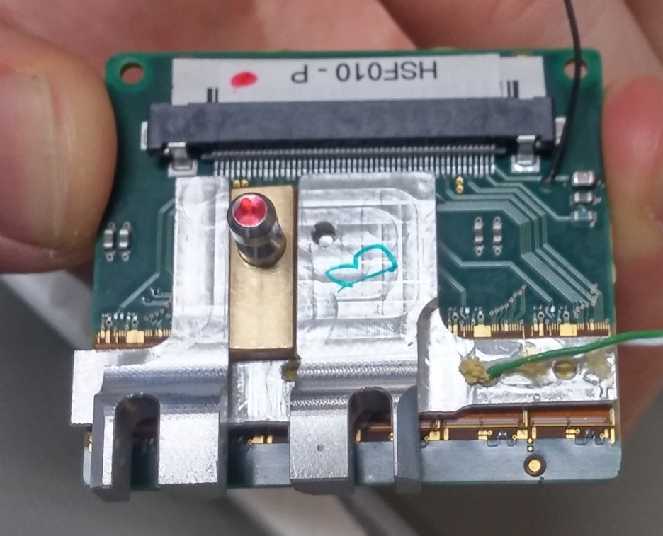
Keratherm on FW/BW hybrids
BW module
FW module
Keratherm strip between APV25 chips and APV guard to establish thermal contact

Slide 7
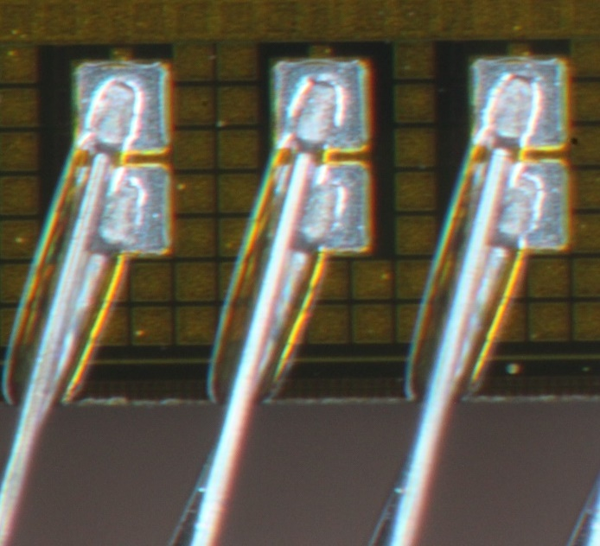
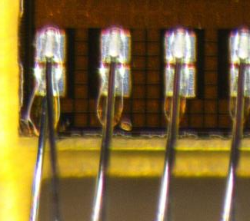
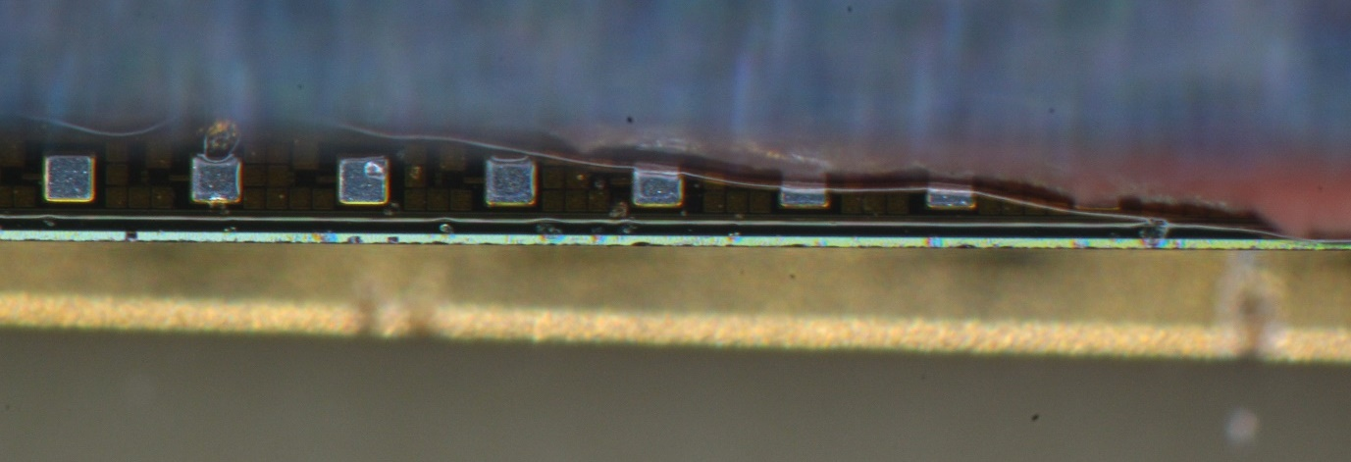
Keratherm issue
In Oct. 2015 a liquid was observed on the forward APV25 chips of L4.905 (class B-) and later also found on other ladders
The liquid is silicone oil, squeezed out of the Keratherm foil as it is compressed by more than 30% of its thickness (“bleeding”)
After consultation with the manufacturer we considered replacing the Softtherm 86/125 foil (red) by low bleeding Softtherm 86/235 (yellow)
Fluid at the edge of Keratherm
APV guard
Hybrid PCB
Side edge of APV chip

Slide 8
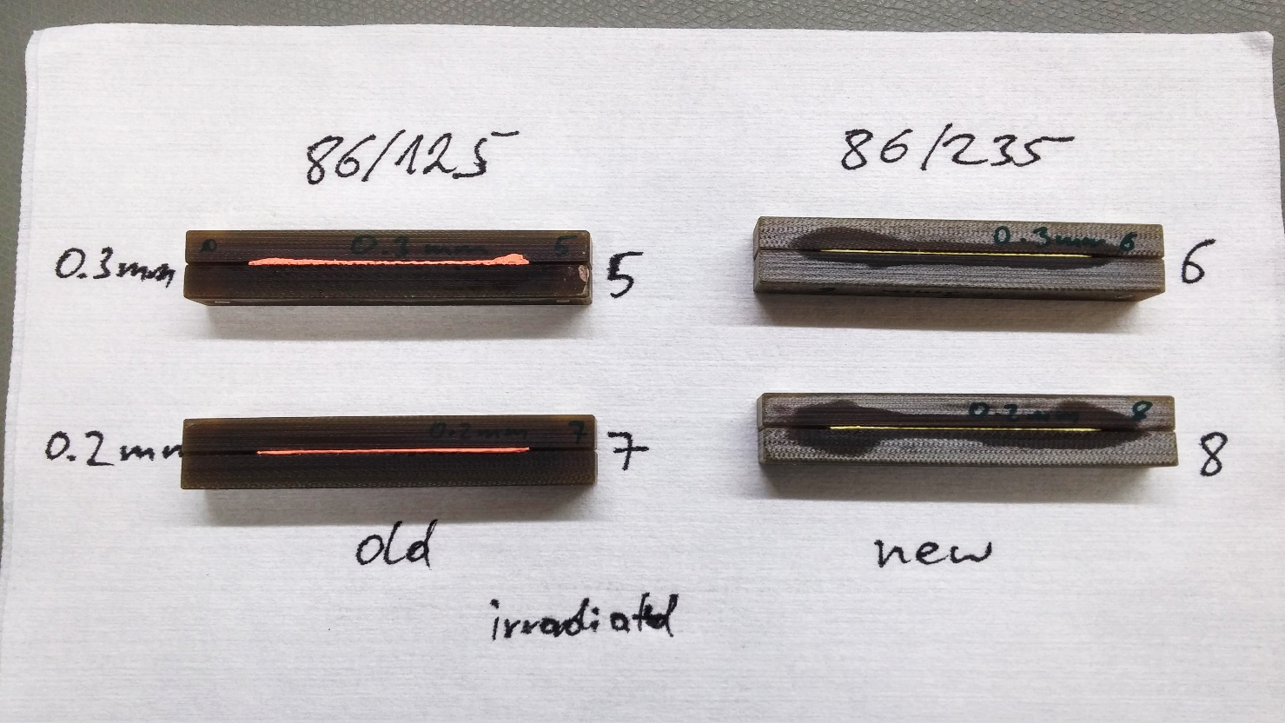
Leakage after ~1 month and >10 Mrad irradiation
Softtherm 86/125 (red): Full surfaces of FR4 blocks moistened with oil
Softtherm 86/235 (yellow): Surfaces of FR4 blocks only partially moistened with oil

Slide 9
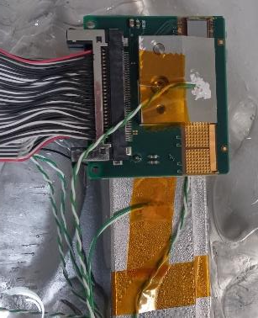
Summary of the Keratherm R&D
Irradiation test
Samples of the old and new material were gamma irradiated at Takasaki Advanced Radiation Research Institute, JAEA (⁶⁰Co source, >10 Mrad)
Bleeding test
Bleeding of silicone oil was studied on irradiated samples for different gap widths
Although also the new material leaks, it is significantly less
Thermal test
Keratherm thermal conductivity was studied in FW/BW modules, both before and after irradiation
Thermal properties of both materials are similar
No significant change due to irradiation
FW / BW module
Temperature probe
Al block
Ice water (~ 0°C)
Probes are placed on surfaces of end mount and APV guard
Thermal test setup
We decided to use the yellow Softtherm 86/235 for FW and BW end mounts

Slide 10
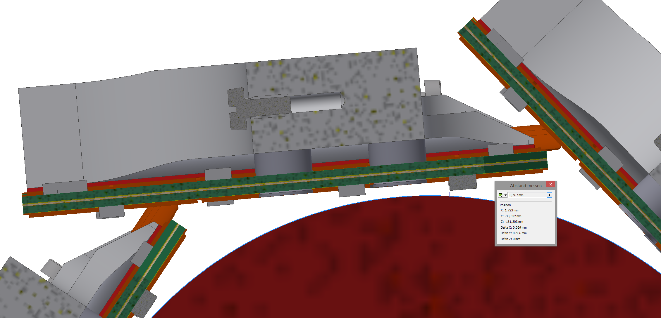
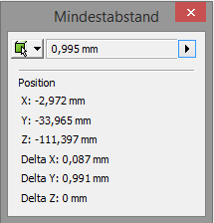
PXD-SVD L3 clearance issue
BW situation
New capacitor without solder (~300µm higher)
PXD volume Ø66.2mm
Clearance between PXD and the new C35 capacitor in L3 is only 467µm in the CAD model (without solder thickness)
Clearance between PXD and the APV25 bonding pads is 995µm

Slide 11
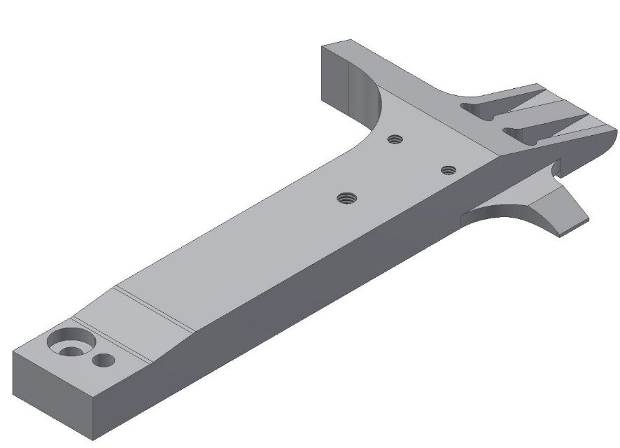
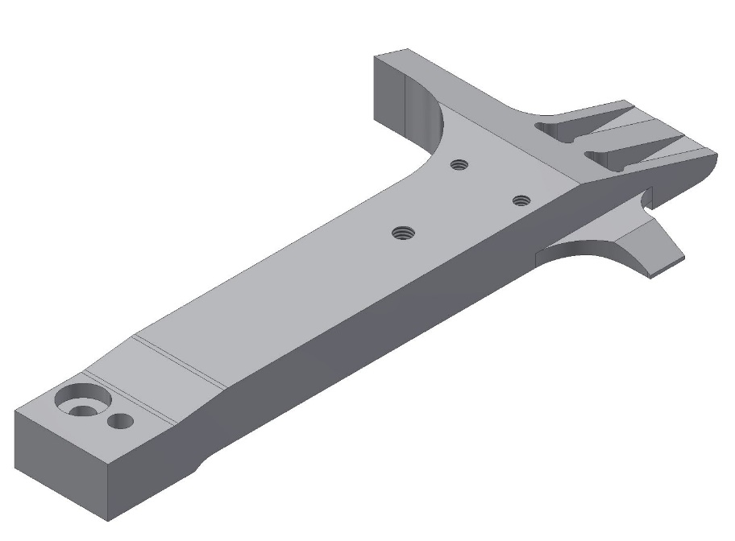
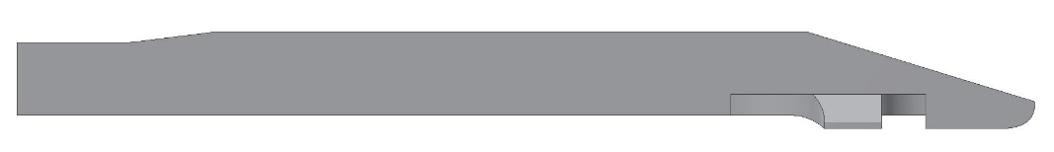
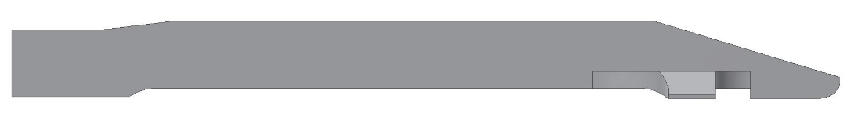
Modification on BWD bridge in L3
We decided to mitigate the clearance issue by shifting L3 by 1 mm outwards by modifying the L3 bridges
OLD
NEW
Increase this area (1mm)

Slide 12
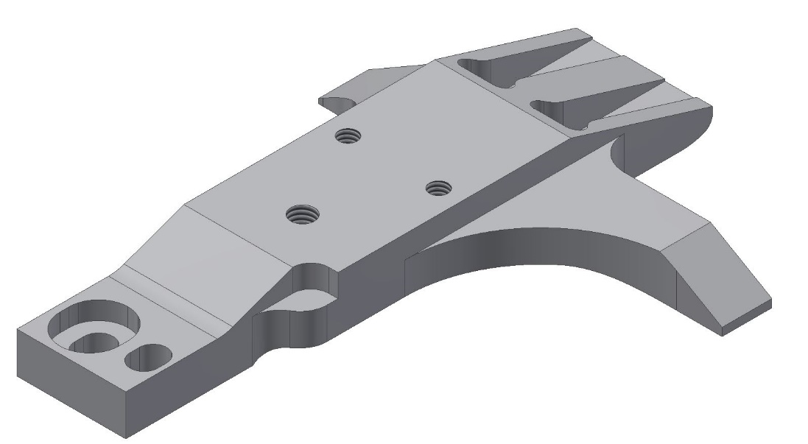
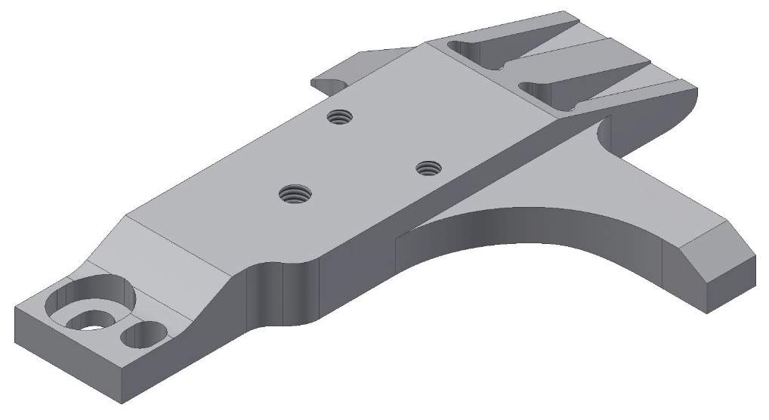
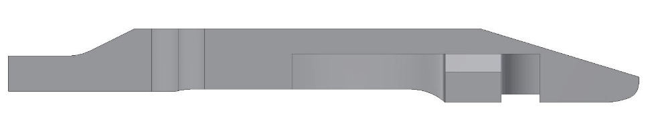
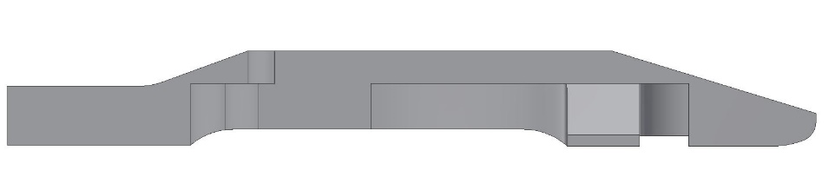
Modification on FWD bridge in L3
Chamfer is bigger and shifted to the right
NEW
OLD
Increase the chamfer in this area
Reduce material
Radius is shifted to the left
Increase this area (1mm)
A number of modifications are necessary on the FWD bridges to avoid L4 inference issues after the 1 mm shift

Slide 13
Summary of the L3 modification studies
The L3 radius is increased by 1 mm to mitigate the clearance issue with the PXD volume
This increase is achieved by modifying the design of the L3 bridges – the end rings are unchanged
The SVD mechanics group has developed a new L3 bridge design that avoids interference problems with L4 in FW emerging after the shift
The Melbourne group (L3 assembly) has analyzed the impact of the new bridge design on every assembly step and made small modifications to the assembly procedure
The SVD software group has assessed the impact of the 1 mm shift on tracking performance, PXD ROI finding and alignment performance

Slide 14
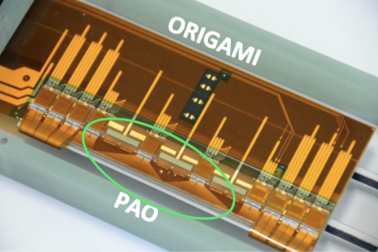
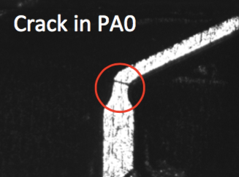
PA0 & Origami: the history
Aug 2014: crack problem found in PA0 flex that bring signals from sensor strips to APV25 chips on ORIGAMI flex circuits
Full reproduction of ORIGAMI+PA0 needed
ORIGAMI reproduced by the company end of 2014, PA0 crack problem need still to be solved
Oct 2014: PA task force in place
Several months of investigations, optimization of the process and new design of the PA0
Specifications documents for PA0 production & ORIGAMI assembly written
Detailed QA procedure implemented: several electrical tests and visual inspection during production of PA0 & assembly of the ORIGAMI
Aug 2015: PA0 pre-prod. (batch0) successfully produced & assembled on 12 ORIGAMI, no cracks on PA0 and full test on a L5 class B ladder
PA0 mass production started in Aug-Sep 2015: tested & no cracks
Oct 2015: ORIGAMI assembly started, divided in 3 batches with delivery expected in Dec 2015, Feb 2016, Mar 2016

Slide 15
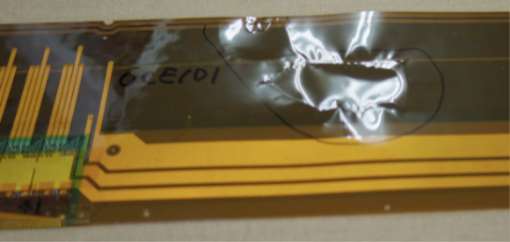
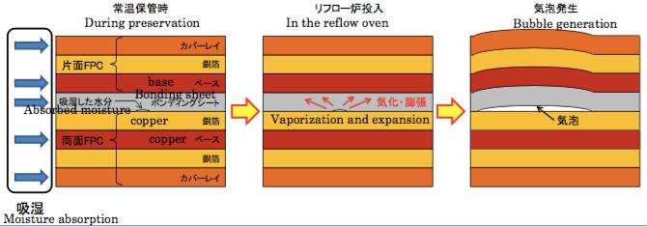
Origami flex blister issue
End of Nov 2015: large blisters appear on 5 out of 5 OCE circuits during the reflow step of batch1 mass production
Potential to destroy all origami circuits, mass production is halted for investigation of the issue
Bubbles are most likely due to humidity absorbed by the circuits (long storage at soldering company in non-humidity controlled environment)
Moisture expands in the oven due to high temperature (230 °C) during reflow

Slide 16
Possible solutions
Manual soldering
Hybrid option
Components on origami are placed and soldered by hand
10 circuits/week (compared to 11.5 for reflow)
Circuits are dried by pre-baking at 120 °C for 17 hours
Dry reflow is performed to select good pieces
Perform another pre-baking at the day of reflow
Reflow soldering of components, except connectors
Manual soldering of connectors
Reproduction of failed circuits

Slide 17
Possible solutions
Manual soldering
Hybrid option
Pros:
Effective
Schedule predictable and faster than the hybrid plan (10 circuits/week)
Cons:
Costs 50% higher than the original plan
Costs could be higher than in the hybrid option depending on the failure rate
Pros:
Possibly cheaper in case of low failure rate of the pre-baking cure
Cons:
Failure rate not precisely know, could be 40%
Pre-baking could cause pad oxidation leading to bonding/soldering problems
Schedule depends on failure rate, lower than manual soldering

Slide 18
Recovery strategy
Short term
A few pieces (8 O+Z and 6 O-Z) have already survived standard reflow @ Saiden
5 OCE have been populated by hand soldering @ Saiden
15 circuits (5 OCE, 5 O+Z, 5 O-Z) have been successfully pre-baked and will be equipped by vapor-phase soldering @ HEPHY
Complete these circuits and distribute them in an optimized way to assembly sites in time to maintain production
This allows to operate from mid March to end of June 2016
Long term
Perform the necessary R&D to choose one solution (manual soldering or hybrid option)
Determine failure rate with long pre-baking+reflow & perform tests on pad oxidation
Complete this R&D by end of March 2016

Slide 19
SVD ladder assembly

Slide 20
Today

Slide 21
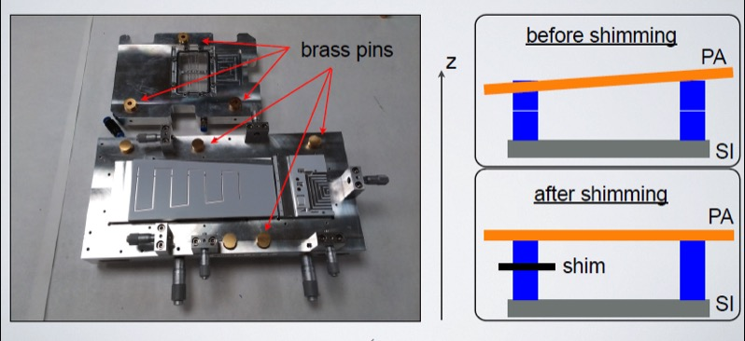
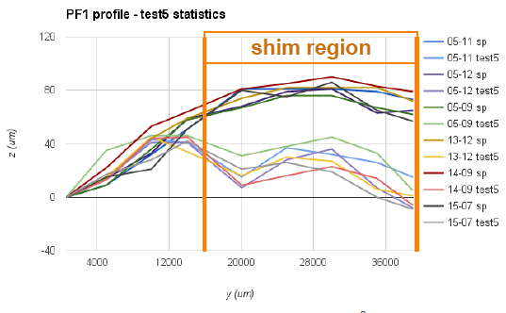
Pisa (FW/BW)
Shimming on brass pins
Production status
15 class A FW sub-assemblies and 23 class A BW sub-assemblies have been completed out of 47 each
Brass pins
P-side glue failure
PF1 was found lifted up on 2 SFWs
Before shimming
Shimming on PF1 chuck
Traced back to non-planarity of the PA:
Original shimming on brass pins used to compensate this effect
Better cure found with a 50 um shim applied on the PF1 chuck
Resume SFW production after the Feb 2016 B2GM
After shimming on PF1 chuck

Slide 22
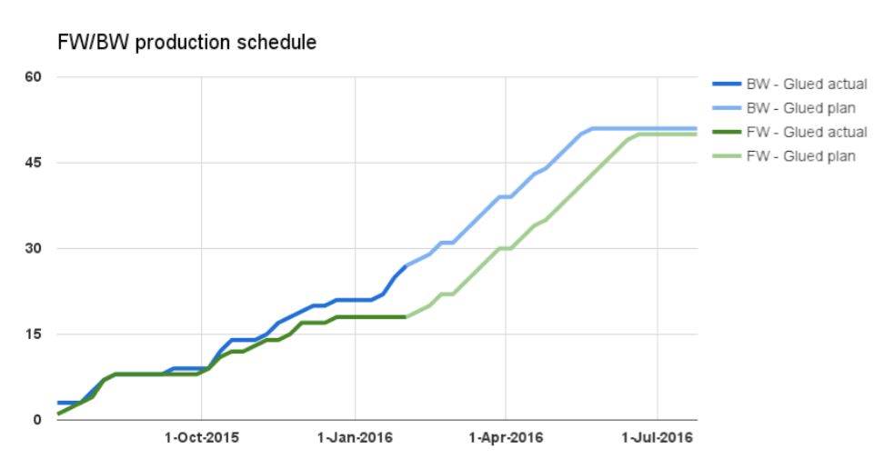
Pisa schedule
Today’s status

Slide 23
Melbourne (L3)
Qualification review for class A production was held Oct-29, 2015
Follow-up issue: no glue under bias pads or PA may peel off from detector
Cured by a modification of the moveable parts of the gluing jig, to allow for a correct glue thickness and spread all over the pad line
The impact of the L3 bridge design change on the assembly procedure was studied and minor modifications were implemented
L3 production will start after the L3 bridges are re-manufactured and the assembly procedure is confirmed on a mechanical dummy

Slide 24
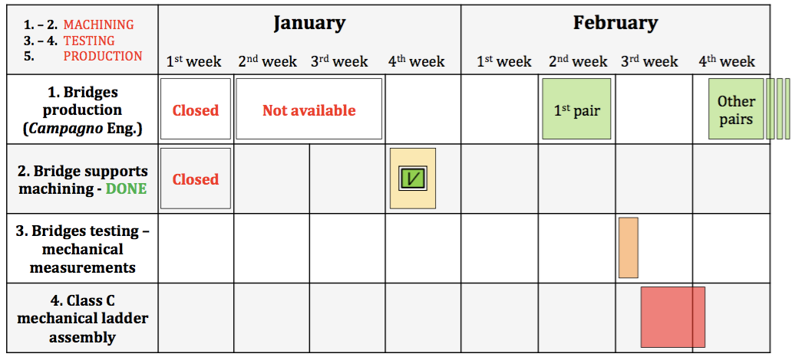
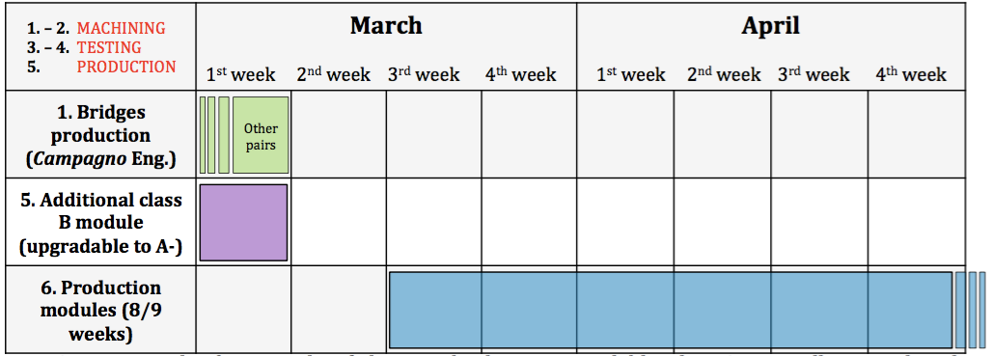
Melbourne schedule
To finish in May…

Slide 25
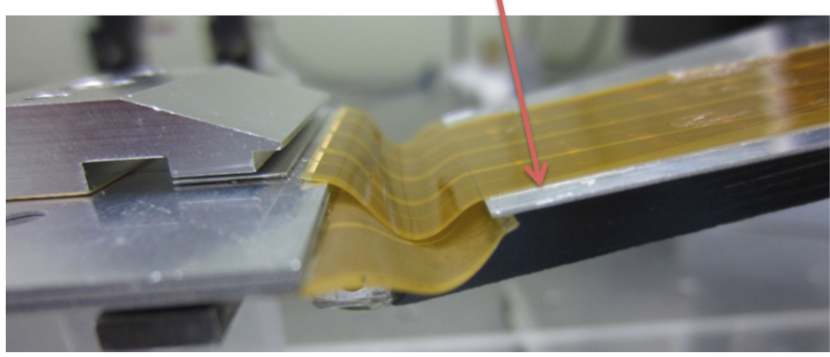
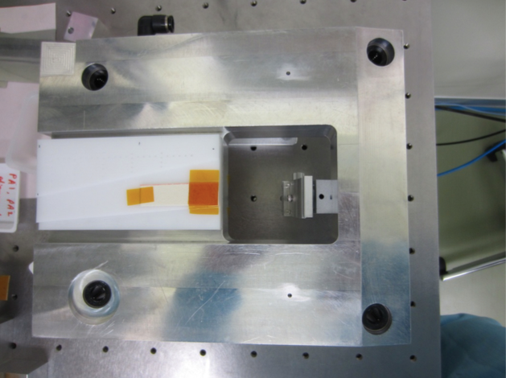
TIFR (L4)
L4.906 ladder (assembled in Oct 2015): One reference point on the FW sensor was shifted by ~400 μm
Traced back to stress generated on the sensor during clamping of the FW hybrid board
Can be cured by a shim placed in the slant jig
Started the assembly of the final prototype (class B)
Qqualification for class A production to beheld starting of March
shim
clamp

Slide 26
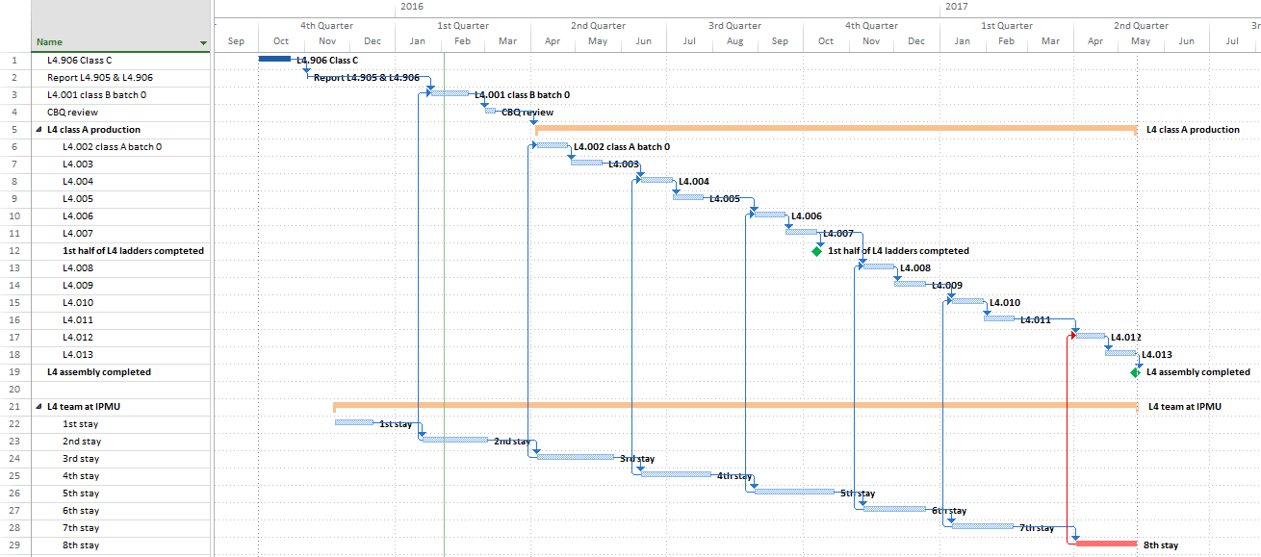
TIFR schedule
1st half shell completed: Oct 2016
Production completed: May 2017

Slide 27
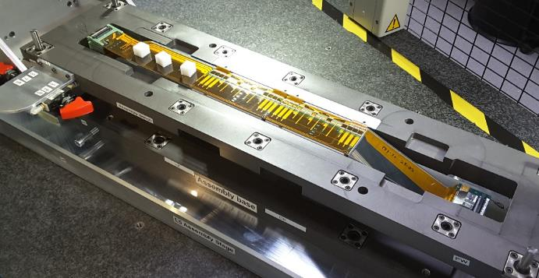
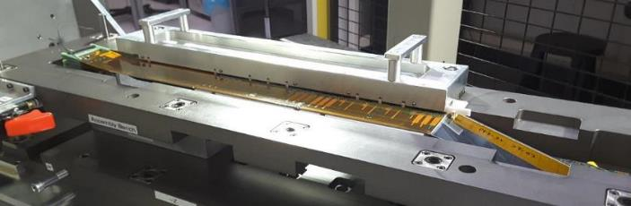
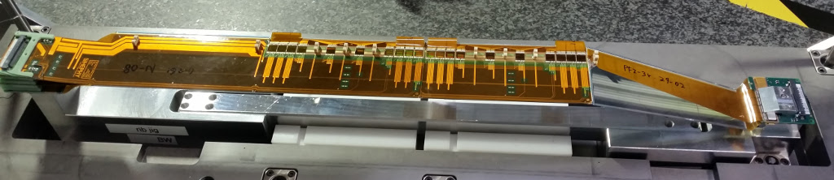
HEPHY (L5)
Site qualified for ladder production in Aug 2015
Sep – Dec 2015: class C ladder for ladder mount test, Keratherm R&D
First class A ladder (L5.002) started Jan 14, 2016 and completed Feb 1, 2016 (12 working days)
Mechanical survey ongoing, electrical test will be done mid of Februrary
L5.002: OS5 gluing
L5.002: CO₂ clip gluing – 2016-01-29
Completed L5.002, still on assembly base – 2016-02-01

Slide 28
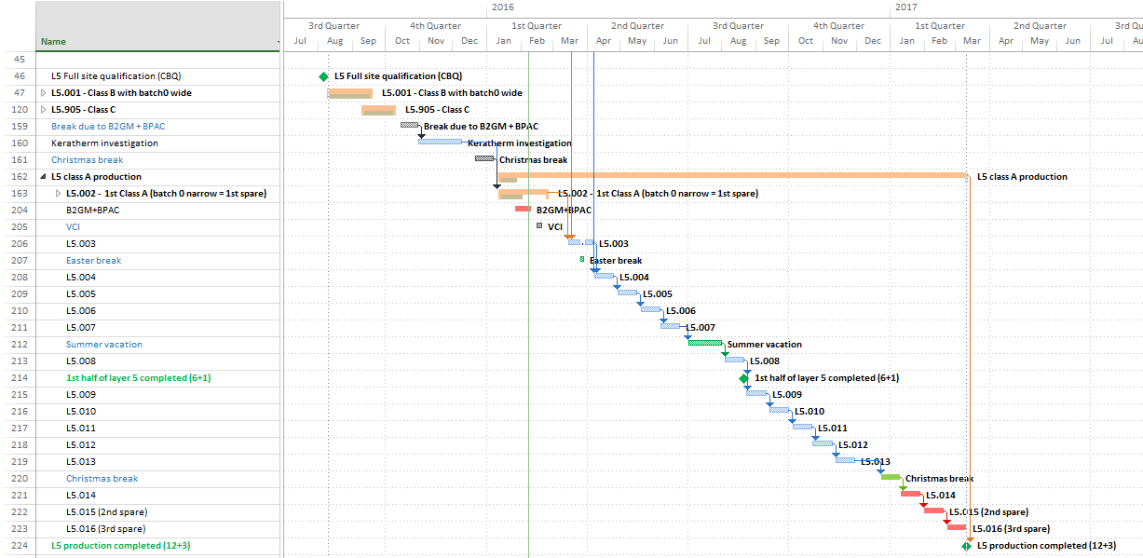
HEPHY schedule
1st half shell completed: Aug 2016
Production completed: Mar 2017

Slide 29
Kavli IPMU (L6)
To address issues identified in the Sep 2015 class C prototype, the group decided to assemble a “class D” ladder
In addition, a focused review (lead by H. Tajima) was held on Dec-9, 2015 and the list of items to investigate was extended
Study items in the class-D ladder
PA1/PA2 gluing and wrapping
High electrical noise around the rib region
FW DSSD lift-up (similar to L4)
Common DB use
Documentation

Slide 30
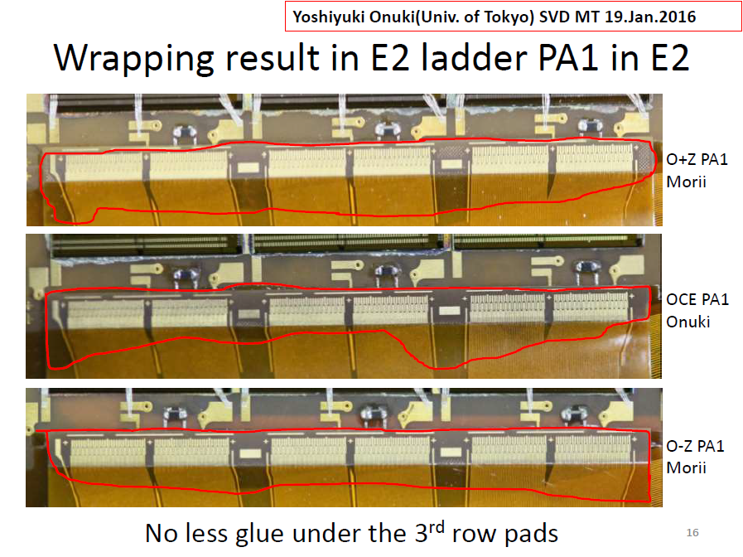
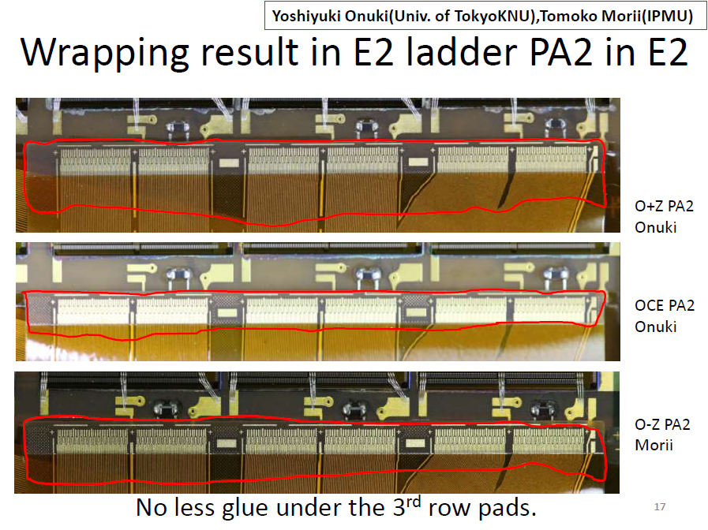
PA1/PA2 gluing and wrapping
Gluing parameters were tuned to reduce the amount of glue as requested by reviewers, glue spreads successfully under the wire bonding pads

Slide 31
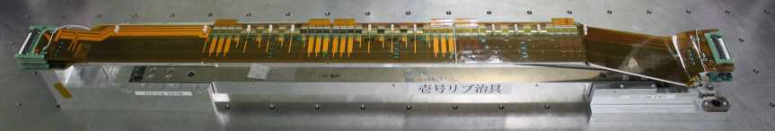
Kavli IPMU (L6)
The class-D assembly was completed on Jan 15, 2016
Outstanding issue in this ladder
Reference points on one side of the ladder are systematically lower by 100-200 μm than nominal
The gap between sensors and ribs will be monitored in the next assembly
The final prototype assembly (class B) has started last week

Slide 32
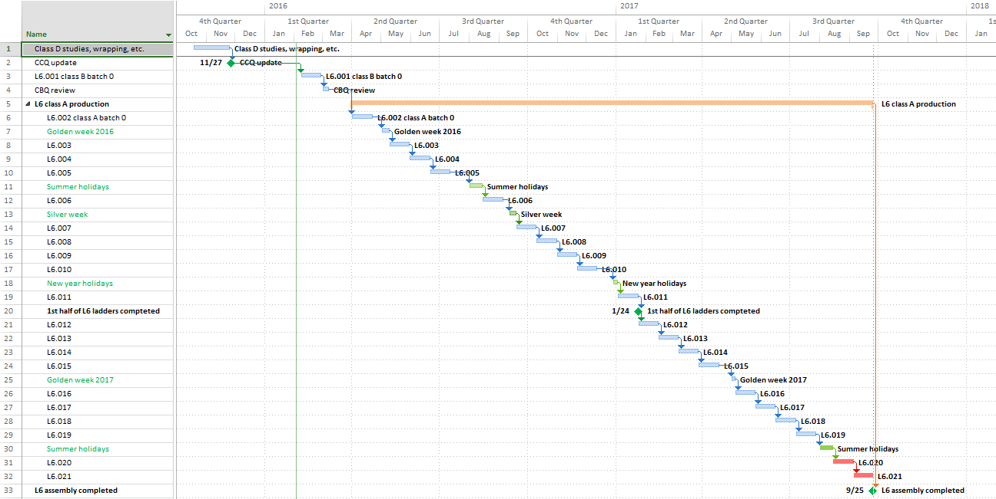
Kavli IPMU schedule
1st half shell completed: Jan 2017
Production completed: Sep 2017

Slide 33
Mechanics and commissioning

Slide 34
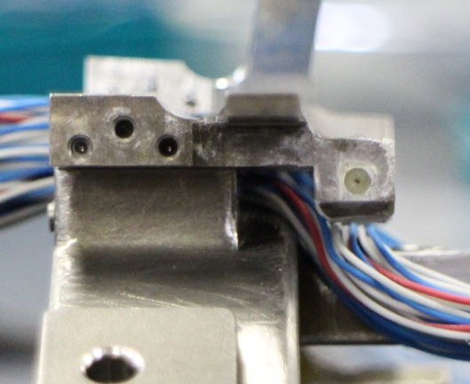
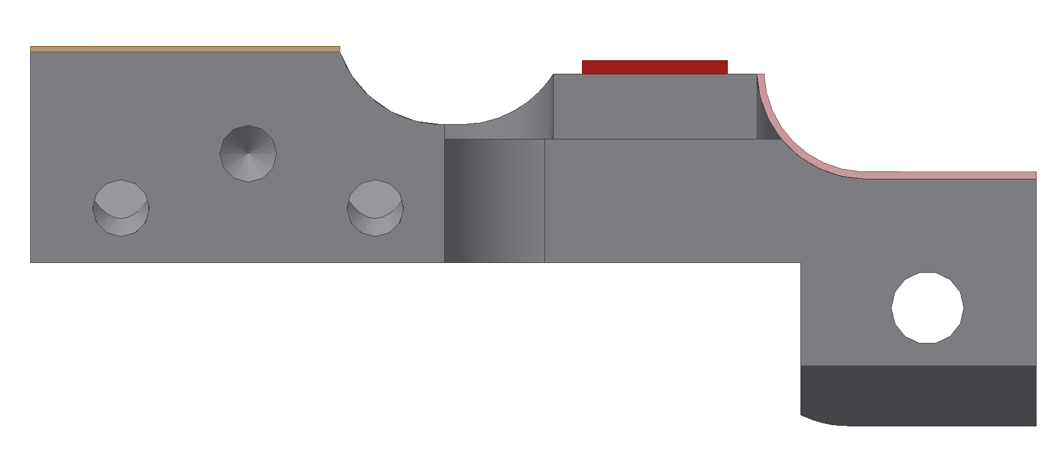
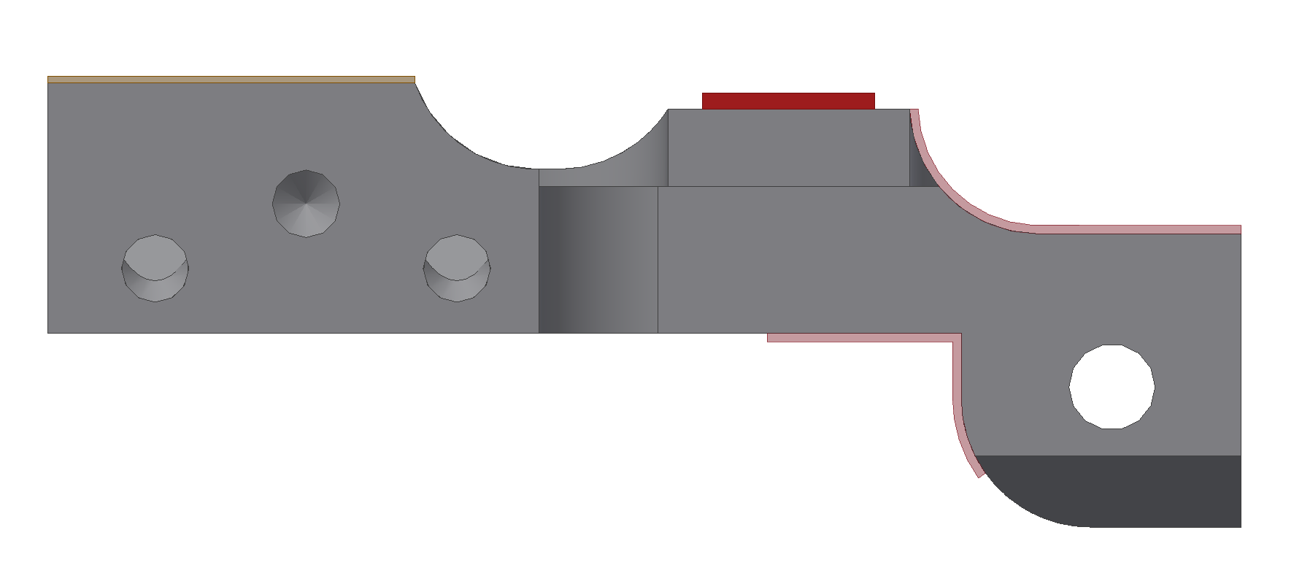
SVD design revision 2.4 → 2.5
Includes
Modification of the L3 bridges, to shift L3 by 1 mm
Fix of a few clearance problems in rev. 2.4
Modification FW L4 endmount to improve L3 cable routing
L4 end mount
OLD
R=3mm
L3 cables (100 wires)
NEW

Slide 35
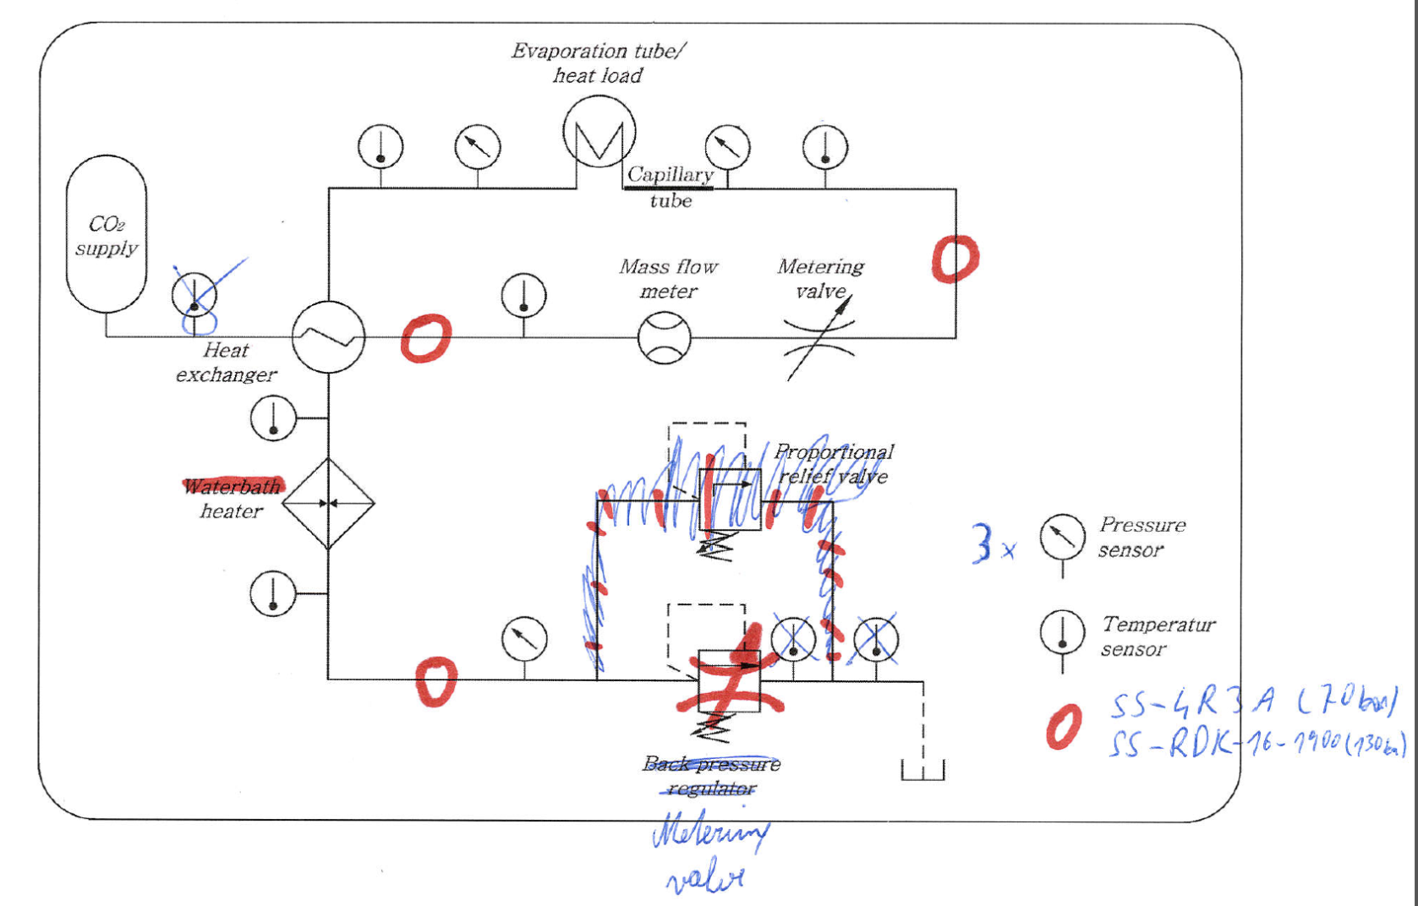


Refurbishment of open CO₂ cooling system
Schedule
December 2015: disassemble current box, order new parts (done)
January 2016: make new box (done)
February 2016: install devices (ongoing)
March 2016: re-write software and test
End of March 2016: Shipping to KEK

Slide 36

CO₂ cooling pipe bending tool
Support for the bent pipe
Bending radius
(much smaller then result due to springback)
For pipe fixation and length control

Slide 37






L6 cooling pipe attachment with cradle tool (Jan-29, 2016)

Slide 38





L6 cooling pipe attachment with cradle tool (Jan-29, 2016)

Slide 39

L6 cooling pipe attachment with cradle tool (Jan-29, 2016)
Support arms are to be prepared to confirm realistic movement for the next step
Similar tool/pipe needs to be prepared for L5 and L4

Slide 40
Schedule for ladder mount
Feb – Jun 2016: Production of missing prototype tools and jigs
24th B2GM (Jun 2016):
Prototype tools/jigs to discuss feedback to final jigs are prepared
Jun 17, 2016 (Fri): Review of ladder mount procedure with the prototype tools/jigs
Jun – Oct 2016: Production of final tools and jigs
25th B2GM (Oct 2016):
Final tools/jigs are prepared
Review of ladder mount procedure with the final tools/jigs as the final feedback
Oct 2016 – Feb 2017: Repeat a number of practices
Address all issues in the ladder mount procedure and finalize it
26th B2GM (Feb 2017):
Get approval of the finalized procedure from SVD group by showing demonstration of a whole steps
Afterwards start ladder mount
End of ladder mount: Oct 2017
Unfortunately, we are ‘one B2GM’ behind the schedule presented at the Oct 2015 BPAC review

Slide 41
Electronics

Slide 42

SVD readout system

Slide 43
FADC redesign
V2 (current version)
2 systems available (one at HEPHY, one at KEK)
Each one capable of reading more than one full ladder
Used in CERN test beams
V3 (redesign)
Main changes: elimination of daughter boards, direct connection between Stratix FPGA and VME bus
Jul – Aug 2015: V3 schematics at HEPHY
Sep – Dec 2015: conversion P-cad → Mentor done by company
Feb 2016: manufacturing of two prototype PCBs, firmware migration to V3
Feb/Mar 2016: testing and debugging of V3 at HEPHY
Apr 2016: test of V3 at the DESY test beam

Slide 44

Improving noise hardness of the FADC system
Increasing C35 capacitor from 10 → 100 nF
Presented at the Oct 2015 VXD review
C35 now changed on all hybrid boards, new C35 will be used in origami assembly
LV power lines
Separate +10V LV power lines for p- and n-sides have been identified as a potential source of common mode noise
Combining the lines up to the DOCKs would require a change in FADC, DOCK PCBs and PS patch panels
The proposal is to implement this in FADC V4

Slide 45
Updated FADC schedule
May – Sep 2016: Development of V4 hardware (FADC, junction board) and remaining firmware
Oct – Dec 2016: Production of V4 and junction board prototypes
Jan/Feb 2017: Final test of V4 at HEPHY
Mar – May 2017: “mass production” (58 boards) of V4 including optical and electric testing at the company, in system test at HEPHY

Slide 46
SVD schedule

Slide 47

Ladder production schedule
End of FW/BW production: Jul 2016
End of L6 production: Sep. 2017

Slide 48

Integration schedule
SVD ready: Dec 2017
Start of ladder mount: Feb 2017
VXD integration: from Dec 2017

Slide 49
SVD milestones
 | Feb 2016 BPAC (Oct 2015 BPAC)
Completion origami+PA0 mass production | ¹⁾ (Mar 2016)
All assembly sites qualified | Mar 2016 (Jan 2016)
First class A ladder | Jan 2016 (Nov 2015)
Start of ladder mount | Feb 2017 (Oct 2016)
SVD ready | Dec 2017 (Sep 2017)
Start of VXD integration | Dec 2017 (Nov 2017)
Start of VXD installation | Jun 2018 (Apr 2018)
¹⁾ Depends on the option to be chosen for the origami mass production

Slide 50
Schedule risk
Critical path defined by
L6 production
VXD integration and installation
Very little contingency in the present schedule
No contingency in the L6 schedule
2 months SVD only commissioning very tight
3 months VXD commissioning very tight
Any further delay accumulated in L6 production must be absorbed in the VXD integration/installation phase

Slide 51
L6 schedule risk and mitigation stragegy
L6 critical schedule is determined by several elements
Delay in the availability of components and start of assembly
Marginality of manpower at IPMU
Especially in terms of long-term availability of expert manpower
Complexity and length of the L6 ladder assembly procedures
All aspects need to be addressed to mitigate the risk
Great technical progress at IPMU, light at the end of the tunnel for the origamis.
Reassess at the end the class B production (end of Feb)
So far weak counter measures have been realized
Need a stronger reaction from IPMU→hire 2 HW postdocs
Organize longer working hours and weekend/vacation activity
Explore the possibility of a wide mobilization of the collaboration to provide manpower at IPMU
Only little optimization of the procedures is foreseeable
Explore the possibility of setting up a second production line

Slide 52
Second L6 assembly line
In December 2015 Pisa was asked to explore the possibility to setup a second L6 assembly line
A preliminary schedule for setting up the line is the following:
Jig production, site qualification, prototypes (6-8 months): →Oct 2016
Class C/B production: November-December 2016
Final qualification: End of 2016
Several issues need to be resolved and understood
funding and support from INFN
preparation of the jigs and qualification of the site
availability of class C sensors for prototyping
compatibility with the FW/BW assembly and manpower in Pisa
Another possibility is to setup a second line at IPMU in the L4 assembly area once L4 is finished
Need acceleration of L4 effort (injection of manpower required)
Need full support from IPMU for jig reproduction
We ask BPAC for guidance in how to proceed to most effectively reduce the schedule risks for the overall SVD production

Slide 53
Summary
Ladder assembly
The Pisa, HEPHY and Melbourne sites are in production mode, TIFR and Kavli IPMU are almost there
Need to make a transition into production mode
L6
Great progress following the December review, very dim light at the end of tunnel
However, we need to restore contingency in the L6 schedule as it poses a serious risk to the overall schedule → BPAC input
Origami mass production
Stopped due to blister formation in reflow step
Mitigation plan exists – impact on the overall schedule is limited
Mechanics and commissioning
We have seen nice progress in the development of the ladder mount procedure but unfortunately a milestone has been missed, resulting in ~3 months delay
Electronics
FADC redesign is on schedule, V3 is will tested in the DESY April 2016 testbeam

Slide 54
backup

Slide 55


Keratherm foils
Manufacturer:
Kerafol, Germany
Product family:
Softtherm
Thermoplastic elastomere
Contains silicone oil
Originally foreseen material:
Softtherm 86/125
0.5mm thickness
Color: red
Replacement candidate:
Softtherm 86/235
0.5mm thickness
Color: yellow

Slide 56

Temperatures before and after irradiation
 |  | Softtherm 86/235 (yellow, new)
 |  | end mount | apv guard | cooling | Δt | Δt
 |  | p | n | block | p | n
FW | normal | 13,3 °C | 20,4 °C | 6,1 °C | 7,2 °C | 14,3 °C
 | irradiated | 12,4 °C | 19,9 °C | 4,7 °C | 7,7 °C | 15,2 °C
BW | normal | 9,3 °C | 19,2 °C | 3,5 °C | 5,8 °C | 15,7 °C
 | irradiated | 7,4 °C | 18,2 °C | 4,2 °C | 3,3 °C | 14,0 °C
 |  | Softtherm 86/125 (red, old)
 |  | end mount | apv guard | cooling | Δt | Δt
 |  | p | n | block | p | n
FW | normal | 11,9 °C | 19,0 °C | 3,9 °C | 8,0 °C | 15,1 °C
 | irradiated | 8,7 °C | 17,2 °C | 4,1 °C | 4,6 °C | 13,1 °C
BW | normal | 10,7 °C | 19,7 °C | 4,9 °C | 5,8 °C | 14,8 °C
 | irradiated | 7,9 °C | 18,5 °C | 3,6 °C | 4,3 °C | 14,9 °C
APV guard (n)
Δt n
APV guard (p)
Δt p
Cooling block
Ice water
Softtherm 86/235, BW, irradiated
Thermal properties of both materials are similar
No significant change due to irradiation

Slide 57


Measurement of softness
Put 2 strips of Softtherm on granite table, placed Al plate on top
Measured height of plate with CMM
Put weight on aluminum plate (~2kg) and measured height of plate again
Height difference shows the compression of the Softtherm
Deformation = Height difference | Softtherm 86/125 red, old type | Softtherm 86/235 yellow, new type
unirradiated sample | 71µm | 35µm
Irradiated sample | 6µm | 14µm
Old red Softtherm 86/125:
Highly compressible at beginning but get much harder due to irradiation.
New yellow Softtherm 86/235:
Less compressible, but stay more compressible after irradiation.

Slide 58
Hybrid soldering (reflow+hand) option
Procedure at Saiden
Prebaking + dry reflow (120 ℃ for 17 hours)
Not at once, divided in some batches (for example 30 * 4)
Bonding pads masked
Kept in the desiccator
Masking work
Kept in the desiccator
Second prebaking (120 ℃ 17 hours)
Solder paste printing
Reflow
Visual inspection at KEK for blisters
Hand soldering of connectors

