Slide 1
SVD Update
Most slides from Christoph Schwanda presentation at
BPAC 7-9/2/2018 https://kds.kek.jp/indico/event/20409/
Francesco Forti
Stefano Bettarini

Slide 2
Summary of updates
Origami blisters
Ladder assembly
Ladder mount and commissioning
Schedule
Second assembly line

Slide 3
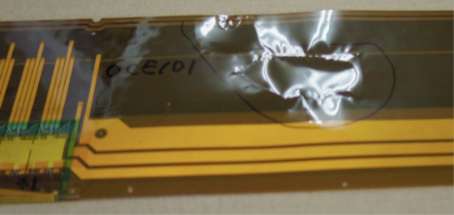
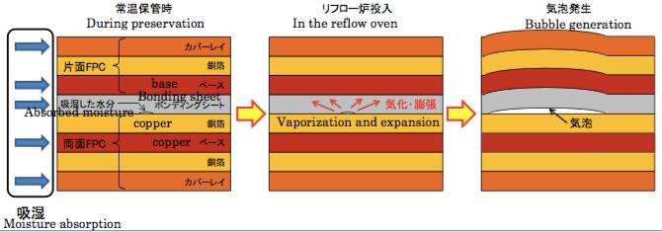
Origami flex blister issue
End of Nov 2015: large blisters appear on 5 out of 5 OCE circuits during the reflow step of batch1 mass production
Potential to destroy all origami circuits, mass production is halted for investigation of the issue
Bubbles are most likely due to humidity absorbed by the circuits (long storage at soldering company in non-humidity controlled environment)
Moisture expands in the oven due to high temperature (230 °C) during reflow

Slide 4
Possible solutions
Manual soldering
Hybrid option
Components on origami are placed and soldered by hand
10 circuits/week (compared to 11.5 for reflow)
Circuits are dried by pre-baking at 120 °C for 17 hours
Dry reflow is performed to select good pieces
Perform another pre-baking at the day of reflow
Reflow soldering of components, except connectors
Manual soldering of connectors
Reproduction of failed circuits

Slide 5
Possible solutions
Manual soldering
Hybrid option
Pros:
Effective
Schedule predictable and faster than the hybrid plan (10 circuits/week)
Cons:
Costs 50% higher than the original plan
Costs could be higher than in the hybrid option depending on the failure rate
Pros:
Possibly cheaper in case of low failure rate of the pre-baking cure
Cons:
Failure rate not precisely know, could be 40%
Pre-baking could cause pad oxidation leading to bonding/soldering problems
Schedule depends on failure rate, lower than manual soldering

Slide 6
Recovery strategy
Short term
A few pieces (8 O+Z and 6 O-Z) have already survived standard reflow @ Saiden
5 OCE have been populated by hand soldering @ Saiden
15 circuits (5 OCE, 5 O+Z, 5 O-Z) have been successfully pre-baked and will be equipped by vapor-phase soldering @ HEPHY
Complete these circuits and distribute them in an optimized way to assembly sites in time to maintain production
This allows to operate from mid March to end of June 2016
Long term
Perform the necessary R&D to choose one solution (manual soldering or hybrid option)
Determine failure rate with long pre-baking+reflow & perform tests on pad oxidation
Complete this R&D by end of March 2016

Slide 7
SVD ladder assembly
FW/BW assemblies: Pisa is in full production mode
L3: Melbourne qualified, waiting for the modified bridges
L4: TIFR producing the final class B → CBQ Feb 26
L5: HEPHY produced the first class A
L6: IPMU producing the final class B →CBQ beg March
Production should start in full swing in March
Today

Slide 8
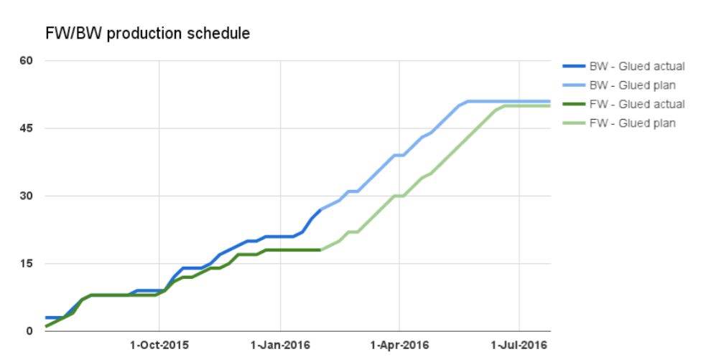
Pisa schedule
Today’s status

Slide 9
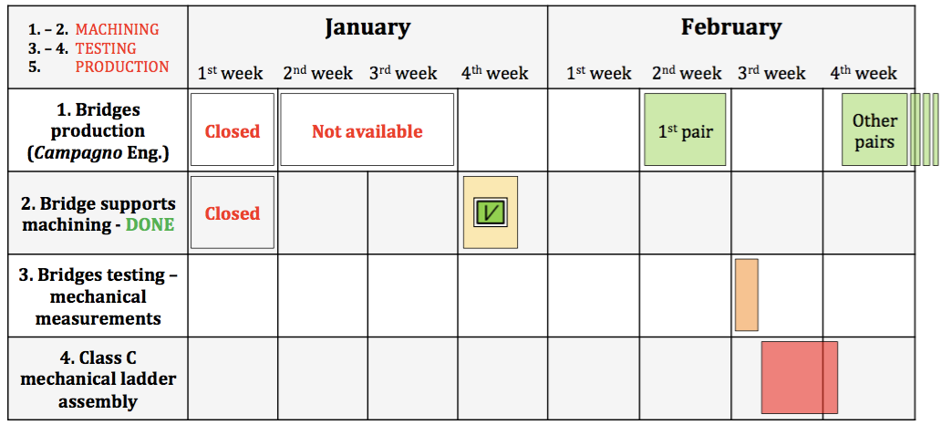
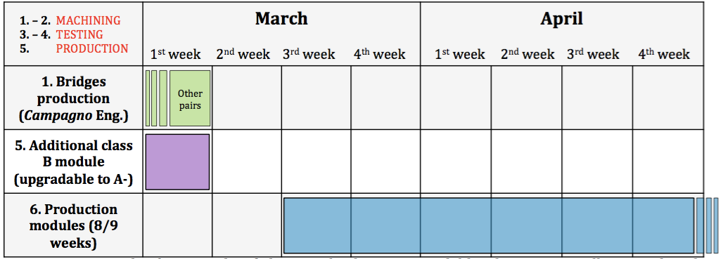
Melbourne schedule
To finish in May…

Slide 10
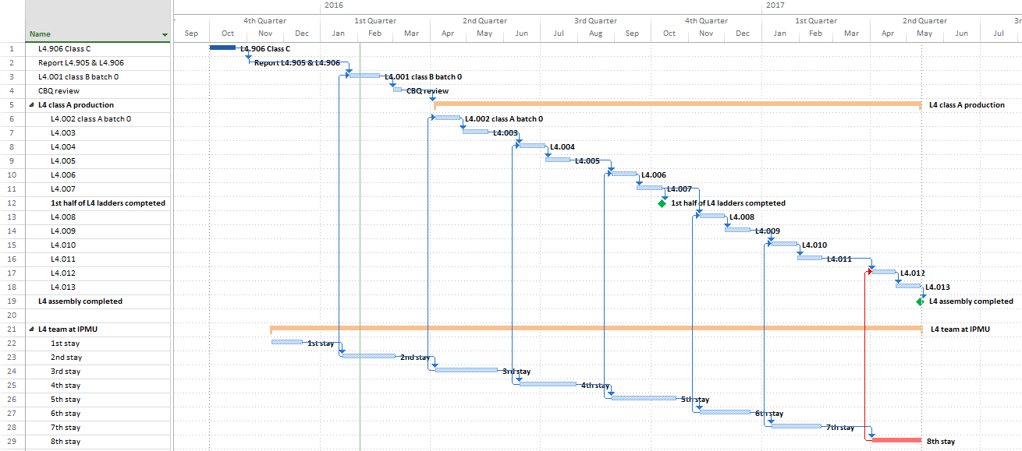
TIFR schedule
1st half shell completed: Oct 2016
Production completed: May 2017
Note the suspension periods due to personnel travel constraints

Slide 11
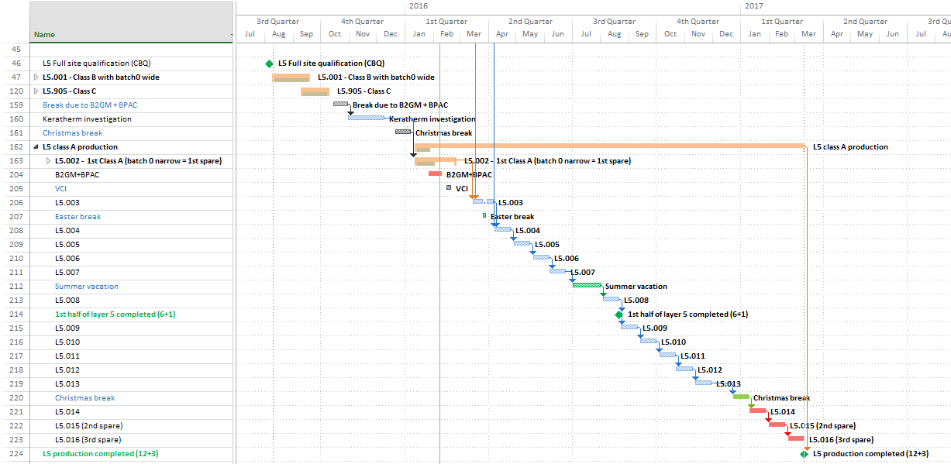
HEPHY schedule
1st half shell completed: Aug 2016
Production completed: Mar 2017
Group in HEPHY seems adequate to cover the needs

Slide 12
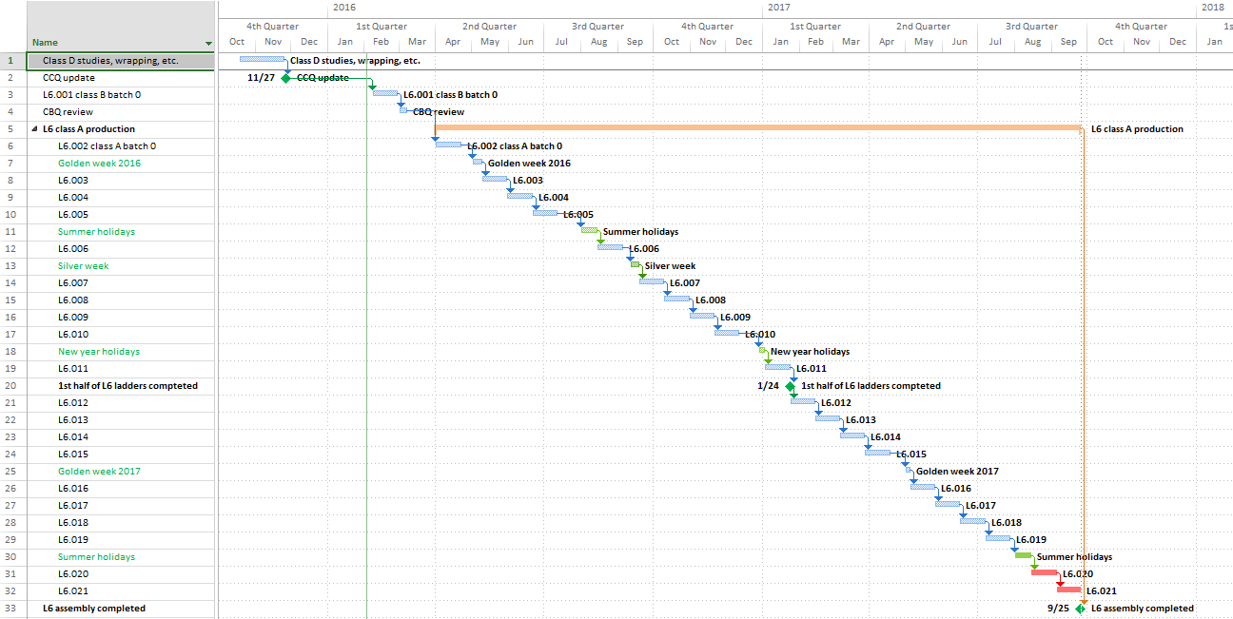
Kavli IPMU schedule
1st half shell completed: Jan 2017
Big improvement in focus after internal Japanese review
Manpower (especially long term) marginal
Production completed: Sep 2017

Slide 13
Ladder mount and commissioning

Slide 14
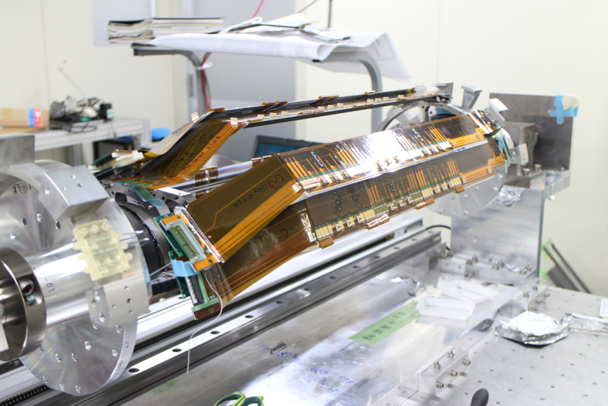
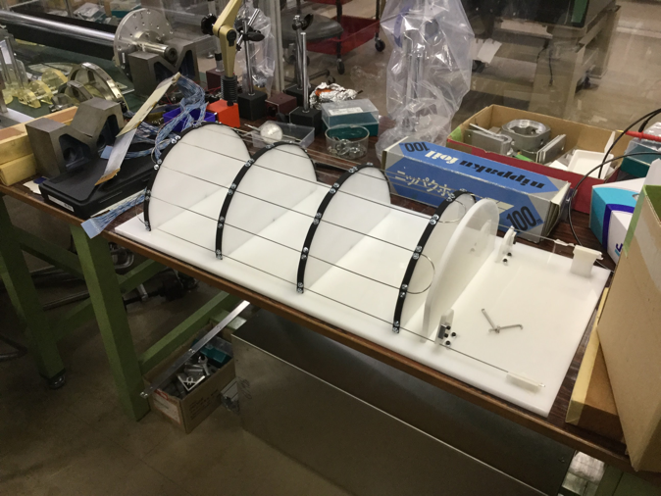
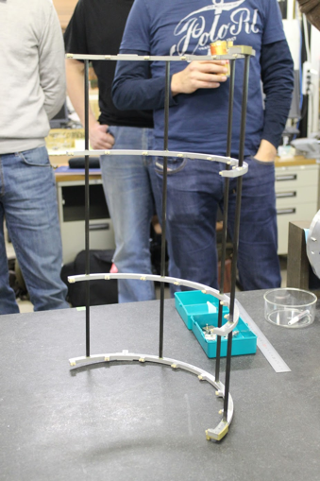
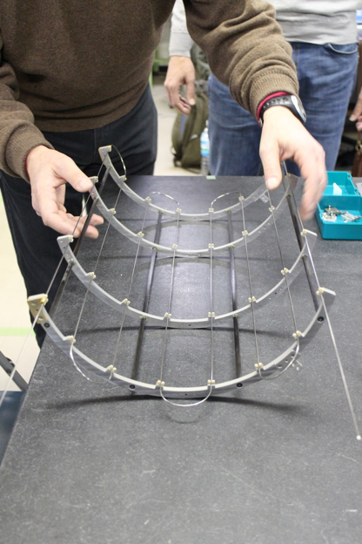
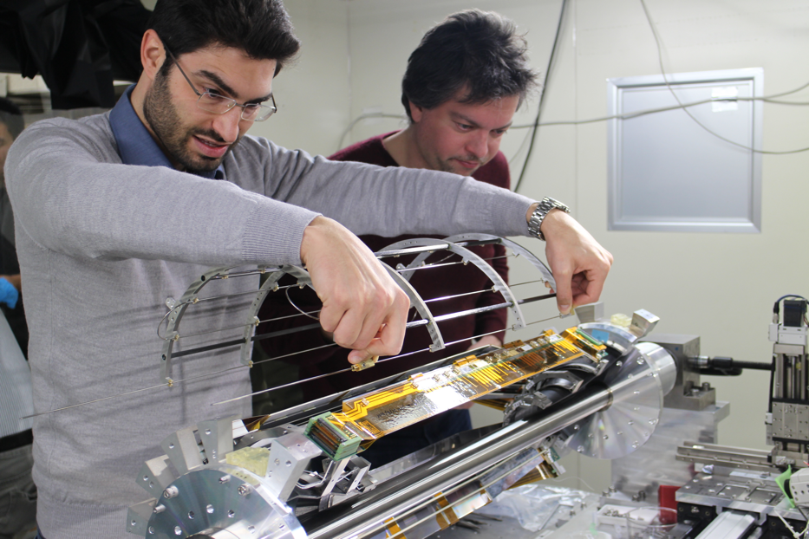
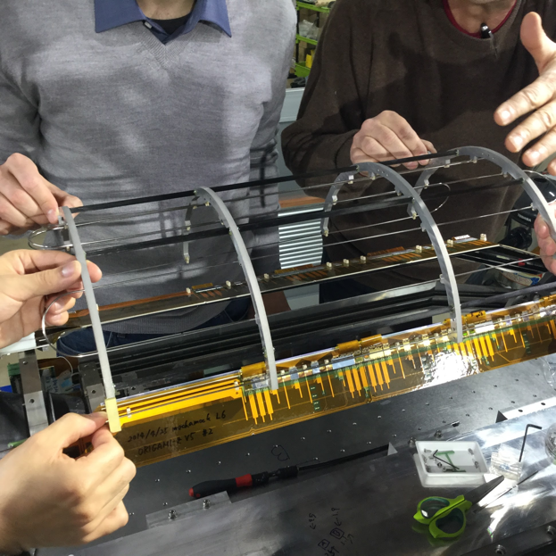
L6 cooling pipe attachment with cradle tool (Jan-29, 2016)

Slide 15

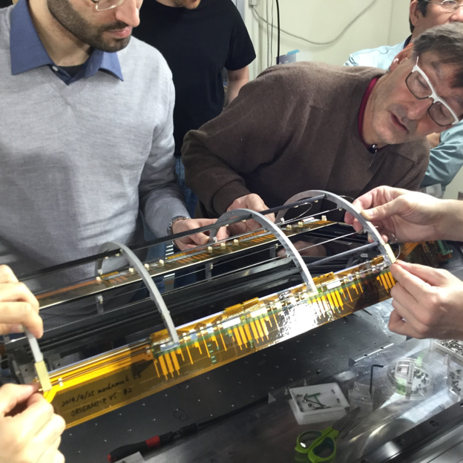
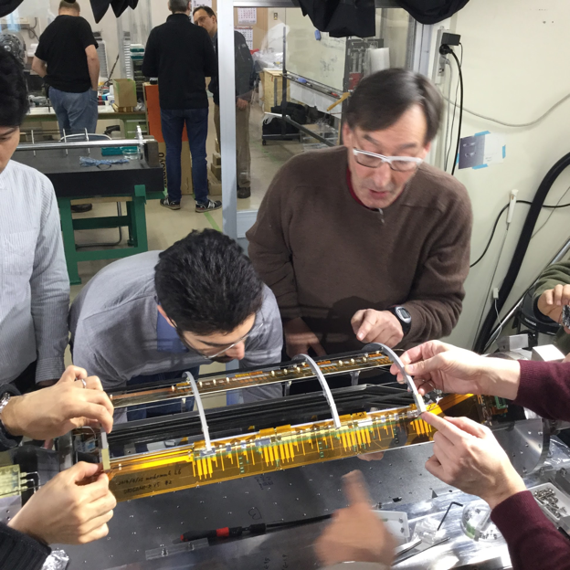
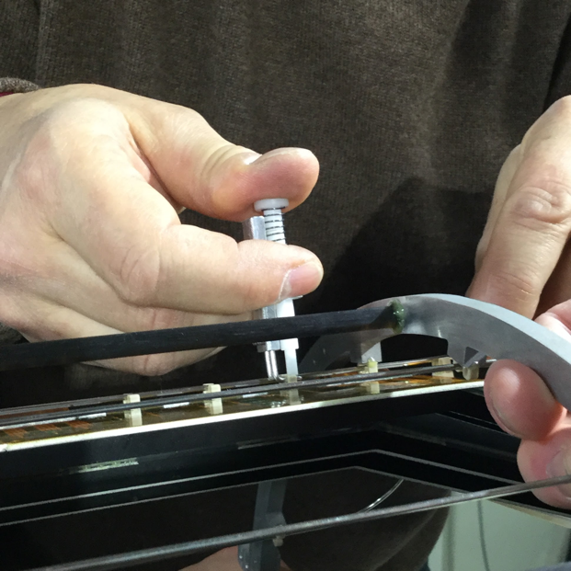
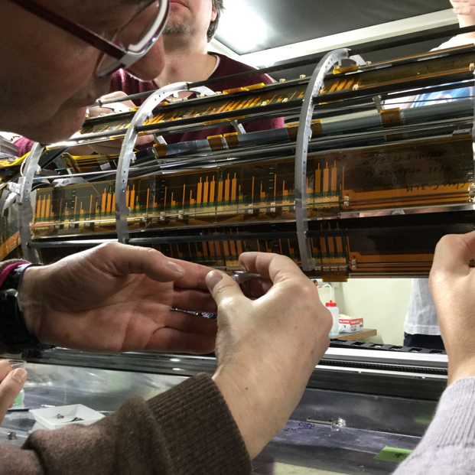
L6 cooling pipe attachment with cradle tool (Jan-29, 2016)

Slide 16
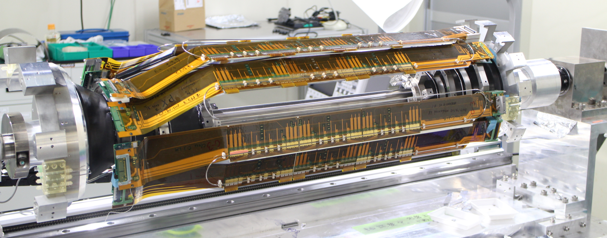
L6 cooling pipe attachment with cradle tool (Jan-29, 2016)
Support arms are to be prepared to confirm realistic movement for the next step
Similar tool/pipe needs to be prepared for L5 and L4

Slide 17
Schedule for ladder mount
Feb – Jun 2016: Production of missing prototype tools and jigs
24th B2GM (Jun 2016):
Prototype tools/jigs to discuss feedback to final jigs are prepared
Jun 17, 2016 (Fri): Review of ladder mount procedure with the prototype tools/jigs
Jun – Oct 2016: Production of final tools and jigs
25th B2GM (Oct 2016):
Final tools/jigs are prepared
Review of ladder mount procedure with the final tools/jigs as the final feedback
Oct 2016 – Feb 2017: Repeat a number of practices
Address all issues in the ladder mount procedure and finalize it
26th B2GM (Feb 2017):
Get approval of the finalized procedure from SVD group by showing demonstration of a whole steps
Afterwards start ladder mount
End of ladder mount: Oct 2017
Unfortunately, we are ‘one B2GM’ behind the schedule presented at the Oct 2015 BPAC review

Slide 18
SVD schedule

Slide 19
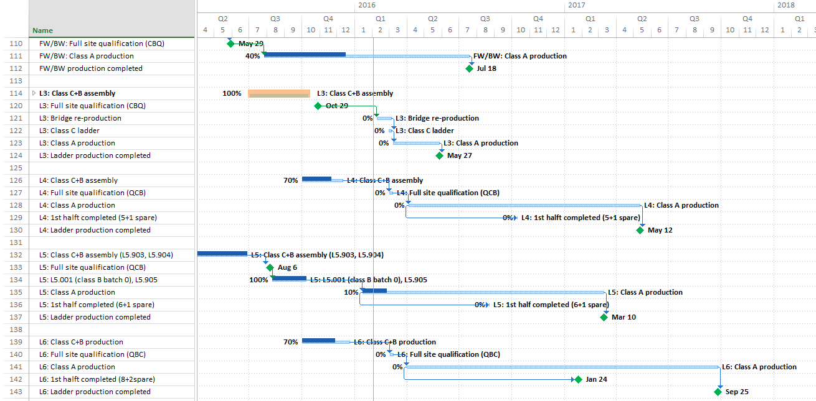
Ladder production schedule
End of FW/BW production: Jul 2016
End of L6 production: Sep. 2017

Slide 20
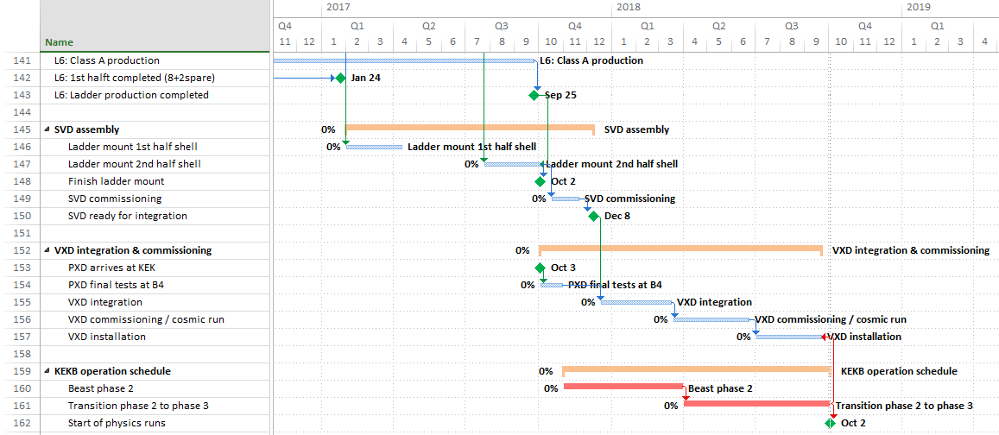
Integration schedule
SVD ready: Dec 2017
Start of ladder mount: Feb 2017
VXD integration: from Dec 2017

Slide 21
SVD milestones
 | Feb 2016 BPAC (Oct 2015 BPAC)
Completion origami+PA0 mass production | ¹⁾ (Mar 2016)
All assembly sites qualified | Mar 2016 (Jan 2016)
First class A ladder | Jan 2016 (Nov 2015)
Start of ladder mount | Feb 2017 (Oct 2016)
SVD ready | Dec 2017 (Sep 2017)
Start of VXD integration | Dec 2017 (Nov 2017)
Start of VXD installation | Jun 2018 (Apr 2018)
¹⁾ Depends on the option to be chosen for the origami mass production

Slide 22
Schedule risk
Critical path defined by
L6 production
VXD integration and installation
Very little contingency in the present schedule
No contingency in the L6 schedule
2 months SVD only commissioning very tight
3 months VXD commissioning very tight
Any further delay accumulated in L6 production must be absorbed in the VXD integration/installation phase

Slide 23
L6 schedule risk and mitigation stragegy
L6 critical schedule is determined by several elements
Delay in the availability of components and start of assembly
Marginality of manpower at IPMU
Especially in terms of long-term availability of expert manpower
Complexity and length of the L6 ladder assembly procedures
All aspects need to be addressed to mitigate the risk
Great technical progress at IPMU, light at the end of the tunnel for the origamis.
Reassess at the end the class B production (end of Feb)
So far weak counter measures have been realized
Need a stronger reaction from IPMU→hire 2 HW postdocs
Organize longer working hours and weekend/vacation activity
Explore the possibility of a wide mobilization of the collaboration to provide manpower at IPMU
Only little optimization of the procedures is foreseeable
Explore the possibility of setting up a second production line

Slide 24
Second L6 assembly line
In December 2015 Pisa was asked to explore the possibility to setup a second L6 assembly line
A preliminary schedule for setting up the line is the following:
Jig production, site qualification, prototypes (6-8 months): →Oct 2016
Class C/B production: November-December 2016
Final qualification: End of 2016
Several issues need to be resolved and understood
funding and support from INFN
preparation of the jigs and qualification of the site
availability of class C sensors for prototyping
compatibility with the FW/BW assembly and manpower in Pisa
Another possibility is to setup a second line at IPMU in the L4 assembly area once L4 is finished
Need acceleration of L4 effort (injection of manpower required)
Need full support from IPMU for jig reproduction
We ask BPAC for guidance in how to proceed to most effectively reduce the schedule risks for the overall SVD production

Slide 25
Second assembly line discussion
Creating a second assembly line for L6 is essential to create contingency in the schedule
The overhead of creating the line in Pisa (cost, effort, time) does not seem justified at this time
Seriously explore the possibility to create a second L6 line at IPMU after the L4 assembly is completed
Need to accelerate the L4 assembly
Second assembly bench available. Need to duplicate some jigs, but many can be shared between the two assembly lines with careful scheduling.
Need significant injection of manpower
IPMU will hire 1 (+1) postdocs dedicated to the assembly + wirebonding expert to replace esisting one (maternity leave)
Need help from other institutes

Slide 26
Collaboration mobilization
To accelerate the L4 assembly schedule
Optimize and parallelize the operations (some small gain is possible)
Cover the 1 month-periods when the main TIFR person needs to be back home:
May 2016 – conflicts with FW/BW assembly
Aug 2016 – difficult. Maybe in part
Oct-Nov 2016 – yes
Beg 2017 – yes
Team: 1 Pisa phys + 1 Pisa technician + 1-2 TIFR technicians
Possibility to gain 2-3 months → end of L4 beginning of 2017.
To operate L6 assembly lines at IPMU
Combination of IPMU + Pisa + TIFR starting in fall 2016, but mostly in 2017
Travel costs
Model of sharing the costs among the institutions
Details to be worked out

Slide 27
Attività Pisa SVD
Nel 2016:
FW-BW procedono come previsto
Contributo rilevante all’assemblaggio delle cooling pipes
Nel 2016 preparazione. Effettivo montaggio nel 2017
Mobilitazione per risolvere i problemi di schedule:
Si prevede una necessita’ totale di circa 4 mu nel 2016
2 persone x (15 gg training + 45 gg operativi)
Speriamo che IPMU possa coprire 1 mu
Finalizzazione patch panel power supplies; DESY beam test
Nel 2017:
Continuazione ladder assembly a IPMU fino a Maggio – Giugno
Da quantificare – anche considerando la disponibilta’ delle persone
Inizio ladder mount e cooling pipe assembly
Prima metà a partire da Feb 2017, seconda metà a partire da Lug 2017
Integration, commissioning,….

