Slide 1
PADME Ecal status
Mauro Raggi
PADME general meeting Frascati, 2 March 2015

Slide 2
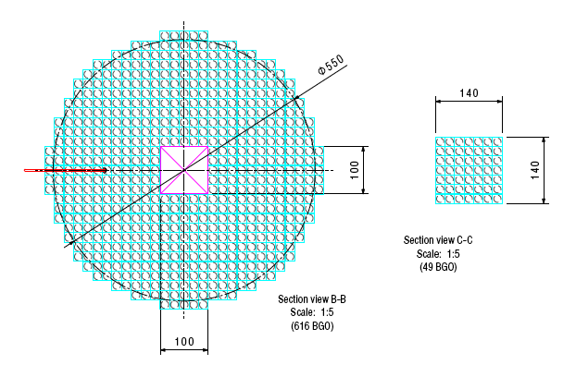
The PADME photon veto system
Geometrical defintion
6 cm θ=20 mrad
28.5 cm θ=93 mrad
ECal
SAC
(small angle calorimeter)
Good gamma defintion
9 cm θ= 30 mrad
24 cm θ= 80 mrad

Slide 3
ToyMC BG studies
Detector acceptance
Lost
LAV
Target
Ecal
SAC
Detector | Angle | Name
Small angle Calo | 0-20 mrad | NSAC
Electromagnetic Calo | 20-80 mrad | NCal
Large angle Veto | 80-110 mrad | NLAV
Lost | >110 mrad | Nlost
Define the layout of the photon veto system of the PADME experiment on the basis of rejection factors for γγ and γγγ BG
Uses 100K e⁺e⁻ ->γγ generated using CalcHep program
Uses 1M e⁺e⁻ ->γγ(γ) generated using CalcHep program
Provides kinematics distribution of the 3 final state gamma
Still to be implemented angular correlation with primary positron in MC and beam spot size

Slide 4
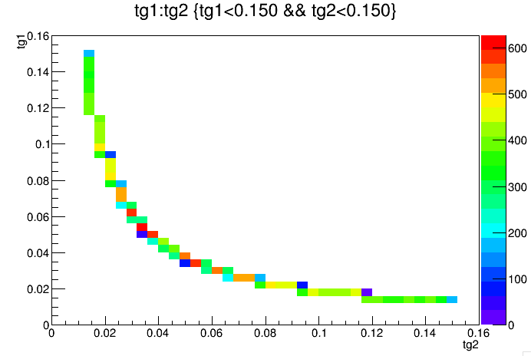
The 2γ background kinematic
Ecal acc
Ecal good γ
Ecal good γ
Ecal acc

Slide 5
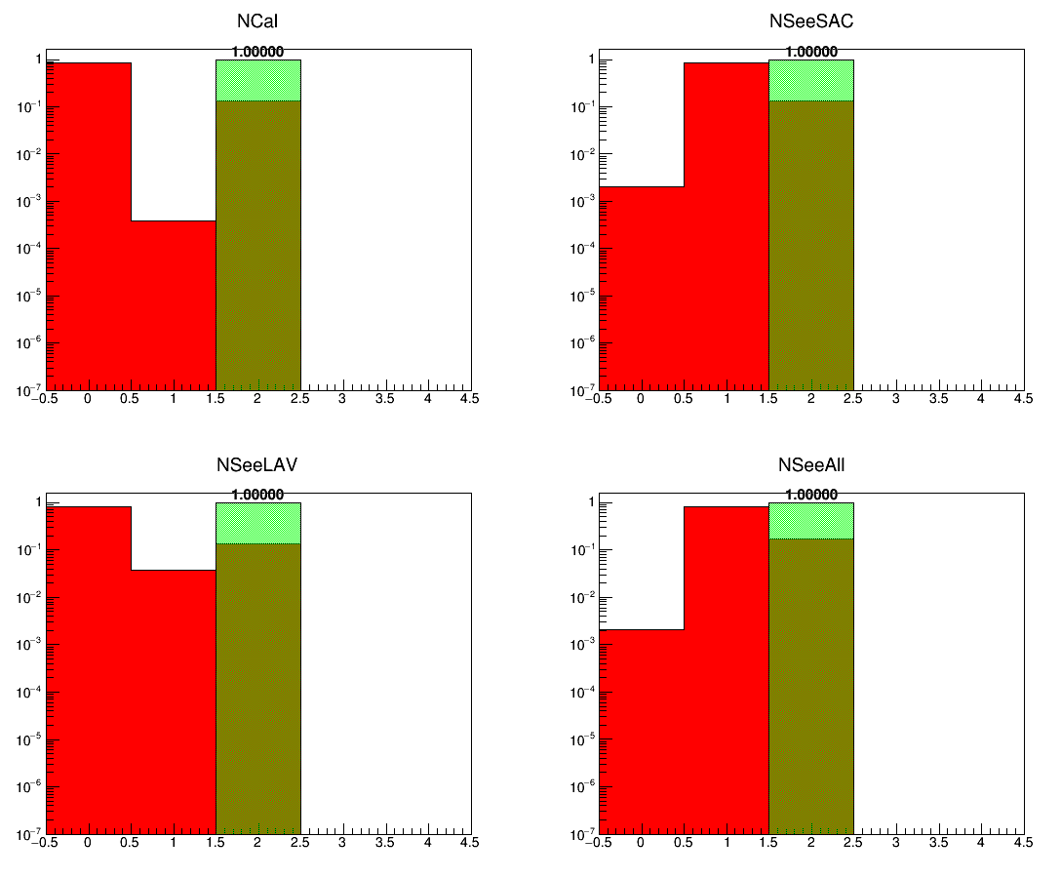
After applying the 1γ cut
Ncal
NSAC+Ncal
Pure geometry
1 good gamma:
1γ in 30<θ<80 mrad
10<Eγ<500 MeV
Ncal+LAV
NSAC+Ncal+LAV

Slide 6
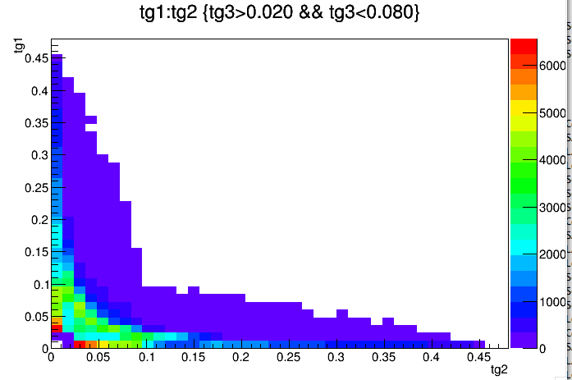
3g background kinematics

Slide 7
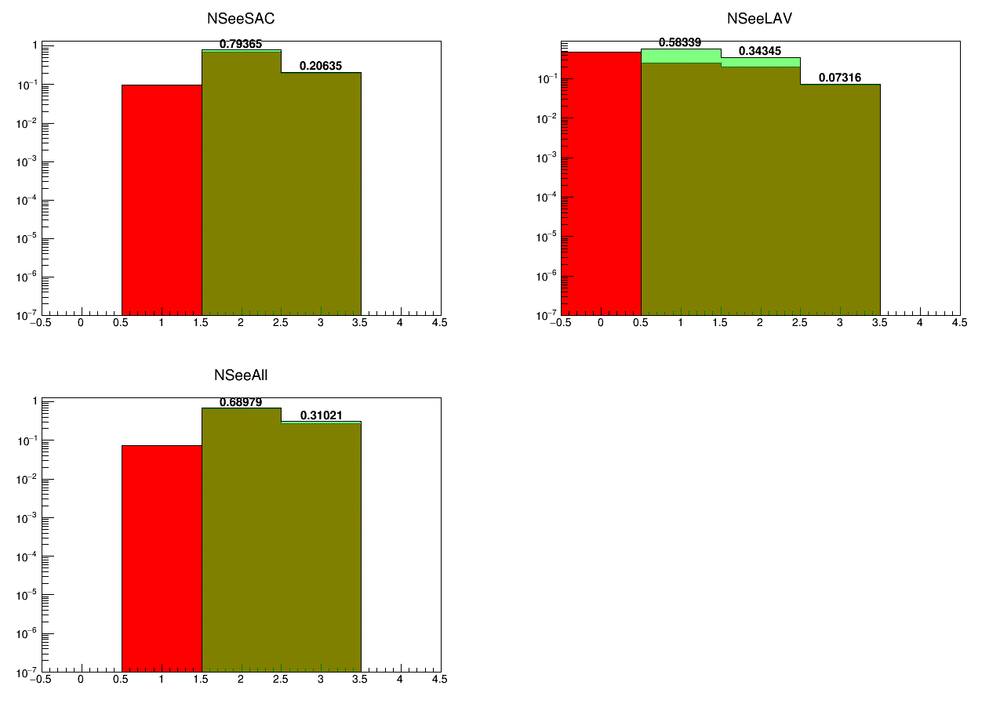
With standard 1γ definition
NSAC+Ncal
Ncal+LAV
NSAC+Ncal+LAV
Pure geometry
1 good gamma:
1γ in 30<θ<80 mrad
10<Eγ<500 MeV
Ecal + SAC always contain at least 2 gammas if Ecal has a good one Ecal +LAV has a 58% inefficiency! LAV does’nt help that much.

Slide 8
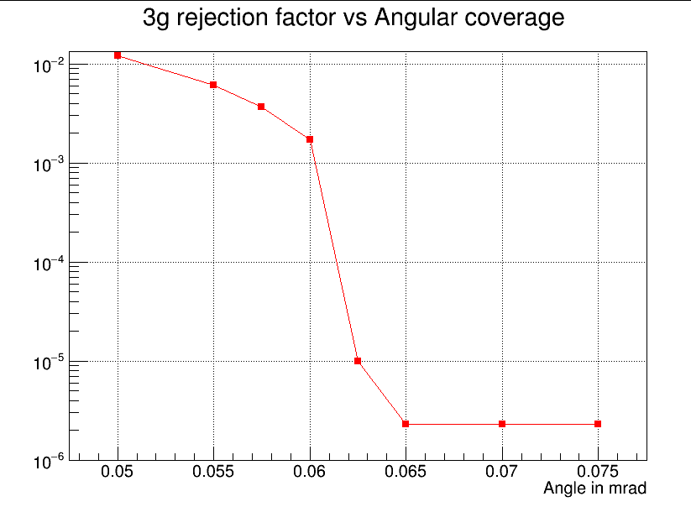
Changing acceptance
Two gamma BG can be reduced to 0 just by using the Ecal if Ecal acceptance is properly defined
At least 2 of the 3 gamma background can be detected with a full angular coverage of θ<65 mrad (ECal+SAC)
Minimum energy in the SAC is not that relevant in the SAC inefficiency

Slide 9
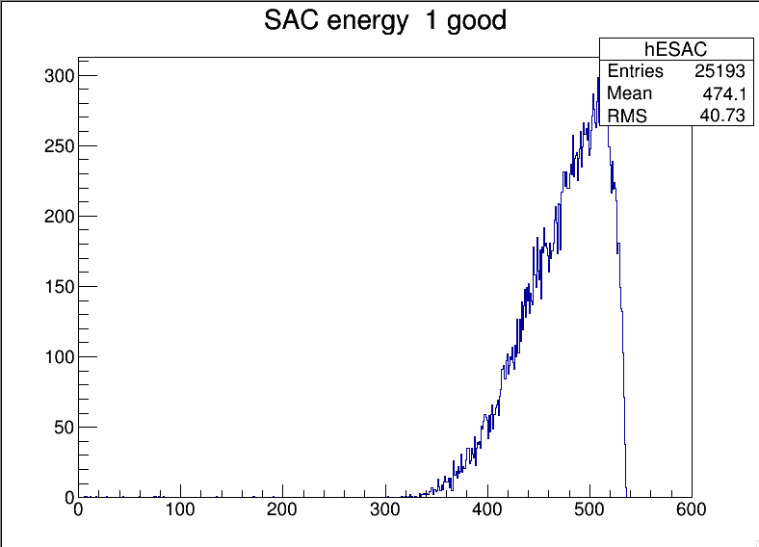
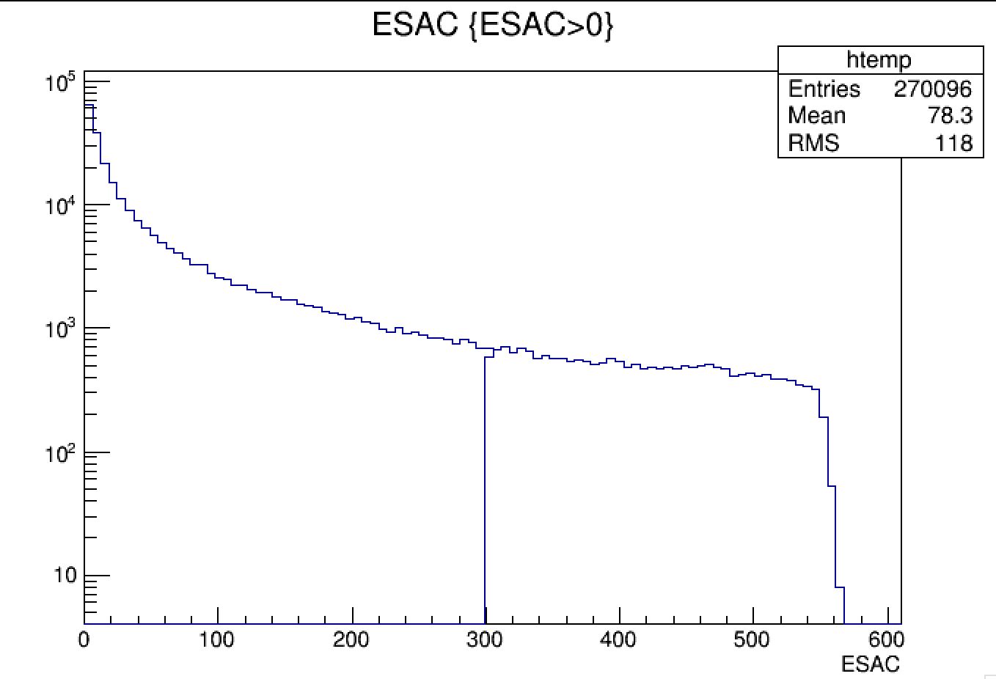
SAC energy distributions
Eγ distribution in the sac
from 3γ
Eγ distribution in the sac
from Bremsstrahlung
270096
20749
Energy distribution in the sac under the condition:
(GisGood==1. && NClusters==1. && NSAC<2)
Only about 7.7% of the IB photon with E>300MeV
Need a detector blind to photons below 100 MeV

Slide 10
Study of veto efficiency due to timing
Assuming the system has a timing resolution in the difference Ecal-SAC of the order of 500ps with small dependence from the energy
Ecal <700 ps per crystal
SAC <300 ps per crystal
We can estimate the effect of missing gamma due to timing by hit and miss technique once a inefficiency is established
Obtain BG estimates for the full 1e13 run.
The inefficiency is related to the timing window of the veto.
We can estimate random veto probability per single photon

Slide 11
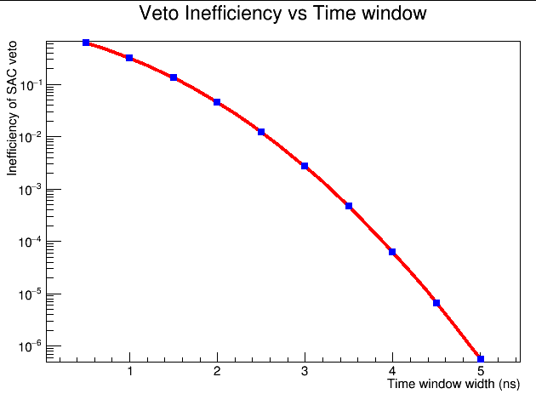
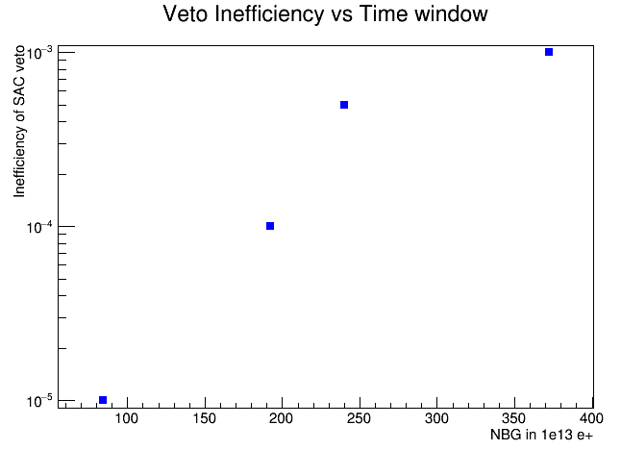
Veto Ineff vs time window
3.3 ns window
3.5 ns window
3.8 ns window
4.4 ns window
Ineff SAC | BG acc | NBG 1e13 | T_{wind} in ns | Veto prob 1γ
1e-3 | 6.2e-5 | 372 | 3.3 | 8.2% in 40ns
5e-4 | 4.0e-5 | 240 | 3.5 | 8.75% in 40ns
1e-4 | 3.2e-5 | 192 | 3.8 | 9.5% in 40ns
1e-5 | 1.4e-5 | 84 | 4.4 | 11% in 40ns

Slide 12
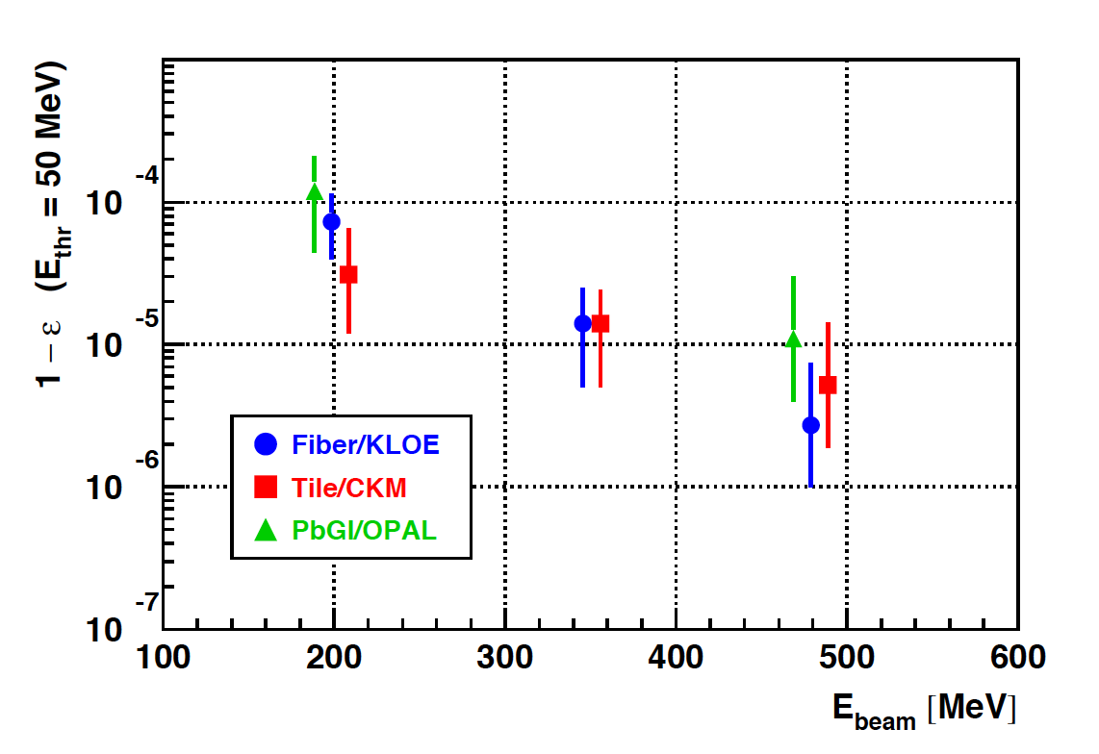
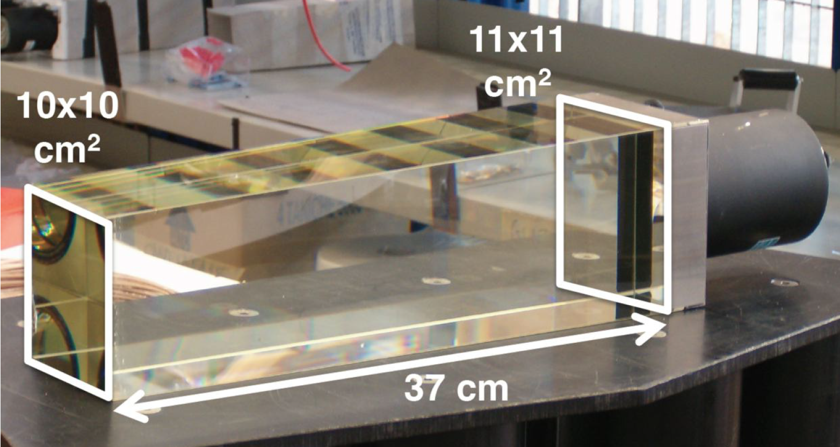
Possible Pbgl SF57 based SAC
Very fast signal to cope with very high rate
Rate up to 5-10 cluster in 40 ns expected
Minimum E_{γ} to detect > 50 MeV
No need for very high LY
Good time resolution (<300ps)
Why don’t we us a Cherenkov radiator??
NA62 reused ex OPAL SF57 block
Inefficiency for electrons at BTF

Slide 13
Ecal plans

Slide 14
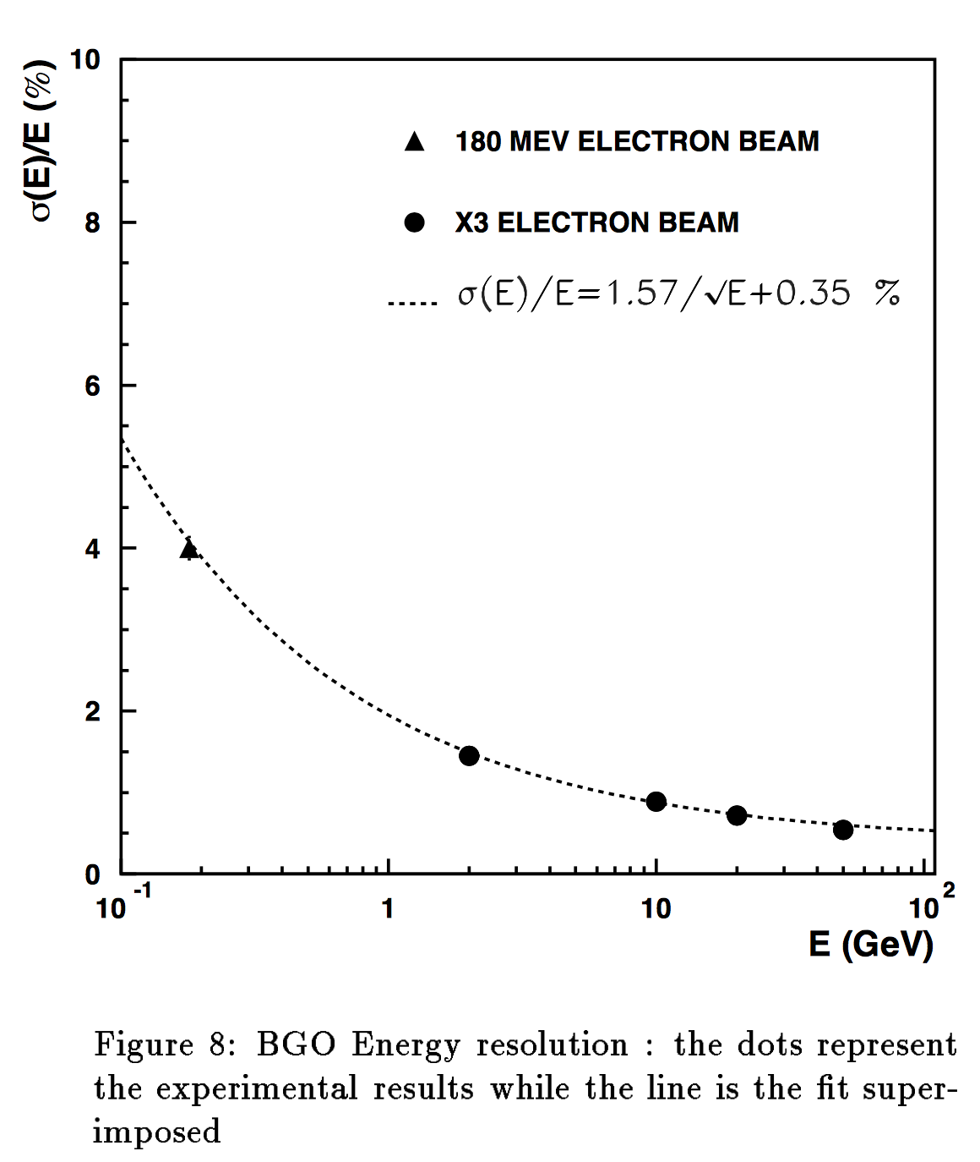
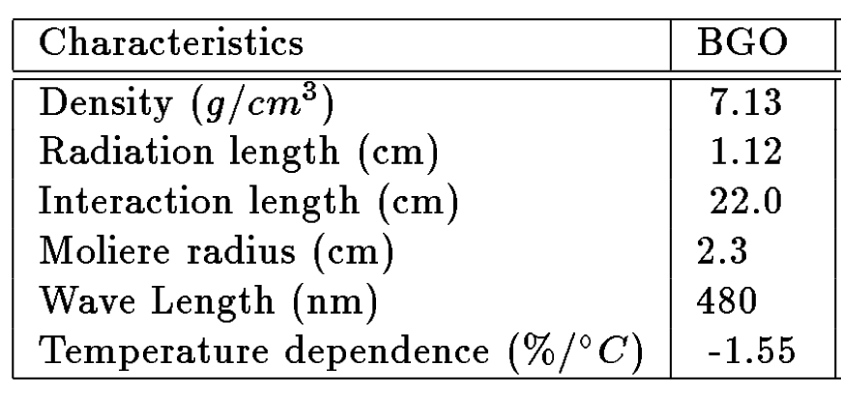
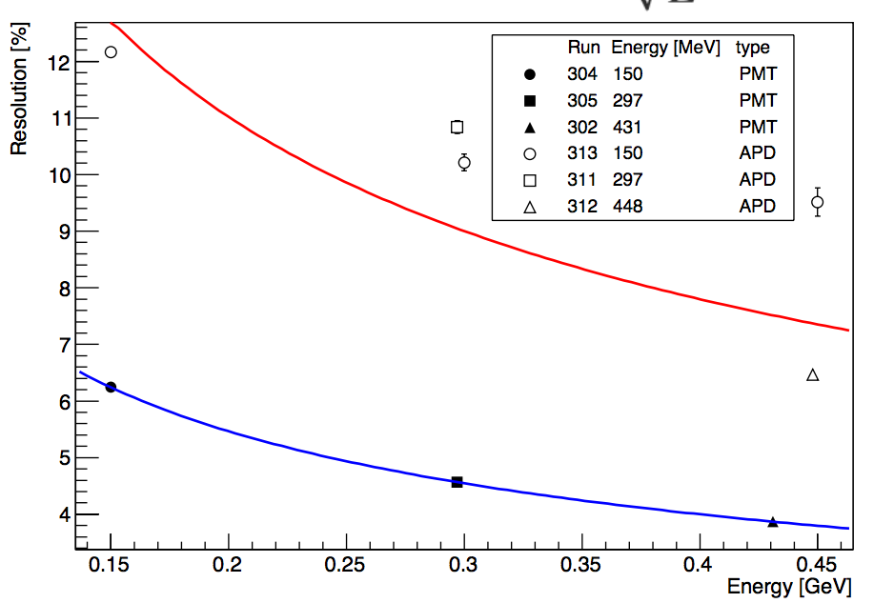
L3 BGO and PADME test beam
L3 collaboration
PADME

Slide 15
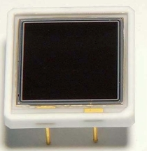
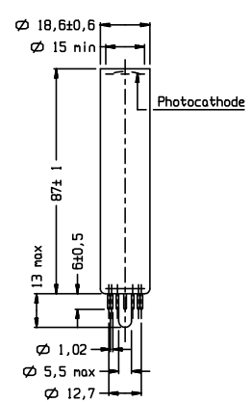
Calorimeter photosensors
APD solution
20x20mm² crystals with Hamamatsu APD S8664-1010
Quoted price 315 euro/pcs (total cost 700 pcs 220K€)
After the test beam we know they are not ideal solution
Gain too small ~200 + G=300 on FE give a lot of noise 6x10⁴
We now have other 6pcs ordered from Hamamatsu in November
Total of 16 pcs can equip a 4x4 matrix need to be tested and calibrated
10x10mm
PMT solution
HZC Photonics XP1911-XP1912 identical to orginal Photonis
Quoted price very cheap at the level of the APD
Several interaction but still difficult to place and order
The XP1911 could be the baseline solution for Ecal but:
Quality of the PMT to be verified
Interaction with the firm rather difficult so far.
Do we know any Chinese?

Slide 16
Ecal Schedule
Delay foreseen in the crystal recovery procedure
We still don’t have the crystals in our hands
Milestone in autumn of 2016 for the photosensor choice need successful July test beam!

Slide 17
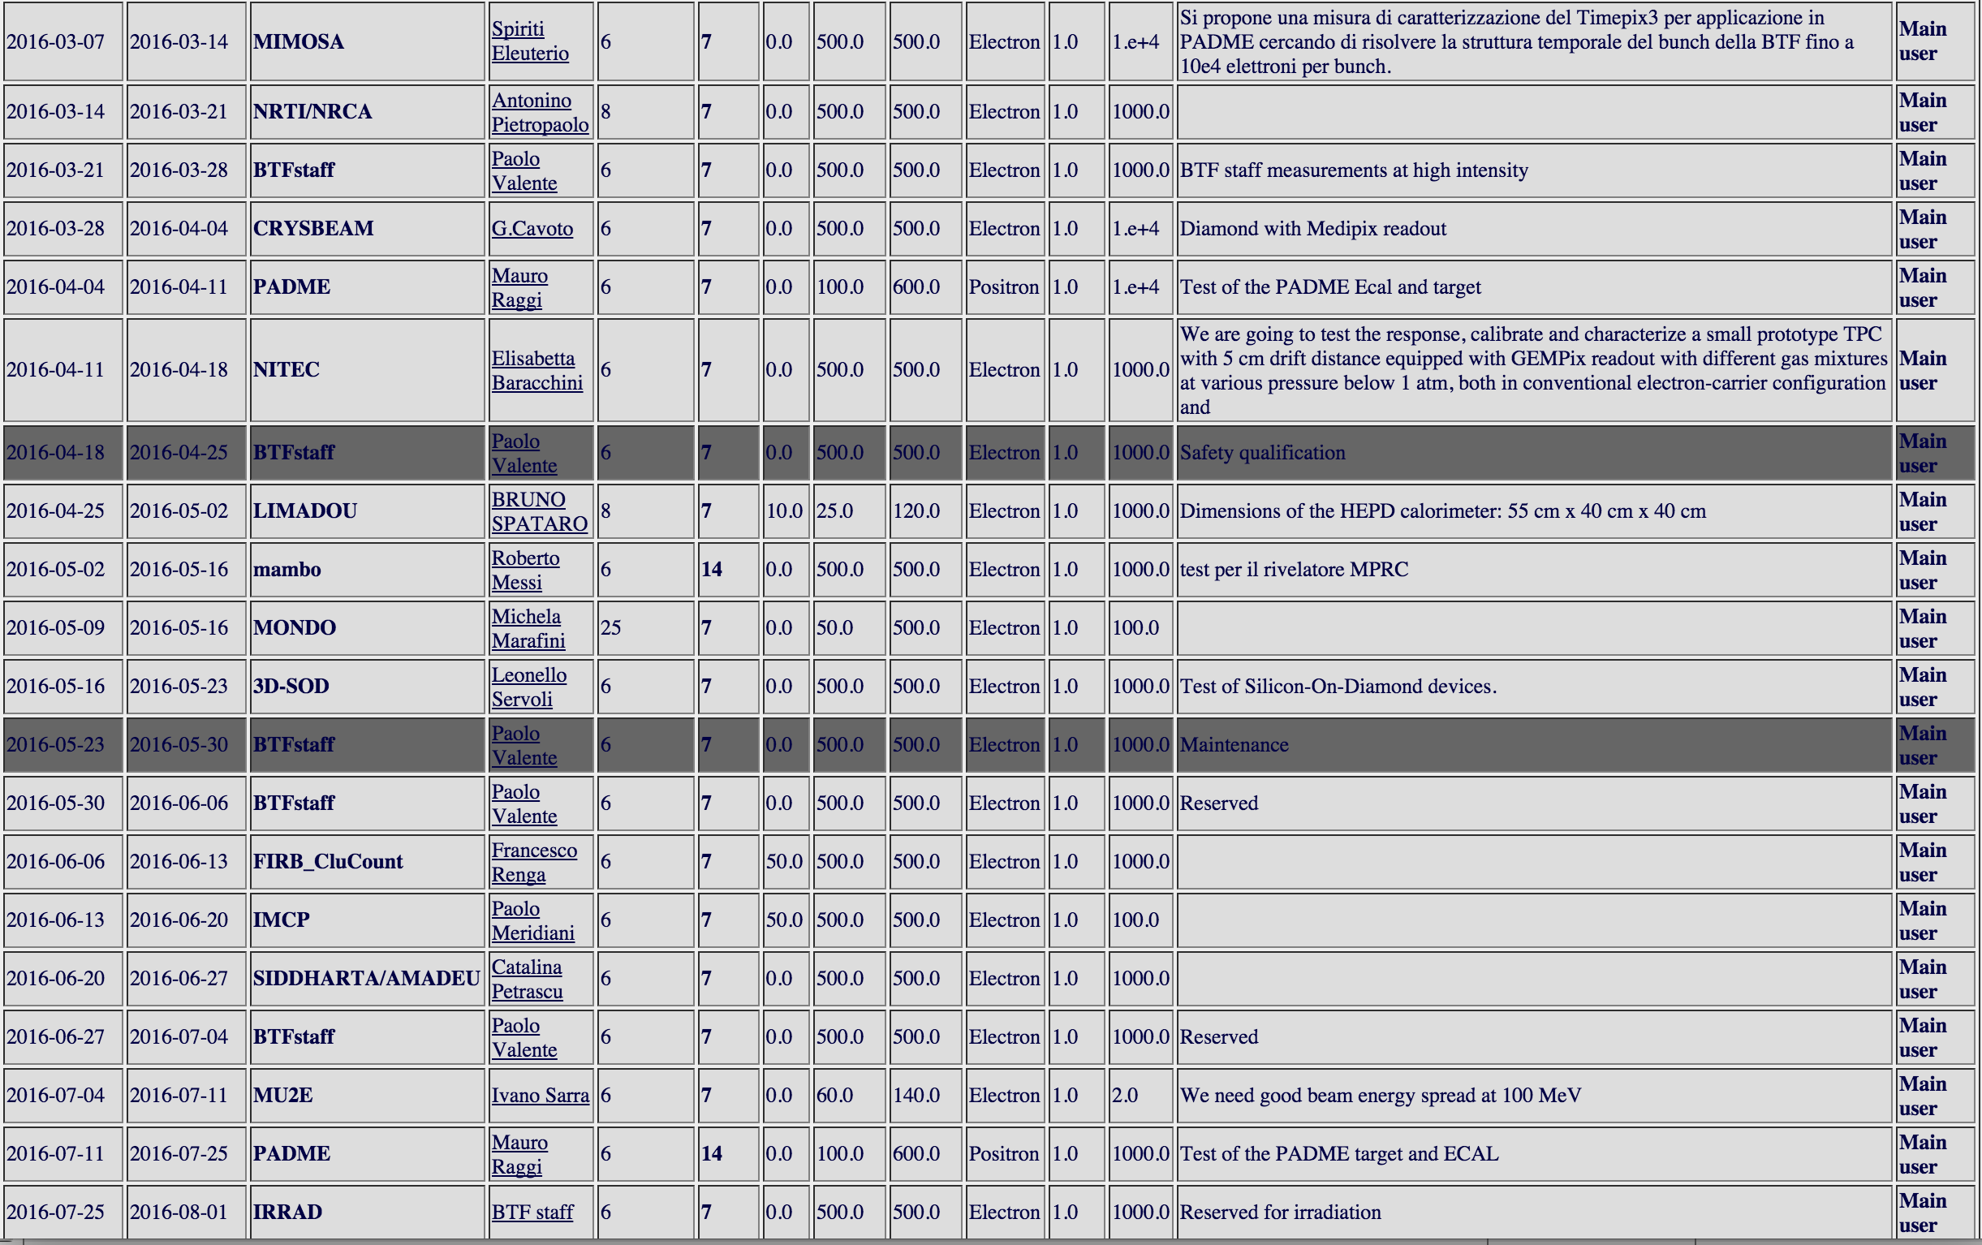
Test beam in 2016

Slide 18
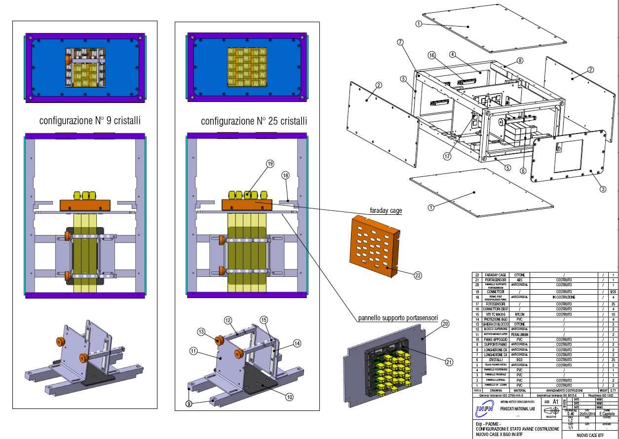
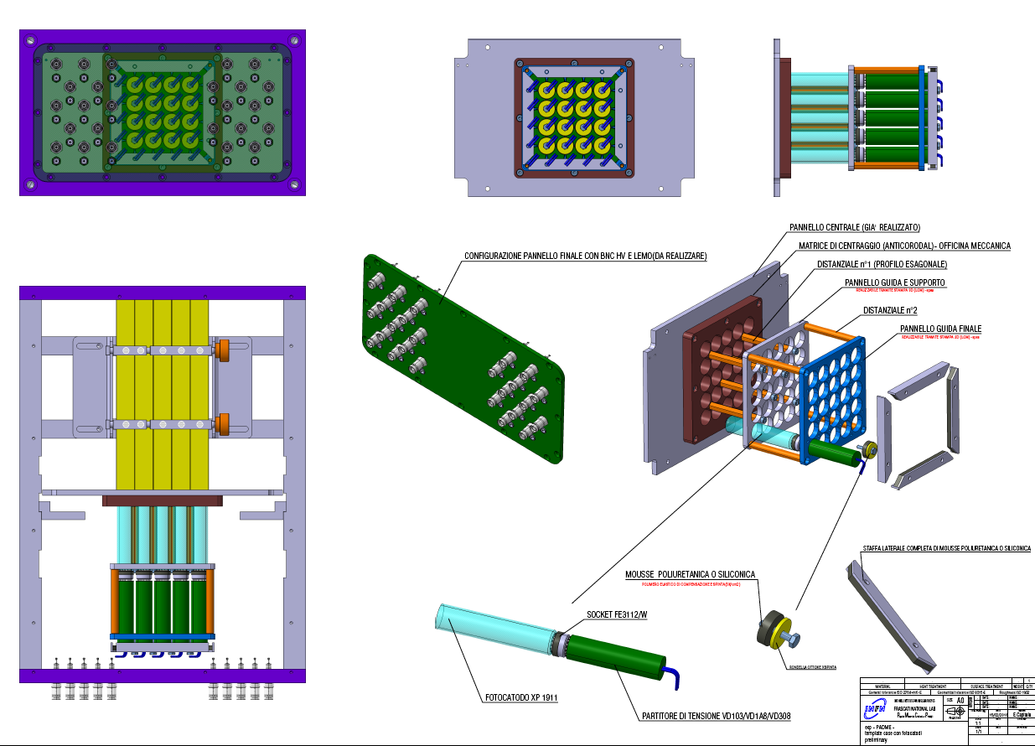
ECAL prototype mechanics

Slide 19
July test beam setup
Need to have both Ecal readout (APD PMT) fully operational
25 PMTs and 16 APD with proper readout electronics.
Need calibrated PMT APD and crystal (radioactive source)
Need an external tracking system to select single electron
Study spatial resolution wrt to independent measurement
Need external precise timing to measure time resolution of Ecal
Positron veto bars?
Measure both single crystal and cluster time resolution
Trigger = (beam & Pveto) OR random
Ecal prototype
Positron beam
Tpix3?
Pveto

Slide 20
Crystal characterization setup
We need to start calibrating crystals with radioactive Co60 to measure light yield and minimum energy threshold.
At LNF there is a dedicated area where radioactive sources are accessible. I already discussed with the head of HEP division the possibility of installing a permanent PADME test stand.
We have to book a period and start working soon with cobalt.
Need to optimize wrapping, optical polishing of lateral surface, optical coupling to PMT/APD.
Co⁶⁰
V1742 Analog In
Trigger crystal
CO
Crystal to test
γ₁
γ₂
V1742 Analog In
FO
Discr
V1742 Trig In

Slide 21
Update from test data analysis

Slide 22
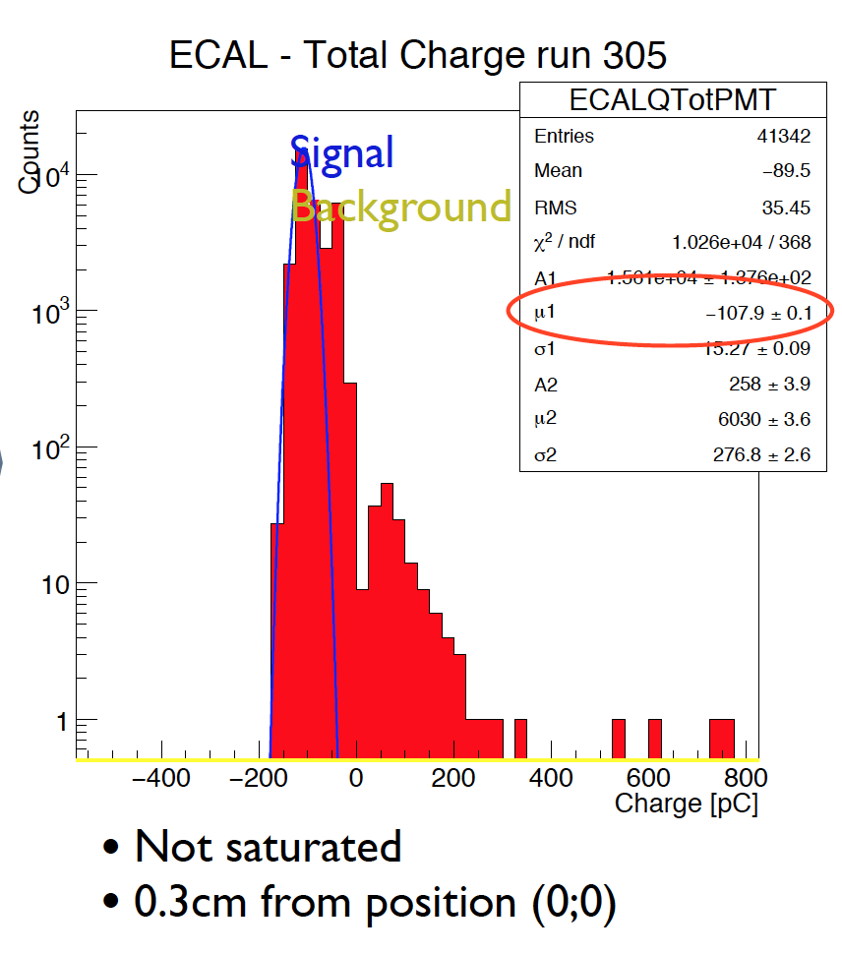
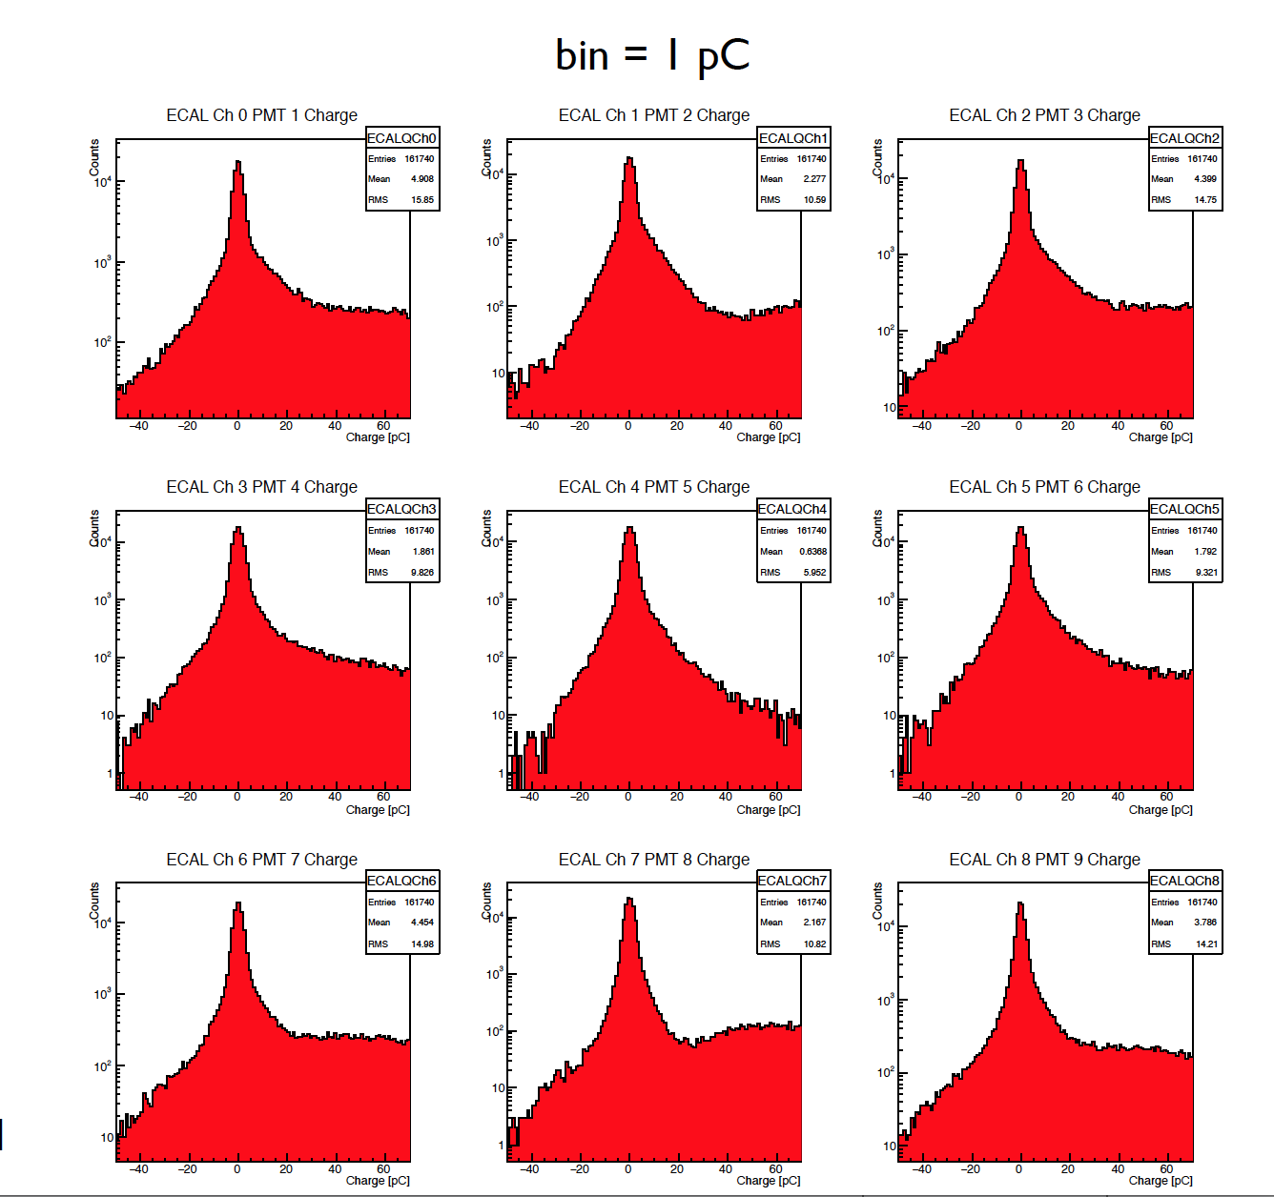
Improving pedestal distribution
Fit 980 points empty event

Slide 23
Test beam study

Slide 24
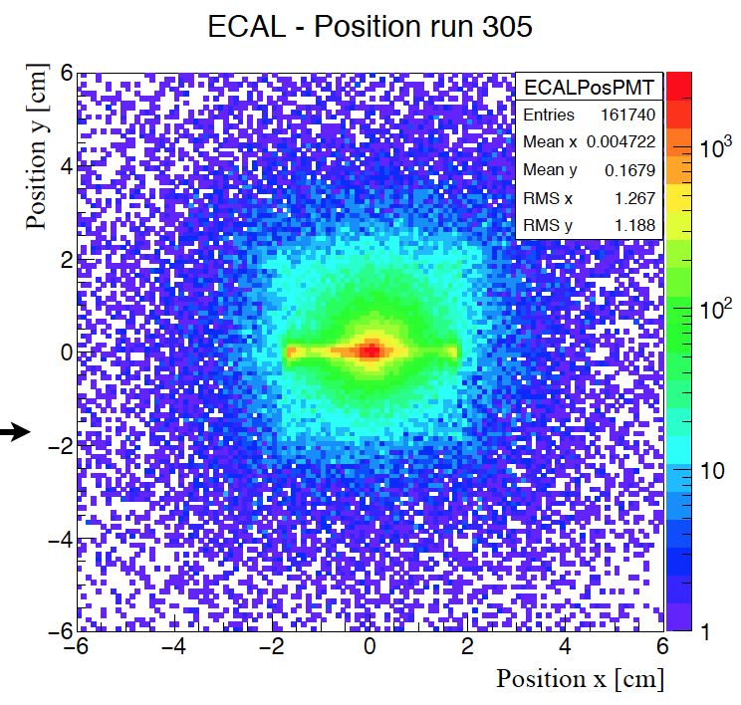
Corrected position evaluation
Old version

Slide 25
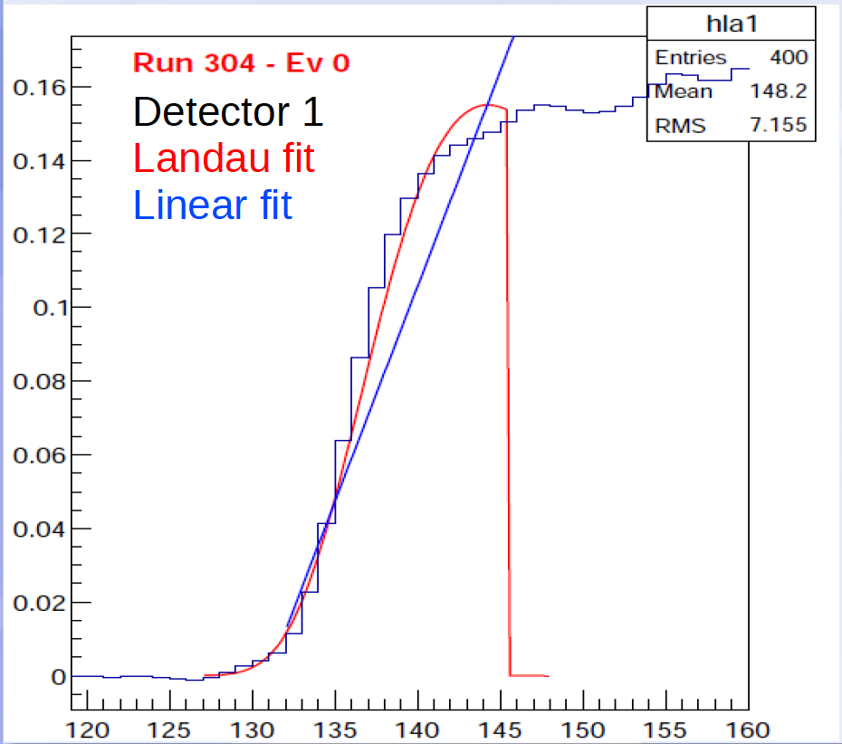
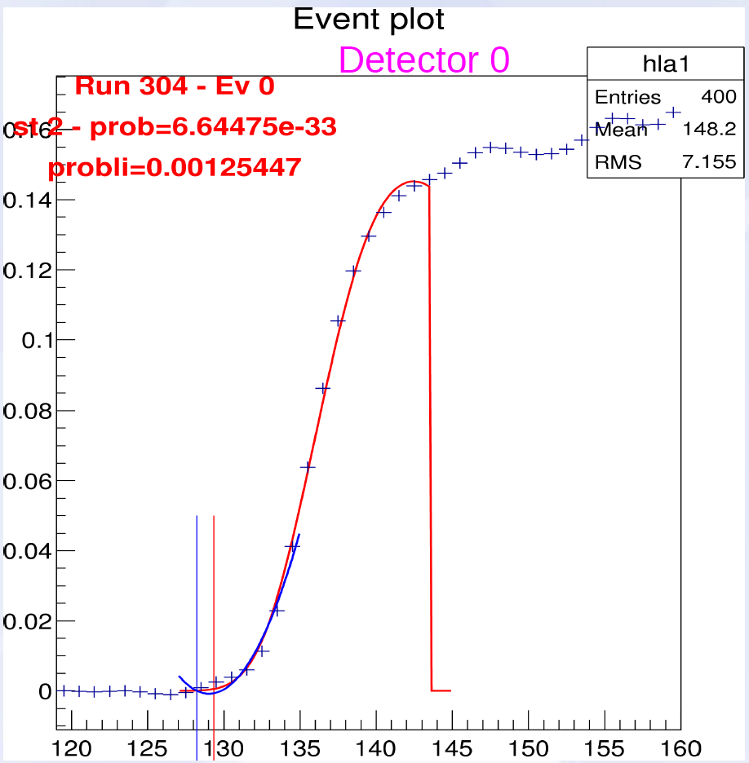
Timing study
Landau
Pol2

Slide 26
Conclusions
ee->γγ background can be rejected just using Ecal
ee->γγ(γ) background needs an angular coverage up to 65 mrad
Calorimeter position and geometry almost finalized
Sensitivity comparison required by INFN as milestone
Acceptance for recoil photon up to 80 mrad can be achieved
Timing is a crucial aspect of the Veto system
The efficiency could be limited by the random veto probability more than from the detector performance.
OPAL lead glass SF57 is a possible candidate for SAC
LY to be estimated by G4 simulation. Is a test in July possible?
Progress on test beam pedestal study and timing

