Slide 1
Beam studies for PADME
P. Valente, B. Buonomo, C. Di Giulio, L. Foggetta

Slide 2
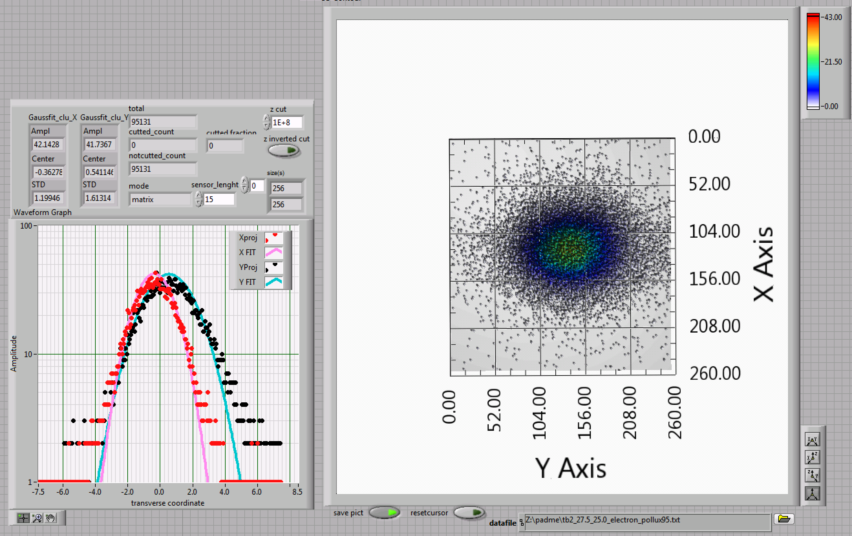
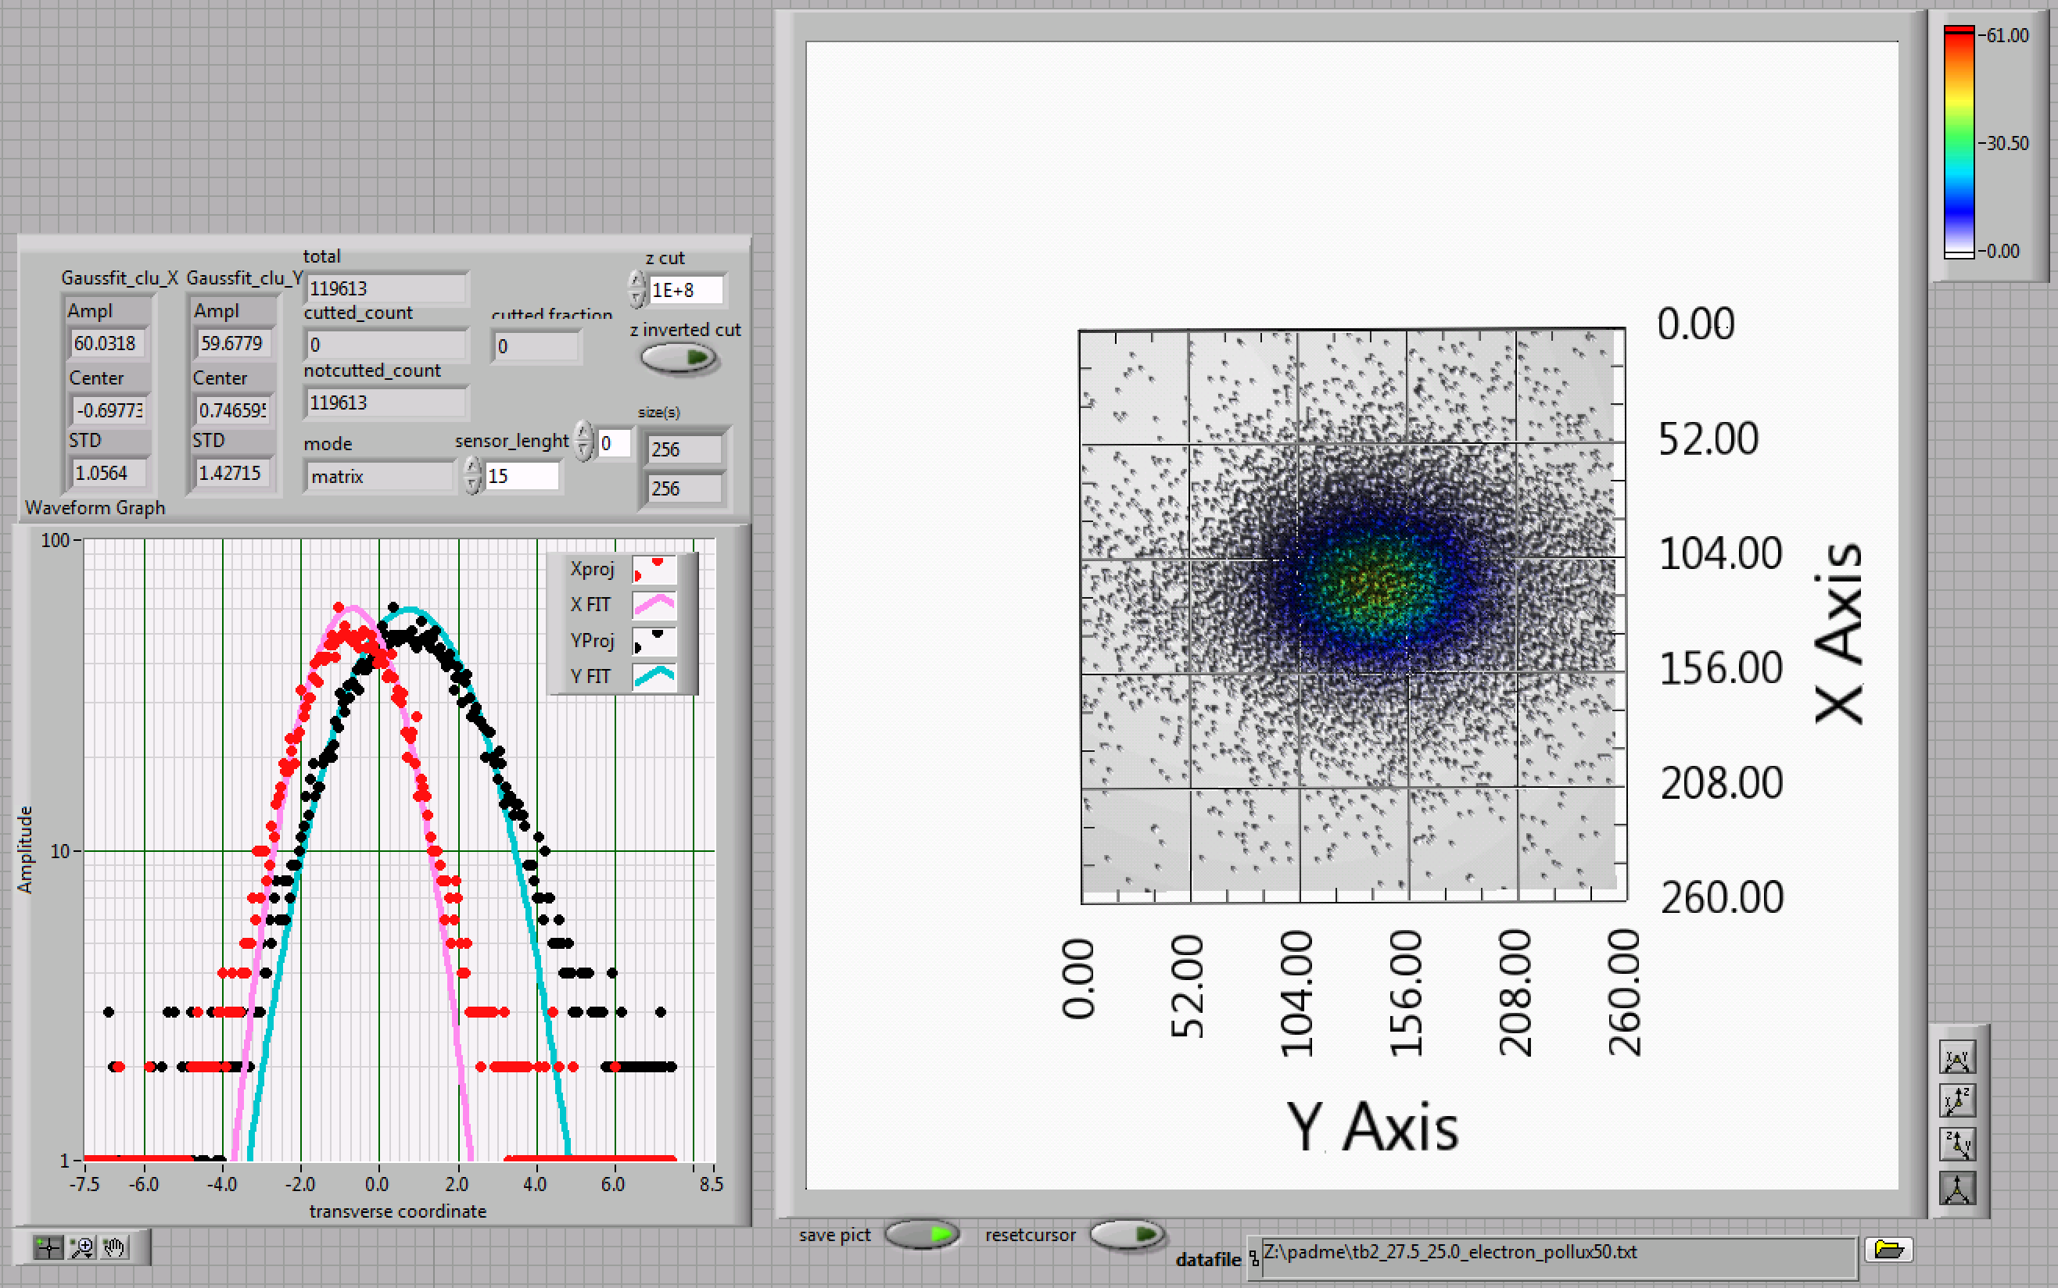
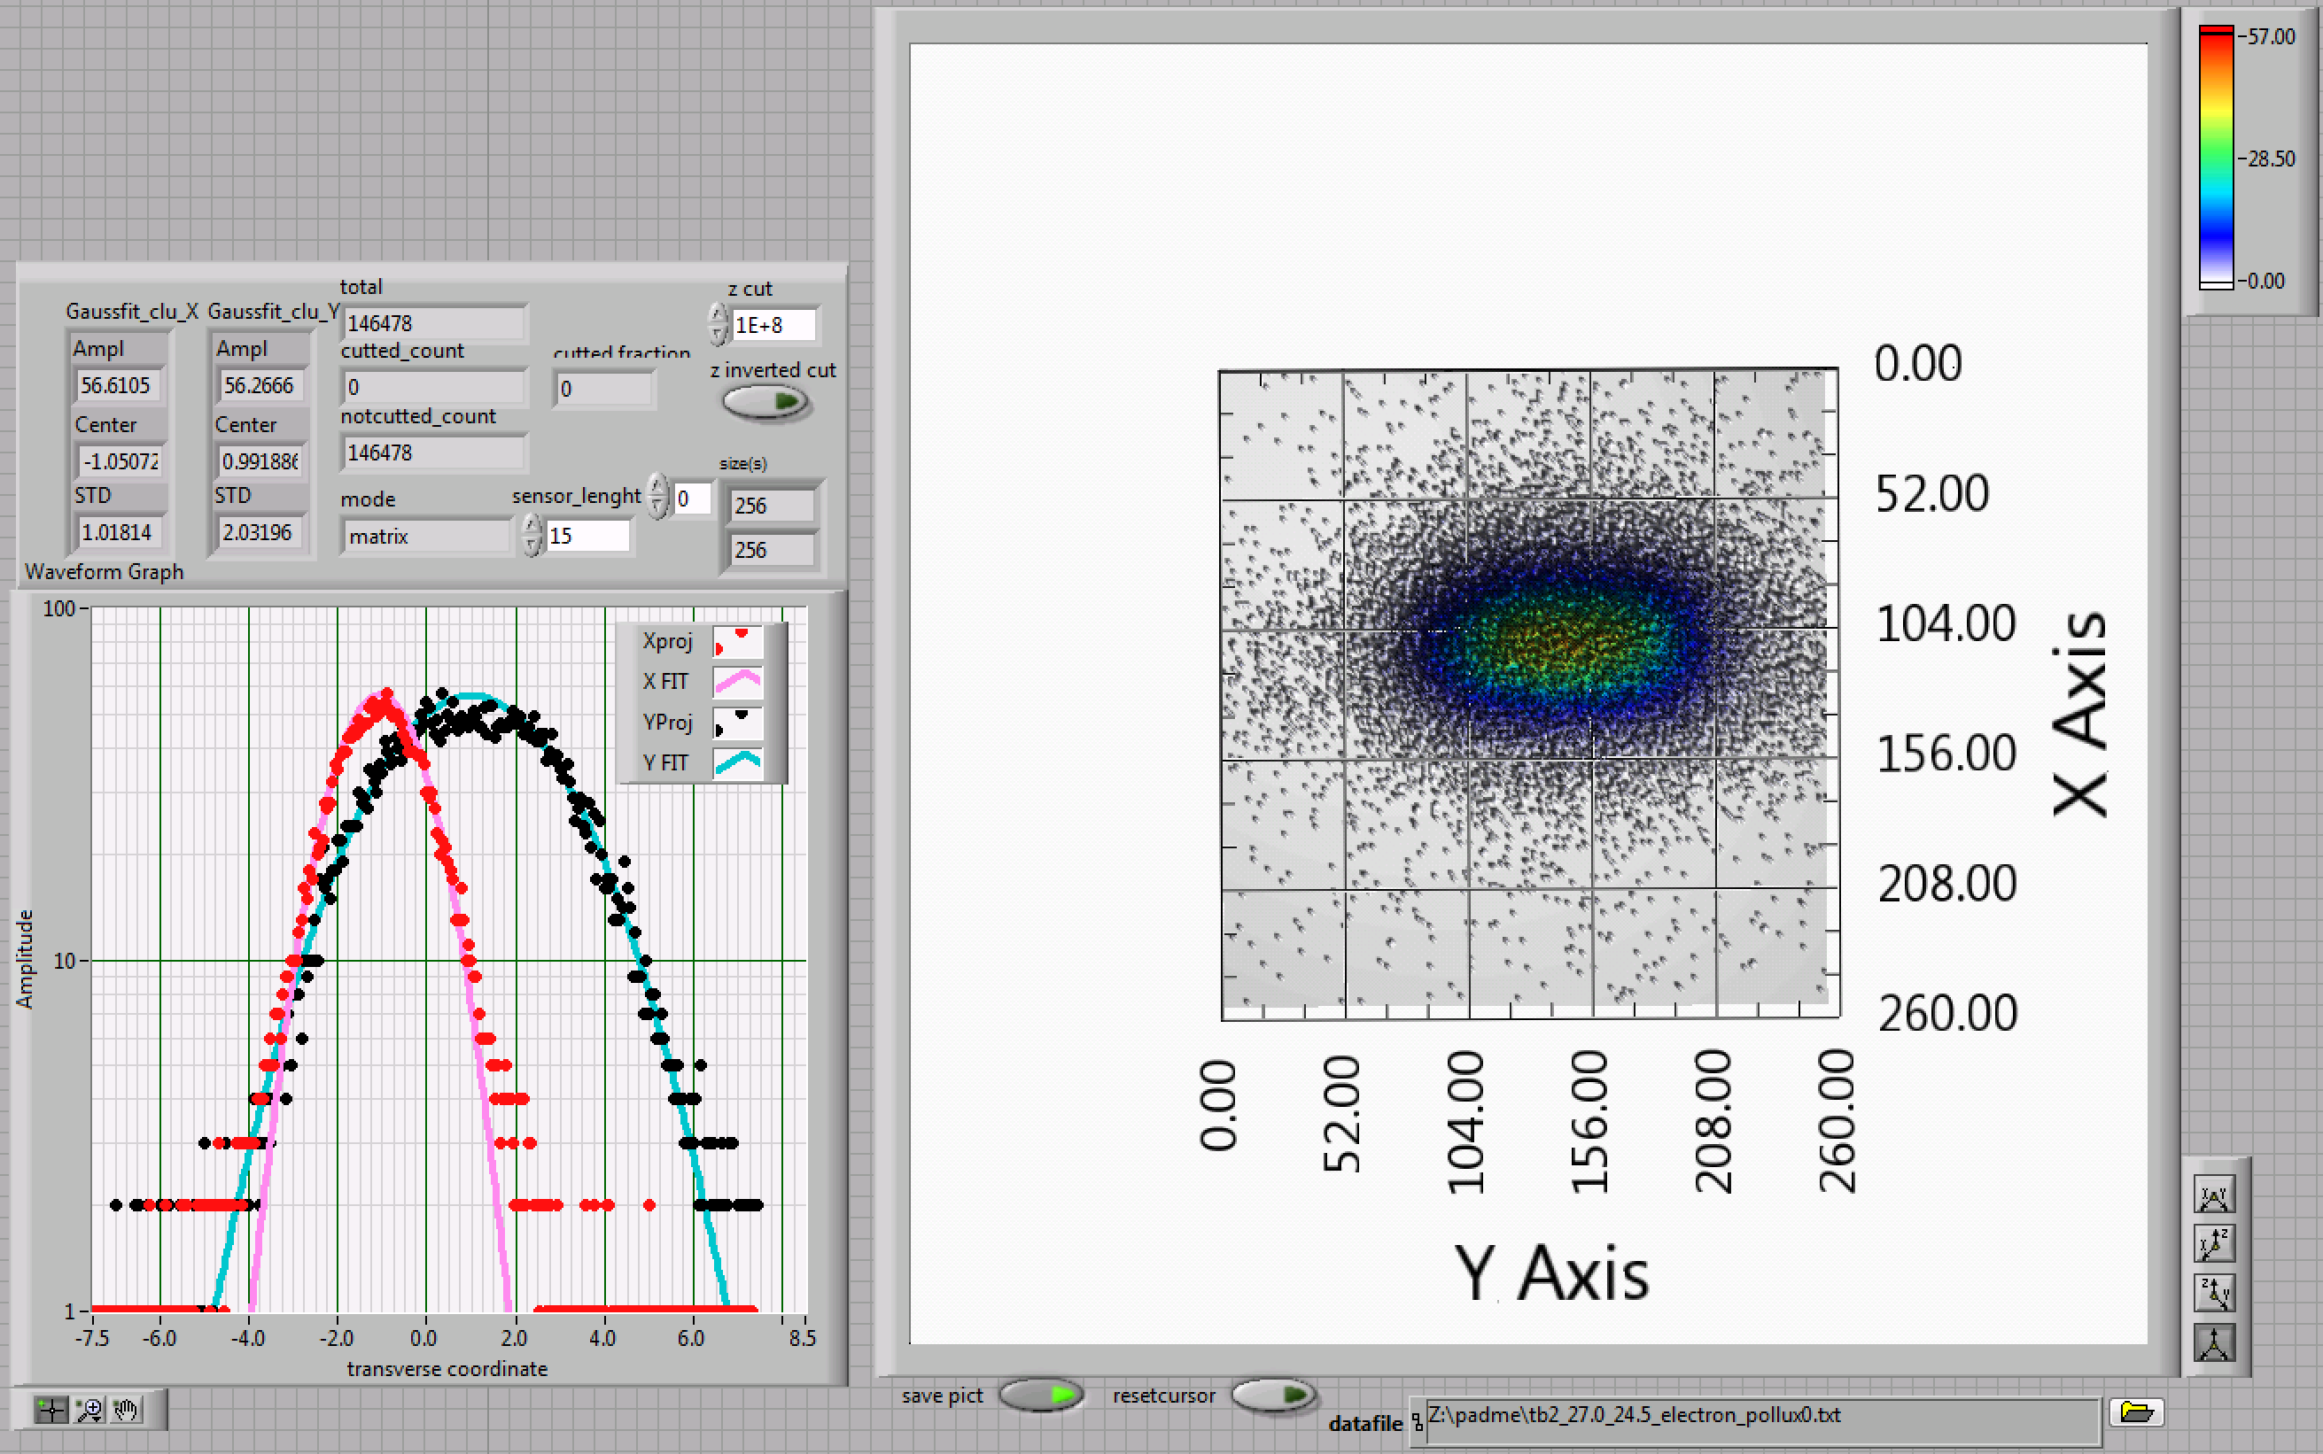
Effect of TB2 slits

Slide 3
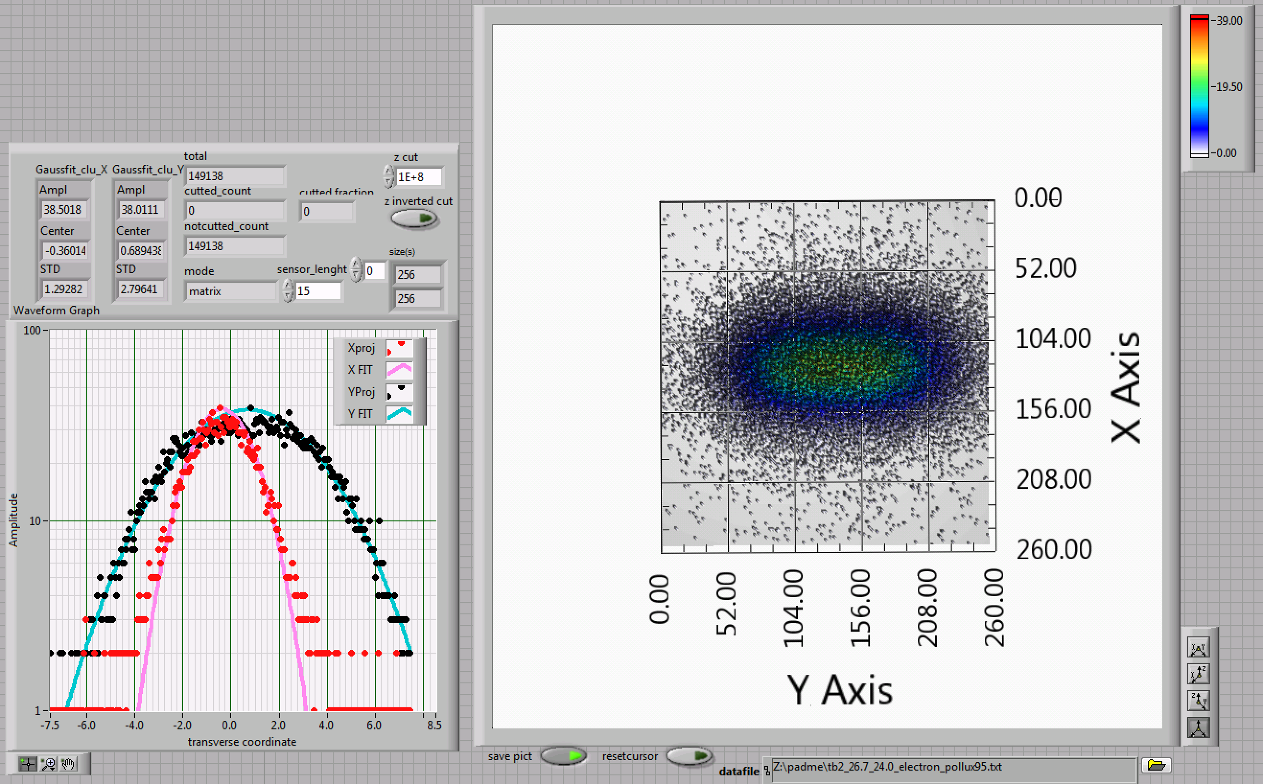
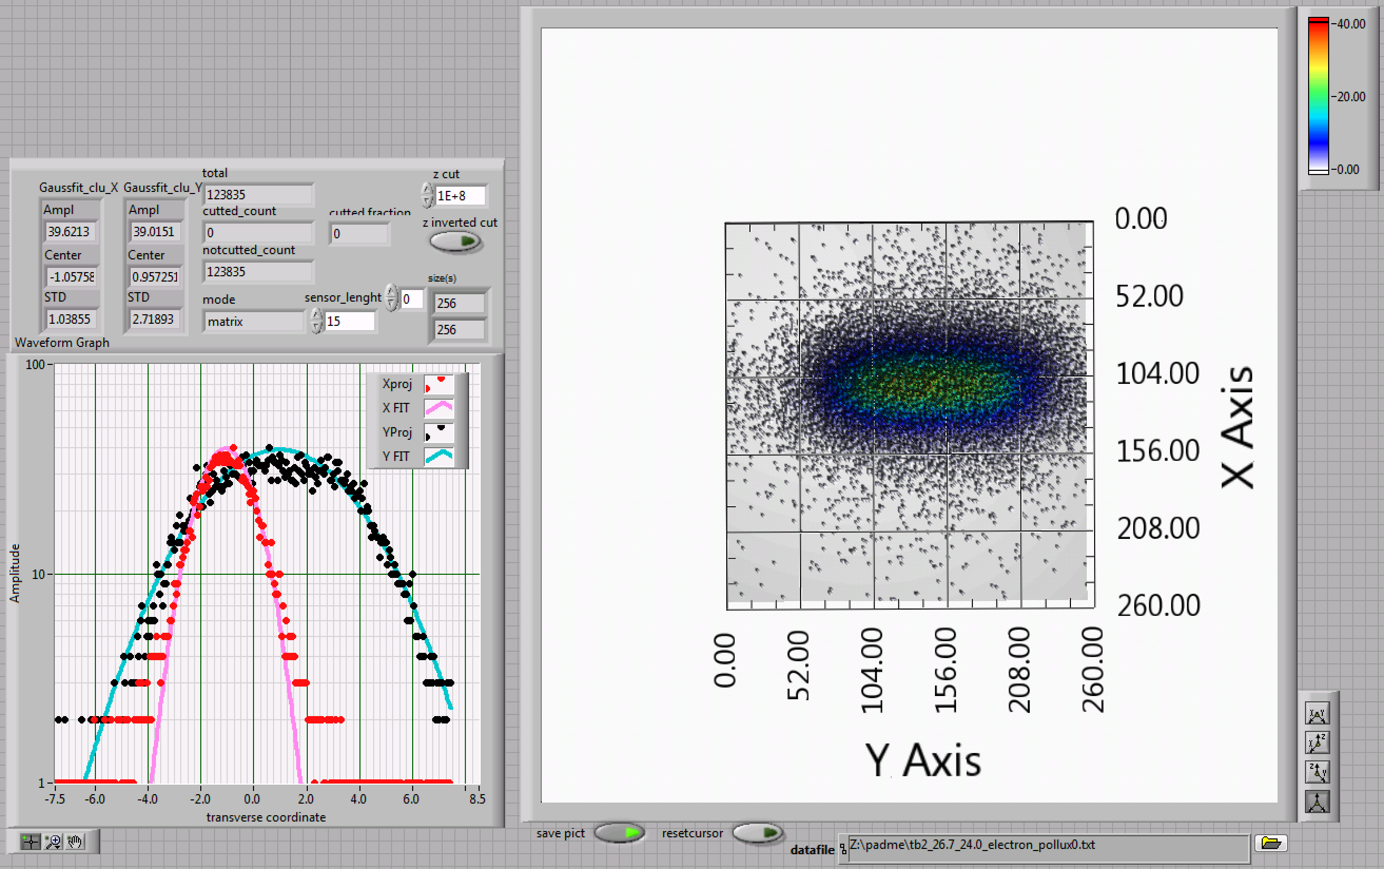
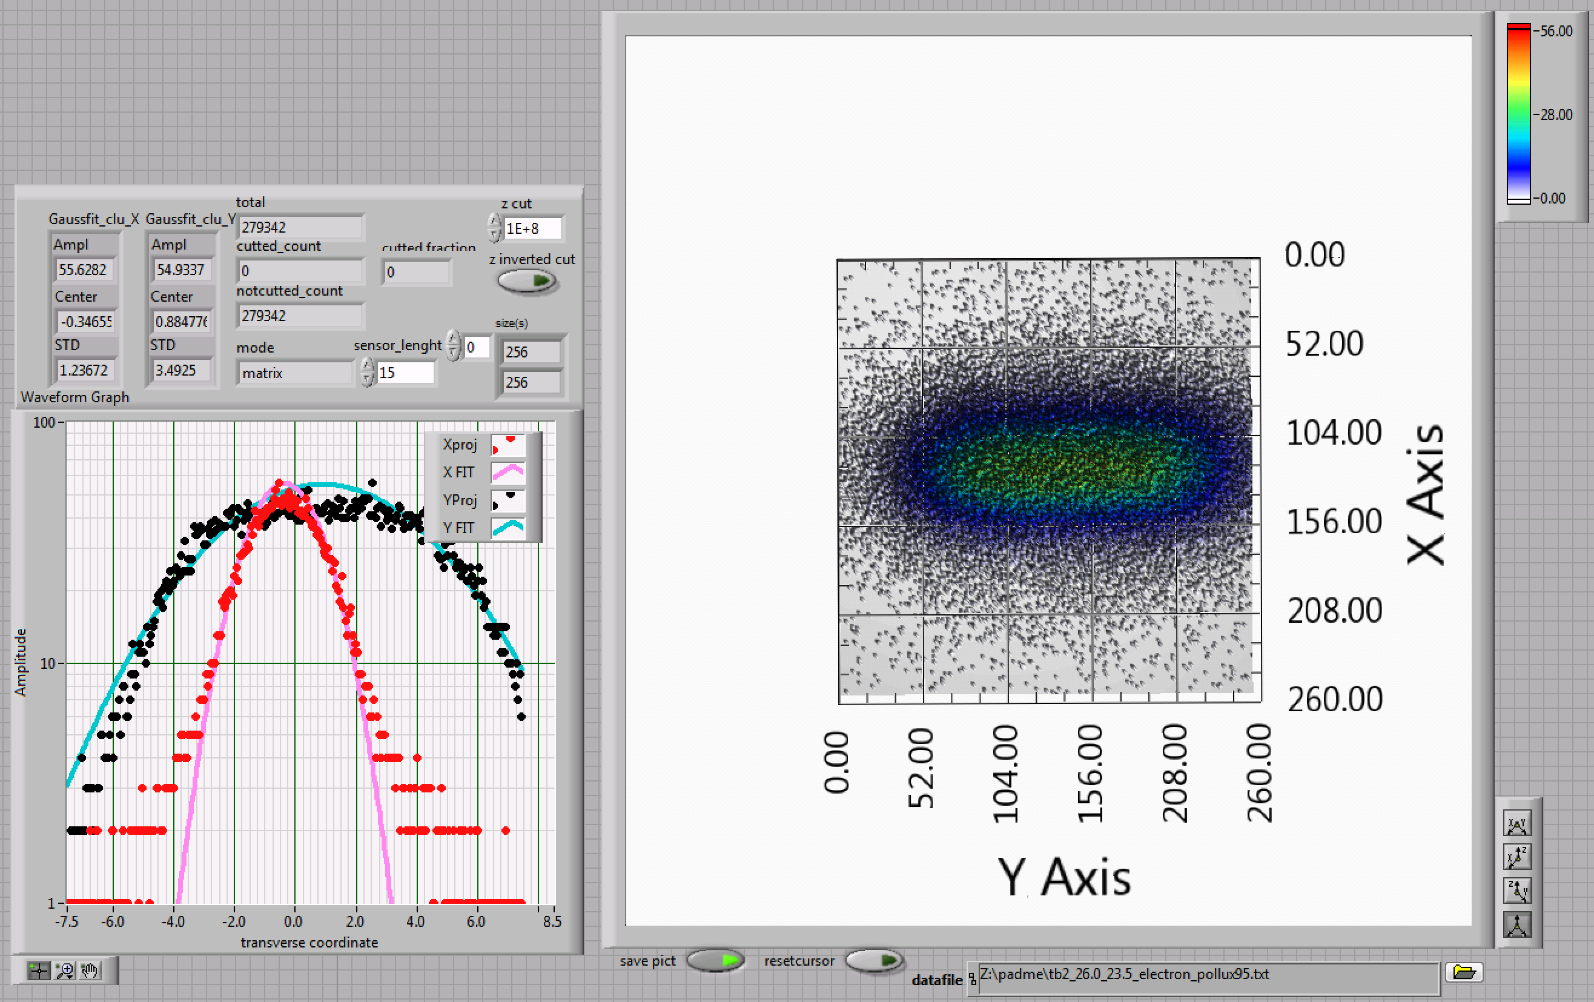
Effect of TB2 slits
In order to increase the positron multiplicity, given the LINAC primary energy and intensity, the horizontal slits upstream of the DHSTB01 momentum-selecting dipole should be opened
This increases the momentum spread and thus the horizontal spot size downstream of the DHSTB02 dipole, due to the dispersion

Slide 4
Test 16 febbraio 2016
LINAC 700 MeV, 40 ns
Linea BTF, elettroni, 600 MeV
N=4000-4500
TB2=25.5/26.0
TB4=22.0/19.0

Slide 5
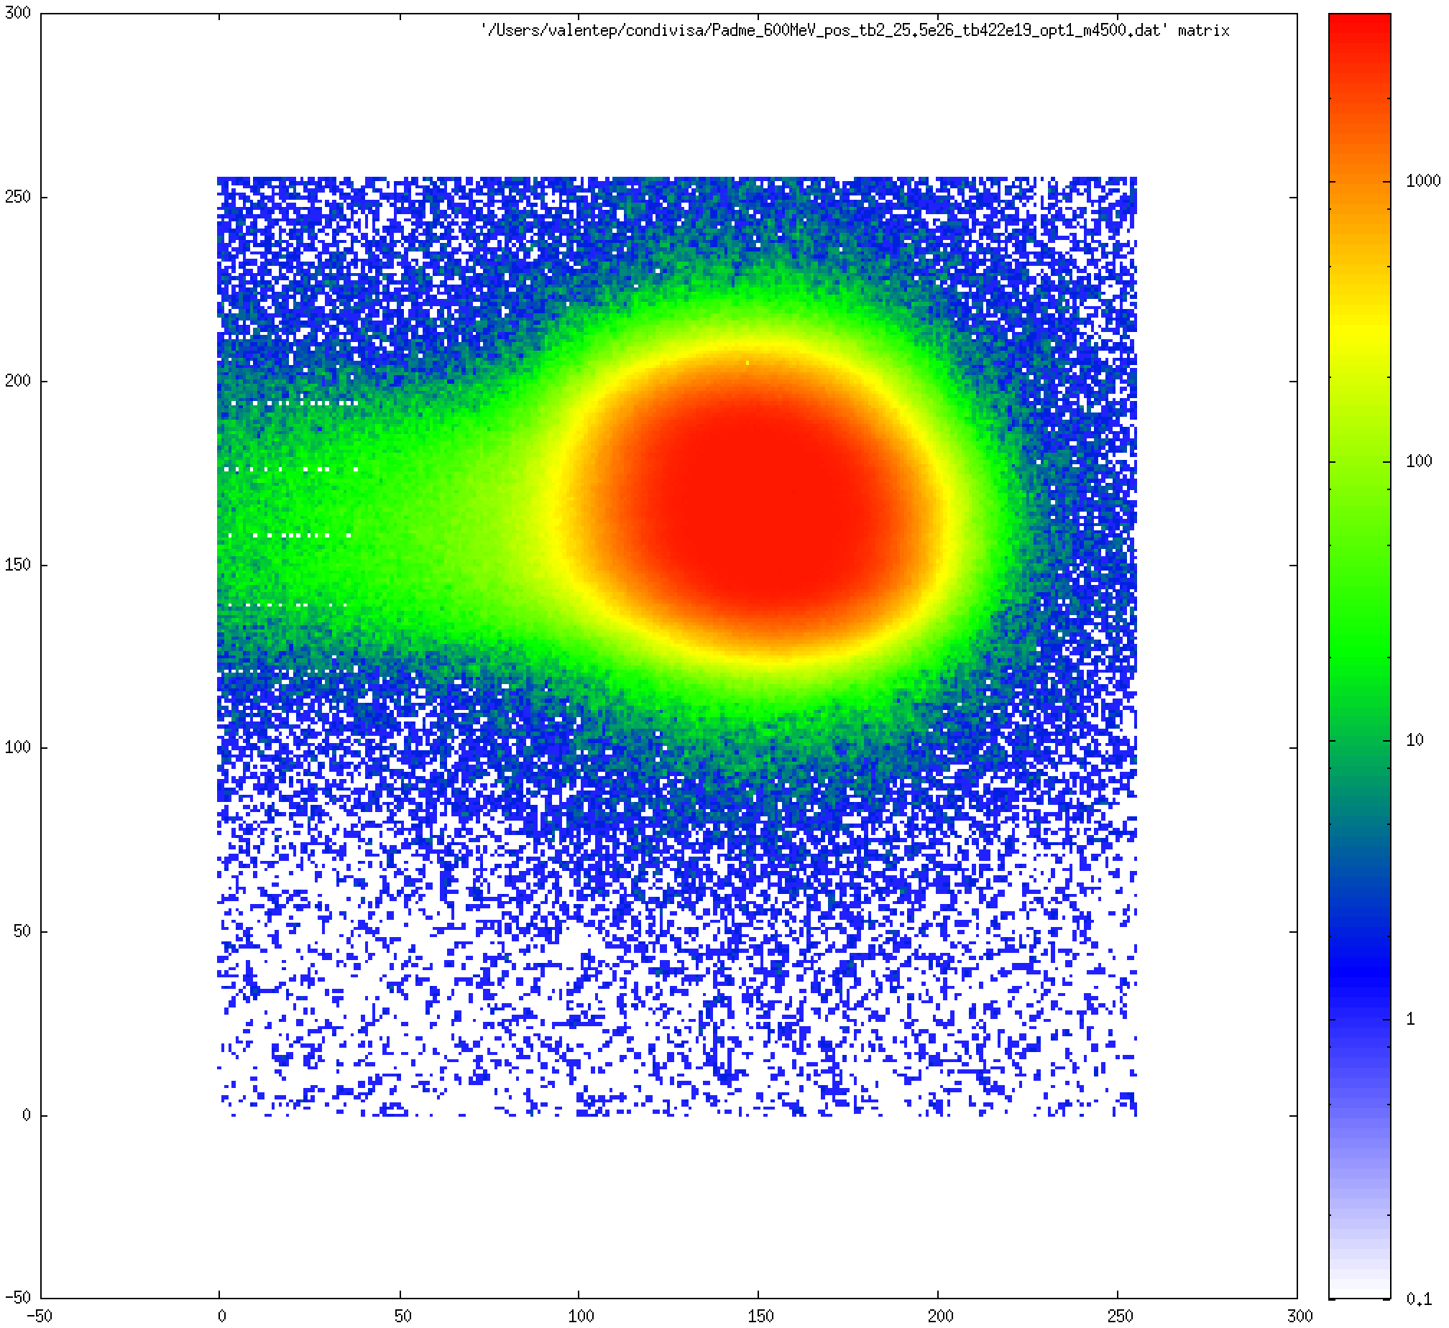
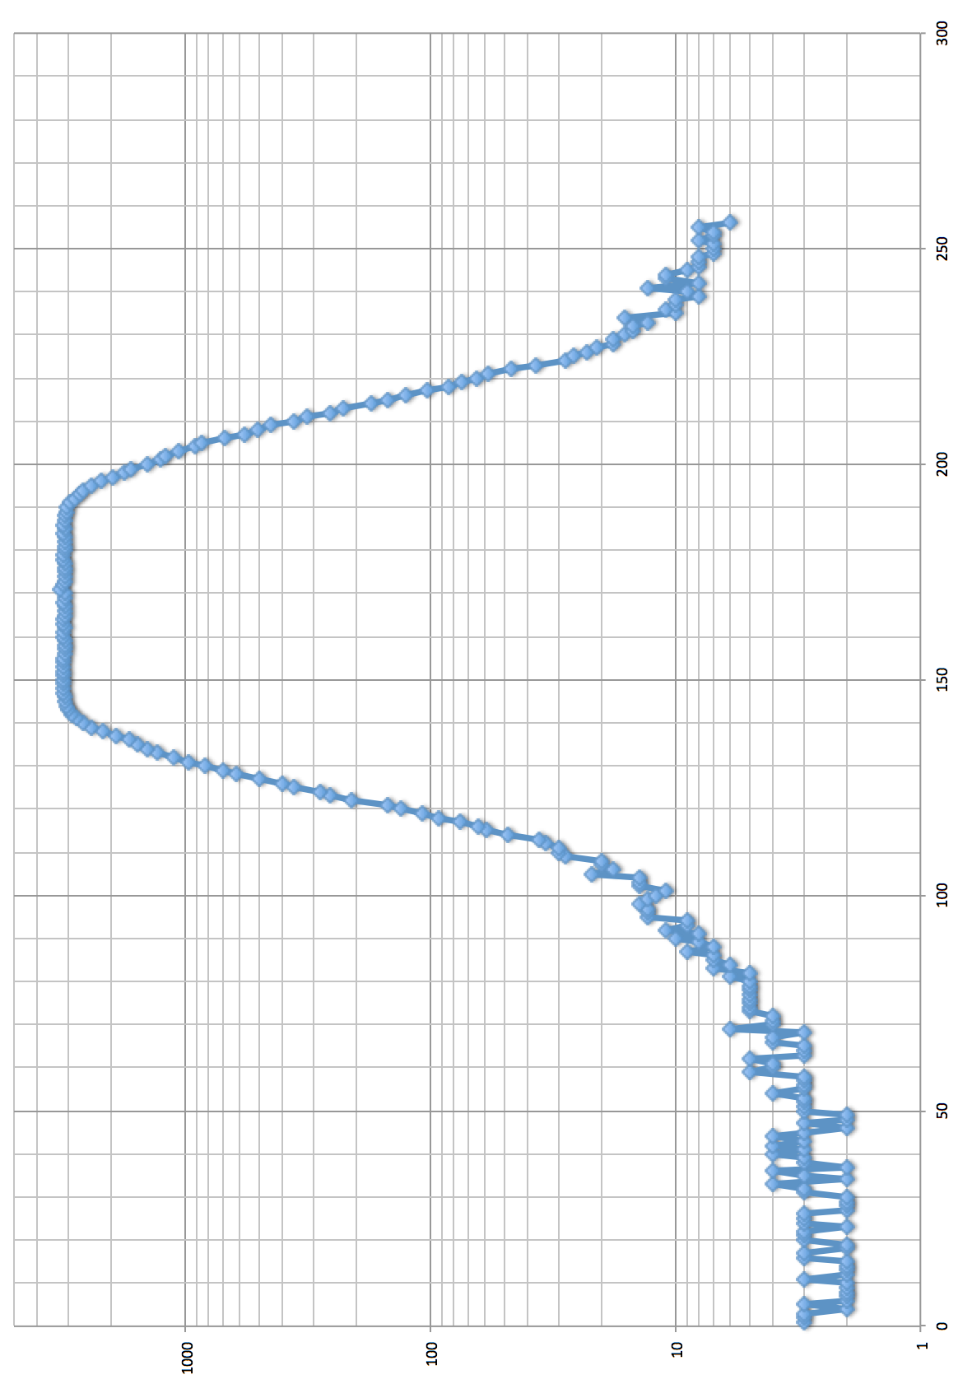
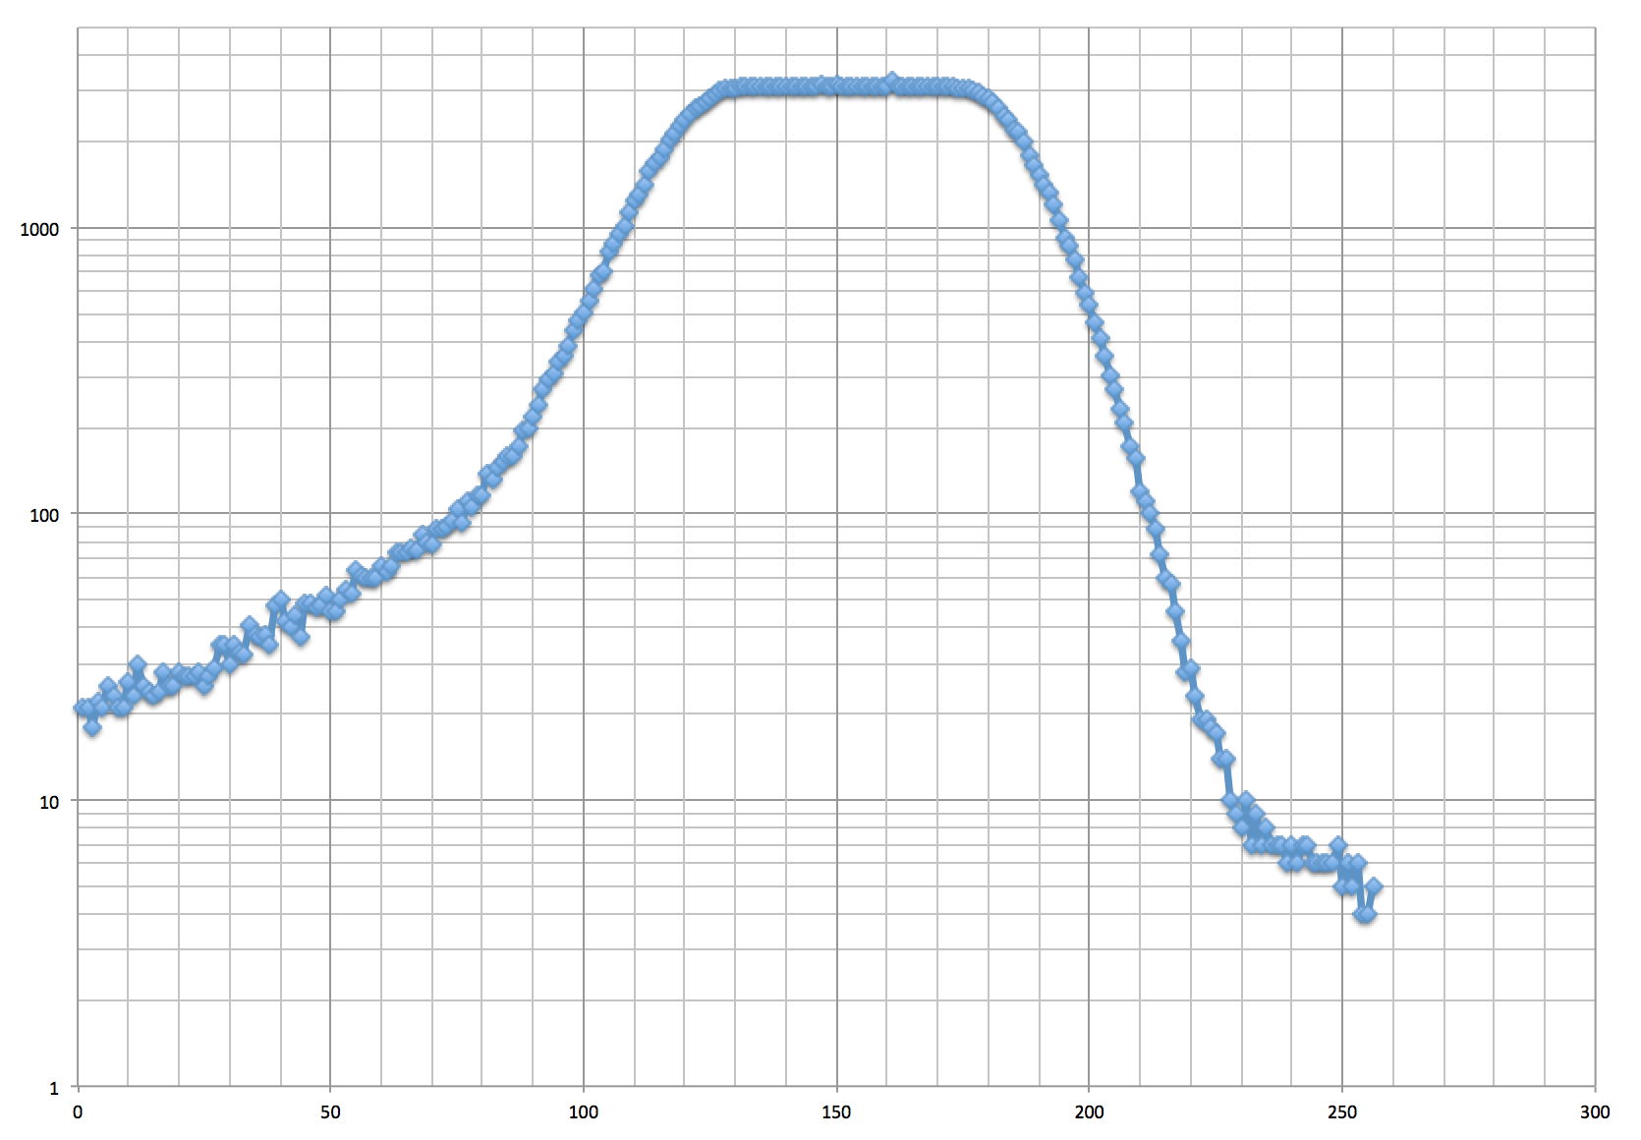
Timepix imaging detector
Log scale
1.4×1.4 cm²
55 μm pitch

Slide 6
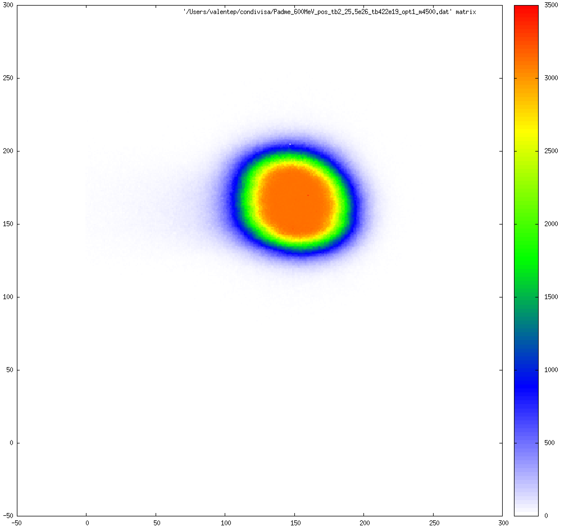
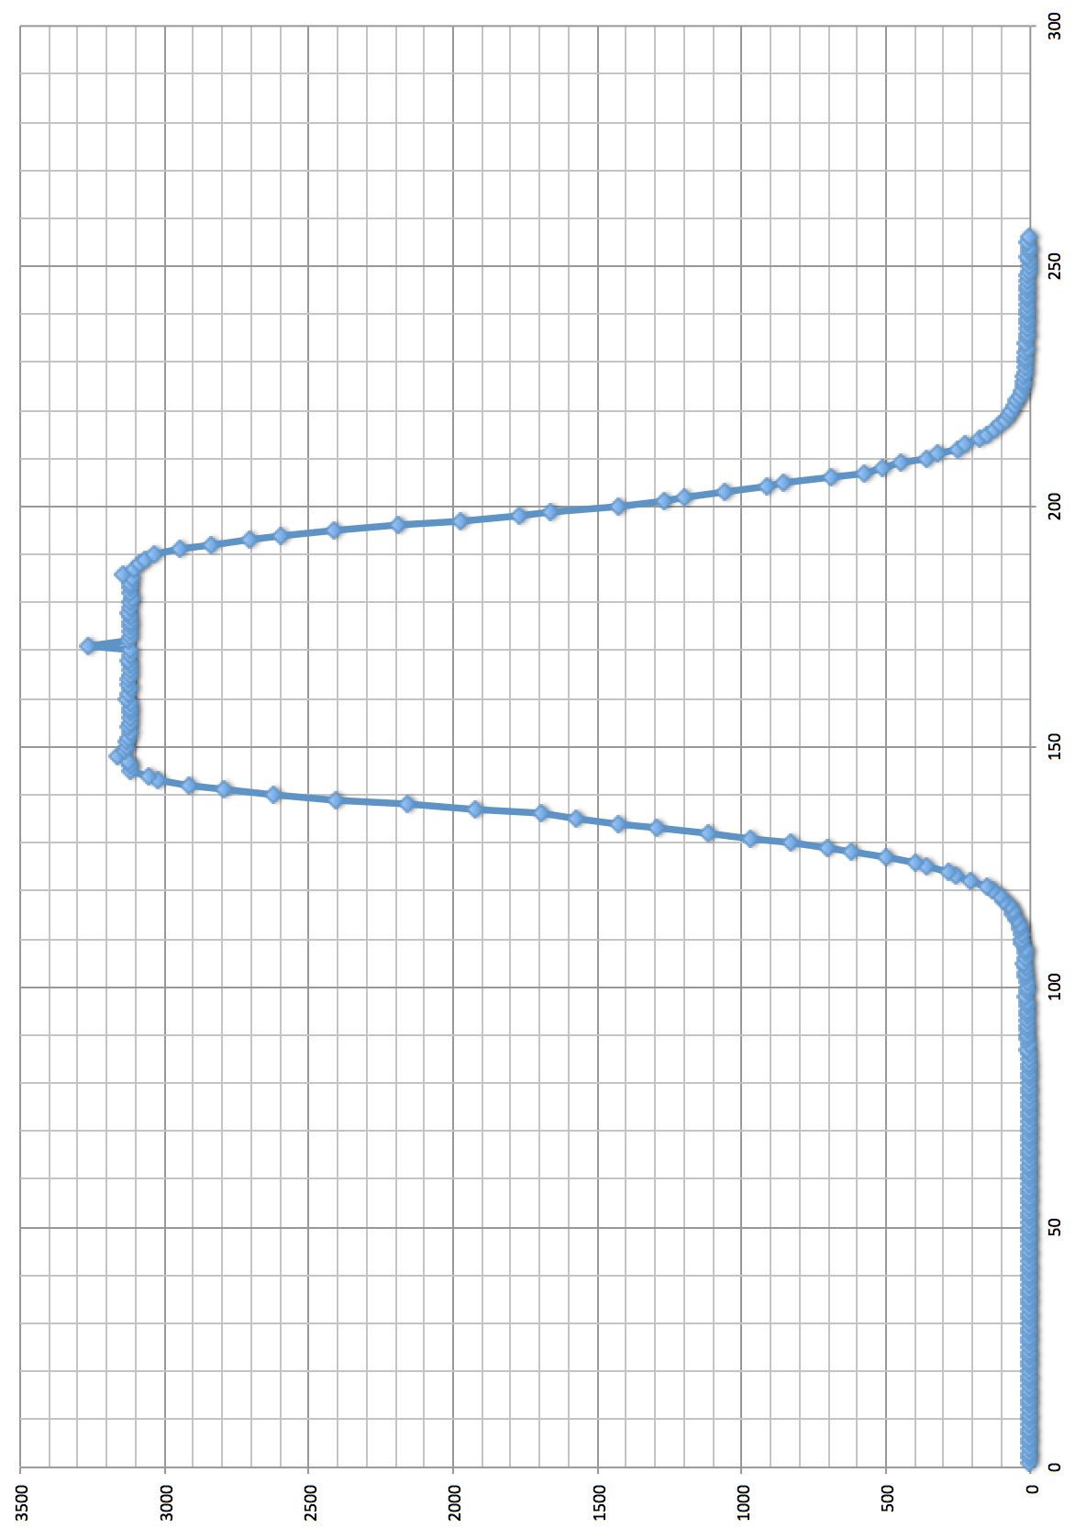
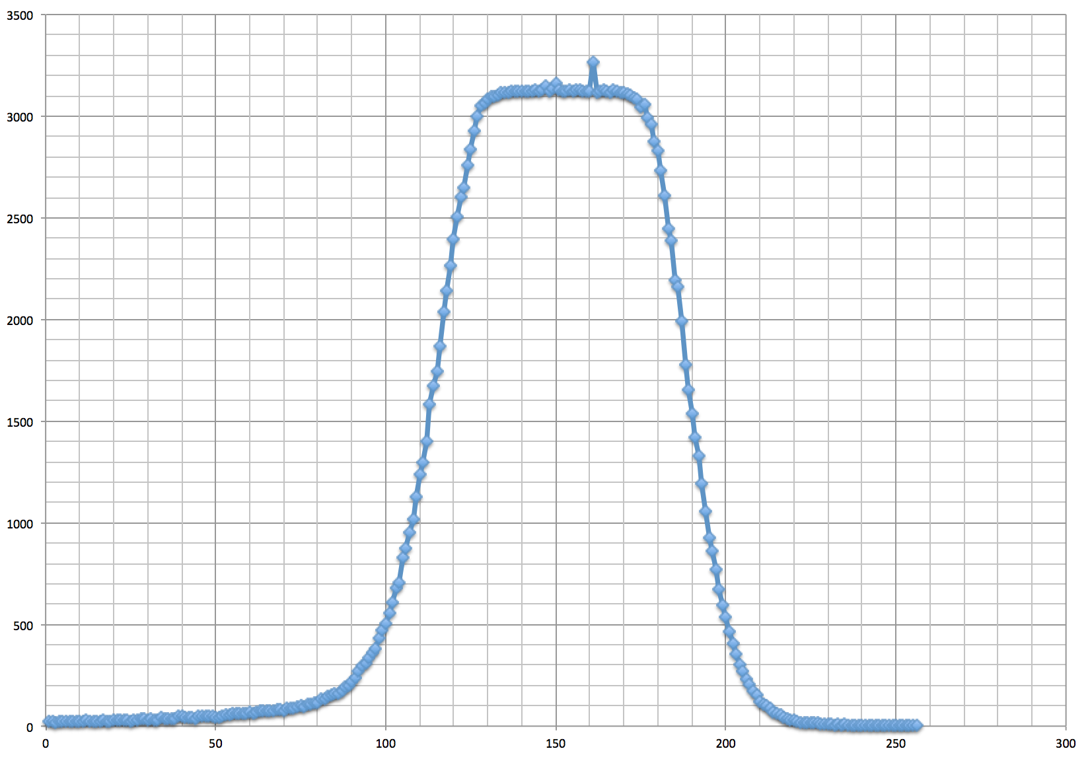
Linear scale

Slide 7
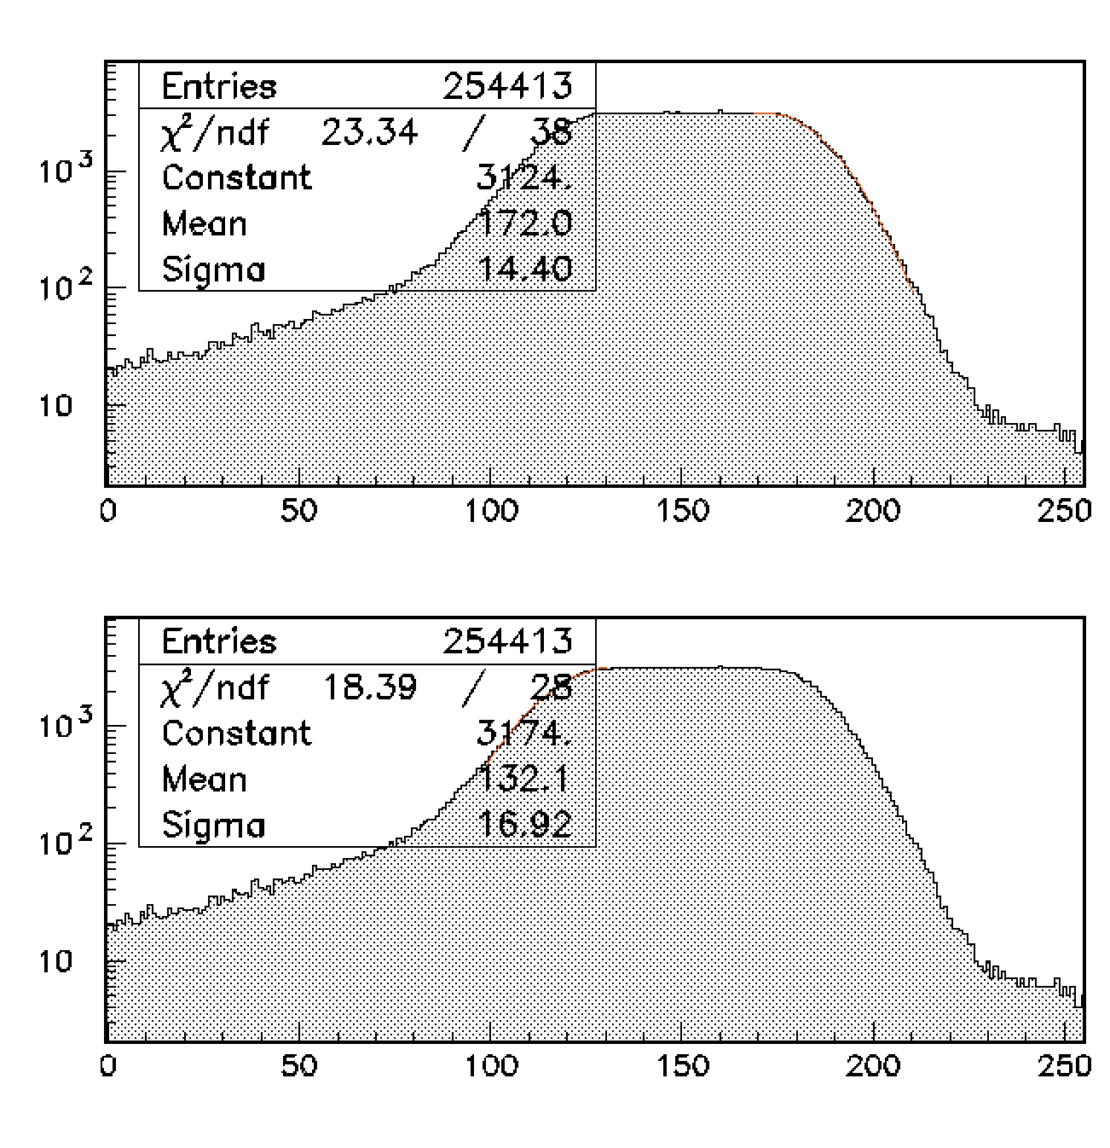
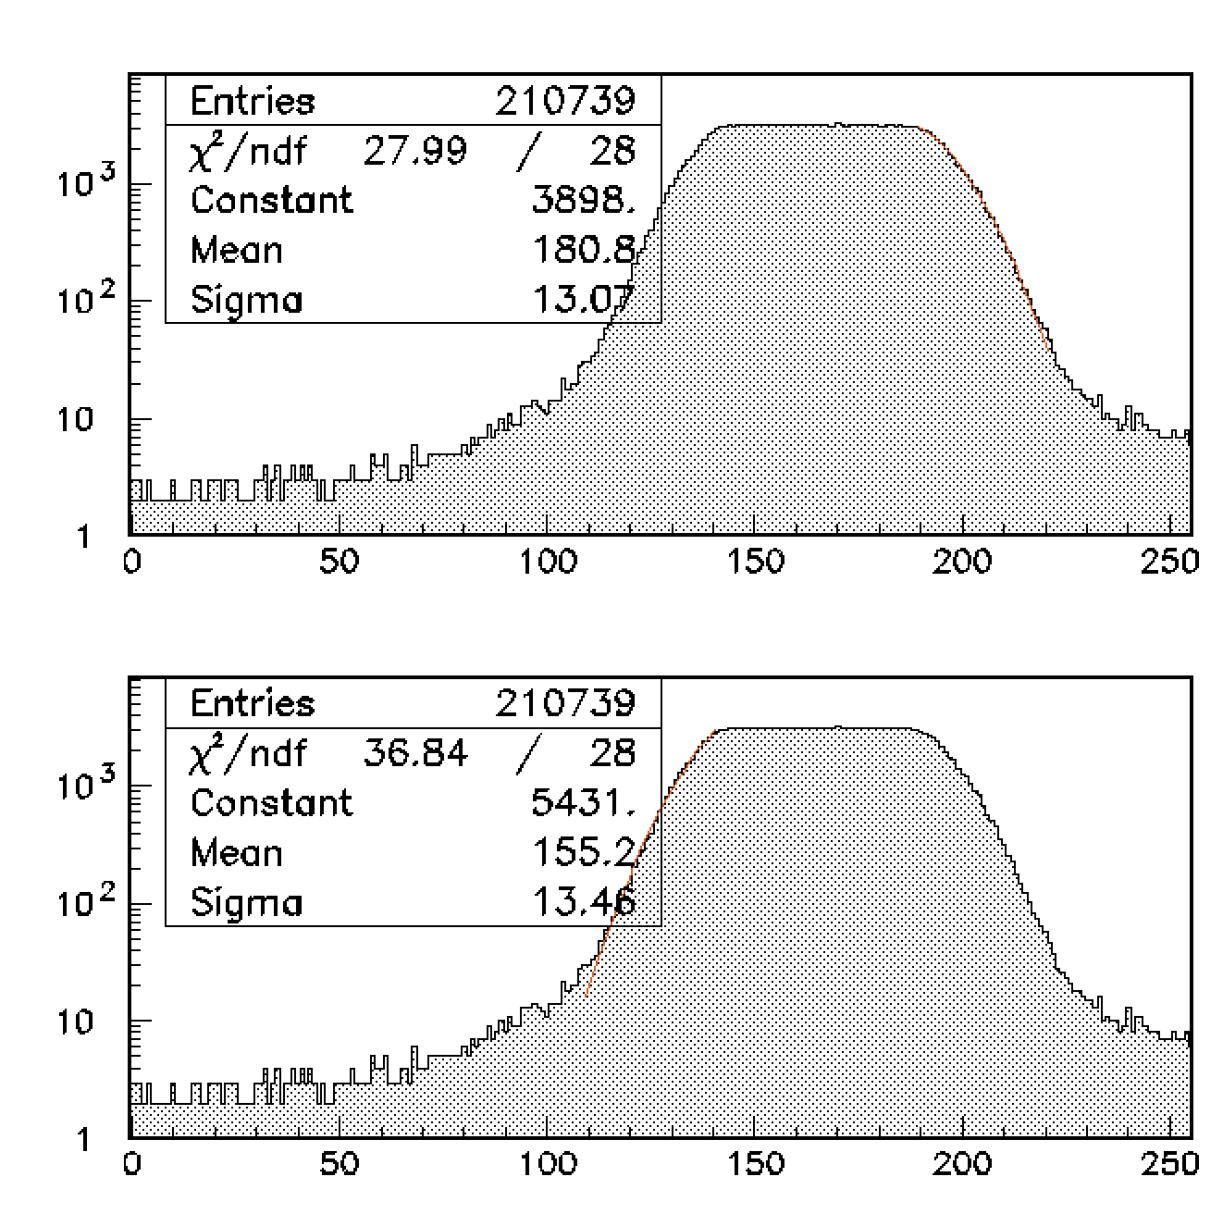
x
y
40*0.055=+/-1.1 mm flat
σ=0.850
+/-0.7 mm flat
σ=0.720

Slide 8
More tests in single particle mode

Slide 9
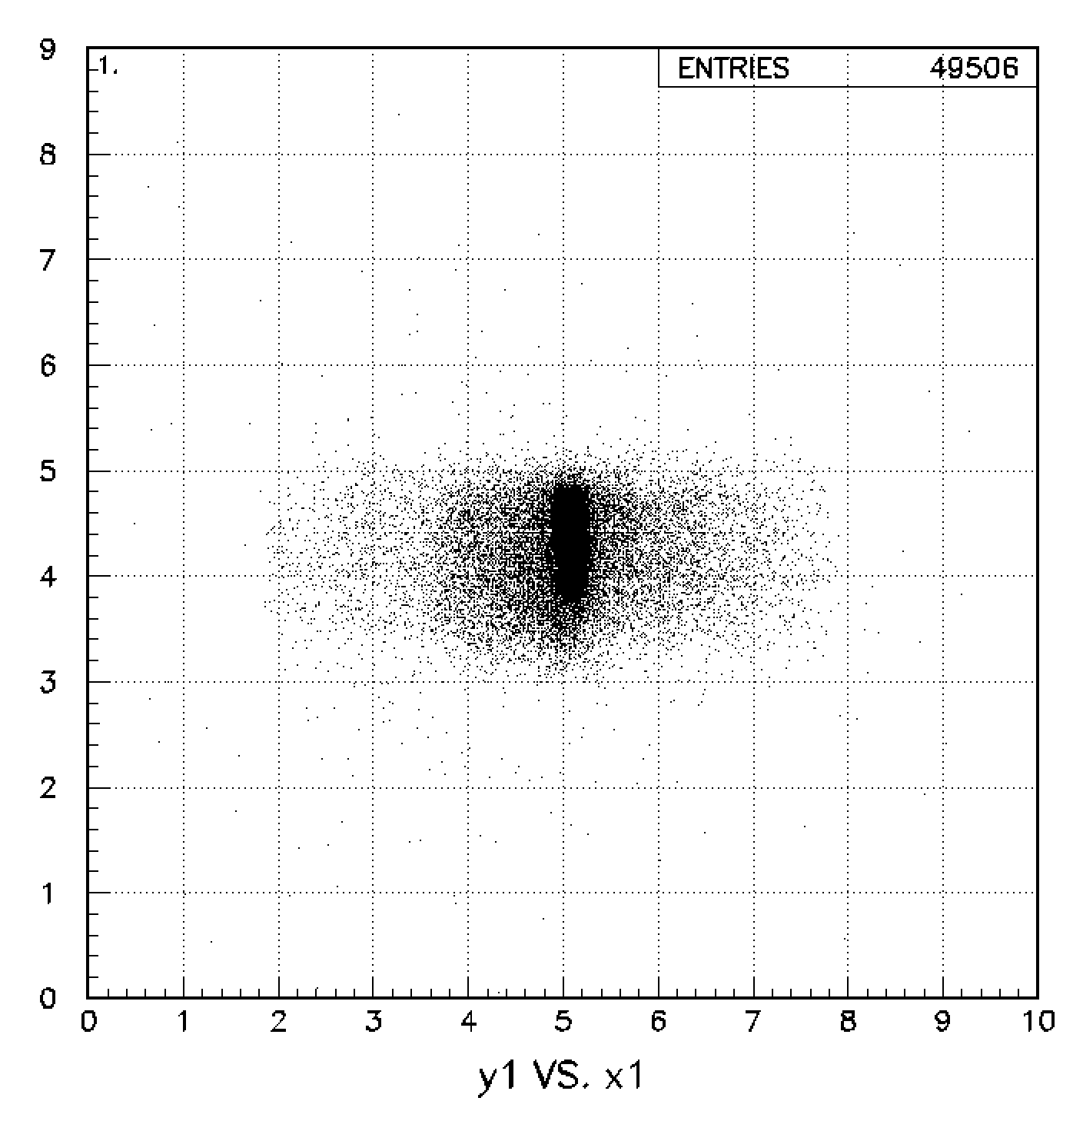
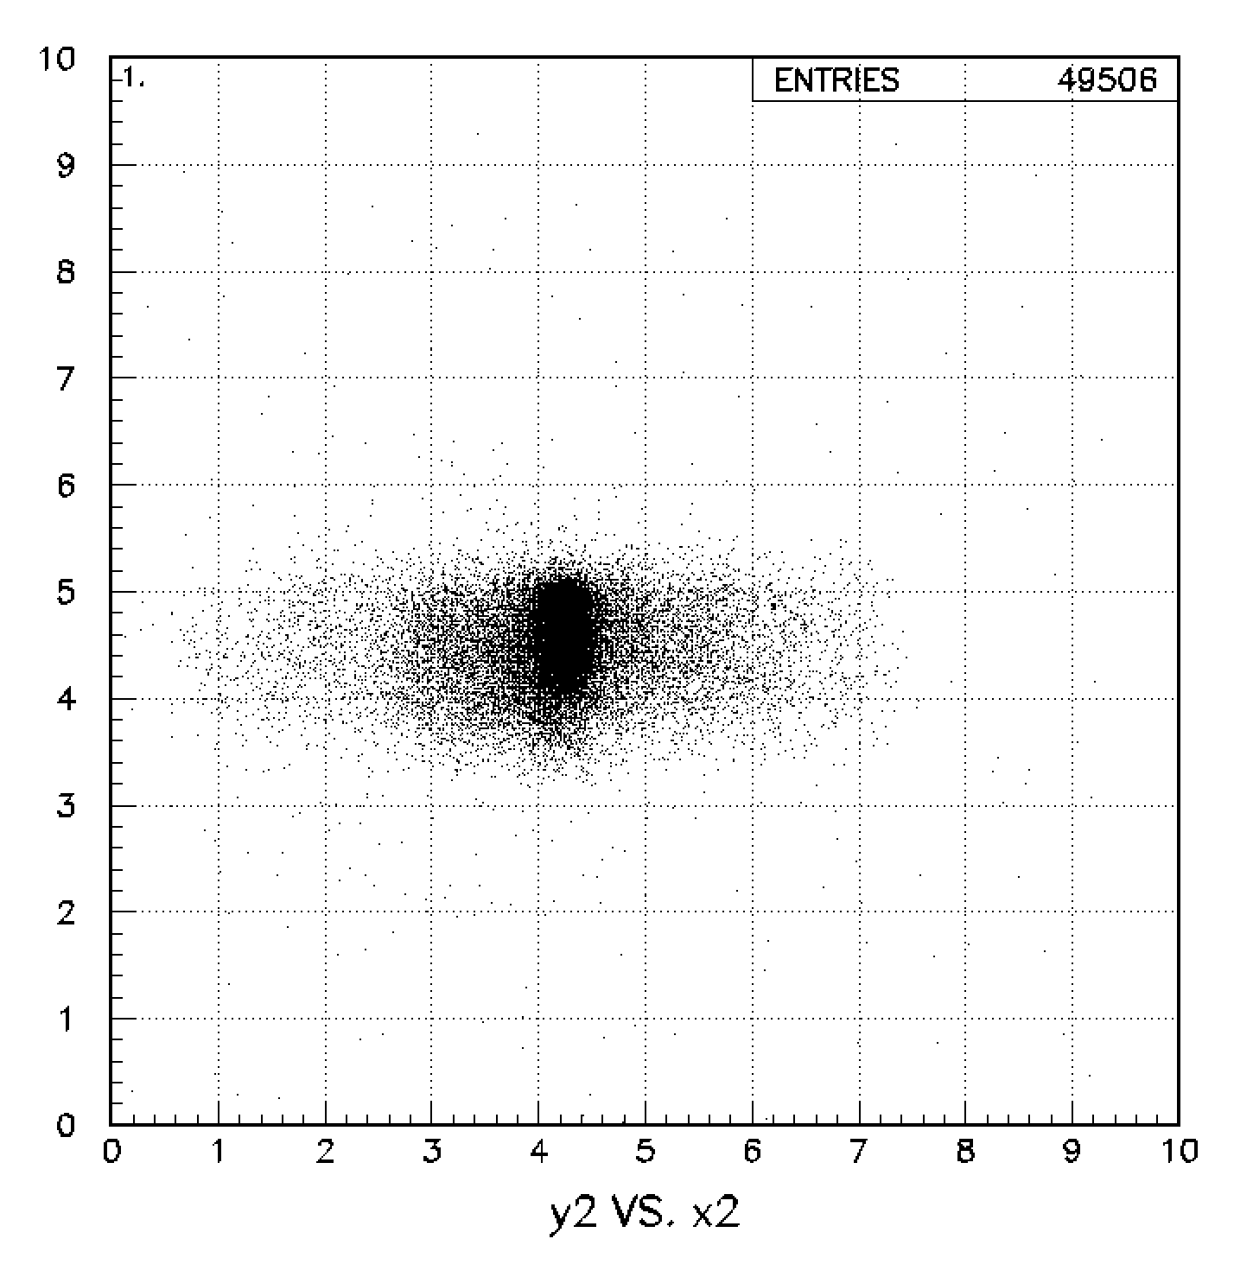
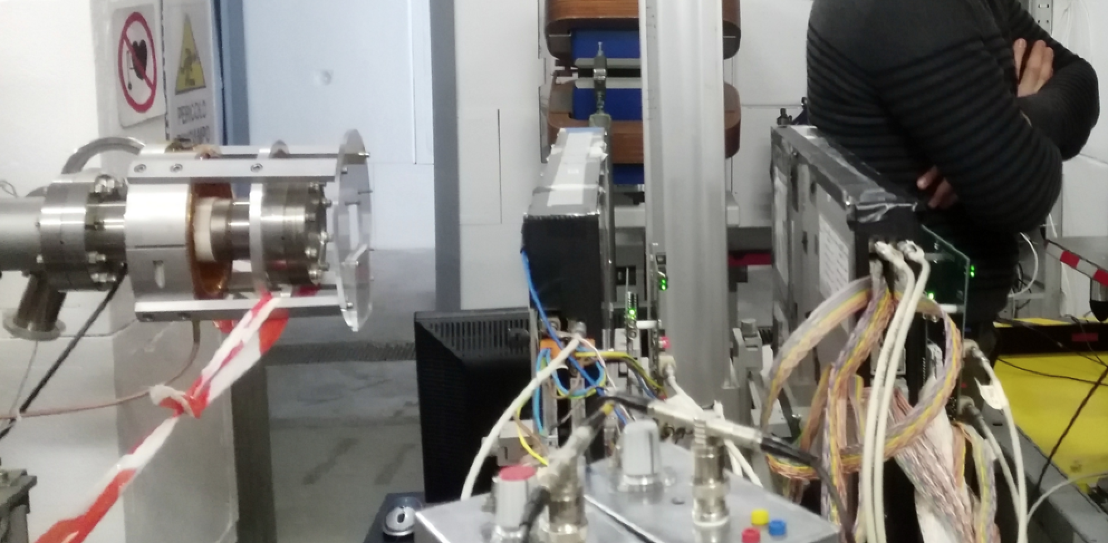
Wide area silicon micro-strip tracker
In collaboration with INSULAB
M. Prest, A. Berra
“AGILE” type Silicon micro-strip detectors
Single sided, 9.5×9.5 cm² area, 4×410 μm thickness, 242 μm readout pitch

Slide 10
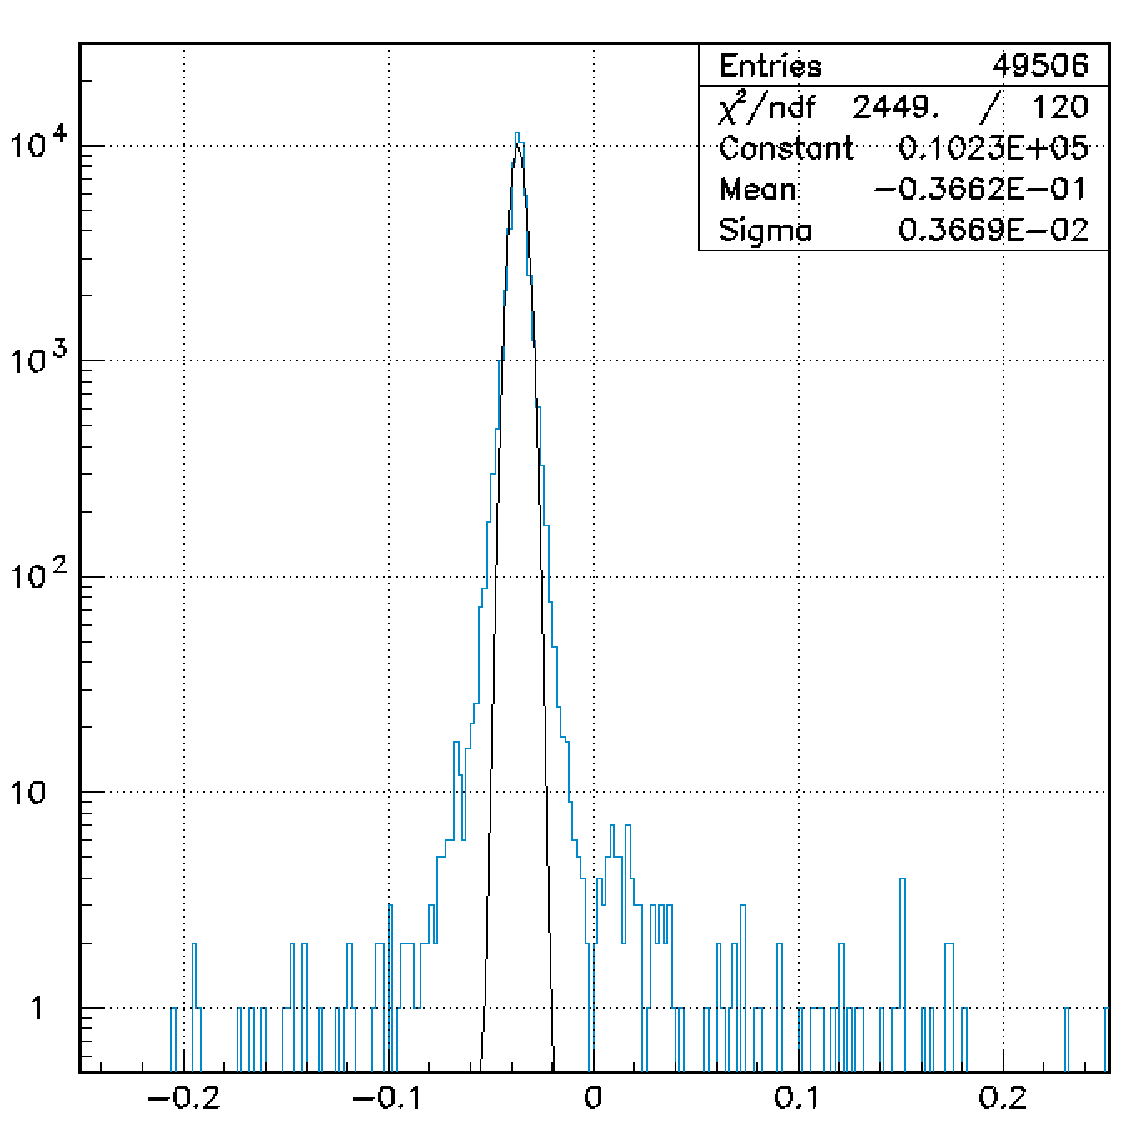
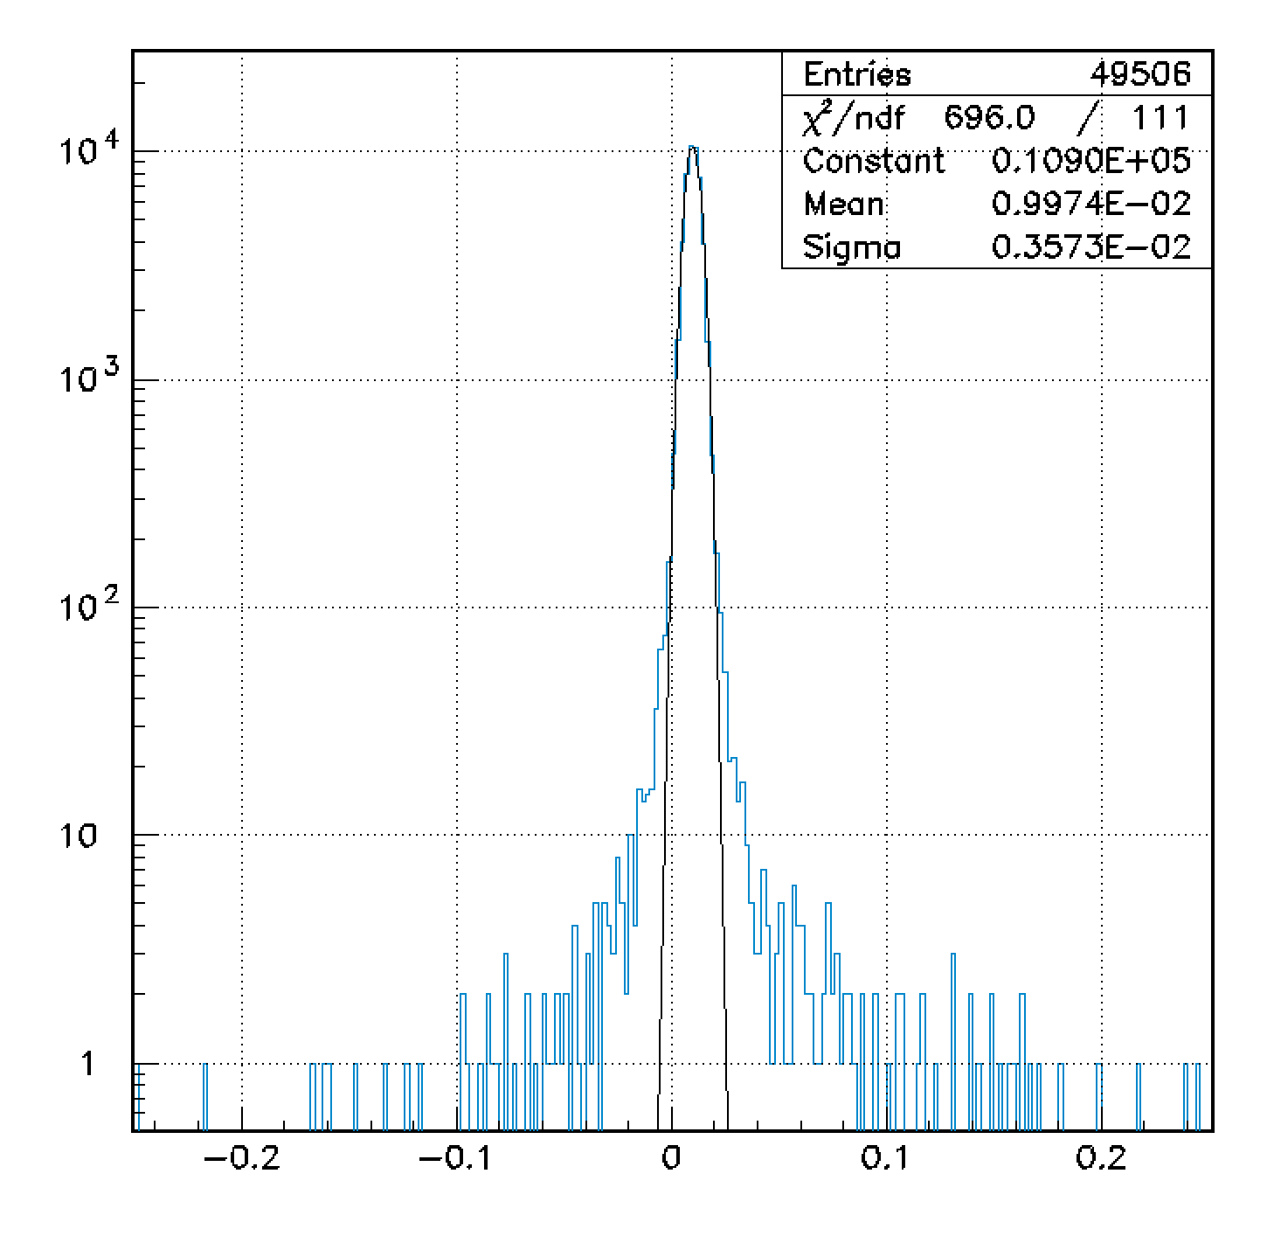
Track angles
θ_{x} = (x₂-x₁)/d
θ_{y} = (y₂-y₁)/d
d=23 cm
x₂,y₂
x₁,y₁
θ_{x} (rad)
θ_{y} (rad)

Slide 11
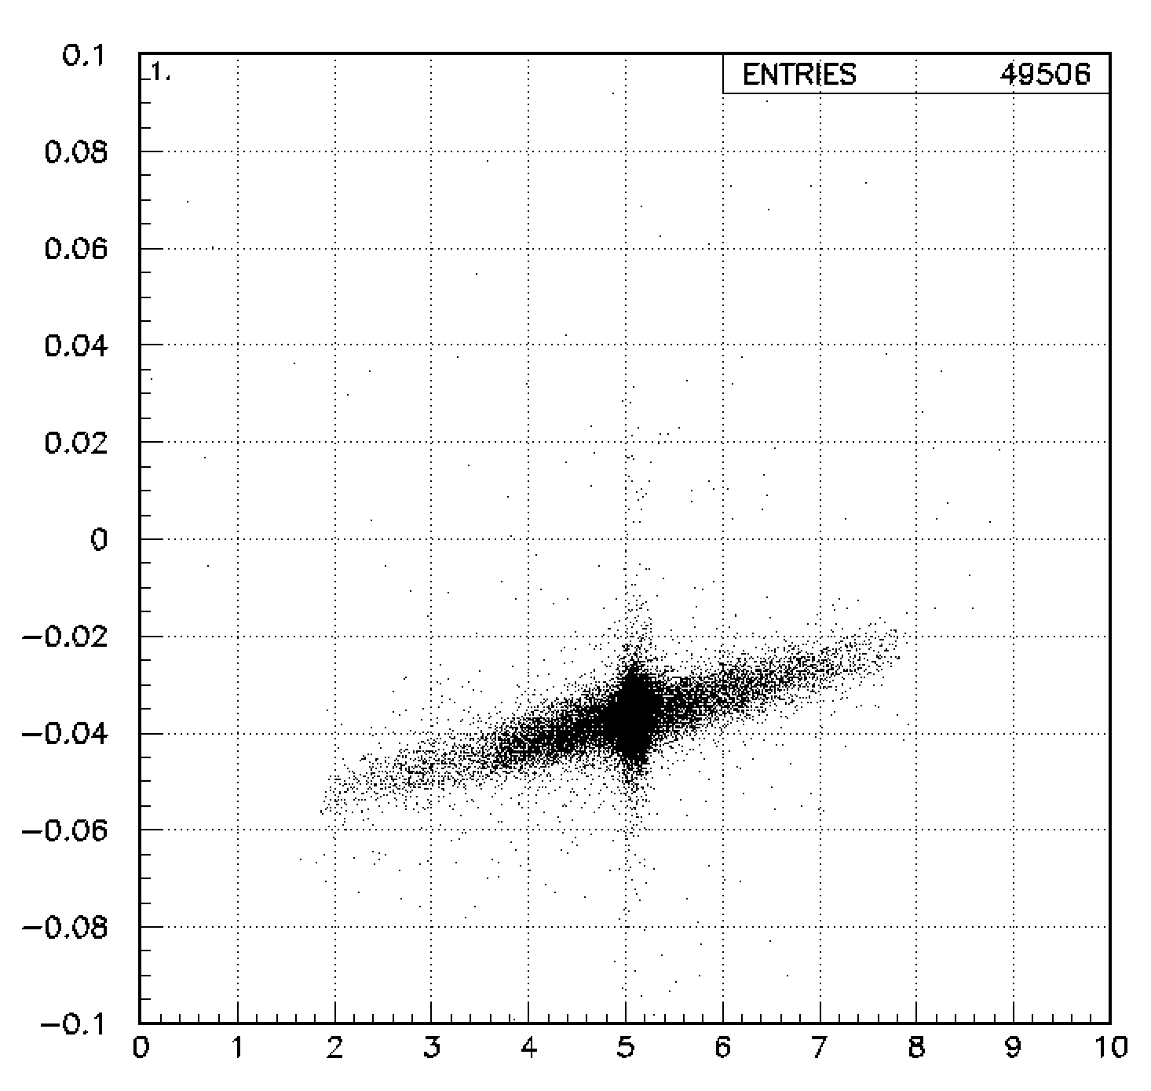
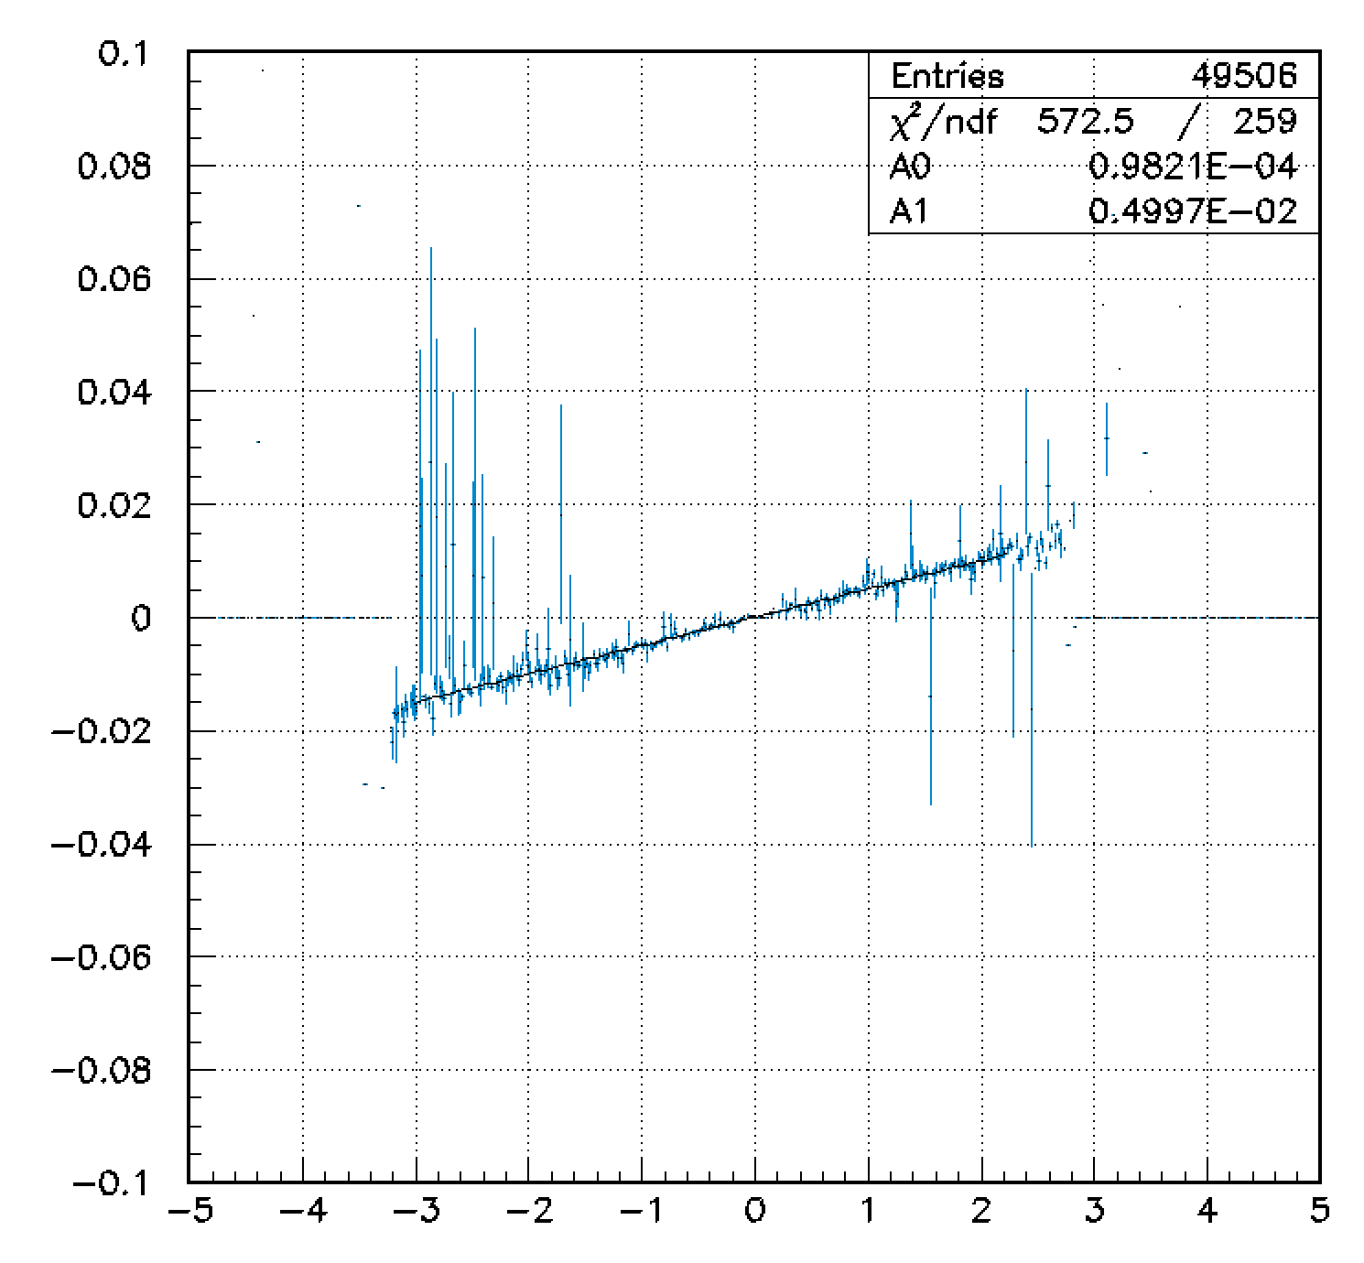
θ_{x} (rad)
-36.6 mrad ≈ -2°
average horizontal angle
x₁ (cm)
θ_{x} – x correlation
due to divergence
5 mrad/cm
D_{bend} = 2 m
θ_{x}-θ_{x0}
x_{B}
θ_{B}
x_{A}
θ_{A}
x₁-x_{center1}
D_{bend}

Slide 12
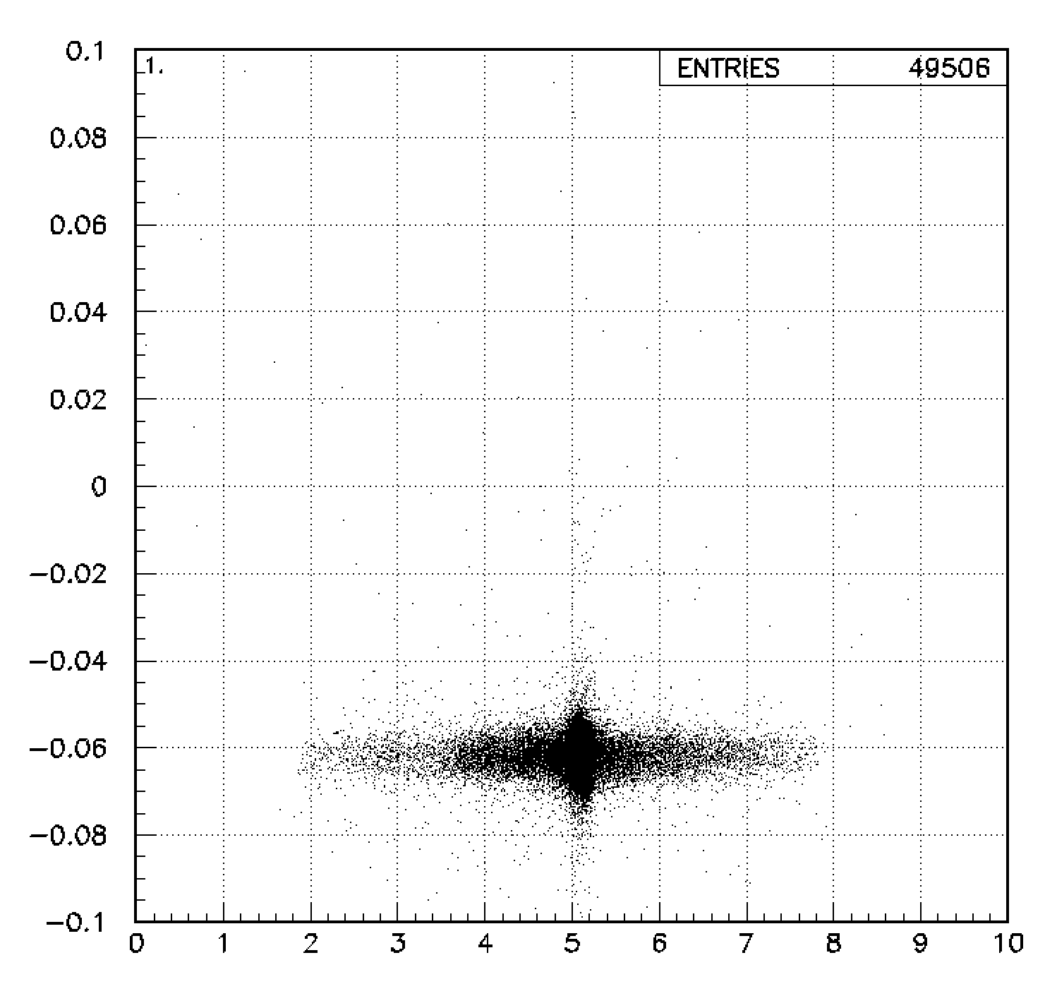
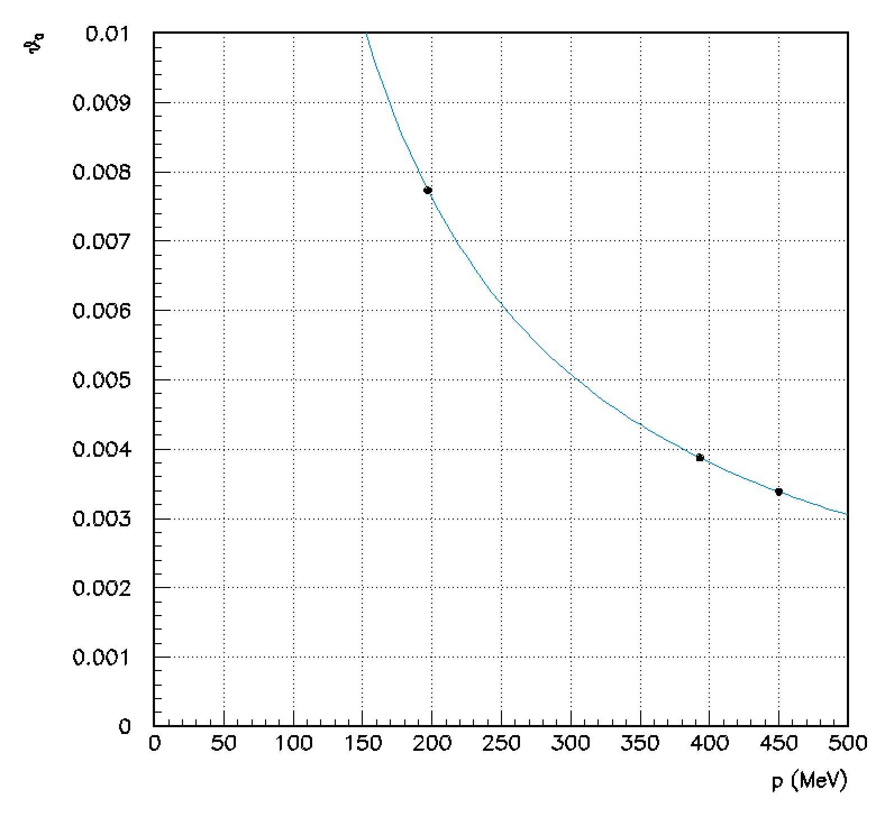
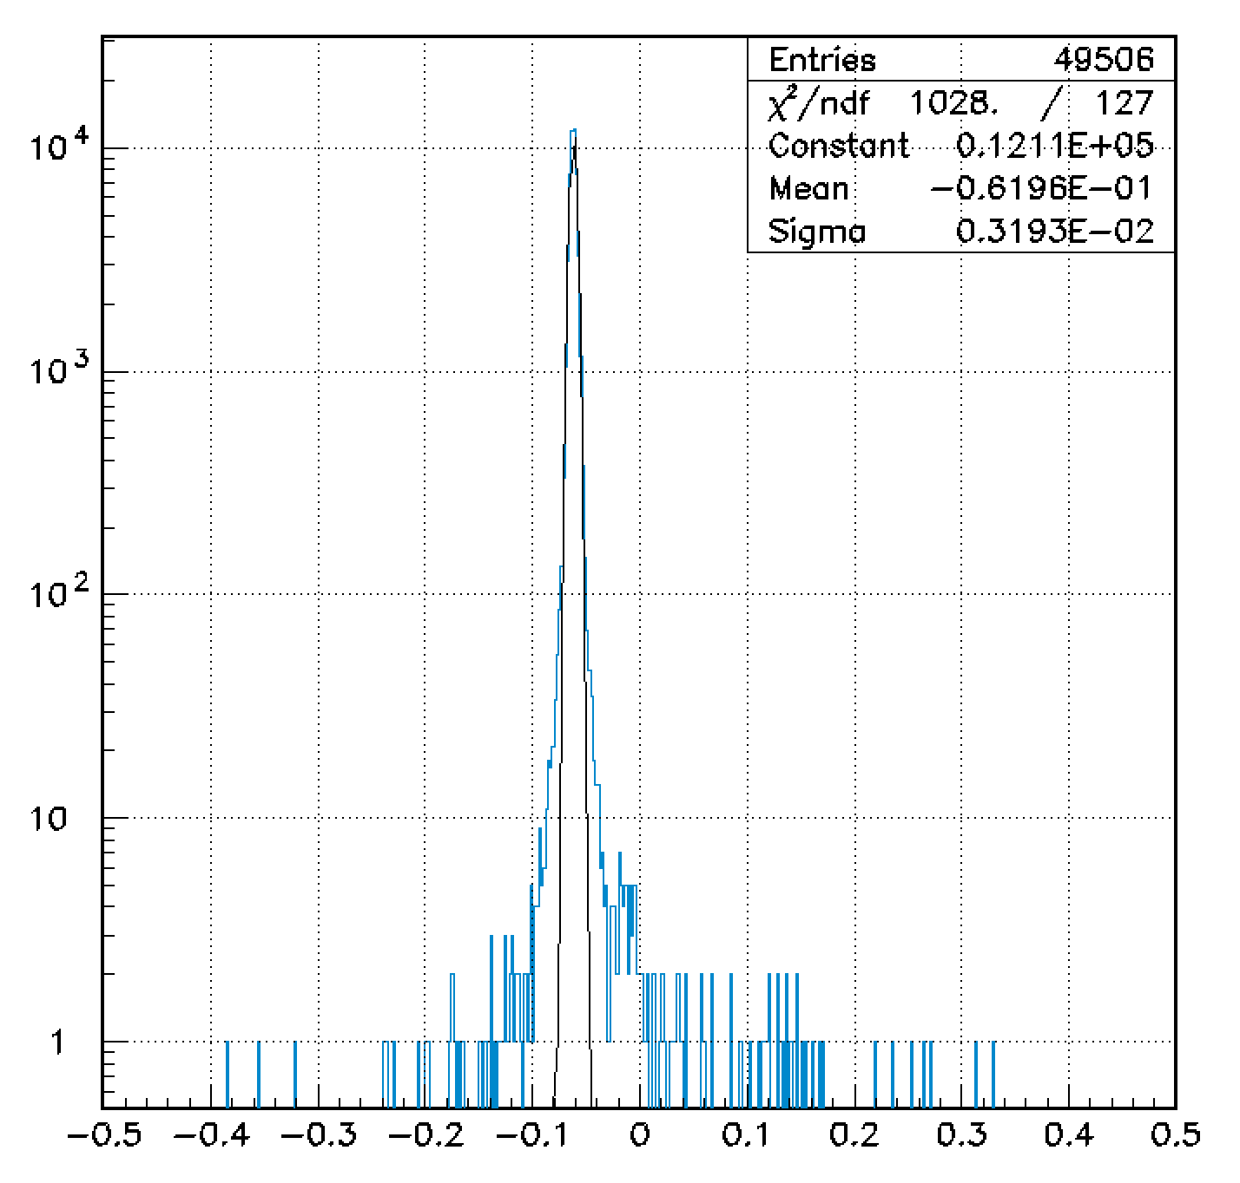
After divergence correction
θ_{x} (rad)
x₁ (cm)
X₀(Si) = 9.36 cm
4×410 μm = 1.75%
θ₀ = 0.432/p(MeV)
X₀(Be) = 35.28 cm
500 μm = 0.14%
Totally dominated by multiple scattering
θ_{x} (rad)

Slide 13
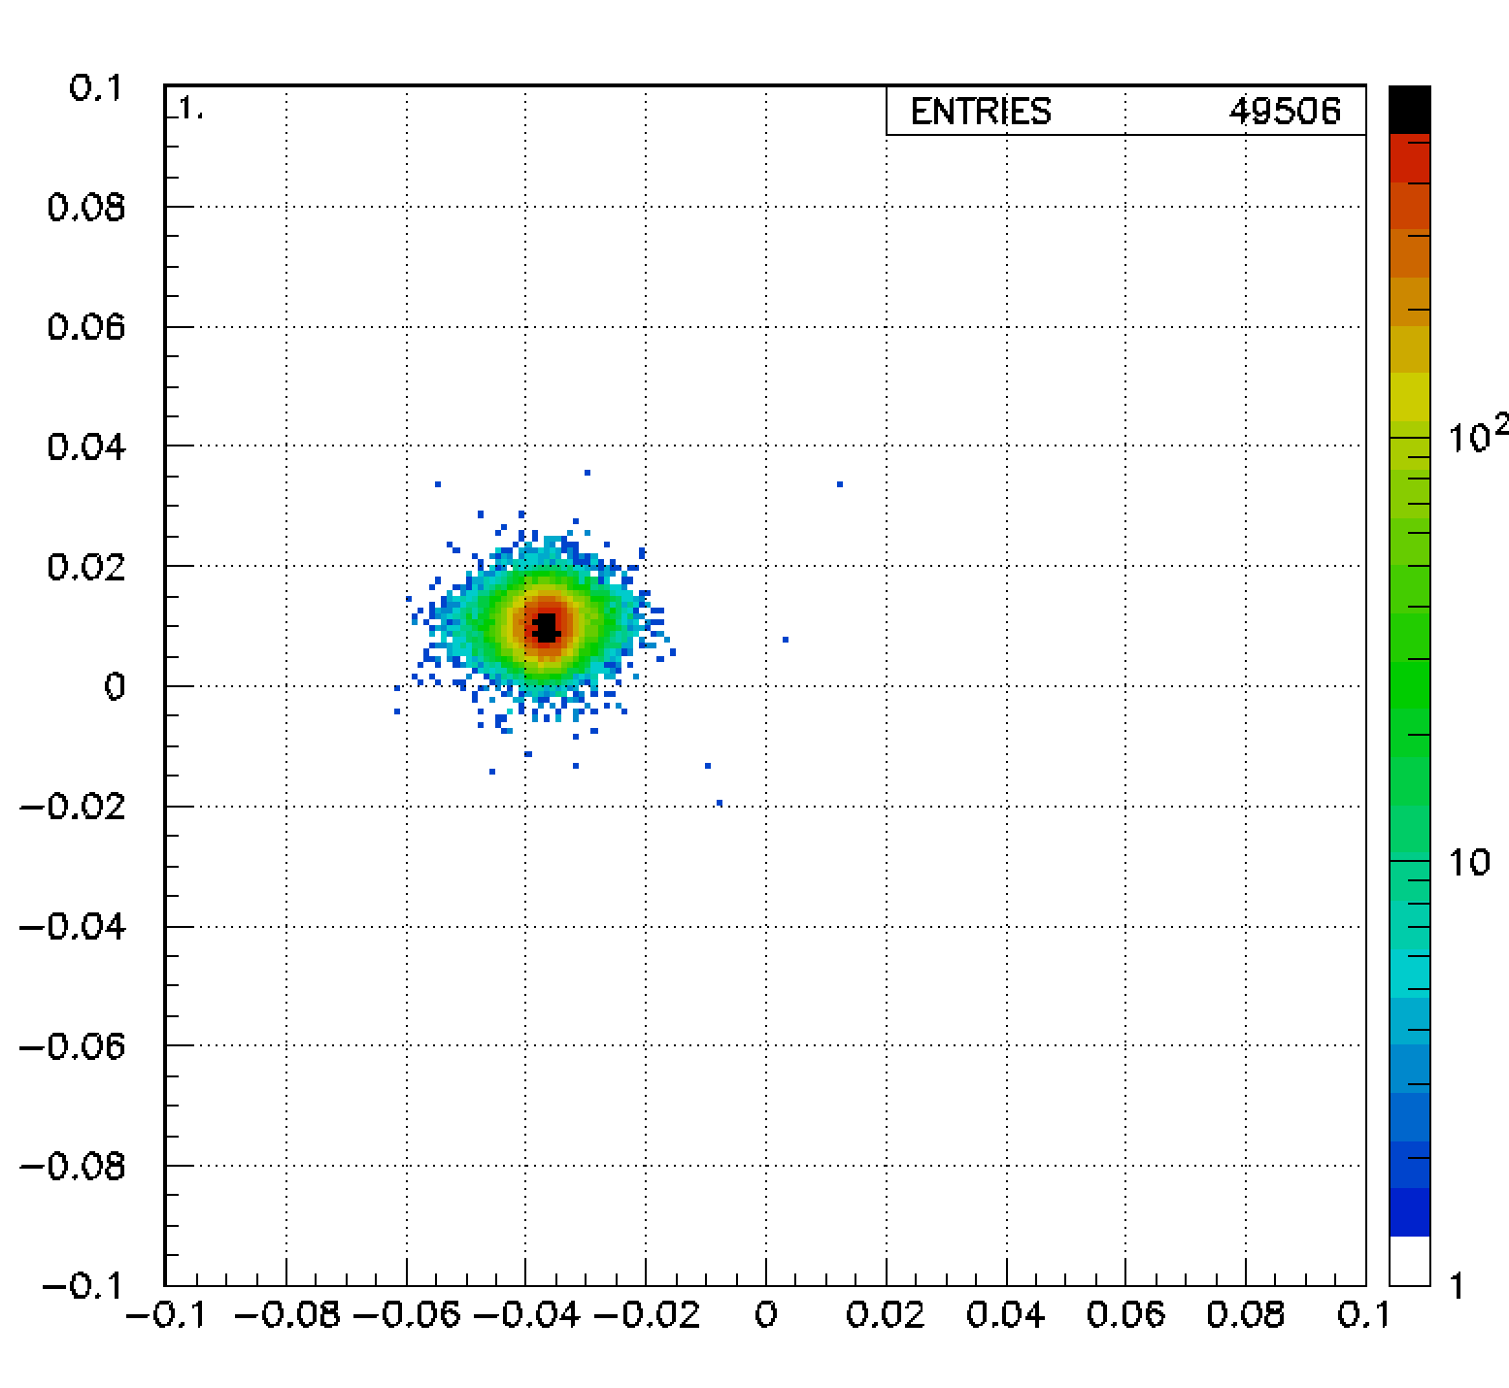
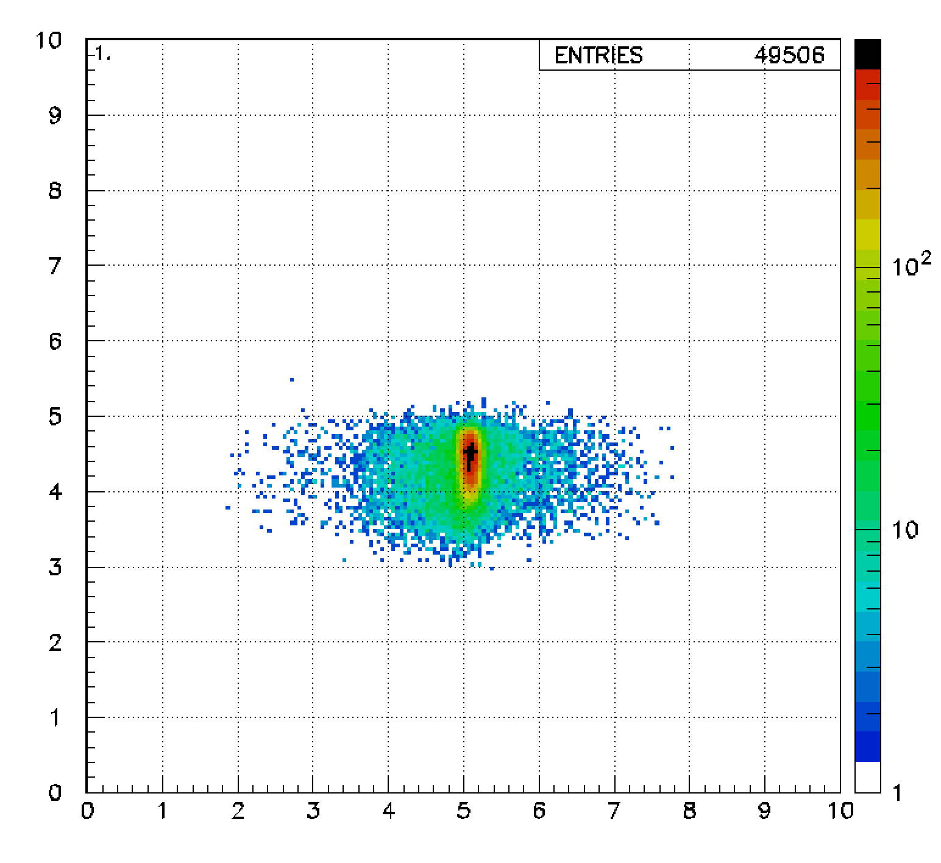
450 MeV
θ_{y} (rad)
θ_{x} (rad)
y₁ (cm)
x₁ (cm)

Slide 14
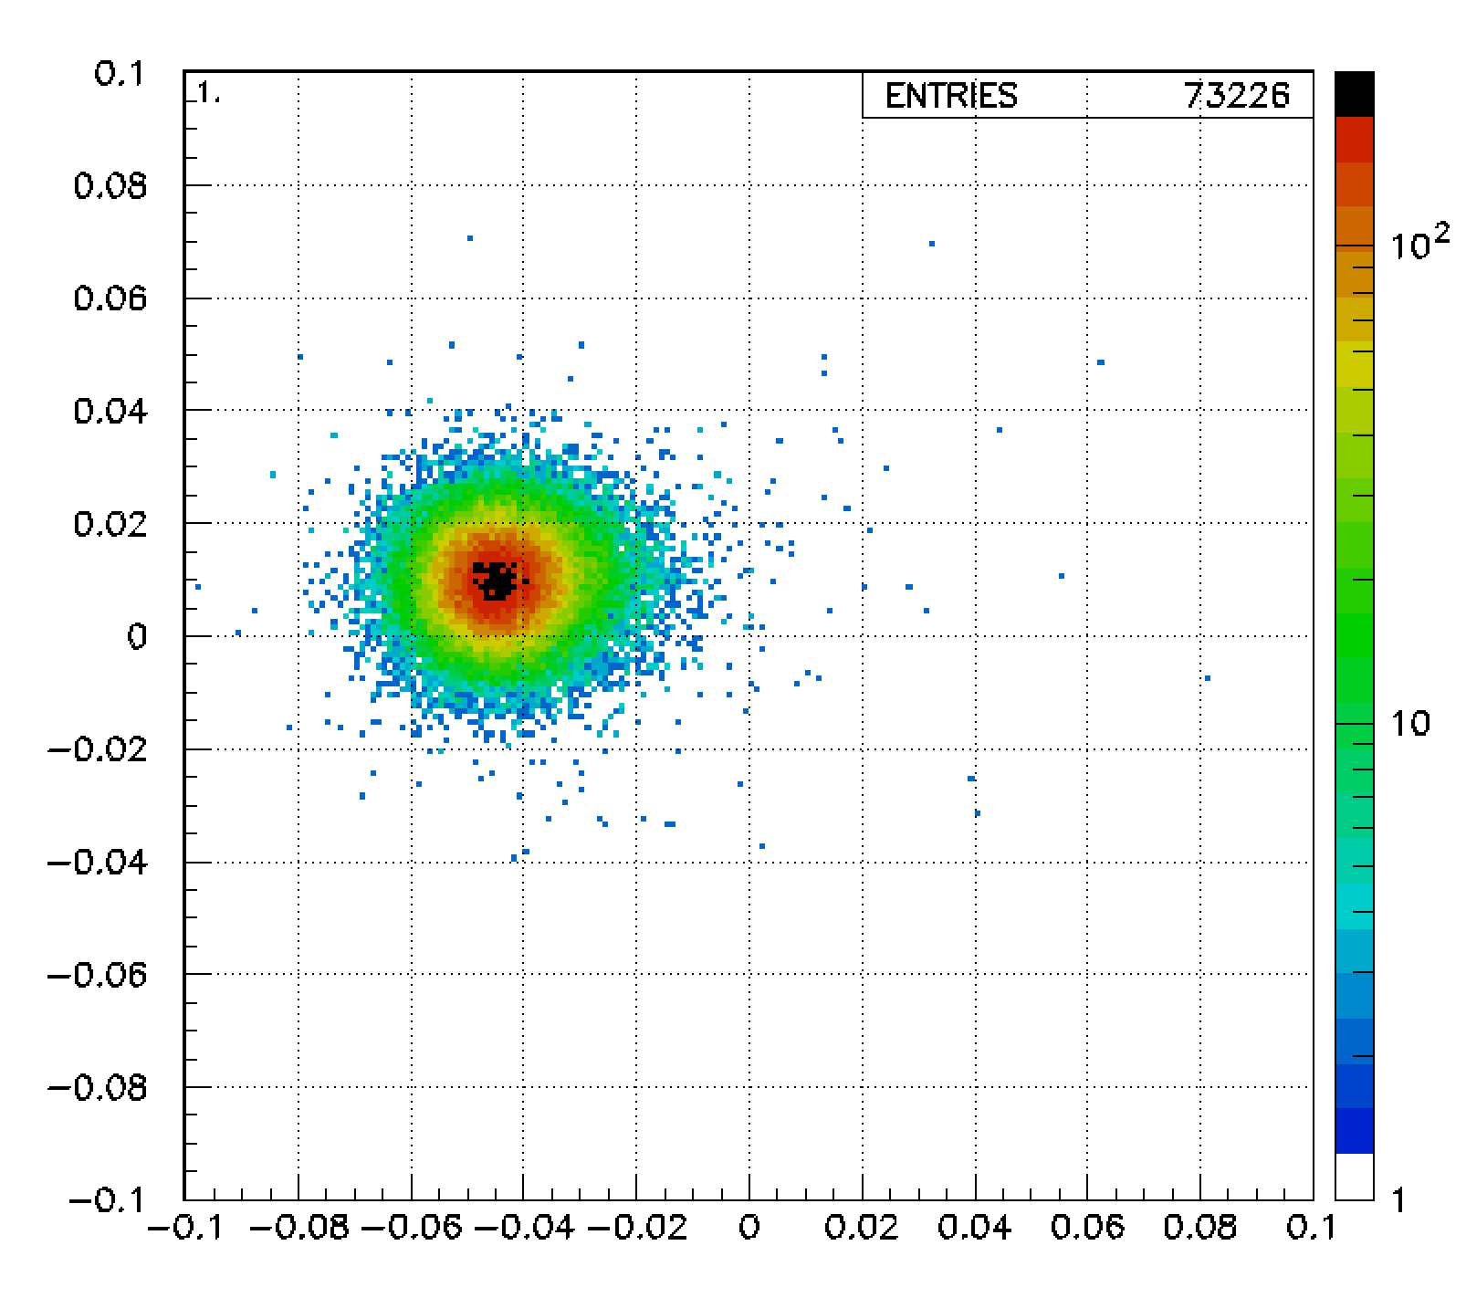
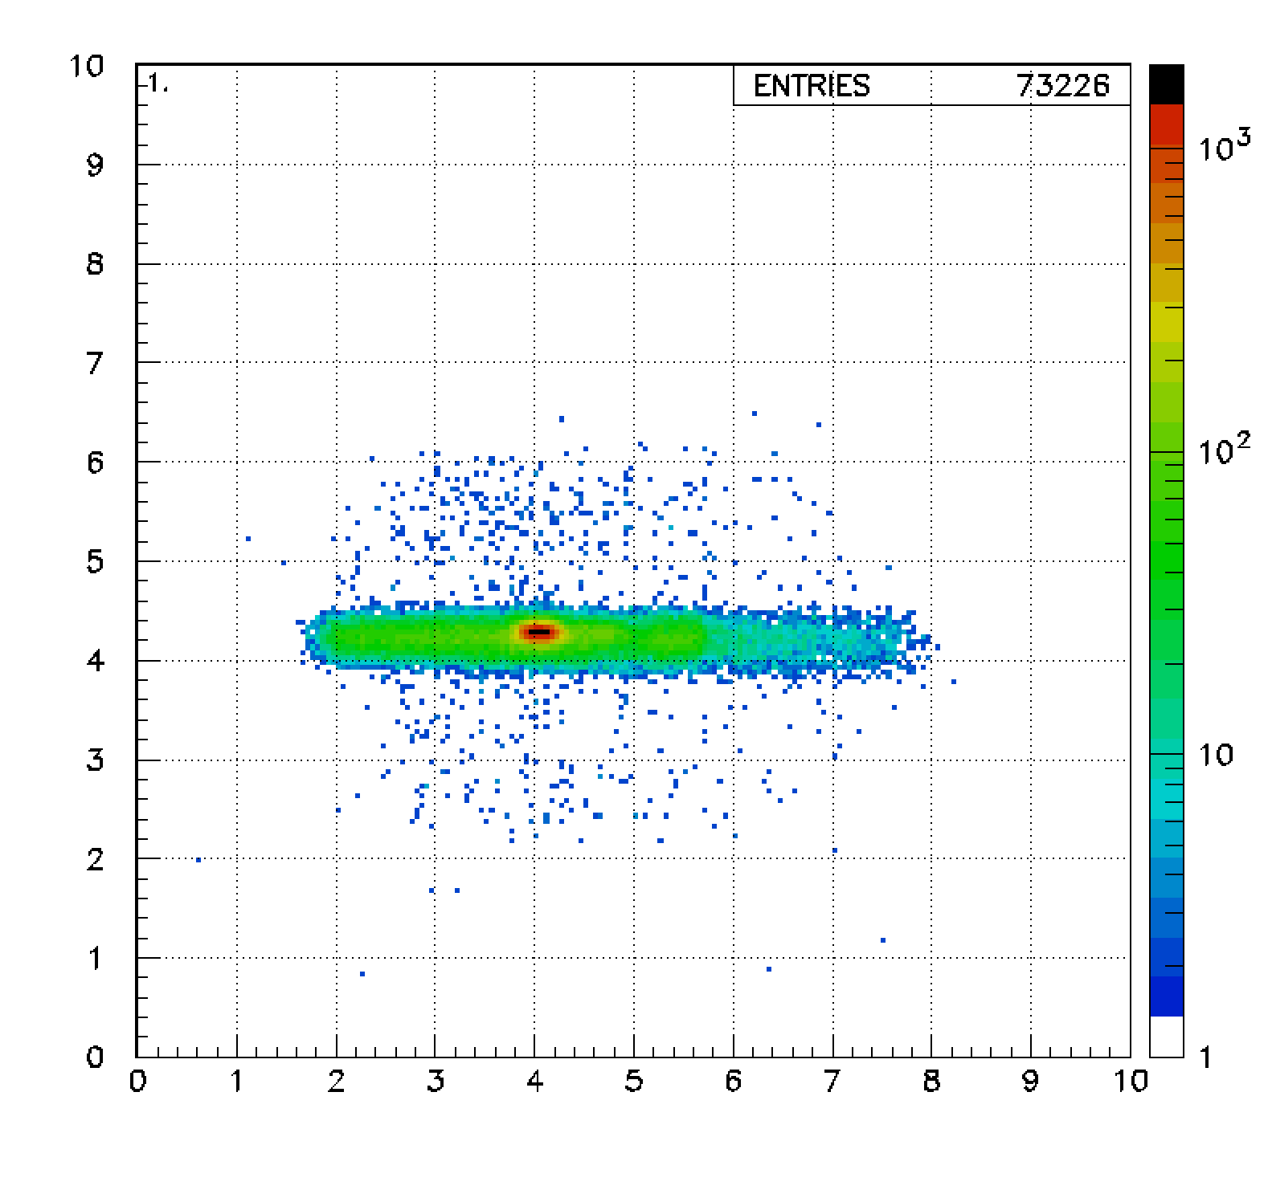
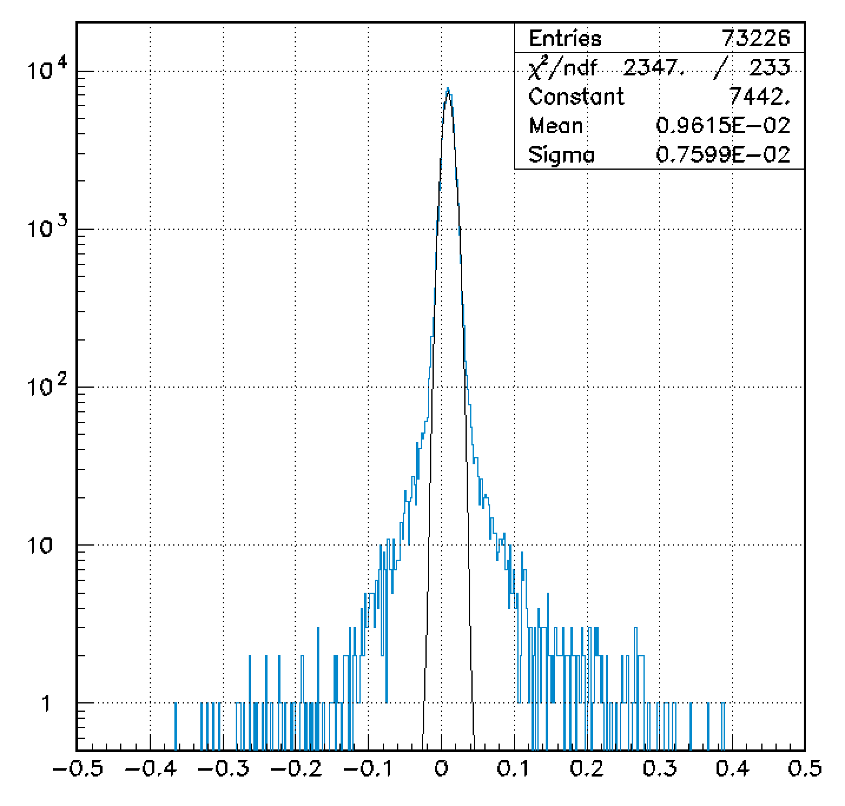
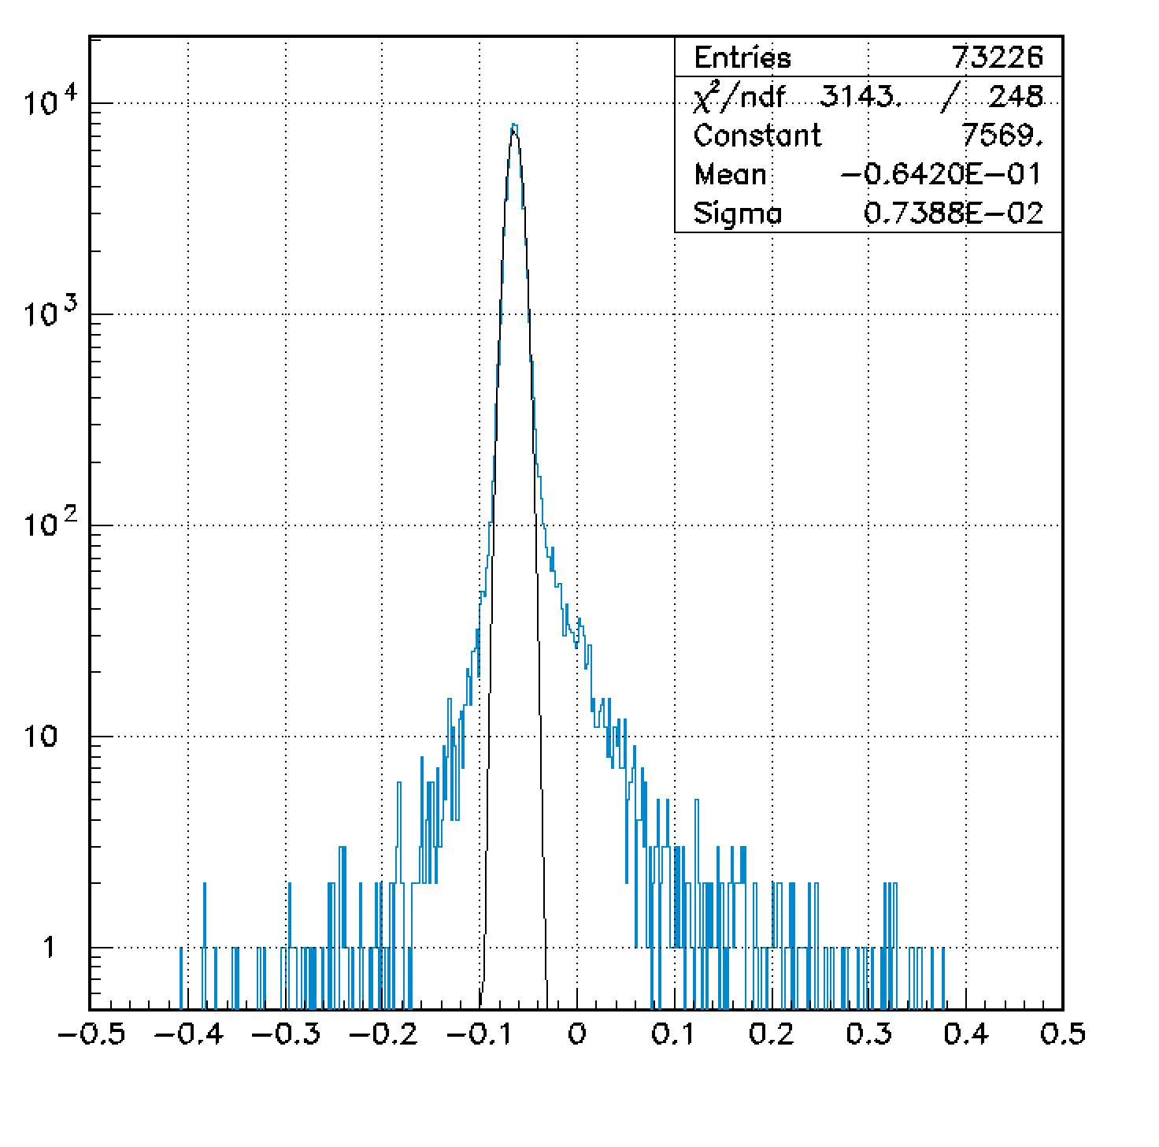
197 MeV
θ_{y} (rad)
θ_{x} (rad)
θ_{x} (rad)
y₁ (cm)
x₁ (cm)
θ_{y} (rad)
θ_{x} (rad)

Slide 15
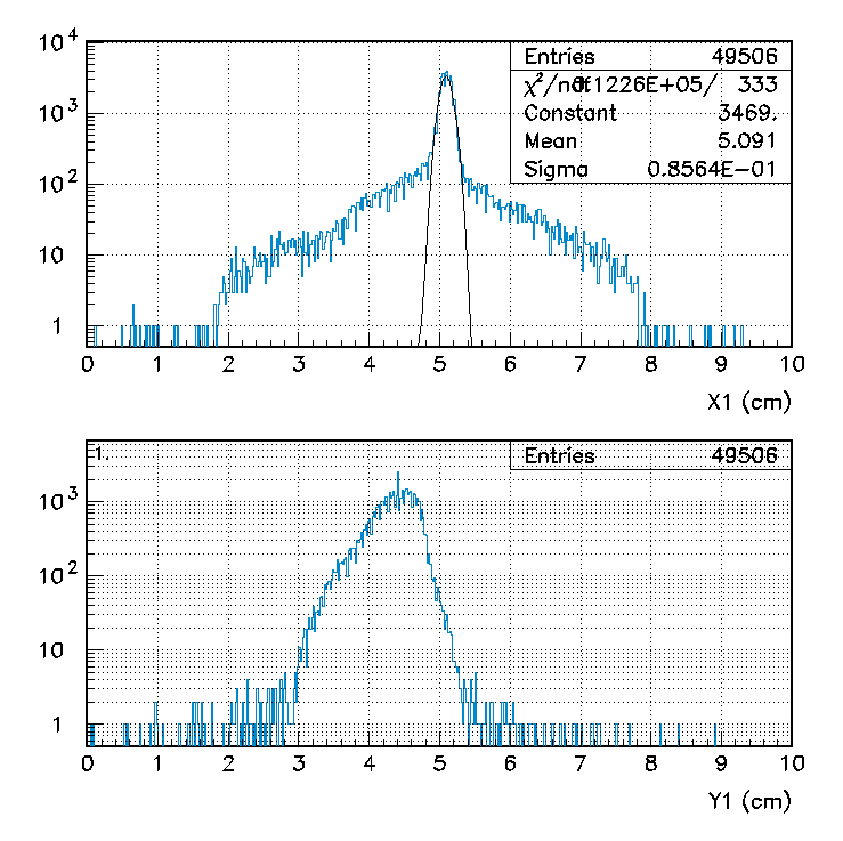
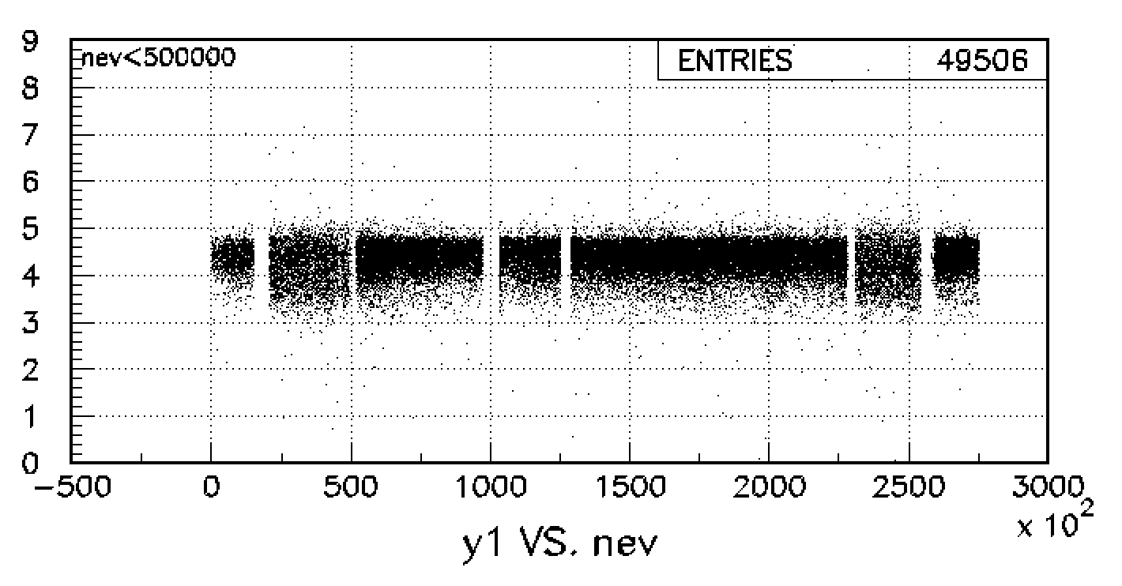
Electron/Positron LINAC mode
Impact of DAFNE running

Slide 16
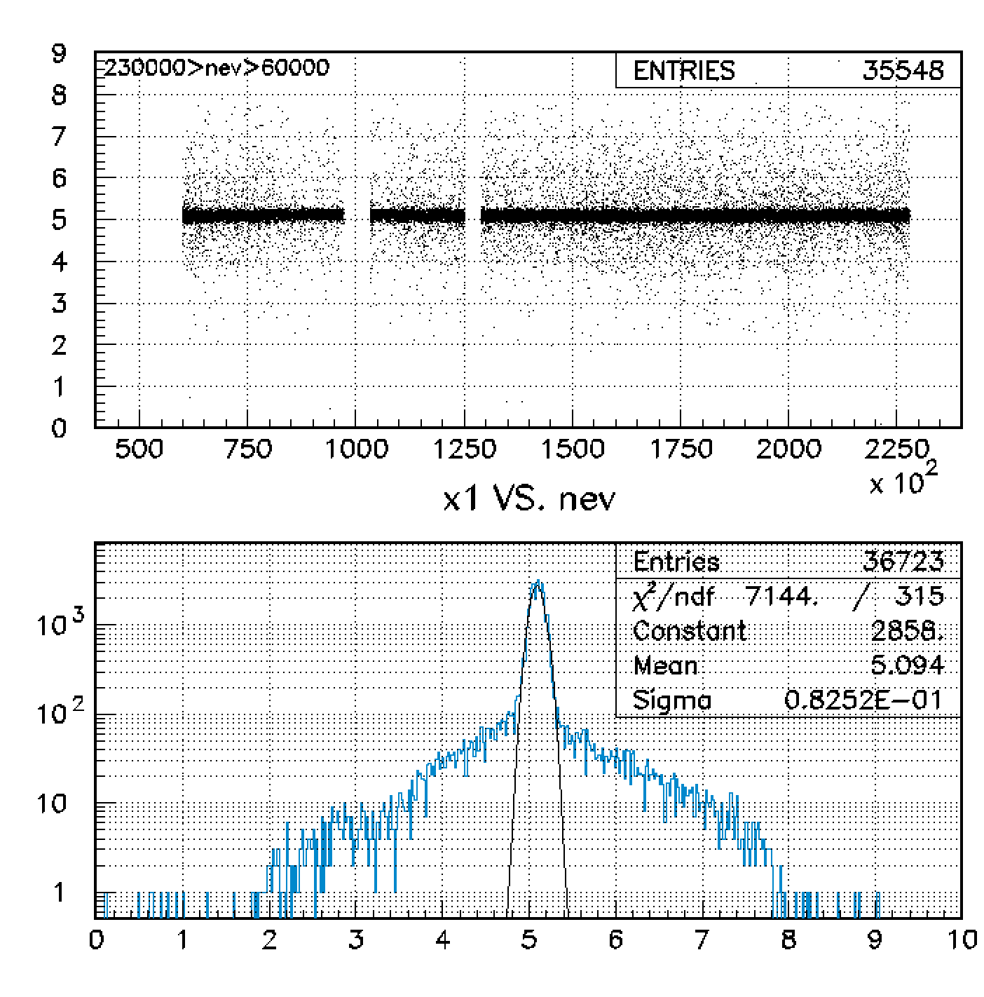
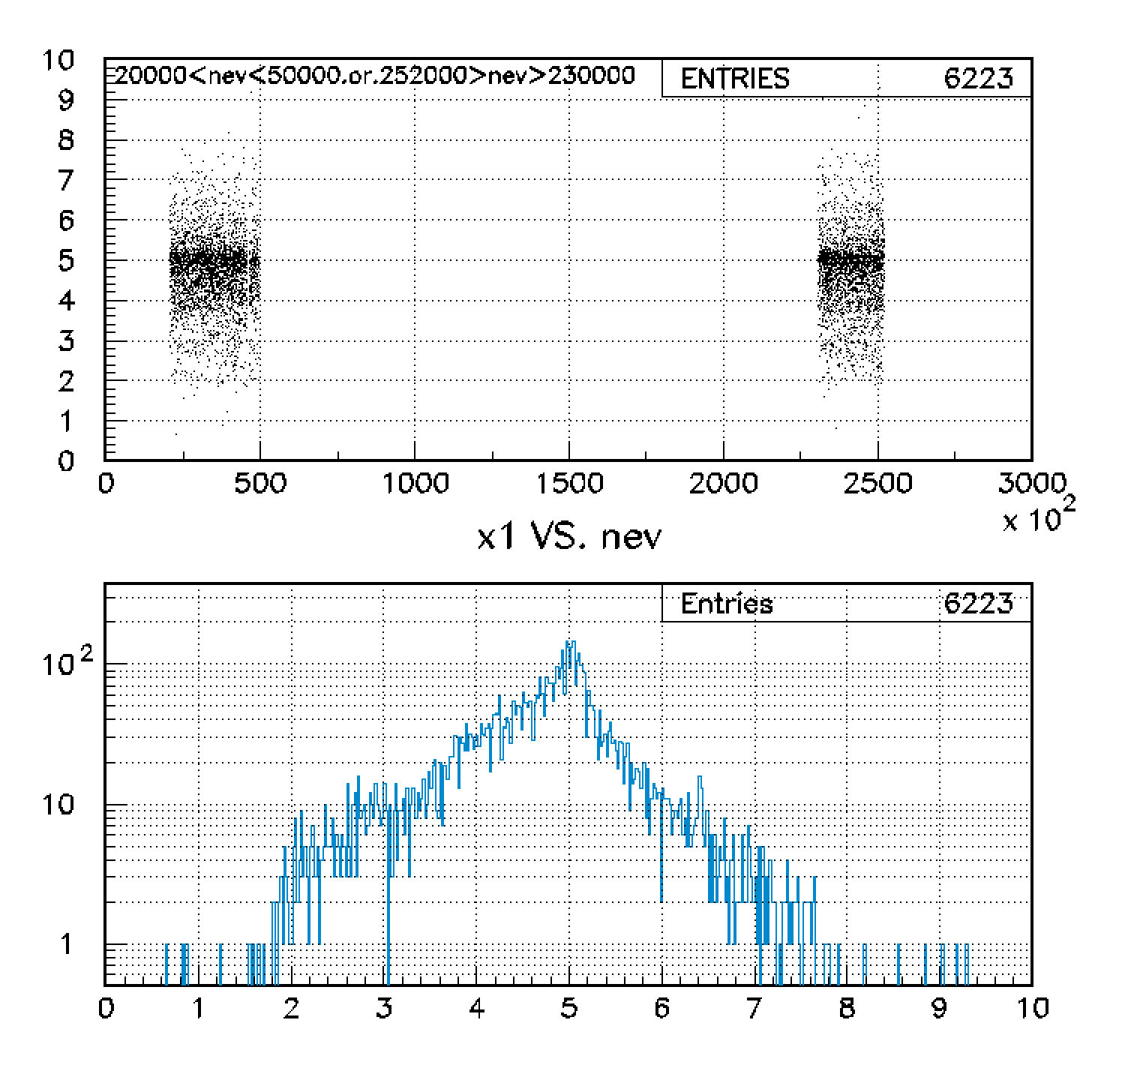
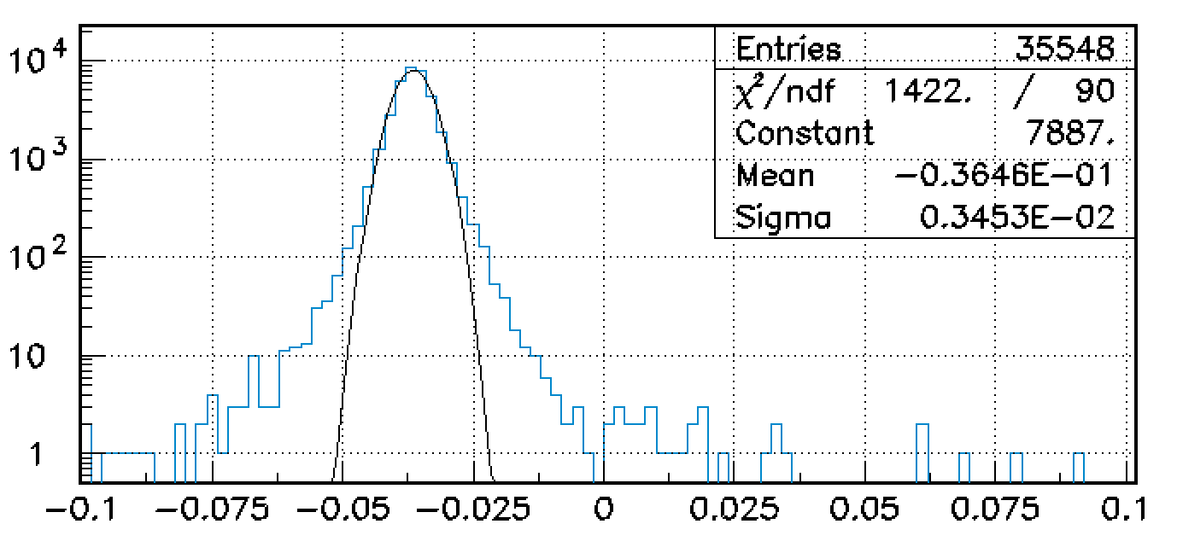
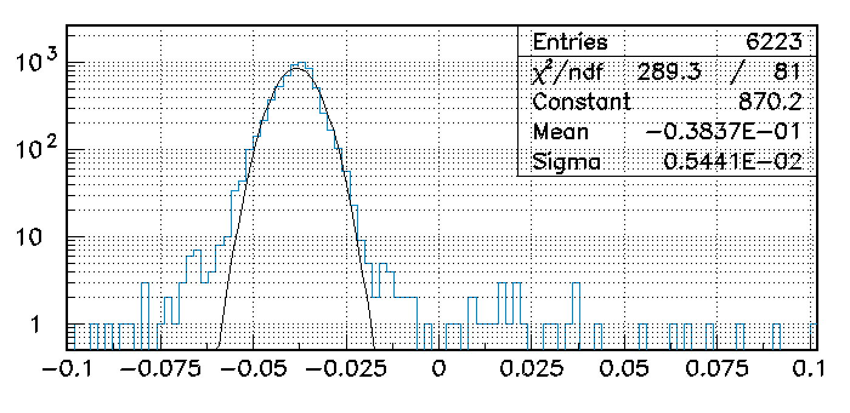

Slide 17
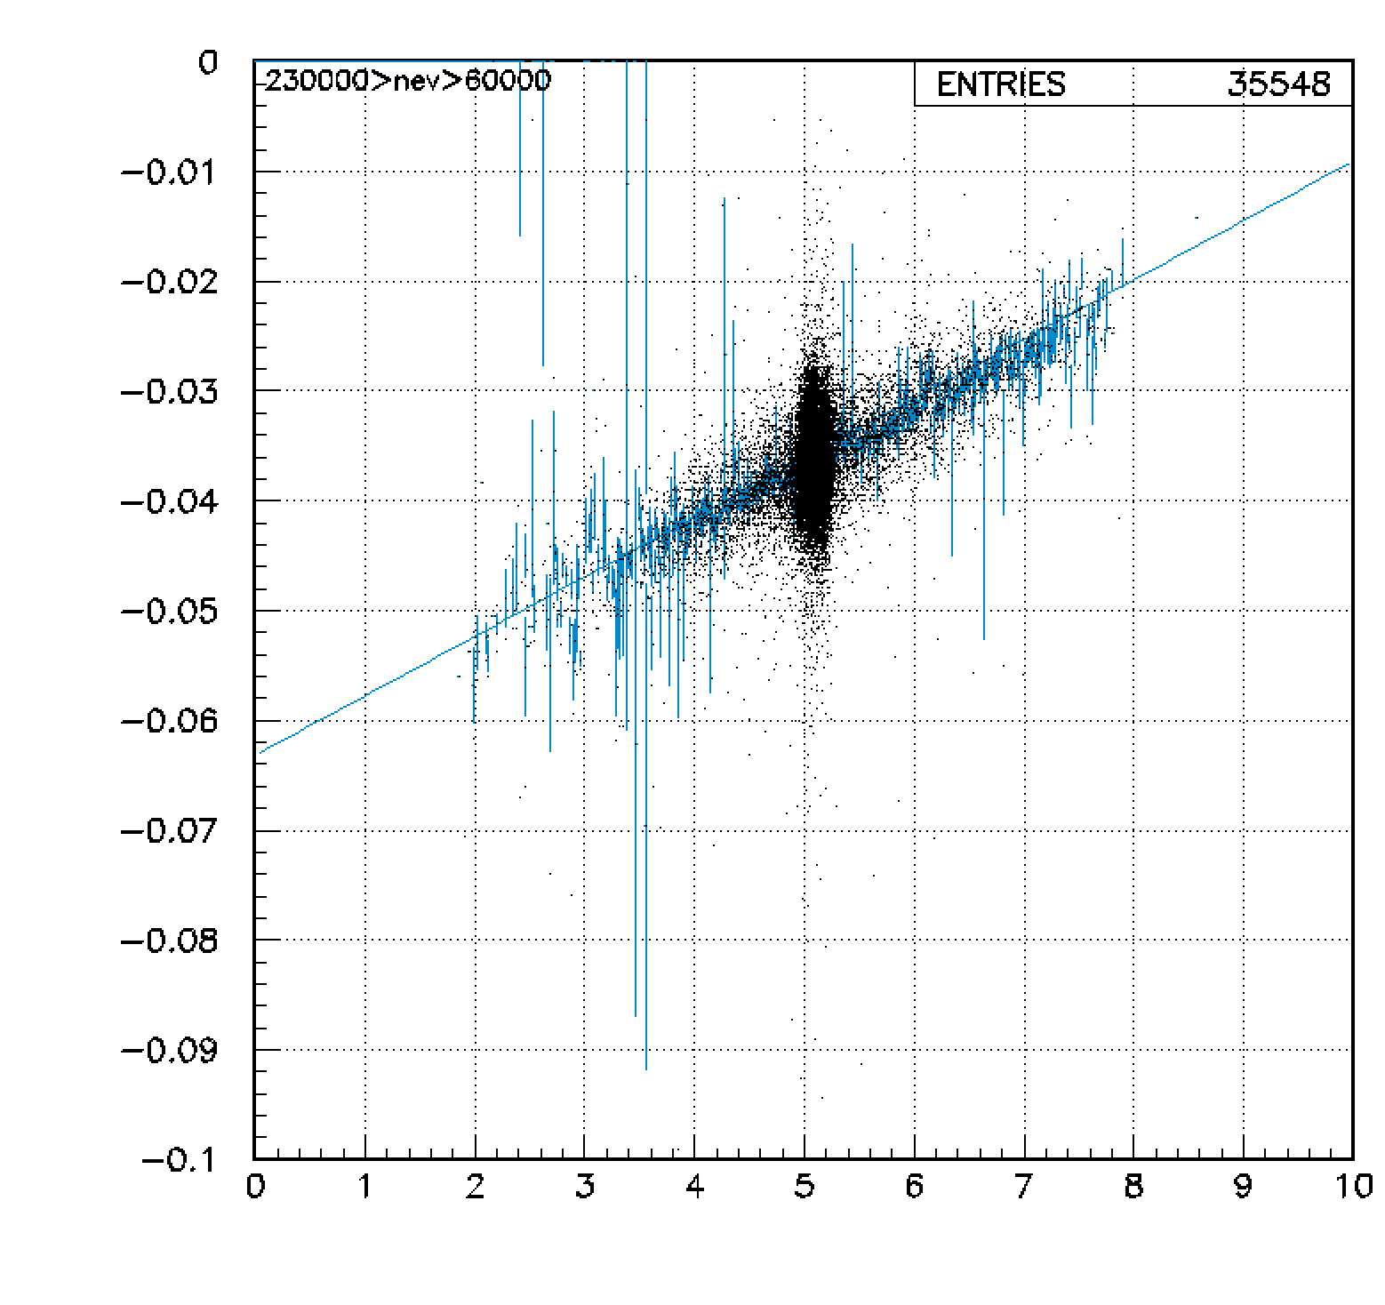
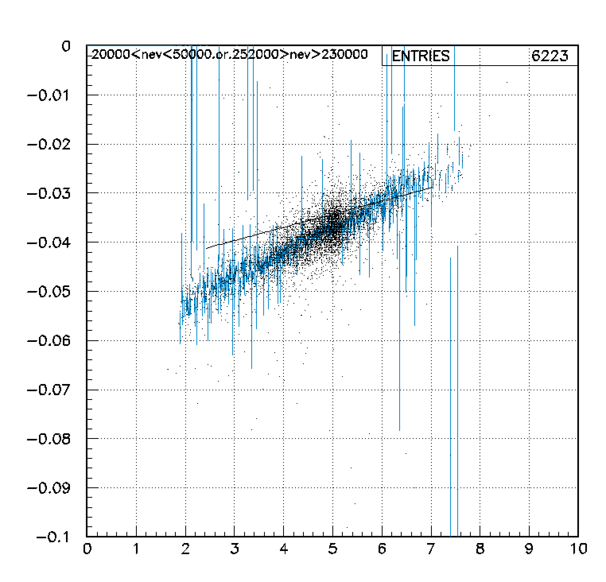
Focussing

Slide 18
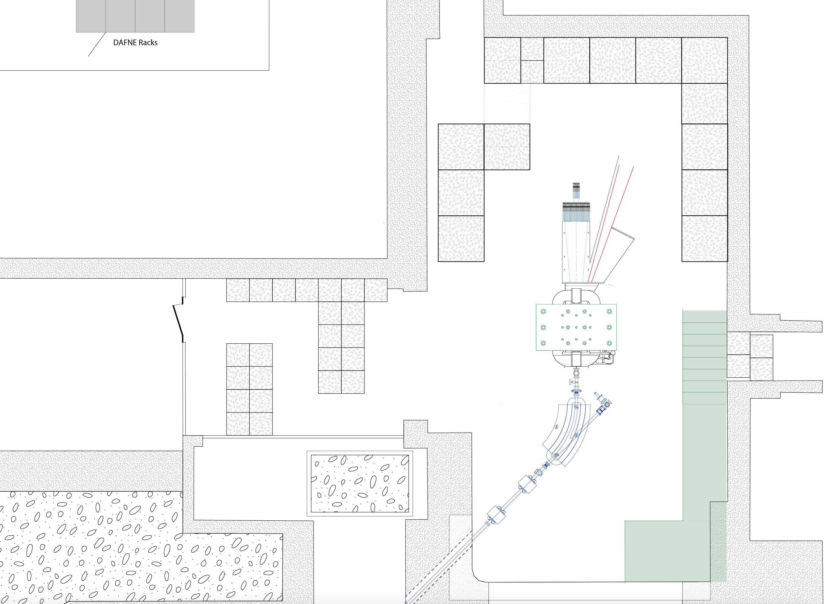
PADME in BTF (present)

Slide 19
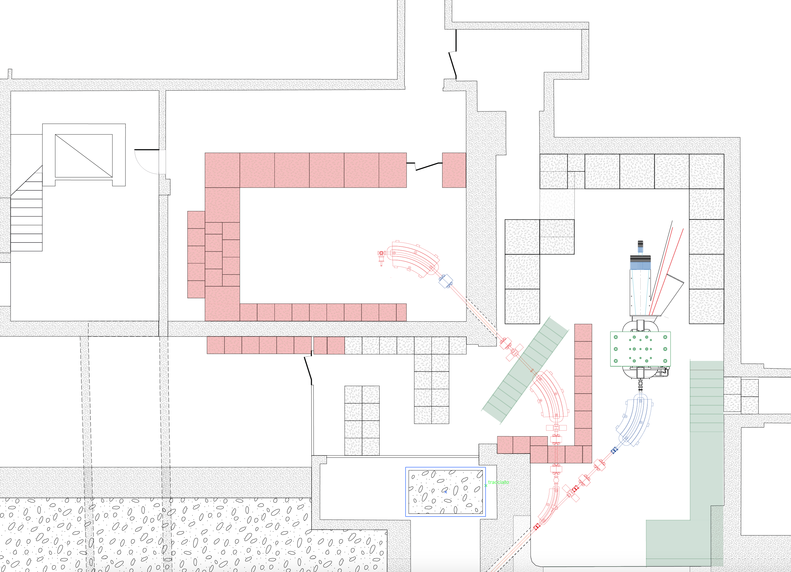
PADME in BTF (future)

