Slide 1
PADME magnet
B. Bolli, F. Iungo, S. Martelli, L. Sabatini, F. Sardone, P. Valente

Slide 2
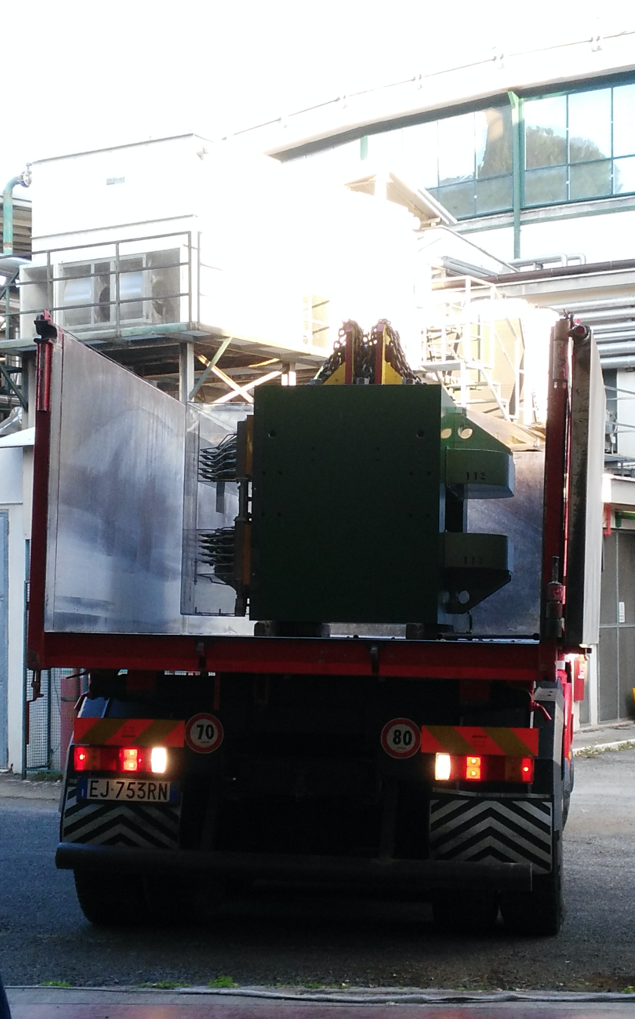

Slide 3
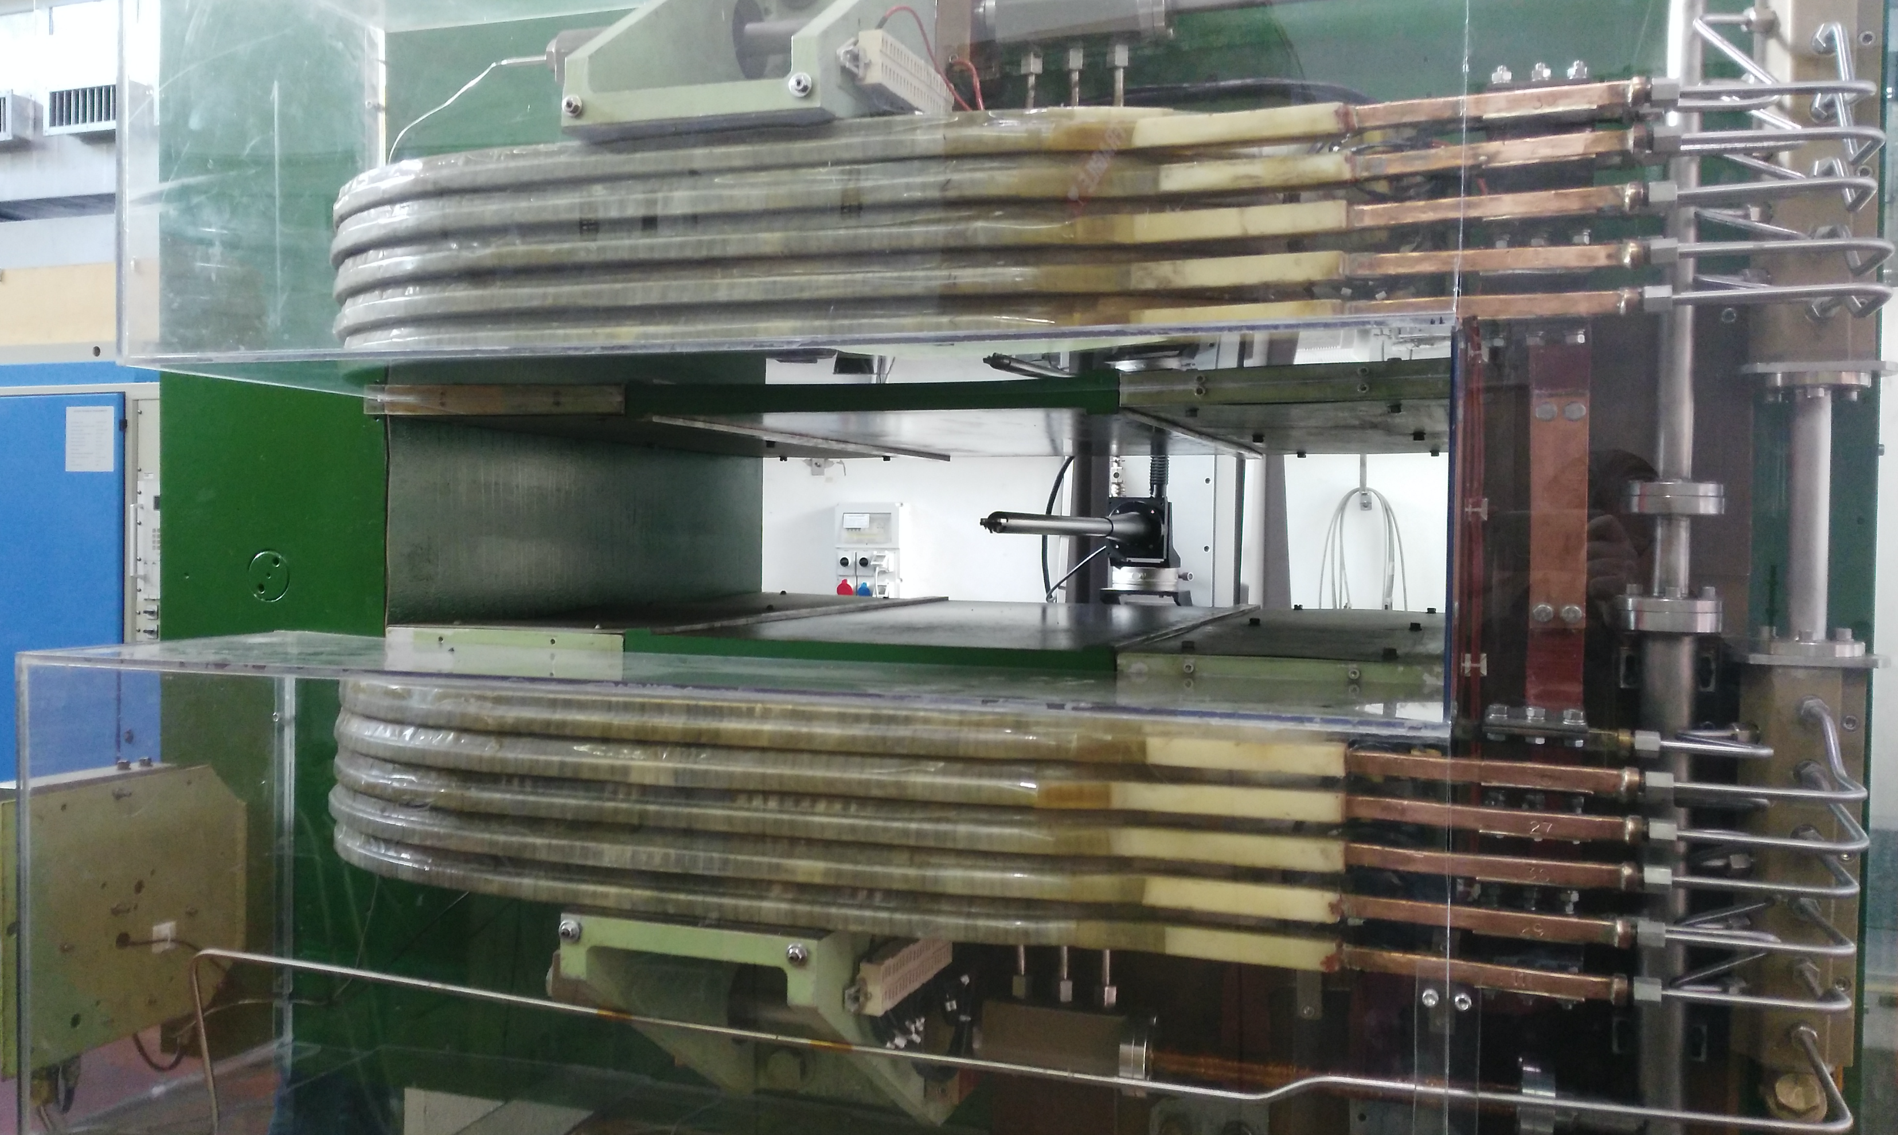

Slide 4
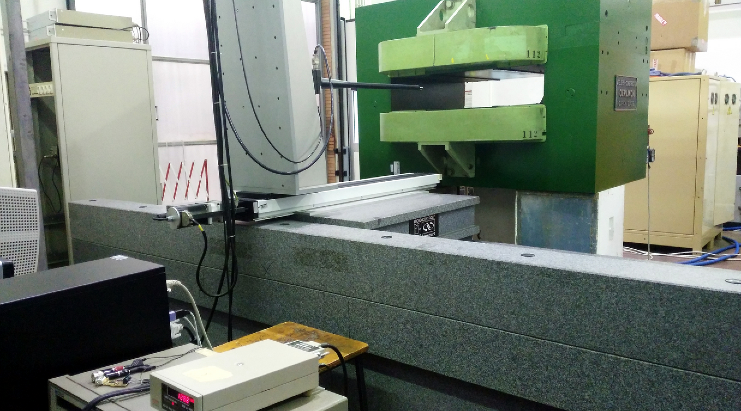
B field measurements
y
z
x
Alignment wrt to the measuring machine axes done while positioning magnet on concrete blocks with the crane
Probably not better than 1-2 mm
In particular tilt angle in the x-z plane

Slide 5
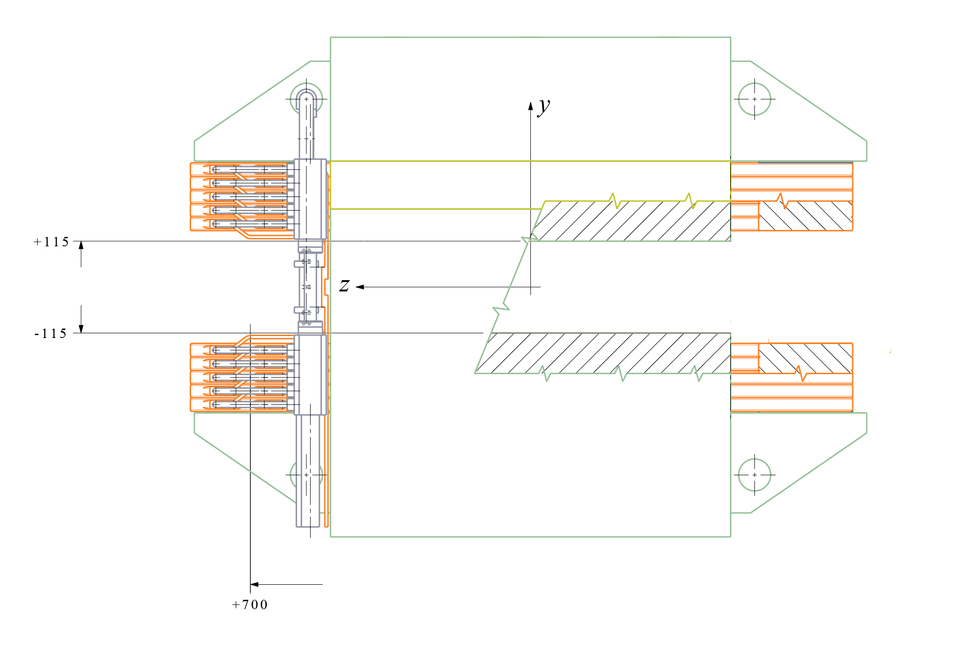
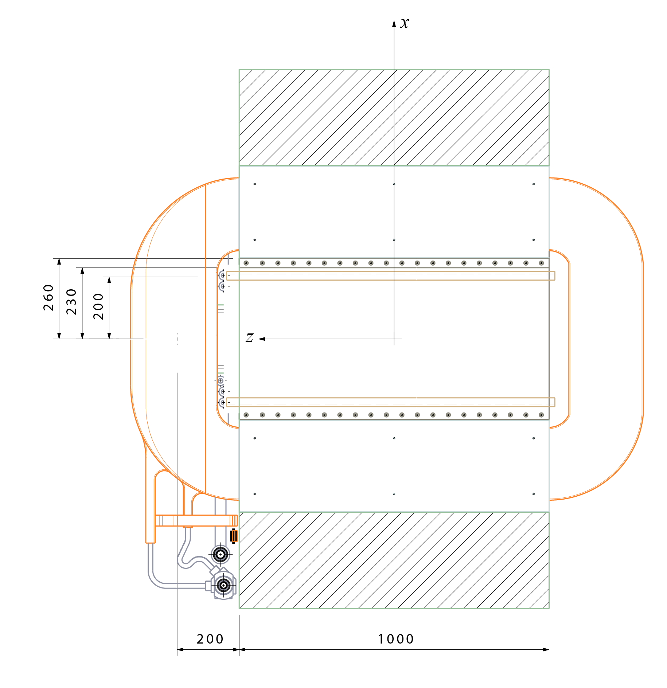
Coordinate system
Positron side
Target side
Calorimeter side
Target side
Calorimeter side
Up
Down
Measuring range ≈ 1 m
Electron side

Slide 6
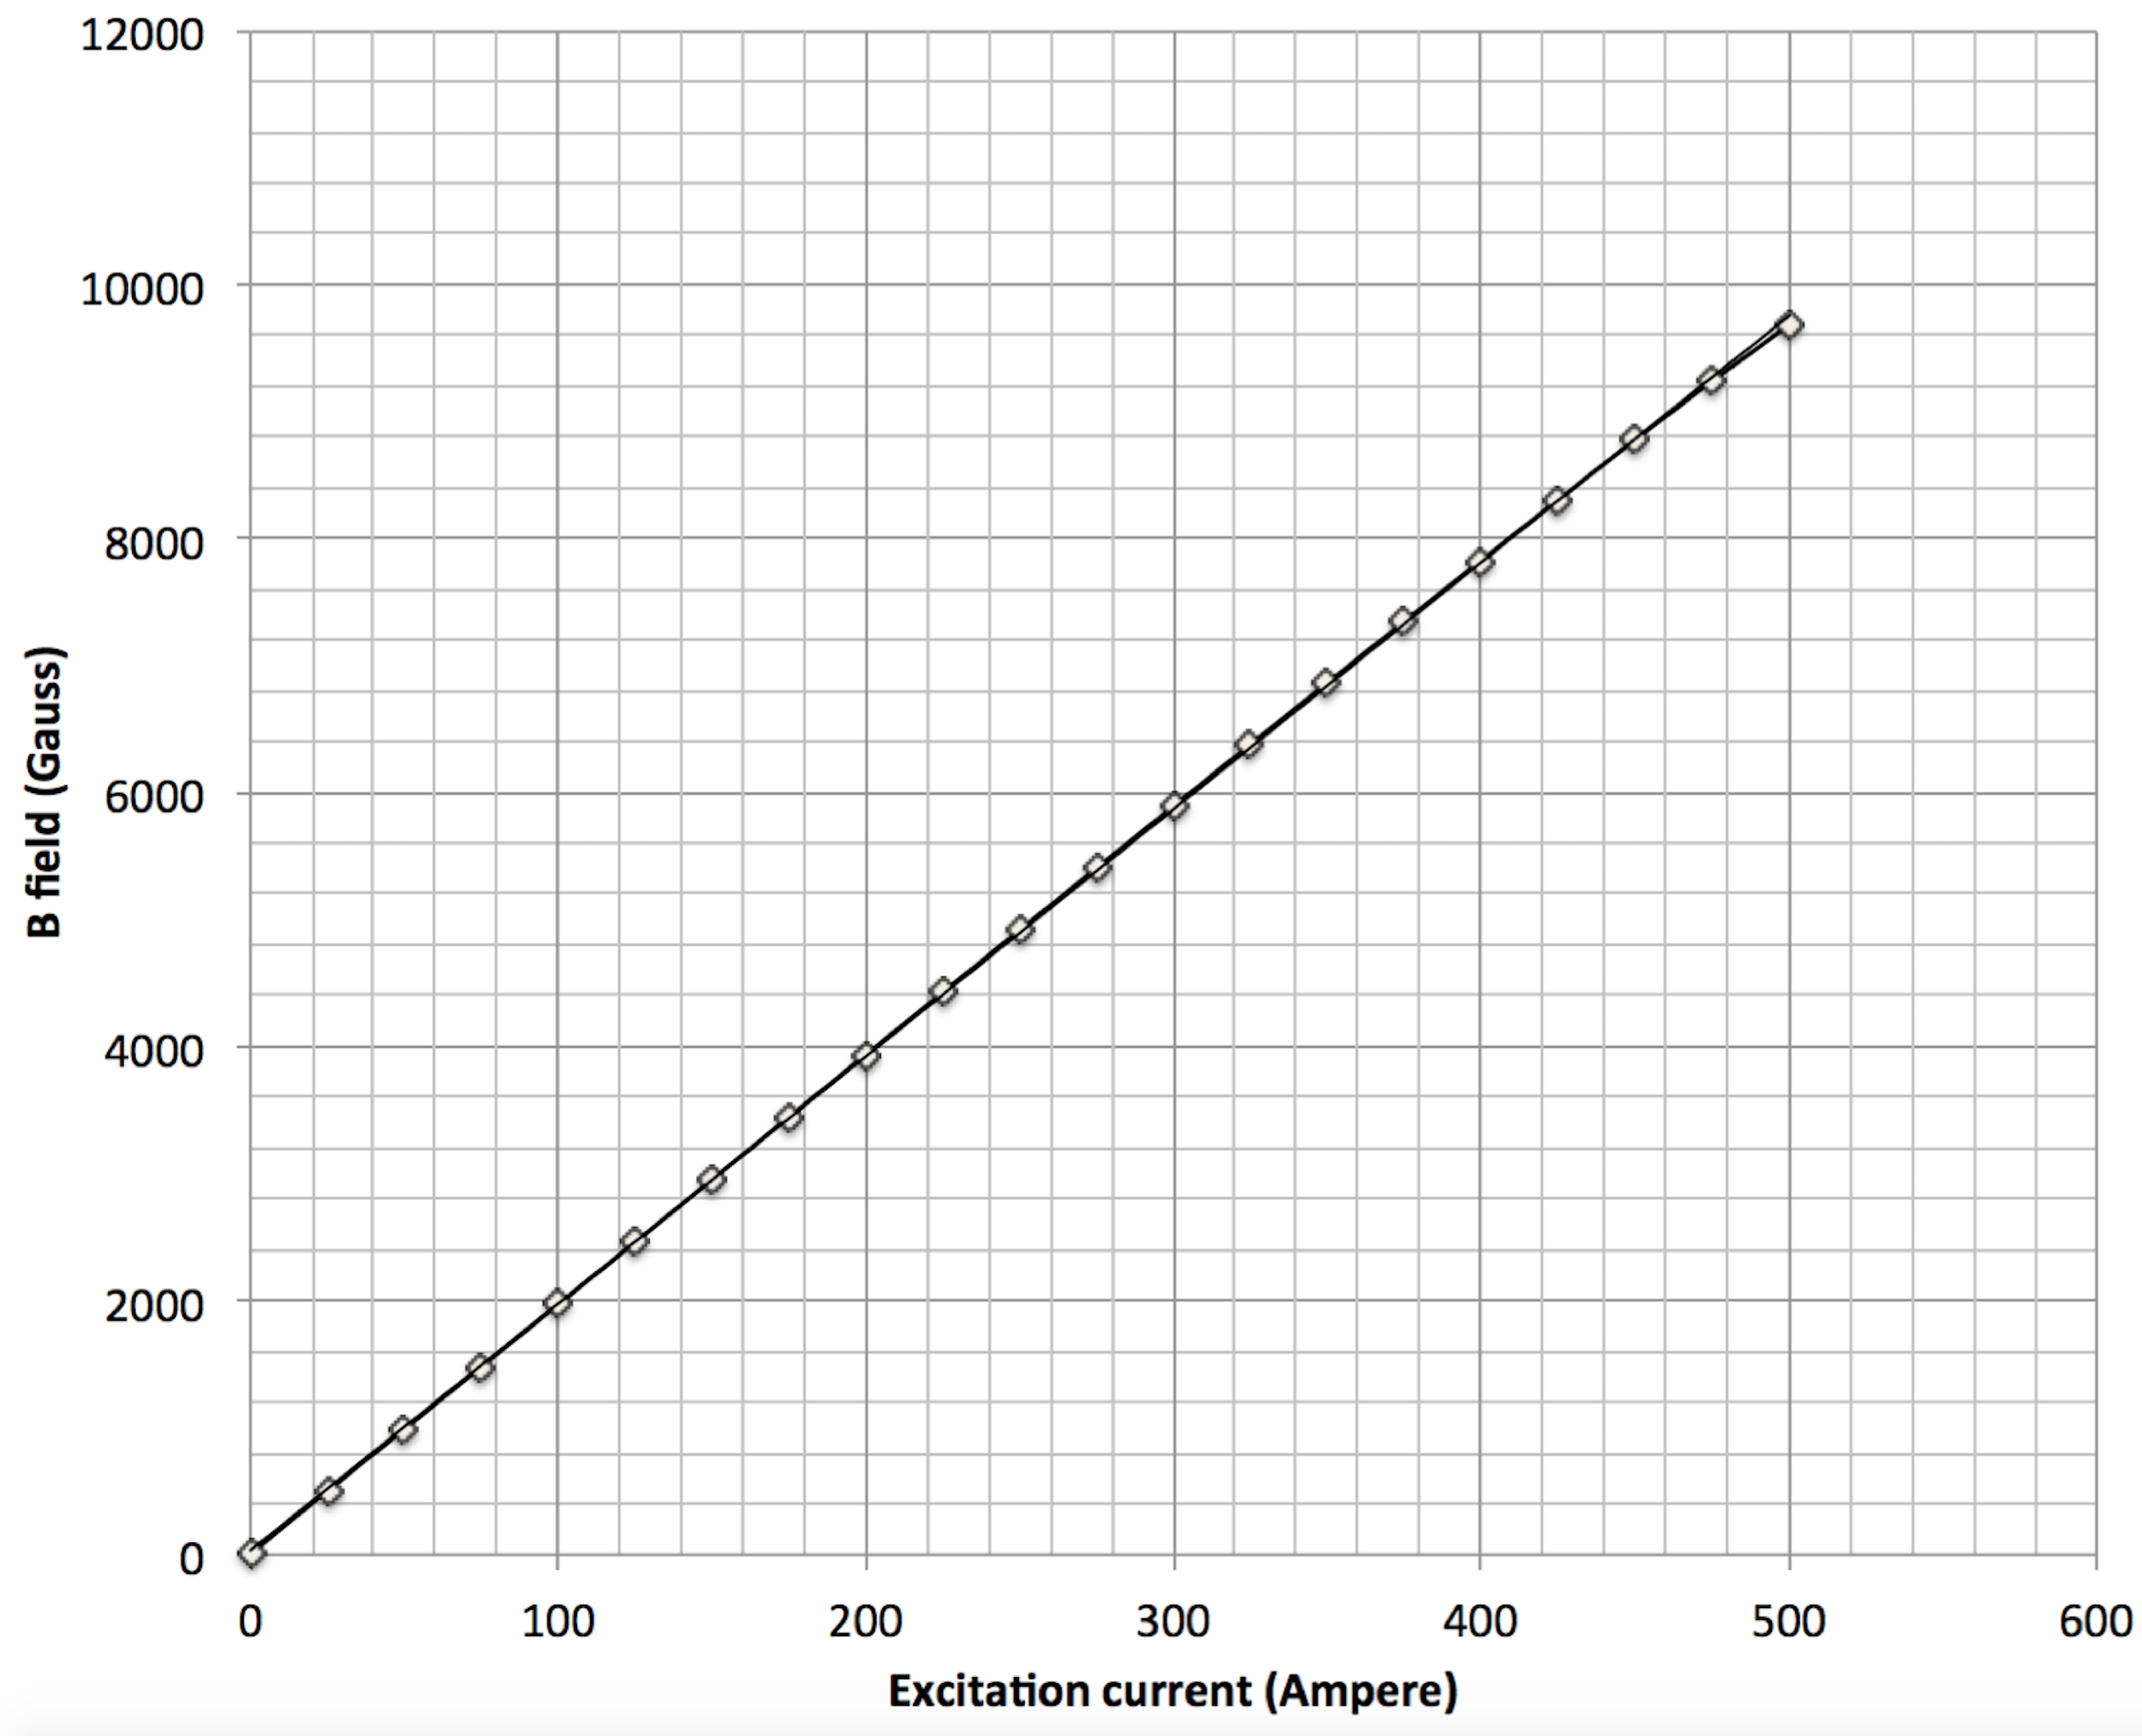
Excitement curve at magnet center
Detailed maps at I=275 A, B_{max}=0.55 T

Slide 7
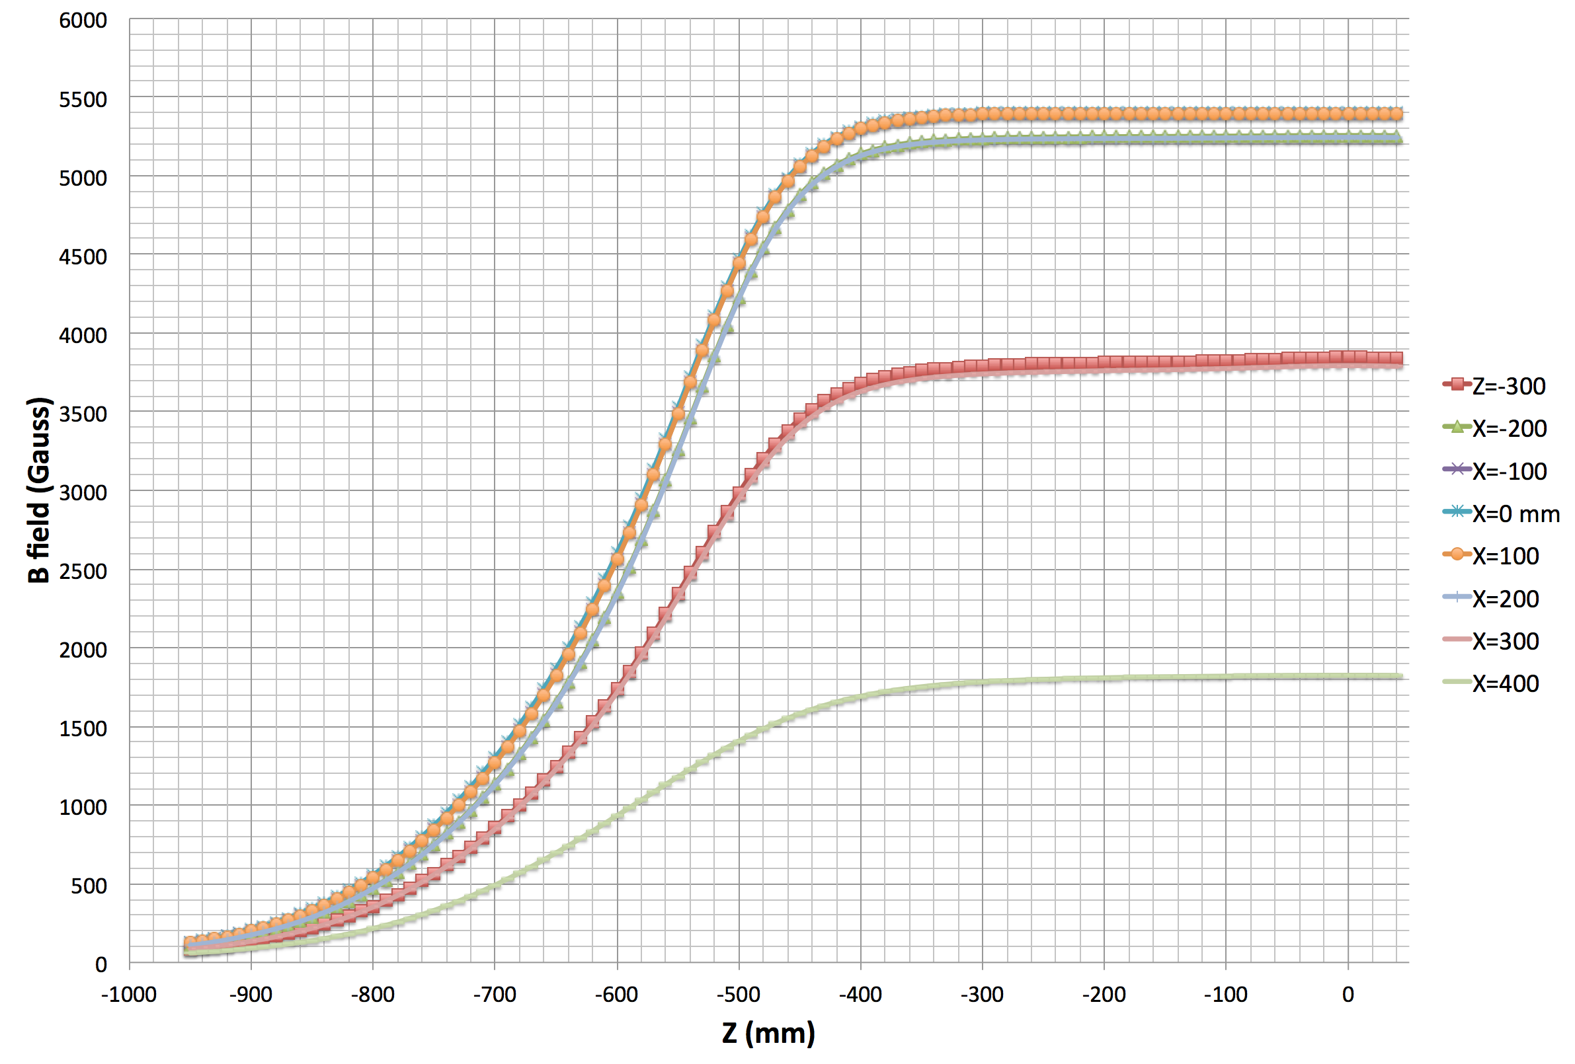
B field
y=0

Slide 8
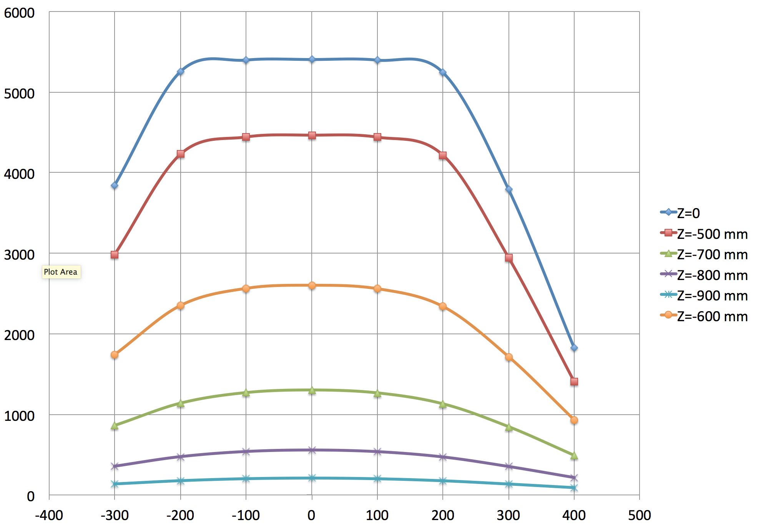
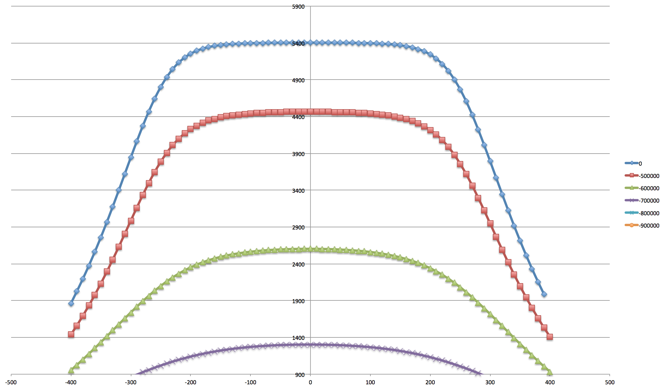
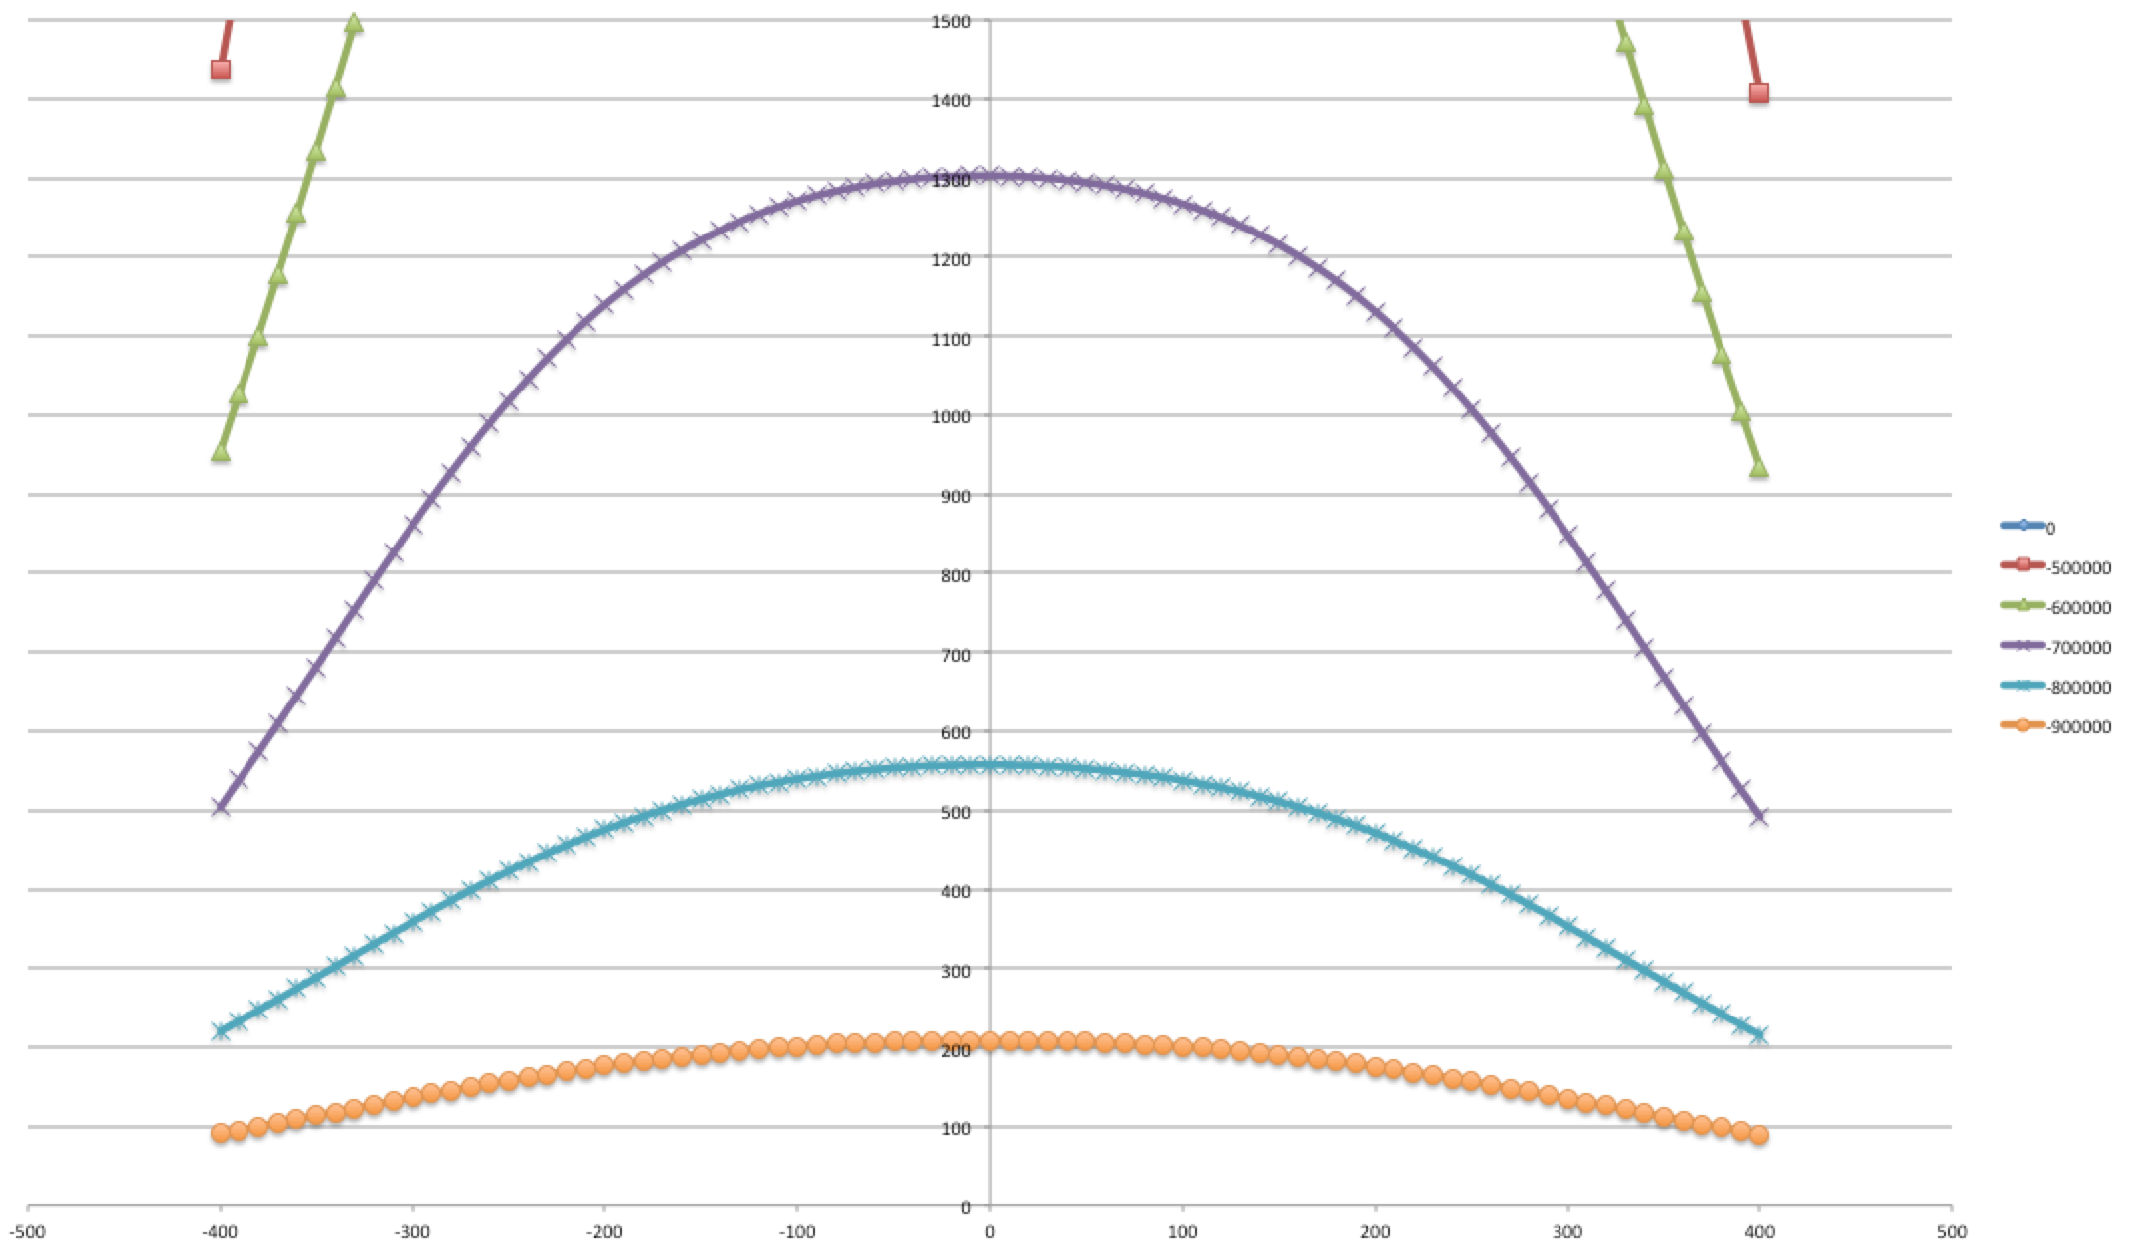
B field
Fine x scan
y=0

Slide 9
B field
y=0

Slide 10
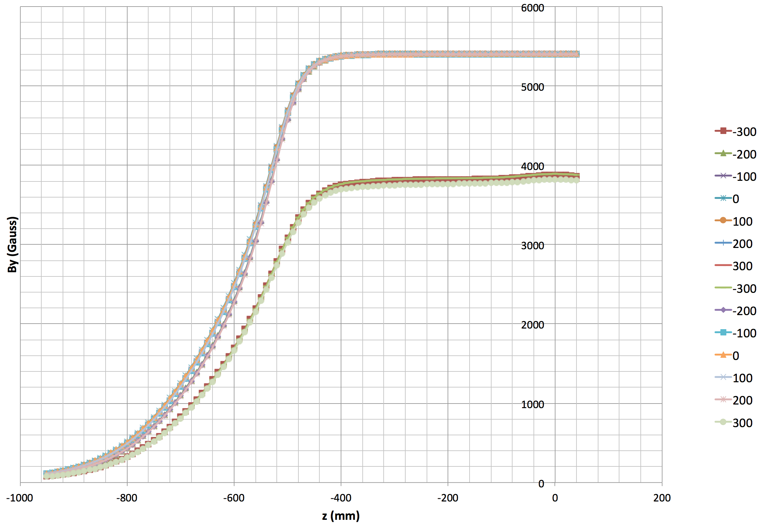
B field
x
y=±50 mm

Slide 11
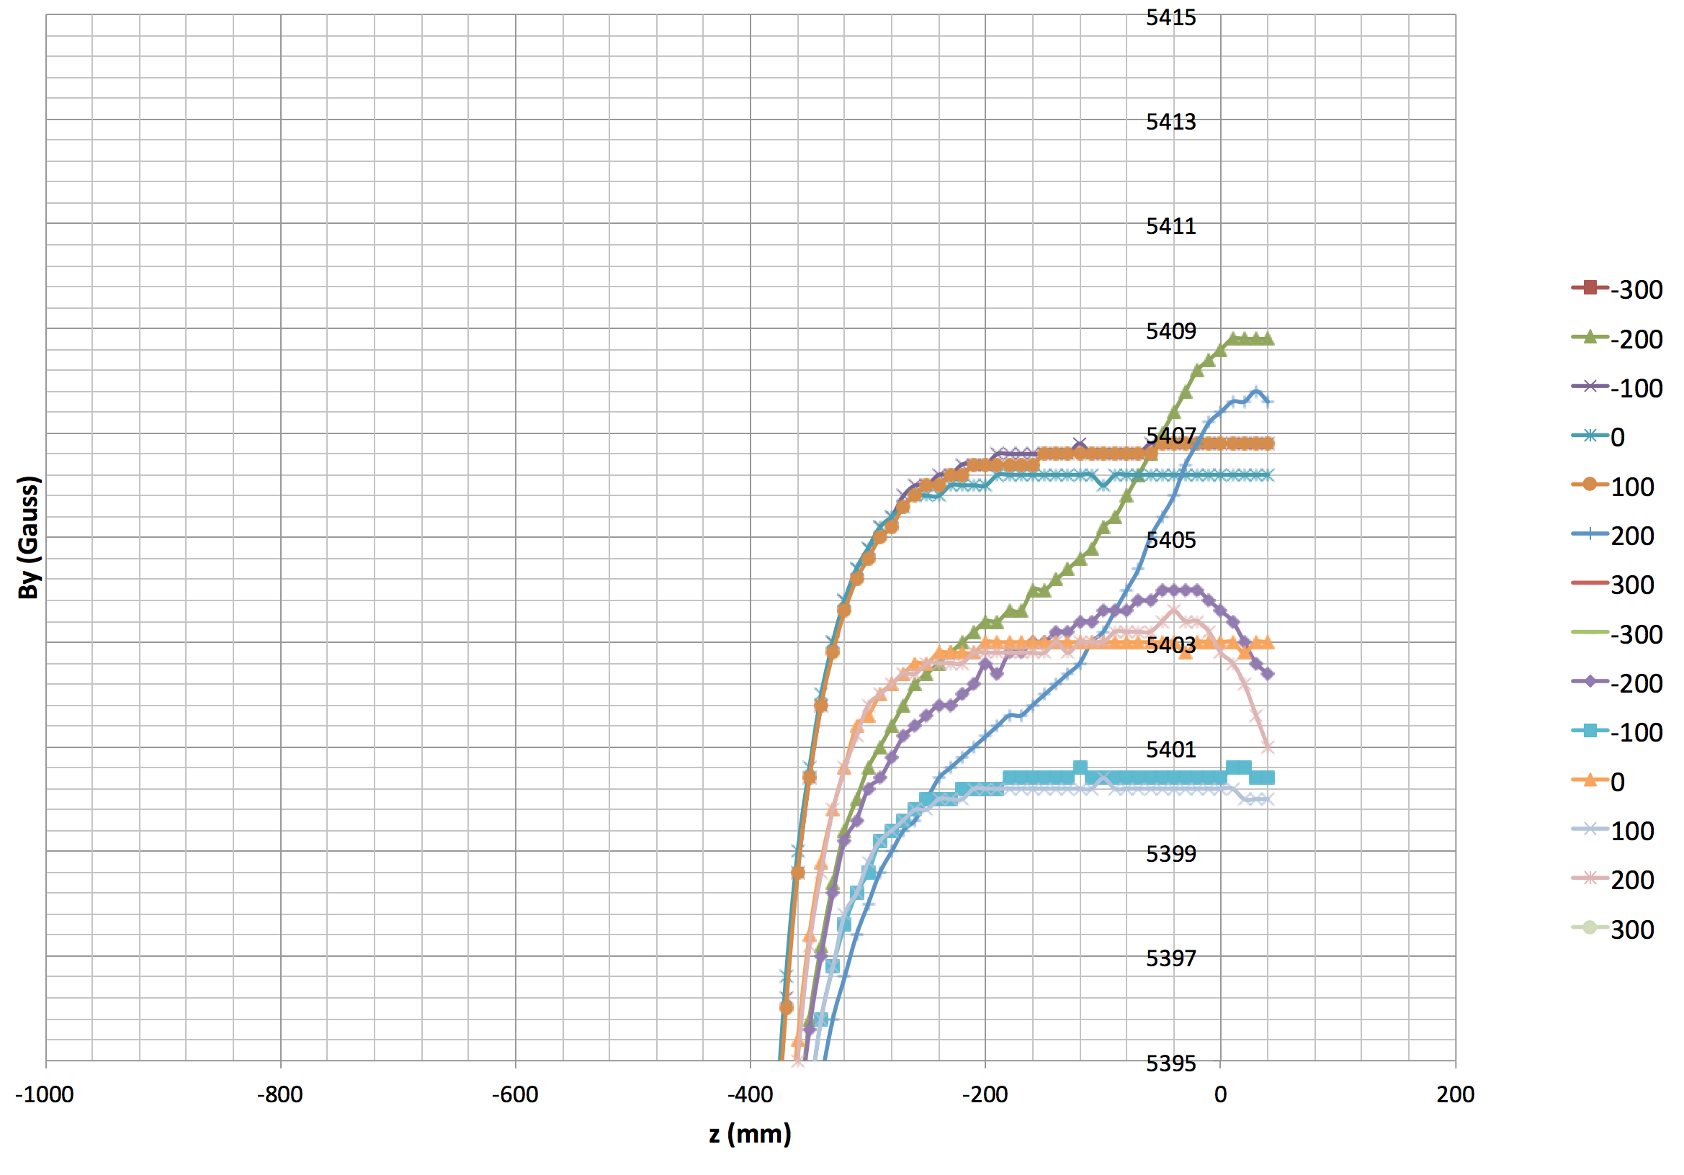
B field
y=-50 mm
0.15%
y=+50 mm

Slide 12
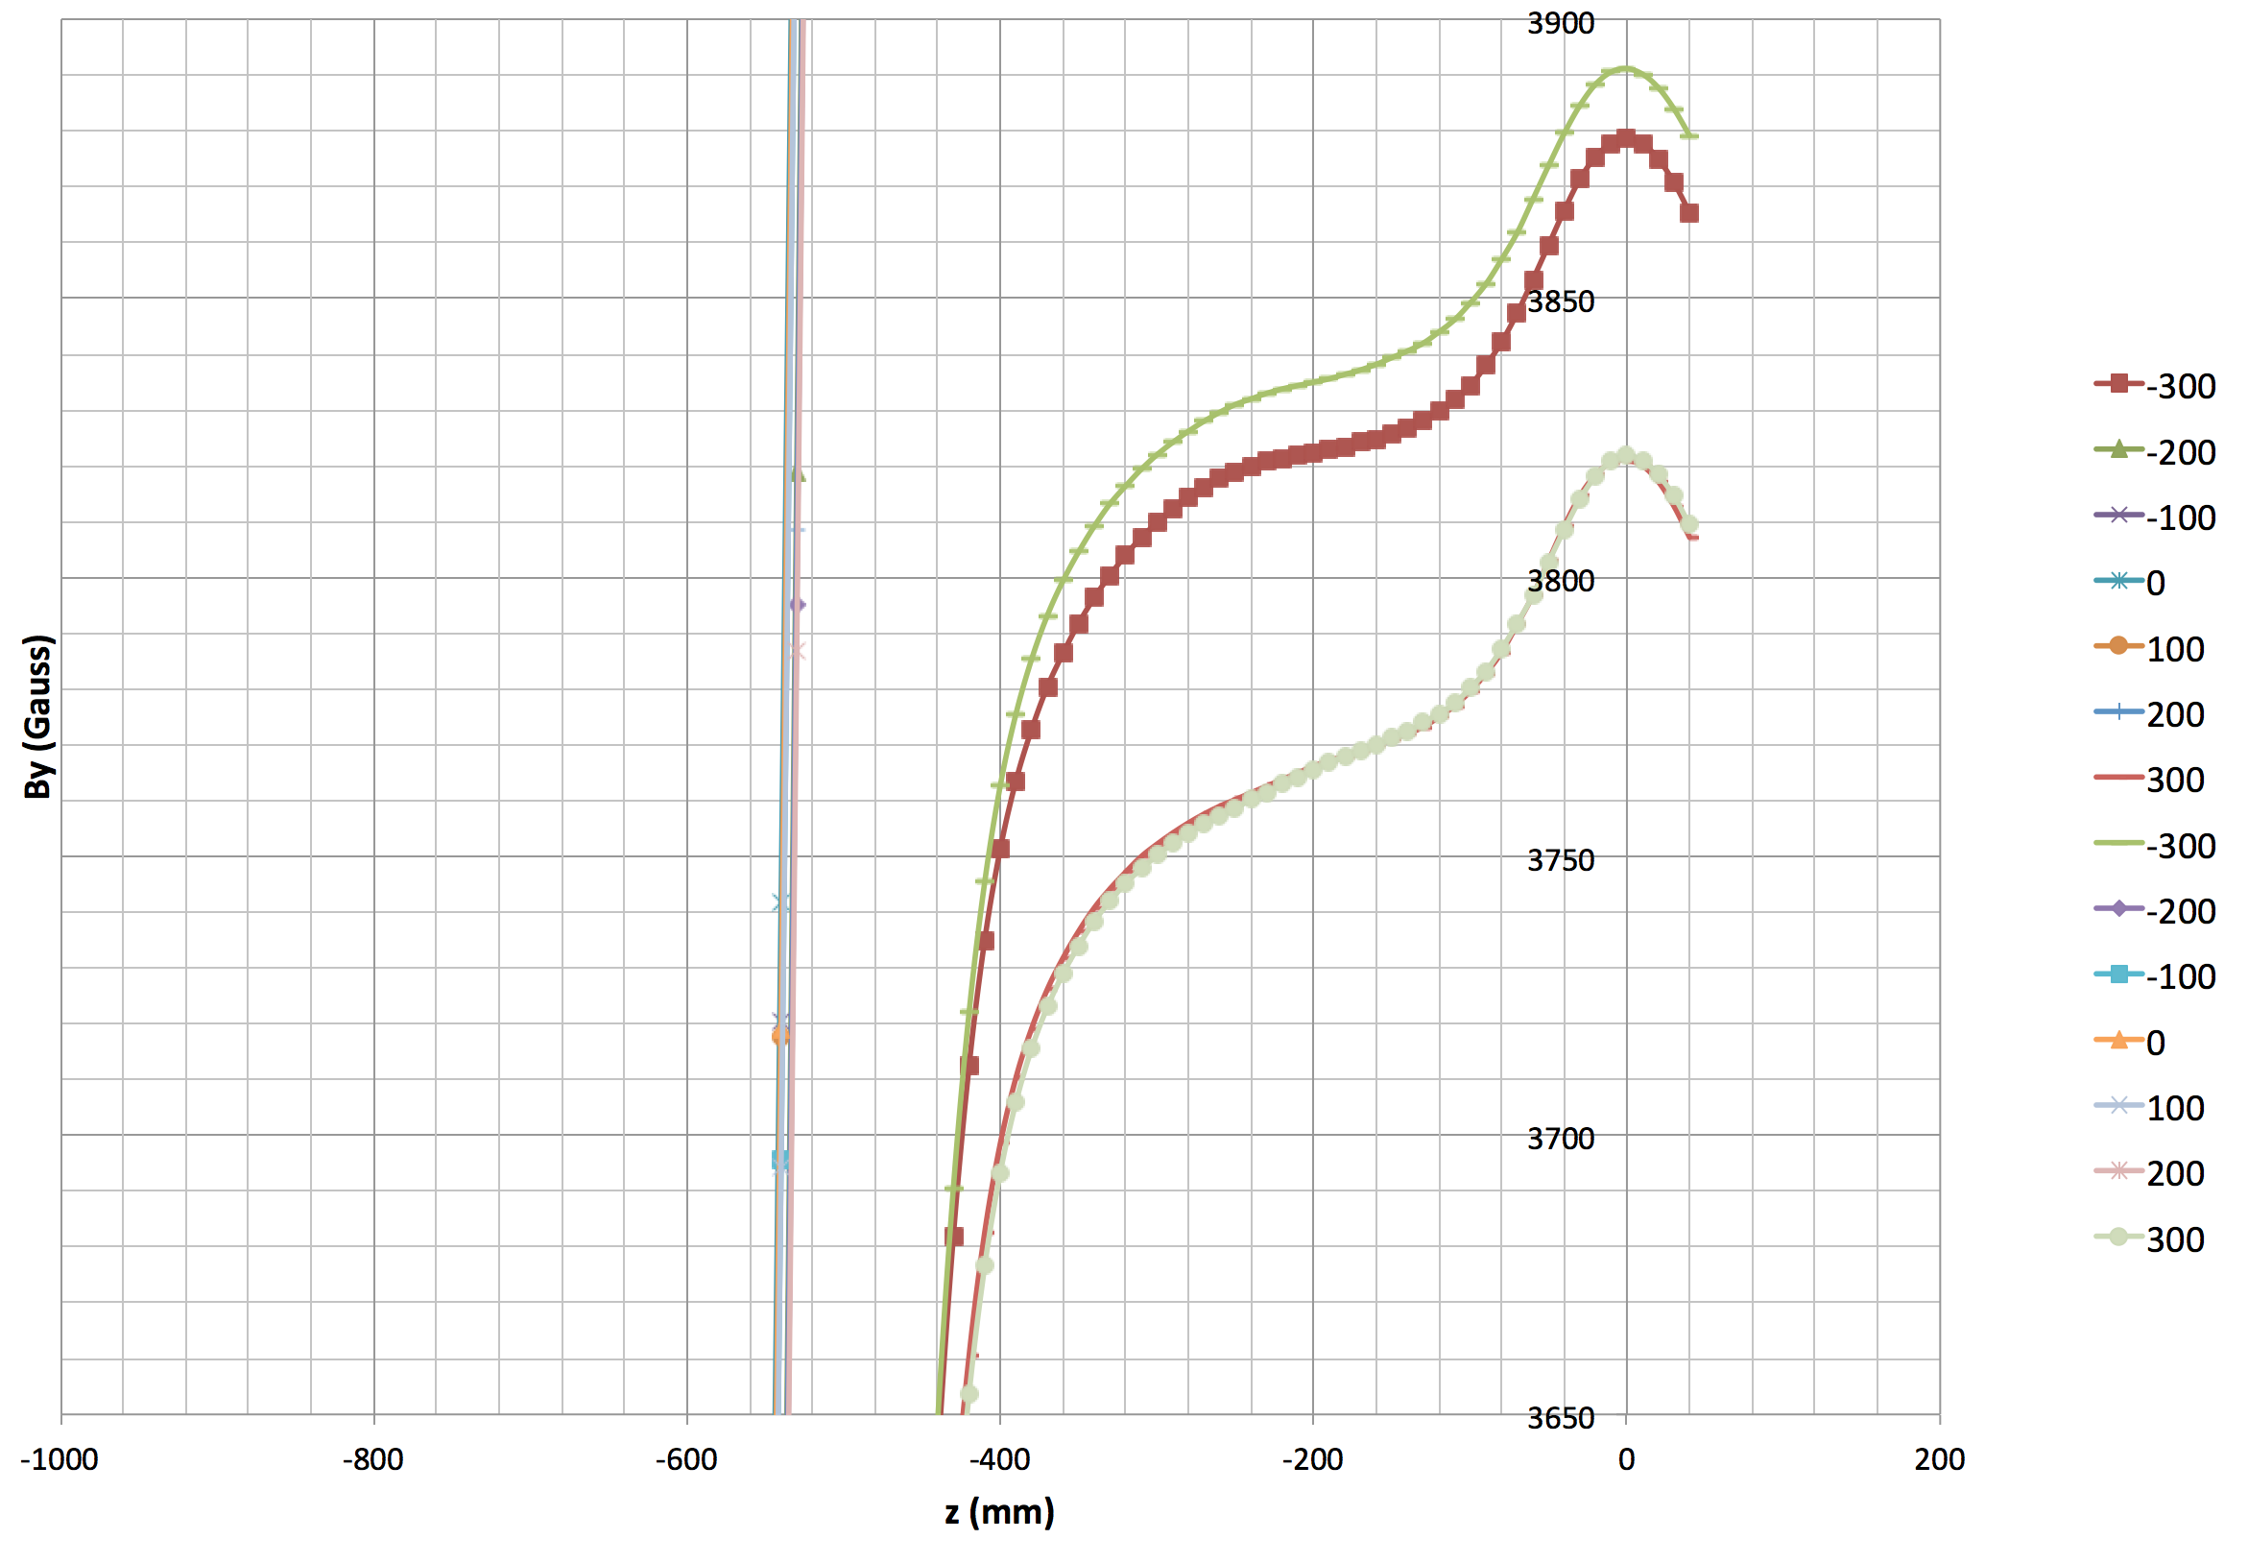
B field
1.7%
y=-50 mm
y=+50 mm

Slide 13
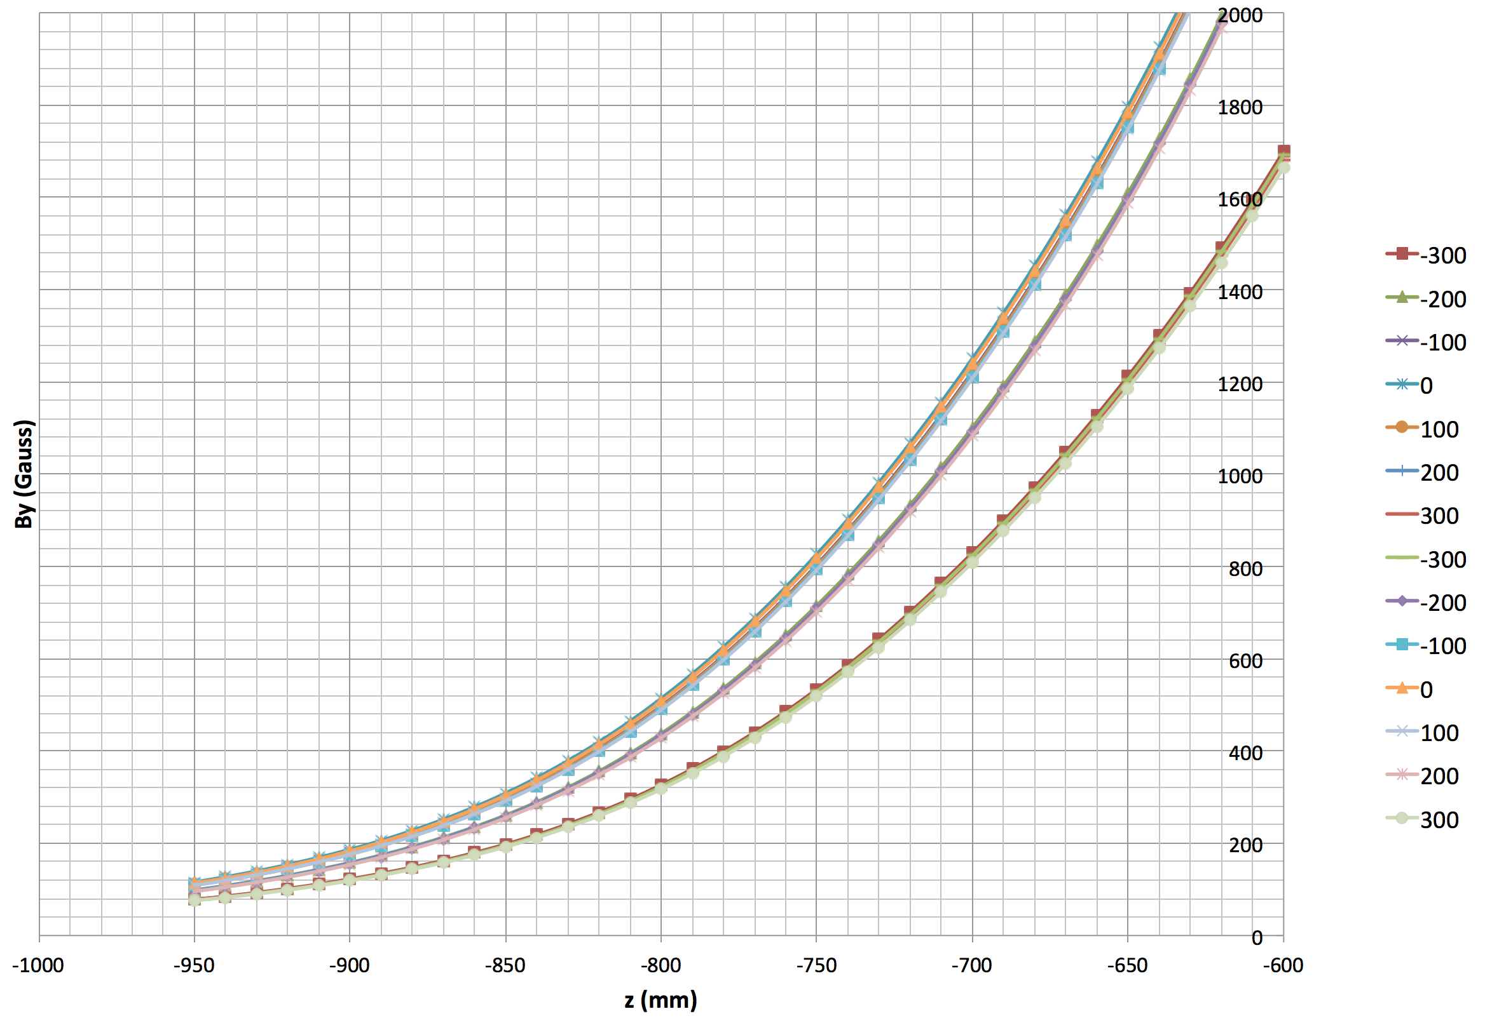
B field

Slide 14
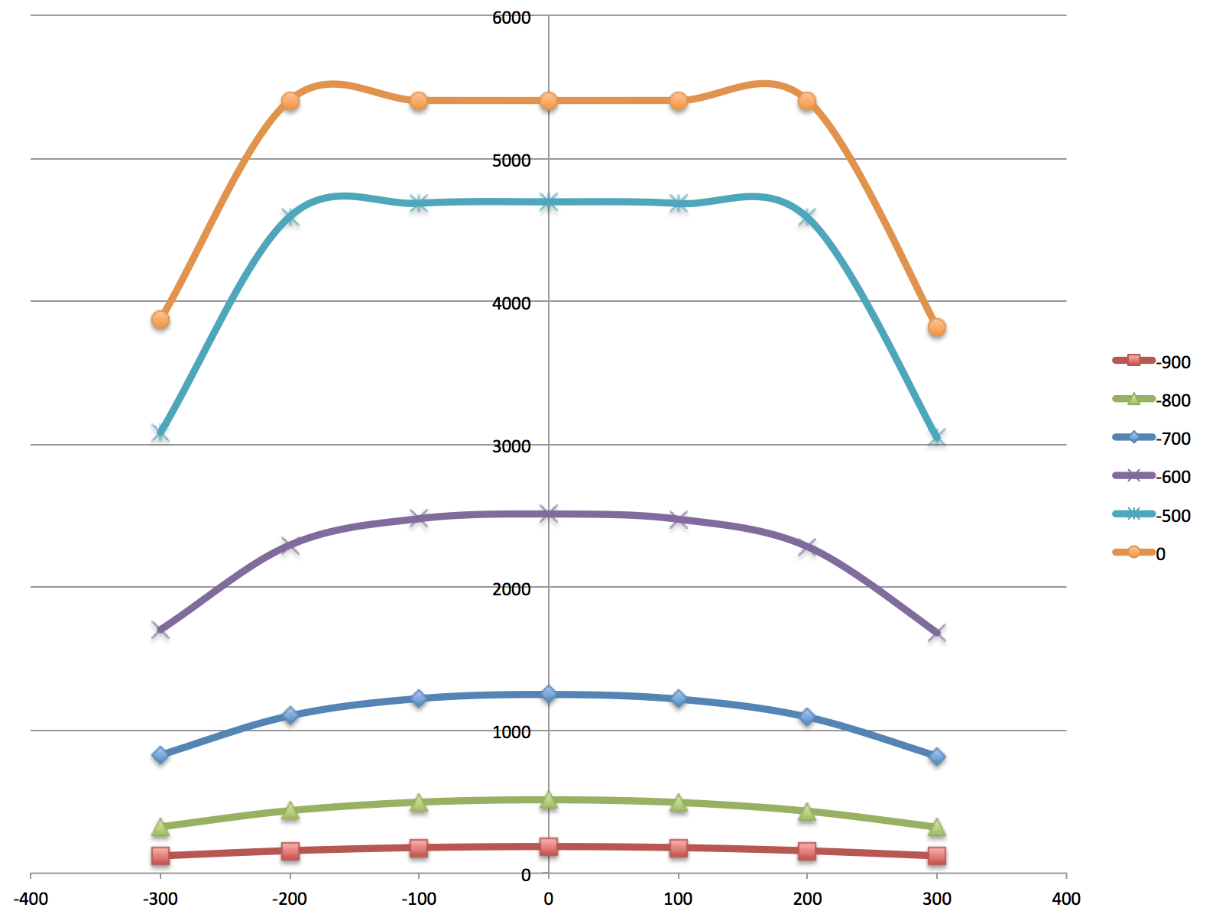
Scan x, y=0 vs. y=-50 mm
y=0

Slide 15
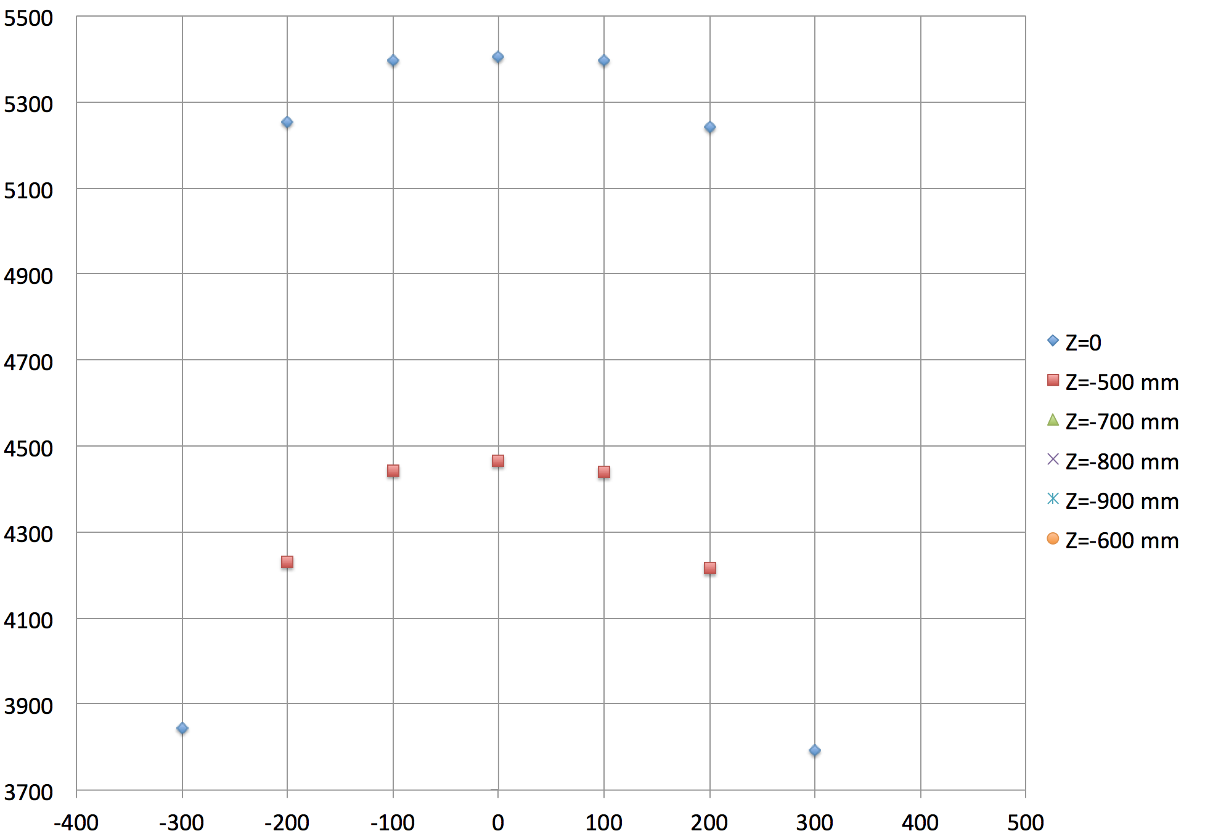
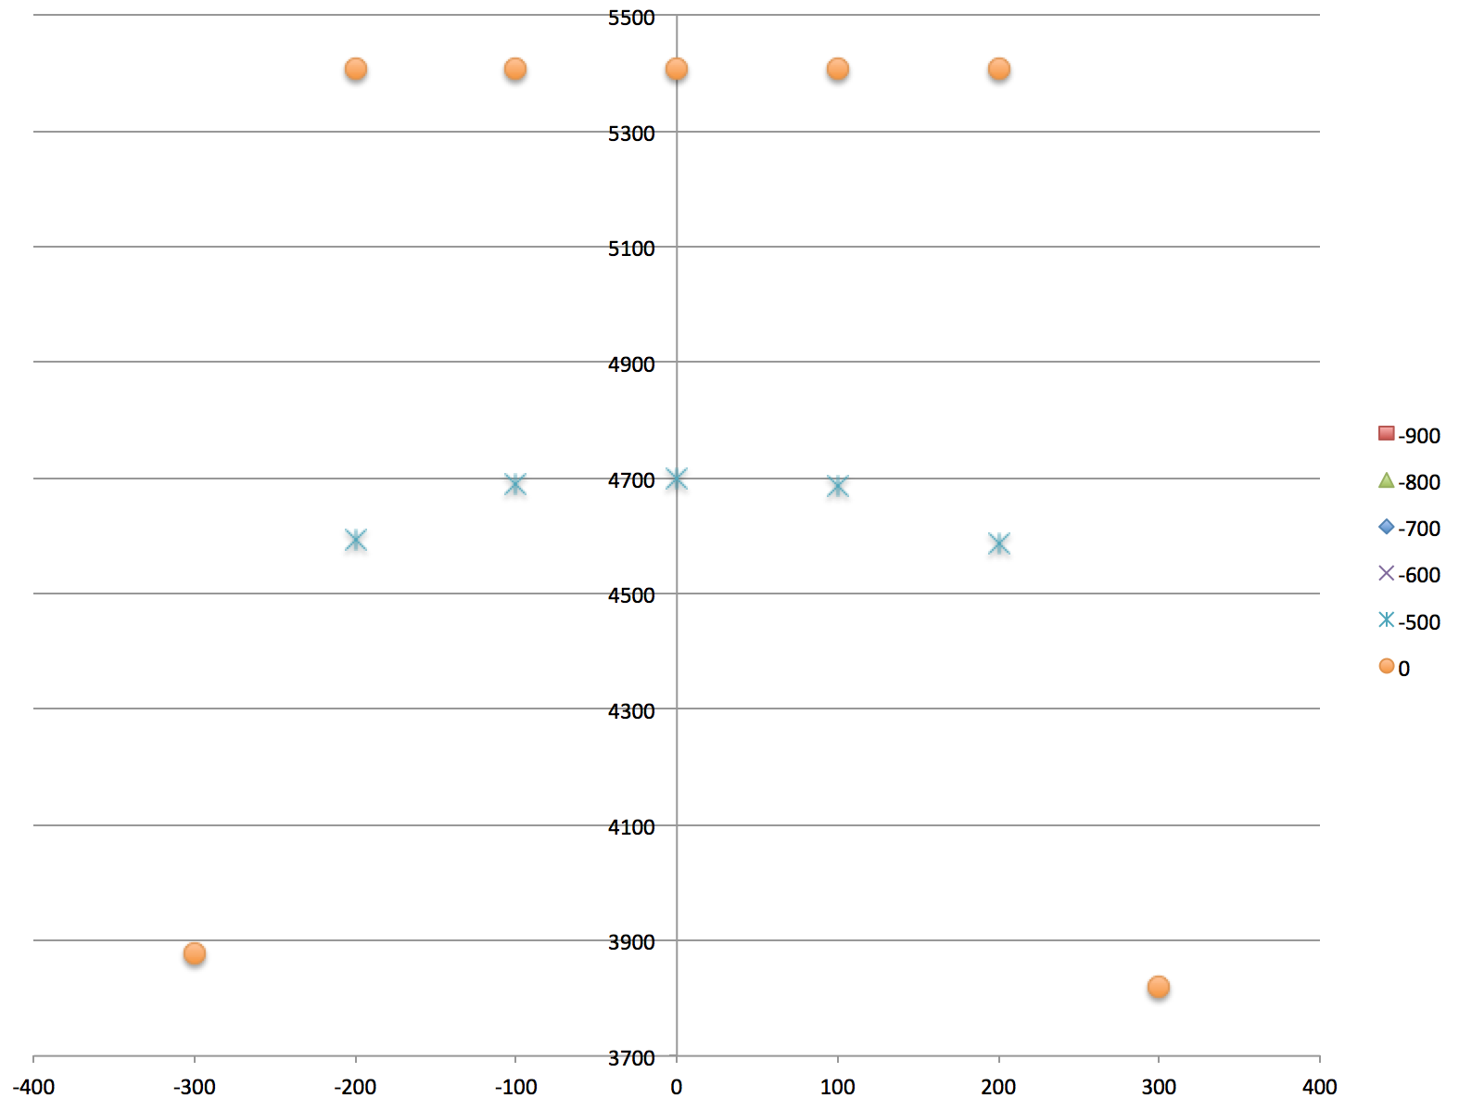
Scan x, y=0 vs. y=-50 mm
3.8%
9%

Slide 16
More measurements?
±110
±80

